Slide 1
University of Cyprus
MAI611 Fundamentals of Artificial Intelligence
Elpida Keravnou-Papailiou
September - December 2022

Slide 2
MAI611 Artificial Intelligence Fundamentals (8 ECTS)
Course purpose and objectives: The purpose of the course is to introduce students to the fundamental principles and techniques that underline software systems that exhibit “intelligent” behavior.
Learning outcomes: Upon completion of this course, students will have acquired a good understanding of modern Artificial Intelligence, the problems that it addresses and the fundamental solution methods that it uses. More specifically the students will know the main knowledge representation techniques and reasoning methods that underlie artificial intelligence problem solving and be able to develop simple solvers for artificial intelligence systems.
Required: Knowledge of a high-level programing language, object-based data concepts and structures.
Teaching methodology: Lectures, discussions of practical examples and (unsupervised) lab activities where the active learning element is encouraged and supported. Students would be strongly guided to view all topics presented and discussed with a critical eye, identifying the limits of AI both in its foundational years and the current situation characterized by an explosion of multimedia data of varying degrees of usability, quality and ethical considerations.
Assessment: Final exam (50%), midterm exam (30%) and homework (theoretical and/or programming assignments) (20%).
Main text:
S. Russel and P. Norvig, Artificial Intelligence: A Modern Approach, 4th Edition, Pearson, 2021.
Other reading:
R. J. Brachman, H. J. Levesque, Knowledge Representation and Reasoning, Elsevier, 2004.
N. J. Nilsson: The Quest for Artificial Intelligence: A history of ideas and achievements, Cambridge University Press, 2010.
M. Ginsberg: Essentials of Artificial Intelligence, Morgan Kaufman,1993.
P. H. Winston: Artificial Intelligence, 3rd Edition, Addison-Wesley, 1992.
E. Keravnou, Artificial Intelligence and Expert Systems (in Greek), Greek Open University, 2000.
G.F. Luger and W.A. Stubblefield, Artificial Intelligence: Structures and Strategies for Complex Problem Solving, 5th edition, Addison-Wesley, 2005.
G. Weiss (editor), Multiagent Systems: a modern approach to distributed AI, The MIT Press, 2nd edition, 2013.
P. Jackson, Introduction to Expert Systems, 3rd edition, Addison-Wesley, 1999.

Slide 3
INTRODUCTION
Historical Landmarks, AI Definitions and Symbolic versus Connectionist AI
CONTENTS
Tracing the history of Artificial Intelligence through its landmarks from Alan Turing’s imitation game to Deep Mind
Defining Artificial Intelligence: The birth of the name and its many guises
Symbolic versus Connectionist Artificial Intelligence

Slide 4
INTENDED LEARNING OUTCOMES
Upon completion of this introductory unit, students will be able:
To present the important landmarks in the history of AI.
To appreciate the different meanings ascribed to the term “Artificial Intelligence” and hence the lack of a universally accepted definition.
To give and critically analyze several of these definitions.
To discuss Alan Turing’s seminal thesis on computing machinery and intelligence rooted on his famous test for machine intelligence, the imitation game.
To discuss Allen Newell and Herbert Simon’s foundational work on symbols, search and the physical symbol system hypothesis, that underline their proposition about computer science as an empirical enquiry.
To draw a distinction between symbolic and connectionist AI.

Slide 5
Tracing the history of Artificial Intelligence through its landmarks from Alan Turing’s imitation game to DeepMind

Slide 6
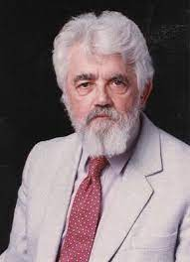
Scientific achievements that paved the way
1956
Dartmouth College Summer Research Project on
Artificial Intelligence
Organized by John McCarthy who coined the term
What followed

Slide 7
Scientific achievements that paved the way
1763: Thomas Bayes invented a framework for reasoning about the probability of events – Bayesian inference
1854: George Boole specified the representation of logic in equations – Logical reasoning
1935: Alan Turing conceived the principle of the modern computer that could also learn from experience by altering its own instructions
1943: As a leading cryptanalyst, Turing led efforts to create the first fully functioning digital computer, named Colossus
1945: ENIAC the first electronic general-purpose computer was built

Slide 8
Scientific achievements that paved the way
1949: Claude Shannon developed the first computer chess playing program
1950: Turing proposed a test for machine intelligence – the imitation game
1952: Arthur Samuel developed the first computer checkers program – early demonstration of machine learning
1955: Allen Newell developed the first program to mimic human problem solving – together with Herbert Simon they started working on the Logic Theorist
1956: Over the Xmas holiday Herbert Simon and Allen Newell invented a thinking machine – Simon earned in 1978 a Nobel prize for his pioneering work on heuristic problem solving

Slide 9
August 1955: A Proposal for the Dartmouth Summer Project on Artificial Intelligence
http://jmc.stanford.edu/articles/dartmouth/dartmouth.pdf
Submitted to the Rockefeller Foundation, that accepted to fund the project in the summer of 1956
Proposers: John McCarthy, Marvin Minsky, Nathaniel Rochester and Claude Shannon

Slide 10
Indicative aspects of the artificial intelligence problem in the McCarthy et. al. proposal
Automatic computers: if a machine can do a job, then an automatic calculator can be programmed to simulate the machine.
How can a computer be programmed to use a language: It may be speculated that a large part of human thought consists of manipulating words according to rules of reasoning and rules of conjecture.
Neuron Nets: How can a set of (hypothetical) neurons be arranged so as to form concepts.
Theory of the size of a calculation: If we are given a well-defined problem (one for which it is possible to test mechanically whether or not a proposed answer is a valid one) one way of solving it is to try all answers in order.
Self-Improvement: Probably a truly intelligent machine will carry out activities which may best be described as self-improvement.
Abstractions: A number of “types” of abstraction can be distinctly defined and several others less distinctly.
Randomness and creativity: A fairly attractive and yet clearly incomplete conjecture is that the difference between creative thinking and unimaginative competent thinking lies in the injection of some randomness.

Slide 11
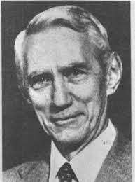
Individual Research Proposals
Claude Shannon
Application of information theory concepts to computing machines and brain models
The matched environment – brain model approach to automata

Slide 12
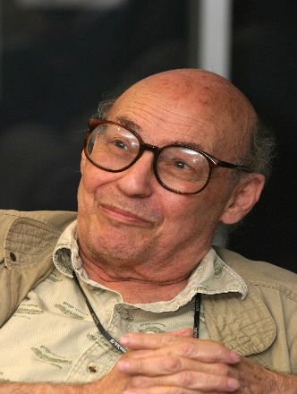
Individual Research Proposals
Marvin Minsky
Design a machine that exhibits learning: given a criterion of “success” and “failure” a machine can be trained to exhibit goal-seeking behavior
Progress on a very tentative proposal given in his dissertation towards having a model of such a machine fairly close to the stage of programming in a computer

Slide 13
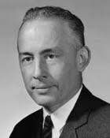
Individual research proposals
Nathaniel Rochester
Originality in machine performance
The process of invention or discovery
The machine with randomness

Slide 14
Individual research proposals
John McCarthy
Study the relation of language to intelligence
Construct an artificial language which a computer can use on problems requiring conjecture and self-reference
Using this language might be possible to program a machine to learn to play games well and to do other tasks

Slide 15
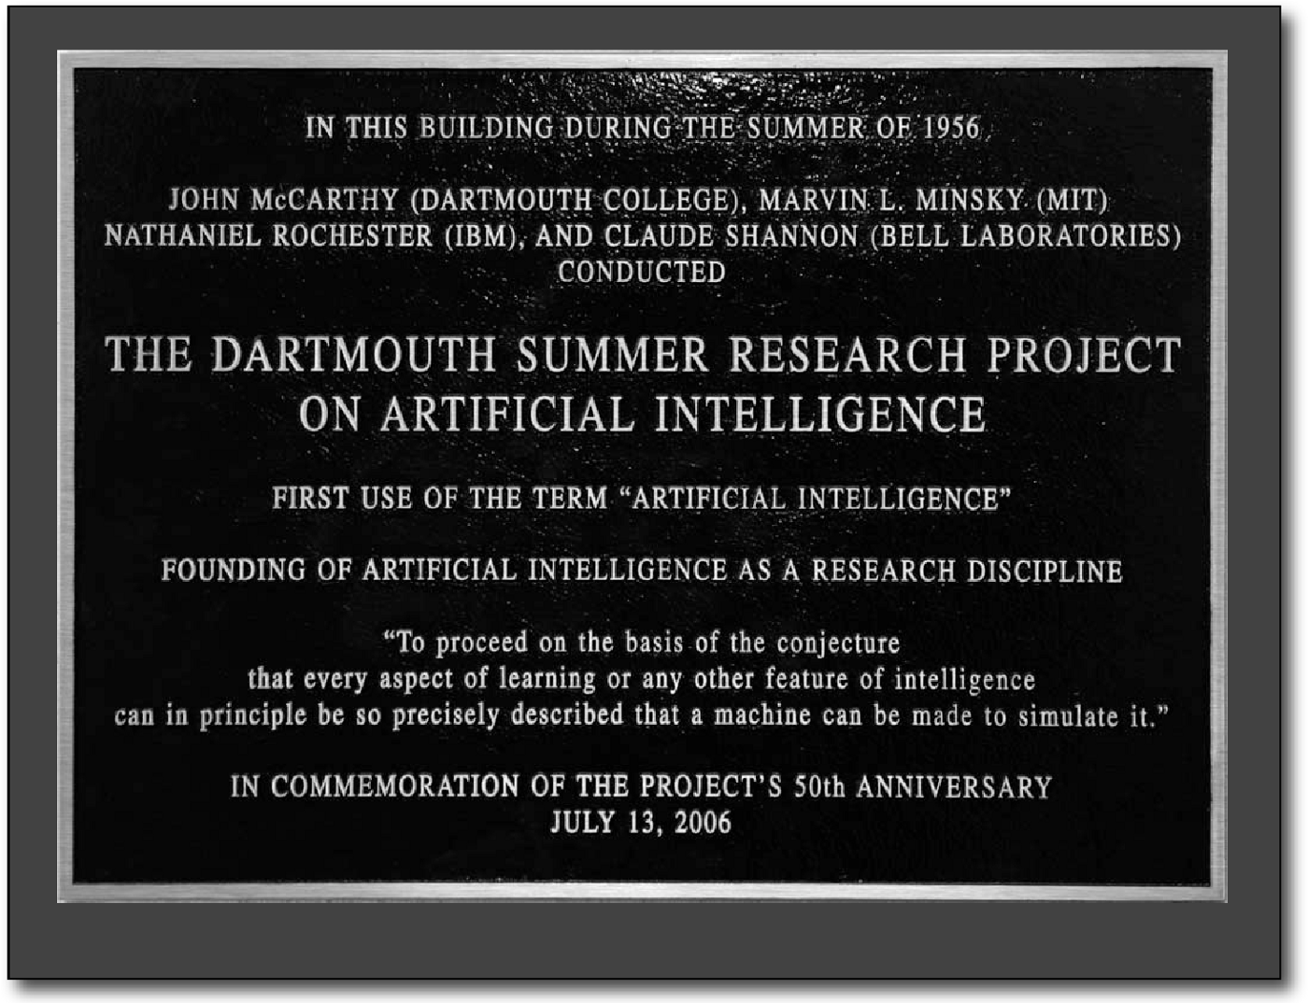
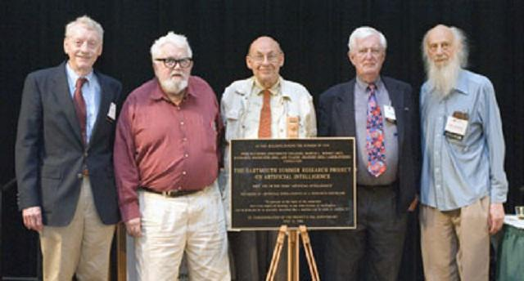
The birth of Artificial Intelligence in the summer of 1956 at Dartmouth College
50th anniversary picture

Slide 16
What followed
1957: Frank Rosenblatt invented the perceptron algorithm and machine – precursor to neural network and deep learning
1958: The programming language LISP (list processing) devised by John McCarthy appeared – founded on the mathematical theory of recursive functions
1959: Herbert Simon, John Clifford Shaw and Allen Newell worked on the General Problem Solver (GPS) indented to work as a universal problem solver machine – in contrast to Logic Theorist, GPS used means-ends analysis
1959: Arthur Samuel, a gaming world pioneer coined the term “machine learning” – how a computer could be programmed to play a better game of checkers than its creator – mastering the process of learning
1961: First industrial robot called Unimate began working on an assembly line in the General Motors plant in New Jersey

Slide 17
What followed
1966: ELIZA, the world’s first chatbot was created at the MIT AI Lab by Joseph Weizenbaum – demonstrates basic communications between humans and machines – example of early NLP program
https://web.njit.edu/~ronkowit/eliza.html
1970s: Criticism growing about AI researchers overpromising and underdelivering products or solutions with real-world impact
1976: Allen Newell and Herbert Simon, 10th Turing Lecture “Computer Science as Empirical Enquiry: Symbols and Search”
1980s: “AI Winter”: During the late 1980s and early 1990s excitement surrounding AI fell.
1982: Japan’s Ministry of International Trade and Industry began the Fifth Generation Computer Systems (FGCS) initiative – create computers using massively parallel computing and logic programming

Slide 18
What followed
1997: Deep Blue (IBM) – Chess-playing program defeating world champion Garry Kasparov
mid-2000s: Resurgence of interest
2007: a team from Princeton University assembled ImageNet, a large database of annotated images – in 2012 a CNN with 650,000 neurons reduced error rate to 15.3%
2009: Google started a secret project to develop a driverless car – in 2014 the first autonomous vehicle passed a U.S. state self-driving test
2011: IBM Watson, a cognitive computing platform, to compete in the tv show Jeopardy! – defeats two former champions. IBM launches Watson as a major move to bring AI to healthcare
2016: Microsoft made a major breakthrough in speech recognition

Slide 19
What followed
2015: AlphaGo (DeepMind – Dennis Hassabits), using reinforcement learning defeating European Go champion – in 2016 AlphaGo beat the Korean Go champion and in 2019 the World Go champion
2017: AlphaZero (DeepMind) – superhuman play in multiple games and trained by self-play
2019: AlphaStar (DeepMind) – Deep reinforcement learning defeating StarCraft player

Slide 20
Defining Artificial Intelligence: the birth of the name and its many guises

Slide 21
Birth of the name “Artificial Intelligence”: 1956 Dartmouth College Summer Research Project
The present purpose of the Artificial Intelligence problem is taken to be that of making a machine behave in ways that would be called intelligent if a human were so behaving.

Slide 22
John McCarthy: What is Artificial Intelligence? http://jmc.stanford.edu/articles/whatisai/whatisai.pdf (2007)
It is the science and engineering of making intelligent machines, especially intelligent computer programs. It is related to the similar task of using computers to understand human intelligence, but AI does not have to confine itself to methods that are biologically observable.
Intelligence is the computational part of the ability to achieve goals in the world. Varying kinds and degrees of intelligence occur in people, many animals and some machines.

Slide 23
John McCarthy: What is Artificial Intelligence?
Intelligence involves mechanisms, and AI research has discovered how to make computers carry out some of them and not others. If doing a task requires only mechanisms that are well understood today, computer programs can give very impressive performance on these tasks. Such programs should be considered “somewhat intelligent”.
AI programs haven’t yet reached the level of being able to learn much of what a child learns from physical experience. Nor do present programs understand language well enough to learn much by reading.

Slide 24
John McCarthy on chess
Chess is the Drosophila of AI: analogy with geneticists’ use of the fruit fly to study inheritance
Chess programs play at grandmaster level, but with limited intellectual mechanisms compared to those used by a human chess player
Large amounts of computation are substituted for understanding
Once human mechanisms are understood, human-level chess programs can do far less computation
Deep Blue did millions of times as much computation

Slide 25
John McCarthy on computability, complexity and algorithms
Computability theory and computational complexity are relevant but don’t address the fundamental problems of AI
What is important for AI is to have algorithms as capable as people at solving problems

Slide 26
Branches of AI
representation
logical AI
pattern recognition
Facts about the world must be represented in some way, e.g., languages of mathematical logic
search
Knowledge about the world, facts of a specific situation and goals represented as sentences of some mathematical logical language
Compare observations with a pattern
Examine large numbers of possibilities

Slide 27
Branches of AI
inference
learning from experience
planning
common sense knowledge and reasoning
From some facts, others can be inferred (e.g., logical deduction, non-monotonic reasoning, default reasoning)
Generate a strategy for achieving a goal, often a sequence of actions
Connectionism and neural nets specialize in that – programs can only learn what facts or behaviors their formalisms can represent
Area in which AI is farthest from human-level

Slide 28
Branches of AI
epistemology
genetic programming
heuristics
ontology
A study of the kinds of knowledge that are required for solving problems in the world
A technique for solving a task by mating and selecting fittest in millions of generations
Rules of thumb for guiding the solution to a problem – not infallible
The study of the kinds of things that exist – kinds of objects and their properties

Slide 29
AI applications
Game playing
Speech recognition
Understanding natural language
Computer vision
Expert systems
Heuristic classification

Slide 30
Other definitions of Artificial Intelligence
Artificial Intelligence makes computers do things that would require intelligence if done by people
Artificial Intelligence is the development of computers whose observable performance has features which in humans we would attribute to mental processes

Slide 31
Other definitions of Artificial Intelligence
Artificial Intelligence is the study of how to build and/or program computers to enable them to do the sorts of things that minds can do. Some of these things are commonly regarded as requiring intelligence:
Medical diagnosis and/or prescription
Legal or scientific advice
Proving theorems in logic or mathematics
While others are not, as all adults can do them and typically do not involve conscious control:
Seeing things in sunlight or shadows
Finding a path through cluttered terrain
Using one’s common sense

Slide 32
A rather controversial definition
Artificial Intelligence is the science of intelligence in general or, more accurately, as the intellectual core of cognitive science
Its goal is to provide a systematic theory that can explain (and perhaps enable us to replicate) both the general categories of intentionality and the diverse psychological capacities grounded in them

Slide 33
Yet more definitions . . . No one is universally adopted
Artificial Intelligence is a branch of informatics that deals with the automation of intelligent behavior.
Artificial Intelligence is the study of mechanisms that underline intelligent behavior through the construction and evaluation of systems that represent these mechanisms
Artificial Intelligence is the development of computer systems to solve difficult problems that cannot be solved by exhaustive examination of all solutions since they can be too many
Artificial Intelligence is the study of how to make a computer do something that currently humans do better

Slide 34
Critical periods in the lifetime of AI
Late 50s until early 60s: torrent of theories and experiments which moved AI forward and brought it in the public and government spotlight
1974 until 1980: the first AI Winter
1987 until 1993: the second AI Winter
From mid 2000s: Resurgence of interest in AI – it is not an exaggeration to say that AI generates value for the present and transforms the future

Slide 35
Clear indications of the impact of AI
Tech giants compete for supremacy
Europe and most countries formulate strategies and pass legislation to regulate AI
Companies train staff to adopt AI
The recently announced “Informatics Reference Framework for School” of the European Coalition "Informatics for all" includes the suggestion for familiarization of children, from primary to high school, with elements of AI since the new generation of powerful computer systems is based on AI
America is in "strategic competition" with China having the belief that the one who leads in AI will lead the world

Slide 36
High Performance Intelligent Systems
Data
Algorithms
High Performance Intelligent Systems
Computation Power (HPC, cloud)

Slide 37
Categorizing AI
Weak or Narrow AI: is good at performing a single task
Strong or General AI: the type that can understand and reason across its environment as a human would. Has always been elusive and not likely on the short-term horizon.
Artificial Super Intelligence: a level of computer sophistication where machines become smarter than the humans that create them
Good Old-Fashioned AI (GOFAI): The symbolic AI in the 1950s to the late 1980s. “Neat” AI mainly rooted on
Symbolic representations of problems
Top-down approaches of logic, problem solving and expert systems

Slide 38
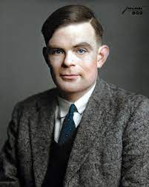
Alan Turing’s Computing Machinery and Intelligence
(Oct 1950)
https://phil415.pbworks.com/f/TuringComputing.pdf

Slide 39
The imitation game: Can machines think?
A machine is a digital, discrete-state, computer
Draws a sharp line between the physical and the intellectual capacities of a human
The interrogator cannot see, touch, or hear the competitors
A machine to play the game satisfactorily, should try and provide answers that would naturally be given by a human
interrogator

Slide 40
Critique of Turing’s Imitation Game as a Test for Machine Intelligence
It molds machine intelligence to the measures of human intelligence
May not machines carry out something which ought to be described as thinking but which is very different from what a human does?
Limits itself to problem-solving tasks in a symbolic way, completely ignoring other important elements of intelligence
Is ‘behavior’ enough to prove intelligence?

Slide 41
Objections addressed by Turing
The Theological Objection:
Thinking is a function of a human being’s immortal soul
The “Heads in the Sand” Objection:
The consequences of machines thinking would be dreadful. Let us hope and believe that they cannot be so.
The Mathematical Objection:
In any sufficiently powerful logical system, statements can be formulated which can neither be proved nor disproved within the system
Similar limitations apply to the human intellect

Slide 42
Objections addressed by Turing
The Consciousness Objection:
The only way by which one could be sure that a machine thinks is to be the machine and to feel oneself thinking
The Various Disabilities Objection:
Machines cannot be kind, resourceful, beautiful, friendly, have initiative, have a sense of humor, tell right from wrong, . . . .
Lady Lovelace’s Objection:
Babbage’s Analytical Engine can do whatever we know how to order it to perform
Machines not capable of doing something new, therefore incapable of learning

Slide 43
Objections addressed by Turing
The Nervous System Continuity Objection:
The nervous system is not a discrete-state machine
The Informality of Behavior Objection:
It is not possible to produce a set of rules to describe what a human should do in every conceivable set of circumstances

Slide 44
Turing’s Learning Machines: Abstract Digital Computing Machine
Has a limitless memory, and
A scanner that moves back and forth through the memory, symbol by symbol, reading what it finds and writing further symbols
Could learn from experience by altering its own instructions
The problem is mainly one of programming

Slide 45
Turing’s Learning Machines: Punishment, Reward, Randomness
Teach a machine through punishments and rewards, by programming it to
Avoid repeating events leading to a punishment
Increase the probability of repeating events leading to a reward
Rules with ephemeral validity can be changed
A random element in a learning machine is useful when searching for a solution
E.g., find a number between 50 and 200 which is equal to the square of the sum of its digits

Slide 46
Turing’s Prediction and Wish
Prediction: By 2000, it will be possible so that an average interrogator will not have more than 70% chance of making the right identification after 5 minutes of questioning
Wish: Machines will eventually compete with humans in all purely intellectual fields
Which are the best intellectual fields to start with?
Many people think that a very abstract activity like the playing of chess would be best
However, he states that his initial question “Can machines think?” is meaningless to deserve discussion!

Slide 47
Turing’s Concluding Sentence in his essay on Computing Machinery and Intelligence
We can see only a short distance ahead,
but we can see that much remains to be done.

Slide 48
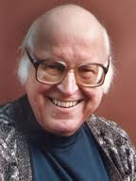
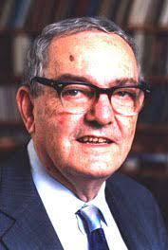
Allen Newell and Herbert Simon, 10th Turing Lecture “Computer Science as Empirical Enquiry: Symbols and Search” (1976)
https://citeseerx.ist.psu.edu/viewdoc/download?doi=10.1.1.104.2482&rep=rep1&type=pdf

Slide 49
Computer Science as Empirical Enquiry
As basic scientists we build machines and programs as a way of discovering new phenomena and analysing phenomena we already know about.
Symbolic Search – Heuristic Search
Have deep significance for understanding how information is processed and how intelligence is formed.

Slide 50
Symbol Processing
Physical-Symbol System
Symbols lie at the root of intelligent action
The Physical-Symbol System Hypothesis

Slide 51
Physical-Symbol System
It consists of a set of entities, which are called symbols, and are physical patterns.
Symbols can occur as components of another type of entity, called an expression or symbol structure.
The symbols that make up a symbol structure are related in some physical way, such as being next to each other.
The system also has a number of processes, which operate on expressions and produce other expressions, such as creation, modification, reproduction, and destruction processes.

Slide 52
Physical-Symbol System
At any instant of time, the system contains a collection of such symbol structures.
It is therefore a machine that produces through time an evolving collection of symbol structures.
Such a system exists in a world of objects wider than just these symbolic expressions themselves.

Slide 53
World of objects
Physical-Symbol System
symbols
expressions
interpretation
designation
processes
objects

Slide 54
Designation and Interpretation
Designation:
Expressions designate objects and this way access to objects is provided
The system can either affect the object or behave in ways depending on the object
Interpretation:
An expression designates a process for interpreting it
Given the expression, the system carries out the process

Slide 55
Requirements of completeness and closure
Symbols may dynamically designate any expression
Symbols and their relations determine which object is designated by a complex expression
Every process is designated by some expression
There exist processes for creating/modifying any expression in arbitrary ways
Expressions continue to exist once created until explicitly modified or deleted
The number of expressions that a system can hold is unbounded

Slide 56
The Physical-Symbol System Hypothesis
A physical-symbol system has the necessary and sufficient means for general intelligent action
It is an empirical hypothesis
General intelligent action: same scope of intelligence as in human action
necessary
can by analyzed to show that it is
A system that exhibits general intelligence
A physical-symbol system
sufficient
can by organized further to be

Slide 57
The LISP language – devised by John McCarthy in 1958
LISt Processing
Based on the evolving experience with list-processing
Arose out of the attempt to construct intelligent programs
Symbols and s-expressions
Programs and data defined uniformly as s-expressions
Functions, recursion, objects
PROLOG (PROgramming in LOGic) came much afterwards

Slide 58
The role of search in intelligence
Symbol systems solve problems through heuristic search
Heuristic Search Hypothesis
Problem solutions are represented as symbolic structures
A Physical-Symbol System progressively generates and modifies symbol structures, through heuristic search, until it produces a solution structure
Heuristic search is used because the system computing resources are scarce relative to the problem solution complexity
Problem space
A space of symbol structures, representing problem situations, including initial and goal situations
Move generators are processes for modifying one situation in the problem space into another
During the first decade of AI research, the study of problem-solving was almost synonymous with the study of search processes

Slide 59
Example: Given AX + B = CX + B, find the solution X = E such that AE + B = CE + D
Non-intelligent approach: continuously produce numbers and test
Intelligent approach:
AX + B = CX + D
AX – CX + B = D
B = CX – AX + D
X(A – C) + B = D
AX – CX = D – B
B = X(C – A) + D
B – D = CX – AX
X(A – C) = D – B
B – D = X(C – A)
X = (D – B)/(A – C)
X = (B – D)/(C – A)

Slide 60
Avert exponential explosion of search
This is the art of intelligence
Generate only structures that show promise of being solutions or of being along the path towards a solution
Decrease rate of branching, not to prevent it entirely
Employ information-using techniques to guide search
Means-ends analysis; best-first search, . . . . .
The Empirical Base
Research in AI is concerned with how symbol systems must be organized in order to behave intelligently
What to do next?

Slide 61
Symbolic versus Connectionist Artificial Intelligence

Slide 62
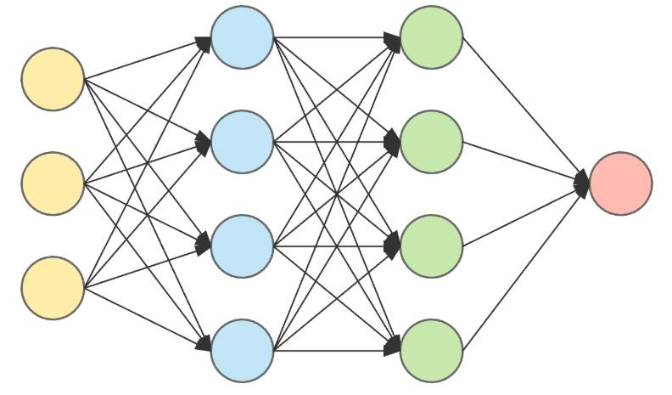

Slide 63
EC High-Level Expert Group on Artificial Intelligence
https://www.aepd.es/sites/default/files/2019-12/ai-definition.pdf
AI systems can either use symbolic rules or learn a numeric model
Symbolic approach
Knowledge: modelling, representation, reasoning (search)
Connectionist approach
Machine learning, neural networks, deep learning, decision trees, …..
Solve problems that cannot be precisely specified, or whose solution method cannot be described symbolically
ML techniques produce a numeric model (that is, a mathematical formula) used to compute the decision from the data
Explainability is a property of those AI systems that can provide a form of explanation of their actions/decisions/recommendations

Slide 64
European Commission’s Definition of AI
Artificial Intelligence (AI) refers to systems that display intelligent behavior by analyzing their environment and taking actions – with some degree of autonomy – to achieve specific goals.
AI systems can be purely software-based, acting in the virtual world (e.g., voice assistants, image analysis software, search engines, speech and face recognition systems) or AI can be embedded in hardware devices (e.g., advanced robots, autonomous cars, drones, or Internet of Things applications).

Slide 65
Rationality rather than intelligence
Intelligence (both in machines and in humans) is a vague concept
Better use the notion of rationality: the ability to choose the best action to take in order to achieve a certain goal, given certain criteria to be optimized and the available resources; often only bounded rationality is achieved.
Rationality, although not the only ingredient of intelligence, it is a significant part of it.
Embedding
Usually, AI systems are embedded as components of larger systems, rather than stand-alone systems

Slide 66
Definition proposed by High-Level Expert Group
Artificial intelligence (AI) systems are software (and possibly also hardware) systems designed by humans that, given a complex goal, act in the physical or digital dimension by perceiving their environment through data acquisition, interpreting the collected structured or unstructured data, reasoning on the knowledge, or processing the information, derived from this data and deciding the best action(s) to take to achieve the given goal. AI systems can either use symbolic rules or learn a numeric model, and they can also adapt their behavior by analyzing how the environment is affected by their previous actions.

Slide 67
Summary
Important landmarks in the history of AI
Different meanings ascribed to the term “Artificial Intelligence”
Alan Turing’s seminal thesis on computing machinery and his imitation game
Allen Newell and Herbert Simon’s foundational work on symbols, search and the physical symbol system hypothesis
Symbolic and connectionist AI

