Slide 1
University of Cyprus
MAI611 Fundamentals of Artificial Intelligence
Elpida Keravnou-Papailiou
September – December 2022

Slide 2
Artificial Intelligence and Explanation

Slide 3
UNIT 2
Artificial Intelligence and Explanation
CONTENTS
The significance of explanation in AI
Some theories of explanation that have influenced AI
Tracing the history of explanations in symbolic AI
The resurgence of interest in explanation in connectionist AI – opening the ‘black box’

Slide 4
INTENDED LEARNING OUTCOMES
Upon completion of this unit on Artificial Intelligence and explanation, students will be able:
To enhance further their understanding (as distilled from the previous course units) of the significance of explanation in relation to AI systems.
To discuss C.S. Peirce’s and P. Thagard’s general theories of explanation that have influenced the AI field, and the role of causality in the production of explanations.
To trace the history of explanations in symbolic AI, pointing out key milestones (rule-based explanations, strategic explanations, user-tailored explanations, case-based explanations).
To outline the recent resurgence of interest in explanation, in relation to connectionist AI, and the establishment of the research field referred to as XAI (eXplainable AI) aiming to ‘open’ the black box.

Slide 5
The significance of explanation in AI

Slide 6
Why do AI systems need explanations?
There are many (critically) important reasons ……
In general, decision support systems must be interpretable and not black-boxes – recall the roles of expert knowledge-based systems as consultants, critics or tutors.
By and large AI systems are interactive, i.e., they do not just get an input, process it and give an output, but they engage in a dialogue with a human user, who needs to take a ‘final’ decision that could impact on another human (e.g., a patient) or an organization, the society, etc.
Particularly critical domains are the medical/health care, legal, and defense domains.
Explanations have at least a dual purpose: (i) understanding the logic/model of the system, also facilitating ‘debugging’ (e.g., revealing biases in logic/data and erasing them); (ii) understanding the rationale of the recommended outcome of a specific consultation and be convinced of its validity; recall that AI systems are complex software systems deploying algorithms and knowledge/data.

Slide 7
Why do AI systems need explanations?
Traditionally, the central role of the explanation model is to reveal the system’s reasoning; however, it has a subsidiary role in relation to information-acquisition interactions, that concerns individual items of information rather than the system reasoning processes:
The user needs to be able to ask, not only why the system is asking a particular question (i.e., how does it relate to the reasoning process), but also what the given question means.
Nowadays the strive for responsible, trustworthy and ethical AI, emphasizes even more the need for AI systems to be bestowed with appropriate, user-tailored and hence fit for purpose, explanation models; different categories of users have different explanation needs.
EU’s General Data Protection Regulation (GDPR) and ACM’s Statement on Algorithmic Transparency and Accountability make direct references to the need for explanation while the European Research Consortium for Informatics and Mathematics (ERCIM) devoted one of its special issues on transparency in algorithmic decision making.

Slide 8
GDPR
According to R. Guidotti, A. Monreale, S. Ruggieri, F. Turini, D. Pedreschi and F. Giannotti, “A survey of methods for explaining black box models”, ACM Computing Surveys 51(5):93, 2018, DOI 10.1145/3236009:
An innovative aspect of the GDPR, which has been debated, are the clauses on automated (algorithmic) individual decision-making, including profiling, which for the first time introduce, to some extent, a right of explanation for all individuals to obtain “meaningful explanations of the logic involved” when automated decision making takes place. Despite divergent opinions among legal scholars regarding the real scope of these clauses, everybody agrees that the need for the implementation of such a principle is urgent and that it represents today a huge open scientific challenge. Without an enabling technology capable of explaining the logic of black boxes, the right to an explanation will remain a “dead letter”.

Slide 9
ACM Policy Council: Statement on Algorithmic Transparency and Accountability, 2017. https://www.acm.org/binaries/content/assets/public-policy/2017_usacm_statement_algorithms.pdf

Slide 10
A. Rauber, R. Trasarti and F. Giannotti (eds.), Transparency in algorithmic decision making, Special theme, ERCIM News, Number 116, January 2019.
https://ercim-news.ercim.eu/images/stories/EN116/EN116-web.pdf

Slide 12
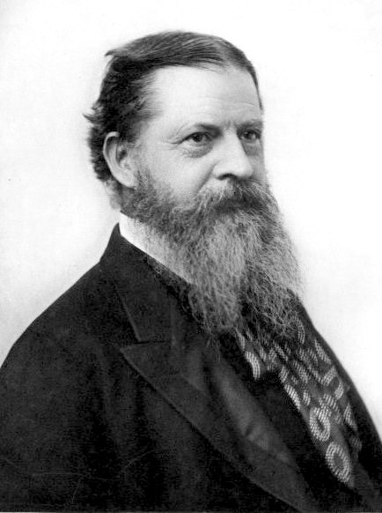
Some theories of explanation that have influenced AI
C.S. Peirce’s hypothesis of abduction – finding the most likely explanation of a set of observations
P. Thagard’s theory of explanatory coherence

Slide 13
C.S. Peirce’s hypothesis of abduction
Has its origins on Peirce’s architecture of theories (https://arisbe.sitehost.iu.edu/menu/library/bycsp/arch/arch.htm)

Slide 14
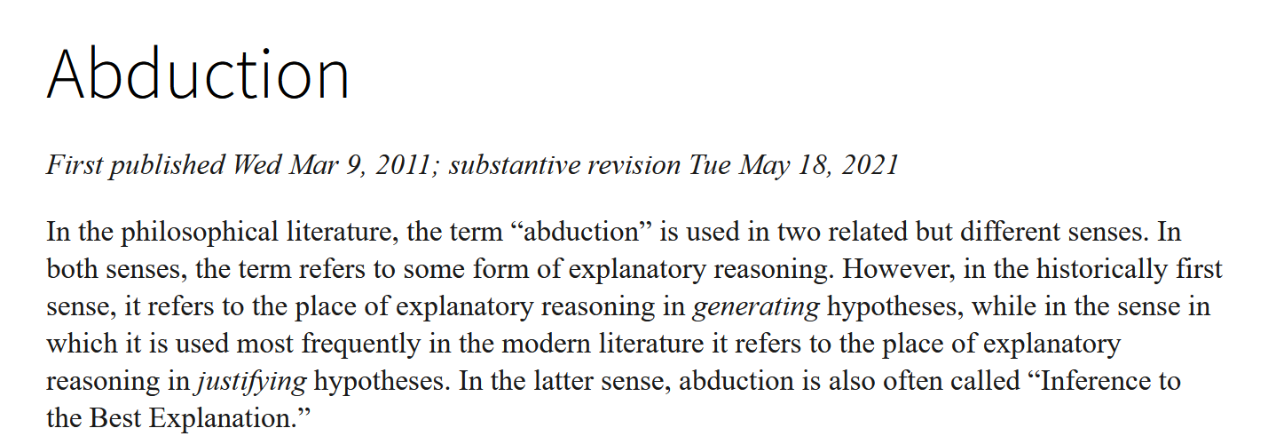
From the Stanford Encyclopedia of Philosophy
https://plato.stanford.edu/entries/abduction/index.html#DedIndAbd

Slide 15
Relevance to AI decision-making tasks
Any decision-making task strives to reach a decision that constitutes the best solution and hence best explanation of the problem at hand, whether it refers to a classification, prediction, plan of action, etc.
Explanations are essential when decisions are critical, unclear or not easily understandable.
problem (visible phenomena that need to be explained)
decision (solution)
decision-making task
understandable solution (best explanation)
WHY?

Slide 16
The basic reasoning methods
Abduction: Formulates hypotheses, making a combined space to create new ideas
Deduction: Tests hypotheses to narrow down existing choices
Recall hypothetico-deductive model of reasoning leading to best explanation, where deduction is a sub-process of abduction: Contextualized versus unconstrained deductions
Induction: Reaches conclusions and generalizes existing ideas
Explanations arise as rational connections between hypotheses and observations

Slide 17
H.E. People’s Mechanization of Abductive Logic
https://www.ijcai.org/Proceedings/73/Papers/017.pdf
In a deduction, the objective is to determine whether some statement is true
In an abduction, the objective is to determine why something is true (i.e., why the observed abnormalities hold)
In answering the why question, it is obviously important to be able to determine whether, thus deduction may be considered a process subordinate to deduction

Slide 18
Abduction and Deduction
Abduction is far more complicated than deduction.
A queried statement may be deduced (derived) in a multitude of ways, and any of these suffices; effective deductive systems are able to follow the simplest derivation paths, but this is an implementation rather than a conceptual issue.
In abduction, it is not sufficient just to generate one plausible explanation of the observed situation; instead, all plausible explanations need to be compared and contrasted.
An explanation is usually not deducible, and so once an explanation is hypothesized, it is not possible to deduce it.

Slide 19
What are the plausible explanations and
(ii) How is the best explanation selected?
Peirce has not specified any criteria …
A trend in abductive diagnosis has been to explore how much can be achieved with somewhat restrictive and thus nonpragmatic criteria
Explanation plausibility: complete accounting (coverage) of all observations of abnormality irrespective of their relative importance, say, for therapy
Two celebrated theories of abductive diagnosis are based on this restricted notion of explanation plausibility:
Peng and Reggia’s parsimonious covering theory
Poole’s logic-based theory
The principle used to select the best explanation from the plausible ones is that of simplicity

Slide 20
Peng and Reggia’s parsimonious covering theory
Parsimonious criteria based on:
Relevancy – every disorder hypothesis included in an explanation is causally related to some observation of abnormality
Irredundancy – none of the proper subsets of an explanation is itself an explanation
Minimality – prefer the explanation with the minimum cardinality

Slide 21
Pool’s logic-based theory
Criteria based on:
Minimality – prefer the explanation that makes the fewest, in terms of set inclusion, assumptions
Least presumption – prefer the explanation that makes the fewest, in terms of what can be implied, assumptions
Minimal abnormality – prefer the explanation that makes the fewest failure assumptions or makes the same abnormality assumptions but fewer normality assumptions

Slide 22
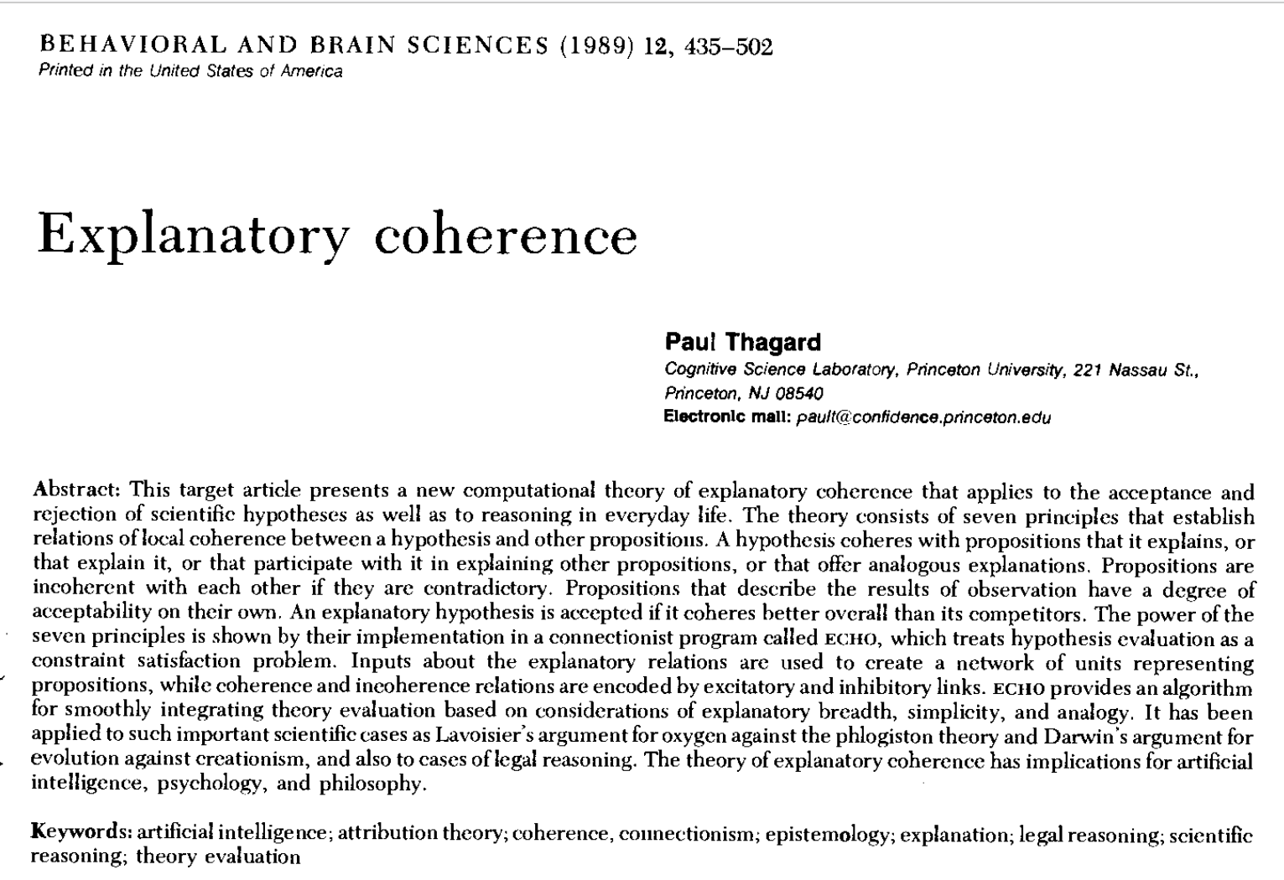
P. Thagard’s theory of explanatory coherence
http://cogsci.uwaterloo.ca/Articles/1989.explanatory.pdf

Slide 23
P. Thagard’s theory of explanatory coherence
Thagard is quite emphatic about the need for a tight coupling between the formation and evaluation of hypotheses in computational, abductive systems.
More specifically, he says that there are three possible models:
the two processes are completely independent, and hypotheses are formed in a random fashion, a nonviable option under limited resources;
the processes are weakly related, and only hypotheses that explain at least something are formed, or
they are strongly related, and only hypotheses that constitute likely possibilities are formed.
He also points out the inability (of some AI systems) to recognize those observations in need of explanation (this is a limitation because not every observation demands explanation) and subsequently the need to identify how evaluation constraints can be used more effectively to help limit the range of hypotheses that can be generated in order to lead to ones more likely to be accepted.

Slide 24
Thagard’s general criteria for measuring the quality of explanatory hypotheses
Consilience which is concerned not only with how much a hypothesis explains but also the variety of things it explains; a hypothesis is dynamically consilient if it becomes more credible over time
Simplicity which is concerned with the number of supporting assumptions, the well-known Occam’s razor: What can be done with fewer assumptions is done in vain with more
Analogy which advocates the reusability of successful explanation models in analogous situations
The above notions have been incorporated in the theory of explanatory coherence.

Slide 25
Abductive Diagnosis using Time-Objects: criteria for the evaluation of solutions https://citeseerx.ist.psu.edu/viewdoc/download?doi=10.1.1.1069.4339&rep=rep1&type=pdf
Primitive Evaluation Criteria
Coverage: focus-coverage, hard-coverage, current-coverage
Consistency: case-consistent
Strength of integration: strongly-integrated (or coherent), loosely-integrated (or incoherent); single or multiple point of failure
Satisfiability: N/T/C-satisfiable (necessary, typical, common expectations)
Ambiguity: alternative explanations for focus-abnormalities
Redundancy: a strict subset has the same coverage
Minimality: not redundant
Optimality: has focus-coverage, and it is case-consistent, satisfiable, strongly-integrated and minimal

Slide 26
Causality
The notion of causality is strongly coupled to the ‘quality’ of explanations:
Theories of explanation implicitly or explicitly entail causality, e.g., Peng and Reggia’s relevancy criterion states that every disorder hypothesis included in an explanation is causally related to some observation of abnormality
Causal models are deeper than associational (rule-based) models and can provide justifications to associationally derived solutions; recall the case of NEOMYCIN and many other second-generation knowledge-based systems
Association can arise between variables having causation or those not having causation; hence causality implies association but not the opposite

Slide 27
Causal Explanation
Is the strictest form of explanation
It arises from the construction of causal models, which require that explanations for arising predictions are, in fact, “recipes” for reconstructing that prediction
A causal model captures directed causal relationships, usually in a graphical representation:
Either forwards in time (A causes B) or backwards in time (B caused-by A)
Richness of temporal and other semantics varies in different models

Slide 28
Judea Pearl, the father of Bayesian networks and probabilistic reasoning states …
“To build truly intelligent machines, teach them cause and effect”

Slide 29
Paradoxical association due to lack of causal knowledge …
Asthmatics are less likely to die from pneumonia!

Slide 30
AI needs more WHY
observation
intervention
intervention
observation
asthma with pneumonia
direct ICU hospitalization
application of aggressive treatment
causes
reduction in likeliness of dying
causes
causes
associated-with – hence do not recommend asthmatics to the ICU!
Pearl’s three levels of causality:
Association: invokes purely statistical relationships defined by the data – What does a symptom tell me about a disease?
Intervention: not just observing what is, but changing what one sees, e.g., reliably estimating the effect if one performs an action – If I take a baby Aspirin, will my risk of heart failure reduce?
Counterfactuals: reasoning about hypothetical situations which enables us to estimate the unobserved outcomes (this is abduction) – Was the Aspirin that saved me from a heart attack?

Slide 31
A. Lavin, “AI needs more why”, Forbes, 2019.
https://www.forbes.com/sites/alexanderlavin/2019/05/06/ai-needs-more-why/#70ea2a5f156d
The pneumonia example shows that without considering clinical contexts, counterintuitive predictions and models with unintended consequences can be derived.
By taking into consideration domain expertise of the hospital’s policy, level 2 causal structure (clinical context, i.e., interventions) can be added.
The incorporated knowledge in the form of causal graph depicts which associations in the observed data are assumed to be valid cause-effect relationships.
However, this is not enough since relationships caused by action policies, won’t necessarily generalize when the policy changes.
Reliable decision support models need to learn counterfactual objectives; for levels 2 and 3 Pearl proposes the use of do-calculus, a formalism for causal logic.

Slide 32
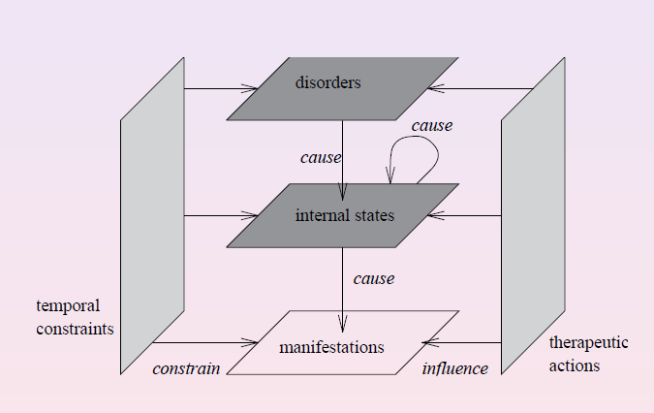
The Causal-Temporal-Action (C-T-A) Model
Causal inference can be leveraged to reason explicitly about actions-and-effects underlying observational data.

Slide 33
Challenge: infer causality from purely observational data
Pearl’s stance: “Causal reasoning is an indispensable component of human thought that should be formalized and algorithimitized toward achieving human-level machine intelligence.”

Slide 34
Tracing the history of explanations in symbolic AI

Slide 35
Kim et. al., A multi-component framework for the analysis and design of explainable AI (https://www.mdpi.com/2504-4990/3/4/45)
“Explanations have always been an indispensable component of decision making, learning, understanding, and communication in the human-in-the-loop environments. After the emergence and rapid growth of artificial intelligence as a science in the 1950s, an interest in interpreting underlying decisions of intelligent systems also proliferated.”

Slide 36
Rule-based expert systems championed explanations in symbolic AI
The MYCIN system pioneered symbolic explanations for different purposes:
Justification of the system’s recommendations (MYCIN – ‘intelligent’ consultant)
Knowledge-base debugging (TEIRESIAS – ‘intelligent’ debugger)
Tutoring medical students (GUIDON – ‘intelligent’ tutor)
Revealing chains of rules in the derived inference trees, also giving unsuccessful rules; pseudo natural language presentation
Presenting the current confidence in (context-attribute-value) derivations stored in the context tree (working memory)
Presentation and comparative analysis of full inference trees and other explanatory features of TEIRESIAS
Canned text for individual rules; presentation of rules independently of specific consultations

Slide 37
Despite their pioneering significance, problems soon surfaced with rule-based explanations, deeming them largely inadequate ….
“Explanations” were just rule playbacks and not meaningful
Missing/implicit knowledge
No support (causality) or strategic knowledge
User-tailored explanations subsequently added through a rudimentary user model
Complexity, importance of concepts and rule associations
User level of knowledge/detail of explanations
Adequate explanations to be an inborne feature of the design of a knowledge-based system from the start and not a subsequent add-on or reengineered into the system
Differentiating, explicating and implementing relevant knowledge types (e.g., causality)
Modelling human expertise (factual and reasoning knowledge) – bottleneck!

Slide 38
Second-generation, deep knowledge-based systems, offered new, promising avenues towards more adequate symbolic explanations …
NEOMYCIN explicated important knowledge types utilized in explanations
Support knowledge in the form of a causal model, having a dual purpose
As an alternative means to solving problems
For augmenting rule-based explanations with a more detailed/deep justification
Strategic knowledge, enabling the provision of strategic explanations
GUIDON2 was more successful than GUIDON as an ‘intelligent’ tutoring system
Still many challenges remained, e.g.,
Explaining the rational basis of strategies
Revoking choices (including strategic choices) and/or derivations and explaining these
Inadequacies with reasoning, truth maintenance, non-monotonicity
Handling and justifying exceptions
User tailoring

Slide 39
Case-based explanations
CBR offered yet another paradigm to symbolic explanations
Contextualized, evidence-based explanations
The similarity between the current case and the retrieved/selected past case needs to be explained
Where solution adaptation is made, this would also need to be explained
In many domains the case-based element is the domineering element in decision making, e.g., legal system in Cyprus
A past case sets precedence for future similar cases – fair/consistent handling
A decision is justified based on past cases – transparency, trust
Repeating a successful past solution for a new similar case is sufficient explanation on its own without requiring further justification – It worked for a similar case in the past!
Listing unsuccessful past cases, similar to the new case, provides further explanation/ justification for not adopting their (erroneous) solution and opting for something different
Avoiding past mistakes and reinforcing successes – learning from them

Slide 40
The resurgence of interest in explanation in connectionist AI – opening the ‘black box’ and the creation of the acronym XAI (eXplainable AI)

Slide 41
The knowledge acquisition bottleneck of symbolic AI systems, coupled with the performance success of Machine Learning and more recently Deep Neural Networks triggered interest in data-driven approaches.
But a new challenge emerged … making the resulting, highly-performing “black boxes”, interpretable and explainable!

Slide 42
Not all ML approaches result in ‘black boxes’; e.g., decision trees are not, and symbolic rules can result from each branch from root to leaf of such trees; hence a decision tree can be flattened into a set of if-then rules.

Slide 43
Some survey papers on the topic of eXplainable AI (XAI) ….
M-Y Kim et. al., A multi-component framework for the analysis and design of explainable AI (https://www.mdpi.com/2504-4990/3/4/45)
G. Vilone and L. Longo, Classification of explainable AI methods through their output formats (https://www.mdpi.com/2504-4990/3/3/32)
A.B. Arrieta et. al., Explainable AI (XAI): Concepts, taxonomies, opportunities and challenges toward responsible AI (https://www.sciencedirect.com/science/article/abs/pii/S1566253519308103)
R. Guidotti et. al., A survey of methods for explaining black box models (https://www.researchgate.net/publication/322976218_A_Survey_of_Methods_for_Explaining_Black_Box_Models)

Slide 44
The opening remarks of these surveys ….
M-Y Kim et. al.: “The rapid growth of research in explainable artificial intelligence (XAI) follows on two substantial developments. First, the enormous application success of modern machine learning methods, especially deep and reinforcement learning, having created high expectations for industrial, commercial, and social value. Second, the emerging and growing concern for creating ethical and trusted AI systems, including compliance with regulatory principles to ensure transparency and trust.”
G. Vilone and L. Longo: “Machine and deep learning have proven their utility to generate data-driven models with high accuracy and precision. However, their non-linear, complex structures are often difficult to interpret. Consequently, many scholars have developed a plethora of methods to explain their functioning and the logic of their inferences.”

Slide 45
The opening remarks of these surveys ….
A.B. Arrieta et. al.: “In the last few years, AI has achieved a notable momentum that, if harnessed appropriately, may deliver the best of expectations over many application sectors across the field. For this to occur shortly in Machine Learning, the entire community stands in front of the barrier of explainability, an inherent problem of the latest techniques brought by sub-symbolism (e.g., ensembles or Deep Neural Networks) that were not present in the last hype of AI (namely, expert systems and rule-based models).”
R. Guidotti et. al.: “In the last years many accurate decision support systems have been constructed as black boxes, that is as systems that hide their internal logic to the user. This lack of explanation constitutes both a practical and an ethical issue.”

Slide 46
Opening the Black Box
Explaining the black box model
Explaining the outcome
Inspecting the black box internally
Providing a transparent solution
Source: R. Guidotti et. al., A survey of methods for explaining black box models (https://www.researchgate.net/publication/322976218_A_Survey_of_Methods_for_Explaining_Black_Box_Models)

Slide 47
Black box and comprehensible predictors
A black box predictor b belongs to the set of uninterpretable data mining and machine learning models
The reasoning behind the function is not understandable by humans and the outcome returned does not provide any clue for its choice
In real-world applications, b is an opaque classifier
A comprehensible predictor is one for which a global or a local explanation is available; its performance is generally evaluated by two measures:
Accuracy: comparing the real target values against the respective predicted target values of the black box and comprehensible predictors
Fidelity: how good is the comprehensible predictor in mimicking the black box predictor

Slide 48
Explaining the black box model
Given a black box predictor b and a dataset D = {X, Y}, the black box explanation problem consists in finding a function f which takes as input a black box b and a dataset D, and returns a comprehensible global predictor c_{g,} i.e., f(b, D) = c_{g}, such that c_{g} is able to mimic the behavior of b and exists a global explanator function that can derive from c_{g} a set of explanations modeling in a human understandable way the logic behind c_{g} .
For example, the set of explanations can be modelled by a decision tree or by a set of rules.

Slide 49
Explaining the outcome
Given a black box predictor b and a dataset D = {X, Y}, the black box outcome explanation problem consists in finding a function f which takes as input a black box b and a dataset D, and returns a comprehensible local predictor c_{l,} i.e., f(b, D) = c_{l}, such that c_{l} is able to mimic the behavior of b and exists a local explanator function that takes as input the black box b, the comprehensible local predictor c_{l} and a data record x, and returns a human understandable explanation for the record x.
The various approaches proposed to implement function f, aim to overcome the limitations of explaining the whole model. The returned explanation may be either a path of a decision tree or an association rule.

Slide 50
Inspecting the black box internally
Given a black box predictor b and a dataset D = {X, Y}, the black box inspection problem consists in finding a function f which takes as input a black box b and a dataset D and returns a visual (or textual) representation of the behavior of the black box, i.e., f(b, D) = v.
For example, the visualization returned highlights the feature importance for the predictions. Overall, the aim is either to understand how the black box model works or why the black box returns certain predictions more likely than others.

Slide 51
Providing a transparent solution
Given a dataset D = {X, Y}, the transparent box design problem consists in finding a learning function L_{c} which takes as input the dataset D and returns a (locally or globally) comprehensible predictor c, i.e., L_{c}(D) = c.
This implies that there exists a local or a global explanator function that takes as input the comprehensible predictor c and returns a human understandable explanation or explanations.
For example, L_{c} and c may be the decision tree learner and predictor respectively, while the global explanator may return the choices taken along the various branches of the tree and the local explanator may return the textual representation of the path followed according to the (particular) decision suggested by the predictor.

Slide 52
Agnostic Explanator
Is a comprehensible predictor, not tied to a particular type of black box, explanation or data type.
In theory it can explain indifferently a neural network or a tree ensemble using a single tree or a set of rules.

Slide 53
Reverse Engineering
A common approach to solve the black box model and outcome explanation problems and the black box inspection problem
The black box predictor b is queried with a certain test dataset in order to create an oracle dataset that in turn is used to train the comprehensible predictor
The name reverse engineering comes from the fact that only the input and output of the black box can be observed.

Slide 54
Summary
The significance of explanation in AI
Abduction and Explanatory Coherence
Causality
Revisiting explanations in symbolic AI
Opening the ‘black box’ in connectionist AI

