Slide 1
University of Cyprus
MAI611 Fundamentals of Artificial Intelligence
Elpida Keravnou-Papailiou
September - December 2022

Slide 2
Knowledge Representation Formalisms of Frames and Production Rules

Slide 3
UNIT 6
Knowledge Representation Formalisms of Frames and Production Rules
CONTENTS
Frames
Production Rules

Slide 4
INTENDED LEARNING OUTCOMES
Upon completion of this unit on the knowledge representation formalisms of frames and production rules, students will be able:
Regarding Frames:
Explain what a frame is and discuss the key structural features of this representation formalism, namely slots and facets.
Discuss procedural attachment and the use of active procedures or demons.
Explain what a frame system is, how reasoning is performed in such a system of control and object frames and how object frames can be instantiated (filling their slots).
Discuss inheritance and give algorithms for simple inheritance applied to strict hierarchies and multiple inheritance applied to non-strict hierarchies.
Analyze how the formalism of frames combines declarative and procedural representations.

Slide 5
INTENDED LEARNING OUTCOMES
Upon completion of this unit on the knowledge representation formalisms of frames and production rules, students will be able:
Regarding Production Rules:
Explain what a production rule is and discuss the architecture of a production system in terms of its key components (production memory, working memory and control structure).
Present the two basic ways of applying production rules, namely forwards and backwards chaining, and outline the key concepts of the Rete algorithm for forward chaining.
Distinguish between chaining and reasoning (goal-driven, or backwards, and event-driven, or forwards, reasoning).
Discuss the control structure of a production system, present performance criteria and global strategies, and explain meta-rules for local control.
Explain an inference network (or AND/OR tree), the indexing of the production memory, and give algorithms for the procedures, Findout for objects and Monitor for rules that collectively implement backward chaining.
Discuss explanations why and how.
Present in more detail (than in Unit 4) the blackboard model and its underlining strategy of opportunistic search.

Slide 6
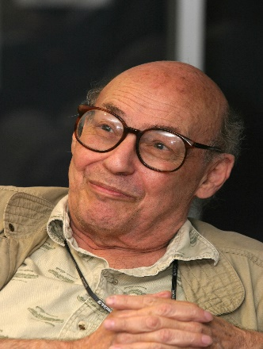
Frames
Marvin Minsky, A Framework for Representing Knowledge, MIT, 1974 (https://dspace.mit.edu/bitstream/handle/1721.1/6089/AIM-306.pdf?%2520sequence%3D2)

Slide 7
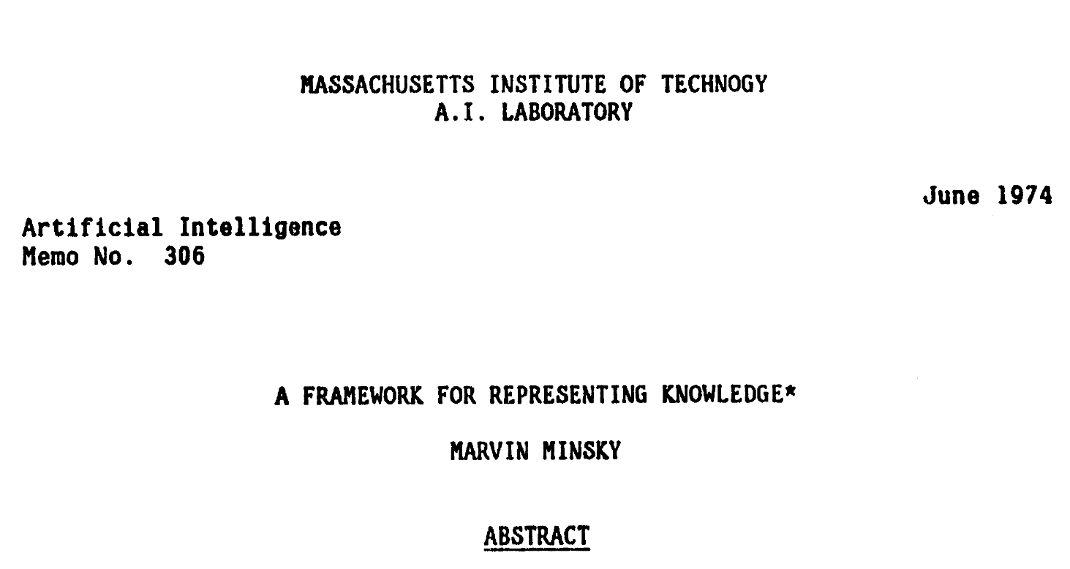
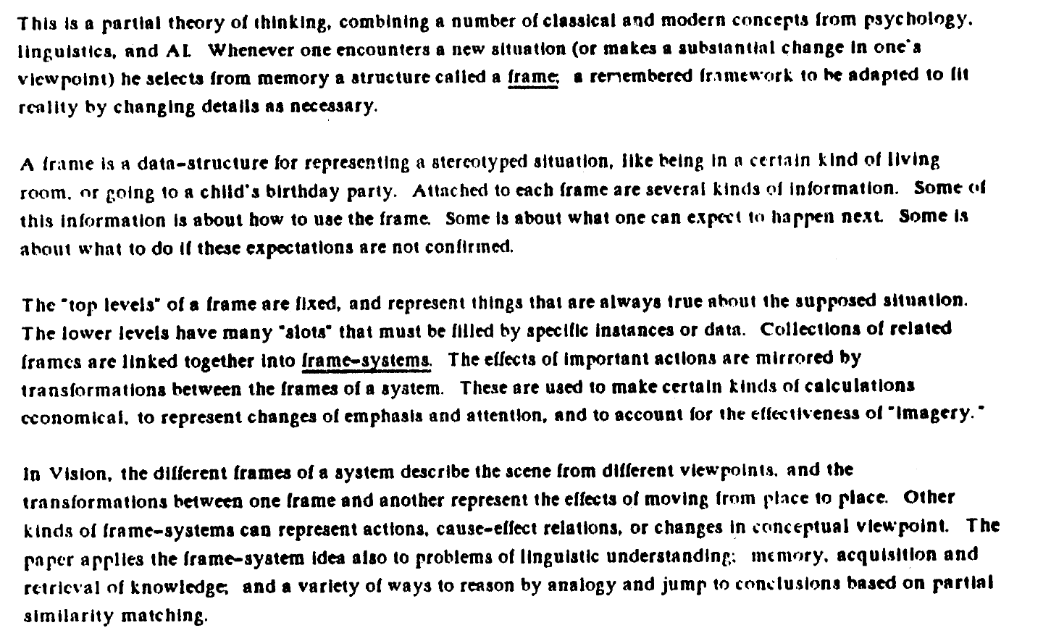
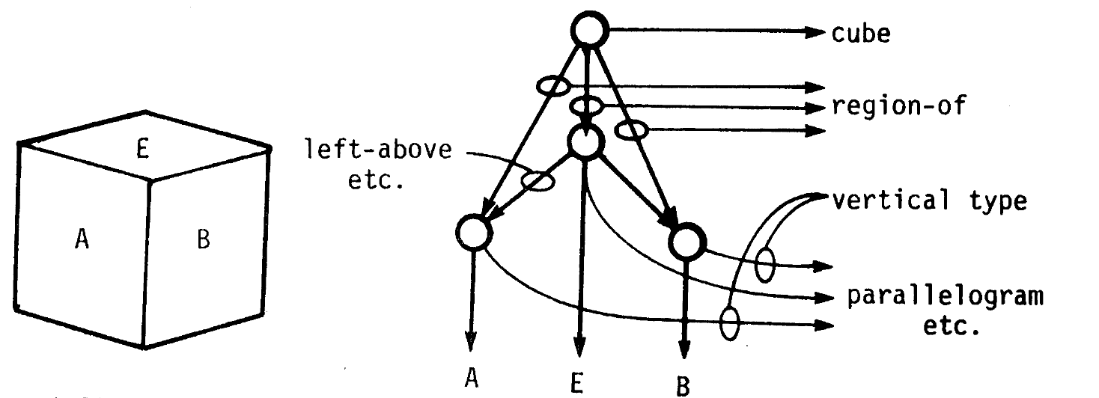

Slide 8
Frames
The concept of frame is due to Marvin Minsky who formulated his proposal in relation to research in machine vision.
A frame gives the ‘totality’ of knowledge about the (abstract or concrete) entity it represents:
Part of the knowledge describes the entity, while another is about its use.
For example, a frame may describe a stereotypical situation, such as going to a restaurant. Part of the knowledge is related to what is going to happen when someone goes to a restaurant, as well as what to do if the expected does not happen, i.e., any exceptions and the actions involved.
The formalism combines declarative and procedural representation.

Slide 9
Slots and Facets
The key structural elements of a frame are the slots and their facets
Slots represent the characteristics of the entity
Slots are “filled” (obtain values) based on various constraints expressed in the facets
A slot could be single-valued (only one of its domain values can be assigned to it) or multi-valued (can be assigned more than one value)

Slide 10
Typical Facets
Values
Permitted set of values or conditions that need to be satisfied for any filler of the slot
This is the only facet for the slots of frame instances
Hence, the frame instantiation procedure involves the assignment of values to facet ‘values’ of the relevant slots
This is referred to as ‘filling’ the slots
Default
Value that can be assumed to hold in the absence of any contra-indications
Procedural attachments or ‘demons’

Slide 11
Procedural attachments or ‘good demons’
These facets represent reasoning knowledge in the form of procedures
The given ‘good demons’ are activated automatically based on specific conditions:
if-added: Actions that need to take place when the slot is filled or when new information has been added to the slot
if-removed: Actions that need to take place when the filler of the slot is removed
if-needed: Procedure for computing the value of the slot. Its use is underlined by various conditions safeguarding the availability of the necessary information for the computation

Slide 12
Consistency control by ‘demons’
Demons ‘if-needed’ and ‘if-removed’ aim to maintain the consistency of information
Every procedure provides control at local level
The initial activation of some demon could lead to the activation of a whole chain of other such procedures involving several slots; these activations collectively achieve consistency at global level

Slide 13
Example: Frame for the abstract concept ‘chair’
Chair
Isa: furniture
Use:
Values: for-sitting, for-standing, for-support
Default: for-sitting
If-needed: ask
Number-of-legs:
Values: ‘up-to-four’
Default: 4
Status:
Values: ok, broken, partially-hidden
If-needed: Number-of-legs = 4 → ok
Number-of-legs = 1 → broken
. . . . . . . . . . .

Slide 14
Reasoning with Frames
A frame is defined in order to allow reasoning about the concept it represents.
A comprehensive frame for the concept of chair could support reasoning about chairs such as:
Walking into a room, which objects are chairs?
Can someone climb on a chair to reach a high shelf?
When can one sit on a chair? when in a museum? when in a dollhouse? when already in use?
Etc.

Slide 15
Key Question: Can frames be formulated 'completely' in advance, to support common-sense reasoning or specialized reasoning?

Slide 16
Frame Instantiation
The instantiation of a frame that represents an abstract concept, refers to the filling of the slots to create specific cases (instances) of the concept
The specific frames have the general frame as their direct predecessor in the hierarchy

Slide 17
Party
Isa: Event
Place:
Purpose:
Instances:
Party-1
Party-2
Isa: Party
Place: University of Cyprus
Purpose: Welcoming of new students
Isa: Party
Place: . . . . . . . . . . . . . . . .
Purpose: . . . . . . . . . . . . . . . .

Slide 18
Frame System
In a frame system, the different frames are interrelated in various ways
Frames fall into two general categories
Object frames
Control frames - define how other frames are used

Slide 19
Frame System
A frame system is an organized base of control frames and object frames, for a given purpose.
It is a search space, where the goal is to create instances of object frames that collectively provide the solution to the problem.

Slide 20
Critical Points of Reasoning Process:
The initial focus on the search space
Further navigation in this space especially if the expectations do not correspond to reality
Based on some incomplete, uncertain and vague information, an attempt is made to identify an external condition, whether it refers to a visible object, such as a chair, or to some non-visible condition, such as the internal dysfunction of a patient.
A basic mechanism is the matching of expectations, as they are formulated in the relevant frame, with reality, as it appears (partially) through incomplete information.

Slide 21
Links between object frames
Hierarchical links
relations ‘isa’ and ‘is_part’
Opposing links
identify differences between frames with many common characteristics, that as a result of this similarity, the existence of one may be mistaken for the existence of the other
The subnet created by the set of opposing links is called the similarity matrix
Complementary links
they connect one frame to others that represent concepts, complementary to the concept of the first
Triggering links
they suggest which frames to activate, by and large initially; these links are usually contained in control frames, and hence they are context-independent, that is, they operate at global level

Slide 22
Example Similarity Matrix
Chair
Bench
Opposing links:
Very big, without back
Very broad, without back
Very tall, without back
………………………
Stool
………………………
Table
Desk
Opposing links:
Without drawers
Opposing links:
No knee space
Desk Extension
………………………

Slide 23
Inheritance
What is the value of characteristic S of object frame instance F?
Inheritance algorithms are used by the frame instantiation process.
Inheritance allows the flow of information from categories to instances. This flow is not monotonic.
Simple inheritance − strict taxonomies
Multiple inheritance − a frame can have multiple direct predecessors
Relevant facets: ‘values’, ‘if-needed’, and ‘default’

Slide 24
Taxonomy
animals
ISA
Meronomy
mammals
ISA
chair
ISA
ISA
dogs
cats
IS_PART
IS_PART
elephants
ISA
legs
My cat
seat

Slide 25
Taxonomies and Meronomies of Concepts
A taxonomy is an organization of categories and subcategories
‘ISA’ (is-a-kind-of (isa))
A meronomy is an organization of constituent parts/components
‘IS_PART’ (is_part)
Relations ‘ISA’ and ‘IS_PART’ are transitory and hence the hierarchies formed from these relations are hereditary (support the inheritance of properties)
The top-down flow of information, in some taxonomy, is not monotonic, i.e., exceptions should be supported

Slide 26
Example
if all wedges are triangular, it can be concluded that any specific wedge is triangular.
If we know that the volume of a cube is V and the density of its matter is d, then its weight can be calculated as the product of Vd.
It can be reasonably assumed that a particular toy cube is made of wood, because most such cubes are made of wood, and that the purpose of a cube is entertainment if seen as a toy, or support if seen as a structure.

Slide 27
Simple Inheritance
Bird
Can-fly:
Value: yes, no
Default: yes
ISA
ISA
Sparrow
. . . . . . . . .
Penguin
Can-fly:
Values: no
ISA
ISA
Sparrow-1
Can-fly?
Penguin-1
Can-fly?

Slide 28
N-Inheritance Algorithm
Starting from the frame representing object F, move upwards using the ‘ISA’ chain of links. In every frame visited check if there is a ‘values’ facet for characteristic S, that gives a categorical value. If yes, stop.
If step 1 failed, repeat the upwards traversing but this time examine the ‘if-needed’ facet.
Finally, if step 2 failed, then repeat examining the ‘default’ facet.
1
2
3
values
if-needed
default

Slide 29
Z-Inheritance Algorithm
Starting from the frame representing object F, move upwards using the ‘ISA’ chain of links. In each frame visited examine the facets ‘values’, ‘if-needed’, and ‘default’, of slot S, in this order. If a value is obtained for the slot stop, otherwise proceed to the immediately above frame.
Question:Which of the two algorithms is better?
values
if-needed
default

Slide 30
Remarks
Z-inheritance is based on the heuristic that the closest answer is the correct one, even if it comes from a default, while N-inheritance gives the highest weight to facet ‘values’ (and the least weight to facet ‘default’), even if the value would come from a frame at a great distance from the starting frame.
The examination of facet ‘if-needed’ could lead to a recursive call of the algorithm.
In the worst case, that is the case where either no value can be derived, or the value comes from the default facet of the highest frame, the two algorithms have the same complexity, provided that the ascent cost is zero.

Slide 31
Multiple Inheritance
In multiple inheritance there could be contradictory suggestions as to the value of characteristic S of frame F.
Bird
Can-fly: yes
QUAKER
Pacifist: yes
REPUBLICAN
Pacifist: no
ISA
ISA
ISA
ISA
Ostrich
Can-fly: no
Pet-bird
Dick
Pacifist?
ISA
ISA
(b)
Fofi
Can-fly?
(a)

Slide 32
Simple Algorithm
Select the answer that comes from the nearest frame.
If there is just one value, this is the answer.
If not, the contradiction cannot be resolved.

Slide 33
Bird
Can-fly: ναι
REPUBLICAN
Pacifist: no
ISA
Ostrich
Can-fly: no
ISA
ISA
Conservative-Republican
ISA
Pet-bird
Ostrich-with-Plume
ISA
QUAKER
Pacifist: yes
White-Ostrich-with-Plum
ISA
ISA
ISA
Dick
Ειρηνιστής;
ISA
Fofi
Can-fly?
(b)
(a)

Slide 34
The value is chosen based on the inferential distance and not the path distance.
Inferential Distance
Category C₁ is nearer (reasoning-wise) to category C₂ in relation to category C₃ if and only if C₁ has a reasoning path to C₃ through C₂.
This relation defines a partial order.
Fofi is nearer to ostrich in relation to bird since there is a route from Fofi to bird through ostrich.
However, the relation is not defined for the triplet Dick, Quaker, and Republican.

Slide 35
Set of Conflicting Values for Characteristic S of Object F
Consists of:
Values coming from hierarchically higher frames, X.
They are not in contradiction with values coming from some frame, Y, which is at a smaller inferential distance from frame F in relation to frame X.
The set of conflicting values for characteristic ‘Can-fly’ of object Fofi is {no} while for the characteristic ‘Pacifist’ of object Dick is {yes, no}.

Slide 36
Multiple Inheritance Algorithm based on Inferential Distance
CANDIDATES ← [ ]
2. Apply breath-first (or depth-first) search starting from frame F and following upwards all hierarchical links. At every step examine whether there is a value for characteristic S:
(a) If there is a value, add it in CANDIDATES and terminate the given route
(b) If there is no value, but there are upwards ‘ISA’ links then follow them
(c) Otherwise terminate the particular route

Slide 37
Continuation of Multiple Inheritance Algorithm based on Inferential Distance
3. For every element Y of CANDIDATES:
(a) Examine whether there is another element of CANDIDATES coming from a category which is nearer (reasoning-wise) to F than the category from where Y came
(b) If yes delete Υ from CANDIDATES
4. Examine the number of elements of CANDIDATES:
(a) If it is 0, no value has been found
(b) If it is 1, then return the single candidate as the sought value
(c) Otherwise note the contradiction

Slide 38
Production Rules
The simplest knowledge representation formalism

Slide 39
INTENDED LEARNING OUTCOMES
Upon completion of this unit on the knowledge representation formalisms of frames and production rules, students will be able:
Regarding Production Rules:
Explain what a production rule is and discuss the architecture of a production system in terms of its key components (production memory, working memory and control structure).
Present the two basic ways of applying production rules, namely forwards and backwards chaining, and outline the key concepts of the Rete algorithm for forward chaining.
Distinguish between chaining and reasoning (goal-driven, or backwards, and event-driven, or forwards, reasoning).
Discuss the control structure of a production system, present performance criteria and global strategies, and explain meta-rules for local control.
Explain an inference network (or AND/OR tree), the indexing of the production memory, and give algorithms for the procedures, Findout for objects and Monitor for rules that collectively implement backward chaining.
Discuss explanations why and how.
Present in more detail (than in Unit 4) the blackboard model and its underlining strategy of opportunistic search.

Slide 40
A central postulate of Artificial Intelligence is that intelligent behavior is governed by rules
If (premise) then (conclusion), or
If (condition) τότε (action)
Production System
A production system represents its knowledge as rules.
Its knowledge base is called production memory.

Slide 41
Production System Architecture
Rule Interpreter
(Control Structure)
Data
Answers
Rules
(Production Memory)
Data
(Working Memory)

Slide 42
Production Rules
P₁, …., P_{m} → Q₁, …., Q_{n}, where m, n ≥ 1.
Semantics: If the premises (conditions) P₁, …, P_{m}, are true in the specific contexts, then the conclusions (actions), Q₁, .., Q_{n}, can be derived (executed))
The sentences P_{i} and Q_{j} are symbol structures, usually triplets of the form:
(⟨object⟩ ⟨attribute⟩ ⟨value⟩)

Slide 43
Dictionary of Rules
set Α of object names
set Χ of property names that bestow attributes to objects
set Τ of attribute values
Usually sets A and T intersect in order to be able to express relationships between objects, e.g.:
(Knowledge-Representation subunit Artificial-Intelligence)
Where symbols ‘Knowledge-Representation’ and ‘Artificial-Intelligence’ belong to both sets A and T, while symbol ‘subunit’ belongs to set X. ‘

Slide 44
Several atomic sentences referring to the same object could be merged, e.g.:
(α, χ₁, τ₁), (α, χ₂, τ₂), …., (α, χ_{n}, τ_{n})
⇓
(α, χ₁, τ₁, χ₂, τ₂, …, χ_{n}, τ_{n})
OPS5: (Production-Rules ^author Keravnou ^subunit AI-Fundamentals)
CLIPS: (Production-Rules (author Keravnou) (subunit AI-Fundamentals))

Slide 45
Rule Syntax
(rule ⟨rule-name⟩
⟨premise-1⟩ . . . . . ⟨premise-n⟩
→ ⟨action-1⟩ . . . . . . ⟨action-m⟩)
Example
(rule under-probation
(Student ^name Smith ^semester-average 4.8)
→ (add Place ^name Smith ^under-probation yes))
This formulation does not give the rule, but an instantiation of it. The proper formulation of the rule uses variables.

Slide 46
(rule under-probation
(Student ^name ?Ο ^semester-average ?A)
(:less-than ?A 5.0)
→ (add Place ^name ?Ο ^under-probation yes))
The scope of each variable is the given rule. Every appearance of the same variable refers to the same value.
Moreover, premises could involve external, computable predicates, such as less-than. These premises are ‘computed’, they are not matched against specific symbolic expressions.
The binding of variables with values is done by a pattern matching process.

Slide 47
Let’s assume the following data:
D1: (Student ^name Smith ^semester-average 4.8)
D2: (Student ^name Jones ^semester-average 7.2)
D3: (Student ^name Adams ^semester-average 4.7)
The symbolic expression in the first premise of rule ‘under-probation’ matches against each of the above data.
However, the second, computable, premise is verified only in relation to data D1 and D3..
Hence, in this case there are only two instantiations of the given rule:
1. In relation to datum D1 where the bindings are
?Ο = Smith και ?A = 4.8
2. In relation to datum D3 where the bindings are
?Ο = Adams και ?A = 4.7

Slide 48
Working Memory
Data D1-D3 are stored in the working memory, a global data base.
The application of the above rule instantiations would result in the addition of the following data in the working memory:
D4: (Place ^name Smith ^under-probation yes)
D5: (Place ^name Adams ^under-probation yes)
However, the reasoning in a production system, is not entirely monotonic as it is the case with predicate logic.

Slide 49
Basic ways of applying rules
Forwards chaining
Backwards chaining

Slide 50
Forwards Chaining
The symbolic expressions in the rule premises are matched against the symbolic expressions in the working memory
The rule instantiations thus derived constitute a conflict set, out of which one instantiation is selected and applied, i.e., its action is executed
The recognize-act cycle continues until either there is no rule instantiation (the conflict set is empty) or none of the rule instantiations can lead to progress (modifications or additions to the working memory)

Slide 51
Backwards Chaining
The rules are applied in the opposite direction, i.e., from actions/conclusions to premises
Initially some action/goal-conclusion is set
The rules whose right-hand sides match against the goal constitute a conflict set, from which one rule is then selected whose premises in turn become subgoals to be pursued
This way an inference tree is recursively formed

Slide 52
Reasoning versus Chaining
Goal-driven reasoning, otherwise known as backwards reasoning
Event-driven reasoning, otherwise known as forwards reasoning
The form of reasoning is at the level of design, while the form of chaining is at the level of implementation
Reasoning is implemented through chaining, but not the opposite
The languages OPS5 and CLIPS provide only forwards chaining, but both forms of reasoning (goal-driven or event-driven) can be implemented

Slide 53
Deductive Reasoning versus Abductive Reasoning
Deductive reasoning leads to conclusions in a categorical way, e.g., the reasoning in predicate logic
Deductive reasoning is hypothetical reasoning; It leads to possible hypotheses for further investigation

Slide 54
Critical point of both chaining methods
The selection of the next rule (instantiation) to be applied
The selection is guided by various heuristics, in the form of
General control strategies
Meta-rules
Resolving the conflict set

Slide 55
Forwards Chaining - ‘Recognize-Act’ cycle
Example (continuation)
Dismissal Rules:
Second failure on a mandatory course
Failure on more than two mandatory courses in the same semester.
Under-probation for two consecutive semesters.

Slide 56
Rule Coding
(rule dismissal-1
(Failure ^name ?O ^course ?C ^semester ?S1)
(Failure ^name ?O ^course ?C ^semester ?S2)
(:different ?S1 ?S2)
(Mandatory ^course ?C ^for ?Ο)
→ (add Potential-Dismissal ^for ?Ο
^reason second-failure-on-mandatory))

Slide 57
(rule dismissal-2
(Failure ^name ?O ^course ?C1 ^semester ?S)
(Failure ^name ?O ^course ?C2 ^semester ?S)
(Failure ^name ?O ^course ?C3 ^semester ?S)
(:all-different ?C1 ?C2 ?C3)
(Mandatory ^course ?C1 ^for ?Ο)
(Mandatory ^course ?C2 ^for ?Ο)
(Mandatory ^course ?C3 ^for ?Ο)
→ (add Potential-Dismissal ^for ?Ο
^reason failure-on-2plus-mandatory))

Slide 58
(rule dismissal-3
(Under-probation ^name ?Ο ^semester ?S1)
(Under-probation ^name ?Ο ^semester ?S2)
(:consecutive ?S1 ?S2)
→ (add Potential-Dismissal ^for ?Ο
^reason 2-consecutive-under-dismissal))
Remark: Each rule is expressed as an independent, self-explanatory entity. Reasoning, however, is achieved based on the indirect correlations of the rules.

Slide 59
Other Rules
(rule course-failure
(Attended ^name ?Ο ^course ?C ^semester ?S ^mark ?M)
(:less-than ?M 5.0)
→ (add Failure ^name ?Ο ^course ?C ^semester ?S)

Slide 60
Modification of initial ‘under-probation’ rule
(rule under-probation
(Semester-Average ^name ?Ο ^semester ?S ^average ?A)
(:less-than ?A 5.0)
→ (add Under-Probation ^name ?Ο ^semester ?S))
data abstraction
Remark: Each rule needs to be properly ‘integrated’ with the other rules.

Slide 61
Algorithm for Forwards Chaining
(‘Recognize-Act’ Cycle)
Repeat
RINST → all the rule instantiations, the premises of which are verified against the contents of the working memory
Select, based on the heuristics, R ∈ RINST for execution
If a rule instantiation R has been selected, execute its action in relation to the working memory
Until either no rule instantiation R can be selected, or the action of the selected R implies termination of the process

Slide 62
Rule Application
Initial Working Memory Contents
D1: (Mandatory ^course CS300 ^for Jones)
D2: (Mandatory ^course CS301 ^for Jones)
D3: (Mandatory ^course CS302 ^for Jones)
D4: (Attended ^name Jones ^course CS300 ^semester 1 ^mark 4.5)
D5: (Attended ^name Jones ^course CS300 ^semester 3 ^mark 4.0)
D6: (Attended ^name Jones ^course CS301 ^semester 3 ^mark 3.5)
D7: (Attended ^name Jones ^course CS302 ^semester 3 ^mark 4.0)

Slide 63
First cycle
The conflict set contains four instantiations of rule ‘course-failure’, say R1-R4, respectively in relation to data D4-D7.
Let’s assume that instantiation R1 is selected, whose execution adds the following new datum (conclusion) to the working memory:
D8: (Failure ^name Jones ^course CS300 ^semester 1)

Slide 64
Second cycle
The conflict set consists of the remaining three rule instantiations, R2-R4, while rules ‘dismissal-1’ and ‘dismissal-2’ have been matched partly due to the new datum, D8.
Let’s assume that instantiation R2 is selected, whose execution adds the following new datum (conclusion) to the working memory:
D9: (Failure ^name Jones ^course CS300 ^semester 3)

Slide 65
Third cycle
A new rule instantiation, say R5, is added in the conflict set, referring to rule ‘dismissal-1’ in connection with the data D1, D8 and D9.
Rule ‘dismissal-2’ continues to be partly matched.
Complete the execution of the forwards chaining algorithm

Slide 66
Control Structure
In every cycle, the selection of the rule instantiation to be executed next, is governed by various heuristics that constitute the control structure of the rule interpreter
General performance criteria
Sensitivity:
Ability to respond quicky to changes in the environment as these are depicted in the working memory
Stability:
Ability to demonstrate coherence in the line of reasoning

Slide 67
Global Control Strategies
Refractoriness
Recency
Specificity

Slide 68
Refractoriness Control Strategy
The same rule instantiation can be executed only once
In monotonic production systems it would not make sense to execute the same rule instantiation more than once
Weaker version: Only the rule instantiation executed at the immediately preceding cycle to be excluded

Slide 69
Recency Control Strategy
Every datum in the working memory is associated with its time of entrance
Rule instantiations that concern more recent data are preferrable to those that concern older data
Weakness: Older data can be indefinitely ignored, unless the current line of reasoning fails

Slide 70
Specificity Control Strategy
Rule instantiations that have more premises are to be preferred
The rationale being that such rules take into consideration more of the data
The use of this strategy facilitates the handling of exceptions, e.g.:
General rule: ‘If X is a bird, then Χ can fly’
Rule exceptions:
‘If Χ is a bird and Χ is a penguin, then Χ cannot fly’
‘If Χ is a bird and Χ is an ostrich, then Χ cannot fly’
‘If X is a bird and X has a broken wing, then X cannot fly’
Etc.

Slide 71
Rete: a fast algorithm for the many pattern/many object pattern match problem (http://www.csl.sri.com/users/mwfong/Technical/RETE%20Match%20Algorithm%20-%20Forgy%20OCR.pdf)
Charles L. Forgy, Artificial Intelligence Journal, 1982
Incorporated in the OPS5 programming language
The algorithm and various improvements thereon, are a key component of forward-chaining production systems
E.g., the XCON system (originally called R1) contained several thousand rules for designing configurations of computer components for customers of the Digital Equipment Corporations; it was one of the first clear commercial successes in the field of expert systems
Many other similar systems have been built and implemented in the general-purpose language OPS5
Objective: How to compute fast, at each cycle, the conflict set, i.e., the applicable rule instantiations
Even when sophisticated indexing and hashing was used, still 90% of the computation time was used in rule matching

Slide 72
Rete Algorithm – Key Concepts
Production Memory
Compiled into
Network from the rule antecedents
The production memory does not change during problem solving and the patterns must be compilable
Many rules share conditions
RETE
(patten matcher)
conflict set
changes to the conflict set
Working Memory
Working Memory changes (tokens)
Pattern matching done incrementally
Tokens represent new or changed working memory elements
Partially matched rules maintained when tokens are filtered from the top of the network downwards
The objects must be constant (cannot include variables) and must change relatively slowly between cycles

Slide 73
Overview of Rete Algorithm
From R.J. Brachman and H.J. Levesque, Knowledge Representation and Reasoning, Elsevier, 2004
“Tokens” are passed incrementally through the network of tests (rule conditions)
Tokens that make it all the way through the network on any given cycle are considered to satisfy all the conditions of a rule
At each cycle, a new conflict set can then be calculated from the previous one and any incremental changes made to working memory
This way, only a very small part of the working memory is rematched against any rule conditions, drastically reducing the time needed to calculate the conflict set
Thus, at any given point, the state of a Rete network captures all the partial matches of the rules, avoiding a great deal of re-computation

Slide 74
Example: A sample Rete Network
From R.J. Brachman and H.J. Levesque, Knowledge Representation and Reasoning, Elsevier, 2004
RULE23
IF (person name: x age: {< 14} father: y)
(person name: y occupation: doctor)
THEN . . . .
α: type = person
α: age < 14
α: occupation = doctor
. . . .
alpha node: represents a simple, self-contained test
beta node: represents a constraint between different parts of an antecedent, emanating from variables
β: father ~ name
. . . .
. . . .
RULE23

Slide 75
Backwards Chaining
The rules discussed above of a system monitoring the performance of students, could have been applied through backwards chaining
Inference Network
Or AND/OR tree or goal tree
Follows from the indirect connections of the rules
The symbolic expressions constitute goals and subgoals

Slide 76
Inference Network
(Potential-Dismissal ^for ?Ο ^reason ?R)
dismissal-1
dismissal-2
dismissal-3
(Failure …)
(Failure …)
(Mandatory .. )
(Under-Probation …)
course-failure
course-failure
under-propation
(Attended …)
(Semester-Average…)
symbolic expression
rule
external predicate
OR node (selection)
AND node (conjunction)

Slide 77
Example: Production System that advises on the best way to go to a given theater.
Production Memory
(rule r1
(Distance ^value greater-than-5-miles)
→ (add Means ^value driving))
(rule r2
(Distance ^value greater-than-1-mile)
(Time ^value less-than-15-minutes)
→ (add Means ^value driving))
(rule r3
(Distance ^value greater-than-1-mile)
(Time ^value more-than-15-minutes)
→ (add Means ^value walking))

Slide 78
(rule r4
(Means ^value driving)
(Location ^value center)
→ (add Action ^value get-taxi))
(rule r5
(Means ^value driving)
(Location ^value outside-center)
→ (add Action ^value drive-your-car))
(rule r6
(Means ^value walking)
(Weather ^value bad)
→ (add Action ^value take-coat-and-walk))
(rule r7
(Means ^value walking)
(Weather ^value good)
→ (add Action ^value walk))
Production Memory (cont.)

Slide 79
Remarks
The rules do not contain any variables and thus they are specific.
Primitive objects: ‘Distance’, ‘Time’, ‘Location’ and ‘Weather’
They are considered ‘askable’ objects
Object which is the ultimate goal: ‘Action’

Slide 80
Production Memory Indexing
Based on the appearance of the objects in the rules, the production memory can be indexed in two dimensions:
Look-ahead dimension
Which rules mention the object in their premises
It concerns forwards chaining
Updated-by dimension
Which rules mention the object in their conclusions
It concerns backwards chaining
The information on each object, including its look-ahead and updated-by rules could be represented either collectively in a table or as separate frames for each object

Slide 81
Object Table
Object | Askable? | Question | Values | Look-ahead | Updated-by
Distance | Yes | How far is the theater? | greater-than-1-mile, greater-than-5-miles | r1, r2, r3
Time | Yes | How much time do you have? | more-than-15-minutes, less-than-15-minutes | r2, r3
Location | Yes | Where is the theater? | center, outside-center | r4, r5
Weather | Yes | How is the weather? | good, bad | r6, r7
Means | No | What means do you have? | walking, driving | r4, r5, r6, r7 | r1, r2, r3
Action | No |  | get-taxi, drive-your-car, take-coat-and-walk, walk |  | κ4, κ5, κ6, κ7

Slide 82
Findout and Monitor
In backward chaining, the rule interpreter has two basic procedures that exhibit chain recursion:
Findout for objects, and
Monitor for rules
These two procedures were invented by Edward Shortliffe in connection to the expert system MYCIN that he implemented, and which is considered one of the founding expert systems.

Slide 83
Findout for Objects
Input: Object Α
1. Is Α askable?
2. If not, then:
2.1 U ← rules in the updated-by list for Α
2.2 Call Monitor for each R∈ U
2.3 If no value is derived for A, then ask the user
3. Otherwise
3.1 Ask the user
3.2 If the user does not know the value, then
U ← rules in the updated-by list for Α
Call Monitor for each R ∈ U

Slide 84
Monitor for Rules
Input: Rule R
1. P ← first condition in the premise of R
Does the working memory include all information on P?
3. If yes, and P is verified, then
3.1 If there are other conditions in R’s premise, then
P ← next condition, and
return to 2
3.2 Otherwise apply R’s action to the working memory
4. If yes, and P is either false or unknown, then reject rule R
5. Otherwise solicit the relevant information regarding P’s object through the Findout

Slide 85
Findout and Monitor
Findout is called initially with input the object of the ultimate goal, e.g., ‘Action’ in the theater example
In fact, the input to Findout refers to some attribute of the relevant object
Findout
Monitor

Slide 86
Conversation Example
Findout: Action
How far is the theater?
1. greater-than-1-mile
2. greater-than-5-miles
→ 1
How much time do you have?
1. more-than-15-minutes
2. less-than-fifteen-minutes
2
Where is the theater?
1. center
2. outside-center
1
Action ^value get-taxi

Slide 87
goal: Action
(r4, r5, r6, r7)
rule: r4
goal: Means goal: Location
(r1, r2, r3) [center]
rule: r1 rule: r2
goal: Distance goal: Distance goal: Time
[greater- [less-than-
than-1-mile] 15-minutes]
Inference Tree

Slide 88
Conversation
Driven entirely by the system.
The user simply replies to the questions, which correspond to terminal, askable, subgoals.
The user answers are recorded in the working memory.

Slide 89
Why and How Explanations
The inference network records all the reasoning of the system in the given consultative conversation
It is a trace of the system’s reasoning steps
Types of explanation:
‘Why are you asking me this’ − i.e., why are you pursuing this goal?
‘How did you reach this conclusion?’ − i.e., how was this goal achieved?
The explanations are provided by ascending (‘Why?’ questions) or descending (‘How?’ questions) the inference tree

Slide 90
‘Why?’ Explanations
Findout: Action
How far is the theater?
1. greater-than-1-mile
2. greater-than-5-miles
→ Why?
I am trying to decide the Distance to derive the Means.
Rule r1:
If the Distance is greater that 5 miles
Then the Means is driving
Why?
I am trying to decide the Means in order to derive the Action.
Rule r4:
If the Means is driving and
the Location is center
Then the Action is get a taxi
Why?
Because you have asked me!

Slide 91
goal: Action
(r4, r5, r6, r7)
rule: r4
goal: Means goal: Location
(r1, r2, r3)
rule: r1
goal: Distance
Why?
Why?
Inference Tree

Slide 92
‘How?’ Explanations
Action is get taxi.
How?
Based on rule r4:
If 1. Means is driving
2. Location is center
Then Action is get taxi
How 1?
Based on rule r2:
If 3. Distance is greater than 5 miles
4. Time is less than 15 minutes
Then Means is driving
Rule r1 was monitored unsuccessfully.
How 3?
You told me that the Distance is greater than 1 mile.
→ OK

Slide 93
goal: Action
(r4, r5, r6, r7)
rule: r4
goal: Means goal: Location
(r1, r2, r3) [center]
rule: r1 rule: r2
goal: Distance goal: Distance goal: Time
[greater- [less-than-
than-1-mile] 15-minutes]
How Action?
How Means?
How Distance?
Inference Tree

Slide 94
Why being able to provide explanations is important?
For the acceptance of the (advisory) system by its user
To debug the knowledge of the system
To use the system as an educational tool
Explainable AI - XAI
Now adays we talk about Explainable artificial intelligence (XAI) as a set of processes and methods that allows human users to comprehend and trust the results and output created by machine learning algorithms. Explainable AI is used to describe an AI model, its expected impact and potential biases.

Slide 95
Remark
Whether the ‘mechanistic' explanations of the 'Why?' and 'How?' types presented above are satisfactory explanations depends on whether the rules are understood, since explanations are nothing more than the traces of chains of rules.

Slide 96
Local control through meta-rules
Meta-rules are rules about the use of other rules
They concern a specific knowledge domain
They specify priorities about groups of rules, e.g., which rules in specific contexts should be ignored or processes before some other rules, etc.
In a system that applies backward chaining, meta-rules are connected with ojects, or properties of objects.

Slide 97
Blackboard Model
Revisiting the blackboard model that was previously introduced (unit 4) as a multiagent architecture.
The blackboard model can also be considered as a distributed, heterogeneous, cooperative, production system.
The central components of a system based on this model are:
The blackboard
The knowledge sources; each knowledge source is a separate ‘agent’

Slide 98
KS: Knowledge Source
KS₁
KS₂
Blackboard
KS₃
KS₈
KS₇
KS₄
KS₆
KS₅

Slide 99
Blackboard
It is a structured working memory, playing a role analogous to that of a blackboard when used by a group of people with the goal of solving collaboratively some problem
It is a global data structure, consisting (in the general case) of a number of levels (of abstraction), where each level is broken down into several layers (of abstraction)

Slide 100
Knowledge Sources
They correspond to the members of some working team, in other words the various specialists for specific parts of the overall problem
Some of these have the role of coordinator, e.g., the teacher, and the rest have the role of solver, e.g., the students
Every knowledge source is a separate production system, with its own production memory, rule interpreter, and working memory, that concerns the solving/coordination of a subproblem of the given problem; in fact, it is not necessary to be a production system, but any computational entity
Hence every knowledge source is an independent, autonomous system for solving part of the problem:
It consists of a public and a private part
The public part defines its interface with the blackboard
The private part implements its task
The functioning of a set of knowledge sources is underlined by the so call opportunistic search
increasing abstraction
layer
level

Slide 101
Blackboard use
The information (symbolic expressions) that can be entered on each layer of every level are defined
There are two basic relations between the layers of the same level, and between the levels:
reduction, from bottom to top
expectation, from top to bottom
Initially, information is entered at the lowest layer of the lowest level
Eventually the solution of the problem will be derived at the highest layer of the highest level
The information entered on the blackboard is classified as facts, goals or expectations

Slide 102
Cognitive Architectures in terms of Production Systems
Cognitive architectures are models of human reasoning
Production systems are popular in cognitive architectures, e.g., ACT and SOAR
In such systems, the “working memory” models human short-term memory, and the productions are part of long-term memory
Production Systems and Databases
In comparison to databases, production systems often have many rules and relatively few facts
With suitably optimized matching technology, production systems can operate in real time with tens of millions of rules

Slide 103
Summary
Frames – slots and facets
Frame System – links between object frames
Inheritance – simple and multiple
Production Systems – architecture
Forwards chaining – the Rete algorithm
Backwards chaining – inference tree, Monitor and Findout
Why and How explanations
Blackboard Model

