Slide 1
University of Cyprus
COGNITIVE PROGRAMMING FOR HUMAN-CENTRIC AI
Antonis Kakas
Autumn 2022

Slide 2
Lecture 1
Methodology for Cognitive Decision Making
Knowledge in terms of Arguments
Cognition as a process of Argumentation
Decision Making in Argumentation
Comprehension in Argumentation

Slide 3
Cognitive Architecture
Goal Decision
Environment
action
COGNITION
Comprehension:
Current World Model
sense
PERCEPTION

Slide 4
Cognitive Architecture in Argumentation
Knowledge in terms of Arguments
Cognition as a process of Argumentation
Decision Making in Argumentation
Comprehension in Argumentation

Slide 5
Cognitive Applications Approach
Knowledge as Argument Schemes via Scenarios
Knowledge acquired by:
Elicited from Experts
Machine Learned
Hybrid Acquisition
Knowledge types:
Expert
Common Sense
Personal biases

Slide 6
Decision Making in Argumentation Knowledge for Decision Making
Language
Describe Options: e.g. allow(call), deny(call)
Describe the (relevant part of the) World:
Level 1: sensory level e.g. call number
Level 2: cognitive concept level e.g. colleague call
Knowledge is in the form of:
Preferences: According to User values
Common Sense Preferences

Slide 7
Decision Making in Argumentation Knowledge for Decision Making
General, Cognitive Form of Knowledge:
“Generally, in SITUATION prefer Oi, but when in particular CONTEXT, prefer Oj.”
“Generally, deny calls when {busy at work} but allow calls from {collaborators}.”
Scenario-based Preferences:
<Id, Scenario, Preferred_Options>

Slide 8
Decision Making in Argumentation Knowledge for Decision Making
Natural Language
Scenario-based Preferences
Argument (rules)
Cognition Process via Argumentation
Code
For automated cognition (via automated argumentation).

Slide 9
Methodology for SBPs acquisition
We need a high-level methodology for acquiring SBPs
At the language level of the application
No need for the expert or user to know about the technology
SoDA Methodology
Choose minimal scenarios that enable/unlock options
Default preference in each minimal scenario
Refine scenario with contexts that changes preference.
Consider combinations of (minimal) scenarios
Authoring tools for SBPs acquisition (and SoDA)
No programming – Just recording/learning expert/user know

Slide 10
Nutrition Advisor
Options Language: take vitamin A, B, C, D, E
We will write as: vitA, vitB, … etc.
Scenarios Language:
General Demographic user information
E.g. Age, weight, … etc
Specific User information
E.g. Illnesses, Allergies, Pregnant, …
Purpose of seeking advice
E.g. Tiredness, Loss/gain weight, Flu Protection, …
Note: This is high–level cognitive information

Slide 11
Nutrition Advisor
Options: take vitamin A, B, C, D, E
Simple scenario-based preferences/rules
WHEN tired THEN vitA
WHEN flu THEN vitC
WHEN old THEN {vitB, vitA}
WHEN old THEN vitB
WHEN old THEN vitA
WHEN pregnant THEN vitD
WHEN sleepless THEN vitD
…

Slide 12
Nutrition Advisor
Scenario based preferences
<1, gain_energy, {vitA, vitC}>
<2, loose_weight, {vitB, vitE}>
<3, reduce_stress, {vitB, vitE}>
Combined scenarios & their preferences
<10, {old, loose_weight}, {vitB,vitA}>
<11, {pregnant, gain-energy}, {vitA,vitD}>
<12, {gain-energy,reduce_stress}, {vitA,vitE}>

Slide 13
Nutrition Advisor
Scenario based argument rules
WHEN gain_energy THEN {vitA, vitC}
WHEN gain_energy THEN vitA
WHEN gain_energy THEN vitC
WHEN loose_weight THEN {vitB, vitE}
WHEN reduce_stress THEN {vitB, vitE}
Combined scenario based argument rules
WHEN {old, loose_weight} THEN {vitB,vitA}
WHEN {pregnant, gain-energy} THEN {vitA,vitD}
WHEN {gain-energy,reduce_stress} THEN {vitA,vitE}
Typically, are stronger than “simpler scenario” arguments

Slide 14
Nutrition Advisor
We have seen above recommendation arguments and scenario-based preferences.
These are preferences amongst the various alternative options, e.g. Vitamins, where one is preferred over the other.
We can also have rejection or blocking arguments and for scenario-based preferences each option separately
These are local preferences between an option and its negation, e.g. between taking or not a certain vitamin.

Slide 15
Nutrition Advisor – Rejection Arguments
Scenario-based rejection (arguments)
WHEN pregnant THEN NOT vitE
WHEN young THEN NOT vitB
Scenario-based restrictions (arguments)
<1, {young}, {not VitB}>
<2, {young, athlete}, {VitB}>
<3, {athlete, before_game}, {not VitB}>
Combined <23, {…}, ???> ???
Typically, rejections arguments are are stronger than recommendation arguments

Slide 16
Nutrition Advisor - Restriction Arguments
Scenario-based restrictions (arguments)
“Do not take vitA with vitE”
WHEN vitA THEN NOT vitE
WHEN vitE THEN NOT vitA
“When diabetic do not take vitB and vitD together”
WHEN {diabetic, vitB} THEN NOT vitD
WHEN {diabetic, vitD} THEN NOT vitB
These are also stronger than recommendation arguments

Slide 17
Nutrition Advisor – Comprehension Level
Comprehension Knowledge
From low-level sensory information to high-level conceptual or cognitive information
What would such knowledge be?
WHEN heart_beat > 120 THEN high_stress
WHEN {excersicing,heart_beat > 120} THEN not high_stress
The 2nd argument rule is stronger that the 1st one:
It undercuts the first argument.

Slide 18
Nutrition Advisor – Comprehension Level
Decision problem amongst conceptual beliefs
Example: Belief of high_stress , yes or no?
Can use scenario-based preferences again:
<1, {heart_beat > 120 }, {high_stress}>
<1, {heart_beat > 120, excersicing}, {not high_stress}>

Slide 19
Advanced Example of Cognitive Assistant
Cognitive On-line Shopping Assistant
“The quality of food is very important for me. I like to eat organic food. I am not diabetic but I like to avoid sugary foods. I prefer not to eat red meat except for special occasions. When possible try to economize.”
“The fish last night was very good. I would have liked a bigger portion.”

Slide 20
Simple example of Cognitive Assistant
Scenario Generation
“Normally, discard coupons. If a coupon is related to my wish list, save it unless it is expensive. If it offers a large discount, save it. Discard the coupons that are out-of-date.”

Slide 21
Scenario Generation
“Normally, discard coupons. If a coupon is related to my wish list, save it, unless it is expensive. If it offers a large discount, save it. Discard the coupons that are out-of-date.”
<1, 1, {}, discard(Coupon)>
<2, 2, {related_to(Coupon,wish_list)}, save(Coupon)>}
<3, 2, {expensive(Coupon), related_to(Coupon,wish_list)}, neg(save(Coupon))>
<4, 3, {large(discount), offer(Coupon,discount)}, save(Coupon)>
<5, 4, {out_of_date(Coupon)}, discard(Coupon)>

Slide 22
Combining scenarios - Follow SoDA Methodology
“Normally, discard coupons. If a coupon is related to my wish list, save it, unless it is expensive. If it offers a large discount, save it. Discard the coupons that are out-of-date.”
<6, {2,4}, {related_to(C,wish_list), out_of_date(C)}, discard(C)>
<7, {3,4}, {large(discount), offer(C,discount), out_of_date(C)}, discard(C)>}
<8, {2,3}, {expensive(C), related_to(C,wish_list), large(discount), offer(C,discount)}, {save(C), discard(C)}>
<9, {2,3,4}, {expensive(C), related_to(C,wish_list), large(discount), offer(C,discount), out_of_date(C)}, discard(C)>

Slide 23
Coupons Policy:
Automatically generated Internal Gorgias “Code”
Object-level argument rules:
r1(Coupon): save(Coupon) ← true
r2(Coupon): discard(Coupon) ← true
Default Priority rules:
% Generally, discard coupons:
R1(Coupon): r2(Coupon) > r1(Coupon) ← true
Special – Contextual- Priority rules:
% Generally, save coupons when in my wish list:
R2(Coupon): r1(Coupon) > r2(Coupon) ← wish_list(Coupon)
C1(C): R2(C) > R1(C) ← true
% Except, when expensive coupons:
C2(Coupon): R1(Coupon) > R2(Coupon) ← expensive(Coupon)
D1(C): C2(Coupon) > C1(Coupon) ← true

Slide 24
Coupons Policy:
Internal Gorgias Code
rule(r1(Coupon), save(Coupon), []).
rule(r2(Coupon), discard(Coupon), []).
rule(p1(C), prefer(r2(C), r1(C)), []).
rule(p2(C), prefer(r1(C), r2(C)), [wish_list(C)]).
rule(c1(C), prefer(p2(C), p1(C)), []).
rule(c2(C), prefer(p1(C), p2(C)), [expensive(C)]).
rule(d1(C), prefer(c2(C), c1(C)), []).
.
.
.
complement(save(Coupon), discard(Coupon)).

Slide 25
Gorgias Applications Methodology (SoDA)
Application guidelines/policy in (structured)
Natural Language or from Machine Learning.
Extract information in terms of (typical) scenarios and contextual refinements of these.
Hierarchies of scenario preferences – directly in the high-level application language.
Argumentation representation in GORGIAS code.

Slide 26
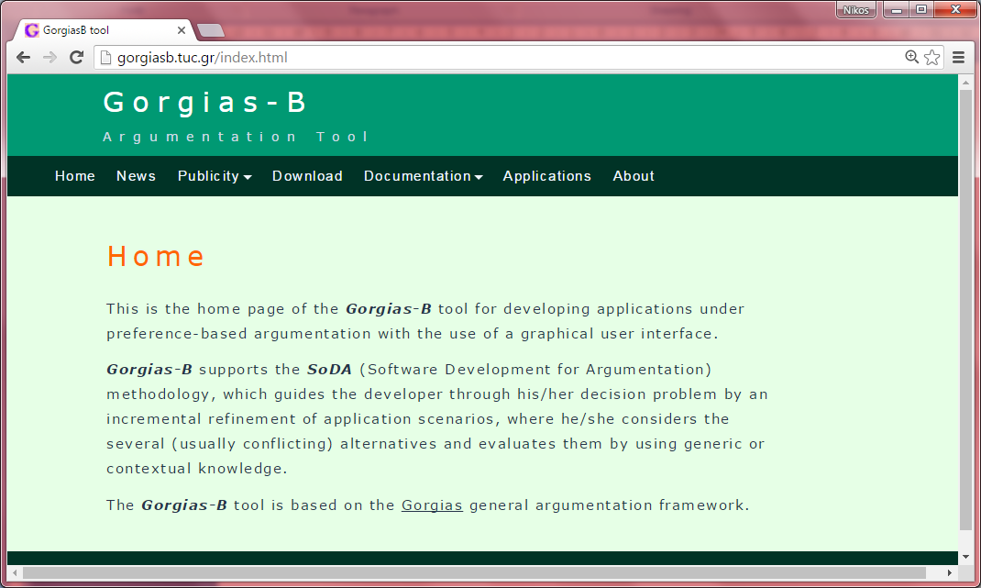
Gorgias-B: Authoring Scenario Preferences

Slide 27
Methodology for SBPs acquisition
We need a high-level methodology for acquiring SBPs
At the language level of the application
No need for the expert or user to know about the technology
SoDA Methodology
Choose minimal scenarios that enable/unlock options
Default preference in each minimal scenario
Refine scenario with contexts that changes preference.
Consider combinations of (minimal) scenarios
Authoring tools for SBPs acquisition (and SoDA)
No programming – Just recording/learning expert/user know

