Slide 1
Natural Language Processing
Introduction and Course Overview
Demetris Paschalides
Department of Computer Science
University of Cyprus

Slide 2
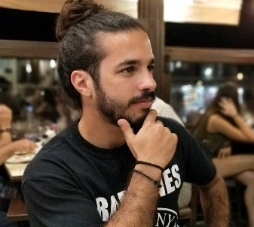
About the Instructor
Name: Demetris Paschalides
Professional Experience: 7.5 years of Academic Research
Research Interest: Use of Natural Language Processing (NLP) and Machine Learning (ML) to address social and ethical challenges.
Examples: misinformation, hate-speech, and polarization (social or political).

Slide 3
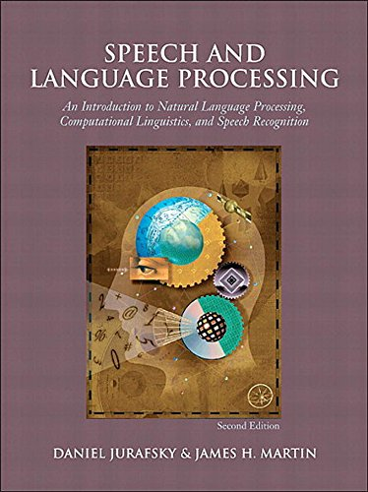
Textbook

Slide 4
Introduction to NLP
Notes:
For the project,
initially, you need to create teams with 3-5 students and then you have to select a dataset and describe your goal and why the dataset is interesting and refers to big data.
Then, you need to specify the tools that you will use and why

Slide 5
From Language to Information

Slide 6
From Language to Information
Automatically extracting meaning and structure from:
Human language text and speech (news, social media, etc.)
Social networks
Genome sequences

Slide 7
From Language to Information
Automatically extracting meaning and structure from:
Human language text and speech (news, social media, etc.)
Social networks
Genome sequences
Interacting with humans via language
Dialog systems/Chatbots
Question Answering
Recommendation Systems

Slide 8
Industry and commercial applications

Slide 9
Extracting Information from Language
Information retrieval
Year 2020: 6.9 billion daily Google searches (estimate).
Text-based information retrieval → the most frequently used software in the world.

Slide 10
Conversational Agents
Speech Recognition
Language Analysis
Dialogue Processing
Information Retrieval
Text-to-speech

Slide 11
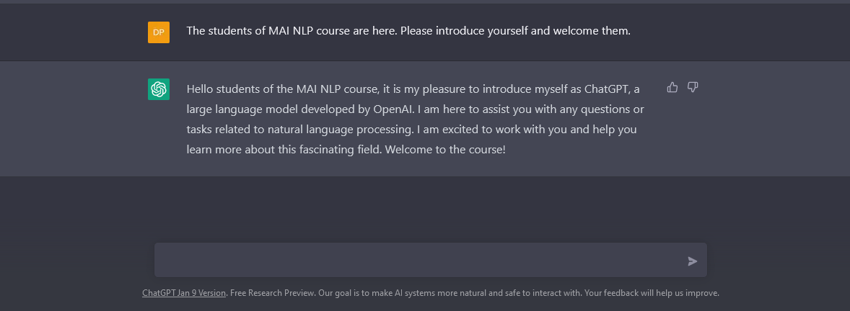
ChatGPT Revolution

Slide 12
ChatGPT LLMs Revolution

Slide 13
ChatGPT LLMs Revolution

Slide 14
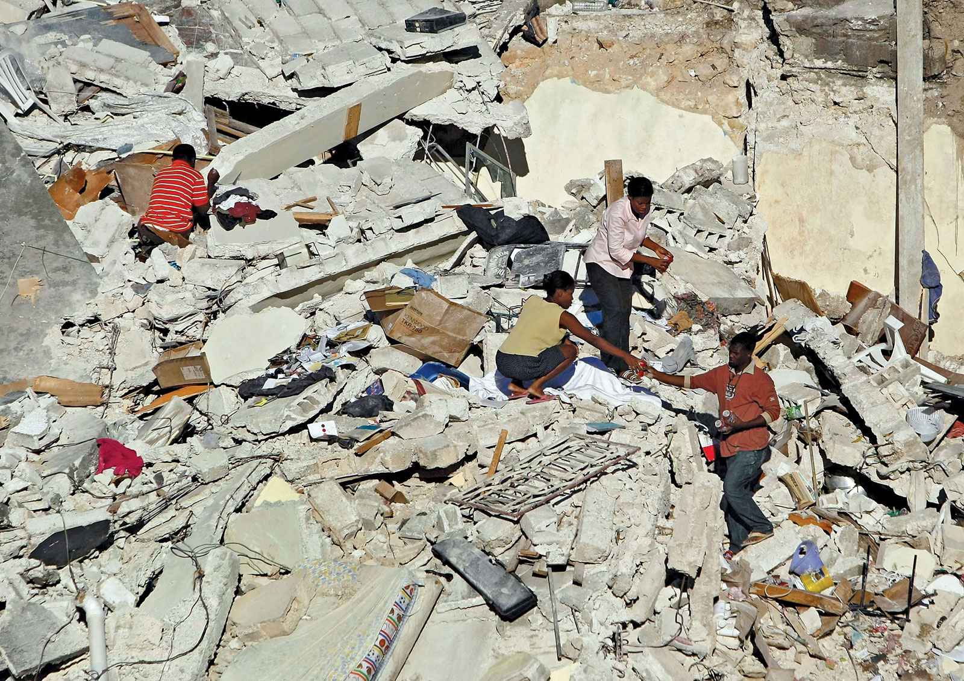
Text classification: Disaster Response
Haiti earthquake 2010
Classifying SMS messages
Haitian Creole: “Mwen thomassin 32 nan pyron mwen ta renmen jwen yon ti dlo gras a dieu bo lakay mwen anfom se sel dlo nou bezwen”
English: “I am in Thomassin number 32, in the area named Pyron. I would like to have some water. Thank God we are fine, but we desperately need water.”
Meier, P., & Munro, R. (2010). The unprecedented role of SMS in disaster response: Learning from Haiti. SAIS Rev. Int'l Aff., 30, 91. Caragea, C., McNeese, N. J., Jaiswal, A. R., Traylor, G., Kim, H. W., Mitra, P., & Yen, J. (2011, May). Classifying text messages for the Haiti earthquake. In ISCRAM.

Slide 15
Recommendation engines
The good:
Products: Amazon, ebay
Content: Netflix, Spotify

Slide 16
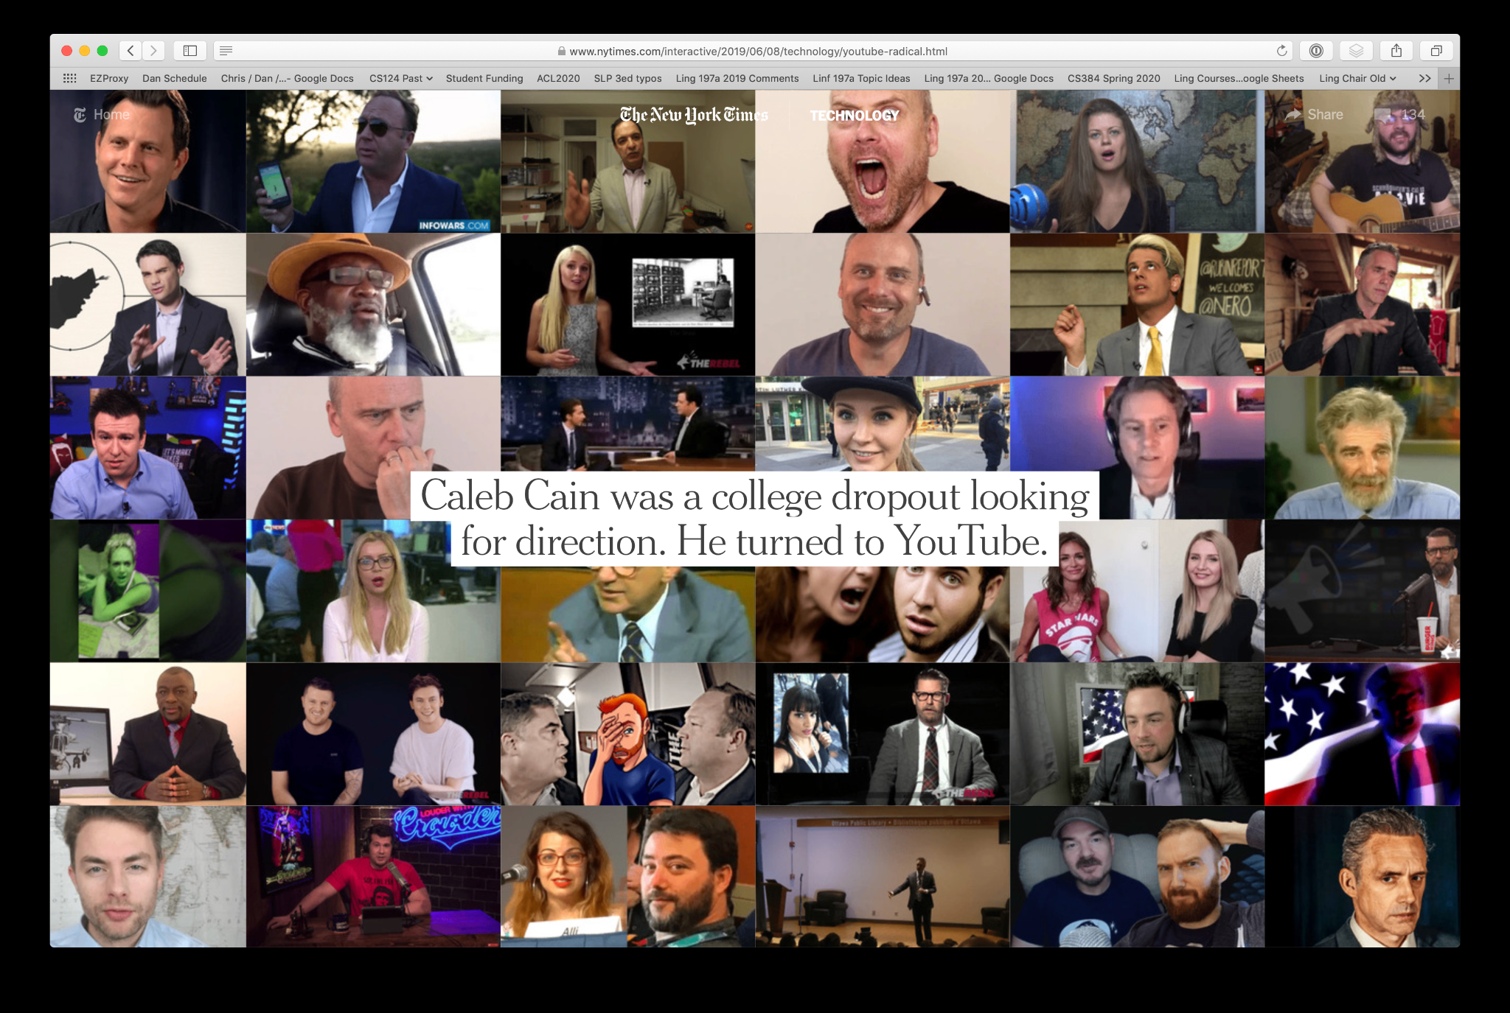
Recommendation engines
The good:
Products: Amazon, ebay
Content: Netflix, Spotify
The bad
Youtube radicalization
Papadamou, K., Zannettou, S., Blackburn, J., De Cristofaro, E., Stringhini, G., & Sirivianos, M. (2021). " How over is it?" Understanding the Incel Community on YouTube. Proceedings of the ACM on Human-Computer Interaction, 5(CSCW2), 1-25.

Slide 17
Recommendation engines
The good:
Products: Amazon, ebay
Content: Netflix, Spotify
The bad
Youtube radicalization
Papadamou, K., Zannettou, S., Blackburn, J., De Cristofaro, E., Stringhini, G., & Sirivianos, M. (2021). " How over is it?" Understanding the Incel Community on YouTube. Proceedings of the ACM on Human-Computer Interaction, 5(CSCW2), 1-25.

Slide 18
Linguistic Knowledge Levels
Speech
Orthography
Morphology
Lexemes
Syntax
Semantics
Pragmatics
Discourse
Text
Phonetics
Phonology
shallower deeper

Slide 19
Phonetics and Phonology
Pronunciation Modeling
Sounds: T h i s i s a s i m p l e s e n t e n c e

Slide 20
Words
Language Modeling
Tokenization
Spelling Correction
Words: T h i s i s a s i m p l e s e n t e n c e

Slide 21
Morphology
Morphology Analysis
Tokenization
Lemmatization
Words: T h i s i s a s i m p l e s e n t e n c e
Morphology: be present

Slide 22
Part-of-Speech
Part-of-Speech (PoS) Tagging
PoS: DT VBZ DT JJ NN
Words: T h i s i s a s i m p l e s e n t e n c e
Morphology: be present

Slide 23
Syntax
Syntactic Parsing S
Syntax: VP
NP NP
PoS: DT VBZ DT JJ NN
Words: T h i s i s a s i m p l e s e n t e n c e
Morphology: be present

Slide 24
Semantics
Named Entity Recognition S
Syntax: VP
NP NP
PoS: DT VBZ DT JJ NN
Words: T h i s i s a s i m p l e s e n t e n c e
Morphology: be present

Slide 25
Language Interpretation is Hard

Slide 26
Language Interpretation is Hard
Ambiguity
Sentence: “I made her duck”

Slide 27
Language interpretation is hard
Ambiguity
Sentence: “I made her duck”
At least 6 different meanings:
I cooked waterfowl for her (to eat)
I cooked waterfowl of her
I created the plastic waterfowl she owns
I caused her to quickly lower her head or body

Slide 28
Language interpretation is hard
Ambiguity
Sentence: “I made her duck”
At least 6 different meanings:
I cooked waterfowl for her (to eat)
I cooked waterfowl of her
I created the plastic waterfowl she owns
I caused her to quickly lower her head or body
“Duck” can be a Noun or Verb

Slide 29
Language interpretation is hard
Ambiguity
Sentence: “I made her duck”
At least 6 different meanings:
I cooked waterfowl for her (to eat)
I cooked waterfowl of her
I created the plastic waterfowl she owns
I caused her to quickly lower her head or body
“her” can be:
a possessive pronoun “of her”
a dative pronoun “for her”

Slide 30
Language Interpretation is Hard
Ambiguity
Sentence: “I made her duck”
At least 6 different meanings:
I cooked waterfowl for her (to eat)
I cooked waterfowl of her
I created the plastic waterfowl she owns
I caused her to quickly lower her head or body
“make” can mean “cooked”, “created”, or “caused”

Slide 31
Challenges: Slang, Emojis and Hashtags
“OMG” =
“w8” =
“brb” =

Slide 32
Challenges: Slang, Emojis and Hashtags
“OMG” = Oh my god
“w8” = wait
“brb” = be right back

Slide 33
Challenges: Slang, Emojis and Hashtags
“OMG” = Oh my god
“w8” = wait
“brb” = be right back

Slide 34
Challenges: Slang, Emojis and Hashtags
“OMG” = Oh my god
“w8” = wait
“brb” = be right back
Happy
Sad

Slide 35
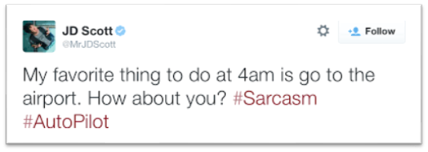
Challenges: Slang, Emojis and Hashtags
“OMG” = Oh my god
“w8” = wait
“brb” = be right back
Happy
Sad

Slide 36
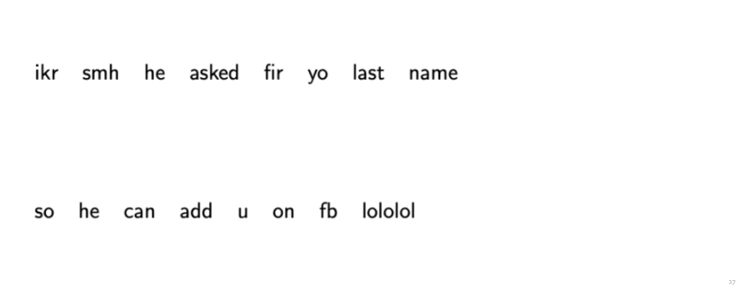
Challenges on PoS Tagging

Slide 37
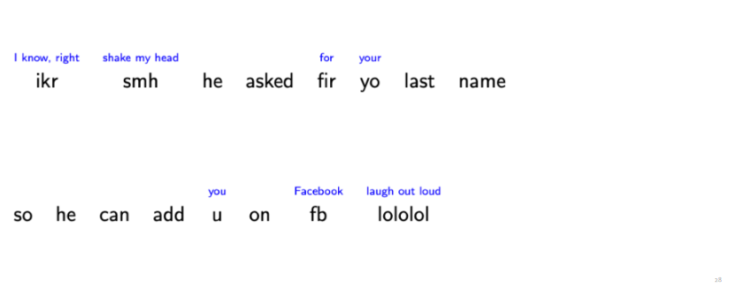
Challenges on PoS Tagging

Slide 38
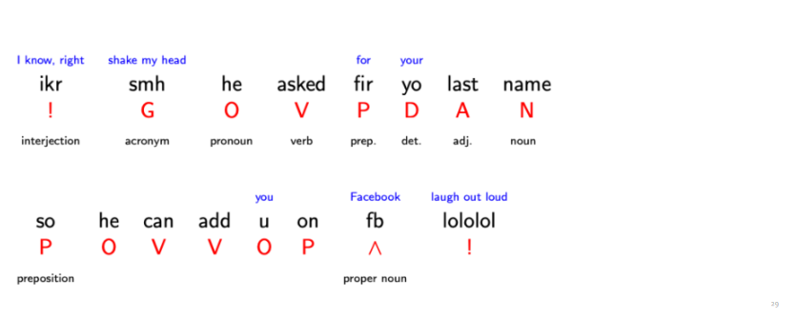
Challenges on PoS Tagging

Slide 39
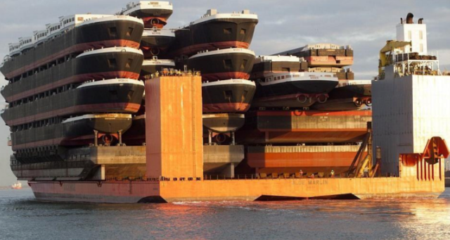
Challenging Morphology and Syntax
“A ship-shipping ship, shipping shipping-ships”.

Slide 40
Tackling the problem
What tools do we need?
Knowledge about language and the world.
Ways to combine knowledge sources.
How we do this?
Neural and other machine learning models build from language data

Slide 41
Models and tools
Regular Expressions
Edit Distance
Language Models
Neural Word Embeddings
Machine Learning Classifiers
Sentiment Lexicons
Emotion Lexicons
Network Algorithms
Recommendation Algorithms

Slide 42
Word embeddings
A word’s semantic meaning as a 300-dimensional vector
Image taken from: https://towardsdatascience.com
Plots are a product of dimensionality reduction to 3D and 2D.

Slide 43
Embeddings are the core of NLP
Word embeddings are the core technology for any NLP task:
Finding synonyms of words.
Deciding the similarity of two sentences.
Capturing the context of a text.

Slide 44
How to learn the embeddings?
Push co-occurring words together in space:
Read millions of words → Study their co-occurrence.
“Elizabeth II is Queen of the United Kingdom ... Her father ascended the throne in 1936 upon the abdication of his brother, King Edward VIII ... She was educated privately at home ... In November 1947, she married Philip Mountbatten, a former prince of Greece and Denmark ... When her father died in February 1952, Elizabeth—then 25 years old—became queen regnant …”

Slide 45
Course Outline
Text Pre-processing
Language Modeling
Text Classification
Word Vector Representation
Distributed Contextual Embeddings
Application of NLP in:
Hate-speech Identification
Fake News Detection
Political Polarization
Introduction to Large Language Models

Slide 46
Thank You

