Slide 1
Natural Language Processing
Text Classification
Demetris Paschalides
Department of Computer Science
University of Cyprus

Slide 2
Classification
A mapping h from input data x ∈ X to a label y ∈ Y.
X = set of all documents
Y = {y₁, y₂, …, y_{k}}
x = a single document
y = output label for x

Slide 3
Movie Reviews
Y = {Positive, Negative, Neutral}

Slide 4
Movie Reviews
Y = {Positive, Negative, Neutral}
x₁ = “This film blew me away, exciting, fast paced, surprisingly gritty, and genuinely had an awesome story…”
y₁ =

Slide 5
Movie Reviews
Y = {Positive, Negative, Neutral}
x₁ = “This film blew me away, exciting, fast paced, surprisingly gritty, and genuinely had an awesome story…”
y₁ = Positive

Slide 6
Movie Reviews
Y = {Positive, Negative, Neutral}
x₁ = “This film blew me away, exciting, fast paced, surprisingly gritty, and genuinely had an awesome story…”
y₁ = Positive
x2 = “... This boring 3 hour movie had no proper plot whatsoever but just a bunch of random scenes and stupid dialogues ...”
y₂ =

Slide 7
Movie Reviews
Y = {Positive, Negative, Neutral}
x₁ = “This film blew me away, exciting, fast paced, surprisingly gritty, and genuinely had an awesome story…”
y₁ = Positive
x2 = “... This boring 3 hour movie had no proper plot whatsoever but just a bunch of random scenes and stupid dialogues ...”
y₂ = Negative

Slide 8
Opinion Mining

Slide 9
Opinion Mining
Positive

Slide 10
Opinion Mining
Positive
Negative

Slide 11
Author: Male or Female ?
By 1925 present-day Vietnam was divided into three parts under French colonial rule. The southern region embracing Saigon and the Mekong delta was the colony of Cochin-China; the central area with its imperial capital at Hue was the protectorate of Annam…
Clara never failed to be astonished by the extraordinary felicity of her own name. She found it hard to trust herself to the mercy of fate, which had managed over the years to convert her greatest shame into one of her greatest assets…
S. Argamon, M. Koppel, J. Fine, A. R. Shimori, 2003. “Gender, Genre, and Writing Style in Formal Written Texts,” Text, vol. 23, p. 321-346

Slide 12
Author: Male or Female ?
By 1925 present-day Vietnam was divided into three parts under French colonial rule. The southern region embracing Saigon and the Mekong delta was the colony of Cochin-China; the central area with its imperial capital at Hue was the protectorate of Annam…
Clara never failed to be astonished by the extraordinary felicity of her own name. She found it hard to trust herself to the mercy of fate, which had managed over the years to convert her greatest shame into one of her greatest assets…
S. Argamon, M. Koppel, J. Fine, A. R. Shimori, 2003. “Gender, Genre, and Writing Style in Formal Written Texts,” Text, vol. 23, p. 321-346

Slide 13
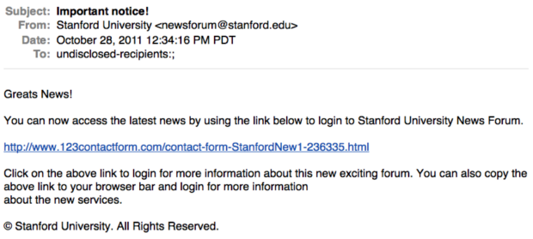
Is this SPAM ?

Slide 14
Subject of Articles
Politics
Sports
Lifestyle
Gossip
Health
…

Slide 15
Text Classification Problem
Given a text W = (w₁, w₂, …, w_{T}), with w_{i} ∈ V, predict a label y ∈ Y

Slide 16
Τext Classification Applications
Task | X | Y
Language Identification | Text | { English, Greek, Mandarin, … }
SPAM Classification | Email | { SPAM, not SPAM }
Authorship Attribution | Text | { J.K. Rowling, George R. R. Martin, … }
Genre Classification | Novel | { Detective, Romance, Fantasy, … }
Sentiment Classification | Text | { Positive, Negative, Neutral, Mixed }
Hate-speech Classification | Text | { Toxic, Sexist, Hate, Racism, … }
Veracity Classification | Text | { Fake, Real, Reliable, Unreliable }

Slide 17
Classification Methods: Rule-based Classification
Rules based on patterns, word combinations or other features.
SPAM / UNRELIABLE:
Black-listed sources e.g. www.realnews.124.info
If rules refined by experts → high accuracy scores.

Slide 18
Classification Methods: Rule-based Classification
Rules based on patterns, word combinations or other features.
SPAM / UNRELIABLE:
Black-listed sources e.g. www.realnews.124.info
If rules refined by experts → high accuracy scores.
Building / Maintaining / Filtering rules → Time Consuming & Resource Demanding

Slide 19
Classification Methods: Supervised Machine Learning
Input data:
a document d
a fixed set of classes C = { c₁, c₂, …, c_{k} }
a training set of annotated documents m = { (d₁, c₁) , … , (d_{m}, c_{m}) }
Output:
a learned classifier γ : d → c

Slide 20
Classification Methods: Supervised Machine Learning
Input data:
a document d
a fixed set of classes C = { c₁, c₂, …, c_{k} }
a training set of annotated documents m = { (d₁, c₁) , … , (d_{m}, c_{m}) }
Output:
a learned classifier γ : d → c
Examples of Classifiers:
Naive Bayes
Logistic Regression
Support Vector Machines
k-Nearest Neighbors
…

Slide 21
Text Vectorization
Computers do not understand text, syntax and relation between words → Need a way to represent words with numbers.

Slide 22
Text Vectorization
Computers do not understand text, syntax and relation between words → Need a way to represent words with numbers.
Text vectorization: The process of converting text into numerical representation
Popular basic text representation: Bag of Words (BoW)

Slide 23
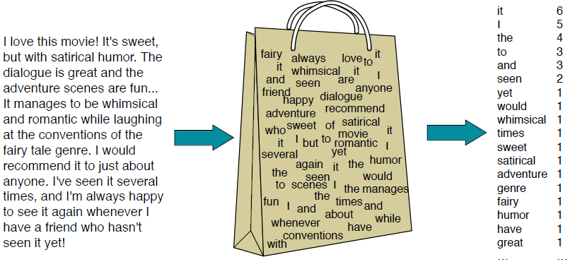
Bag-of-Words Representation

Slide 24
Bag-of-Words Representation
The bag-of-words is a fixed-length representation, which consists of a vector of word counts:
s = “It was the best of times, it was the worst of times”
x = [ aardvark, …, best, …, it, …, of, …, zyther ]
The length of x equals to the size of vocabulary
For each x, there can be many w, depending on word order
0
1
2
2
0

Slide 25
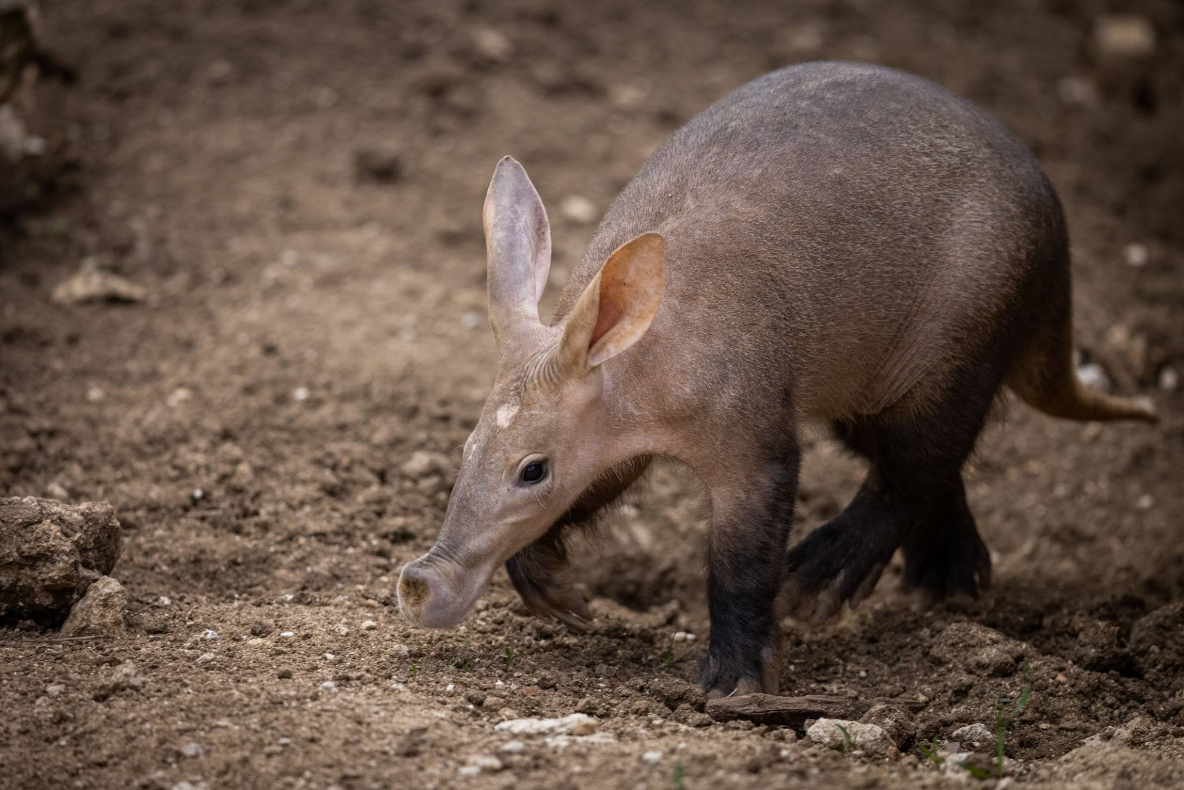
Bag-of-Words Representation
1
2
2

Slide 26
Linear Classification on BoW
Let ψ(x, y) score the compatibility of bow x and label y, then

Slide 27
Linear Classification on BoW
Let ψ(x, y) score the compatibility of bow x and label y, then
In a linear classifier, this scoring function has the form of
where θ is a vector of weights / coefficients and f is a feature function.
Learning problem: find right weights θ, assuming dataset

Slide 28
Probabilistic Classification
Naive Bayes is a probabilistic classifier based on the following strategy:
Define a probability model p(x, y)
Estimate the parameters of the probability model by maximum likelihood on the training dataset.
Bayes Rule for document d and class / label c :

Slide 29
Naive Bayes Classifier
MAP is “maximum a posteriori” = Most likely class

Slide 30
Naive Bayes Classifier
MAP is “maximum a posteriori” = Most likely class
Bayes Rule

Slide 31
Naive Bayes Classifier
MAP is “maximum a posteriori” = Most likely class
Bayes Rule
P(d) is removed because is redundant. For a d, its probability is the same for all c.
Dropping the denominator

Slide 32
Naive Bayes Classifier

Slide 33
Naive Bayes Classifier
Likelihood

Slide 34
Naive Bayes Classifier
Likelihood
Prior

Slide 35
Naive Bayes Classifier
Likelihood
Prior
Document d represented as features x₁ … x_{n}

Slide 36
Naive Bayes Classifier
Likelihood
Prior
Document d represented as features x₁ … x_{n}
O(|X|^{n} x |C|) parameters → If we have many features then we need large amount of training examples.

Slide 37
Multinomial Naive Bayes Independence Assumptions
BoW Assumption: Word positioning does not matter.
Conditional Independence: The feature probabilities P(x_{i} | c_{j} ) are independent given class / label c.

Slide 38
Multinomial Naive Bayes
For text classification:
Positions = all word positions in test document

Slide 39
Issues with Probability Product
Multiplying many probabilities can result in numerical underflow.
0.0006 x 0.0007 x 0.0009 x 0.01 x 0.5 x 0.000008 …
Solution: Use logs → log(a x b) = log(a) + log(b)

Slide 40
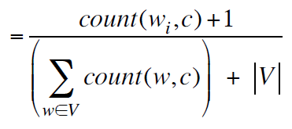
Learning of Naive Bayes
Learning of Naive Bayes:
Use of Laplace (add-1) smoothing to address zero probabilities.

Slide 41
Learning of Naive Bayes
Learning of Naive Bayes:
Use of Laplace (add-1) smoothing to address zero probabilities.
1. Extract Vocabulary V from corpus

Slide 42
Learning of Naive Bayes
Learning of Naive Bayes:
Use of Laplace (add-1) smoothing to address zero probabilities.
1. Extract Vocabulary V from corpus
2. Calculate P(c_{j}) terms: ∀ c_{j} ∈ C → docs_{j} = docs of c_{j}

Slide 43
Learning of Naive Bayes
Learning of Naive Bayes:
Use of Laplace (add-1) smoothing to address zero probabilities.
1. Extract Vocabulary V from corpus
2. Calculate P(c_{j}) terms: ∀ c_{j} ∈ C → docs_{j} = docs of c_{j}
3. Calculate P(w_{k} | c_{j}) terms: text_{j} = merge of docs_{j} ∀ w_{k} ∈ V → n_{k} = occur(w_{k}, text_{j})

Slide 44
Sentiment Analysis with Naive Bayes
Document | Category
Just plain boring | Negative
Entirely predictable and lacks energy | Negative
No surprises and very few laughs | Negative
Very powerful | Positive
The most fun film of the summer | Positive
Predictable with no fun | ?
Training
Test

Slide 45
Sentiment Analysis with Naive Bayes
|V| =
Document | Category
Just plain boring | Negative
Entirely predictable and lacks energy | Negative
No surprises and very few laughs | Negative
Very powerful | Positive
The most fun film of the summer | Positive
Predictable with no fun | ?
Training
Test

Slide 46
Sentiment Analysis with Naive Bayes
|V| = 20
Document | Category
Just plain boring | Negative
Entirely predictable and lacks energy | Negative
No surprises and very few laughs | Negative
Very powerful | Positive
The most fun film of the summer | Positive
Predictable with no fun | ?
Training
Test

Slide 47
Sentiment Analysis with Naive Bayes
|V| = 20
Document | Category
Just plain boring | Negative
Entirely predictable and lacks energy | Negative
No surprises and very few laughs | Negative
Very powerful | Positive
The most fun film of the summer | Positive
Predictable with no fun | ?
1. + / - Probabilities
P(-) = P(+) =
Training
Test

Slide 48
Sentiment Analysis with Naive Bayes
|V| = 20
Document | Category
Just plain boring | Negative
Entirely predictable and lacks energy | Negative
No surprises and very few laughs | Negative
Very powerful | Positive
The most fun film of the summer | Positive
Predictable with no fun | ?
1. + / - Probabilities
P(-) = 3 / 5 P(+) = 2 / 5
Training
Test

Slide 49
Sentiment Analysis with Naive Bayes
|V| = 20
Document | Category
Just plain boring | Negative
Entirely predictable and lacks energy | Negative
No surprises and very few laughs | Negative
Very powerful | Positive
The most fun film of the summer | Positive
Predictable with no fun | ?
1. + / - Probabilities
P(-) = 3 / 5 P(+) = 2 / 5
Training
2. Clean Texts
Test
Remove “with”.

Slide 50
3. Calculate Training Likelihoods
Document | Category
Just plain boring | Negative
Entirely predictable and lacks energy | Negative
No surprises and very few laughs | Negative
Very powerful | Positive
The most fun film of the summer | Positive
Predictable with no fun | ?
|V| = 20

Slide 51
3. Calculate Training Likelihoods
Document | Category
Just plain boring | Negative
Entirely predictable and lacks energy | Negative
No surprises and very few laughs | Negative
Very powerful | Positive
The most fun film of the summer | Positive
Predictable with no fun | ?
|V| = 20

Slide 52
3. Calculate Training Likelihoods
Document | Category
Just plain boring | Negative
Entirely predictable and lacks energy | Negative
No surprises and very few laughs | Negative
Very powerful | Positive
The most fun film of the summer | Positive
Predictable with no fun | ?
|V| = 20

Slide 53
3. Calculate Training Likelihoods
Document | Category
Just plain boring | Negative
Entirely predictable and lacks energy | Negative
No surprises and very few laughs | Negative
Very powerful | Positive
The most fun film of the summer | Positive
Predictable with no fun | ?
|V| = 20

Slide 54
3. Calculate Training Likelihoods
Document | Category
Just plain boring | Negative
Entirely predictable and lacks energy | Negative
No surprises and very few laughs | Negative
Very powerful | Positive
The most fun film of the summer | Positive
Predictable with no fun | ?
|V| = 20

Slide 55
3. Calculate Training Likelihoods
Document | Category
Just plain boring | Negative
Entirely predictable and lacks energy | Negative
No surprises and very few laughs | Negative
Very powerful | Positive
The most fun film of the summer | Positive
Predictable with no fun | ?
|V| = 20

Slide 56
4. Test Set Scoring
Document | Category
Just plain boring | Negative
Entirely predictable and lacks energy | Negative
No surprises and very few laughs | Negative
Very powerful | Positive
The most fun film of the summer | Positive
Predictable with no fun | ?
|V| = 20

Slide 57
4. Test Set Scoring
Document | Category
Just plain boring | Negative
Entirely predictable and lacks energy | Negative
No surprises and very few laughs | Negative
Very powerful | Positive
The most fun film of the summer | Positive
Predictable with no fun | ?
The test document is more probable to be of NEGATIVE class
|V| = 20

Slide 58
Naive Bayes and LM
Naive Bayes classifier can use different features:
URLs, emails, dictionaries, numerical and network features.
However, if we only use word features, and consider the whole corpus (not just a subset of words)
Naive Bayes is quite similar to Language Modeling from the previous lectures.

Slide 59
Naive Bayes and LM
Assigning each word: P( word | c )
Assigning each sentence: P( s | c ) = ∏ P( word | c )
Class POSITIVE
0.1 | I
0.1 | love
0.01 | this
0.05 | fun
0.1 | film

Slide 60
Naive Bayes and LM
Assigning each word: P( word | c )
Assigning each sentence: P( s | c ) = ∏ P( word | c )
Class POSITIVE
0.1 | I
0.1 | love
0.01 | this
0.05 | fun
0.1 | film
I | love | this | fun | film
0.1 | 0.1 | 0.05 | 0.01 | 0.1
P( s | POSITIVE ) = 0.0000005

Slide 61
Naive Bayes as a LM
Which class assigns the higher probability to s?
Class POSITIVE
0.1 | I
0.1 | love
0.01 | this
0.05 | fun
0.1 | film
Class NEGATIVE
0.2 | I
0.001 | love
0.01 | this
0.005 | fun
0.1 | film
I | love | this | fun | film
0.1 | 0.1 | 0.05 | 0.01 | 0.1
0.2 | 0.001 | 0.01 | 0.005 | 0.1
P( s | POSITIVE ) = 0.0000005
P( s | NEGATIVE ) = 0.0000001

Slide 62
Naive Bayes as a LM
Which class assigns the higher probability to s?
Class POSITIVE
0.1 | I
0.1 | love
0.01 | this
0.05 | fun
0.1 | film
Class NEGATIVE
0.2 | I
0.001 | love
0.01 | this
0.005 | fun
0.1 | film
I | love | this | fun | film
0.1 | 0.1 | 0.05 | 0.01 | 0.1
0.2 | 0.001 | 0.01 | 0.005 | 0.1
P( s | POSITIVE ) = 0.0000005
P( s | NEGATIVE ) = 0.0000001

Slide 63
Other Classifiers
Naive Bayes is named as such because of:
Naively ignoring the dependencies between words and their order in the text, treating each word as equally informative.
The feature probabilities P(xi | cj ) are independent given class / label c.
S
Discriminative classifiers avoid this problem by not attempting to model the “generative” probability p(x)

Slide 64
Perceptron Classifier
Error-driven rather than independence assumption.
Perceptron Learning Rule:
Run the current classifier on an instance of the training data, obtaining y^ = argmax_{y}ψ(x^{(i)}, y)
If the prediction is incorrect:
Increase the weights for the features of the true label.
Decrease the weights for the features of the predicted label. θ ← θ + f(x^{(i)}, y^{(i)}) - f(x^{(i)},y^)
Repeat until all the training instances are correctly classified, or run out of time.
Perceptron
θ₁
X₁
y
X₂
θ₂

Slide 65
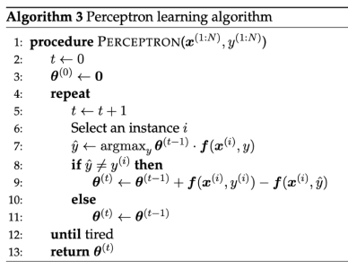
Perceptron Classifier
Objective: Minimizing a loss function on the weights.
Loss functions should be:
A good proxy of the classifiers accuracy.
Easy to optimize.

Slide 66
More on Sentiment Analysis
Dealing with Negation
I really like this movie.
I really don’t like this movie.
Negation reverses the sentiment meaning.
Simple baseline method:
Doesn’t let us get bored.
Don’t miss it!

Slide 67
More on Sentiment Analysis
Dealing with Negation
I really like this movie.
I really don’t like this movie.
Negation reverses the sentiment meaning.
Simple baseline method: Create new words / tokens by add NOT_ between negation occurrence and punctuation.
Didn’t like this movie.
Didn’t NOT_like NOT_this NOT_movie.
Doesn’t let us get bored.
Don’t miss it!

Slide 68
More on Sentiment Analysis
Sentiment Lexicons
If you don’t have enough training / labeled data use pre-built word lists, named Lexicons.
MPQA Subjectivity Cues: 2718 POSITIVE and 4912 NEGATIVE words / phrases with intensity (strong/weak)
General Inquirer: 1915 POSITIVE and 2291 NEGATIVE, with annotations of Strong vs Weak, Active vs Passive, Overstated vs. Understated and Pleasure, Pain, Virtue, Vice, Motivation, Cognitive Orientation, etc

Slide 69
More on Sentiment Analysis
Opinion Lexicon: 2006 POSITIVE and 4789 NEGATIVE words / phrases with intensity (strong/weak)
AFINN: The AFINN lexicon is a list of English terms manually rated for valence with an integer between -5 (NEGATIVE) and +5 (POSITIVE)
Loughran-McDonald: English sentiment lexicon created for use with financial documents → Financial Sentiment Analysis
Using Lexicons
Vector of counts whenever a word from lexicon occurs.

Slide 70
Text Classification Evaluation
 | Correct | Not Correct
Selected | TP | FP
Not Selected | FN | TN
Confusion Matrix

Slide 71
Text Classification Evaluation
 | Correct | Not Correct
Selected | TP | FP
Not Selected | FN | TN
Confusion Matrix
Correct: What we know is correct from the dataset.
Not Correct: What is not correct based on the dataset.
Selected: What the classifier selected (result).
Not Selected: What the classifier did not return
TP (True Positive): What the classifier returned and is correct.
FP (False Positive): What the classifier returned and is Not Correct
FN (False Negative): What the classifier missed but was Correct.
TN (True Negative): What the classifier did not return and was Not Correct.

Slide 72
Precision, Recall, and F Measure
Precision: % of Selected items that are Correct
Recall: % of Correct items that are Selected
F Measure: Combined measure that assesses the Precision and Recall tradeoff (Weighted Harmonic Mean)

Slide 73
Precision, Recall, and F Measure
Precision: % of Selected items that are Correct
Recall: % of Correct items that are Selected
F Measure: Combined measure that assesses the Precision and Recall tradeoff (Weighted Harmonic Mean) F = 2PR / (P+R)
 | Correct | Not Correct
Selected | TP | FP
Not Selected | FN | TN
Commonly used as balanced F1 measure with β=1 (or α=½)

Slide 74
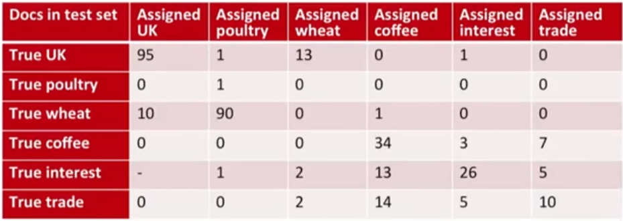
Multi-Class Evaluation
Predicted Classes
True Classes

Slide 75
Multi-Class Evaluation
Predicted Classes
True Classes

Slide 76
Multi-Class Evaluation
Predicted Classes
True Classes
90 documents related to wheat where incorrectly classified as related to poultry

Slide 77
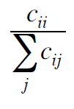
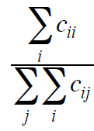
Multi-Class Evaluation
Precision: Fraction of documents assigned class i that are actually about class i:
Recall: Fraction of documents in class i classified correctly:
Accuracy: Fraction of documents classified correctly:

Slide 78
Multi-Class Evaluation
Predicted Classes
True Classes

Slide 79
Micro- and Macro- Averaging
For multi-class classification, combine per-class performance measures with micro- and macro- averaging.
Macro-Averaging: Compute performance for each class, then average.
Micro-Averaging: Compute contingency table for all classes and evaluate

Slide 80
Micro- and Macro- Averaging
For multi-class classification, combine per-class performance measures with micro- and macro- averaging.
Macro-Averaging: Compute performance for each class, then average.
Micro-Averaging: Compute contingency table for all classes and evaluate
Macro-Averaged Precision: ( 0.5 + 0.9 ) / 2 = 0.7
Micro-Averaged Precision: 100 / 120 = 0.83
Micro-Averaged Score is dominated by score on common classes.
Class 1
Class 2
Macro Averaging Table
 | Truth: YES | Truth: NO
CLF: YES | 10 | 10
CLF: NO | 10 | 970
 | Truth: YES | Truth: NO
CLF: YES | 90 | 10
CLF: NO | 10 | 890
 | Truth: YES | Truth: NO
CLF: YES | 100 | 20
CLF: NO | 20 | 1860

Slide 81
Summary
Types of Classification:
Rule-based Classification
Supervised Classification
Introduction to Text Vectorization → Input to ML models.
Example of vectorization: Bag-of-Words
Probabilistic Classification
Example of Naive Bayes
Naive Bayes as a Language Model
Classification Evaluation.

Slide 82
Resources
Jurafsky, D. and H. Martin Justin, Chapter 4. "Naive Bayes and Sentiment Classification" Speech and Language Processing
Jurafsky, D. and H. Martin Justin, Chapter 5. "Logistic Regression" Speech and Language Processing
Python Tutorial on Text Classification using SKLearn: https://scikit-learn.org/stable/tutorial/text_analytics/working_with_text_data.html

