Slide 1
Natural Language Processing
Vector Semantics and Embeddings
Demetris Paschalides
Department of Computer Science
University of Cyprus

Slide 2
What is the meaning of Words?
From N-Gram and Text Classification:
Words are sequences of letters, or indices w_{i} in a vocabulary list.

Slide 3
What is the meaning of Words?
From N-Gram and Text Classification:
Words are sequences of letters, or indices w_{i} in a vocabulary list.
How can we represent the meaning of a word?

Slide 4
What is the meaning of Words?
From N-Gram and Text Classification:
Words are sequences of letters, or indices w_{i} in a vocabulary list.
How can we represent the meaning of a word?
Look at Lexical Semantics, the linguistic study of word meaning.
Words, lemmas, senses, definitions

Slide 5
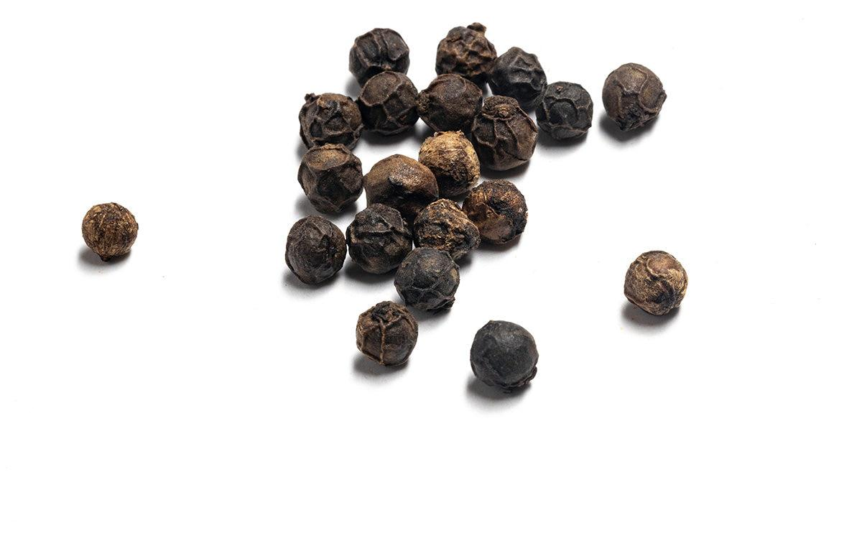
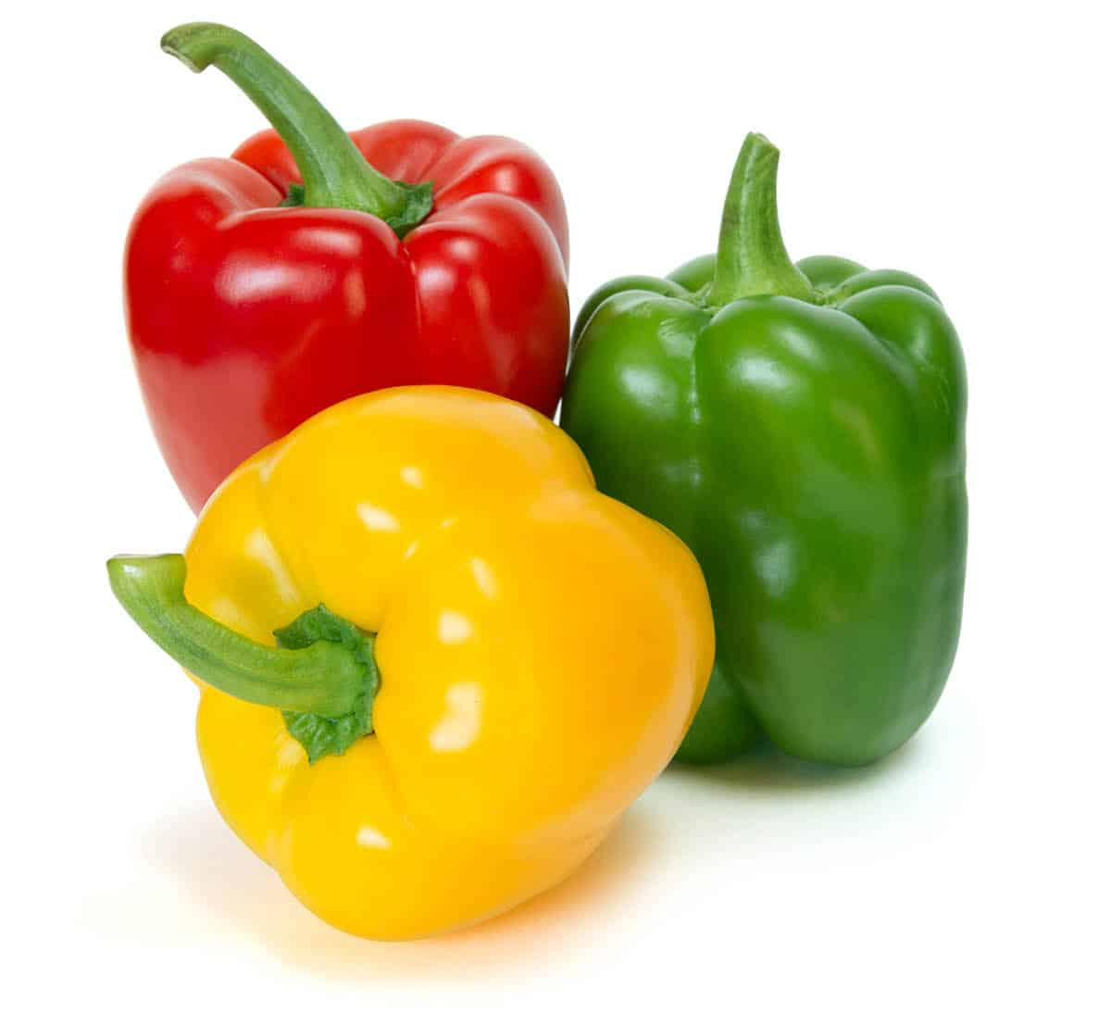
Lemmas and Senses
Lemma “Pepper”
Sense 1: Spice from pepper plant
Sense 2: The pepper plant itself
Sense 3: Another similar plant (Jamaican pepper)
Sense 4: Another plant with peppercorns (California pepper)
Sense 5: The bell pepper

Slide 6
Lemmas and Senses
Lemma “Pepper”
Sense 1: Spice from pepper plant
Sense 2: The pepper plant itself
Sense 3: Another similar plant (Jamaican pepper)
Sense 4: Another plant with peppercorns (California pepper)
Sense 5: The bell pepper
A sense or “concept” is the meaning component of a word.

Slide 7
Lemmas and Senses
Lemma “Mouse”
Sense 1: Any numerous small rodents.
Sense 2: A hand-operated device that controls a cursor.

Slide 8
Lemmas and Senses
Lemma “Mouse”
Sense 1: Any numerous small rodents.
Sense 2: A hand-operated device that controls a cursor.
How should we represent the meaning of a word?
Use of words, lemmas, senses, and definitions
Use of relationships between words or senses

Slide 9
Relation: Synonymity
Synonyms have the same meaning in some or all contexts.
Couch / Sofa
Big / Large
Automobile / Car
Water / H₂O

Slide 10
Relation: Synonymity
Synonyms have the same meaning in some or all contexts.
Couch / Sofa
Big / Large
Automobile / Car
Water / H₂O
Note that there are probably no examples of perfect synonymity.
Even if aspects of meaning are identical.
Still may not preserve the acceptability based on notions of politeness, slang, register, genre, etc.

Slide 11
Relation: Synonymity
Synonyms have the same meaning in some or all contexts.
Couch / Sofa
Big / Large
Automobile / Car
Water / H₂O
“My big sister” ≠ “My large sister”
Note that there are probably no examples of perfect synonymity.
Even if aspects of meaning are identical.
Still may not preserve the acceptability based on notions of politeness, slang, register, genre, etc.

Slide 12
Relation: Antonymy
Senses that are opposites with respect to one feature of meaning (otherwise, they are very similar) .
Dark / Light, Short / Long, Fast / Slow, Hot / Cold, Up / Down, In / Out
Formally, antonyms can:
Define a binary opposition: Short / Long, Fast / Slow
Be reverse: Up / Down, Rise / Fall

Slide 13
Relation: Similarity
Words with similar meanings.
NOT synonyms, but sharing some element of meaning
Car / Bicycle, Cow / Horse
Ask humans how similar two words are → SimLex-999 Dataset Hill et al. 2015
Word 1 | Word 2 | Similarity
vanish | disappear | 9.80
behave | obey | 7.30
belief | impression | 5.95
muscle | bone | 3.65
modest | flexible | 0.98
hole | agreement | 0.30

Slide 14
Relation: Word Relatedness
Also known as “Word Association”
Words can be related in any way, perhaps via a semantic field.
coffee and tea: SIMILAR
coffee and cup: RELATED, not SIMILAR
car, bicycle: SIMILAR
car, gas: RELATED, not SIMILAR

Slide 15
Semantic Field
A semantic field is a set of words which cover a particular semantic domain and bear structured relations with each other.
Hospitals:
Surgeon, scalpel, nurse, anesthetic, hospital
Restaurants:
Waiter, menu, plate, food, chef
Houses:
Door, roof, kitchen, family, bed

Slide 16
Relation: Superordinate / Subordinate
One sense is a subordinate of another if the first sense is more specific, denoting a subclass of the other
Car is a subordinate of vehicle.
Mango is a subordinate of fruit.
Conversely superordinate:
Vehicle is a superordinate of car.
Fruit is a superordinate of Mango.
Superordinate | Basic | Subordinate
office chair
chair
piano chair
rocking chair
furniture
lamp
torchiere
desk lamp
table
end table
coffee table

Slide 17
Connotation / Sentiment
Words also have affective meanings
Positive connotations Happy
Negative connotations Sad
Connotations can be subtle
Positive connotations Happy
Negative connotations Sad
Evaluation - Sentiment
Positive Evaluation Great, Love
Negative connotations Terrible, Hate

Slide 18
Connotation / Sentiment
Words vary along 3 affective dimensions:
Valence: the pleasantness of the stimulus
Arousal: the intensity of emotion provoked by the stimulus
Dominance: the degree of control exerted by the stimulus
 | Word | Score | Word | Score
Valence | love | 1.000 | toxic | 0.008
 | happy | 1.000 | nightmare | 0.005
Arousal | elated | 0.960 | mellow | 0.069
 | frenzy | 0.965 | napping | 0.046
Dominance | powerful | 0.991 | weak | 0.045
 | leadership | 0.983 | empty | 0.081
Values from NRC VAD Lexicon (Mohammad 2018)

Slide 19
Semantic Frame
A set of words that denote perspectives or participants in a particular type of event:
“buy”: the event from the perspective of the buyer
“sell” : from the perspective of the seller
“pay”: focusing on the monetary aspect
John hit Bill
Bill was hit by John
Frames have semantic roles (like buyer, seller, goods, money) and words in a sentence cant take these roles.

Slide 20
Lexical Semantics
How should we represent the meaning of a word?
Words, lemmas, senses, and definitions
Relationships between words or senses
Taxonomy of relationships
Word similarity and relatedness
Connotation and sentiment
Semantic frames and roles

Slide 21
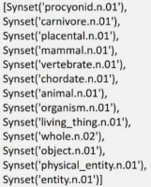
Resources and Dictionaries
WordNet
from nltk.corpus import wordnet as wn panda = wn.synset(‘panda.n.01’) hyper = lambda s: s.hypernyms() list(panda.closure(hyper))

Slide 22
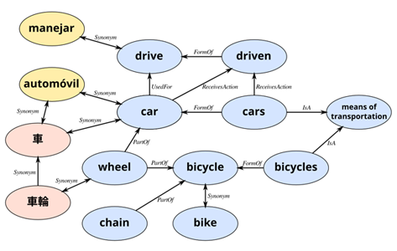
Resources and Dictionaries
ConceptNet
ConceptNet is a freely-available semantic network, designed to help computers understand the meanings of words that people use.

Slide 23
Problems with Discrete Representation
Approaches as BoW and 1-Hot-Encoding are too coarse, sparse and expensive.
Expert → Skillful
Word relationships are hard to compute!
expert | 0 | 1 | 0 | 0 | 0 | 0 | 0 | 0
skillful | 0 | 0 | 0 | 0 | 0 | 1 | 0 | 0

Slide 24
Problems with Discrete Representation
Approaches as BoW and 1-Hot-Encoding are too coarse, sparse and expensive.
Expert → Skillful
Word relationships are hard to compute!
Look at Vector Semantics
expert | 0 | 1 | 0 | 0 | 0 | 0 | 0 | 0
skillful | 0 | 0 | 0 | 0 | 0 | 1 | 0 | 0

Slide 25
Summary
Types of Word Semantic Relations:
Synonymity
Antonymy
Similarity
Relatedness
Superordinate / Subordinate
Sentiment
Resources and Semantic Dictionaries e.g. ConceptNet
Issues with Discrete Representations

Slide 26
Resources
Jurafsky, D. and H. Martin Justin, Chapter 6. "Vector Semantics and Embeddings" Speech and Language Processing
ConceptNet: https://conceptnet.io/
WordNet: https://wordnet.princeton.edu/

