Slide 1
Natural Language Processing
Distributed Contextual Embeddings
Demetris Paschalides
Department of Computer Science
University of Cyprus

Slide 2
Word Embeddings
Word embeddings are the basis of deep learning for NLP

Slide 3
Word Embeddings
Word embeddings are the basis of deep learning for NLP
Word embeddings (word2vec, GloVe) are often pre-trained on text corpus from co-occurrence statistics.

Slide 4
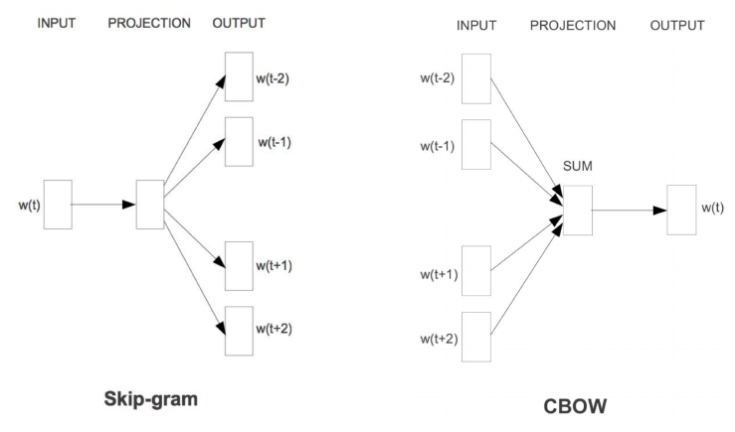
Recap on Word2Vec
Skip-Gram Algorithm
Input: positive and negative training examples
Output: word vectors of 300 dimensions
Initialization: Randomly initialize the word vectors.

Slide 5
Recap on Word2Vec
Skip-Gram Algorithm
Input: positive and negative training examples
Output: word vectors of 300 dimensions
Initialization: Randomly initialize the word vectors.
Iteratively apply the learning goal, adjusting the vectors so that we:
Maximize the similarity of the target and context word pairs (w, c_{POS}) from the positive data.
Minimize the similarity of the (w, c_{NEG}) pairs drawn from the negative data

Slide 6
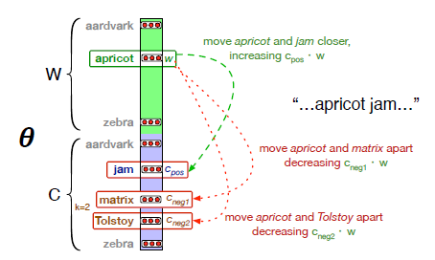
Recap on Word2Vec
Skip-Gram Embeddings
Skip-gram learns two sets of embeddings: 1) target embeddings matrix W; 2) context embedding matrix C;

Slide 7
Recap on Word2Vec
Skip-Gram Embeddings
Skip-gram learns two sets of embeddings: 1) target embeddings matrix W; 2) context embedding matrix C;
Add them together, representing word i as the vector w_{i} + c_{i}

Slide 8
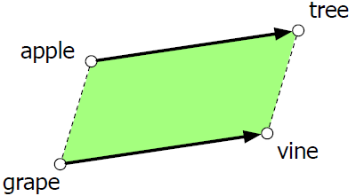
Analogy: Relational Meaning
Parallelogram model of analogical reasoning (Rumelhart and Abrahamson 1973).
Problem: “Apple is to tree as grape is to ______”
Notes:
Add (tree - apple) to grape to get vine

Slide 9
Analogy: Relational Meaning
Parallelogram model of analogical reasoning (Rumelhart and Abrahamson 1973).
Problem: “Apple is to tree as grape is to ______”
Parallelogram method can solve analogies with both sparse and dense embeddings (Mikolov et al. 2013)
vector(“king”) - vector(“man”) + vector(“woman”) ≈ vector(“queen”)
vector(“Paris”) - vector(“France”) + vector(“Italy”) ≈ vector(“Rome”)
Notes:
Compute distance of all words in embedding space to a* - a + b and return the maximum.

Slide 10
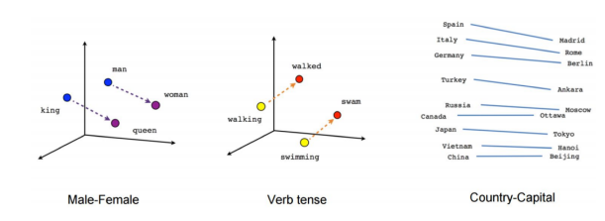
Analogy: Relational Meaning
vector(“king”) - vector(“man”) + vector(“woman”) ≈ vector(“queen”)
vector(“Paris”) - vector(“France”) + vector(“Italy”) ≈ vector(“Rome”)

Slide 11
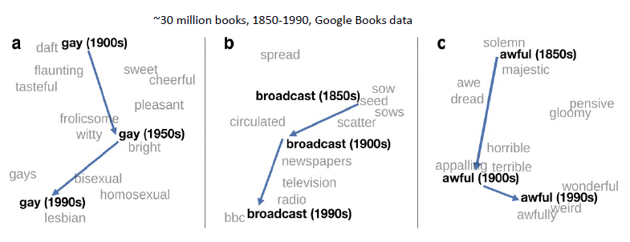
Embeddings & Historical Semantics
Train embeddings on different decades of historical text to see meanings shift (Hamilton et al. 2016) .

Slide 12
Embeddings & Cultural Bias
Embeddings reflect cultural bias (Bolukbasi et al. 2016).
Ask “Paris : France :: Tokyo : X”
X = “Japan”
Ask “father : doctor :: mother : X”
X = “nurse”
Ask “man : computer programmer :: woman : X”
X = “homemaker”

Slide 13
Word2Vec Embeddings Issues
Word2Vec Embeddings have two problems:

Slide 14
Word2Vec Embeddings Issues
Word2Vec Embeddings have two problems:
Same representation for a word regardless of its context
We just have one representation for a word, but words have different aspects, including semantics, syntactic behavior, and register/connotations.

Slide 15
Word Embedding Representations
Count-based
TF-IDF, PPMI
Class-based
Brown Clusters
Distributed Prediction-based Embeddings
Word2Vec, FastText
Distributed Contextual Embeddings from Language Models
Elmo, BERT
Variants
Multi-lingual, Multi-sense etc.
Notes:
Word2Vec embeddings are static embeddings - Method leans one fixed embeddings for each word in the vocabulary.
An alternative to these static embeddings are more recent methods for learning dynamic, contextual embeddings, like the popular BERT representations in which the vector of each word is different to each context.

Slide 16
Context is Everything
p( play | Elmo and Cookie Monster play a game. )

Slide 17
Context is Everything
p( play | Elmo and Cookie Monster play a game. )
p( play | The Broadway play premiered yesterday. )

Slide 18
Context is Everything
p( play | Elmo and Cookie Monster play a game. )
p( play | The Broadway play premiered yesterday. )

Slide 19
Context is Everything
p( play | Elmo and Cookie Monster play a game. )
p( play | The Broadway play premiered yesterday. )

Slide 20
Context is Everything
p( play | Elmo and Cookie Monster play a game. )
p( play | The Broadway play premiered yesterday. )
How to handle different word senses?
So far word embedding models produce single vector for the word “play”.

Slide 21
Context is Everything
p( play | Elmo and Cookie Monster play a game. )
p( play | The Broadway play premiered yesterday. )
How to handle different word senses?
So far word embedding models produce single vector for the word “play”.
Train a neural language model to predict the next word given previous words in the sentence

Slide 22
Context is Everything
p( play | Elmo and Cookie Monster play a game. )
p( play | The Broadway play premiered yesterday. )
How to handle different word senses?
So far word embedding models produce single vector for the word “play”.
Train a neural language model to predict the next word given previous words in the sentence, use its internal representations as word vectors.

Slide 23
Neural Language Models
Recall the Language Modeling task.
Input: sequence of words.
Output: probability of the next word w.

Slide 24
Neural Language Models
Recall the Language Modeling task.
Input: sequence of words.
Output: probability of the next word w.
Initial approaches: Feed Forward Neural Networks (FFNN) looking at context.

Slide 25
Neural Language Models
Improvements over N-Gram Language Model:
No sparsity problem.
Don’t need to store all observed N-Grams.

Slide 26
Neural Language Models
Improvements over N-Gram Language Model:
No sparsity problem.
Don’t need to store all observed N-Grams.
Limitations:
Fixed window is too small.
Enlarging window enlarges W.
Windows can never be large enough!
Different words are multiplied by completely different weights. No symmetry in how the inputs are processed.

Slide 27
Neural Language Models
Improvements over N-Gram Language Model:
No sparsity problem.
Don’t need to store all observed N-Grams.
Limitations:
Fixed window is too small.
Enlarging window enlarges W.
Windows can never be large enough!
Different words are multiplied by completely different weights. No symmetry in how the inputs are processed.
We need a neural architecture that can process any length.

Slide 28
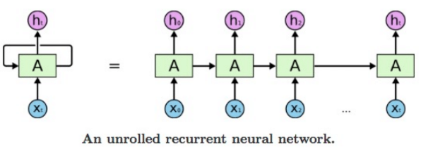
Recurrent Neural Networks (RNN)

Slide 29
Recurrent Neural Networks (RNN)
Take sequential input of any length.
Apply the same weights on each step.
Optionally produce output on each step.

Slide 30
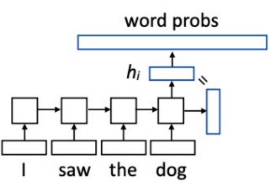
RNN Language Modeling
P( w | context ) = softmax( Wh_{i} )
W is a (vocabulary size) x (hidden size) matrix.

Slide 31
RNN Language Modeling
P( w | context ) = softmax( Wh_{i} )
W is a (vocabulary size) x (hidden size) matrix.
Training RNN Language Model
Input = a sequence of words Output = words shifted one position

Slide 32
RNN Language Modeling
P( w | context ) = softmax( Wh_{i} )
W is a (vocabulary size) x (hidden size) matrix.
Training RNN Language Model
Input = a sequence of words Output = words shifted one position
This allows us to efficiently batch up training across time.
Also, produces features from across sentences / paragraphs.

Slide 33
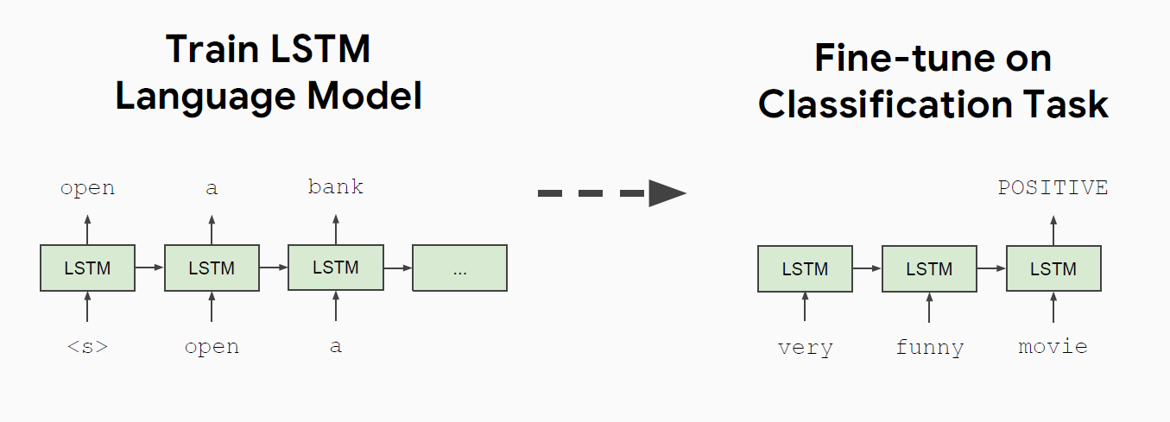
Semi-Supervised Sequence Learning

Slide 34
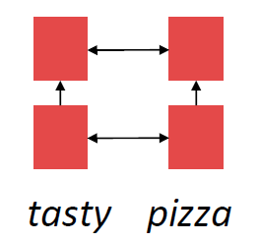
Linear Interaction Distance Issue
RNNs are unrolled “left to right”.
It encodes linear locality: a useful heuristic;

Slide 35
Linear Interaction Distance Issue
RNNs are unrolled “left to right”.
It encodes linear locality: a useful heuristic;
Linear Interaction Distance:
O(sequence length) steps for distant word pairs to interact means:
Hard to learn long distance dependencies (gradient problems);
Linear order of words is “baked in”;

Slide 36
Linear Interaction Distance Issue
RNNs are unrolled “left to right”.
It encodes linear locality: a useful heuristic;
Linear Interaction Distance:
O(sequence length) steps for distant word pairs to interact means:
Hard to learn long distance dependencies (gradient problems);
Linear order of words is “baked in”;
Limitations: Need pointing mechanism to repeat recent words.

Slide 37
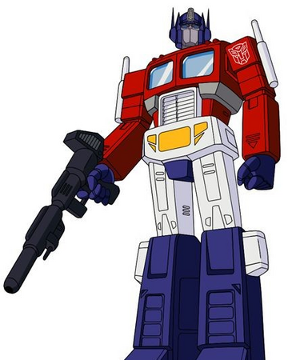
Linear Interaction Distance Issue
RNNs are unrolled “left to right”.
It encodes linear locality: a useful heuristic;
Linear Interaction Distance:
O(sequence length) steps for distant word pairs to interact means:
Hard to learn long distance dependencies (gradient problems);
Linear order of words is “baked in”;
Limitations: Need pointing mechanism to repeat recent words.
Solution: Transformers

Slide 38
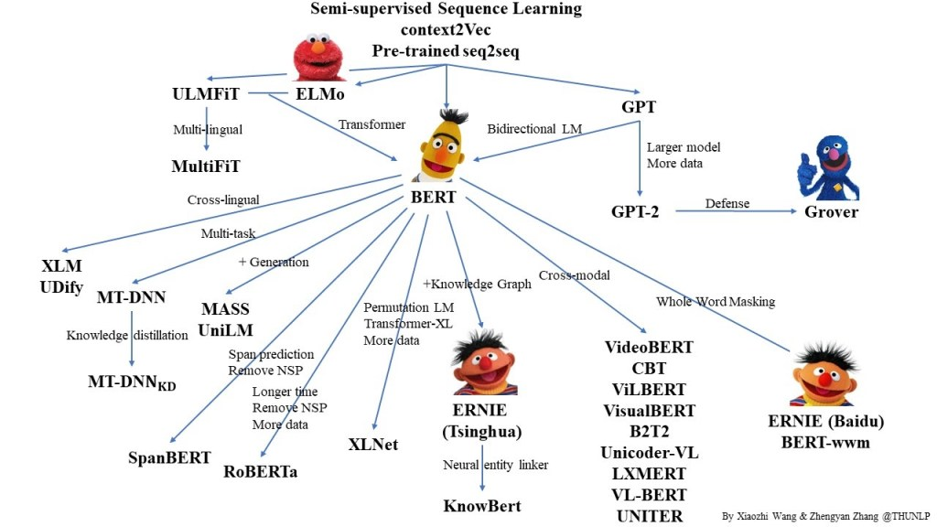
History on Transformers

Slide 39
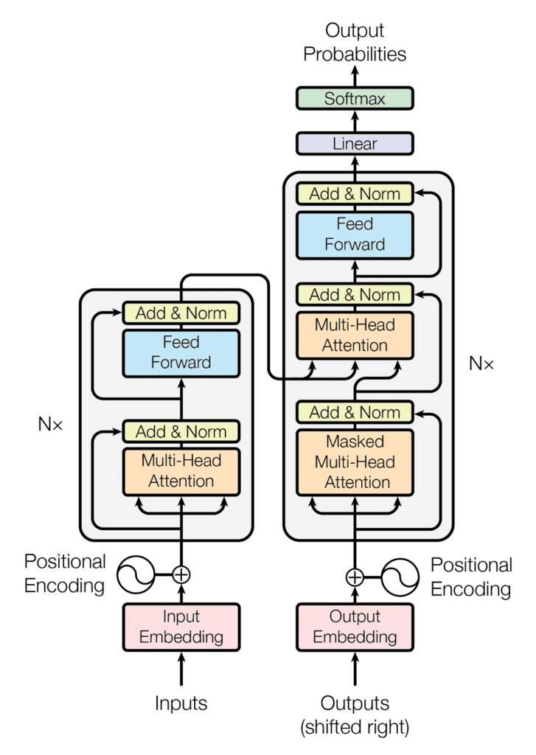
The Transformer Architecture
Transformer architecture follows an encoder-decoder structure.

Slide 40
The Transformer Architecture
Transformer architecture follows an encoder-decoder structure.
The encoder maps an input sequence to a sequence of continuous representations, which is then fed into a decoder.

Slide 41
The Transformer Architecture
Transformer architecture follows an encoder-decoder structure.
The encoder maps an input sequence to a sequence of continuous representations, which is then fed into a decoder.
The decoder receives the output of the encoder together with the decoder output at the previous time step to generate an output sequence.

Slide 42
ELMo: Deep Contextualized Word Representation
Instead of using a fixed embedding for each word, ELMo looks at the entire sentence before assigning each word in it an embedding.

Slide 43
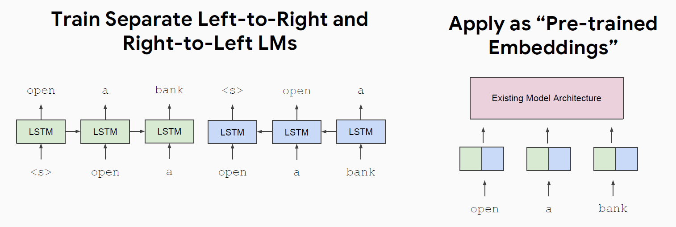
ELMo: Deep Contextualized Word Representation
Instead of using a fixed embedding for each word, ELMo looks at the entire sentence before assigning each word in it an embedding.

Slide 44
ELMo: Deep Contextualized Word Representation
Instead of using a fixed embedding for each word, ELMo looks at the entire sentence before assigning each word in it an embedding.

Slide 45
A Review of ELMo
ELMo learns word embeddings through building bidirectional LM (BiLMs).
BiLMs consist of forward and backward LMs.
Forward:
Backward:

Slide 46
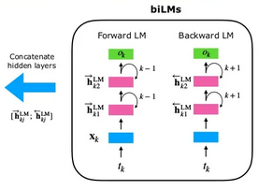
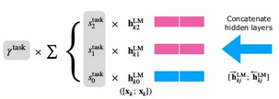
A Review of ELMo
ELMo learns word embeddings through building bidirectional LM (BiLMs).
BiLMs consist of forward and backward LMs.
Forward:
Backward:
ELMo represents a word t_{k} as a linear combination of corresponding hidden layers, including its embedding.

Slide 47
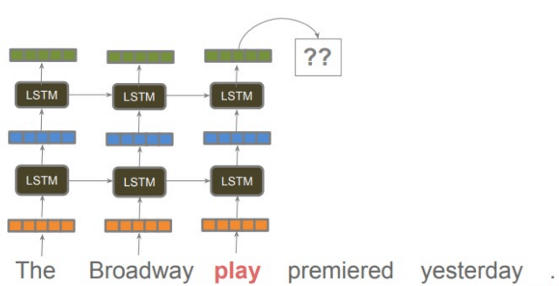
A Review of ELMo
An example of ELMo:

Slide 48
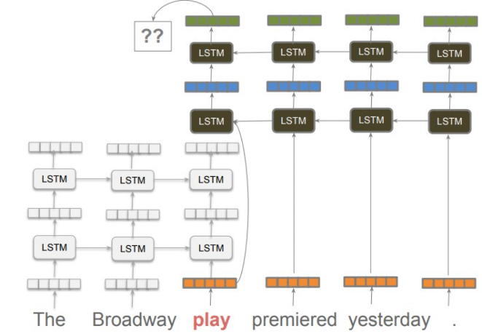
A Review of ELMo
An example of ELMo:

Slide 49
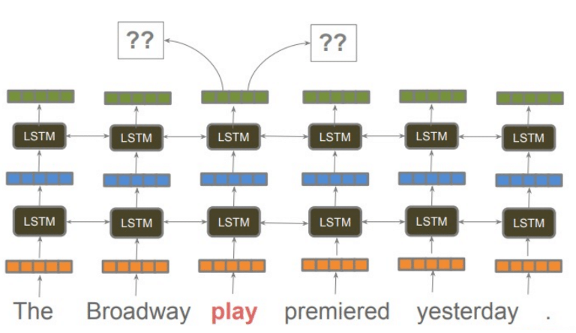
A Review of ELMo
An example of ELMo:

Slide 50
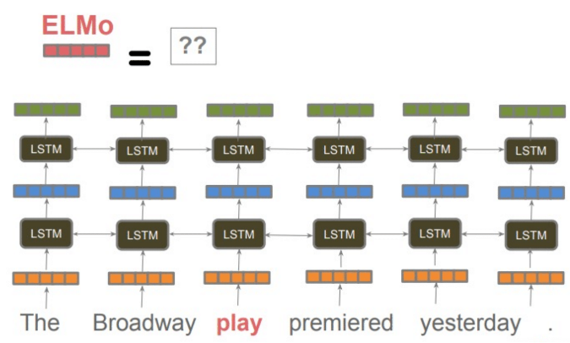
A Review of ELMo
An example of ELMo:

Slide 51
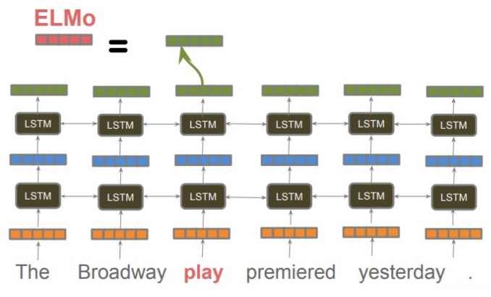
A Review of ELMo
An example of ELMo:

Slide 52
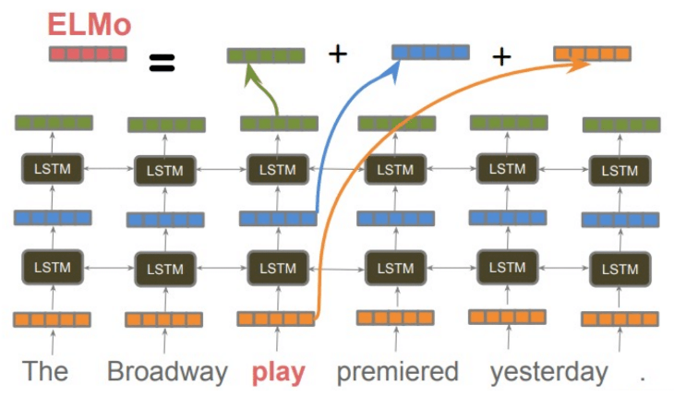
A Review of ELMo
An example of ELMo:

Slide 53
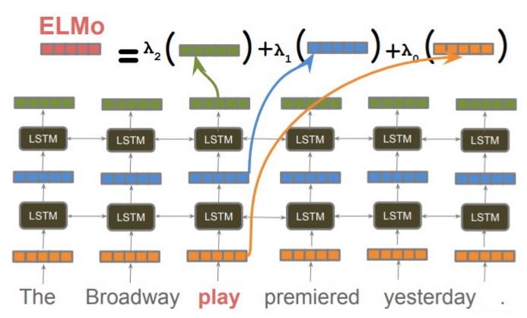
A Review of ELMo
An example of ELMo:

Slide 54
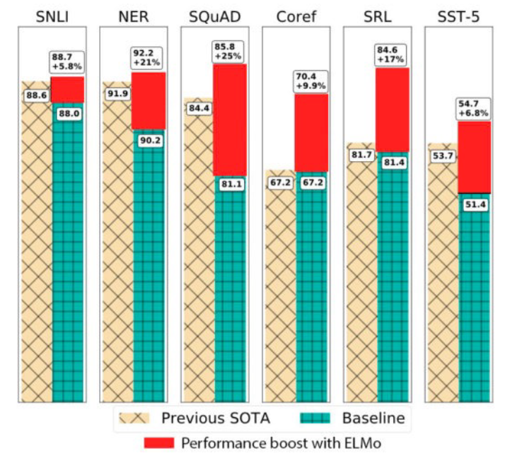
Evaluation with Extrinsic Tasks

Slide 55
OpenAI GPT: Generative Pre-trained Transformer

Slide 56
OpenAI GPT: Generative Pre-trained Transformer
Unsupervised pre-training to maximize the log-likelihood :
D
Where U = {u₁, …, u_{n}} is an unsupervised corpus of tokens, k is the size of context window, P is modelled as a neural network with parameters Θ (Radford et al., 2018).

Slide 57
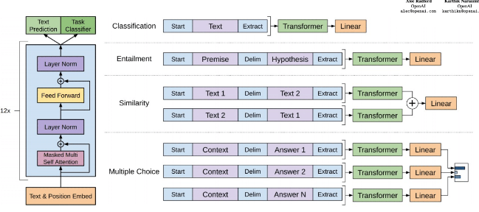
OpenAI GPT: Generative Pre-trained Transformer
Input transformations for fine-tuning on different tasks.
Convert all structured inputs into token sequences, followed linear + softmax layer.
Transformer architecture and training objectives

Slide 58
Issues with Previous Methods

Slide 59
Issues with Previous Methods
Problem: Language models only use left context or right context, but language understanding is bidirectional.

Slide 60
Issues with Previous Methods
Problem: Language models only use left context or right context, but language understanding is bidirectional.
Why are LMs unidirectional?

Slide 61
Issues with Previous Methods
Problem: Language models only use left context or right context, but language understanding is bidirectional.
Why are LMs unidirectional?
Reason 1: Directionality is needed to generate a well-formed probability distribution.

Slide 62
Issues with Previous Methods
Problem: Language models only use left context or right context, but language understanding is bidirectional.
Why are LMs unidirectional?
Reason 1: Directionality is needed to generate a well-formed probability distribution.
Reason 2: Words can “see themselves” in a bidirectional encoder.

Slide 63
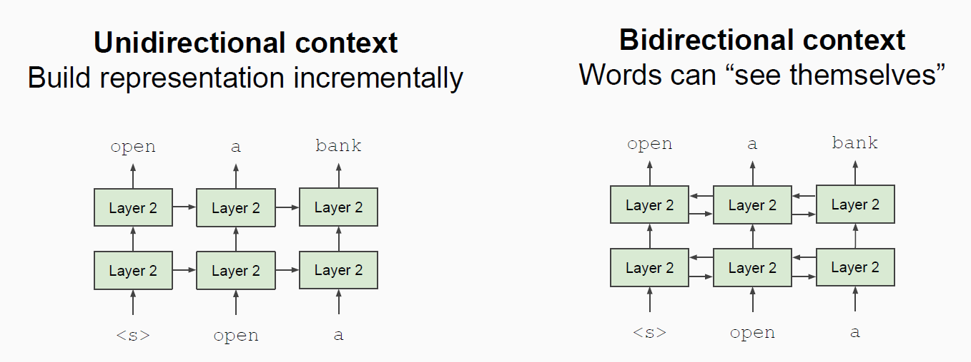
Unidirectional vs. Bidirectional Models

Slide 64
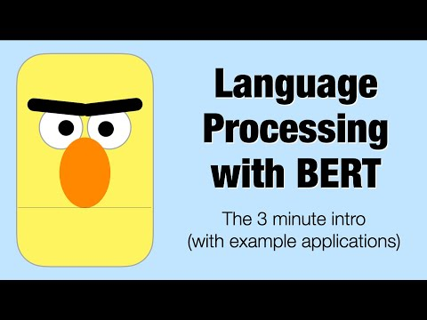
Bidirectional Encoder Representations from Transformers (BERT)

Slide 65
Bidirectional Encoder Representations from Transformers (BERT)
BERT was introduced by Google Research in 2018 (Devlin et al., 2018)

Slide 66
Objectives for BERT Training
Next-token prediction: Sequential / Unidirectional Transformer

Slide 67
Objectives for BERT Training
Next-token prediction: Sequential / Unidirectional Transformer
Masked-token prediction: Bidirectional Transformer

Slide 68
Objectives for BERT Training
Next-token prediction: Sequential / Unidirectional Transformer
Masked-token prediction: Bidirectional Transformer
Mask out k% of the input words, and then predict the masked words.
Input: The man went to the [MASK]₁. He bought a [MASK]₂ of milk.
Labels: [MASK]₁ = store; [MASK]₂ = gallon

Slide 69
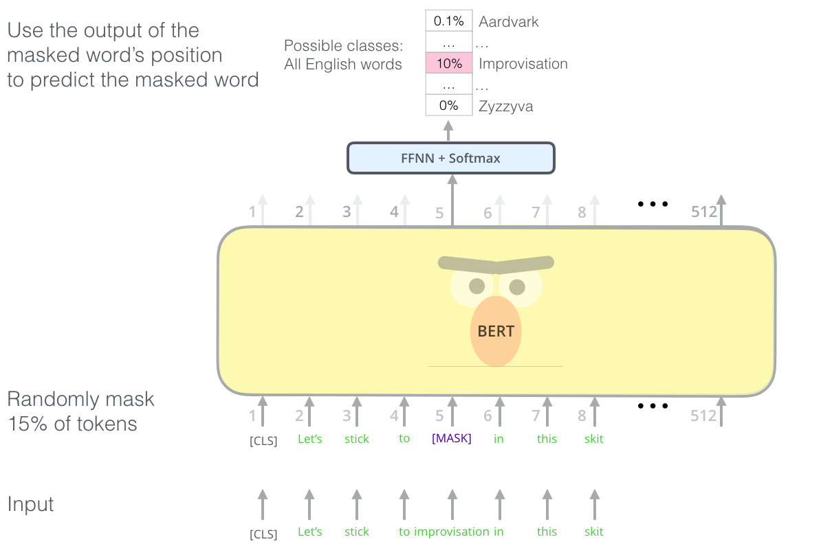
Masked Language Modeling
BERT's clever language modeling task masks 15% of words in the input and asks the model to predict the missing word.

Slide 70
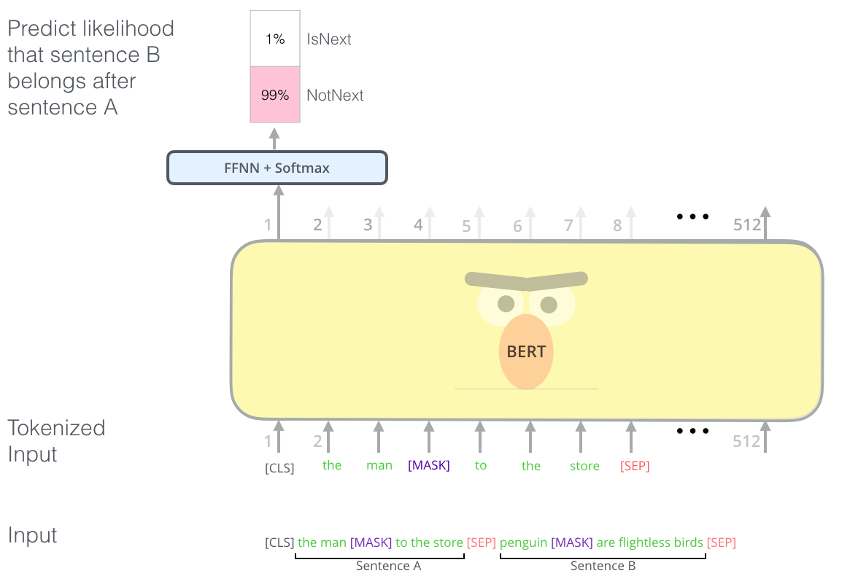
Next Sentence Prediction
The second task BERT is pre-trained on is a two-sentence classification task. The tokenization is oversimplified in this graphic as BERT actually uses WordPieces as tokens rather than words --- so some words are broken down into smaller chunks.

Slide 71
BERT Input Representation
Use 30,000 WordPiece vocabulary on input.
Each token is sum of three embeddings: Position, Segment, and Token.
Single sequence is much more efficient.

Slide 72
BERT Performance Comparison
Notes:
The General Language Understanding Evaluation (GLUE) benchmark is a collection of resources for training, evaluating, and analyzing natural language understanding systems.

Slide 73
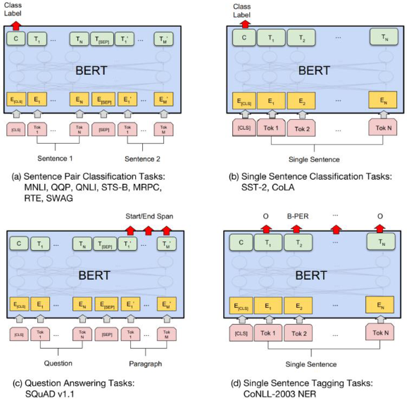
Fine-Tuning BERT
Context vector C: Take the final hidden state corresponding to the first token in the input [CLS].
Transform to a probability distribution of the class labels: P = softmax(CW^{T}).
Batch size: 16, 32
Learning rate: 5e-5, 3e-5, 2e-5
Number of epochs: 3, 4

Slide 74
Fine-Tuning BERT
Context vector C: Take the final hidden state corresponding to the first token in the input [CLS].
Transform to a probability distribution of the class labels: P = softmax(CW^{T}).
Batch size: 16, 32
Learning rate: 5e-5, 3e-5, 2e-5
Number of epochs: 3, 4

Slide 75
Embeddings for Semantic Similarity
BERT uses a cross-encoder: Two sentences are passed to the transformer network and the target value is predicted.
However, this setup is unsuitable for various pair regression tasks due to too many possible combinations (Reimers et al. 2019).

Slide 76
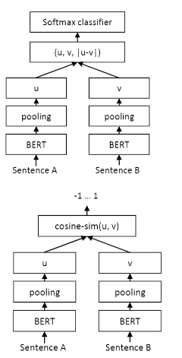
Embeddings for Semantic Similarity
BERT uses a cross-encoder: Two sentences are passed to the transformer network and the target value is predicted.
However, this setup is unsuitable for various pair regression tasks due to too many possible combinations (Reimers et al. 2019).
Sentence-BERT (SBERT), a modification of the BERT network using siamese and triplet networks that is able to derive semantically meaningful sentence embeddings, which can be used for large-scale semantic similarity comparison.

Slide 77
Semantic Textual Similarity
Using the output of BERT leads to rather poor performances.
We only observe minor difference between SBERT and SRoBERTa for generating sentence embedding.
Try it: https://www.sbert.net/

Slide 78
Summary
Introduction to Distributed Contextual Embeddings
History of Neural Language Models
Recurrent Neural Networks RNNs
ELMo
GPT
BERT
Inner-workings of Transformers and fine-tuning approaches
Masked Language Modeling and Next Sentence Prediction.

Slide 79
Resources
Jurafsky, D. and H. Martin Justin, Chapter 7. "Neural Networks and Neural Language Models" Speech and Language Processing
Jurafsky, D. and H. Martin Justin, Chapter 11. "Transfer Learning with Contextual Embeddings and Pre-trained language models" Speech and Language Processing
Illustrated BERT, ELMo by Jay Alammar: https://jalammar.github.io/illustrated-bert/
Hugging Face’s Transformers: https://huggingface.co/docs/transformers/index
Transformer-based Models Hub: https://huggingface.co/models

Slide 80
SBERT Method
SBERT adds a pooling operation on top of the encoder to derive a fixed sized sentence embedding.
Objective functions:
Classification: o = softmax(W_{t}(u, v, |u-v|))
Regression: cosine-sim(u, v)
Triplet: max(||s_{a}-s_{p}||-||s_{a}-s_{n}||+ε, 0)
Trained on Semantic Neural Language Inference (SNLI).

