Slide 1
Natural Language Processing
Case Studies and Applications
Detecting Online Hate-speech
Demetris Paschalides
Department of Computer Science
University of Cyprus

Slide 2
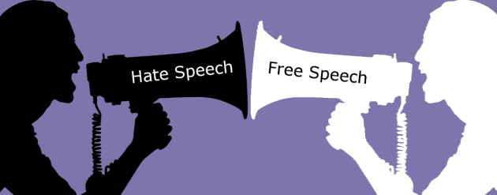
What is Hate-speech?
Hate-speech has no formal definition but there is a consensus:
Hate-speech is the extreme dislike of a person or group of people because of their race, ethnicity, religion, gender, or gender orientation.
Different laws applying to different countries and organizations.

Slide 3
What is Hate-speech?
Hate-speech has no formal definition but there is a consensus:
Hate-speech is the extreme dislike of a person or group of people because of their race, ethnicity, religion, gender, or gender orientation.
Different laws applying to different countries and organizations.
Fine line between hate-speech and free-speech.

Slide 4





Hate-speech Legislations and Policies
US - Hate-speech is protected under the free speech provisions of the First Amendment.
Laws prohibiting hate-speech as it promotes violence or social disorder.
European Court of Human Rights adopted an open-ended definition of hate-speech covering all forms of hateful expression.
People convicted of using hate-speech can often face large fines and even imprisonment.

Slide 5




Hate-speech Legislations and Policies
US - Hate-speech is protected under the free speech provisions of the First Amendment.
Laws prohibiting hate-speech as it promotes violence or social disorder.
European Court of Human Rights adopted an open-ended definition of hate-speech covering all forms of hateful expression.
People convicted of using hate-speech can often face large fines and even imprisonment.
These laws extend to the internet and social media, leading many OSNs to create their own provisions against hate-speech.

Slide 6



Hate-speech in OSNs

Slide 7
Hate-speech in OSNs
Online social networks (OSN), like Twitter and Facebook, have revolutionized communication.
Freely share thoughts, opinions and real-life experiences.

Slide 8
Hate-speech in OSNs
Online social networks (OSN), like Twitter and Facebook, have revolutionized communication.
Freely share thoughts, opinions and real-life experiences.
Unfortunately, certain people take advantage of this infrastructure:
  Exploit the openness of OSNs, properties of anonymity and mobility
  Spread hate-speech and organize hateful activities.

Slide 9
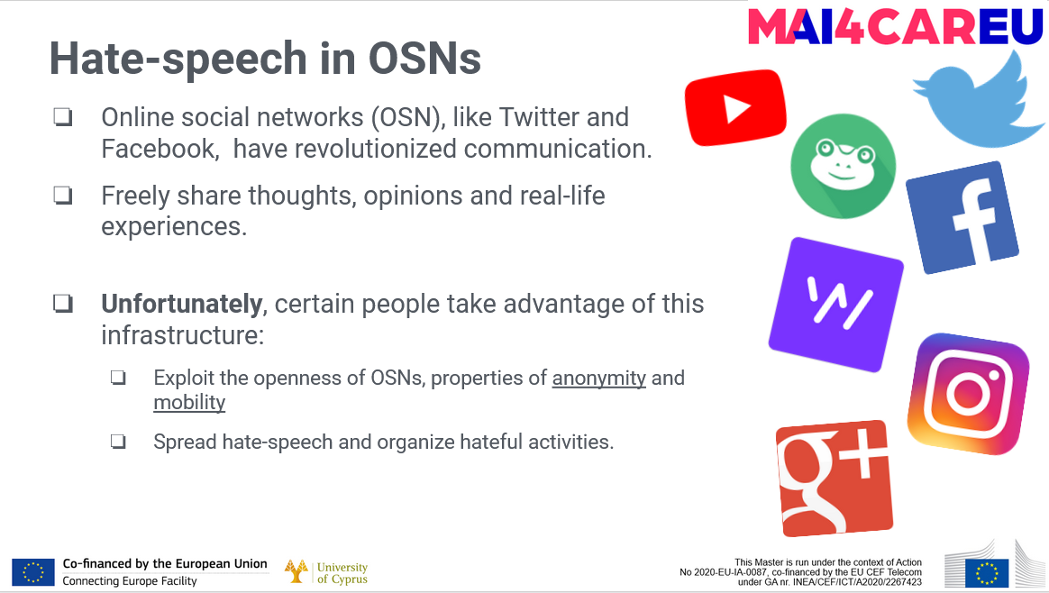
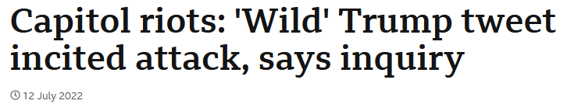
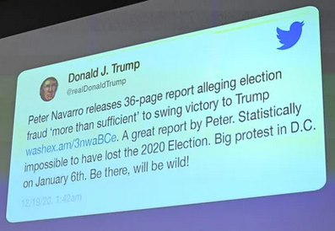

Slide 10

Hate-speech in OSNs
UK - Significant increase of hate-speech towards the migrant communities
EU - Rise of hate-speech and hate-crimes based on religious beliefs, ethnicity, or gender
  80% of the respondents have encountered online hate-speech and 40% felt attacked or threatened.
US - Rise of hate-speech and hate-crimes since the Trump election.
#@$!%&

Slide 11
Hate-speech in OSNs
UK - Significant increase of hate-speech towards the migrant communities
EU - Rise of hate-speech and hate-crimes based on religious beliefs, ethnicity, or gender
  80% of the respondents have encountered online hate-speech and 40% felt attacked or threatened.
US - Rise of hate-speech and hate-crimes since the Trump election.
Urgent development of countermeasures.
Range of international initiatives launched for the qualification of the problem (MANDOLA).
#@$!%&

Slide 12

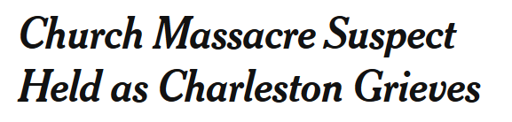
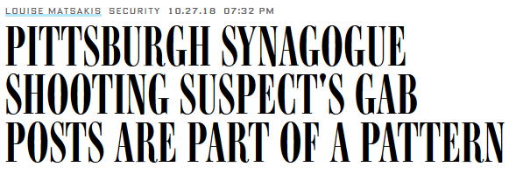
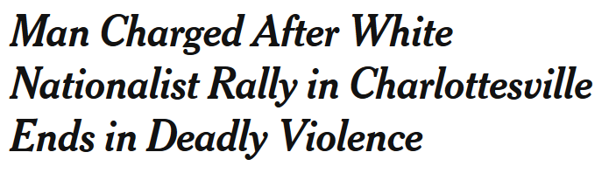
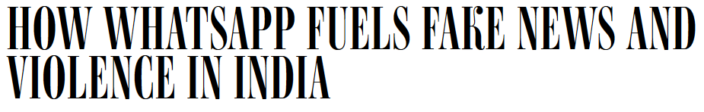
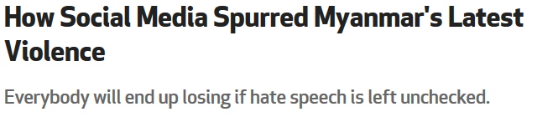
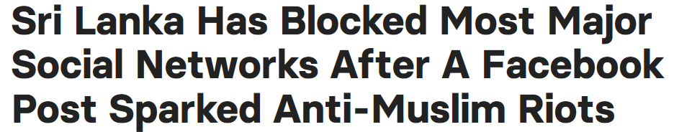
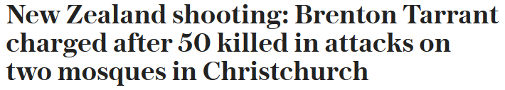
Online Social Networks and Hate-speech
‹#›

Slide 13
Defining Hate-speech
Research works in hate-speech detection adopt their own hate-speech definition.
Silva et al. 2016 - Hate-speech is any offense motivated in whole or in a part, by the offender's bias against an aspect of a group of people.

Slide 14
Defining Hate-speech
Research works in hate-speech detection adopt their own hate-speech definition.
Silva et al. 2016 - Hate-speech is any offense motivated in whole or in a part, by the offender's bias against an aspect of a group of people.
Gitari et al. 2015 - Hate-speech is defined in three parts:
  It is targeted at a group of people and not at a single person (ethnicity, religion, gender, social orientation, disability and class).
  May contain some of the hallmarks of dangerous speech (comparing group of people with insects).
  Dangerous speech often encourages the audience to condone or commit violent acts on the targeted group (discriminate, loot, riot, beat, forcefully evict, and kill).

Slide 15
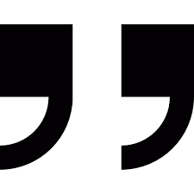
Defining Hate-speech
We adopt the definition from Davidson et al. 2017:
The language that is used to express hatred towards a targeted group or is intended to be derogatory, to humiliate, or to insult the members of the group.

Slide 16



Defining Hate-speech
We adopt the definition from Davidson et al. 2017:
The language that is used to express hatred towards a targeted group or is intended to be derogatory, to humiliate, or to insult the members of the group.
Does not include all instances of offensive language.
People use highly offensive terms to certain groups but in a qualitatively different manner.
For example in everyday language and online slung, in song lyrics e.g. rap songs, or by teenagers whilst play video games.

Slide 17
MANDOLA Big-Data Processing System
There are two major difficulties in dealing with online hate-speech:
Lack of reliable data
Poor awareness

Slide 18
Quiz Time
Is it Hate-speech
or Not?

Slide 19
#California is full of white trash who moved from #Oklahoma
NO HATE
HATE
Notes:
InfoWars is notorious for perpetuating wildly false and sometimes outright racist conspiracy theories.

Slide 20
#California is full of white trash who moved from #Oklahoma
NO HATE
HATE
Notes:
InfoWars is notorious for perpetuating wildly false and sometimes outright racist conspiracy theories.

Slide 21
#Dutch farmers are white trash.
NO HATE
HATE
Notes:
InfoWars is notorious for perpetuating wildly false and sometimes outright racist conspiracy theories.

Slide 22
#Dutch farmers are white trash.
NO HATE
HATE
Notes:
InfoWars is notorious for perpetuating wildly false and sometimes outright racist conspiracy theories.

Slide 23
We should play together soon I've been playing with random faggots but it's fun
NO HATE
HATE
Notes:
InfoWars is notorious for perpetuating wildly false and sometimes outright racist conspiracy theories.

Slide 24
We should play together soon I've been playing with random faggots but it's fun
HATE
NO HATE
Notes:
InfoWars is notorious for perpetuating wildly false and sometimes outright racist conspiracy theories.

Slide 25
F**k michelle obama. That monkey doesn’t belong in the white house
NO HATE
HATE
Notes:
InfoWars is notorious for perpetuating wildly false and sometimes outright racist conspiracy theories.

Slide 26
F**k michelle obama. That monkey doesn’t belong in the white house
NO HATE
HATE
Notes:
InfoWars is notorious for perpetuating wildly false and sometimes outright racist conspiracy theories.

Slide 27
Well, Maryland is just a bunch of hateful rednecks, anyway.
NO HATE
HATE
Notes:
InfoWars is notorious for perpetuating wildly false and sometimes outright racist conspiracy theories.

Slide 28
Well, Maryland is just a bunch of hateful rednecks, anyway.
NO HATE
HATE
Notes:
InfoWars is notorious for perpetuating wildly false and sometimes outright racist conspiracy theories.

Slide 29
The majority of them are as stupid as real Negroes.
NO HATE
HATE
Notes:
InfoWars is notorious for perpetuating wildly false and sometimes outright racist conspiracy theories.

Slide 30
The majority of them are as stupid as real Negroes.
NO HATE
HATE
Notes:
InfoWars is notorious for perpetuating wildly false and sometimes outright racist conspiracy theories.

Slide 31
I bet you can see the Mexic-ants from space with the Google Earth.
NO HATE
HATE
Notes:
InfoWars is notorious for perpetuating wildly false and sometimes outright racist conspiracy theories.

Slide 32
I bet you can see the Mexic-ants from space with the Google Earth.
NO HATE
HATE
Notes:
InfoWars is notorious for perpetuating wildly false and sometimes outright racist conspiracy theories.

Slide 33
The holocaust never existed except in the minds of the people who believed it .
NO HATE
HATE
Notes:
InfoWars is notorious for perpetuating wildly false and sometimes outright racist conspiracy theories.

Slide 34
The holocaust never existed except in the minds of the people who believed it .
NO HATE
HATE
Notes:
InfoWars is notorious for perpetuating wildly false and sometimes outright racist conspiracy theories.

Slide 35
Holocaust is the persecution and murder of Jews by the Nazis
NO HATE
HATE
Notes:
InfoWars is notorious for perpetuating wildly false and sometimes outright racist conspiracy theories.

Slide 36
Holocaust is the persecution and murder of Jews by the Nazis
HATE
NO HATE

Slide 37




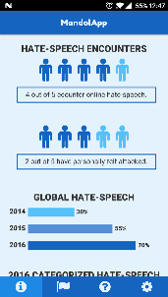
Big-Data Processing System
There are two major difficulties in dealing with online hate-speech: Lack of reliable data and Poor awareness
MANDOLA's objective is to fill this gap by:
Monitoring the spread of online hate-speech.
Providing policymakers with actionable information.
Providing ordinary citizens with useful tools to deal with online hate-speech.
Transferring best practices among EU member states.
http://mandola.grid.ucy.ac.cy
@mandola_project

Slide 38
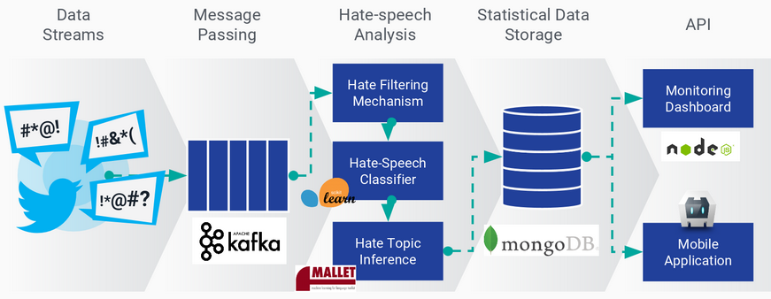
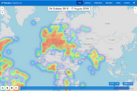
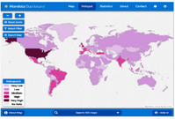
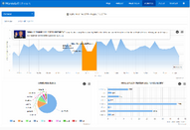
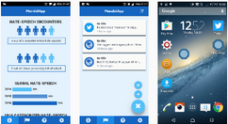
MANDOLA Big-Data Processing System
MANDOLA Big-Data Processing System (MBDPS) is a big-data processing pipeline with modules responsible for data collection, processing and classification.

Slide 39
MANDOLA Big-Data Processing System
MANDOLA Big-Data Processing System (MBDPS) is a big-data processing pipeline with modules responsible for data collection, processing and classification.

Slide 40
Managing Data Streams
Twitter data stream is collected via Twitter Stream API using a framework to efficiently retrieve large collection of tweets per day.
Master
Token Pool
Data Collection
Data Collection
Collector Instance
1
Collector Instance
N
Collector Instance
1
Collector Instance
N

Slide 41

Hate-Speech Analysis
Consists of the following modules:
Hate Filtering Mechanism: Filtering probable hate-speech for annotators to manually label as hate-speech and enrich the dataset.
Hate Filtering
Mechanism
Hate-Speech
Classifier
Hate Topic
Inference

Slide 42
Hate-Speech Analysis
Consists of the following modules:
Hate Filtering Mechanism: Filtering probable hate-speech for annotators to manually label as hate-speech and enrich the dataset.
Hate-speech Classification: Online classification of incoming content as hate-speech or not.
Hate Filtering
Mechanism
Hate-Speech
Classifier
Hate Topic
Inference

Slide 43
Hate-Speech Analysis
Consists of the following modules:
Hate Filtering Mechanism: Filtering probable hate-speech for annotators to manually label as hate-speech and enrich the dataset.
Hate-speech Classification: Online classification of incoming content as hate-speech or not.
Hate Topic Inference: Topic inference regarding the content previously classified as hate-speech.
Hate Filtering
Mechanism
Hate-Speech
Classifier
Hate Topic
Inference

Slide 44
Hate Filtering Mechanism
Subjectivity Classifier
Subjectivity Classifier:
Hate-base Classifier:
Polarity Classifier:
Hate-base Classifier
Polarity Classifier

Slide 45
Hate Filtering Mechanism
Subjectivity Classifier
Subjectivity Classifier: Hate-speech tends to be opinionated, thus subjective sentences are more likely to contain hate-speech than objective.
Hate-base Classifier:
Polarity Classifier:
Hate-base Classifier
Polarity Classifier

Slide 46
Hate Filtering Mechanism
Subjectivity Classifier
Subjectivity Classifier: Hate-speech tends to be opinionated, thus subjective sentences are more likely to contain hate-speech than objective.
Hate-base Classifier: Sentiment lexicon for hate specific terms which often express hate against the referent.
Polarity Classifier:
Hate-base Classifier
Polarity Classifier

Slide 47
Hate Filtering Mechanism
Subjectivity Classifier
Subjectivity Classifier: Hate-speech tends to be opinionated, thus subjective sentences are more likely to contain hate-speech than objective.
Hate-base Classifier: Sentiment lexicon for hate specific terms which often express hate against the referent.
Polarity Classifier: Hate-speech tends to have negative meaning, thus sentences with negative polarity are more likely to contain hate-speech.
Hate-base Classifier
Polarity Classifier

Slide 48
Detecting Hate-speech
Online hate-speech detection can be defined as the classification task of documents (e.g. tweets, comments) into hate-speech, or hate-speech subclasses like racism and sexism.
Existing methods of hate-speech classification can be divided into two main categories:
Traditional Methods
Deep Learning Methods
Anna Schmidt, Michael Wiegand, A Survey on Hate Speech Detection using Natural Language Processing, Proceedings of the Fifth International Workshop on Natural Language Processing for Social Media, 2017

Slide 49
Detecting Hate-speech Traditional Methods
Rely on manual feature engineering that generates domain specific features which are then fed into machine learning (ML) algorithms.
Example of such ML algorithms are Logistic Regression, Random Forest, Naive Bayes and Support Vector Machines.

Slide 50
Detecting Hate-speech Traditional Methods
Rely on manual feature engineering that generates domain specific features which are then fed into machine learning (ML) algorithms.
Example of such ML algorithms are Logistic Regression, Random Forest, Naive Bayes and Support Vector Machines.
Hate-speech features categories:
  Simple surface: bag-of-words, n-grams, number of hashtags, words etc.
  Word generalization: word embeddings, word2vec, GloVe etc.
  Lexical resources: profane, hateful, modal words etc.
  Linguistic features: dependency parsing, part-of-speech (PoS) tagging etc.
  Sentiment analysis: polarity, subjectivity etc.
  Meta-information: user-level, network-level etc.

Slide 51
Detecting Hate-speech Deep Learning Methods
Revolve around the recent deep learning paradigm which is applied in many different domains, promising satisfying results.
The main difference with the traditional methods is that the input is not directly used for the classification, but rather to derive new abstract feature representations, that have proven to be more effective for learning.
Deep learning methods for hate-speech detection can be divided in three categories:
  Word-level Methods
  Character-level Methods
  Metadata-level Methods

Slide 52
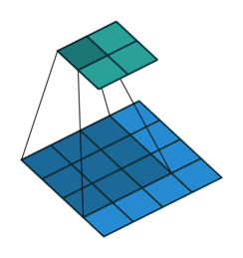
Detecting Hate-speech Word-level Methods
Popular DL architectures are Convolutional Neural Network (CNN) and Recurrent Neural Network (RNN).
CNN is well known as feature-extractors.
  Extract word combination to detect hate-speech.
RNN are able to learn word dependencies in an orderly fashion.

Slide 53
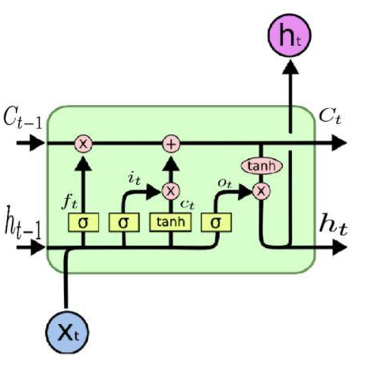
Detecting Hate-speech Word-level Methods
Popular DL architectures are Convolutional Neural Network (CNN) and Recurrent Neural Network (RNN).
CNN is well known as feature-extractors.
  Extract word combination to detect hate-speech.
RNN are able to learn word dependencies in an orderly fashion.
There are also architectures combining both CNN and RNN.
  Extract high-level features using CNN.
  Learn their dependencies with RNN.

Slide 54
Detecting Hate-speech Character-Level Methods
Character includes key signals that are able to improve model performance.
Word embeddings are vocabulary dependent.

Slide 55
Detecting Hate-speech Character-Level Methods
Character includes key signals that are able to improve model performance.
Word embeddings are vocabulary dependent.
  On the other hand all words are formed by 96 characters being able to form all of words even if they are OOV - out-of-vocabulary.

Slide 56
Detecting Hate-speech Character-Level Methods
Character includes key signals that are able to improve model performance.
Word embeddings are vocabulary dependent.
  On the other hand all words are formed by 96 characters being able to form all of words even if they are OOV - out-of-vocabulary.
It can handle misspelled words, emoticons, new words, infrequent words and #hashtags.
It reduces complexity and improving the performance in terms of speed.
Similarly to as Word-level Models, Character-level models are also implemented using CNN, RNN and a combination of them.

Slide 57
Detecting Hate-speech Metadata-Level Methods
Use features rather than one-hot encoding and embedding layers.
Features: Simple surface, Word generalization, Lexical resources, Linguistic features, Sentiment analysis, Meta-information

Slide 58
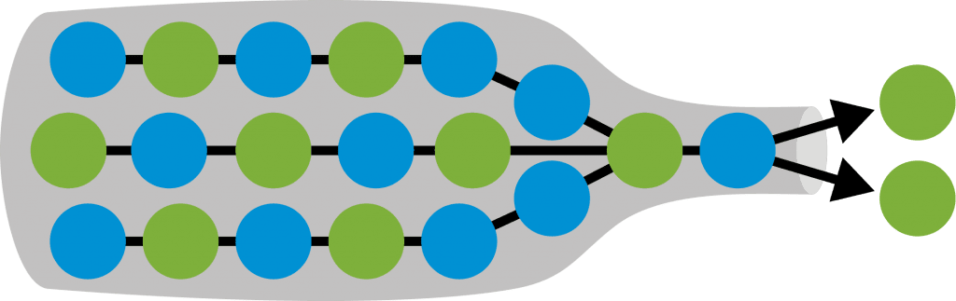
Detecting Hate-speech Metadata-Level Methods
Use features rather than one-hot encoding and embedding layers.
Features: Simple surface, Word generalization, Lexical resources, Linguistic features, Sentiment analysis, Meta-information
One of the most popular architectures to deal with scalar features is the bottleneck.
Bottleneck architecture has been shown to result in automatic construction of high-level features.

Slide 59
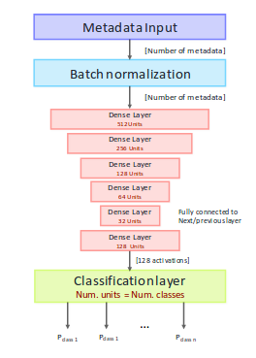
Detecting Hate-speech Metadata-Level Methods
Use features rather than one-hot encoding and embedding layers.
Features: Simple surface, Word generalization, Lexical resources, Linguistic features, Sentiment analysis, Meta-information
One of the most popular architectures to deal with scalar features is the bottleneck.
Bottleneck architecture has been shown to result in automatic construction of high-level features.

Slide 60
Combining Models
Each of the word-level, character-level and metadata-level models have specific benefits and limitations.

Slide 61
Combining Models
Each of the word-level, character-level and metadata-level models have specific benefits and limitations.
  Word-level model (long range word dependencies, OOV issue).

Slide 62
Combining Models
Each of the word-level, character-level and metadata-level models have specific benefits and limitations.
  Word-level model (long range word dependencies, OOV issue).
  Character-level model (mitigates OOV).

Slide 63
Combining Models
Each of the word-level, character-level and metadata-level models have specific benefits and limitations.
  Word-level model (long range word dependencies, OOV issue).
  Character-level model (mitigates OOV).
  Metadata-level model: (another signal, performance boost).

Slide 64
Combining Models
Each of the word-level, character-level and metadata-level models have specific benefits and limitations.
  Word-level model (long range word dependencies, OOV issue).
  Character-level model (mitigates OOV).
  Metadata-level model: (another signal, performance boost).
The three models are complementary.
A holistic approach should improve individual performance.

Slide 65
Combining Models
Each of the word-level, character-level and metadata-level models have specific benefits and limitations.
  Word-level model (long range word dependencies, OOV issue).
  Character-level model (mitigates OOV).
  Metadata-level model: (another signal, performance boost).
The three models are complementary.
A holistic approach should improve individual performance.
Methods for implementing this approach: i) Ensemble Classifiers and ii) Hybrid Models

Slide 66
Combining Models Ensemble Classifiers
Strategic combinations of different models and classifiers that improve the classification performance.
Three main ensemble methods are i) Bagging, ii) Boosting and iii) Stacking
  Stacking Ensembles: use a new classifier CM to correct the errors of a previous classifier C1, C2, Cn,
  The classifiers are stacked on top of one another.

Slide 67
Combining Models Hybrid Models
The previously mentioned models compliment each other.

Slide 68
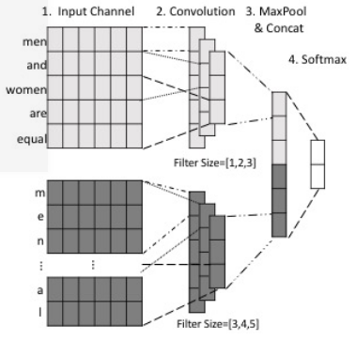
Combining Models Hybrid Models
The previously mentioned models compliment each other.
Several works show that the combination of individual models can improve the overall performance.
  For example HybridCNN: combines a word-based and character-based CNN"

Slide 69
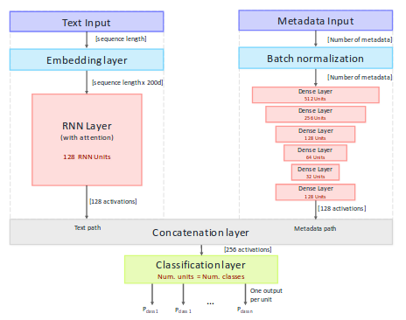
Combining Models Hybrid Models
The previously mentioned models compliment each other.
Several works show that the combination of individual models can improve the overall performance.
  For example HybridCNN: combines a word-based and character-based CNN"
  Also UnifiedNN: combines word-level RNN with metadata-level DNN

Slide 70
Hybrid Models Training
The hybrid models are straightforward but training the whole combined networks at once is not optimal.

Slide 71

Hybrid Models Training
The hybrid models are straightforward but training the whole combined networks at once is not optimal.
There are several ways to train hybrid models:

Slide 72
Hybrid Models Training
The hybrid models are straightforward but training the whole combined networks at once is not optimal.
There are several ways to train hybrid models:
  Training the entire network at once: Suboptimal - because the individual models might have different convergence rates.

Slide 73
Hybrid Models Training
The hybrid models are straightforward but training the whole combined networks at once is not optimal.
There are several ways to train hybrid models:
  Training the entire network at once: Suboptimal - because the individual models might have different convergence rates.
  Transfer learning: Pre-training individual models separately and joining them afterwards.

Slide 74
Hybrid Models Training
The hybrid models are straightforward but training the whole combined networks at once is not optimal.
There are several ways to train hybrid models:
  Training the entire network at once: Suboptimal - because the individual models might have different convergence rates.
  Transfer learning: Pre-training individual models separately and joining them afterwards.
  Combined learning with interleaving: Train the full network simultaneously while mitigating the aforementioned drawbacks.

Slide 75
Hybrid Models Training Interleaved Training
A
B
Initialize two identical hybrid models A and B.
Input Layer
Input Layer
h1
h2
h1
h2
Concatenation Layer
Concatenation Layer
Softmax Layer
Softmax Layer

Slide 76
Hybrid Models Training Interleaved Training
A
B
Initialize two identical hybrid models A and B.
Freeze h1 path in A and h2 path in B.
Input Layer
Input Layer
h1
h2
h1
h2
Concatenation Layer
Concatenation Layer
Softmax Layer
Softmax Layer

Slide 77
Hybrid Models Training Interleaved Training
A
B
Initialize two identical hybrid models A and B.
Freeze h1 path in A and h2 path in B.
Set initial model as A and begin training.
Input Layer
Input Layer
h1
h2
h1
h2
Epoch Number = 1
Batch Number = 1
Model Index = Epoch Number + Batch Number
If Model Index % 2 = 0 then
Model = A else
Model = B
Concatenation Layer
Concatenation Layer
Softmax Layer
Softmax Layer

Slide 78
Hybrid Models Training Interleaved Training
A
B
Initialize two identical hybrid models A and B.
Freeze h1 path in A and h2 path in B.
Set initial model as A and begin training.
If epoch number + batch number is even, set model to A, else to B.
After each training batch, copy frozen weights to the other copy.
Input Layer
Input Layer
h1
h2
h1
h2
Concatenation Layer
Concatenation Layer
Softmax Layer
Softmax Layer

Slide 79
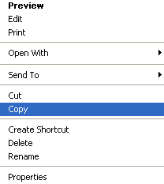
Hybrid Models Training Interleaved Training
A
B
Initialize two identical hybrid models A and B.
Freeze h1 path in A and h2 path in B.
Set initial model as A and begin training.
If epoch number + batch number is even, set model to A, else to B.
After each training batch, copy frozen weights to the other copy.
Input Layer
Input Layer
h1
h2
h1
h2
Concatenation Layer
Concatenation Layer
Softmax Layer
Softmax Layer

Slide 80
Hybrid Models Training Interleaved Training
A
B
Initialize two identical hybrid models A and B.
Freeze h1 path in A and h2 path in B.
Set initial model as A and begin training.
If epoch number + batch number is even, set model to A, else to B.
After each training batch, copy frozen weights to the other copy.
Input Layer
Input Layer
h1
h2
h1
h2
Concatenation Layer
Concatenation Layer
Softmax Layer
Softmax Layer

Slide 81
Hybrid Models Training Interleaved Training
A
B
Initialize two identical hybrid models A and B.
Freeze h1 path in A and h2 path in B.
Set initial model as A and begin training.
If epoch number + batch number is even, set model to A, else to B.
After each training batch, copy frozen weights to the other copy.
Input Layer
Input Layer
h1
h2
h1
h2
Paste
Concatenation Layer
Concatenation Layer
Softmax Layer
Softmax Layer

Slide 82
Hybrid Models Training Interleaved Training
A
B
Initialize two identical hybrid models A and B.
Freeze h1 path in A and h2 path in B.
Set initial model as A and begin training.
If epoch number + batch number is even, set model to A, else to B.
After each training batch, copy frozen weights to the other copy.
Input Layer
Input Layer
h1
h2
h1
h2
Epoch Number = 1
Batch Number = 2
Model Index = Epoch Number + Batch Number
If Model Index % 2 = 0 then
Model = A else
Model = B
Concatenation Layer
Concatenation Layer
Softmax Layer
Softmax Layer

Slide 83
Our Intuition
Word-level, Character-level and Metadata-level models:
  Trained on different inputs.
  Generate different abstract features.
  Are complementary of each other.

Slide 84
Our Intuition
Word-level, Character-level and Metadata-level models:
  Trained on different inputs.
  Generate different abstract features.
  Are complementary of each other.
Hybrid approaches propose models comprised of 2 - at most - models.
  For example HybridCNN (word-level and character-level) and UnifiedNN (word-level and metadata-level).

Slide 85
Our Intuition
Word-level, Character-level and Metadata-level models:
  Trained on different inputs.
  Generate different abstract features.
  Are complementary of each other.
Hybrid approaches propose models comprised of 2 - at most - models.
  For example HybridCNN (word-level and character-level) and UnifiedNN (word-level and metadata-level).
MANDOLA proposes a novel approach to a 3-way hybrid model for hate-speech detection, comprised of character-level, word-level and metadata-level models that perform well individually.

Slide 86
Our Methodology
Based on these observations, we want to implement a hybrid model, comprised of three models, namely word-level, character-level and metadata-level that are empirically shown to be very effective feature extractors for identifying hate-speech.
Approach Workflow:
Re-implementation of the state-of-the-art
Select best Word, Character and Metadata Approaches
Word-Level Model
Combine models
Evaluate and Compare Results
Character-Level Model
Hybrid
Metadata-Level Model
Ensemble

Slide 87
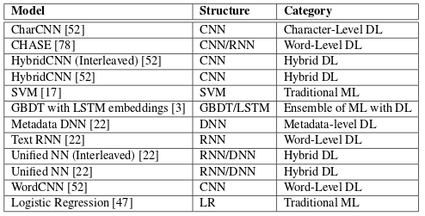
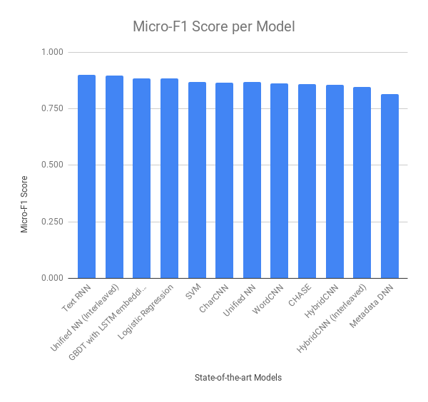
Re-implementation and Selection
The models selected to be used are:
Word-level: CHASE
Character-level: CharCNN
Metadata-level: MetadataDNN

Slide 88
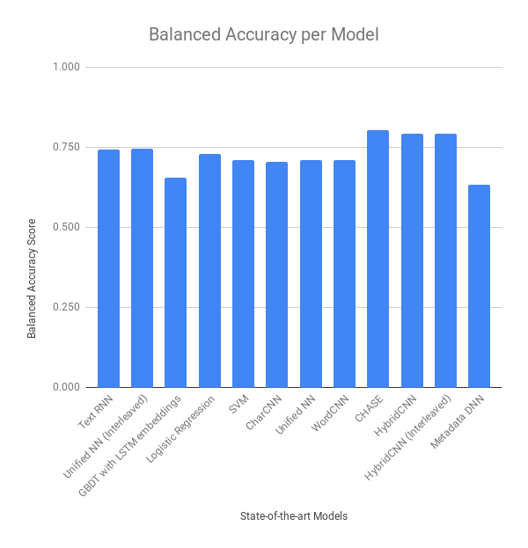
Re-implementation and Selection
The models selected to be used are:
Word-level: CHASE
Character-level: CharCNN
Metadata-level: MetadataDNN

Slide 89
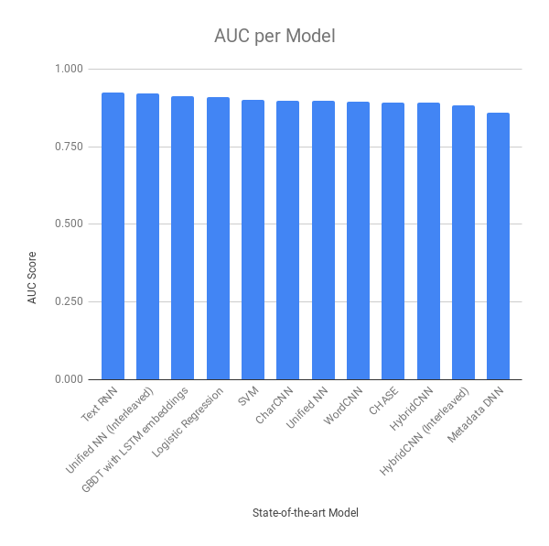
Re-implementation and Selection
The models selected to be used are:
Word-level: CHASE
Character-level: CharCNN
Metadata-level: MetadataDNN

Slide 90
Word-Level Model CHASE
Input Pre-processing
(misspellings, normalize, stemming)
Combination of CNN and RNN structures.
  CNN extracts word combination from input.
  RNN learns word dependencies from input.
Input Padding and Truncating
(threshold ~27)
Word Embeddings
(Twitter GloVe 200 dimensions)
Network Structure
(GRU-CNN)
Classification Layer

Slide 91
Word-Level Model CHASE
Input Pre-processing
(misspellings, normalize, stemming)
Combination of CNN and RNN structures.
  CNN extracts word combination from input.
  RNN learns word dependencies from input.
Example: “These refugees are troublemakers and parasites, they should be deported from my country”
  Words of refugee, troublemakers, parasites and deported do not indicate hate-speech.
  The combination of them however can be more indicative of hate-speech.
Input Padding and Truncating
(threshold ~27)
Word Embeddings
(Twitter GloVe 200 dimensions)
Network Structure
(GRU-CNN)
Classification Layer

Slide 92
Word-Level Model CHASE
Input Pre-processing
(misspellings, normalize, stemming)
Preprocessing
Input Padding and Truncating
(threshold ~27)
Word Embeddings
(Twitter GloVe 200 dimensions)
Network Structure
(GRU-CNN)
Classification Layer

Slide 93
Word-Level Model CHASE
Input Pre-processing
(misspellings, normalize, stemming)
Preprocessing
  Correct misspellings, normalize, segment hashtags e.g. #banrefugees into ban refugees and stemming.
Input Padding and Truncating
(threshold ~27)
Word Embeddings
(Twitter GloVe 200 dimensions)
Network Structure
(GRU-CNN)
Classification Layer

Slide 94
Word-Level Model CHASE
Input Pre-processing
(misspellings, normalize, stemming)
Preprocessing
  Correct misspellings, normalize, segment hashtags e.g. #banrefugees into ban refugees and stemming.
Padded and Truncated
  The inputs have to be of the same length, thus are left padded with zeros if length below threshold (~27), truncated otherwise.
Input Padding and Truncating
(threshold ~27)
Word Embeddings
(Twitter GloVe 200 dimensions)
Network Structure
(GRU-CNN)
Classification Layer

Slide 95
Word-Level Model CHASE
Input Pre-processing
(misspellings, normalize, stemming)
Preprocessing
  Correct misspellings, normalize, segment hashtags e.g. #banrefugees into ban refugees and stemming.
Padded and Truncated
  The inputs have to be of the same length, thus are left padded with zeros if length below threshold (~27), truncated otherwise.
Word embeddings
  Use of GloVe Twitter embeddings, converting each tweet to a 27x200 matrix.
Input Padding and Truncating
(threshold ~27)
Word Embeddings
(Twitter GloVe 200 dimensions)
Network Structure
(GRU-CNN)
Classification Layer

Slide 96
Word-Level Model CHASE
Input Pre-processing
(misspellings, normalize, stemming)
Preprocessing
  Correct misspellings, normalize, segment hashtags e.g. #banrefugees into ban refugees and stemming.
Padded and Truncated
  The inputs have to be of the same length, thus are left padded with zeros if length below threshold (~27), truncated otherwise.
Word embeddings
  Use of GloVe Twitter embeddings, converting each tweet to a 27x200 matrix.
3 Convolutional Layers of 100 Filters and Sizes of 2, 3, 4
  Each layer corresponds to word bi-grams, tri-grams and quad-grams.
  Each layer enters a Max Pooling layer of size 4.
Input Padding and Truncating
(threshold ~27)
Word Embeddings
(Twitter GloVe 200 dimensions)
Network Structure
(GRU-CNN)
Classification Layer

Slide 97
Word-Level Model CHASE
Input Pre-processing
(misspellings, normalize, stemming)
Preprocessing
  Correct misspellings, normalize, segment hashtags e.g. #banrefugees into ban refugees and stemming.
Padded and Truncated
  The inputs have to be of the same length, thus are left padded with zeros if length below threshold (~27), truncated otherwise.
Word embeddings
  Use of GloVe Twitter embeddings, converting each tweet to a 27x200 matrix.
3 Convolutional Layers of 100 Filters and Sizes of 2, 3, 4
  Each layer corresponds to word bi-grams, tri-grams and quad-grams.
  Each layer enters a Max Pooling layer of size 4.
The outputs are concatenated into one Max Pooling Layer, entering a GRU RNN Layer treating features as timesteps.
Finally a Softmax Layer unit number equal the classes
Input Padding and Truncating
(threshold ~27)
Word Embeddings
(Twitter GloVe 200 dimensions)
Network Structure
(GRU-CNN)
Classification Layer

Slide 98
Character-Level Model CharCNN
Character Quantization
(One-Hot Encoding)
Based on the work of Kim et al 2015.
Alphabet used consists of 70 symbols:
  26 lowercase letters from the English alphabet
  10 digits, 0 to 9
  34 special characters
Character Embeddings
(70x280 matrix)
Network Structure
(CNN)
Classification Layer

Slide 99
Character-Level Model CharCNN
Character Quantization
(One-Hot Encoding)
Based on the work of Kim et al 2015.
Alphabet used consists of 70 symbols:
  26 lowercase letters from the English alphabet
  10 digits, 0 to 9
  34 special characters
Input is a 70x280 matrix, resulted from the character quantization of the input.
  280 corresponds to the Twitter character limitation and 70 to the alphabet used.
Proposed structure: 6 Convolutional Layer and 3 Dense Layers
Character Embeddings
(70x280 matrix)
Network Structure
(CNN)
Classification Layer

Slide 100
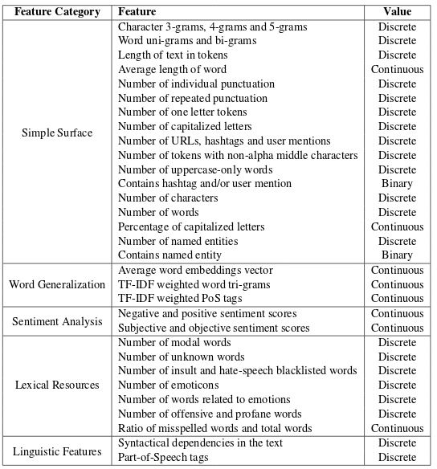
Metadata-Level Model Metadata DNN
The textual features selected based on the categorization of hate-speech features of Schmidt et al. 2017.
Simple Surface: 17
Word Generalization: 3
Sentiment Analysis: 2
Lexical Resources: 7
Linguistic Features: 2

Slide 101
Metadata-Level Model Metadata DNN
The textual features selected based on the categorization of hate-speech features of Schmidt et al. 2017.
Simple Surface: 17
Word Generalization: 3
Sentiment Analysis: 2
Lexical Resources: 7
Linguistic Features: 2
Batch Normalization Layer
Bottleneck
Structure
Classification Layer

Slide 102
Metadata-Level Model Metadata DNN
A dense DNN with stacked fully connected layers to learn the features.
Input first goes through a Batch Normalization Layer
  Mean close to 0 and the standard deviation close to 1.
  Faster learning and higher accuracy.

Slide 103
Metadata-Level Model Metadata DNN
A dense DNN with stacked fully connected layers to learn the features.
Input first goes through a Batch Normalization Layer
  Mean close to 0 and the standard deviation close to 1.
  Faster learning and higher accuracy.
Designed so that a bottleneck is formed
  Proven to result in the automatic construction of high-level features.
  Use of the hyperbolic tangent - tanh activation function.
  Five stacked layers of sizes: 512, 256, 128, 64, 32
Finally, the Softmax activation layer.

Slide 104
Combining Selected Models Hybrid
The three models can handle individually:
  Sequence of words
  Sequence of characters
  Metadata extracted from text
The three paths are combined to create the hybrid model.
The combination is done by concatenating the models at their penultimate layer.

Slide 105
Combining Selected Models Ensemble
Three-layer classifier architecture.
Leverages the predictions as features.

Slide 106
Combining Selected Models Ensemble
Three-layer classifier architecture.
Leverages the predictions as features.
  C1, C2 and C3 are the word, character and metadata level models.

Slide 107
Combining Selected Models Ensemble
Three-layer classifier architecture.
Leverages the predictions as features.
  C1, C2 and C3 are the word, character and metadata level models.
  C4 is a one-vs-all Logistic Regression (LR) with l2 regularization over word vectors.

Slide 108
Combining Selected Models Ensemble
Three-layer classifier architecture.
Leverages the predictions as features.
  C1, C2 and C3 are the word, character and metadata level models.
  C4 is a one-vs-all Logistic Regression (LR) with l2 regularization over word vectors.
  C5 is a one-vs-all LR with l2 regularization over the features.

Slide 109
Combining Selected Models Ensemble
Three-layer classifier architecture.
Leverages the predictions as features.
  C1, C2 and C3 are the word, character and metadata level models.
  C4 is a one-vs-all Logistic Regression (LR) with l2 regularization over word vectors.
  C5 is a one-vs-all LR with l2 regularization over the features.
  C6 is a 2nd layer ensemble of LR, trained on the predictions from the C1, C2 and C3.

Slide 110
Combining Selected Models Ensemble
Three-layer classifier architecture.
Leverages the predictions as features.
  C1, C2 and C3 are the word, character and metadata level models.
  C4 is a one-vs-all Logistic Regression (LR) with l2 regularization over word vectors.
  C5 is a one-vs-all LR with l2 regularization over the features.
  C6 is a 2nd layer ensemble of LR, trained on the predictions from the C1, C2 and C3.
  CM is the master classifier of the ensemble, an SVM with l2 regularization.

Slide 111
Experiments and Evaluations Data Overview
Handful of datasets, all of them with imbalanced nature.

Slide 112
Experiments and Evaluations Data Overview
Handful of datasets, all of them with imbalanced nature.
For the purpose of this thesis, Davidson et al. 2017 dataset was used.
  The data have three types: hate, offensive and non-hate.

Slide 113
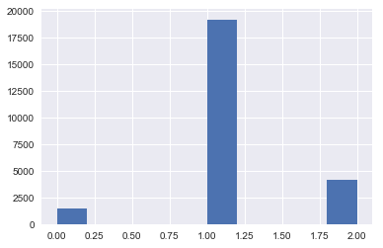
Experiments and Evaluations Data Overview
Handful of datasets, all of them with imbalanced nature.
For the purpose of this thesis, Davidson et al. 2017 dataset was used.
  The data have three types: hate, offensive and non-hate.
The data were annotated by experts (3+ people) with intercoder-agreement of 92%.
Significant bias towards non-hate classes
  Hate 6%,
  Offensive 77%
  Non-hate 17%

Slide 114
Experiments and Evaluations Evaluation Metrics
Standard classification evaluation metrics of Precision, Recall and F1.

Slide 115
Experiments and Evaluations Evaluation Metrics
Standard classification evaluation metrics of Precision, Recall and F1.
Micro-averaging adaptations of the metrics were used due to the imbalanced nature of the data.

Slide 116
Experiments and Evaluations Evaluation Metrics
Standard classification evaluation metrics of Precision, Recall and F1.
Micro-averaging adaptations of the metrics were used due to the imbalanced nature of the data.
Existing studies on hate-speech detection primarily reported their results using micro-Precision, micro-Recall and micro-F1 - Mask real performance of minority classes.

Slide 117
Experiments and Evaluations Evaluation Metrics
Standard classification evaluation metrics of Precision, Recall and F1.
Micro-averaging adaptations of the metrics were used due to the imbalanced nature of the data.
Existing studies on hate-speech detection primarily reported their results using micro-Precision, micro-Recall and micro-F1 - Mask real performance of minority classes.
Balanced accuracy - adaptation of accuracy for imbalanced data.
Area Under the Curve (AUC)

Slide 118



Experiments and Evaluations Setup
The models were implemented in Python Keras with Tensorflow backend, as well as Scikit-Learn.
Jupyter Notebooks https://jupyter.org/ were used for each approach for readability and usability purposes.
VM Ubuntu 16.4 with 16 VCPUs and 32GB RAM
Google’s Colab VM with 13GB RAM and a Tesla K80 GPU.
For the models training:
  For each model the training epochs were fixed at 100 with mini-batches of 128.
  Early-stopping mechanism was introduced in order to stop the models from overfitting stopping the training if the validation loss does not drop for 10 consecutive epochs.
  All the experiments were run in 10-fold stratified cross validation.

Slide 119
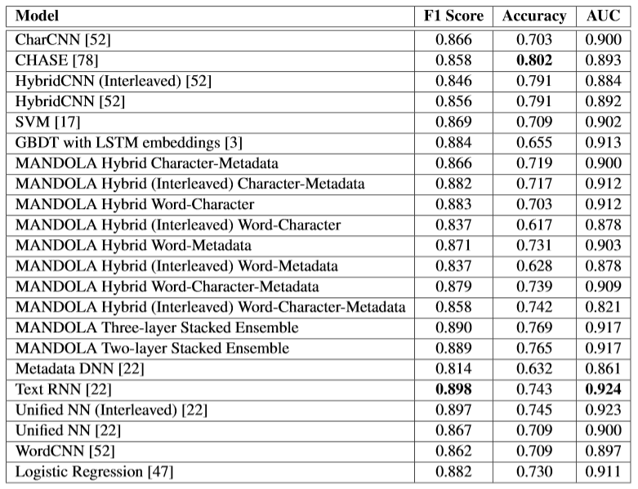
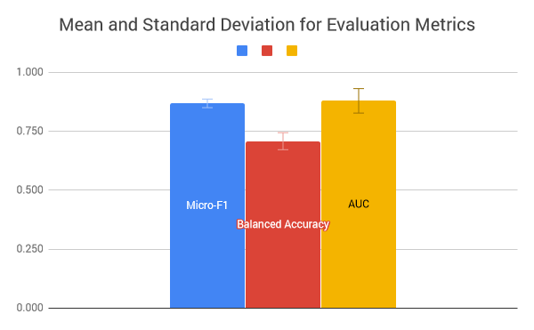
Experiments and Evaluations Overall Results
Text RNN achieves the best F1 of 0.898 and AUC of 0.924

Slide 120
Experiments and Evaluations Overall Results
Text RNN achieves the best F1 of 0.898 and AUC of 0.924
CHASE achieves the best accuracy score of 0.802

Slide 121
Experiments and Evaluations Overall Results
Text RNN achieves the best F1 of 0.898 and AUC of 0.924
CHASE achieves the best accuracy score of 0.802
Interleaved models performed worse than the ones trained as a whole. This is due to:
  Extreme imbalance of dataset.
  Diversity of models and convergence rates.

Slide 122
Experiments and Evaluations Overall Results
Text RNN achieves the best F1 of 0.898 and AUC of 0.924
CHASE achieves the best accuracy score of 0.802
Interleaved models performed worse than the ones trained as a whole. This is due to:
  Extreme imbalance of dataset.
  Diversity of models and convergence rates.
The ensemble methods are placed near the top with 0.890 F1, 0.765 accuracy and 0.917 AUC.

Slide 123
Experiments and Evaluations Overall Results
Text RNN achieves the best F1 of 0.898 and AUC of 0.924
CHASE achieves the best accuracy score of 0.802
Interleaved models performed worse than the ones trained as a whole. This is due to:
  Extreme imbalance of dataset.
  Diversity of models and convergence rates.
The ensemble methods are placed near the top with 0.890 F1, 0.765 accuracy and 0.917 AUC.
Per-class evaluation due to minor differences in evaluation.

Slide 124
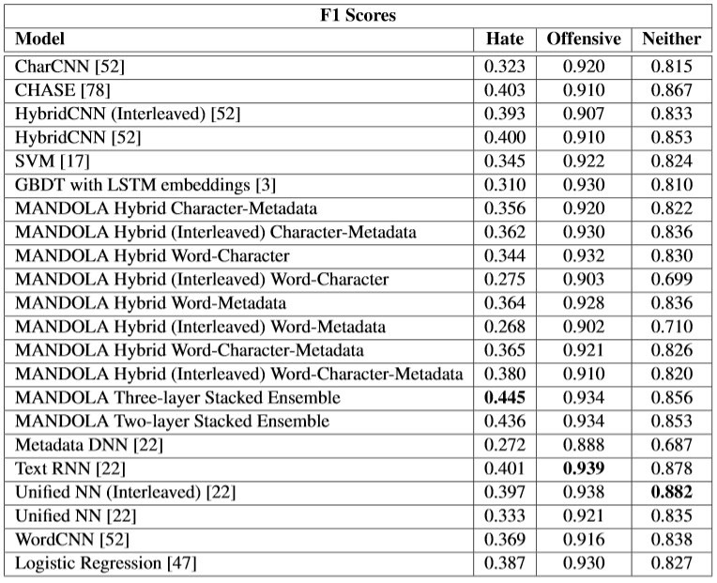
Experiments and Evaluations Per-Class Results
Despite the overall results are high, the per-class results show hate-speech scores are poor.

Slide 125
Experiments and Evaluations Per-Class Results
Despite the overall results are high, the per-class results show hate-speech scores are poor.
This is due to extreme imbalance of dataset.
  Overall evaluation metrics mask the performance of the minority class.

Slide 126
Experiments and Evaluations Per-Class Results
Despite the overall results are high, the per-class results show hate-speech scores are poor.
This is due to extreme imbalance of dataset.
  Overall evaluation metrics mask the performance of the minority class.
Our ensemble approaches perform better in hate-speech classification with F1 score of 0.445 (3-layer) and 0.436 (2-layer), whereas CHASE comes after with 0.403.

Slide 127
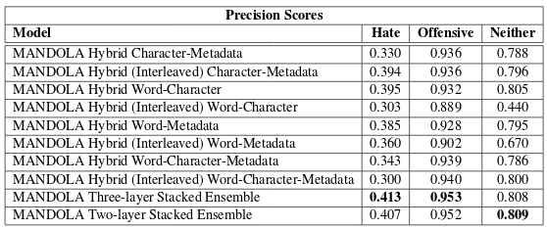
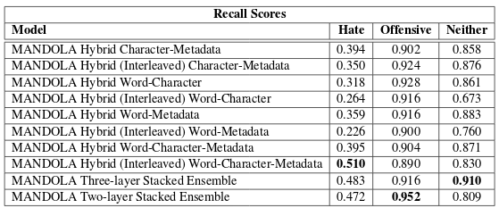
Experiments and Evaluations Per-Class Results
Word-level models trained with interleaved, achieve worst results than the traditionally trained.
This is due to the larger dimensionality of the feature space (vocabulary length).
The results also justify that our ensemble approaches achieve the best results in both precision and recall.

Slide 128
Summary
In recent years, an ominous picture concerning online hate-speech has started to materialize within OSNs (anonymity, mobility).
Efforts to counter-measure online hate-speech rely on the automated semantic analysis
Crucial task: The detection and classification of hate-speech based on distinguishable linguistic attributes.
We presented the MANDOLA Big Data Processing System, with focus on the hate-speech classification module.

Slide 129
Conclusions
This thesis makes two major contributions:
The largest state-of-the-art model comparison for online hate-speech detection in order to find the best word-level, character-level and metadata-level models.
  Twelve state-of-the-art works were re-implemented and evaluated on per-class basis.
  This resulted to the exposure of the biased evaluation scores due to the imbalance nature of the datasets.

Slide 130
Conclusions
This thesis makes two major contributions:
The largest state-of-the-art model comparison for online hate-speech detection in order to find the best word-level, character-level and metadata-level models.
  Twelve state-of-the-art works were re-implemented and evaluated on per-class basis.
  This resulted to the exposure of the biased evaluation scores due to the imbalance nature of the datasets.
Proposed combination approaches of the complementary character-level, word-level and metadata-level models.
  The results show that the 3-layer stacked ensemble classifier achieves the best results on per-class basis with F1 score of 0.445 with the next state-of-the-art being 0.403.

Slide 131
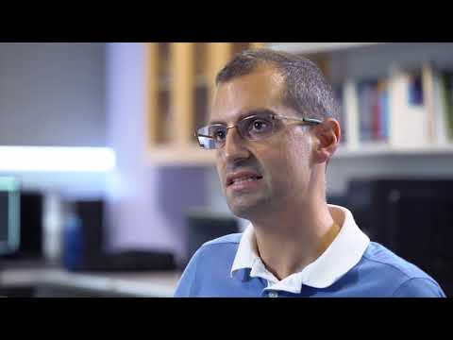


Thank You
This work has been produced with the financial support of the Rights, Equality and Citizenship (REC) Programme of the European Union under Grant Agreement:
JUST/2014/RRAC/AG/HATE/6652

