Slide 1
Natural Language Processing
Case Studies and Applications
Detecting Fake News
Demetris Paschalides
Department of Computer Science
University of Cyprus

Slide 2
Misinformation
/ˌmɪsɪnfəˈmeɪʃ(ə)n/
NOUN
false information that is spread, regardless of whether there is
intent to mislead

Slide 3
Disinformation
/ˌdɪsɪnfəˈmeɪʃ(ə)n/
NOUN
deliberately misleading or biased information; manipulated narrative or facts; propaganda

Slide 4
Misinformation vs. Disinformation
The difference between misinformation and disinformation comes down to intent.
People spreading misinformation often believe the information they are sharing.
In contrast, disinformation is shared with the goal of misleading others, thus, people who spread disinformation know its false.
Example: If a politician knowingly spreads false information (articles, photos, memes, etc.) that’s disinformation. When an individual sees this disinformation, believes it, and then shares it, that’s misinformation.

Slide 5
Quiz Time
Is it Fake News
or Not?

Slide 6
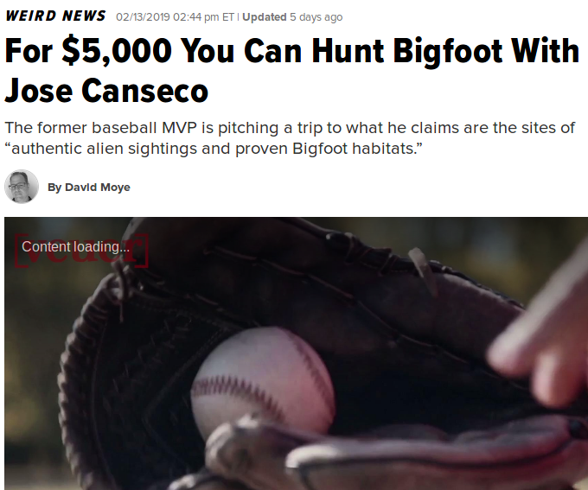
Real
Fake

Slide 7
Real
Fake

Slide 8
Real
Fake

Slide 9
Real
Fake

Slide 10
Real
Fake

Slide 11
Real
Fake

Slide 12
Real
Fake

Slide 13
Real
Fake

Slide 14
Real
Fake

Slide 15
Real
Fake

Slide 16
Real
Fake

Slide 17
Real
Fake

Slide 18
Real
Fake

Slide 19
Real
Fake

Slide 20
What are Fake News?
Fake news are news, stories or hoaxes created to deliberately misinform or deceive readers.
Usually, these stories are created to:
Influence people’s views
Push a political agenda
Cause confusion
Be a profitable business for online publishers.
Fake news stories can deceive people by looking like trusted websites or using similar names and web addresses to reputable news organisations.

Slide 21
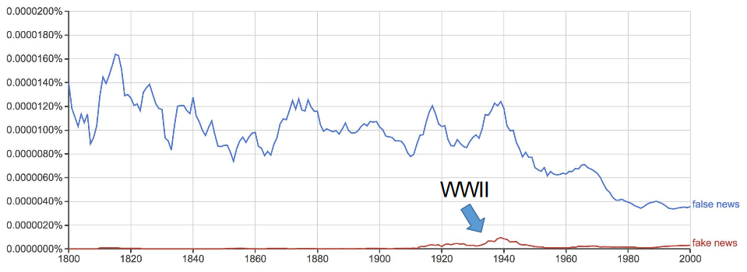
The Rise of Fake News
Fake news is not new topic.
Traditionally we got our news from trusted sources, journalists and media outlets with strict codes of practice.
However, the internet has enabled a new way to publish, share and consume information and news with very little regulation or editorial standards.
Image source: https://books.google.com/ngrams
Image source: https://medium.com/@tobiasrose/empathy-to-democracy-b7f04ab57eee

Slide 22
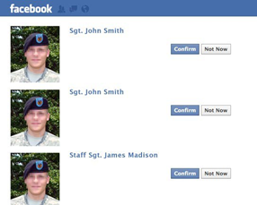
How do Fake News spread?
Use of fake accounts and bots:
Mid-2018 Facebook had 1.27B fake accounts.
June 2018, Twitter had suspended 70M accounts
Image source: https://marriedtothearmy.com/are-you-dating-an-army-soldier-or-a-fake/comment-page-10/

Slide 23
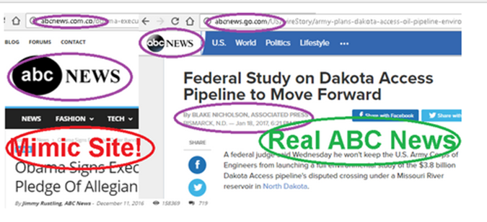
How do Fake News spread?
Mimic existing trusted news sources:
Example: abcnews.go.co and abcnews.go.com
Use of “catchy” names
Example: Chicago Daily News (originally closed down in 1976)
Target audience that is easily convinced
Use of echo chambers
The same information comes from all directions
Image source: https://slideplayer.com/slide/15195139/

Slide 24
Statistics on Fake News
Twitter has 70 million fake accounts.
Facebook has 1.27 billion fake accounts.
Pew Research poll:
64% of US adults said that “made-up news” has caused a “great deal of confusion” about the facts of current events.
Eurobarometer study:
37% of the respondents come across fake news every day.
85% agree that fake news is a problem in their country.

Slide 25
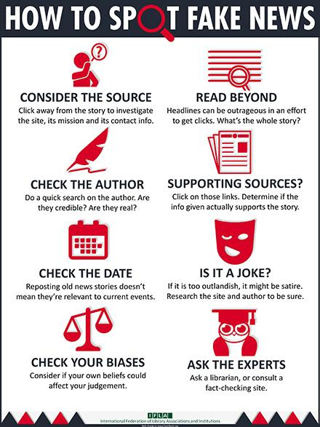
Spotting Fake News
Video source: https://www.youtube.com/watch?v=AkwWcHekMdo
Image taken from https://www.ifla.org/publications/node/11174

Slide 26
Towards Mitigating Misinformation
Both Industry and Academia take on the battle against misinformation.
Studies have been made in understanding their propagation and impact.
Contribution of fact checking organizations.
Advancement in Deep Learning and Neural
Natural Language Processing.
Materialized as browser plugins or commercialized:

Slide 27
Defining Fake News
Similarly to hate-speech, fake news comes with many definitions:
Allcott et al. 2017 & Shu et al. 2017: “A news article that is intentionally and verifiably false.”
Golbeck et al. 2018: “Information presented as a news story that is factually incorrect and designed to deceive the consumer into believing it is true.”

Slide 28
Defining Fake News
Similarly to hate-speech, fake news comes with many definitions:
Allcott et al. 2017 & Shu et al. 2017: “A news article that is intentionally and verifiably false.”
Golbeck et al. 2018: “Information presented as a news story that is factually incorrect and designed to deceive the consumer into believing it is true.”
Sharma et al. 2019 define fake news as: “A news article or message published and propagated through media, carrying false information regardless the means and motives behind it.”
Fabricated content (completely false)
Misleading content (misleading use of information to frame an issue)
Imposter content (genuine sources impersonated with false ones)
Manipulated content (genuine information manipulated to deceive)
False connection (headlines etc. that do not support the content)
False context (genuine content shared with false contextual information)

Slide 29
Psycho-social Nature of Fake News
Inability to discern fake news ↔ cognitive and ideological biases
People who tend to manage discern fake from real news:
Propensity and analytical thinking.
More time consuming in social media.
Higher education.
Older people.
Notes:
Individuals seek, consume and share information that is aligned with their own views.

Slide 30
Psycho-social Nature of Fake News
Inability to discern fake news ↔ cognitive and ideological biases
People who tend to manage discern fake from real news:
Propensity and analytical thinking.
More time consuming in social media.
Higher education.
Older people.
Adjusted assessments after told that information was incorrect:
Lower cognitive ability tends to adjust.
Higher cognitive ability rarely adjust.
Notes:
Individuals seek, consume and share information that is aligned with their own views.

Slide 31
Psycho-social Nature of Fake News
Inability to discern fake news ↔ cognitive and ideological biases
People who tend to manage discern fake from real news:
Propensity and analytical thinking.
More time consuming in social media.
Higher education.
Older people.
Adjusted assessments after told that information was incorrect:
Lower cognitive ability tends to adjust.
Higher cognitive ability rarely adjust.
Ideological priors: important factors in perception and sharing of fake news:
Confirmation bias, naive realism and normative influence theory.
Result to manifestation of Echo Chambers and Filter Bubbles.
Notes:
Individuals seek, consume and share information that is aligned with their own views.

Slide 32
Detecting Fake News Content Methods
Features extracted from news content based on linguistics and NLP.
Focus on writing style characteristics:
Textual complexity
Uncertainty
Sentiment
Subjectivity
Informality quoted content (attributed or not)
Readability
Vocabulary richness
Negatively related to fake news
Positively related to fake news
Neutrally related to fake news

Slide 33
Detecting Fake News Content Methods
Features extracted from news content based on linguistics and NLP.
Focus on writing style characteristics:
Textual complexity
Uncertainty
Sentiment
Subjectivity
Informality quoted content (attributed or not)
Readability
Vocabulary richness
Both news headlines and main bodies are equally important:
Showed that fake news titles use significantly fewer stop-words and nouns, focusing on proper nouns and verb phrases.
Complexity and writing style of fake news similar to satire news.
Negatively related to fake news
Positively related to fake news
Neutrally related to fake news

Slide 34
Detecting Fake News Content Methods
Fake News Titles:
BREAKING BOMBSHELL: NYPD Blows Whistle on New Hillary Emails: Money Laundering, Sex Crimes with Children, Child Exploitation, Pay to Play, Perjury
Sam Elliott, Famous for Mocking Liberals, Dead at 83
Michelle Was Caught Cheating with Eric Holder - OBAMA IS FURIOUS!!!
Real News Titles
Pre-existing Conditions and Republican Plans to Replace Obamacare
MEPs elect first female EU Commission president
Apollo 11: Partial lunar eclipse on 50th anniversary

Slide 35
Detecting Fake News Knowledge Methods
Knowledge is represented as triples in the form of SUBJECT - PREDICATE - OBJECT (SPO).
E.g. “Donald Trump is the president of the U.S.” ➔ (Donald Trump, Profession, President)
The aim of these methods is to construct a Knowledge Base (KB) or Knowledge Graph (KG) to be used for verification of claims.
Knowledge inference can be achieved by network analysis to predict whether an unobserved triple is likely to appear in a KG using:
Semantic proximity (Ciampaglia et al. 2015)
Discriminative predicate path (Shi et al. 2016)
LinkNBed (Trivedi et al. 2018)

Slide 36
Knowledge-based Methods
“... Barack Obama is the 44th and current President of the United States ... Born in Honolulu, Hawaii, Obama is a graduate of Columbia University and Harvard Law School … Obama is a Protestant Christian ..." - Wikipedia
Protestant
Christian
Honolulu
Hawai
capital_of
born_in
religion
Barack
Obama
state_of
president_of
graduate
United
States
of America
graduate
Columbia University
Harvard
Law
School

Slide 37
Knowledge-based Methods
The Birther Movement - A conspiracy theory questioning the location of the birth of Barack Obama and the validity of his birth certificate. The conspiracy was most notably pushed by President Trump.
Protestant
Christian
Honolulu
Hawai
capital_of
born_in
religion
Barack
Obama
state_of
president_of
graduate
United
States
of America
graduate
Columbia University
Harvard
Law
School

Slide 38
Knowledge-based Methods
"Barack Obama: I’m the First Sitting American President to Come From Kenya’ (Video)." - Supremeinsider.com
Protestant
Christian
Honolulu
Hawai
capital_of
Barack
Obama
born_in
religion
Barack
Obama
state_of
born_in
president_of
Kenya
graduate
United
States
of America
graduate
Columbia University
Harvard
Law
School

Slide 39
Knowledge-based Methods
"Barack Obama: I’m the First Sitting American President to Come From Kenya’ (Video)." - Supremeinsider.com
Protestant
Christian
Honolulu
Hawai
capital_of
Barack
Obama
born_in
religion
Barack
Obama
state_of
born_in
president_of
Kenya
graduate
United
States
of America
graduate
Columbia University
Harvard
Law
School

Slide 40
Knowledge-based Methods
"We have a problem in this country. It's called Muslims. You know our current president is one. You know he's not even an American." - President D.Trump audience member
Protestant
Christian
Honolulu
Hawai
capital_of
Barack
Obama
Negation
born_in
religion
Barack
Obama
state_of
born_in
president_of
United
States
of America
religion
graduate
United
States
of America
graduate
Columbia University
Muslim
Harvard
Law
School

Slide 41
Knowledge-based Methods
"We have a problem in this country. It's called Muslims. You know our current president is one. You know he's not even an American." - President D.Trump audience member
Protestant
Christian
Honolulu
Hawai
capital_of
Barack
Obama
Negation
born_in
religion
Barack
Obama
state_of
born_in
president_of
United
States
of America
religion
graduate
United
States
of America
graduate
Columbia University
Muslim
Harvard
Law
School

Slide 42
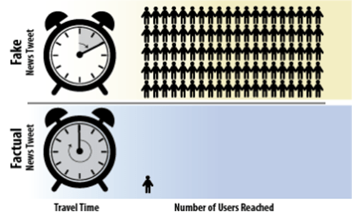
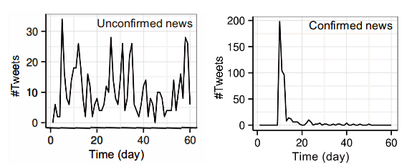
Detecting Fake News Propagation Methods
Fake news propagation patterns:
Unconfirmed news often gets renotice - exhibit multiple and periodic discussion spikes.
False news spreads further, faster and more widely than true news.
Political false news are more prominent in the propagation rather than other domains.
Popular fake news tweets reach 100x as many people as factually correct, and travel 6x faster.
Image taken from http://berkeleysciencereview.com/article/fake-news/
Notes:
Social media is the de-facto medium for disseminating fake news.

Slide 43
Detecting Fake News Propagation Methods
Propagation based features:
User features measure users’ characteristics and credibility.
Post features represent users’ social responses, such as stances.
Network features are extracted by constructing specific social networks, such as diffusion networks or co-occurrence networks.
Model categories:
Stance-based models utilize users’ opinions towards the news to infer news veracity.
Propagation-based models apply propagation methods to model unique patterns of information spread.
Notes:
Cascade-based: Distinguish fake news by computing the similarity of its cascade to that of other true/false news or properly representing its cascade using an informative representation that facilitates distinguishing fake news from true news.
Network-based: Evaluating the credibility of news-related posts in i.e. Twitter. This can be done by connecting posts with edges supporting or opposing relations and calculating similarities ➔ graph optimization problem.

Slide 44
Detecting Fake News Propagation Methods
Propagation based features:
User features measure users’ characteristics and credibility.
Post features represent users’ social responses, such as stances.
Network features are extracted by constructing specific social networks, such as diffusion networks or co-occurrence networks.
Model categories:
Stance-based models utilize users’ opinions towards the news to infer news veracity.
Propagation-based models apply propagation methods to model unique patterns of information spread.
User account registration time, the account verification, political bias, personality measurements and status count are the most important user characteristics to identify fake news.
Notes:
Cascade-based: Distinguish fake news by computing the similarity of its cascade to that of other true/false news or properly representing its cascade using an informative representation that facilitates distinguishing fake news from true news.
Network-based: Evaluating the credibility of news-related posts in i.e. Twitter. This can be done by connecting posts with edges supporting or opposing relations and calculating similarities ➔ graph optimization problem.

Slide 45
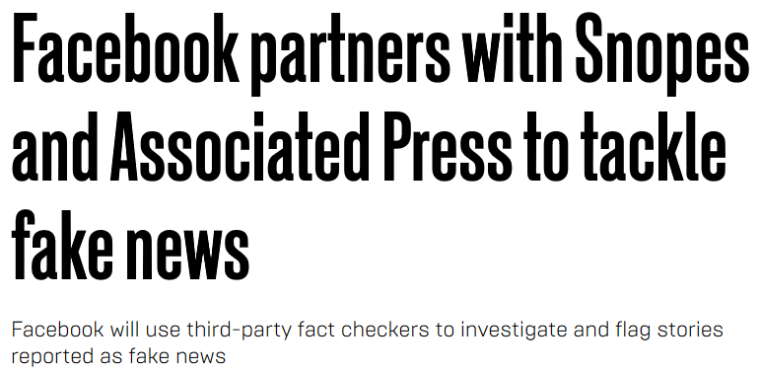
Are we winning against Fake news?
Many works, both academic and industrial, try to mitigate the problem of fake news with some promising results.

Slide 46
Current Status on Mitigating Fake News
Although these works make use of AI and ML as a way to automate the fact-checking process of an article.
Experts like Carnegie Mellon’s Dean Pomerleau and Facebook’s Yann Lecun stress that the problem at hand is too complex for technology alone.
Andreas Vlachos, stated that, in the near future, the only solution for automated fact-checking is with human-in-the-loop, "because we don’t have enough fact-checking at the moment".

Slide 47
Current Status on Mitigating Fake News
It is difficult even for trained humans to distinguish intentionally misleading news from genuine mistakes, satirical pieces or even real articles that only sound absurd.
Defining the criteria under which to classify news as “fake” requires human judgement.
“... would mean AI has reached human-level intelligence ...” - Dean Pomerleau
"It’s not just about the technical solutions, it’s about the lack of data quality". - Chengkai Li

Slide 48
Introducing “Check-It”
Web browser plugin that uses a combination of different signals into a pipeline for fake news identification.

Slide 49
Introducing “Check-It”
Web browser plugin that uses a combination of different signals into a pipeline for fake news identification.
Objective: Improving critical thinking by accurately warning user regarding fake news, while respecting the user’s privacy.

Slide 50
Technical Requirements
High Confidence: Accurately (high precision) labelling an article as fake, otherwise better not do it at all.
User Privacy: Work locally on the user’s browser without external communication. All the required files (e.g. model, flaglist) should be synced with the user.
Low Response Time: Due to all the computations being executed locally, the required resources (dictionaries, flaglist) should be efficiently loaded.
Lightweight Computations: Use of asynchronous processing and web workers to parallelize computations.

Slide 51
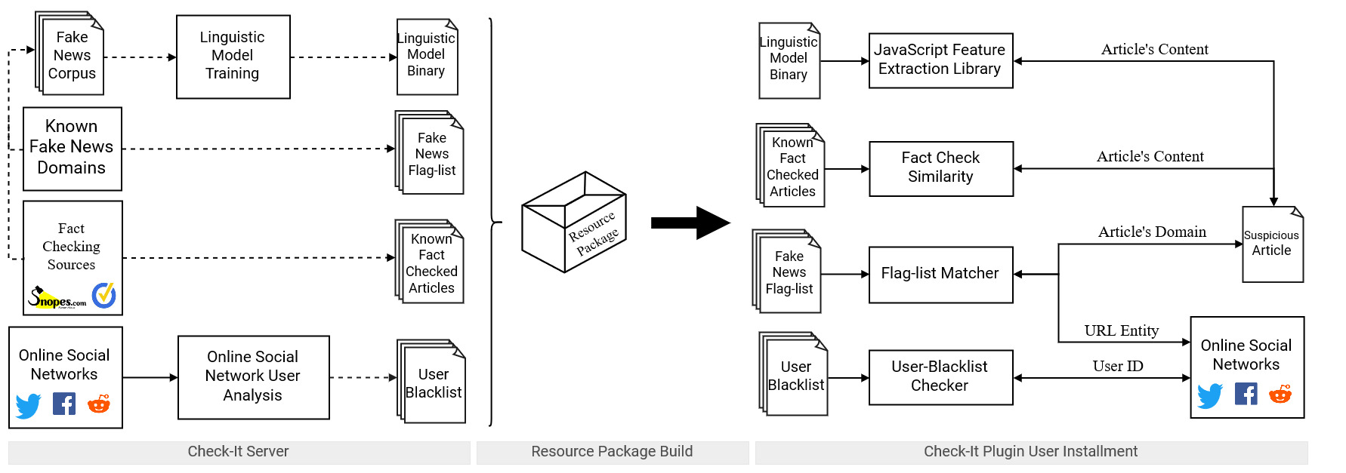
Check-It Architecture

Slide 52
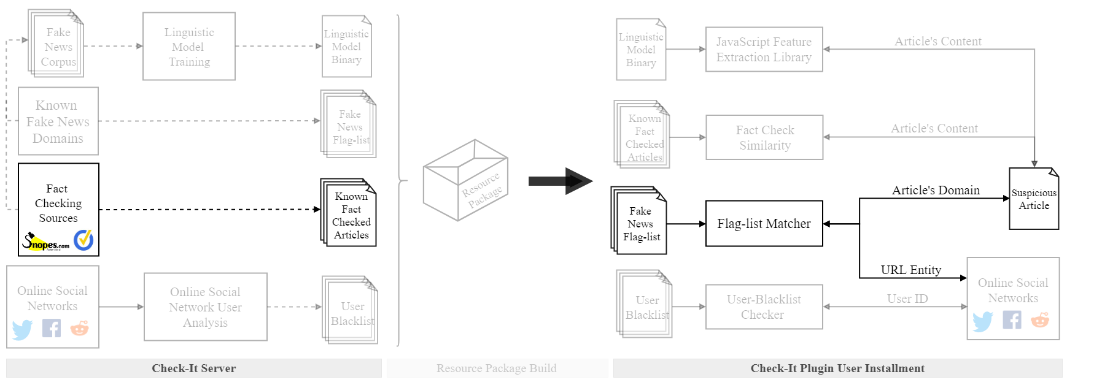
Check-it Module - Flag-list Matcher

Slide 53
Check-It Fake News Detection Engine
Check-it combines information from several different sources:
Flag-list Matcher checks the domain hosting an article.
Fact-check Similarity checks against known fact-checks.
User-Blacklist checks the social-media users’ reputation.
Linguistic Model checks the stylistic properties of the article’s content.
Developed as a Web Browser
Plugin for Google Chrome
and Mozilla Firefox.
Check-it Fake News Detection Engine
Flag-list Matcher
Fact-
Check Similarity
User-
Blacklist
Linguistic Model

Slide 54
Check-it Module - Flag-list Matcher
Non-exhaustive list of flagged domains based on flag-lists maintained by researchers and volunteers (e.g. Kaggle, OpenSources and Greek-Hoaxes):
Is the domain credible?
Has it hosted fake news before?
Has it been flagged for disinformation?

Slide 55
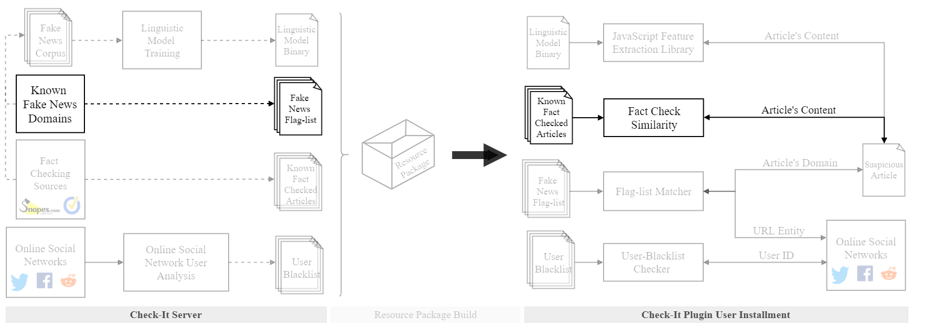
Check-it Module - Fact-Check Similarity

Slide 56
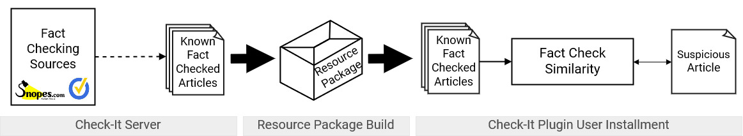
Check-it Module - Fact-Check Similarity
Cross checking every article against a list of fact-checking websites.
Fact Check Similarity component utilizes Simhash LSH algorithm which is fast and with low resource requirements e.g. memory.
Monika Henzinger. 2006. Finding near-duplicate web pages: a large-scale evaluation of algorithms. In Proceedings of the 29th annual international ACM SIGIR conference on Research and development in information retrieval (SIGIR '06). ACM, New York, NY, USA, 284-291. DOI=http://dx.doi.org/10.1145/1148170.1148222

Slide 57
Check-it Module - Fact-Check Similarity
“Fact-checking is the act of checking factual assertions in non-fictional text in order to determine the veracity and correctness of the factual statements in the text” - From Wikipedia

Slide 58
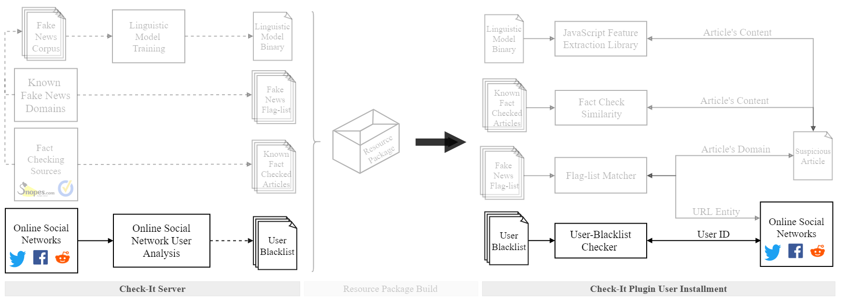
Check-it Module - User-Blacklist

Slide 59
Check-it Module - User-Blacklist
Social media is the de-facto medium for disseminating fake news.
Popular fake news tweets reach 100x as many people as factually correct, and travel 6x faster.
Image taken from http://berkeleysciencereview.com/article/fake-news/

Slide 60
Check-it Module - User-Blacklist
Social media is the de-facto medium for disseminating fake news.
Popular fake news tweets reach 100x as many people as factually correct, and travel 6x faster.
Check-It User-Blacklist module:
Analyzes the propagation of known fake
news articles, and generates a User-Blacklist
with user probabilities for disseminating fake
news.
User Blacklist
USER 1: 0.8
USER 2: 0.5
USER 3: 0.2
USER N-1: 0.6
USER N: 0.4
Image taken from http://berkeleysciencereview.com/article/fake-news/

Slide 61
Check-it Module - User-Blacklist
Social media is the de-facto medium for disseminating fake news.

Slide 62
Check-it Module - User-Blacklist
Social media is the de-facto medium for disseminating fake news.
Tweets with Known Fake News Domains
Timely Retweet Graph Generation
De Groot Probabilistic Model
User Blacklist
Fake News Matcher
Apache Spark
General Tweets
Tweets

Slide 63
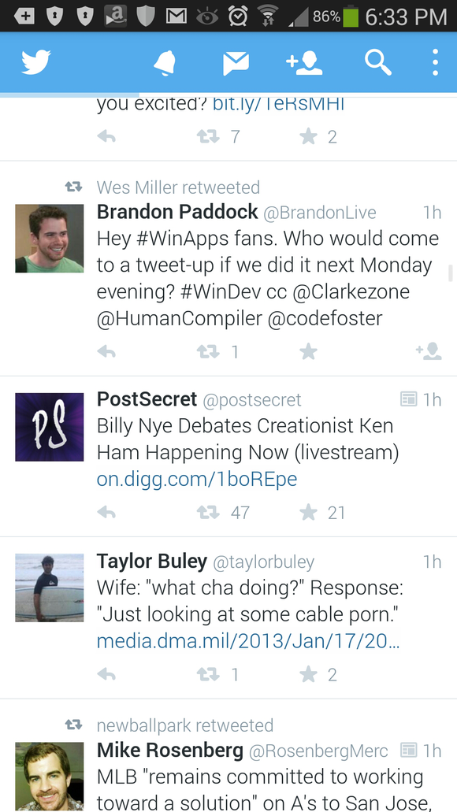
Check-it Module - User-Blacklist [Server]
Twitter Stream

Slide 64
Check-it Module - User-Blacklist [Server]
Apache Spark
Sessionize Twitter Stream in Sliding Windows of ~ 1 hour
Twitter Stream

Slide 65
Check-it Module - User-Blacklist [Server]
Apache Spark
Sessionize Twitter Stream in Sliding Windows of ~ 1 hour
Twitter Stream

Slide 66
Check-it Module - User-Blacklist [Server]
Apache Spark
Sessionize Twitter Stream in Sliding Windows of ~ 1 hour
Twitter Stream
Retweet Graphs

Slide 67
Check-it Module - User-Blacklist [Server]
Apache Spark
De Groot’s Probabilistic Model
Sessionize Twitter Stream in Sliding Windows of ~ 1 hour
Twitter Stream
Retweet Graphs

Slide 68
Check-it Module - User-Blacklist [Server]
Use of De Groot’s Learning Model due to simplicity, low requirements and good results.
Apache Spark
De Groot’s Probabilistic Model
Sessionize Twitter Stream in Sliding Windows of ~ 1 hour
Twitter Stream
Retweet Graphs

Slide 69
Check-it Module - User-Blacklist [Server]
Use of De Groot’s Learning Model due to simplicity, low requirements and good results.
Apache Spark
De Groot’s Probabilistic Model
Sessionize Twitter Stream in Sliding Windows of ~ 1 hour
Extract falsity scores - The probability of a user disseminating fake news articles
Twitter Stream
Retweet Graphs

Slide 70
Check-it Module - User-Blacklist [Server]
After the calculation of the windows probabilities, the user flaglist is updated and synced with the user’s file system, using the push API.
Tweets with Known Fake News Domains
Timely Retweet Graph Generation
Calculate
Fake News Dissemination Probabilities
User Blacklist
Fake News Matcher
Apache Spark
General Tweets
Tweets

Slide 71
Check-it Module - User-Blacklist Process
The system run from 31st of October to 2nd of December 2018.
The run resulted in:
Tweets: 150 million tweets (30 million contained fake news URLs)
Users: 8.1 million unique users.
Categorized the users based on their falsity into 4 groups of low (0-0.25), medium (0.25-0.50), high (0.50-0.75) and ultra high (0.75-1.0).
Then we sampled the top 1K users from each group and analyzed their recent 3K posts.

Slide 72
Check-it Module - User-Blacklist Evaluation
Low Falsity: Large tweeting frequency with low frequency of fake URLs.

Slide 73
Check-it Module - User-Blacklist Evaluation
Low Falsity: Large tweeting frequency with low frequency of fake URLs.
Medium/ High Falsity: Rise on the frequency of tweets containing fake URLs.

Slide 74
Check-it Module - User-Blacklist Evaluation
Low Falsity: Large tweeting frequency with low frequency of fake URLs.
Medium/ High Falsity: Rise on the frequency of tweets containing fake URLs.
Ultra High Falsity: Lower frequency, but high frequency of tweets with fake URLs.

Slide 75
Check-it Module - User-Blacklist Evaluation
Low Falsity: Large tweeting frequency with low frequency of fake URLs.
Medium/ High Falsity: Rise on the frequency of tweets containing fake URLs.
Ultra High Falsity: Lower frequency, but high frequency of tweets with fake URLs.
Thus, the User-Blacklist consists of the users from the ultra high falsity group

Slide 76
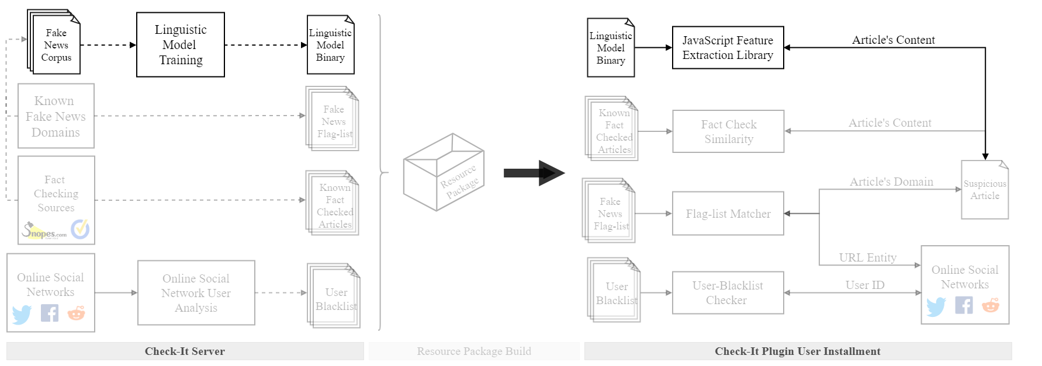
Check-it Module - Linguistic Model

Slide 77
Check-it Module - Linguistic Model
The Linguistic Model checks the linguistic features of both title and content to determine if it is real or fake.
In order to be in-line with the high confidence requirement, during the evaluation of the model, we target high precision (~99%).
Developed using Tensorflow (for the model training) and Tensorflow JS (for the model browser compatibility).

Slide 78
Check-it Module - Linguistic Model [Server]
New Annotated Data are coming from various fact-checking sources (e.g. Snopes. Politifact), flagged domains and datasets.
Check-It’s Fake News Corpus is continuously updated and the model is retraining.

Slide 79
Check-it Module - Linguistic Model Training
The dataset used is the Fake News Corpus:
Contains ~1 million fake news and ~2 million reliable news.
Annotated from various sources e.g. opensources.co, NYTimes and WebHose.
The linguistic features are grouped as follows:
Part-of-Speech (20)
Readability Indices (10)
Psychological Processes (23)
Vocabulary Richness (10)
Sentiment (5)
Syntactic (9)
Surface (14)
Punctuation (34)

Slide 80
Check-it Module - Linguistic Model Training
The dataset used is the Fake News Corpus:
Contains ~1 million fake news and ~2 million reliable news.
Annotated from various sources e.g. opensources.co, NYTimes and WebHose.
The linguistic features are grouped as follows:
Part-of-Speech (20)
Readability Indices (10)
Psychological Processes (23)
Vocabulary Richness (10)
Sentiment (5)
Syntactic (9)
Surface (14)
Punctuation (34)
Total of 250 features for both title and content of news articles

Slide 81
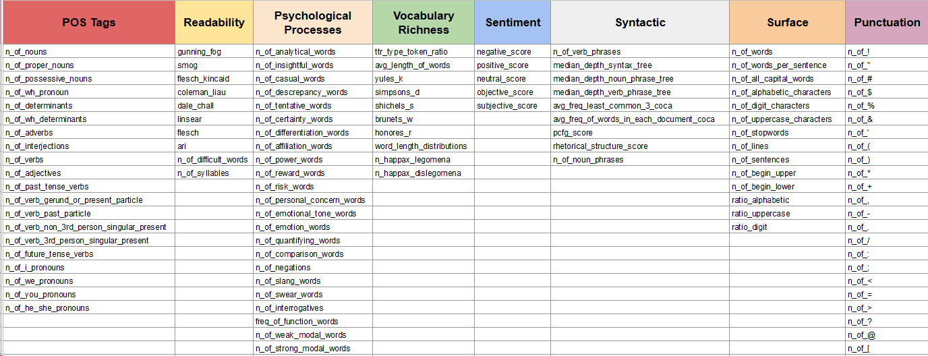
Check-it Module - Linguistic Model Features

Slide 82
Check-it Module - Linguistic Model Features
Based on requirements we need the model to be small in size:
Small size → Dimensionality reduction → Feature selection
Feature selection pipeline:
Missing Values.
Single Unique Value
Highly Correlated Features
Zero Importance Features
Low Importance Features

Slide 83
Check-it Module - Linguistic Model Features
Based on requirements we need the model to be small in size:
Small size → Dimensionality reduction → Feature selection
Feature selection pipeline:
Missing Values
Single Unique Value
Highly Correlated Features
Zero Importance Features
Low Importance Features
Selected the top 20 features → the smallest number of features with highest model performance.

Slide 84
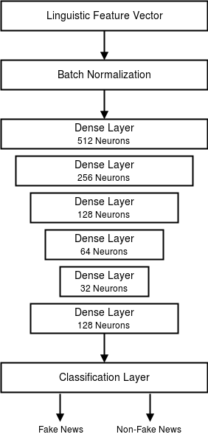
Check-it Module - Linguistic Model Architecture
Deep Learning Model for Fake News Detection
One of the most popular architectures to deal with scalar features is the bottleneck.
Bottleneck architecture has been shown to result in automatic construction of high-level features.
Model Architecture Overview:
Input Vector → Batch Normalization → Bottleneck (dense layers of 512, 256, 128, 64 and 32 neurons) → Classification layer, one neuron per class is used with softmax activation function.

Slide 85
Check-it Module - Linguistic Model Evaluation
Apart from Fake News Corpus, we trained on two other datasets to compare to the state-of-the-art:
Buzzfeed (BF): 182 news articles with 91 fake and 91 real.
Politifact (PF): 240 news articles with 120 fake and 120 real.
We compared our system against 3 state-of-the-art works:
Shu et al. 2018: Trained SVM classifiers over BF and PF datasets with LIWC and Rhetorical Structure Theory (RST) features.
Shu et al. 2018b: Trained different models including SVM, Logistic Regression (LR), Naive Bayes (NB) and a Convolutional Neural Network (CNN).
Potthast et al. 2017: Trained 4 Random Forest (RF) on style and topic of articles, two being generic and two including political orientation.

Slide 86
Check-it Module - Linguistic Model Evaluation
Comparison of state-of-the-art on the BF dataset
Comparison of state-of-the-art on the PF dataset
Note: For a fair comparison we chose baselines that only consider news contents.
Reference | Model | Acc. | P | R | F1
Shu et al. 2018 | SVM_{LIWC} | 0.610 | 0.602 | 0.561 | 0.555
 | SVM_{RST} | 0.655 | 0.683 | 0.628 | 0.623
Potthast et al. 2017 | GRF_{STYLE} | 0.550 | 0.520 | 0.525 | 0.520
 | GRF_{TOPIC} | 0.520 | 0.515 | 0.515 | 0.510
 | ORF_{STYLE} | 0.550 | 0.535 | 0.540 | 0.535
 | ORF_{TOPIC} | 0.580 | 0.555 | 0.555 | 0.560
Check-It | DNN | 0.703 | 0.713 | 0.703 | 0.700
Reference | Model | Acc. | P | R | F1
Shu et al. 2018 | SVM_{LIWC} | 0.571 | 0.595 | 0.533 | 0.544
 | SVM_{RST} | 0.637 | 0.621 | 0.667 | 0.615
Shu et al. 2018b | SVM | 0.580 | 0.611 | 0.717 | 0.659
 | LR | 0.642 | 0.757 | 0.543 | 0.633
 | NB | 0.617 | 0.674 | 0.630 | 0.651
 | CNN | 0.629 | 0.807 | 0.456 | 0.583
Check-It | DNN | 0.722 | 0.725 | 0.725 | 0.722
Fake News
Corpus
Performance:
Model | Acc. | P | R | F1
Check-It | 0.96 | 0.95 | 0.97 | 0.95

Slide 87
Conclusion
We presented Check-It, a web browser plugin for fake news detection.
Check-It empowers users with tools to improve critical thinking.
It combines several signals in order to improve the detection performance of fake articles.
Key takeaways:
Trade-off between local operation and model’s performance.
Fake News Corpus: Easily distinguishable fake and real articles. Future work includes working with harder to distinguish, e.g. GossipCop dataset.

