Slide 1
Natural Language Processing
Case Studies and Applications
Towards Understanding Polarization
Demetris Paschalides
Department of Computer Science
University of Cyprus

Slide 2
Introduction
Polarization is becoming a major concern at a global scale:
Consequences in social cohesion and stability.
Dominant in online social networks (OSNs) and web communities.
Direct relation with misinformation, media manipulation and hate-speech.

Slide 3
Introduction
Polarization is becoming a major concern at a global scale:
Consequences in social cohesion and stability.
Dominant in online social networks (OSNs) and web communities.
Direct relation with misinformation, media manipulation and hate-speech.
Key role in shaping of events and debates:

Slide 4
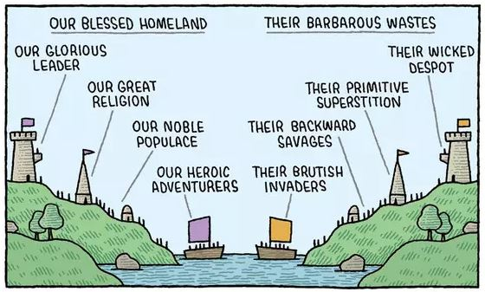
Understanding Social Polarization
Social Polarization: “The social process whereby a social or political group is segregated into two or more opposing sub-groups with conflicting beliefs”.
Witnessed in domains such as political, public policies, gender, racial, sports etc.
Explanatory theories for polarization:
Social categorization
Social identity
Social comparison
Motivated reasoning
Tribalism/Naive realism
H. Tajfel 1979
3-Step Intergroup Conflict
Image taken from http://tiny.cc/2sdwjz
H. Tajfel et al., “An integrative theory of intergroup conflict,” The Social Psychology of Intergroup Relations, vol. 33, no. 47, p. 74, 1979.
M. Del Vicario et al.“The spreading of misinformation online,” PNAS, vol. 113, no. 3, pp. 554–559, 2016
A. L. Schmidt et al. “Anatomy of news consumption on facebook,” PNAS, vol. 114, no. 12, pp. 3035–3039, 2017
N. Gillani et al. “Me, my echo chamber, and i: Introspection on social media polarization,” WWW 2018
F. Zollo et al., “Debunking in a world of tribes,” PLOS ONE, vol. 12, no. 7, pp. 1–27, 07 2017
Sunstein, C. R. 2002. The Law of Group Polarization. Journal of Political Philosophy 10(2):175–195.
Notes:
Social categorization: Tendency to categorize individuals (including oneself) based on different criteria, such as ethnicity, country of origin, religion, sexuality, social privileges etc.
Prerequisite for social identity: Build their own identity by classifying themselves in a group or by rejecting another.
Social categories can encourage people to associate stereotypes to groups of people, leading to forms of discrimination towards people of this group.
Social identity: Individuals adopt an identity similar to that of a group they categorized themselves as belonging to.
Individual behaviors can change based on the extent of the emotional attachment to the group.
Social comparison: Once member of a group = tendency to compare with other groups.
Maintain pride and self-esteem by comparing favorably with other groups.
Critical to understanding prejudice, as two groups which identify themselves as rivals, are forced to compete to maintain their self-esteem.
Competition and hostility between groups is thus not only a matter of competing for resources, like jobs, but also the result of competing identities.
Motivated reasoning: individuals and groups are motivated to believe whatever confirms their opinions.
Adam Waytz provides an explanatory example in a recent interview: “If you’re motivated to believe negative things about Hillary Clinton, you’re more likely to trust outrageous stories about her that might not be true. Over time, motivated reasoning can lead to a false social consensus”.
Fuse that sparks more polarization and conflict between groups of different beliefs.
Tribalism/Naive realism: tendency to believe that a group’s perception of reality is the only accurate view and that people who disagree with them are necessarily uninformed, irrational, or biased.

Slide 5
Requirements
Framework requirements:
Applicable in any domain e.g. political, economical, cultural.
Does NOT require prior domain-specific knowledge about topics.
Identify topics, and quantify their polarization.
Focus on News Media:
Formal, richer and more reliable source of information.
Quantify polarization in multiple spectrums:
Polarization ALSO exists outside the political spectrum (Left - Right).
Most existing approaches → define polarization between Democrats and Republicans
Pre-defined spectrum and conflicting communities.

Slide 6
Polarization Data Model
Entity : Real-world object with abstract or physical existence:
ID: A unique identifier of the entity
Type: PERSON, NATIONALITY, RELIGION, ORGANIZATION , LOCATION, PRODUCT, EVENT, LAW, or LEGISLATION.
Entity Relationship with positive or negative nature.

Slide 7
Polarization Data Model
Entity : Real-world object with abstract or physical existence:
ID: A unique identifier of the entity
Type: PERSON, NATIONALITY, RELIGION, ORGANIZATION , LOCATION, PRODUCT, EVENT, LAW, or LEGISLATION.
Entity Relationship with positive or negative nature.
Entity Fellowship : Community described by the (mostly) positive entity relationships.

Slide 8
Polarization Data Model
Entity : Real-world object with abstract or physical existence:
ID: A unique identifier of the entity
Type: PERSON, NATIONALITY, RELIGION, ORGANIZATION , LOCATION, PRODUCT, EVENT, LAW, or LEGISLATION.
Entity Relationship with positive or negative nature.
Entity Fellowship : Community described by the (mostly) positive entity relationships.
Fellowship Dipole : Fellowship Pair with (mostly) negative relationships between them.

Slide 9
Polarization Data Model
Dipole Discussion Topic: Topics of discussion between dipole’s conflicting fellowships.
Discuss
Topic 1
Topic 2
Topic 3

Slide 10
Polarization Data Model
Dipole Discussion Topic: Topics of discussion between dipole’s conflicting fellowships.
Sentiment Attitudes: Opposition (O) or Support (S) from entities toward topics.
Topic 1
Topic 2
Topic 3

Slide 11
Polarization Data Model
Dipole Discussion Topic: Topics of discussion between dipole’s conflicting fellowships.
Sentiment Attitudes: Opposition (O) or Support (S) from entities toward topics.
Topic 1
Frequency
O
S
Topic 1
Topic 2
Topic 3

Slide 12
Polarization Data Model
Dipole Discussion Topic: Topics of discussion between dipole’s conflicting fellowships.
Sentiment Attitudes: Opposition (O) or Support (S) from entities toward topics.
Topic 1
Topic 1
Topic 2
Frequency
Frequency
O
S
O
S
Topic 1
Topic 2
Topic 3

Slide 13
Polarization Data Model
Dipole Discussion Topic: Topics of discussion between dipole’s conflicting fellowships.
Sentiment Attitudes: Opposition (O) or Support (S) from entities toward topics.
Topic 1
Topic 1
Topic 2
Topic 3
Frequency
Frequency
Frequency
O
S
O
S
O
S
Topic 1
Topic 2
Topic 3

Slide 14
Polarization Data Model
Dipole Discussion Topic: Topics of discussion between dipole’s conflicting fellowships.
Sentiment Attitudes: Opposition (O) or Support (S) from entities toward topics.
Topic 1
Topic 1
Topic 2
Topic 3
Frequency
Frequency
Frequency
O
S
O
S
O
S
Topic 1: No Polarization - Consensus
Topic 2: No Polarization - Balance
Topic 3: Polarization - Clear separation to the extremes
Topic 1
Topic 2
Topic 3

Slide 15
POLAR Framework
Named Entity Recognition and Linking
Generate SAG
Fellowship Dipole Generation
Polarizing Topic Extraction

Slide 16
1. Process News Articles
Named Entity Recognition and Linking
Generate SAG
Fellowship Dipole Generation
Polarizing Topic Extraction
Example News Article
“Minneapolis police officer, Derek Chauvin, has been charged with the murder of Floyd. … The Black Lives Matter movement demanded justice for the death of George Floyd from Minneapolis and president Trump, with Benjamin Crump and Erica McDonald promised to deliver. … Trump assigns National Guard to the disposal of states’ governors as riots respond similarly to Minneapolis.”

Slide 17
1.1 Sentence Segmentation
Named Entity Recognition and Linking
Generate SAG
Fellowship Dipole Generation
Polarizing Topic Extraction
Example News Article
“Minneapolis police officer, Derek Chauvin, has been charged with the murder of Floyd. … The Black Lives Matter movement demanded justice for the death of George Floyd from Minneapolis and president Trump, with Benjamin Crump and Erica McDonald promised to deliver. … Trump assigns National Guard to the disposal of states’ governors as riots respond similarly to Minneapolis.”
Article Sentences S
“Minneapolis police officer, Derek Chauvin, has been charged with the murder of Floyd.
The Black Lives Matter movement demanded justice for the death of George Floyd from Minneapolis and president Trump, with Benjamin Crump and Erica McDonald promised to deliver.
Trump assigns National Guard to the disposal of states’ governors as riots respond similarly to Minneapolis.”
Sentence Segmentation

Slide 18
1.2 Named Entity Recognition
Named Entity Recognition and Linking
Generate SAG
Fellowship Dipole Generation
Polarizing Topic Extraction
Example News Article
“Minneapolis police officer, Derek Chauvin, has been charged with the murder of Floyd. … The Black Lives Matter movement demanded justice for the death of George Floyd from Minneapolis and president Trump, with Benjamin Crump and Erica McDonald promised to deliver. … Trump assigns National Guard to the disposal of states’ governors as riots respond similarly to Minneapolis.”
Article Sentences S
“Minneapolis police officer, Derek Chauvin, has been charged with the murder of Floyd.
The Black Lives Matter movement demanded justice for the death of George Floyd from Minneapolis and president Trump, with Benjamin Crump and Erica McDonald promised to deliver.
Trump assigns National Guard to the disposal of states’ governors as riots respond similarly to Minneapolis.”
Named Entities V
(Minneapolis police, ORG),
(Derek Chauvin, PERSON),
(Floyd, PERSON)
(Black Lives Matter, ORG),
(George Floyd, PERSON),
(Minneapolis, LOC),
(Benjamin Crump, PERSON),
(Erica McDonald, PERSON)
(Trump, PERSON),
(National Guard, ORG), (Minneapolis, LOC)
Sentence Segmentation
Named Entity Recognition

Slide 19
1.3 Named Entity Linking
Named Entity Recognition and Linking
Generate SAG
Fellowship Dipole Generation
Polarizing Topic Extraction
Example News Article
“Minneapolis police officer, Derek Chauvin, has been charged with the murder of Floyd. … The Black Lives Matter movement demanded justice for the death of George Floyd from Minneapolis and president Trump, with Benjamin Crump and Erica McDonald promised to deliver. … Trump assigns National Guard to the disposal of states’ governors as riots respond similarly to Minneapolis.”
Article Sentences S
“Minneapolis Police Dpt. officer, Derek Chauvin, has been charged with the murder of George Floyd.
The Black Lives Matter movement demanded justice for the death of George Floyd from Minneapolis and president Donald Trump, with Benjamin Crump and Erica McDonald promised to deliver.
Donald Trump assigns National Guard to the disposal of states’ governors as riots respond similarly to Minneapolis.”
Named Entities V
(Minneapolis Police, ORG),
(Derek Chauvin, PERSON),
(George Floyd, PERSON)
(Black Lives Matter, ORG),
(George Floyd, PERSON),
(Minneapolis, LOC),
(Donald Trump, PERSON),
(Benjamin Crump, PERSON),
(Erica McDonald, PERSON)
(Donald Trump, PERSON),
(National Guard, ORG), (Minneapolis, LOC)
Sentence Segmentation
Named Entity Recognition
Named Entity Linking

Slide 20
2. Generate Sentiment Attitude Graph
Named Entity Recognition and Linking
Generate SAG
Fellowship Dipole Generation
Polarizing Topic Extraction
Article Sentences S
“Minneapolis Police Dpt. officer, Derek Chauvin, has been charged with the murder of George Floyd.
The Black Lives Matter movement demanded justice for the death of George Floyd from Minneapolis and president Donald Trump, with Benjamin Crump and Erica McDonald promised to deliver.
Donald Trump assigns National Guard to the disposal of states’ governors as riots respond similarly to Minneapolis.”
Named Entities V
(Minneapolis Police, ORG),
(Derek Chauvin, PERSON),
(George Floyd, PERSON)
(Black Lives Matter, ORG),
(George Floyd, PERSON),
(Minneapolis, LOC),
(Donald Trump, PERSON),
(Benjamin Crump, PERSON),
(Erica McDonald, PERSON)
(Donald Trump, PERSON),
(National Guard, ORG), (Minneapolis, LOC)

Slide 21
2.1 Identify Entity-to-Entity Relationships
Named Entity Recognition and Linking
Generate SAG
Fellowship Dipole Generation
Polarizing Topic Extraction
Article Sentences S
“Minneapolis Police Dpt. officer, Derek Chauvin, has been charged with the murder of George Floyd.
The Black Lives Matter movement demanded justice for the death of George Floyd from Minneapolis and president Donald Trump, with Benjamin Crump and Erica McDonald promised to deliver.
Donald Trump assigns National Guard to the disposal of states’ governors as riots respond similarly to Minneapolis.”
Named Entities V
(Minneapolis Police, ORG),
(Derek Chauvin, PERSON),
(George Floyd, PERSON)
(Black Lives Matter, ORG),
(George Floyd, PERSON),
(Minneapolis, LOC),
(Donald Trump, PERSON),
(Benjamin Crump, PERSON),
(Erica McDonald, PERSON)
(Donald Trump, PERSON),
(National Guard, ORG), (Minneapolis, LOC)
Entity-to-Entity Relationship Extraction

Slide 22
2.1 Identify Entity-to-Entity Relationships
Named Entity Recognition and Linking
Generate SAG
Fellowship Dipole Generation
Polarizing Topic Extraction
Article Sentences S
“Minneapolis Police Dpt. officer, Derek Chauvin, has been charged with the murder of George Floyd.
The Black Lives Matter movement demanded justice for the death of George Floyd from Minneapolis and president Donald Trump, with Benjamin Crump and Erica McDonald promised to deliver.
Donald Trump assigns National Guard to the disposal of states’ governors as riots respond similarly to Minneapolis.”
Named Entities V
(Minneapolis Police, ORG),
(Derek Chauvin, PERSON),
(George Floyd, PERSON)
(Black Lives Matter, ORG),
(George Floyd, PERSON),
(Minneapolis, LOC),
(Donald Trump, PERSON),
(Benjamin Crump, PERSON),
(Erica McDonald, PERSON)
(Donald Trump, PERSON),
(National Guard, ORG), (Minneapolis, LOC)
Entity 1 (e₁) | Entity 2 (e₂)
Derek Chauvin | George Floyd
Minneapolis | George Floyd
Minneapolis Police Dpt. | George Floyd
...
Minneapolis Police Dpt. | Derek Chauvin
Black Lives Matter | George Floyd
Black Lives Matter | Minneapolis
Entity-to-Entity Relationship Extraction

Slide 23
2.2 Calculate Entity-to-Entity Attitude
Named Entity Recognition and Linking
Generate SAG
Fellowship Dipole Generation
Polarizing Topic Extraction
Article Sentences S
“Minneapolis Police Dpt. officer, Derek Chauvin, has been charged with the murder of George Floyd.
The Black Lives Matter movement demanded justice for the death of George Floyd from Minneapolis and president Donald Trump, with Benjamin Crump and Erica McDonald promised to deliver.
Donald Trump assigns National Guard to the disposal of states’ governors as riots respond similarly to Minneapolis.”
Named Entities V
(Minneapolis Police, ORG),
(Derek Chauvin, PERSON),
(George Floyd, PERSON)
(Black Lives Matter, ORG),
(George Floyd, PERSON),
(Minneapolis, LOC),
(Donald Trump, PERSON),
(Benjamin Crump, PERSON),
(Erica McDonald, PERSON)
(Donald Trump, PERSON),
(National Guard, ORG), (Minneapolis, LOC)
Entity 1 (e₁) | Entity 2 (e₂)
Derek Chauvin | George Floyd
Minneapolis | George Floyd
Minneapolis Police Dpt. | George Floyd
...
Minneapolis Police Dpt. | Derek Chauvin
Black Lives Matter | George Floyd
Black Lives Matter | Minneapolis
Entity-to-Entity Relationship Extraction
Sentiment Attitude Calculation

Slide 24
2.2 Calculate Entity-to-Entity Attitude
Named Entity Recognition and Linking
Generate SAG
Fellowship Dipole Generation
Polarizing Topic Extraction
Article Sentences S
“Minneapolis Police Dpt. officer, Derek Chauvin, has been charged with the murder of George Floyd.
The Black Lives Matter movement demanded justice for the death of George Floyd from Minneapolis and president Donald Trump, with Benjamin Crump and Erica McDonald promised to deliver.
Donald Trump assigns National Guard to the disposal of states’ governors as riots respond similarly to Minneapolis.”
Named Entities V
(Minneapolis Police, ORG),
(Derek Chauvin, PERSON),
(George Floyd, PERSON)
(Black Lives Matter, ORG),
(George Floyd, PERSON),
(Minneapolis, LOC),
(Donald Trump, PERSON),
(Benjamin Crump, PERSON),
(Erica McDonald, PERSON)
(Donald Trump, PERSON),
(National Guard, ORG), (Minneapolis, LOC)
Entity 1 (e₁) | Entity 2 (e₂) | Nature (s)
Derek Chauvin | George Floyd | Negative
Minneapolis | George Floyd | Negative
Minneapolis Police Dpt. | George Floyd | Negative
...
Minneapolis Police Dpt. | Derek Chauvin | Positive
Black Lives Matter | George Floyd | Positive
Black Lives Matter | Minneapolis | Negative
Entity-to-Entity Relationship Extraction
Sentiment Attitude Calculation

Slide 25
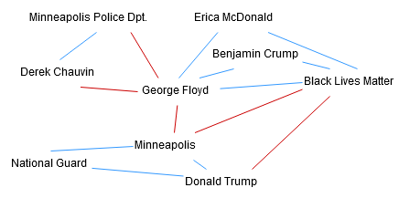
2.3 Populate SAG
Named Entity Recognition and Linking
Generate SAG
Fellowship Dipole Generation
Polarizing Topic Extraction
Article Sentences S
“Minneapolis Police Dpt. officer, Derek Chauvin, has been charged with the murder of George Floyd.
The Black Lives Matter movement demanded justice for the death of George Floyd from Minneapolis and president Donald Trump, with Benjamin Crump and Erica McDonald promised to deliver.
Donald Trump assigns National Guard to the disposal of states’ governors as riots respond similarly to Minneapolis.”
Named Entities V
(Minneapolis Police, ORG),
(Derek Chauvin, PERSON),
(George Floyd, PERSON)
(Black Lives Matter, ORG),
(George Floyd, PERSON),
(Minneapolis, LOC),
(Donald Trump, PERSON),
(Benjamin Crump, PERSON),
(Erica McDonald, PERSON)
(Donald Trump, PERSON),
(National Guard, ORG), (Minneapolis, LOC)
Entity-to-Entity Relationship Extraction
Sentiment Attitude Calculation
Generate SAG

Slide 26
Extracting Entity Relationships
Named Entity Recognition and Linking
Generate SAG
Fellowship Dipole Generation
Polarizing Topic Extraction
Calculate entity co-occurrence frequencies in sentences.
Intuition: Higher the co-occurence freq. → more probable real-life connection.

Slide 27
Extracting Entity Relationships
Named Entity Recognition and Linking
Generate SAG
Fellowship Dipole Generation
Polarizing Topic Extraction
Calculate entity co-occurrence frequencies in sentences.
Intuition: Higher the co-occurence freq. → more probable real-life connection.
Example Sentences
“Minneapolis Police Dpt. officer, Derek Chauvin, has been charged with the murder of George Floyd.
George Floyd was killed by Derek Chauvin.

Slide 28
Extracting Entity Relationships
Named Entity Recognition and Linking
Generate SAG
Fellowship Dipole Generation
Polarizing Topic Extraction
Calculate entity co-occurrence frequencies in sentences.
Intuition: Higher the co-occurence freq. → more probable real-life connection.
Example Sentences
“Minneapolis Police Dpt. officer, Derek Chauvin, has been charged with the murder of George Floyd.
George Floyd was killed by Derek Chauvin.
Entity 1 (e₁) | Entity 2 (e₂) | Co-oc. Frequency
Derek Chauvin | George Floyd | 2
Minneapolis Police Dpt. | George Floyd | 1
Minneapolis Police Dpt. | Derek Chauvin | 1

Slide 29
Extracting Entity Relationships
Named Entity Recognition and Linking
Generate SAG
Fellowship Dipole Generation
Polarizing Topic Extraction
Calculate entity co-occurrence frequencies in sentences.
Intuition: Higher the co-occurence freq. → more probable real-life connection.
Example Sentences
“Minneapolis Police Dpt. officer, Derek Chauvin, has been charged with the murder of George Floyd.
George Floyd was killed by Derek Chauvin.
Entity 1 (e₁) | Entity 2 (e₂) | Co-oc. Frequency
Derek Chauvin | George Floyd | 2
Minneapolis Police Dpt. | George Floyd | 1
Minneapolis Police Dpt. | Derek Chauvin | 1

Slide 30
Sentiment Attitude Calculation
Named Entity Recognition and Linking
Generate SAG
Fellowship Dipole Generation
Polarizing Topic Extraction
Nature of the relationship of entity-pair e1 and e2 → Average of the sentiment attitude observations between them.

Slide 31
Sentiment Attitude Calculation
Named Entity Recognition and Linking
Generate SAG
Fellowship Dipole Generation
Polarizing Topic Extraction
Nature of the relationship of entity-pair e1 and e2 → Average of the sentiment attitude observations between them.
Sentiment Attitude: Calculated based on the sentiment score of the syntactical dependency path of e1 and e2 within a sentence.
Example Sentences
“Minneapolis Police Dpt. officer, Derek Chauvin, has been charged with the murder of George Floyd.
George Floyd was killed by Derek Chauvin.

Slide 32
Sentiment Attitude Calculation
Named Entity Recognition and Linking
Generate SAG
Fellowship Dipole Generation
Polarizing Topic Extraction
Nature of the relationship of entity-pair e1 and e2 → Average of the sentiment attitude observations between them.
Sentiment Attitude: Calculated based on the sentiment score of the syntactical dependency path of e1 and e2 within a sentence.
Example Sentences
“Minneapolis Police Dpt. officer, Derek Chauvin, has been charged with the murder of George Floyd.
George Floyd was killed by Derek Chauvin.

Slide 33
Sentiment Attitude Calculation
Named Entity Recognition and Linking
Generate SAG
Fellowship Dipole Generation
Polarizing Topic Extraction
Nature of the relationship of entity-pair e1 and e2 → Average of the sentiment attitude observations between them.
Sentiment Attitude: Calculated based on the sentiment score of the syntactical dependency path of e1 and e2 within a sentence.
Example Sentences
“Minneapolis Police Dpt. officer, Derek Chauvin, has been charged with the murder of George Floyd.
George Floyd was killed by Derek Chauvin.
Derek Chauvin
charged, with, murder
George Floyd
Derek Chauvin
killed, by
George Floyd

Slide 34
Sentiment Attitude Calculation
Named Entity Recognition and Linking
Generate SAG
Fellowship Dipole Generation
Polarizing Topic Extraction
Nature of the relationship of entity-pair e1 and e2 → Average of the sentiment attitude observations between them.
Sentiment Attitude: Calculated based on the sentiment score of the syntactical dependency path of e1 and e2 within a sentence.
Example Sentences
“Minneapolis Police Dpt. officer, Derek Chauvin, has been charged with the murder of George Floyd.
George Floyd was killed by Derek Chauvin.
Derek Chauvin
charged, with, murder
George Floyd
Derek Chauvin
killed, by
George Floyd
Sentiment Score: Negative

Slide 35
3.1 Extracting Entity Fellowships
Named Entity Recognition and Linking
Generate SAG
Fellowship Dipole Generation
Polarizing Topic Extraction
Fellowship: Densely connected subgraph of SAG with positive attitudes
→ Definition of clusters in signed network clustering.
Signed network clustering: “Finding clusters such that most edges within clusters are positive, and most edges across clusters are negative.”

Slide 36
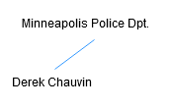
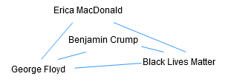
3.1 Extracting Entity Fellowships
Named Entity Recognition and Linking
Generate SAG
Fellowship Dipole Generation
Polarizing Topic Extraction
Fellowship: Densely connected subgraph of SAG with positive attitudes
→ Definition of clusters in signed network clustering.
Signed network clustering: “Finding clusters such that most edges within clusters are positive, and most edges across clusters are negative.”
Entity Fellowship Extraction

Slide 37
3.2 Generating Fellowship Dipoles
Named Entity Recognition and Linking
Generate SAG
Fellowship Dipole Generation
Polarizing Topic Extraction
Initial Dipole Set → All possible Fellowship pairs
Maximize the probability of a polarized state using heuristics:

Slide 38
3.2 Generating Fellowship Dipoles
Named Entity Recognition and Linking
Generate SAG
Fellowship Dipole Generation
Polarizing Topic Extraction
Initial Dipole Set → All possible Fellowship pairs
Maximize the probability of a polarized state using heuristics:
Negative across
Frustration.

Slide 39
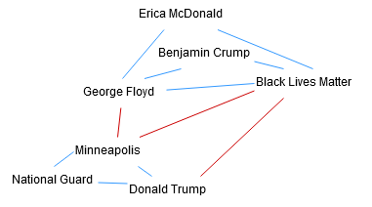
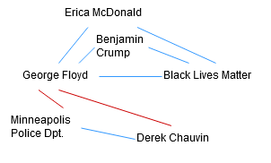
3.2 Generating Fellowship Dipoles
Named Entity Recognition and Linking
Generate SAG
Fellowship Dipole Generation
Polarizing Topic Extraction
Initial Dipole Set → All possible Fellowship pairs
Maximize the probability of a polarized state using heuristics:
Negative across
Frustration.
Dipole Generation

Slide 40
3.2 Generating Fellowship Dipoles
Named Entity Recognition and Linking
Generate SAG
Fellowship Dipole Generation
Polarizing Topic Extraction
Negative across (r) heuristic
Ratio of negative edges connecting fellowships.
Intuition: Dipole with higher negative across → More likely to be polarized.
Manual inspection: ≥ 0.5

Slide 41
3.2 Generating Fellowship Dipoles
Named Entity Recognition and Linking
Generate SAG
Fellowship Dipole Generation
Polarizing Topic Extraction
Negative across (r) heuristic
Ratio of negative edges connecting fellowships.
Intuition: Dipole with higher negative across → More likely to be polarized.
Manual inspection: ≥ 0.5
r : 1.0 (3/3)
r : 1.0 (2/2)

Slide 42
3.2 Generating Fellowship Dipoles
Named Entity Recognition and Linking
Generate SAG
Fellowship Dipole Generation
Polarizing Topic Extraction
2. Frustration (f) Heuristic
Takes into account the structural balance of a dipole.
r : 1.0 (3/3)
r : 1.0 (2/2)

Slide 43
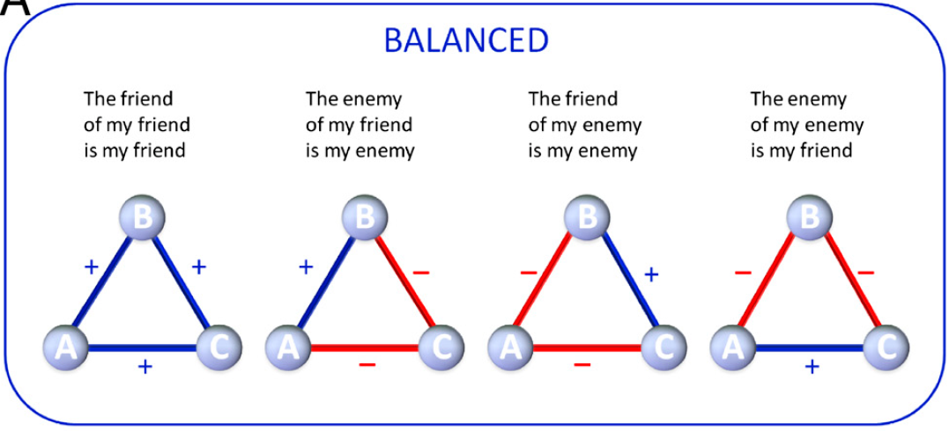
3.2 Generating Fellowship Dipoles
Named Entity Recognition and Linking
Generate SAG
Fellowship Dipole Generation
Polarizing Topic Extraction
2. Frustration (f) Heuristic
Takes into account the structural balance of a dipole.
r : 1.0 (3/3)
r : 1.0 (2/2)

Slide 44
3.2 Generating Fellowship Dipoles
Named Entity Recognition and Linking
Generate SAG
Fellowship Dipole Generation
Polarizing Topic Extraction
2. Frustration (f) Heuristic
Takes into account the structural balance of a dipole.
Intuition: A Dipole with high structural balance → high polarized state.
r : 1.0 (3/3)
r : 1.0 (2/2)

Slide 45
3.2 Generating Fellowship Dipoles
Named Entity Recognition and Linking
Generate SAG
Fellowship Dipole Generation
Polarizing Topic Extraction
2. Frustration (f) Heuristic
Takes into account the structural balance of a dipole.
Intuition: A Dipole with high structural balance → high polarized state.
Metric: Frustration index
Minimum number of edges whose removal results in balance.
Normalized between 0 to 1, with 0 being totally imbalanced, and 1 perfectly balanced.
r : 1.0 (3/3)
r : 1.0 (2/2)

Slide 46
3.2 Generating Fellowship Dipoles
Named Entity Recognition and Linking
Generate SAG
Fellowship Dipole Generation
Polarizing Topic Extraction
2. Frustration (f) Heuristic
Takes into account the structural balance of a dipole.
Intuition: A Dipole with high structural balance → high polarized state.
Metric: Frustration index
Minimum number of edges whose removal results in balance.
Normalized between 0 to 1, with 0 being totally imbalanced, and 1 perfectly balanced.
Manual inspection: ≥ 0.7
r : 1.0 (3/3)
r : 1.0 (2/2)

Slide 47
3.2 Generating Fellowship Dipoles
Named Entity Recognition and Linking
Generate SAG
Fellowship Dipole Generation
Polarizing Topic Extraction
2. Frustration (f) Heuristic
Takes into account the structural balance of a dipole.
Intuition: A Dipole with high structural balance → high polarized state.
Metric: Frustration index
Minimum number of edges whose removal results in balance.
Normalized between 0 to 1, with 0 being totally imbalanced, and 1 perfectly balanced.
Manual inspection: ≥ 0.7
r : 1.0 (3/3)
f : 1.0 (0/11)
r : 1.0 (2/2)
f : 1.0 (0/8)

Slide 48
4.1 Dipole Topic Extraction
Named Entity Recognition and Linking
Generate SAG
Fellowship Dipole Generation
Polarizing Topic Extraction
Topics: Semantically similar Noun Phrases (NPs)
Noun-phrase: Phrases that include nouns → Important in understanding context

Slide 49
4.1 Dipole Topic Extraction
Named Entity Recognition and Linking
Generate SAG
Fellowship Dipole Generation
Polarizing Topic Extraction
Topics: Semantically similar Noun Phrases (NPs)
Noun-phrase: Phrases that include nouns → Important in understanding context
Article Sentences S
“Minneapolis Police Dpt. officer, Derek Chauvin, has been charged with the murder of George Floyd.
The Black Lives Matter movement demanded justice for the death of George Floyd from Minneapolis and president Donald Trump, with Benjamin Crump and Erica McDonald promised to deliver.
Donald Trump assigns National Guard to the disposal of states’ governors as riots respond similarly to Minneapolis.”
murder
riots respond
death
justice

Slide 50
4.1 Dipole Topic Extraction
Named Entity Recognition and Linking
Generate SAG
Fellowship Dipole Generation
Polarizing Topic Extraction
Topics: Semantically similar Noun Phrases (NPs)
Noun-phrase: Phrases that include nouns → Important in understanding context

Slide 51
4.1 Dipole Topic Extraction
Named Entity Recognition and Linking
Generate SAG
Fellowship Dipole Generation
Polarizing Topic Extraction
Topics: Semantically similar Noun Phrases (NPs)
Noun-phrase: Phrases that include nouns → Important in understanding context
Extract Dipole’s NPs

Slide 52
4.1 Dipole Topic Extraction
Named Entity Recognition and Linking
Generate SAG
Fellowship Dipole Generation
Polarizing Topic Extraction
Topics: Semantically similar Noun Phrases (NPs)
Noun-phrase: Phrases that include nouns → Important in understanding context
Extract Dipole’s NPs
Encode NPs with BERT
BERT - Bidirectional Encoder Representations from Transformers
Pre-trained context-base word embeddings developed by Google.
State-of-the-art results across NLP tasks

Slide 53
4.1 Dipole Topic Extraction
Named Entity Recognition and Linking
Generate SAG
Fellowship Dipole Generation
Polarizing Topic Extraction
Topics: Semantically similar Noun Phrases (NPs)
Noun-phrase: Phrases that include nouns → Important in understanding context
Cluster 2
Cluster 4
Cluster N
Extract Dipole’s NPs
Encode NPs with BERT
Apply Clustering
Cluster 1
Cluster 3
BERT - Bidirectional Encoder Representations from Transformers
Pre-trained context-base word embeddings developed by Google.
State-of-the-art results across NLP tasks

Slide 54
4.1 Dipole Topic Extraction
Named Entity Recognition and Linking
Generate SAG
Fellowship Dipole Generation
Polarizing Topic Extraction
Topics: Semantically similar Noun Phrases (NPs)
Noun-phrase: Phrases that include nouns → Important in understanding context
Cluster 2
Cluster 4
Clusters
=
Dipole Discussion Topics
Cluster N
Extract Dipole’s NPs
Encode NPs with BERT
Apply Clustering
Cluster 1
Cluster 3
BERT - Bidirectional Encoder Representations from Transformers
Pre-trained context-base word embeddings developed by Google.
State-of-the-art results across NLP tasks

Slide 55
4.2 Quantifying Topic Polarization
Named Entity Recognition and Linking
Generate SAG
Fellowship Dipole Generation
Polarizing Topic Extraction
Polarization Index μ: “a population is perfectly polarized when divided into two groups of the same size and with opposite attitudes”.
μ=1 if attitudes are perfectly polarized, and μ=0 if not polarized at all.

Slide 56
4.2 Quantifying Topic Polarization
Named Entity Recognition and Linking
Generate SAG
Fellowship Dipole Generation
Polarizing Topic Extraction
Polarization Index μ: “a population is perfectly polarized when divided into two groups of the same size and with opposite attitudes”.
μ=1 if attitudes are perfectly polarized, and μ=0 if not polarized at all.
Attitude Populations
Attitude Distributions
Polarization Index μ
Topic 1
Topic 3

Slide 57
4.2 Quantifying Topic Polarization
Named Entity Recognition and Linking
Generate SAG
Fellowship Dipole Generation
Polarizing Topic Extraction
Polarization Index μ: “a population is perfectly polarized when divided into two groups of the same size and with opposite attitudes”.
μ=1 if attitudes are perfectly polarized, and μ=0 if not polarized at all.
Attitude Populations
Attitude Distributions
Polarization Index μ
Topic 1
_
+
+
_
+
+
+
Topic 3
_
_
+
_
+
+
Topic 1
Topic 3

Slide 58
4.2 Quantifying Topic Polarization
Named Entity Recognition and Linking
Generate SAG
Fellowship Dipole Generation
Polarizing Topic Extraction
Polarization Index μ: “a population is perfectly polarized when divided into two groups of the same size and with opposite attitudes”.
μ=1 if attitudes are perfectly polarized, and μ=0 if not polarized at all.
Attitude Populations
Attitude Distributions
Polarization Index μ
Topic 1
Topic 1
_
+
+
_
+
+
+
Frequency
O
S
Topic 3
Topic 3
_
_
+
_
+
+
Frequency
Topic 1
Topic 3
O
S

Slide 59
4.2 Quantifying Topic Polarization
Named Entity Recognition and Linking
Generate SAG
Fellowship Dipole Generation
Polarizing Topic Extraction
Polarization Index μ: “a population is perfectly polarized when divided into two groups of the same size and with opposite attitudes”.
μ=1 if attitudes are perfectly polarized, and μ=0 if not polarized at all.
Attitude Populations
Attitude Distributions
Polarization Index μ
Topic 1
Topic 1
_
+
+
_
+
+
+
Frequency
μ = 0.26
O
S
Topic 3
Topic 3
_
_
+
_
+
+
Frequency
μ = 1.0
Topic 1
Topic 3
O
S

Slide 60
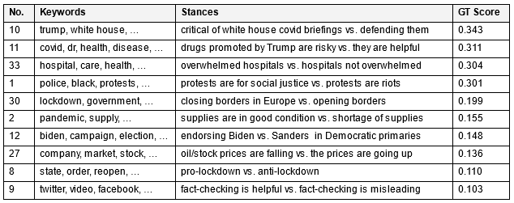
POLAR Evaluation
Compare the topic ranked list with the ground truth and the PaCTE approach
PaCTE Evaluation Methodology:
Quantitative evaluation on the effectiveness of capturing the topical polarization of a list of topics.
The authors identified the top-3 most polarizing topics between Liberal and Conservative source pairs
Recall@3 for main evaluation metric on finding top-3 GT polarizing topics.

Slide 61
PaCTE vs. POLAR Recall@3
The average recall@3 over the nine news source pairs is 0.26, 0.51 and 0.49 for LOE, PaCTE and POLAR respectively.
Note that recall@3 corresponds to the raw overlap of the top-3 polarizing topics, and DOES NOT CONSIDER the polarization ranking at all.
In the POLAR evaluation methodology, we incorporate the rankings of the topics’ polarization, as well as look into all the topics, not limited to the top-3.

Slide 62
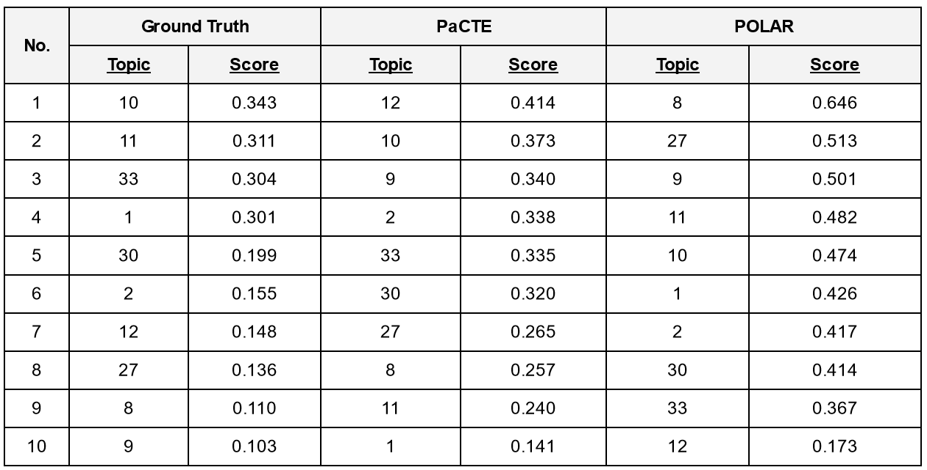
Topic Rank Lists for GT, POLAR, and PaCTE
Compare the aggregated GT polarizing topic list with the lists from PaCTE and POLAR.
Generate the aggregated rank list by averaging polarization scores for each topic and sorting them.
Use a ranking evaluation metric, either Pearson Correlation Ranking, or Ranked Bias Overlap (RBO).
Pearson: + Defacto metric for comparing ranks - Quite sensitive metric - Large penalties even with small errors.
RBO addresses this sensitivity by testing the overlap between different ranks of the lists provided, while accepting a parameter p indicating the weight on the top-k elements.
Very small ranking gaps → RBO

Slide 63
Comparing Rank Lists @3
Comparing the all-source aggregated lists, we get for GT-PaCTE an RBO score of 0.445 and for the GT-POLAR an RBO score of 0.443.
Also compare the source-pair ranked list of PaCTE and POLAR with the GT (sim. to PaCTE).
The above table presents RBO scores for top-3 ranked elements.
POLAR outperforms PaCTE in 5/9 pairs, whereas PaCTE is better in 2/7, and the two have equal performances in 2/7 source pairs.

Slide 64
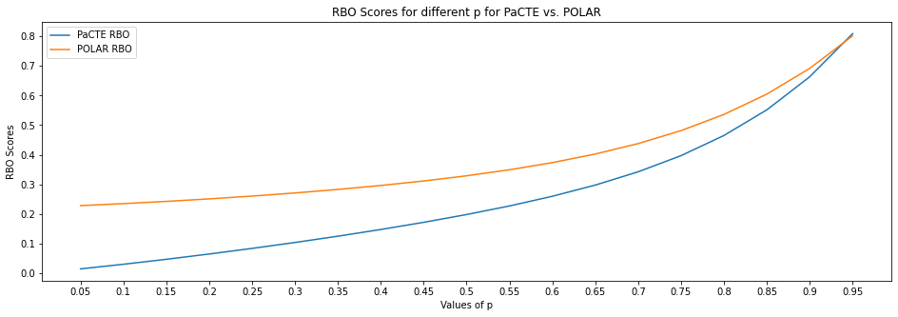
Comparing Rank Lists
Looking past the top-3, if we include the rest of the rank list elements, POLAR is able to outperform the overall PaCTE performance compared to the GT rank list.
PaCTE overall RBO score is 0.66, whereas POLAR score is 0.69.
Test the impact of RBO’s p value transition → run the experiment p values of 0.05 to 0.95.
POLAR achieves better results than PaCTE especially in lower rank list elements.
Notes:
Considering the change in the overall results from the p value transition, we run the experiment for a series of p values, from 0.05 to 0.95.
We can see that POLAR achieves better results than PaCTE in general, especially when considering lower rank list elements for the RBO (lower values of p). As the values of p increase, so does the RBO score of both POLAR and PaCTE.
While the values increase we can see that the RBO scores come closer to each other, with both of them converging to ~0.80 with p = 0.95 (maximum).

