Slide 1
MAI 622: AI Entrepreneurship
Master Programs in Artificial Intelligence for Careers in EU (MAI4CAREU)
This document has been produced with the support of THE EUROPEAN COMMISSION under THE CONNECTING EUROPE FACILITY - TELECOMMUNICATIONS SECTOR AGREEMENT No INEA/CEF/ICT/A2020/2267423. It reflects the views only of the author, and the Commission cannot be held responsible for any use which may be made of the information contained therein.

Slide 2
Course Objective
Help students master concepts of relevance to AI and Data-driven entrepreneurship, by:
Introducing basic terminology and concepts of innovation, entrepreneurship, and intellectual property
Discussing case studies of turning ideas to successful companies, and visions for the future of AI
Learning and practicing steps entailed in start-up foundation, as captured in MIT’s Disciplined Entrepreneurship methodology.
Understanding and practicing business model development.
Learning how to pitch to attract investment

Slide 3
Learning Objectives
After taking this course, students should be able to:
Recognize and describe key concepts and terminology related to innovation, entrepreneurship, AI and data-driven economy.
Understand and explain the interplay between AI, Machine Learning, Big Data, and various application domains.
Analyze, evaluate and propose entrepreneurial ideas, especially for innovative products, processes or services based on AI, and apply the key stages of turning an idea or invention into a commercial product.
Understand issues of Intellectual Property (IP) and methods for IP protection.
Understand the basics of incorporation and company structure.
Understand the key challenges for attracting talent, establishing and managing a startup team.

Slide 4
Learning Outcomes and Acquired Skills
The students who complete this course successfully, will be able to:
Understand, describe and apply methodologies and tools for innovative entrepreneurship, such as the Disciplined Entrepreneurship Methodology, the Lean Product Methodology and Lean AI.
Understand and create Business Models using the Business Model Canvas.
Define and apply techniques for market analysis, product design, value proposition definition, customer acquisition, pricing products or services, and sales.
Understand the basics of fundraising and financing options for startups.
Prepare pitch decks, and pitch in front of potential investors, an ΑΙ-related business idea/product/service.
Use state-of-the-art collaboration, ideation and rapid prototyping tools.

Slide 5
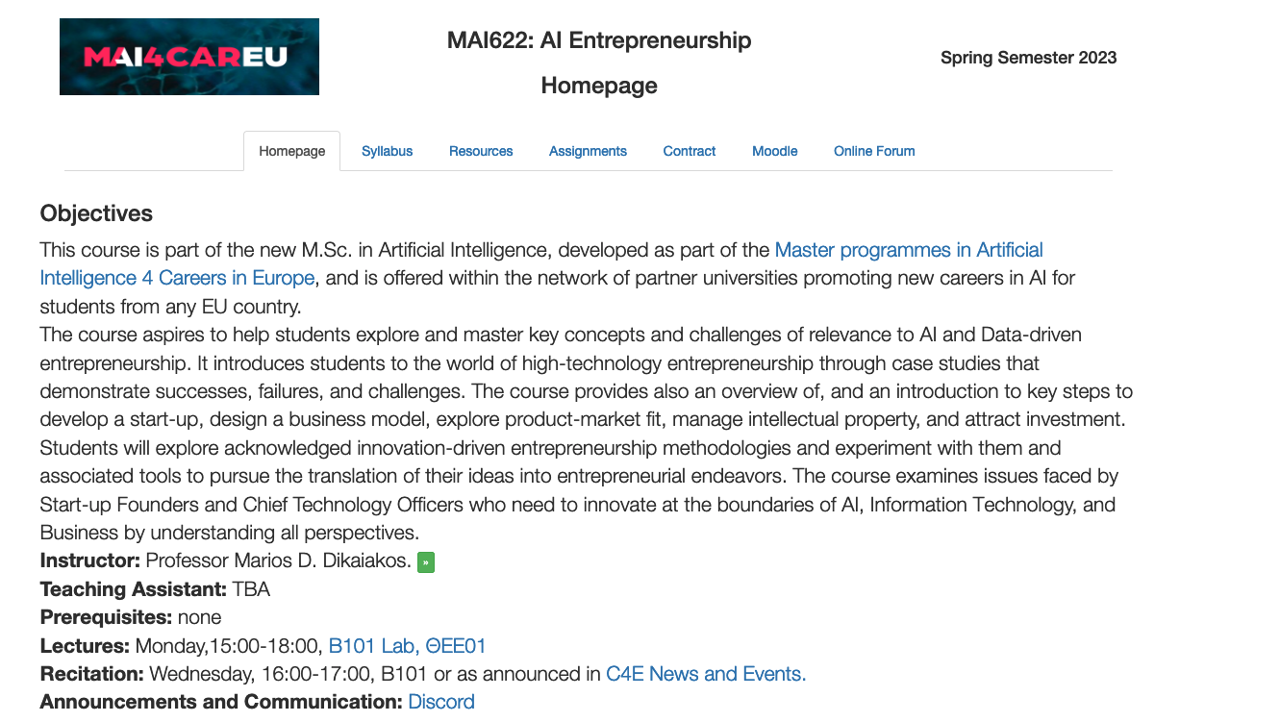
Web
Site
http://www.cs.ucy.ac.cy/courses/MAI622/

Slide 6
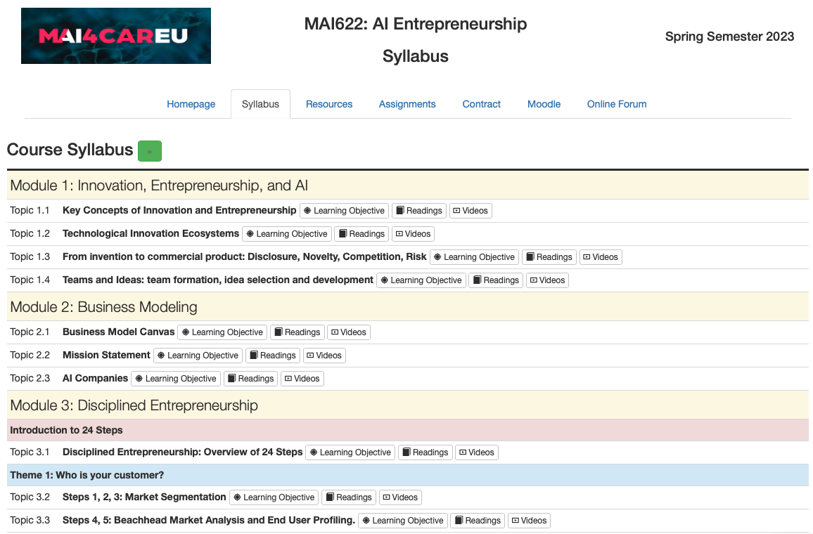
Web
Site

Slide 7
Web
Site

Slide 8
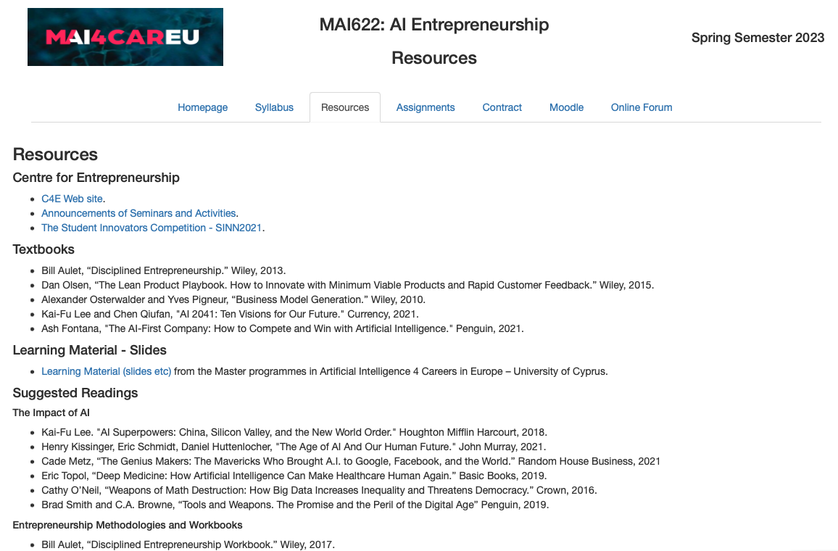
Web
Site

Slide 9
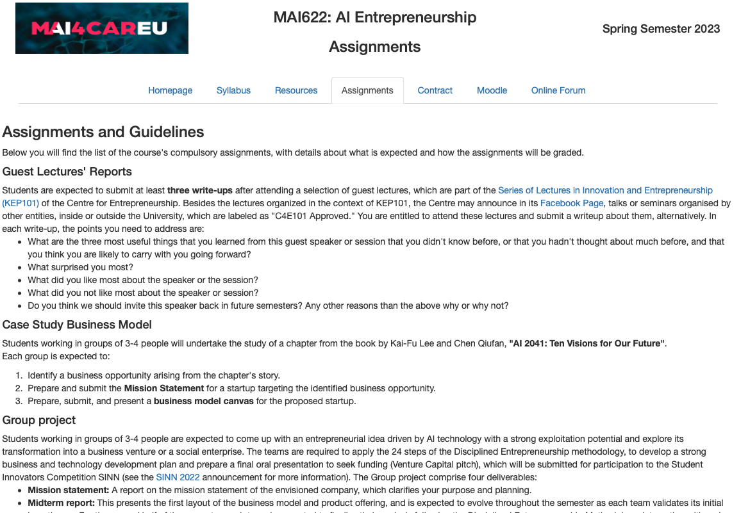
Web
Site

Slide 10
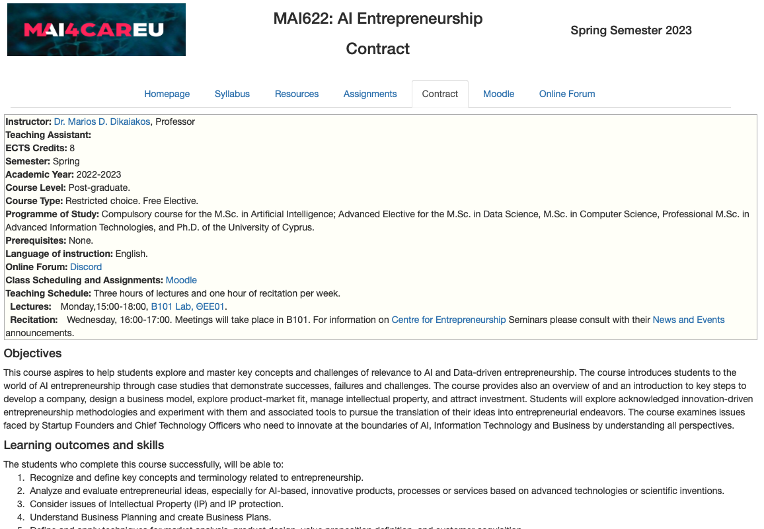
Web
Site

Slide 11
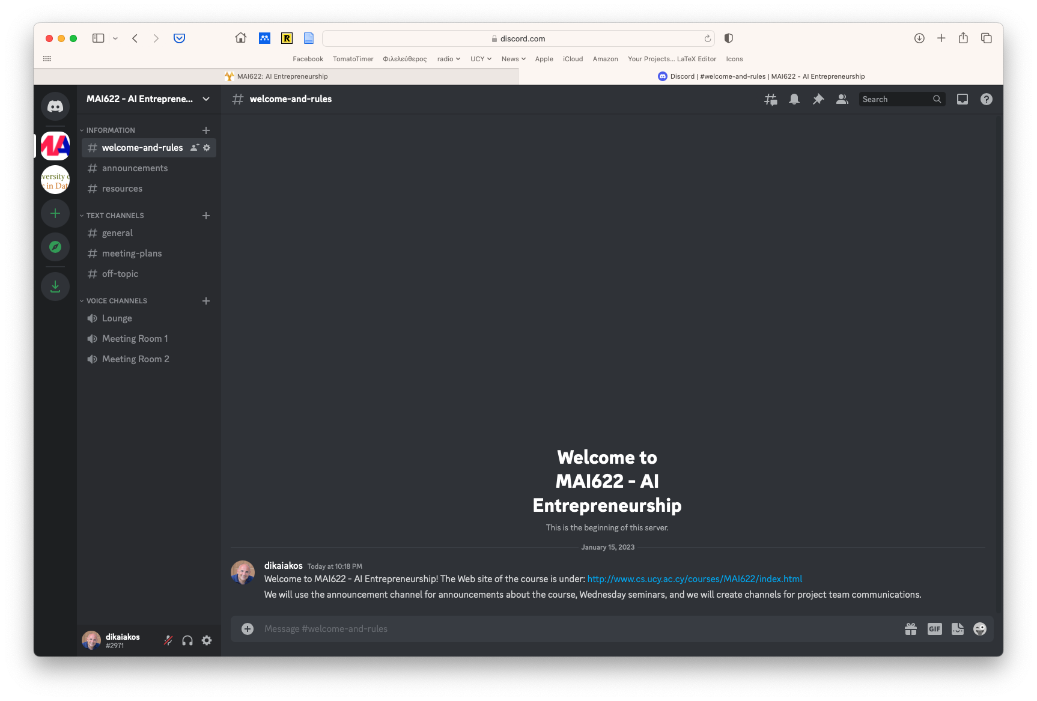
Online
Forum:
Discord
Subscription code (valid for a few days): https://discord.gg/prnRSqcD
Notes:
https://discord.gg/prnRSqcD

Slide 12
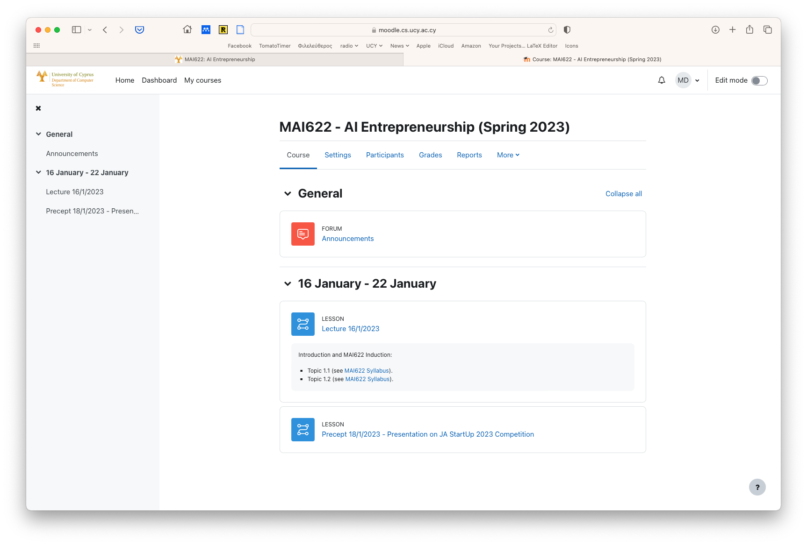
Moodle
https://moodle.cs.ucy.ac.cy/course/view.php?id=363
You will be registered to Moodle and you can use this to see the topics covered in each lecture, get slides and notes, and submit your assignments.

Slide 13
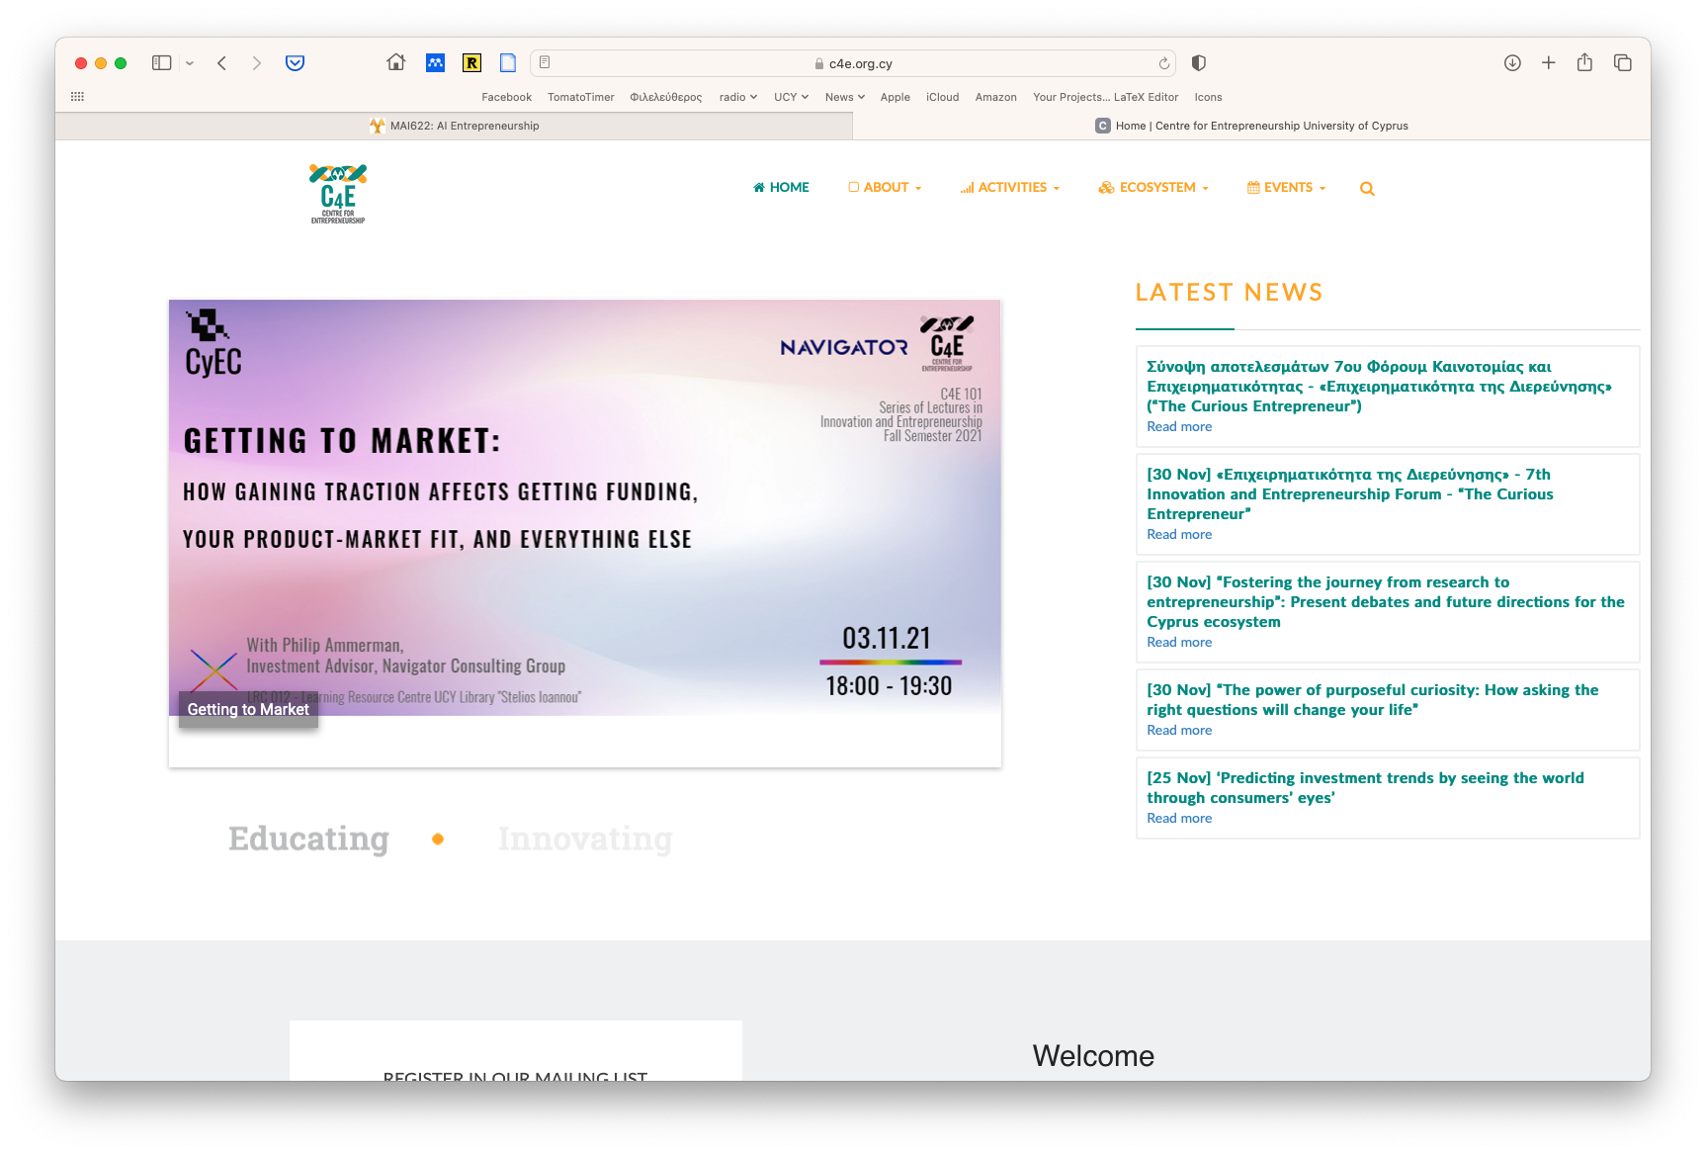
https://c4e.org.cy/

Slide 14
https://c4e.org.cy/

Slide 15
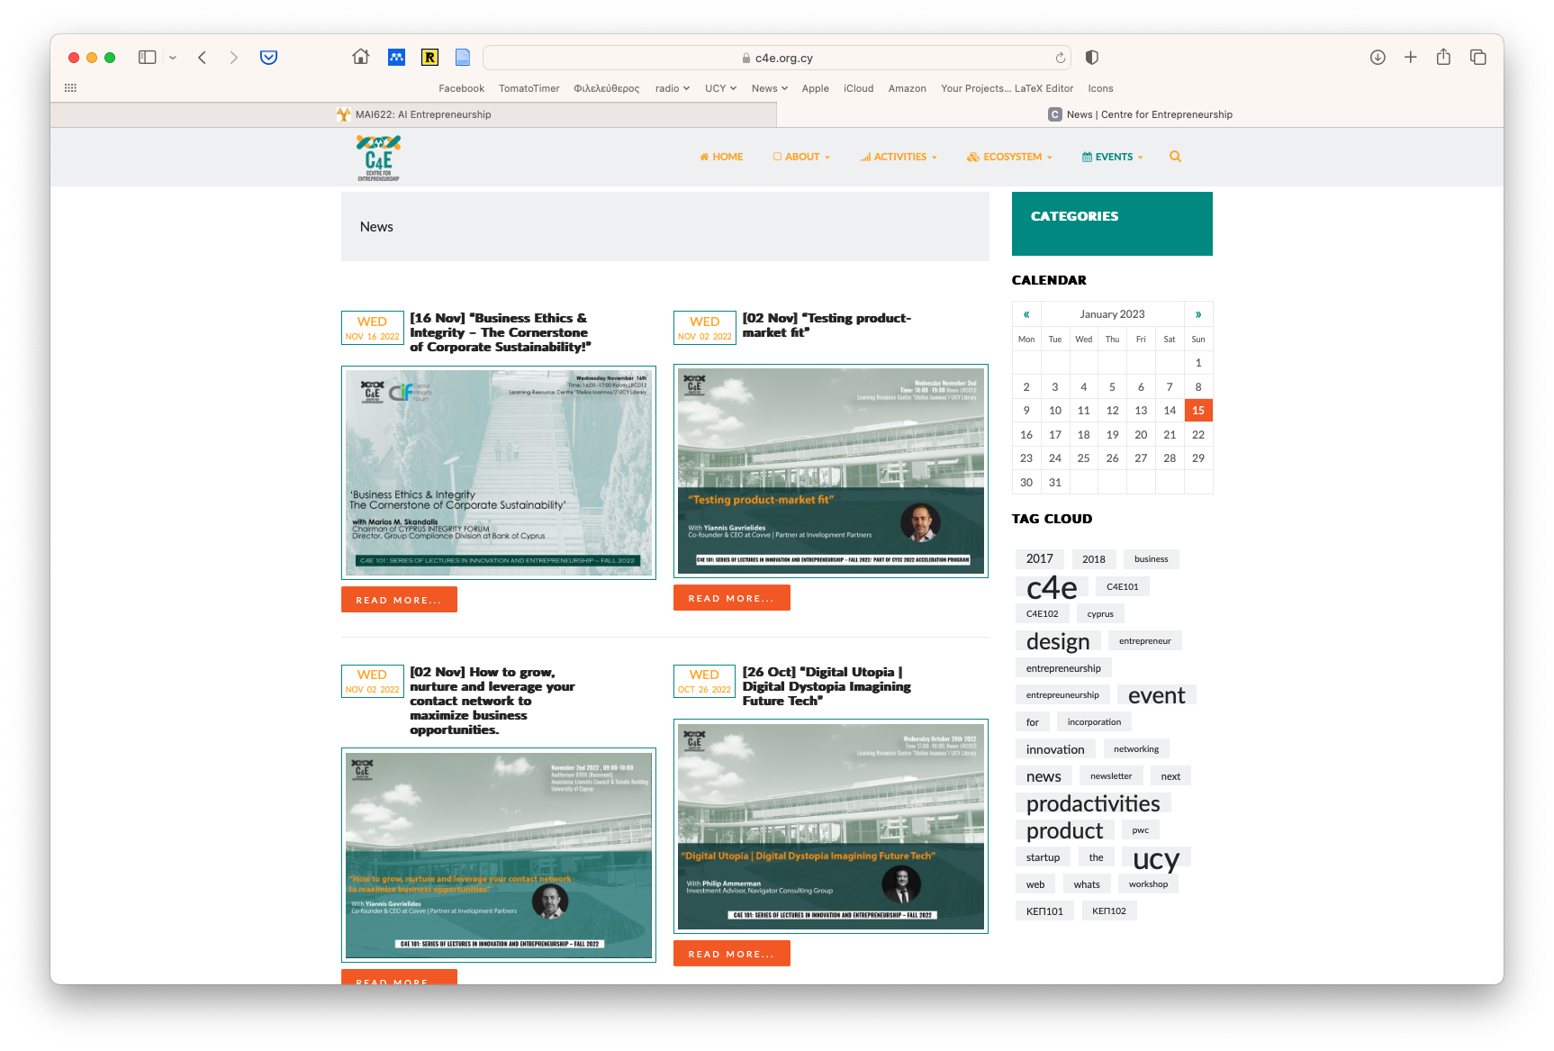

Slide 16
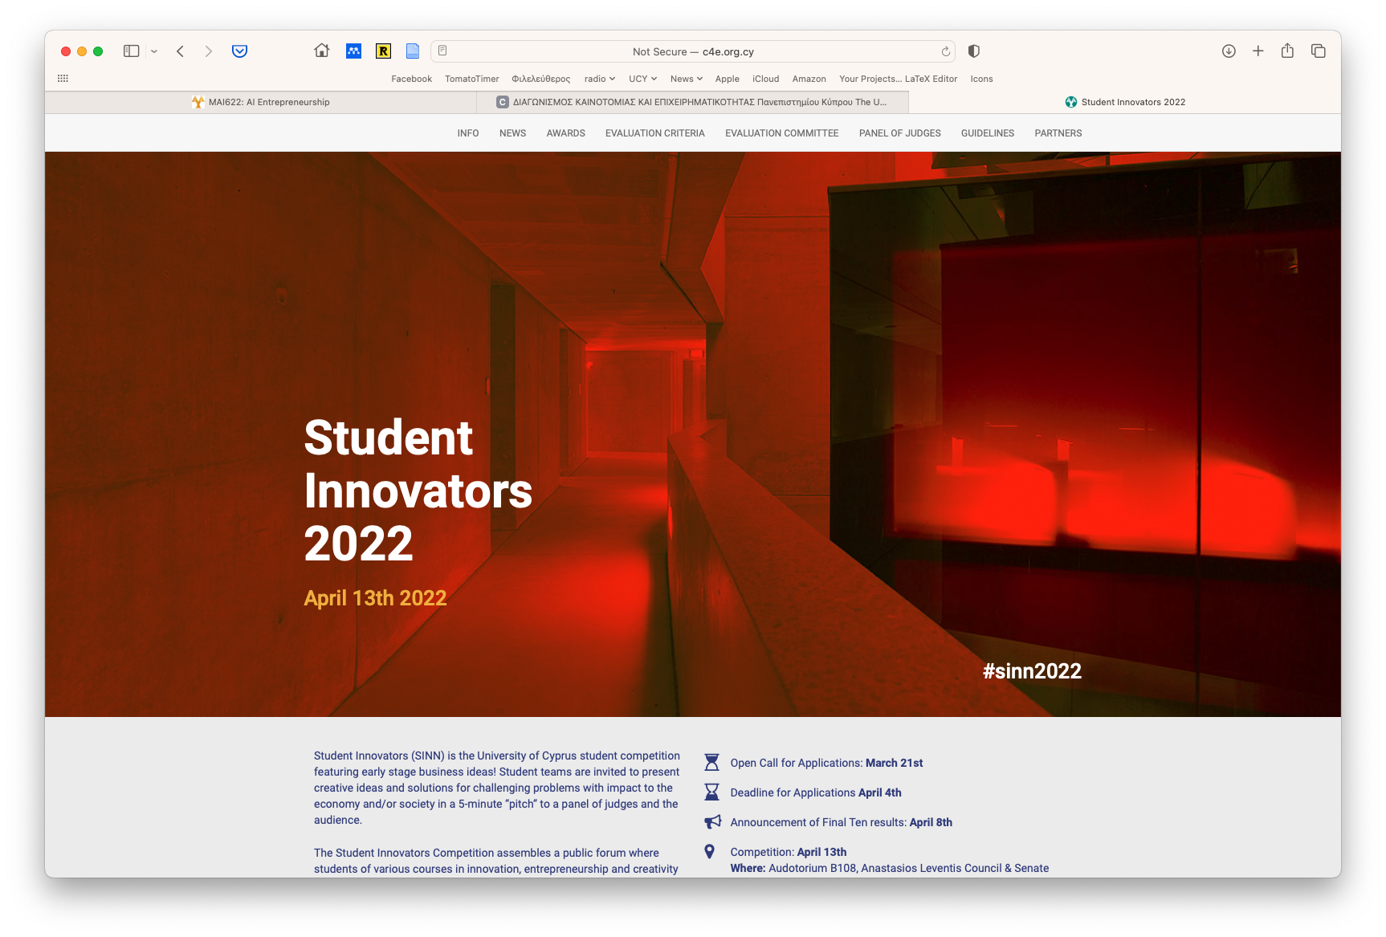
SINN

Slide 17
CyEC

Slide 18
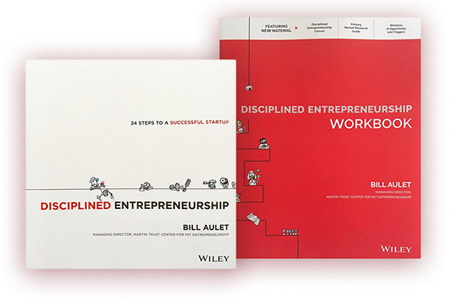
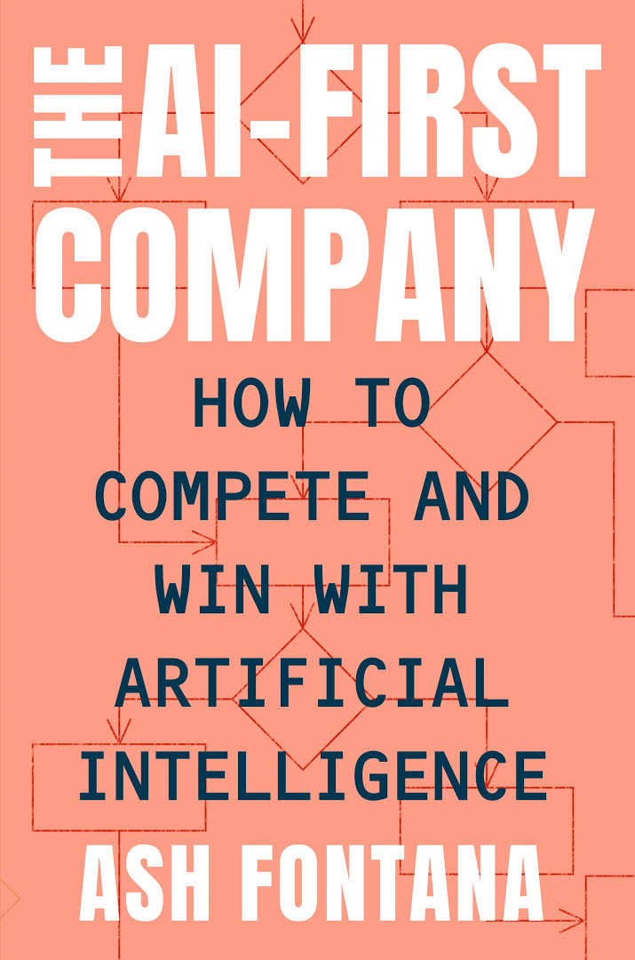
Main Sources for Learning Materials

Slide 19
Textbooks
Bill Aulet (2013) “Disciplined Entrepreneurship.” Wiley.
Bill Aulet (2017) “Disciplined Entrepreneurship Workbook.” Wiley.
Alexander Osterwalder et al (2010) “Business Model Generation.” Wiley.
Ash Fontana (2021) “The AI-First Company.” Penguin.
European Patent Office. “Inventors’ Handbook.” https://www.epo.org/learning-events/materials/inventors-handbook.html
Reading List

Slide 20
Additional Readings
AI Case Studies & Vision
Kai-Fu Lee & Chen Qiufan (2021). “AI 2041. Ten Visions for Our Future.” Penguin.
Cade Metz (2021). “The Genius Makers: The Mavericks Who Brought A.I. to Google, Facebook, and the World.” Random House Business.
Eric Topol (2019). “Deep Medicine: How Artificial Intelligence Can Make Healthcare Human Again.” Basic Books.

Slide 21
Y Combinator’s Resources
https://www.ycombinator.com/resources/
Steve Blank, “How to build a startup?” Udacity
https://classroom.udacity.com/courses/ep245
Sam Altman, “How to start a startup?”
http://startupclass.samaltman.com/
Centre for Entrepreneurship: C4E video lectures library
https://www.youtube.com/c/c4eOrgCy/videos
Online Videos & Courses

Slide 22
Context & Policy
Henry A Kissinger, Eric Schmidt, Daniel Huttenlocher (2021)“The Age of AI and Our Human Future.” Little, Brown and Company.
Smith, B. and Browne C.A. (2019) “Tools and Weapons. The Promise and the Peril of the Digital Age.” Penguin.
Lee, Kai-Fu (2018) “AI Superpowers: China, Silicon Valley, And The New World Order.” Houghton Mifflin Harcourt Company.
O’Neil, C. (2016) “Weapons of Math Destruction: How Big Data Increases Inequality and Threatens Democracy.” Crown.
Sinan Aral (2021) “The Hype Machine.” Penguin.
Additional Readings

Slide 23
Additional Readings
Disruptive Startups
Ben Horowitz (2014) “The Hard Thing about Hard Things.” Harper Business.
Steven G. Blank (2006) “The Four Steps to the Epiphany. Successful Strategies for Products that Win.” Lulu.
Peter Thiel with Blake Masters (2015) “Zero to One: Notes on Startups, or How to Build the Future.” Virgin Books.
Jeff Bezos (2014) “The Everything Store: Jeff Bezos and the Age of Amazon.” Corgi.
Clayton Christensen (2016) “The Innovator's Dilemma: When New Technologies Cause Great Firms to Fail (Management of Innovation and Change).” Harvard Business Review Press.
Alexander Osterwalder et al (2014) “Value Proposition Design: How to Create Products and Services Customers Want.” Wiley.

Slide 24
Course Structure
Module 1: Innovation, Start-Ups and AI
Module 2: Business Modeling
Module 3: Disciplined Entrepreneurship
Module 4: Fundraising and Pitching

Slide 25
Module 1 Structure
Invention, Entrepreneurship, Innovation, Research, Start-ups, Ecosystems, Risk, Venture Capital
Intellectual Property Elements
Steps involved to turn an Invention to a Start-up
Explore success stories and failures of AI entrepreneurship; discuss visions for the future

Slide 26
Module 2 Structure
Introduction to the Business Model Canvas
How to prepare a Mission Statement
The ”AI-First” Company

Slide 27
Module 3 Structure
Section 1: Introduction to DH
Section 2: Who is your Customer?
Market segmentation – DE Step 1
Beachhead market selection – DE Step 2
End-user Profile Definition – DE Step 3
Total Addressable Market Size (TAM) of Beachhead – DE Step 4
Profile Persona development for the Beachhead – DE Step 5
Identify your Next 10 Customers – DE Step 9
Section 3: What can you do for your Customer?
Full Life Cycle Use Case – DE Step 6
High-level Product Specification – DE Step 7
Value Proposition: Definition and Quantification – DE Step 8
Define your Core – DE Step 10
Charting your Competitive Position – DE Step 11

Slide 28
Module 3 Structure
Section 4: How does your Customer acquire your Product?
Customer’s Decision-Making Unit Definition – DE Step 12
Map Process to Acquire Paying Customer – DE Step 13
Map the Process to Acquire a Customer – DE Step 18
Section 5: How do you Scale your Business?
Calculate TAM Size for Follow-on Markets – DE Step 14
Develop a Product Plan – DE Step 24
Section 6: Business Models
Design a Business Model – DE Step 15
Business Model Patterns
Introduction to Platform Economy, Network effects, Platform-based services
Business Model Generation – Business Model Canvas

Slide 29
Module 3 Structure
Section 7: Pricing, Lifetime Value and Cost of Customer Acquisition
Set Your Pricing Framework – DE Step 16
Calculate Lifetime Value of Acquired Customer – DE Step 17
Cost of Customer Acquisition (COCA) Analysis – DE Step 19
Section 8: Design and Build your Product
Design and test key assumptions – DE Steps 20, 21
Minimum Viable Business Product – DE Step 22
Product demonstration and customer-satisfaction assessment – DE Step 23
Lean Product Methodology Overview

Slide 30
Module 4 Structure
Introduction to Start-up Financing and Fundraising
Pitching your idea/product/company to investors

Slide 31
Learning Methods
Attending lectures, where the main concepts and methodologies are presented and critically appraised, and active participation in class.
Reading and self-study of readings defined in the Course Outline.
Participation to Guest Lectures and Seminars of the Series of Lectures in Innovation and Entrepreneurship (KEP101) of the Centre for Entrepreneurship; these are scheduled typically (but not exclusively) on Wednesdays, 16:00-17:00 or 17:00-18:00.
Attending announced recitations (on Wednesdays, 16:00-17:00), where we will expand on topics covered in the Lectures and discuss group projects.
Reading and video assignments: Students required to read articles, watch videos and write short critiques, commentaries or essays on assigned readings.
Group projects, where teams of students are expected to develop an idea with a strong exploitation potential through a business venture or a social enterprise. Teams are required to:
Undertake all necessary activities to develop a strong business plan and prepare an oral presentation to seek funding (Venture Capital pitch).
Participate and present at SINN2023 and/or JAStart-up Competitions.

Slide 32
Evaluation
Student progress evaluated continuously through:
Class and C4E Seminar participation
Writing assignments
Group project
Group project deliverable comprises three documents:
Written Midterm report
Written Final report
Oral Presentation (Pitch): In class, @SINN or @JAStartup
Midterm and Final project report should address the issues examined in the 24 steps of Disciplined Entrepreneurship methodology

Slide 33
Grading
The final grade is based on the following formula:
C4E Seminars Reports:……………… 10%
Case Study Business Model:……….. 20%
Term Project Midterm Report:………. 5%
Term Project Final Report:………….. 35%
Term Project Pitching Presentation:..30%

Slide 34
ECTS Analysis
Successful participation to the course credited with 8 units of the European Credit Transfer System (ECTS)
One ECTS unit corresponds on average of 25-30 hours of work.
Successful completion of the class requires a total of 187.5-225 hours of work.
Student workload analyzed as follows:
Class and Recitation participation: 4 hours per week for 13 weeks, totaling to 52 hours.
Study at home: 2 hours per week for 14 weeks, totaling 28 hours.
Write-ups: A total of 15 hours.
Group project Midterm Report: 30 hours
Final presentation: 30 hours.
Group project Final Report: 50 hours

Slide 35
Group Project
Students are expected to establish teams and develop an idea with a strong exploitation potential through a business venture or a social enterprise related to Artificial Intelligence or Data Science.
The teams are required to undertake all necessary activities to develop a strong business and technology development plan and prepare a final oral presentation to seek funding (Venture Capital pitch).

Slide 36
Group Project Deliverables
Midterm report: This presents the first layout of the business model and product offering and is expected to evolve throughout the semester as each team validates its initial hypotheses. For the second half of the semester, each team is expected to interact with real customers, partners, providers etc to evaluate its business model, in addition to developing its product offering.
Oral Presentation: This is a "Venture Capital Pitch," to be presented in a 10-minutes oral presentation, followed by a Q&A session. The pitch should be prepared according to guidelines and best practices discussed in class and relevant readings. The presentation should be a self-contained document (often called a "deck") with no more than 10 slides , which should be read-able if you email it to someone. All members of each team should participate in the presentation.
Written Final report: The final report should present a comprehensive summary of achievements.

Slide 37
Final Report Structure
Final Report should comprise two sections:
The first section is a critical appraisal of the midterm report, describing and explaining what has changed since the midterm report was written, and detailing how your ideas have evolved.
The second section, provides a description of progress made since the midterm report in developing your product, conducting market research and evaluating your business model. Also, a description of your prototype implementation and your technology stack.

Slide 38
Group Project Team Formation
Establish teams with 3-4 people
Brainstorm
Discuss ideas for a company
Reach a consensus on the purpose of your team
Agree on an early draft of your mission statement
You will be required to elaborate your idea throughout the course, following the Disciplined Entrepreneurship Methodology, to end up with a business plan and a pitch
Be careful on what you agree upon, because this will stay with your for the whole semester!

Slide 39
“Today the image of the heroic entrepreneur is someone who is ultra-focused on turning an idea into a start-up that will attract investors.
Steve Jobs and Bill Gates, both of whom dropped out of college, are icons of American ingenuity.
Despite what each has said about the importance of a broad learning across a variety of fields, what their admirers take away is “learn only what you need to know to monetize your idea.”
Notes:
Beyond the University
Roth, Michael S.

Slide 40
Thank you!
Questions?
This document has been produced with the support of THE EUROPEAN COMMISSION under THE CONNECTING EUROPE FACILITY - TELECOMMUNICATIONS SECTOR AGREEMENT No INEA/CEF/ICT/A2020/2267423. It reflects the views only of the author, and the Commission cannot be held responsible for any use which may be made of the information contained therein.

