Slide 1
MAI 622: AI Entrepreneurship
This document has been produced with the support of THE EUROPEAN COMMISSION under THE CONNECTING EUROPE FACILITY - TELECOMMUNICATIONS SECTOR AGREEMENT No INEA/CEF/ICT/A2020/2267423. It reflects the views only of the author, and the Commission cannot be held responsible for any use which may be made of the information contained therein.

Slide 2
Course
Objective
Help students master concepts of relevance to AI and Data-driven entrepreneurship, by:
Introducing basic terminology and concepts of innovation, entrepreneurship, and intellectual property
Discussing case studies of turning ideas to successful companies, and visions for the future of AI
Learning and practicing steps entailed in start-up foundation, as captured in MIT’s Disciplined Entrepreneurship methodology.
Understanding and practicing business model development.
Learning how to pitch to attract investment

Slide 3
Learning
Objectives
After taking this course, students should be able to:
Recognize and describe key concepts and terminology related to innovation, entrepreneurship, AI and data-driven economy.
Understand and explain the interplay between AI, Machine Learning, Big Data, and various application domains.
Analyze, evaluate and propose entrepreneurial ideas, especially for innovative products, processes or services based on AI, and apply the key stages of turning an idea or invention into a commercial product.
Understand issues of Intellectual Property (IP) and methods for IP protection.
Understand the basics of incorporation and company structure.
Understand the key challenges for attracting talent, establishing and managing a startup team.

Slide 4
Innovation, Research, Start-Ups
MAI 622: AI Entrepreneurship - Module 1

Slide 5
Module 1
Contents
Key Concepts of Innovation and Entrepreneurship
Ecosystems of Technological Innovation
Intellectual Property: From Inventions to Products

Slide 6
Planning
Week 1 and 2:
2 150-minute lectures
2 60-minute seminars
5 Video Assignments
2 Reading Assignments

Slide 7
Learning
Objectives
After attending this module, studying the suggested readings, and watching proposed videos students should be able to:
Recognize and describe key concepts and terminology related to the nexus of innovation, research and start-ups.
Understand and explain key concepts of Intellectual Property (IP) and methods for IP protection.
Understand, analyze, explain and follow the main issues and steps involved in translating an invention to a commercial product or venture.

Slide 8
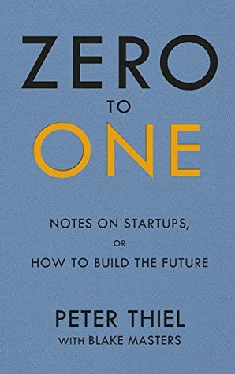
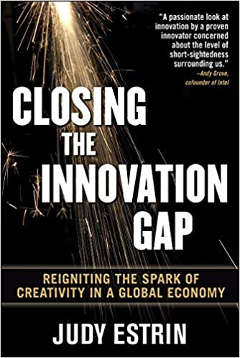
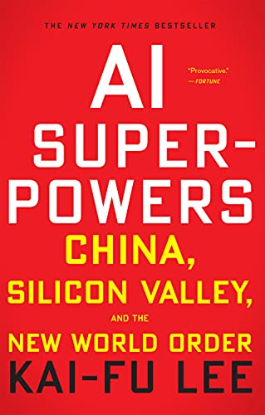
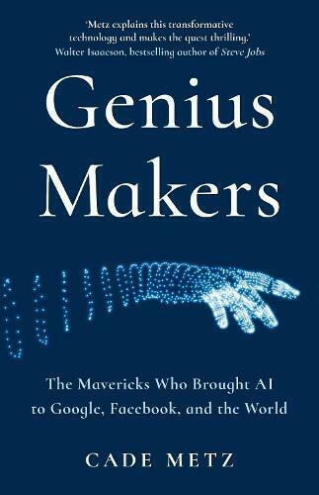
Suggested
Readings
Peter Thiel with Blake Masters (2014) ”Zero to One”
European Patent Office. “Inventors’ Handbook” https://www.epo.org/learning-events/materials/inventors-handbook.html
Judy Estrin (2008) “Closing the Innovation Gap”
Kai-Fu Lee (2018) “AI Super-Powers”
Cade Metz (2021) ”Genius Makers”

Slide 9
Navigating Data and AI Opportunities and Risks: New Challenges for Business and Regulators. Professor Theodoros Evgeniou, INSEAD. C4E IEF2020 - PwC Distinguished Lecture.
  https://www.youtube.com/watch?v=OtD2fr1Bo6A
The Challenges of AI for Business and Policy Making . Panel Discussion, C4E IEF2020.
  https://www.youtube.com/watch?v=eYh_O67r2w8
Closing the Innovation Gap. Judith Estrin, U. of Washington Colloquium, Feb. 2000.
  https://www.youtube.com/watch?v=I24T28z6jJU
Computers and Humans Will Each Do Their Best. Eric Schmidt, The G.S. Beckwith Gilbert ’63 Lectures, Princeton Univ. May 2015
  https://mediacentral.princeton.edu/media/The+G.S.+Beckwith+Gilbert+’63+LecturesA+Eric+Schmidt+’76+-+“Computers+and+Humans+Will+Each+Do+Their+Best%22/1_ndnym9sd
IP law / Commercializing IP. Nick Kounoupias. C4E, Feb. 2018 (slides)
  https://youtu.be/3iP9WaNvaqU
EU Intellectual Property Helpdesk videos:
  https://www.youtube.com/playlist?list=PLNhMWKRzktjIFb0JRJgLSzEeGFpNwOkGN
Online Videos & Courses

Slide 10
Section 1: Key Concepts
Module 1: Innovation, Research, Start-Ups

Slide 11
Key Concepts
Understanding some key concepts:
Invention
Innovation
Entrepreneurship
Intangibles
Risk
Disruption
Ecosystem
Research & Education

Slide 12
Innovation
Key Concepts

Slide 13
Innovation:
Why is it Important?

Slide 14
The Importance of Innovation
Technological innovation is the ultimate source of productivity
[Robert Solow, MIT, Nobel Prize in Economics, 1987]
Νow, more than ever, productivity is the main driver of future growth and prosperity
[OECD, “The Future of Productivity”, 2015]

Slide 15
The Importance of Innovation
Without new technology, globalisation is unsustainable in a world of scarce resources.
[Peter Thiel with Blake Masters, ”Zero to One” 2014]
Who gets to control innovation is a
central question of our time.
[Susan Liautaud, Public Policy Program, Stanford University,
“Ethical Innovation Means Giving Society a Say,” WIRED, 12/6/2017]

Slide 16


Slide 17
Invention
Invention: anything novel
  scientific-technological (including medicine)
  socio-political (including economics and law)
  humanistic, or cultural
Patentable Invention
  Novel, non-obvious, possible industrial application
  Not all the inventions can be patented
  Patents: not the only way to protect or exploit inventions

Slide 18
Innovation
A new or changed entity, which creates or redistributes value [ISO TC 279 on innovation management, standard ISO 56000:2020]
Something original and effective which creates value, including the creation of a new market/new needs/new business models.
Involves the practical implementation of an invention to have impact in a market or society.

Slide 19
Innovation
Scientific & Tech
Advancement
Innovation
= ?
= Invention x Commercialization
Entrepreneurship
Bill Aulet, Martin Trust Center for MIT Entrepreneurship, 2017

Slide 20
Invention vs Innovation
Invention may or may not result in innovation (creation of value)
Ιnnovation does not strictly need an invention.

Slide 21

Entrepreneurship
“Entrepreneurship is the creation or extraction of economic value. With this definition, entrepreneurship is viewed as change, generally entailing risk beyond what is normally encountered in starting a business, which may include other values than simply economic ones.”
Source: Wikipedia

Slide 22
Why is Entrepreneurship Important?

Slide 23
Entrepreneurship
is the principal mechanism through which developed and developing economies can take advantage of inventions and manage to evolve and regenerate
[Monitor Group. Paths to Prosperity: Promoting Entrepreneurship in the 21st Century. 2009]

Slide 24
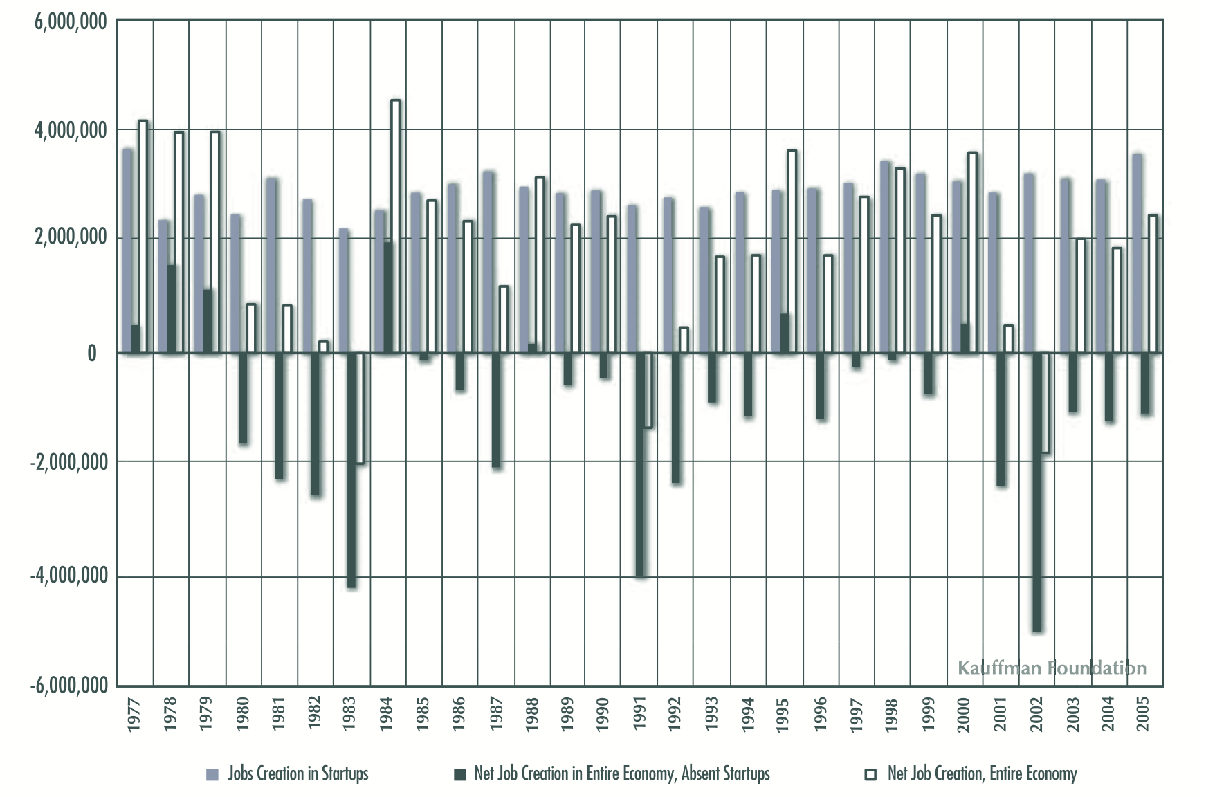

Importance of Entrepreneurship
“Without start-ups, the net rate of increase in employment in the USA between 1980-2005 would have been negative.”
[US Census Bureau, circa 2009]

Slide 25
Section 1
Outline
Understanding some key concepts:
Invention
Innovation
Entrepreneurship
Disruption
Intangibles
Risk
Ecosystem
Research & Education

Slide 26
Disruption
Disruption describes a process whereby a smaller company with fewer resources is able to successfully challenge established incumbent businesses. [Clayton M. Christensen, Michael E. Raynor, and Rory McDonald, “What is Disruptive Innovation?” HBR, Dec. 2015]
Disruptive innovation: innovation that creates a new market and value network or enters at the bottom of an existing market and eventually displaces established market-leading firms, products, and alliances. [Wikipedia]
Notes:
https://hbr.org/2015/12/what-is-disruptive-innovation

Slide 27
What drives disruption?
Ideas Needs

Slide 28
Sources of Disruption
Ideas
  Scientific and Technological progress
Needs
  Planetary-scale Problems and Challenges

Slide 29
Can you identify some Disruptive Innovation?

Slide 30
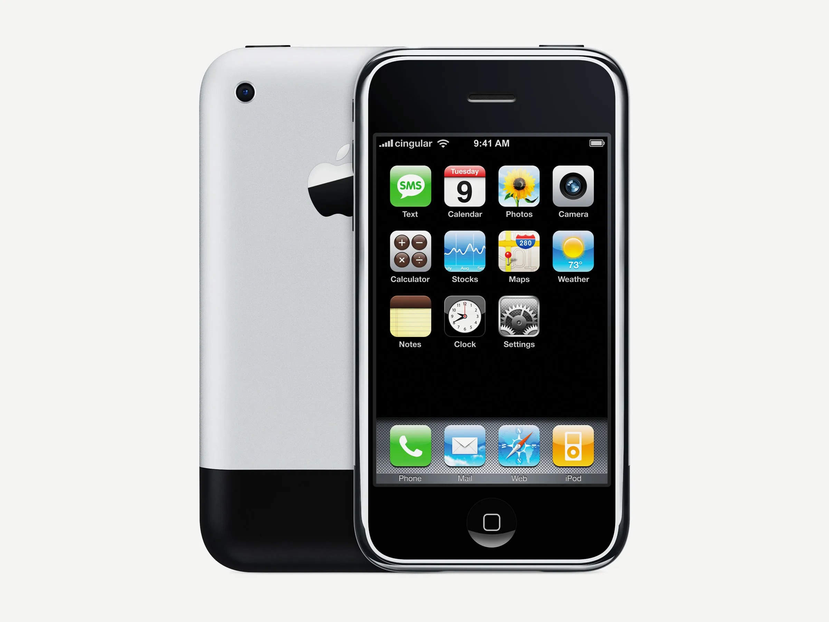
Steve Jobs "We're here to make a dent in the universe"

Slide 31
Which ideas are behind the i-Phone?

Slide 32
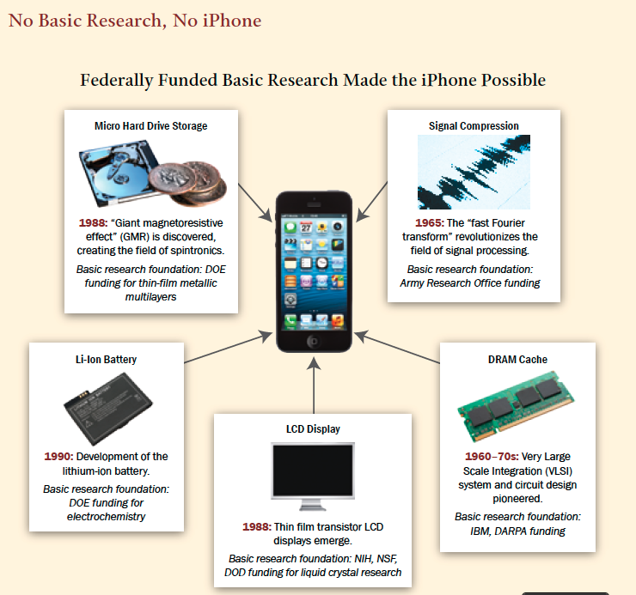
“Restoring the Foundation.” American Academy of Arts & Sciences, 2014.

Slide 33
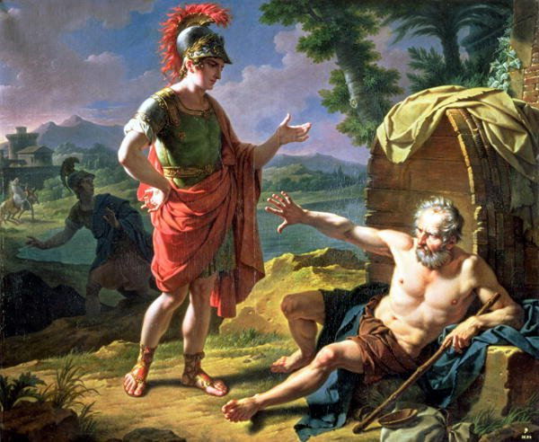
“Stand out of my light”
Plutarch’s, Alexander

Slide 34
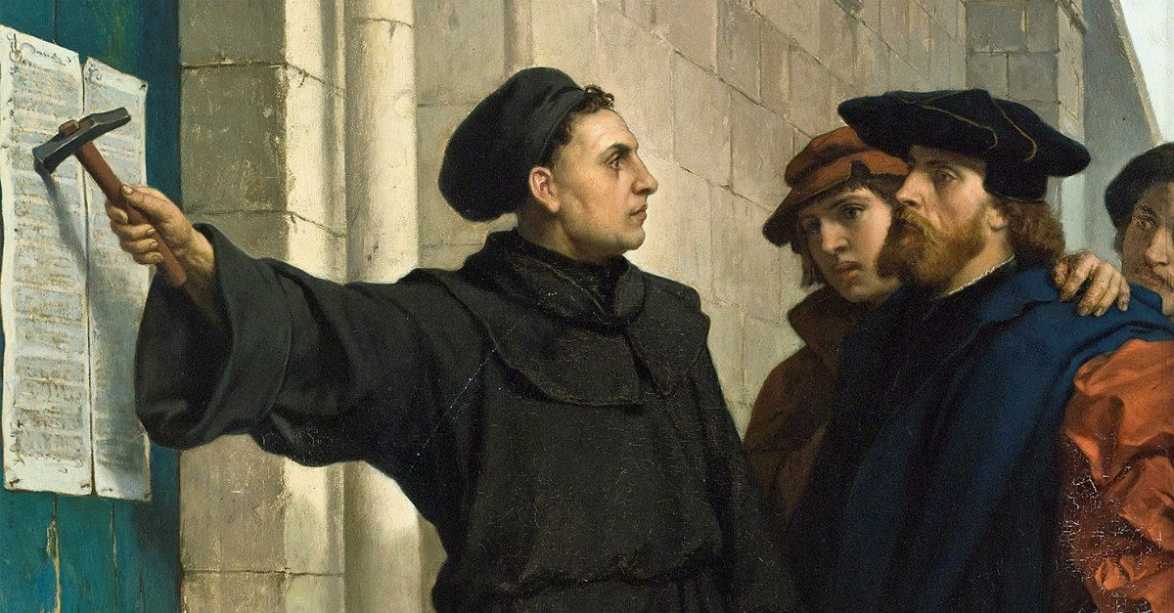
«Ninety-five Theses: propositions for debate concerned with the question of indulgences»
Disputatio pro declaratione virtutis indulgentiaru
Μartin Luther (31/10/1517)

Slide 35
Ideas
Behind the Scientific & Technological Progress in the 21st Century Landscape
We are on the verge of a large scale revolution enabled by the emergence the next-generation of innovation
Thanks to exponential advances in Technology & Scientific knowledge:
    Computing, Big Data, AI, Robotics
    Renewable Energy, Materials, 3D Printing, Nanotechnology
    Genomics & Biology

Slide 36
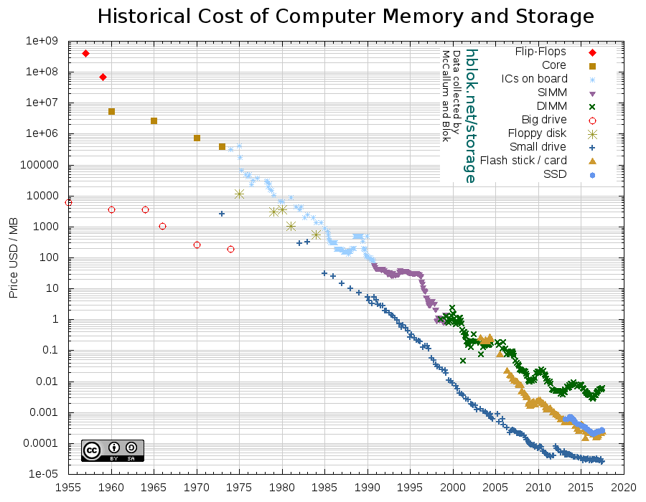
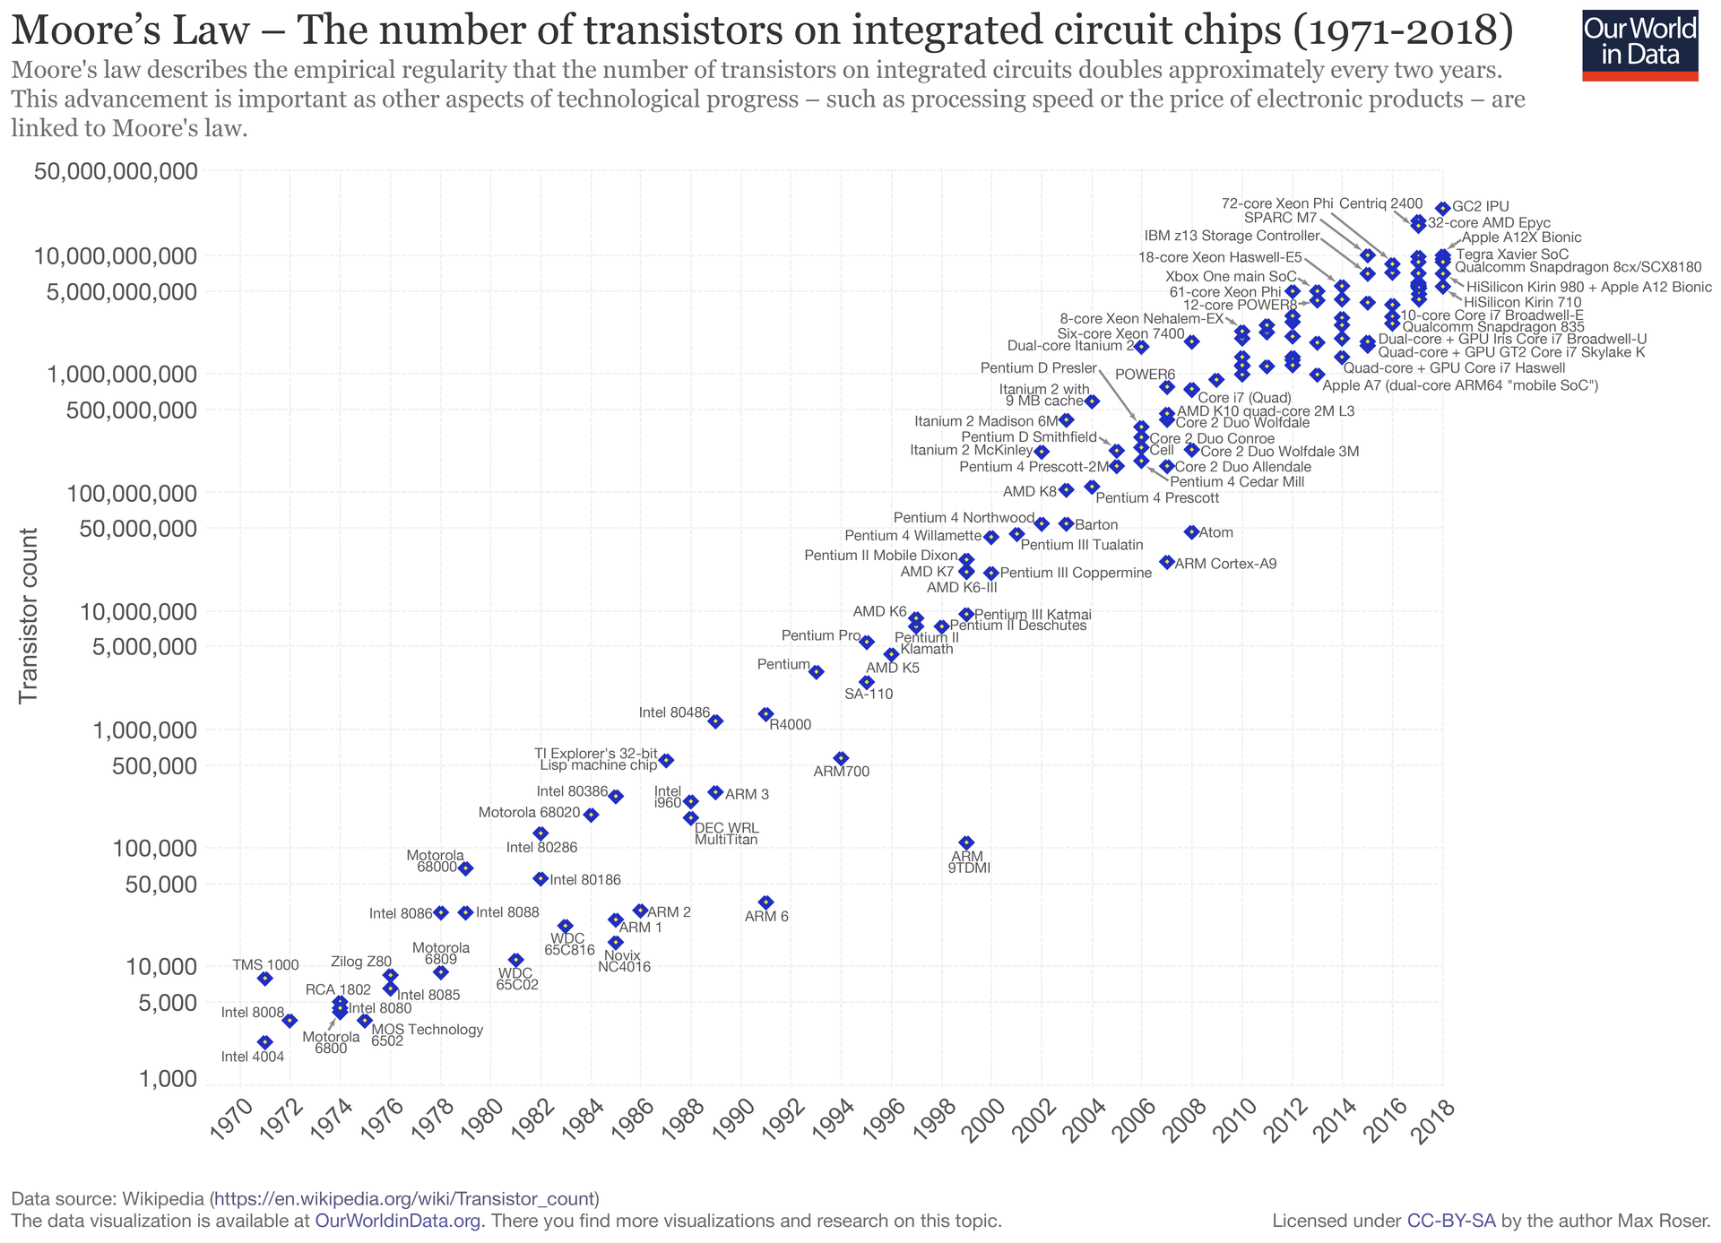
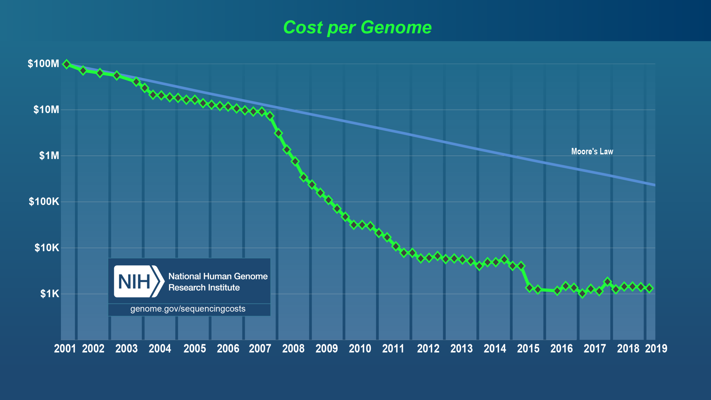
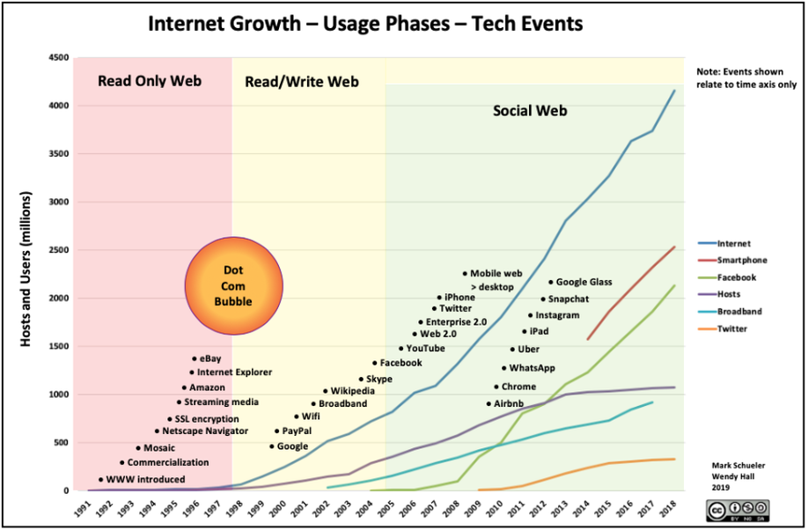
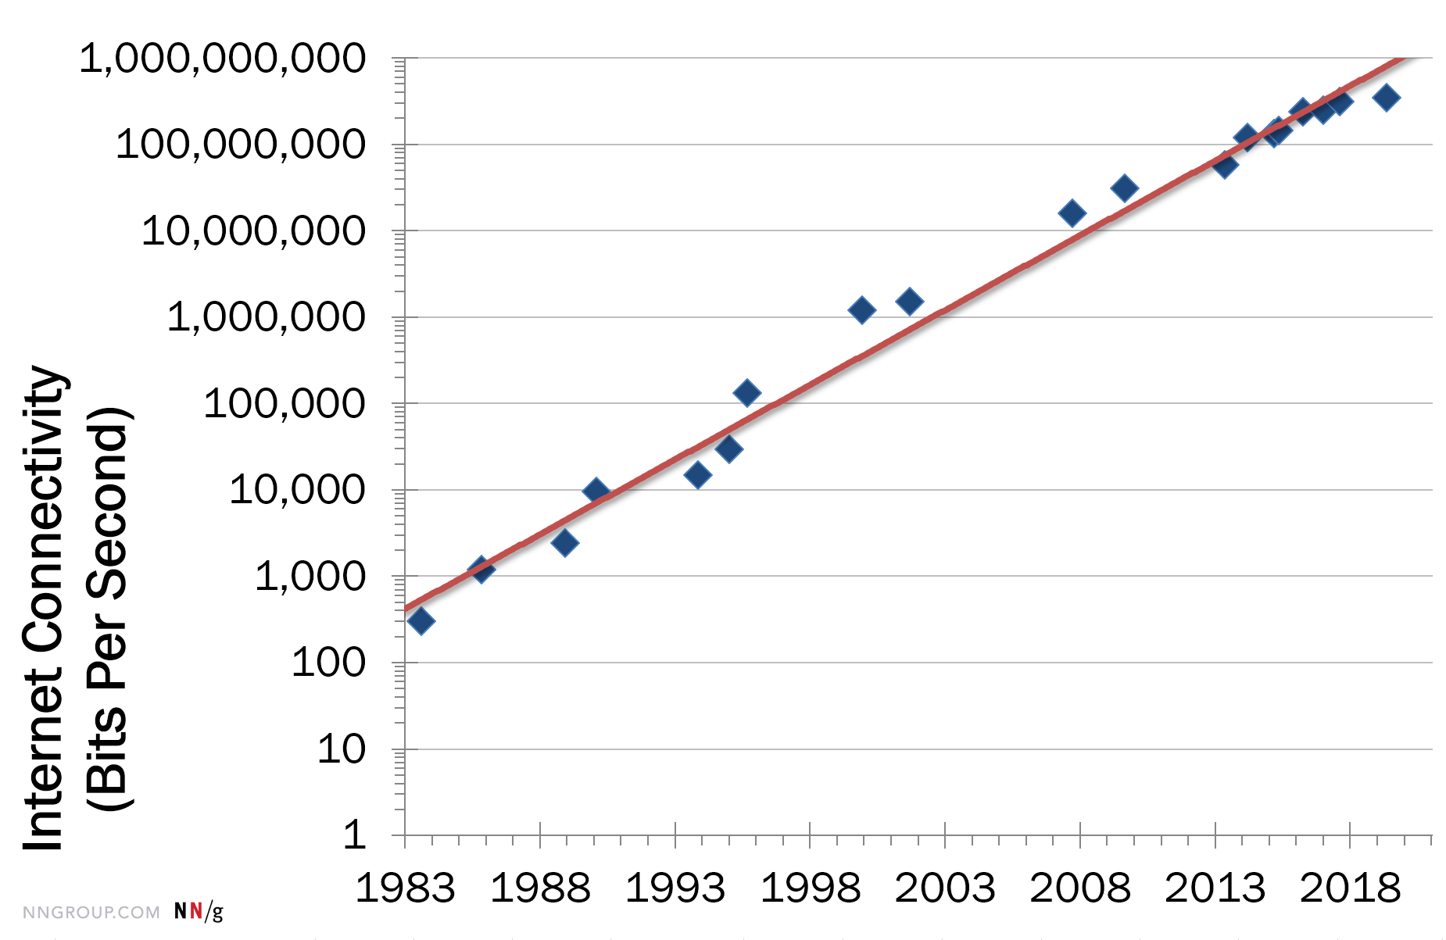
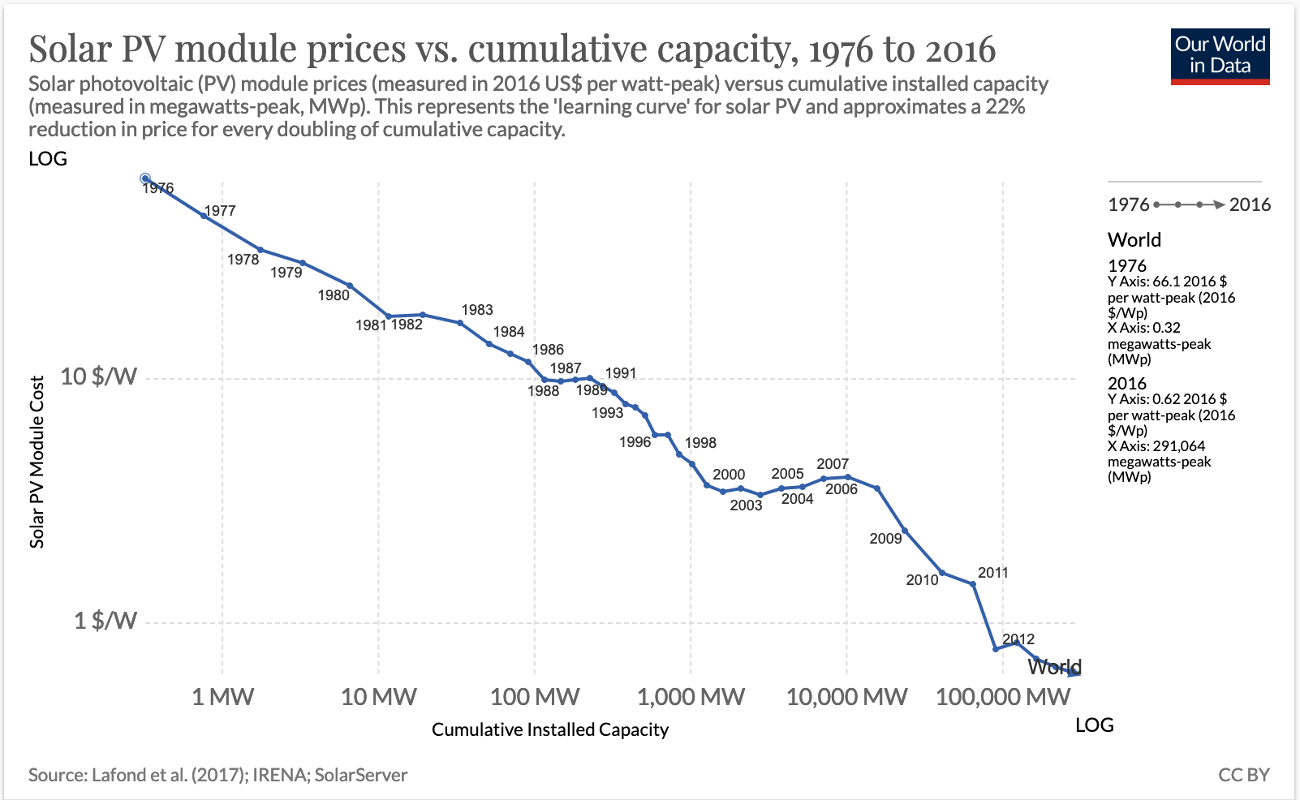

Slide 37

The Knowledge Avalanche
Rapid pace of knowledge creation:
available technical knowledge (number
of pages published in scientific journals)
    2007: doubles every 7 years
    2030: doubles every 72 days
80% of the knowledge required to perform
an advanced technical job is rendered obsolete within 10 years.
In 25 years from the time of that study, the employment landscape would be profoundly different.
2007

Slide 38
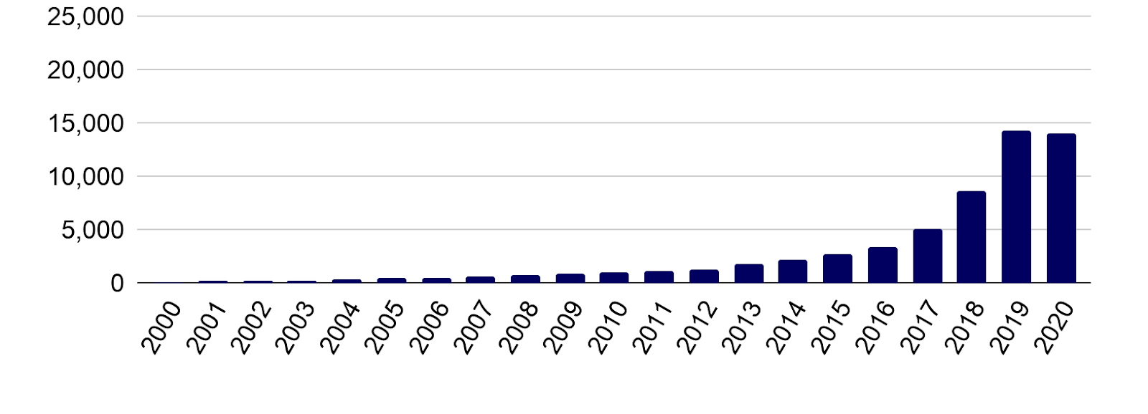
Knowledge Avalanche in AI
Publications involving AI methods in biology (e.g. deep learning, NLP, computer vision, RL) are growing >50% year-on-year since 2017. Papers published since 2019 account for 25% of all output since 2000.
Source: State of AI Report 2020 & PubMed

Slide 39
Investment in AI
In 2020, AI start-ups raised funds of:
Almost $38 billion (USA)
$25 billion (Asia)
$8 billion (Europe)

Slide 40
Innovation: The Case of Deep Learning
Key Concepts

Slide 41
The Case of Deep Learning
https://www.wired.com/story/secret-auction-race-ai-supremacy-google-microsoft-baidu/
Notes:
2018 Turing Award

Slide 42

The Case of Deep Learning
Notes:
2018 Turing Award

Slide 43

The Case of Deep Learning
Notes:
2018 Turing Award

Slide 44
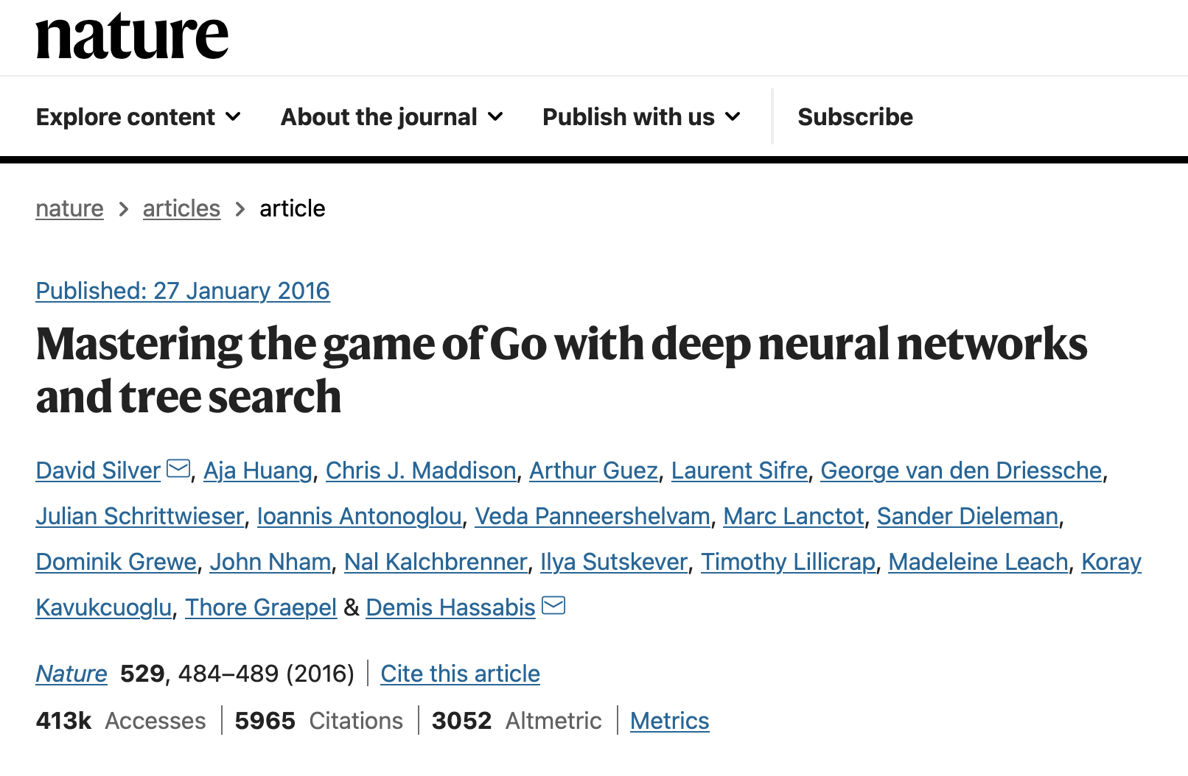

“our program AlphaGo achieved a 99.8% winning rate against other Go programs, and defeated the human European Go champion by 5 games to 0. This is the first time that a computer program has defeated a human professional player in the full-sized game of Go, a feat previously thought to be at least a decade away.”

Slide 45
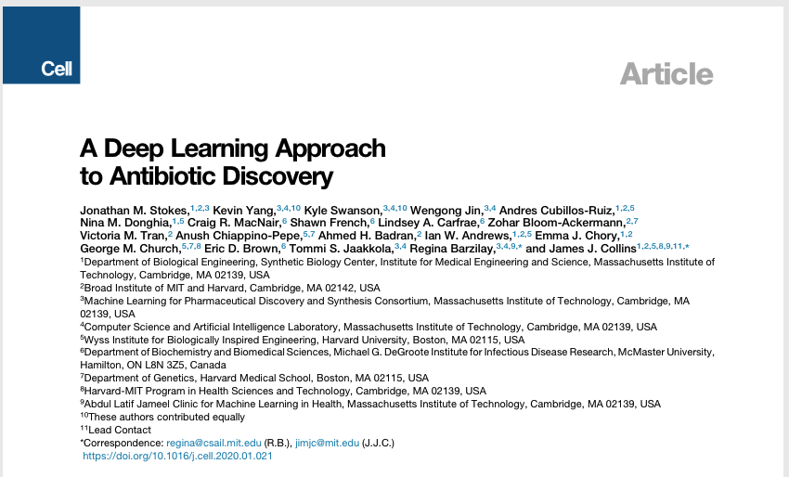

“A pioneering machine-learning approach has identified powerful new types of antibiotic from a pool of more than 100 million molecules — including one that works against a wide range of bacteria, including tuberculosis and strains considered untreatable […] the antibiotic, called halicin, is the first discovered with artificial intelligence (AI).
[…]
this is the first time AI has identified completely new kinds of antibiotic from scratch, without using any previous human assumptions.”

Slide 46
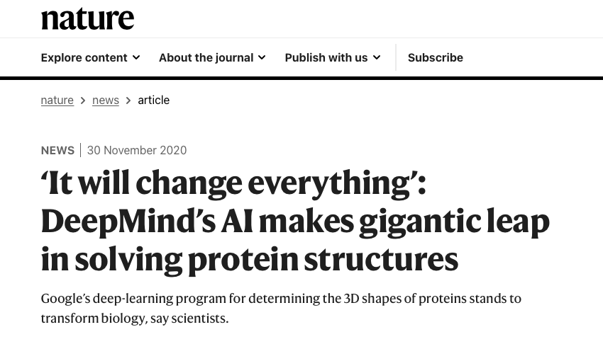
“The announcement [30/11/2020] by DeepMind that its AlphaFold technology is able to predict protein structure with accuracy comparable to slow and costly experimental methods is a harbinger of breakthroughs to come.”

Slide 47
The case of AlphaFold
by
DeepMind
2021: DeepMind releases and open sources AlphaFold, an AI system to predict the 3D structure of a protein just from its 1D amino acid sequence.
Proteins are the building blocks of life, they underpin every biological process in every living thing.
A protein’s shape is closely linked with its function: thus, knowing a protein’s structure unlocks a greater understanding of what it does and how it works.

Slide 48
“The genomes we believed were blueprints for life, were effectively encrypted—this will unlock them and transform biological and biomedical research.”
[Tim Hubbard, Kings College]
https://deepmind.com/blog/article/alphafold-a-solution-to-a-50-year-old-grand-challenge-in-biology

Slide 49


Slide 50

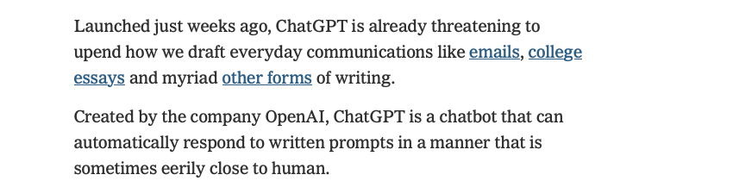

Slide 51
Previous
Week
Overview of MAI622:
  Learning Objectives
  Structure
  Teaching & Learning Methodologies
  Projects and Evaluation
  Communication
Introduction and Key Concepts
  Innovation
  Entrepreneurship
  Disruption and its sources
Precept: JA StartUp Programme & Competition

Slide 52
This week
Lecture 23/1/2023
  Disruption Sources: Ideas & Needs
  Intangibles
  Risk
  Ecosystem
  Research & Education
Precept:

Slide 53
What drives disruption?
Ideas Needs

Slide 54
Needs (21st century)
In the physical world:
  Climate Change, Depletion of Natural Resources, Food Production, Epidemics
In the cyberspace:
  Cybercrime & Cyberterrorism, Privacy, Sovereignty
In the society:
  Globalisation, Work, Ageing, Migration, Human Cognition, Education

Slide 55
Ideas lead to new Needs
The Threat of Automation
Nearly half of 702 professions in the U.S. could be susceptible to elimination due to diminishing costs of ICT and exponential improvements in hardware, algorithms and software.
Frey & Osborne, “The Future Of Employment: How susceptible Are Jobs To Computerisation.” 9/2013
Based on the current trends of technology advancement and adoption, I predict that within fifteen years, artificial intelligence will technically be able to replace around 40 to 50 % of jobs in the United States. Actual job losses may end up lagging those technical capabilities by an additional decade.
Kai-Fu Lee, “AI Super-Powers, China, Silicon Valley, and the New World Order.” 2018
18 / 1 / 2014

Slide 56
Section 1
Outline
Understanding some key concepts:
Invention
Innovation
Entrepreneurship
Disruption
Intangibles
Risk
Ecosystem
Research & Education

Slide 57
Intangibles
Key Concepts

Slide 58
The Rise of the Intangible Economy
A society’s capital stock comprises
  all the things in which people, businesses, and governments have invested over time with the goal of delivering an enduring benefit.
A steady shift in the world's capital stock observed since the 1980s:
  As a society gets richer, most business investment goes to intangible assets
Intangible assets are:
  Things that you can't touch: Research and development, branding, organizational development, and software.
  Things that are costly to acquire, last a long time, and are valuable to a company/society, but are not physical.
Over the decades, intangible investment has become more and more important to the economies of the world; growing since at least the 1980s.
[“Capitalism without Capital”, Haskel & Westlake, 2018]

Slide 59
Intangibles Example
Apple's intangible assets include:
Knowledge gained from R&D
Design of its products
Its widely trusted brands
The valuable and durable relationships with its suppliers (including both its physical supply chain and the developers who support the Apple ecosystem)
Staffers' internal firm knowledge and relationships
Software in its operating system, and its vast data resources.

Slide 60
Intangible vs Tangible Assets
Intangible assets tend to differ from tangible assets in four main ways:
Are often highly scalable: an asset like an algorithm can be used across a very large business
Have spillovers: a business investing in, say, R&D cannot be sure it will be the only entity to benefit from its investment
Are sunk costs: they are often not worth much to creditors if a business fails
Have synergies: they are often massively more valuable when combined with other intangibles
[“Restarting the Future”, Haskel & Westlake, 2018]

Slide 61
Implications of Intangibles
Businesses that own scalable intangibles can grow very rapidly and become large, as in the case of today's tech giants.
Businesses that invest in intangibles may find that their competitors end up reaping the benefits through spillovers (e.g. Xerox, Blackberry and Nokia):
  They strengthen the case for governments to subsidize investment in scientific research, training, and education.
[“Restarting the Future”, Haskel & Westlake, 2018]

Slide 62
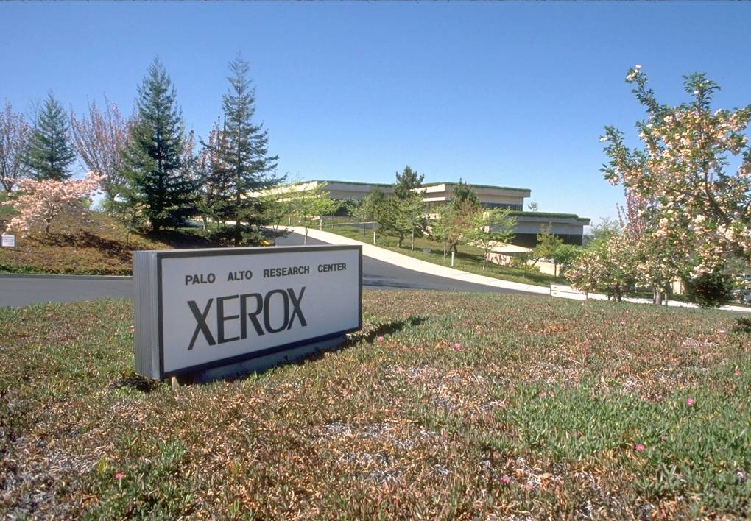

The case of Xerox

Slide 63
The case of Xerox
Xerox PARC has been the inventor and incubator of many elements of modern computing in the contemporary office work place:
  Laser printers,
  Computer-generated bitmap graphics
  The graphical user interface, featuring windows and icons, operated with a mouse
  The WYSIWYG text editor
  Interpress, a resolution-independent graphical page-description language and the precursor to PostScript
  Ethernet as a local-area computer network
  Fully formed object-oriented programming in the Smalltalk programming language and integrated development environment.
  Model–view–controller software architecture

Slide 64
The case of AlphaFold
by
DeepMind
DeepMind’s Announcement (28/7/22)
It’s been one year since:
  we released and open sourced AlphaFold, our AI system to predict the 3D structure of a protein just from its 1D amino acid sequence, and
  created the AlphaFold Protein Structure Database (AlphaFold DB) to freely share this scientific knowledge with the world.
Just twelve months later, AlphaFold has been accessed by more than half a million researchers and used to accelerate progress on important real-world problems ranging from plastic pollution to antibiotic resistance.
In partnership with EMBL’s European Bioinformatics Institute (EMBL-EBI), AlphaFold released the predicted structures for nearly all catalogued proteins known to science, expanding the AlphaFold DB by over 200x - from nearly 1 million structures to over 200 million structures.
Notes:
Proteins are the building blocks of life, they underpin every biological process in every living thing.
A protein’s shape is closely linked with its function: thus, knowing a protein’s structure unlocks a greater understanding of what it does and how it works.

Slide 65
Implications of Intangibles
The fact that intangibles are often sunk costs raises challenges for business finance, especially for small businesses where debt finance is often ultimately secured against a business's assets.
  Businesses whose assets are worth little if the business fails are less attractive lending prospects for banks-a problem in a world where debt finance and bank lending are the main sources of external finance for most businesses.
Synergies increase the importance of combining the right intangibles, hence the inexorable growth of jobs involving brokering ideas, brands, or skills, and the prosperity of dynamic cities in which this kind this kind of activity happens most easily.
[“Restarting the Future”, Haskel & Westlake, 2018]

Slide 66
Intangibles-Rich Economy
Often associated to the “Knowledge Economy” or the“Postindustrial Economy.”
However, intangibles comprise also more things besides knowledge-related assets.
[“Restarting the Future”, Haskel & Westlake, 2018]

Slide 67
About the Knowledge Economy
An economic system in which the production of goods and services is based principally on knowledge-intensive activities that contribute to advancement in technical and scientific innovation.
Key element of value: greater dependence on human capital and intellectual property (IP) for the source of the innovative ideas, information and practices.
Organizations are required to capitalize this "knowledge" into their production to stimulate and deepen the business development process.
Less reliance on physical input and natural resources: knowledge-based economy relies on the crucial role of intangible assets in facilitating modern economic growth.
[“Restarting the Future”, Haskel & Westlake, 2018]

Slide 68
Intangibles vs Knowledge
Some intangibles can fairly be described as knowledge or information. E.g.:
  Results of R&D to develop a new drug, a new production technique, or the results of training a worker in a new skill.
  Software programs or databases, consist of information, which is very similar to knowledge, if not precisely synonymous with it.
But other intangibles are about something more than knowledge or information: relational or expressive capital.
E.g., the value of a brand, does not lie only in the informational content of the name and the logo. The brand is both relational and expressive:
  Relational: it is a sort of promise and a reminder of the past, tacitly referencing countless past transactions that make up the brand's reputation and purporting to offer customers a particular experience or quality.
  Expressive: it conveys an emotional message about the product, one consumers often value.
[“Restarting the Future”, Haskel & Westlake, 2018]

Slide 69
Intangible Economy: Summary
If you want to think about how intangible-intensive economies differ from less intangible-intensive economies, don't think about knowledge work, small manufacturing sectors, or big tech companies.
Think instead of an economy where:
  what people do is more heavily and intimately connected in economic relationships;
  activities of all sorts, from factory production to supermarket shopping, are more information rich;
  economic activity is more freighted with meaning, association, and with emotional significance.

Slide 70
Intangible Economy’s Crisis
Intangibles’ characteristics often have important effects leading to αν “Intangibles Crisis”:
Increased inequality
Weaker competitive dynamics.
They change the type of institutions that a society needs for continued, healthy economic growth.
[“Restarting the Future”, Haskel & Westlake, 2018]
Notes:
In many cases, there is a discrepancy between the institutions we need and the ones we have.

Slide 71
Section 1
Outline
Understanding some key concepts:
Invention
Innovation
Entrepreneurship
Disruption
Intangibles
Risk
Ecosystem
Research & Education

Slide 72

Risk
Reliance on technology is hugely risky.
Relatively few technical innovations bring immediate economic benefit that will justify required investments of time and resources
Peter Drucker, "Innovation and Entrepreneurship"

Slide 73
Section 1
Outline
Understanding some key concepts:
Invention
Innovation
Entrepreneurship
Disruption
Intangibles
Risk
Ecosystem
Research & Education

Slide 74
Ecosystem
Image Source: https://www.zmescience.com/ecology/ecosystems-what-they-are-and-why-they-are-important/

Slide 75
Ecosystem: Traits
Dynamic rather than static
Organically grown but maybe some design too
Heterogeneous rather than monoculture
Symbiotic rather than competitive
Competitive rather than symbiotic..

Slide 76
Innovation Ecosystem
“An innovation ecosystem refers to a loosely interconnected network of companies and other entities that coevolve capabilities around a shared set of technologies, knowledge, or skills, and work cooperatively and competitively to develop new products and services.”
Predators and Prey: A New Ecology of Competition, James F. Moore, HBR, 1993

Slide 77
The Trust Factor
The entrepreneur-investor relationship characterized by uncertainty and information asymmetry:
  Entrepreneurs always possess more accurate information about themselves and their business than their investors possibly can;
  and no one knows whether products can be developed, customers will purchase them, or new businesses will compete successfully against others.
To secure capital from investors, entrepreneurs must overcome the information asymmetry and uncertainty problems by:
  sharing as much information about themselves and their business as they can, in order to
  creating trust with investors

Slide 78
Dimensions of Trustworthiness
Ability
Benevolence
Integrity
Values: need to be prevalent in an ecosystem and its members

Slide 79
Section 1
Outline
Understanding some key concepts:
Invention
Innovation
Entrepreneurship
Disruption
Intangibles
Risk
Ecosystem
Research & Education

Slide 80
Research and Education
Key Concepts

Slide 81
Research & Education
Governments around the world are looking to technology innovation as a driver for national economic growth.
Governments increasingly see universities as the incubators of the national innovation capacity.
[A new mission for public research, EPO, 2013.]
“Universities are at the centre of national and international efforts to solve global challenges.”
[Raimun Lutz, Vice-President, EPO, 2013]

Slide 82
Why Universities?

Slide 83
Why Universities?
Scientific & Tech
Advancement
Innovation
=
Invention x Commercialization
Entrepreneurship

Slide 84
Why Universities?
Scientific & Tech
Advancement
Innovation
=
Invention x
Commercialization
Highly specialised & skilled
human capital
Entrepreneurship

Slide 85
Human Capital
“Highly specialized human capital is a scarce resource that can be used either for innovation of products and services or for educating future innovators.”
  Kenneth Arrow. Economic Welfare and the Allocation of Resources for Invention (1962)

Slide 86
Knowledge
Check
Describe the difference between Invention, Research, Innovation
Explain how AlphaGo became a source of future Innovation
What is the business model that Martin Luther disrupted?

Slide 87
Knowledge
Check
Discuss if universities can catalyze or produce innovations and create synergies required to address these challenges?
Discuss if Universities around the world can respond to these aspirations successfully
in a period of disruption?

Slide 88
Section 2: Technological Innovation Ecosystems
Module 1: Innovation, Research, Start-Ups

Slide 89
Innovation
Ecosystems
Successful Ecosystems
Cargo Cults and Simulacra
Silicon Valley’s Origins
Research Commercialization
Start-ups and Technology Transfer
Overcoming Barriers
Concluding Remarks

Slide 90
Which universities have created the world’s most successful technology innovation ecosystems?
This document has been produced with the support of THE EUROPEAN COMMISSION under THE CONNECTING EUROPE FACILITY - TELECOMMUNICATIONS SECTOR AGREEMENT No INEA/CEF/ICT/A2020/2267423. It reflects the views only of the author, and the Commission cannot be held responsible for any use which may be made of the information contained therein.

Slide 91
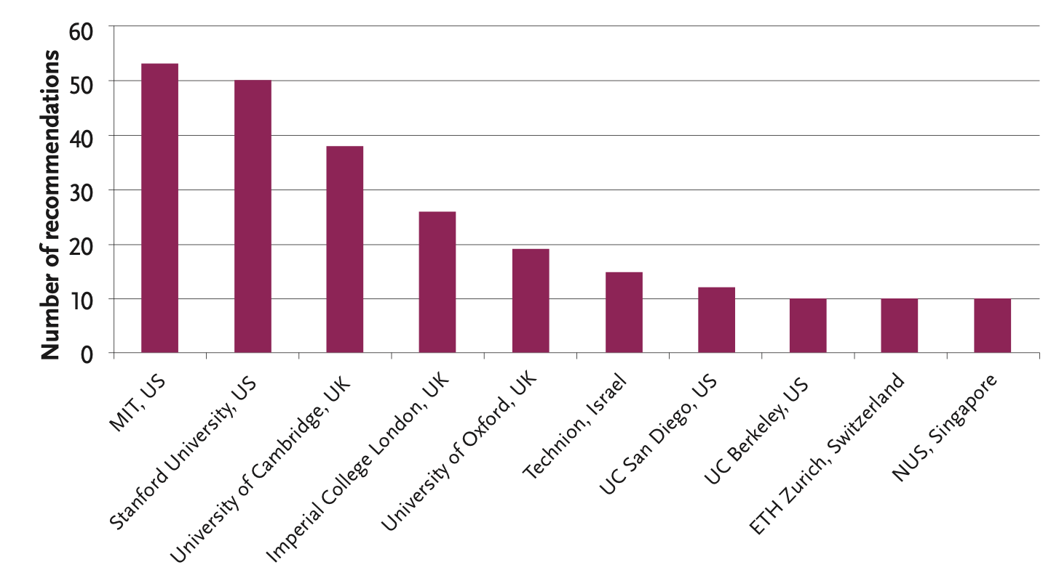

‘Which universities would you identify as having created/ supported the world’s most successful technology innovation ecosystems?’
[MIT-Skoltech Study, June 2014: 61 experts from 20 countries]

Slide 92


Most Successful Ecosystems
Silicon Valley
Kendall Square, Boston
Stanford
UC Berkeley
MIT
Harvard

Slide 93
Some evidence: Stanford
Stanford’s Office of Technology Licensing (circa 2014)
  licensed 8000 campus-inspired inventions
  generated $1.3 billion in royalties for the university
Five thousand companies “trace their origins to Stanford ideas or to Stanford faculty and students”
  Hewlett-Packard, Yahoo, Cisco Systems, Sun Microsystems, eBay, Netflix, Electronic Arts, Intuit, Fairchild Semiconductor, Agilent Technologies, Silicon Graphics, LinkedIn, and E*Trade
Source: “Get Rich U. There are no walls between Stanford and Silicon Valley. Should there be?”
Ken Auletta, New Yorker, April 30, 2012

Slide 94
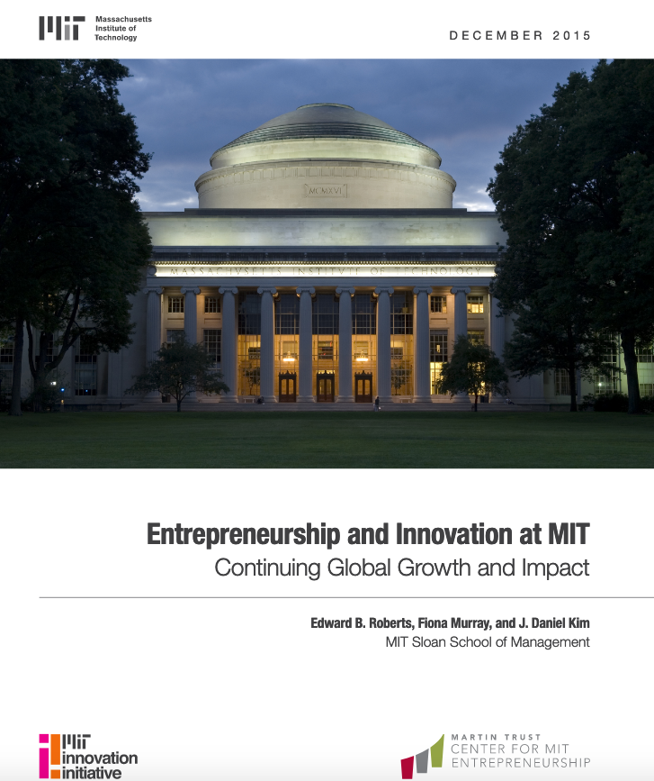
Some evidence: MIT
30,000 active companies founded by MIT alumni:
  employ 4.6 million people
  generate annual world revenues of $1.9 trillion
  producing the equivalent of the 10th-largest economy in the world as of 2014
“Entrepreneurship and Innovation at MIT: Continuing Global Growth and Impact”
Edward B. Roberts, Fiona Murray, and J. Daniel Kim (2015)

Slide 95
Some evidence: US ICT Sector
Source: Continuing Innovation
in Information Technology
U.S. National Academies Press, 2012

Slide 96
Key Lessons: the role of the University
A clear link exists between building indigenous research capacity and economic growth in a post-industrial knowledge economy
University-based research is the most effective driver of scientific discovery and economically relevant new technologies
World-class Universities provide ideal context for educating students for careers in science, industry, government, and civil society.
Produce graduates with the intellectual breadth and critical-thinking skills to solve problems, innovate and lead.
R. Levin, “The Rise of Asia’s Universities”. Foreign Affairs, May/June 2010
Notes:
These examples have taught us some key lessons - derived from the examples of Silicon Valley, Stanford - Kendall Square and MIT, Harvard, Boston U demonstrate that…

Slide 97
Let’s do the next Silicon Valley!
This document has been produced with the support of THE EUROPEAN COMMISSION under THE CONNECTING EUROPE FACILITY - TELECOMMUNICATIONS SECTOR AGREEMENT No INEA/CEF/ICT/A2020/2267423. It reflects the views only of the author, and the Commission cannot be held responsible for any use which may be made of the information contained therein.

Slide 98
"I've had dozens of meetings over the years with leaders from around the world who asked how they can build their own Silicon Valley.
It never works.”
J. Breyer, Breyer Capital & Accel Partners [WEF ’14, Bloomberg’s GII 2014]

Slide 99
“It would be much better to study the early history of Silicon Valley than trying to copy what they are doing now”
MIT-Skoltech Study, June 2014

Slide 100
The End of Silicon Valley?
Four trends that may shape the future of Silicon Valley:
  Consumer internet entrepreneurs lack many of the skills needed for the life sciences revolution.
  Internet regulation is upon us.
  Climate response is capital intensive, and inherently local.
  The end of the betting economy.
Prediction: The nexus of machine learning and medicine, biology, and materials science will be to the coming decades what Silicon Valley has been to the late 20th and early 21st century.
T. O’Reilly, “The End of Silicon Valley as We Know It?”. 2021
Notes:
There are two economies, often confused: the operating economy, in which companies make and sell products and services, and the betting economy, in which wealthy people bet on which companies will win and which will lose in the beauty contest that stock markets have become. In the operating economy, the measure of success is, as Nick Hanauer and Eric Beinhocker memorably put it, “the solution to human problems.” Companies compete to solve those problems more effectively and earn a profit thereby. Along the way, they employ people productively, create valuable new goods and services, and contribute to their communities.
In the betting economy, the measure of success is stock price, the higher the better

Slide 101

Reading Assignment

Slide 102
Innovation
Ecosystems
Successful Ecosystems
Cargo Cults and Simulacra
Silicon Valley’s Origins
Research Commercialization
Start-ups and Technology Transfer
Overcoming Barriers
Concluding Remarks

Slide 103
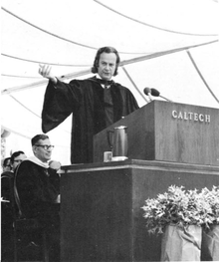
The Cargo Cult Danger
“In the South Seas there is a Cargo Cult of people. During the war they saw airplanes land with lots of good materials, and they want the same thing to happen now. So they’ve arranged to make things like runways, to put fires along the sides of the runways …
They’re doing everything right.
The form is perfect.
It looks exactly the way it looked before.
But it doesn’t work!
No airplanes land.
They follow all the apparent precepts and forms
but they’re missing something essential”

Slide 104

Cargo Cults
“Cargo cults are religious practices that have appeared in many traditional tribal societies in the wake of interaction with technologically advanced cultures.
They focus on obtaining the material wealth (the "cargo") of the advanced culture by imitating the actions they believe cause the appearance of cargo: by building landing strips, mock aircraft, mock radios, and the like.”

Slide 105
Simulacra
Simulacra, a concept introduced by cultural theorist Jean Beaudrillard to describe inauthenticity in modern societies [“Simulacres et Simulation.” Jean Baudrillard, 1981]
Simulacra, refers to: conditions defined by imitations and driven by symbols that, like Disneyland, take on a new a new life of their own that is, however, detached from the underlying reality.
“The simulacrum is never that which conceals the truth—it is the truth which conceals that there is none.”

Slide 106
The Origins of Silicon Valley
Section 2: Technological Innovation Ecosystems

Slide 107
The Origins
Eric Schmidt, Former executive Chairman of Google; US President’s Council of Advisors on Science and Technology; UK Prime Minister’s Advisory Council.
G.S. Beckwith Gilbert ’63 Lecture, Princeton University (April 30, 2015): “Computers and Humans Will Each Do Their Best”
Notes:
Apr 3, 1944 Jan 23, 1984

Slide 108
Origin #1: Vannevar Bush
Director, Office of Scientific Research & Development, 1941- 1947
“Science, The Endless Frontier” report to US president Truman (July 1945)
  Basic research is "the pacemaker of technological progress”
  Supported federal patronage for the advancement of knowledge in the United States
  Establishment of National Science Foundation (NSF)
  By late 1970s: US$75 billion per year US Govt spending on R&D.
”No American has had greater influence in the growth of science and technology than Vannevar Bush” (Wiesner, Biographical Memoir, National Academy of Sciences)
Notes:
Coordinated the activities of some six thousand leading American scientists in the application of science to warfare. During the was channeled funding to US Universities
Wiesner: MIT President

Slide 109
Three driving principles
Government: bears primary responsibility for funding basic research and determines the total amount of funding available in different fields
Universities: primary institutions responsible for carrying out government-funded research
Assessment: based not on political or commercial grounds but on meritocracy, through an intensely competitive process of peer review by independent experts based on scientific merit alone
R. Levin, “The Rise of Asia’s Universities”. Foreign Affairs, May/June 2010
Notes:
National system of support for scientific research founded in three principles

Slide 110
Why the government?
“Because the full economic benefit of a breakthrough in pure science can rarely be captured by the original inventor, private enterprises will typically have insufficient incentive to make many socially productive investments”
R. Levin, “The Rise of Asia’s Universities”. Foreign Affairs, May/June 2010

Slide 111
Why the University?
Exposes postgraduate scientists-in-training to the most cutting edge techniques and areas of research
Allows undergraduates to witness meaningful science first-hand, rather than merely reading about last decade’s milestones in textbooks
Students develop ability to collaborate and assimilate new information, solve problems, and create new knowledge
Best research gets funded - not research proposed by those who are politically well-connected
R. Levin, “The Rise of Asia’s Universities”. Foreign Affairs, May/June 2010
Notes:
of the world-class research university

Slide 112
What kind of University?
“If you think of technology as something that’s spreading like a sort of fractal stain, every point on the edge represents an interesting problem.
One guaranteed way to turn your mind into the type to start up ideas […] is to get yourself to the leading edge of some technology.
[…] when you get there, ideas that seem uncannily prescient to other people will seem obvious to you”
Paul Graham, Y Combinator, 2014
Notes:
The way to get new ideas is to notice anomalies: what seems strange, or missing, or broken? You can see anomalies in everyday life (much of standup comedy is based on this), but the best place to look for them is at the frontiers of knowledge.
Knowledge grows fractally. From a distance its edges look smooth, but when you learn enough to get close to one, you'll notice it's full of gaps. These gaps will seem obvious; it will seem inexplicable that no one has tried x or wondered about y. In the best case, exploring such gaps yields whole new fractal buds.

Slide 113

(btw) The “short-termism” curse
“Americans think everything had to happen yesterday; they have a very short time frame.
My company is 108 years old. Most of my American counterparts are thinking about what’s happening this quarter.
But, we think in generational terms.”
W. Fung, Chairman of Li & Fung (world’s largest consumer-goods sourcing and logistics company), 2014

Slide 114
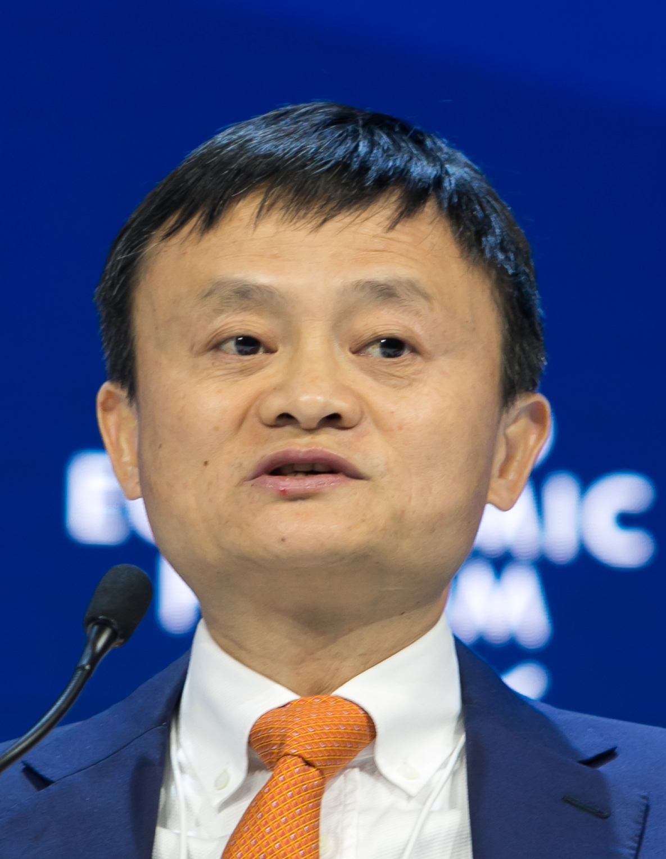
(btw) The “short-termism” curse
"When Alibaba was founded in 1999, our goal was to build a company that could make China and the world proud and one that could cross three centuries to last 102 years.
However, we all knew that no one could stay with the company for 102 years.
A sustainable Alibaba would have to be built on sound governance, culture-centric philosophy, and consistency in developing talent.
No company can rely solely on its founders. […] Because of physical limits on one’s ability and energy, no one can shoulder the responsibilities of chairman and CEO forever.”
Jack Ma, Founder of AliBaba, Letter on retirement, Sept. 2018
Notes:
https://www.bloomberg.com/news/articles/2018-09-10/alibaba-chairman-ma-s-letter-to-staff-on-retirement-full-text

Slide 115
Origin #2: Arthur Rock
One of America’s first venture capitalists
He played a key role in launching Fairchild Semiconductor, Teledyne, Intel, Apple, and many other high- tech companies.
A driving force in the emergence of Silicon Valley as a centre of innovation and entrepreneurship.
Between 1961 and 1968, invested $3 million and returned $100 million to their investors.
Arthur Rock
America’s first venture capitalist
Key role in launching Intel & Apple.
Notes:
Apple established in 1976

Slide 116
Origin #2: Arthur Rock
“I think my biggest accomplishment was starting the venture capital business if, in fact, I did that. If I have to go down in history for doing one thing, I guess that’s it.
But success for me is in helping to build great companies. Having money is nice. Being able to travel and do the things I want to do is all very nice.
But I would give up some of that for the feeling of success, of having created jobs. I helped create jobs. I helped create companies. I helped create wealth for a lot of people. That gives me a great deal of satisfaction.”
Arthur Rock’s interview with Harvard Business School, 2001

Slide 117




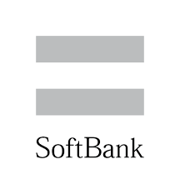





Venture Capital
A type of funding for new or growing businesses, which typically pursue innovative products or services, in high growth technology industries.
Usually comes from venture capital firms that specialize in building high risk financial portfolios.
Venture capital firms give funding to the startup company in exchange for equity in the startup.

Slide 118
Innovation
Ecosystems
Successful Ecosystems
Cargo Cults and Simulacra
Silicon Valley’s Origins
Research Commercialization
Start-ups and Technology Transfer
Overcoming Barriers
Concluding Remarks

Slide 119
Research Commercialization
By late 1970s:
  US$75 billion per year US Govt spending on R&D.
  28,000 patents accumulated.
However, less than 20 patents commercialised, although Universities engaged in licensing, joint ventures, or spinoffs from university research.

Slide 120
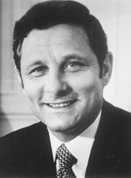
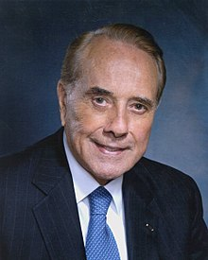


Bayh and Dole
1980 Bayh-Dole Act: allowed federally-funded intellectual property to be owned by Universities
“It is not government’s responsibility … to assume the commercialisation function. Unless private industry has the protection of some exclusive use under patent or license agreements, they cannot afford the risk of commercialisation expenditure.”
1980-1997: >7000 patents granted to academic institutions; >2,200 new companies formed based on licensing of academic inventions
M. Ehrlich, “The National Science Foundation’s Lean Startup Push” Venture Findings, Issue#4(2016), CIV, Tel Aviv University
Birch Bayh
U.S. Senator
(D) Indiana
Bob Dole
U.S. Senator
(R) Kansas
Possibly the most inspired piece of legislation to be enacted in America over the past half-century. More than anything, this single policy measure helped reverse America's precipitous slide into industrial irrelevance.
The Economist. December 14, 2002.

Slide 121
Innovation
Ecosystems
Successful Ecosystems
Cargo Cults and Simulacra
Silicon Valley’s Origins
Research Commercialization
Start-ups and Technology Transfer
Overcoming Barriers
Concluding Remarks

Slide 122
Start-ups vs Tech Transfer
Section 2: Technological Innovation Ecosystems

Slide 123


How does it work? Start-ups
Investors
Research University
Startups
~1%
Inventors
Consumer
Demand
ROI
Small
Fraction
~10% of
startups
Open Knowledge,
Invention
Innovative Products and
Services
Source: prof. Kai Li, Princeton Univ.
Notes:
HIGH RISK

Slide 124

How does it work? Tech Transfer
Businesses, Govt
University
Consumer
Demand
Small
subset
ROI
Patents
Intellectual Property
Innovative Processes,
Products & Services

Slide 125
Another way to see Innovation
Government-funded Research: transformation of money into knowledge
Innovation: transformation of knowledge into money
[Geoffrey Nicholson, 3M (Inventor of the Post-It Note)

Slide 126

Key factors for commercial success
Entrepreneur
Investor
Inventor
Market
“Environment”
“the most important task in business – the creation of new value - cannot be reduced to a formula”
[Peter Thiel with Blake Masters, ”Zero to One” 2014]

Slide 127
The Environment
Knowledge &
Human Capital
(Education & Research)
Capital & Markets
(Investment &
Entrepreneurship)
Culture &
Mindset
Policy Making
(Laws & Incentives)

Slide 128
Outline
Successful Ecosystems
The risk of the Cargo Cult
Silicon Valley’s Origins
Research Commercialization
Start-ups and Technology Transfer
Overcoming Barriers
Concluding Remarks

Slide 129
Overcoming Barriers
Section 2: Technological Innovation Ecosystems

Slide 130


A proliferation of “Silicon Valleys”
Notes:
100sM$ Cornell in Qatar, Sorbonne in Abu Dhabi
KAUST: $10B endowment
C9 - China’s Ivy League

Slide 131
Common barriers
National culture that does not support entrepreneurial behavior and risk-taking.
Geographical isolation and/or limited local market.
Lack of venture capital or multinational companies in the region.
No existing high-ranking research-led university within the ecosystem base.

Slide 132
Success in the face of challenges
“Which universities would you identify as having created/supported highly effective technology innovation ecosystems despite a challenging environment?”
Notes:
2/12-8/12 survey: 83 individuals from 23 countries

Slide 133
Factors to Identify Emerging Leaders
Not simply a result of strong government funding.
Playing an active role in establishing / growing a vibrant ecosystem.
Critical entrepreneurial development still in its ‘startup phase’.
Key Entrepreneurship & Innovation components driving change still in place.
Taken a distinctive path in their E&I policy in response to particular barriers faced in their environment.
A significant focus on engineering and technology in their entrepreneurship activities.

Slide 134
Key features of Emerging Leaders
Well-connected champions with common vision, rich connections
  Inspire, implement and sustain the effort
Public endorsement by senior management of university engagement with entrepreneurship
  Prominence in regional and national strategies for economic growth
Regional, national or government support, on a sustained basis, often responsive and flexible in nature
  Prioritising high-potential players, supporting international strategic partnerships
Relationships of trust with the regional E&I community
  A focal point through which university and local E&I community come together to establish necessary synergies and “support the next generation of entrepreneurs”
Mobilisation and drive of student entrepreneurial movement
  Often a result of strong culture and direct communication lines between this group and university management
Creating a market for university entrepreneurship when limited existing E&I strengths in immediate environment
  Partnerships with alumni entrepreneurs, establishing agency for international industry partnerships, open-access support for entrepreneurial development and start-up creation

Slide 135
Key building blocks of E&I strength
University senior management - leadership & governance
  excellence in strategy & implementation
University departments - academic culture
  excellence in disciplinary and cross-disciplinary research, curricular and co-curricular activities
University-led E&I activity - E&I training and skills
  proper focus and alignment
Student-led E&I activity - need-driven
  enthusiasm and “can-do” attitude
External E&I community - wider context
  robust relationships of trust, synergies and flow of people & ideas
Notes:
1. University senior management: Strong university leadership and governance, actively promoting a clear and prominent E&I agenda that is responsive to the regional and national entrepreneurial environment.
2. University departments: An academic culture that acknowledges, supports and rewards E&I enquiry within a cross-disciplinary context, helping to nurture influential disciplinary-based role models, curricular and co- curricular activities, and champions for institutional change.
3. University-led E&I activity: Distributed responsibility for E&I delivery across multiple university agencies, with a range of support services and participation routes for both students and staff throughout each stage of their personal entrepreneurial growth.
4. Student-led E&I activity: An empowered, cohesive, inventive, bold and well-connected student-led entrepreneurial community, benefitting from sustained low-level funding, seasoned entrepreneurial mentors and direct connections to university senior management.
5. External E&I community: Robust relationships built on trust and mutual benefit between the university and the regional/national E&I community, with a platform for these individuals to play a visible and influential role in university life.

Slide 136
Development models
Model A: ‘bottom-up’ and community-led, catalysed by students, alumni, entrepreneurs in the regional economy with a ‘loose IP control’
  Strong partnerships of trust with regional entrepreneurial community
  Investment focused on regional rather than institutional capacity
Model B: ‘top-down’ and university-led, working through established university structures, with a ‘tight IP control’
  Driven by and focused on strong TTO
  Emphasis on university-owned IP - often leaves students and alumni marginalised

Slide 137
Main success factors
Institutional Entrepreneurship & Innovation culture
Strength of university leadership
University research capability
The local or regional quality of life
Regional or government support
Effective institutional strategy
Powerful student-led entrepreneurship drive
Strong partnerships of trust with regional entrepreneurial community

Slide 138
Ongoing challenges
Potential conflict between research excellence and entrepreneurial ambitions
Disconnect between grassroots, community-driven E&I and formal university channels
Integration of E&I into the university’s mission, policies and incentive systems
Definition of proper E&I metrics

Slide 139
Balancing critical components
University E&I agenda reflected
in its policies, mission, budget
allocations, incentives and curriculum
Inclusive grassroots community of E&I engagement across
university & regional community
Strength in industry-funded research and licensing of university-owned technology

Slide 140
Success in challenging environments
Section 2: Technological Innovation Ecosystems

Slide 141



A Start-up Nation
Notes:
“Which universities would you identify as having created/supported highly effective technology innovation ecosystems despite a challenging environment?”

Slide 142
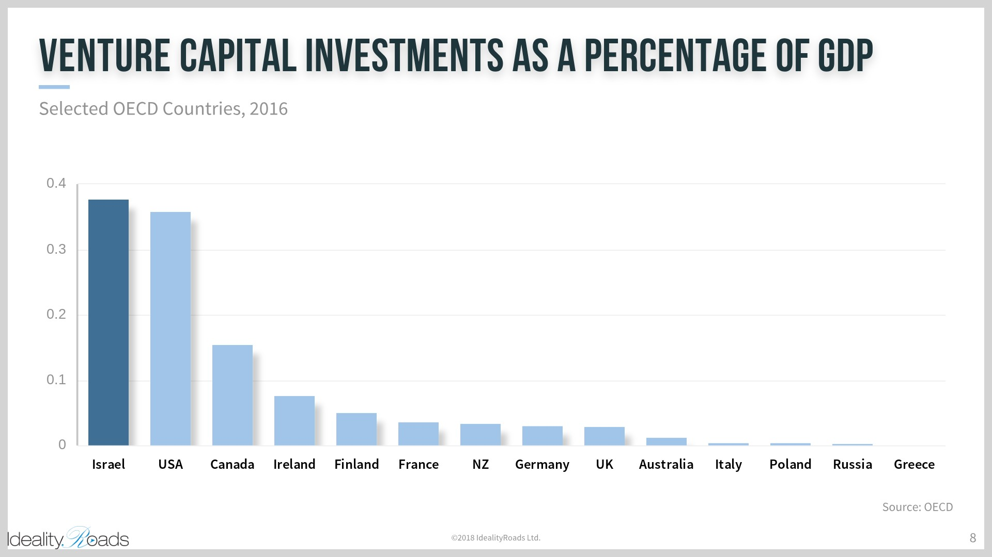
VC Investment
Source: Oren Gershthein, IdealityRoads Ltd.

Slide 143
Highest Venture Capital Availability
Venture Capital investment per person, selected countries, 2010, US$
5,000 active tech companies
600 new companies / year
US$ 2 Billion invested / year
Source: The Economist 2012, based on National Venture Capital Association, European Private Equity & Venture Capital Association, Israel Venture Capital Research Center, UN

Slide 144





























300 Multinational R&D Centres Employing 50,000 People
Source: Nava Swersky Sofer

Slide 145
Hardship breeds Innovation
Interdisciplinary
No strong traditions => Open to change
Strong military => training, innovative technology
International outlook
Brain power, education => innovation
Novel job creation schemes
Small
New
Isolated
No natural resources,
not even water
Immigration –
from 600k to 8 million
in 65 years
Source: Nava Swersky Sofer

Slide 146
The Innovation Recipe
Infra- structure
Environ-ment
Culture
Source: Nava Swersky Sofer

Slide 147
Infrastructure
Education
Innovative research
Smart funding
Management
Facilities
IP system
Infra- structure
Source: Nava Swersky Sofer

Slide 148
Highly-educated workforce
Very high-quality education infrastructure
  Highest ratio of university degrees to population in the world
Bill Gates: “The quality of education is one of the key factors that has made Israel so unique in the great companies and partners we've had…"
Warren Buffet: “If you go to the Middle-East looking for oil, you do not need to stop in Israel. But, if you are looking for brains, for energy and for integrity, the only stop you need is in Israel.”

Slide 149
Successful Academic Commercialization
World pioneer in technology transfer since 1959
Two of world’s top tech transfer companies
  Yeda, Weizmann Institute of Science ( est.1959)
  Yissum, Hebrew University of Jerusalem (est.1964)
>$22 Billion in licensed product sales per annum
>$500 Million in tech transfer revenues annually
Hundreds of spin-off companies
Many success stories
  Copaxone®, Exelon™, Erbitux®, Azilect™, Doxil™, Rebif®, Cherry tomatoes, peppers, NDS Ltd. encryption algorithm, MobilEye driver assistance system…
Source: ITTN, Israeli Central Bureau of Statistics Aug 2014

Slide 150
Tech Transfer in Israel, UK, US & Japan
2012 Figures | Israel | UK | USA | Japan
Invention disclosures | 528 | 4,300 | 23,741 | 8,949
Patent applications | 431 | 1,942 | 14,224 | 6,962
License agreements | 1,056 | 4,300 | 5,130 | 8,808
Spin-off companies | 29 | 191 | 705 | 54
IP-related revenues ($M) | 481 | 111 | 2,600 | 410
Source: Israeli Central Bureau of Statistics Aug 2014

Slide 151
Environment
Regulation
Market access
Tax credits
Institutional investment
Environ-ment
Nava Swersky Sofer

Slide 152
Smart Government Intervention
Office of the Chief Scientist supporting private sector innovation since 1969
Strategic decision to create military R&D capabilities
Venture industry created by government => privatised
Incubators: from job creation scheme to pillar of national innovation eco-system
Innovative industry/academia support mechanisms
Evolving policies addressing market needs, e.g.
  Early stage funding
  Multinationals
Strategic initiatives, e.g. nanotechnology, cybersecurity
Source: Nava Swersky Sofer

Slide 153
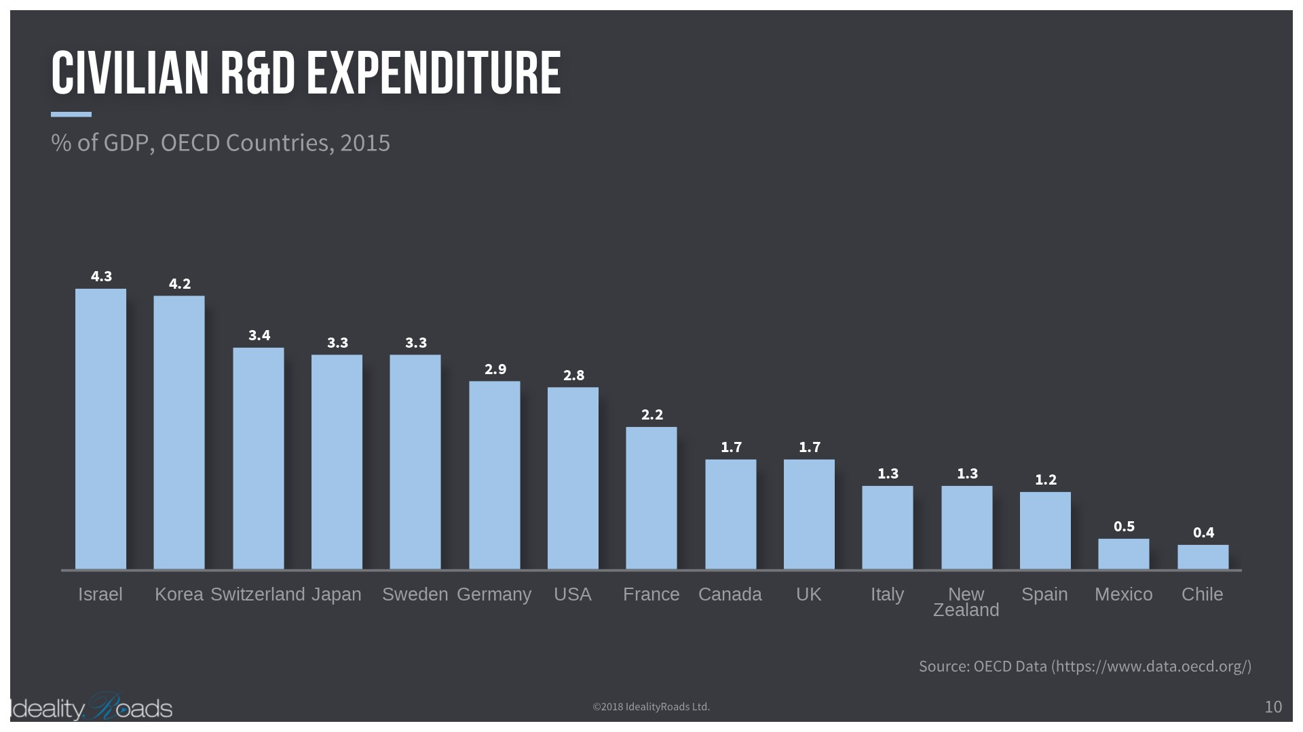
Strong R&D Investment
Courtesy: Oren Gershthein, IdealityRoads Ltd.

Slide 154
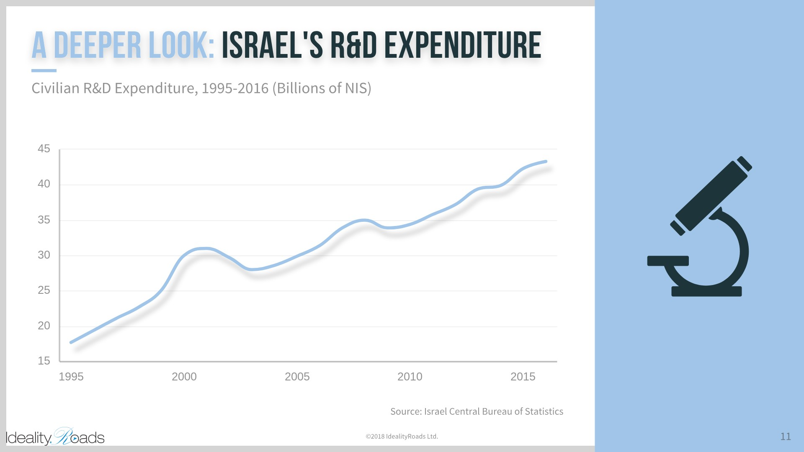
Strong R&D Investment
Courtesy: Oren Gershthein, IdealityRoads Ltd.
Courtesy: Oren Gershthein, IdealityRoads Ltd.

Slide 155
Culture
Breaking old habits
Encouraging entrepreneurship
Learning to embrace failure. It’s part of the package
Culture
Nava Swersky Sofer

Slide 156
The Innovation Recipe
Make best use of available assets
  Research
  Facilities
  Funding
  Supportive environment
Focus on areas of strength
Import best practices
  Fine tune for local needs
Culture change takes time
Source: Nava Swersky Sofer

Slide 157

A “copycat” nation?
Critics have accused China of being a “copycat” nation characterised by wide-spread infringement of intellectual property rights
Copying is an accepted practice, and competitors will stop at nothing to win a new market”
Prevailing western attitudes suggested that:
  Familiar stories of Asian copycat production demonstrated that China is not a place that indeed threatened Silicon Valley’s leadership in good innovation.
  A copycat mentality is a core stumbling block on the path to true innovation, killing imagination and chances of creating original and innovative products.
  The Chinese would never access the innovation magic that drove Silicon Valley.
  [Silvia Lindtner, 2015, Kai-Fu Lee, 2018]
Notes:
This practice is perhaps best personified by “The Cloner”

Slide 158


The “Cloner"
Wang Xing - a serial copycat
In 2003, 2005, 2007, and 2010 he took America’s hottest startup of the year and copied it for Chinese users
  [Gady Epstein, “The Cloner.” Forbes, 4/2011]
However…
  China has more recently been investing in technology, leading to a huge jump in the numbers of patents filed — seen as one yardstick with which to measure innovation.
btw, Wang Xing’s Meituan-Diangping, “Most Innovative Company” by FastCompany, 2019.

Slide 159
Chinese patenting activity
Growing exponentially!
  In 2008 Chinese authorities received 204,268 patent filings, compared with 428,881 in the US.
  By 2017 China’s State Intellectual Property Office received 1.3m applications — more than double the number received by the US.
Patent applications coming out of China reflect a geographical shift of innovation from west to east
Francis Gurry, World Intellectual Property Organisation director-general, Financial Times, July 9, 2019

Slide 160
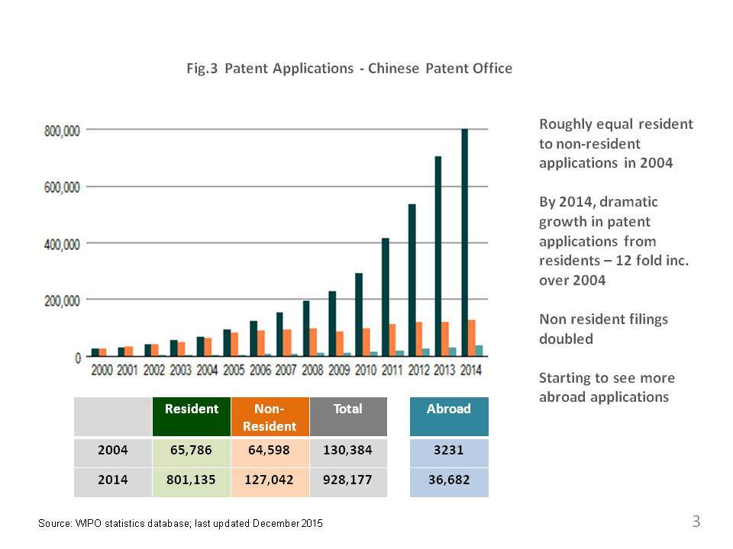
Notes:
How did this happen?

Slide 161
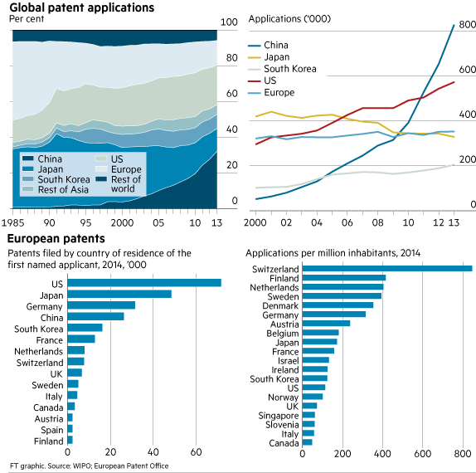
Notes:
How did this happen?

Slide 162
Learning through copying
By cloning early versions of Google, Facebook, Twitter, Groupon etc, Chinese entrepreneurs:
  Built up baseline engineering and digital entrepreneurship skills, totally absent in China at the time.
  Took inspiration from American business models and through fierce local competition adapted and optimised them for Chinese users.
  [Kai-Fu Lee, “AI Super-powers. China, Silicon Valley and the New World Order” 2018]

Slide 163
“Our history of copycat is nothing to be ashamed of. Copying means learning. It means you are redoing it, but in your own way.
It’s like learning a language.
It’s a very natural process. It’s nothing to be ashamed of or blamed for.’’
Eric Pan, founder and CEO of Seeed Studio as quoted in Silvia Lindtner, “Hacking with Chinese Characteristics: The Promises of the Maker Movement against China's Manufacturing Culture.” Science, Technology & Human Values 40(5):854-879 · July 2015
Notes:
Chinese CEO

Slide 164
A National Strategy
“to promote original innovation in scientific research and the innovation and integration of key technologies, so as to scale the heights of world science and technology, and make fundamental, strategic and forward-looking contributions to China's economic reconstruction, national security and sustainable development”
[Guidelines. Chinese Academy of Sciences, 2017]

Slide 165
A National Strategy
“Mass Entrepreneurship - Mass Innovation” aspiration announced by Premier Li Keqiang, 9/2014, WEF @ Tianjin,“Summer Davos”]
5/2015: State Council’s directive on advancing “Mass Entrepreneurship - Mass Innovation” by:
  Directly subsidising Chinese technology entrepreneurs.
  Encouraging the creation of thousands of technology incubators and entrepreneurship zones.
  Establishing government-backed “guiding funds” to attract VCs.
  Offering tax breaks and simplifying administrative procedures.
Central government set the goals, for regional and local administrations to implement them.
Move from “Made in China” to “Create in China”: “Only through owning independent intelligence property and developing its own patents and brands, will China be able to stand out in the world, and Chinese people will then live a life of “equality, freedom and dignity.” [H. Chen, COO, TusPark]

Slide 166

How Does it work?
“The central government does not simply issue commands that are instantly implemented throughout the nation.
But it does have the ability to pick out certain long-term goals and mobilise epic resources to move to push in that direction”

Slide 167
Concluding Remarks
Section 2: Technological Innovation Ecosystems

Slide 168
Conclusions
Cannot cut and paste. Each country/place/university has to find its own model:
  Silicon Valley was developed in an environment of abundance, building on top of a long tradition and strong foundations of strong science, education, mentorship, and inspiration - mission driven.
  Israel success was a needs-based evolution supported by culture.
  China - market-driven, profit-hungry, cut-throat entrepreneurship but with government orchestration.
  New York & London – financial industry and media.
  Singapore and Korea - by design.
Creative innovative mindset requires changing attitudes – takes time.
Strong, consistent, and persistent policy making requires changing attitudes and social pressure.

Slide 169
Concluding Remarks
“the stable development of a research commercialisation activity, outside a one-off “blockbuster” innovation, would take at least 10-15 years”

Slide 170
Concluding Remarks
universities develop the entrepreneurs of the future
not
the ventures of today...

Slide 171
Concluding Remarks
“Start-ups and the Entrepreneurs who found them are not born in a vacuum. Their business models, products and core values constitute an expression of the unique cultural time and place in which they come of age.”

Slide 172
Reading
Assignment
Read Part 1 – Chapters 1-6 (A New Kind of Machine) of the book “Genious Makers” by Cade Metz.
These chapters discuss the scientific and technical evolutions that brought neural networks to the forefront of the present AI revolution.
How long did it take for this evolution to materialize?
Who were the key persons and what each of them achieved?
What were the main factors that led to the successes of AI and ML after so many failures?

Slide 173

Section 3: From invention to commercial product
Module 1: Innovation, Research, Start-Ups
Source:

Slide 174
Section 3
Outline
From invention to commercial product
Disclosure and confidentiality
Assessing Novelty
Competition and Market Potential
Risk Assessment
Exploitation Routes
Prototyping and Proof of Concept
Protecting your Invention

Slide 175
Introduction
Review key stages of turning an invention into a commercial product…
… or turning an idea into an enterprise, if we are to widen our definition of 'invention' to include:
  novel processes
  business methods
  social interactions etc
Notes:
Though invention has traditionally been associated with manufactured products, it is now better understood that new wealth has always been created primarily from new knowledge, or novel uses of existing knowledge.

Slide 176
The element of risk
Any new business venture involves risk, but
invention carries extra risk because it is impossible to predict how well an unknown, untried product will perform in the market-place.
No matter how thoroughly the market is researched, no one can guarantee success.
Most companies and investors know this, and it is the main reason why they are reluctant to gamble on inventions. There are always safer ways to invest money!

Slide 177
The element of risk
A single, simple lesson that inventors need to learn, to maximise chances of success:
  reduce risk and control costs at all times
Most risk is financial, so controlling costs is vital.
  It is easy to overspend on an invention because optimism tends to overrule caution.
  Many invention projects fail because too much money has been spent too soon, or on the wrong things.

Slide 178
The element of risk
As an inventor you must be able to demonstrate that you have done everything you possibly can to eliminate risk from your project.
This means not just the risk to you, but also the risk to:
  potential investors,
  licensees and
  business associates.
If you can show a positive attitude to risk reduction, you are much more likely to attract investment and support.
You should therefore regard reducing risk as essential to improving the chances for your invention - perhaps even more essential than acquiring strong IP rights!

Slide 179
Disclosure and confidentiality
Section 3: From invention to commercial product
Source:

Slide 180
Disclosure and confidentiality
What is disclosure?
The dangers of disclosure are real, and need to be taken seriously as soon as you start thinking about your invention.
Protecting your idea against disclosure is not quite the same as protecting your idea against infringement.
  It depends largely on your own common-sense measures, which you should take from the day you first think of your idea.
Protecting your idea against infringement depends largely on the correct use of formal legal procedures when the time is right to use them.

Slide 181
Assessing the risk of disclosure
Disclosing an idea without adequate legal protection is always dangerous. The main risks are:
  Someone may use knowledge of your idea for their own gain - which usually means your loss.
  Disclosure now may prevent you from obtaining a worthwhile patent later.
In the very earliest stages of an idea, the problem for many inventors is twofold:
  It is usually inadvisable to apply too early for a patent. The timing of a patent application can be critical.
  Yet in order to make progress with an invention, some disclosure may be unavoidable.
How then should you protect your idea in the early stages of its development?

Slide 182
Disclosure risks
Disclosure to individuals during private meetings
  This type of risk is controllable as long as you take a few basic precautions, detailed below.
Public disclosure: the dangers here are less obvious. Particularly problematic areas are:
  Media publicity and competitions. Both may be useful after you have legally protected your idea but definitely not before it.
  Inventions which originate as student projects - especially if there is a requirement to exhibit or publish your work.
    Any form of public display of an idea legally constitutes disclosure and can have serious consequences.

Slide 183
Who can you trust?
You should be safe disclosing details of your idea to people whose professions require them to observe confidence in all dealings with clients:
  patent attorneys, other legal professionals, EPO and national IP office personnel
  public servants such as business or technology advisers and funding scheme administrators.
When dealing with anyone else - companies in particular - you should disclose nothing without at least (a) a signed non-disclosure agreement (NDA) and (b) free forms of legal protection in place, such as copyright or unregistered design right.
Notes:
More in Part 5

Slide 184
Disclosure strategy
You should try to avoid:
  Obsessive secrecy.
  A demand for payment before disclosing any detail of your idea.
Few people will be willing or able to help you if you use such negative tactics.
Instead before talking to companies or individuals not bound by confidentiality (either a professional code or a signed NDA), decide exactly how much you can tell them without describing the inventive parts of your idea.
  Revealing broadly what it is (‘It is a novel mousetrap') may be safe; revealing what makes it novel is dangerous.
The more you discuss the technical aspects of your idea, the greater the risk of disclosing secrets. Try instead to focus your presentation on the competitive benefits of your invention: for example, ‘It is cheaper', ‘It is more reliable', ‘It is easier to use’.
Be diplomatic but firm about your need to restrict disclosure. If the people you are talking to want more detail from you, insist that they sign your NDA.
  If they refuse to sign, walk away! Even if they do sign, disclose as little as possible.
Even if protected by an NDA, be very careful what you reveal to experts in your field of invention. They may need only one or two small details to guess the unique features of your invention.

Slide 185
Protecting your idea (IP)
At some point you must legally protect your intellectual property (IP) or you will not be able to:
  Disclose it safely.
  Be recognized in law as its owner.
  Profit from its commercial exploitation.
  Prevent or discourage its unauthorized use by others.
There are several forms of protection known as intellectual property rights (IPR). Usually, the best way to protect an invention as it evolves is to use a strategic combination of IPR.
  Many inventors assume that the only way to protect their idea is to patent it. While patents tend to be of primary importance, other forms of IPR should also be considered.
Notes:
(see The patenting process later)

Slide 186
Patent Attorneys
IPR is a complex area of law that holds many dangers for inexperienced inventors. A patent attorney's advice will be helpful when you are planning an effective IP protection strategy, and essential if you decide to patent your idea.
Patent attorneys are usually experts in all forms of IPR. They can improve your chances of obtaining worthwhile protection for your idea, and can act for you when problems arise.
Your patent attorney should be able to advise you fully on IP matters in your own country and all of Europe. For IP matters outside Europe, most patent attorney firms in your own country will be able to act for you, or arrange representation, in any country.
However, it is important to understand that no patent attorney can ensure that your IPR will bring you any financial reward. You or your team of other experts must take responsibility for the commercial success of your invention.

Slide 187
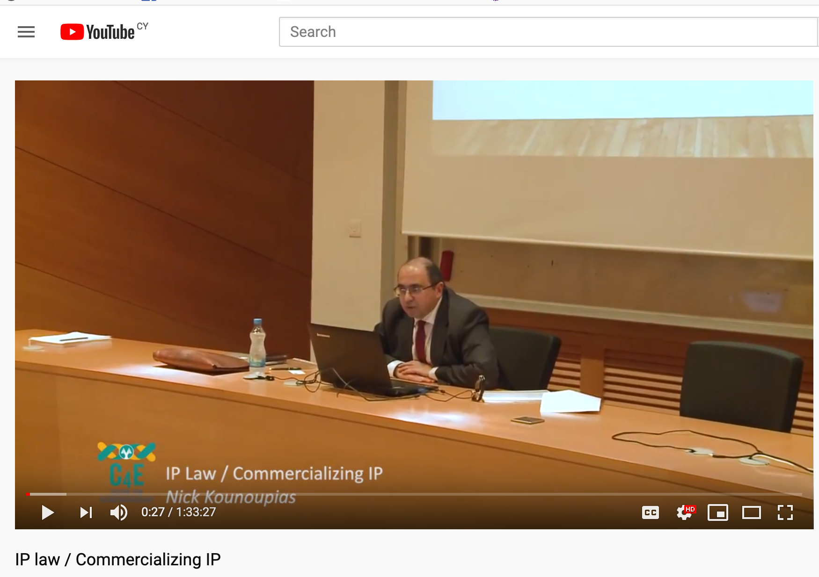
IP Law
https://www.youtube.com/watch?v=3iP9WaNvaqU

Slide 188
Section 3
Outline
From invention to commercial product
Disclosure and confidentiality
Assessing Novelty
Competition and Market Potential
Risk Assessment
Exploitation Routes
Prototyping and Proof of Concept
Protecting your Invention

Slide 189
Novelty
Section 3: From invention to commercial product
Source:

Slide 190
What is an invention?
For your idea to be regarded as an invention, at least one significant part of its technology must be completely novel (that is, new).
  There must be no evidence that this novel aspect of your idea has ever been described before, or used for the same purpose before.
Not all the technology of an invention needs to be novel.
  An idea may be an invention if existing technologies are combined in a way that is novel, or used in a way that is novel.
  The inventive element might be only a small part of the whole idea. But if that small part makes a big difference to the commercial prospects of the idea, it could be an important and valuable invention.
Many people claim to have thought of a novel use of technology. The reality is that in most cases, the idea is already known. It therefore cannot be novel and so there may be little point trying to commercialise it.
  The inventor will usually be unable to protect it strongly, and without strong intellectual property protection to attract them, few companies or investors will be interested.

Slide 191
How do you find out if your idea is novel?
You do it by searching for prior art.

Slide 192
What is prior art?
Prior art is any evidence that your invention is already known.

Slide 193
Prior art
Prior art does not need to exist physically or be commercially available. It is enough that someone, somewhere, sometime previously has described or shown or made something that contains a use of technology that is very similar to your invention.
An existing product is the most obvious form of prior art. This can lead many inventors to make a common mistake: just because they cannot find a product containing their invention for sale in any shops, they assume that their invention must be novel.
The reality is very different. Many inventions never become products, yet there may be evidence of them somewhere. That evidence - whatever form it may take - will be prior art.
Some experts estimate that for every recorded invention that eventually reaches the market, ten never will. This means that if you want to find out if your invention is novel, you should indeed search products past and present - but you should also search much further.
Notes:
A prehistoric cave painting can be prior art. A piece of technology that is centuries old can be prior art. A previously described idea that cannot possibly work can be prior art. Anything can be prior art.

Slide 194
Where can you search for prior art?
Worldwide patent system
Some patent databases - including the European Patent Office's free database Espacenet - contain 90 million documents collected and indexed over many years by patent offices in many countries.
Thanks to the internet, and to the international classification systems used to organise inventions by subject, it is quite easy for inventors to do their own patent searching.

Slide 195
Competing art
While looking for prior art, you should also look for competing art. These are ideas that may not be at all like yours but do the same job.
It is important to study competing art for two reasons:
  Most inventions are a solution to a problem, and most problems have more than one possible solution. You need to examine other solutions, as some may offer more advantages than yours.
  If you try to exploit your idea commercially, alternative solutions may be strong competition. In order to argue successfully that your solution is better than alternatives, you need to know what the alternatives are!

Slide 196
Why is novelty important?
For an invention, a lack of novelty matters for 2 main reasons:
  You are unlikely to be able to obtain any worthwhile intellectual property rights for an idea that is not novel.
    In most cases this means that your idea will have little or no commercial value. (Exceptions include ideas that rely more for their success on skilful marketing than IPR, or where a rights owner agrees to license the IPR.)
  An idea that is not novel cannot legally belong to you. If someone else owns the rights to it, you risk having legal action taken against you if you try to exploit it without their permission.
    Nor can you claim the idea as yours even if it has no legal owner (for example, if it is an old idea).

Slide 197
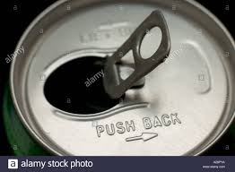
Why is novelty important?
Even if an idea is novel, novelty on its own may not mean much. For an invention to have good commercial potential, it needs to be a significant improvement on prior art. This depends on many factors. Some improvements may be small in technology terms but have high commercial value.
For example, the drinks can ring-pull is simple technology, but its advantages -
  it is secured by a rivet that does not penetrate the can, and
  the underside of the ring is shaped to give mechanical advantage - made it a significant invention with huge commercial value.

Slide 198
Why is novelty important?
It is possible for a commercially successful idea to be novel but not particularly inventive.
  For example, electric toothbrushes used to be too expensive to sell well.
  Then someone discovered that it was possible to use a much cheaper motor. Prices fell and sales soared.
  This new type of electric toothbrush simply included a well known motor, and functioned in a well known way, so there was no invention - but the novelty of combining motor and toothbrush gave it a large commercial advantage.

Slide 199
Why is novelty important?
“Reinventing the Suitcase by Adding the Wheel” NYT 4/10/2010
https://www.nytimes.com/2010/10/05/business/05road.html

Slide 200
Is the idea obvious?
To be regarded as an invention, an idea needs to include an inventive step, i.e. something:
  non-obvious
  does not readily occur to an expert in the relevant technology.
Obvious: something that would be the next logical step along your path from the problem to the solution.

Slide 201
Obvious is not so … obvious
Judging what might be obvious can be very difficult. The following inventions could be considered as obvious:
  Inventions which involve combining equipment, the result of which combinations might be a new product, but its properties or functionality might be entirely predictable as soon as one knew its components.
  A product in which one component has been replaced for a different one with equivalent properties.
  A new problem which can be solved with a well known piece of equipment: the ‘novel' process for solving this problem might be considered obvious if there was only one solution to the problem, and it would be known to the typical technician facing the problem (the so-called ‘person skilled in the art').

Slide 202
Non-obvious Inventions
When components are combined to make a product or process with properties which are greater than the sum of its parts, or better than expected.
In a problem with many possible solutions, where the inventor:
  did research to select the best one
  defied some technical prejudice and solved it by doing something every other expert had previously believed would not work.

Slide 203
Where do inventors go wrong?
When it comes to prior art searching, many inventors simply scratch the surface.
By far the most common mistake they make is to assume that their idea is novel, when a simple patent search would tell them that it was not.
  They then make things worse by spending often large sums of money on an idea that is extremely unlikely to be commercially successful.

Slide 204
The inventor of an odourless toilet bowl visited many companies with a complete working toilet, performing 1600 demonstration flushes.
But he had never done a patent search.
Eventually he found a company interested enough to do its own patent search.
They soon found so much prior art that it became obvious that the idea was unprotectable.
The inventor threw away his toilet.

Slide 205
Prior art searching
Prior art search processes: a product search and a patent search.
  You must do both to be confident that you have done a thorough prior art search. You must also do them before spending significant amounts of time and money on your idea.
Warnings:
  It may take only minutes on the internet to find prior art. If you do not look for it, companies and investors almost certainly will. You are unlikely to get help or funding if they find crucial prior art that you have missed.
  Do not ignore evidence you do not like. The purpose of a prior art search is to go looking for evidence you may not like.
  An absence of prior art at the time of your searches may not be a permanent absence. You should update your prior art searches periodically as you develop your idea.

Slide 206
Prior art searching Steps
Step 1: Finding the right keywords
Step 2: Product searching
Step 3: Patent searching
Notes:
https://www.epo.org/learning-events/materials/inventors-handbook/novelty/searching.html

Slide 207
Find the keywords
To maximise your chances spend some time thinking of key words or search terms which best describe your idea.
When using search engines, the most obvious key words may be unhelpful. For example, let us say your idea is a mousetrap
  A search for ‘mousetrap' produces over two million hits - many of them irrelevant, and an impossible number to search.
  But a search for ‘rodent trap' (what else it is) and ‘trapping mice' (what it does) produces 20,000 and 700 hits respectively. These are still not small numbers but they are likely to be more relevant, so we can usefully start searching here.
The most productive search terms may be specialist technical terms that you do not know. For example, a search for external devices that pump blood round the human body required the crucial medical term ‘extra corporeal'.
  A searcher with no medical knowledge would be unlikely to know this term, but might find it while examining the results of other key word searches. It may therefore take a few preliminary searches to find better keywords to use for more accurate searches.
Look out too for new terms for new technologies: for example, ‘virtual fit' for software systems to replace trying on clothes in shops, and ‘telemedicine' for remote monitoring of patients in their own homes.

Slide 208
Product searching
You need to find out what is already on the market:
  That is similar to your idea (prior art).
  That tackles the same problem (competing art).
Obsolete technologies or products may be prior art, so:
  check historical as well as current sources of information.
Products in development but not yet on the market may be prior art, so
  Search news sites, industry journals, trade show and exhibition websites. Perhaps especially search academic research activity, as this is where many new products start out, often years before a commercial product appears.
  Search offline - in shops, books, periodicals, printed catalogues etc.
  Talk to people with relevant experience - for example, retailers and suppliers - who will have seen products come and go over the years and may have seen your idea among them.
Notes:
(People who have retired from relevant careers can be valuable sources of information, as their experience may go back much further than current practitioners!)

Slide 209
Patent searching
For many ideas, patent searching will be far more important than product searching.
  Although many products on the market do not have a patent, they are probably heavily outnumbered by the many ideas that are successfully patented but never reach the market.
Patent searching involves two skills:
  Finding every patent document that is relevant to your invention.
  Interpreting the significance of your patent search findings.

Slide 210
How long will your search take?
From a few minutes (if your first keywords are accurate and there is a great deal of prior art) to many hours.
Be prepared to spend all the time it takes to be confident that you have done a proper job.
Your mission is: find evidence that disproves the novelty of your invention!
  Your hope is that you will fail, but in the interests of a thorough search you must put that to the back of your mind.
Assume that if you are not finding prior art, you are looking in the wrong places.
Keep searching until you are confident that there is nowhere else left to look.
Keep records of everywhere you look and everything relevant that you find.
You are unlikely to be as good as a professional searcher, so in some cases it may be advisable to ask a professional to search for you
Notes:
A thorough and well-recorded search is essential - because how else do you prove an absence of prior art?

Slide 211
Simple Espacenet Searching
Use your keywords to find at least some relevant patents: prepare search strings of up to ten keywords (Use Espacenet's wildcard feature to find plurals and other variants).
  This may produce enough prior art to end your search.
  If not, go back to Smart Search and try different search strings.
Work with bibliographic screens to looks for patent abstracts and/or examining individual patents.
If you have not found enough prior art after repeating this procedure a few times, try shifting the basis of your search from keywords to classifications or CPCs (Cooperation Patent Classifications).
  Use relevant patents found to identify relevant subject classification for your idea.
  Try combining keywords with CPC terms to refine your search.
Notes:
For example: to find ventilator(s), ventilate(s), ventilated, ventilating and ventilation all at the same time, just key in ventilat*.

Slide 212


Slide 213


Slide 214


Slide 215
A word of caution
Most documents in patent databases will be applications only and not granted patents.
Although the claims in applications count as disclosure, they are often modified later and so may be no guide to:
  the claims - if any - eventually granted
  the extent to which your idea might infringe someone else's patent.

Slide 216
Professional patent searching
It is advisable to use professional patent search services if you can afford them. Such services typically include:
  A PATLIB (PATent LIBrary) centre. A joint initiative of the national patent offices of the EPO member states and their regional patent information centres, the PATLIB network consists of over 320 centres throughout Europe. Qualified and experienced staff can provide a range of search and other information services.
  Database searches offered by many libraries and business information services. Many of these are provided at low cost as a public service, but may not be performed by qualified or experienced patent searchers.
  Commercial search services offered by national Patent Offices. Options and costs may vary.
  Commercial search service providers. There are several major companies in this market, and many smaller specialist consultancies. See, for example, the members of PATCOM . Fees and services vary, so shop around.
  Searches by patent attorneys. Fees usually vary according to the type of search you need. A patent attorney will also be able to help you interpret your search findings. This is the real skill in patent searching.

Slide 217
Section 3
Outline
From invention to commercial product
Disclosure and confidentiality
Assessing Novelty
Competition and Market Potential
Risk Assessment
Exploitation Routes
Prototyping and Proof of Concept
Protecting your Invention

Slide 218
Competition and Market Potential
Section 3: From invention to commercial product

Slide 219
Competition and Market Potential
Is your idea a good business opportunity?
  Novelty alone may mean nothing if your idea does not have good commercial potential. Very few people will buy a product simply because it is an invention. They will buy it only if they have a use for it and prefer it to competing products.
  Therefore, if you hope to interest companies and investors in your idea, you must convince them that it offers a lucrative business opportunity with as few risks as possible. They must see enough profit potential in your idea to recover their investment many times over.
  Thinking commercially also helps to reduce your own financial risk, which will increase as you develop your idea.

Slide 220
Competition and Market Potential
When thinking about the market potential of your idea, you must consider how it might cope with competition.
You also need to study competition for another reason: if your idea is completely new, what you can find out about competing products or companies may be the only reliable market data available.
Competition does not just mean products exactly like your idea. It means anything currently used or done to solve the problem your idea addresses.
For example, if your idea is a novel mousetrap, competition is not just all other mousetraps. It must include all methods of getting rid of mice - even cats!

Slide 221
Assessing your competition
Key questions:
  Who are your competitors?
  How much of a threat are they?
  Can your idea compete successfully against them?

Slide 222
Who are your competitors?
Using the internet, it should be quite easy to find competing products and technologies anywhere in the world. Do not ignore a product simply because it is not sold in your country. Markets are now global, and products currently sold in only one country could be available worldwide within months.
As with prior art, look also in shops, trade-only outlets, catalogues etc. Read industry journals and visit trade exhibitions to find out what people are buying and not buying, and to find out about new product launches.
Talk to people who work in relevant trades or professions. Ask them which products and methods they use or do not use, and why. (Do not, of course, disclose your invention.)
  Retired experts in particular may be able to give you valuable information that they would not have been free to disclose when they were employed. They may also have time to spare, and if they like what you are doing, they may be happy to become involved in your project.

Slide 223
How much of a threat are they?
You need to know as much as possible about each competing company. If the company sells many products, consider only those that will compete with your idea. For example:
  How much money are they making from those products?
  How do they price products?
  How often do they improve or replace products?
  What is their market share, and is it rising or falling?
  How and where do they distribute their products?
  How widely do they advertise their products and their brand?
  How good is their technical and after-sales support?
  What is their reputation among customers and within the trade?
Be aware that a company's ability to compete may depend more on marketing than on technology, so do not underestimate the threat from a technically inferior product if the company selling it can afford to spend a lot of money marketing it.

Slide 224
Can your idea compete successfully?
Launching a new product is never easy because the market already belongs to the competition.
They are known, experienced and perhaps trusted, while your product is an unknown quantity.
You must consider carefully whether your idea really does have the potential to take enough of the market to be a tempting business opportunity for a company or investor.

Slide 225
Assessing your product’s potential
Does anyone actually need your product?
  The problem your invention solves may interest you, but do enough other people feel the same way? If they do not, the market may be too small and unprofitable to be worth bothering with.
What is the best market for your product?
  This is rarely as easy to answer as many inventors think. The same invention can often be developed in different ways, so look for gaps in the market - areas where existing provision or competition is weak.
What is the easiest market to enter?
  Minimising risk has to be a priority when launching a new product. If your ‘best' market is costly to enter, it may be a good idea to start with one that is cheaper to enter, even if it is less profitable. Success in this market may make it easier to enter more profitable markets later.

Slide 226
Assessing your product’s potential
How healthy is your target market?
  Is it growing or shrinking? You should hesitate to enter a declining market unless you feel your product can revive it. Looking into the future, are there any emerging technological, social, regulatory or legal changes that might radically affect its fortunes?
At what price might your product have to sell?
  If the price of your product is not similar to prices charged by competitors, you may find it difficult either to make sales or make a profit. Your competitors have done much of your research for you: they have discovered the price the market will bear.
Will your product meet standards?
  Most products need to meet national or international standards of safety, performance etc before they can legally be sold. Achieving compliance can be a long and expensive process, so find out what will be required.

Slide 227
Research guidelines
You will probably have to do your own market research. Professional research is often too expensive, and if your idea is still at concept stage there is a risk that other people will not fully understand it.
Universities are a possible source of low cost research assistance. For example, some departments may need real-life project material for their students. A problem is that students differ in ability, and so quality cannot be guaranteed.
All your research needs to look professional. This is important because at some point you may have to present your research to other professionals as part of a proposal for funding.
Use only reliable or first-hand sources of information, and record each source. Never do what some inventors do, and present as evidence a collection of articles from popular newspapers and magazines.
Consumer surveys may seem like a good idea, but many people say one thing to researchers and do the exact opposite later. Surveys may therefore be a poor guide to actual buying behaviour.
Do not trust the opinions of family and friends! Most will lie to you in order to avoid arguments, or because they do not want to hurt your feelings.
Do not ignore someone whose opinion is different from all the rest. That person may be the only one to identify a major weakness in your idea.

Slide 228
Free or cheap market information sources
Mainly the internet. Be careful though, as much of the data you find may be outdated or inaccurate.
Many academic and large public libraries have business information departments, staffed by helpful librarians with fact-finding expertise.
Use Espacenet to look at recent patent applications. This can give you clues about the products and technologies major companies may be working on.
Visit relevant trade fairs and exhibitions. Talk to people, find out who is doing what.

Slide 229
Risk Assessment
Section 3: From invention to commercial product

Slide 230
Assessing the risk ahead
‘Is there enough evidence to justify taking my idea any further?'
This matters for three reasons:
  Even if an idea is novel and appears to have market potential, that does not automatically make it worth exploiting.
  Up to now, your idea should have cost you little. But if you decide to exploit it commercially, the costs and risks will soon become much higher.
  Thinking about exploiting an idea is easy. Doing it is much more difficult. You will therefore need to be confident of your own skills and abilities before deciding to go ahead.

Slide 231
Key questions
To help you make the big decision - do I take this idea further or not? - you should address three key questions:
  Is my idea significantly novel?
  Does my idea have significant commercial potential?
  Am I ready for the personal challenge of turning my idea into a business opportunity?

Slide 232
Significant novelty
Your idea should be different from existing products or documented ideas. But being only a little bit different will not be enough. Your idea should offer clear technical or commercial advantages that existing products or other ideas do not offer.
These advantages should also have the potential to be strongly protectable in law, because in most cases only strong intellectual property (IP) has commercial value.
To estimate the degree of novelty of your idea, you need to look in detail at the products and patents you have found in your searches:
  Any element of your idea that can be found in existing products and ideas will reduce its novelty.
  And anything that reduces the novelty of your idea is likely also to reduce its potential commercial value.

Slide 233
Evaluating patents
This is an exercise that must be done thoroughly, and patents can be complex, highly technical documents. You may therefore need the help of a patent attorney to do some or all of the following. If you think your idea has good commercial potential, this will be money well spent.
1. List, in order of importance, the novel features of your idea.
2. Assemble all the patents you have found that seem relevant to your idea.
3. Search each patent in full for similarities to your idea. Look particularly closely at the claims made or granted for it, and at official search reports. (If a search report cites other patents, you may need to look at them too.)
4. Whenever you find a feature of your idea covered by prior art, remove it from your list.
5. At the end of the exercise, how many features of your idea remain on your list?
  If one or more of its main features are gone, what remains may be too weak to be of significant commercial value.

Slide 234
Is there room for your idea?
If there are large numbers of patents in a particular technology area, there may be few strong prospects for new ideas.
  For example, there are currently over 60 patents for floating soap - a fairly simple product, so one has to question how strong many of those patents can be.
  Anyone with yet another idea for floating soap might find it difficult to acquire worthwhile IP.

Slide 235
Who owns what?
Find who owns the patents that are most relevant to your idea.
If major companies have a strong IP presence in ‘your' technology area, it may be difficult to compete with them even if your idea is different from any of theirs.
  Inventors occasionally win in ‘David and Goliath' encounters, but in such a situation your idea will need to have outstanding commercial potential if you are to stand any chance of success - particularly when it comes to attracting investment.

Slide 236
Significant commercial potential
You may think your idea has good commercial potential, but something else matters more: other people have to think so too.
Significant commercial potential means the prospect of sales and profit on a large enough scale to make all the risk generated by your idea worth taking.
Businesses in particular will need strong evidence that your product will sell, as they are the ones who may have to spend millions of euros to get it to market.
In business there is no such thing as a guaranteed winner. For every new product that sells well, there will be other new products that sell poorly.

Slide 237
Significant commercial potential
What most companies will look for is:
  Something that can give them (usually through strong IP) a commanding or even monopoly position in the market.
  Something that consumers will want in preference to competing products.
  Something that offers a good return on investment.
  Something that offers a clear, low-risk route to market.
From your searches and investigations, what evidence can you present to companies or investors that your idea has the potential to meet these requirements?

Slide 238
New product categories
New products tend to fall into three broad categories:
  Exceptional products which dominate their market and set new standards.
  Good but unexciting products which offer opportunities for a business to increase its profits or its market share.
  Unexceptional products which offer just one more choice among alternatives.
In which category would most people place your idea?
You need to evaluate any opinion you have had so far from businesses or individuals with expert knowledge of relevant markets.
A lack of evidence in favour of your idea could mean one of three things:
  The commercial prospects for your idea are poor.
  Your idea may need re-thinking to make it more commercially viable.
  Your idea may only succeed if you become an entrepreneur and market it yourself.

Slide 239
Personal challenge
Inventors often fail to appreciate how much of the spotlight will be on them when they present their idea to businesses.
Experienced investors tend to back the person rather than the idea, so they will look closely at your ability to help make your idea succeed.
How do you think you might measure up to the challenge?
  Do you know how far you want to take your idea?
  Do you have a plan for getting there?
  How much of the actual work will you do?
  Who will perform the tasks you cannot do?
It is important to understand that:
  Few individuals possess all the skills needed to develop an invention.
  Many investors are reluctant to back one-person ventures.
  Many businesses will not deal with individuals.
Therefore, some kind of team effort is usually needed.
Before you can answer this question, you perhaps need to consider the different ways in which you might benefit financially from your idea.

Slide 240
Last
Lecture
From invention to commercial product
When and how to Disclose?
Confidentiality
Assessing Novelty : prior art
Competition
Market Potential
Risk Assessment

Slide 241
Section 3
Outline
From invention to commercial product
Disclosure and confidentiality
Assessing Novelty
Competition and Market Potential
Risk Assessment
Exploitation Routes
Prototyping and Proof of Concept
Protecting your Invention

Slide 242
Exploitation routes
Section 3: From invention to commercial product

Slide 243
Exploitation routes
There are basically four ways of exploiting an invention:
  A licensing agreement with a company
  Business start-up: get your idea to market yourself
  A joint venture
  Outright sale of your idea
Notes:
More: https://www.epo.org/learning-events/materials/inventors-handbook/risk/exploitation.html

Slide 244
Licensing (αδειοδότηση)
A complex process with a simple outcome: permission given by the owner (Licensor) to a user (Licensee) to use the IP in return for some form of consideration.
  Without a license, the owner could prevent the use of the IP by the user.
  A license agreement must be carefully drafted to avoid future pitfalls or drawbacks.
  No license = risk and risk can materialize.

Slide 245
Licensing
One or more companies enter into a licensing agreement with you that allows them to use your IP in return for payment to you.
  Payment normally takes the form of royalties paid at agreed, regular intervals for the duration of the agreement.
The exact terms of the license must be negotiated in a process that can be lengthy (often many months) and complex.
The license is a binding legal document (contract), so it is usually essential to involve patent attorneys and other legal professionals:
  ideally is well-negotiated, balanced and comprehensive
  it can be oral (not recommended).
The licensor remains the owner of the IP.

Slide 246
Licensing benefits
Broadly, a license:
  Benefits you by making the licensee reward you for the use of your IP.
  Benefits the licensee by giving them a product or technology advantage over competitors.
  Allows you or the licensee (depending on the terms of the license) to take legal action against others who steal or copy the idea.

Slide 247
Common IP licensing situations
Generating revenue
Expanding a business geographically or into new business lines
Avoiding or settling infringement claims
Selling a business or assets

Slide 248
License Types
sole
(non-) exclusive
cross-license
(ir)revocable
(non-)assignable (i.e. (non-)transferable)
worldwide (or not)
perpetual (or not)
hybrid or addressing specific IP rights
for a specific business activity or field of use (or not) − sub-licensable (or not)
royalty-free or royalty-bearing
other terms

Slide 249
License structure
Parties
Recitals (‘whereas’ clauses)
Definitions
Grant of rights
Consideration and payment terms
Obligations of licensor and licensee
Confidentiality
Improvements, enhancements and modifications
Warranties and indemnities
Term and termination
Boiler plate clauses
Notes:
‘Recitals’ or ‘Whereas’ clauses in an agreement throw light on the background of an agreement and help in the interpretation of the purpose and the objective of an agreement. This includes the introduction to the agreement setting forth the parties to the agreement and their relevant businesses as well as the context explaining the events that led to the agreement.
In a license agreement, just like any other agreement the purpose of a recital clause is to introduce the parties signing the agreement, the subject matter i.e what is going to be licensed under the agreement, and the intention of the licensor to grant a license to the licensee(s) in accordance to the terms of the agreement.
For example in a trademark license agreement, the recital clause should look like-
WHEREAS, Licensor is involved in the business of (Insert the relevant business) and is the lawful and registered owner of the trademark (Insert the trademark)
WHEREAS, the Licensee is engaged in (Insert the relevant business) and desires to obtain the license to use the trademark owned by the Licensor and the Licensor agrees to grant to the Licensee the said license subject to the terms and conditions of the agreement.
Here the terms and conditions of the grant of the license should be elaborately set out in the body of the agreement and the idea of the recital clause is just to give a background to the agreement. This is however only a blanket clause and needs to be modified on a case-to-case basis.

Slide 250
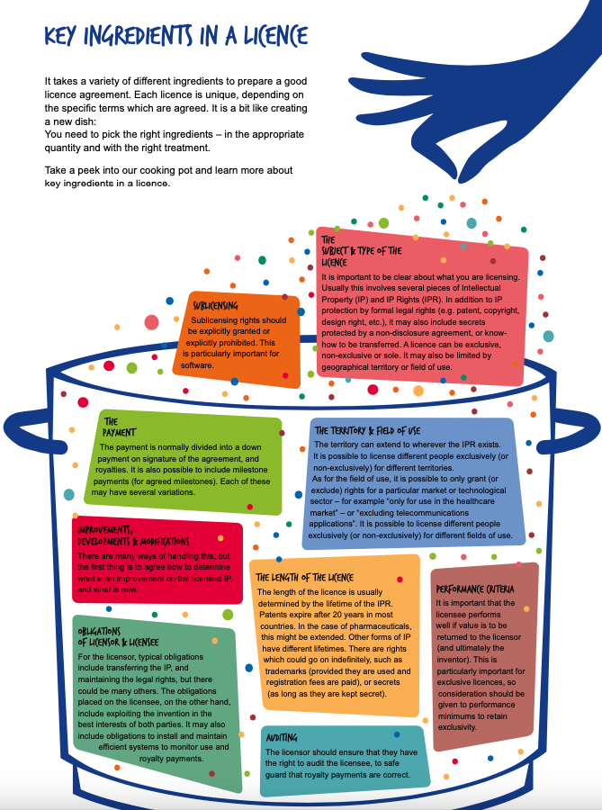

Slide 251
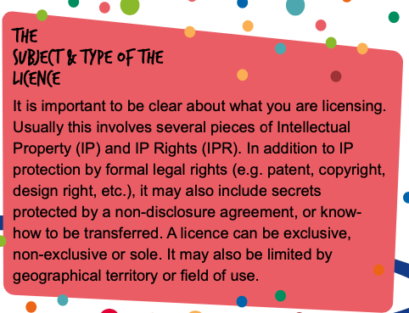
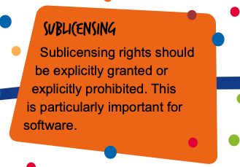
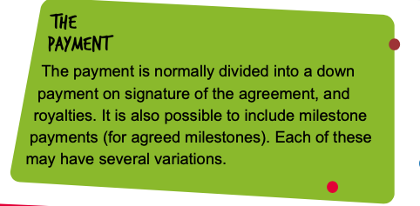
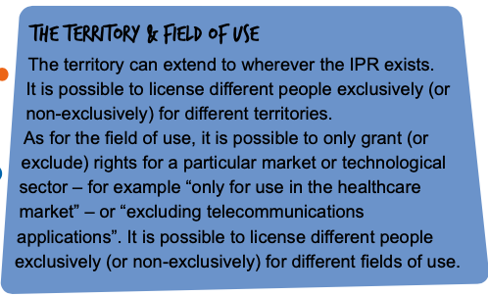

Slide 252
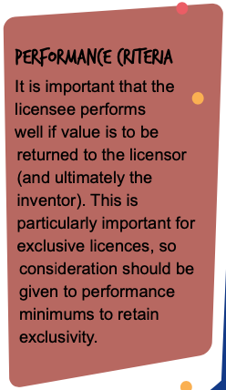
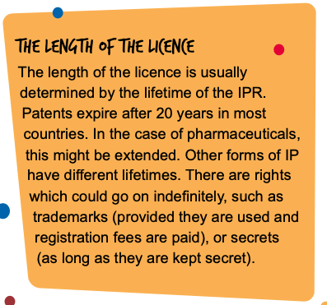
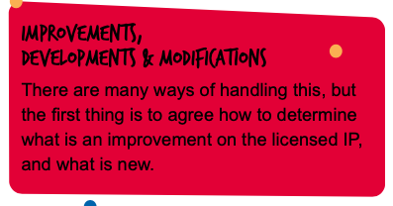
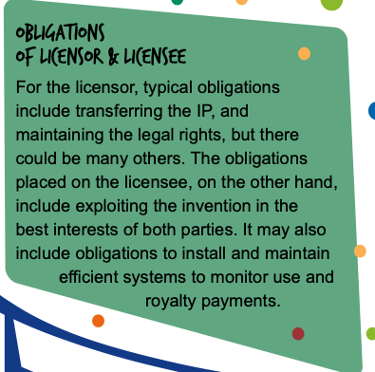
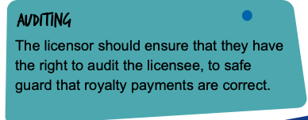

Slide 253
Licensing advantages
For many inventors, licensing is the best way to benefit from an invention:
  The licensee bears the costs and risks of production and marketing.
  Only established companies may have the resources to exploit an idea with major potential.
  Licensing can provide the inventor with an income over many years for relatively little effort.
Some inventors - mostly in high technology fields - set up companies solely to license out their IP and monitor the progress of their licensing agreements.
  This is a possible option if you want to start your own business but do not want it to grow too large.

Slide 254
When to go for licensing?
Types of invention that may be better licensed include:
  Components that many companies depend on, such as the drinks can ring-pull.
  Accessories or peripherals dependent on a specific existing product. These may have little future unless licensed to the company controlling the host product.
  Products with high set-up costs.
However, only the strongest forms of IP will interest potential licensees. In most cases this means a patent.
  If your idea cannot be patented, or if the claims you are allowed are not very strong, few companies are likely to want a license from you.
  Even if they are interested, they may not want to pay much for the license.
Notes:
https://www.iprhelpdesk.eu/sites/default/files/newsdocuments/bulletin/01/IP-H_b01_titel.html

Slide 255
Business start-up
Business start-up may be your first choice if you have ambitions to be an entrepreneur, or it may be an option that you have to consider if you cannot interest any companies in a licensing agreement.
Types of invention that may succeed as business start-ups include:
  Products in knowledge-based industries - for example information technology or high-value medical technology - where small companies can thrive.
  Cheap-to-make products which depend primarily on marketing.
  Products that cannot be patented strongly.
  Products that do not have enough profit potential to interest larger companies.
Starting a business is not for everyone. However, experience suggests that inventors who become entrepreneurs tend to be more likely to succeed than those who rely on finding licensees.

Slide 256
Joint venture
Another form of entrepreneurship: a joint venture with a company - or an individual, or perhaps a university - whose expertise and resources you need.
  For example, your joint venture partner could be a company willing to help you to develop your idea further in order to give them a better idea of its potential.
Such a joint venture is perhaps best viewed as an experiment that may or may not succeed. You should therefore not expect to make a profit from it.
  If successful, it could result in a licensing agreement, a spin-off company or some other form of more permanent business relationship.

Slide 257
Outright sale
It is possible that a company may offer to buy the IP in your invention for a fixed sum.
  If you have an invention with good market potential, it might be wiser to refuse.
  A sale may be worth considering if idea is of relatively low or short-term value, both to the company and you.
  The company benefits by not being tied for years to a licensing agreement.
  You benefit from (a) a cash windfall and (b) freedom from all responsibilities and expenses of ownership of the idea, which may include the maintenance of patents.
Much, of course, depends on the size of the sum offered. You should seek professional advice on a realistic valuation of your idea, but for both sides it will always be something of a gamble.
  You may regret it if the product goes on to make unexpectedly large profits.
  The company may regret it if the product fails to sell.

Slide 258
Invention promotion agencies
Some companies would like you to think that there is a fifth option - paying them to market your idea. Be very cautious about dealing with any such company.
Invention promotion companies tend to operate in broadly the same way.
  They will offer to give you an opinion of the market prospects of your idea, for a fee of typically a few hundred euros.
  They will usually send you a highly favourable report, with little or no mention of prior art. (It is not in their interests to tell you about prior art!)
  They will then tell you that for a fee of several thousand euros, they can help you market your idea.
  In many cases, their ‘help' amounts to little more than a supply of stationery and a list of company addresses. You have to contact the companies yourself.
  Often the invention promoter will be based in a different country from you, making it difficult for you to seek compensation.
Untrustworthy invention promotion companies only thrive because of the gullibility of some inventors, so you must be suspicious of anyone who praises your invention and offers to market it at your expense.

Slide 259
Entrepreneurial option
What if your idea is not novel but does have commercial potential?
If there is prior art for your idea but no commercial product, and you are convinced that a product could be successful, a possible strategy is to stop trying to be an inventor and consider becoming an entrepreneur.
  Try contacting the owner of the IP in the idea. If the owner is not ‘working' the IP, it may be worth discussing a deal in which you take a license to exploit the idea.
Or there may be an existing product but it is not being sold in your country. You could consider becoming an importer, or a manufacturer under license.
Or you might discuss with the IP owner the possibility of your redesigning or modifying the invention for a different application or a different market.
If you are entrepreneurially minded, something may be possible!

Slide 260
Section 3
Outline
From invention to commercial product
Disclosure and confidentiality
Assessing Novelty
Competition and Market Potential
Risk Assessment
Exploitation Routes
Prototyping and Proof of Concept
Protecting your Invention

Slide 261
Prototyping and Proof of Concept
Section 3: From invention to commercial product

Slide 262
Proving the invention
The need for prototypes: you need to prove - first to yourself, later to investors or companies - that your idea works.
  For an invention that is a process or a business method, physical proof may not be possible or necessary.
  For an invention that is a substance (for example, a new kind of shampoo), samples to test may be sufficient.
  If your invention is a manufacturable product, you need to show it looking as close to a finished article as you can manage or afford. That usually means producing at least one and often a series of prototypes. This may be where your first serious costs begin, so you need to plan and control your prototyping activities.
For some inherently costly ideas you may need to seek funding for the prototype itself. In that case you must gather convincing evidence that your idea will work, and has the potential to make enough profit to justify the much greater level of risk.

Slide 263

Planning an MVP
Watch the video from Y Combinator:
https://www.startupschool.org/videos/65
Notes:
minimum viable product, so MVP.

Slide 264
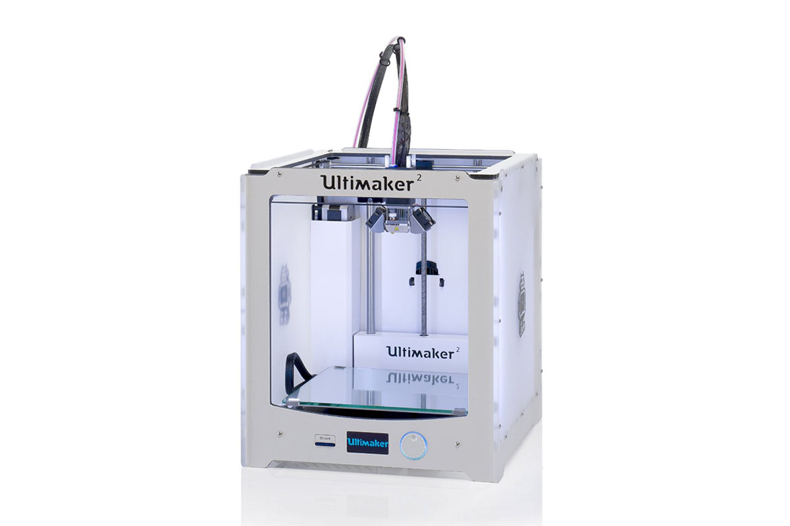
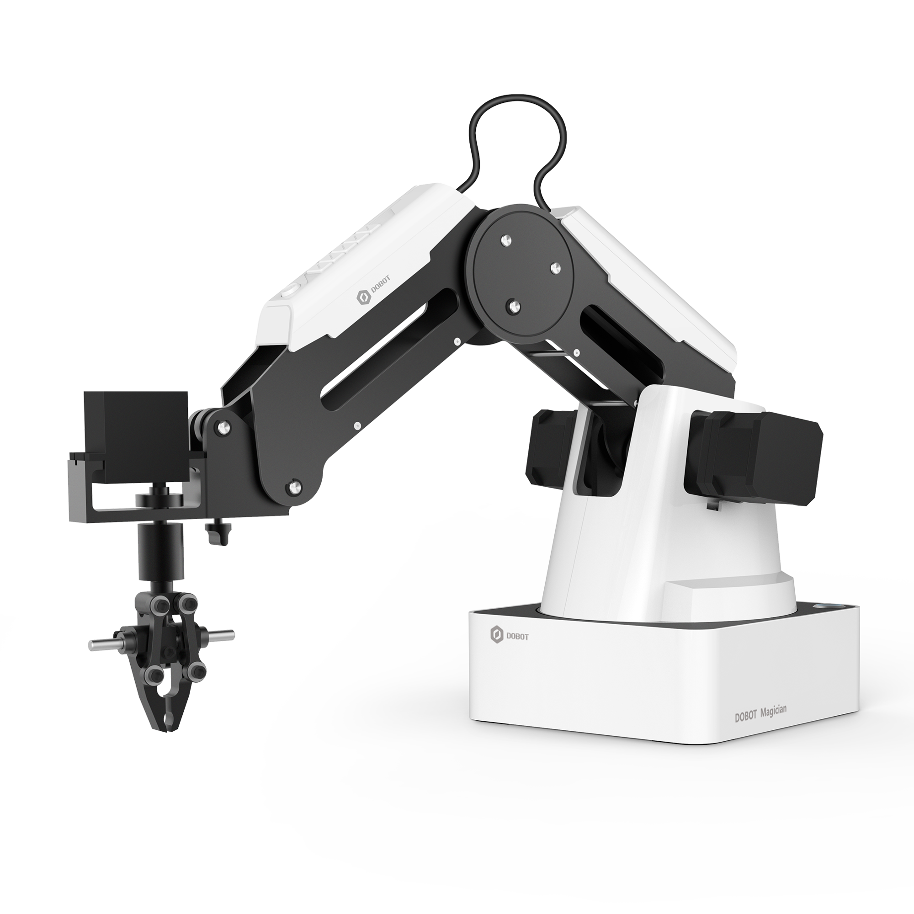
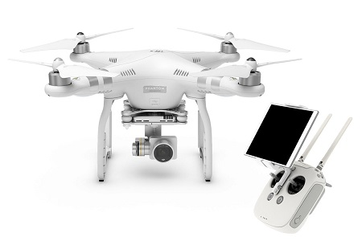
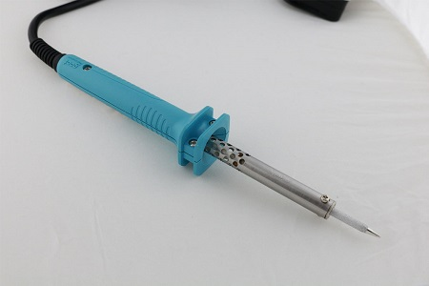

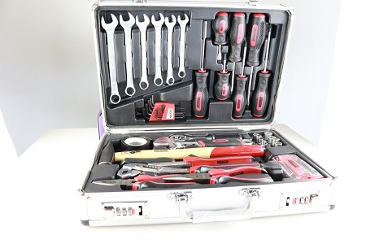






Prototyping @ UCY: C4E Makerspace
https://www.c4e.org.cy/activities/makerspace/

Slide 265

CYENS Makerspace
https://makerspace.cyens.org.cy/

Slide 266

CYENS Makerspace

Slide 267
Prototype Strategy: First prototypes
First prototypes are for you alone. No one else need see them, so they can be made from any suitable cheap materials. Their purpose is:
  To convince you that your idea works.
  To enable you to solve or at least identify technical and design problems.
  To enable you to improve the idea through trial and error.
If you can, use computer aided design (CAD) for much of this stage.
  CAD can save significant time and cost, and may provide you with much additional data that might be difficult or impossible to collect from physical prototypes.
It is advisable not to move beyond first prototype stage until you have done all the problem-solving and design refinement you can. This may be frustrating, but solving problems or redesigning your idea at a later stage is likely to be much more difficult and expensive.

Slide 268
Finished or presentation prototypes
These are the prototypes which you will use to demonstrate your idea to other people - in particular, to potential investors or licensees.
They should look and perform as much as possible like a finished product. The main reasons are:
  Most potential investors or licensees will want to see ideas with as few unresolved problems as possible, because that reduces their risk.
  Few people have the ability to look at a rough early prototype and visualise a finished, quality product.
  The closer your prototype is to a finished product, the more you will learn about the design, production and cost aspects of your idea. This knowledge will be invaluable when you need to convince people of the technical and commercial viability of your idea.
You may need professional help to produce a finished prototype: for example, from a product designer or a company that specialises in prototypes. The cost may be worthwhile if it enables other people to understand more fully (a) the potential of your invention and (b) your own professionalism and commitment.
However, if you use professionals try to avoid unnecessary costs. Designing and making an entirely original prototype will be expensive. Using at least some standard industrial components, or parts ‘borrowed' from existing products, may be much cheaper.
You must set a budget that balances quality and affordability, and you should always question any proposal that substantially increases cost for only a marginal gain in function or appearance.

Slide 269
Finished product
Without doubt, the best form of finished prototype is a saleable product.
You can prove that your idea sells, even if only on a small scale, and you have a supply of samples to speed up evaluation by companies.
This strategy will not be suitable for every invention, but it may be worth considering if there is relatively little difference between the cost of a single prototype and the cost of a trial batch of, for example, 100 further units.
  In most forms of manufacturing, the greatest cost is the set-up; the products themselves cost relatively little.

Slide 270
Working prototype plus model
If you cannot afford a high quality prototype, an acceptable alternative may be a combination of the best of your first prototypes (to demonstrate performance) and a non-working model (to demonstrate appearance).
For the model you can use any cheap workable material - for example, painted wood to represent plastic.

Slide 271
A short video
A video may be essential support material if:
  Your prototype has a lengthy operating cycle.
  Demonstrating your prototype requires a site visit or a special environment.
  You have to show people using your prototype.
  Your prototype cannot be guaranteed to work on every occasion.
  You need to record a unique event: for example, trials of your prototype tested against competing products.
Edit the video to no longer than a few minutes so that it does not occupy too much time during a typical first meeting of 30-45 minutes.

Slide 272
Is there a risk showing a video?
Video can be easily copied and will count as disclosure, so be careful to ensure that:
your idea has adequate legal protection and
you do not allow unauthorised viewing and copying of the video
the video itself should be protected by copyright!

Slide 273
Other support materials
Additional material that may help you present your idea could include:
  Product packaging. This may be expensive to do well, and so may only be worth the effort if packaging is of more than usual importance to your target market.
  A draft advertisement or brochure to show how you see the product being marketed.
  A website on which you can put information about your idea (landing page). This can be an inexpensive way of meeting business information needs.
However, seek advice from a patent attorney to ensure that you do not disclose anything that may compromise a future patent application.

Slide 274
Help with design or re-design
Design - in terms of both function and appearance - is a key factor in the success of commercial products.
  You therefore need to think about the design of your invention from day one, because its potential may not be recognised if all other people can see is an impractical or unappealing design.
An experienced product designer can help you deal with manufacturers or component suppliers, either at prototype or full production stage.
  Manufacturers need detailed specifications before they can make anything, and if queries or problems arise they need to talk to someone who is technically knowledgeable.
The cost of professional design may be offset if your designer can find ways of improving product quality or reducing manufacturing costs through good design.
However, if your designer contributes ideas which significantly improve your invention, the designer may be legally entitled to a share of the IP.
  You should first discuss how any new IP in the idea will be shared, in order to prevent disputes arising later. Your agreement should be based on advice from a patent attorney and documented before work starts.

Slide 275
Manufacturing prototypes
If you need to involve a manufacturer in prototyping your idea, ask several companies for prices as manufacturing costs can vary widely:
  Small companies tend to be cheaper and more prepared to accept very small orders.
  Larger companies tend to be cheaper only at high volume - it may be useful to know how cheaply your product could be manufactured in larger quantities.
Ask for prices based on the detailed drawings that you or your designer have produced but make sure that those drawings represent exactly what you want.
  A late request for even a minor modification may increase costs considerably.

Slide 276
Proof of concept
If you cannot make a prototype without financial help, you must focus on proof of concept: presenting enough evidence to persuade an investor or innovation support organisation to pay for at least a prototype.
Proof of concept, aims:
  Make it difficult for anyone to say: ’You have not told us this' or ‘Where is your evidence for that?'
  Produce detailed and credible data - including mathematical proof where relevant - to support every technical claim you make for your idea. You must also make a strong case that your idea has excellent commercial prospects.
It may help greatly if you can produce independent expert evaluations of your idea alongside your proof of concept.
  E.g., it may be possible to obtain expert opinion at relatively low cost from a university that specialises in your technology area.

Slide 277
Subcontracting product development
Armed with proof of concept, it may be possible to approach a company specializing in product development and prototyping.
  They may be prepared to develop your invention in return for a stake in your IP.
This solution may be worth considering if it is clear that your idea cannot be developed or even prototyped without substantial funding and specialist expertise.
  However, companies willing to share the product development risk are likely to consider only ideas with outstanding profit and growth potential in high-value markets.
  They may have little interest in ‘ordinary' consumer products.
  For that reason, they typically reject most of the ideas offered to them for development.
Such companies should not be confused with invention promoters. None-the-less, they should be selected with care:
  You could start by seeking impartial advice from government approved technology support agencies.
  Before entering into any agreement to share your IP, you will certainly need detailed advice from your own patent attorney.

Slide 278
  Protecting your invention
Section 3: From invention to commercial product

Slide 279

One of the key inventions that defined the twentieth century

Slide 280

Can you name two inventors who shaped the automobile industry of the 20th century?

Slide 281
The Selden Story
If you look at vintage American automobiles from around 1900, you'll see that many of them share an unusual feature:
A brass plate stating that the car is the design of a man named George Selden.

Slide 282
The Selden Patent
Selden was not an engineer but a patent attorney, and at the time he had not produced a single car.
Selden filed a patent in 1879 that he claimed covered all gasoline-powered cars (US patent 549,160).'
He made the most of this patent, forming in due course a cartel with a number of other businesses to demand royalties from every car sold:
  In 1899 he sold his patent rights to William C. Whitney, owner of the Electric Vehicle Company, for a royalty of US$15 per car with a minimum annual payment of US$5,000.
  Whitney and Selden then worked together to collect royalties from other budding automobile manufacturers, negotiating a 0.75% royalty on all cars sold by the Association of Licensed Automobile Manufacturers.
A precursor of: patent trolls who acquire obscure patents and use them to shake down tech companies today.
A dynamic industry looked like it might fall victim to a greedy collective.

Slide 283
Patent
Wars
Several years later, Henry Ford challenged Selden’s patent, eventually prevailing after an eight-year lawsuit.
The legal fight lasted eight years, generating a case record of 14,000 pages.
Ford's testimony included the comment: ”It is perfectly safe to say that George Selden has never advanced the automobile industry in a single particular...and it would perhaps be further advanced than it is now if he had never been born.”
But the situation could have turned out differently, moving the American auto industry onto a different path and affecting the wider history of the motorcar, too.
The brass plaque is a reminder that the development of the automobile was not, in fact, a sure thing.

Slide 284
Patent wars
Patent wars have not been limited to the auto industry.
America's aviation industry was defined, and nearly derailed, by a similar patent war only a few years later.
Hollywood is synonymous with cinema in part because early moviemakers went there to escape the legal constraints of Thomas Edison's Motion Picture Patents Company.

Slide 285
The evolution of many new technologies, and their economic consequences, depended on good fortune in terms of rules, laws, and institutions.
Selden's brass plaques are a reminder of a lucky economic escape from bad rules that nearly held back a major technology in its earliest days.
Sometimes society is not so lucky, and bad institutions bring material progress grinding to a halt.
[“Restarting the Future”, Haskel & Westlake, 2018]

Slide 286
At some point you must legally protect your intellectual property (IP) or you will not be able to:
  Disclose it safely.
  Be recognised in law as its owner.
  Profit from its commercial exploitation.
  Prevent or discourage its unauthorised use by others.

Slide 287
Section 3
Outline
From invention to commercial product
Disclosure and confidentiality
Assessing Novelty
Competition and Market Potential
Risk Assessment
Exploitation Routes
Prototyping and Proof of Concept
Protecting your Invention

Slide 288
Protecting your idea
There are several forms of protection known as intellectual property rights (IPR).
Usually, the best way to protect an invention as it evolves is to use a strategic combination of IPR.
Many inventors assume that the only way to protect their idea is to patent it.
While patents tend to be of primary importance, other forms of IPR should also be considered.
One or more of these may have an important role to play in protecting your idea.

Slide 289
Confidentiality
Protecting your Invention

Slide 290
Confidential information & NDAs
Confidential information is closely related to, and often regarded as, intellectual property - although not covered by any statutory IPRs.
The most common form of protection for confidential information is a non-disclosure agreement (NDA).
An NDA can protect you:
  By documenting someone's promise not to use or pass on information about your idea. Anyone who breaks the terms of an NDA risks legal action.
  At every stage of the development of your idea - no matter what other forms of IPR you have, and even long after your invention is on the market.

Slide 291
Confidential information & NDAs
NDAs are widely used in all forms of business, so you should certainly consider using them yourself.
NDAs are binding legal agreements, and use them only when both parties accept that significant disclosure is necessary.
NDAs can only restrain others from disclosing or exploiting specific and unique secrets which they get only from you.

Slide 292
When NDA are not useful?
Any information that is already general knowledge is free for anyone to continue using, regardless of the NDA.
If the confidential information covered by the NDA later becomes public knowledge by some other means, then the original parties to the NDA will no longer be bound by it.

Slide 293
NDAs Main Challenge
Persuading other people to sign your NDA.
Many large companies take the view that NDAs only have a use when they are seriously interested in an idea.
  That can only be after they know what it is!
To overcome this: train yourself to communicate the business benefits of your idea without disclosing its novel aspects.

Slide 294
Where can you find templates for Nda?
You can find many free examples of NDAs on the internet.
Lambert Toolkit:
https://assets.publishing.service.gov.uk/government/uploads/system/uploads/attachment_data/file/551428/lambert-sample-nondisclosure-agreement.doc
It may be wise to seek the advice of a patent attorney when constructing your own version.

Slide 295


Slide 296
Know-how
Protecting your Invention

Slide 297
Know-how
Know-how is undocumented information known only to you. It is similar to trade secrets.
Without your know-how, others may find it difficult or unrewarding to exploit your idea.
  For example, you may know how to reduce production costs significantly by using conventional equipment in an unconventional way.
Know-how can be commercially valuable, and can be included in licensing agreements.

Slide 298
Challenges with Know-how
Genuinely valuable know-how is rare.
There is also no way of registering it and its theft can be hard to establish (theft usually by employees or associates).
Risk: if your know-how is information that ought to be included in a patent, you may invalidating the patent by leaving it out.
Seek advice of a patent attorney when considering what to treat as know-how.

Slide 299
Copyright
Protecting your Invention

Slide 300
Copyright
Protects for many years against the unauthorised copying or adapting of drawn, written or photographic descriptions of your idea.
Does not protect the idea itself, but in some cases - for example computer code - may be the only effective way of protecting your IP.
Arises automatically and is free.
Important because it can easily establish dates of origin of an idea, or of changes to an idea.

Slide 301
Challenges with Copyright
It gives you no protection against someone who independently comes up with the same or a similar idea.
A competitor may say that their idea is similar to yours by coincidence, or that your idea is a copy of theirs.
Challenge: How can your prove that your idea was the original?

Slide 302
Proving copyright ownership
The following steps may help you to prove that you are the copyright owner in a later dispute:
  Make written descriptions, drawings, photos etc of your idea and print them out or perhaps burn them to a CD or DVD.
  Place your documents or disc in a securely sealed envelope bearing a signed and dated statement from an independent witness, certifying that the envelope was sealed on the date when he or she examined it.
  Send the envelope by registered mail to yourself or a place of safe keeping, and keep the clearly dated postage receipt.
  The envelope must remain unopened until required by a court of law. (It may be advisable to have more than one envelope, in case your copyright claim is tested more than once. An opened envelope is no longer valid as proof of copyright.)

Slide 303
Protecting Designs & Trademarks
Protecting your Invention

Slide 304
Unregistered design right (UDR)
Protects the outward appearance of a product, including its shape, pattern, texture and decorations(EU).
In some national UDR laws (for example, the UK) internal configurations may be protected even if these are invisible to the user.
UDR may protect features of the design which are new, have an individual character, and which come from a ‘freedom' of design.
UDR is similar to copyright:
  Free
  Gives you a right to prevent unauthorised copying for a number of years.
However, there is no official design right registry and so it can be difficult for others to know of your design.

Slide 305
Challenges with UDR
UDR may not protect designs that are:
  copied or routine designs;
  immediately suggestive of other designs;
  parts of a design which are dictated by functional needs to fit or match with other components.
    For example, a novel wing tea pot can be shaped in many different ways, and so can be protected because the designer has exercised his or her design ‘freedom'.
    But a vehicle brake pad can only have one shape if it is to fit in the brake callipers. It therefore has no design ‘freedom' and so no protection.
Though often useful as part of an IPR strategy, UDR on its own will not protect most inventions.

Slide 306
UDR protection
UDR arises automatically when the design is created
However, you should follow the same ‘sealed envelope' procedure described above for copyright to provide yourself with evidence of a priority date.
  This is because you can only take legal action against someone when you can prove that they must have copied your design, rather than made something similar by coincidence.

Slide 307
Design registration
More robust protection for designs comes through formal registration, which can last up to 25 years.
Applications can be made to most national IP offices, or to the European Union Intellectual Property Office (EUIPO) where a single application can be registered for the whole of the European Community.
You can take action against anyone who makes, sells, uses or imports articles which look like the article registered. Unlike UDR, there is no need to prove that another design was copied from yours - you only need to prove that it looks similar. Even designs which are similar by accident can be challenged by the owner of a registered design.
The application process is fast and relatively cheap, but design registration usually only makes sense if the outward appearance of your invention is going to be a strong selling feature.

Slide 308
Design registration criteria
The same criteria apply as for UDR: to be validly registered the design must be:
  new
  have ‘individual character' and
  be the result of a ‘freedom' of design.
A single registration may protect patterns, ornaments, decorations and logos which are suitable for application across a range of articles
  For example, a floral design applied to table linen, bedding, curtains, crockery etc.

Slide 309
Trade marks
A word, slogan, logo or combination that distinguishes your product or business from others.
Trade marks can be valid indefinitely if correctly used and maintained, so a trade mark associated with a popular brand name can be of enormous value to its owner.
The granting and registration of trade marks is administered by national IP offices, to whom you apply.
For multinational cover you can make a single application for either an International Trade Mark under the Madrid system at the World Intellectual Property Organization (WIPO), or a Community Trade Mark (for protection in the EU) at the EUIPO.
  To avoid problems, you will probably need help from a trade mark attorney. (Many patent attorneys are also trade mark attorneys.)

Slide 310
Trade marks’ challenges
Trade marks do not protect ideas, or products per se.
But if you want to market your own invention, a trade mark could be a very worthwhile long-term investment.
It might eventually become your most valuable form of IPR.

Slide 311
Last
Lecture
Exploitation Routes:
  Licensing
  Joint venture
  Business Start-up
  Outright sale
  Entrepreneurial option
Proof of Concept
  Prototyping
  Support material
  Videos
Protecting your invention
  Opportunities & Dangers - patent wars
  Confidentiality and NDAs
  Know-how
  Copyright
  Designs and Trademarks

Slide 312
Patents
Protecting your Invention

Slide 313
Patent
A patent is a form of legal monopoly - the right to say:
‘This is mine and you cannot use it without paying me'
Governments grant patents in return for public disclosure of ideas. And that is all it is.
Patent systems exist in most countries and their purpose is to encourage the development of new technologies.
It is important to understand what a patent can and cannot do:
  Patenting your idea will not necessarily increase its commercial value.
  If no one wants your invention, a patent is unlikely to make any difference.
  But if your invention has commercial potential, a patent may be your only way of ensuring that you can benefit financially from it.
  Many inventors of commercially successful products acknowledge that they owe their financial rewards almost entirely to strong patent protection.

Slide 314
Patents’ challenges
The cost and complexity of patenting can be a problem for many inventors.
Therefore, a decision to apply for a patent should never be taken without careful consideration of several factors.
You should ideally seek the advice of a patent attorney before making your decision.
If you decide to go ahead, you should let a patent attorney represent you during the lengthy, complicated and rigorous application process.
If you do not use a patent attorney, you run a large risk of making mistakes which could leave you with no effective patent protection. There may then be little prospect of ever benefiting from your invention.
In general, patents last for 20 years but only if annual renewal fees are paid.

Slide 315
The patenting process
An invention is patentable only if it is:
  New and previously undisclosed.
  Distinguished by an inventive step not obvious to someone expert in that technology.
  Capable of industrial application - that is, it is physically possible to make the invention.
  Computer software on its own can be protected by copyright but not by patents in Europe.
    However, an invention that is implemented on computers by means of software - for example, an improved data handling system - is patentable in Europe.
    Get advice of a patent attorney when patenting inventions which are run on computers because practice can differ between Europe and the USA.
  Business methods may be patentable in the USA but not easily patentable elsewhere.
Always seek advice from a patent attorney if you have concerns about whether your idea is patentable.
Notes:
https://www.epo.org/learning-events/materials/inventors-handbook/protection/patents.html

Slide 316
Issues to consider
Do you really need a patent?
  Would some combination of other forms of IPR protect your idea adequately?
  Be honest with yourself - are you perhaps motivated more by vanity (the prospect of a patent in your name) than by commercial necessity?
Have you studied the total cost of patenting?
  Should include annual renewal fees in every country in which you have protection.
Is your invention likely to earn enough income to justify the cost?
  Normally, you should not apply for a patent until you have thoroughly researched the commercial and financial potential of your idea.
Is the time right to apply for a patent?
  Application starts a sequence of events which cannot be delayed.
  Do you apply for a patent early on, or wait until the invention is market-ready and more capable of quickly recouping its IPR costs?
  Later may be better than sooner, but circumstances will vary so you should always seek the advice of a patent attorney.

Slide 317
Issues to consider
Does your invention have a short product life cycle?
  Patenting process typically takes 3-4 years.
  If your invention is aimed at a highly competitive market in which products are rapidly replaced or improved, your patent may be worth little by the time it is granted.
Who will pay to enforce your patent?
  National IP offices do not enforce patents or monitor them for infringement.
  These are the responsibilities of the patent owner or a licensee. Until funds are potentially available to enforce your patent - from royalties or sales income - it may offer limited practical protection.
How strongly might your patent resist legal challenge?
  The validity of patent claims is often challenged, usually by competitors who want to copy a successful product.
  If they succeed, you may be left with a valueless patent and an order to pay the victor's legal costs.

Slide 318
Applying for a patent
Applying for a patent is a legal process governed by strict timescales and usually immovable deadlines. It is not something to rush into!
To maximise your chances of a worthwhile patent you should:
  Study the application procedure in detail.
  Aim to apply not in haste, but strategically - at a time and for a reason that most benefits your exploitation plans.
  Use a patent attorney! Do not do it all yourself - the risk of making mistakes is too great.
See guide for the application process for a European Patent according to the European Patent Convention (EPC): https://www.epo.org/applying/basics.html
  Applying for a patent at a national IP office is roughly similar to stages 1-6 below, but an application must be made in the local language.
  Making an international application through the Patent Co-operation Treaty (PCT) involves a single procedure for stages 1-4 (below) but 30 months after filing the application goes through stages 5 and 6 in every national or regional IP office where you wish to take up protection.
  For more information on the PCT see www.wipo.int/pct

Slide 319
Where to apply?
Choosing your route for a patent application (EPC, PCT, national and regional, or combinations thereof) will depend on:
  Your invention.
  Your business plan.
  Your available funds.
  Your intended market.
  The likeliest sources of infringing products.

Slide 320
Patenting process
Applying for Patents

Slide 321
Applying for a patent: Stage 1
Your patent attorney must provide documentation consisting of:
  A request for a patent.
  Details of the applicant (you).
  A description of the invention.
  Claims.
  Drawings (if any).
  An abstract.
A fee must also be paid. In order to avoid delay, it is vital that all documentation conforms in every detail to official requirements.
At the EPO, applications are accepted in English, French or German.
Patent attorney’s role:
  For your patent attorney to prepare all the information about your invention, he or she will obviously need to work closely with you.
  Do not assume that you know best because it is your invention. You must trust the skill and judgement of your patent attorney, as patenting involves a complex mix of law and technology.
  The claims in particular need to be drafted with skill, as they are the most important aspect of a patent.

Slide 322
Stage 2: Filing date & initial examination
If your documentation appears correct, your application is given a filing date - also known as your priority date.
  After filing there is a formalities examination to ensure that your documentation is correct and complete.
At any time in the next 12 months you can file for patent protection in other countries and have those later filings treated as if they had been filed on your priority date.
In practice, this gives you a year to decide how many countries you wish to include in your patent protection.

Slide 323
Stage 3: Search
A search report is sent to you, listing and including copies of all prior art documents found by an experienced examiner and regarded as relevant to your invention.
The search is based mainly on your claims for novelty, but your description and any drawings will also be taken into account.
The report will often include an initial opinion on the patentability of your invention.

Slide 324
Stage 4: Publication
Your application is published 18 months after the filing date.
  Your invention will appear in databases accessible to other people around the world.
  It will act as prior art against any future patent applications from other inventors or companies for similar inventions.
You then have 6 further months to make two decisions:
  Do you want to continue with your application? You indicate ‘yes' by requesting a more thorough (‘substantive') examination.
  Which countries do you want to include (‘designate') in your patent protection? Designation fees must be paid.
After your patent is granted, you may claim damages for infringements originating as far back as the publication date of your application.
  However, to enjoy this right in some countries it may be necessary to file a translation of your claims with their national IP office and for them to publish the translated claims.

Slide 325
Stage 5: Substantive examination
If you request substantive examination, the EPO has to decide whether your invention and your application meet the requirements of the European Patent Convention.
For maximum objectivity there are usually three EPO examiners, one of whom maintains contact with your patent attorney.
This stage will often involve dialogue between the examiners and your patent attorney, which may result in the re-drafting of key parts of your application.
Your patent attorney will defend your application, and this is one more reason why it is essential to have professional representation.

Slide 326
Stage 6: Decision to grant a patent
If:
  the examiners decide to grant a patent, and
  all fees have been paid and
  any claims translations filed,
the decision is reported in the European Patent Bulletin.
The decision to grant takes effect on the date of publication.

Slide 327
Stage 7: Validation
What you have now got is a ‘bundle' of individual national patents.
After the EPO decision to grant is published, your patent has to be validated in each designated state within a specific time limit.
If this is not done, your patent may not be enforceable in that state.
In some states, validation may include having to file (and pay for) a translation of the whole patent, or just a translation of the granted claims.

Slide 328
Stage 8: Opposition
A granted patent may be opposed by third parties - usually the applicant's competitors - if they believe it should not have been granted.
After the grant is reported in the European Patent Bulletin they have nine months in which to file notice of opposition.
  The most common charge is that the invention is not novel or lacks an inventive step.
  The case will be examined by an EPO team, again of three examiners.
Opposition is the last chance to attack a European patent as a single entity in a single forum.
Later, the patent can only be challenged in national courts and a ruling in one country has no effect on the patents for the same invention in other countries.
This gives competitors a strong incentive to challenge an invention during the opposition period, as challenging patents in separate national courts can be much more expensive.

Slide 329
Stage 9: Appeal
All EPO decisions are open to appeal.
Responsibility for decisions on appeals is taken by independent boards of appeal.

Slide 330
Patenting strategy
There is more to patenting than simply meeting the formal requirements of a patent office.
You should try to fit your patent application into the broader framework of developing your invention.
Points to discuss with your patent attorney may include these:
  When to apply
  Pressure to patent
  Continuing prior art searching
  Licensing or business start-up?
  Re-filing
  Temporary advantage
  Funding
Notes:
https://www.epo.org/learning-events/materials/inventors-handbook/protection/strategy.html

Slide 331
When to apply?
Because of the formality of the patent application process, the timing of your application may make a big difference to the pressures you find yourself under later.
Is it better to apply for a patent earlier, or later?
  There is no easy answer to this question. Many inventors are keen to apply for a patent as early as possible - yet many successful companies delay filing until products are almost ready for market.
One disadvantage of early filing is that you may incur substantial costs before you know whether your idea is commercially viable.
  Applicants have up to two years from filing before becoming liable for significant patent fees, but this is rarely long enough to reach a licensing agreement with a company. It may not even be long enough to establish the commercial prospects of an invention.
One disadvantage of late filing is that someone may file a very similar idea before you.
For many private inventors, cost will be a major factor. The later you file, the longer you delay the costs. But how late can you afford to leave it?
As long as your patent attorney knows all the facts, they may be able to identify an optimum date for filing, and advise on the steps you can take to protect your idea in the meantime.

Slide 332
Pressure to patent
You may be tempted to apply for a patent prematurely because business advisers or potential licensee companies tell you that this is what you should do.
Always consider whose interests are best served by this advice.
In many cases there will be little benefit in it for you.

Slide 333
Continuing prior art searching
The world does not stand still once you have filed your application.
You must keep up your patent and product searching, as something may happen after you have filed which may affect your later decision whether to continue with your application.

Slide 334
Licensing or business start-up?
The period between filing and requesting substantive examination should be used to seek opportunities to exploit the invention.
Even if your preference is a licensing agreement, it may be worth setting a date after which you plan instead for business start-up.
The reason is that if no company shows interest in your idea, you do not want to reach substantive examination stage with no other option to pursue.

Slide 335
Re-filing
You may be able to gain extra time to seek a licensing agreement by withdrawing your application and re-filing it later.
This is a tactic that you must discuss with your patent attorney, or you may lose more than you gain.

Slide 336
Temporary advantage
It is possible to use a patent application for purely temporary advantage, and to decline substantive examination.
  For example, you might wish to use it to protect your idea for long enough to achieve your exploitation objectives.
  There may be risks that you have not considered in this approach: One almost certain outcome of abandoning an application is that you will find it much more difficult - in fact, probably impossible - to license your invention to anyone.
Just having your patent application published may be enough. Once published, potential customers and business partners can find out about your invention and contact you if they are interested.
Your published application will also be prior art, which could prevent competitors from patenting the same or a similar idea in the future. This might leave you free to operate in that market even if your application is not subsequently granted.
If this suits your business strategy, you might then choose to go no further with the patenting process, especially if you could not afford the expense of acquiring or subsequently enforcing a patent.

Slide 337
Funding
A granted patent may help persuade investors that your idea is worth backing, and by that means the cost of patenting may be covered.
You should therefore think of a patent not just as a means of protecting the idea, but also as an instrument for raising funding.

