Slide 1
University of Cyprus
MAI – 642 – DEEP LEARNING
Theocharis Theocharides
Nov, 2023

Slide 2
Deep Learning
Lecture 1:
Introduction
Theocharis Theocharides
Associate Professor
Dept. of Electrical and Computer Engineering
Director of Research, KIOS Research and Innovation Center of Excellence
University of Cyprus

Slide 3
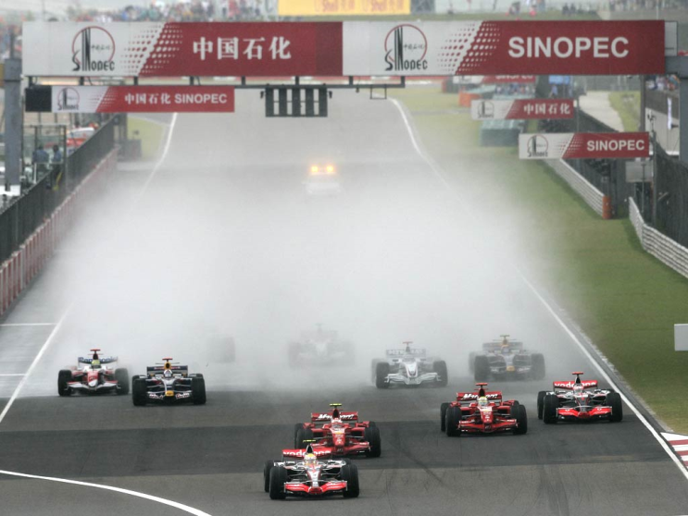
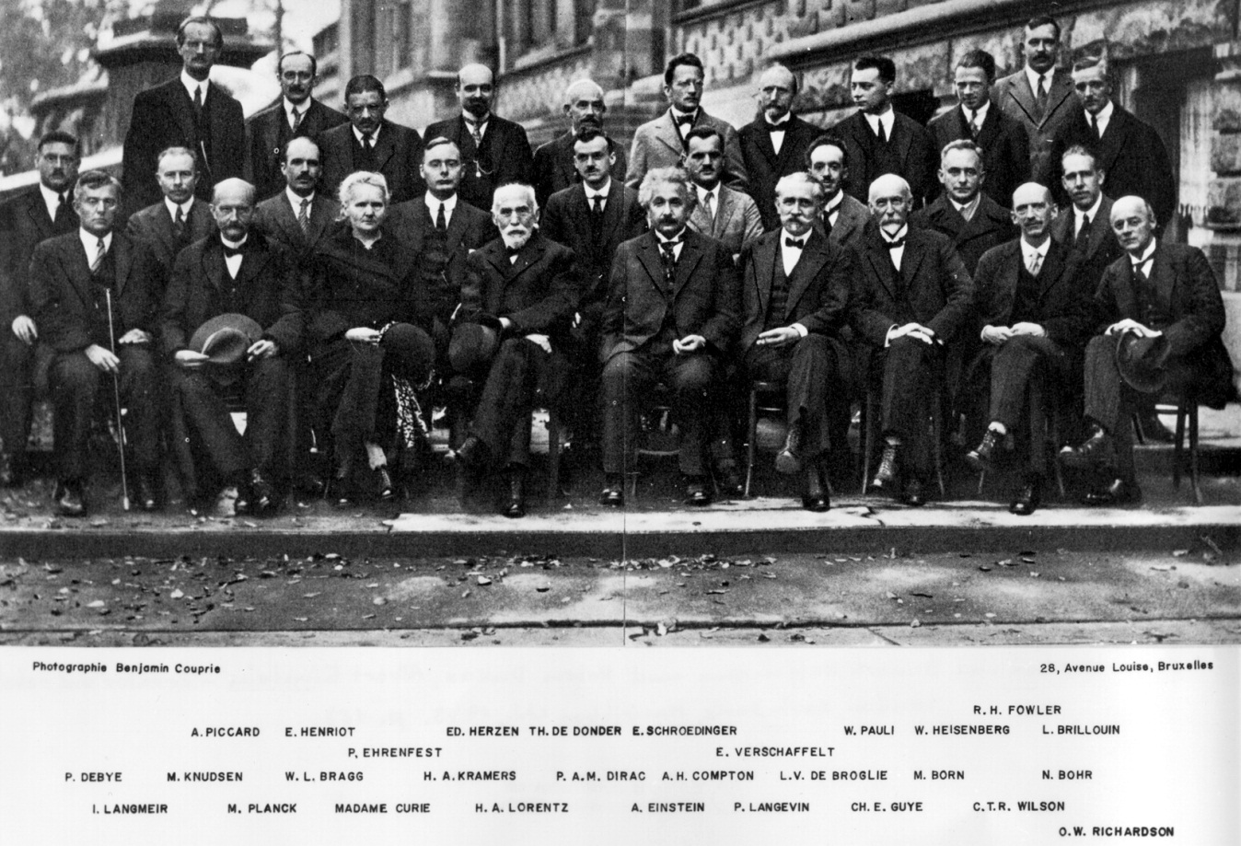
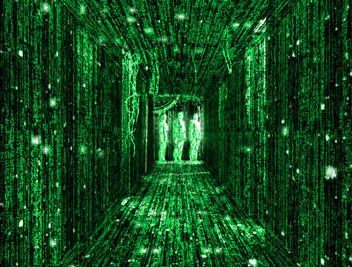
Keyword: To LEARN!
How do we (humans) learn?
What does the information tell us?

Slide 4
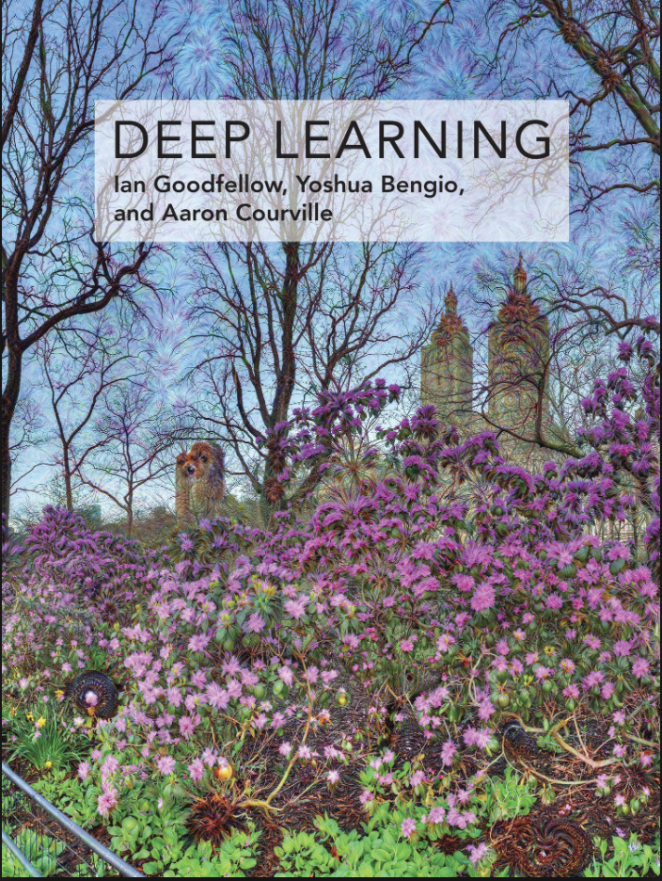
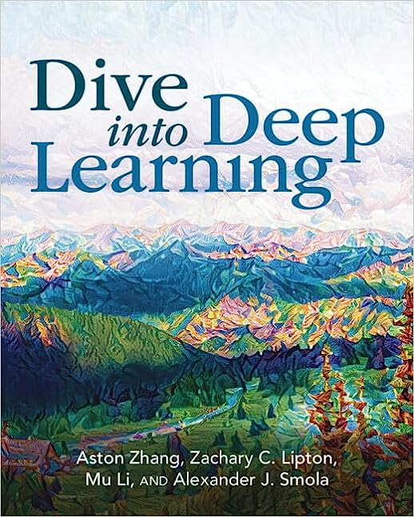
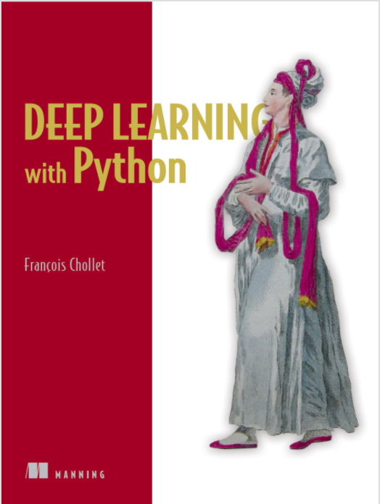
Books and Reading
Recommended textbook: “Deep learning”
by Goodfellow, Bengio, Courville
https://www.deeplearningbook.org/
Another recommended textbook: “Dive into Deep Learning” - https://d2l.ai/
Lots of further material available online, e.g.:
http://cs231n.stanford.edu/ http://course.fast.ai/
https://developers.google.com/machine-learning/crash-course/
www.nvidia.com/dlilabs http://introtodeeplearning.com/
https://github.com/oxford-cs-deepnlp-2017/lectures,
https://jalammar.github.io/
Coursera, Youtube, etc.
“Deep Learning with Python” by François Chollet
for labs + assignments

Slide 5
Online Resources
So many, impossible to fit in a single lecture presentation:
https://github.com/shellysheynin/Deep-Learning-Book
https://www.deeplearning.ai/resources/
https://m2dsupsdlclass.github.io/lectures-labs/
https://cds.nyu.edu/deep-learning/
https://www.deepmind.com/learning-resources/deep-learning-lecture-series-2020

Slide 6
Course Schedule & Content
DATE | Overview | Lecture Details | Scope
Week 1 | Introduction - Course Structure, Logistics, Fundamentals of Machine Learning and Neural Networks | 1. Introduction to Neural Network, Multilayer Perceptron, Back Propagation Learning - What is Deep Learning? | BASICS
Week 2 | Fundamentals of Learning | 2. Introduction to Deep Learning, Bayesian Learning, Hebbian Learning, Decision Surfaces, Representation Learning. 3. Theory of Deep Learning (Universal approximation theorem, convergence rate, and recent mathematical results)
Week 3 | Mathematics & Fundamentals of Deep Learning | 4. Linear Classifiers, Linear Machines with Hinge Loss, Gradient Descent, Activation and Loss Functions. 5. Optimization Techniques, Gradient Descent, Batch Optimization, Introduction to Meta-Learning, Hessian-Free Optimization.
Week 4 | Deep Neural Networks | Deep Neural Networks: Features, Feature Representation, Representation Learning, BoFs/BoWs, Feature Maps, Deep vs. Shallow Nets | FUNDAMENTALS OF DEEP (CONVOLUTIONAL) LEARNING
Week 5 | Convolutional Neural Networks | 6. Convolutional Neural Networks, Building blocks of CNN | DEEP NEURAL NETWORKS - DEEP INTO DEEP LEARNING
Week 6 | Deep Convolutional Neural Networks | Pooling, Convolutional, Softmax Layers
Week 7 | Deep Convolutional Neural Networks | Optimizing ConvNets, Transfer Learning, Residual Networks
Week 8 | Deep Learning Optimization | 11. Deep Learning Model Optimization; Early Stopping/Exit, Dropout, Batch Normalization, Instance Normalization, Group Normalization, Pruning, Quantization, Hyperparameter Optimization.
Week 9 | Recurrent Neural Networks, Transformers | RNNs, LSTMs
Week 10 | Transformers, Attention | Attention Mechanisms and Transformer Networks | EMERGING DEEP LEARNING RESEARCH AND APPLICATIONS
Week 11 | Generative Adversarial Networks | Unsupervised Learning with Deep Network, Autoencoders Cont’d, 8. Generative Adversarial Networks, Adversarial Learning Models, Variational Autoencoders
Week 12 | Deep Reinforcement Learning - Graph Neural Networks | Deep Reinforcement Learning (Q-learning, actor-critic, policy gradient, experience replay, double Q-learning, deep bootstrap networks).
Week 13 | Graph Neural Networks and Deep Learning Trends | Graph Neural Networks – Graph Signal Processing, Convolutional Networks on Graphs, Gated Graph Sequence Networks, Semi-Supervised Graph Convolutional Networks Interpretable Deep Neural Networks DNNs for Vision and NLP - GPTS/LLMS
Exam Period | Final Exam | Comprehensive Final Exam | EVALUATION

Slide 7
Background Requirement
A basic undergraduate mathematics course in linear algebra, statistics & probability, and an introductory course in ML
  Basic Programming Skills (C/C++?)
  Basic Calculus (fundamentals)
This course should NOT be your first ever ML course!!!
  Students are expected to know fundamentals of ML such as:
    Gradient Descent / Fundamentals of Optimization
    Data Representation
      Linear Algebra, dimensional spaces, vectors, tensors, etc.
    Basic ANNs, SVMs, Boosting, Features, etc.
    Bayes Rule, Bayesian Learning, Probability/Statistics
    Basic Calculus

Slide 8
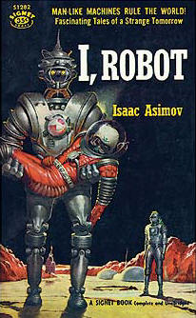
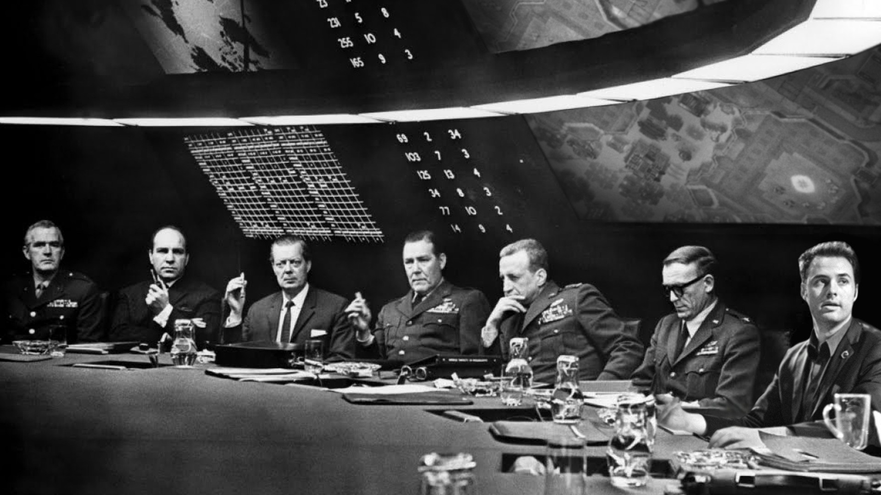

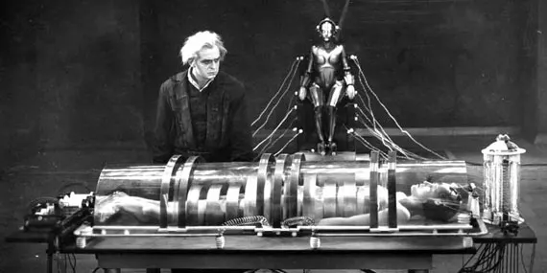
Science Fiction?

Slide 9
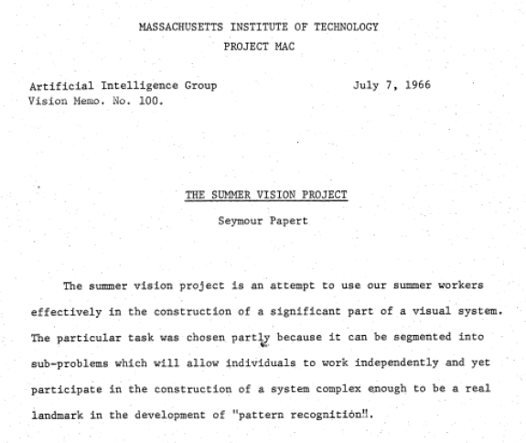

1966: The Summer Vision Project @ MIT
In 1966, Marvin Minsky (Director) and Seymour Papert (Co-Director) of the AI Group @ MIT, asked then-student Gerald Jay Sussman to coordinate an effort to “spend the summer linking a camera to a computer and getting the computer to describe what it saw”.
Source: CSAIL - MIT

Slide 10
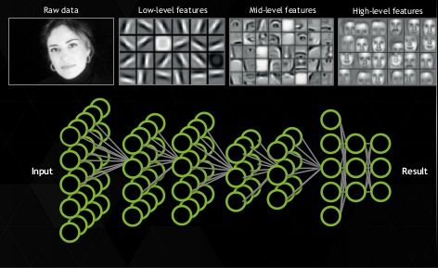
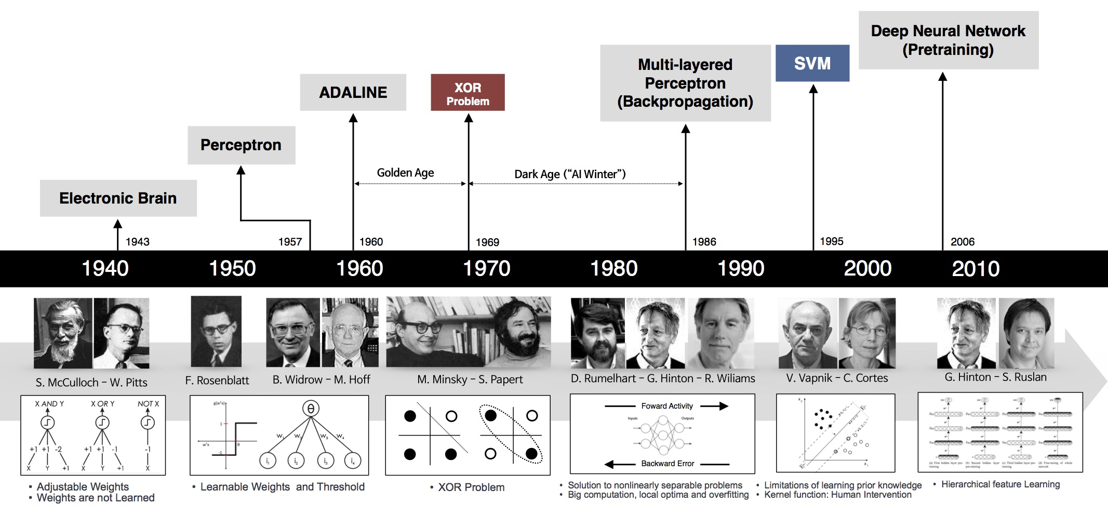
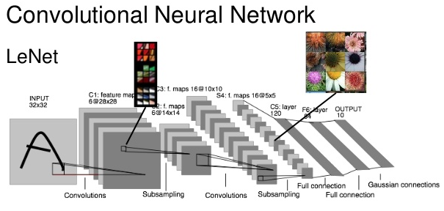
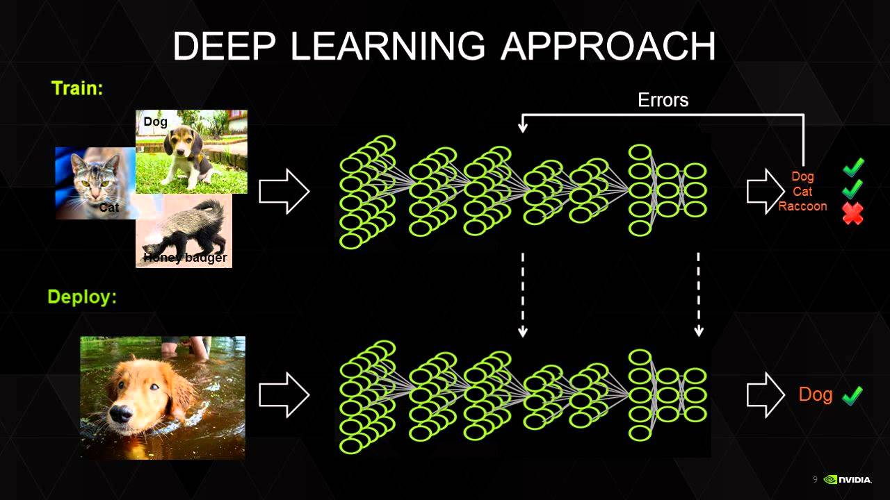
The Deep Learning Revolution
Yann Lecun at AT&T Bell Labs.

Slide 11
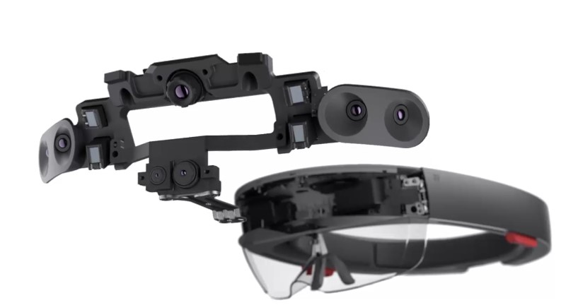


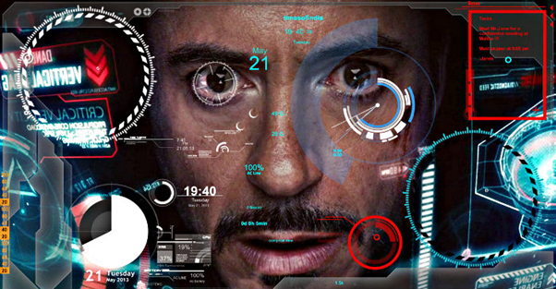
2020+: Augmented Reality Perhaps?
Sources: Marvel & Disney, Microsoft, Facebook.

Slide 12

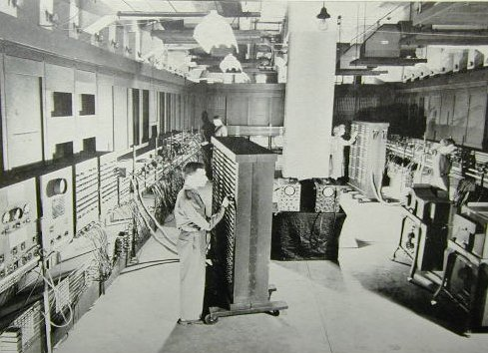
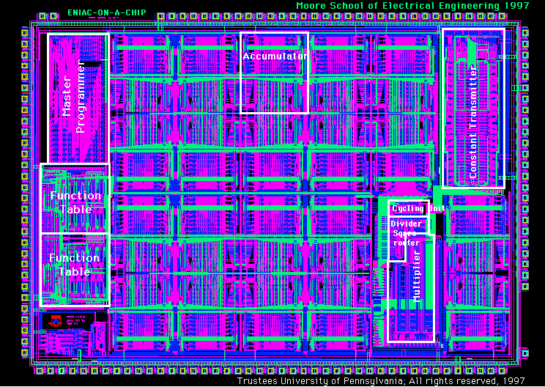
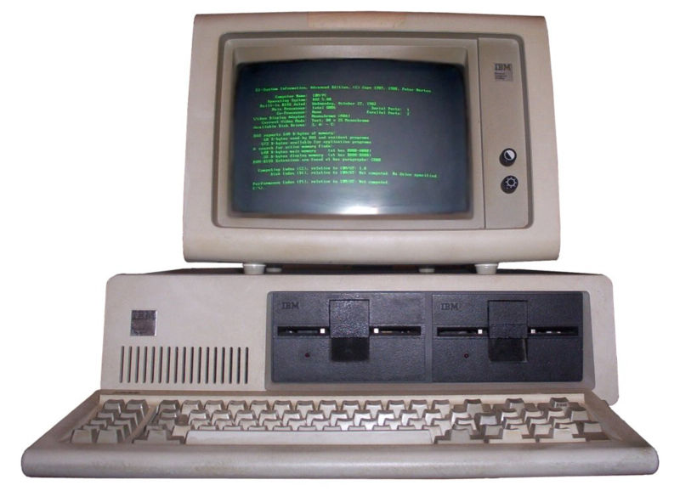

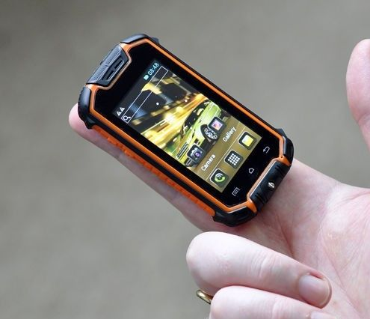
Technology Scaling
1940 - ENIAC
1995 – ENIAC-on-a-chip (apx. 40mm²)
1983 – IBM PC
2016 – No Comment!!!
Sources: IBM, Intel

Slide 13

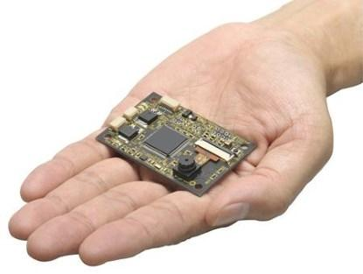


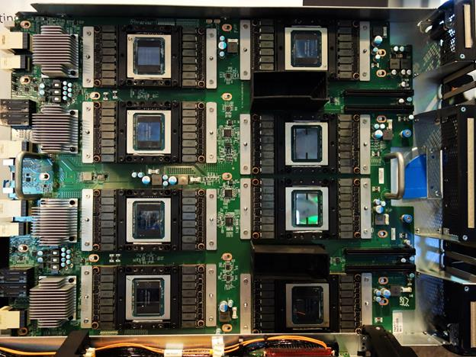
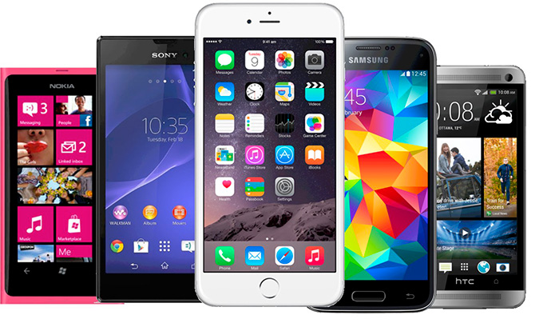
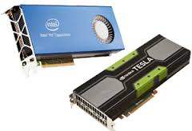
Machine Learning entering the embedded world…
Sources: Intel, NVIDIA, Embedded Vision Alliance, OMRON, Raspberry Pi.

Slide 14
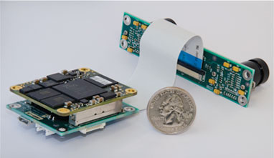
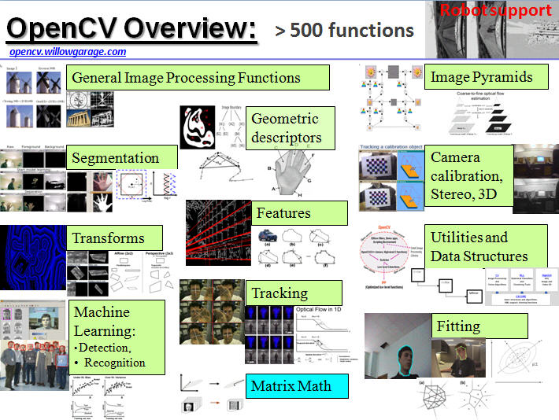
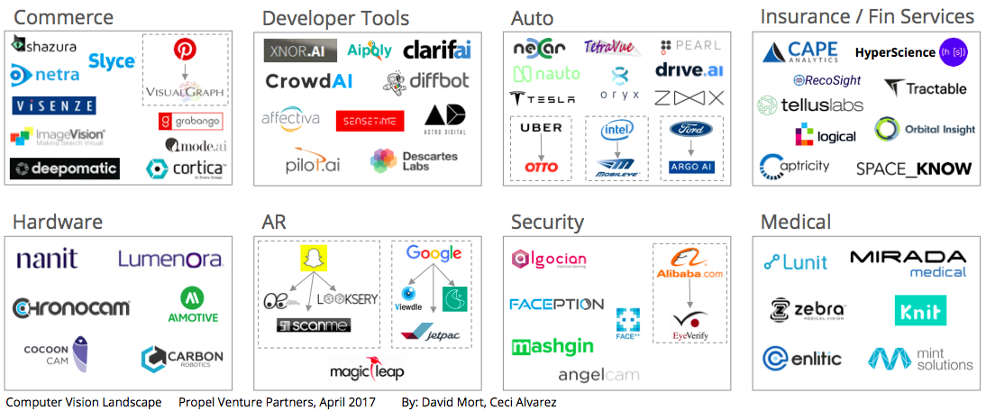
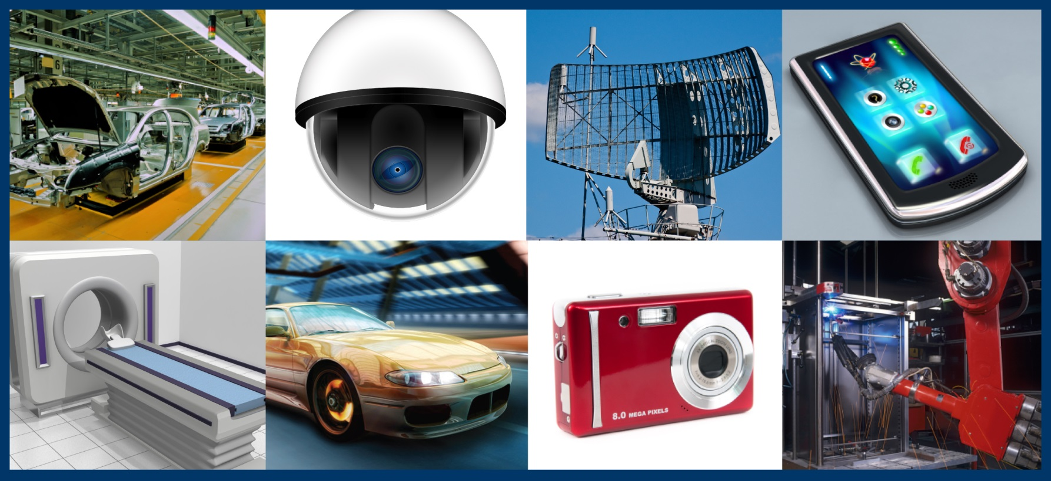
Embedded & TinyML today!
Sources: SRI International, OpenCV

Slide 15
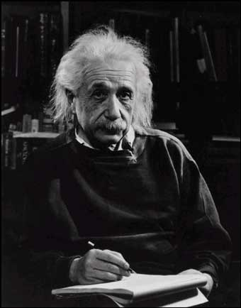
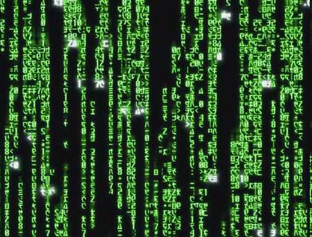
Human Vs. Machine (ok, advanced machine)
What we see
What a computer sees

Slide 16
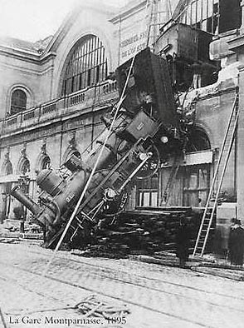
Can the computer match human intelligence?
Yes and no (mainly no)
  computers can be better at “easy” things
  humans are much better at “hard” things
But huge progress has been made
  Especially in the last 10 years
  What is considered “hard” keeps changing

Slide 17
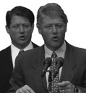
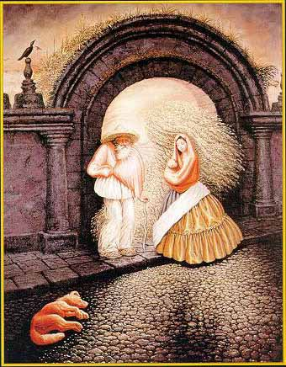
Human understanding has its shortcomings
Sinha and Poggio, Nature, 1996

Slide 18



But humans can understand MUCH more about what’s important to them, from VERY little information…

Slide 19
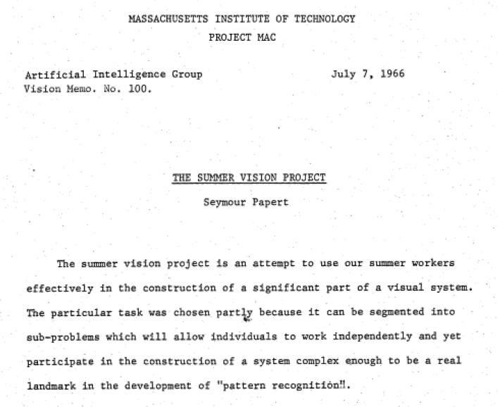
A Simple Visual System (MIT, 1962-63)
A simple world
A simple image formation model
A simple goal

Slide 20
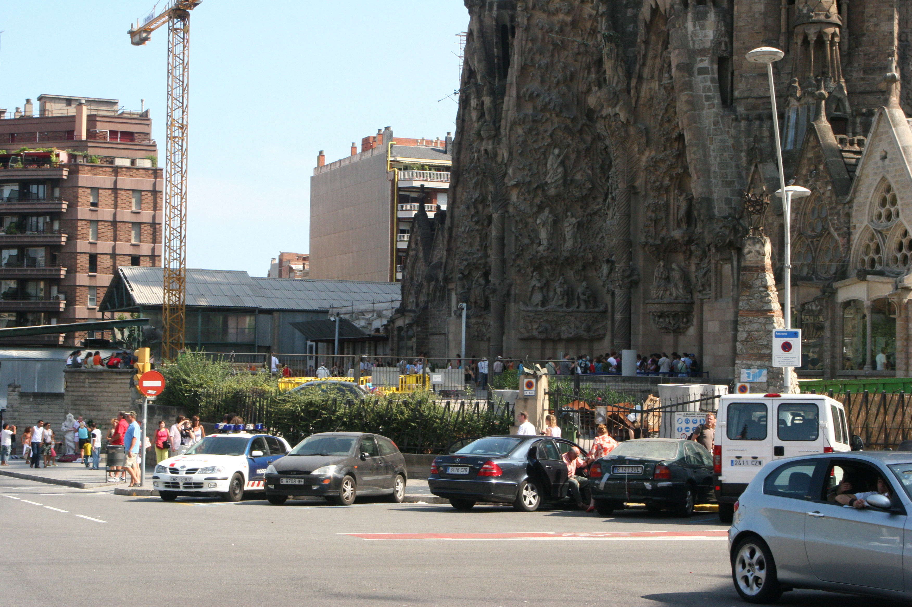
A Simple World?

Slide 21

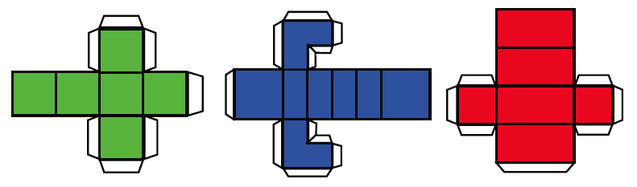

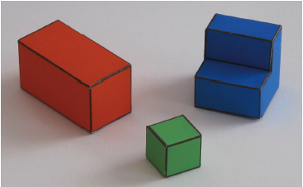
A Simple World

Slide 22
What is artificial intelligence?
Artificial intelligence is the ability of a computer to perform tasks commonly associated with intelligent beings.

Slide 23
What is machine learning?
Machine learning is the study of algorithms that learn from examples and experience instead of relying on hard-coded rules and make predictions on new data.

Slide 24
What is deep learning?
Deep learning is a subfield of machine learning focusing on learning data representations as successive layers of increasingly meaningful representations.

Slide 25
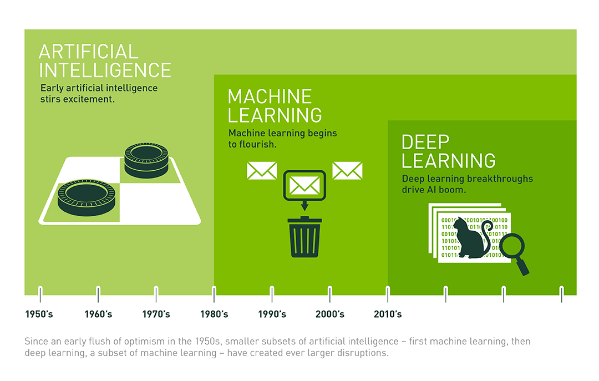
Image from https://blogs.nvidia.com/blog/2016/07/29/whats-difference-artificial-intelligence-machine-learning-deep-learning-ai/

Slide 26

“Traditional” machine learning:
handcrafted features
learned classifier
cat
Deep, “end-to-end” learning:
learned low-level features
learned mid-level features
learned high-level features
learned classifier
cat

Slide 27
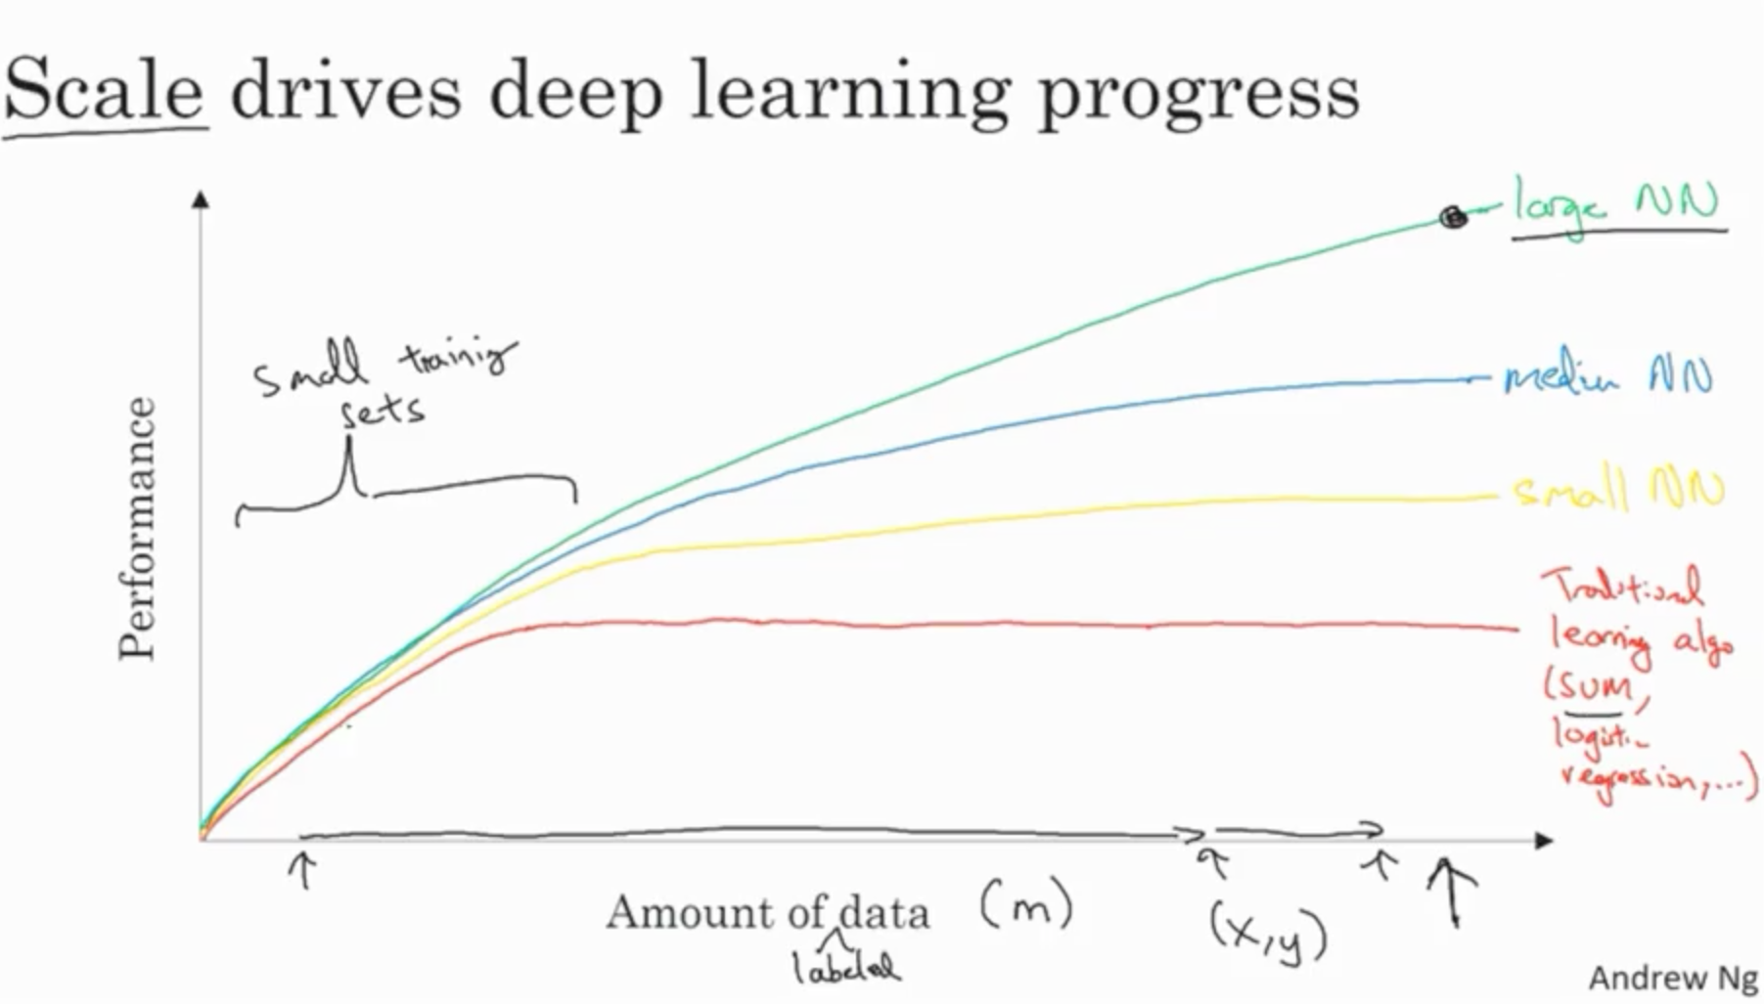

Slide 28
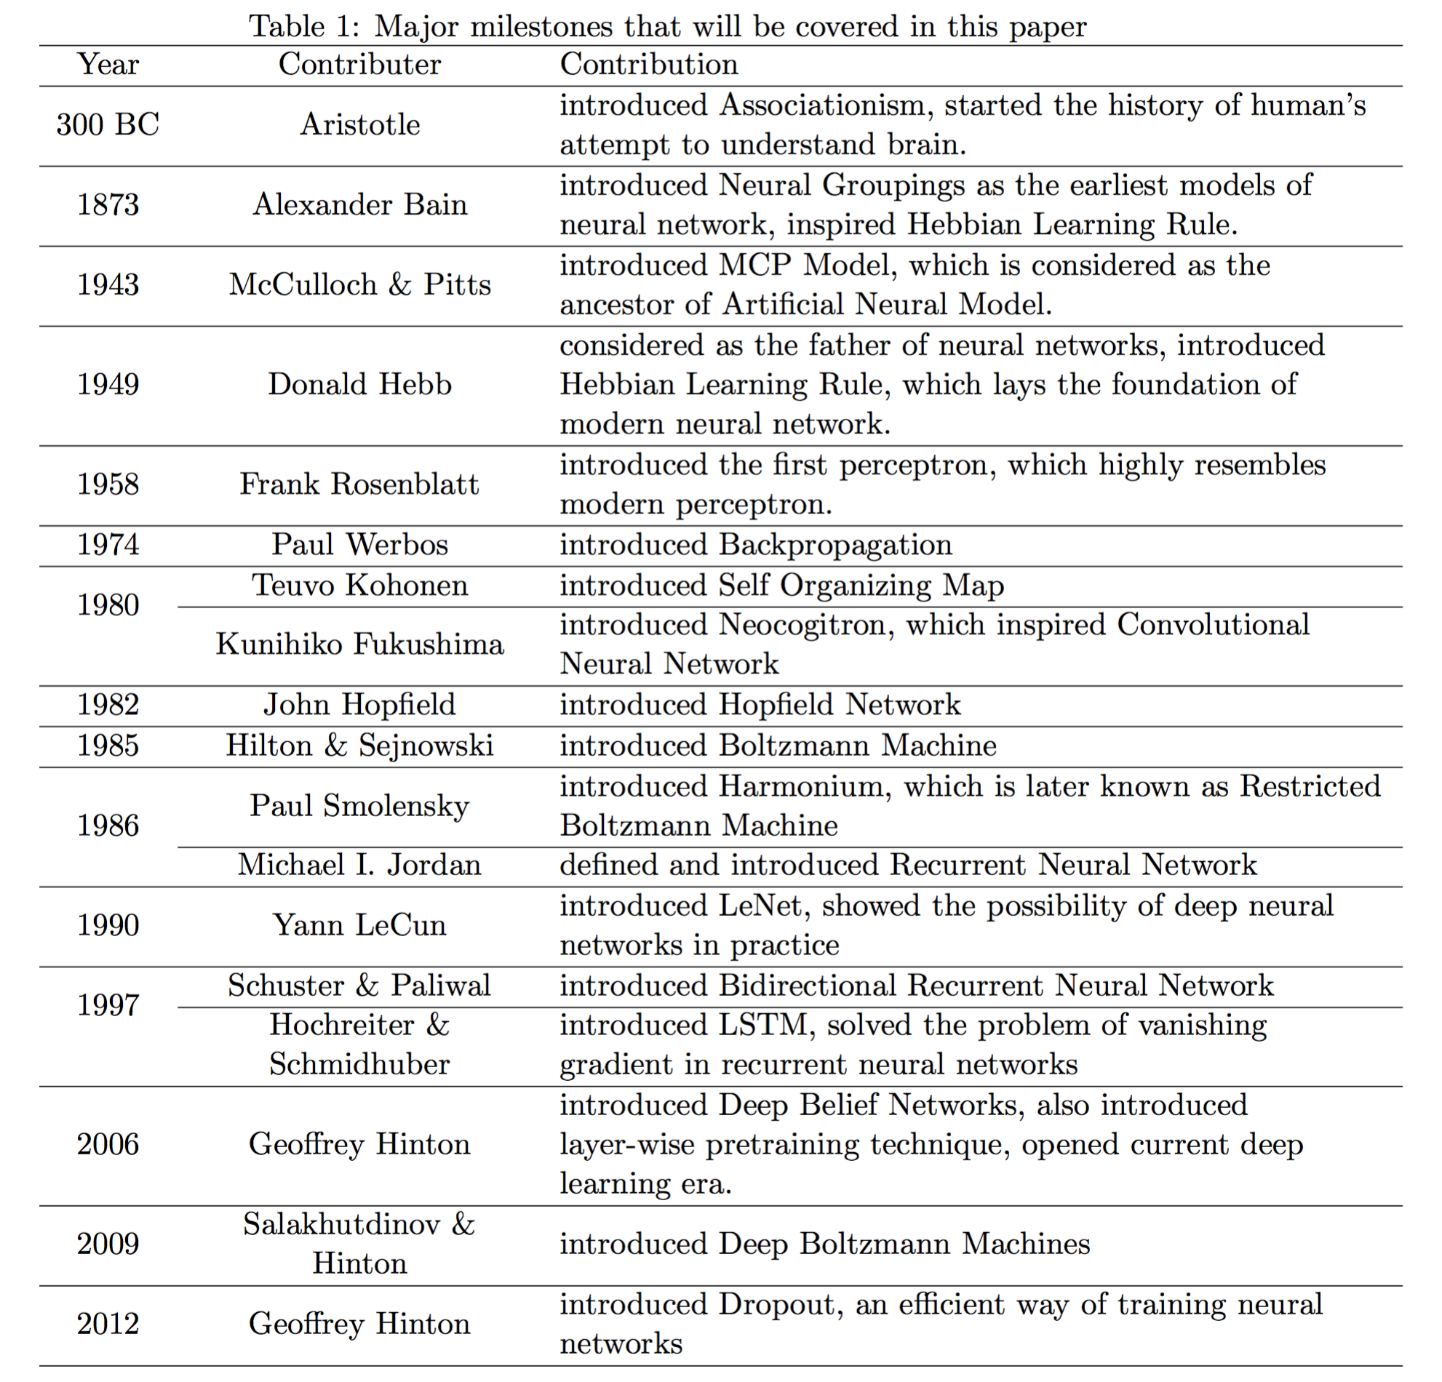
From: Wang & Raj: On the Origin of Deep Learning (2017)

Slide 29
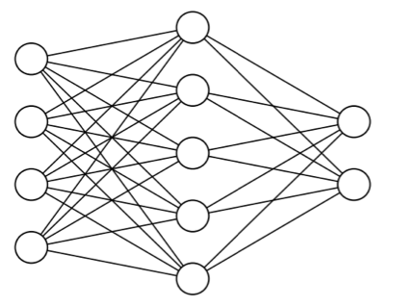
Main types of machine learning
Supervised learning
Unsupervised learning
Self-supervised learning
Reinforcement learning
cat
dog

Slide 30
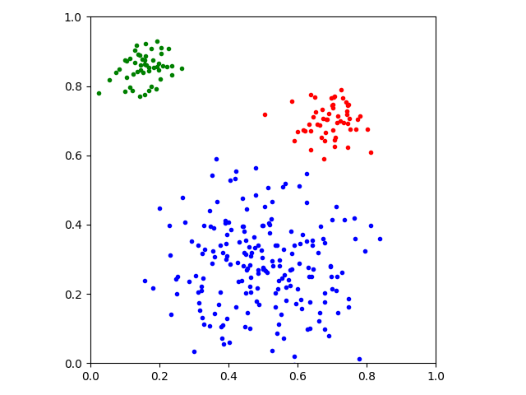
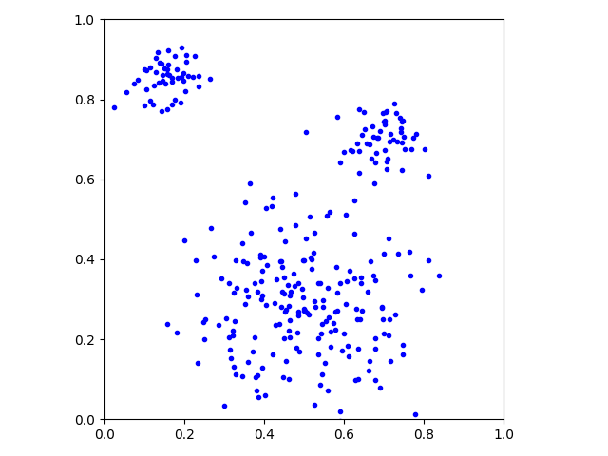
Main types of machine learning
Supervised learning
Unsupervised learning
Self-supervised learning
Reinforcement learning

Slide 31
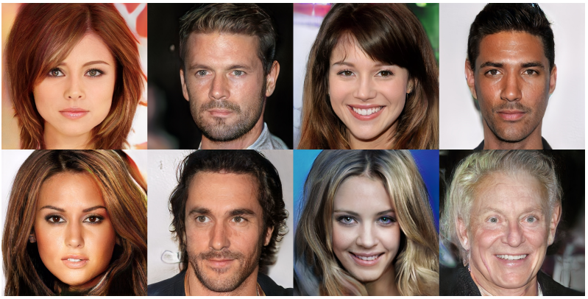
Main types of machine learning
Supervised learning
Unsupervised learning
Self-supervised learning
Reinforcement learning
Image from https://arxiv.org/abs/1710.10196

Slide 32
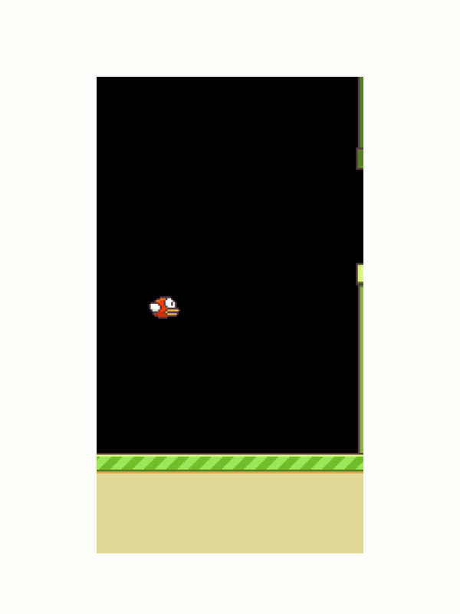
Main types of machine learning
Supervised learning
Unsupervised learning
Self-supervised learning
Reinforcement learning
Animation from https://yanpanlau.github.io/2016/07/10/FlappyBird-Keras.html

Slide 33
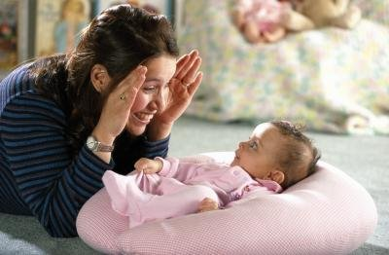
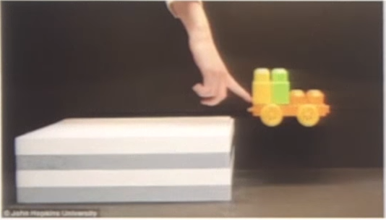
Data
Humans learn by observation and unsupervised learning
  model of the world /
  common sense reasoning
Machine learning needs lots of (labeled) data to compensate

Slide 34
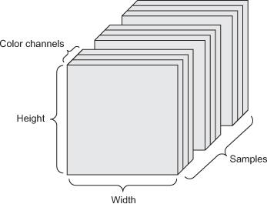

Data
Tensors: generalization of matrices
to n dimensions (or rank, order, degree)
  1D tensor: vector
  2D tensor: matrix
  3D, 4D, 5D tensors
  numpy.ndarray(shape, dtype)
Training – validation – test split (+ adversarial test)
Minibatches
  small sets of input data used at a time
  usually processed independently
Image from: https://arxiv.org/abs/1707.08945

Slide 35
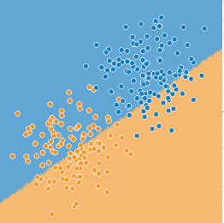
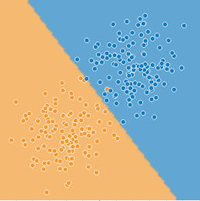


Model – learning/training – inference
http://playground.tensorflow.org/
parameters 𝜃 and hyperparameters

Slide 36


Optimization
Mathematical optimization:
“the selection of a best element (with
regard to some criterion) from some
set of available alternatives” (Wikipedia)
Main types:
finite-step, iterative, heuristic
Learning as an optimization problem
  cost function:
By Rebecca Wilson (originally posted to Flickr as Vicariously) [CC BY 2.0], via Wikimedia Commons
loss
regularization

Slide 37

Optimization
Image from: Li et al. “Visualizing the Loss Landscape of Neural Nets”, arXiv:1712.09913

Slide 38



Gradient descent
Derivative and minima/maxima of functions
Gradient: the derivative of a multivariable function
Gradient descent:
(Mini-batch) stochastic gradient
descent (and its variants)
Image from: https://towardsdatascience.com/gradient-descent-algorithm-and-its-variants-10f652806a3

Slide 39

Over- and underfitting, generalization, regularization
Models with lots of parameters can easily overfit to training data
Generalization: the quality of ML model is measured on new, unseen samples
Regularization: any method* to prevent overfitting
  simplicity, sparsity, dropout, early stopping
  *) other than adding more data
By Chabacano [GFDL or CC BY-SA 4.0], from Wikimedia Commons

Slide 40

Anatomy of a deep neural network
Layers
Input data and targets
Loss function
Optimizer

Slide 41


Layers
Data processing modules
Many different kinds exist
  densely connected
  convolutional
  recurrent
  pooling, flattening, merging, normalization, etc.
Input: one or more tensors
output: one or more tensors
Usually have a state, encoded as weights
  learned, initially random
When combined, form a network or
a model

Slide 42
Input data and targets
The network maps the input data X to predictions Y′
During training, the predictions Y′ are compared to true targets Y using the loss function
cat
dog

Slide 43
Loss function
The quantity to be minimized (optimized) during training
  the only thing the network cares about
  there might also be other metrics you care about
Common tasks have “standard” loss functions:
  mean squared error for regression
  binary cross-entropy for two-class classification
  categorical cross-entropy for multi-class classification
  etc.
https://lossfunctions.tumblr.com/

Slide 44

Optimizer
How to update the weights based on the loss function
Learning rate (+scheduling)
Stochastic gradient descent, momentum, and their variants
  RMSProp is usually a good first choice
  more info: http://ruder.io/optimizing-gradient-descent/
Animation from: https://imgur.com/s25RsOr
Notes:
RMSProp mentioned in Hinton’s lecture notes

Slide 45
Anatomy of a deep neural network

Slide 46

Deep learning frameworks
Actually tools for defining static or dynamic general-purpose computational graphs
Automatic differentiation
Seamless CPU / GPU usage
  multi-GPU, distributed
Python/numpy or R interfaces
  instead of C, C++, CUDA or HIP
Open source
+
+
✕
✕
x
y
5

Slide 47












Slide 48
Deep learning frameworks
Lasagne
Keras
TF Estimator
torch.nn
Gluon
Theano
TensorFlow
CNTK
PyTorch
MXNet
Caffe
Keras is a high-level
neural networks API
  we will use TensorFlow
  as the compute backend
  included in TensorFlow 2 as tf.keras
  https://keras.io/ , https://www.tensorflow.org/guide/keras
PyTorch is:
  a GPU-based tensor library
  an efficient library for dynamic neural networks
  https://pytorch.org/
CUDA, cuDNN
HIP, MIOpen
MKL, MKL-DNN
GPUs
CPUs

Slide 49


Slide 50




Biological neuron
Artificial neuron

Slide 51

Modeling Individual Neurons

Slide 52

Modeling Individual Neurons
rectified

Slide 53
What is Machine Learning?
It is very hard to write programs that solve problems like recognizing a three-dimensional object from a novel viewpoint in new lighting conditions in a cluttered scene.
  We don’t know what program to write because we don’t know how its done in our brain.
  Even if we had a good idea about how to do it, the program might be horrendously complicated.
It is hard to write a program to compute the probability that a credit card transaction is fraudulent.
  There may not be any rules that are both simple and reliable. We need to combine a very large number of weak rules.
  Fraud is a moving target. The program needs to keep changing.

Slide 54
The Machine Learning Approach
Instead of writing a program by hand for each specific task, we collect lots of examples that specify the correct output for a given input.
A machine learning algorithm then takes these examples and produces a program that does the job.
  The program produced by the learning algorithm may look very different from a typical hand-written program. It may contain millions of numbers.
  If we do it right, the program works for new cases as well as the ones we trained it on.
  If the data changes the program can change too by training on the new data.
Massive amounts of computation are now cheaper than paying someone to write a task-specific program.

Slide 55
Some examples of tasks best solved by learning
Recognizing patterns:
  Objects in real scenes
  Facial identities or facial expressions
  Spoken words
Recognizing anomalies:
  Unusual sequences of credit card transactions
  Unusual patterns of sensor readings in a nuclear power plant
Prediction:
  Future stock prices or currency exchange rates
  Which movies will a person like?

Slide 56
A standard example of machine learning
A lot of genetics is done on fruit flies.
  They are convenient because they breed fast.
  We already know a lot about them.
The MNIST database of hand-written digits is the the machine learning equivalent of fruit flies.
  They are publicly available and we can learn them quite fast in a moderate-sized neural net.
  We know a huge amount about how well various machine learning methods do on MNIST.
We will use MNIST as our standard task.

Slide 57

It is very hard to say what makes a 2

Slide 58
Beyond MNIST: The ImageNet task
1000 different object classes in 1.3 million high-resolution training images from the web.
  Best system in 2010 competition got 47% error for its first choice and 25% error for its top 5 choices.
Jitendra Malik (an eminent neural net sceptic) said that this competition is a good test of whether deep neural networks work well for object recognition.
  A very deep neural net (Krizhevsky et. al. 2012) gets less that 40% error for its first choice and less than 20% for its top 5 choices.

Slide 59

Some examples from an earlier version of the net

Slide 60

It can deal with a wide range of objects

Slide 61

It makes some really cool errors

Slide 62
The Speech Recognition Task
A speech recognition system has several stages:
  Pre-processing: Convert the sound wave into a vector of acoustic coefficients. Extract a new vector about every 10 mille seconds.
  The acoustic model: Use a few adjacent vectors of acoustic coefficients to place bets on which part of which phoneme is being spoken.
  Decoding: Find the sequence of bets that does the best job of fitting the acoustic data and also fitting a model of the kinds of things people say.
Deep neural networks pioneered by George Dahl and Abdel-rahman Mohamed are now replacing the previous machine learning method for the acoustic model.

Slide 63
Phone recognition on the TIMIT benchmark
(Mohamed, Dahl, & Hinton, 2012)
  After standard post-processing using a bi-phone model, a deep net with 8 layers gets 20.7% error rate.
  The best previous speaker- independent result on TIMIT was 24.4% and this required averaging several models.
  Li Deng (at MSR) realised that this result could change the way speech recognition was done.
183 HMM-state labels
not pre-trained
2000 logistic hidden units
5 more layers of pre-trained weights
2000 logistic hidden units
2000 logistic hidden units
15 frames of 40 filterbank outputs
+ their temporal derivatives

Slide 64
Word error rates from MSR, IBM, & Google
(Hinton et. al. IEEE Signal Processing Magazine, Nov 2012)
The task | Hours of training data | Deep neural network | Gaussian Mixture Model | GMM with more data
Switchboard (Microsoft Research) | 309 | 18.5% | 27.4% | 18.6% (2000 hrs)
English broadcast news (IBM) | 50 | 17.5% | 18.8%
Google voice search (android 4.1) | 5,870 | 12.3% (and falling) |  | 16.0% (>>5,870 hrs)

Slide 65
Reasons to study neural computation
To understand how the brain actually works.
  Its very big and very complicated and made of stuff that dies when you poke it around. So we need to use computer simulations.
To understand a style of parallel computation inspired by neurons and their adaptive connections.
  Very different style from sequential computation.
    should be good for things that brains are good at (e.g. vision)
    Should be bad for things that brains are bad at (e.g. 23 x 71)
To solve practical problems by using novel learning algorithms inspired by the brain (this course)
  Learning algorithms can be very useful even if they are not how the brain actually works.

Slide 66
A typical cortical neuron
Gross physical structure:
  There is one axon that branches
  There is a dendritic tree that collects input from other neurons.
Axons typically contact dendritic trees at synapses
  A spike of activity in the axon causes charge to be injected into the post-synaptic neuron.
Spike generation:
  There is an axon hillock that generates outgoing spikes whenever enough charge has flowed in at synapses to depolarize the cell membrane.
axon
axon hillock
body
dendritic
tree

Slide 67
Synapses
When a spike of activity travels along an axon and arrives at a synapse it causes vesicles of transmitter chemical to be released.
  There are several kinds of transmitter.
The transmitter molecules diffuse across the synaptic cleft and bind to receptor molecules in the membrane of the post-synaptic neuron thus changing their shape.
  This opens up holes that allow specific ions in or out.

Slide 68
How synapses adapt
The effectiveness of the synapse can be changed:
  vary the number of vesicles of transmitter.
  vary the number of receptor molecules.
Synapses are slow, but they have advantages over RAM
  They are very small and very low-power.
  They adapt using locally available signals
    But what rules do they use to decide how to change?

Slide 69
How the brain works on one slide!
Each neuron receives inputs from other neurons
  A few neurons also connect to receptors.
  Cortical neurons use spikes to communicate.
The effect of each input line on the neuron is controlled
by a synaptic weight
  The weights can be positive or negative.
The synaptic weights adapt so that the whole network learns to perform useful computations
  Recognizing objects, understanding language, making plans, controlling the body.
You have about neurons each with about weights.
  A huge number of weights can affect the computation in a very short time. Much better bandwidth than a workstation.

Slide 70
Modularity and the brain
Different bits of the cortex do different things.
  Local damage to the brain has specific effects.
  Specific tasks increase the blood flow to specific regions.
But cortex looks pretty much the same all over.
  Early brain damage makes functions relocate.
Cortex is made of general purpose stuff that has the ability to turn into special purpose hardware in response to experience.
  This gives rapid parallel computation plus flexibility.
  Conventional computers get flexibility by having stored sequential programs, but this requires very fast central processors to perform long sequential computations.

Slide 71
Idealized neurons
To model things we have to idealize them (e.g. atoms)
  Idealization removes complicated details that are not essential for understanding the main principles.
  It allows us to apply mathematics and to make analogies to other, familiar systems.
  Once we understand the basic principles, its easy to add complexity to make the model more faithful.
It is often worth understanding models that are known to be wrong (but we must not forget that they are wrong!)
  E.g. neurons that communicate real values rather than discrete spikes of activity.

Slide 72
Linear neurons
These are simple but computationally limited
  If we can make them learn we may get insight into more complicated neurons.
bias
th
i input
weight on
output
th
i
input
index over
input connections

Slide 73
Linear neurons
These are simple but computationally limited
  If we can make them learn we may get insight into more complicated neurons.
y
0
0

Slide 74
Binary threshold neurons
McCulloch-Pitts (1943): influenced Von Neumann.
  First compute a weighted sum of the inputs.
  Then send out a fixed size spike of activity if the weighted sum exceeds a threshold.
  McCulloch and Pitts thought that each spike is like the truth value of a proposition and each neuron combines truth values to compute the truth value of another proposition!
1
output
0
threshold
weighted input

Slide 75
Binary threshold neurons
There are two equivalent ways to write the equations for a binary threshold neuron:
1 if
1 if
0 otherwise
0 otherwise

Slide 76
Rectified Linear Neurons
(sometimes called linear threshold neurons)
They compute a linear weighted sum of their inputs.
The output is a non-linear function of the total input.
y
z
0 otherwise
0

Slide 77
Sigmoid neurons
These give a real-valued output that is a smooth and bounded function of their total input.
  Typically they use the logistic function
  They have nice derivatives which make learning easy (see lecture 3).
1
0.5
0
0

Slide 78
Stochastic binary neurons
These use the same equations as logistic units.
  But they treat the output of the logistic as the probability of producing a spike in a short time window.
We can do a similar trick for rectified linear units:
  The output is treated as the Poisson rate for spikes.
1
0.5
0
0

Slide 79
A very simple way to recognize handwritten shapes
Consider a neural network with two layers of neurons.
  neurons in the top layer represent known shapes.
  neurons in the bottom layer represent pixel intensities.
A pixel gets to vote if it has ink on it.
  Each inked pixel can vote for several different shapes.
The shape that gets the most votes wins.
0 1 2 3 4 5 6 7 8 9

Slide 80


How to display the weights
1 2 3 4 5 6 7 8 9 0
The input image
Give each output unit its own “map” of the input image and display the weight coming from each pixel in the location of that pixel in the map.
Use a black or white blob with the area representing the magnitude of the weight and the color representing the sign.

Slide 81
How to learn the weights
1 2 3 4 5 6 7 8 9 0
The image
Show the network an image and increment the weights from active pixels to the correct class.
Then decrement the weights from active pixels to whatever class the network guesses.

Slide 82

1 2 3 4 5 6 7 8 9 0
The image

Slide 83

1 2 3 4 5 6 7 8 9 0
The image

Slide 84

1 2 3 4 5 6 7 8 9 0
The image

Slide 85

1 2 3 4 5 6 7 8 9 0
The image

Slide 86

1 2 3 4 5 6 7 8 9 0
The image

Slide 87

The learned weights
1 2 3 4 5 6 7 8 9 0
The image
The details of the learning algorithm will be explained in future lectures.

Slide 88
Why the simple learning algorithm is insufficient
A two layer network with a single winner in the top layer is equivalent to having a rigid template for each shape.
  The winner is the template that has the biggest overlap with the ink.
The ways in which hand-written digits vary are much too complicated to be captured by simple template matches of whole shapes.
  To capture all the allowable variations of a digit we need to learn the features that it is composed of.

Slide 89
Examples of handwritten digits that can be recognized correctly the first time they are seen

Slide 90
Basics of ML – A VERY short intro…

Slide 91



Machine Learning Types
Machine Learning Basics
Supervised: learning with labeled data
  Example: email classification, image classification
  Example: regression for predicting real-valued outputs
Unsupervised: discover patterns in unlabeled data
  Example: cluster similar data points
Reinforcement learning: learn to act based on feedback/reward
  Example: learn to play Go
class A
class B
Classification
Regression
Clustering
Slide credit: Ismini Lourentzou – Introduction to Deep Learning

Slide 92
Types of learning task
Supervised learning
  Learn to predict an output when given an input vector.
Reinforcement learning
  Learn to select an action to maximize payoff.
Unsupervised learning
  Discover a good internal representation of the input.

Slide 93
Unsupervised Learning
Machine Learning Basics
Unsupervised learning categories and techniques
  Clustering
    k-means clustering
    Mean-shift clustering
    Spectral clustering
  Density estimation
    Gaussian mixture model (GMM)
    Graphical models
  Dimensionality reduction
    Principal component analysis (PCA)
    Factor analysis
Slide credit: Y-Fan Chang – An Overview of Machine Learning

Slide 94
Unsupervised learning
For about 40 years, unsupervised learning was largely ignored by the machine learning community
  Some widely used definitions of machine learning actually excluded it.
  Many researchers thought that clustering was the only form of unsupervised learning.
It is hard to say what the aim of unsupervised learning is.
  One major aim is to create an internal representation of the input that is useful for subsequent supervised or reinforcement learning.
  You can compute the distance to a surface by using the disparity between two images. But you don’t want to learn to compute disparities by stubbing your toe thousands of times.

Slide 95
Other goals for unsupervised learning
It provides a compact, low-dimensional representation of the input.
  High-dimensional inputs typically live on or near a low-dimensional manifold (or several such manifolds).
  Principal Component Analysis is a widely used linear method for finding a low-dimensional representation.
It provides an economical high-dimensional representation of the input in terms of learned features.
  Binary features are economical.
  So are real-valued features that are nearly all zero.
It finds sensible clusters in the input.
  This is an example of a very sparse code in which only one of the features is non-zero.

Slide 96
Nearest Neighbor Classifier
Machine Learning Basics
Nearest Neighbor – for each test data point, assign the class label of the nearest training data point
  Adopt a distance function to find the nearest neighbor
    Calculate the distance to each data point in the training set, and assign the class of the nearest data point (minimum distance)
  It does not require learning a set of weights
Test example
Training examples from class 2
Training examples from class 1
Picture from: James Hays – Machine Learning Overview

Slide 97
k-Nearest Neighbors Classifier
Machine Learning Basics
k-Nearest Neighbors approach considers multiple neighboring data points to classify a test data point
  E.g., 3-nearest neighbors
    The test example in the figure is the + mark
    The class of the test example is obtained by voting (based on the distance to the 3 closest points)
x2
x
x
x
o
x
x
x
x
+
o
x
o
o
x
o
+
o
o
o
o
x1
Picture from: James Hays – Machine Learning Overview

Slide 98
Supervised Learning
Machine Learning Basics
Supervised learning categories and techniques
  Numerical classifier functions
    Linear classifier, perceptron, logistic regression, support vector machines (SVM), neural networks
  Parametric (probabilistic) functions
    Naïve Bayes, Gaussian discriminant analysis (GDA), hidden Markov models (HMM), probabilistic graphical models
  Non-parametric (instance-based) functions
    k-nearest neighbors, kernel regression, kernel density estimation, local regression
  Symbolic functions
    Decision trees, classification and regression trees (CART)
  Aggregation (ensemble) learning
    Bagging, boosting (Adaboost), random forest
Slide credit: Y-Fan Chang – An Overview of Machine Learning

Slide 99
Reinforcement learning
In reinforcement learning, the output is an action or sequence of actions and the only supervisory signal is an occasional scalar reward.
  The goal in selecting each action is to maximize the expected sum of the future rewards.
  We usually use a discount factor for delayed rewards so that we don’t have to look too far into the future.
Reinforcement learning is difficult:
  The rewards are typically delayed so its hard to know where we went wrong (or right).
  A scalar reward does not supply much information.
This course cannot cover everything and reinforcement learning is one of the important topics we will not cover.

Slide 100
Two types of supervised learning
Each training case consists of an input vector x and a target output t.
Regression: The target output is a real number or a whole vector of real numbers.
  The price of a stock in 6 months time.
  The temperature at noon tomorrow.
Classification: The target output is a class label.
  The simplest case is a choice between 1 and 0.
  We can also have multiple alternative labels.

Slide 101
How supervised learning typically works
We start by choosing a model-class:
  A model-class, f, is a way of using some numerical parameters, W, to map each input vector, x, into a predicted output y.
Learning usually means adjusting the parameters to reduce the discrepancy between the target output, t, on each training case and the actual output, y, produced by the model.
  For regression, is often a sensible measure of the discrepancy.
  For classification there are other measures that are generally more sensible (they also work better).

Slide 102

Supervised Learning In Neural Networks

Slide 103


Neural network
An (artificial) neural network is a collection of neurons
Usually organized in layers
  input layer
  one or more hidden layers
  (sizes, activation functions are hyperparameters)
  output layer

Slide 104



Output activation
Input
Usually a non-linear activation after each layer
Typically ReLU between the layers
At the output layer we need to consider the task, i.e., what kinds of outputs we want, e.g,
  Multi-label classification
  each K output separate probability (values 0.0-1.0)
  → sigmoid
  Multi-class classification
  probability distribution over K classes (sums to 1.0)
  → softmax
  Regression
  free range of values → linear
Layer 1
ReLU
Layer 2
ReLU
Layer 3
e.g. softmax
softmax:
Output

Slide 105

Backpropagation
Neural networks are trained with gradient descent,
starting from a random weight initialization
Algorithm for computing the gradients for a neural network:
An error (loss) when comparing to the correct label
cat
dog
Backpropagate errors =
How to change each weight to reduce error
Based on the chain rule of calculus:

Slide 106



Neuron as a linear classifier
By User:ZackWeinberg, based on PNG version by User:Cyc [CC BY-SA 3.0], via Wikimedia Commons

Slide 107



A non-linear classifier?

Slide 108


Non-linearity = activation function
A smooth (differentiable) nonlinear function that is applied after the inner product with the weights

Slide 109


Slide 110

Linear Classifier
Machine Learning Basics
Linear classifier
  Find a linear function f of the inputs x_{i} that separates the classes
  $$f\left(x_{i},W,b\right)=Wx_{i}+b$$
  Use pairs of inputs and labels to find the weights matrix W and the bias vector b
    The weights and biases are the parameters of the function f
  Several methods have been used to find the optimal set of parameters of a linear classifier
    A common method of choice is the Perceptron algorithm, where the parameters are updated until a minimal error is reached (single layer, does not use backpropagation)
  Linear classifier is a simple approach, but it is a building block of advanced classification algorithms, such as SVM and neural networks
    Earlier multi-layer neural networks were referred to as multi-layer perceptrons (MLPs)

Slide 111

Linear Classifier
Machine Learning Basics
The decision boundary is linear
  A straight line in 2D, a flat plane in 3D, a hyperplane in 3D and higher dimensional space
Example: classify an input image
  The selected parameters in this example are not good, because the predicted cat score is low
Picture from: https://cs231n.github.io/classification/

Slide 112



Support Vector Machines
Machine Learning Basics
Support vector machines (SVM)
  How to find the best decision boundary?
    All lines in the figure correctly separate the 2 classes
    The line that is farthest from all training examples will have better generalization capabilities
  SVM solves an optimization problem:
    First, identify a decision boundary that correctly classifies the examples
    Next, increase the geometric margin between the boundary and all examples
  The data points that define the maximum margin width are called support vectors
  Find W and b by solving:

Slide 113
Linear vs Non-linear Techniques
Linear vs Non-linear Techniques
Linear classification techniques
  Linear classifier
  Perceptron
  Logistic regression
  Linear SVM
  Naïve Bayes
Non-linear classification techniques
  k-nearest neighbors
  Non-linear SVM
  Neural networks
  Decision trees
  Random forest

Slide 114



Linear vs Non-linear Techniques
Linear vs Non-linear Techniques
For some tasks, input data can be linearly separable, and linear classifiers can be suitably applied
For other tasks, linear classifiers may have difficulties to produce adequate decision boundaries
Picture from: Y-Fan Chang – An Overview of Machine Learning

Slide 115




Non-linear Techniques
Linear vs Non-linear Techniques
Non-linear classification
  Features $z_{i}$are obtained as non-linear functions of the inputs $x_{i}$
  It results in non-linear decision boundaries
  Can deal with non-linearly separable data
Inputs: $x_{i}=\left[\begin{matrix}x_{n1} & x_{n2}\end{matrix}\right]$
Features: $z_{i}=\left[\begin{matrix}x_{n1} & x_{n2} & \begin{matrix}x_{n1}∙x_{n2} & x_{n1}^{2} & x_{n2}^{2}\end{matrix}\end{matrix}\right]$
Outputs: $f\left(x_{i}, W, b\right)=Wz_{i}+b$
Picture from: Y-Fan Chang – An Overview of Machine Learning

Slide 116

Binary vs Multi-class Classification
Binary vs Multi-class Classification
A classification problem with only 2 classes is referred to as binary classification
  The output labels are 0 or 1
  E.g., benign or malignant tumor, spam or no-spam email
A problem with 3 or more classes is referred to as multi-class classification

Slide 117

Binary vs Multi-class Classification
Binary vs Multi-class Classification
Both the binary and multi-class classification problems can be linearly or non-linearly separated
  Figure: linearly and non-linearly separated data for binary classification problem

Slide 118

Computer Vision Tasks (DNNs EXCEL!)
Machine Learning Basics
Computer vision has been the primary area of interest for ML
The tasks include: classification, localization, object detection, instance segmentation
Picture from: Fie-Fei Li, Andrej Karpathy, Justin Johnson – Understanding and Visualizing CNNs

Slide 119
No-Free-Lunch Theorem
Machine Learning Basics
Wolpert (2002) - The Supervised Learning No-Free-Lunch Theorems
The derived classification models for supervised learning are simplifications of the reality
  The simplifications are based on certain assumptions
  The assumptions fail in some situations
    E.g., due to inability to perfectly estimate ML model parameters from limited data
In summary, No-Free-Lunch Theorem states:
  No single classifier works the best for all possible problems
  Since we need to make assumptions to generalize

Slide 120

ML vs. Deep Learning
Introduction to Deep Learning
Conventional machine learning methods rely on human-designed feature representations
  ML becomes just optimizing weights to best make a final prediction
Picture from: Ismini Lourentzou – Introduction to Deep Learning

Slide 121

ML vs. Deep Learning
Introduction to Deep Learning
Deep learning (DL) is a machine learning subfield that uses multiple layers for learning data representations
  DL is exceptionally effective at learning patterns
Picture from: https://www.xenonstack.com/blog/static/public/uploads/media/machine-learning-vs-deep-learning.png

Slide 122





















ML vs. Deep Learning
Introduction to Deep Learning
DL applies a multi-layer process for learning rich hierarchical features (i.e., data representations)
  Input image pixels → Edges → Textures → Parts → Objects
Low-Level Features
Mid-Level Features
High-Level Features
Trainable Classifier
Output
Slide credit: Param Vir Singh – Deep Learning

Slide 123
Why is DL Useful?
Introduction to Deep Learning
DL provides a flexible, learnable framework for representing visual, text, linguistic information
  Can learn in supervised and unsupervised manner
DL represents an effective end-to-end learning system
Requires large amounts of training data
Since about 2010, DL has outperformed other ML techniques
  First in vision and speech, then NLP, and other applications

Slide 124


Representational Power
Introduction to Deep Learning
NNs with at least one hidden layer are universal approximators
  Given any continuous function h(x) and some $ε>0$, there exists a NN with one hidden layer (and with a reasonable choice of non-linearity) described with the function f(x), such that $∀x, \left|h\left(x\right)−f(x)\right|<ε$
  I.e., NN can approximate any arbitrary complex continuous function
NNs use nonlinear mapping of the inputs x to the outputs f(x) to compute complex decision boundaries
But then, why use deeper NNs?
  The fact that deep NNs work better is an empirical observation
  Mathematically, deep NNs have the same representational power as a one-layer NN

Slide 125

Introduction to Neural Networks
Introduction to Neural Networks
Handwritten digit recognition (MNIST dataset)
  The intensity of each pixel is considered an input element
  Output is the class of the digit
Input
Output
y₁
is 1
0.1
y₂
is 2
0.7
The image is “2”
……
……
……
y₁₀
0.2
is 0
16 x 16 = 256
Ink → 1
No ink → 0
Each dimension represents the confidence of a digit
Slide credit: Hung-yi Lee – Deep Learning Tutorial

Slide 126


Introduction to Neural Networks
Introduction to Neural Networks
Handwritten digit recognition
y₁
Machine
y₂
“2”
……
……
$$f:R^{256}→R^{10}$$
y₁₀
The function $f$ is represented by a neural network
Slide credit: Hung-yi Lee – Deep Learning Tutorial

Slide 127


Elements of Neural Networks
Introduction to Neural Networks
NNs consist of hidden layers with neurons (i.e., computational units)
A single neuron maps a set of inputs into an output number, or $f:R^{K}→R$
$$a=σ\left(z\right)$$
…
…
output
Activation function
weights
input
bias
Slide credit: Hung-yi Lee – Deep Learning Tutorial

Slide 128





Elements of Neural Networks
Introduction to Neural Networks
A NN with one hidden layer and one output layer
Weights
Biases
$$hidden layer h=σ(W_{1}x+b_{1})$$
$$output layer y=σ(W_{2}h+b_{2})$$
Activation functions
4 + 2 = 6 neurons (not counting inputs)
[3 × 4] + [4 × 2] = 20 weights
4 + 2 = 6 biases
26 learnable parameters
$$y$$
$$x$$
$$h$$
Slide credit: Ismini Lourentzou – Introduction to Deep Learning

Slide 129

Elements of Neural Networks
Introduction to Neural Networks
A neural network playground link

Slide 130
Elements of Neural Networks
Introduction to Neural Networks
Deep NNs have many hidden layers
  Fully-connected (dense) layers (a.k.a. Multi-Layer Perceptron or MLP)
  Each neuron is connected to all neurons in the succeeding layer
Input
Layer 1
Layer 2
Layer L
Output
……
y₁
……
y₂
……
……
……
……
……
……
y_{M}
Input Layer
Output Layer
Hidden Layers
Slide credit: Hung-yi Lee – Deep Learning Tutorial

Slide 131

Feedforward Architectures

Slide 132

Recurrent Architectures

Slide 133
More Jargon!

Slide 134
Ensemble Learning
Ensemble Learning
Ensemble learning is training multiple classifiers separately and combining their predictions
  Ensemble learning often outperforms individual classifiers
  Better results obtained with higher model variety in the ensemble
  Bagging (bootstrap aggregating)
    Randomly draw subsets from the training set (i.e., bootstrap samples)
    Train separate classifiers on each subset of the training set
    Perform classification based on the average vote of all classifiers
  Boosting
    Train a classifier, and apply weights on the training set (apply higher weights on misclassified examples, focus on “hard examples”)
    Train new classifier, reweight training set according to prediction error
    Repeat
    Perform classification based on weighted vote of the classifiers

Slide 135

Deep vs Shallow Networks
Deep vs Shallow Networks
Deeper networks perform better than shallow networks
  But only up to some limit: after a certain number of layers, the performance of deeper networks plateaus
output
Shallow NN
Deep
NN
……
……
input
Slide credit: Hung-yi Lee – Deep Learning Tutorial

Slide 136



Convolutional Neural Networks (CNNs)
Convolutional Neural Networks
Convolutional neural networks (CNNs) were primarily designed for image data
CNNs use a convolutional operator for extracting data features
  Allows parameter sharing
  Efficient to train
  Have less parameters than NNs with fully-connected layers
CNNs are robust to spatial translations of objects in images
A convolutional filter slides (i.e., convolves) across the image
Convolutional
3x3 filter
Input matrix
Picture from: http://deeplearning.stanford.edu/wiki/index.php/Feature_extraction_using_convolution

Slide 137


Convolutional Neural Networks (CNNs)
Convolutional Neural Networks
When the convolutional filters are scanned over the image, they capture useful features
  E.g., edge detection by convolutions
0 1 0
1 -4 1
0 1 0
Filter
Input Image
Convoluted Image
Slide credit: Param Vir Singh – Deep Learning

Slide 138
Convolutional Neural Networks (CNNs)
Convolutional Neural Networks
In CNNs, hidden units in a layer are only connected to a small region of the layer before it (called local receptive field)
  The depth of each feature map corresponds to the number of convolutional filters used at each layer
w1 | w2
w3 | w4
w5 | w6
w7 | w8
Filter 1
Filter 2
Input Image
Layer 1 Feature Map
Layer 2 Feature Map
Slide credit: Param Vir Singh – Deep Learning

Slide 139
Convolutional Neural Networks (CNNs)
Convolutional Neural Networks
Max pooling: reports the maximum output within a rectangular neighborhood
Average pooling: reports the average output of a rectangular neighborhood
Pooling layers reduce the spatial size of the feature maps
  Reduce the number of parameters, prevent overfitting
MaxPool with a 2×2 filter with stride of 2
1 | 3 | 5 | 3
4 | 2 | 3 | 1
3 | 1 | 1 | 3
0 | 1 | 0 | 4
4 | 5
3 | 4
Output Matrix
Input Matrix
Slide credit: Param Vir Singh – Deep Learning

Slide 140

Convolutional Neural Networks (CNNs)
Convolutional Neural Networks
Feature extraction architecture
  After 2 convolutional layers, a max-pooling layer reduces the size of the feature maps (typically by 2)
  A fully convolutional and a softmax layers are added last to perform classification
Living Room
Bedroom
64
64
128
128
256
256
256
512
512
512
512
512
512
Kitchen
Bathroom
Conv layer
Max Pool
Outdoor
Fully Connected Layer
Slide credit: Param Vir Singh – Deep Learning

Slide 141


Residual CNNs
Convolutional Neural Networks
Residual networks (ResNets)
  Introduce “identity” skip connections
    Layer inputs are propagated and added to the layer output
    Mitigate the problem of vanishing gradients during training
    Allow training very deep NN (with over 1,000 layers)
  Several ResNet variants exist: 18, 34, 50, 101, 152, and 200 layers
  Are used as base models of other state-of-the-art NNs
    Other similar models: ResNeXT, DenseNet

Slide 142
Recurrent Neural Networks (RNNs)
Recurrent Neural Networks
Recurrent NNs are used for modeling sequential data and data with varying length of inputs and outputs
  Videos, text, speech, DNA sequences, human skeletal data
RNNs introduce recurrent connections between the neurons
  This allows processing sequential data one element at a time by selectively passing information across a sequence
  Memory of the previous inputs is stored in the model’s internal state and affect the model predictions
  Can capture correlations in sequential data
RNNs use backpropagation-through-time for training
RNNs are more sensitive to the vanishing gradient problem than CNNs

Slide 143














Recurrent Neural Networks (RNNs)
Recurrent Neural Networks
RNN use same set of weights $w_{h}$ and $w_{x}$ across all time steps
  A sequence of hidden states $\left\{h_{o},{h_{o}h}_{2},h_{3}, …\right\}$is learned, which represents the memory of the network
  The hidden state at step t, $h\left(t\right)$, is calculated based on the previous hidden state $h\left(t−1\right)$ and the input at the current step $x\left(t\right)$, i.e.,$h\left(t\right)=f_{h}\left(w_{h}∗h\left(t−1\right)+w_{x}∗x\left(t\right)\right)$
  The function $f_{h}\left(∙\right)$ is a nonlinear activation function, e.g., ReLU or tanh
RNN shown rolled over time
HIDDEN STATES SEQUENCE: ${h_{o},h}_{1},h_{2},h_{3}, ….$
OUTPUT
$$w_{h}$$
$$w_{h}$$
$$w_{h}$$
$$w_{y}$$
h0
$f_{h}$(·)
h1
$f_{h}$(·)
h2
$f_{h}$(·)
h3
$f_{y}$(·)
$$w_{x}$$
$$w_{x}$$
$$w_{x}$$
x1
x2
x3
INPUT SEQUENCE: $x_{1},x_{2},x_{3}, ….$
Slide credit: Param Vir Singh – Deep Learning

Slide 144


Recurrent Neural Networks (RNNs)
Recurrent Neural Networks
RNNs can have one of many inputs and one of many outputs
RNN
Application
Input
Output
Image Captioning
A person riding a motorbike on dirt road
Sentiment Analysis
Awesome movie. Highly recommended.
Positive
Machine Translation
Happy Diwali
शुभ दीपावली
Slide credit: Param Vir SIngh– Deep Learning

Slide 145




Bidirectional RNNs
Recurrent Neural Networks
Bidirectional RNNs incorporate both forward and backward passes through sequential data
  The output may not only depend on the previous elements in the sequence, but also on future elements in the sequence
  It resembles two RNNs stacked on top of each other
$${\overset{⃑}{h}}_{t}= σ({\overset{⃑}{W}}^{(hh)}{\overset{⃑}{h}}_{t−1}+{\overset{⃑}{W}}^{(hx)}x_{t})$$
$${\overset{⃖}{h}}_{t}= σ({\overset{⃖}{W}}^{(hh)}{\overset{⃖}{h}}_{t+1}+{\overset{⃖}{W}}^{(hx)}x_{t})$$
$$y_{t}=f\left( \left[{\overset{⃑}{h}}_{t}{;\overset{⃖}{h}}_{t}\right] \right)$$
Outputs both past and future elements
Slide credit: Param Vir Singh – Deep Learning

Slide 146
LSTM Networks
Recurrent Neural Networks
Long Short-Term Memory (LSTM) networks are a variant of RNNs
LSTM mitigates the vanishing/exploding gradient problem
  Solution: a Memory Cell, updated at each step in the sequence
Three gates control the flow of information to and from the Memory Cell
  Input Gate: protects the current step from irrelevant inputs
  Output Gate: prevents current step from passing irrelevant information to later steps
  Forget Gate: limits information passed from one cell to the next
Most modern RNN models use either LSTM units or other more advanced types of recurrent units (e.g., GRU units)

Slide 147


LSTM Networks
Recurrent Neural Networks
LSTM cell
  Input gate, output gate, forget gate, memory cell
  LSTM can learn long-term correlations within data sequences

Slide 148
References
Hung-yi Lee – Deep Learning Tutorial
Ismini Lourentzou – Introduction to Deep Learning
CS231n Convolutional Neural Networks for Visual Recognition (Stanford CS course) (link)
James Hays, Brown – Machine Learning Overview
Param Vir Singh, Shunyuan Zhang, Nikhil Malik – Deep Learning
Sebastian Ruder – An Overview of Gradient Descent Optimization Algorithms (link)

Slide 149


Slide 150
Thank You!

