Slide 1
University of Cyprus
MAI – 642 – DEEP LEARNING
Theocharis Theocharides
Nov, 2023

Slide 2
Deep Learning Generative Adversarial Networks
Theocharis Theocharides
Associate Professor Dept. of Electrical and Computer Engineering University of Cyprus

Slide 3
Course Schedule & Content
DATE | Overview | Lecture Details | Scope
Week 1 | Introduction - Course Structure, Logistics, Fundamentals of Machine Learning and Neural Networks | 1. Introduction to Neural Network, Multilayer Perceptron, Back Propagation Learning - What is Deep Learning? | BASICS
Week 2 | Fundamentals of Learning | 2. Introduction to Deep Learning, Bayesian Learning, Hebbian Learning, Decision Surfaces, Representation Learning. 3. Theory of Deep Learning (Universal approximation theorem, convergence rate, and recent mathematical results)
Week 3 | Mathematics & Fundamentals of Deep Learning | 4. Linear Classifiers, Linear Machines with Hinge Loss, Gradient Descent, Activation and Loss Functions. 5. Optimization Techniques, Gradient Descent, Batch Optimization, Introduction to Meta-Learning, Hessian-Free Optimization.
Week 4 | Deep Neural Networks | Deep Neural Networks: Features, Feature Representation, Representation Learning, BoFs/BoWs, Feature Maps, Deep vs. Shallow Nets | FUNDAMENTALS OF DEEP (CONVOLUTIONAL) LEARNING
Week 5 | Convolutional Neural Networks | 6. Convolutional Neural Networks, Building blocks of CNN | DEEP NEURAL NETWORKS - DEEP INTO DEEP LEARNING
Week 6 | Deep Convolutional Neural Networks | Pooling, Convolutional, Softmax Layers
Week 7 | Deep Convolutional Neural Networks | Optimizing ConvNets, Transfer Learning, Residual Networks
Week 8 | Deep Learning Optimization | 11. Deep Learning Model Optimization; Early Stopping/Exit, Dropout, Batch Normalization, Instance Normalization, Group Normalization, Pruning, Quantization, Hyperparameter Optimization.
Week 9 | Recurrent Neural Networks, Transformers | RNNs, LSTMs
Week 10 | Transformers, Attention | Attention Mechanisms and Transformer Networks | EMERGING DEEP LEARNING RESEARCH AND APPLICATIONS
Week 11 | Generative Adversarial Networks | Unsupervised Learning with Deep Network, Autoencoders Cont’d, 8. Generative Adversarial Networks, Adversarial Learning Models, Variational Autoencoders
Week 12 | Deep Reinforcement Learning - Graph Neural Networks | Deep Reinforcement Learning (Q-learning, actor-critic, policy gradient, experience replay, double Q-learning, deep bootstrap networks).
Week 13 | Graph Neural Networks and Deep Learning Trends | Graph Neural Networks – Graph Signal Processing, Convolutional Networks on Graphs, Gated Graph Sequence Networks, Semi-Supervised Graph Convolutional Networks Interpretable Deep Neural Networks DNNs for Vision and NLP - GPTS/LLMS
Exam Period | Final Exam | Comprehensive Final Exam | EVALUATION

Slide 4
Deep Learning needs DATA!!!!!
Real life: IMBALANCE, LIMITED DATA SETS & MISSING DATA
Naïve Sampling
Synthetic Sampling
Ensembles
Cost-sensitive learning
Algorithmic-level
Generative modelling
Hybrid Sampling
Synthetic sampling is the default method
But generative models are becoming more popular

Slide 5
Why Generative Models
We know of discriminative models
Given an X, predict a label Y
Estimates P(Y|X)
Discriminative models have several disadvantages
Can’t model P(X), i.e. the probability of seeing a certain point
Thus, can’t sample from P(X), i.e. can’t generate new data
Generative models (in general) cope with all of above
Can model P(X)
Can generate new data

Slide 6
GENERATIVE MODELS
Given samples from a data density, x ∼ q(x), we would like to learn a generative model with density p that matches the data density q. Then we can sample from p.
A generative model is any type of model that captures the training data distribution
From this, we can sample new examples
There are 2 types of density estimation approaches in use
We are interested in GANs as these are better
Better sample quality
No distributional assumptions
Sampling in parallel
No Markov chains
No variational bounds
Robust to over-fitting
No maximum likelihood estimation
Wider applications
Explicit density
Direct
Markov
Implicit density
Approximate
Tractable
Fully Visible Belief Nets
NADE
MADE
PixelCNN/RNN
Variational Inference
Markov chain
Boltzmann Machine
GAN
Generative Moment Matching Network
Generative Stochastic Networks
Change of variable models
Non-linear independent component analysis
Variational Autoencoder
Vanilla GAN
GAN variants

Slide 7
Traditional Generative Models
Generative models discover patterns from the data by modeling the data generating distribution, a probabilistic model of the data generating process that includes latent variables capturing the unobservables.
For example, in latent Dirichlet allocation (Blei et al. 2003), the joint distribution of documents and topics is $p\left(β,θ,z,w\right)=p\left(β\right)p\left(θ\right)p\left(z | θ\right)p(w|β,z)$, where $β$ are latent topics, $θ$ are document-level topic proportion (also latent), $z$ are word-level latent topic, and $w$ are observed words.
The inference of new document likelihood $p(w_{new}|w)$ and posteriors such as topics $p\left(β|w\right)$ and topic proportions $p\left(θ|w\right)$ often uses sampling-based methods or variational methods.
Such generative models often face the tradeoffs between model complexity and computational efficiency.
Sampling-based methods: the more latent variables are involved in the data generating distribution, the more iterations are needed.
Variational methods: the more latent variables are involved, the less reliable the variational approximation becomes.
In many cases, simplifying assumptions have to be made to the data generating process, as a compromise, to avoid intractable joint distributions.

Slide 8
Deep Generative Models
Neural network models are known for accommodating for complex non-linear relations, and are now equipped with improved computational efficiency (attributed to the recent development in deep learning.)
Deep generative models couple generative models with neural networks in order to model complex data generating distributions with reasonable computational efficiency.
Modeling data generating distributions with neural networks has at least three notable advantages:
Neural networks can model a wide range of complex data generating distributions, which are intractable under traditional generative modeling without making simplifying assumptions.
There is no need to prespecify data generating processes, because the neural network would learn the data generating process directly from the data. As a result, the risk of misspecified data generating processes is significantly reduced.
The data generating distributions learned by neural networks are empirically found to be closer to the actual ones than traditional generative models.
The state-of-the-art deep generative models are now capable of effectively modeling complex data generating processes of various data types, including image, speech, and text.
The next few slides showcase the state-of-the-art applications of deep generative models in these contexts.

Slide 9
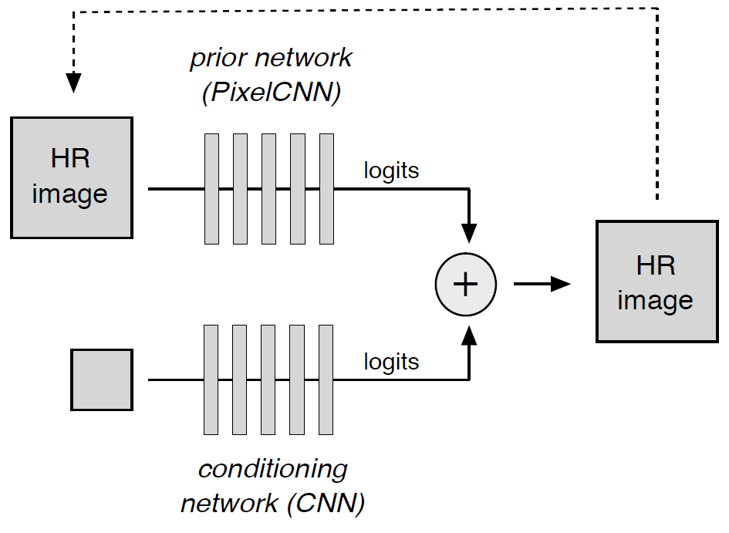
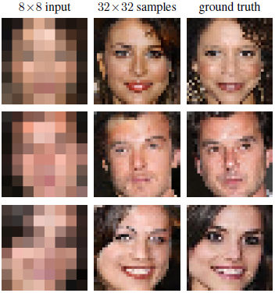
Application: Image Super Resolution
Image data generating distributions can be used for recovering a plausible high-resolution image given a low resolution input.
CNN’s are used to model the conditional distribution of a pixel and the prior distribution of a high-resolution pixel.
8x8 input
output
Ground truth
An Example of Using Deep Generative Models for Image Super Resolution
Dahl, R., Norouzi, M., & Shlens, J. (2017). Pixel Recursive Super Resolution. In 2017 IEEE International Conference on Computer Vision (ICCV) (pp. 5449-5458).
Notes:
Dahl, R., Norouzi, M., & Shlens, J. (2017). Pixel Recursive Super Resolution. In 2017 IEEE International Conference on Computer Vision (ICCV) (pp. 5449-5458).

Slide 10
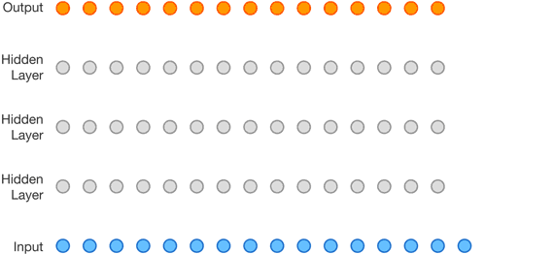
Application: Text-to-Speech (TTS)
Learned audio features
The joint probability of a waveform:
Output
Modeling the joint probability with a stack of causal convolutional layers
van den Oord, A., Dieleman, S., Zen, H., Simonyan, K., Vinyals, O., Graves, A., ... & Kavukcuoglu, K. (2016) WaveNet: A Generative Model for Raw Audio. In 9th ISCA Speech Synthesis Workshop (pp. 125-125).
Notes:
https://deepmind.com/blog/wavenet-generative-model-raw-audio/

Slide 11
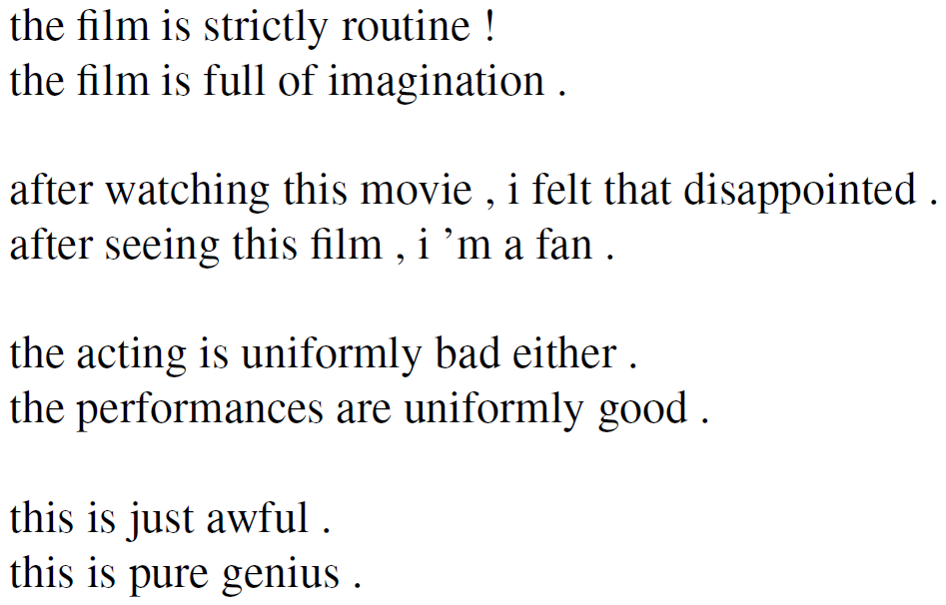
Application: Controllable Text Generation
Generate plausible sentences with designated semantic structures (e.g., sentiment, tense, etc.).
Generated texts with negative/positive sentiment
Input text
Text generating statistics
Designated semantic structure
Output text
Text generating distribution
Generated texts with varying tense
Hu, Z., Yang, Z., Liang, X., Salakhutdinov, R., & Xing, E. P. (2017). Toward Controlled Generation of Text. In International Conference on Machine Learning (pp. 1587-1596).

Slide 12
Deep Generative Models
Three most representative deep generative models: Deep Belief Networks, Variational Autoencoders, and Generative Adversarial Networks.
Deep Belief Networks (DBN) employ layer-wise generative modeling to initialize each layer and simultaneously capture multiple levels of data representation.
Started the recent deep learning renaissance
Hinton, G. E, Osindero, S., and Teh, Y. W. (2006). A fast learning algorithm for deep belief nets. Neural Computation, 18:1527-1554.
Variational Autoncoder (VAE) is a variational algorithm that infers the statistical characteristics of latent variables using an autoencoder neural network architecture.
Kingma, D. P., & Welling, M. (2014). Auto-Encoding Variational Bayes. In Proceedings of International Conference on Learning Representations (ICLR).
Generative Adversarial Networks (GAN) train two neural networks (a generative neural network and a discriminative neural network) contesting with each other in a zero-sum game framework.
Goodfellow, I., Pouget-Abadie, J., Mirza, M., Xu, B., Warde-Farley, D., Ozair, S., … Bengio, Y. (2014). Generative Adversarial Nets. In Advances in Neural Information Processing Systems 27 (pp. 2672–2680).

Slide 13
Unsupervised Pre-Training
The first Deep-Learning approach (Deep Belief Networks 2006 – G. Hinton)
Unsupervised Pre-Training uses unsupervised learning in the deep layers to transform the inputs into features that are easier to learn by a final supervised model
Often not a lot of labeled data available while there may be lots of unlabeled data.
Unsupervised Pre-Training can take advantage of unlabeled data. Can be a huge issue for some tasks.

Slide 14
Deep Belief Networks (DBN)
Beginning of Deep Learning hype (2006) – outperformed kernel methods (SVMs) on MNIST – Also generative
Uses Greedy layer-wise training but each layer is an RBM (Restricted Boltzmann Machine)
RBM is a constrained
Boltzmann machine with
No lateral connections between
hidden (h) and visible (x) nodes
Symmetric weights, different biases
Typically uses probabilistic logistic node, but other activations possible

Slide 15
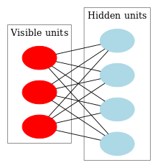
Restricted Boltzmann Machine
A DBN can be efficiently trained in an unsupervised, layer-by-layer manner, where the layers are typically made of restricted Boltzmann machines (RBM).
RBM: undirected, generative energy-based model with a "visible" input layer and a hidden layer, and connections between the layers but not within layers.
The joint probability distribution: $p\left(v=v,h=h\right)∝\exp\left(−E\left(v,h\right)\right)$ where the energy function $E\left(v,h\right)=−b^{T}v−c^{T}v−v^{T}Wh$
The training method for RBMs proposed by Geoffrey Hinton for use with training "Product of Expert" models is called contrastive divergence (CD).
$$h$$
$$v$$
$$h$$
$$v$$
$$h$$
$$v$$
$$h$$
An RBM with fully connected visible and hidden units
*Note there are no hidden-hidden or visible-visible connections.

Slide 16
Deep Belief Networks
A deep belief network (DBN) is a probabilistic, generative model made up of multiple layers of hidden units.
A composition of simple learning modules that make up each layer
A DBN can be used to generatively pre-train a deep neural network by using the learned DBN weights as the initial DNN weights.
Back-propagation or other discriminative algorithms can then be applied for fine-tuning of these weights.
Advantages:
Particularly helpful when limited training data are available
These pre-trained weights are closer to the optimal weights than are randomly chosen initial weights.

Slide 17
RBM Sampling and Training
Initial state typically set to a training
example x (can be real valued)
Sample in an iterative back and forth process
P(h_{i} = 1|x) = sigmoid(W_{i}x + c_{i}) = 1/(1+e^{-net(hi)}) // c_{i} is hidden node bias
P(x_{i} = 1|h) = sigmoid(W'_{i}h + b_{i}) = 1/(1+e^{-net(xi)}) // b_{i} is visible node bias
Contrastive Divergence (CD-k): the difference from the original training example to the relaxed version after k relaxation steps
Then update weights to decrease the divergence

Slide 18
Deep Belief Network Training
Greedy layer-wise approach
First train lowest RBM (h⁰ – h¹) using RBM update algorithm (note h⁰ is x)
Freeze weights and train subsequent RBM layers
Then connect final outputs to a supervised model and train that model
Finally, unfreeze all weights, and fine tune as an MLP using the initial weights found by DBN training
Can do execution as just the tuned MLP

Slide 19
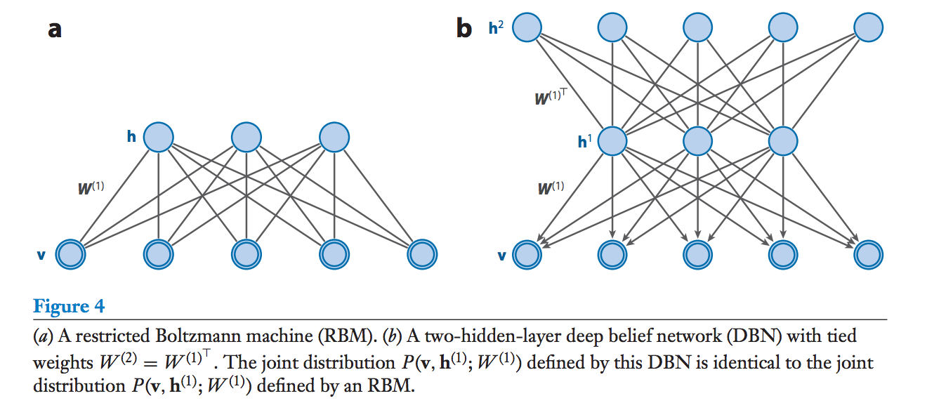
Deep Belief Networks
A DBN is a probabilistic generative model with an RBM in the top two layers and a directed sigmoid belief network in the lower layers.

Slide 20
Deep Belief Networks
The joint distribution over the DBN can be decomposed into the top RBM and the directed sigmoid belief network:
Directed sigmoid belief network:
Top RBM:

Slide 21
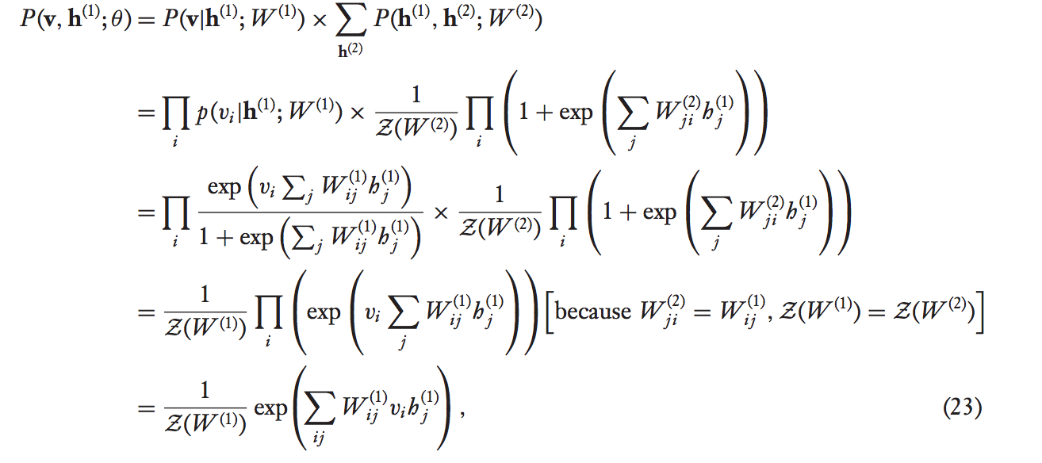
Deep Belief Networks
If we set W⁽²⁾ = W^{(1)T}, then the joint distribution over the visible and first hidden layer of the DBN is actually equal to the joint distribution of the RBM with weights W⁽¹⁾.
Note that the marginal P(h⁽¹⁾) is the same for the RBM and the DBN, as is the conditional P(v | h⁽¹⁾).

Slide 22
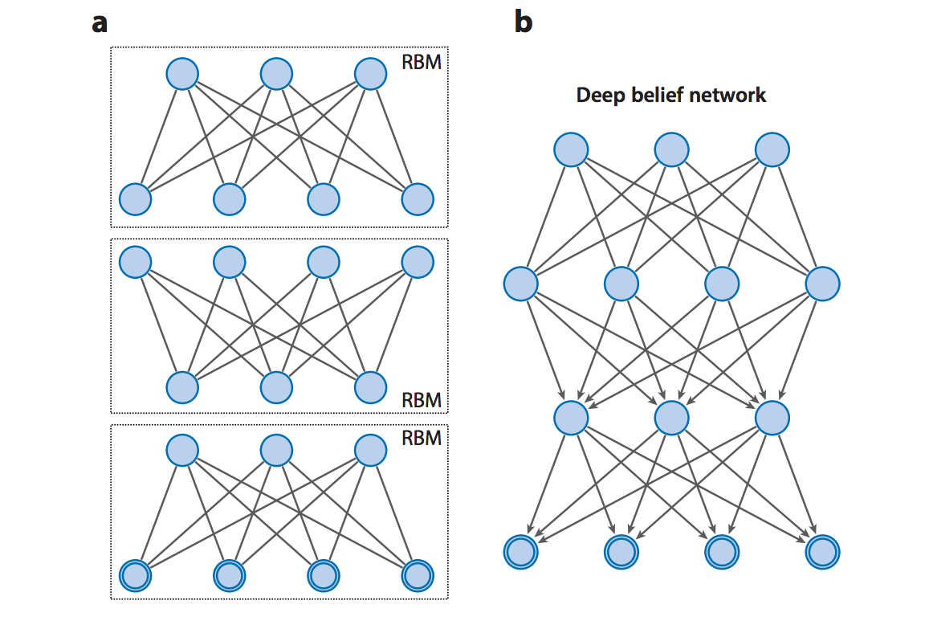
DBNs – Learning Procedure
Greedy layer-by-layer training approach where each pair of layers is trained as an RBM

Slide 23
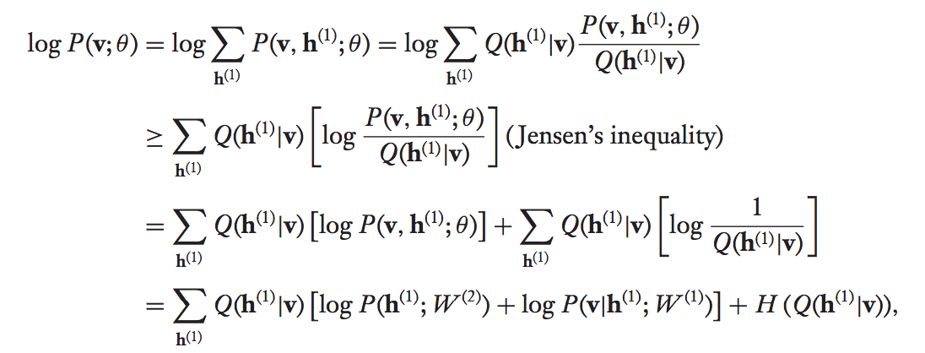
DBNs – Learning Procedure
The variational lower bound of the log-likelihood of the visible data is:
We set the approximating distribution Q to the corresponding conditional from the RBM:
Hence to maximize this bound with fixed W⁽¹⁾, we maximize ,which is equivalent to maximum likelihood training of the second-layer RBM.

Slide 24
DBN – Learning Procedure
The variational bound is initially tight when training the second hidden layer, and so improving it strictly improves the log-likelihood of the data.
However for deeper layers, it is not initially tight and so there is no guarantee, but in practice it does work.

Slide 25
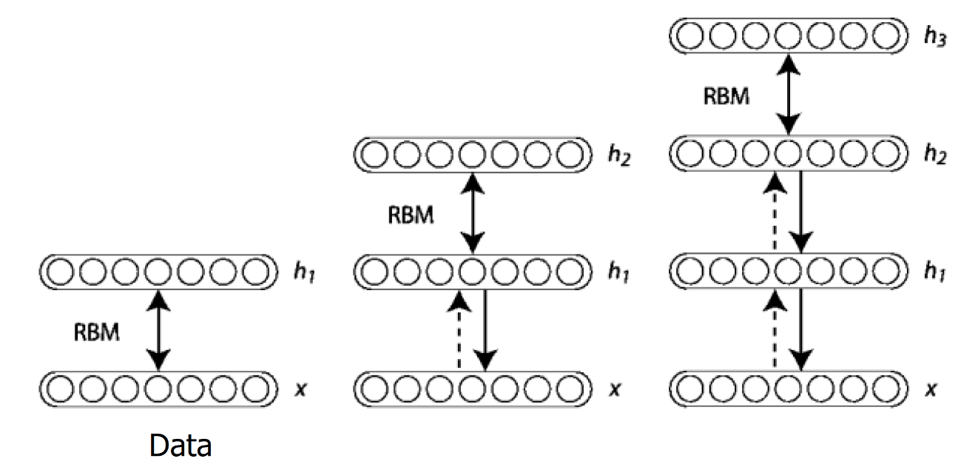
Deep Belief Network Architecture: Layer-wise Training
Once an RBM is trained, another RBM is "stacked" atop it, taking its input from the final already-trained layer.
The new visible layer is initialized to a training vector, and values for the units in the already-trained layers are assigned using the current weights and biases.
The new RBM is then trained with the CD procedure.
This whole process is repeated until some desired stopping criterion is met.
Fig. 3. DBN Architecture

Slide 26
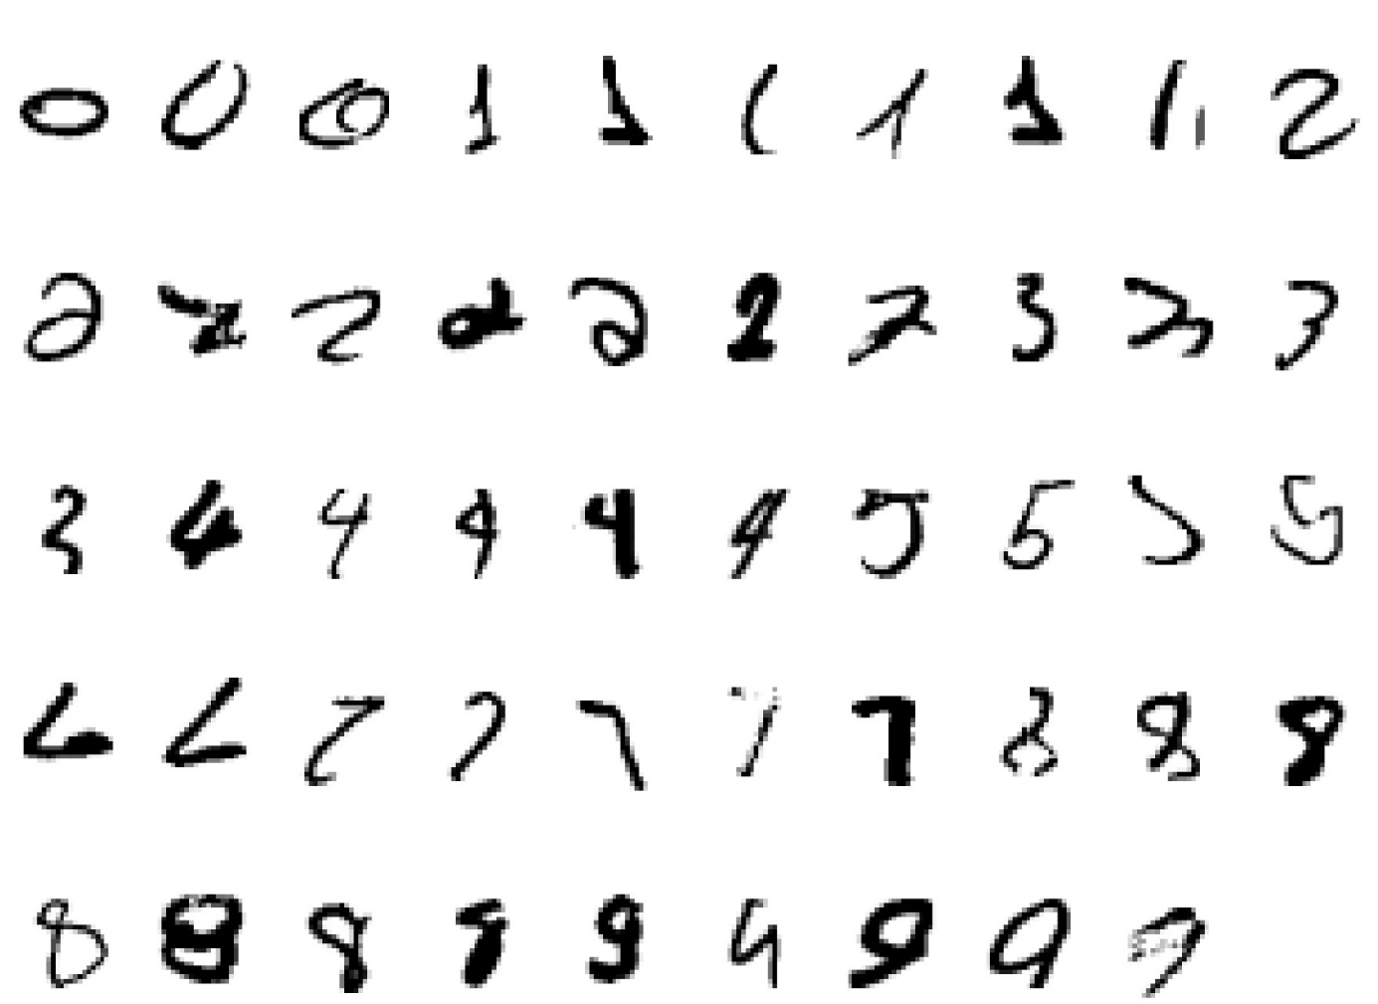
DBN Example: Hand-written Digit Recognition
Input:
Fig. 4. Hand-written Digits

Slide 27
DBN Example: Hand-written Digit Recognition
2000 top-level neurons
The top two layers form an associative memory whose energy landscape models the low dimensional manifolds of the digits.
10 label neurons
500 neurons
The model learns to generate combinations of labels and images.
To perform recognition we start with a neutral state of the label units and do an up-pass from the image followed by a few iterations of the top-level associative memory.
500 neurons
28 x 28 pixel image
Fig. 5. Hand-written Digit Recognition

Slide 28
DBN Example: Hand-written Digit Recognition
2000 top-level neurons
0
1
2
3
4
500 neurons
5
6
7
8
9
10 label neurons
500 neurons
Hidden representations of the data generating process
28 x 28 pixel image
Fig. 6. Hand-written Digit Recognition
Notes:
I don’t know how to name this figure. I think more explanation is needed.

Slide 29
DBN Example: Hand-written Digit Recognition
How well does it discriminate on MNIST test set (hand-written image) with no extra information about geometric distortions?
Generative model based on RBM’s 1.25% (error rate)
Support Vector Machine (Decoste et. al.) 1.4%
Backprop with 1000 hiddens (Platt) ~1.6%
Backprop with 500 -->300 hiddens ~1.6%
K-Nearest Neighbor ~ 3.3%
See Le Cun et. al. 1998 for more results
Its better than backprop and much more neurally plausible because the neurons only need to send one kind of signal, and the teacher can be another sensory input.

Slide 30
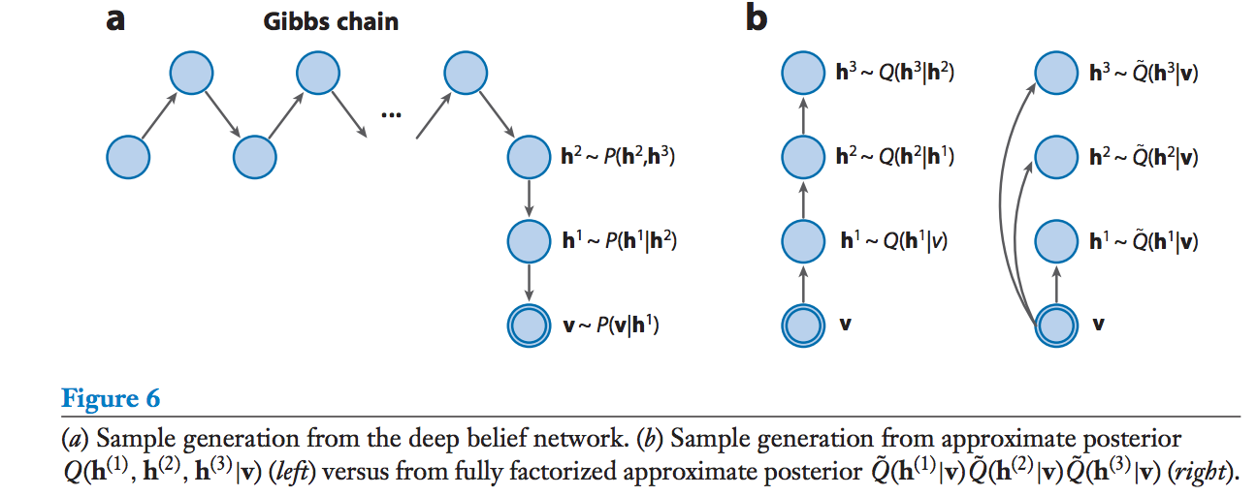
DBN – Inference

Slide 31
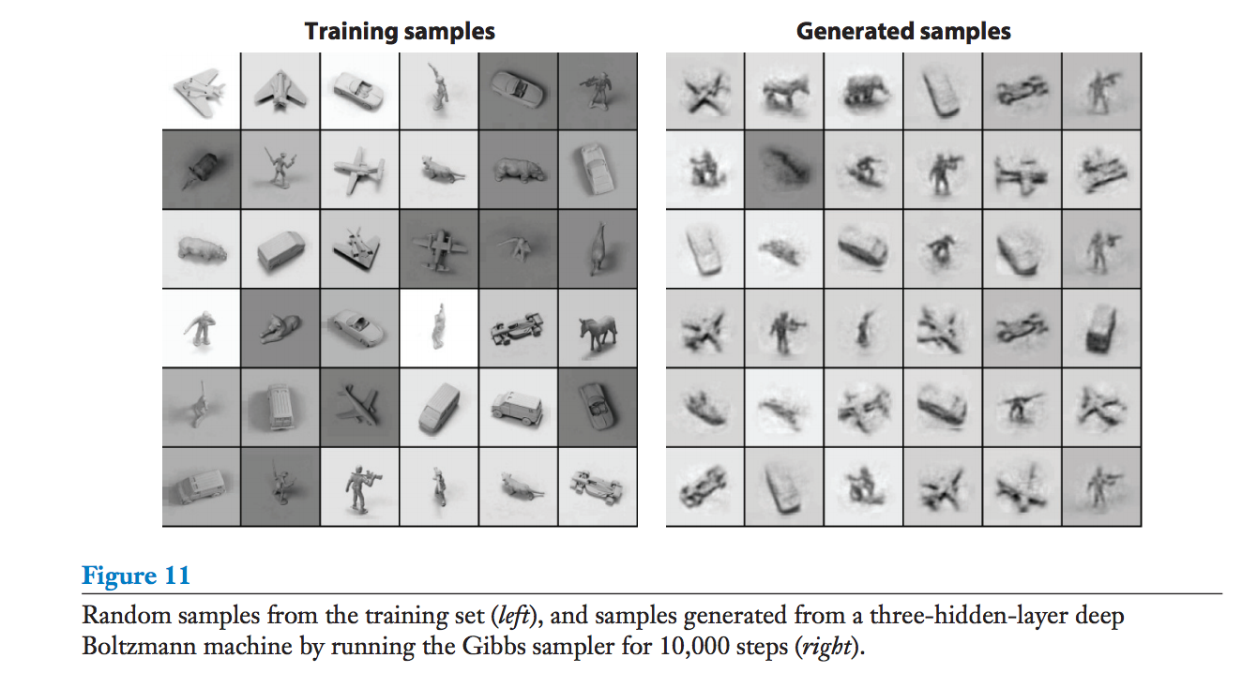
DBN - Inference

Slide 32
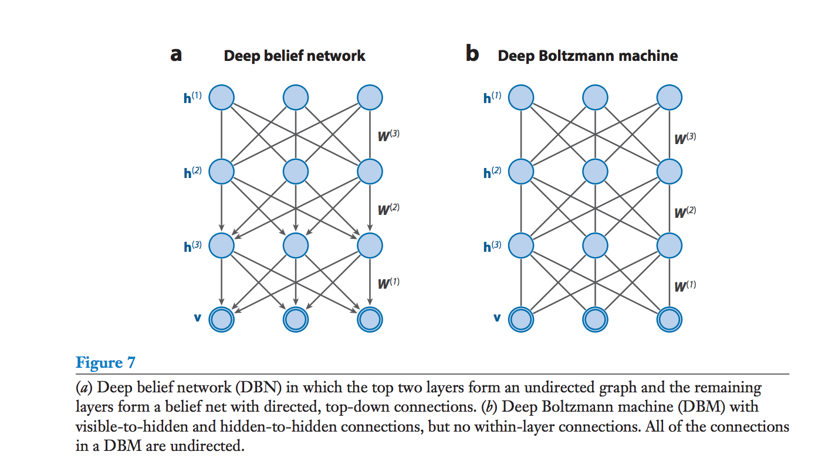
Deep Boltzmann Machines
DBMs are a more general form of DBNs where all of the edges are undirected.

Slide 33
Discriminative DBNs and DBMs
DBNs/DBMs can easily be applied to discriminative tasks after pre-training on unlabelled data.
The stochastic binary variables of the DBN/DBM are converted to deterministic, real-valued variables.
A top layer is added to the network, which transforms the hidden variables into the desired output.
The standard backpropagation algorithm is then used to optimize the weights of this multilayer network.
For DBMs, an approximating distribution Q(h⁽²⁾ | v) is used to create an augmented input for the network, in addition to the actual input.

Slide 34
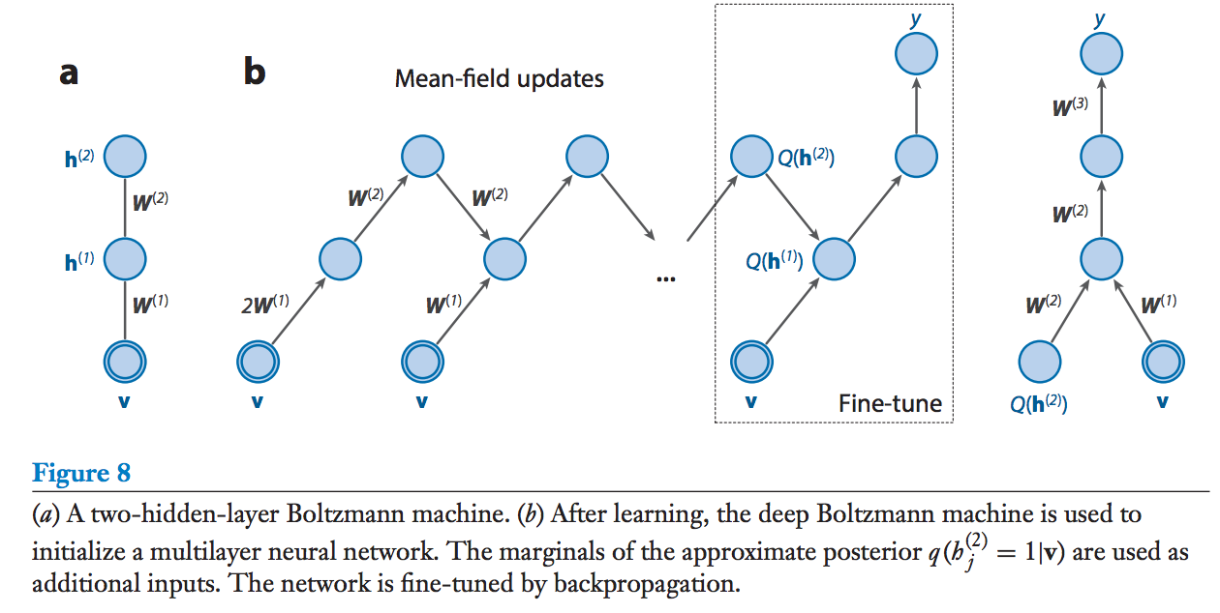
Deep Boltzmann Machines

Slide 35
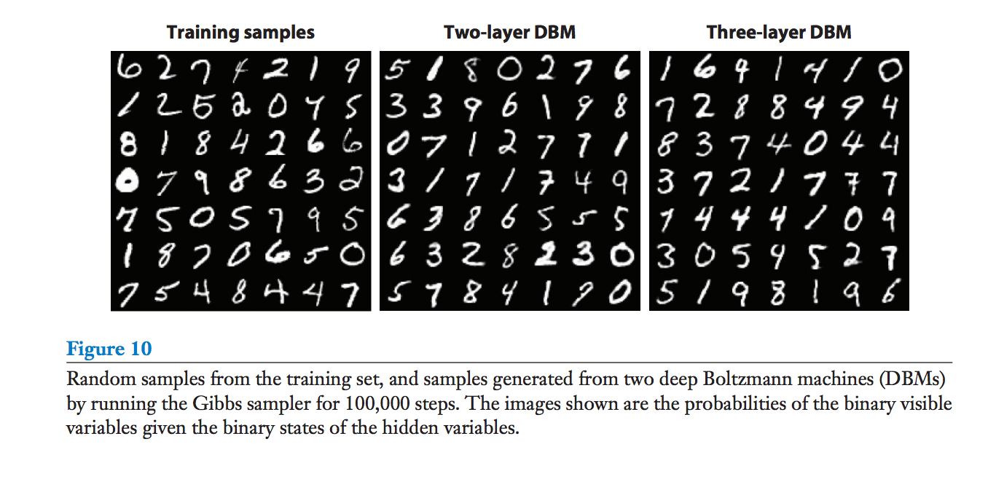
Experimental Results (with DBMs)
MNIST: 0.95% error rate on full MNIST test set with 2-layer RBM, compared to 1.4% by SVMs, 1.2% achieved by DBN.

Slide 36
Experimental Results (with DBMs)
NORB: 10.8% error on full test set, compared to 11.6% by SVM, 22.5% by logistic regression, 18.4% by k-nearest-neighbours.

Slide 37
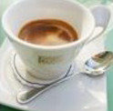
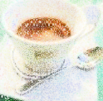
Autoencoder
As close as possible
NN
Encoder
NN
Decoder
code
Randomly generate a vector as code
NN
Decoder
code
Image ?

Slide 38
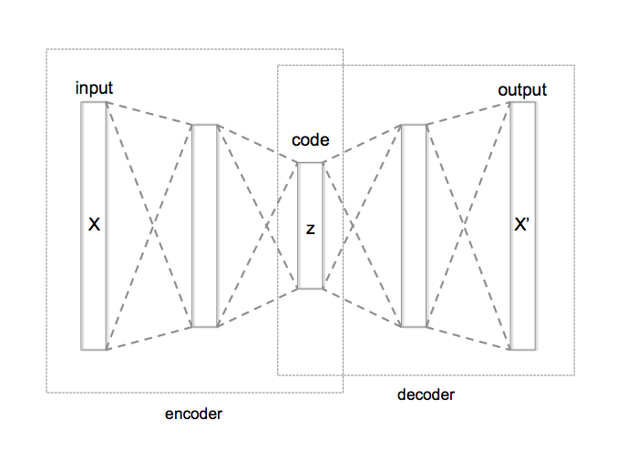
Autoencoder with 3 fully connected layers
Training: model.fit(X,X)
Cost function: Σ_{k=1..N} (x_{k} – x’_{k})²
Large → small, learn to compress

Slide 39
Auto-encoder
2D code
NN
Decoder
code
NN
Decoder
-1.5
1.5
NN
Decoder
Notes:
SOM: http://alaric-research.blogspot.tw/2011/02/self-organizing-map.html

Slide 40
Auto-encoder
NN
Encoder
NN
Decoder
input
output
code
VAE
Minimize reconstruction error
m₁
m₂
NN
Encoder
m₃
input
c₁
NN
Decoder
exp
+
c₂
output
σ₁
σ₂
c₃
σ₃
X
c_{i} = exp(σ_{i})e_{i} + m_{i}
From a normal distribution
e₁
e₂
Minimize
e₃
Σ_{i=1..3} [exp(σ_{i})−(1+σ_{i})+(m_{i})² ]
Auto-Encoding Variational Bayes, https://arxiv.org/abs/1312.6114
This constrains σ_{i} approacing 0 is good

Slide 41
Problems of VAE
It does not really try to simulate real images
code
NN
Decoder
Output
As close as possible
One pixel difference to the target
Also one pixel difference to the target
Realistic
Fake
VAE treats these the same

Slide 42
Gradual and step-wise generation
NN
Generator
v1
NN
Generator
v2
NN
Generator
v3
Discriminator
v1
Discriminator
v2
Discriminator
v3
Generated
images
These are
Binary classifiers
Real images:

Slide 43
Autoencoder
The autoencoder idea is motivated by the concept of a good representation.
For example, for a classifier, a good representation can be defined as one that will yield a better performing classifier.
Vincent et al. (2010): “a good representation is one that can be obtained robustly from a corrupted input and that will be useful for recovering the corresponding clean input.”
An encoder is a deterministic mapping $f_{φ}$ that transforms an input vector $X$ into hidden representation $z$
$θ=\{W,b\}$, where $W$ is the weight matrix and $b$ is bias (an offset vector)
A decoder maps back the hidden representation $z$ to the reconstructed input $\hat{X}$ via $g_{θ}$.
Autoencoding: compares the reconstructed output $\hat{X}$ to the original input $X$ and try to minimize this error to make $\hat{X}$ as close as possible to $X$.
Hidden Representation
$$X$$
Encoder neural network
Decoder neural network
$$\hat{X}$$
z
Autoencoder Architecture

Slide 44
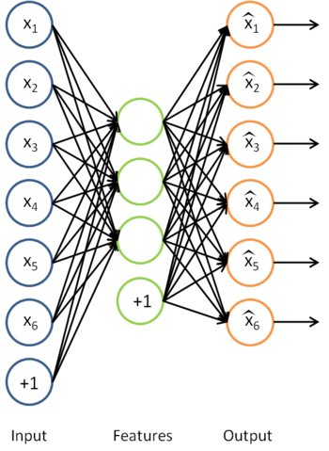
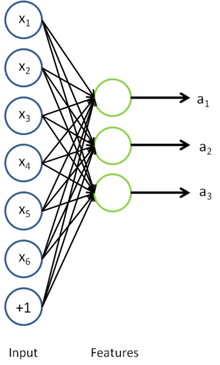
Auto-Encoders
A type of unsupervised learning which discovers generic features of the data (self-supervised learning)
Learn identity function by learning important sub-features
Compression, etc. – Undercomplete |h| < |x|
For |h| ≥ |x| (Overcomplete case more common in deep nets) use regularized autoencoding

Slide 45
Sparse Auto-Encoders
Use more hidden nodes in the encoder
Use regularization techniques which encourage sparseness (e.g. a significant portion of nodes have zero output for any given input)
Penalty in the learning function for non-zero nodes
Weight decay
De-noising Auto-Encoder
Stochastically corrupt training instance each time, but still train auto-encoder to decode the uncorrupted instance
Improved empirical results

Slide 46
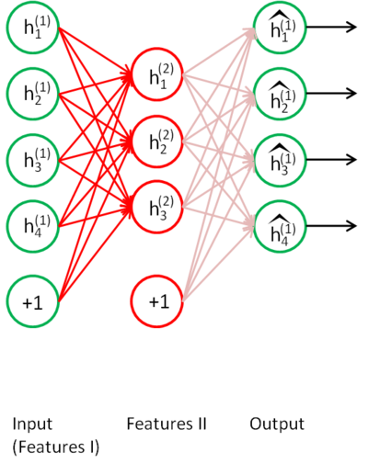
Stacked Auto-Encoders
Bengio (2007) – After Deep Belief Networks (2006)
Stack many (sparse) auto-encoders in succession and train them using greedy layer-wise training
Drop the decode output layer each time

Slide 47
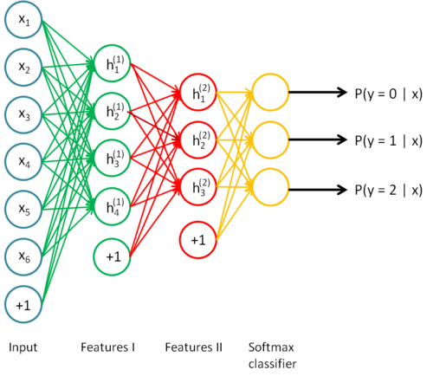
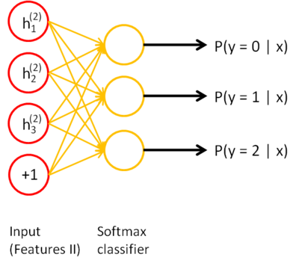
Stacked Auto-Encoders
Do supervised training (can now only used labeled examples) on the last layer using final features
Then do supervised training on the entire network to fine- tune all weights (optional)

Slide 48
A Generative Modeling Perspective of Autoencoders
The hidden representation $z$ can be considered as a latent random variable determining the observation $X$: the decoder neural network $\hat{X}=g_{θ}(z)$ can be modeled as the conditional distribution $p(X|z)$.
The detailed data distribution is therefore captured entirely by the decoder neural network.
The encoder neural network $z=f_{φ}(X)$ can be considered as a recognition model $q(z|X)$, an approximation to the intractable true posterior $p(z|X)$.
Instead of deriving the functional form of the true posterior $p(z|X)$, we can use the encoder neural network to learn an approximation $q(z|X)$.
Therefore, the autoencoder framework can be leveraged to solve a relatively general family of generative model:
A latent continuous random variable $z$ is generated from a prior distribution $p(z)$.
The observation is generated from a conditional distribution $p(X|z)$.
While traditional generative models would introduce a number of latent variables to properly model $p(X|z)$, the autoencoder-based technique approaches $p(X|z)$ through fitting the decoder neural network.

Slide 49
Variational Autoencoder
With variational inference, the aforementioned generative model family can be solved by maximizing the following objective function: $\log{p\left(X\right)≥ℒ\left(X\right)=−D_{KL}[q\left(z | X\right)\left\|p\left(z\right)\right.]+𝔼_{z\sim q(z|X)}[\log{p(X|z)}]}$
Typically, $p\left(z\right)$ often uses $Gaussian(0,I)$ and $q\left(z | X\right)$ is set to $Gaussian(μ\left(X\right),σ(X))$, where $μ\left(X\right)$ is the posterior mean approximation and $σ(X)$ is the posterior variance approximation. $μ\left(X\right)$ and $σ(X)$ are probabilistic hidden representations of input $X$.
Minimizing the difference between prior $p\left(z\right)$ and posterior approximation $q\left(z | X\right)$ as measured by KL-divergence
Maximizing the likelihood of the observed data as specified by the generative model
Random variable from $Gaussian(μ\left(X\right),σ(X))$
$$μ\left(X\right)$$
$$X$$
Encoder $q\left(z | X\right)$
Decoder $p(X|z)$
$$\hat{X}$$
$$z$$
$$σ(X)$$
Variational Autoencoder Architecture

Slide 50
Variational Autoencoder: the Famous Reparameterization Trick
This objective function can be challenging to optimize with stochastic gradient ascent.
Main reason: the latent variable $z\sim Gaussian(μ\left(X\right),σ(X))$ is causing stochastic gradient estimators to have high variance and $q(z|X)$ to be indifferentiable.
Solution: the reparameterization trick
Replacing random variable $z\sim Gaussian(μ\left(X\right),σ(X))$ with deterministic formulation $z=μ\left(X\right)+σ(X)∙ε$, where the auxiliary random variable $ε\sim Gaussian(0,I)$.
This formulation allows $q(z|X)$ to be differentiable.
Deterministic formulation
$$μ\left(X\right)$$
$$X$$
Encoder $q\left(z | X\right)$
Decoder $p(X|z)$
$$\hat{X}$$
$$σ(X)$$
$$z$$
$$ε$$
Random variable from $Gaussian(0,I)$
Variational Autoencoder with Reparameterization Trick

Slide 51
TensorFlow (Python) VAE Example: Hand-written Digits Generation
Initializing weights and biases in the encoder neural network $q(z|X)$
*Note: xavier_init() is a commonly used function for initializing weights.
Q_W1 = tf.Variable(xavier_init([X_dim, h_dim]))
Q_b1 = tf.Variable(tf.zeros(shape=[h_dim]))
Q_W2_mu = tf.Variable(xavier_init([h_dim, z_dim]))
Q_b2_mu = tf.Variable(tf.zeros(shape=[z_dim]))
Q_W2_sigma = tf.Variable(xavier_init([h_dim, z_dim]))
Q_b2_sigma = tf.Variable(tf.zeros(shape=[z_dim]))
def Q(X):
h = tf.nn.relu(tf.matmul(X, Q_W1) + Q_b1)
z_mu = tf.matmul(h, Q_W2_mu) + Q_b2_mu
z_logvar = tf.matmul(h, Q_W2_sigma) + Q_b2_sigma
return z_mu, z_logvar
def sample_z(mu, log_var):
eps = tf.random_normal(shape=tf.shape(mu))
return mu + tf.exp(log_var / 2) * eps
P_W1 = tf.Variable(xavier_init([z_dim, h_dim]))
P_b1 = tf.Variable(tf.zeros(shape=[h_dim]))
P_W2 = tf.Variable(xavier_init([h_dim, X_dim]))
P_b2 = tf.Variable(tf.zeros(shape=[X_dim]))
def P(z):
h = tf.nn.relu(tf.matmul(z, P_W1) + P_b1)
logits = tf.matmul(h, P_W2) + P_b2
prob = tf.nn.sigmoid(logits)
return prob, logits
Constructing the encoder neural network $q(z|X)$
*Note: tf.nn.relu() is ReLU (Rectified Linear Unit) activation function. The form is ReLU(x)=max(0,x)
Reparameterizing the hidden variable $z$
Initializing and constructing the decoder neural network $p(X|z)$
*Complete python code can be found in the appendix.

Slide 52
TensorFlow (Python) VAE Example: Hand-written Digits Generation
X = tf.placeholder(tf.float32, shape=[None, X_dim])
z = tf.placeholder(tf.float32, shape=[None, z_dim])
z_mu, z_logvar = Q(X)
z_sample = sample_z(z_mu, z_logvar)
_, logits = P(z_sample)
X_samples, _ = P(z)
recon_loss=tf.reduce_sum(tf.nn.sigmoid_cross_entropy_with_logit s(logits=logits, labels=X), 1)
kl_loss = 0.5 * tf.reduce_sum(tf.exp(z_logvar) + z_mu**2 - 1. - z_logvar, 1)
vae_loss = tf.reduce_mean(recon_loss + kl_loss)
solver = tf.train.AdamOptimizer().minimize(vae_loss)
sess = tf.Session()
sess.run(tf.global_variables_initializer())
for it in range(1000000):
X_mb, _ = mnist.train.next_batch(mb_size)
_, loss = sess.run([solver, vae_loss], feed_dict={X: X_mb})
samples = sess.run(X_samples, feed_dict={z:np.random.randn(16, z_dim)})
Constructing the autoencoder neural network architecture
Formulating $𝔼_{z\sim q(z|X)}[\log{p(X|z)}]$
Formulating $−D_{KL}[q\left(z | X\right)\left\|p\left(z\right)\right.]$
Objective function
Iteratively optimizing the objective function with data sampled from the MNIST dataset
Generate samples with random hidden variable $z$
*Complete python code can be found in the appendix.

Slide 53
TensorFlow (Python) VAE Example: Hand-written Digits Generation
samples = sess.run(X_samples, feed_dict={z:np.random.randn(16, z_dim)})
Recall:
def P(z):
h = tf.nn.relu(tf.matmul(z, P_W1) + P_b1)
logits = tf.matmul(h, P_W2) + P_b2
prob = tf.nn.sigmoid(logits)
return prob, logits
Generated samples
Input
Decoder (P)
16 random vectors from $Ν\left(0,I\right)$; each vector has 100 dimensions;
First fully connected layer with ReLU
Second fully connected layer with Sigmoid
Plot
Fig. 10. Variational Autoencoder for Digit Generation
z:np.random.randn(16, z_dim)

Slide 54
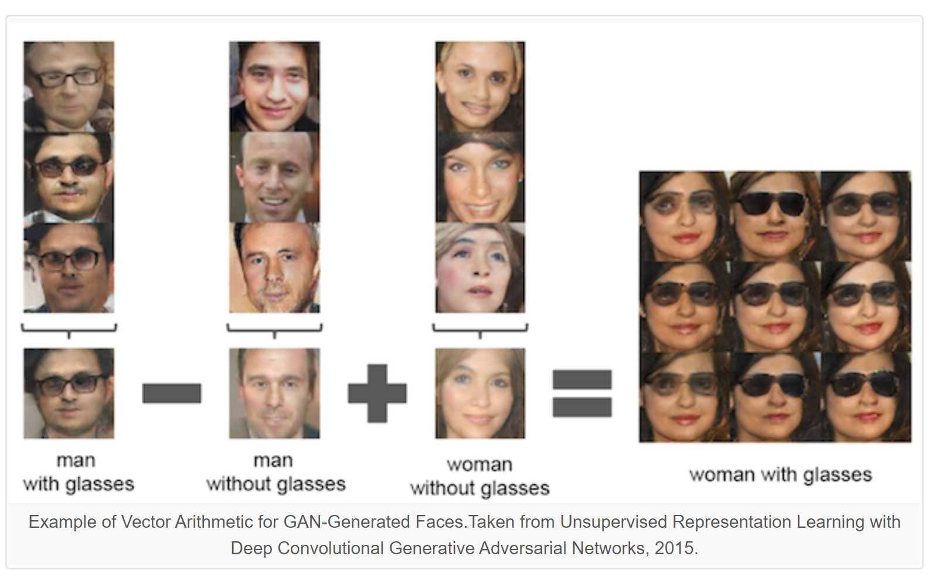
GENERATIVE ADVERSARIAL NETWORKS
“…the most interesting idea in the last 10 years in machine learning...”
- Facebook’s AI research director Yann LeCun

Slide 55
Generative Adversarial Network
GAN was first introduced by Ian Goodfellow et al in 2014
Have been used in generating images, videos, poems, some simple conversation.
Note, image processing is easy (all animals can do it), NLP is hard (only human can do it).
This co-evolution approach might have far-reaching implications. Bengio: this may hold the key to making computers a lot more intelligent.
Ian Goodfellow:
https://www.youtube.com/watch?v=YpdP_0-IEOw
Radford, (generate voices also here)
https://www.youtube.com/watch?v=KeJINHjyzOU
Tips for training GAN: https://github.com/soumith/ganhacks

Slide 56
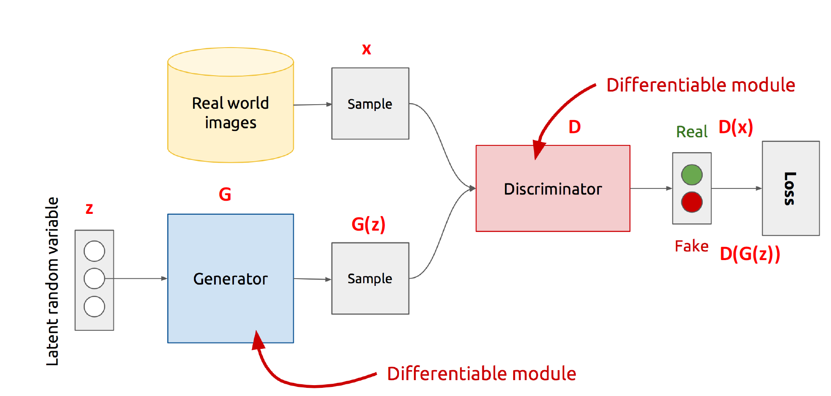
Generative Adversarial Network
Generative
Learn a generative model
Adversarial
Trained in an adversarial setting
Network
Use Deep Neural Networks
https://www.slideshare.net/xavigiro/deep-learning-for-computer-vision-generative-models-and-adversarial-training-upc-2016

Slide 57
GENERATIVE ADVERSARIAL NETWORKS
Generator (G) tries to fool the Discriminator (D)
G generates new instances from a latent space Z
D is a classifier i.e. real vs. fake
D tries not to be fooled
D evaluates instances for authenticity
Models are trained simultaneously
As G gets better, D has a more challenging task
As D gets better, G has a more challenging task
Issues?
Mode collapse, convergence, vanishing gradient, unstable, etc.
Wide interest and extensive applications since 2014

Slide 58
GAN TAXONOMY
Loss Function
f-divergence
Conditional
InfoGAN
Variational Autoencoder
Architectural
Hierarchical
Autoencoder
DCGAN
Mode Collapse
Theoretical
DRAGAN
Unrolled GAN
GAN hacks
Relativistic GAN
LSGAN
IPM
WGAN
PROGAN
Stacked GAN
BigGAN
BEGAN
EBGAN
Auxiliary Classifier GAN
cGAN
VAE-GAN
alpha GAN
Principled methods for GAN training
MMD-GAN
Fisher
f-GAN
SAGAN
MR-GAN
Multi-Learning
Coupled GAN
Disco GAN
Cycle GAN
GAN
MAGAN
GANs are notoriously difficult to train, unstable convergence and mode collapse problem. Lots of variants improve these challenges.

Slide 59
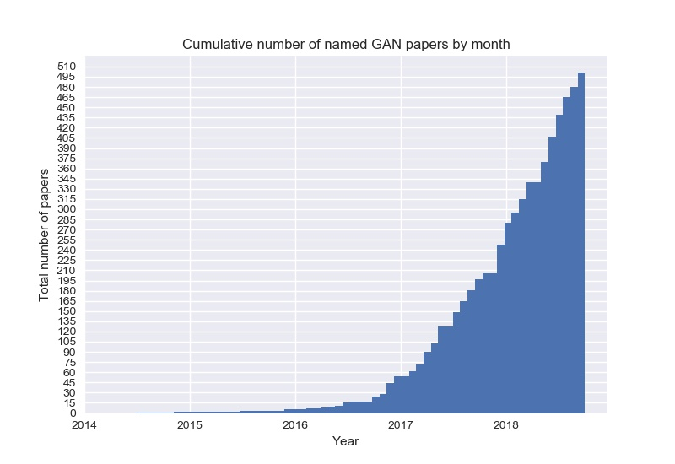
GAN POPULARITY & MAGIC
Ledig, Christian, et al. "Photo-realistic single image super-resolution using a generative adversarial network." arXiv preprint arXiv:1609.04802 (2016).
https://github.com/hindupuravinash/the-gan-zoo

Slide 60
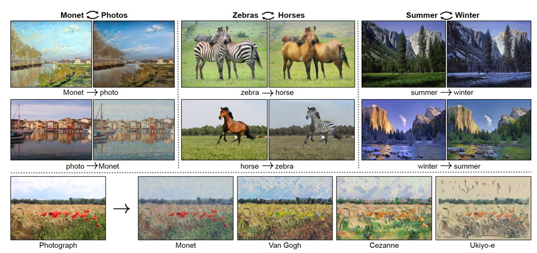
COMPUTER VISION
Image generation (CGAN, DCGAN)
Image translation (Cycle GAN)
Super-resolution (SRGAN, ProGAN)
Face aging (StarGAN, AgeC-GAN)
Texture synthesis (Style GAN)
Video (MoCoGAN, Pose-GAN)
Text-to-images (StackGAN, PSGAN)
Image Synthesis (BigGAN, ProGAN, SAGAN)
Object detection (Perceptual GAN)
Picture: Cycle GAN paper
Applications in short-term insurance e.g. telematics, weather patterns, crime spots, risk assessment, claims etc.

Slide 61
DATA AUGMENTATION
Boost training data sets and thereby the accuracy of predictive models
Train a GAN and use the generator to create new examples
Add samples to augment the training data set
Common on augmenting image data sets but fewer applications on tabular data sets such as mortality data
Data Augmentation GANs (DAGAN, BAGAN, TableGAN)
We show an example of this implemented in Python using a number of data sets
Applications in experience analysis, predictive modelling and pricing. Build a machine learning model, augment training data sets and get better predictive power i.e. rich data ~ powerful models.

Slide 62
TIME SERIES
Traditional time series models such as ARIMA & GARCH make strong data, dependence structure & model assumptions
GAN offers the use of recurrent neural networks to generate time series data using Recurrent Conditional GANs
Stochastic modelling, economic modelling, stock prediction, mortality forecasting, Value-at-Risk, financial projections etc.

Slide 63
ANOMALY DETECTION
The generator models the distribution and create fake data
The discriminator judges if it’s close to the training data
What happens to the judging part if we give it some sample not seen from the training distribution?
AnoGAN/GANomaly for anomaly detection of medical images. Extension to other data sets.
Identify rare items or events which are suspicious from the majority of the data
Picture: AnoGAN
Unsupervised learning applications, potentially without having to do cluster analysis which makes rather strong assumptions than GANs.

Slide 64
SEMI-SUPERVISED LEARNING
Semi-Supervised GAN trains the discriminator into a classifier which can achieve superior classification accuracy from as few labeled examples as possible
Reduction in dependency of classification tasks on enormous labeled data sets
Discriminative modelling
Alternative classifier
Shown to generate better than a comparable, fully-supervised classifier
This has been Lauded as the most useful GAN application with good performance with a small number of labels on data sets. Very effective on limited, imbalanced data sets.

Slide 65
MISSING DATA IMPUTATION
Missing data causes issues in standard analytic methods
Single imputation vs. multiple imputation
GAIN/MisGAN appear better than imputation
There are many reasons data may be missing and it is appropriate that this is dealt with correctly
Missing data mechanisms e.g. missing at random, missing completely at random and missing not at random
Percentage of missingness
Especially with complicated missing data mechanisms and higher missing data percentages
This is almost always bound to happen in any model or analysis
No dependence on missing data mechanism and model distributions

Slide 66
PRIVACY PRESERVATION
OTHER DOMAIN AREAS
Data of a lot of companies can be a secret, confidential or sensitive (such as medical diagnosis data)
Sometimes need to share with third parties
Can share salient features, sampled from a generative model
This way we won’t share exact data, just something that looks like it
Privacy-preservation GANs accomplish this task (still relatively new)
Useful for synthetic model points to be fed through any model, without needing policy details
Domain adaptation e.g. training & testing data from different distributions
Learning joint distribution e.g. morbidity vs. mortality ~ single model
Attention prediction e.g. focus on underlying key business
Reinforcement learning e.g. stock optimization
Fashion e.g. create new styles and matching
Video-to-video synthesis (Vid2VID)
Arts (GANGogh, GauGAN)
Music (MuseGAN)
Games e.g. Pokémon games
e-Commerce
Drug discovery & development (ChemGAN)
Content creation etc.
Check out more applications:
https://github.com/nashory/gans-awesome-applications
https://machinelearningmastery.com/impressive-applications-of-generative-adversarial-networks/

Slide 67
What are GANs?
System of two neural networks competing against each other in a zero-sum game framework.
They were first introduced by Ian Goodfellow et al. in 2014.
Can learn to draw samples from a model that is similar to data that we give them.
Notes:
Unsupervised Machine Learning
System of two neural networks competing against each other in a zero sum game framework
Introduced in 2014 by Ian Goodfellow
Generative and Discriminative
Draw samples from a model that is similar to the data given to it

Slide 68
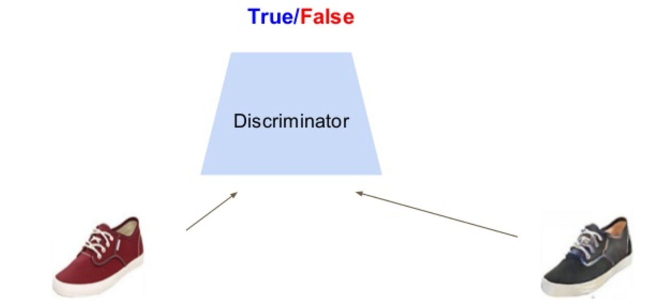
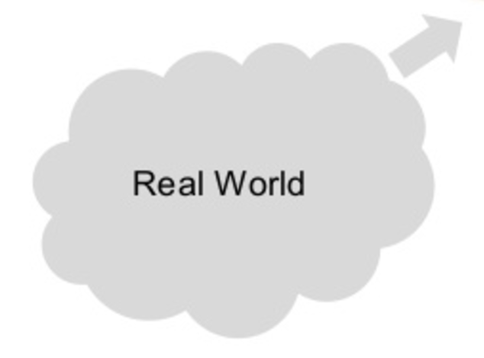
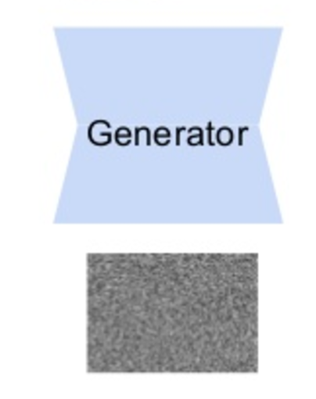
Components of GANs
Noise
Slide credit – Victor Garcia

Slide 69
Probabilistic Generative Models
Real world
observations
=
goal of modeling
Model
synthetic
observations
Density Estimation
$Pr\left(observation\right)=Pr(synthetic obs.)$

Slide 70
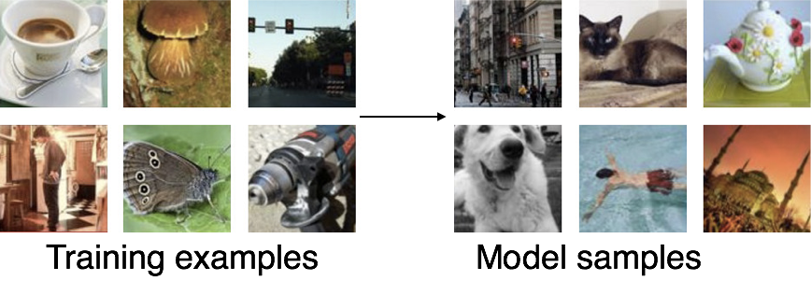
Synthesizing Examples From Probabilistic Generative Model
$$Pr(obs.)$$
Goodfellow (2017)
Goodfellow NIPS tutorial and accompanying paper (arXiv:1701.00160v4 [cs.LG]) provided some figures

Slide 71
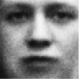
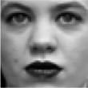
Adversarial Networks
real or fake?
Generative Model
Real world
Discriminative Model

Slide 72
Generative Model
How to make it generate different samples each time it is run?
input to model is noise
Generative model as a neural network
computes $x=G(z|θ)$
differentiable
does not have to be invertible
$z$typically has very high dimensionality (higher than $x$)
noise ($z$)
Generative Model

Slide 73
Discriminative Model
Think of it as a critic
a good critic can tell real from fake
Discriminative model as a neural net
differentiable
computes $D(x)$, with value 1 if real, 0 if fake
real or fake?
Discriminative Model

Slide 74
Overview of GANs
Source: https://ishmaelbelghazi.github.io/ALI

Slide 75
Discriminative Models
A discriminative model learns a function that maps the input data (x) to some desired output class label (y).
In probabilistic terms, they directly learn the conditional distribution P(y|x).
Notes:
1. Examples – SVMs, Logistic Regression

Slide 76
Generative Models
A generative model tries to learn the joint probability of the input data and labels simultaneously i.e. P(x,y).
Potential to understand and explain the underlying structure of the input data even when there are no labels.
Notes:
1. This can be converted to P(y|x) for classification via Bayes rule, but the generative ability could be used for something else as well, such as creating likely new (x, y) samples.

Slide 77
How GANs are being used?
Applied for modelling natural images.
Performance is fairly good in comparison to other generative models.
Useful for unsupervised learning tasks.
Notes:
Other generative models – Naïve Bayes, Hidden Markov model etc.
MLE estimates – Fixed set – Map to real world data – Select best set of parameters.

Slide 78
Generative Adversarial Networks
Ian Goodfellow et al., “Generative Adversarial Nets”, NIPS 2014
Problem: Want to sample from complex, high-dimensional training distribution. No direct way to do this!
Solution: Sample from a simple distribution, e.g. random noise. Learn transformation to training distribution.
Q: What can we use to represent this complex transformation?
Output: Sample from training distribution
A: A neural network!
Generator Network
Input: Random noise
z
Slide Credit: Fei-Fei Li, Justin Johnson, Serena Yeung, CS 231n
Notes:
Mapping z to data manifold?
Hard to sample from high dimensional distribution. Take random noise, transform to real distribution

Slide 79
Generative Adversarial Networks (GANs)
GANs are a combination of the following ideas:
Learning to Sample
Connection to Inverse Transform Sampling
Adversarial Training

Slide 80
Training GANs: Two-player game
Generator network: try to fool the discriminator by generating real-looking images
Discriminator network: try to distinguish between real and fake images
Real or Fake
Discriminator Network
Fake Images
(from generator)
Real Images
(from training set)
Generator Network
Random noise
z
Fake and real images copyright Emily Denton et al. 2015. Reproduced with permission.
Slide Credit: Fei-Fei Li, Justin Johnson, Serena Yeung, CS 231n
Notes:
Mapping z to data manifold?

Slide 81
Training GANs: Two-player game
Generator network: try to fool the discriminator by generating real-looking images
Discriminator network: try to distinguish between real and fake images
Train jointly in minimax game
Minimax objective function:
Slide Credit: Fei-Fei Li, Justin Johnson, Serena Yeung, CS 231n
Notes:
Mapping z to data manifold?

Slide 82
Training GANs: Two-player game
Generator network: try to fool the discriminator by generating real-looking images
Discriminator network: try to distinguish between real and fake images
Train jointly in minimax game
Minimax objective function:
Discriminator outputs likelihood in (0,1) of real image
Discriminator output for real data x
Discriminator output for generated fake data G(z)
Slide Credit: Fei-Fei Li, Justin Johnson, Serena Yeung, CS 231n
Notes:
Mapping z to data manifold?

Slide 83
Training GANs: Two-player game
Generator network: try to fool the discriminator by generating real-looking images
Discriminator network: try to distinguish between real and fake images
Train jointly in minimax game
Minimax objective function:
Discriminator outputs likelihood in (0,1) of real image
Discriminator output for real data x
Discriminator output for generated fake data G(z)
Discriminator (θ_{d}) wants to maximize objective such that D(x) is close to 1 (real) and D(G(z)) is close to 0 (fake)
Generator (θ_{g}) wants to minimize objective such that D(G(z)) is close to 1 (discriminator is fooled into thinking generated G(z) is real)
Slide Credit: Fei-Fei Li, Justin Johnson, Serena Yeung, CS 231n
Notes:
Mapping z to data manifold?

Slide 84
Training GANs: Two-player game
Minimax objective function:
Alternate between:
Gradient ascent on discriminator
2. Gradient descent on generator
Slide Credit: Fei-Fei Li, Justin Johnson, Serena Yeung, CS 231n
Notes:
Mapping z to data manifold?

Slide 85
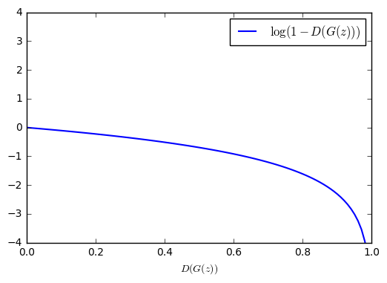
Training GANs: Two-player game
Minimax objective function:
Gradient signal dominated by region where sample is already good
Alternate between:
Gradient ascent on discriminator
2. Gradient descent on generator
When sample is likely fake, want to learn from it to improve generator. But gradient in this region is relatively flat!
In practice, optimizing this generator objective does not work well!
Slide Credit: Fei-Fei Li, Justin Johnson, Serena Yeung, CS 231n
Notes:
Mapping z to data manifold?

Slide 86
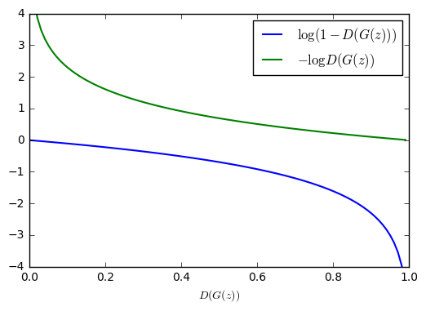
Training GANs: Two-player game
Minimax objective function:
Alternate between:
Gradient ascent on discriminator
2. Instead: Gradient ascent on generator, different objective
Instead of minimizing likelihood of discriminator being correct, now maximize likelihood of discriminator being wrong.
Same objective of fooling discriminator, but now higher gradient signal for bad samples => works much better! Standard in practice.
High gradient signal
Low gradient signal
Slide Credit: Fei-Fei Li, Justin Johnson, Serena Yeung, CS 231n
Notes:
Mapping z to data manifold?

Slide 87
Training GANs: Two-player game
Minimax objective function:
Aside: Jointly training two networks is challenging, can be unstable. Choosing objectives with better loss landscapes helps training, is an active area of research.
Alternate between:
Gradient ascent on discriminator
2. Instead: Gradient ascent on generator, different objective
Instead of minimizing likelihood of discriminator being correct, now maximize likelihood of discriminator being wrong.
Same objective of fooling discriminator, but now higher gradient signal for bad samples => works much better! Standard in practice.
High gradient signal
Low gradient signal
Slide Credit: Fei-Fei Li, Justin Johnson, Serena Yeung, CS 231n
Notes:
Mapping z to data manifold?

Slide 88
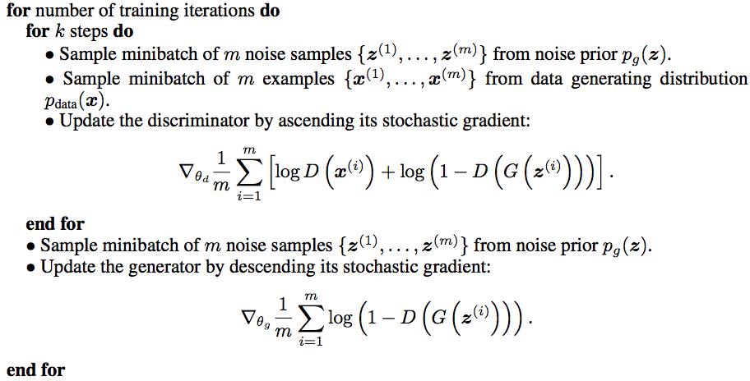
Training GANs: Two-player game
Putting it together: GAN training algorithm
Slide Credit: Fei-Fei Li, Justin Johnson, Serena Yeung, CS 231n
Notes:
Train discriminator for a bit
Then train generator for a bit

Slide 89
Training GANs: Two-player game
Putting it together: GAN training algorithm
Some find k=1 more stable, others use k > 1, no best rule.
Recent work (e.g. Wasserstein GAN) alleviates this problem, better stability!
Slide Credit: Fei-Fei Li, Justin Johnson, Serena Yeung, CS 231n
Notes:
Mapping z to data manifold?
**No clear rule. Sometimes train 1 step discriminator, 1 step gen. Some train disc. More

Slide 90
Training GANs: Two-player game
Generator network: try to fool the discriminator by generating real-looking images
Discriminator network: try to distinguish between real and fake images
Real or Fake
Discriminator Network
Fake Images
(from generator)
Real Images
(from training set)
Generator Network
After training, use generator network to generate new images
Random noise
z
Fake and real images copyright Emily Denton et al. 2015. Reproduced with permission.
Slide Credit: Fei-Fei Li, Justin Johnson, Serena Yeung, CS 231n
Notes:
Mapping z to data manifold?

Slide 91
Training Procedure: Basic Idea
real or fake?
G tries to fool D
D tries not to be fooled
Models are trained simultaneously
As G gets better, D has a more challenging task
As D gets better, G has a more challenging task
Ultimately, we don’t care about the D
Its role is to force G to work harder
Discriminative Model
Real world
noise ($z$)
Generative Model

Slide 92
Loss Functions
real or fake?
Loss function for D
maximize the likelihood that model says ‘real’ to samples from the world and ‘fake’ to generated samples
$𝓛_{D}=−\frac{1}{2}𝔼_{x\sim world} ln D\left(x\right)−\frac{1}{2}𝔼_{z} ln \left(1−D(G\left(z\right))\right)$
What should the loss function be for G?
$𝓛_{G}=−𝓛_{D}$
But because first term doesn’t matter for G (why?)
$𝓛_{D}=\frac{1}{2}𝔼_{z} ln \left(1−D(G\left(z\right))\right)$
Known as a minimax procedure
Discriminative Model
Real world
noise ($z$)
Generative Model

Slide 93
Training Procedure
real or fake?
Train both models simultaneously via stochastic gradient descent using minibatches consisting of
some generated samples
some real-world samples
Training of D is straightforward
Error for G comes via back propagation through D
Two ways to think about training
(1) freeze D weights and propagate$𝓛_{G}$ through D to determine $∂𝓛_{G}/∂x$
(2) Compute $∂𝓛_{D}/∂x$ and then ${∂𝓛_{G}}/{∂x}=−∂𝓛_{D}/∂x$
D can be trained without altering G, and vice versa
May want multiple training epochs of just D so it can stay ahead
May want multiple training epochs of just G because it has a harder task
Discriminative Model
Real world
noise ($z$)
Generative Model

Slide 94
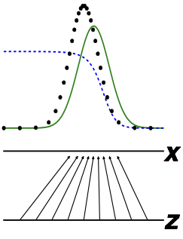
The Discriminator Has a Straightforward Task
real or fake?
D has learned when
$D\left(x\right)=Pr\left(real | x\right)= \frac{Pr(x|real)}{Pr(x|real)+Pr(x|synthesized)}$
Discriminative Model
real
discriminator
model
Real world
noise ($z$)
Generative Model
Goodfellow (2017)

Slide 95
Three Reasons That It’s a Miracle GANs Work
real or fake?
G has a reinforcement learning task
it knows when it does good (i.e., fools D) but it is not given a supervised signal
reinforcement learning is hard
back prop through D provides G with a supervised signal; the better D is, the better this signal will be
Can’t describe optimum via a single loss
Will there be an equilibrium?
D is seldom fooled
but G still learns because it gets a gradient telling it how to change in order to do better the next round.
Discriminative Model
Real world
noise ($z$)
Generative Model

Slide 96
How to train GANs?
Objective of generative network - increase the error rate of the discriminative network.
Objective of discriminative network – decrease binary classification loss.
Discriminator training - backprop from a binary classification loss.
Generator training - backprop the negation of the binary classification loss of the discriminator.
Notes:
Generator is typically a deconvolutional neural network, and the discriminator is a convolutional neural network.
Goal – Find a setting of parameters that makes generated data look like the training data to the discriminator network.

Slide 97
Loss Functions
Generator
Discriminator

Slide 98
GAN – Learn a discriminator
NN
Generator
v1
Randomly sample a vector
0
0
0
0
Something like Decoder in VAE
Real images
Sampled from DB:
1
1
1
1
image
Discriminator
v1
1/0
(real or fake)

Slide 99
GAN – Learn a generator
Randomly sample a vector
NN
Generator
v1
Updating the parameters of generator
Train
this
v2
The output be classified as “real” (as close to 1 as possible)
They have
Opposite
objectives
Generator + Discriminator = a network
Do not
Train
This
Discri-minator
v1
Using gradient descent to update the parameters in the generator, but fix the discriminator
1.0
0.13

Slide 100
“Improved Techniques for Training GANs” by Salimans et. al
One-sided Label smoothing - replaces the 0 and 1 targets for a classifier with smoothed values, like .9 or .1 to reduce the vulnerability of neural networks to adversarial examples.
Virtual batch Normalization - each example x is normalized based on the statistics collected on a reference batch of examples that are chosen once and fixed at the start of training, and on x itself.
Notes:
Batch normalization greatly improves optimization of neural networks, and was shown to be highly effective for DCGANs.
It causes the output of a neural network for an input example x to be highly dependent on several other inputs x 0 in the same minibatch.
The reference batch is normalized using only its own statistics. VBN is computationally expensive because it requires running forward propagation on two minibatches of data, so we use it only in the generator network

Slide 101
GANs
Demo
https://poloclub.github.io/ganlab/

Slide 102
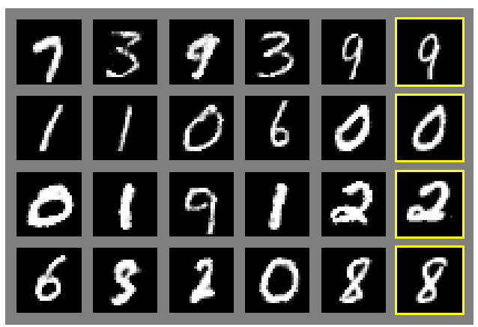
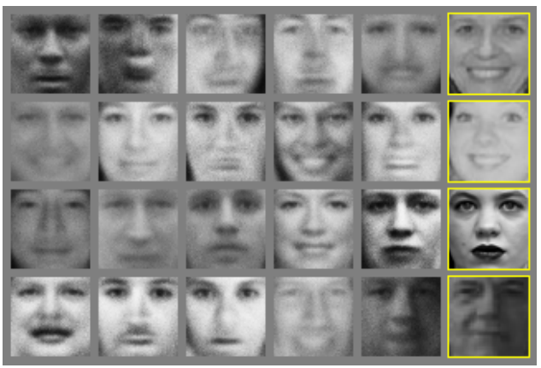
Generative Adversarial Nets
Generated samples
Nearest neighbor from training set
Figures copyright Ian Goodfellow et al., 2014. Reproduced with permission.
Slide Credit: Fei-Fei Li, Justin Johnson, Serena Yeung, CS 231n
Notes:
Realistic samples, never directly memorizes training set

Slide 103
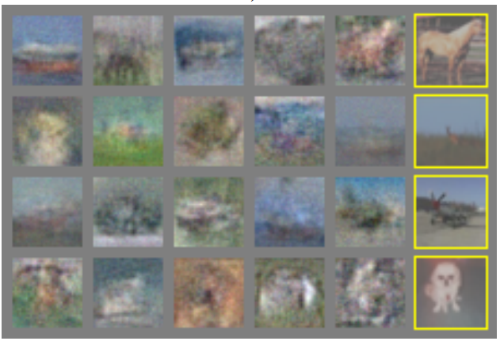
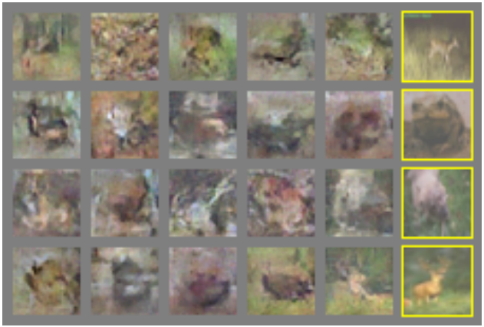
Generative Adversarial Nets
Generated samples (CIFAR-10)
Nearest neighbor from training set
Figures copyright Ian Goodfellow et al., 2014. Reproduced with permission.
Slide Credit: Fei-Fei Li, Justin Johnson, Serena Yeung, CS 231n
Notes:
Original work from 2014, not such great quality yet

Slide 104
Generative Adversarial Nets: Convolutional Architectures
Generator is an upsampling network with fractionally-strided convolutions
Discriminator is a convolutional network
Radford et al, “Unsupervised Representation Learning with Deep Convolutional Generative Adversarial Networks”, ICLR 2016
Slide Credit: Fei-Fei Li, Justin Johnson, Serena Yeung, CS 231n
Notes:
Since this time, a lot of work on improving GANs.
This work ICLR2016 on adding convolutional architectures to GANs

Slide 105
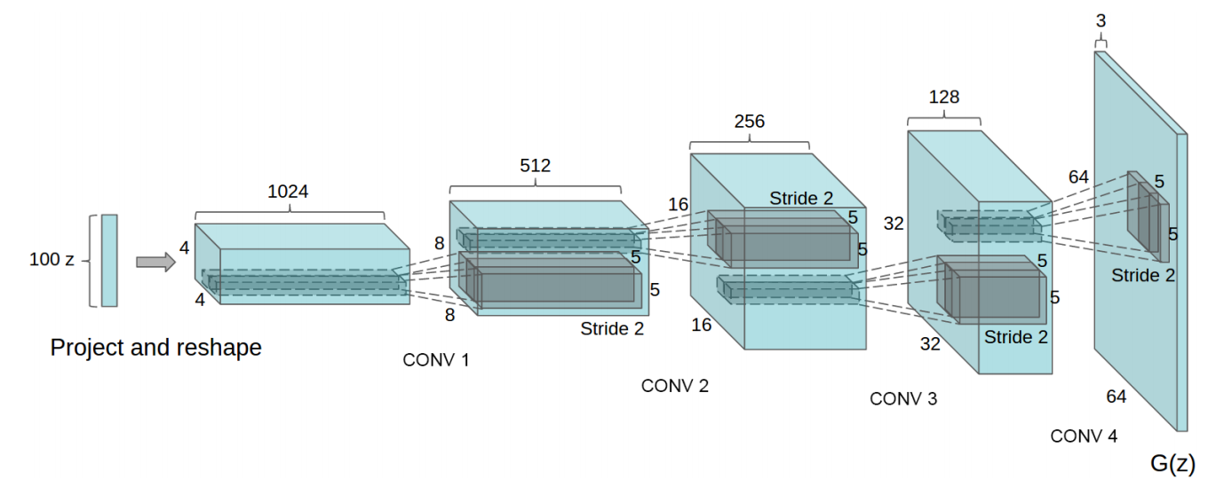
Generative Adversarial Nets: Convolutional Architectures
Generator
Radford et al, “Unsupervised Representation Learning with Deep Convolutional Generative Adversarial Networks”, ICLR 2016
Slide Credit: Fei-Fei Li, Justin Johnson, Serena Yeung, CS 231n

Slide 106
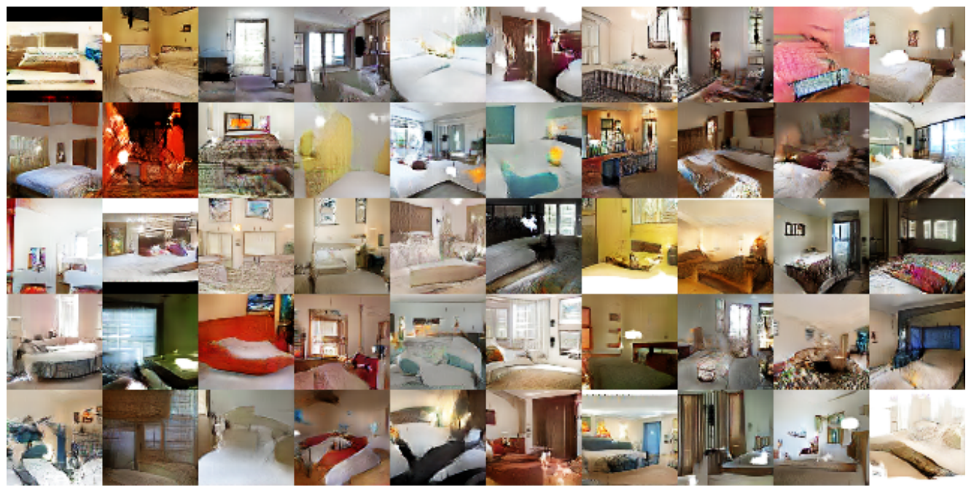
Generative Adversarial Nets: Convolutional Architectures
Samples from the model look much better!
Radford et al, ICLR 2016
Slide Credit: Fei-Fei Li, Justin Johnson, Serena Yeung, CS 231n

Slide 107
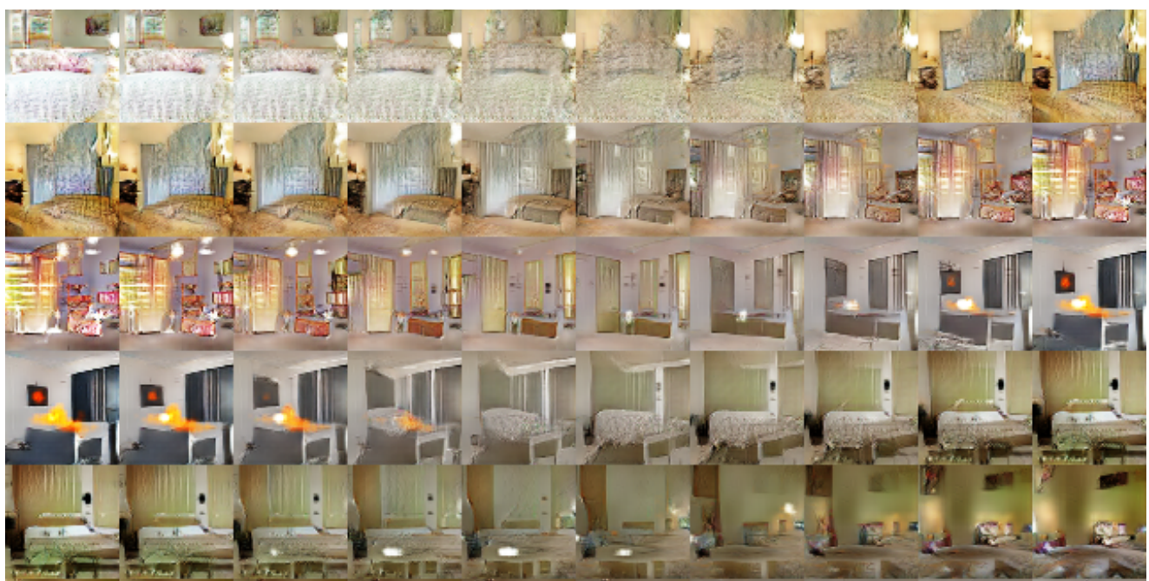
Generative Adversarial Nets: Convolutional Architectures
Interpolating between random points in latent space
Radford et al, ICLR 2016
Slide Credit: Fei-Fei Li, Justin Johnson, Serena Yeung, CS 231n
Notes:
Take 2 points of z (2 random vectors), and interpolate between these points

Slide 108
Results over the years
The Malicious Use of Artificial Intelligence: Forecasting, Prevention, and Mitigation, 2018. https://arxiv.org/abs/1802.07228

Slide 109
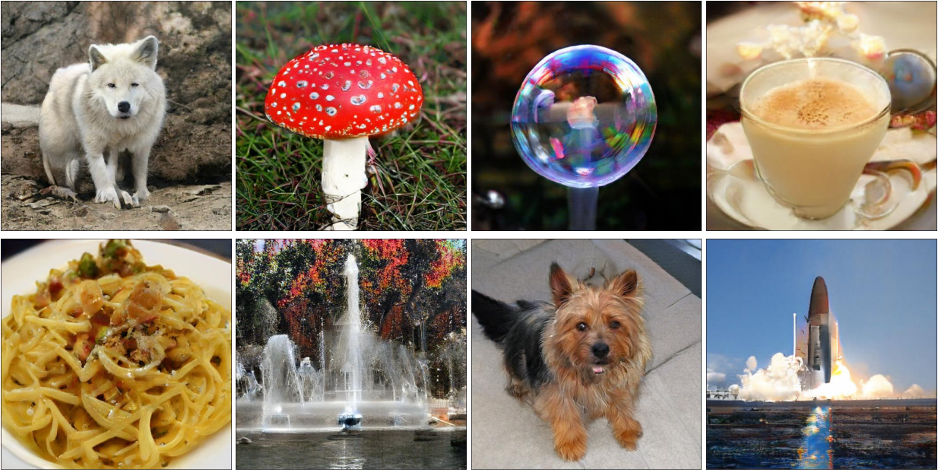
BigGAN
Large Scale GAN Training for High Fidelity Natural Image Synthesis
Andrew Brock, Jeff Donahue, Karen Simonyan https://arxiv.org/abs/1809.11096

Slide 110
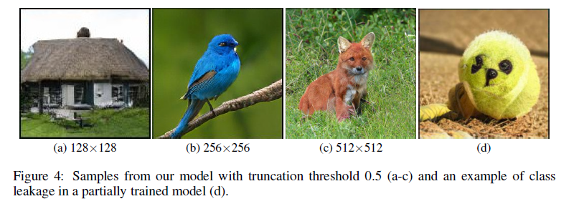
BigGAN
Large Scale GAN Training for High Fidelity Natural Image Synthesis
Andrew Brock, Jeff Donahue, Karen Simonyan https://arxiv.org/abs/1809.11096

Slide 111
BigGAN
https://gist.github.com/phillipi/d2921f2d4726d7e3cdac7a4780c6050a

Slide 112
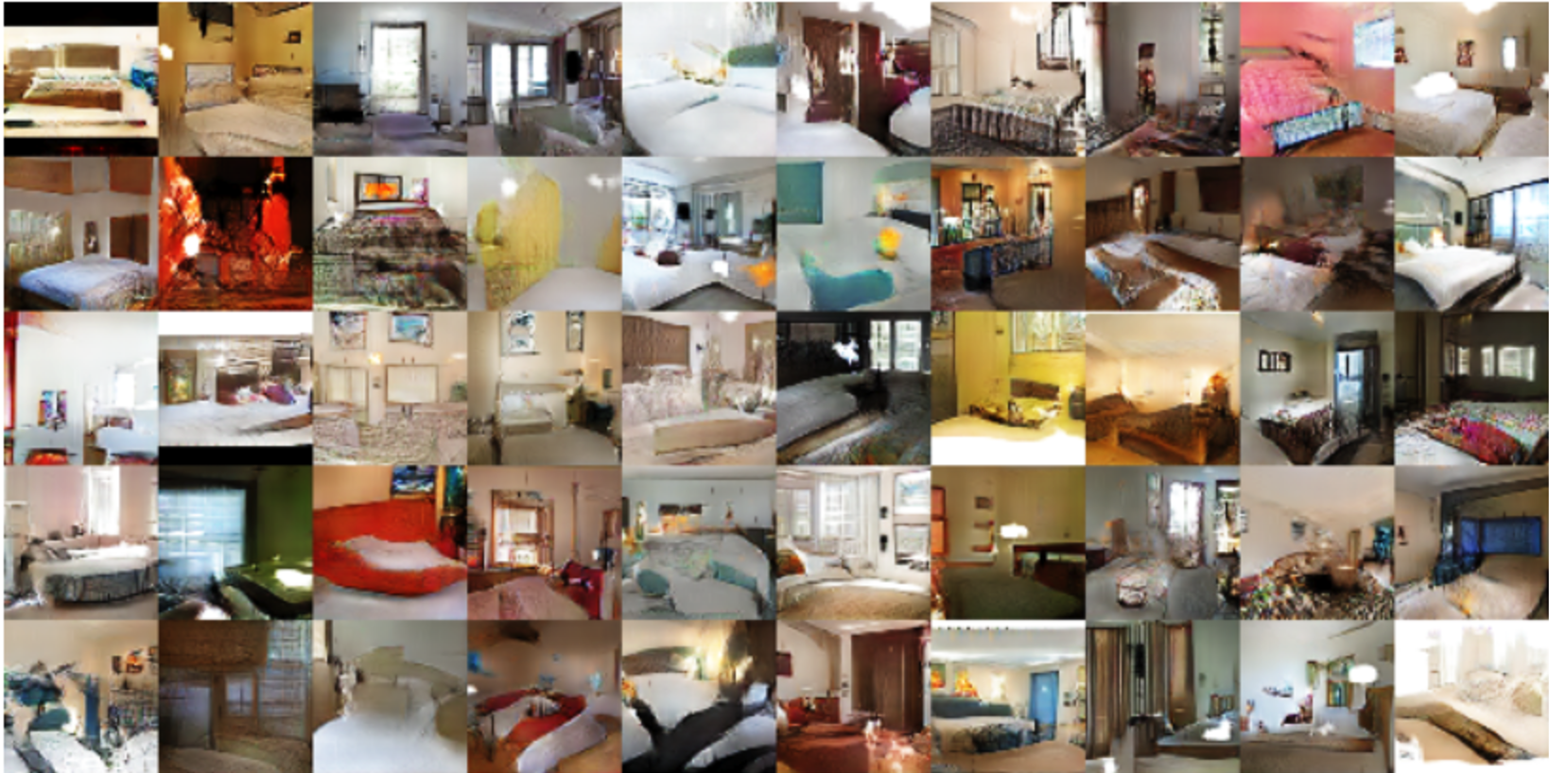
Generated bedrooms. Source: “Unsupervised Representation Learning with Deep Convolutional Generative Adversarial Networks” https://arxiv.org/abs/1511.06434v2

Slide 113
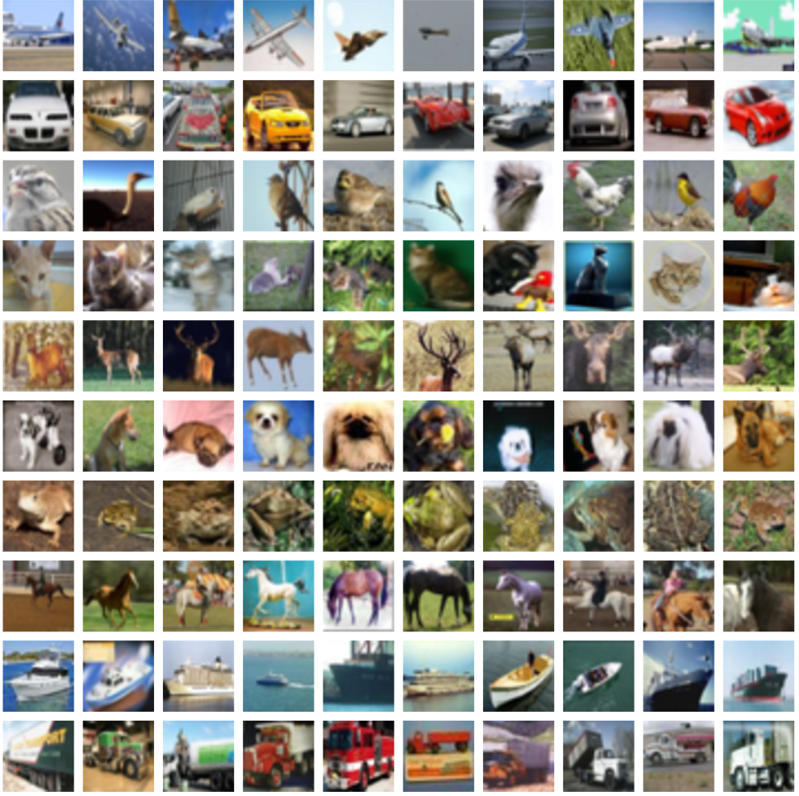
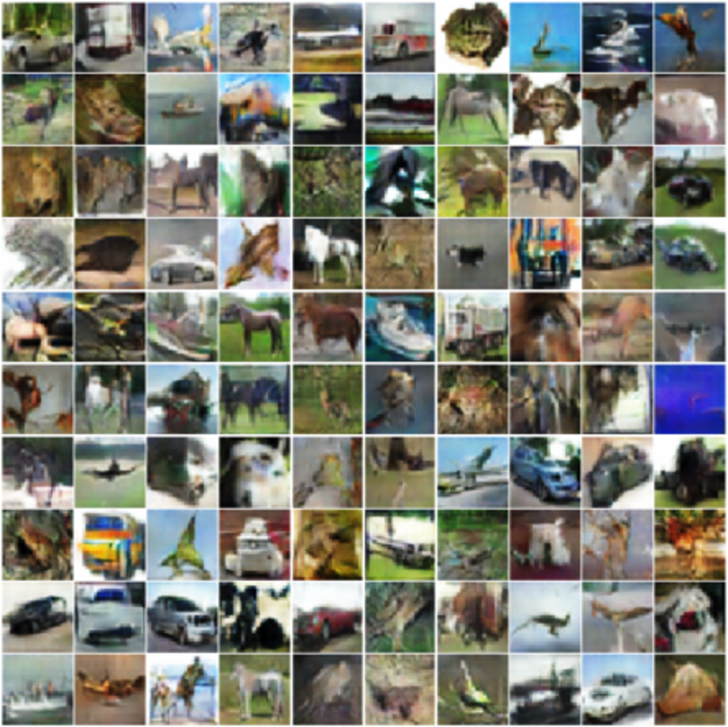
Original CIFAR-10 vs. Generated CIFAR-10 samples
Source: “Improved Techniques for Training GANs” https://arxiv.org/abs/1606.03498

Slide 114
Variations to GANs
Several new concepts built on top of GANs have been introduced –
InfoGAN – Approximate the data distribution and learn interpretable, useful vector representations of data.
Conditional GANs - Able to generate samples taking into account external information (class label, text, another image). Force G to generate a particular type of output.

Slide 115
Major Difficulties
Networks are difficult to converge.
Ideal goal – Generator and discriminator to reach some desired equilibrium but this is rare.
GANs are yet to converge on large problems (E.g. Imagenet).
Notes:
1. “On small problems, they sometimes converge and sometimes don’t. On large problems, like modeling ImageNet at 128x128 resolution, I’ve never seen them converge yet.” – Ian Goodfellow

Slide 116
Common Failure Cases
The discriminator becomes too strong too quickly and the generator ends up not learning anything.
The generator only learns very specific weaknesses of the discriminator.
The generator learns only a very small subset of the true data distribution.
Notes:
1. The discriminator classifies generated data as fake so accurately and confidently that there is nothing in the discriminator’s back-propagated loss function gradients for the generator to learn.
2. Takes advantage of these to trick the discriminator into classifying generated data as real instead of learning to represent the true data distribution.
3. An example of this occurring in practice is the case where for every possible input, the generator is generating the same data sample and there is no variation among it’s outputs.

Slide 117
So what can we do?
Normalize the inputs
A modified loss function
Use a spherical Z
BatchNorm
Avoid Sparse Gradients: ReLU, MaxPool
Use Soft and Noisy Labels
DCGAN / Hybrid Models
Track failures early (D loss goes to 0: failure mode)
If you have labels, use them
Add noise to inputs, decay over time
Notes:
normalize the images between -1 and 1. Tanh as the last layer of the generator output.
min (log 1-D) vanishing gradients early on. Use max log D. Flip labels when training generator: real = fake, fake = real
Sample from a gaussian distribution instead of a Uniform distribution
Construct different mini-batches for real and fake, i.e. each mini-batch needs to contain only all real images or all generated images.
the stability of the GAN game suffers if you have sparse gradients
Label Smoothing, i.e. if you have two target labels: Real=1 and Fake=0, then for each incoming sample, if it is real, then replace the label with a random number between 0.7 and 1.2, and if it is a fake sample, replace it with 0.0 and 0.3 (for example).

Slide 118
Conclusions
Train GAN – Use discriminator as base model for transfer learning and the fine-tuning of a production model.
A well-trained generator has learned the true data distribution well - Use generator as a source of data that is used to train a production model.

Slide 119
References
https://tryolabs.com/blog/2016/12/06/major-advancements-deep-learning-2016/
https://blog.waya.ai/introduction-to-gans-a-boxing-match-b-w-neural-nets-b4e5319cc935#.6l7zh8u50
https://en.wikipedia.org/wiki/Generative_adversarial_networks
http://blog.aylien.com/introduction-generative-adversarial-networks-code-tensorflow/
https://github.com/soumith/ganhacks

Slide 120
Explosion of GANs
“The GAN Zoo”
“The GAN Zoo”
https://github.com/hindupuravinash/the-gan-zoo
Also see https://paperswithcode.com/task/image-generation/latest
Slide Credit: Fei-Fei Li, Justin Johnson, Serena Yeung, CS 231n

Slide 121
“The GAN Zoo”
Explosion of GANs
See also: https://github.com/soumith/ganhacks for tips and tricks for trainings GANs
https://github.com/hindupuravinash/the-gan-zoo
Slide Credit: Fei-Fei Li, Justin Johnson, Serena Yeung, CS 231n

Slide 122
Dive Deeper?
Ian Goodfellow’s NIPS 2016 Tutorial
Available online.

Slide 123
More Examples

Slide 124
Next few images from Goodfellow lecture
Traditional mean-squared
Error, averaged, blurry

Slide 125
Last 2 are by deep learning approaches.

Slide 127
256x256 high resolution pictures by Plug and Play generative network

Slide 128
Text to Image, by conditional GAN

Slide 129
Text to Image - Results
"red flower with black center"
From CY Lee lecture

Slide 130
Using Labels Can Improve Generated Samples (Denton et al., 2015)
LAPGAN: multiresolution deconvolutional pyramid
CC-LAPGAN: class conditional LAPGAN
GAN: original Goodfellow model
Notes:
GAN in lower right corner
LAPGAN next to it
6 classes from LSUN
Yellow circled images are closest real examples [to show it’s not just generating training data]

Slide 131
With Image Pyramid, Can Also Seed Generator With Low-Res Image + Class (Denton et al., 2015)
bedroom
church
tower
Notes:
columns are different draws

Slide 132
Schemes to Ensure Samples Are Diverse (Salimans et al., 2016)
Use nearest neighbor on latent representation to detect samples in a minibatch that are too similar
CIFAR training images
Synthesized images

Slide 133
kjkjkj
ImageNet training images

Slide 134
Cherry Picked Results
Goodfellow (2017)

Slide 135
Problems With Counting
Goodfellow (2017)

Slide 136
Problems With Perspective
Goodfellow (2017)

Slide 137
Problems With Global Structure
Goodfellow (2017)

Slide 138
Visually-Aware Fashion Recommendation and Design With GANs (Kang et al., 2017)
Recommender systems predict how much a particular user will like a particular item
Can predict based on features of item (e.g., movie director, dress length)
Can also predict directly from images
Twist here is that instead of predicting from a predefined set, generate images that would be liked.

Slide 139
Visually-Aware Fashion Recommendation and Design With GANs (Kang et al., 2017)
Optimize with GAN
find latent representation $z$ that obtains the highest recommendation score
gradient ascent search

Slide 141
Cycle GANs (Zhu et al., 2017; arXiv:1703:10593v2 [cs.CV])
Given two image collections
algorithm learns to translate an image from one collection to the other
does not require corres-pondence between images

Slide 142
Photos
to paintings

Slide 143
Paintings
to photos

Slide 145
Training and Mathematics behind GAN

Slide 146
Maximum Likelihood Estimation
Give a data distribution P_{data}(x)
We use a distribution P_{G}(x;θ) parameterized by θ to approximate it
E.g. P_{G}(x;θ) is a Gaussian Mixture Model, where θ contains means and variances of the Gaussians.
We wish to find θ s.t. P_{G}(x;θ) is close to P_{data}(x)
In order to do this, we can sample
{x¹,x², … x^{m}} from P_{data}(x)
The likelihood of generating these
x^{i}’s under P_{G} is
L= Π_{i=1…m} P_{G}(x^{i}; θ)
Then we can find θ* maximizing the L.

Slide 147
KL (Kullback-Leibler) divergence
Discrete:
D_{KL}(P||Q) = Σ_{i}P(i)log[P(i)/Q(i)]
Continuous:
D_{KL}(P||Q) = p(x)log [p(x)/q(x)]
Explanations:
Entropy: - Σ_{i}P(i)logP(i) - expected code length (also optimal)
Cross Entropy: - Σ_{i}P(i)log Q(i) – expected coding
length using optimal code for Q
D_{KL}= Σ_{i}P(i)log[P(i)/Q(i)] = Σ_{i}P(i)[logP(i) – logQ(i)], extra bits
JSD(P||Q) = ½ D_{KL}(P||M)+ ½ D_{KL}(Q||M), M= ½ (P+Q), symmetric KL
* JSD = Jensen-Shannon Divergency
∞
−∞

Slide 148
Maximum Likelihood Estimation
θ* = arg max_{θ} Π_{i=1..m}P_{G}(x^{i}; θ) →
arg max_{θ} log Π_{i=1..m}P_{G}(x^{i}; θ)
= arg max_{θ} Σ_{i=1..m} log P_{G}(x^{i}; θ), {x¹,..., x^{m}} sampled from P_{data}(x)
= arg max_{θ} Σ_{i=1..m} P_{data}(x^{i}) log P_{G}(x^{i}; θ) --- this is cross entropy
≅ arg max_{θ} Σ_{i=1..m} P_{data}(x^{i}) log P_{G}(x^{i}; θ) - Σ_{i=1..m} P_{data}(x^{i} )logP_{data}(x ^{i})
= arg min_{θ} KL (P_{data}(x) || P_{G}(x; θ)) --- this is KL divergence
Note: P_{G} is Gaussian mixture model, finding best θ will still be Gaussians, this only can generate a few blubs. Thus this above maximum likelihood approach does not work well.
Next we will introduce GAN that will change P_{G}, not just estimating P_{G is} parameters We will find best P_{G} , which is more complicated and structured, to approximate P_{data}.

Slide 149
Thus let’s use an NN as P_{G}(x; θ)
P_{G}(x,θ)
P_{data}(x)
G
θ
Prior
distribution
of z
Smaller
dimension
Larger
dimension
How to compute the likelihood?
P_{G}(x) = Integration_{z} P_{prior}(z) I_{[G(z)=x]}dz
https://blog.openai.com/generative-models/

Slide 150
Basic Idea of GAN
Hard to learn P_{G} by maximum likelihood
Generator G
G is a function, input z, output x
Given a prior distribution P_{prior}(z), a probability distribution P_{G}(x) is defined by function G
Discriminator D
D is a function, input x, output scalar
Evaluate the “difference” between P_{G}(x) and P_{data}(x)
In order for D to find difference between P_{data} from P_{G}, we need a cost function V(G,D):
G*=arg min_{G}max_{D}V(G,D)
Note, we are changing distribution G, not just update
its parameters (as in the max likelihood case).

Slide 151
Basic Idea
G* = arg min_{G}max_{D} V(G,D)
Pick JSD function: V = E_{x~P_data} [log D(x)] + E_{x~P_G}[log(1-D(x))]
Given a generator G, max_{D}V(G,D) evaluates the
“difference” between P_{G} and P_{data}
Pick the G s.t. P_{G} is most similar to P_{data}
V(G₁,D)
V(G₂,D)
V(G₃,D)
G₁
G₂
G₃

Slide 152
Max_{D}V(G,D), G*=arg min_{G}max_{D}V(G,D)
Given G, what is the optimal D* maximizing
Given x, the optimal D* maximizing is:
f(D) = alogD + blog(1-D) ➔ D*=a/(a+b)
V = E_{x~P_data} [log D(x)] + E_{x~P_G}[log(1-D(x))]
= Σ [ P_{data}(x) log D(x) + P_{G}(x) log(1-D(x) ]
Thus: D*(x) = P_{data}(x) / (P_{data}(x)+P_{G}(x))
Assuming D(x) can have any value here

Slide 153
max_{D}V(G,D), G* = arg min_{G}max_{D} V(G,D)
D₁*(x) = P_{data}(x) / (P_{data}(x)+P_{G_1}(x))
D₂*(x) = P_{data}(x) / (P_{data}(x)+P_{G_2}(x))
“difference” between P_{G1} and P_{data}
V(G₁,D*₁)
V(G₁,D)
V(G₂,D)
V(G₃,D)

Slide 154
max_{D}V(G,D)
V = E_{x~P_data} [log D(x)]
+ E_{x~P_G}[log(1-D(x))]
max_{D} V(G,D)
= V(G,D*), where D*(x) = P_{data} / (P_{data} + P_{G}), and
1-D*(x) = P_{G} / (P_{data} + P_{G})
= E_{x~P_data} log D*(x) + E_{x~P_G} log (1-D*(x))
≈ Σ [ P_{data} (x) log D*(x) + P_{G}(x) log (1-D*(x)) ]
= -2log2 + 2 JSD(P_{data} || P_{G} ),
JSD(P||Q) = Jensen-Shannon divergence
= ½ D_{KL}(P||M)+ ½ D_{KL}(Q||M)
where M= ½ (P+Q).
D_{KL}(P||Q) = Σ P(x) log P(x) /Q(x)
Notes:
Converge

Slide 155
Summary:
V = E_{x~P_data} [log D(x)]
+ E_{x~P_G}[log(1-D(x))]
Generator G, Discriminator D
Looking for G* such that
Given G, max_{D} V(G,D)
= -2log2 + 2JSD(P_{data}(x) || P_{G}(x))
What is the optimal G? It is G that makes JSD smallest = 0:
P_{G}(x) = P_{data} (x)
G* = arg min_{G}max_{D} V(G,D)

Slide 156
Algorithm
G* = arg min_{G}max_{D} V(G,D)
L(G), this is the
loss function
To find the best G minimizing the loss function L(G):
θ_{G} ← θ_{G} =−η L(G)/ θ_{G ,} θ_{G} defines G
Solved by gradient descent. Having max ok. Consider simple case:
f(x) = max {D₁(x), D₂（x), D₃(x)}
If D_{i}(x) is the
Max in that region,
then do dD_{i}(x)/dx
D₁(x)
D₃(x)
D₂(x)
dD₁(x)/dx
dD₂(x)/dx
dD₃(x)/dx

Slide 157
Algorithm
G* = arg min_{G}max_{D} V(G,D)
L(G)
Given G₀
Find D*₀ maximizing V(G₀,D)
V(G₀,D₀*) is the JS divergence between P_{data}(x) and P_{G0}(x)
θ_{G} ← θ_{G} −η ΔV(G,D₀*) / θ_{G} ➔ Obtaining G₁ (decrease JSD)
Find D₁* maximizing V(G₁,D)
V(G₁,D₁*) is the JS divergence between P_{data}(x) and P_{G1}(x)
θ_{G} ← θ_{G} −η ΔV(G,D₁*) / θ_{G} ➔ Obtaining G₂ (decrease JSD)
And so on …

Slide 158
In practice …
V = E_{x~P_data} [log D(x)]
+ E_{x~P_G}[log(1-D(x))]
Given G, how to compute max_{D}V(G,D)?
Sample {x¹, … ,x^{m}} from P_{data}
Sample {x*¹, … ,x*^{m}} from generator P_{G}
Maximize:
V’ = 1/m Σ_{i=1..m} logD(x^{i}) + 1/m Σ_{i=1..m} log(1-D(x*^{i}))
Positive example
D must accept
Negative example
D must reject
This is what a Binary Classifier do
Output is D(x)
Minimize Cross-entropy
If x is a positive example
Minimize –log D(x)
If x is a negative example
Minimize –log(1-D(x))

Slide 159
Binary Classifier
Output is f(x)
Minimize Cross-entropy
If x is a positive example
Minimize –log f(x)
If x is a negative example
Minimize –log(1-f(x))
D is a binary classifier (can be deep) with parameters θ_{d}
{x¹,x², … x^{m}} from P_{data} (x)
Positive examples
{x*¹,x*², … x*^{m}} from P_{G}(x)
Negative examples
Minimize
L = - V’
or
Maximize
V’ = Σ_{i=1..m} logD(x^{i}) + 1/m Σ_{i=1..m} log(1-D(x*^{i}))

Slide 160
Algorithm
Initialize θ_{d} for D and θ_{g} for G
Can only find lower bound of JSD or max_{D}V(G,D)
In each training iteration
Sample m examples {x¹,x², … x^{m}} from data distribution P_{data}(x)
Sample m noise samples {z¹, … , z^{m}} from a simple prior P_{prior}(z)
Obtain generated data {x*¹, … , x*^{m}}, x*^{i}=G(z^{i})
Update discriminator parameters θ_{d} to maximize
V’ ≈ 1/m Σ_{i=1..m} logD(x^{i}) + 1/m Σ_{i=1..m} log(1-D(x*^{i}))
θ_{d} ← θ_{d} + ηΔV’(θ_{d}) (gradient ascent)
Simple another m noise samples {z¹,z², … z^{m}} from the prior P_{prior}(z)，G(z^{i})=x*^{i}
Update generator parameters θ_{g} to minimize
V’= 1/mΣ_{i=1..m} logD(x^{i}) + 1/m Σ_{i=1..m} log(1-D(x*^{i}))
θ_{g} ← θ_{g} − ηΔV’(θ_{g}) (gradient descent)
Ian Goodfellow
comment: this
is also done once
Learning D
Repeat k times
Learning G
Only Once
Notes:
位什麼要 1- 啊

Slide 161
Objective Function for Generator in Real Implementation
V = E_{x~P_data} [log D(x)
+ E_{x~P_G}[log(1-D(x))]
Training slow at the beginning
V = E_{x~P_G} [ − log (D(x)) ]
Real implementation:
label x from P_{G} as positive

Slide 162
Evolution
http://www.guokr.com/post/773890/
Better

Slide 163
Evolution needs to be smooth:
P_{G_0}(x)
JSD(P_{G_0} || P_{data}) = log2
P_{data}(x)
……
Better
P_{G_50}(x)
P_{data}(x)
JSD(P_{G_50} || P_{data}) = log2
Not really better ……
……
P_{G_100}(x)
P_{data}(x)
JSD(P_{G_100} || P_{data}) = 0

Slide 164
One simple solution: add noise
Add some artificial noise to the inputs of discriminator
Make the labels noisy for the discriminator
Discriminator cannot perfectly separate real and generated data
P_{data}(x) and P_{G}(x) have some overlap
Noises need to decay over time

Slide 165
Thank You!

