Slide 1
University of Cyprus
MAI – 642 – DEEP LEARNING
Theocharis Theocharides
Nov, 2023

Slide 2
Deep Learning Lecture 11: Deep Reinforcement Learning
Theocharis Theocharides
Associate Professor Dept. of Electrical and Computer Engineering University of Cyprus

Slide 3
Course Schedule & Content
DATE | Overview | Lecture Details | Scope
Week 1 | Introduction - Course Structure, Logistics, Fundamentals of Machine Learning and Neural Networks | 1. Introduction to Neural Network, Multilayer Perceptron, Back Propagation Learning - What is Deep Learning? | BASICS
Week 2 | Fundamentals of Learning | 2. Introduction to Deep Learning, Bayesian Learning, Hebbian Learning, Decision Surfaces, Representation Learning. 3. Theory of Deep Learning (Universal approximation theorem, convergence rate, and recent mathematical results)
Week 3 | Mathematics & Fundamentals of Deep Learning | 4. Linear Classifiers, Linear Machines with Hinge Loss, Gradient Descent, Activation and Loss Functions. 5. Optimization Techniques, Gradient Descent, Batch Optimization, Introduction to Meta-Learning, Hessian-Free Optimization.
Week 4 | Deep Neural Networks | Deep Neural Networks: Features, Feature Representation, Representation Learning, BoFs/BoWs, Feature Maps, Deep vs. Shallow Nets | FUNDAMENTALS OF DEEP (CONVOLUTIONAL) LEARNING
Week 5 | Convolutional Neural Networks | 6. Convolutional Neural Networks, Building blocks of CNN | DEEP NEURAL NETWORKS - DEEP INTO DEEP LEARNING
Week 6 | Deep Convolutional Neural Networks | Pooling, Convolutional, Softmax Layers
Week 7 | Deep Convolutional Neural Networks | Optimizing ConvNets, Transfer Learning, Residual Networks
Week 8 | Deep Learning Optimization | 11. Deep Learning Model Optimization; Early Stopping/Exit, Dropout, Batch Normalization, Instance Normalization, Group Normalization, Pruning, Quantization, Hyperparameter Optimization.
Week 9 | Recurrent Neural Networks, Transformers | RNNs, LSTMs
Week 10 | Transformers, Attention | Attention Mechanisms and Transformer Networks | EMERGING DEEP LEARNING RESEARCH AND APPLICATIONS
Week 11 | Generative Adversarial Networks | Unsupervised Learning with Deep Network, Autoencoders Cont’d, 8. Generative Adversarial Networks, Adversarial Learning Models, Variational Autoencoders
Week 12 | Deep Reinforcement Learning - Graph Neural Networks | Deep Reinforcement Learning (Q-learning, actor-critic, policy gradient, experience replay, double Q-learning, deep bootstrap networks).
Week 13 | Graph Neural Networks and Deep Learning Trends | Graph Neural Networks – Graph Signal Processing, Convolutional Networks on Graphs, Gated Graph Sequence Networks, Semi-Supervised Graph Convolutional Networks Interpretable Deep Neural Networks DNNs for Vision and NLP - GPTS/LLMS
Exam Period | Final Exam | Comprehensive Final Exam | EVALUATION

Slide 4
The landscape
Reinforcement Learning
Courtesy A. Edelen

Slide 5
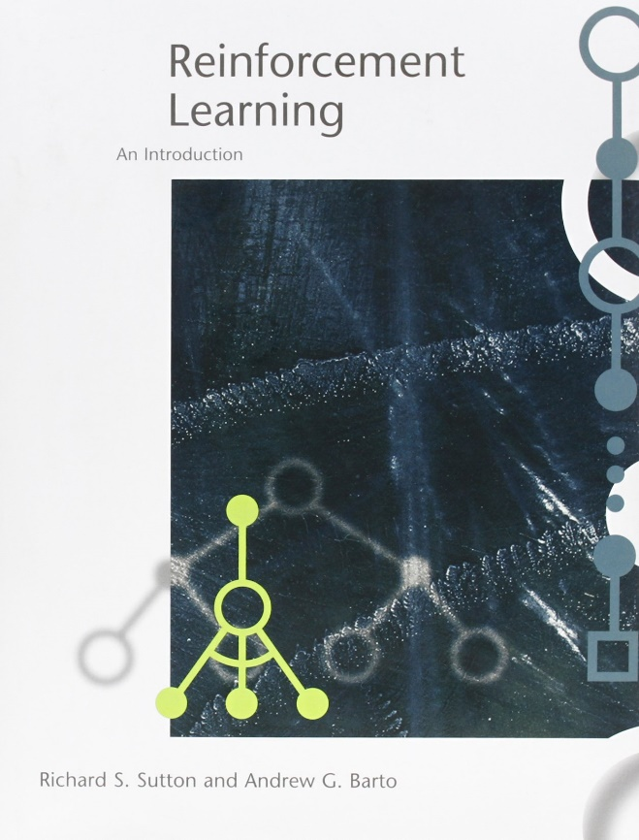
Textbooks
Reinforcement Learning
Sutton and Barto, Reinforcement Learning: An Introduction
http://incompleteideas.net/book/the-book.html
Vitay, Deep Reinforcement Learning
https://julien-vitay.net/deeprl/
Introduction to Reinforcement Learning with David Silver - DeepMind x UCL
https://deepmind.com/learning-resources/-introduction-reinforcement-learning-david-silver
CS 285: Deep Reinforcement Learning – UC Berkeley
http://rail.eecs.berkeley.edu/deeprlcourse/
Credits to Chia-Yi Su – National Kaohsiun University of Science and Technology

Slide 6
Facets of Reinforcement Learning

Slide 7
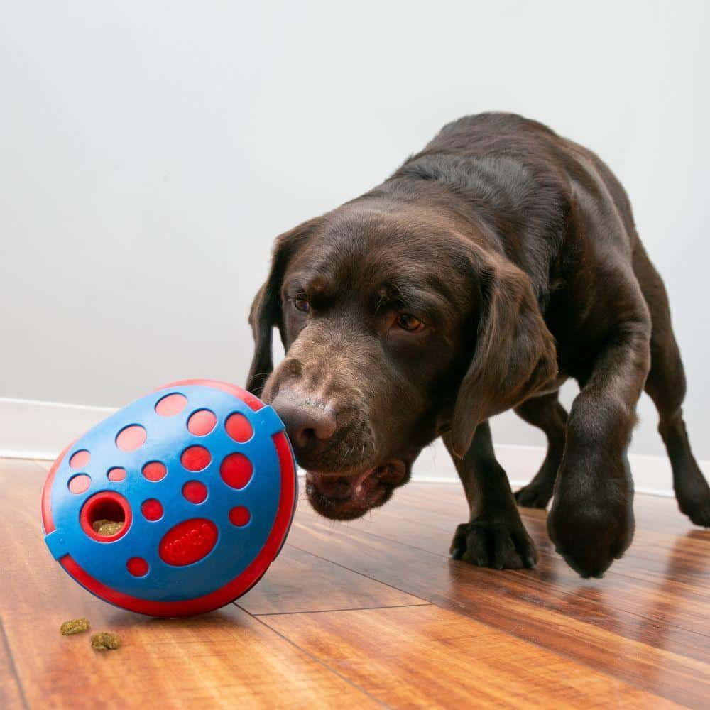
Difference between Reinforcement Learning and other Learning Algorithms
No supervisor, only reward signals.
Does not get feedbacks instantaneously.
Data is sequential!
The action of the agent will affect subsequent data that agent receives.

Slide 8
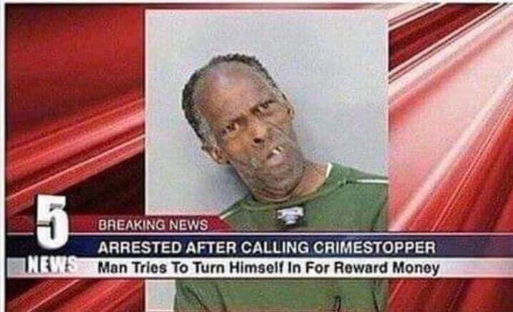
Rewards
A reward
R_{t} is a scalar feedback signal.
Indicates how well an agent is doing at time t.
The goal of an agent is to maximize cumulative reward.

Slide 9
Sequential Decision Making
Goal: Select actions to maximize total future rewards.
Actions may have long-term consequence.
Reward may be delayed.
It may be better to sacrifice instantaneous reward to gain more long-term reward.
E.g.
A Financial Investment
Refueling a Helicopter
Blocking Opponent Moves

Slide 10
Agent and Environment
Observation
Action
Reward

Slide 11
Agent and Environment
An agent at time t:
Executes an action A_{t}
Receives observations O_{t}
Receives a scalar reward R_{t}
An environment:
Receives an action A_{t}
Emits observation O_{t+1}
Emits a scalar reward R_{t+1}

Slide 12
History
History is defined as a sequence of observations, rewards, and actions.
$$H_{t}=O_{1}, R_{1},A_{1},…,A_{t−1}, O_{t},R_{t}$$
i.e. All observable variables up to time t
What happens next depends on the history:
The agent selects an action.
The environment emits rewards and observations.

Slide 13
State
State is used to decide what happens next.
State is the function of the history.
Formally, state can be represented as follows:
$S_{t}={f(H}_{t})$

Slide 14
Environment State
The environment state is the information used to determine the next observation and reward.
The environment state is invisible to the agent.
Even the agent can see the environment state, the information is irrelevant.

Slide 15
Agent State
The agent state is the information used to determine the next action.
i.e. the information used by the RL algorithm.
Agent State can be any function of the history.
$$S_{t}={f(H}_{t})$$

Slide 16
Information State
An information state (a.k.a. Markov state) contains all useful information from the history.
A state $S_{t}$ is Markov iff
$$P\left[S_{t+1}|S_{t}\right]=P\left[S_{t+1}|S_{1},S_{2,}…, S_{t}\right]$$
“The future is independent of the past given the present“
$$H_{1:t}→S_{t}→H_{t+1:∞}$$
The history can be given up when the state is known.
The environment state and history are Markov states!

Slide 17
Fully Observable Environments
Fully Observability: An agent directly observes the environment state.
$$O_{t}=S_{t}^{a}=S_{t}^{e}$$
i.e. Agent State = Environment State = Information State
This is formally called Markov Decision Process (MDP).

Slide 18
Partially Observable Environments
Partially Observability: an agent observes the environment indirectly e.g.:
A robot with camera doesn’t have the absolute location.
A trading agent only observes current prices.
A poker agent only observes the public cards.
i.e. Agent State ≠ Environment State
This is formally called Partially Observable Markov Decision Process (POMDP).
This agent must construct its own state representation $S_{t}^{a}$.
Complete history: $S_{t}^{a}$ = $H_{t}$
Beliefs of environment state: $S_{t}^{a}=\left(P\left[S_{t}^{e}=S^{1}\right],…, P\left[S_{t}^{e}=S^{n}\right]\right)$
Recurrent neural network: $S_{t}^{a}=σ\left(S_{t−1}^{a}W_{s}+{O_{t}W}_{o}\right)$

Slide 19
Components of RL Agents
The components that an agent includes are as follows:
Policy: A function to decide the behavior of an agent.
Value Function: A function to decide the goodness of an action.
Model: An agent’s perspective of an environment.
Three components of an RL agents are not always necessary.

Slide 20
Policy
A policy is
A behavior of an agent
Mapping states to action
Two Approaches of Policy Making
Deterministic Policy Making: a = $π\left(s\right)$
Stochastic Policy Making: $π\left(a|s\right)=P\left[A_{t}=a|S_{t}=s\right]$

Slide 21
Value Function
The value function is
Used to calculate the expected total reward of the future.
Formally defined as follows:
$$V_{π}\left(s\right)=E\left[R_{t+1}+{γR}_{t+2}+γ^{2}R_{t+3}+…|{ S}_{t}=s\right]$$

Slide 22
Model
The model predicts what the environment will do next.
The information that model predicts is as follows:
Next state $S_{t+1}^{a}=P\left[S_{t+1}=s^{′}|S_{t}=s,A_{t}=a\right]$
Next reward $R_{t+1}^{a}=P\left[R_{t+1} |S_{t}=s,A_{t}=a\right]$
The model is optional.

Slide 23
Maze Example
Rewards: -1 each time step
Actions: N, E, S, W
States: Location of an Agent

Slide 24
Maze Example: Policy

Slide 25
Maze Example: Value Function

Slide 26
Maze Example: Model

Slide 27
Taxonomies of RL Agents
Model Free
No Model
Model Based
Policy and/or Value Function
Model
Value Based
Value Function
Policy Based
Policy
Actor Critic
Value Function
Policy

Slide 28
Two Problems in Sequential Decision Making
Reinforcement Learning:
The agent needs to explore the environment by itself.
The agent interacts with the environment.
Planning:
The agent does not need to explore the model by itself. a.k.a. the environment is known.
The agent uses this model to make decisions.
Finally, the agent improves its policy.

Slide 29
Atari Example: Planning

Slide 30
Planning
$$a_{3}$$
$$r_{1}$$
$$a_{1}$$
$$s_{2}$$
$$a_{4}$$
$$s_{1}$$
$$a_{2}$$
$$r_{2}$$
$$s_{3}$$
$$a_{5}$$

Slide 31
Planning
$$a_{3}$$
$$r_{1}$$
$$a_{1}$$
$$s_{2}$$
Start estimating $q(s,a)$!
$$a_{4}$$
$$s_{1}$$
$$a_{2}$$
$$r_{2}$$
$$s_{3}$$
$$a_{5}$$

Slide 32
Planning
$$a_{6}$$
$$r_{3}$$
$$a_{3}$$
$$s_{4}$$
$$r_{1}$$
$$a_{1}$$
$$s_{2}$$
$$a_{7}$$
$$a_{4}$$
$$s_{1}$$
$$s_{5}$$
$$r_{4}$$
$$a_{2}$$
$$a_{8}$$
$$r_{2}$$
$$s_{3}$$
$$a_{5}$$
$$s_{6}$$
$$r_{5}$$

Slide 33
Planning
$$a_{6}$$
$$r_{3}$$
$$a_{3}$$
$$s_{4}$$
$$r_{1}$$
Start estimating $v(s)$!
$$a_{1}$$
$$s_{2}$$
$$a_{7}$$
$$a_{4}$$
$$s_{1}$$
$$s_{5}$$
$$r_{4}$$
$$a_{2}$$
$$a_{8}$$
$$r_{2}$$
$$s_{3}$$
$$a_{5}$$
$$s_{6}$$
$$r_{5}$$

Slide 34
Planning
$$a_{9}$$
$$r_{6}$$
$$a_{6}$$
$$s_{7}$$
$$r_{3}$$
$$a_{3}$$
$$s_{4}$$
$$a_{10}$$
$$r_{1}$$
$$r_{7}$$
$$a_{1}$$
$$s_{2}$$
$$a_{7}$$
$$s_{8}$$
$$a_{4}$$
$$a_{11}$$
$$s_{1}$$
$$r_{4}$$
$$s_{5}$$
$$a_{2}$$
$$a_{8}$$
$$r_{2}$$
$$s_{3}$$
$$r_{8}$$
$$s_{9}$$
$$a_{5}$$
$$s_{6}$$
$$a_{12}$$
$$r_{5}$$

Slide 35
Planning
$$a_{13}$$
$$r_{9}$$
$$a_{9}$$
$$s_{10}$$
$$r_{6}$$
$$s_{7}$$
$$a_{14}$$
$$a_{6}$$
$$r_{3}$$
$$r_{10}$$
$$a_{3}$$
$$s_{4}$$
$$a_{10}$$
$$s_{11}$$
$$r_{1}$$
$$r_{7}$$
$$a_{15}$$
$$a_{1}$$
$$s_{2}$$
$$a_{7}$$
$$s_{8}$$
$$s_{1}$$
$$a_{4}$$
$$a_{11}$$
$$r_{4}$$
$$s_{5}$$
$$r_{11}$$
$$s_{12}$$
$$a_{2}$$
$$a_{8}$$
$$a_{16}$$
$$r_{2}$$
$$s_{3}$$
$$r_{8}$$
$$s_{9}$$
$$a_{5}$$
$$s_{6}$$
$$a_{12}$$
$$r_{5}$$
$$r_{12}$$
$$s_{13}$$

Slide 36
Roll-outs? – What to do when chances are close to each other?
$$r_{10}$$
$$a_{3}$$
$$a_{10}$$
$$s_{11}$$
$$r_{1}$$
$$r_{7}$$
$$a_{15}$$
$$a_{1}$$
$$s_{2}$$
$$a_{7}$$
$$s_{8}$$
$$a_{4}$$
$$a_{11}$$
$$s_{1}$$
$$s_{5}$$
$$r_{4}$$
$$a_{2}$$
$$a_{8}$$

Slide 37
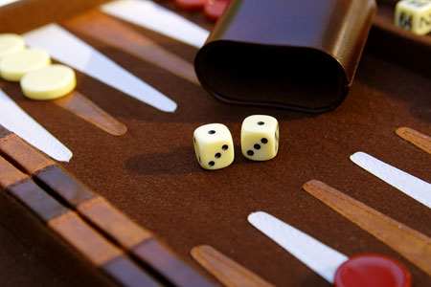
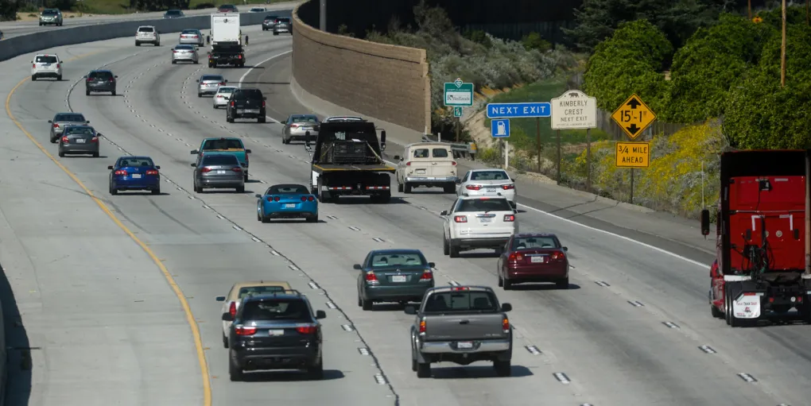
Roll-outs
Exploitation vs. Exploration

Slide 38
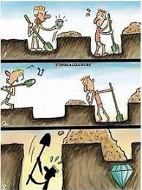
Exploration and Exploitation: Introduction
Reinforcement Learning is a trial-and-error learning method.
The goal is to maximize rewards.
However: The agent should explore the good policy from the environment by giving up some rewards.

Slide 39
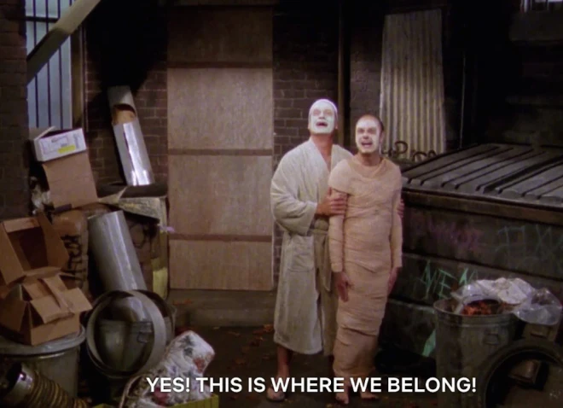
Exploration and Exploitation: Definition
Exploration is to find more information in the environment by giving up some rewards.
Exploitation is to exploit known information to maximize the rewards.
Exploration is equally important as exploitation.

Slide 40
Exploration and Exploitation: Examples
Restaurant Selection
Exploration: Trying a new one
Exploitation: Trying the favorite one
Oil Drilling
Exploration: Drilling the new location
Exploitation: Drilling the best known location
Game Playing
Exploration: Moving toward experimental direction
Exploitation: Moving toward familiar direction

Slide 41
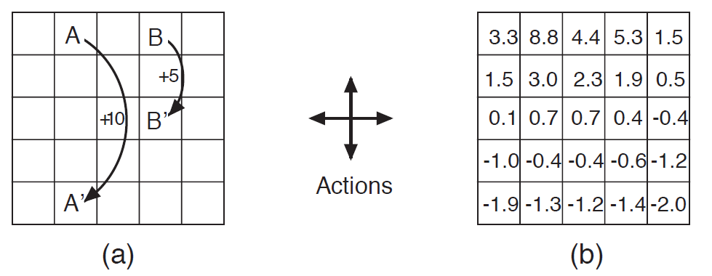
Prediction and Control: Definition
Prediction: Evaluating how well the policy is
Control: Optimizing the policy
i.e. Find the best policy

Slide 42
Prediction and Control: Control Example

Slide 43
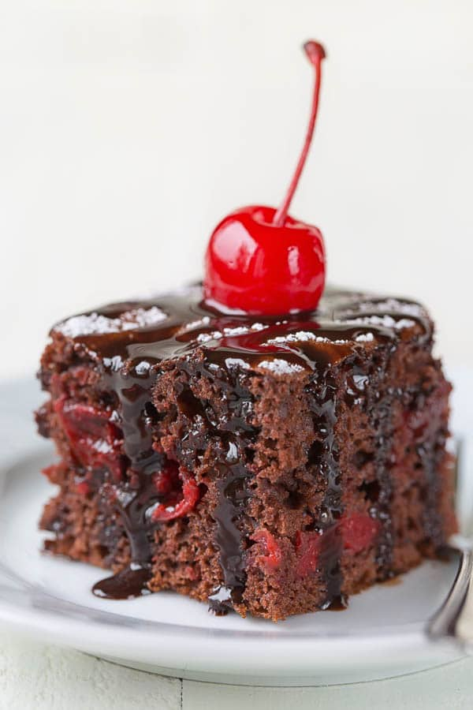
Yann LeCun’s cake!
Cake: unsupervised learning
Icing: supervised learning
Cherry: reinforcement learning

Slide 44
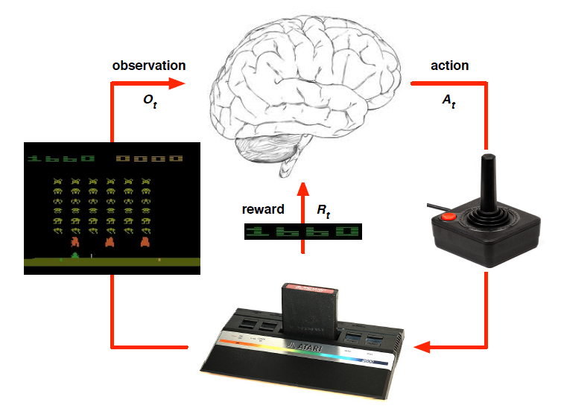
Atari Example: Reinforcement Learning

Slide 45
Reinforcement Learning
Characteristics of Reinforcement Learning:
Exploration
Delayed Rewards
Continuous Learning
Similar to Supervised in that there are rewards for “good behavior” (similar to a loss function)
Similar to Unsupervised in that you have no “correct results” to work with
However, “Semi-Supervised Learning” is a different thing all together
Question: Why was Reinforcement Learning able to beat a Go master where other types of Artificial Intelligence failed to do so?

Slide 46
Notes:
https://www.youtube.com/watch?v=eRwTbRtnT1I&t=123s

Slide 47
Architecture

Slide 48
Recall: The Markov Decision Process (MDP)
S = States agent can be in
A = Actions agent can take
At time t, the agent senses current state: S_{t}
Agent takes action A_{t}
The environment gives reward R_{t} in response and moves agent to state S_{t+1}:
δ(S_{t}, A_{t}) = S_{t+1}(State Transition Function)
r(S_{t}, A_{t}) = R_{t} (Reward Function)
Key Assumption: Those two functions depend only on current state/action
Not previous ones!
Less limiting than it sounds – any past state info can be ‘promoted’ to be part of the current state

Slide 49
Example of Markov Decision Process
States and Actions

Slide 50
Optimal Policy
An optimal policy conceptually looks like this:

Slide 51
Optimal value function and optimal policy
The Optimal Value Function:
An optimal policy can be created from the optimal value function

Slide 52
Q-Function and Optimal Value Function
The Q-Function is the expected value of a given state and action:
The Optimal Value Function can be created from the Q-Function:
72.9
81
90
65.61
72.9
72.9
81
90

Slide 53
But how do I calculate the value function/Q function?
States and Actions
If I have the transition function and reward function, I could calculate the optimal value function directly using dynamic programming

Slide 54
It is possible to approximate the Q-function…
We use the Bell Equation in the following form:
Where the Q-Function is recursively defined in terms of itself
This allows us to iteratively approximate Q with no knowledge of the transition function or reward function!
Start with a table of Q values for every state/action pair
Initial ‘estimate’ for the Q values can be all zeroes or even random values. Then follow this algorithm:
Q-Learning Algorithm:
Select an action a and execute it
Receive immediate reward r
Observe the new state s’ (s’ becomes new s)
Update the table entry as follows:

Slide 55
Q Learning
S
A
R
tate
ction
eward

Slide 56
Q Learning
Learning Rate
Discount Factor
New State
Old State
Reward

Slide 57
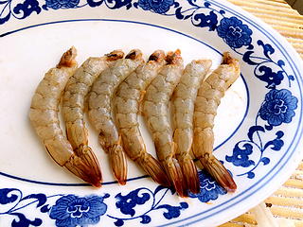
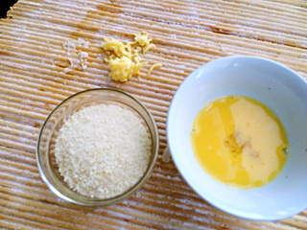
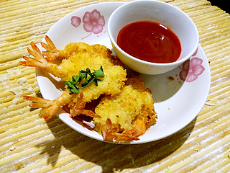
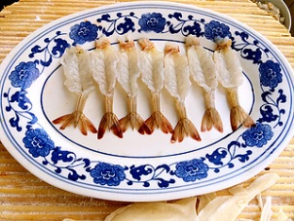
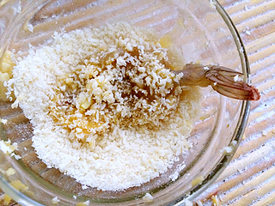
Traditional Cooking

Slide 58
Traditional Cooking

Slide 59
Traditional Cooking

Slide 60
Traditional Cooking

Slide 61
Traditional Cooking

Slide 62
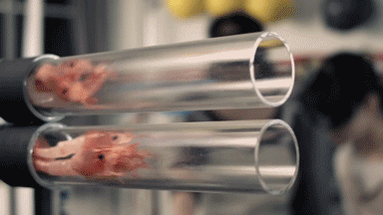
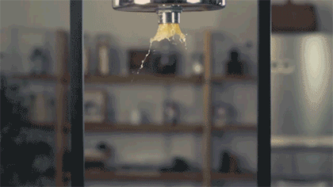
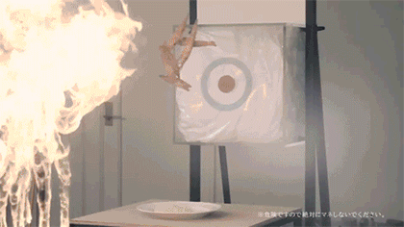
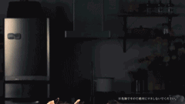
End to End Cooking

Slide 63
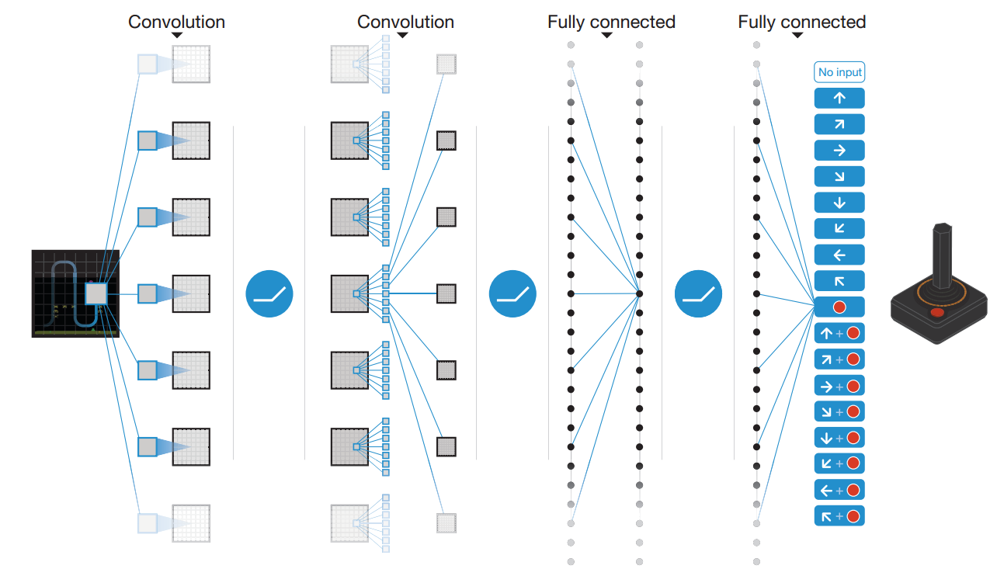
End to End Learning

Slide 64
Formulation
1
2
3
Target
Variable

Slide 65
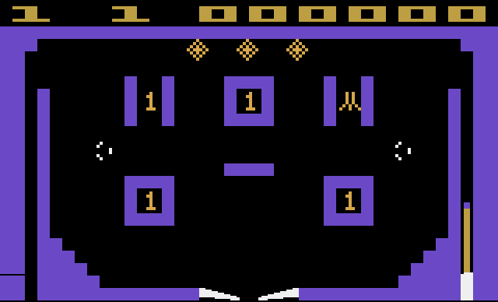
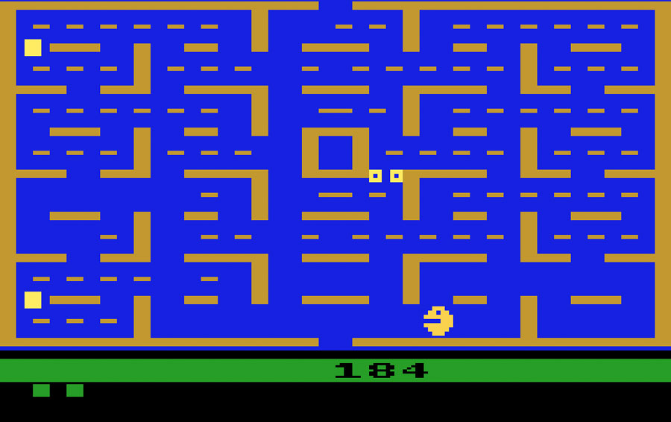
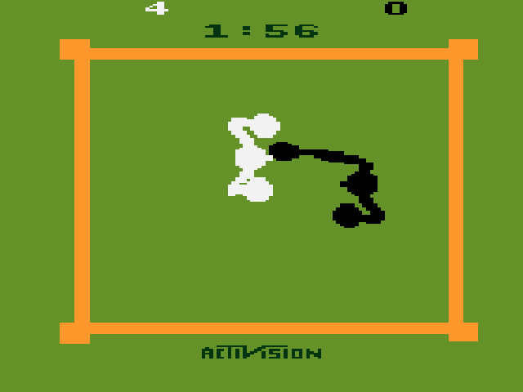
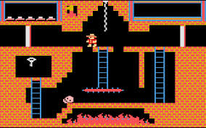
Results Analysis
DQN is good at …
DQN is bad at …

Slide 66
Discussion
Q: What is the key contributing factor?
A: Almost unlimited training data
Q: How to account for long term dependency ?
A: Long short term memory may be the solution

Slide 67
Q-Learning in Practice
Current State = 7 (Start)
States and Actions
Q-Learning Algorithm:
Select an action a and execute it
Receive immediate reward r
Observe the new state s’ (s’ becomes new s)
Update the table entry as follows:
def updateQ(self, s, a, s_prime, a_prime, r):
# Update Q table (s_prime is next state and a_prime is max (optimal) move from s_prime
self.Q[s, a] = ((1.0 - self.alpha) * self.Q[s, a]) + (self.alpha * (r + (self.gamma * self.Q[s_prime, a_prime])))

Slide 68
Q-Learning in Practice
1
2
3
4
5
6
7
8
9
Q[s, a] = (0.8 * Q[s, a]) + (0.2 * (reward + 0.9 * Max Q[s_prime, a_prime]))
Q[s, a] = (0.8 * 0) + (0.2 * (0 + 0.9 * 0))
Q[s, a] = 0

Slide 69
Q-Learning in Practice
1
2
3
Goal! Reward 100!
4
5
6
7
8
9
Q[s, a] = (0.8 * Q[s, a]) + (0.2 * (reward + 0.9 * Max Q[s_prime, a_prime]))
Q[2, R] = (0.8 * Q[s, a]) + (0.2 * (reward + 0.9 * Max Q[s_prime, a_prime]))
Q[2, R] = (0.8 * 0) + (0.2 * (100 + 0.9 * 0))
Q[2, R] = 20

Slide 70
Q-Learning in Practice
1
2
3
4
5
6
7
8
9
Q[s, a] = (0.8 * Q[s, a]) + (0.2 * (reward + 0.9 * Max Q[s_prime, a_prime]))
Q[1, U] = (0.8 * Q[s, a]) + (0.2 * (reward + 0.9 * Max Q[s_prime, a_prime]))
Q[1, U] = (0.8 * 0) + (0.2 * (0 + 0.9 * 20))
Q[1, R] = 3.6

Slide 71
Q-Learning in Practice
1
2
3
Goal! Reward 100!
4
5
6
7
8
9
Q[s, a] = (0.8 * Q[s, a]) + (0.2 * (reward + 0.9 * Max Q[s_prime, a_prime]))
Q[2, R] = (0.8 * Q[s, a]) + (0.2 * (reward + 0.9 * Max Q[s_prime, a_prime]))
Q[2, R] = (0.8 * 20) + (0.2 * (100 + 0.9 * 0))
Q[2, R] = 36

Slide 72
Q-Learning in Practice: Explore, Exploit, Converge!
1
2
3
81
90
100
4
5
6
72
81
81
90
100
7
8
9
81
90
Problem: Once a path performs ‘best’ how would you discover a better path?
Solution: The Exploit / Explore Trade-off, i.e. random moves with decaying occurrence

Slide 73
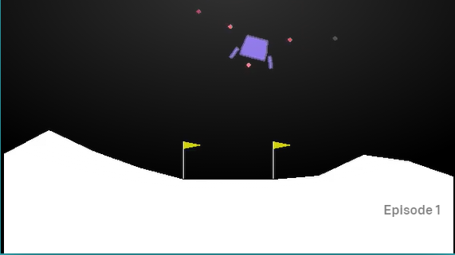
Lunar Lander
In 1973 Lunar Lander was created to show off the DEC GT40 (Texted based)
Atari published an arcade version in 1979 (Graphic version)

Slide 74
Lunar lander
Actions for this game are:
Do nothing
Fire left orientation engine
Fire right orientation engine
Fire main engine
Note: All actions are discrete, i.e. off or on
Source: Solving The Lunar Lander Problem under Uncertainty using Reinforcement Learning by Gadgil, et al

Slide 75
Lunar lander
“State” for this game consists of 8 values:
X Position (real)
Y Position (real)
X Velocity (real)
Y Velocity (real)
Angle of lander (real)
Left leg contact with ground? (bool)
Right leg contact with ground? (bool)
Source: Solving The Lunar Lander Problem under Uncertainty using Reinforcement Learning by Gadgil, et al
Problem: 6 of those are real values and are continuous. So the state space is infinite.
How do you use Q-Learning on such a state space?

Slide 76
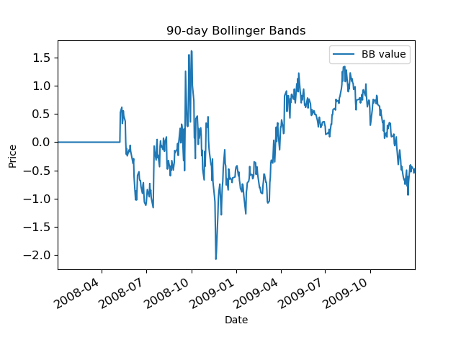
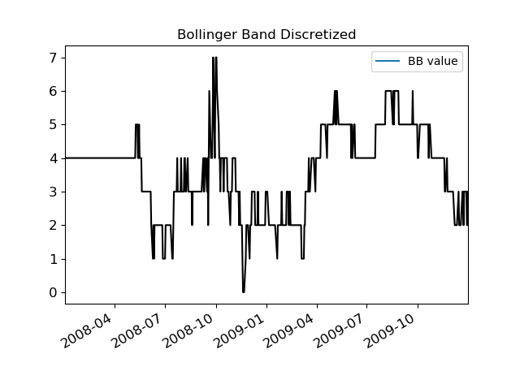
Approach 1: Discretize

Slide 77
Outcome of discretization
Even with a Q-Table with 1,000,000 state/action pairs the lander did little more than sort head towards the middle while crashing
Problem: Nobody could seem to play the game nearly enough to fill up the Q-table. Most of the table stayed at zeroes and thus gave bad information

Slide 78
Approach : Deep Reinforcement Learning
Intuition: Neural Nets can theoretically approximate any function
Universal Approximation Theorem
A Q-Table is just a function:
Q-Function(State, Action) returns Q-Value which is the current known value of being in that state and taking that action
Why not just use a neural network to approximate the Q-Function?

Slide 79
Deep Reinforcement Learning
New problem: How do you train a neural net to replace the Q-Function?
Normally we use supervised learning to train neural nets which requires a human to label ‘ground truth.’
But we have no ‘ground truth’ to work with here
Proposed solution:
Let the neural net train itself!

Slide 80
Track the following
(state, action, reward, next state, done?)
State: All 8 values
Action taken
Reward received, if any
New state you found yourself in after the action
Did the episode end? (Crash or success)
Train off of this history by grabbing a mini-batch of a random 100 elements

Slide 81
So…how do we go “deep”?
We rip out the Q-Table and replace it with a neural net that takes states as an input and outputs an action.
This effectively replaces the Q-Table because we only use it to determine, given a state, which action to take.
But neural nets naturally generalize well, so we don’t need to come up with enough tests to hit every single ‘state’
Plus, for free, we can now handle continuous (read: infinite) state spaces

Slide 82
Recall: Reinforcement Learning
$r,s→a$
$π:s→a$
$v:s→\sum{r}$
$q:s,a→\sum{r}$

Slide 83
$$r,s→a$$

Slide 84
⏰

Slide 85
$$r′,s′→a′$$

Slide 86
⏰

Slide 87
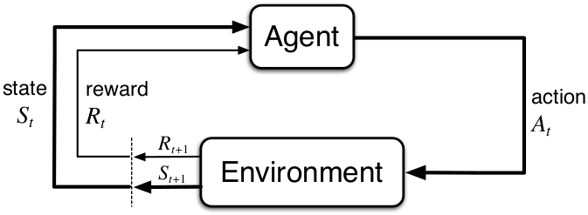

Slide 88
Deep Reinforcement Learning
“given” $r,s,a,r^{′},s^{′},a^{′},…$
learn “good” $s→a$

Slide 89
(Deep) Reinforcement Learning
Terminology → learn how to act, given a certain state to maximize reward
Reward function r(s_{t},a_{t}) is obtained in state s_{t+1}
From course “Deep Reinforcement Learning”, Sergey Levine; http://rail.eecs.berkeley.edu/deeprlcourse/static/slides/lec-4.pdf

Slide 90
(Deep) Reinforcement learning
Goal of reinforcement learning: find θ such that policy maximizes expected total reward

Slide 91
Q-function and value function
How to find optimal policy? Use concepts of Q and value function
The Q function, its value for given action and state depend on policy
The V function, its value for state depend on policy

Slide 92
Algorithm types
Goal:
Policy gradients: directly differentiate the above objective
Value-based: estimate value function or Q-function of the optimal policy
(no explicit policy)
Actor-critic: estimate value function or Q-function of the current policy, use it to improve policy
Model-based RL: estimate the transition model, and then...
Use it for planning (no explicit policy)
Use it to improve a policy
…

Slide 93
Sample efficiency
How often do we have to interact with machine?
Started with off-policy Q-function learning (value function algorithm)
plan to try model-based RL (e.g. Bayesian learning)
From course “Deep Reinforcement Learning”, Sergey Levine;

Slide 94
HOW IS REINFORCEMENT LEARNING DIFFERENT FROM ML/DL?
Statistics - Understand data distribution, the dispersion of data points, methods to tell how two groups of data are different
Machine Learning - Based on existing data representation – you teach a ‘machine’ to recognize patterns and predict it
Deep Learning - A fancier version of machine learning where your machine recognizes decision boundaries which are non-linear in nature – a function approximator
Reinforcement Learning - Teach a ‘machine’ how to decide (ACTION) based on a ‘prior’ understanding of the environment (STATE) and possible outcomes (REWARDS) of the decision(subset of ML/DL algorithms)
Next slides credited to: RESHMI GHOSH,
DATA AND APPLIED SCIENTIST II, MICROSOFT
Notes:
Imitation Learning – learn from experience of others – observes another intelligent agent and

Slide 95
REINFORCEMENT LEARNING FRAMEWORK
ACTION
REWARDS
ENVIRONMENT
STATES
What does an agent decide to do?
Is the decision right or wrong?
In what conditions is the agent operating?
What are possible ‘environments’ the agent can transition into after making a decision?
Notes:
How an agent interacts with its environment to ultimately maximize cumulative reward? Learn a function that determines what action to take in a given state such that the total expected future reward is maximized – Such a function is called policy

Slide 96
Reinforcement Learning Examples
A game of chess
States: What influences your action?
Actions: Which move to choose?
Reward: What do you gain or lose?
Robots completing a certain task
States: ?
Actions: ?
Reward:?
Notes:
So let’s talk try to define the action, reward, and states for each of these situations. In a game of chess, you are sitting down with an opponent (which is the environment), your opponent makes a move and you only have only so many finite moves to counter that, which is your actions at any time t, after your opponent makes the move, you are in a new situation – that is your state, and based on what action you take, you will be either one step closer to winning or losing the game
Next, let’s think about a robot (for example a self driving car) on the road trying to go from destination A to B – can someone tell me

Slide 97
Reinforcement Learning Examples
A game of chess
States:
Actions: Which move to choose?
Reward: What do you gain or lose?
Robots completing a certain task
States: Observation from sensors
Actions: What is the next move?
Reward:
Appreciation for the correct move towards completion of task
Penalty for unexpected moves, accidents
Notes:
So let’s talk try to define the action, reward, and states for each of these situations. In a game of chess, you are sitting down with an opponent (which is the environment), your opponent makes a move and you only have only so many finite moves to counter that, which is your actions at any time t, after your opponent makes the move, you are in a new situation – that is your state, and based on what action you take, you will be either one step closer to winning or losing the game
Next, we will transition to see mathematically how do we formulate these actions, rewards, and states in a logical way to implement our Reinforcement Learning algorithm

Slide 98
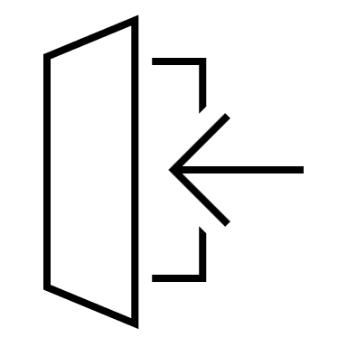
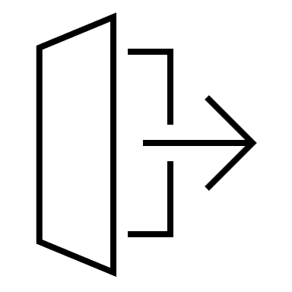
Markov Property
AI must be able to deal with series of tasks and reach a goal
Markov property: agent keeps track of how the changes occur from previous state to current state
“Future is independent of the past given the present”
state₁
state_{n}
Transition probability: The probability that the agent will move from one state to another
From state S_{t} to S_{t+1}, the state transition probability is given by P_{ss’} = P(S_{t+1} = s’ | S_{t} = s)
We can also define a state Transition probability matrix
Notes:
Let’s talk about how transitions are typically defined between states and for this we leverage the Markov Property –
The Markov property states that Future is independent …. The equation means that the transition from state St to St+1 is entirely independent of the past
Intuitively meaning that our current state already captures the information of past states
And every transition thus is a probabilistic function of where your agent could go next

Slide 99
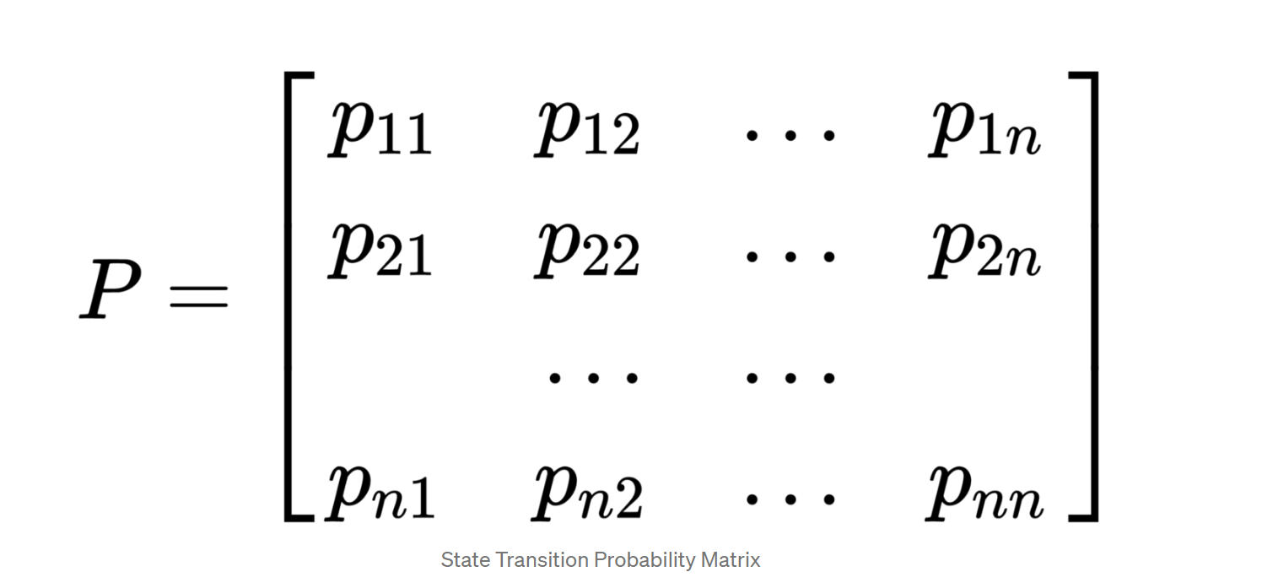
Markov Property
AI must be able to deal with series of tasks and reach a goal
state₁
state_{n}
Transition probability: The probability that the agent will move from one state to another
From state S_{t} to S_{t+1}, the state transition probability is given by P_{ss’} = P(S_{t+1} = s’ | S_{t} = s)
We can also define a state Transition probability matrix
Each row represents the probability from moving from current state/original state
Sum of each row = 1
Notes:
So the transitions between states can really be defined as a matrix where each row represents the probability of going from

Slide 100
Markov Reward Process
Mathematically
R_{s} = E[R_{t+1} | S_{t} ]
How much reward (R_{s}) we get from a particular state S_{t}
Notes:
So we understood how Markov property defined the dynamics of a state transition, but reinforcement learning is all about maximizing the reward for a specific task. So let’s add reward to the Markov chain which gives us the Markov Reward Process.

Slide 101
Markov Decision Process (MDP) – Model based
States $S$
Actions$A$ (not all actions possible in every state**)
Reward function $R: A X S →ℛ$
Transition Probability Matrix
Sequence of interactions between agent and environment
s₁, a₁, R₁, s₂, a₂, R₂, …..
Notes:
MDP is a MRP with decisions. Everything is same as MRP but now the agent makes decisions meaning it actually takes some actions
Our reward is dependent on the action – until now we spoke about how we get a reward when our agent transitions through a set of states following some strategy (which is basically called policy, something we will discuss in the next slides)
Transition function

Slide 102
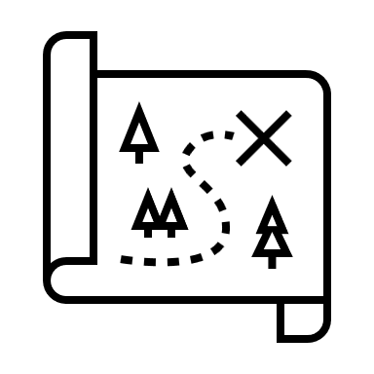
Policy
Strategy employed by agent to determine the next action based on the current state
A mechanism to take decisions
Maps state to actions, specifically the actions that result in largest reward
Should be tractable
Cannot be a set of if-else conditions
∏(a|s) policy
Notes:
Value algorithm
Initialize V(s) arbitrarily
Loop until policy is good enough
Loop for s $ε S$
Loop for a $ε A$
Q(s, a):= R(s,a) + $γ\sum_{s^{′}ε S}{T\left(s, a, s^{′}\right)V^{∗}\left(S^{′}\right)})$
V(s) := max_a Q(s,a)
Policy algorithm
Choose an arbitrary policy

Slide 103
Optimal Policy
Maps state to actions, specifically the actions that result in largest reward
Should be tractable
Cannot be a set of if-else conditions
Considers a set of past experience
To make the agent behave optimally – it needs to learn how to choose the best action for each state, i.e., optimal policy
Infinite Horizon: include a discounting factor $γ$
Maximize the ‘expected’ rewards - $E$($\sum_{t}^{∞}{γ^{t}R_{t}}$)
Notes:
Can anyone tell me why are we even bothered about the

Slide 104
Optimal Policy
Maps state to actions, specifically the actions that result in largest reward
Should be tractable
Cannot be a set of if-else conditions
Considers a set of past experience
To make the agent behave optimally – it needs to learn how to choose the best action for each state, i.e., optimal policy
How do we define the discount factor? - Arbitrarily set to 0.9
Infinite Horizon: include a discounting factor $γ$
Maximize the ‘expected’ rewards - $E$($\sum_{t}^{∞}{γ^{t}R_{t}}$)
Notes:
Talk about discount factor?
SO do you want to have a uniform discount factor? This is where practice differs from theory. Depending on the task you will want to decide on if it makes sense to assign more weightage to decisions in near future than for actions near the terminal state.
For example – Imagine you have a product website that makes money through ads. A customer interfaces with this website to look for something, do you want a customer to click a news article which shows them somewhat relevant ads or do you want to collect more information about customer behavior and show more relevant ads as they are navigating through different web pages of your website.
Policies in the MDP depend on the current state, they do not depend on history – following the Markov property.
n a chess game, the goal is to defeat the opponent’s king. If we give importance to the immediate rewards like a reward on pawn defeat any opponent player then the agent will learn to perform these sub-goals no matter if his players are also defeated. So, in this task future rewards are more important. In some, we might prefer to use immediate rewards like the water example we saw earlier.

Slide 105
Optimal Policy
Value of a state: expected infinite cumulative reward that has been discounted after agent applies the ‘optimal policy’
$V\left(s\right)=\max{E\left(\sum_{t}^{∞}{γ^{t}R_{t}}\right)}$
Using the value function, define the optimal policy
$π_{}^{∗}\left(s\right)=\arg{\max{(R\left(s, a\right)+ γ\sum_{s^{′}ε S}{T\left(s, a, s^{′}\right)V^{∗}\left(S^{′}\right)})}}$
Notes:
Value algorithm : Value of any state s is the expected return starting from state s and following policy pi for the next steps until we reach the terminal state of the end. The important thing to note here is that value of a state is not a stochastic parameter as we find the expectation of rewards, but returns is stochastic. This function is also called the state-value function
Initialize V(s) arbitrarily
Loop until policy is good enough
Loop for s $ε S$
Loop for a $ε A$
Q(s, a):= R(s,a) + $γ\sum_{s^{′}ε S}{T\left(s, a, s^{′}\right)V^{∗}\left(S^{′}\right)})$
V(s) := max_a Q(s,a)
Policy algorithm
Choose an arbitrary policy

Slide 106
AI PLANNING: EXPLORATION Vs. EXPLOITATION
How does agent learn optimal policy?
Needs to evaluate every possible action for all (infinite) states.
What if the agent chooses an action that it thinks is best all the time? – unexplored parts of state space ignored.
What if the agent chooses to explore extensively? How to leverage (exploit) what the agent has learned?
Delayed consequences
Notes:
You have a view of the world
Delayed consequences
Temporal credit assignment
Exploration needed even after optimal policy convergence to adapt to small perturbations in the environment

Slide 107
Q-learning – Model free
We cannot always accurately model the state transition probabilities
Easy to define value functions
No explicit need to model Reward and Penalty functions

Slide 108
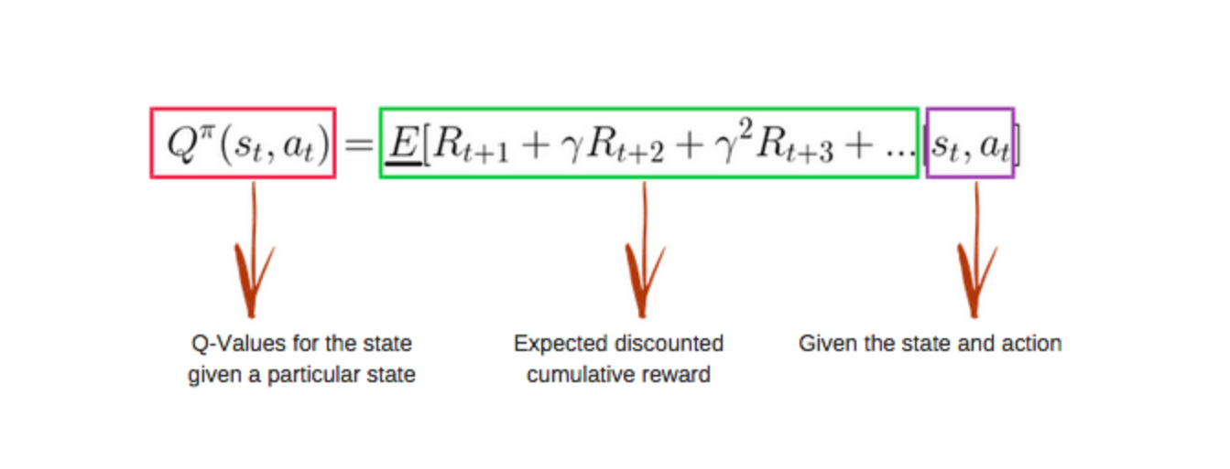
Q-learning over MDP
No transition function – approximate value of each state based on the actions taken and rewards/penalty received
$π^{∗}\left(s\right)=argmax Q^{∗}(s, a)$
Observe transition (s, a, r, s’)
$Q\left(s,a\right)=\left(1−α\right)Q\left(s,a\right)+α(r+ γ\max{Q\left(s^{′}, a^{′}\right)})$

Slide 109
Q-learning over MDP
Q-values are initialized as zeros – and through an iterative process of exploring environment, approximating state and rewards, the values are updated
Notes:
In practice value iteration is impractical

Slide 110
COMPLEX SCENARIo - GO GAME
19x19 different positions
3 DIFFERENT STRATEGIES – BLACK STONE, WHITE STONE, NO STONE
Possible number of states? 319X19
Impossible to learn the transition matrix – instead approximate it
What is the best way to approximate a function?
Hence, Deep Reinforcement learning
State and actions are not always discrete + difficult to store all possible states and action values
**Convergence is not guaranteed for models with function approximation
Notes:
Let’s consider the Go-Game, where you have to maximize your presence on the board by

Slide 111
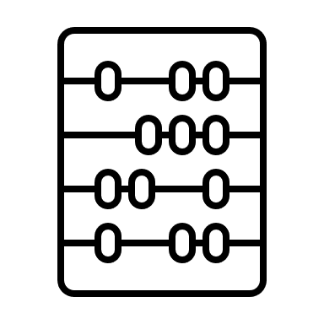
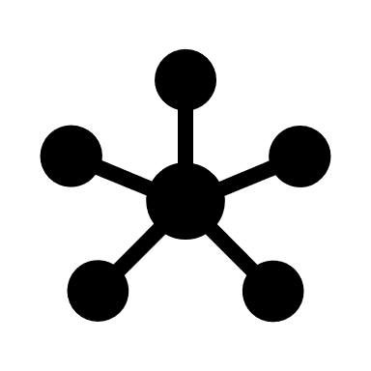
Deep Q-Networks
Deep Q-Networks Neural Networks + Q-values
Agent learns from experience
Q-value functions estimated using a neural network model
States
Neural Network model
Q-values (outputs)
All past experiences by agent stored in memory

Slide 112
Deep Q-Networks
Deep Q-Networks Neural Networks + Q-values
Agent learns from experience
Q-value functions estimated using a neural network model
States
Neural Network model
Q-values (outputs)
All past experiences by agent stored in memory
Inputs are constantly changing – different from conventional Deep Learning formulations

Slide 113
Deep Q-Learning
Q-value
Network
States
Action
Use DNN to approximate Q functions
Use observed trajectories of state-action-rewards
‘Human level control through Deep Reinforcement Learning’, 2015 – by DeepMind
Feed the network with state-action pair to output a corresponding Q-value

Slide 114
Deep Q-Learning
Q-value 1
Q-value 2
Q-value n
Network
States
Use DNN to approximate Q functions
Use observed trajectories of state-action-rewards
‘Human level control through Deep Reinforcement Learning’, 2015 – by DeepMind
Compute Q-values for all actions in one go

Slide 115
Deep Q-Learning formulation
Formulate the value function by Deep Q-network with weights w
Objective function – MSE in Q values
Algorithm - Transition -> (s, a, r, s’)
Feedforward pass for current state s to get predicted Q-values for all actions
Feedforward pass for next state s’ and calculate argmax across all network outputs argmax Q(s’, a’)
Assign Q-value target for action to $r+ γ\max{Q\left(s^{′}, a^{′}\right)}$
Update weights during backprop
Notes:
Agent aims to ma

Slide 116
Pitfalls
Policy changes frequently with small changes to Q-values, may oscillate
Compute Q-learning targets w.r.t old, fixed parameters w
Scale of rewards and Q-values – unknown, thus gradients can be large and unstable
Clip rewards or normalize network adaptively
Experience Replay!
Notes:
The caveat to these novel deep Q-learning formulation is the significant amount of instability during training. Imagine you are trying to train a RL model in a multi-player game setting, to play as the opponent. Your training set is essentially a collection of screenshots of various time stamps of the game, but since these screenshots are highly correlated to each other the Deep learning model overfits very easily. Your model is doing gradient descent on similar correlated inputs

Slide 117
Problems with stability
Off-policy learning
Learning from data generated by a policy about a different policy – better value approximation for the policy actually being implemented
Bootstrapping
Learning value estimates from other value estimates
Q-learning diverges in presence of:

Slide 118
Bandit Algorithms
A bandit is a metaphor for slot machine in a casino
Introduced by William R. Thompson, clinical trials being the first intended applications (predicting what drug should a certain patient receive)
Payoffs have a random probability when you pull the lever of an armed bandit. Do you keep pulling the lever of the same bandit (slot-machine), or do you want to try your luck with other slot machines?
Captures the fundamental dilemma a learner faces when choosing between uncertain options

Slide 119
Bandit Algorithms
A bandit is a metaphor for slot machine in a casino
Introduced by William R. Thompson, clinical trials being the first intended applications (predicting what drug should a certain patient receive)
Payoffs have a random probability when you pull the lever of an armed bandit. Do you keep pulling the lever of the same bandit (slot-machine), or do you want to try your luck with other slot machines?
Captures the fundamental dilemma a learner faces when choosing between uncertain options
Repeatedly choose between actions with unknown payoffs – maximize the cumulative gain
Exploit the best payout option found until now

Slide 120
Multi-arm Bandit Algorithms
Imagine trying your luck with multiple slot machines (multiple one-armed bandits)
You need to develop an intuition between finding the machines that has greater payoff and *exploiting* the machine which has the greatest payout so far.
What do you do?

Slide 121
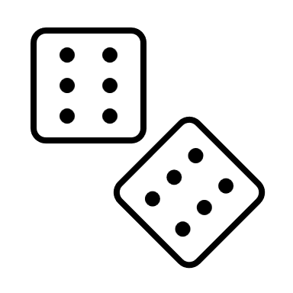
Multi-arm Bandit Algorithms
Imagine trying your luck with multiple slot machines (multiple one-armed bandits)
You need to develop an intuition between finding the machines that has greater payoff and *exploiting* the machine which has the greatest payout so far.
What do you do?
Your intuition without ‘any external information’ is random – i.e. you will randomly try to decide which lever to pull next

Slide 122
Multi-arm Bandit Algorithms
Imagine trying your luck with multiple slot machines (multiple one-armed bandits)
You need to develop an intuition between finding the machines that has greater payoff and *exploiting* the machine which has the greatest payout so far.
What do you do?
Your intuition without ‘any external information’ is random – i.e. you will randomly try to decide which lever to pull next
Stateless – you operate without any perception of the external environment changes after every lever you click

Slide 123
Multi-arm Bandit Algorithms
What do you do?
Your intuition without ‘any external information’ is random – i.e. you will randomly try to decide which lever to pull next
Action
Reward
Stateless – you operate without any perception of the external environment changes after every lever you click
Stateless
State
Action
Reward
Full RL framework
Notes:
Imagine you are trying to create this website showing pictures of cats and dogs to an user – and the website makes random decisions of showing any picture without the context of the user

Slide 124
Multi-arm Bandit Algorithms
What do you do?
Your intuition without ‘any external information’ is random – i.e. you will randomly try to decide which lever to pull next
Action
Reward
Stateless – you operate without any perception of the external environment changes after every lever you click
Stateless
State
Action
Reward
Your bandit (slot-machine) selection strategy is Policy ∏
Full RL framework
Notes:
Imagine you are trying to create this website showing pictures of cats and dogs to an user – and the website makes random decisions of showing any picture without the context of the user

Slide 125
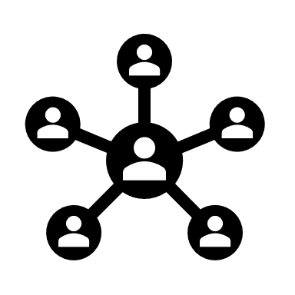
Multi-arm Bandit Algorithms (MAB) Caveats
What do you do?
Random intuition to choose the next action (in our case, pulling the lever of a slot machine) – is not suited for practical setting
Knowledge of the problem setting (state) is very important to deploy appropriate actions
Consider applying MAB to ad recommendations and machine failure – and every time making the same choice irrespective of considering the user/machine characteristics
Notes:
Imagine you are trying to create this website showing pictures of cats and dogs to an user – and the website makes random decisions of showing any picture without the context of the user

Slide 126
Contextual Bandit Algorithms
Agent has access to additional information about the ‘situation’ at beginning of each action round
Specializing actions to context – better rewards
Notes:
Imagine you are trying to create this website showing pictures of cats and dogs to an user – and the website makes random decisions of showing any picture without the context of the user

Slide 127
Contextual Bandit Algorithms
Agent has access to additional information about the ‘situation’ at beginning of each action round
Specializing actions to context – better rewards
Context
State
Action
Reward
State
Action
Reward
Full RL framework
Notes:
Learning about the env, making decisions and collecting rewards

Slide 128
Contextual Bandit Algorithms
At each round $t=1, 2, ……T$:
Environment reveals a context $x_{t}∈X$
Agent chooses an action $α_{t}∈A$
Environment reveals an award $r_{t}∈\left[0,1\right]$
We assume there is an unknown joint distribution over contexts and rewards for all actions, $D_{t}$ (marginal distribution over contexts and conditional distribution over rewards given a context)
Notes:
Learning about the env, making decisions and collecting rewards

Slide 129
Contextual Bandit Algorithms
At each round $t=1, 2, ……T$:
Environment reveals a context $x_{t}∈X$
Agent chooses an action $α_{t}∈A$
Environment reveals an award $r_{t}∈\left[0,1\right]$
We assume there is an unknown joint distribution over contexts and rewards for all actions, $D_{t}$ (marginal distribution over contexts and conditional distribution over rewards given a context)
Choose$x_{t} \sim D_{t} ; r_{t}\sim D_{t}(.|x_{t}, a_{t})$
Agent is equipped with a set of policies $Π⊆\left\{X→A\right\}:$
find a policy $π∈Π$ to attain largest reward
Notes:
Learning about the env, making decisions and collecting rewards

Slide 130
Contextual Bandit Algorithms
At each round $t=1, 2, ……T$:
Environment reveals a context $x_{t}∈X$
Agent chooses an action $α_{t}∈A$
Environment reveals an award $r_{t}∈\left[0,1\right]$
We assume there is an unknown joint distribution over contexts and rewards for all actions, $D_{t}$ (marginal distribution over contexts and conditional distribution over rewards given a context)
Choose$x_{t} \sim D_{t} ; r_{t}\sim D_{t}(.|x_{t}, a_{t})$
Agent is equipped with a set of policies $Π⊆\left\{X→A\right\}:$
find a policy $π∈Π$ to attain largest reward
Expectation of reward given a specific context $x$ and policy $π(x)$
Average reward for policy $π$
$$V\left(π\right)=\frac{1}{T}\sum_{t=1}^{T}{Ε_{x\sim D_{t}}[Ε\left[r_{t}\right|x, π\left(x\right)]]}$$
Notes:
Learning about the env, making decisions and collecting rewards

Slide 131
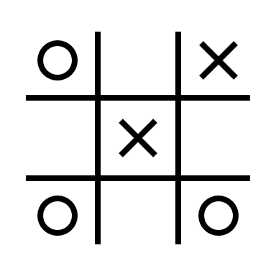
Contextual Bandits: E-commerce - Why not collaborative filtering or A/B Testing?
Goal: Improve customer experience and engagement with personalized ranking
Challenges:
Non-stationary content pool
Change in user preferences over time – how to adapt?
Real time updates to replace requirements for delayed A/B testing

Slide 132
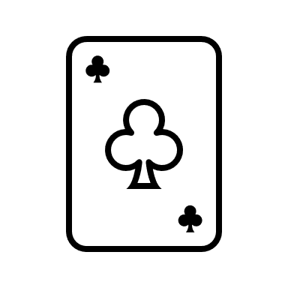
Contextual Bandits: E-commerce - Why not collaborative filtering or A/B Testing?
Goal: Improve customer experience and engagement with personalized ranking
Challenges:
Non-stationary content pool
Change in user preferences over time – how to adapt?
Real time updates to replace requirements for delayed A/B testing
Solution:
Optimize the metrics with contextual bandits
Find the best strategy for a given context; not overall best strategy

Slide 133
Deep Reinforcement Learning for Dialogue Generation

Slide 134
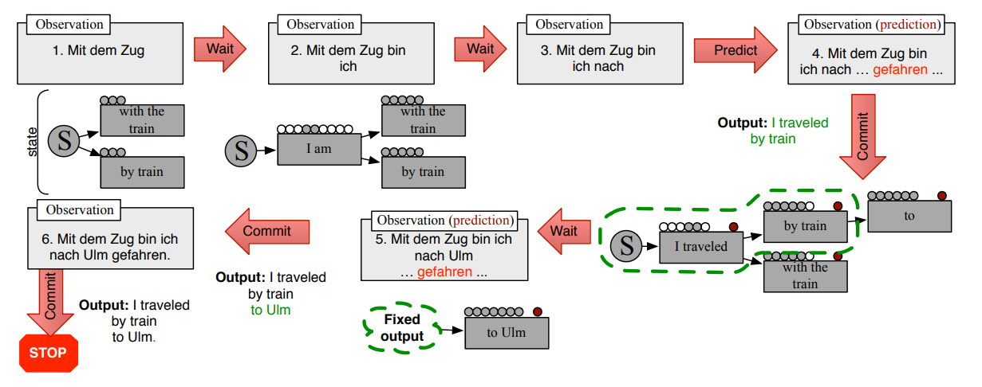
Architecture

Slide 135
(D)RL Examples

Slide 136
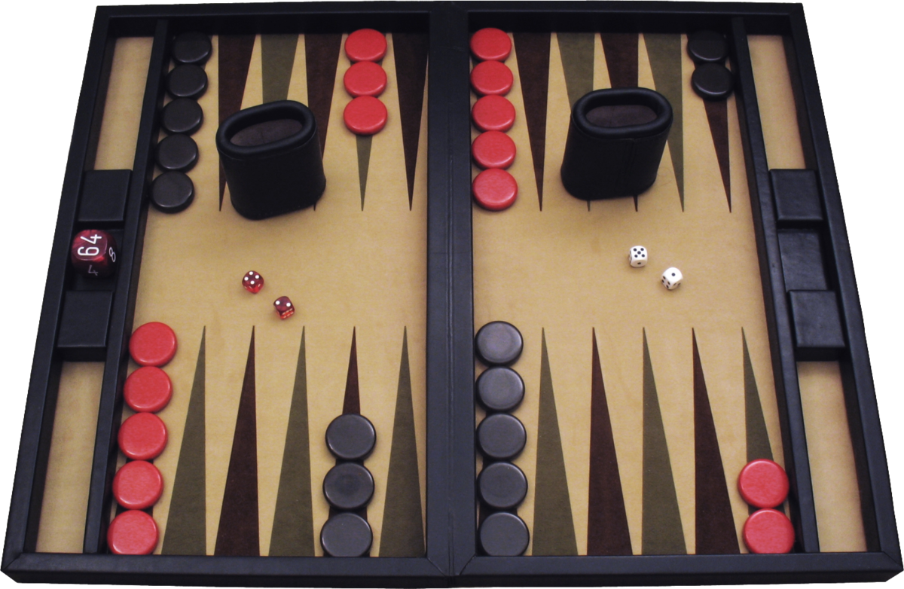
Backgammon

Slide 137
TD-Gammon (1992)
$s$ is custom features
$v$ with shallow neural net
$r$ is 1 for a win, 0 otherwise
TD($λ$)
eligibility traces
self-play
shallow forward search

Slide 138
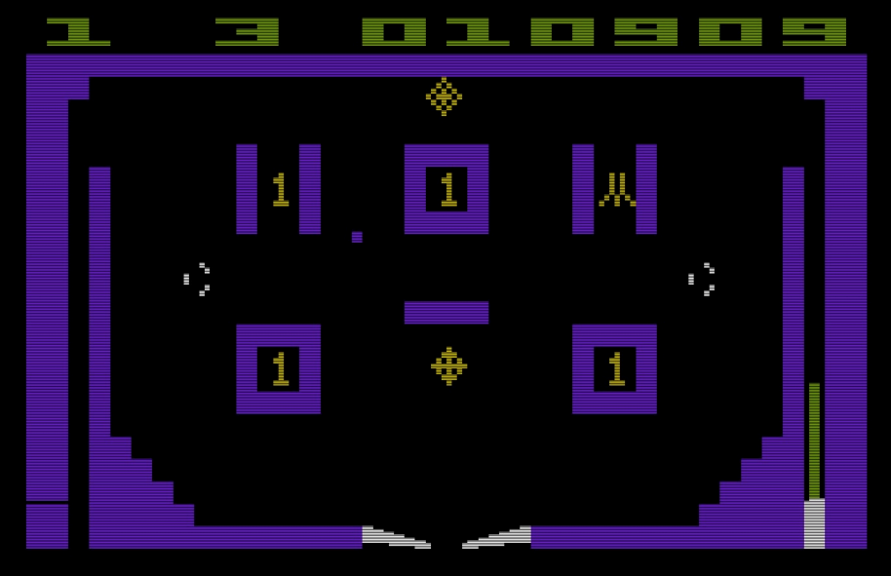
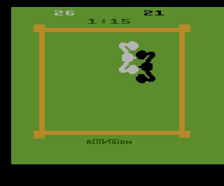
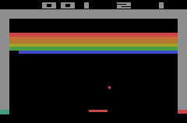
Atari

Slide 139
Atari

Slide 140
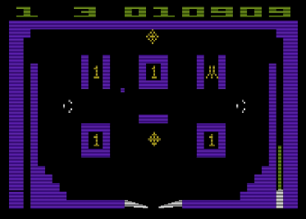
DQN (2015)
$s$ is four frames of video
$q$ with deep convolutional neural net
$r$ is 1 if score increases, -1 if decreases, 0 otherwise
Q-learning
usually-frozen target network
clipping update size etc.
$ε$-greedy
experience replay

Slide 141
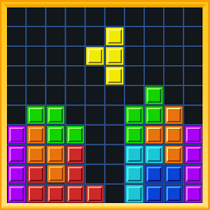
Tetris

Slide 142
evolution (2006)
$s$ is custom features
$π$ has a simple parameterization
evaluate by final score
cross-entropy method

Slide 143
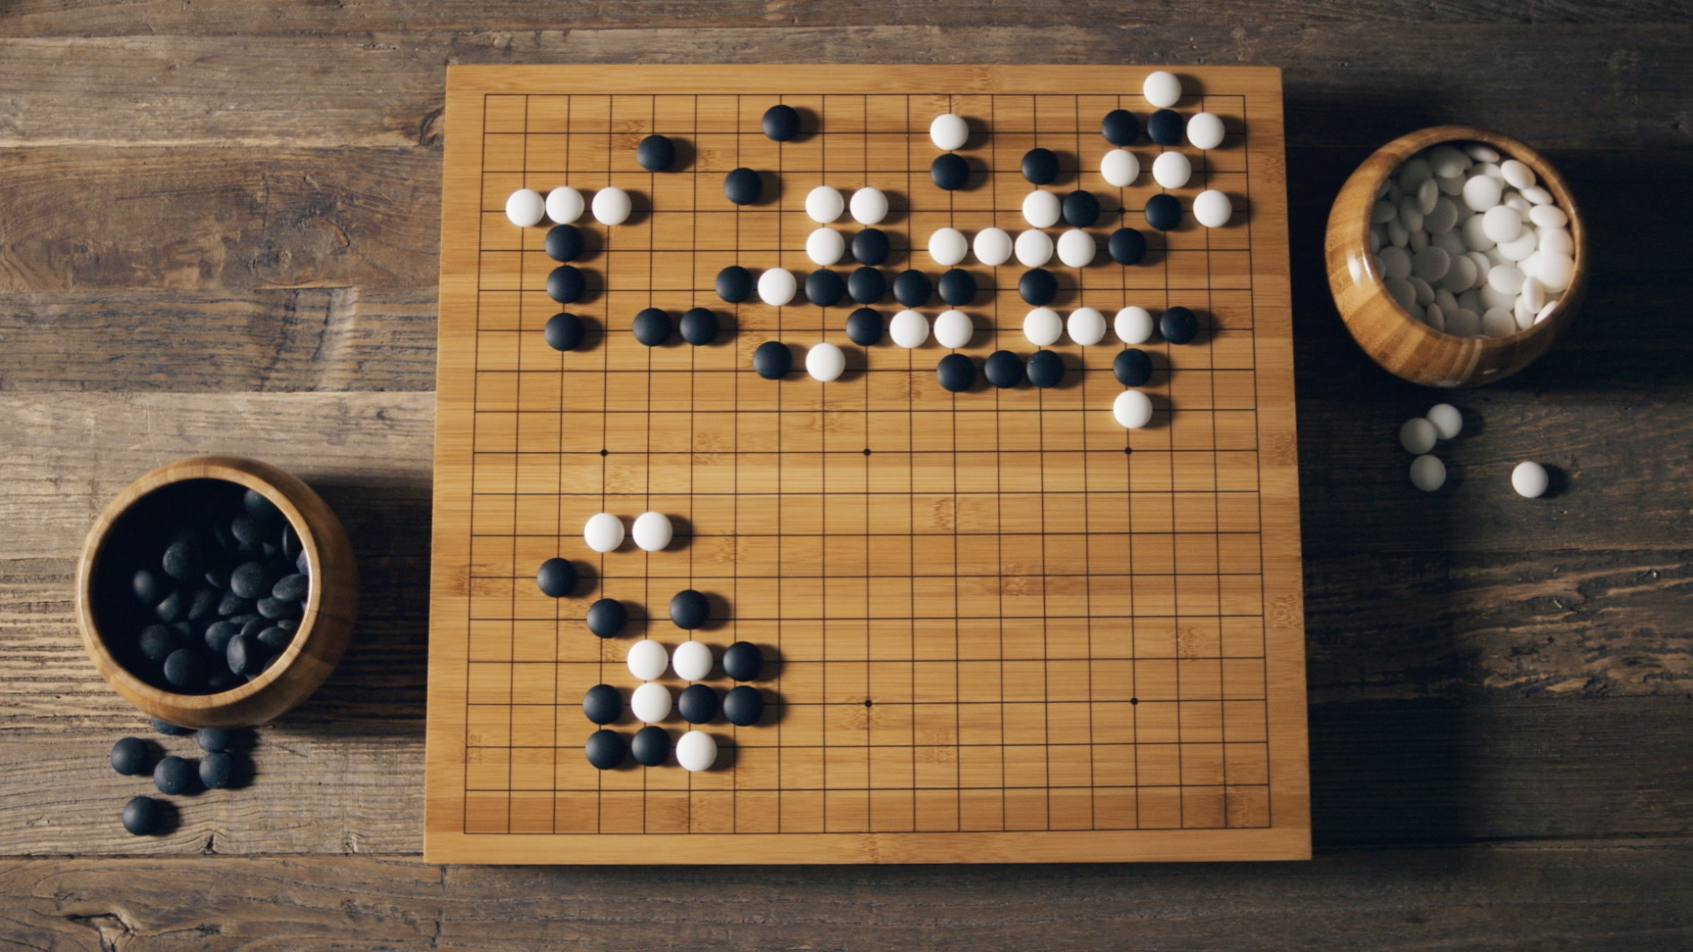
Go

Slide 144
AlphaGo (2016)
$s$ is custom features over geometry
big and small variants
$π_{SL}$ with deep convolutional neural net, supervised training
$π_{rollout}$ with smaller convolutional neural net, supervised training
$r$ is 1 for a win, -1 for a loss, 0 otherwise
$π_{RL}$ is $π_{SL}$ refined with policy gradient peer-play reinforcement learning
$v$ with deep convolutional neural net, trained based on $π_{RL}$ games
asynchronous policy and value Monte Carlo tree search
expand tree with $π_{SL}$
evaluate positions with blend of $v$ and $π_{rollout}$ rollouts
4 nets

Slide 145
AlphaGo Zero (2017)
$s$ is simple features over time and geometry
$π,v$ with deep residual convolutional neural net
$r$ is 1 for a win, -1 for a loss, 0 otherwise
Monte Carlo tree search for self-play training and play
1 net

Slide 146
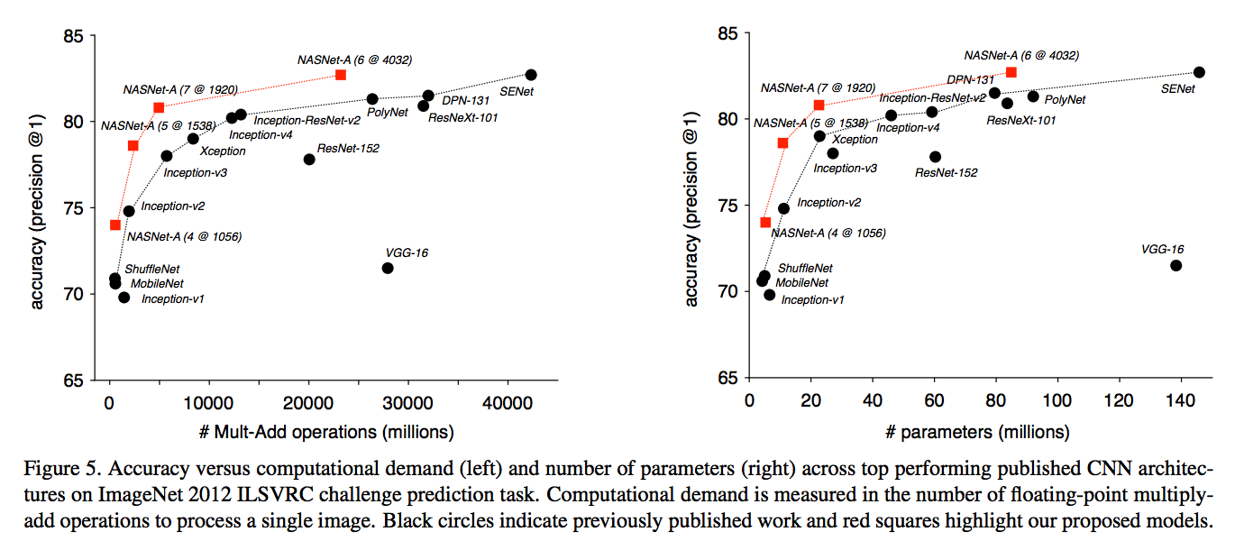
Neural Architecture Search (NAS)
policy gradient where the actions design a neural net
reward is designed net’s validation set performance

Slide 147
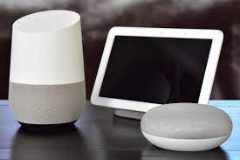
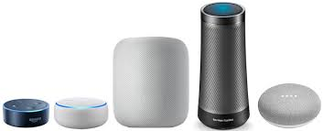
Google Assistant, Alexa, Siri…

Slide 148
Robot control

Slide 149
Self-driving cars
interest
results?

Slide 150
Other Examples
Notes:
https://www.youtube.com/watch?v=W4joe3zzglU&t=16s

Slide 151
Notes:
https://www.youtube.com/watch?v=V1eYniJ0Rnk

Slide 152
Notes:
https://www.youtube.com/watch?v=0JL04JJjocc

Slide 153
References
Deep Reinforcement Learning:
Human-level control through deep reinforcement learning | Nature
6. Deep Q-Learning | Deep Reinforcement Learning with Python: With PyTorch, TensorFlow and OpenAI Gym (oreilly.com)
Deep Reinforcement Learning (julien-vitay.net)
Contextual Bandits:
GitHub - Mathtodon/Contextual_Bandits_Tree: Contains Code for Contextual Bandits Decision Tree*1802.04064.pdf (arxiv.org)
Multi-Arm Bandits:
Multi-Armed Bandits: Exploration versus Exploitation (stanford.edu)

Slide 154
Openai gym

Slide 155
Thank You!

