Slide 1
University of Cyprus
MAI – 642 – DEEP LEARNING
Theocharis Theocharides
Nov, 2023

Slide 2
Deep Learning
Lecture 12:
Emerging Trends in Deep Learning
Theocharis Theocharides
Associate Professor
Dept. of Electrical and Computer Engineering
University of Cyprus

Slide 3
Course Schedule & Content
DATE | Overview | Lecture Details | Scope
Week 1 | Introduction - Course Structure, Logistics, Fundamentals of Machine Learning and Neural Networks | 1. Introduction to Neural Network, Multilayer Perceptron, Back Propagation Learning - What is Deep Learning? | BASICS
Week 2 | Fundamentals of Learning | 2. Introduction to Deep Learning, Bayesian Learning, Hebbian Learning, Decision Surfaces, Representation Learning. 3. Theory of Deep Learning (Universal approximation theorem, convergence rate, and recent mathematical results)
Week 3 | Mathematics & Fundamentals of Deep Learning | 4. Linear Classifiers, Linear Machines with Hinge Loss, Gradient Descent, Activation and Loss Functions. 5. Optimization Techniques, Gradient Descent, Batch Optimization, Introduction to Meta-Learning, Hessian-Free Optimization.
Week 4 | Deep Neural Networks | Deep Neural Networks: Features, Feature Representation, Representation Learning, BoFs/BoWs, Feature Maps, Deep vs. Shallow Nets | FUNDAMENTALS OF DEEP (CONVOLUTIONAL) LEARNING
Week 5 | Convolutional Neural Networks | 6. Convolutional Neural Networks, Building blocks of CNN | DEEP NEURAL NETWORKS - DEEP INTO DEEP LEARNING
Week 6 | Deep Convolutional Neural Networks | Pooling, Convolutional, Softmax Layers
Week 7 | Deep Convolutional Neural Networks | Optimizing ConvNets, Transfer Learning, Residual Networks
Week 8 | Deep Learning Optimization | 11. Deep Learning Model Optimization; Early Stopping/Exit, Dropout, Batch Normalization, Instance Normalization, Group Normalization, Pruning, Quantization, Hyperparameter Optimization.
Week 9 | Recurrent Neural Networks, Transformers | RNNs, LSTMs
Week 10 | Transformers, Attention | Attention Mechanisms and Transformer Networks | EMERGING DEEP LEARNING RESEARCH AND APPLICATIONS
Week 11 | Generative Adversarial Networks | Unsupervised Learning with Deep Network, Autoencoders Cont’d, 8. Generative Adversarial Networks, Adversarial Learning Models, Variational Autoencoders
Week 12 | Deep Reinforcement Learning - Graph Neural Networks | Deep Reinforcement Learning (Q-learning, actor-critic, policy gradient, experience replay, double Q-learning, deep bootstrap networks).
Week 13 | Graph Neural Networks and Deep Learning Trends | Graph Neural Networks – Graph Signal Processing, Convolutional Networks on Graphs, Gated Graph Sequence Networks, Semi-Supervised Graph Convolutional Networks Interpretable Deep Neural Networks DNNs for Vision and NLP - GPTS/LLMS
Exam Period | Final Exam | Comprehensive Final Exam | EVALUATION

Slide 4
Emerging Trends in Deep Neural Networks

Slide 5
Object Detection
deer
cat
Notes:
Input: image
Output: object category and location for every object in the image

Slide 6
Object Detection as Classification
deer?
CNN
cat?
background?

Slide 7
Object Detection as Classification
deer?
CNN
cat?
background?

Slide 8
Object Detection as Classification
deer?
CNN
cat?
background?

Slide 9
Object Detection as Classification with Sliding Window
deer?
CNN
cat?
background?
Notes:
Main idea:

Slide 10
Object Detection as Classification with Box Proposals

Slide 11
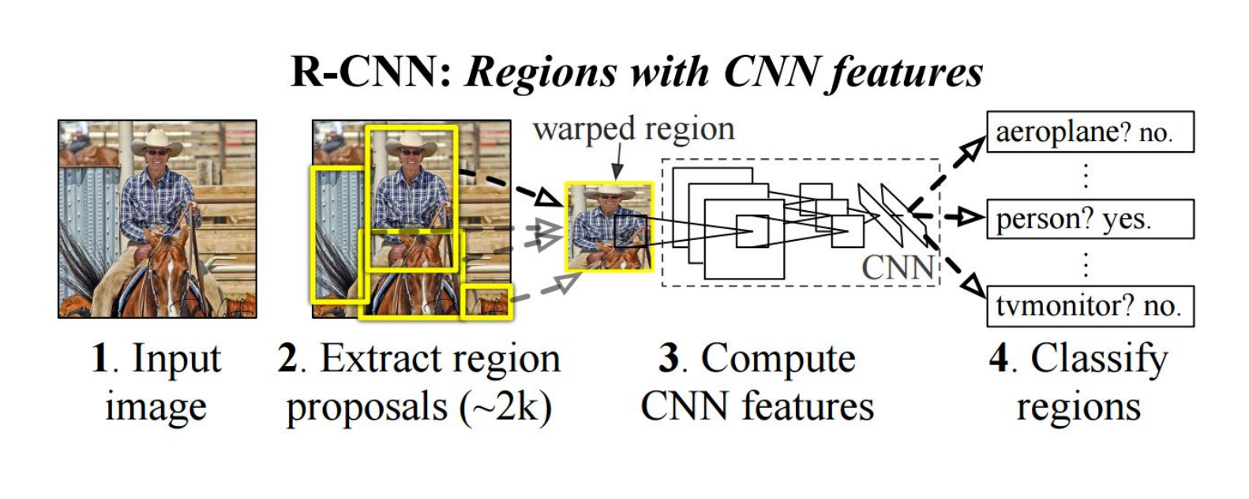
RCNN
https://people.eecs.berkeley.edu/~rbg/papers/r-cnn-cvpr.pdf
Rich feature hierarchies for accurate object detection and semantic segmentation. Girshick et al. CVPR 2014.

Slide 12
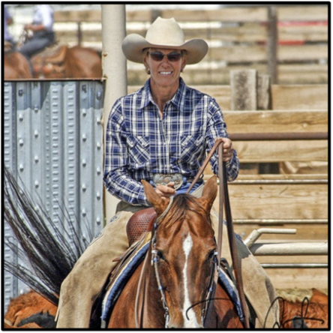
RCNN
First stage: generate category-independent region proposals.
2000 Region proposals for every image
Selective Search: combine the strength of both an exhaustive search and segmentation.
Uijlings et al. IJCV 2013.
Notes:
On the one hand, use the image structure to guide the sampling process. On the other hand: aim to capture all possible object locations.

Slide 13
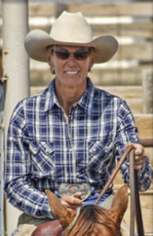
RCNN
First stage: generate category-independent region proposals.
2000 Region proposals for every image
Second stage: extracts a fixed-length feature vector from each region.
a 4096-dimensional feature vector from each region proposal
warp
feature vector
CNN
Arbitrary rectangles?
A fixed size input? 227 x 227
5 conv layers + 2 fully connected layers
Notes:
On the one hand, use the image structure to guide the sampling process. On the other hand: aim to capture all possible object locations.

Slide 14
RCNN
First stage: generate category-independent region proposals.
2000 Region proposals for every image
Second stage: extracts a fixed-length feature vector from each region.
people?
a 4096-dimensional feature vector from each region proposal
feature vector
linear
svm
horse?
background?
Third stage: a set of class- specific linear SVMs.
x
y
w
h
Bounding box regression
object category and location
proposal location
Notes:
On the one hand, use the image structure to guide the sampling process. On the other hand: aim to capture all possible object locations.

Slide 15
RCNN
Fast-RCNN
Simple and scalable.
improves mAP.
A multistage pipeline.
Training is expensive in space and time (features are extracted from each region proposal in each image and written into disk).
Object detection is slow.
?

Slide 16
Fast-RCNN
https://arxiv.org/abs/1504.08083
Fast R-CNN. Girshick. ICCV 2015.
Idea: No need to recompute features for every box independently

Slide 17
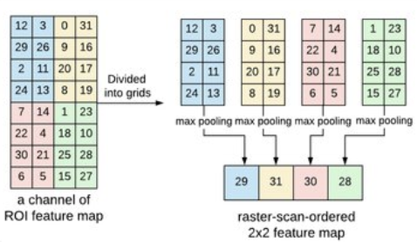
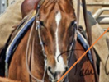
Fast-RCNN
Process the whole image with several convolutional (conv) and max pooling layers to produce a conv feature map.
a region of interest (RoI) pooling layer extracts a fixed-length feature vector from the region feature map.
FC+
softmax
feature vector
K + 1 categories
+
four real-valued numbers for each of the K object classes.
FC+
regressor
…

Slide 18
RCNN
Fast-RCNN
Faster-RCNN
Simple and scalable.
improves mAP.
Higher mAP.
Single stage, end-to-end training.
No disk storage is required for feature caching.
A multistage pipeline.
Training is expensive in space and time (features are extracted from each region proposal in each image and written into disk).
Object detection is slow.
?
proposals are the computational bottleneck in detection systems.

Slide 19
Faster-RCNN
Idea: Integrate the Bounding Box Proposals as part of the CNN predictions
https://arxiv.org/abs/1506.01497
Ren et al. NIPS 2015.

Slide 20
Faster-RCNN
Region Proposal Networks:
k anchors boxes
2k scores
4k coordinates
object or not object
bounding box proposal
RPN
1x1 conv layer
1x1 conv layer
cls layer
reg layer
nxn conv layer
Shared conv layers
Fast-RCNN
feature map
sliding window, nxn
…

Slide 21
RCNN
Fast-RCNN
Faster-RCNN
Simple and scalable.
improves mAP.
Higher mAP.
Single stage, end-to-end training.
No disk storage is required for feature caching.
compute proposals with a deep convolutional neural network --Region Proposal Network (RPN)
merge RPN and Fast R-CNN into a single network, enabling nearly cost-free region proposals.
A multistage pipeline.
Training is expensive in space and time (features are extracted from each region proposal in each image and written into disk).
Object detection is slow.
proposals are the computational bottleneck in detection systems.
?

Slide 22
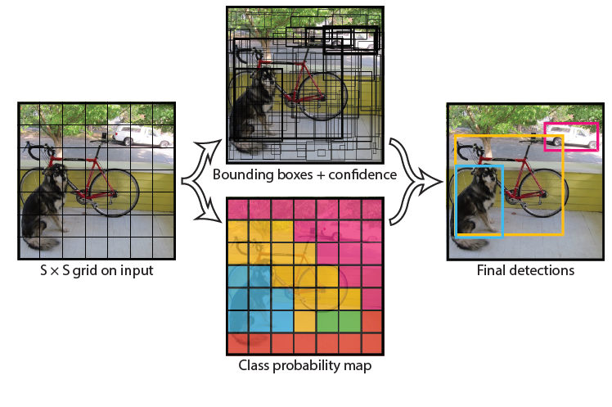
YOLO- You Only Look Once
Idea: No bounding box proposal.
A single regression problem, straight from image pixels to bounding box coordinates and class probabilities.
extremely fast
reason globally
learn generalizable representations
https://arxiv.org/abs/1506.02640
Redmon et al. CVPR 2016.

Slide 23
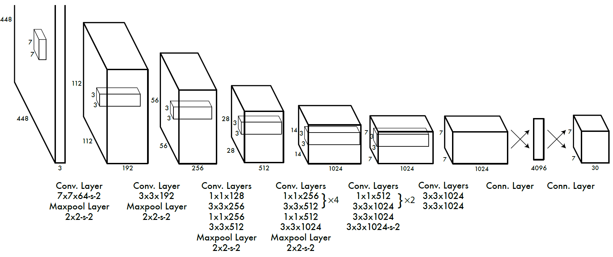
YOLO- You Only Look Once
Divide the image into 7x7 cells.
Each cell trains a detector.
The detector needs to predict the object’s class distributions.
The detector has 2 bounding-box predictors to predict bounding-boxes and confidence scores.

Slide 24
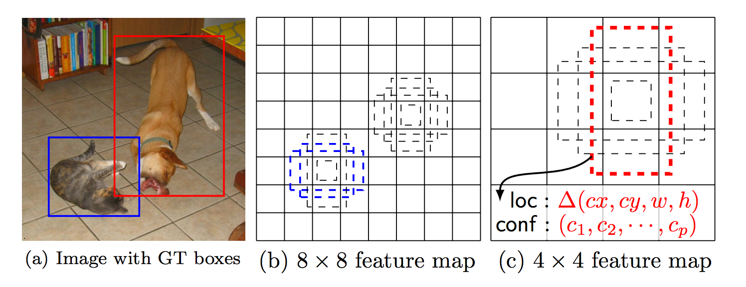
SSD: Single Shot Detector
Idea: Similar to YOLO, but denser grid map, multiscale grid maps. + Data augmentation + Hard negative mining + Other design choices in the network.
Liu et al. ECCV 2016.

Slide 25
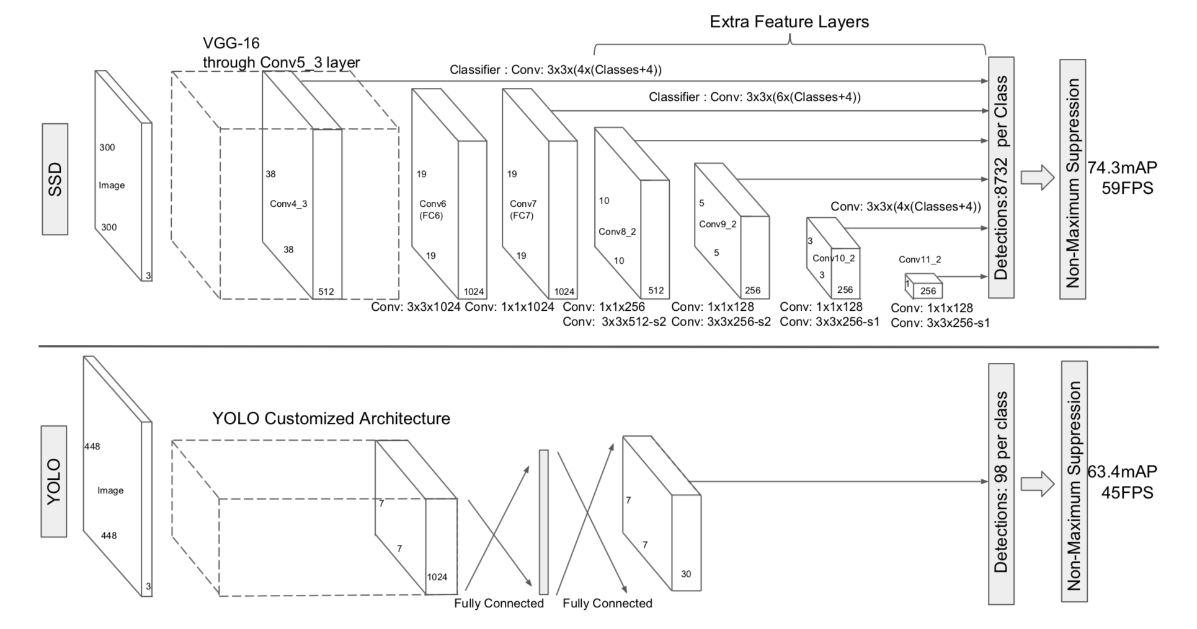

Slide 26
Recall…

Slide 27
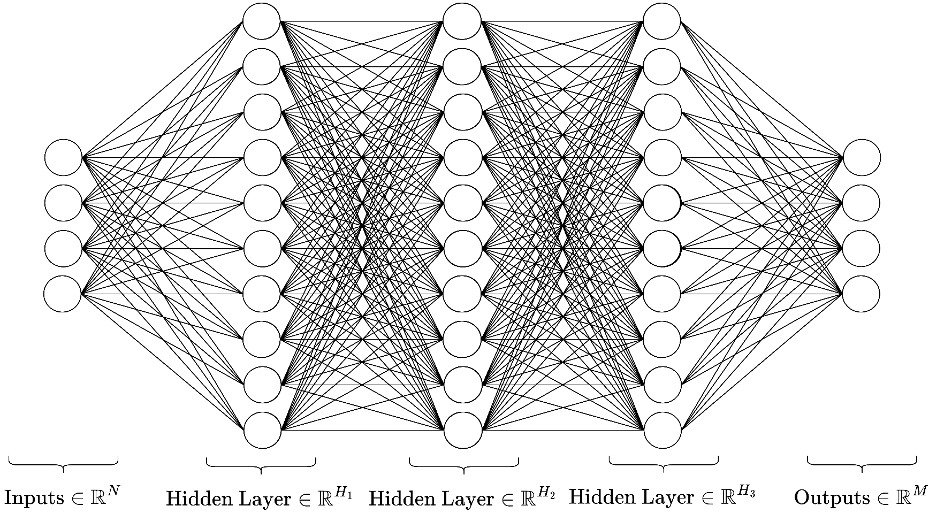
Multi-layer Perceptrons
Useful for static input-output relations
More hidden layers ~ better approximation of more complicated functions
Quick to design and implement

Slide 28
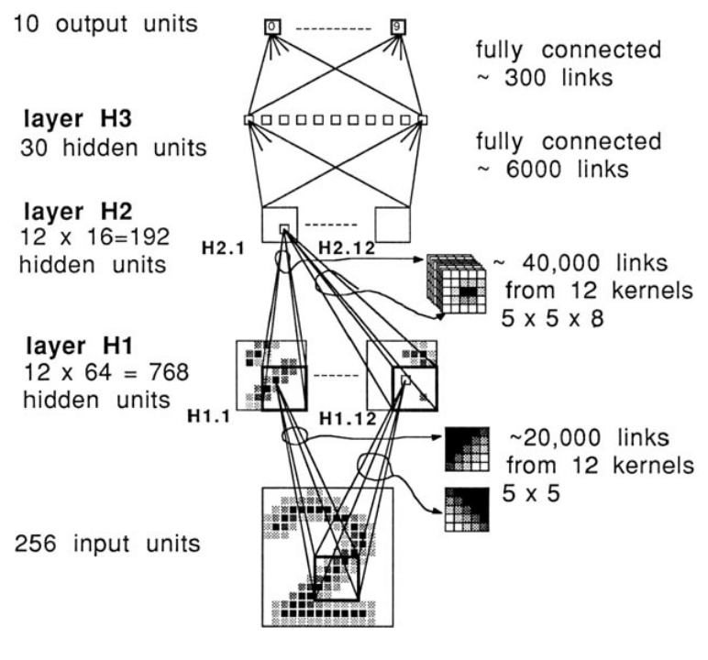
Convolutional Neural Networks
Learn “kernels”, i.e. matrices that convolve over n-dimensional data to extract abstract, lower-dimensional features.
Used often in image and signal processing tasks such as object detection and segmentation.
Accounts for translational variance: the object can be anywhere in the image and still be found
LeNet’s architecture: One of the first CNNs
https://doi.org/10.1162/neco.1989.1.4.541

Slide 29
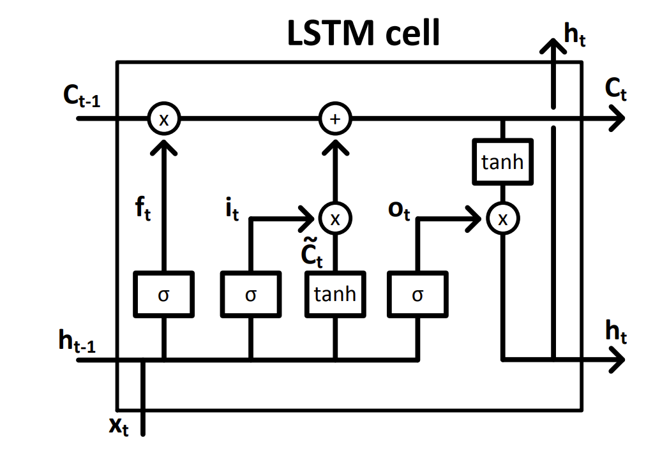
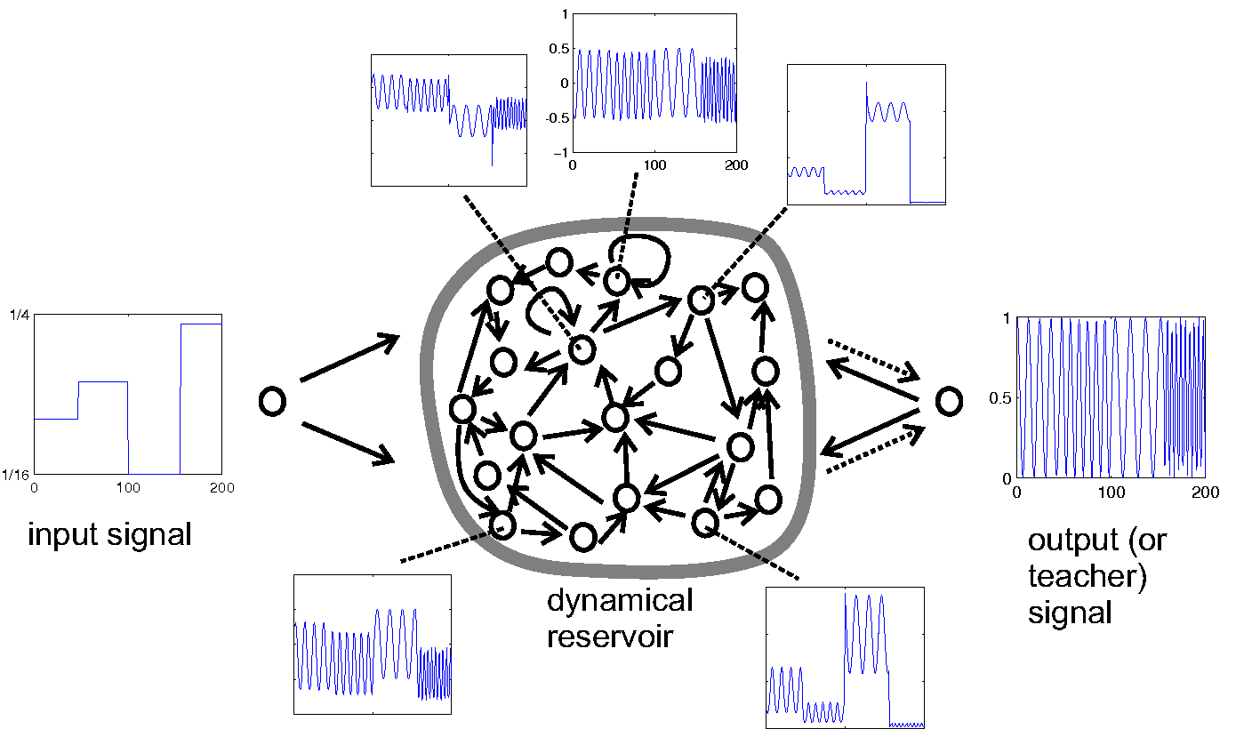
Recurrent Neural Networks
Outputs go back and forth between neurons (loops exist in the graphs)
Approximates dynamical systems
- Any time-based function
- Any data that can be modelled as being “ordered”
Used often in time-series tasks like signal processing, natural language processing
Several types: Fully-connected, LSTMs, GRUs, reservoirs
An LSTM cell schematic. Adapted from: doi.org/10.4233/uuid:dc73e1ff-0496-459a-986f-de37f7f250c9
Echo state network schematic. Adapted from www.scholarpedia.org/article/Echo_state_network

Slide 30
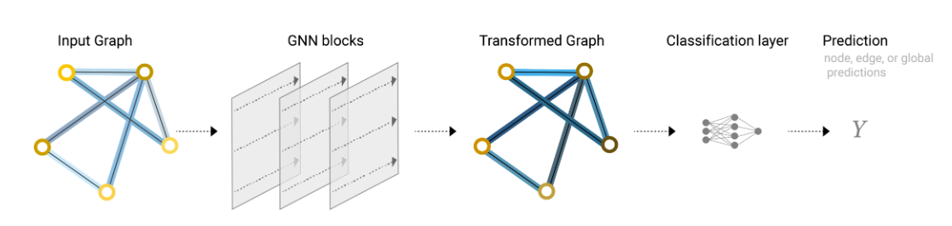
Graph Neural Networks
Models any system that can be modelled as a graph
Learns relations between nodes,
edges, global properties
Used in e.g. image segmentation,
chemistry and pharmacy models,
NLP, hierarchically-related data
Image adapted from this excellent intro to GNNs: https://distill.pub/2021/gnn-intro/

Slide 31
Graph Neural Networks

Slide 32
Introduction
Graph Neural Networks (GNNs) is general form of most neural networks such as NNs, CNNs or RNNs, even unsupervised learning like RBM and DBNs.
Supervised
Unsupervised
GNNs
DBNs and RBM
DNNs
Fig. 1: Illustration of relations between GNNs and other networks.
RNNs
CNNs
AE
SNNs
GAN
Source: Self-made

Slide 33
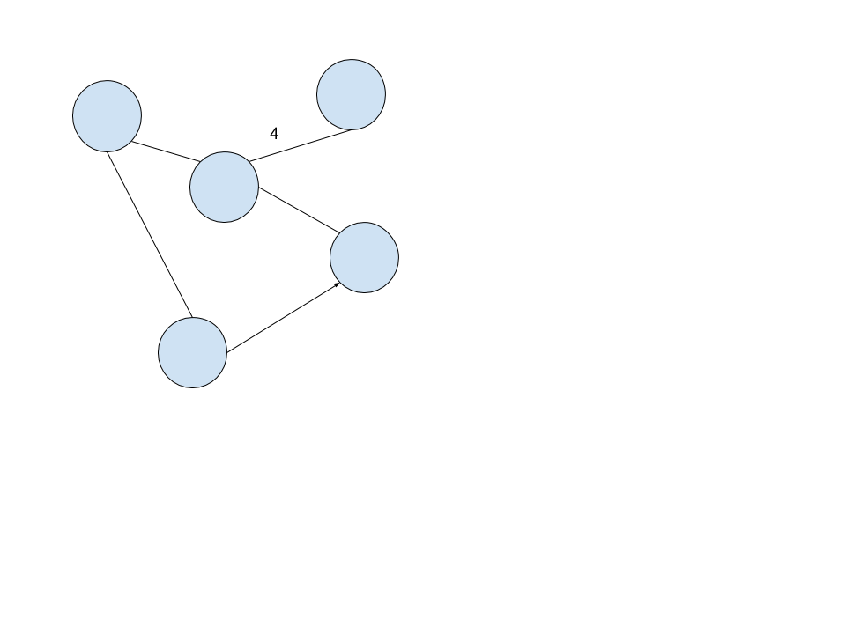
What is a Graph?
Graph is a Data Structure that consists of vertices/nodes and edges.
The Edges can be non-directional, directional, weighted and non-weighted.
Each Node has features associated with it.

Slide 34
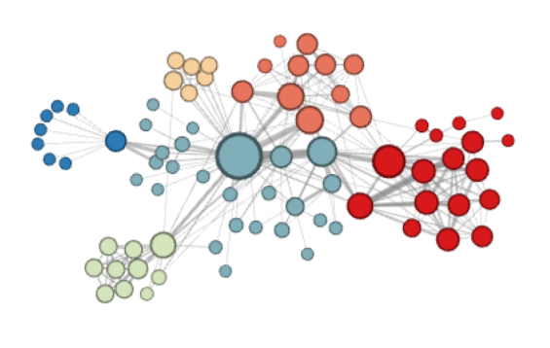
A Graph Network
Source: https://www-cs.stanford.edu/people/jure/pubs/graphrepresentation-ieee17.pdf

Slide 35
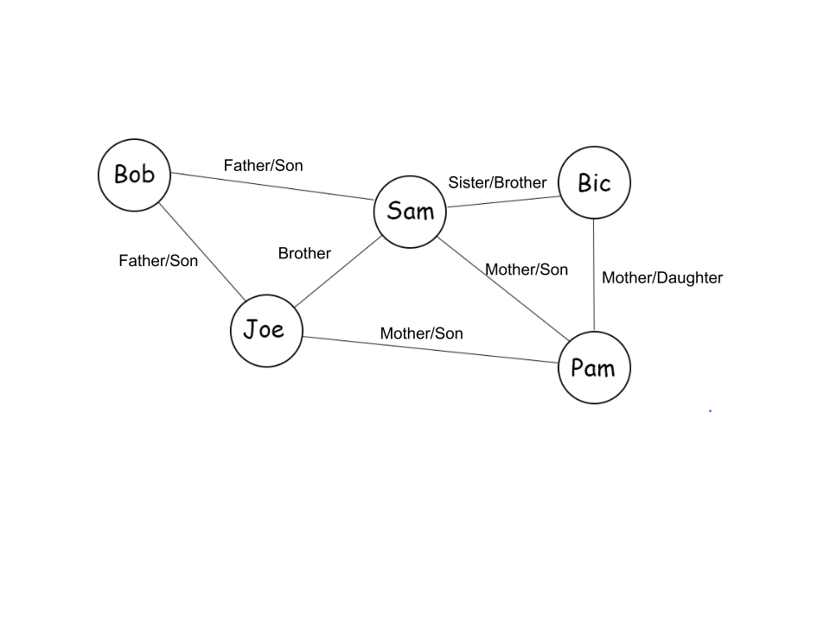
A Graph Network – Social Relations

Slide 36
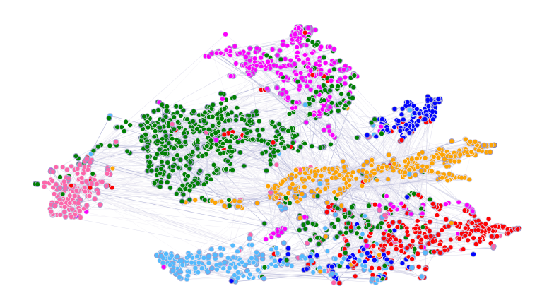
Cora Dataset – Dataset of Scientific Publications
[1] Peter Velickovic, Guillem Cucurull, Arantxa Casanova, and Adriana Romero. Graph Attention Networks. In International Conference on Learning Representations, 2018

Slide 37
Why Graph Learning?
Many systems of interactions in the natural world can be easily modeled using Graphs.
  Molecular Structures, Social Interactions, Biological Protein Networks, Financial Networks etc.
It is not always possible to fully represent these complex relationships in a compact manner in the conventional tabular form (Euclidean data) which can then be used for learning using the standard algorithms.
In order to make inferences/decisions from these Networks directly we need Graph learning.

Slide 38
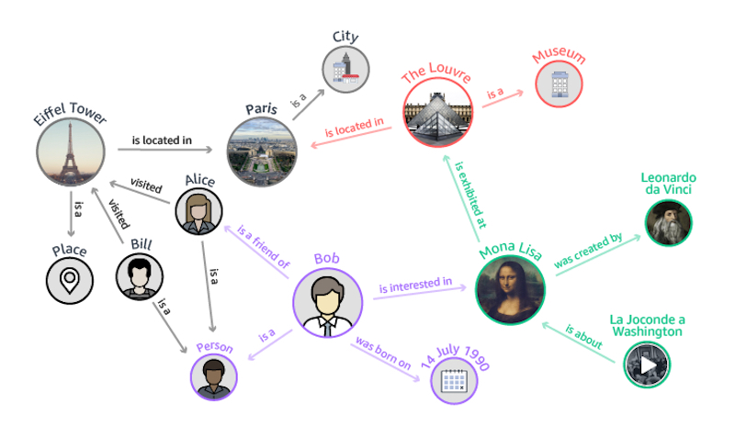
Graphs for Data Representation
A data graph is a mathematical representation of entities (nodes) and their relationships (edges).
Why data graphs?
  they represent data intuitively
  they make it easier to explore the data
  a lot of real-world examples are already graph structured
Notes:
** → more details on subsequent slides

Slide 39
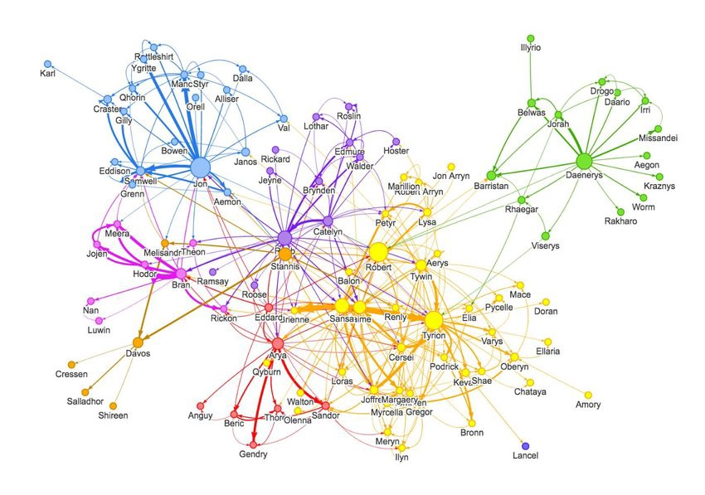
Graphs for Data Representation
Examples of real-world graph data:
  WWW, Internet
  Social Networks
  Citation networks
  Protein interaction networks
  Communication networks
  Word co-occurrences networks
  Food webs
  Financial networks
  Economic networks
  Knowledge graphs
  ……

Slide 40
Overview of Graph Based Data Science
Graph based data science combines querying, statistics and graph algorithms to power ML/AI applications by leveraging the relationships and topology of graph data
  Graph Analytics: uses queries and graph statistics/algorithms to answer such questions as:
    how many customers are in a marketing graph?
    are there any fraud rings in the transaction data?
    who’s the most important influencer in a network?
  Graph Enhanced ML and AI: uses queries, graph statistics/algorithms and specialized graph aware ML/AI techniques to describe the global topology or connectivity of a data set. The results define graph-based features that are used as input to downstream ML/AI tasks
Notes:
The distinction is mostly for educational/presentational purposes and does not reflect a clear-cut division

Slide 41
Overview of Graph Based Data Science³
Graph Queries: retrieve an explicit pattern within the dataset e.g.
  fetch the names of George’s co-authors
  compute the average salary of a company’s employees
Graph Statistics: are based on local properties of the graph nodes:
  Graph size
  Graph density
  Degree distribution
  Local clustering coefficient
Notes:
Dense vs Sparse graphs
Node degree + number of node neighbors
The local clustering coefficient of a vertex (node) in a graph quantifies how close its neighbours are to being a clique (complete graph).

Slide 42
Overview of Graph Based Data Science³
Graph Algorithms: employ graph traversals
  Connected Components: identify strongly connected subgraphs
  Community Detection: partition a graph based on relationships
  Centrality: reveal which nodes are important based on graph topology
  Node Similarity: identify similar nodes based on their neighbors or properties
  Pathfinding: find the shortest or most efficient paths to traverse a graph
  Link Prediction: predict unobserved or future relationships between nodes
  Some of the graph algorithms employ ML techniques themselves!

Slide 43
Graph Kernels
  Graph Kernels can be intuitively understood as functions quantifying the similarity of pairs of graphs.
G₁
G₂
G₃

Slide 44
Graph Kernels
What is a graph kernel?
  Map two graphs g₁ and g₂ using mapping φ into feature space Η
  Measure their similarity in Η as <φ(g₁), φ(g₁)>
  Actualize kernel trick: devise kernel function k such k(g₁, g₂) = <φ(g₁), φ(g₁)>
Notes:
<> → inner product

Slide 45
Graph Kernels
Requirement for graph kernel functions:
  Positive definite (in order to be a valid kernel function)
  Expressive
    define a non-trivial measure of similarity on graphs
    represent subgraph features that allow to tell if the topology, node and edge labels of two graphs are similar
  Applicable to a wide range of graphs
  Efficient to compute

Slide 46
Graph Kernels
Graph Kernel variants: graph kernels take the form of an aggregation over metrics that describe different aspects of the graph topology:
based on local structure: two graphs are similar if they are composed of nodes with similar neighborhoods
graph components: compare graphs by identifying the best possible matching of the components making up the graphs (nodes, labels, edges, subgraphs etc.)
paths and walks: compare sequences of node or edge attributes encountered through graph traversals (e.g., shortest paths, random walks)
Notes:
Weisfeiler-Lehman Graph Kernels⁵⁶: influential family of kernels

Slide 47
Graph Kernels
Applications of Graph Kernels:
  ML/AI
    Allow kernelized ML algorithms (e.g., SVMs) to work directly on graphs
    Can be employed to learn node embeddings
      Chemoinformatics : predicting the toxicity of chemical molecules
      Drug discovery: virtual screening
      Bioinformatics : protein function prediction
      Web data mining and Social Networks:
        node classification
        link prediction
      etc.

Slide 48
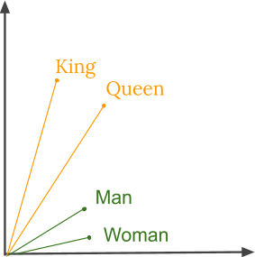
Graph Embeddings
Embedding in ML/AI consists of representing complex objects like text, images or graphs with continuous vectors of a reduced dimensionality compared to the dimensionality of the dataset, while keeping the most important information about them.

Slide 49
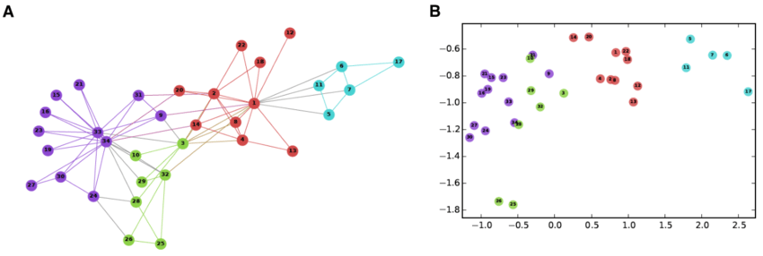
Graph Embeddings
Graph embeddings should capture the graph topology, node-to-node relationships, and content information.
Node embeddings
Whole graph embeddings

Slide 50
Node Embeddings
Each node is represented with a continuous vector of a fixed dimensionality. They are used to perform visualization or prediction at the node level, e.g., link prediction.
Popular techniques:
  Random Walk Based Approaches:
    DeepWalk : uses random walks to produce embeddings
    node2vec : modification of DeepWalk that provides control over the explored neighborhoods
  Deep Learning Approaches
    GraphSAGE : an inductive scalable technique
    Graph Neural Networks**
Notes:
Factorization Approaches has been consistently outperformed by more recent methods

Slide 51
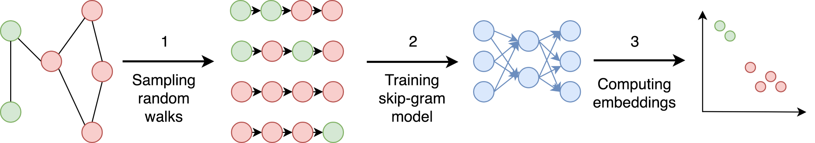
Node Embeddings
DeepWalk
The graph is sampled using random walks
A skip-gram (MLP) network accepts a node from the random walk as a one-hot vector as an input and maximizes the probability for predicting neighbor nodes
The node embedding is the output of the last hidden layer of the network
Notes:
2. Choose the middle node of a random walk as input and the words right and left of it as context

Slide 52
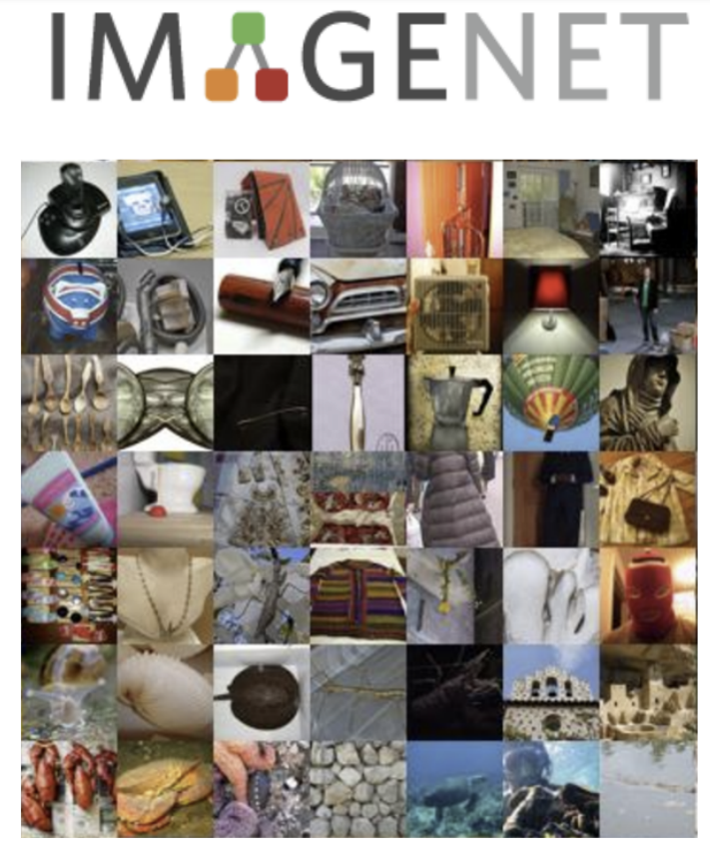
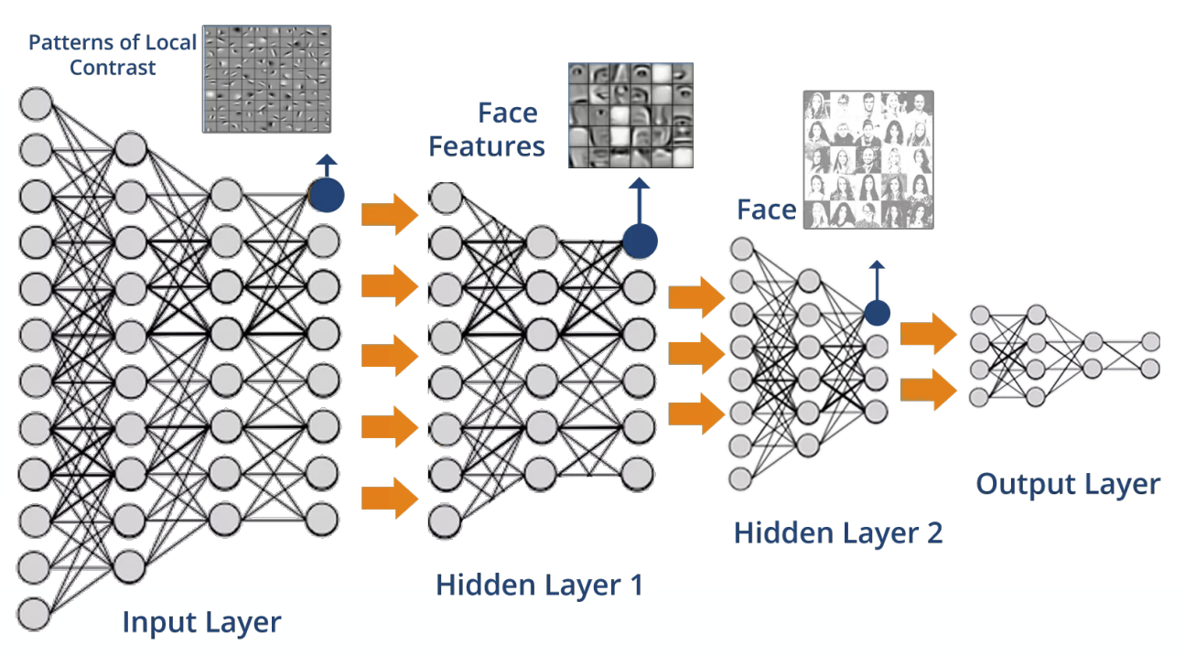
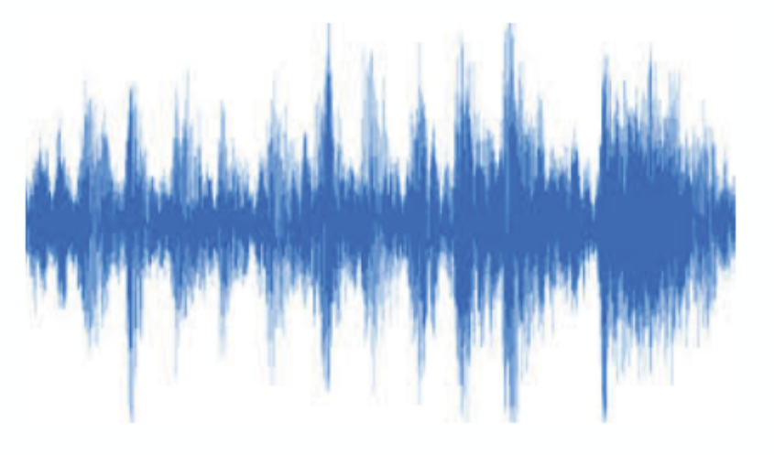
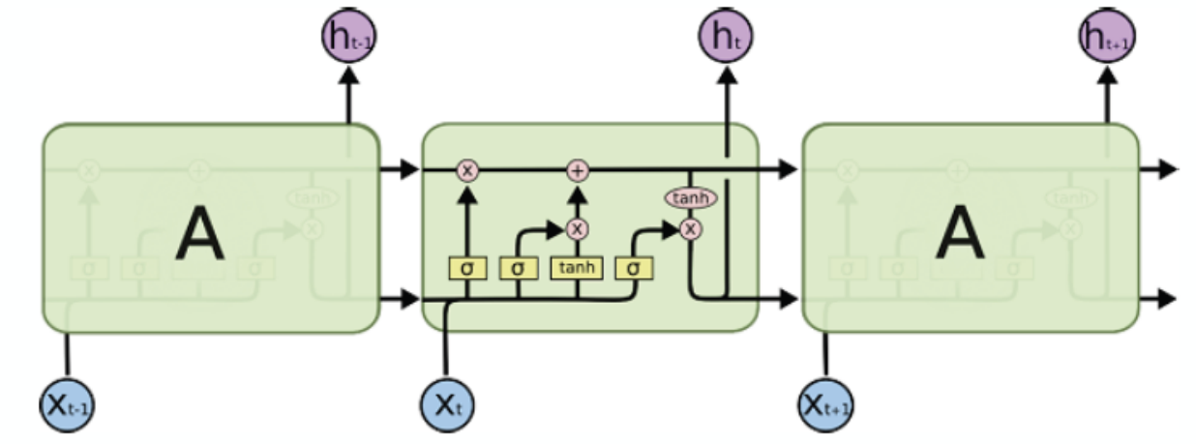
Graph Neural Network (GNN)
Traditional neural networks are designed for simple sequences & grids
Speech/Text
[Slide credit: http://web.stanford.edu/class/cs224w]

Slide 53
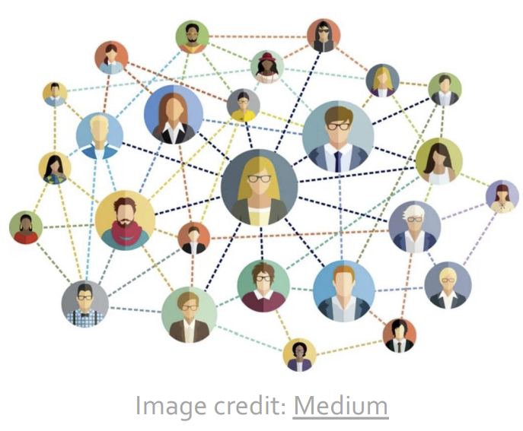
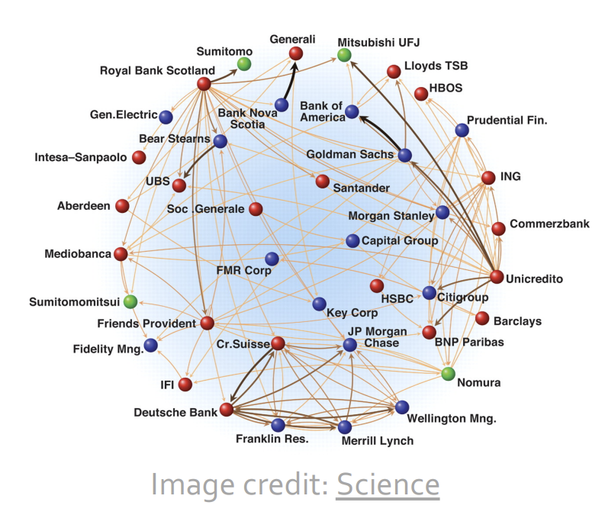
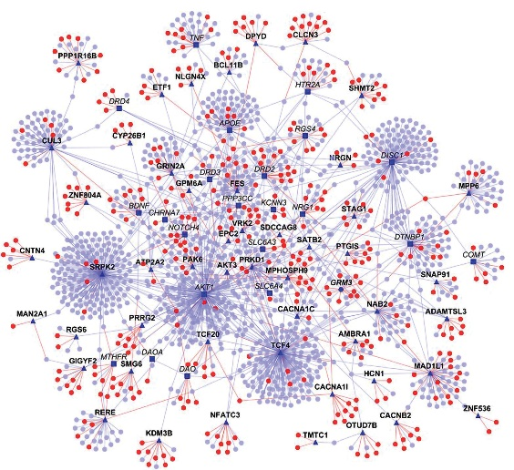
Graph Neural Network (GNN)
Reality: A lot of real-world data does not “live” on grids
  Arbitrary size and complex topological structure
  No fixed node ordering or reference point
  Often dynamic and have multimodal features
Image credit: Madhavicmu / Wikimedia Commons/CC-BY-SA-4.0
Social Networks
Economic Networks
Protein Interaction Networks

Slide 54
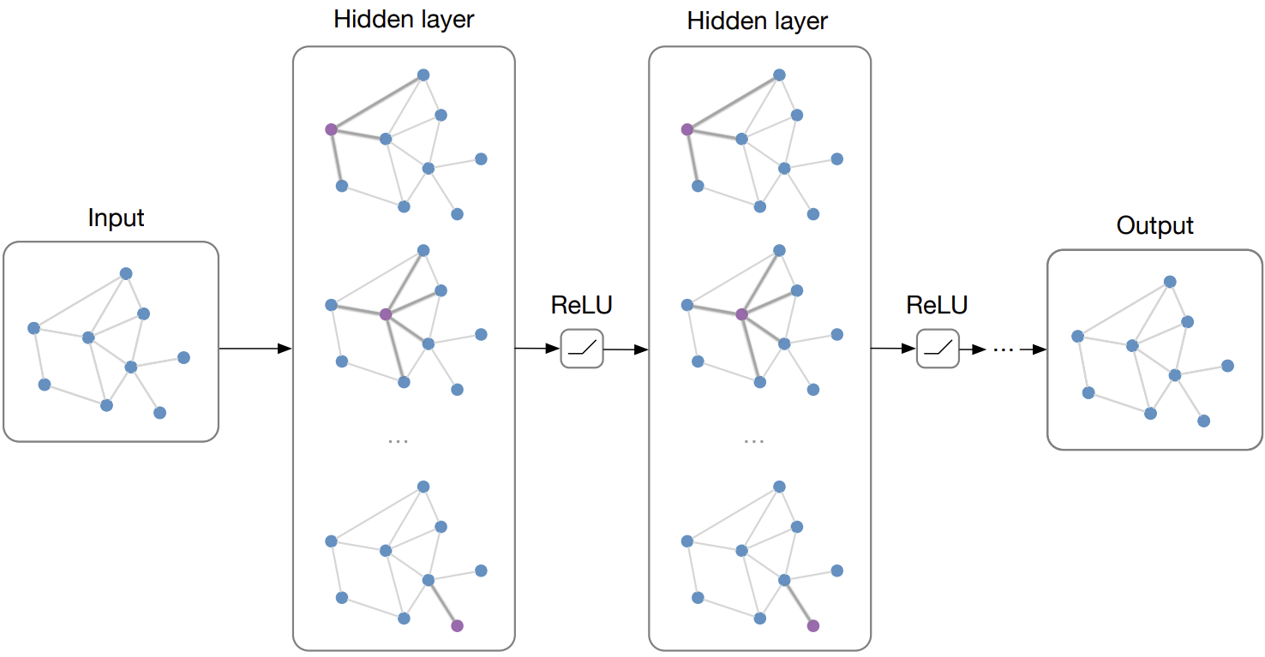
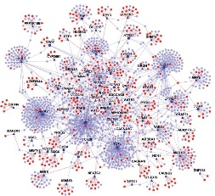
Graph Neural Network (GNN)
Main Idea: Pass massages between pairs of nodes and agglomerate
[Slide credit: Structured deep models: Deep learning on graphs and beyond]

Slide 55
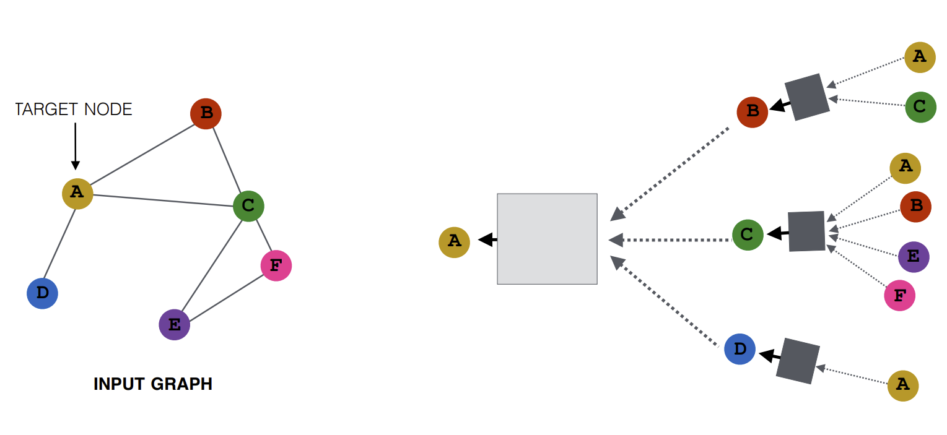
How is GNN Computed?
Key idea: Generate node embeddings based on local network neighborhoods
  Node embedding: a vector to represent the node features
MLP
MLP
MLP
MLP
[Slide credit: http://web.stanford.edu/class/cs224w]

Slide 56
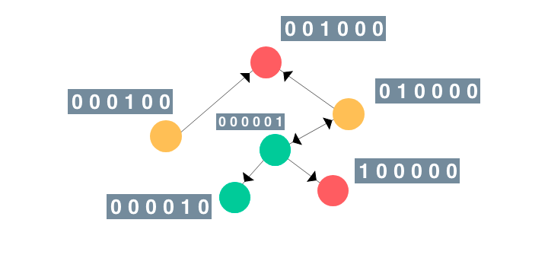
Graph Neural Networks
Graph Neural Networks (GNNs) are connectionist models that capture the relationships represented in the graphs:
there is one GNN ‘recurrent unit’ for each node in the graph: each unit maintains stateful information (embeddings) that captures
  the properties of the related node
  the neighborhood properties of that node
Notes:
Connectionist → modeling interactions, behaviors etc

Slide 57
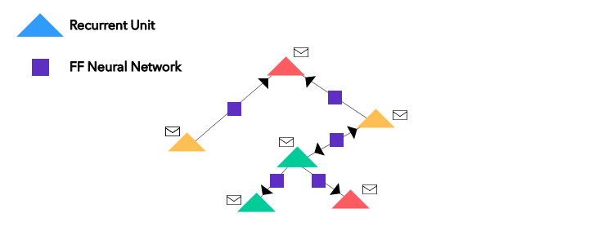
Graph Neural Networks
Graph Neural Networks (GNNs) are connectionist models that capture the relationships represented in the graphs:
an MLP for each edge learns the importance/properties of the underlying relation

Slide 58
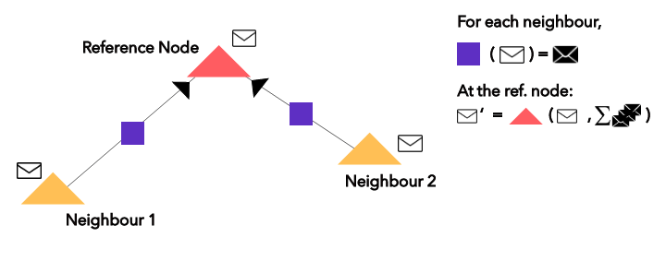
Graph Neural Networks
Graph Neural Networks (GNNs) are connectionist models that capture the relationships represented in the graphs:
neighborhood aggregation is employed to identify the dependencies between the nodes of graphs
Notes:
Messages are among immediate neighbors

Slide 59
Graph Neural Networks
Graph Neural Networks (GNNs) are connectionist models that capture the relationships represented in the graphs:
once neighborhood aggregation is performed the node embeddings capture more accurately the information about their own features and that of their neighboring nodes
the vector H that results by taking the sum of all the node embeddings represents the whole graph
Notes:
Messages are among immediate neighbors

Slide 60
Graph Neural Networks
Applications of GNNs:
  ML/AI
    Node classification
    Link Prediction
  Physical Systems: model Interaction Networks and predict future trajectories
  Chemistry:
    more flexible means to predict the properties of a new molecule by learning from example molecules
    predict side effects due to drug interactions
  Image Classification: alternative to CNNs to achieve zero-shot or few-shot learning
  Combinatorial Optimization: have shown promise as alternatives to relaxation-based techniques
  Social graphs: content recommendation
  Transportation: traffic prediction
  etc.

Slide 61

Graph Neural Networks
Directly Operates on the Graph Structured Data.
Typically used for the purpose of node classification, edge classification or a classification of the whole graph network as a whole (Supervised Learning).
Unsupervised learning frameworks also exist such as Graph Autoencoders.
Typically the Graph Neural Networks consist of two matrices:
  A Feature Description Matrix(H) that consists of the features of all nodes. (Dimensions - Nodes x Features per node)
  A Adjacency matrix(A) that encodes the structure of edges.
Graph Network Layer:

Slide 62
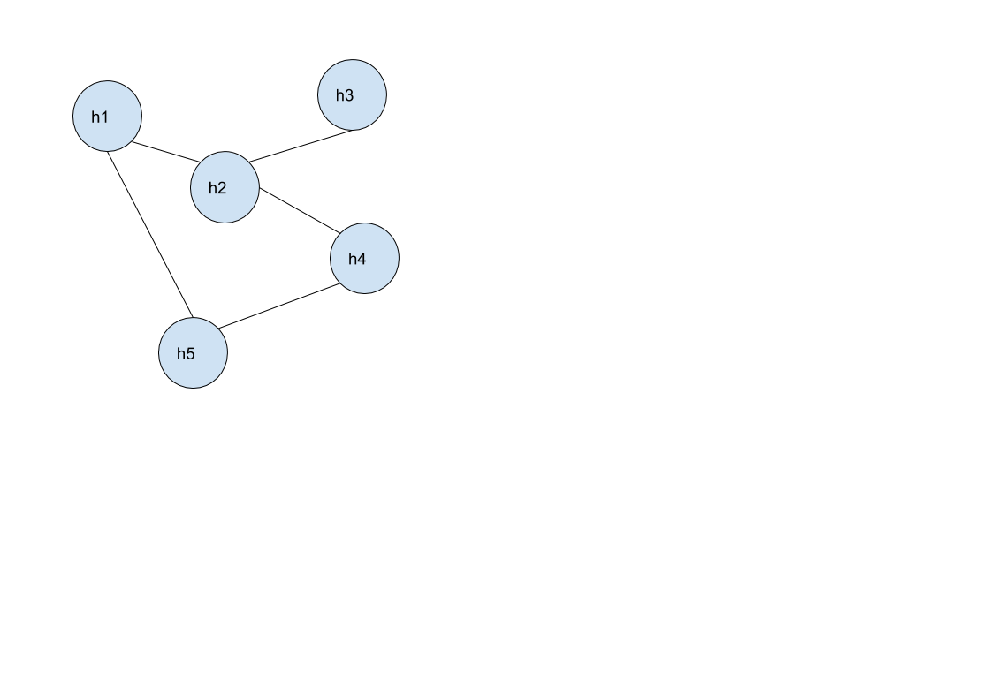
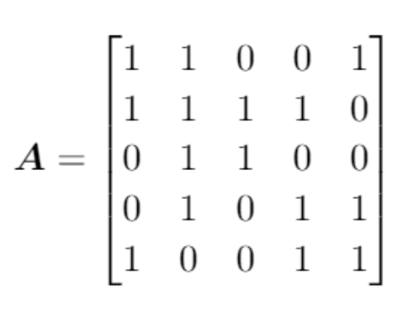
Adjacency Matrix

Slide 63



Graph Convolutional Networks
Analogous to the Convolutional Neural Network.
Can Handle Edges with Weights.
We Transform the Matrix encoding the Graph Structure from the Spatial to the Spectral Domain using Fourier Transform.
From Spectral Graph Analysis the Graph Laplacian is given by :
Here W is the Weighted Adjacency Matrix. D is a Diagonal Degree Matrix –
The Laplacian Matrix is diagonalizable by the Fourier Basis
such that
U consists of the complete set of orthonormal Eigenvectors of L.
The graph Fourier Transform of
The inverse Operation is given by

Slide 64

Graph Convolution
The Convolution Operation (* g) is defined in the Fourier Domain as follows:
This gives us the following representation for a node vector being filtered by (g_{θ}).
Drawbacks:
Requires the knowledge of complete graph for performing the convolution operation. This is due to the fact that all the Eigenvalues(λ) of the graph structure has to be calculated for this operation which is very expensive computationally.
New additions to the Graph requires recalculation of the entire architecture parameters due to change in Eigenvalues(λ) .
Cannot transfer knowledge from one domain to another. (Transductive Learning)
Element-wise Hadamard Product

Slide 65
Graph Attention Networks
Non-Spectral Approach : Convolutions directly on spatially close neighbors of a graph.
Attention is a mechanism by which we find out which features of a nearby neighbour node affect the features of the node under consideration and how important they are.

Slide 66

Example: Graph Attention Layer
Basic Building Block of the Graph Attention Network
Linear Transformation
h_{i} - feature vector of length F
A linear transformation – Weighted
Matrix W applied to each node.
Dimensions of W – (F’,F)

Slide 67
Mobile – Edge AI
(Edge Neural Networks)

Slide 68
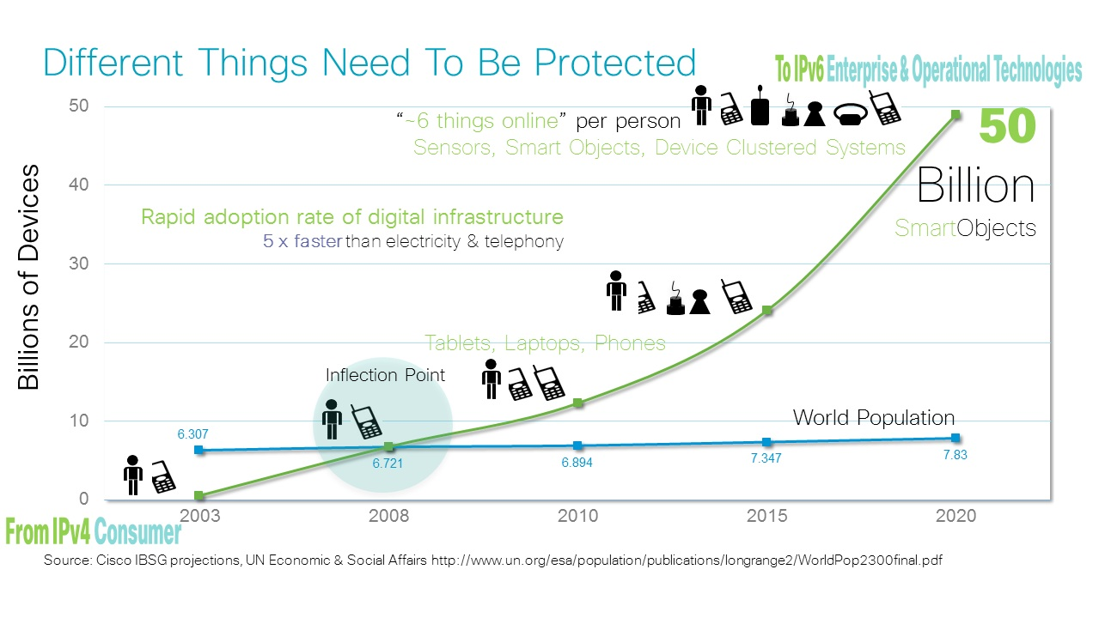
Edge Devices: Complexity Trends and Challenges
Complexity of IoT Systems is exponentially increasing
  10s of billions of connected heterogeneous devices

Slide 69
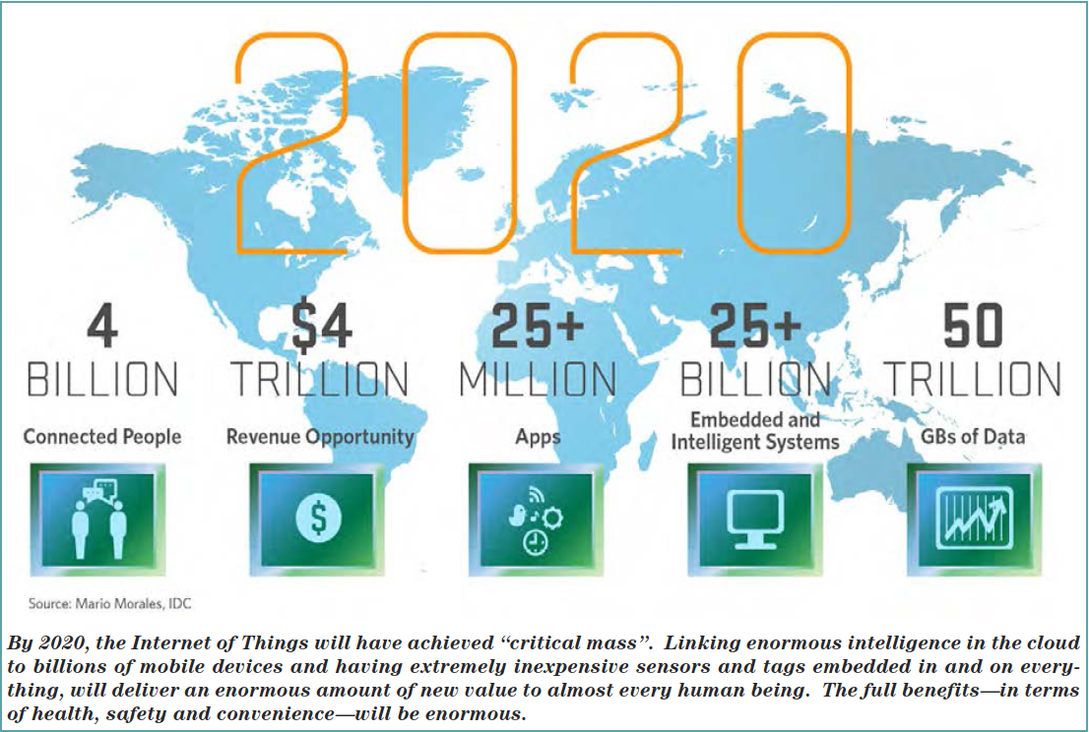



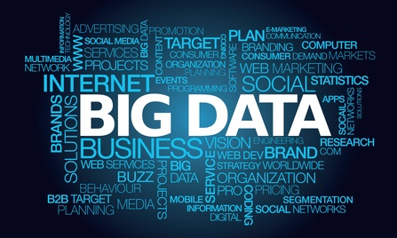
Edge Devices: Complexity Trends and Challenges
Complexity of IoT Systems is exponentially increasing
  10s of billions of connected heterogeneous devices
Exponentially Increasing Data Trends
  Variety and Volume of Data
  Demand => High Velocity of Data
  Key Challenge
  Robust (Reliable & Secure), Resource-Constrained, and Real-Time technologies for intelligent IoT @ Edge
10²¹
Zetta Bytes of Data in 2020
Ref: Ciso reports 2014
Volume of data
Number of Things

Slide 70
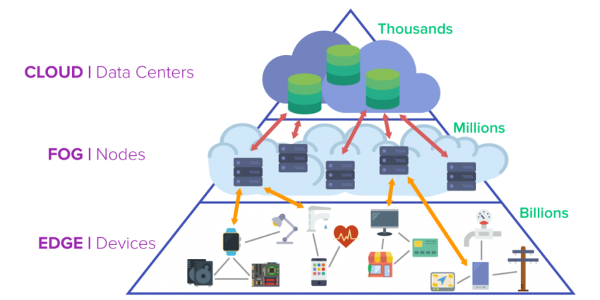
From the Cloud, to the Fog, towards the Edge…
https://erpinnews.com/fog-computing-vs-edge-computing

Slide 71
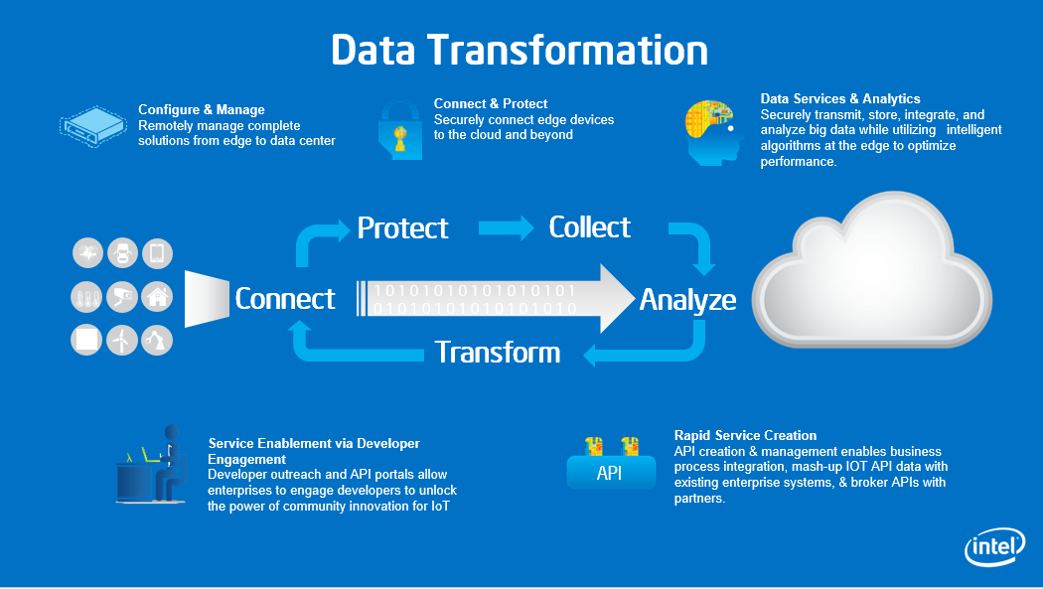








Traditionally…
Configure & Manage
Remotely manage complete solutions from edge to data center
Connect & Protect
Securely connect edge devices to the cloud and beyond
Data Services & Analytics
Securely transmit, store, integrate, and analyze big data while utilizing intelligent algorithms at the edge to optimize performance.
Protect
Collect
Connect
1 0 1 0 1 0 1 0 1 0 1 0 1 0 1 0 1
0 1 0 1 0 1 0 1 0 1 0 1 0 1 0 1 0
Analyze
Transform
Service Enablement via Developer Engagement
Developer outreach and API portals allow enterprises to engage developers to unlock the power of community innovation for IoT
Rapid Service Creation
API creation & management enables business process integration, mash-up IOT API data with existing enterprise systems, & broker APIs with partners.
API
Notes:
One of the key elements of IoT solutions is the servive creation layer.
Now that we have connected the Thing to the internet via a gateway of some sort and are processing data to the data center in realtime and are analytizing this data with our big data tools, how do we enable new services to be created??
One are a couple of elements to the Service Creation aspects of IoT. Once is the Service enablement via the Developer Engagement. This includes a developer out reach program and an API portals to allow enterprises to engaged the developers to create applications that tale adnatage of the data. For example, in the case of smart cities, you can have a plethora of sensors that are monitoring traffic, polution, noise etc that are fed into the cloud but only when this data is provided to an App that is used by the city government and/ or the citizens of the city, you have the power of IoT.
The other element really is the API creation and management aspects that allow integration of the data with the existingbusiness processes and the mashup of the data with existing enterprise systems and with other partners data.

Slide 72
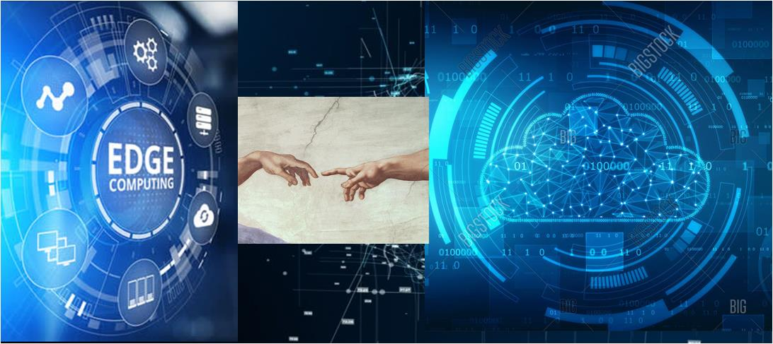
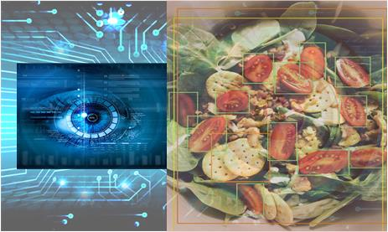
Infer from the Cloud to the Edge…
Let there be thinking…!
…at the edge of the world!
Notes:
The notion of a real-time connected world has been a vision for quite some time, even if it’s been classified as “science fiction” in the 60’s

Slide 73

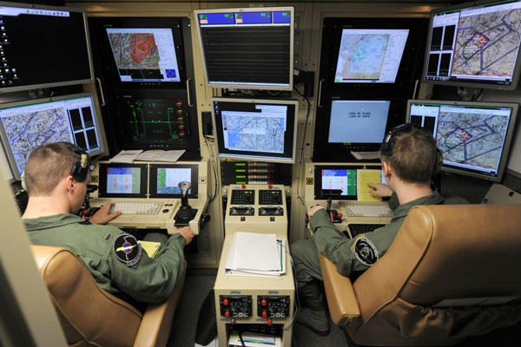
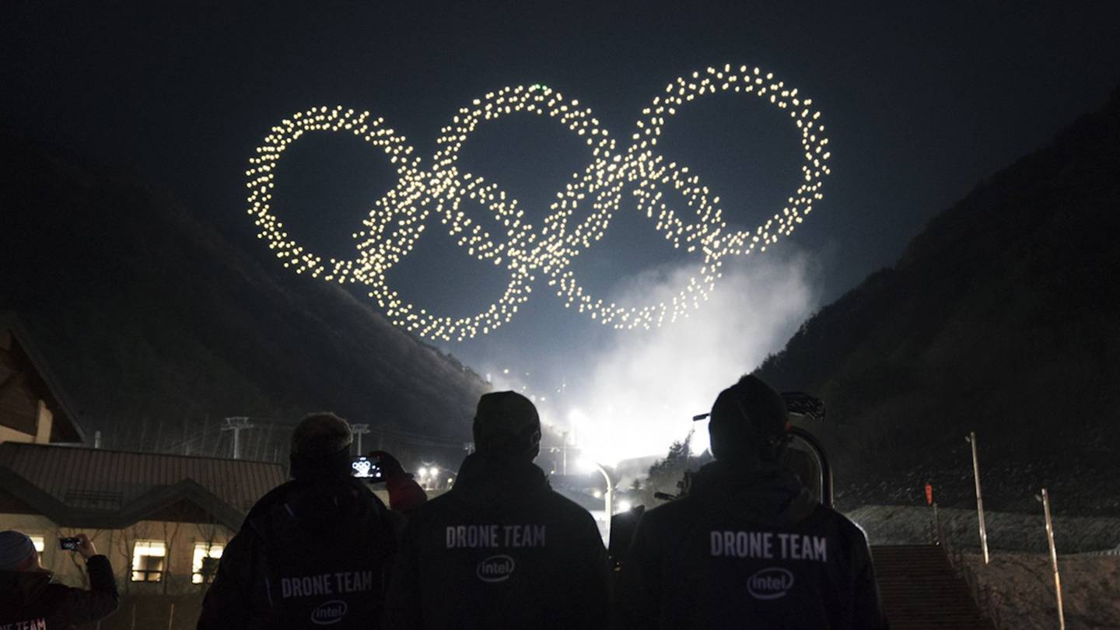
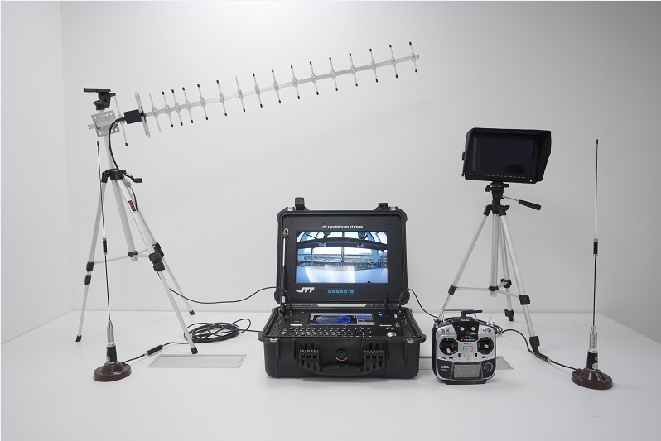
What does it mean in real-life IoT!
Cloud
Edge
Fog

Slide 74
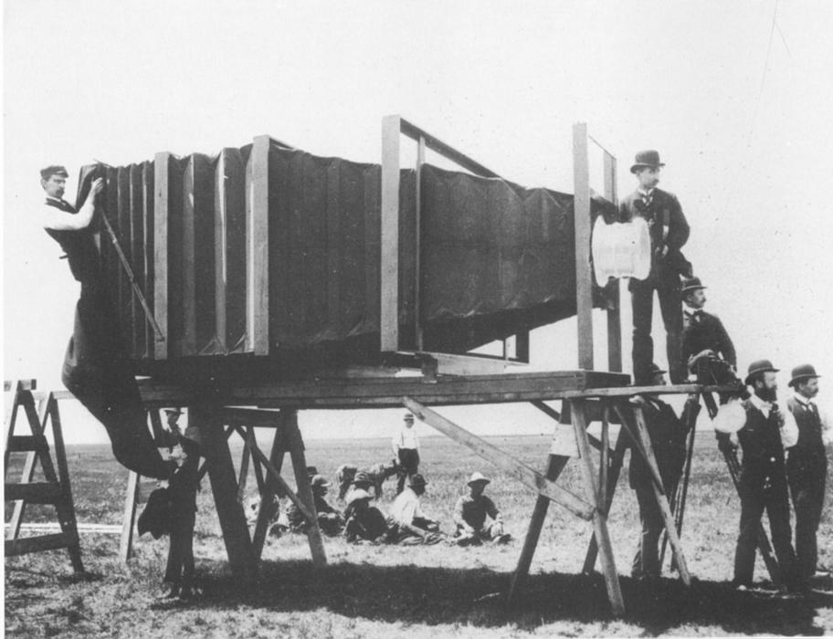
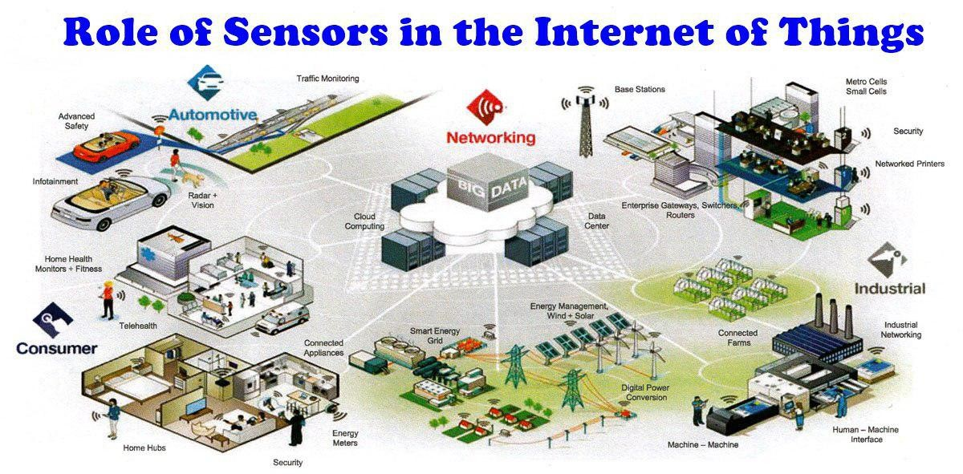


Sensor Evolution
THE MAMMOTH CAMERA OF GEORGE R. LAWRENCE - 1900
Photo Credit: Universal Pictures, GoPro, NVIDIA, KernelSphere

Slide 75







Sensors abundant in the IoT era!
Sources: Adafruit, Huwaei, Arduino

Slide 76





Remote Sensing and Sensor Fusion
Photo Credit: Wired, BeamPro, NASA

Slide 77

E.G. Vision → dominant source of information!
INTERESTING VISION FACTS:
Two thirds of the brain electrical activity (2/3 billion firings /s)
when eyes open.
50% of our neural tissue directly (or indirectly) related to vision
Source: R. S. Fixot, Neuroanatomist, 1957
More neurons dedicated to vision than all four senses combined
Olfactory cortex losing ground to visual cortex
(i.e. vision is “eating” our smell!)
Source: John Medina, Brain Rules, 2015

Slide 78




But…the senses need a brain!
Eleftherias Square
CONTEXT!!!
I am in Nicosia!

Slide 79

Brain - Memories
Bran: He’ll come for me. He’s tried before. Many times, with many Three-Eyed Ravens.
Sam: Why? What does he want?
Bran: An endless night. He wants to erase this world, and I am its memory.
Sam: That’s what death is, isn’t it? Forgetting … being forgotten. If we forget where we’ve been and what we’ve done we’re not men anymore. Just animals. Your memories don’t come from books; your stories aren’t just stories. If I wanted to erase the world of men, I’d start with you.
From: HBO’s Game of Thrones,
Episode: “The Long Night’

Slide 80

Brain is what UNDERSTANDS
Source: Popular Science, July 2014

Slide 81

Edge Intelligence
More Accurate
Less Secure
Slower overall!
Robustness depends on data
refresh rate
Bound by budget & needs
Real-Time
More secure
Robust
Resource-Constrained
Computing on the Edge (https://www.ptgrey.com/edge-computing)

Slide 82






Brain @ the Edge!
Sources: Intel, NVIDIA, Embedded Vision Alliance, OMRON, Raspberry Pi.

Slide 83






Technology Scaling
1940 - ENIAC
1995 – ENIAC-on-a-chip (apx. 40mm²)
1983 – IBM PC
2020 – Personal(?) Compute Device
Sources: IBM, Intel

Slide 84



But we don’t just go from this…
Sources: Sony, Google, Carnegie Melon.
…to this and call it a day!

Slide 85


Challenges – Constraints!
Memory, Data-Flow…
Pin-out limitations, buffering, bandwidth…
  HD Frame processing in parallel… 1920x1080x32 pins!!!
Arithmetic…
  Bit-width precisions, accumulation, rounding, look-up tables, different number systems?
Real-time operation → Dedicated H/W!
Accuracy still not 100%
What tradeoffs can we exploit?
Hardware-friendly solutions?
          Power Efficiency, Cooling, Battery,
          Cost (overheads), Reliability,
          Speed (latency), Size…
          Implementation – Prototyping
          Real-World Deployment & Simulation

Slide 86
Challenges and Opportunities of Edge Intelligence
Shift computation towards the edge of the network
  improve time-to-action and reduce latency
  greater privacy and security
  lower cost
Challenges on the edge
  limited compute resources (low-power devices)
  low-memory
  limited storage
There is a need for optimization of the model and the structure based on the:
  device H/W (embedded, FPGA, CPU, GPU) ,
  algorithm,
  task (e.g. pattern recognition, classification, decision support, control output, etc. )
Notes:
There is in fact an opportunity to shift the computation toward the edge of the network to improve time-to-action and latency, to have greater privacy and security, and to minimize the cost by avoiding costly servers and communication infrastuctures
In order to achieve that we need to face the challenges such as the limited compute resources by creating algorithm with low complexity. Minimize the memory and storage requirements in order to run those algorithms on the edge
There is a need of course, to optimize the models and the structure of machine learning algorithms, such as Convolutional Neural Networks based on the device that we want to run our algorithm, the algorithm and of course the computer vision task such as classification or detection

Slide 87


Why Edge Intelligence matters…
The Past…
The Future…
Cloud
Cloud
Edge
Edge

Slide 88

Architectures For Deep Neural Networks…
https://tanjo.ai/contents/2323923
Notes:
GPU: 200-250W
CPU: 90-100+W
Virtex: 18W, Altera 20-22 W

Slide 89




The Race for the Edge is ON!

Slide 90




Google’s Edge TPU and NVIDIA Jetson TX2
The Edge TPU is the little brother of the regular Tensor Processing Unit, which Google uses to power its own AI, and which is available for other customers to use via Google Cloud. Credit: Google

Slide 91
Challenges
Edge related constraints:
  Power Efficiency
  Cooling
  Battery
  Cost (overheads)
  Robustness
  Speed (latency)
  Physical Size…
  Implementation
  Prototyping
  Real-World Deployment
  Validation
  Evaluation
  …
Real-time operation (w.r.t. needs) → Dedicated H/W?
Accuracy → (Approximate Computing)
What tradeoffs can we exploit?
Hardware-friendly solutions?
Memory, Data-Flow…
Pin-out limitations, buffering, bandwidth…
  e.g. an HD frame in parallel… 1920x1080x32 pins!!!
Arithmetic…
  Bit-width precisions, accumulation, rounding, look-up tables, different number systems?

Slide 92
Designing Neural Networks for Edge Intelligence
Deep Neural Networks
  decision making and data analytics
  high computation and memory requirements
Current Trends
  Design & Train a CNN to achieve max. accuracy & THEN Optimize for Edge:
  reduce the bit-width precision of the network parameters and the processed data
  use binary values
  use compression techniques with quantization and pruning to reduce the network demand for memory and storage
    ¹XNOR-Net
    ²Deep Compression
¹M. Rastegari, V. Ordonez, J. Redmon, and A. Farhadi, “Xnor-net:Imagenet classification using binary convolutional neural networks,”
²Han, H. Mao, and W. J. Dally, “Deep compression: Compressing deep neural network with pruning, trained quantization and Huffman coding”
Notes:
Neural networks are increasingly being used in many applications to provide decision making and data analytics (CNNs for computer vision tasks).
Artificial Intelligence(AI) is currently facilitated using machine learning algorithms such as Deep Neural Networks(DNN) which demands high computation and memory requirements.
Therefore, the computation was pushed from device to remote computing infrastructure.
Current trends for designing Neural network for the edge are trying to reduce both memory and computational requirement by reducing the bit-width precision of both the network parameters and processed data
Another techniques is to use binary values for the representation of the weights in order to avoid floating point operations which are high computational demanding
Lastly compression techniques with quantization and pruning of the network has show significant impact of both memory and storage. Some examples are the Xnor-Net and the deep compression network

Slide 93







Challenges Associated with ML in IoT
Computation Complexity
Software / Coding
Training/Inference Anomalies
Src: Reiter@CCS2016
Hardware Trojans
Machine Learning in IoT
Side Channel Attacks
Src: google Image
Processing
Computations
Power Supply
Memory
1
0
1
1
0
Aging
Process Variation
Soft Errors
NBTI
HCID

Slide 94

Deep Neural Networks (DNN)
Deep Neural Networks (DNN) generally optimize for performance in terms of accuracy
As a result, DNN are huge and have parameters in the order of millions
The very popular AlexNet has around 62 million parameters, A trained AlexNet takes around 200MB of space
Credit: Xu et al, 2019, Wikipedia Alexnet

Slide 95

Complexity of Neural Networks
Different DNN architectures and their resource requirements
Huge Memory and Computational Requirements
(ResNET: 152 Layers, 11.3G MACs,
60M weights)
Source: [Sze et al. @ https://arxiv.org/abs/1703.09039]
Framework | fps (NVIDIA Jetson TXI) | IOU/mAP.
Fast YOLO | 17.85 [1] | 52.7 [2]
O-YOLOv2 | 11.8 [1] | 65.1 [1]
YOLOv2 | 5.4 [1] | 67.2 [1]
Sources:
[1]: Shafiee et al. @ arXiv:1709.05943 (2017)
[2]: Wei@ECCV1’6

Slide 96



Computational Efficiency Gap: AI vs. Humans
Deep Blue vs. Garry Kasparov
900W + Power for 480 dedicated ASICs
20W
AlphaGO vs. Lee Sedol
30 P2SC nodes + 480 dedicated ASICs to play chess
1MW
1,920 CPUs and 280 GPUs
IBM RS/6000 SP high-performance computer
Google's cloud computing
Jeopardy
1996
2011
2016
Chess
GO
IBM Watson vs. Brad Rutter and Ken Jennings
200KW
2,880 POWER7 processor threads and 16 terabytes of RAM
IBM Blue Gene supercomputer
Data Source: https://jacquesmattheij.com/another-way-of-looking-at-lee-sedol-vs-alphago

Slide 97


Take advantage of opportunities!
Application-Oriented Optimization!
  e.g autonomous cars
  →see a pedestrian silhouette is enough
  Process images at low resolution
  →provided accuracy degradation not costly

Slide 98




Applications – efficient edge inference on mobile devices
Artificial Neural Networks are a general-purpose solution that delivers state-of-the-art performance in many application domains.
Autonomous decision
making
Object detection
Speech recognition
Language translation

Slide 99






Energy-Efficient Deep Learning
SW/Algo Level
Loop Perforation, Pruning, Quantization, Data Decimation, Skipping Computation,
Variability-aware Software, Compiler for AC
Approximate Accelerators, Relaxed communication, Approximate cache,
Approximate SPMs, Stochastic processors
Approximate memory cells, Approximate functional units, Memristive X-Bars, Analog
processing unit
Architecture
Circuits
Accuracy vs. Energy
Trade-Offs

Slide 100






Energy and Performance-Efficient DNNs
Hidden layer
Software based techniques
  Structured Pruning
  Unstructured Pruning
  Weight sharing
  Quantization
Hardware based techniques
  Fixed point representation
  Limited fixed point precision
  Systolic array based designs
Input layer
x
Output layer
x
$$w_{11}$$
x
$$w_{32}$$
x
$$w_{11}=w_{32}$$
$$w_{11}∈\{1,0,−1\}$$
Processing Element (PE)
Image Source: Eyeriss@MIT

Slide 101
Motivation
Energy consumption is dominated by memory access.
Operation | Energy [pJ]
32 bit int ADD | 0.1
32 bit float ADD | 0.9
32 bit SRAM Cache | 5
32 bit DRAM Memory | 640
Large networks do not fit in on-chip storage and hence require the more costly DRAM accesses.
If deep model were small enough to fit in SRAM, that would then reduce energy consumption.
Han et al, Deep Compression: Compressing Deep Neural Network with Pruning, Trained Quantization and Huffman Coding, ICLR 2016

Slide 102

Deep Compression
35 X decrease in AlexNet size from 240MB to 6.9MB
Song Han et al, Deep Compression: Compressing Deep Neural Network with Puning, Trained Quantization and Huffman Coding, ICLR 2016

Slide 103
Deep Compression: Network Pruning
Three steps:
  Train the model: we start by learning the connectivity via normal network training.
  Prune the small-weight connections: all connections with weights below a threshold are removed from the network.
  Retrain: Finally, we retrain the network to learn the final weights for the remaining sparse connections.
Song Han et al, Deep Compression: Compressing Deep Neural Network with Pruning, Trained Quantization and Huffman Coding, ICLR 2016

Slide 104

Deep Compression: Weight Sharing
Each filter weight are partitioned into k clusters using K-means.
Reduce Weight Representation
Song Han et al, Deep Compression: Compressing Deep Neural Network with Pruning, Trained Quantization and Huffman Coding, ICLR 2016

Slide 105

Deep Compression: Quantization and Huffman Coding
In their experiment (theoretically) they found no loss of accuracy when quantized upto 8-bits instead of 32-bits
HUFFMAN CODING
  popular weight will be assigned less bits for representation while rare weights will be assigned larger bits.
The compression pipeline can save 35× to 49× parameter storage with no loss of accuracy.
Song Han et al, Deep Compression: Compressing Deep Neural Network with Pruning, Trained Quantization and Huffman Coding, ICLR 2016

Slide 106



Deep Neural Network structure
All these networks have a common structure:
$$a=φ\left(\sum_{i=0}^{K−1}{w_{i}⋅d_{i}}\right)$$
Notes:
Networks consist of layers with multiply-accumulate kernels, ranging from 10s to 100s multiply-accumulations per kernel.

Slide 107


Application-specific network optimizations
Recurrent Neural Networks for sequence processing (e.g. audio, text, video)
Convolutional Neural Networks for computer vision
(e.g. images, video)
Notes:
Many application-specific optimizations are possible, but the general computations remains a dot-product
Examples:
- Keyword spotting using an LSTM network (e.g. in speech assistants such as Google Home and Amazon Echo)
- Image classification using a CNN (e.g. in automative driving domain)

Slide 108

DNN image classification algorithm workload
Current State-of-the-Art ImageNet CNNs:
    35M – 65M parameters.
    100K – 200K MACs/pixel.
    8 – 269 layers.
Image source: An Analysis of Deep Neural Network Models for Practical Applications (Canziani et al.)
Notes:
state-of-the-art models require a lot of computation and have a huge memory foot-print
Improve memory footprint by quantization
Improve throughput/efficiency by increasing the MACs/cycle and MACs/nJ

Slide 109


Model deployment on embedded and mobile SoCs
Modern SoCs provide efficient integer data-paths.
    Examples: ARM NEON and Qualcomm Hexagon HVX co-processors.
* Images: courtesy to ARM and Qualcomm, online sources.

Slide 110
What is DNN model quantization?
Reduction of the number of bits (i.e. precision) of
    weights to reduce model size and weight access cost.
    feature maps to reduce intermediate storage and access cost.
    gradients to save communication bandwidth in distributed training and enables efficient training on platforms such as FPGAs.
      However, learning requires higher precision than inference → best to concentrate on weights and activations!
  to save energy and/or increase throughput while preserving accuracy!

Slide 111

Reduced-precision number formats
Fixed-point: 32 / 16 / 8 / x bits
Ternary: 2 bits
  Binary: 1 bit
  Codebook = {set of used values}
    e.g. $2^{k}$ (power-of-two), requiring $\log_{2}{k}$ bits.
    can also be adaptive (learned from data).
Layer conv3 of AlexNet
Image source: Deep Compression: Compressing Deep Neural Networks with Pruning, Trained Quantization and Huffman Coding – S. Han et al. (ICLR 2016)
Notes:
We fo

Slide 112


What do we gain?
  Smaller memory footprint and external memory bandwidth requirements.
  More efficient data-path i.e.
    float32 to int32;
    ${E_{int,mul}∝{bits}^{2}, E}_{int,add}∝bits$*.
  Target platform: off-the-shelf architectures vs custom accelerators
    CPUs and DSPs typically only support a small number of data types.
    FPGAs and custom ASICs can be used for binary/ternary formats.
* See e.g. Computing’s Energy Problem (and what we can do about it) – Mark Horowitz (2014)
Table source: EIE: Efficient Inference Engine on Compressed Deep Neural Network – Song Han et al. (2016)
Notes:
Messages:
- Get rid of floating-point arithmetic
- Reduce the precision
---------------------------------------------------------------------------
Table copied from: https://arxiv.org/pdf/1602.01528.pdf
Similar table: Computing’s Energy Problem (and what we can do about it) – Mark Horowitz (2014)
Also presented in: https://media.nips.cc/Conferences/2015/tutorialslides/Dally-NIPS-Tutorial-2015.pdf

Slide 113
Quantization approaches
Quantization of pre-trained high-precision models (with fine-tuning)
    Fast and only small dataset is required.
    Accuracy loss can be reduced by fine-tuning.
Quantization-aware training
    Slow and large dataset is required.
Quantization of training procedure
    Popular for making training procedure more efficient (for e.g. training on FPGAs).
Notes:
We focus primarily on quantization for
---------------------------
Quantization and Training of Neural Networks for Efficient Integer-Arithmetic-Only Inference – Jacob et al. (2017)
Quantizing deep convolutional networks for efficient inference: A whitepaper – (2018)

Slide 114
Quantization approaches – some references
Quantization of pre-trained high-precision models (with fine-tuning)
    Ristretto: Hardware-Oriented Approximation of Convolutional Neural Networks – Philipp Gysel (ArXiv 2016)
    Fixed point quantization of deep convolutional networks – D. Lin et al. (JMLR 2016)
    Angel-Eye: A Complete Design Flow for Mapping CNN Onto Embedded FPGA (ISVLSI 2016).
Quantization-aware training
    DoReFa-Net: Training Low Bitwidth Convolutional Neural Networks with Low Bitwidth Gradients – S. Zhou et al. (ArXiv 2016)
    Quantization and Training of Neural Networks for Efficient Integer-Arithmetic-Only Inference – B. Jacob et al. (ArXiv 2017)
Quantization of training procedure
    Flexpoint: An Adaptive Numerical Format for Efficient Training of Deep Neural Networks – U. Köster et al. (NIPS 2017)
    Mixed precision training of convolutional neural networks using integer operations – D. Das et al. (ICLR 2018)

Slide 115
Quantization approaches – Summary
Approach | Training time | Quantization time | Quality of results
Quantization of pre-trained model | +++ | ++ | +
Quantization of pre-trained model w/ fine-tuning | ++ | + | ++ / +++
Quantization-aware training | + | +++ | +++
Quantized training procedure | ++* | +++ | +++
* on platforms that are specialized for high-throughput integer computations (e.g. FPGAs).

Slide 116


Quantization issues – learning
How to back-propagate through quantized neurons?
How to update weights during training?
* Image: Ristretto: Hardware-oriented approximation of Convolutional Neural Networks – Philipp Gysel et al. (ICLR 2016)
Notes:
How to back-propagate through quantized neurons?
All regions in discrete step function (quantizer) have a zero derivative.
Discontinuity is not the problem: also ReLU(x) = max(0, x) is not differentiable at t=0.
Solution: use Straight-Through Estimator (STE) function for gradient estimation.
How to update weights during training?
Gradient values below weight precision get truncated to zero, which prohibits learning.
Solution: simulated quantized forward pass, high-precision backward pass.
Alternative solution: higher precision or non-standard number format.

Slide 117
Quantization issues – finding a good solution
How to quantize a single layer?
    How many bits do we use for weights/activations?
How to quantize multiple layers?
    Different fixed-point format for every layer?
    Brute force solution space or heuristic?

Slide 118

Example – Caffe-Ristretto (2016)
Tool for quantization and fine-tuning of pre-trained models.
    Target platform: custom N-bit integer data-path.
    Deterministic quantization for forward pass, stochastic rounding for fine-tuning*.
    Uses different fixed-point format for weights and activations in every layer.
    Uses heuristic to quickly find an acceptable solution.
Image: Ristretto: Hardware-oriented approximation of Convolutional Neural Networks – Philipp Gysel et al. (ICLR 2016)
* Survey: A Survey on Method and Theories of Quantized Neural Networks – Yunhui Guo (ArXiv 2018) and Deep Learning with Limited Numerical Precision – S. Gupta et al. (PMLR 2015)

Slide 119

Fixed-point number formats
Number format | Range (absolute) | Accuracy
float32 | ${10}^{−38}$ to ${10}^{38}$ | $$0.000006\%$$
float16 | ${6⋅10}^{−5}$ to ${6⋅10}^{4}$ | $$0.05\%$$
int32 | $0$to ${2⋅10}^{9}$ | $$0.5$$
int16 | $0$ to ${3⋅10}^{4}$ | $$0.5$$
int8 | $0$ to $127$ | $$0.5$$
S
E (8)
M (23)
S
E (5)
M (10)
S
M (31)
S
M (15)
S
M (7)
* Slide inspired by Eyeriss ISCA 2018 tutorial

Slide 120



Fixed-point number format
Bit Width = Fractional (Word) Length + Integer (Word) Length + 1 (Sign)
Approximate real value $x$ by computing $\hat{x}=Round\left(x⋅2^{FL}\right)⋅2^{−FL}$
Representable range: $−2^{IL}≤\hat{x}≤2^{IL}−2^{−FL}$ with precision/step size $2^{−FL}$
Integer
Length (3)
Fractional Length (4)
IL = -1
FL = 5
0
0
1
0
1
0
1
0
$=42⋅2^{−4}$ $= 2.625$
0
1
0
1
1
$=11⋅2^{−5}$ $=0.34375$
Bit Width (8)
BW = 5
See e.g. Ristretto: A Framework for Empirical Study of Resource-Efficient Inference in Convolutional Neural Networks – P. Gysel et al. (2018)

Slide 121



Dynamic Fixed-point 16-bit multiplication example
FL = 4
FL = 5
0
0
1
0
1
0
1
0
$$= 2.625$$
0
1
0
1
1
$$=0.34375$$
BW = 8
BW = 5
FL = 5 + 4
0
0
0
1
1
1
0
0
1
1
1
0
$$=0.90234375$$
BW = 8 + 5 – 1*
* Note: ‘– 1’ only valid if int16min x int16min case is ignored.

Slide 122


Integer-based MAC data path
Quantization of integer-based platform:
    Accumulator must be large enough to fit K MACs:
    $$\left(BW_{w}+BW_{d}−1\right)+⌈\log_{2}{K⌉≤BW_{acc}}$$
    to prevent overflow.
    Typically no precision-reduction of intermediate results to prevent error accumulation and enable fast quantization*.
    Input/output precision between layers must be aligned using shiftRoundSaturate routine.
* fixed-point integer data-path w/o intermediate precision reduction can be simulated by fast floating-point kernels (see e.g. Caffe-Ristretto).
Notes:
Tensorflow/Keras provide the following:
Post-training weight pruning: set low-weight connections to zero. This does not reduce inference runtime, but allows for more compression due to the large amount of zeros.
Post-training quantization: convert as many layers as possible to integer format. I have to try this out to see what it exactly does.
TensorRT
Blackbox quantization approach
Pytorch is a bit easier to extend, so many papers are ported to it:
Post-training weight pruning: https://github.com/zepx/pytorch-weight-prune
Post-training channel pruning: https://github.com/synxlin/nn-compression
Post-training quantization: my framework

Slide 123
Deep Neural Network quantization
What to quantize?
    Convolutional and fully-connected layers.
    (Batch-)normalization operation can be fused with conv/fc layer.*
    Pooling and activation quantization only important at low bit widths (≤ 4 bit).**
Quantized input
Quantized
weights
Quantized input
Quantized Conv2D
Quantized
weights
Batch Normalization
Repeat
M times
Quantized Linear
Repeat
N times
Quantized Activation
Quantized Activation
Max Pooling
Quantized output
Quantized output
* see e.g. Quantizing deep convolutional networks for efficient inference: A whitepaper – R. Krishnamoorthi (2018)
** ”Aggressive” Quantization: INT4 and Lower. (https://nervanasystems.github.io/distiller/quantization.html)
Notes:
Common sequences of layers

Slide 124
Typical quantization procedure
For every convolutional and fully-connected layer:
    Range Analysis to determine minimum integer length. Design decisions:
      Fixed-point group granularity: weights and/or activations within network, layer, or even channel.
    Determine optimal bit width of fixed-point groups. Design decisions:
      Number of solutions to consider: exhaustive testing (with heuristics) on validation set or analytical model.
    Check if quality of final solution is sufficient.
  Improve results with model fine-tuning:
      Simulated quantized forward pass, high-precision backward pass.
      Not always possible; requires access to large training dataset.

Slide 125


1. Determine Integer Length with Range Analysis
Forward small data set and monitor ranges.
Key observations:
    Weights and activations are clustered.
    Weights are small, activations are large.

Slide 126



1. Determine Integer Length with Range Analysis (2)
Determine integer length using heuristic:
$IL=⌊\log_{2}{\max_{x∈x}{|x|}⌋+1}$
    Problem: many bits wasted!
$$BW= ?$$
$$IL=5$$

Slide 127




1. Determine Integer Length with Range Analysis (3)
Solution for dynamic range problem:
    Multiple fixed-point groups in layers → wide dynamic range!
    Only rescaling between layers → negligible overhead!
$$BW_{w}=8$$
$${IL}_{w}=−2$$
$$BW_{d}=8$$
$${IL}_{d}=5$$

Slide 128

Range Analysis details
Computation of maximum scaling factor (for fixed-point group $x$) if $BW$ is known, from which we can derive maximum fractional length $FL=2^{⌊\log_{2}{S}⌋}$.
    Symmetric quantizer: $S=\frac{2^{BW−1}−1}{Range}$, where$Range=\max_{x∈x}{|x|}$
    Asymmetric quantizer : $S=\frac{2^{BW−1}−1}{Range}$, where $Range=\max_{x∈x}\left(x\right)−\min_{x∈x}\left(x\right)$
If we lack any constraint on bit width $BW$, we can assume infinite precision and compute integer length as
    $IL=⌊\log_{2}{(Range)⌋+1}$ (slightly optimistic)
See for example Practical Considerations in Fixed-Point FIR Filter Implementations – Randy Yates (2013)
or https://nervanasystems.github.io/distiller/algo_quantization.html for more information.

Slide 129

Fixed-point group granularity
Multiple fixed-point groups result in superior accuracy:
Image source: Ristretto: Hardware-Oriented Approximation of Convolutional Neural Networks – P. Gysel (2016)

Slide 130


Fixed-point group granularity (2)
Fine-grained per kernel quantization results in slightly better results:
Image source: Quantizing deep convolutional networks for efficient inference: A whitepaper – R. Krishnamoorthi (2018)

Slide 131


2. Find fixed-point solution for every layer
  Difficult problem: find the best bit width for every fixed-point group.
    Often boils down to testing many solutions on a small validation data set.
    Valid combinations are platform-dependent, for example:
      Only 8-bit or 16-bit integer data types supported.
      Accumulator is only 16-bit wide.
Solution space for 4-layer DNN

Slide 132
Proposed quantization heuristics
  Off-the-shelf platforms (e.g. CPU, DSP):
      Test supported data-types (8 or 16-bit). Assumes that intermediate results do not overflow.
      Slightly more involved if we consider a platform with a small (≤16-bit) accumulator.*
      Train model from scratch i.e. start with enough precision, and constrain fixed-point format during training.**
  Custom accelerators (e.g. FPGA, ASIC):
      Analytical model to determine bit width of every layer based on range analysis.***
      Minimize bits of convolution weights, then fully-connected weights, finally activations.****
      Train binary/ternary model from scratch.
* Quantization of Constrained Processor Data Paths Applied to Convolutional Neural Networks – B. de Bruin et al. (2018)
** Flexpoint: An Adaptive Numerical Format for Efficient Training of Deep Neural Networks – U. Köster et al. (2017)
*** Fixed Point Quantization of Deep Convolutional Networks – D. Lin et al. (2016)
**** Ristretto: Hardware-Oriented Approximation of Convolutional Neural Networks – P. Gysel (2016)

Slide 133

Post-quantization fine-tuning to recover accuracy
Two issues for fixed-point training/fine-tuning:
    Small weight update steps might get truncated to zero, which prohibits learning.
    All regions in discrete step function (quantizer) have a zero derivative.
Solution:
    Simulate quantized forward pass, keep backward pass high-precision.
    Estimate the quantizer gradients using an Straight-Through Estimator (STE).
      STE is just an identity function i.e. f’(x) = 1 and often clipped (≤ 4 bit).
Notes:
How to back-propagate through quantized neurons?
All regions in discrete step function (quantizer) have a zero derivative.
Discontinuity is not the problem: also ReLU(x) = max(0, x) is not differentiable at t=0.
Solution: use Straight-Through Estimator (STE) function for gradient estimation.
How to update weights during training?
Gradient values below weight precision get truncated to zero, which prohibits learning.
Solution: simulated quantized forward pass, high-precision backward pass.
Alternative solution: higher precision or non-standard number format.

Slide 134

Impact of post-quantization fine-tuning
Fixed-point fine-tuning recovers some of the quantization precision loss.
Image source: Ristretto: A Framework for Empirical Study of Resource-Efficient Inference in Convolutional Neural Networks – P. Gysel et al. (2018)

Slide 135

Post-quantization fine-tuning pipeline
Forward pass: simulated fixed-point computation to compute loss function.
Backward pass: quantizers replaced by (clipped) identity function (STE).

Slide 136



Simulated quantized forward pass during quantization
Optional wrap-around operator. Example:
$${\hat{y}}_{wrap}=2^{IL_{acc}^{l}}+ (2^{IL_{acc}^{l}}+\hat{y}) mod{ 2}^{IL_{acc}^{l}+1}$$
Fast high-precision
floating-point kernel
Quantization operator. Example:
$$\hat{d}=Round\left(d⋅2^{FL_{d}^{l}}\right)⋅2^{−FL_{d}^{l}}$$
After quantization the data quantizers are replaced by shiftRoundSaturate routine. Example for input data:
$$x=Round\left(d⋅2^{FL_{out}^{l−1}−FL_{d}^{l}} \right)$$
$$\hat{d}=Clip\left(x, −2^{IL_{d}^{l}},{ 2}^{IL_{d}^{l}}−2^{−FL_{d}^{l}}\right)$$
After quantization the weights are saved as integers!
Notes:
Symmetric Linear Quantizer;

Slide 137
Summary – quantization for off-the-shelf platforms
For efficient deployment on embedded or mobile devices models are converted to integer-only arithmetic. We can either convert a pre-trained model to reduced-precision, or train a quantized model from scratch.
A symmetric linear quantizer is a conventional fixed-point format. Asymmetric linear quantizers are used if the value distribution is not symmetric. Non-linear quantizers are sometimes used in the literature, but difficult to efficiently use on general-purpose platforms.
Multiple fixed-point groups are used to capture the different distributions within layers of the network more efficiently.
Typically, a number of quantization solutions will be tested, depending on the platform characteristics (supported data types and accumulator size).
Model fine-tuning or retraining is essential to recover some of the lost accuracy. Some measures needs to be taken to enable simulated quantized fine-tuning.

Slide 138
Conclusions
Quantization are an essential tool for efficient model deployment.
These techniques can be combined with other compression methods, such as pruning.
8-bit data and weights with 32-bit accumulators is sufficient for recent DNNs.
Another Emerging Trend: Binary Neural Networks
For custom accelerators there is a huge shift from fixed-point to binary/ternary networks, which can potentially replace MACs by XNOR and POPCOUNT instructions.

Slide 139
For the future?

Slide 140






Why Brain-Inspired Computing…
Power-Efficiency
20W consumption
Always ON
Learning Capability
Supervised/Unsupervised
Object identification
Language understanding
Fault-Tolerance
Noisy Inputs
Neurons may die

Slide 141


…for Big Data?
http://www.etsi.org/technologies-clusters/technologies/intelligent-transport

Slide 142
Big Data – Big Sensory Coverage!
BIG DATA
According to Merriam-Webster:
  an accumulation of data that is too large and complex
  for processing by traditional database management tools
According to Google:
  extremely large data sets that may be analyzed computationally to reveal patterns, trends, and associations, especially relating to human behavior and interactions.
INTERESTING VISION FACTS:
Two thirds of the brain electrical activity (2/3 billion firings /s)
when eyes open.
50% of our neural tissue directly (or indirectly) related to vision
Source: R. S. Fixot, Neuroanatomist, 1957
More neurons dedicated to vision than all four senses combined
Olfactory cortex losing ground to visual cortex
(i.e. vision is “eating” our smell!)
Source: John Medina, Brain Rules, 2015

Slide 143



Deep Learning ← (bio)-inspired!
  Our Brain
  >10¹⁶ complex operations / second
  (10 Petaflops!!!)
  10-15 watts!!!
  1.5 kg
“K computer“ (RIKEN, Japan)
8.162 petaflops
9.89 MW
  Nature achieves efficient and reliable computation based on fuzzy input data in an uncontrolled environment
Ellis et al. "human cross-sectional anatomy" 1991, Ed. Butterworth
http://www.nsc.riken.jp

Slide 144












Brain-Inspired Computing: Trends
Deep Learning Architectures
Post-CMOS Technologies
Software
(Multi-Cores, GPUs)
Neuromorphic Architectures and Beyond
Approximate Computing
?
?
1 uJ/neuron
Source: S. Mitra, P. Wong (Stanford), C. Mackin (MIT), J. Zhang (Google)
In-Memory Computing
Source: Huawei Kirin Chip
Source: IBM Research
CPS
Source: IBM, TrueNorth Chip

Slide 145









Why Intelligent IoT Becomes Critical
Smart Automobiles
Smart Traffic Control
http://www.it5g.com/latest-software-enhancements-in-the-auto-industry/
Intelligent Transportation Systems
https://www.emaze.com/@ACIOWOWR/IMSA-Slide-Show
https://www.automotiveworld.com/analysis/automotive-cyber-physical-systems-next-computing-revolution/
Critical Infrastructure Systems
Smart Robots
Smart Health Care
http://alpha-smart.com/alphaboten
Smart House
Smart Grids
Industry 4.0
https://www.linkedin.com/pulse/smart-homes-private-secure-future-intelligent-home-tripti-jha
http://solutions.3m.com/wps/portal/3M/en_EU/SmartGrid/EU-Smart-Grid/
https://vimeo.com/145877805
Notes:
Integration of Computation with Physical Processes via Communication Network

Slide 146
Thank You!

