Slide 1
University of Cyprus
MAI – 642 – DEEP LEARNING
Theocharis Theocharides
Nov, 2023

Slide 2
Deep Learning
Lecture 2:
Fundamentals
Theocharis Theocharides
Associate Professor
Dept. of Electrical and Computer Engineering
Director of Research, KIOS Research and Innovation Center of Excellence
University of Cyprus

Slide 3
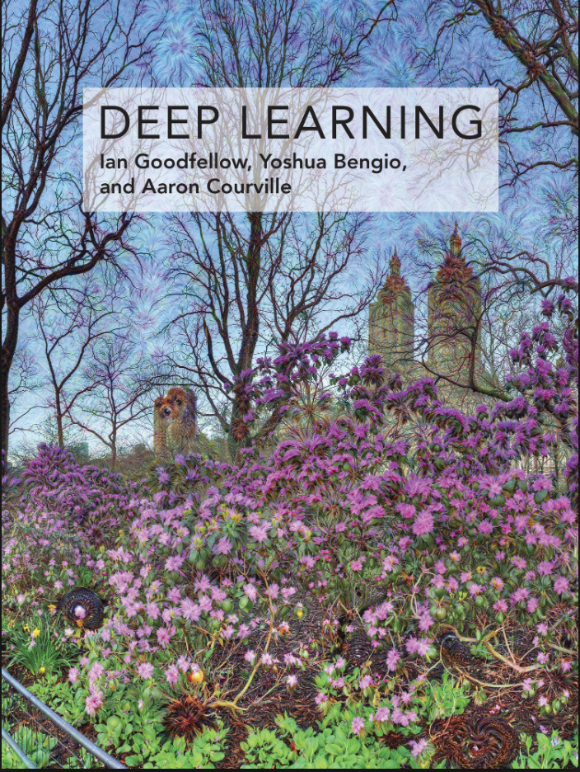
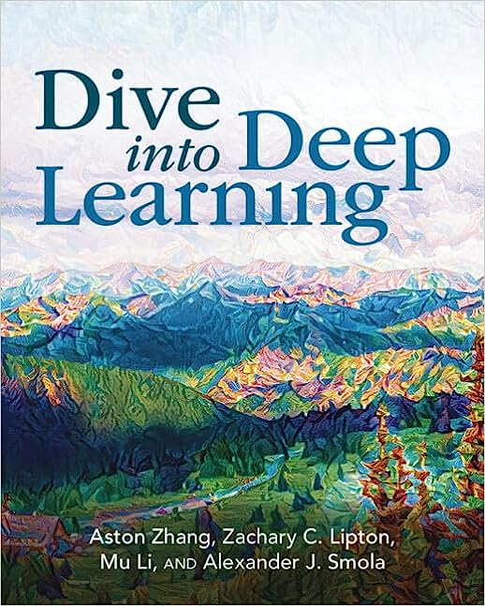
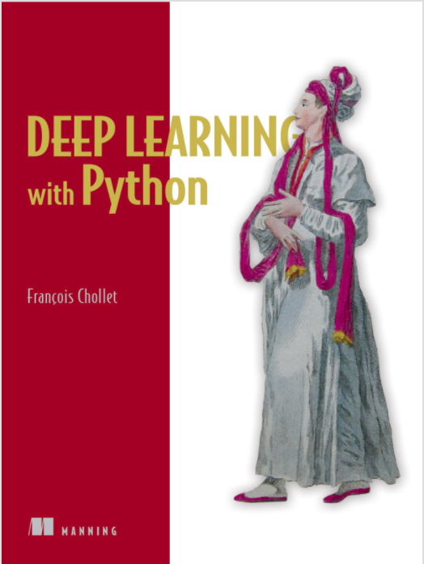
Books and Reading
Recommended textbook: “Deep learning”
by Goodfellow, Bengio, Courville
https://www.deeplearningbook.org/
Another recommended textbook: “Dive into Deep Learning” - https://d2l.ai/
Lots of further material available online, e.g.:
http://cs231n.stanford.edu/ http://course.fast.ai/
https://developers.google.com/machine-learning/crash-course/
www.nvidia.com/dlilabs http://introtodeeplearning.com/
https://github.com/oxford-cs-deepnlp-2017/lectures,
https://jalammar.github.io/
Coursera, Youtube, etc.
“Deep Learning with Python” by François Chollet
for labs + assignments

Slide 4
Online Resources
So many, impossible to fit in a single lecture presentation:
https://github.com/shellysheynin/Deep-Learning-Book
https://www.deeplearning.ai/resources/
https://m2dsupsdlclass.github.io/lectures-labs/
https://cds.nyu.edu/deep-learning/
https://www.deepmind.com/learning-resources/deep-learning-lecture-series-2020

Slide 5
Course Schedule & Content
DATE | Overview | Lecture Details | Scope
Week 1 | Introduction - Course Structure, Logistics, Fundamentals of Machine Learning and Neural Networks | 1. Introduction to Neural Network, Multilayer Perceptron, Back Propagation Learning - What is Deep Learning? | BASICS
Week 2 | Fundamentals of Learning | 2. Introduction to Deep Learning, Bayesian Learning, Hebbian Learning, Decision Surfaces, Representation Learning. 3. Theory of Deep Learning (Universal approximation theorem, convergence rate, and recent mathematical results)
Week 3 | Mathematics & Fundamentals of Deep Learning | 4. Linear Classifiers, Linear Machines with Hinge Loss, Gradient Descent, Activation and Loss Functions. 5. Optimization Techniques, Gradient Descent, Batch Optimization, Introduction to Meta-Learning, Hessian-Free Optimization.
Week 4 | Deep Neural Networks | Deep Neural Networks: Features, Feature Representation, Representation Learning, BoFs/BoWs, Feature Maps, Deep vs. Shallow Nets | FUNDAMENTALS OF DEEP (CONVOLUTIONAL) LEARNING
Week 5 | Convolutional Neural Networks | 6. Convolutional Neural Networks, Building blocks of CNN | DEEP NEURAL NETWORKS - DEEP INTO DEEP LEARNING
Week 6 | Deep Convolutional Neural Networks | Pooling, Convolutional, Softmax Layers
Week 7 | Deep Convolutional Neural Networks | Optimizing ConvNets, Transfer Learning, Residual Networks
Week 8 | Deep Learning Optimization | 11. Deep Learning Model Optimization; Early Stopping/Exit, Dropout, Batch Normalization, Instance Normalization, Group Normalization, Pruning, Quantization, Hyperparameter Optimization.
Week 9 | Recurrent Neural Networks, Transformers | RNNs, LSTMs
Week 10 | Transformers, Attention | Attention Mechanisms and Transformer Networks | EMERGING DEEP LEARNING RESEARCH AND APPLICATIONS
Week 11 | Generative Adversarial Networks | Unsupervised Learning with Deep Network, Autoencoders Cont’d, 8. Generative Adversarial Networks, Adversarial Learning Models, Variational Autoencoders
Week 12 | Deep Reinforcement Learning - Graph Neural Networks | Deep Reinforcement Learning (Q-learning, actor-critic, policy gradient, experience replay, double Q-learning, deep bootstrap networks).
Week 13 | Graph Neural Networks and Deep Learning Trends | Graph Neural Networks – Graph Signal Processing, Convolutional Networks on Graphs, Gated Graph Sequence Networks, Semi-Supervised Graph Convolutional Networks Interpretable Deep Neural Networks DNNs for Vision and NLP - GPTS/LLMS
Exam Period | Final Exam | Comprehensive Final Exam | EVALUATION

Slide 6
Basics of ML – A VERY short intro…
The simplest neural network (threshold neuron) lacks the capability of learning, which is its major drawback. In the book “The Organisation of Behaviour”, Donald O. Hebb proposed a mechanism to update weights between neurons in a neural network. This method of weight updating, enabled neurons to learn and was named as Hebbian Learning.
Three major points were stated as a part of this learning mechanism :
Information is stored in the connections between neurons in neural networks, in the form of weights.
Weight change between neurons is proportional to the product of activation values for neurons.
As learning takes place, simultaneous or repeated activation of weakly connected neurons incrementally changes the strength and pattern of weights, leading to stronger connections.

Slide 7
Hebbian Learning, Cont’d
The repeated stimulus of weak connections between neurons leads to their incremental strengthening.
The new weights are calculated by the equation :
This is another kind of connection, that have an opposite response to a stimulus. Here, the connection strength decreases with repeated or simultaneous stimuli.

Slide 8
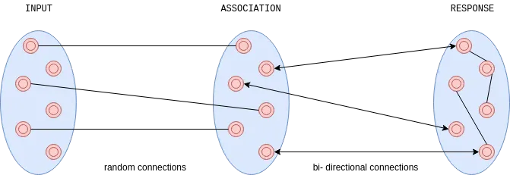
Perceptron
A perceptron draws inspiration from a biological visual neural model with three layers illustrated as follows :
Input Layer is synonymous to sensory cells in the retina, with random connections to neurons of the succeeding layer.
Association layers have threshold neurons with bi-directional connections to the response layer.
Response layer has threshold neurons that are interconnected with each other for competitive inhibitory signaling.
Response layer neurons compete with each other by sending inhibitory signals to produce output. Threshold functions are set at the origin for the association and response layers. This forms the basis of learning between these layers. The goal of the perception is to activate correct response neurons for each input pattern.
Hebbian Learning is inspired by the biological neural weight adjustment mechanism. It describes the method to convert a neuron an inability to learn and enables it to develop cognition with response to external stimuli. These concepts are still the basis for neural learning today.

Slide 9

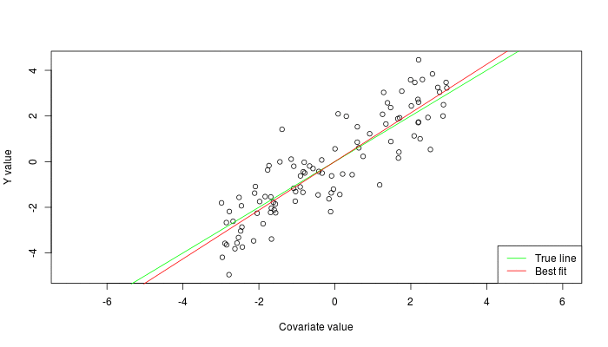
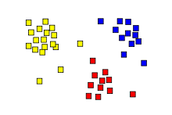
Machine Learning Types
Machine Learning Basics
Supervised: learning with labeled data
  Example: email classification, image classification
  Example: regression for predicting real-valued outputs
Unsupervised: discover patterns in unlabeled data
  Example: cluster similar data points
Reinforcement learning: learn to act based on feedback/reward
  Example: learn to play Go
class A
class B
Classification
Regression
Clustering
Slide credit: Ismini Lourentzou – Introduction to Deep Learning

Slide 10
Unsupervised Learning
Machine Learning Basics
Unsupervised learning categories and techniques
  Clustering
    k-means clustering
    Mean-shift clustering
    Spectral clustering
  Density estimation
    Gaussian mixture model (GMM)
    Graphical models
  Dimensionality reduction
    Principal component analysis (PCA)
    Factor analysis
Slide credit: Y-Fan Chang – An Overview of Machine Learning

Slide 11
Unsupervised learning
For about 40 years, unsupervised learning was largely ignored by the machine learning community
  Some widely used definitions of machine learning actually excluded it.
  Many researchers thought that clustering was the only form of unsupervised learning.
It is hard to say what the aim of unsupervised learning is.
  One major aim is to create an internal representation of the input that is useful for subsequent supervised or reinforcement learning.
  You can compute the distance to a surface by using the disparity between two images. But you don’t want to learn to compute disparities by stubbing your toe thousands of times.

Slide 12
Example of Unsupervised Learning:
Nearest Neighbor Classifier
Machine Learning Basics
Nearest Neighbor – for each test data point, assign the class label of the nearest training data point
  Adopt a distance function to find the nearest neighbor
    Calculate the distance to each data point in the training set, and assign the class of the nearest data point (minimum distance)
  It does not require learning a set of weights
Test example
Training examples from class 2
Training examples from class 1
Picture from: James Hays – Machine Learning Overview

Slide 13
k-Nearest Neighbors Classifier
Machine Learning Basics
k-Nearest Neighbors approach considers multiple neighboring data points to classify a test data point
  E.g., 3-nearest neighbors
    The test example in the figure is the + mark
    The class of the test example is obtained by voting (based on the distance to the 3 closest points)
x2
x
x
x
o
x
x
x
x
+
o
x
o
o
x
o
+
o
o
o
o
x1
Picture from: James Hays – Machine Learning Overview

Slide 14
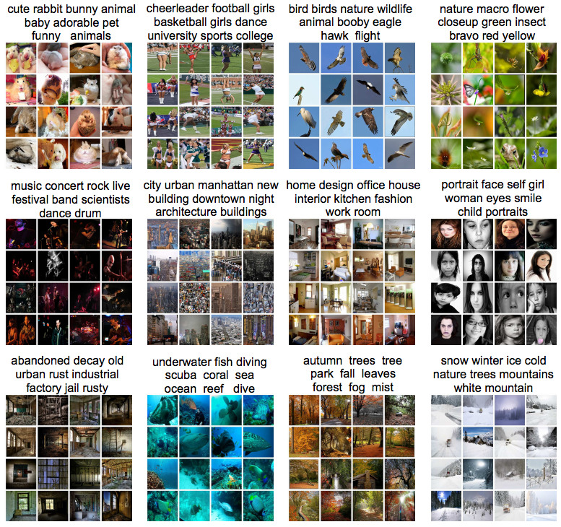
Unsupervised learning
Clustering
  Discover groups of “similar” data points
Y. Gong, Q. Ke, M. Isard, and S. Lazebnik. A Multi-View Embedding Space for Modeling Internet Images, Tags, and Their Semantics. IJCV 2014

Slide 15
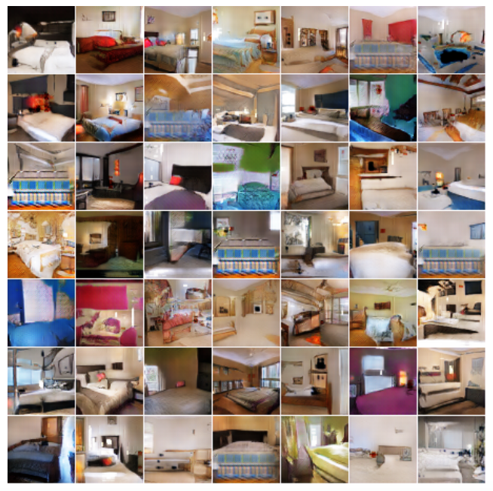
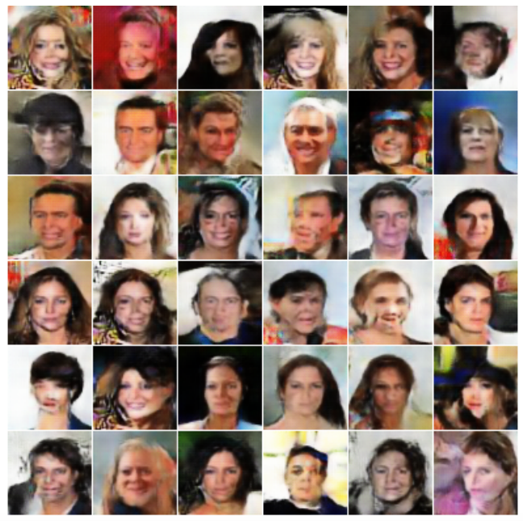
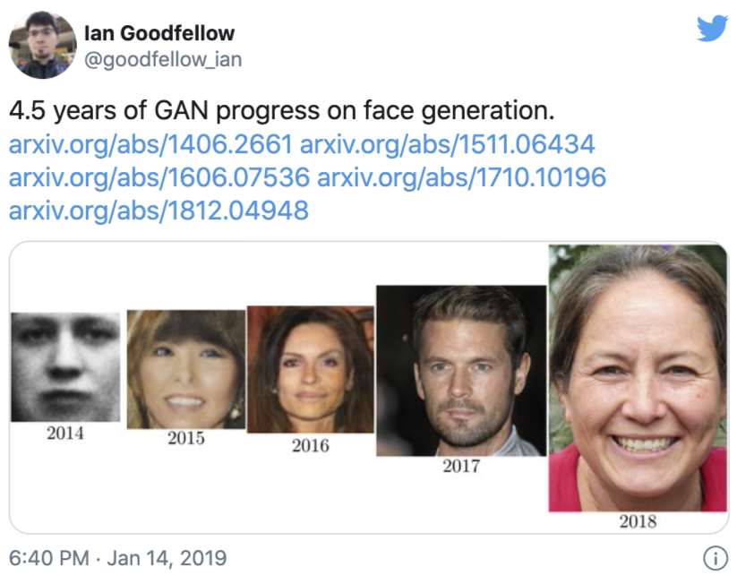
Unsupervised learning
Learning the data distribution
  Learning to sample: Produce samples from a data distribution that mimics the training set
Generative adversarial networks (GANs)
“Bedroom” (circa 2015)
“Face” (circa 2015)

Slide 16
Unsupervised learning
Learning the data distribution
  Learning to sample: Produce samples from a data distribution that mimics the training set
Generative adversarial networks (GANs)
Image source

Slide 17
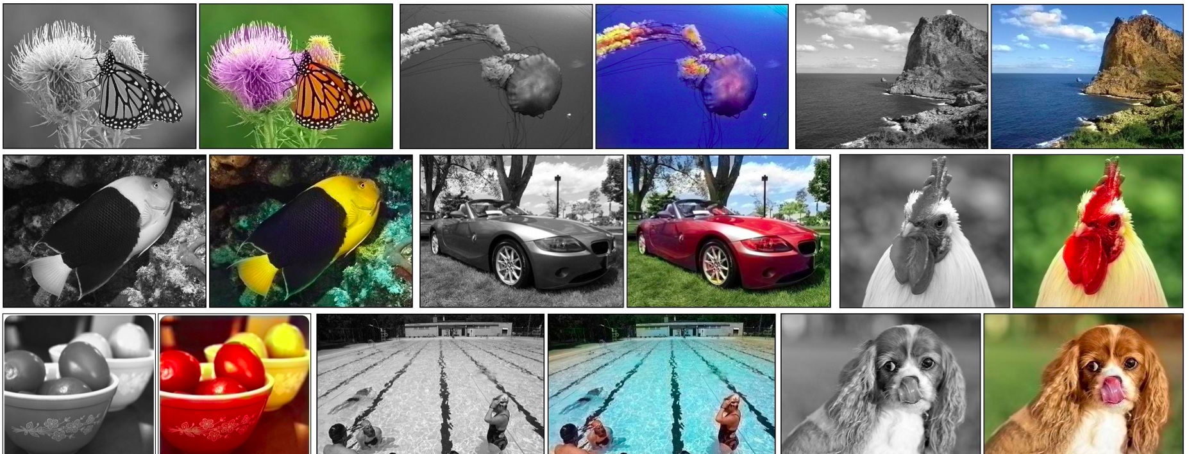
Self-supervised or predictive learning
Use part of the data to predict other parts of the data
  Example: Image colorization
R. Zhang et al., Colorful Image Colorization, ECCV 2016

Slide 18
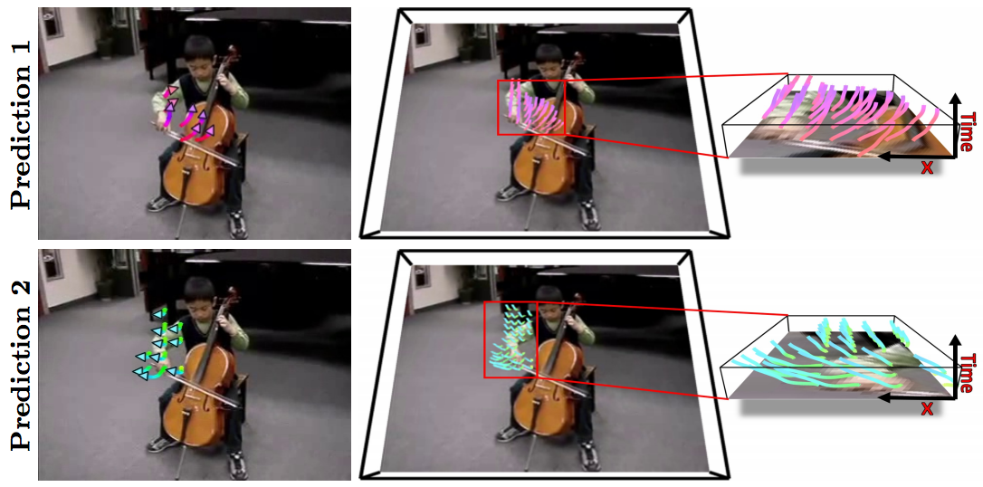
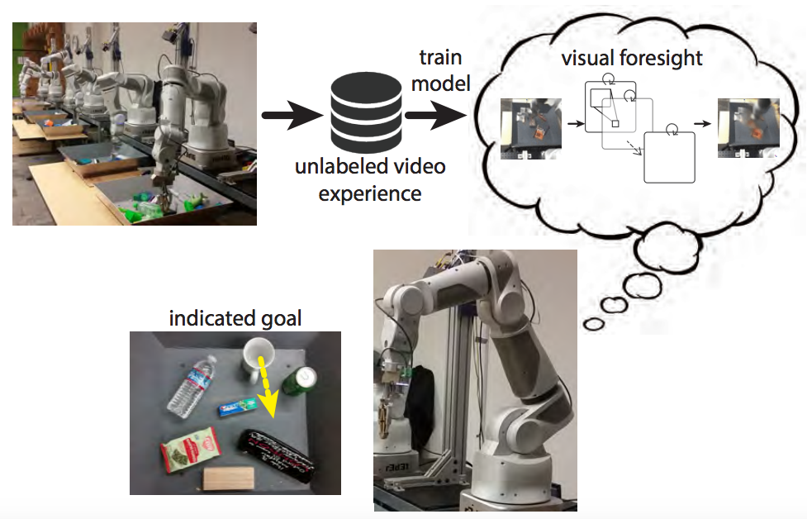
Self-supervised or predictive learning
Use part of the data to predict other parts of the data
  Example: Future prediction
J. Walker et al. An Uncertain Future: Forecasting from Static Images Using Variational Autoencoders. ECCV 2016
C. Finn and S. Levine. Deep Visual Foresight for Planning Robot Motion. ICRA 2017. YouTube video

Slide 19
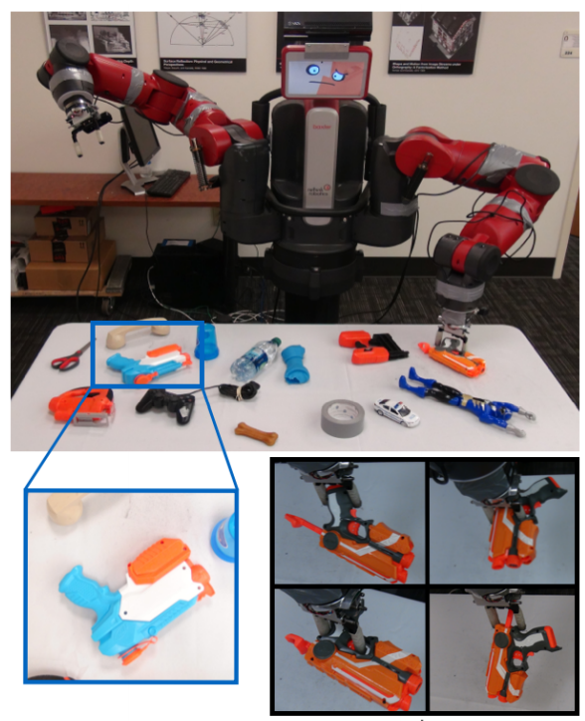
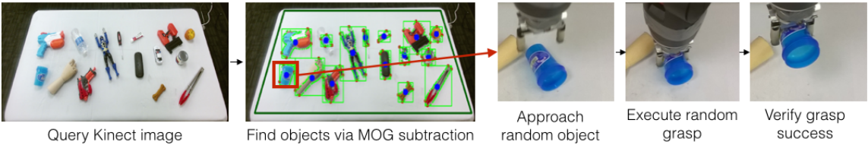
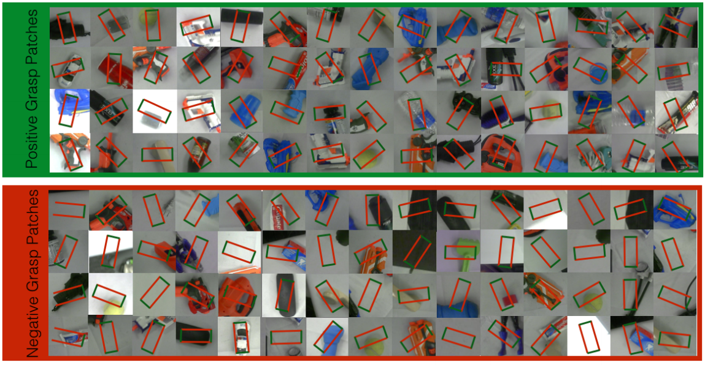
Self-supervised or predictive learning
Use part of the data to predict other parts of the data
  Example: Grasp prediction
L. Pinto and A. Gupta. Supersizing self-supervision: Learning to grasp from 50K tries and 700 robot hours. ICRA 2016

Slide 20
For this class however:
Supervised Learning
Machine Learning Basics
Supervised learning categories and techniques
  Numerical classifier functions
    Linear classifier, perceptron, logistic regression, support vector machines (SVM), neural networks
  Parametric (probabilistic) functions
    Naïve Bayes, Gaussian discriminant analysis (GDA), hidden Markov models (HMM), probabilistic graphical models
  Non-parametric (instance-based) functions
    k-nearest neighbors, kernel regression, kernel density estimation, local regression
  Symbolic functions
    Decision trees, classification and regression trees (CART)
  Aggregation (ensemble) learning
    Bagging, boosting (Adaboost), random forest
Slide credit: Y-Fan Chang – An Overview of Machine Learning

Slide 21
Reinforcement learning
In reinforcement learning, the output is an action or sequence of actions, and the only supervisory signal is an occasional scalar reward.
  The goal in selecting each action is to maximize the expected sum of the future rewards.
  We usually use a discount factor for delayed rewards so that we don’t have to look too far into the future.
Reinforcement learning is difficult:
  The rewards are typically delayed so its hard to know where we went wrong (or right).
  A scalar reward does not supply much information.

Slide 22
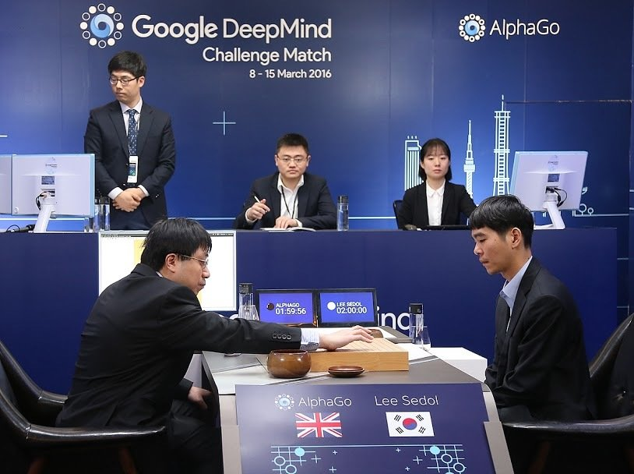
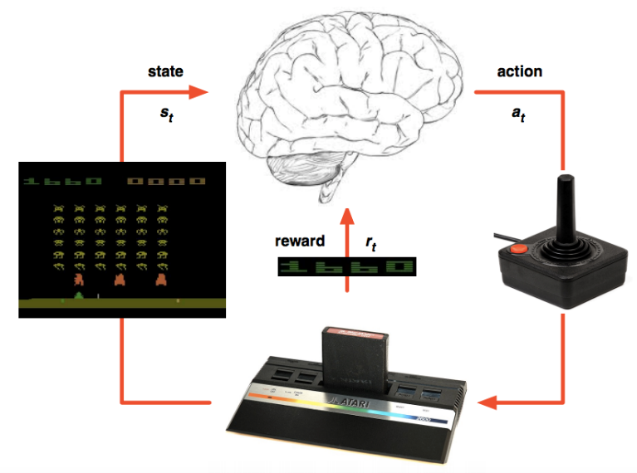
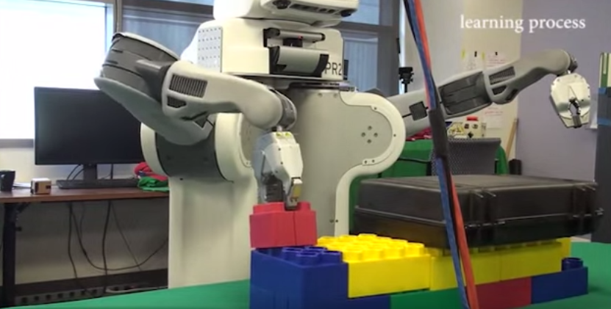
Reinforcement learning
Learning from rewards in a sequential environment
DeepMind’s AlphaGo
DeepMind's Atari system
Sensorimotor learning

Slide 23
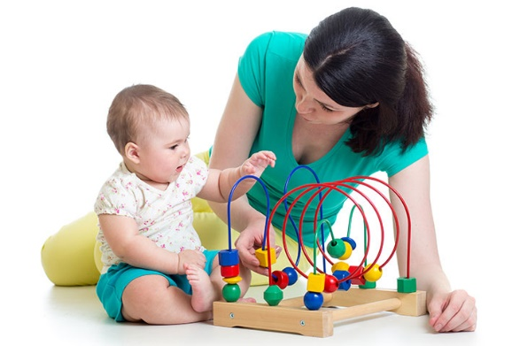
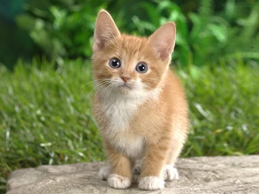
Back to Supervised Learning though…
The goal of ML is to learn from data ---->
  Technically, combines statistics and
  computational tools (optimization)
Example (supervised learning) tasks
Model
Cat or Dog
Image recognition / classification

Slide 24
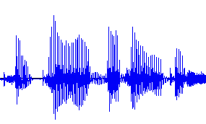
How do we teach machines to learn?
The goal of ML is to learn from data ---->
  Technically, combines statistics and
  computational tools (optimization)
Example (supervised learning) tasks
Cat or Dog
Model
“Wie geht’s dir?”
“How are you?”
“I am fine thank you”

Slide 25

How do we learn?
The goal of ML is to learn from data ---->
  Technically, combines statistics and
  computational tools (optimization)
Example (supervised learning) tasks
  Image recognition
  Speech recognition
  Machine translation
Other form of learnings as we saw
  Unsupervised learning
  Reinforcement learning
Cat or Dog
“Hello”
“Hello”
“Bonjour”

Slide 26
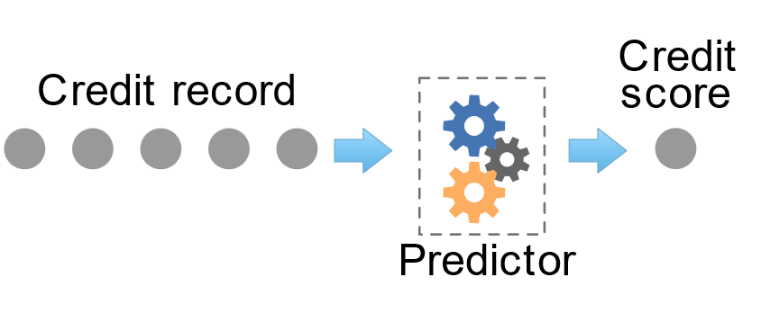
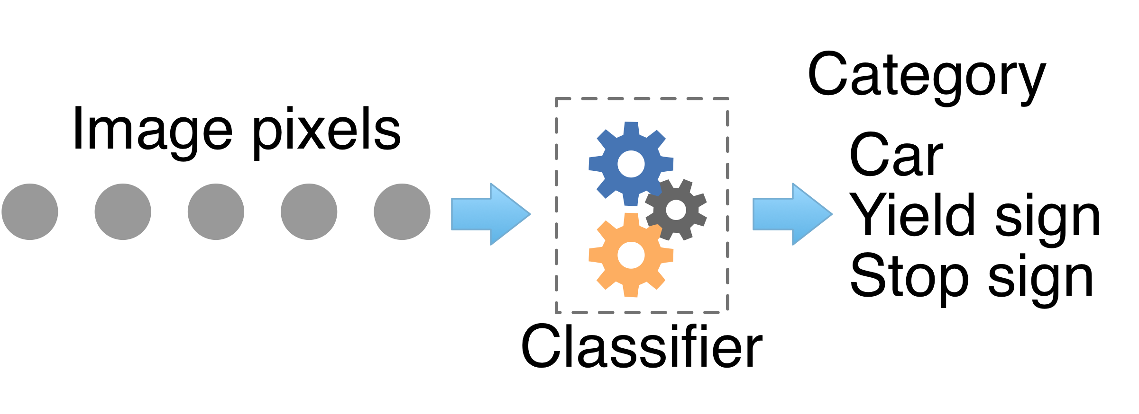
The goal of (supervised) machine learning
Obtain a model that predicts numeric values (regressor) or categories (classifier) from information about an entity:

Slide 27
Two types of supervised learning
Each training case consists of an input vector x and a target output t.
Regression: The target output is a real number or a whole vector of real numbers.
  The price of a stock in 6 months time.
  The temperature at noon tomorrow.
Classification: The target output is a class label.
  The simplest case is a choice between 1 and 0.
  We can also have multiple alternative labels.

Slide 28
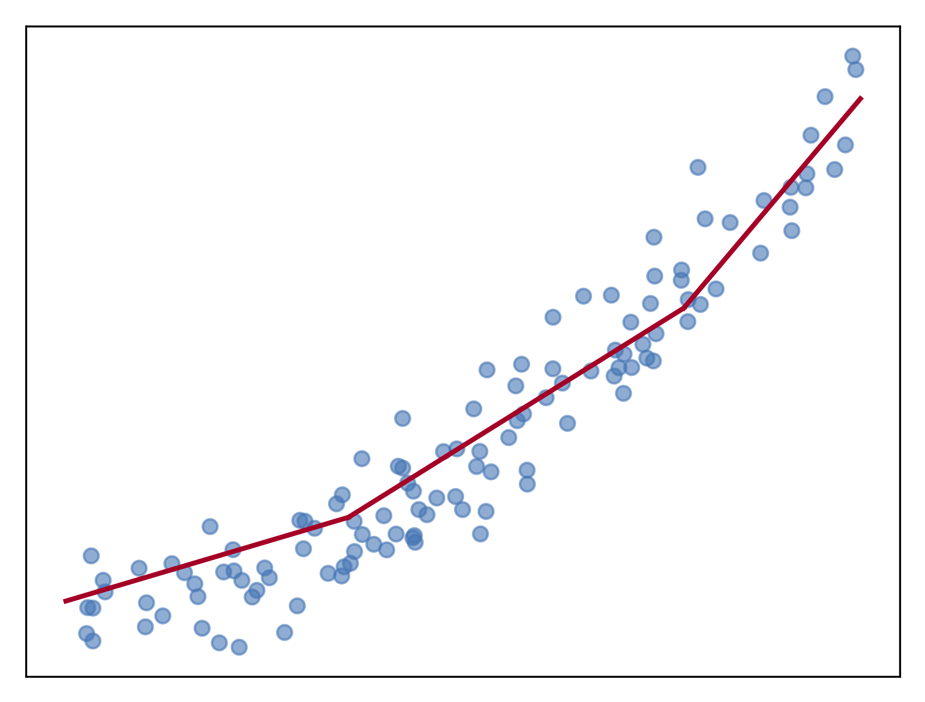
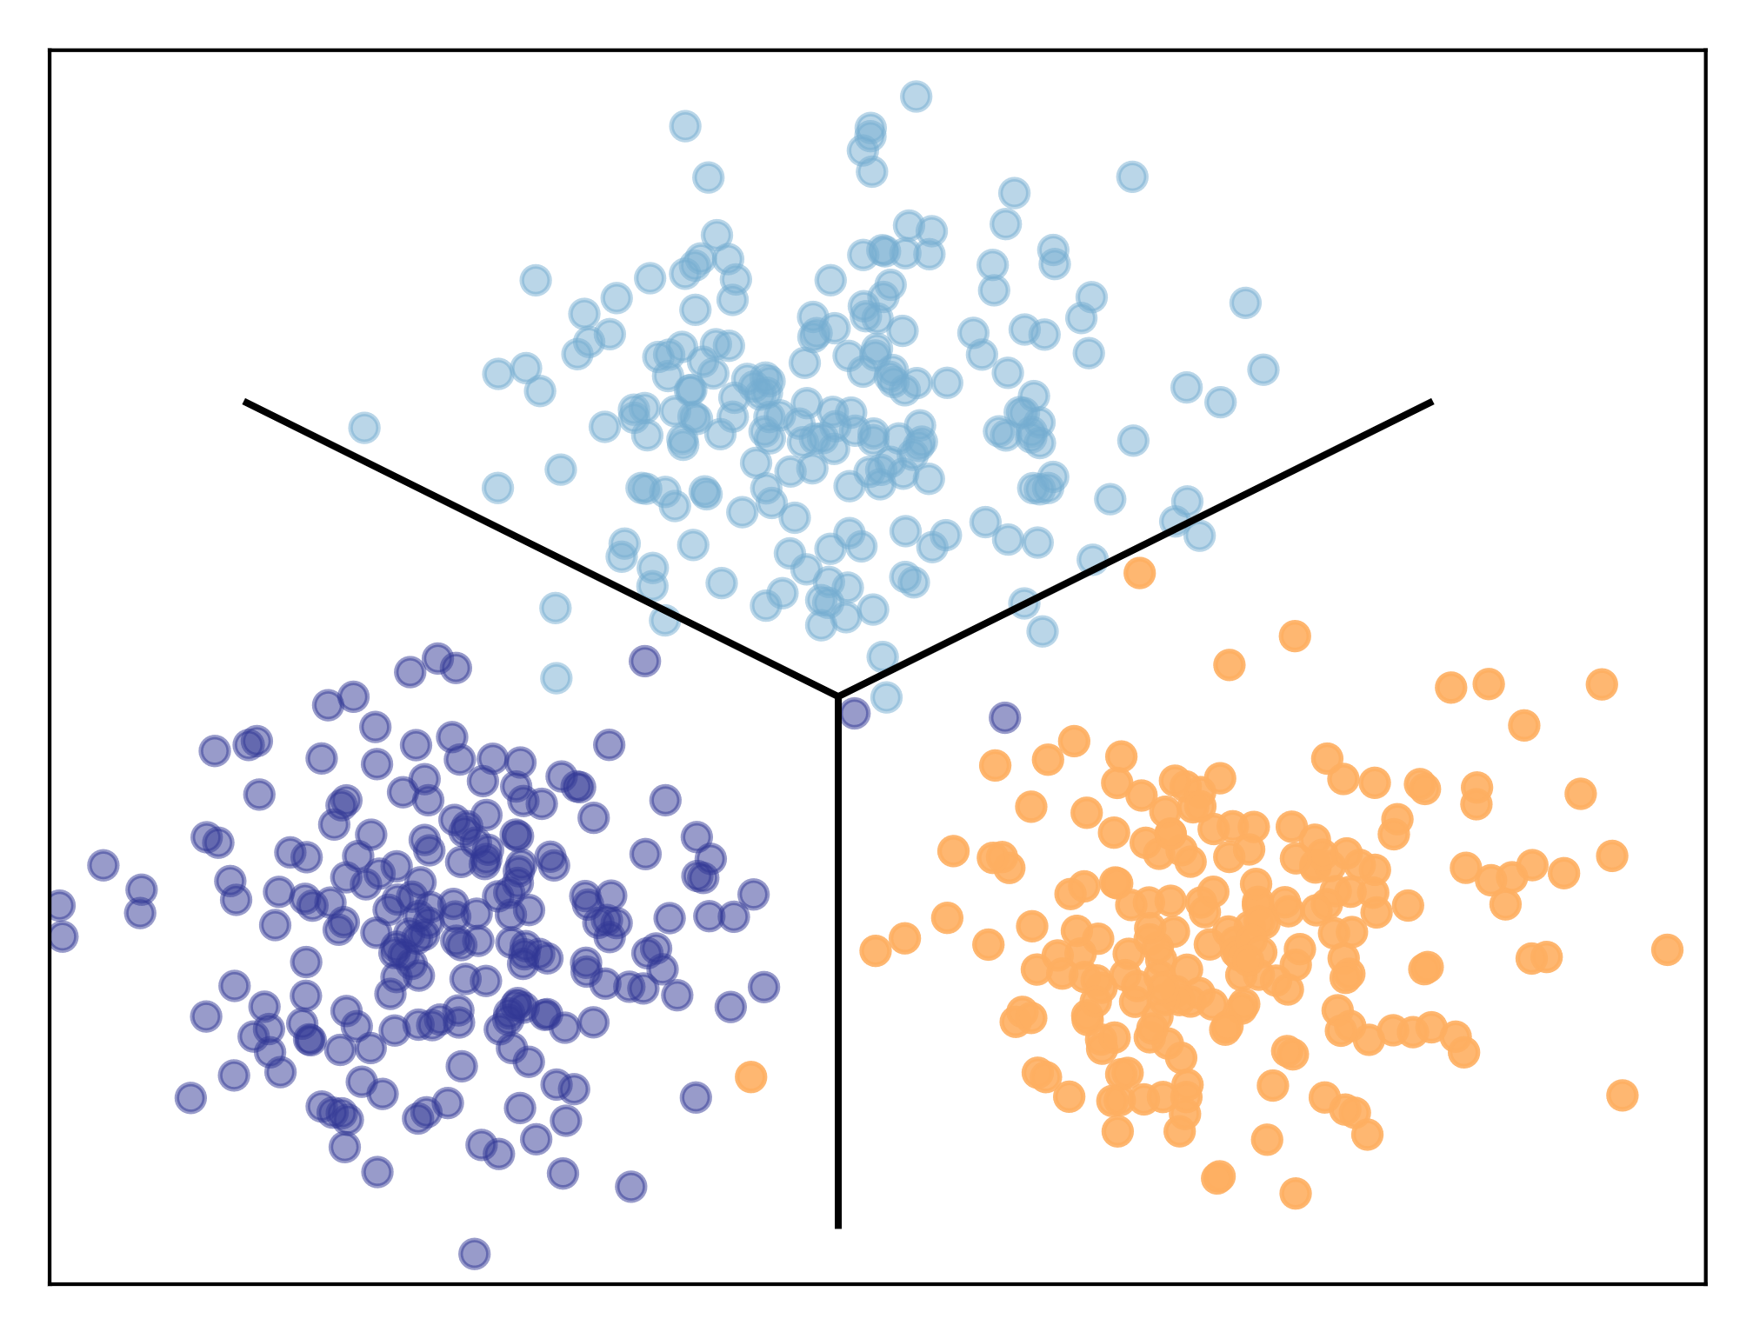
Regression versus classification
Predictors fit curves to data and classifiers draw decision boundaries between data points in different categories
Two sides of the same coin in implementation typically

Slide 29
How supervised learning typically works
We start by choosing a model-class:
  A model-class, f, is a way of using some numerical parameters, W, to map each input vector, x, into a predicted output y.
Learning usually means adjusting the parameters to reduce the discrepancy between the target output, t, on each training case and the actual output, y, produced by the model.
  For regression, is often a sensible measure of the discrepancy.
  For classification there are other measures that are generally more sensible (they also work better).

Slide 30




Training and inference
Training
The loss tells what the output of the model should have been
Training objective can be overly optimistic (overfitting)
Inference (validation)
We care about the performance in this setting
cat
$$f_{θ}(x)$$
Loss
$$f_{θ}(x)$$
0.1
(dog)
Frozen
parameter
0.99
(cat)
Training
data

Slide 31
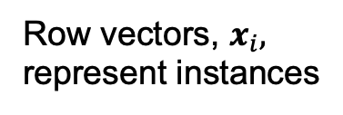
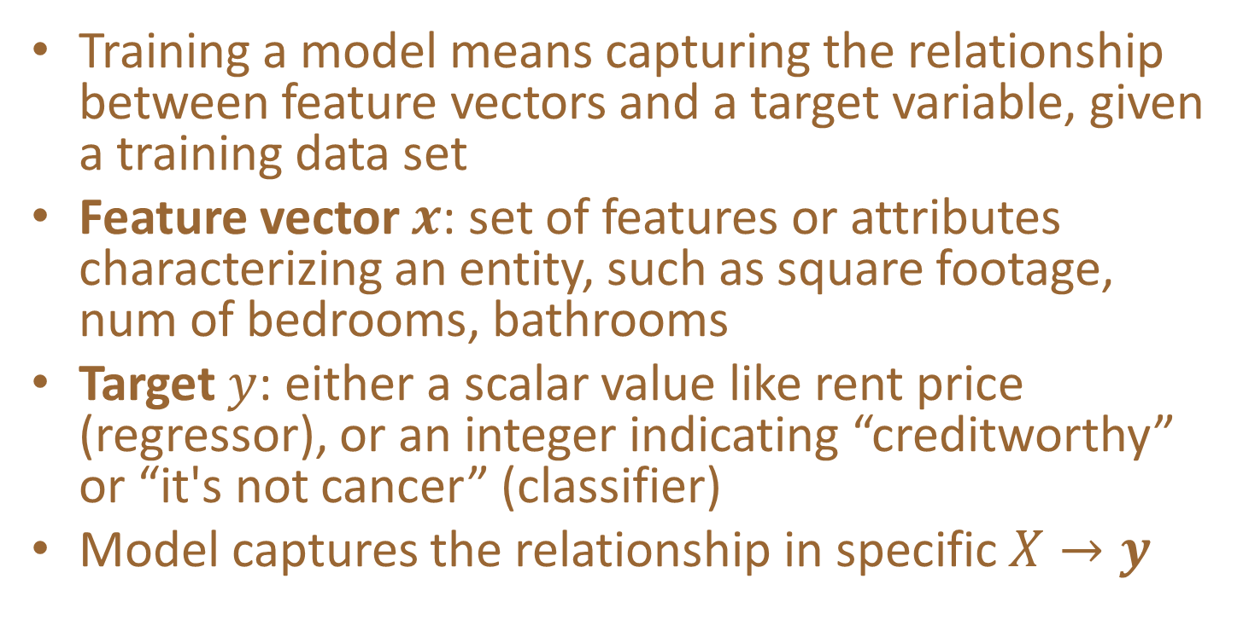
The abstraction
Training a model means capturing the relationship between feature vectors and a target variable, given a training data set
Feature vector $x$: set of features or attributes characterizing an entity, such as square footage, num of bedrooms, bathrooms
Target $y$: either a scalar value like rent price (regressor), or an integer indicating “creditworthy” or “it's not cancer” (classifier)
Model captures the relationship in specific $X→y$
Row vectors, $x_{i},$ represent instances

Slide 32
Models
Models are composed of parameters; predictions are a computation based upon these parameters
Models have architecture; e.g., number of layers, number of neurons per layer, which nonlinearity to use, etc…
Models have hyper-parameters that govern architecture and the training process; e.g., learning rate, weight decay, drop out rate
Hyper-parameters are specified by the programmer, not computed from the training data; must be tuned
Deep learning training greatly affected by learning rate, and even things like random parameter initialization

Slide 33
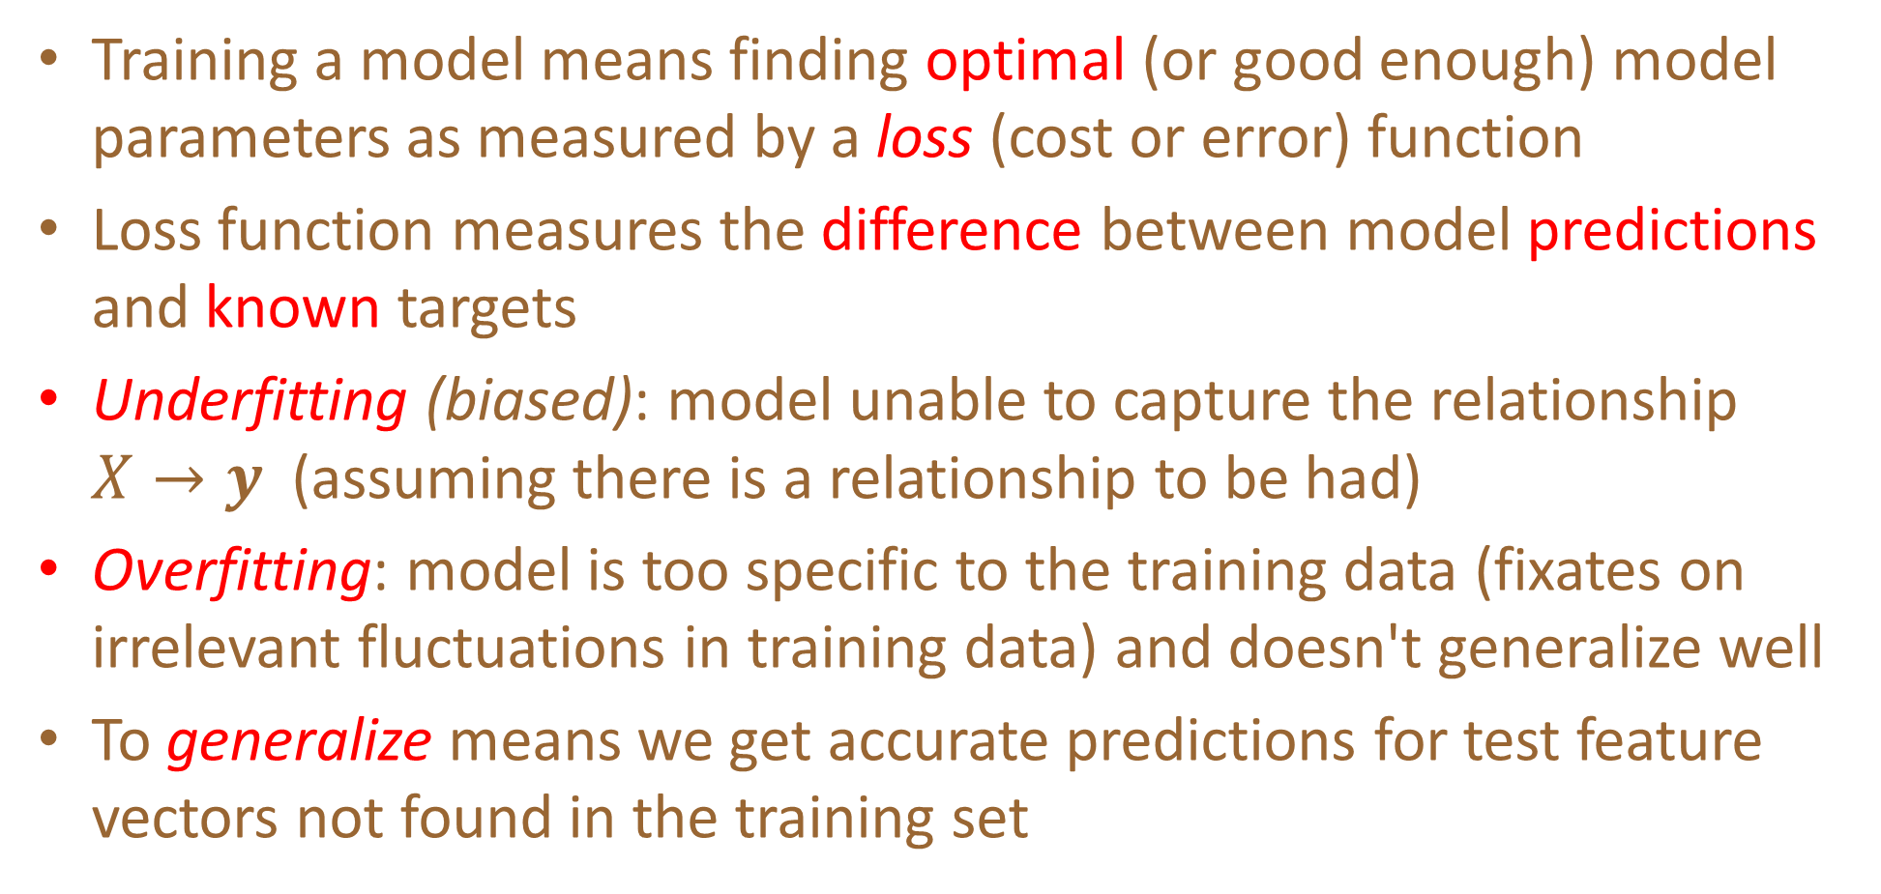
Training
Training a model means finding optimal (or good enough) model parameters as measured by a loss (cost or error) function
Loss function measures the difference between model predictions and known targets
Underfitting (biased): model unable to capture the relationship $X→y$ (assuming there is a relationship to be had)
Overfitting: model is too specific to the training data (fixates on irrelevant fluctuations in training data) and doesn't generalize well
To generalize means we get accurate predictions for test feature vectors not found in the training set

Slide 34
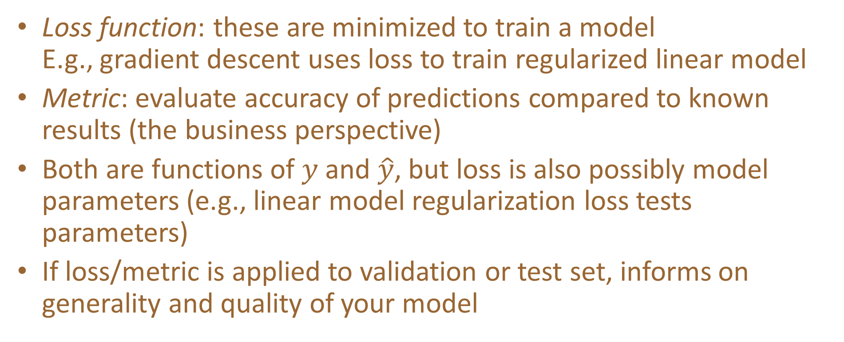
Terminology: Loss function vs metric
Loss function: these are minimized to train a model
E.g., gradient descent uses loss to train regularized linear model
Metric: evaluate accuracy of predictions compared to known results (the business perspective)
Both are functions of $y$ and $\hat{y}$, but loss is also possibly model parameters (e.g., linear model regularization loss tests parameters)
If loss/metric is applied to validation or test set, informs on generality and quality of your model

Slide 35
Train, validate, test
We always need 3 data sets with known answers:
  training
  validation (as shorthand you’ll hear me & others call this test set)
  testing (put in a vault and don’t peek!!)
Validation set: used to evaluate, tune models and features
  Any changes you make to model tailor it to this specific validation set
Test set: used exactly once after you think you have best model
  The only true measure of model’s generality, how it’ll perform in production
  Never use test set to tune model
Production: recombine all sets back into a big training set again, retrain model but don’t change it according to test set metrics

Slide 36

Preparing data
Everything must be numeric
No missing values
Should normalize numeric
features in $X$ to zero-mean,
variance one ("whitening")
  Speeds up training
Compare regression equations,
loss function surfaces…

Slide 37
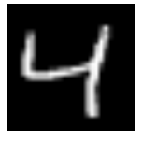
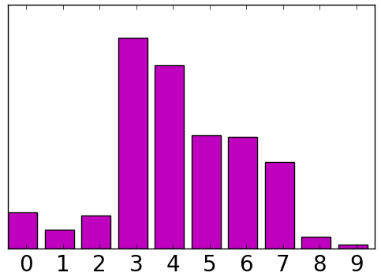

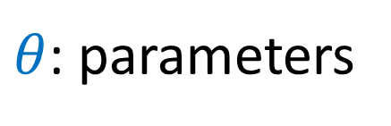

Learning objective
Objective: minimize
$\text{Loss}\left(f_{θ}\left(x\right), y\right)$
for a randomly chosen (x,y) from some distribution D.
  We don’t know the distribution D.
  We only have access to (training) samples from D.
model
$$f_{θ}\left(x\right)$$
$θ$: parameters
4
input x
prediction
label

Slide 38
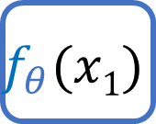

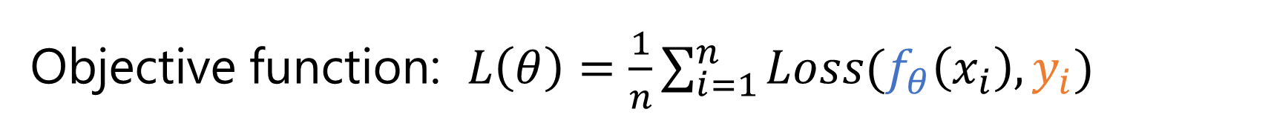
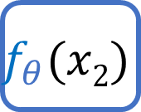
Training objective
Objective function: $L\left(θ\right)=\frac{1}{n}\sum_{i=1}^{n}{Loss(f_{θ}\left(x_{i}\right), y_{i})}$
Approximate the unknown distribution D with the training data average
( , 4)
$$f_{θ}(x1)$$
Loss
+
Training
data
( , 5)
$$f_{θ}(x2)$$
Loss

Slide 39

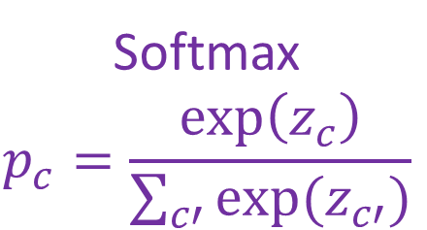
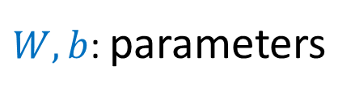

Mapping from input to prediction
input
x
score
z
probability
p
$W,b$: parameters
$$z=Wx+b$$
Softmax
$$p_{c}=\frac{\exp\left(z_{c}\right)}{\sum_{c′}{exp⁡(z_{c′})}}$$
784 dim
10 dim
10 dim

Slide 40
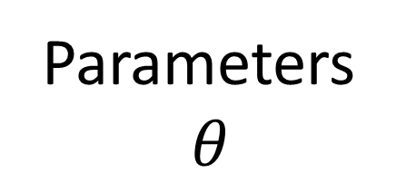
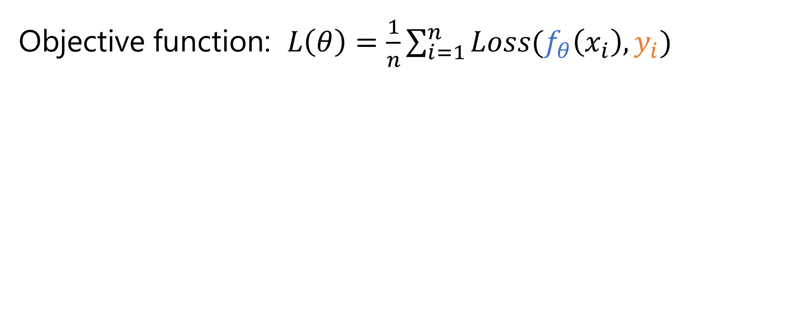
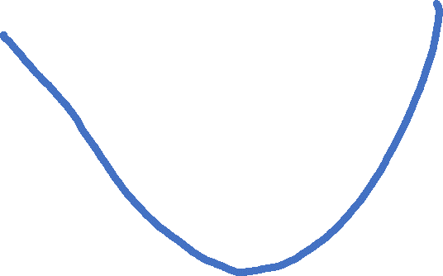
Landscape of training objective
Objective function: $L\left(θ\right)=\frac{1}{n}\sum_{i=1}^{n}{Loss(f_{θ}\left(x_{i}\right), y_{i})}$
Parameters
$$θ$$
Initial parameters
final parameters

Slide 41
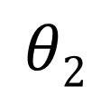

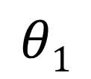

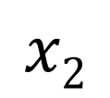
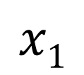
Landscape of training objective
Parameter space
Example space
$$θ2$$
$$x2$$
$$θinit$$
$$θinit$$
$$θ1$$
$$x1$$

Slide 42


Landscape of training objective
Parameter space
Example space
$$θ2$$
$$x2$$
$$θfinal$$
$$θinit$$
$$θfinal$$
$$θ1$$
$$x1$$

Slide 43
Gradient descent
f(x)
x
Notes:
Note: this is not a convex function.

Slide 44

General approach
Pick random starting point.
f(x)
$$a_{1}$$
x

Slide 45

General approach
Compute gradient at point (analytically or by finite differences)
f(x)
$$∇ f(a_{1})$$
$$a_{1}$$
x

Slide 46

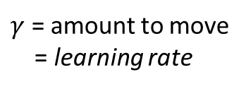

General approach
Move along parameter space in direction of negative gradient
f(x)
$$a_{2}=a_{1}−γ∇ f\left(a_{1}\right)$$
$γ$ = amount to move
= learning rate
$$a_{1}$$
$$a_{2}$$
x

Slide 47


General approach
Move along parameter space in direction of negative gradient.
f(x)
$$a_{3}=a_{2}−γ∇ f\left(a_{2}\right)$$
$γ$ = amount to move
= learning rate
$$a_{1}$$
$$a_{2}$$
$$a_{3}$$
x

Slide 48


General approach
Stop when we don’t move any more.
f(x)
$$a_{stop}:$$
$a_{n−1}−γ∇ f\left(a_{n−1}\right)=$ 0
$$a_{1}$$
$$a_{2}$$
$$a_{3}$$
$$a_{stop}$$
x

Slide 49
Gradient descent
Optimizer for functions.
Guaranteed to find optimum for convex functions.
  Non-convex = find local optimum.
Works for multi-variate functions.
  Need to compute matrix of partial derivatives (“Jacobian”)

Slide 50


Train NN with Gradient Descent
$x^{i},y^{i}$ = n training examples
$f\left(x\right)$ = feed forward neural network
L( x, y; θ) = some loss function
Loss function measures how ‘good’ our network is at classifying the training examples wrt. the parameters of the model (the perceptron weights).
$$\frac{1}{n}\sum_{i=1}^{n}{{\left\|f\left(x^{i}\right)−y^{i}\right\|}^{2}}$$

Slide 51
Train NN with Gradient Descent
Loss function
(Evaluate NN
on training data)
$$a_{1}$$
$$a_{2}$$
$$a_{3}$$
$$a_{stop}$$
Model parameters
(perceptron weights)

Slide 52






Gradient descent
$$θ_{t}$$
Initialize $θ_{0}$ randomly
For t in 0,…, T_{maxiter}
$$θ^{t+1}=θ^{t}−η_{t}⋅∇L\left(θ^{t}\right)$$
$$θ_{t+1}$$
$$θfinal$$
$$θ0$$
Gradient of the objective
Learning rate (step size)
computation of $∇L\left(θ^{t}\right)$ requires a full sweep over the training data
Per-iteration comp. cost = O(n)

Slide 53

Gradient descent oscillations

Slide 54
Gradient descent oscillations
Slow to converge to the (local) optimum
https://www.ibm.com/topics/gradient-descent#:~:text=Gradient%20descent%20is%20an%20optimization,each%20iteration%20of%20parameter%20updates

Slide 55














Gradient Descent
Assume there are only two parameters w₁ and w₂ in a network.
Error Surface
$$θ=\left\{w_{1},w_{2}\right\}$$
The colors represent the value of C.
Randomly pick a starting point $θ^{0}$
Compute the negative gradient at $θ^{0}$
$$w_{2}$$
$$θ^{∗}$$
$$−η∇C\left(θ^{0}\right)$$
$$−∇C\left(θ^{0}\right)$$
$$−∇C\left(θ^{0}\right)$$
$$∇C\left(θ^{0}\right)=\left[\begin{matrix}∂C\left(θ^{0}\right)/∂w_{1} \\ ∂C\left(θ^{0}\right)/∂w_{2}\end{matrix}\right]$$
Times the learning rate $η$
$$θ^{0}$$
$$−η∇C\left(θ^{0}\right)$$
$$w_{1}$$
Notes:
Eta
人站在 ｔｈｅｔａ０ 環顧四周 看看哪裡最低，那個方向就是 ｇｒａｄｉｅｎｔ

Slide 56














Gradient Descent
Eventually, we would reach a minima …..
Randomly pick a starting point $θ^{0}$
Compute the negative gradient at $θ^{0}$
$$θ^{2}$$
$$−η∇C\left(θ^{2}\right)$$
$$−η∇C\left(θ^{1}\right)$$
$$w_{2}$$
$$−∇C\left(θ^{2}\right)$$
$$−∇C\left(θ^{1}\right)$$
$$θ^{1}$$
$$−∇C\left(θ^{0}\right)$$
Times the learning rate $η$
$$θ^{0}$$
$$−η∇C\left(θ^{0}\right)$$
$$w_{1}$$

Slide 57





Gradient Descent
Gradient descent
  Pros
    Guaranteed to converge to global minimum for convex error surface
    Converge to local minimum for non-convex error surface
  Cons
    Very slow
    Intractable for dataset that do not fit in the memory
Different initial point $θ^{0}$
$$C$$
Reach different minima, so different results (non-convex)
$$w_{1}$$
$$w_{2}$$

Slide 58


Gradient Descent: Practical Issues

Slide 59

Stochastic Gradient Descent
Dataset can be too large to strictly apply gradient descent
Instead, randomly sample a data point, perform gradient descent per point, and iterate.
  True gradient is approximated only
  Picking a subset of points: “mini-batch”
Pick starting $W$ and learning rate $γ$
While not at minimum:
  Shuffle training set
  For each data point i=1…n (maybe as mini-batch)
    Gradient descent
“Epoch“
Notes:
Epoch: running through every training data example and performing SGD

Slide 60

Stochastic Gradient Descent
Loss will not always decrease (locally) as training data point is random.
Still converges over time.
https://www.ibm.com/topics/gradient-descent#:~:text=Gradient%20descent%20is%20an%20optimization,each%20iteration%20of%20parameter%20updates

Slide 61


Stochastic gradient descent (SGD)
$$θ_{t}$$
Initialize $θ_{0}$ randomly
For t in 0,…, T_{maxiter}
$$θ^{t+1}=θ^{t}−η_{t}⋅∇Loss\left(f_{θ}\left(x_{i}\right), y_{i}\right)$$
where index i is chosen randomly
$$θ_{t+1}$$
$$θfinal$$
Stochastic gradient
$$θ0$$
computation of $∇Loss\left(…\right)$ requires only one training example
Per-iteration comp. cost = O(1)

Slide 62


Minibatch stochastic gradient descent
$$θ_{t}$$
Initialize $θ_{0}$ randomly
For t in 0,…, T_{maxiter}
$$θ^{t+1}=θ^{t}−η_{t}⋅{\tilde{∇}}_{B}L\left(θ\right)$$
where minibatch B is chosen randomly
$$θ_{t+1}$$
$$θfinal$$
minibatch gradient
$$θ0$$
$\tilde{∇}L\left(θ\right)$is average gradient over random subset of data of size B
Per-iteration comp. cost = O(B)

Slide 63




Overfitting – what is signal vs noise?
Validation data
Imagine:
Powerful models are more likely to overfit
We need validation data: leave out some portion of the training data to validate the generalizability of the model
cat
Training
data
dog

Slide 64


Typical learning curve
Validation loss
Training loss
Number of training steps

Slide 65
Summary so far
A machine learning problem can be specified by:
  Task: What’s the input? What’s the output?
  Model: maps from the input to some numbers
  Loss function: measures how the model is doing
  Training: mini-batch SGD on the sum of empirical losses
  Validation: Are we overfitting?

Slide 66

Back to Neural Networks
Neural Networks
Handwritten digit recognition (MNIST dataset)
  The intensity of each pixel is considered an input element
  Output is the class of the digit
Input
Output
y₁
is 1
0.1
y₂
is 2
0.7
The image is “2”
……
……
……
y₁₀
0.2
is 0
16 x 16 = 256
Ink → 1
No ink → 0
Each dimension represents the confidence of a digit
Slide credit: Hung-yi Lee – Deep Learning Tutorial

Slide 67


Neural Networks
Neural Networks
Handwritten digit recognition
y₁
Machine
y₂
“2”
……
……
$$f:R^{256}→R^{10}$$
y₁₀
The function $f$ is represented by a neural network
Slide credit: Hung-yi Lee – Deep Learning Tutorial

Slide 68


Elements of Neural Networks
Introduction to Neural Networks
NNs consist of hidden layers with neurons (i.e., computational units)
A single neuron maps a set of inputs into an output number, or $f:R^{K}→R$
$$a=σ\left(z\right)$$
…
…
output
Activation function
weights
input
bias
Slide credit: Hung-yi Lee – Deep Learning Tutorial

Slide 69





Elements of Neural Networks
Introduction to Neural Networks
A NN with one hidden layer and one output layer
Weights
Biases
$$hidden layer h=σ(W_{1}x+b_{1})$$
$$output layer y=σ(W_{2}h+b_{2})$$
Activation functions
4 + 2 = 6 neurons (not counting inputs)
[3 × 4] + [4 × 2] = 20 weights
4 + 2 = 6 biases
26 learnable parameters
$$y$$
$$x$$
$$h$$
Slide credit: Ismini Lourentzou – Introduction to Deep Learning

Slide 70

Elements of Neural Networks
Introduction to Neural Networks
A neural network playground link

Slide 71
Elements of Neural Networks
Introduction to Neural Networks
Deep NNs have many hidden layers
  Fully-connected (dense) layers (a.k.a. Multi-Layer Perceptron or MLP)
  Each neuron is connected to all neurons in the succeeding layer
Input
Layer 1
Layer 2
Layer L
Output
……
y₁
……
y₂
……
……
……
……
……
……
y_{M}
Input Layer
Output Layer
Hidden Layers
Slide credit: Hung-yi Lee – Deep Learning Tutorial

Slide 72

Feedforward Architectures

Slide 73

Recurrent Architectures

Slide 74

Supervised Learning In Neural Networks

Slide 75


Neural network
An (artificial) neural network is a collection of neurons
Usually organized in layers
  input layer
  one or more hidden layers
  (sizes, activation functions are hyperparameters)
  output layer

Slide 76

A single neuron in the brain
Input
Output
Notes:
If activated → activation

Slide 77






An artificial neuron: Logistic unit
$${ x}_{0}$$
“Bias unit”
$x=\left[\begin{aligned}x_{0} \\ x_{1} \\ x_{2} \\ x_{3}\end{aligned}\right]$ $θ=\left[\begin{aligned}θ_{0} \\ θ_{1} \\ θ_{2} \\ θ_{3}\end{aligned}\right]$
Sigmoid (logistic) activation function
$${ x}_{1}$$
“Weights”
“Parameters”
“Output”
$${ x}_{2}$$
$$h_{θ}\left(x\right)=\frac{1}{1+e^{−θ^{⊤}x} }$$
$${ x}_{3}$$
“Input”

Slide 78

Visualization of weights, bias, activation function
range determined by g(.)
bias b only change the position of the hyperplane

Slide 79


Activation - sigmoid
Squashes the neuron’s pre-activation between 0 and 1
Always positive
Bounded
Strictly increasing
$$g\left(x\right)=\frac{1}{1+e^{−x} }$$

Slide 80


Activation - hyperbolic tangent (tanh)
Squashes the neuron’s pre-activation between -1 and 1
Can be positive or negative
Bounded
Strictly increasing
$$g\left(x\right)=\tanh\left(x\right)=\frac{e^{x}−e^{−x}}{e^{x}+e^{−x}}$$

Slide 81


Activation - rectified linear(relu)
Bounded below by 0
always non-negative
Not upper bounded
Tends to give neurons with sparse activities
$$g\left(x\right)=relu\left(x\right)=max\left(0, x\right)$$

Slide 82

Activation - softmax
For multi-class classification:
  we need multiple outputs (1 output per class)
  we would like to estimate the conditional probability $p\left(y=c | x\right)$
We use the softmax activation function at the output:
$$g\left(x\right)=\operatorname{softmax}\left(x\right)=\left[\frac{e^{x1}}{{\sum_{c}{e}}^{xc}} … \frac{e^{xc}}{{\sum_{c}{e}}^{xc}}\right]$$

Slide 83



Output activation
Input
Usually a non-linear activation after each layer
Typically ReLU between the layers
At the output layer we need to consider the task, i.e., what kinds of outputs we want, e.g,
  Multi-label classification
  each K output separate probability (values 0.0-1.0)
  → sigmoid
  Multi-class classification
  probability distribution over K classes (sums to 1.0)
  → softmax
  Regression
  free range of values → linear
Layer 1
ReLU
Layer 2
ReLU
Layer 3
softmax:
e.g. softmax
Output

Slide 84



Backpropagation
Neural networks are trained with gradient descent,
starting from a random weight initialization
Algorithm for computing the gradients for a neural network:
An error (loss) when comparing to the correct label
cat
dog
Backpropagate errors =
How to change each weight to reduce error
Based on the chain rule of calculus:

Slide 85



Neuron as a linear classifier
By User:ZackWeinberg, based on PNG version by User:Cyc [CC BY-SA 3.0], via Wikimedia Commons

Slide 86



A non-linear classifier?

Slide 87



Non-linearity = activation function
A smooth (differentiable) nonlinear function that is applied after the inner product with the weights

Slide 88


Slide 89

Linear Classifier
Machine Learning Basics
Linear classifier
  Find a linear function f of the inputs x_{i} that separates the classes
  $$f\left(x_{i},W,b\right)=Wx_{i}+b$$
  Use pairs of inputs and labels to find the weights matrix W and the bias vector b
    The weights and biases are the parameters of the function f
  Several methods have been used to find the optimal set of parameters of a linear classifier
    A common method of choice is the Perceptron algorithm, where the parameters are updated until a minimal error is reached (single layer, does not use backpropagation)
  Linear classifier is a simple approach, but it is a building block of advanced classification algorithms, such as SVM and neural networks
    Earlier multi-layer neural networks were referred to as multi-layer perceptrons (MLPs)

Slide 90

Linear Classifier
Machine Learning Basics
The decision boundary is linear
  A straight line in 2D, a flat plane in 3D, a hyperplane in 3D and higher dimensional space
Example: classify an input image
  The selected parameters in this example are not good, because the predicted cat score is low
Picture from: https://cs231n.github.io/classification/

Slide 91



Support Vector Machines
Machine Learning Basics
Support vector machines (SVM)
  How to find the best decision boundary?
    All lines in the figure correctly separate the 2 classes
    The line that is farthest from all training examples will have better generalization capabilities
  SVM solves an optimization problem:
    First, identify a decision boundary that correctly classifies the examples
    Next, increase the geometric margin between the boundary and all examples
  The data points that define the maximum margin width are called support vectors
  Find W and b by solving:

Slide 92
Linear vs Non-linear Techniques
Linear vs Non-linear Techniques
Linear classification techniques
  Linear classifier
  Perceptron
  Logistic regression
  Linear SVM
  Naïve Bayes
Non-linear classification techniques
  k-nearest neighbors
  Non-linear SVM
  Neural networks
  Decision trees
  Random forest

Slide 93



Linear vs Non-linear Techniques
Linear vs Non-linear Techniques
For some tasks, input data can be linearly separable, and linear classifiers can be suitably applied
For other tasks, linear classifiers may have difficulties to produce adequate decision boundaries
Picture from: Y-Fan Chang – An Overview of Machine Learning

Slide 94




Non-linear Techniques
Linear vs Non-linear Techniques
Non-linear classification
  Features $z_{i}$are obtained as non-linear functions of the inputs $x_{i}$
  It results in non-linear decision boundaries
  Can deal with non-linearly separable data
Inputs: $x_{i}=\left[\begin{matrix}x_{n1} & x_{n2}\end{matrix}\right]$
Features: $z_{i}=\left[\begin{matrix}x_{n1} & x_{n2} & \begin{matrix}x_{n1}∙x_{n2} & x_{n1}^{2} & x_{n2}^{2}\end{matrix}\end{matrix}\right]$
Outputs: $f\left(x_{i}, W, b\right)=Wz_{i}+b$
Picture from: Y-Fan Chang – An Overview of Machine Learning

Slide 95

Binary vs Multi-class Classification
Binary vs Multi-class Classification
A classification problem with only 2 classes is referred to as binary classification
  The output labels are 0 or 1
  E.g., benign or malignant tumor, spam or no-spam email
A problem with 3 or more classes is referred to as multi-class classification

Slide 96

Binary vs Multi-class Classification
Binary vs Multi-class Classification
Both the binary and multi-class classification problems can be linearly or non-linearly separated
  Figure: linearly and non-linearly separated data for binary classification problem

Slide 97
Back to the Basics though: How do we compute the gradient?

Slide 98
How do we compute the gradient?
Manually
  Tedious (model specific), error prone, and not easy to explore new models
Algorithmically
  Back-propagation
  Allow researchers to focus on model building rather than implementing each model correctly

Slide 99


Back propagation for the linear predictor
Identify how each variable influence the loss
x
z
p
Loss
$z=W⋅x+b$
$$p=softmax(z)$$
w
b

Slide 100


Back propagation for the linear predictor
Identify how each variable influence the loss
$$\frac{∂\text{Loss} }{∂W}=\frac{∂Loss}{∂p}⋅\frac{∂p}{∂z}⋅\frac{∂z}{∂W}$$
x
z
p
Loss
$$\frac{∂\text{Loss} }{∂b}=\frac{∂Loss}{∂p}⋅\frac{∂p}{∂z}⋅\frac{∂z}{∂b}$$
w
b

Slide 101


Back propagation
Don’t repeat shared compute. Propagate the gradients backward
$$\frac{∂\text{Loss} }{∂W}=\frac{∂Loss}{∂p}⋅\frac{∂p}{∂z}⋅\frac{∂z}{∂W}$$
x
z
p
Loss
$$\frac{∂\text{Loss} }{∂b}=\frac{∂Loss}{∂p}⋅\frac{∂p}{∂z}⋅\frac{∂z}{∂b}$$
w
b

Slide 102






Back propagation
Don’t repeat shared compute. Propagate the gradients backward
$$∆z=Δp⋅\frac{∂p}{∂z}$$
$$∆p=\frac{∂Loss}{∂p}$$
$$\frac{∂\text{Loss} }{∂W}=\frac{∂Loss}{∂p}⋅\frac{∂p}{∂z}⋅\frac{∂z}{∂W}$$
x
z
p
Loss
$$∆W=Δz⋅\frac{∂z}{∂W}$$
$$∆b=Δz⋅\frac{∂z}{∂b}$$
$$\frac{∂\text{Loss} }{∂b}=\frac{∂Loss}{∂p}⋅\frac{∂p}{∂z}⋅\frac{∂z}{∂b}$$
w
b

Slide 103
No-Free-Lunch Theorem
Machine Learning Basics
Wolpert (2002) - The Supervised Learning No-Free-Lunch Theorems
The derived classification models for supervised learning are simplifications of the reality
  The simplifications are based on certain assumptions
  The assumptions fail in some situations
    E.g., due to inability to perfectly estimate ML model parameters from limited data
In summary, No-Free-Lunch Theorem states:
  No single classifier works the best for all possible problems
  Since we need to make assumptions to generalize

Slide 104

ML vs. Deep Learning
Introduction to Deep Learning
Conventional machine learning methods rely on human-designed feature representations
  ML becomes just optimizing weights to best make a final prediction
Picture from: Ismini Lourentzou – Introduction to Deep Learning

Slide 105

ML vs. Deep Learning
Introduction to Deep Learning
Deep learning (DL) is a machine learning subfield that uses multiple layers for learning data representations
  DL is exceptionally effective at learning patterns
Picture from: https://www.xenonstack.com/blog/static/public/uploads/media/machine-learning-vs-deep-learning.png

Slide 106





















ML vs. Deep Learning
Introduction to Deep Learning
DL applies a multi-layer process for learning rich hierarchical features (i.e., data representations)
  Input image pixels → Edges → Textures → Parts → Objects
Low-Level Features
Mid-Level Features
High-Level Features
Trainable Classifier
Output
Slide credit: Param Vir Singh – Deep Learning

Slide 107
Why is DL Useful?
Introduction to Deep Learning
DL provides a flexible, learnable framework for representing visual, text, linguistic information
  Can learn in supervised and unsupervised manner
DL represents an effective end-to-end learning system
Requires large amounts of training data
Since about 2010, DL has outperformed other ML techniques
  First in vision and speech, then NLP, and other applications

Slide 108


Representational Power
Introduction to Deep Learning
NNs with at least one hidden layer are universal approximators
  Given any continuous function h(x) and some $ε>0$, there exists a NN with one hidden layer (and with a reasonable choice of non-linearity) described with the function f(x), such that $∀x, \left|h\left(x\right)−f(x)\right|<ε$
  I.e., NN can approximate any arbitrary complex continuous function
NNs use nonlinear mapping of the inputs x to the outputs f(x) to compute complex decision boundaries
But then, why use deeper NNs?
  The fact that deep NNs work better is an empirical observation
  Mathematically, deep NNs have the same representational power as a one-layer NN

Slide 109

Computer Vision Tasks (DNNs EXCEL!)
Machine Learning Basics
Computer vision has been the primary area of interest for ML
The tasks include: classification, localization, object detection, instance segmentation
Picture from: Fie-Fei Li, Andrej Karpathy, Justin Johnson – Understanding and Visualizing CNNs

Slide 110

More Jargon!

Slide 111
Ensemble Learning
Ensemble Learning
Ensemble learning is training multiple classifiers separately and combining their predictions
  Ensemble learning often outperforms individual classifiers
  Better results obtained with higher model variety in the ensemble
  Bagging (bootstrap aggregating)
    Randomly draw subsets from the training set (i.e., bootstrap samples)
    Train separate classifiers on each subset of the training set
    Perform classification based on the average vote of all classifiers
  Boosting
    Train a classifier, and apply weights on the training set (apply higher weights on misclassified examples, focus on “hard examples”)
    Train new classifier, reweight training set according to prediction error
    Repeat
    Perform classification based on weighted vote of the classifiers

Slide 112

Active learning
The learning algorithm can choose its own training examples, or ask a “teacher” for an answer on selected inputs
S. Vijayanarasimhan and K. Grauman. Cost-Sensitive Active Visual Category Learning. IJCV 2010

Slide 113

Lifelong or continual learning
J. Wang et al. Wanderlust: Online Continual Object Detection in the Real World. ICCV 2021

Slide 114

Deep vs Shallow Networks
Deep vs Shallow Networks
Deeper networks perform better than shallow networks
  But only up to some limit: after a certain number of layers, the performance of deeper networks plateaus
output
Shallow NN
Deep
NN
……
……
input
Slide credit: Hung-yi Lee – Deep Learning Tutorial

Slide 115



Convolutional Neural Networks (CNNs)
Convolutional Neural Networks
Convolutional neural networks (CNNs) were primarily designed for image data
CNNs use a convolutional operator for extracting data features
  Allows parameter sharing
  Efficient to train
  Have less parameters than NNs with fully-connected layers
CNNs are robust to spatial translations of objects in images
A convolutional filter slides (i.e., convolves) across the image
Convolutional
3x3 filter
Input matrix
Picture from: http://deeplearning.stanford.edu/wiki/index.php/Feature_extraction_using_convolution

Slide 116


Convolutional Neural Networks (CNNs)
Convolutional Neural Networks
When the convolutional filters are scanned over the image, they capture useful features
  E.g., edge detection by convolutions
0 1 0
1 -4 1
0 1 0
Filter
Input Image
Convoluted Image
Slide credit: Param Vir Singh – Deep Learning

Slide 117
Convolutional Neural Networks (CNNs)
Convolutional Neural Networks
In CNNs, hidden units in a layer are only connected to a small region of the layer before it (called local receptive field)
  The depth of each feature map corresponds to the number of convolutional filters used at each layer
w1 | w2
w3 | w4
w5 | w6
w7 | w8
Filter 1
Filter 2
Input Image
Layer 1 Feature Map
Layer 2 Feature Map
Slide credit: Param Vir Singh – Deep Learning

Slide 118
Convolutional Neural Networks (CNNs)
Convolutional Neural Networks
Max pooling: reports the maximum output within a rectangular neighborhood
Average pooling: reports the average output of a rectangular neighborhood
Pooling layers reduce the spatial size of the feature maps
  Reduce the number of parameters, prevent overfitting
MaxPool with a 2×2 filter with stride of 2
1 | 3 | 5 | 3
4 | 2 | 3 | 1
3 | 1 | 1 | 3
0 | 1 | 0 | 4
4 | 5
3 | 4
Output Matrix
Input Matrix
Slide credit: Param Vir Singh – Deep Learning

Slide 119

Convolutional Neural Networks (CNNs)
Convolutional Neural Networks
Feature extraction architecture
  After 2 convolutional layers, a max-pooling layer reduces the size of the feature maps (typically by 2)
  A fully convolutional and a softmax layers are added last to perform classification
Living Room
Bedroom
64
64
128
128
256
256
256
512
512
512
512
512
512
Kitchen
Bathroom
Conv layer
Max Pool
Outdoor
Fully Connected Layer
Slide credit: Param Vir Singh – Deep Learning

Slide 120


Residual CNNs
Convolutional Neural Networks
Residual networks (ResNets)
  Introduce “identity” skip connections
    Layer inputs are propagated and added to the layer output
    Mitigate the problem of vanishing gradients during training
    Allow training very deep NN (with over 1,000 layers)
  Several ResNet variants exist: 18, 34, 50, 101, 152, and 200 layers
  Are used as base models of other state-of-the-art NNs
    Other similar models: ResNeXT, DenseNet

Slide 121
Recurrent Neural Networks (RNNs)
Recurrent Neural Networks
Recurrent NNs are used for modeling sequential data and data with varying length of inputs and outputs
  Videos, text, speech, DNA sequences, human skeletal data
RNNs introduce recurrent connections between the neurons
  This allows processing sequential data one element at a time by selectively passing information across a sequence
  Memory of the previous inputs is stored in the model’s internal state and affect the model predictions
  Can capture correlations in sequential data
RNNs use backpropagation-through-time for training
RNNs are more sensitive to the vanishing gradient problem than CNNs

Slide 122














Recurrent Neural Networks (RNNs)
Recurrent Neural Networks
RNN use same set of weights $w_{h}$ and $w_{x}$ across all time steps
  A sequence of hidden states $\left\{h_{o},{h_{o}h}_{2},h_{3}, …\right\}$is learned, which represents the memory of the network
  The hidden state at step t, $h\left(t\right)$, is calculated based on the previous hidden state $h\left(t−1\right)$ and the input at the current step $x\left(t\right)$, i.e.,$h\left(t\right)=f_{h}\left(w_{h}∗h\left(t−1\right)+w_{x}∗x\left(t\right)\right)$
  The function $f_{h}\left(∙\right)$ is a nonlinear activation function, e.g., ReLU or tanh
RNN shown rolled over time
HIDDEN STATES SEQUENCE: ${h_{o},h}_{1},h_{2},h_{3}, ….$
OUTPUT
$$w_{h}$$
$$w_{h}$$
$$w_{h}$$
$$w_{y}$$
h0
$f_{h}$(·)
h1
$f_{h}$(·)
h2
$f_{h}$(·)
h3
$f_{y}$(·)
$$w_{x}$$
$$w_{x}$$
$$w_{x}$$
x1
x2
x3
INPUT SEQUENCE: $x_{1},x_{2},x_{3}, ….$
Slide credit: Param Vir Singh – Deep Learning

Slide 123


Recurrent Neural Networks (RNNs)
Recurrent Neural Networks
RNNs can have one of many inputs and one of many outputs
RNN
Application
Input
Output
Image Captioning
A person riding a motorbike on dirt road
Sentiment Analysis
Awesome movie. Highly recommended.
Positive
Machine Translation
Happy Diwali
शुभ दीपावली
Slide credit: Param Vir SIngh– Deep Learning

Slide 124




Bidirectional RNNs
Recurrent Neural Networks
Bidirectional RNNs incorporate both forward and backward passes through sequential data
  The output may not only depend on the previous elements in the sequence, but also on future elements in the sequence
  It resembles two RNNs stacked on top of each other
$${\overset{⃑}{h}}_{t}= σ({\overset{⃑}{W}}^{(hh)}{\overset{⃑}{h}}_{t−1}+{\overset{⃑}{W}}^{(hx)}x_{t})$$
$${\overset{⃖}{h}}_{t}= σ({\overset{⃖}{W}}^{(hh)}{\overset{⃖}{h}}_{t+1}+{\overset{⃖}{W}}^{(hx)}x_{t})$$
$$y_{t}=f\left( \left[{\overset{⃑}{h}}_{t}{;\overset{⃖}{h}}_{t}\right] \right)$$
Outputs both past and future elements
Slide credit: Param Vir Singh – Deep Learning

Slide 125
LSTM Networks
Recurrent Neural Networks
Long Short-Term Memory (LSTM) networks are a variant of RNNs
LSTM mitigates the vanishing/exploding gradient problem
  Solution: a Memory Cell, updated at each step in the sequence
Three gates control the flow of information to and from the Memory Cell
  Input Gate: protects the current step from irrelevant inputs
  Output Gate: prevents current step from passing irrelevant information to later steps
  Forget Gate: limits information passed from one cell to the next
Most modern RNN models use either LSTM units or other more advanced types of recurrent units (e.g., GRU units)

Slide 126


LSTM Networks
Recurrent Neural Networks
LSTM cell
  Input gate, output gate, forget gate, memory cell
  LSTM can learn long-term correlations within data sequences

Slide 127



Books
Convex Optimization
Stephen Boyd and Lieven Vandenberghe
Cambridge University Press
Information Theory, Inference and Learning Algorithms
David J. C. MacKay
2003
Neural Networks for Pattern Recognition
Christopher M. Bishop

Slide 128
Thank You!

