Slide 1
University of Cyprus
MAI – 642 – DEEP LEARNING
Theocharis Theocharides
Nov, 2023

Slide 2
Deep Learning
Lecture 3:
Mathematics and Learning
Theocharis Theocharides
Associate Professor
Dept. of Electrical and Computer Engineering
Director of Research, KIOS Research and Innovation Center of Excellence
University of Cyprus

Slide 3


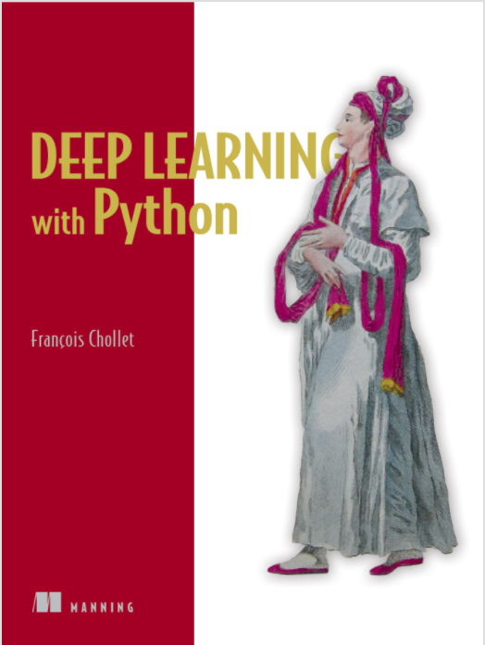
Books and Reading
Recommended textbook: “Deep learning”
by Goodfellow, Bengio, Courville
https://www.deeplearningbook.org/
Another recommended textbook: “Dive into Deep Learning” - https://d2l.ai/
Lots of further material available online, e.g.:
http://cs231n.stanford.edu/ http://course.fast.ai/
https://developers.google.com/machine-learning/crash-course/
www.nvidia.com/dlilabs http://introtodeeplearning.com/
https://github.com/oxford-cs-deepnlp-2017/lectures,
https://jalammar.github.io/
Coursera, Youtube, etc.
“Deep Learning with Python” by François Chollet
for labs + assignments

Slide 4
Course Schedule & Content
DATE | Overview | Lecture Details | Scope
Week 1 | Introduction - Course Structure, Logistics, Fundamentals of Machine Learning and Neural Networks | 1. Introduction to Neural Network, Multilayer Perceptron, Back Propagation Learning - What is Deep Learning? | BASICS
Week 2 | Fundamentals of Learning | 2. Introduction to Deep Learning, Bayesian Learning, Hebbian Learning, Decision Surfaces, Representation Learning. 3. Theory of Deep Learning (Universal approximation theorem, convergence rate, and recent mathematical results)
Week 3 | Mathematics & Fundamentals of Deep Learning | 4. Linear Classifiers, Linear Machines with Hinge Loss, Gradient Descent, Activation and Loss Functions. 5. Optimization Techniques, Gradient Descent, Batch Optimization, Introduction to Meta-Learning, Hessian-Free Optimization.
Week 4 | Deep Neural Networks | Deep Neural Networks: Features, Feature Representation, Representation Learning, BoFs/BoWs, Feature Maps, Deep vs. Shallow Nets | FUNDAMENTALS OF DEEP (CONVOLUTIONAL) LEARNING
Week 5 | Convolutional Neural Networks | 6. Convolutional Neural Networks, Building blocks of CNN | DEEP NEURAL NETWORKS - DEEP INTO DEEP LEARNING
Week 6 | Deep Convolutional Neural Networks | Pooling, Convolutional, Softmax Layers
Week 7 | Deep Convolutional Neural Networks | Optimizing ConvNets, Transfer Learning, Residual Networks
Week 8 | Deep Learning Optimization | 11. Deep Learning Model Optimization; Early Stopping/Exit, Dropout, Batch Normalization, Instance Normalization, Group Normalization, Pruning, Quantization, Hyperparameter Optimization.
Week 9 | Recurrent Neural Networks, Transformers | RNNs, LSTMs
Week 10 | Transformers, Attention | Attention Mechanisms and Transformer Networks | EMERGING DEEP LEARNING RESEARCH AND APPLICATIONS
Week 11 | Generative Adversarial Networks | Unsupervised Learning with Deep Network, Autoencoders Cont’d, 8. Generative Adversarial Networks, Adversarial Learning Models, Variational Autoencoders
Week 12 | Deep Reinforcement Learning - Graph Neural Networks | Deep Reinforcement Learning (Q-learning, actor-critic, policy gradient, experience replay, double Q-learning, deep bootstrap networks).
Week 13 | Graph Neural Networks and Deep Learning Trends | Graph Neural Networks – Graph Signal Processing, Convolutional Networks on Graphs, Gated Graph Sequence Networks, Semi-Supervised Graph Convolutional Networks Interpretable Deep Neural Networks DNNs for Vision and NLP - GPTS/LLMS
Exam Period | Final Exam | Comprehensive Final Exam | EVALUATION

Slide 5
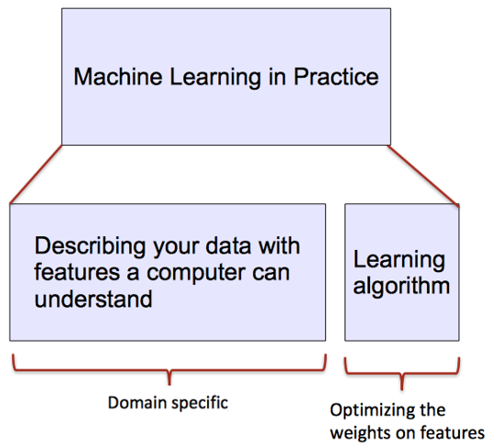
ML vs. Deep Learning
Introduction to Deep Learning
Conventional machine learning methods rely on human-designed feature representations
  ML becomes just optimizing weights to best make a final prediction
Picture from: Ismini Lourentzou – Introduction to Deep Learning

Slide 6
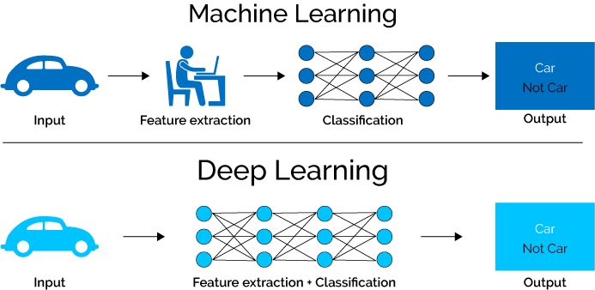
ML vs. Deep Learning
Introduction to Deep Learning
Deep learning (DL) is a machine learning subfield that uses multiple layers for learning data representations
  DL is exceptionally effective at learning patterns
Picture from: https://www.xenonstack.com/blog/static/public/uploads/media/machine-learning-vs-deep-learning.png

Slide 7




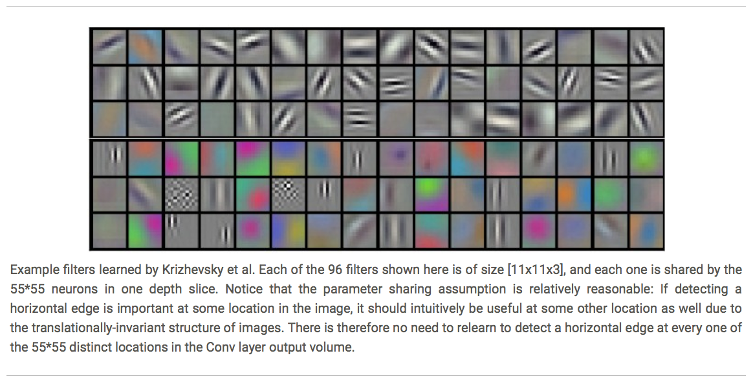














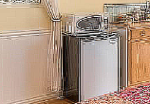

ML vs. Deep Learning
Introduction to Deep Learning
DL applies a multi-layer process for learning rich hierarchical features (i.e., data representations)
  Input image pixels → Edges → Textures → Parts → Objects
Low-Level Features
Mid-Level Features
High-Level Features
Trainable Classifier
Output
Slide credit: Param Vir Singh – Deep Learning

Slide 8
Why is DL Useful?
Introduction to Deep Learning
DL provides a flexible, learnable framework for representing visual, text, linguistic information
  Can learn in supervised and unsupervised manner
DL represents an effective end-to-end learning system
Requires large amounts of training data
Since about 2010, DL has outperformed other ML techniques
  First in vision and speech, then NLP, and other applications

Slide 9
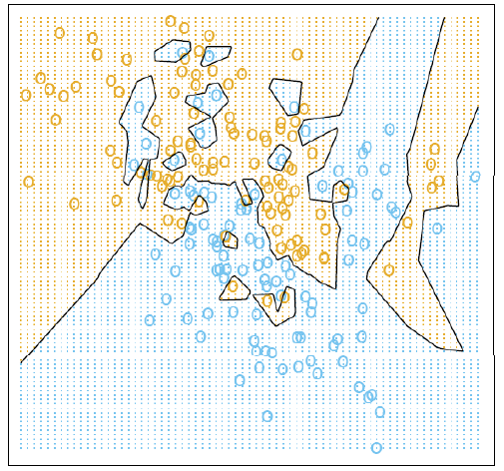
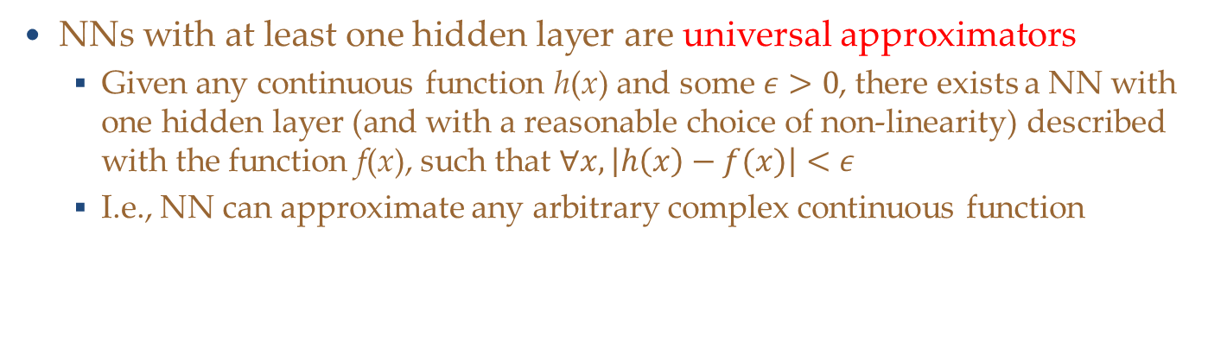
Representational Power
Introduction to Deep Learning
NNs with at least one hidden layer are universal approximators
  Given any continuous function h(x) and some $ε>0$, there exists a NN with one hidden layer (and with a reasonable choice of non-linearity) described with the function f(x), such that $∀x, \left|h\left(x\right)−f(x)\right|<ε$
  I.e., NN can approximate any arbitrary complex continuous function
NNs use nonlinear mapping of the inputs x to the outputs f(x) to compute complex decision boundaries
But then, why use deeper NNs?
  The fact that deep NNs work better is an empirical observation
  Mathematically, deep NNs have the same representational power as a one-layer NN

Slide 10
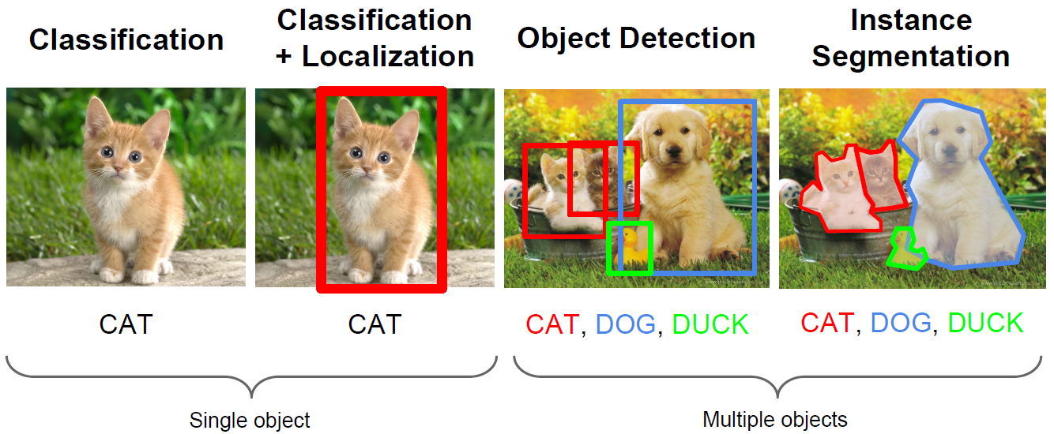
Computer Vision Tasks (DNNs EXCEL!)
Machine Learning Basics
Computer vision has been the primary area of interest for ML
The tasks include: classification, localization, object detection, instance segmentation
Picture from: Fie-Fei Li, Andrej Karpathy, Justin Johnson – Understanding and Visualizing CNNs

Slide 11
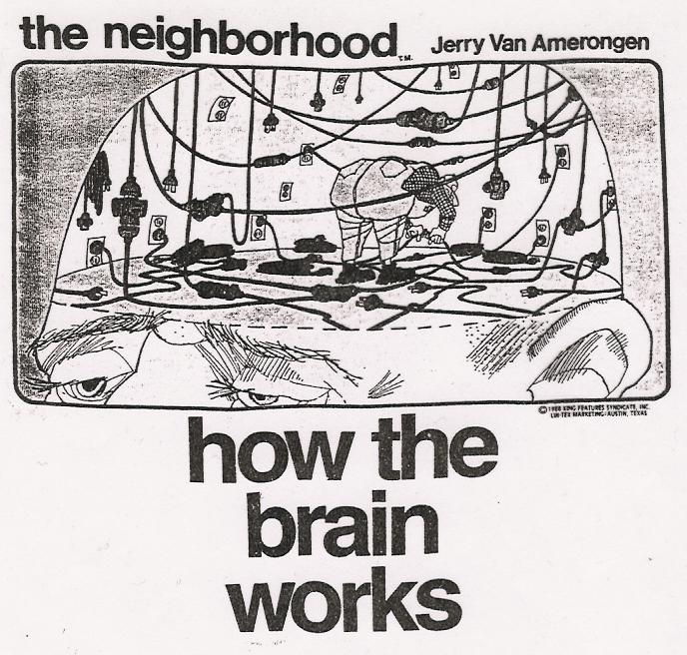
More Jargon!

Slide 12
Ensemble Learning
Ensemble Learning
Ensemble learning is training multiple classifiers separately and combining their predictions
  Ensemble learning often outperforms individual classifiers
  Better results obtained with higher model variety in the ensemble
  Bagging (bootstrap aggregating)
    Randomly draw subsets from the training set (i.e., bootstrap samples)
    Train separate classifiers on each subset of the training set
    Perform classification based on the average vote of all classifiers
  Boosting
    Train a classifier, and apply weights on the training set (apply higher weights on misclassified examples, focus on “hard examples”)
    Train new classifier, reweight training set according to prediction error
    Repeat
    Perform classification based on weighted vote of the classifiers

Slide 13
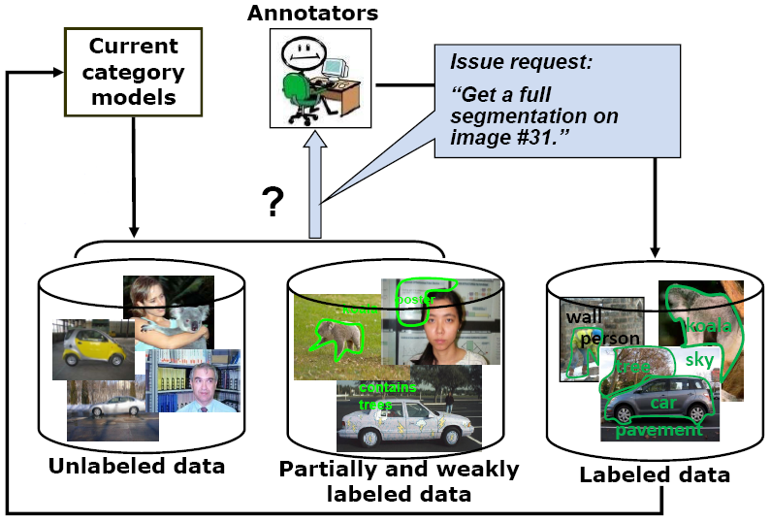
Active learning
The learning algorithm can choose its own training examples, or ask a “teacher” for an answer on selected inputs
S. Vijayanarasimhan and K. Grauman. Cost-Sensitive Active Visual Category Learning. IJCV 2010

Slide 14
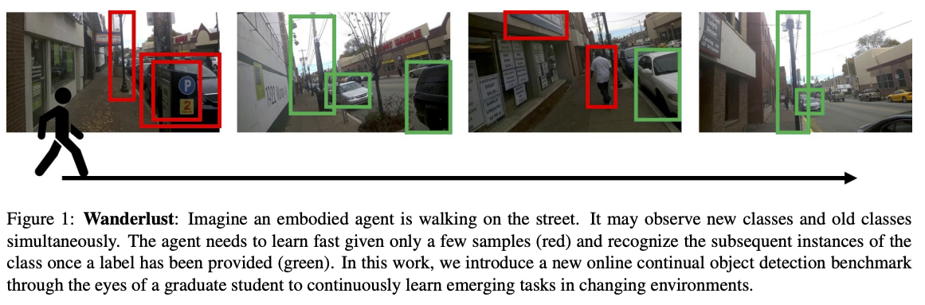
Lifelong or continual learning
J. Wang et al. Wanderlust: Online Continual Object Detection in the Real World. ICCV 2021

Slide 15
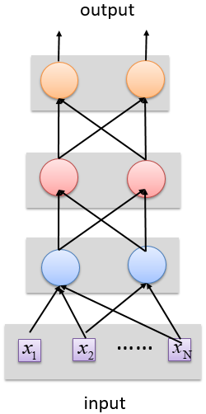
Deep vs Shallow Networks
Deep vs Shallow Networks
Deeper networks perform better than shallow networks
  But only up to some limit: after a certain number of layers, the performance of deeper networks plateaus
output
Shallow NN
Deep
NN
……
……
input
Slide credit: Hung-yi Lee – Deep Learning Tutorial

Slide 16
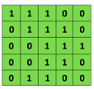
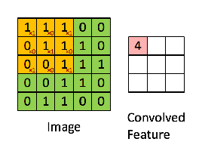

Convolutional Neural Networks (CNNs)
Convolutional Neural Networks
Convolutional neural networks (CNNs) were primarily designed for image data
CNNs use a convolutional operator for extracting data features
  Allows parameter sharing
  Efficient to train
  Have less parameters than NNs with fully-connected layers
CNNs are robust to spatial translations of objects in images
A convolutional filter slides (i.e., convolves) across the image
Convolutional
3x3 filter
Input matrix
Picture from: http://deeplearning.stanford.edu/wiki/index.php/Feature_extraction_using_convolution

Slide 17

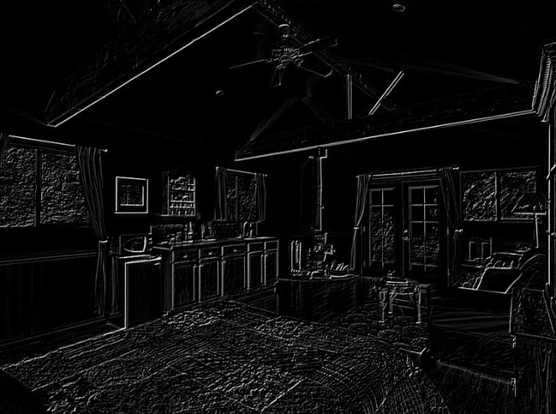
Convolutional Neural Networks (CNNs)
Convolutional Neural Networks
When the convolutional filters are scanned over the image, they capture useful features
  E.g., edge detection by convolutions
0 1 0
1 -4 1
0 1 0
Filter
Input Image
Convoluted Image
Slide credit: Param Vir Singh – Deep Learning

Slide 18
Convolutional Neural Networks (CNNs)
Convolutional Neural Networks
In CNNs, hidden units in a layer are only connected to a small region of the layer before it (called local receptive field)
  The depth of each feature map corresponds to the number of convolutional filters used at each layer
w1 | w2
w3 | w4
w5 | w6
w7 | w8
Filter 1
Filter 2
Input Image
Layer 1 Feature Map
Layer 2 Feature Map
Slide credit: Param Vir Singh – Deep Learning

Slide 19
Convolutional Neural Networks (CNNs)
Convolutional Neural Networks
Max pooling: reports the maximum output within a rectangular neighborhood
Average pooling: reports the average output of a rectangular neighborhood
Pooling layers reduce the spatial size of the feature maps
  Reduce the number of parameters, prevent overfitting
MaxPool with a 2×2 filter with stride of 2
1 | 3 | 5 | 3
4 | 2 | 3 | 1
3 | 1 | 1 | 3
0 | 1 | 0 | 4
4 | 5
3 | 4
Output Matrix
Input Matrix
Slide credit: Param Vir Singh – Deep Learning

Slide 20

Convolutional Neural Networks (CNNs)
Convolutional Neural Networks
Feature extraction architecture
  After 2 convolutional layers, a max-pooling layer reduces the size of the feature maps (typically by 2)
  A fully convolutional and a softmax layers are added last to perform classification
Living Room
Bedroom
64
64
128
128
256
256
256
512
512
512
512
512
512
Kitchen
Bathroom
Conv layer
Max Pool
Outdoor
Fully Connected Layer
Slide credit: Param Vir Singh – Deep Learning

Slide 21
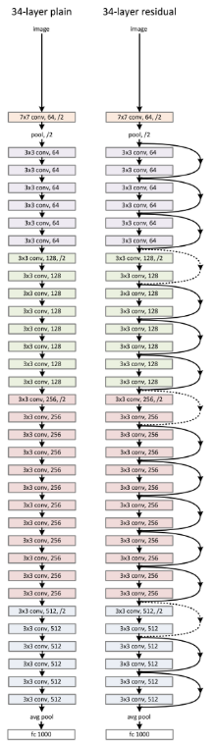
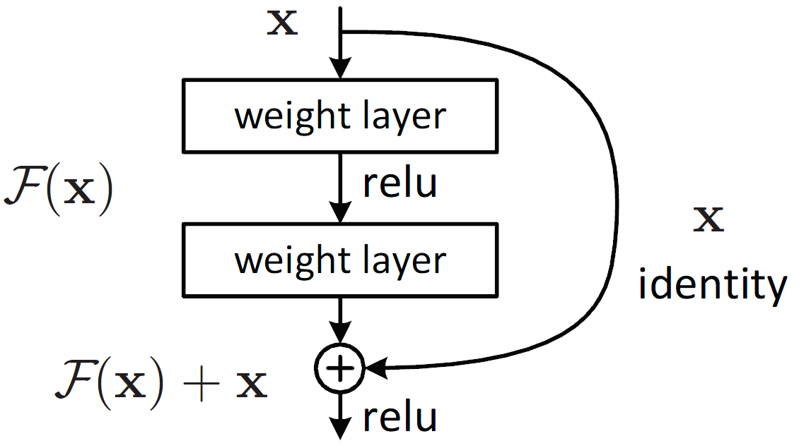
Residual CNNs
Convolutional Neural Networks
Residual networks (ResNets)
  Introduce “identity” skip connections
    Layer inputs are propagated and added to the layer output
    Mitigate the problem of vanishing gradients during training
    Allow training very deep NN (with over 1,000 layers)
  Several ResNet variants exist: 18, 34, 50, 101, 152, and 200 layers
  Are used as base models of other state-of-the-art NNs
    Other similar models: ResNeXT, DenseNet

Slide 22
Recurrent Neural Networks (RNNs)
Recurrent Neural Networks
Recurrent NNs are used for modeling sequential data and data with varying length of inputs and outputs
  Videos, text, speech, DNA sequences, human skeletal data
RNNs introduce recurrent connections between the neurons
  This allows processing sequential data one element at a time by selectively passing information across a sequence
  Memory of the previous inputs is stored in the model’s internal state and affect the model predictions
  Can capture correlations in sequential data
RNNs use backpropagation-through-time for training
RNNs are more sensitive to the vanishing gradient problem than CNNs

Slide 23














Recurrent Neural Networks (RNNs)
Recurrent Neural Networks
RNN use same set of weights $w_{h}$ and $w_{x}$ across all time steps
  A sequence of hidden states $\left\{h_{o},{h_{o}h}_{2},h_{3}, …\right\}$is learned, which represents the memory of the network
  The hidden state at step t, $h\left(t\right)$, is calculated based on the previous hidden state $h\left(t−1\right)$ and the input at the current step $x\left(t\right)$, i.e.,$h\left(t\right)=f_{h}\left(w_{h}∗h\left(t−1\right)+w_{x}∗x\left(t\right)\right)$
  The function $f_{h}\left(∙\right)$ is a nonlinear activation function, e.g., ReLU or tanh
RNN shown rolled over time
HIDDEN STATES SEQUENCE: ${h_{o},h}_{1},h_{2},h_{3}, ….$
OUTPUT
$$w_{h}$$
$$w_{h}$$
$$w_{h}$$
$$w_{y}$$
h0
$f_{h}$(·)
h1
$f_{h}$(·)
h2
$f_{h}$(·)
h3
$f_{y}$(·)
$$w_{x}$$
$$w_{x}$$
$$w_{x}$$
x1
x2
x3
INPUT SEQUENCE: $x_{1},x_{2},x_{3}, ….$
Slide credit: Param Vir Singh – Deep Learning

Slide 24
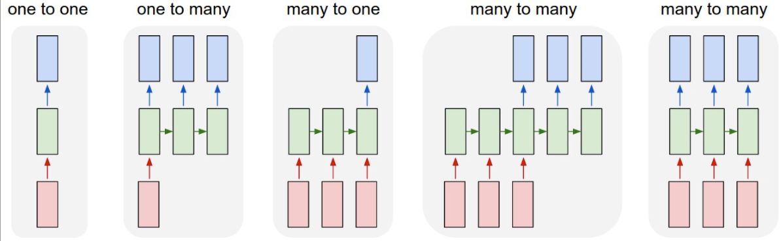

Recurrent Neural Networks (RNNs)
Recurrent Neural Networks
RNNs can have one of many inputs and one of many outputs
RNN
Application
Input
Output
Image Captioning
A person riding a motorbike on dirt road
Sentiment Analysis
Awesome movie. Highly recommended.
Positive
Machine Translation
Happy Diwali
शुभ दीपावली
Slide credit: Param Vir SIngh– Deep Learning

Slide 25
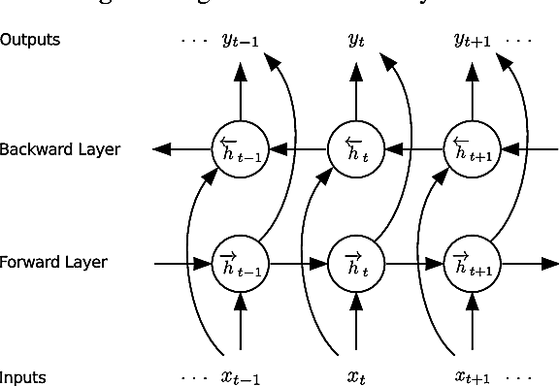



Bidirectional RNNs
Recurrent Neural Networks
Bidirectional RNNs incorporate both forward and backward passes through sequential data
  The output may not only depend on the previous elements in the sequence, but also on future elements in the sequence
  It resembles two RNNs stacked on top of each other
$${\overset{⃑}{h}}_{t}= σ({\overset{⃑}{W}}^{(hh)}{\overset{⃑}{h}}_{t−1}+{\overset{⃑}{W}}^{(hx)}x_{t})$$
$${\overset{⃖}{h}}_{t}= σ({\overset{⃖}{W}}^{(hh)}{\overset{⃖}{h}}_{t+1}+{\overset{⃖}{W}}^{(hx)}x_{t})$$
$$y_{t}=f\left( \left[{\overset{⃑}{h}}_{t}{;\overset{⃖}{h}}_{t}\right] \right)$$
Outputs both past and future elements
Slide credit: Param Vir Singh – Deep Learning

Slide 26
LSTM Networks
Recurrent Neural Networks
Long Short-Term Memory (LSTM) networks are a variant of RNNs
LSTM mitigates the vanishing/exploding gradient problem
  Solution: a Memory Cell, updated at each step in the sequence
Three gates control the flow of information to and from the Memory Cell
  Input Gate: protects the current step from irrelevant inputs
  Output Gate: prevents current step from passing irrelevant information to later steps
  Forget Gate: limits information passed from one cell to the next
Most modern RNN models use either LSTM units or other more advanced types of recurrent units (e.g., GRU units)

Slide 27
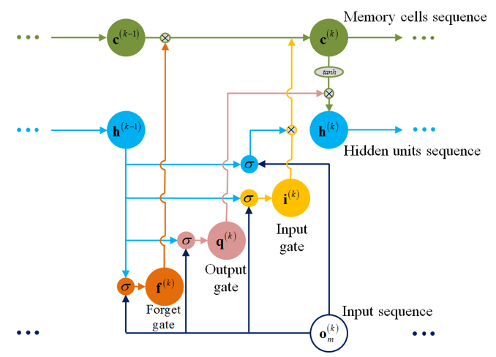
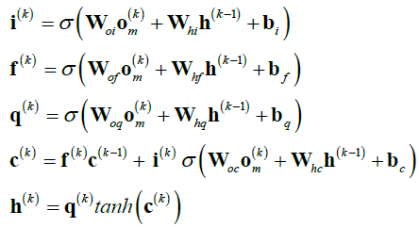
LSTM Networks
Recurrent Neural Networks
LSTM cell
  Input gate, output gate, forget gate, memory cell
  LSTM can learn long-term correlations within data sequences

Slide 28
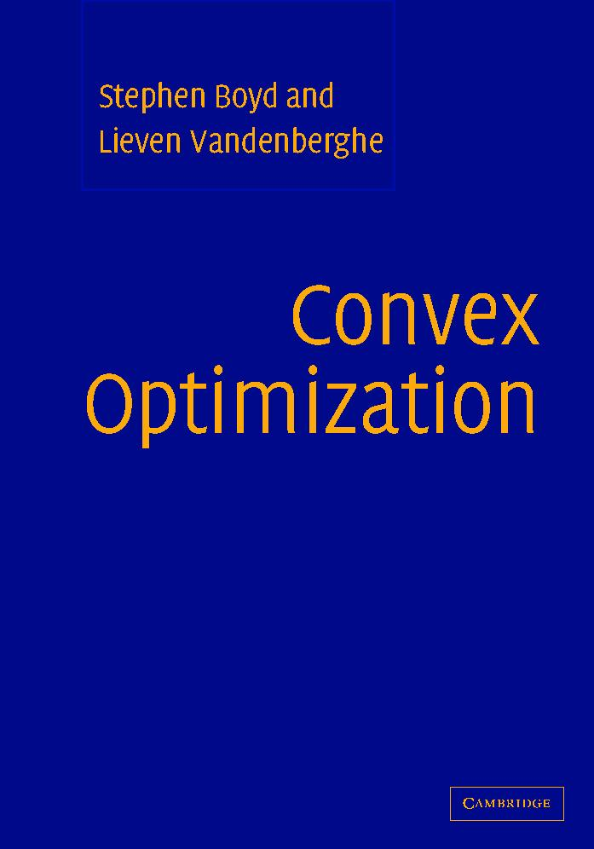

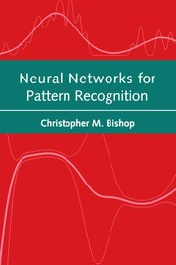
Books
Convex Optimization
Stephen Boyd and Lieven Vandenberghe
Cambridge University Press
Information Theory, Inference and Learning Algorithms
David J. C. MacKay
2003
Neural Networks for Pattern Recognition
Christopher M. Bishop

Slide 29
Neural Network as a Classifier
Weakness
  Long training time
  Require a number of parameters typically best determined empirically, e.g., the network topology or “structure.”
  Poor interpretability: Difficult to interpret the symbolic meaning behind the learned weights and of “hidden units” in the network
Strength
  High tolerance to noisy data
  Ability to classify untrained patterns
  Well-suited for continuous-valued inputs and outputs
  Successful on a wide array of real-world data
  Algorithms are inherently parallel
  Techniques have recently been developed for the extraction of rules from trained neural networks
29
Notes:
29

Slide 30
But, how does this all work!
Y = [w₀x₀ + w₁x₁ + ... + w_{n}x_{n} ] + t
Output
MAC (weights*inputs) + Thresholding
f
Output N_{i}

Slide 31
A Neuron (= a perceptron)
-
t
x₀
w₀
x₁
w₁
∑
f
output y
x_{n}
w_{n}
Input
vector x
weight
vector w
weighted
sum
Activation
function
The n-dimensional input vector x is mapped into variable y by means of the scalar product and a nonlinear function mapping
31
Notes:
31

Slide 32
Perceptron
Basic unit in a neural network
Linear separator
Parts
  N inputs, x₁ ... x_{n}
  Weights for each input, w₁ ... w_{n}
  A bias input x₀ (constant) and associated weight w₀
  Weighted sum of inputs, y = w₀x₀ + w₁x₁ + ... + w_{n}x_{n}
  A threshold function or activation function,
    i.e 1 if y > t, -1 if y <= t

Slide 33
Artificial Neural Networks (ANN)
Model is an assembly of inter-connected nodes and weighted links
Output node sums up each of its input value according to the weights of its links
Compare output node against some threshold t
Perceptron Model
or

Slide 34
Different Network Topologies
Single layer feed-forward networks
  Input layer projecting into the output layer
Single layer
network
Input Output
layer layer

Slide 35
Different Network Topologies
Multi-layer feed-forward networks
  One or more hidden layers. Input projects only from previous layers onto a layer.
2-layer or
1-hidden layer
fully connected
network
Input Hidden Output
layer layer layer

Slide 36
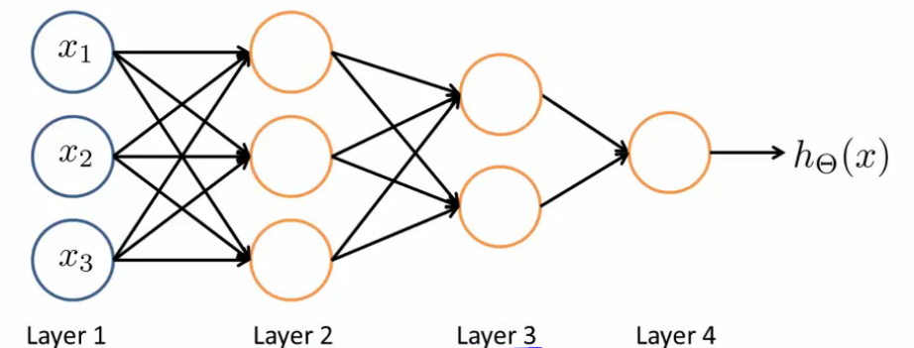
Different Network Topologies
Multi-layer feed-forward networks
Input Hidden Output
layer layers layer

Slide 37
Artificial Neural Networks (ANN)

Slide 38
A Multi-Layer Feed-Forward Neural Network
Output vector
Output layer
Hidden layer
w_{ij}
Input layer
Input vector: X
19 April, 2024
Data Mining: Concepts and Techniques
38
Notes:
38

Slide 39
General Structure of ANN
Training ANN means learning the weights of the neurons

Slide 40
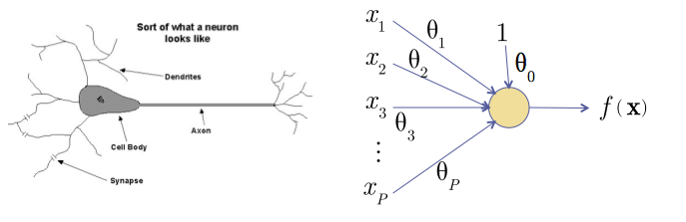
Recall: The Neuron Metaphor
Neurons
  accept information from multiple inputs,
  transmit information to other neurons.
Multiply inputs by weights along edges
Apply some function to the set of inputs at each node

Slide 41

Types of Neurons
Linear Neuron
Logistic Neuron
Potentially more. Require a convex
loss function for gradient descent training.
Perceptron

Slide 42
Multilayer Networks
Cascade Neurons together
The output from one layer is the input to the next
Each Layer has its own sets of weights

Slide 43
Linear Regression Neural Networks
What happens when we arrange linear neurons in a multilayer network?

Slide 44



Linear Regression Neural Networks
Nothing special happens.
  The product of two linear transformations is itself a linear transformation.
Notes:
f(x,\vec{\theta})&=&\sum_{i=0}^D\theta_{1,i}\sum_{n=0}^{N-1}\theta_{0,i,n} {x_n}\\f(x,\vec{\theta})&=&\sum_{i=0}^D\theta_{1,i}[\theta_{0,i}^T\vec{x}]\\f(x,\vec{\theta})&=&\sum_{i=0}^D[\hat\theta_{i}^T\vec{x}]\\

Slide 45
Neural Networks
We want to introduce non-linearities to the network.
  Non-linearities allow a network to identify complex regions in space

Slide 46
Linear Separability
1-layer cannot handle XOR
More layers can handle more complicated spaces – but require more parameters
Each node splits the feature space with a hyperplane
If the second layer is AND a 2-layer network can represent any convex hull.

Slide 47
Feed-Forward Networks
Predictions are fed forward through the network to classify

Slide 48
Feed-Forward Networks
Predictions are fed forward through the network to classify

Slide 49
Feed-Forward Networks
Predictions are fed forward through the network to classify

Slide 50
Feed-Forward Networks
Predictions are fed forward through the network to classify

Slide 51
Feed-Forward Networks
Predictions are fed forward through the network to classify

Slide 52
Feed-Forward Networks
Predictions are fed forward through the network to classify

Slide 53
Algorithm for learning ANN
Initialize the weights (w₀, w₁, …, w_{k})
Adjust the weights in such a way that the output of ANN is consistent with class labels of training examples
  Error function:
  Find the weights w_{i}’s that minimize the above error function
    e.g., gradient descent, backpropagation algorithm

Slide 54
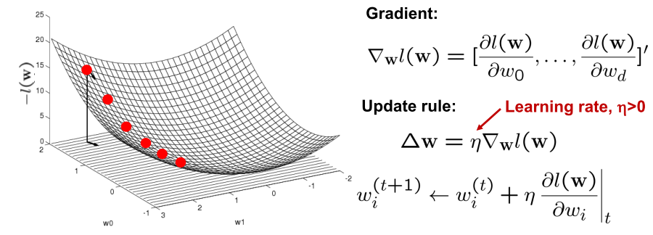
Optimizing concave/convex function
Maximum of a concave function = minimum of a convex function
Gradient ascent (concave) / Gradient descent (convex)
Gradient ascent rule

Slide 55
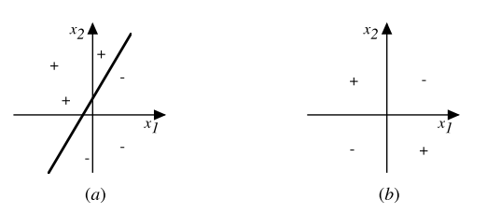
Decision surface of a perceptron
Decision surface is a hyperplane
  Can capture linearly separable classes
Non-linearly separable
  Use a network of them

Slide 56
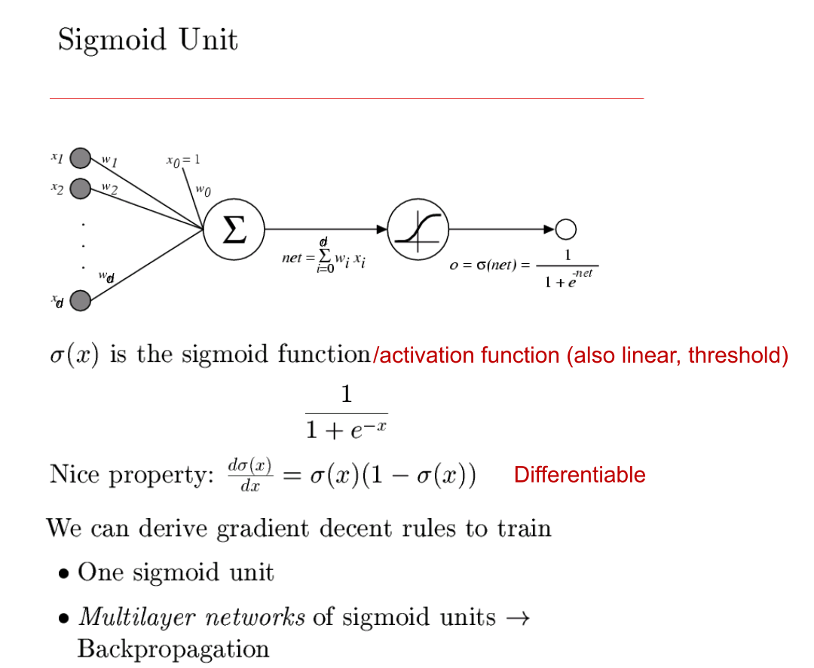

Slide 57
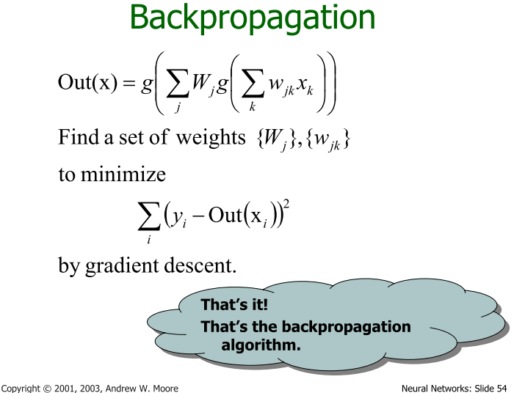

Slide 58


Why backpropagation
Neural networks are sequences of parametrized functions
x
$$h(x;θ)$$
conv
subsample
conv
subsample
linear
filters
filters
weights
Parameters
$$θ$$

Slide 59
Why backpropagation
Neural networks are sequences of parametrized functions
Parameters need to be set by minimizing some loss function
Convolutional network

Slide 60
Why backpropagation
Neural networks are sequences of parametrized functions
Parameters need to be set by minimizing some loss function
Minimization through gradient descent requires computing the gradient

Slide 61
Why backpropagation
Neural networks are sequences of parametrized functions
Parameters need to be set by minimizing some loss function
Minimization through gradient descent requires computing the gradient

Slide 62
Why backpropagation
Neural networks are sequences of parametrized functions
Parameters need to be set by minimizing some loss function
Minimization through gradient descent requires computing the gradient
Backpropagation: way to compute gradient

Slide 63
The gradient of (conv)nets
z₁
z₂
z₃
z₄
z₅ = z
f₁
f₂
f₃
f₄
f₅
x
w₁
w₂
w₃
w₄
w₅

Slide 64
The gradient of (conv)nets
z₁
z₂
z₃
z₄
z₅ = z
f₁
f₂
f₃
f₄
f₅
x
w₁
w₂
w₃
w₄
w₅

Slide 65
The gradient of (conv)nets
z₁
z₂
z₃
z₄
z₅ = z
f₁
f₂
f₃
f₄
f₅
x
w₁
w₂
w₃
w₄
w₅

Slide 66
The gradient of (conv)nets
z₁
z₂
z₃
z₄
z₅ = z
f₁
f₂
f₃
f₄
f₅
x
w₁
w₂
w₃
w₄
w₅

Slide 67
The gradient of (conv)nets
z₁
z₂
z₃
z₄
z₅ = z
f₁
f₂
f₃
f₄
f₅
x
w₁
w₂
w₃
w₄
w₅

Slide 68
The gradient of (conv)nets
z₁
z₂
z₃
z₄
z₅ = z
f₁
f₂
f₃
f₄
f₅
x
w₁
w₂
w₃
w₄
w₅

Slide 69
The gradient of (conv)nets
z₁
z₂
z₃
z₄
z₅ = z
f₁
f₂
f₃
f₄
f₅
x
w₁
w₂
w₃
w₄
w₅
Recurrence going backward!!

Slide 70
The gradient of (conv)nets
z₁
z₂
z₃
z₄
z₅ = z
f₁
f₂
f₃
f₄
f₅
x
w₁
w₂
w₃
w₄
w₅
Backpropagation

Slide 71
Backpropagation for a sequence of functions
Assume we can compute partial derivatives of each function
Use g(z_{i}) to store gradient of z w.r.t z_{i}, g(w_{i}) for w_{i}
Calculate g(z_{i} ) by iterating backwards
Use g(z_{i}) to compute gradient of parameters

Slide 72
Loss as a function
label
conv
subsample
conv
subsample
linear
loss
filters
filters
weights

Slide 73
Putting it all together: SGD training
Sample image and label
Image
label
conv
subsample
conv
subsample
linear
loss
filters
filters
weights

Slide 74
Putting it all together: SGD training
Sample image and label
Pass image through network to get loss (forward)
Image
label
conv
subsample
conv
subsample
linear
loss
filters
filters
weights

Slide 75
Putting it all together: SGD training
Sample image and label
Pass image through network to get loss (forward)
Backpropagate to get gradients (backward)
Image
label
conv
subsample
conv
subsample
linear
loss
filters
filters
weights

Slide 76
Putting it all together: SGD training
Sample image and label
Pass image through network to get loss (forward)
Backpropagate to get gradients (backward)
Take step along negative gradients to update weights
Image
label
conv
subsample
conv
subsample
linear
loss
filters
filters
weights

Slide 77
Putting it all together: SGD training
Sample image and label
Pass image through network to get loss (forward)
Backpropagate to get gradients (backward)
Take step along negative gradients to update weights
Repeat!
Image
label
conv
subsample
conv
subsample
linear
loss
filters
filters
weights

Slide 78
Error Backpropagation
We will do gradient descent on the whole network.
Training will proceed from the last layer to the first.

Slide 79
Error Backpropagation
Introduce variables over the neural network
Notes:
\vec{\theta}=\{w_{ij}, w_{jk}, w_{kl}\}

Slide 80
Error Backpropagation
Introduce variables over the neural network
  Distinguish the input and output of each node
Notes:
\vec{\theta}=\{w_{ij}, w_{jk}, w_{kl}\}

Slide 81



Error Backpropagation
Notes:
\vec{\theta}=\{w_{ij}, w_{jk}, w_{kl}\}

Slide 82
Error Backpropagation
Training: Take the gradient of the last component and iterate backwards
Notes:
\vec{\theta}=\{w_{ij}, w_{jk}, w_{kl}\}

Slide 83
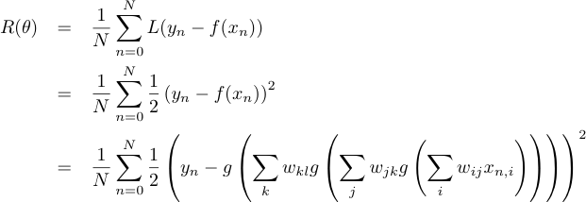
Error Backpropagation
Empirical Risk Function

Slide 84


Error Backpropagation
Optimize last layer weights w_{kl}
Calculus chain rule
Notes:
\frac{\partial R}{\partial w_{kl}}=\frac{1}{N}\sum_n\left[\frac{\partial L_n}{\partial a_{l,n}}\right]\left[\frac{\partial a_{l,n}}{\partial w_{kl}}\right]

Slide 85

Error Backpropagation
Optimize last layer weights w_{kl}
Calculus chain rule

Slide 86

Error Backpropagation
Optimize last layer weights w_{kl}
Calculus chain rule

Slide 87
Error Backpropagation
Optimize last layer weights w_{kl}
Calculus chain rule

Slide 88
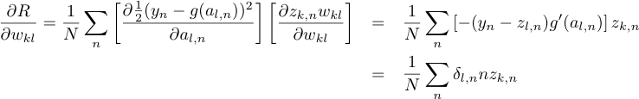
Error Backpropagation
Optimize last layer weights w_{kl}
Calculus chain rule

Slide 89


Error Backpropagation
Optimize last hidden weights w_{jk}
Notes:
\frac{\partial R}{\partial w_{kl}}=\frac{1}{N}\sum_n\left[\frac{\partial \frac{1}{2}(y_n-g(a_{l,n}))^2}{\partial a_{l,n}}\right]\left[\frac{\partial z_{k,n}w_{kl}}{\partial w_{kl}}\right]&=&\sum_n\left[-(y_n-z_{l,n})g'(a_{l,n})\right]z_{k,n}\\&=&\sum_n\delta_nz_{k,n}

Slide 90

Error Backpropagation
Optimize last hidden weights w_{jk}
Multivariate chain rule
Notes:
\frac{\partial R}{\partial w_{kl}}=\frac{1}{N}\sum_n\left[\frac{\partial \frac{1}{2}(y_n-g(a_{l,n}))^2}{\partial a_{l,n}}\right]\left[\frac{\partial z_{k,n}w_{kl}}{\partial w_{kl}}\right]&=&\sum_n\left[-(y_n-z_{l,n})g'(a_{l,n})\right]z_{k,n}\\&=&\sum_n\delta_nz_{k,n}

Slide 91

Error Backpropagation
Optimize last hidden weights w_{jk}
Multivariate chain rule
Notes:
\frac{\partial R}{\partial w_{kl}}=\frac{1}{N}\sum_n\left[\frac{\partial \frac{1}{2}(y_n-g(a_{l,n}))^2}{\partial a_{l,n}}\right]\left[\frac{\partial z_{k,n}w_{kl}}{\partial w_{kl}}\right]&=&\sum_n\left[-(y_n-z_{l,n})g'(a_{l,n})\right]z_{k,n}\\&=&\sum_n\delta_nz_{k,n}

Slide 92

Error Backpropagation
Optimize last hidden weights w_{jk}
Multivariate chain rule
Notes:
\frac{\partial R}{\partial w_{kl}}=\frac{1}{N}\sum_n\left[\frac{\partial \frac{1}{2}(y_n-g(a_{l,n}))^2}{\partial a_{l,n}}\right]\left[\frac{\partial z_{k,n}w_{kl}}{\partial w_{kl}}\right]&=&\sum_n\left[-(y_n-z_{l,n})g'(a_{l,n})\right]z_{k,n}\\&=&\sum_n\delta_nz_{k,n}

Slide 93

Error Backpropagation
Optimize last hidden weights w_{jk}
Multivariate chain rule
Notes:
\frac{\partial R}{\partial w_{jk}}=\frac{1}{N}\sum_n\left[\sum_l\delta_l w_{kl}g'(a_{k,n})\right]\left[z_{j,n}\right]\\

Slide 94
Error Backpropagation
Repeat for all previous layers
Notes:
\frac{\partial R}{\partial w_{ij}}&=&\frac{1}{N}\sum_n\left[\frac{\partial L_n}{\partial a_{j,n}}\right]\left[\frac{\partial a_{j,n}}{\partial w_{ij}}\right]=\frac{1}{N}\sum_n\left[ \sum_k\delta_{k,n}w_{jk}g'(a_{j,n}) \right]z_{i,n} =\frac{1}{N} \sum_n\delta_{j,n}z_{i,n}

Slide 95
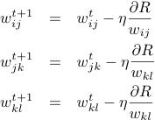
Error Backpropagation
Now that we have well defined gradients for each parameter, update using Gradient Descent
Notes:
\frac{\partial R}{\partial w_{jk}}=\frac{1}{N}\sum_n\left[\sum_l\delta_l w_{kl}g'(a_{k,n})\right]\left[z_{j,n}\right]\\

Slide 96
Error Back-propagation
Error backprop unravels the multivariate chain rule and solves the gradient for each partial component separately.
The target values for each layer come from the next layer.
This feeds the errors back along the network.

Slide 97
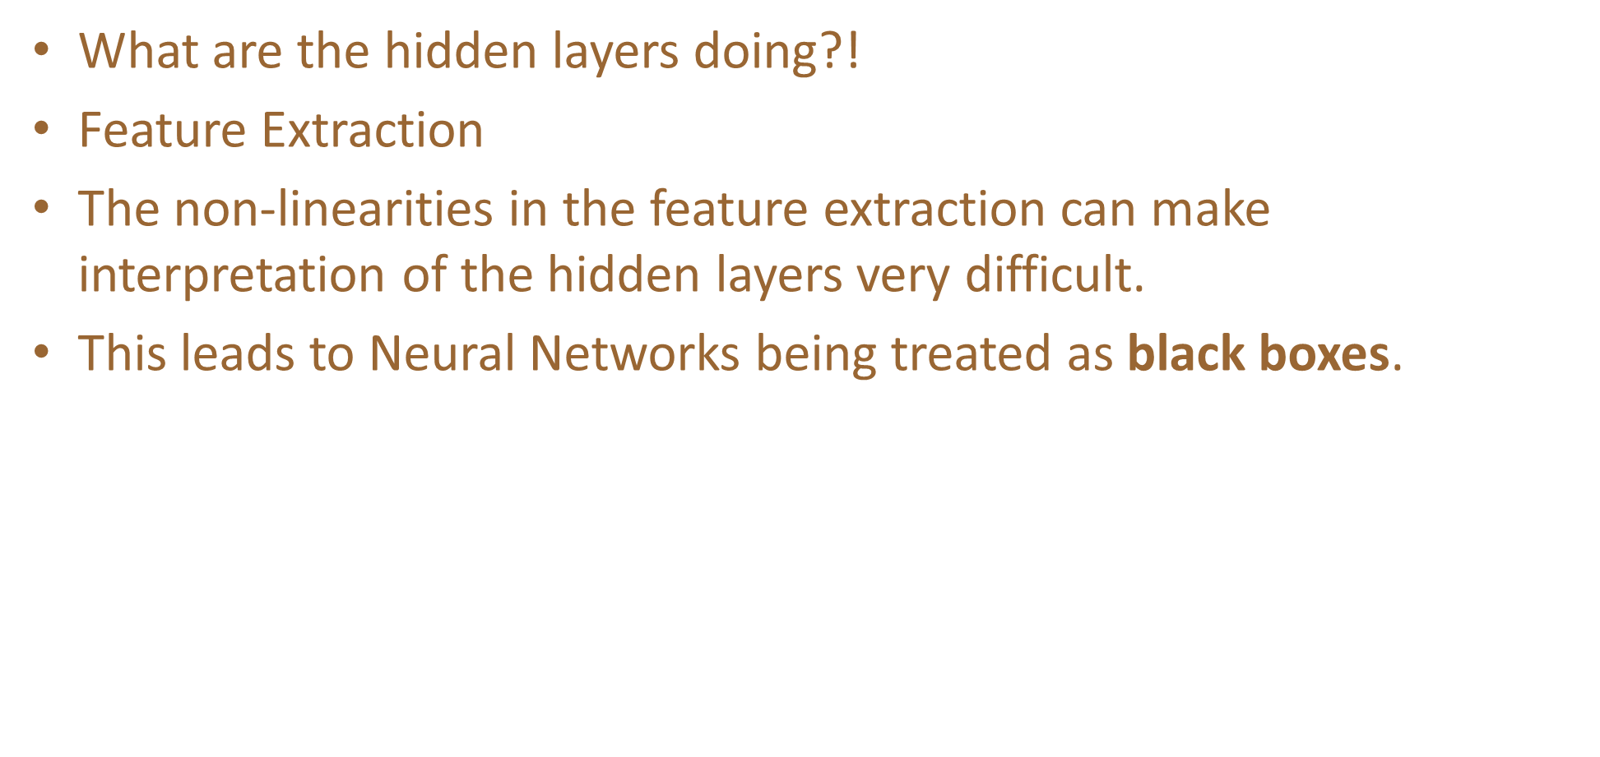
Problems with backpropagation!!!
Interpretation of Hidden Layers
Overfitting

Slide 98
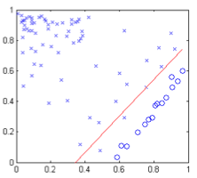
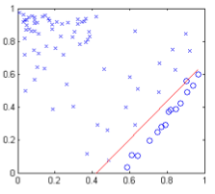
Overfitting in Neural Networks
Neural Networks are especially prone to overfitting.
Recall Perceptron Error
  Zero error is possible, but so is more extreme overfitting
Logistic
Regression
Perceptron

Slide 99
Multiple Outputs
Used for N-way classification.
Each Node in the output layer corresponds to a different class.
No guarantee that the sum of the output vector will equal 1.

Slide 101
Supplementary Material
Adopted from Dr. Alex Vakanski, University of Idaho
Mathematics of ML – Terminology and Fundamentals

Slide 102
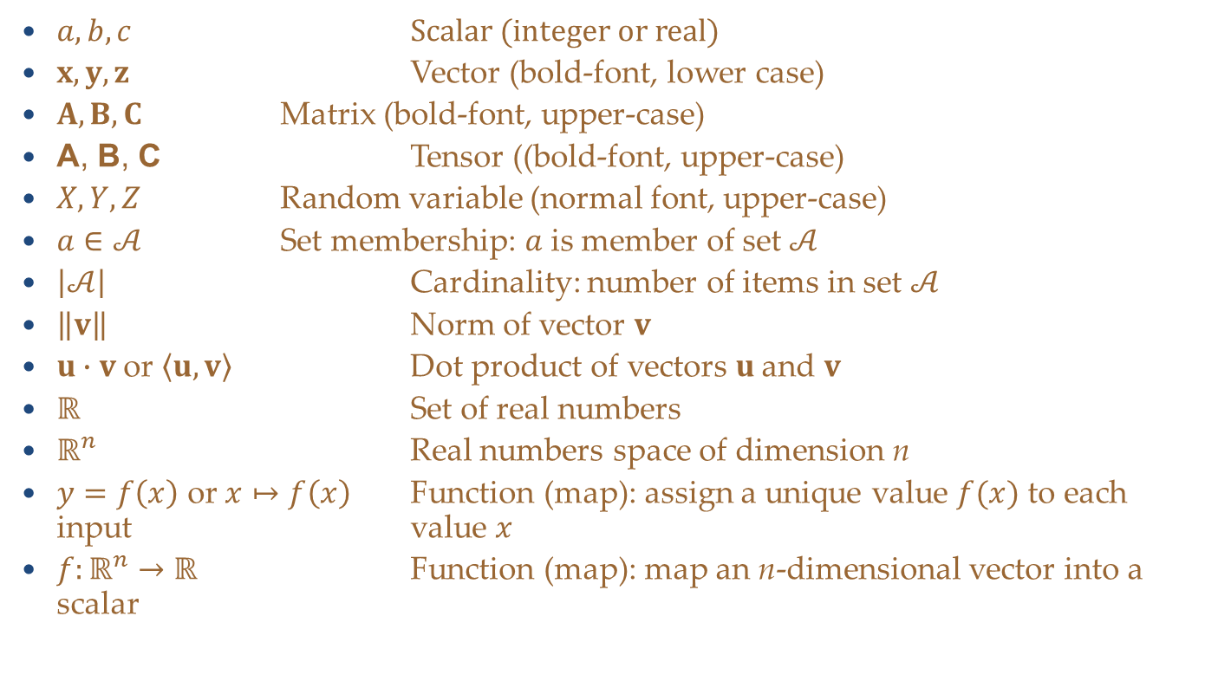
Notation
$a, b, c$ Scalar (integer or real)
$x, y, z$ Vector (bold-font, lower case)
$A, B, C$ Matrix (bold-font, upper-case)
$\text{A}\text{, }\text{B}\text{, }\text{C}$ Tensor ((bold-font, upper-case)
$X, Y, Z$ Random variable (normal font, upper-case)
$a∈𝒜$ Set membership: $a$ is member of set $𝒜$
$\left|𝒜\right|$ Cardinality: number of items in set $𝒜$
$\left\|v\right\|$ Norm of vector $v$
$u∙v$or $\left\langle u, v\right\rangle$ Dot product of vectors $u$and $v$
$ℝ$ Set of real numbers
$ℝ^{n}$ Real numbers space of dimension n
$y=f\left(x\right)$ or$x↦f\left(x\right)$ Function (map): assign a unique value $f(x)$ to each input value $x$
$f:ℝ^{n}→ℝ$ Function (map): map an n-dimensional vector into a scalar

Slide 103
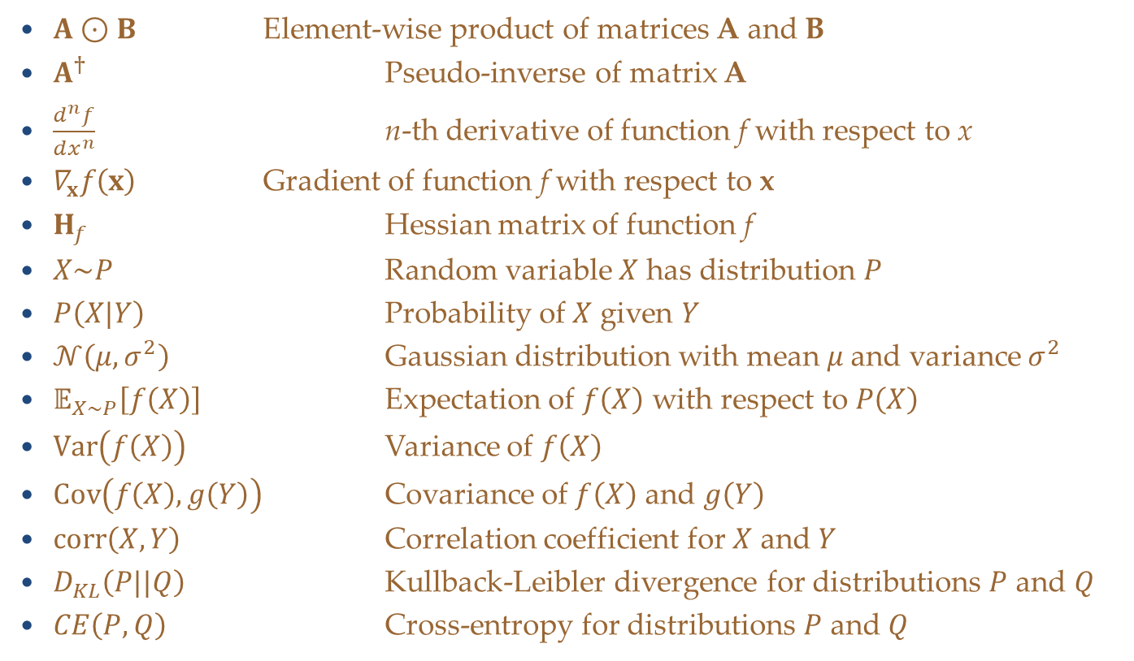
Notation
$A⊙B$ Element-wise product of matrices A and B
$A^{†}$ Pseudo-inverse of matrix A
$\frac{d^{n}f}{dx^{n}}$ n-th derivative of function f with respect to x
$∇_{x}f\left(x\right)$ Gradient of function f with respect to x
$H_{f}$ Hessian matrix of function f
$X\sim P$ Random variable $X$ has distribution $P$
$P\left(X|Y\right)$ Probability of $X$ given $Y$
$𝒩\left(μ,σ^{2}\right)$ Gaussian distribution with mean $μ$and variance $σ^{2}$
$𝔼_{X\sim P}\left[f\left(X\right)\right]$ Expectation of $f\left(X\right)$ with respect to $P\left(X\right)$
$Var\left(f\left(X\right)\right)$ Variance of $f\left(X\right)$
$Cov\left(f\left(X\right),g\left(Y\right)\right)$ Covariance of $f\left(X\right)$ and $g\left(Y\right)$
$corr\left(X,Y\right)$ Correlation coefficient for $X$ and $Y$
$D_{KL}\left(P||Q\right)$ Kullback-Leibler divergence for distributions $P$ and $Q$
$CE\left(P,Q\right)$ Cross-entropy for distributions $P$ and $Q$

Slide 104
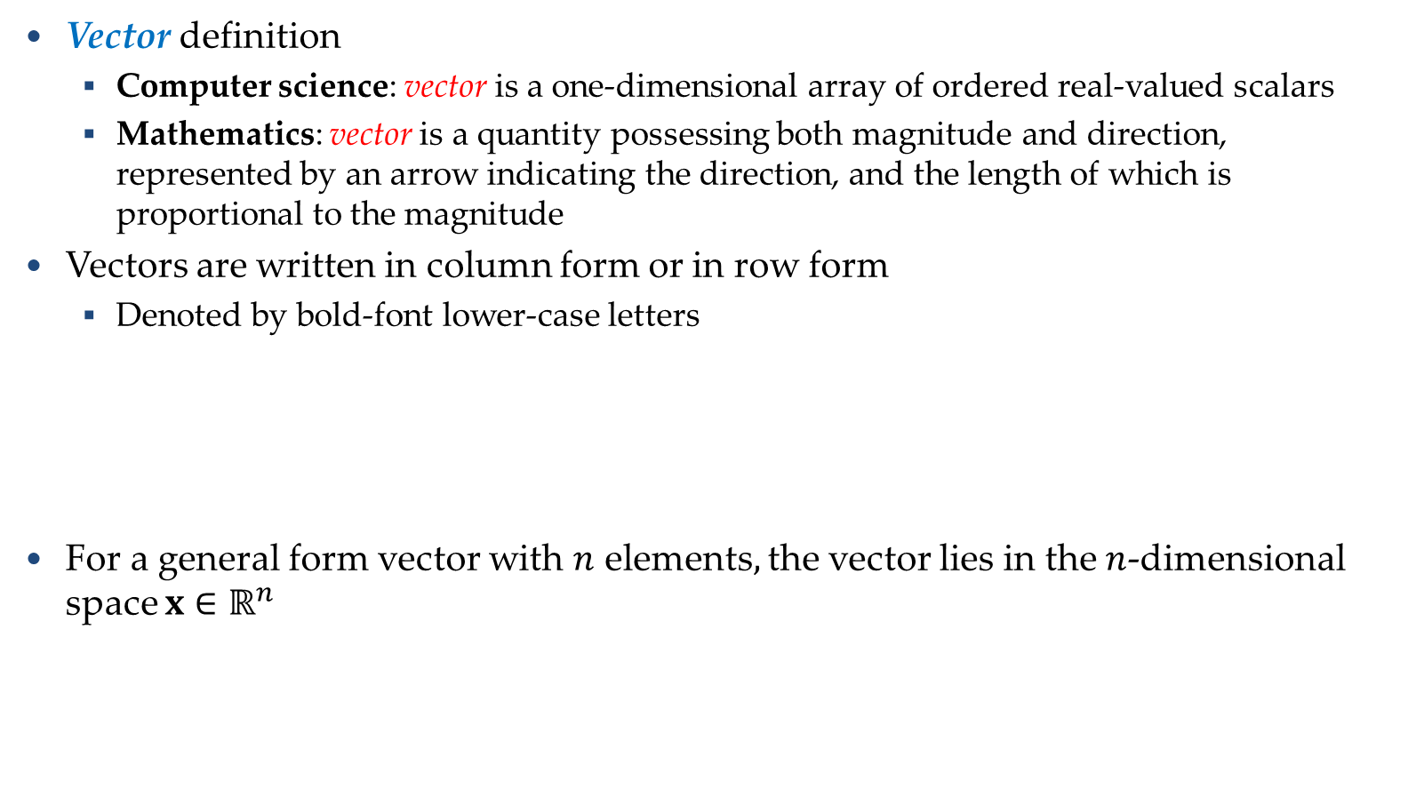



Vectors
Vectors
Vector definition
  Computer science: vector is a one-dimensional array of ordered real-valued scalars
  Mathematics: vector is a quantity possessing both magnitude and direction, represented by an arrow indicating the direction, and the length of which is proportional to the magnitude
Vectors are written in column form or in row form
  Denoted by bold-font lower-case letters
For a general form vector with $n$ elements$,$ the vector lies in the $n$-dimensional space ${x∈ℝ}^{n}$
$x=\left[\begin{matrix}1 \\ \begin{matrix}7 \\ 0\end{matrix} \\ 1\end{matrix}\right]$
$x={\left[\begin{matrix}1 & 7 & \begin{matrix}0 & 1\end{matrix}\end{matrix}\right]}^{T}$
$x=\left[\begin{matrix}x_{1} \\ \begin{matrix}x_{2} \\ ⋮\end{matrix} \\ x_{n}\end{matrix}\right]$

Slide 105
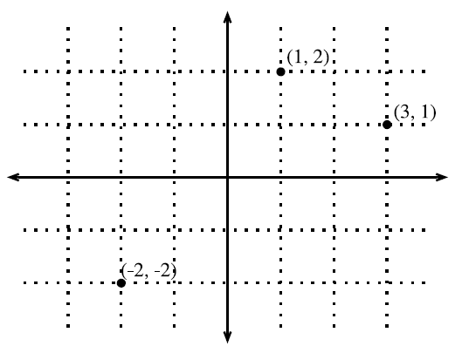
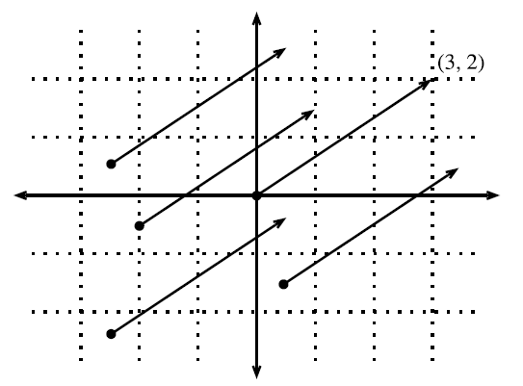
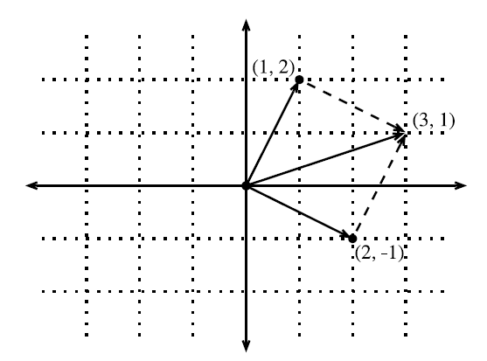
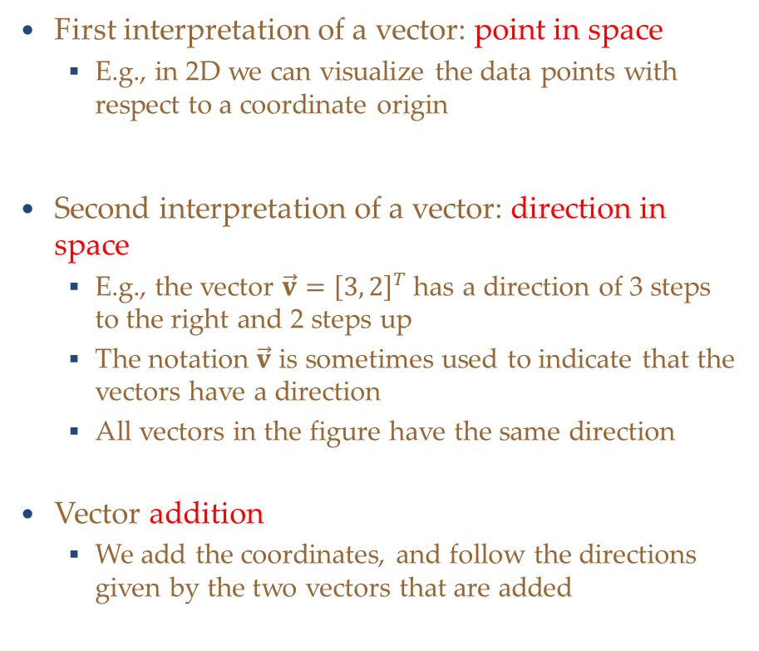
Geometry of Vectors
Vectors
First interpretation of a vector: point in space
  E.g., in 2D we can visualize the data points with respect to a coordinate origin
Second interpretation of a vector: direction in space
  E.g., the vector $\vec{v}={\left[3, 2\right]}^{T}$ has a direction of 3 steps to the right and 2 steps up
  The notation $\vec{v}$ is sometimes used to indicate that the vectors have a direction
  All vectors in the figure have the same direction
Vector addition
  We add the coordinates, and follow the directions given by the two vectors that are added
Picture from: http://d2l.ai/chapter_appendix-mathematics-for-deep-learning/geometry-linear-algebraic-ops.html#geometry-of-vectors

Slide 106
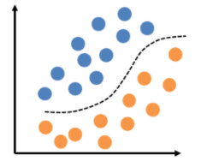
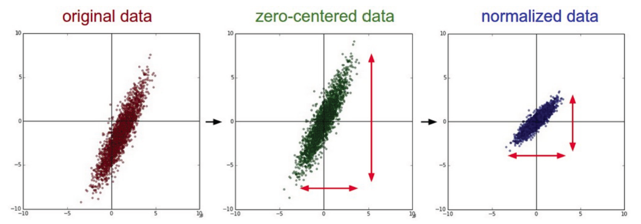
Geometry of Vectors
Vectors
The geometric interpretation of vectors as points in space allow us to consider a training set of input examples in ML as a collection of points in space
  Hence, classification can be viewed as discovering how to separate two clusters of points belonging to different classes (left picture)
    Rather than distinguishing images containing cars, planes, buildings, for example
  Or, it can help to visualize zero-centering and normalization of training data (right picture)

Slide 107
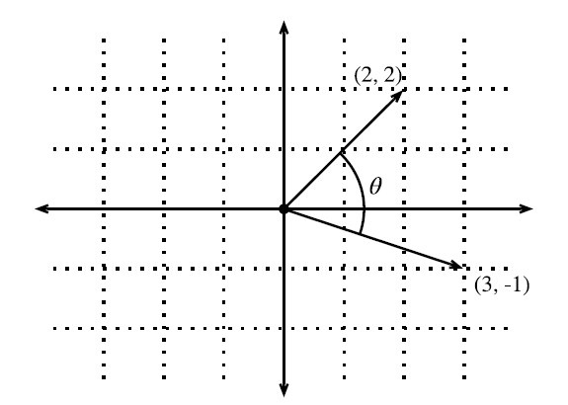



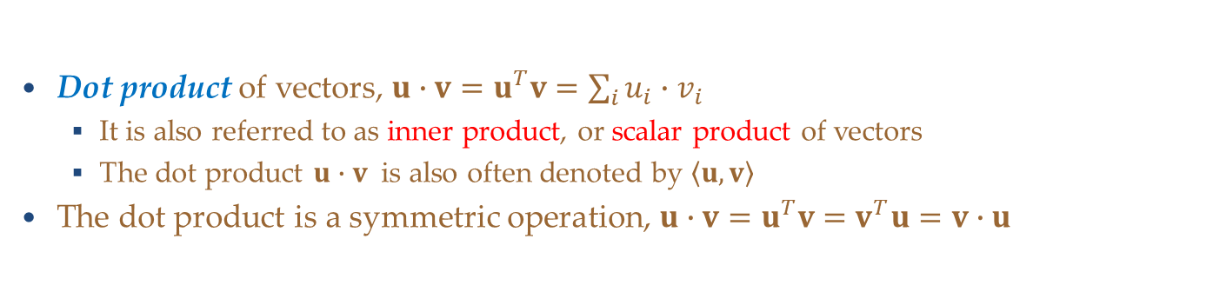

Dot Product and Angles
Vectors
Dot product of vectors, ${u∙v=u}^{T}v=\sum_{i}{u_{i}∙v_{i}}$
  It is also referred to as inner product, or scalar product of vectors
  The dot product $u∙v$ is also often denoted by $\left\langle u, v\right\rangle$
The dot product is a symmetric operation, ${u∙v=u}^{T}v=v^{T}u=v∙u$
Geometric interpretation of a dot product: angle between two vectors
  I.e., dot product $v∙w$over the norms of the vectors is $cos\left(θ\right)$
$$cosθ=\frac{u∙v}{\left\|u\right\|\left\|v\right\|}$$
$$u∙v=\left\|u\right\|\left\|v\right\|cos\left(θ\right)$$
If two vectors are orthogonal: $θ=90°$, i.e., $cos(θ)=0$, then $u∙v=0$
Also, in ML the term $cosθ=\frac{u∙v}{\left\|u\right\|\left\|v\right\|}$ is sometimes employed as a measure of closeness of two vectors/data instances, and it is referred to as cosine similarity
Picture from: http://d2l.ai/chapter_appendix-mathematics-for-deep-learning/geometry-linear-algebraic-ops.html#geometry-of-vectors

Slide 108


Norm of a Vector
Vectors
A vector norm is a function that maps a vector to a scalar value
  The norm is a measure of the size of the vector
The norm $f$ should satisfy the following properties:
  Scaling: $f\left(αx\right)=\left|α\right|f\left(x\right)$
  Triangle inequality: $f\left(x+y\right)≤f\left(x\right)+f\left(y\right)$
  Must be non-negative: $f\left(x\right)≥0$
The general $ℓ_{p}$ norm of a vector $x$ is obtained as:
  On next page we will review the most common norms, obtained for $p=1, 2,$ and $∞$
$${\left\|x\right\|}_{p}={\left(\sum_{i=1}^{n}{{\left|x_{i}\right|}^{p}}\right)}^{\frac{1}{p}}$$

Slide 109




Norm of a Vector
Vectors
$${\left\|x\right\|}_{2}=\sqrt{\sum_{i=1}^{n}{x_{i}^{2}}}=\sqrt{x^{T}x}$$
For $p=2,$we have $ℓ_{2}$ norm
  Also called Euclidean norm
  It is the most often used norm
  $ℓ_{2}$ norm is often denoted just as $\left\|x\right\|$ with the subscript 2 omitted
For $p=1,$we have $ℓ_{1}$ norm
  Uses the absolute values of the elements
  Discriminate between zero and non-zero elements
For $p=∞,$we have $ℓ_{∞}$ norm
  Known as infinity norm, or max norm
  Outputs the absolute value of the largest element
$ℓ_{0}$ norm outputs the number of non-zero elements
  It is not an $ℓ_{p}$ norm, and it is not really a norm function either (it is incorrectly called a norm)
$${\left\|x\right\|}_{1}=\sum_{i=1}^{n}{\left|x_{i}\right|}$$
$${\left\|x\right\|}_{∞}=\max_{i}\left|x_{i}\right|$$

Slide 110


Vector Projection
Vectors
Orthogonal projection of a vector $y$ onto vector $x$
  The projection can take place in any space of dimensionality ≥ 2
  The unit vector in the direction of $x$ is $\frac{x}{\left\|x\right\|}$
    A unit vector has norm equal to 1
  The length of the projection of $y$ onto $x$is $\left\|y\right\|∙cos\left(θ\right)$
  The orthogonal project is the vector${ proj}_{x}\left(y\right)$
  $${proj}_{x}\left(y\right)=\frac{x∙\left\|y\right\|∙cos\left(θ\right)}{\left\|x\right\|}$$
Slide credit: Jeff Howbert — Machine Learning Math Essentials

Slide 111


Hyperplanes
Hyperplanes
Hyperplane is a subspace whose dimension is one less than that of its ambient space
  In a 2D space, a hyperplane is a straight line (i.e., 1D)
  In a 3D, a hyperplane is a plane (i.e., 2D)
  In a d-dimensional vector space, a hyperplane has $d−1$ dimensions, and divides the space into two half-spaces
Hyperplane is a generalization of a concept of plane in high-dimensional space
In ML, hyperplanes are decision boundaries used for linear classification
  Data points falling on either sides of the hyperplane are attributed to different classes
Picture from: https://kgpdag.wordpress.com/2015/08/12/svm-simplified/

Slide 112





Hyperplanes
Hyperplanes
For example, for a given data point $w={\left[2, 1\right]}^{T}$, we can use dot-product to find the hyperplane for which $w∙v=1$
  I.e., all vectors with $w∙v>1$ can be classified as one class, and all vectors with $w∙v<1$ can be classified as another class
Solving $w∙v=1$, we obtain
  I.e., the solution is the set of points for which $w∙v=1$ meaning the points lay on the line that is orthogonal to the vector $w$
    That is the line $2x+y=1$
  The orthogonal projection of $v$ onto $w$ is $\left\|v\right\|cos\left(θ\right)=\frac{1}{\sqrt{5}}$
$$w$$
Picture from: http://d2l.ai/chapter_appendix-mathematics-for-deep-learning/geometry-linear-algebraic-ops.html#hyperplanes

Slide 113


Hyperplanes
Hyperplanes
In a 3D space, if we have a vector $w={\left[1, 2, 3\right]}^{T}$ and try to find all points that satisfy $w∙v=1$, we can obtain a plane that is orthogonal to the vector $w$
  The inequalities $w∙v>1$ and $w∙v<1$ again define the two subspaces that are created by the plane
The same concept applies to high-dimensional spaces as well
Picture from: http://d2l.ai/chapter_appendix-mathematics-for-deep-learning/geometry-linear-algebraic-ops.html#hyperplanes

Slide 114


Matrices
Matrices
Matrix is a rectangular array of real-valued scalars arranged in m horizontal rows and n vertical columns
  Each element $a_{ij}$ belongs to the i^{th} row and j^{th} column
  The elements are denoted $a_{ij}$ or $A_{ij}$ or${ \left[A\right]}_{ij}$ or $A\left(i,j\right)$
For the matrix $A∈ℝ^{m×n}$, the size (dimension) is $m×n$ or $\left(m,n\right)$
  Matrices are denoted by bold-font upper-case letters

Slide 115




Matrices
Matrices
Addition or subtraction
Scalar multiplication
Matrix multiplication
  Defined only if the number of columns of the left matrix is the same as the number of rows of the right matrix
  Note that $AB≠BA$

Slide 116




Matrices
Matrices
Transpose of the matrix: $A^{T}$has the rows and columns exchanged
  Some properties
Square matrix: has the same number of rows and columns
Identity matrix ( I_{n} ): has ones on the main diagonal, and zeros elsewhere
  E.g.: identity matrix of size 3×3 :
$$A+B=B+A$$
$${\left(A+B \right)}^{T}=A^{T}+B^{T}$$
$${\left(A^{T}\right)}^{T}=A$$
$$A\left(B+C\right)=AB+AC$$
$$A\left(BC\right)=\left(AB\right)C$$
$${\left(AB \right)}^{T}=B^{T}A^{T}$$

Slide 117

Matrices
Matrices
Determinant of a matrix, denoted by det(A) or $\left|A\right|,$ is a real-valued scalar encoding certain properties of the matrix
  E.g., for a matrix of size 2×2:
  For larger-size matrices the determinant of a matrix id calculated as
  $$det\left(A\right)=\sum_{j}{a_{ij}{\left(−1\right)}^{i+j}det\left(A_{\left(i,j\right)}\right)}$$
  In the above, $A_{\left(i,j\right)}$ is a minor of the matrix obtained by removing the row and column associated with the indices i and j
Trace of a matrix is the sum of all diagonal elements
$$Tr\left(A\right)=\sum_{i}{a_{ii}}$$
A matrix for which $A=A^{T}$ is called a symmetric matrix

Slide 118


Matrices
Matrices
Elementwise multiplication of two matrices A and B is called the Hadamard product or elementwise product
  The math notation is $⊙$

Slide 119



Matrix-Vector Products
Matrices
Consider a matrix $A∈ℝ^{m×n}$ and a vector $x∈ℝ^{n}$
The matrix can be written in terms of its row vectors (e.g., $a_{1}^{T}$is the first row)
The matrix-vector product is a column vector of length m, whose i^{th} element is the dot product $a_{i}^{T}x$
Note the size: $A\left(m×n\right)∙x\left(n×1\right)=Ax\left(m×1\right)$

Slide 120



Matrix-Matrix Products
Matrices
To multiply two matrices $A∈ℝ^{n×k}$and $B∈ℝ^{k×m}$
We can consider the matrix-matrix product as dot-products of rows in $A$ and columns in $B$
Size: $A\left(n×k\right)∙B\left(k×m\right)=C\left(n×m\right)$

Slide 121



Linear Dependence
Matrices
$$B=\left[\begin{matrix}2 & −1 \\ 4 & −2\end{matrix}\right]$$
For the following matrix
Notice that for the two columns $b_{1}={\left[2, 4\right]}^{T}$ and ${ b}_{2}={\left[−1, −2\right]}^{T}$, we can write ${ b}_{1}=−2∙{ b}_{2}$
  This means that the two columns are linearly dependent
The weighted sum ${a_{1}b}_{1}+a_{2}b_{2}$ is referred to as a linear combination of the vectors${ b}_{1}$ and $b_{2}$
  In this case, a linear combination of the two vectors exist for which ${ b}_{1}+2∙{ b}_{2}=0$
A collection of vectors $v_{1},v_{2},…,$ $v_{k}$ are linearly dependent if there exist coefficients $a_{1},a_{2},…,a_{k}$ not all equal to zero, so that
If there is no linear dependence, the vectors are linearly independent

Slide 122


Matrix Rank
Matrices
For an $n×m$ matrix, the rank of the matrix is the largest number of linearly independent columns
The matrix B from the previous example has $rank\left(B\right)=1$, since the two columns are linearly dependent
The matrix C below has $rank\left(C\right)=2$, since it has two linearly independent columns
  I.e., ${ c}_{4}=−1∙{ c}_{1}$, ${ c}_{5}=−1∙{ c}_{3}$, ${ c}_{2}=3∙{ c}_{1}$ $+3∙{ c}_{3}$
  $$C=\left[\begin{matrix}1 & 3 \\ −1 & 0 \\ \begin{matrix}0 \\ 2\end{matrix} & \begin{matrix}−3 \\ 3\end{matrix}\end{matrix} \begin{matrix}0 & −1 & 0 \\ 1 & 1 & −1 \\ \begin{matrix}1 \\ −1\end{matrix} & \begin{matrix}0 \\ −2\end{matrix} & \begin{matrix}−1 \\ 1\end{matrix}\end{matrix}\right]$$
$$B=\left[\begin{matrix}2 & −1 \\ 4 & −2\end{matrix}\right]$$

Slide 123


Inverse of a Matrix
Matrices
For a square $n×n$ matrix A with rank $n$, $A^{−1}$ is its inverse matrix if their product is an identity matrix I
Properties of inverse matrices
If $det\left(A\right)=0$(i.e., $rank\left(A\right)<n$), then the inverse does not exist
  A matrix that is not invertible is called a singular matrix
Note that finding an inverse of a large matrix is computationally expensive
  In addition, it can lead to numerical instability
If the inverse of a matrix is equal to its transpose, the matrix is said to be orthogonal matrix

Slide 124

Pseudo-Inverse of a Matrix
Matrices
Pseudo-inverse of a matrix
  Also known as Moore-Penrose pseudo-inverse
For matrices that are not square, the inverse does not exist
  Therefore, a pseudo-inverse is used
If $m>n$, then the pseudo-inverse is $A^{†}={\left(A^{T}A\right)}^{−1}A^{T}$ and $A^{†}A=I$
If $m<n$, then the pseudo-inverse is $A^{†}=A^{T}{\left(AA^{T}\right)}^{−1}$ and ${AA}^{†}=I$
  E.g., for a matrix with dimension $X_{2×3}$, a pseudo-inverse can be found of size $X_{3×2}^{†}$, so that ${X_{2×3}X}_{3×2}^{†}=I_{2×2}$

Slide 125

Tensors
Tensors
Tensors are n-dimensional arrays of scalars
  Vectors are first-order tensors, $v∈ℝ^{n}$
  Matrices are second-order tensors, $A∈ℝ^{m×n}$
  E.g., a fourth-order tensor is $\text{T}∈ℝ^{n_{1}×n_{2}×n_{3}×n_{4}}$
Tensors are denoted with upper-case letters of a special font face (e.g., $\text{X}\text{, }\text{Y}\text{, }\text{Z}$)
RGB images are third-order tensors, i.e., as they are 3-dimensional arrays
  The 3 axes correspond to width, height, and channel
  E.g., 224 × 224 × 3
  The channel axis corresponds to the color channels (red, green, and blue)

Slide 126
Manifolds
Manifolds
Earlier we learned that hyperplanes generalize the concept of planes in high-dimensional spaces
  Similarly, manifolds can be informally imagined as generalization of the concept of surfaces in high-dimensional spaces
To begin with an intuitive explanation, the surface of the Earth is an example of a two-dimensional manifold embedded in a three-dimensional space
  This is true because the Earth looks locally flat, so on a small scale it is like a 2-D plane
  However, if we keep walking on the Earth in one direction, we will eventually end up back where we started
    This means that Earth is not really flat, it only looks locally like a Euclidean plane, but at large scales it folds up on itself, and has a different global structure than a flat plane

Slide 127

Manifolds
Manifolds
Manifolds are studied in mathematics under topological spaces
An n-dimensional manifold is defined as a topological space with the property that each point has a neighborhood that is homeomorphic to the Euclidean space of dimension n
  This means that a manifold locally resembles Euclidean space near each point
  Informally, a Euclidean space is locally smooth, it does not have holes, edges, or other sudden changes, and it does not have intersecting neighborhoods
  Although the manifolds can have very complex structure on a large scale, resemblance of the Euclidean space on a small scale allows to apply standard math concepts
Examples of 2-dimensional manifolds are shown in the figure
  The surfaces in the figure have been conveniently cut up into little rectangles that were glued together
  Those small rectangles locally look like flat Euclidean planes
Picture from: http://bjlkeng.github.io/posts/manifolds/

Slide 128


Manifolds
Manifolds
Examples of one-dimensional manifolds
  Upper figure: a circle is a l-D manifold embedded in 2-D, where each arc of the circle locally resembles a line segment
  Lower figures: other examples of 1-D manifolds
  Note that a number 8 figure is not a manifold because it has an intersecting point (it is not Euclidean locally)
It is hypothesized that in the real-world, high-dimensional data (such as images) lie on low-dimensional manifolds embedded in the high-dimensional space
  E.g., in ML, let’s assume we have a training set of images with size $224×224×3$ pixels
  Learning an arbitrary function in such high-dimensional space would be intractable
  Despite that, all images of the same class (“cats” for example) might lie on a low-dimensional manifold
  This allows function learning and image classification
Picture from: http://bjlkeng.github.io/posts/manifolds/

Slide 129


Manifolds
Manifolds
Example:
  The data points have 3 dimensions (left figure), i.e., the input space of the data is 3-dimensional
  The data points lie on a 2-dimensional manifold, shown in the right figure
  Most ML algorithms extract lower-dimensional data features that enable to distinguish between various classes of high-dimensional input data
    The low-dimensional representations of the input data are called embeddings

Slide 130

Eigen Decomposition
Eigen Decomposition
Eigen decomposition is decomposing a matrix into a set of eigenvalues and eigenvectors
Eigenvalues of a square matrix $A$ are scalars $λ$ and eigenvectors are non-zero vectors $v$ that satisfy
$$Av=λv$$
Eigenvalues are found by solving the following equation
$det\left(A−λI \right)=0$
If a matrix $A$ has n linearly independent eigenvectors $\left\{v^{1},…,v^{n}\right\}$ with corresponding eigenvalues $\left\{λ_{1},…{,λ}_{n}\right\}$, the eigen decomposition of $A$ is given by
$$A=VΛ{V }^{−1}$$
  Columns of the matrix $V$ are the eigenvectors, i.e., $V=\left[v^{1},…,v^{n}\right]$
  $Λ$is a diagonal matrix of the eigenvalues, i.e., $Λ=\left[λ_{1},…{,λ}_{n}\right]$
To find the inverse of the matrix A, we can use$A^{−1}=VΛ^{−1}{V }^{−1}$
  This involves simply finding the inverse $Λ^{−1}$ of a diagonal matrix

Slide 131

Eigen Decomposition
Eigen Decomposition
Decomposing a matrix into eigenvalues and eigenvectors allows to analyze certain properties of the matrix
  If all eigenvalues are positive, the matrix is positive definite
  If all eigenvalues are positive or zero-valued, the matrix is positive semidefinite
  If all eigenvalues are negative or zero-values, the matrix is negative semidefinite
    Positive semidefinite matrices are interesting because they guarantee that $∀x$, $x^{T}Ax≥0$
Eigen decomposition can also simplify many linear-algebraic computations
  The determinant of A can be calculated as
  $$det\left(A\right)=λ_{1}∙λ_{2}{⋯λ}_{n}$$
  If any of the eigenvalues are zero, the matrix is singular (it does not have an inverse)
However, not every matrix can be decomposed into eigenvalues and eigenvectors
  Also, in some cases the decomposition may involve complex numbers
  Still, every real symmetric matrix is guaranteed to have an eigen decomposition according to $A=VΛ{V }^{−1}$, where $V$ is an orthogonal matrix

Slide 132


Eigen Decomposition
Eigen Decomposition
Geometric interpretation of the eigenvalues and eigenvectors is that they allow to stretch the space in specific directions
  Left figure: the two eigenvectors $v^{1}$ and $v^{2}$are shown for a matrix, where the two vectors are unit vectors (i.e., they have a length of 1)
  Right figure: the vectors $v^{1}$ and $v^{2}$ are multiplied with the eigenvalues $λ_{1}$ and $λ_{2}$
    We can see how the space is scaled in the direction of the larger eigenvalue $λ_{1}$
E.g., this is used for dimensionality reduction with PCA (principal component analysis) where the eigenvectors corresponding to the largest eigenvalues are used for extracting the most important data dimensions
Picture from: Goodfellow (2017) – Deep Learning

Slide 133

Singular Value Decomposition
Singular Value Decomposition
Singular value decomposition (SVD) provides another way to factorize a matrix, into singular vectors and singular values
  SVD is more generally applicable than eigen decomposition
  Every real matrix has an SVD, but the same is not true of the eigen decomposition
    E.g., if a matrix is not square, the eigen decomposition is not defined, and we must use SVD
SVD of an $m×n$ matrix $A$ is given by
$$A=UDV^{T}$$
  $U$ is an $m×m$ matrix, $D$ is an $m×n$ matrix, and $V$ is an $n×n$ matrix
  The elements along the diagonal of $D$ are known as the singular values of A
  The columns of $U$ are known as the left-singular vectors
  The columns of $V$ are known as the right-singular vectors
For a non-square matrix $A$, the squares of the singular values $σ_{i}$ are the eigenvalues $λ_{i}$ of $A^{T}A$, i.e., $σ_{i}^{2}=λ_{i}$ for $i=1,2,…,n$
Applications of SVD include computing the pseudo-inverse of non-square matrices, matrix approximation, determining the matrix rank

Slide 134





Matrix Norms
Matrix Norms
$${\left\|X\right\|}_{F}=\sqrt{\sum_{i=1}^{m}{\sum_{j=1}^{n}{x_{ij}^{2}}}}$$
Frobenius norm – calculates the square-root of the summed squares of the elements of matrix $X$
  This norm is similar to Euclidean norm of a vector
Spectral norm – is the largest singular value of matrix $X$
  Denoted ${\left\|X\right\|}_{2}$
  The singular values of $X$ are $σ_{1}, σ_{2}$,…, $σ_{m}$
$L_{2,1}$ norm – is the sum of the Euclidean norms of the columns of matrix $X$
Max norm – is the largest element of matrix X
$${\left\|X\right\|}_{2}=σ_{max}\left(X\right)$$
$${\left\|X\right\|}_{2,1}=\sum_{j=1}^{n}{\sqrt{\sum_{i=1}^{m}{x_{ij}^{2}}}}$$
$${\left\|X\right\|}_{max}=\max_{i,j}\left(x_{ij}\right)$$

Slide 135

Differential Calculus
Differential Calculus
For a function $f:ℝ→ℝ,$the derivative of f is defined as
$$f^{′}\left(x\right)=\lim_{h→0}{\frac{f\left(x+h\right)−f\left(x\right)}{h}}$$
If $f^{′}\left(a\right)$ exists, f is said to be differentiable at a
If f ‘$\left(c\right)$ is differentiable for $∀c∈\left[a,b\right]$, then f is differentiable on this interval
  We can also interpret the derivative $f′(x)$as the instantaneous rate of change of $f(x)$ with respect to x
  I.e., for a small change in x, what is the rate of change of $f(x)$
Given $y=f(x)$, where x is an independent variable and y is a dependent variable, the following expressions are equivalent:
$$f^{′}\left(x\right)=f^{′}=\frac{dy}{dx}=\frac{df}{dx}=\frac{d}{dx}f\left(x\right)=Df\left(x\right)=D_{x}f(x)$$
The symbols $\frac{d}{dx}$, D, and $D_{x}$ are differentiation operators that indicate operation of differentiation

Slide 136



Differential Calculus
Differential Calculus
The following rules are used for computing the derivatives of explicit functions

Slide 137

Higher Order Derivatives
Differential Calculus
The derivative of the first derivative of a function $f\left(x\right)$ is the second derivative of $f\left(x\right)$
$$\frac{d^{2}f}{dx^{2}}=\frac{d}{dx}\left(\frac{df}{dx}\right)$$
The second derivative quantifies how the rate of change of $f\left(x\right)$ is changing
  E.g., in physics, if the function describes the displacement of an object, the first derivative gives the velocity of the object (i.e., the rate of change of the position)
  The second derivative gives the acceleration of the object (i.e., the rate of change of the velocity)
If we apply the differentiation operation any number of times, we obtain the n-th derivative of $f\left(x\right)$
$$f^{\left(n\right)}\left(x\right)=\frac{d^{n}f}{dx^{n}}={\left(\frac{d}{dx}\right)}^{n}f\left(x\right)$$

Slide 138



Taylor Series
Differential Calculus
Taylor series provides a method to approximate any function $f(x)$ at a point $x_{0}$ if we have the first n derivatives$\left\{f\left(x_{0}\right), f^{\left(1\right)}\left(x_{0}\right),f^{\left(2\right)}\left(x_{0}\right),…,f^{\left(n\right)}\left(x_{0}\right)\right\}$
For instance, for $n=2$, the second-order approximation of a function $f(x)$ is
$$f\left(x\right)≈{\left.\frac{1}{2}\frac{d^{2}f}{dx^{2}}\right|}_{x_{0}}{\left(x−x_{0}\right)}^{2}+{\left.\frac{df}{dx}\right|}_{x_{0}}\left(x−x_{0}\right)+f\left(x_{0}\right)$$
Similarly, the approximation of $f(x)$ with a Taylor polynomial of n-degree is
$f(x)≈\sum_{i=0}^{n}{{\left.\frac{1}{i!}\frac{d^{\left(i\right)}f}{dx^{i}}\right|}_{x_{0}}{\left(x−x_{0}\right)}^{i}}$
For example, the figure shows the first-order, second-order, and fifth-order polynomial of the exponential function $f(x)=e^{x}$ at the point $x_{0}=0$
Picture from: http://d2l.ai/chapter_appendix-mathematics-for-deep-learning/single-variable-calculus.html

Slide 139


Geometric Interpretation
Differential Calculus
To provide a geometric interpretation of the derivatives, let’s consider a first-order Taylor series approximation of $f\left(x\right)$ at ${x=x}_{0}$
$$f\left(x\right)≈f\left(x_{0}\right)+{\left.\frac{df}{dx}\right|}_{x_{0}}\left(x−x_{0}\right)$$
The expression approximates the function $f\left(x\right)$ by a line which passes through the point $\left(x_{0},f\left(x_{0}\right)\right)$and has slope ${\left.\frac{df}{dx}\right|}_{x_{0}}$(i.e., the value of $\frac{df}{dx}$ at the point $x_{0}$)
Therefore, the first derivative of a function is also the slope of the tangent line to the curve of the function
Picture from: http://d2l.ai/chapter_appendix-mathematics-for-deep-learning/single-variable-calculus.html

Slide 140

Partial Derivatives
Differential Calculus
So far, we looked at functions of a single variable, where $f:ℝ→ℝ$
Functions that depend on many variables are called multivariate functions
Let $y=f\left(x\right)=f(x_{1}, x_{2} ,…,x_{n})$ be a multivariate function with n variables
  The input is an n-dimensional vector $x={\left[x_{1}, x_{2} ,…,x_{n}\right]}^{T}$ and the output is a scalar y
  The mapping is $f:ℝ^{n}→ℝ$
The partial derivative of y with respect to its i^{th} parameter $x_{i}$ is
$$\frac{∂y}{∂x_{i}}=\lim_{h→0}{\frac{f(x_{1}, { x}_{2} ,… ,{ x}_{i}+h, … ,{ x}_{n}) −f(x_{1}, { x}_{2} ,… ,{ x}_{i}, … ,{ x}_{n})}{h}}$$
To calculate $\frac{∂y}{∂x_{i}}$ ($∂$ pronounced “del” or we can just say “partial derivative”), we can treat $x_{1}, { x}_{2} ,…,{ x}_{i−1},$ ${ x}_{i+1}… ,{ x}_{n}$as constants and calculate the derivative of y only with respect to $x_{i}$
For notation of partial derivatives, the following are equivalent:
$$\frac{∂y}{∂x_{i}}=\frac{∂f}{∂x_{i}}=\frac{∂}{∂x_{i}}f\left(x\right)=f_{x_{i}}=f_{i}=D_{i}f=D_{x_{i}}f$$

Slide 141

Gradient
Differential Calculus
We can concatenate partial derivatives of a multivariate function with respect to all its input variables to obtain the gradient vector of the function
The gradient of the multivariate function $f(x)$ with respect to the n-dimensional input vector $x={\left[x_{1}, x_{2} ,…,x_{n}\right]}^{T}$, is a vector of n partial derivatives
$$∇_{x}f\left(x\right)={\left[\frac{∂f\left(x\right)}{∂x_{1}},\frac{∂f\left(x\right)}{∂x_{2}},…,\frac{∂f\left(x\right)}{∂x_{n}}\right]}^{T}$$
When there is no ambiguity, the notations $∇f\left(x\right)$ or $∇_{x}f$are often used for the gradient instead of $∇_{x}f\left(x\right)$
  The symbol for the gradient is the Greek letter $∇$ (pronounced “nabla”), although $∇_{x}f\left(x\right)$is more often it is pronounced “gradient of f with respect to x”
In ML, the gradient descent algorithm relies on the opposite direction of the gradient of the loss function $ℒ$ with respect to the model parameters $θ$ $\left(∇_{θ}ℒ\right)$for minimizing the loss function
  Adversarial examples can be created by adding perturbation in the direction of the gradient of the loss $ℒ$ with respect to input examples $x$ $\left(∇_{x}ℒ\right)$for maximizing the loss function

Slide 142

Hessian Matrix
Differential Calculus
To calculate the second-order partial derivatives of multivariate functions, we need to calculate the derivatives for all combination of input variables
That is, for a function $f(x)$ with an n-dimensional input vector $x={\left[x_{1}, x_{2} ,…,x_{n}\right]}^{T}$, there are $n^{2}$ second partial derivatives for any choice of i and j
$$\frac{∂^{2}f}{∂x_{i}∂x_{j}}=\frac{∂}{∂x_{i}}\left(\frac{∂f}{∂x_{j}}\right)$$
The second partial derivatives are assembled in a matrix called the Hessian
$$H_{f}=\left[\begin{matrix}\frac{∂^{2}f}{∂x_{1}∂x_{1}} & ⋯ & \frac{∂^{2}f}{∂x_{1}∂x_{n}} \\ ⋮ & ⋱ & ⋮ \\ \frac{∂^{2}f}{∂x_{n}∂x_{1}} & … & \frac{∂^{2}f}{∂x_{n}∂x_{n}}\end{matrix}\right]$$
Computing and storing the Hessian matrix for functions with high-dimensional inputs can be computationally prohibitive
  E.g., the loss function for a ResNet50 model with approximately 23 million parameters, has a Hessian of $23 M×23 M=529 T$ (trillion) parameters

Slide 143

Jacobian Matrix
Differential Calculus
The concept of derivatives can be further generalized to vector-valued functions (or, vector fields) $f:ℝ^{n}→ℝ^{m}$
For an n-dimensional input vector $x={\left[x_{1}, x_{2} ,…,x_{n}\right]}^{T}∈ℝ^{n}$, the vector of functions is given as
$f\left(x\right)={\left[f_{1}\left(x\right),f_{2}\left(x\right),…,f_{m}\left(x\right)\right]}^{T}∈$ $ℝ^{m}$
The matrix of first-order partial derivates of the vector-valued function $f\left(x\right)$is an $m×n$ matrix called a Jacobian
$$J=\left[\begin{matrix}\frac{∂f_{1}\left(x\right)}{∂x_{1}} & ⋯ & \frac{∂f_{1}\left(x\right)}{∂x_{n}} \\ ⋮ & ⋱ & ⋮ \\ \frac{∂f_{m}\left(x\right)}{∂x_{1}} & … & \frac{∂f_{m}\left(x\right)}{∂x_{n}}\end{matrix}\right]$$
  For example, in robotics a robot Jacobian matrix gives the partial derivatives of the translational and angular velocities of the robot end-effector with respect to the joints (i.e., axes) velocities

Slide 144


Integral Calculus
Integral Calculus
For a function $f(x)$ defined on the domain $[a, b]$, the definite integral of the function is denoted
$$\int_{a}^{b}{f\left(x\right)dx}$$
Geometric interpretation of the integral is the area between the horizontal axis and the graph of $f(x)$ between the points a and b
  In this figure, the integral is the sum of blue areas (where $f\left(x\right)>0)$ minus the pink area (where $f\left(x\right)<0$)
Picture from: https://mjo.osborne.economics.utoronto.ca/index.php/tutorial/index/1/clc/t

Slide 145

Optimization
Optimization
Optimization is concerned with optimizing an objective function — finding the value of an argument that minimizes of maximizes the function
  Most optimization algorithms are formulated in terms of minimizing a function $f(x)$
  Maximization is accomplished vie minimizing the negative of an objective function (e.g., minimize $−f(x)$)
  In minimization problems, the objective function is often referred to as a cost function or loss function or error function
Optimization is very important for machine learning
  The performance of optimization algorithms affect the model’s training efficiency
Most optimization problems in machine learning are nonconvex
  Meaning that the loss function is not a convex function
  Nonetheless, the design and analysis of algorithms for solving convex problems has been very instructive for advancing the field of machine learning

Slide 146

Optimization
Optimization
Optimization and machine learning have related, but somewhat different goals
  Goal in optimization: minimize an objective function
    For a set of training examples, reduce the training error
  Goal in ML: find a suitable model, to predict on data examples
    For a set of testing examples, reduce the generalization error
For a given empirical function g (dashed purple curve), optimization algorithms attempt to find the point of minimum empirical risk
The expected function f (blue curve) is obtained given a limited amount of training data examples
ML algorithms attempt to find the point of minimum expected risk, based on minimizing the error on a set of testing examples
    Which may be at a different location than the minimum of the training examples
    And which may not be minimal in a formal sense
Picture from: http://d2l.ai/chapter_optimization/optimization-intro.html

Slide 147



Stationary Points
Optimization
Stationary points ( or critical points) of a differentiable function $f(x)$ of one variable are the points where the derivative of the function is zero, i.e., $f′(x)=0$
The stationary points can be:
  Minimum, a point where the derivative changes from negative to positive
  Maximum, a point where the derivative changes from positive to negative
  Saddle point, derivative is either positive or negative on both sides of the point
The minimum and maximum points are collectively known as extremum points
The nature of stationary points can be determined based on the second derivative of $f(x)$ at the point
  If $f^{′′}\left(x\right)>0$, the point is a minimum
  If $f^{′′}\left(x\right)<0$, the point is a maximum
  If $f^{′′}\left(x\right)=0$, inconclusive, the point can be a saddle point, but it may not
The same concept also applies to gradients of multivariate functions

Slide 148


Local Minima
Optimization
Among the challenges in optimization of model’s parameters in ML involve local minima, saddle points, vanishing gradients
For an objective function $f(x)$, if the value at a point x is the minimum of the objective function over the entire domain of x, then it is the global minimum
If the value of $f(x)$ at x is smaller than the values of the objective function at any other points in the vicinity of x, then it is the local minimum
  The objective functions in ML usually have many local minima
    When the solution of the optimization algorithm is near the local minimum, the gradient of the loss function approaches or becomes zero (vanishing gradients)
    Therefore, the obtained solution in the final iteration can be a local minimum, rather than the global minimum
Picture from: http://d2l.ai/chapter_optimization/optimization-intro.html

Slide 149



Saddle Points
Optimization
The gradient of a function $f(x)$ at a saddle point is 0, but the point is not a minimum or maximum point
  The optimization algorithms may stall at saddle points, without reaching a minima
Note also that the point of a function at which the sign of the curvature changes is called an inflection point
  An inflection point ($f′′\left(x\right)=0$) can also be a saddle point, but it does not have to be
For the 2D function (right figure), the saddle point is at (0,0)
  The point looks like a saddle, and gives the minimum with respect to x, and the maximum with respect to y
saddle point
x
Picture from: http://d2l.ai/chapter_optimization/optimization-intro.html

Slide 150

Convex Optimization
Optimization
A function of a single variable is concave if every line segment joining two points on its graph does not lie above the graph at any point
Symmetrically, a function of a single variable is convex if every line segment joining two points on its graph does not lie below the graph at any point
Picture from: https://mjo.osborne.economics.utoronto.ca/index.php/tutorial/index/1/cv1/t

Slide 151


Convex Functions
Optimization
In mathematical terms, the function f is a convex function if for all points $x_{1}, x_{2}$ and for all $λ∈[0,1]$
$$λf(x_{1})+(1−λ)f(x_{2})≥f\left(λx_{1}+(1−λ)x_{2}\right)$$

Slide 152

Convex Functions
Optimization
One important property of convex functions is that they do not have local minima
  Every local minimum of a convex function is a global minimum
  I.e., every point at which the gradient of a convex function = 0 is the global minimum
  The figure below illustrates two convex functions, and one nonconvex function
convex non-convex convex
Picture from: http://d2l.ai/chapter_optimization/convexity.html

Slide 153

Convex Functions
Optimization
Another important property of convex functions is stated by the Jensen’s inequality
Namely, if we let $α1=λ$ and $α2=1−λ$, the definition of convex function becomes
$$α1f(x_{1})+α2f(x_{2})≥f\left(α1x_{1}+α2x_{2}\right)$$
The Danish mathematician Johan Jensen showed that this can be generalized for all $αi$ that are non-negative real numbers a$nd \sum_{i}{αi}$, to the following:
$$α1f\left(x_{1}\right)+α2f\left(x_{2}\right)+⋯+αnf\left(x_{n}\right)≥f\left(α1x_{1}+α2x_{2}+⋯+αnx_{n}\right)$$
This inequality is also identical to
$$𝔼_{x}[f(x)]≥f\left(𝔼_{x}[x]\right)$$
  I.e., the expectation of a convex function is larger than the convex function of an expectation

Slide 154



Convex Sets
Optimization
A set $𝒳$ in a vector space is a convex set is for any $a,b∈𝒳$ the line segment connecting a and b is also in $𝒳$
For all $λ∈[0,1]$, we have
$λ∙a+\left(1−λ\right)∙b∈𝒳$ for all $a,b∈𝒳$
In the figure, each point represents a 2D vector
  The left set is nonconvex, and the other two sets are convex
Properties of convex sets include:
  If $𝒳$ and $𝒴$are convex sets, then $𝒳∩𝒴$ is also convex
  If $𝒳$ and $𝒴$are convex sets, then $𝒳∪𝒴$ is not necessarily convex
Picture from: http://d2l.ai/chapter_optimization/convexity.html

Slide 155

Derivatives and Convexity
Optimization
A twice-differentiable function of a single variable $f:ℝ→ℝ$ is convex if and only if its second derivative is non-negative everywhere
  Or, we can write, $\frac{d^{2}f}{dx^{2}}≥0$
  For example, $f\left(x\right)=x^{2}$ is convex, since $f′\left(x\right)=2x$, and $f′′\left(x\right)=2$, meaning that $f^{′′\left(x\right)}>0$
A twice-differentiable function of many variables $f:ℝ^{n}→ℝ$ is convex if and only if its Hessian matrix is positive semi-definite everywhere
  Or, we can write, $H_{f}≽0$
  This is equivalent to stating that all eigenvalues of the Hessian matrix are non-negative (i.e., $≥0)$

Slide 156

Constrained Optimization
Optimization
The optimization problem that involves a set of constraints which need to be satisfied to optimize the objective function is called constrained optimization
E.g., for a given objective function $f(x)$and a set of constraint functions $c_{i}\left(x\right)$
$$\underset{x}{minimize}{f(x) }$$
$$subject to c_{i}\left(x\right)≤0 for all i∈\left\{1, 2, …, N\right\}$$
The points that satisfy the constraints form the feasible region
Various optimization algorithms have been developed for handling optimization problems based on whether the constraints are equalities, inequalities, or a combination of equalities and inequalities

Slide 157

Lagrange Multipliers
Optimization
One approach to solving optimization problems is to substitute the initial problem with optimizing another related function
The Lagrange function for optimization of the constrained problem on the previous page is defined as
$L\left(x,α\right)=f\left(x\right)+\sum_{i}{α_{i}c_{i}\left(x\right)}$ where $α_{i}≥0$
The variables $α_{i}$ are called Lagrange multipliers and ensure that the constraints are properly enforced
  They are chosen just large enough to ensure that $c_{i}\left(x\right)≤0 for all i∈\left\{1, 2, …, N\right\}$
This is a saddle-point optimization problem where one wants to minimize $L\left(x,α\right)$with respect to $x$ and simultaneously maximize $L\left(x,α\right)$ with respect to $α_{i}$
  The saddle point of $L\left(x,α\right)$gives the optimal solution to the original constrained optimization problem

Slide 158

Projections
Optimization
An alternative strategy for satisfying constraints are projections
E.g., gradient clipping in NNs can require that the norm of the gradient is bounded by a constant value c
Approach:
  At each iteration during training
  If the norm of the gradient $\left\|g\right\|≥c$, then the update is $g^{new}←c∙\frac{g^{old}}{\left\|g^{old}\right\|}$
  If the norm of the gradient $\left\|g\right\|<c$, then the update is $g^{new}←g^{old}$
Note that since $\frac{g^{old}}{\left\|g^{old}\right\|}$ is a unit vector (i.e., it has a norm = 1), then the vector $c∙\frac{g^{old}}{\left\|g^{old}\right\|}$ has a norm = $c$
Such clipping is the projection of the gradient g onto the ball of radius c
  Projection on the unit ball is for $c=1$

Slide 159



Projections
Optimization
More generally, a projection of a vector $x$ onto a set $𝒳$ is defined as
$\underset{𝒳}{Proj}\left(x\right)=arg\min_{x′∈𝒳}{{\left\|x−x′\right\|}_{2}}$
This means that the vector $x$ is projected onto the closest vector $x′$ that belongs to the set $𝒳$
For example, in the figure, the blue circle represents a convex set$𝒳$
  The points inside the circle project to itself
    E.g., $x$is the yellow vector, its closest point $x′$ in the set $𝒳$ is i$tself$: the distance between $x$ and $x′$ is ${\left\|x−x′\right\|}_{2}=0$
  The points outside the circle project to the closest point inside the circle
    E.g., $x$is the yellow vector, its closest point $x′$ in the set $𝒳$ is the red vector
    Among all vectors in the set $𝒳$, the red vector $x′$has the smallest distance to $x$, i.e., ${\left\|x−x′\right\|}_{2}$
Picture from: http://d2l.ai/chapter_optimization/convexity.html

Slide 160

First-order vs Second-order Optimization
Optimization
First-order optimization algorithms use the gradient of a function for finding the extrema points
  Methods: gradient descent, proximal algorithms, optimal gradient schemes
  The disadvantage is that they can be slow and inefficient
Second-order optimization algorithms use the Hessian matrix of a function for finding the extrema points
  This is since the Hessian matrix holds the second-order partial derivatives
  Methods: Newton’s method, conjugate gradient method, Quasi-Newton method, Gauss-Newton method, BFGS (Broyden-Fletcher-Goldfarb-Shanno) method, Levenberg-Marquardt method, Hessian-free method
  The second-order derivatives can be thought of as measuring the curvature of the loss function
  Recall also that the second-order derivative can be used to determine whether a stationary points is a maximum ${(f}^{′′}\left(x\right)<0)$, minimum ($f^{′′}\left(x\right)>0)$
  This information is richer than the information provided by the gradient
  Disadvantage: computing the Hessian matrix is computationally expensive, and even prohibitive for high-dimensional data

Slide 161

Lower Bound and Infimum
Optimization
Lower bound of a subset $𝒮$ from a partially ordered set $𝒳$is an element $a$ of $𝒳$, such that $a≤s$for all $s∈𝒮$
  E.g., for the subset $𝒮=\left\{2, 3, 6, 8\right\}$ from the natural numbers $ℕ$, lower bounds are the numbers 2, 1, 0, $−3$, and all other natural numbers $≤2$
Infimum of a subset $𝒮$ from a partially ordered set $𝒳$is the greatest lower bound i$n 𝒳$, denoted $\inf_{s∈𝒮}{s}$
  It is the maximal quantity $h$ such that $h≤s$for all $s∈𝒮$
  E.g., the infimum of the set $𝒮=\left\{2, 3, 6, 8\right\}$ is $h=$2, since it is the greatest lower bound
Example: consider the subset of positive real numbers (excluding zero) $ℝ_{≥0}\text{=}\left\{x∈ℝ:x≥0\right\}$
  The subset $ℝ_{≥0}$ does not have a minimum, because for every small positive number, there is a another even smaller positive number
  On the other hand, all real negative numbers and 0 are lower bounds on the subset $ℝ_{≥0}$
  0 is the greatest lower bound of all lower bounds, and therefore, the infimum of $ℝ_{≥0}$ is 0

Slide 162

Upper Bound and Supremum
Optimization
Upper bound of a subset $𝒮$ from a partially ordered set $𝒳$is an element $b$ of $𝒳$, such that $b≥s$for all $s∈𝒮$
  E.g., for the subset $𝒮=\left\{2, 3, 6, 8\right\}$ from the natural numbers $ℕ$, upper bounds are the numbers 8, 9, 40, and all other natural numbers $≥8$
Supremum of a subset $𝒮$ from a partially ordered set $𝒳$is the least upper bound i$n 𝒳$, denoted $\sup_{s∈𝒮}{s}$
  It is the minimal quantity $g$ such that $g≥s$for all $s∈𝒮$
  E.g., the supremum of the subset $𝒮=\left\{2, 3, 6, 8\right\}$ is $g=8$, since it is the least upper bound
Example: for the subset of negative real numbers (excluding zero) $ℝ_{≤0}\text{=}\left\{x∈ℝ:x≤0\right\}$
  All real positive numbers and 0 are upper bounds
  0 is the least upper bound, and therefore, the supremum of $ℝ_{≤0}$

Slide 163

Lipschitz Function
Optimization
A function $f\left(x\right)$ is a Lipschitz continuous function if a constant $ρ>0$ exists, such that for all points $x_{1}$, $x_{2}$
$$\left\|f\left(x_{1}\right)−f\left(x_{2}\right)\right\|≤ρ\left\|x_{1}−x_{2}\right\|$$
Such function is also called a $ρ$-Lipschitz function
Intuitively, a Lipschitz function cannot change too fast
  I.e., if the points $x_{1}$ and $x_{2}$ are close (i.e., the distance $\left\|x_{1}−x_{2}\right\|$ is small), that means that the $f\left(x_{1}\right)$ and $f\left(x_{2}\right)$ are also close (i.e., the distance $\left\|f\left(x_{1}\right)−f\left(x_{2}\right)\right\|$ is also small)
    The smallest real number that bounds the change of $\left\|f\left(x_{1}\right)−f\left(x_{2}\right)\right\|$ for all points $x_{1}$, $x_{2}$ is the Lipschitz constant $ρ$ of the function $f\left(x\right)$
  For a $ρ$-Lipschitz function $f\left(x\right)$, the first derivative $f′\left(x\right)$ is bounded everywhere by $ρ$
E.g., the function $f\left(x\right)=log\left(1+exp⁡(x)\right)$ is 1-Lipschitz over $ℝ$
  Since $\left\|f′\left(x\right)\right\|=\left\|\frac{exp⁡(x)}{1+exp⁡(x)}\right\|=\left\|\frac{1}{\exp\left(−x\right)+1}\right\|=\frac{1}{\left\|\exp\left(−x\right)+1\right\|}≤1$
  I.e., $ρ=1$

Slide 164

Lipschitz Continuous Gradient
Optimization
A differentiable function $f\left(x\right)$ has a Lipschitz continuous gradient if a constant $ρ>0$ exists, such that for all points $x_{1}$, $x_{2}$
$$\left\|∇f\left(x_{1}\right)−∇f\left(x_{2}\right)\right\|≤ρ\left\|x_{1}−x_{2}\right\|$$
For a function $f\left(x\right)$ with a $ρ$-Lipschitz gradient, the second derivative $f′′\left(x\right)$ is bounded everywhere by $ρ$
E.g., consider the function $f\left(x\right)=x^{2}$
  $f\left(x\right)$ $=x^{2}$ is not a Lipschitz continuous function, since $f^{′}(x)=2x$, so when $x→∞$ then $f^{′}(x)→∞$, i.e., the derivative is not bounded everywhere
  Since $f^{′′}(x)=2$, therefore the gradient $f^{′}(x)$ is 2-Lipschitz everywhere, since the second derivative is bounded everywhere by 2

Slide 165
Probability
Probability
Intuition:
  In a process, several outcomes are possible
  When the process is repeated a large number of times, each outcome occurs with a relative frequency, or probability
  If a particular outcome occurs more often, we say it is more probable
Probability arises in two contexts
  In actual repeated experiments
    Example: You record the color of 1,000 cars driving by. 57 of them are green. You estimate the probability of a car being green as 57/1,000 = 0.057.
  In idealized conceptions of a repeated process
    Example: You consider the behavior of an unbiased six-sided die. The expected probability of rolling a 5 is 1/6 = 0.1667.
    Example: You need a model for how people’s heights are distributed. You choose a normal distribution to represent the expected relative probabilities.
Slide credit: Jeff Howbert — Machine Learning Math Essentials

Slide 166
Probability
Probability
Solving machine learning problems requires to deal with uncertain quantities, as well as with stochastic (non-deterministic) quantities
  Probability theory provides a mathematical framework for representing and quantifying uncertain quantities
There are different sources of uncertainty:
  Inherent stochasticity in the system being modeled
    For example, most interpretations of quantum mechanics describe the dynamics of subatomic particles as being probabilistic
  Incomplete observability
    Even deterministic systems can appear stochastic when we cannot observe all of the variables that drive the behavior of the system
  Incomplete modeling
    When we use a model that must discard some of the information we have observed, the discarded information results in uncertainty in the model’s predictions
    E.g., discretization of real-numbered values, dimensionality reduction, etc.

Slide 167

Random variables
Probability
A random variable $X$ is a variable that can take on different values
  Example: $X$ = rolling a die
    Possible values of $X$ comprise the sample space, or outcome space, $𝒮=\left\{\text{1, 2, 3, 4, 5, 6}\right\}$
    We denote the event of “seeing a 5” as $\left\{X=5\right\}$ or $X=5$
    The probability of the event is $P\left(\left\{X=5\right\}\right)$ or $P\left(X=5\right)$
    Also, $P\left(5\right)$ can be used to denote the probability that $X$ takes the value of 5
A probability distribution is a description of how likely a random variable is to take on each of its possible states
  A compact notation is common, where $P\left(X\right)$ is the probability distribution over the random variable $X$
    Also, the notation $X\sim P\left(X\right)$ can be used to denote that the random variable $X$ has probability distribution $P\left(X\right)$
Random variables can be discrete or continuous
  Discrete random variables have finite number of states: e.g., the sides of a die
  Continuous random variables have infinite number of states: e.g., the height of a person
Slide credit: Jeff Howbert — Machine Learning Math Essentials

Slide 168

Axioms of probability
Probability
The probability of an event $𝒜$ in the given sample space $𝒮$, denoted as $P\left(𝒜\right)$, must satisfies the following properties:
  Non-negativity
    For any event $𝒜$ ∈ $𝒮$, $P\left(𝒜\right)≥0$
  All possible outcomes
    Probability of the entire sample space is 1, $P\left(𝒮\right)=1$
  Additivity of disjoint events
    For all events $𝒜_{1}{,𝒜}_{2}$∈ $𝒮$ that are mutually exclusive ($𝒜_{1}∩𝒜_{2}=∅)$, the probability that both events happen is equal to the sum of their individual probabilities, $P\left(𝒜_{1}∪𝒜_{2}\right)=P\left(𝒜_{1}\right)$+$P\left(𝒜_{2}\right)$
The probability of a random variable $P\left(X\right)$ must obey the axioms of probability over the possible values in the sample space $𝒮$
Slide credit: Jeff Howbert — Machine Learning Math Essentials

Slide 169



Discrete Variables
Probability
A probability distribution over discrete variables may be described using a probability mass function (PMF)
  E.g., sum of two dice
A probability distribution over continuous variables may be described using a probability density function (PDF)
  E.g., waiting time between eruptions of Old Faithful
  A PDF gives the probability of an infinitesimal region with volume $δX$
  To find the probability over an interval [a, b], we can integrate the PDF as follows:
  $P\left(X∈\left[a,b\right]\right)=\int_{a}^{b}{P\left(X\right)dX}$
Picture from: Jeff Howbert — Machine Learning Math Essentials

Slide 170

Multivariate Random Variables
Probability
We may need to consider several random variables at a time
  If several random processes occur in parallel or in sequence
  E.g., to model the relationship between several diseases and symptoms
  E.g., to process images with millions of pixels (each pixel is one random variable)
Next, we will study probability distributions defined over multiple random variables
  These include joint, conditional, and marginal probability distributions
The individual random variables can also be grouped together into a random vector, because they represent different properties of an individual statistical unit
A multivariate random variable is a vector of multiple random variables $X={\left(X_{1},X_{2},…,X_{n}\right)}^{T}$
Slide credit: Jeff Howbert — Machine Learning Math Essentials

Slide 171


Joint Probability Distribution
Probability
Probability distribution that acts on many variables at the same time is known as a joint probability distribution
Given any values x and y of two random variables $X$ and $Y$, what is the probability that $X$ = x and $Y$ = y simultaneously?
  $P(X=x, Y=y)$ denotes the joint probability
  We may also write $P(x, y)$ for brevity
Slide credit: Jeff Howbert — Machine Learning Math Essentials

Slide 172


Marginal Probability Distribution
Probability
Marginal probability distribution is the probability distribution of a single variable
  It is calculated based on the joint probability distribution $P\left(X, Y\right)$
  I.e., using the sum rule: $P\left(X=x\right)=\sum_{y}{P\left(X=x, Y=y\right)}$
    For continuous random variables, the summation is replaced with integration, $P\left(X=x\right)=\int{P\left(X=x, Y=y\right)}dy$
  This process is called marginalization
Slide credit: Jeff Howbert — Machine Learning Math Essentials

Slide 173


Conditional Probability Distribution
Probability
Conditional probability distribution is the probability distribution of one variable provided that another variable has taken a certain value
  Denoted $P(X=x| Y=y)$
Note that: $P\left(X=x| Y=y\right)=\frac{P\left(X=x, Y=y\right)}{P\left(Y=y\right)}$
Slide credit: Jeff Howbert — Machine Learning Math Essentials

Slide 174

Bayes’ Theorem
Probability
Bayes’ theorem – allows to calculate conditional probabilities for one variable when conditional probabilities for another variable are known
$$P\left(X| Y\right)=\frac{P\left(Y| X\right)P\left(X\right)}{P\left(Y\right)}$$
Also known as Bayes’ rule
Multiplication rule for the joint distribution is used: $P\left(X, Y\right)=P\left(Y| X\right)P\left(X\right)$
By symmetry, we also have: $P\left(Y, X\right)=P\left(X| Y\right)P\left(Y\right)$
The terms are referred to as:
  $P\left(X\right)$, the prior probability, the initial degree of belief for $X$
  $P\left(X| Y\right)$, the posterior probability, the degree of belief after incorporating the knowledge of $Y$
  $P\left(Y| X\right)$, the likelihood of $Y$ g$iven X$
  P(Y), the evidence
  Bayes’ theorem: posterior probability $=\frac{likelihood × prior probability}{evidence}$

Slide 175

Independence
Probability
Two random variables $X$ and $Y$ are independent if the occurrence of $Y$ does not reveal any information about the occurrence of $X$
  E.g., two successive rolls of a die are independent
Therefore, we can write: $P\left(X| Y\right)=P\left(X\right)$
  The following notation is used: $X⊥Y$
  Also note that for independent random variables: $P\left(X,Y\right)=P\left(X\right)P\left(Y\right)$
In all other cases, the random variables are dependent
  E.g., duration of successive eruptions of Old Faithful
  Getting a king on successive draws form a deck (the drawn card is not replaced)
Two random variables $X$ and $Y$ are conditionally independent given another random variable $Z$ if and only if $P\left(X,Y|Z\right)=P\left(X|Z\right)P\left(Y|Z\right)$
  This is denoted as $X⊥Y|Z$
Slide credit: Jeff Howbert — Machine Learning Math Essentials

Slide 176

Continuous Multivariate Distributions
Probability
Same concepts of joint, marginal, and conditional probabilities apply for continuous random variables
The probability distributions use integration of continuous random variables, instead of summation of discrete random variables
  Example: a three-component Gaussian mixture probability distribution in two dimensions
Slide credit: Jeff Howbert — Machine Learning Math Essentials

Slide 177

Expected Value
Probability
The expected value or expectation of a function $f(X)$ with respect to a probability distribution $P\left(X\right)$ is the average (mean) when $X$ is drawn from $P\left(X\right)$
For a discrete random variable X, it is calculated as
$$𝔼_{X\sim P}\left[f\left(X\right)\right]=\sum_{X}{P\left(X\right)f\left(X\right)}$$
For a continuous random variable X, it is calculated as
$$𝔼_{X\sim P}\left[f\left(X\right)\right]=\int{P\left(X\right)f\left(X\right)}dX$$
  When the identity of the distribution is clear from the context, we can write $𝔼_{X}\left[f\left(X\right)\right]$
  If it is clear which random variable is used, we can write just $𝔼\left[f\left(X\right)\right]$
Mean is the most common measure of central tendency of a distribution
  For a random variable: $f\left(X_{i}\right)=X_{i} ⇒ μ=𝔼\left[X_{i}\right]=\sum_{i}{P\left(X_{i}\right){∙X}_{i}}$
  This is similar to the mean of a sample of observations: $μ=\frac{1}{N}\sum_{i}{X_{i}}$
  Other measures of central tendency: median, mode
Slide credit: Jeff Howbert — Machine Learning Math Essentials

Slide 178

Variance
Probability
Variance gives the measure of how much the values of the function $f\left(X\right)$ deviate from the expected value as we sample values of X from $P\left(X\right)$
$$Var\left(f\left(X\right)\right)=𝔼\left[{\left(f\left(X\right)−𝔼\left[f\left(X\right)\right]\right)}^{2}\right]$$
When the variance is low, the values of $f\left(X\right)$ cluster near the expected value
Variance is commonly denoted with $σ^{2}$
  The above equation is similar to a function $f\left(X_{i}\right)=X_{i}−μ$
  We have $σ^{2}=\sum_{i}{P\left(X_{i}\right)∙}{\left(X_{i}−μ\right)}^{2}$
  This is similar to the formula for calculating the variance of a sample of observations: $σ^{2}=\frac{1}{N−1}\sum_{i}{{\left(X_{i}−μ\right)}^{2}}$
The square root of the variance is the standard deviation
  Denoted $σ=\sqrt{Var\left(X\right)}$
Slide credit: Jeff Howbert — Machine Learning Math Essentials

Slide 179






Covariance
Probability
Covariance gives the measure of how much two random variables are linearly related to each other
$$Cov\left(f\left(X\right),g\left(Y\right)\right)=𝔼\left[\left(f\left(X\right)−𝔼\left[f\left(X\right)\right]\right)\left(g\left(Y\right)−𝔼\left[g\left(Y\right)\right]\right)\right]$$
If $f\left(X_{i}\right)=X_{i}−μ_{X}$ and $g\left(Y_{i}\right)=Y_{i}−μ_{Y}$
  Then, the covariance is:$Cov\left(X,Y\right)=\sum_{i}{P\left(X_{i},Y_{i}\right)∙}\left(X_{i}−μ_{X}\right)∙\left(Y_{i}−μ_{Y}\right)$
  Compare to covariance of actual samples: $Cov\left(X,Y\right)=\frac{1}{N−1}\sum_{i}{\left(Y_{i}−μ_{X}\right)\left(Y_{i}−μ_{Y}\right) }$
The covariance measures the tendency for $X$ and $Y$ to deviate from their means in same (or opposite) directions at same time
$$Y$$
No covariance
$$Y$$
High covariance
$$X$$
$$X$$
Picture from: Jeff Howbert — Machine Learning Math Essentials

Slide 180


Correlation
Probability
Correlation coefficient is the covariance normalized by the standard deviations of the two variables
$$corr\left(X,Y\right)=\frac{Cov\left(X,Y\right)}{σ_{X}∙σ_{Y}}$$
  It is also called Pearson’s correlation coefficient and it is denoted $ρ\left(X,Y\right)$
  The values are in the interval$\left[−1, 1\right]$
  It only reflects linear dependence between variables, and it does not measure non-linear dependencies between the variables
Picture from: Jeff Howbert — Machine Learning Math Essentials

Slide 181

Covariance Matrix
Probability
Covariance matrix of a multivariate random variable $X$ with states $x∈ℝ^{n}$ is an $n×n$matrix, such that
$$Cov{\left(X\right)}_{i,j}=Cov\left(x_{i},x_{j}\right)$$
I.e.,
$$Cov\left(X\right)=\left[\begin{matrix}Cov\left(x_{1},x_{1}\right) & \begin{matrix}Cov\left(x_{1},x_{2}\right) & ⋯\end{matrix} & Cov\left(x_{1},x_{n}\right) \\ \begin{matrix}Cov\left(x_{2},x_{1}\right) \\ ⋮\end{matrix} & ⋱ & \begin{matrix}Cov\left(x_{2},x_{n}\right) \\ ⋮\end{matrix} \\ Cov\left(x_{n},x_{1}\right) & \begin{matrix}Cov\left(x_{n},x_{2}\right) & ⋯\end{matrix} & Cov\left(x_{n},x_{n}\right)\end{matrix}\right]$$
The diagonal elements of the covariance matrix are the variances of the elements of the vector
$$Cov\left(x_{i},x_{i}\right)=Var\left(x_{i}\right)$$
Also note that the covariance matrix is symmetric, since $Cov\left(x_{i},x_{j}\right)=Cov\left(x_{j},x_{i}\right)$

Slide 182




Probability Distributions
Probability
Bernoulli distribution
  Binary random variable $X$with states $\left\{0, 1\right\}$
  The random variable can encodes a coin flip which comes up 1 with probability p and 0 with probability $1−p$
  Notation: $X∼Bernoulli\left(p\right)$
Uniform distribution
  The probability of each value $i∈\left\{1,2,…,n\right\}$is $p_{i}=\frac{1}{n}$
  Notation: $X∼U\left(n\right)$
  Figure: $n=5, p=0.2$
$$p=0.3$$
Picture from: http://d2l.ai/chapter_appendix-mathematics-for-deep-learning/distributions.html

Slide 183





Probability Distributions
Probability
Binomial distribution
  Performing a sequence of n independent experiments, each of which has probability p of succeeding, where $p∈\left\{0, 1\right\}$
  The probability of getting k successes in n trials is $P\left(X=k\right)={\left(\begin{matrix}n \\ k\end{matrix}\right)p}^{k}{\left(1−p\right)}^{n−k}$
  Notation: $X∼Binomial\left(n,p\right)$
Poisson distribution
  A number of events occurring independently in a fixed interval of time with a known rate $λ$
  A discrete random variable $X$ with states $k∈ \left\{0, 1, 2,…\right\}$has probability $P\left(X=k\right)=\frac{λ^{X}{∙e}^{−λ}}{X!}$
  The rate $λ$ is the average number of occurrences of the event
  Notation: $X∼Poisson\left(λ\right)$
  $$n=10, p=0.2$$
  $$λ=5$$
Picture from: http://d2l.ai/chapter_appendix-mathematics-for-deep-learning/distributions.html

Slide 184



Probability Distributions
Probability
Gaussian distribution
  The most well-studied distribution
    Referred to as normal distribution or informally bell-shaped distribution
  Defined with the mean $μ$ and variance $σ^{2}$
  Notation: $X∼𝒩\left(μ,σ^{2}\right)$
  For a random variable $X$ with n independent measurements, the density is
  $$P_{X}\left(x\right)=\frac{1}{\sqrt{2πσ^{2}}}e^{−\frac{{\left(x−μ\right)}^{2}}{2σ^{2}}}$$
Picture from: http://d2l.ai/chapter_appendix-mathematics-for-deep-learning/distributions.html

Slide 185

Probability Distributions
Probability
Multinoulli distribution
  It is an extension of the Bernoulli distribution, from binary class to multi-class
  Multinoulli distribution is also called categorical distribution or generalized Bernoulli distribution
  Multinoulli is a discrete probability distribution that describes the possible results of a random variable that can take on one of k possible categories
    A categorical random variable is a discrete variable with more than two possible outcomes (such as the roll of a die)
  For example, in multi-class classification in machine learning, we have a set of data examples $\left\{x_{1},x_{2},…,x_{n}\right\}$, and corresponding to the data example $x_{i}$ is a k-class label $y_{i}=\left\{y_{i1},y_{i2},…,y_{ik}\right\}$ representing one-hot encoding
    One-hot encoding is also called 1-of-k vector, where one element has the value 1 and all other elements have the value 0
    Let’s denote the probabilities for assigning the class labels to a data example by $\left\{p_{1},p_{2},…,p_{k}\right\}$
    We know that $0≤p_{j}≤1$ and $\sum{p_{j}=1}$ for the different classes $j=1, 2, …,k$
    The multinoulli probability of the data example $x_{i}$ is $P\left(x_{i}\right)={p_{1}}^{y_{i1}}∙{p_{2}}^{y_{i2}}⋯{p_{k}}^{y_{ik}}=\prod_{j}{{p_{j}}^{y_{ij}}}$
    Similarly, we can calculate the probability of all data examples as $\prod_{i}{\prod_{j}{{p_{j}}^{y_{ij}}}}$

Slide 186
Information Theory
Information Theory
Information theory studies encoding, decoding, transmitting, and manipulating information
  It is a branch of applied mathematics that revolves around quantifying how much information is present in different signals
As such, information theory provides fundamental language for discussing the information processing in computer systems
  E.g., machine learning applications use the cross-entropy loss, derived from information theoretic considerations
A seminal work in this field is the paper A Mathematical Theory of Communication by Clause E. Shannon, which introduced the concept of information entropy for the first time
  Information theory was originally invented to study sending messages over a noisy channel, such as communication via radio transmission

Slide 187

Self-information
Information Theory
The basic intuition behind information theory is that learning that an unlikely event has occurred is more informative than learning that a likely event has occurred
  E.g., a message saying “the sun rose this morning” is so uninformative that it is unnecessary to be sent
  But, a message saying “there was a solar eclipse this morning” is very informative
Based on that intuition, Shannon defined the self-information of an event $X$ as
$$I\left(X\right)=−log\left(P\left(X\right)\right)$$
  $I\left(X\right)$ is the self-information, and$P\left(X\right)$ is the probability of the event $X$
The self-information outputs the bits of information received for the event $X$
  For example, if we want to send the code “0010” over a channel
  The event “0010” is a series of codes of length n (in this case, the length is $n=$4)
  Each code is a bit (0 or 1), and occurs with probability of $\frac{1}{2}$; for this event $P=\frac{1}{2^{n}}$
  $$I\left("0010"\right)=−log\left(P\left("0010"\right)\right)=−log\left(\frac{1}{2^{4}}\right)=−\log_{2}\left(1\right)+\log_{2}\left(2^{4}\right)=0+4=4 bits$$

Slide 188

Entropy
Information Theory
For a discrete random variable $X$ that follows a probability distribution $P$ with a probability mass function $P(X)$, the expected amount of information through entropy (or Shannon entropy) is
$$H\left(X\right)= 𝔼_{X\sim P}\left[I\left(X\right)\right]=−𝔼_{X\sim P} [log⁡P(X)]$$
Based on the expectation definition $𝔼_{X\sim P}\left[f\left(X\right)\right]=\sum_{X}{P\left(X\right)f\left(X\right)}$, we can rewrite the entropy as
$H\left(X\right)= −\sum_{X}{P\left(X\right)}$ $\log{P\left(X\right)}$
If $X$ is a continuous random variable that follows a probability distribution $P$ with a probability density function $P(X)$, the entropy is
$$H\left(X\right)= −\int_{X}{P\left(X\right)\log{P\left(X\right)}dX}$$
  For continuous random variables, the entropy is also called differential entropy

Slide 189


Entropy
Information Theory
Intuitively, we can interpret the self-information ($I\left(X\right)=−log\left(P(X)\right)$) as the amount of surprise we have at seeing a particular outcome
  We are less surprised when seeing a more frequent event
Similarly, we can interpret the entropy ($H\left(X\right)= 𝔼_{X\sim P}\left[I\left(X\right)\right]$) as the average amount of surprise from observing a random variable $X$
  Therefore, distributions that are closer to a uniform distribution have high entropy
  Because there is little surprise when we draw samples from a uniform distribution, since all samples have similar values

Slide 190

Kullback–Leibler Divergence
Information Theory
Kullback-Leibler (KL) divergence (or relative entropy) provides a measure of how different two probability distribution are
For two probability distributions $P(X)$and $Q\left(X\right)$ over the same random variable $X$, the KL divergence is
$$D_{KL}\left(P||Q\right)= 𝔼_{X\sim P}\left[\log{\frac{P(X) }{Q\left(X\right)}}\right]$$
For discrete random variables, this formula is equivalent to
$D_{KL}\left(P||Q\right)=\sum_{X}{P\left(X\right)}$ $\log{\frac{P(X) }{Q\left(X\right)}=−\sum_{X}{P\left(X\right)\log{\frac{Q(X) }{P\left(X\right)}}}}$
When base 2 logarithm is used, $D_{KL}$ provides the amount of information in bits
  In machine learning, the natural logarithm is used (with base e): the amount of information is provided in nats
KL divergence can be considered as the amount of information lost when the distribution $Q$ is used to approximate the distribution $P$
  E.g., in GANs, $P$ is the distribution of true data, $Q$ is the distribution of synthetic data

Slide 191

Kullback–Leibler Divergence
Information Theory
KL divergence is non-negative: $D_{KL}\left(P||Q\right)≥0$
$D_{KL}\left(P||Q\right)=0$ if and only if $P(X)$ and $Q\left(X\right)$ are the same distribution
The most important property of KL divergence is that it is non-symmetric, i.e.,
$$D_{KL}\left(P||Q\right)≠D_{KL}\left(Q||P\right)$$
Because $D_{KL}$ is non-negative and measures the difference between distributions, it is often considered as a “distance metric” between two distributions
  However, KL divergence is not a true distance metric, because it is not symmetric
  The asymmetry means that there are important consequences to the choice of whether to use $D_{KL}\left(P||Q\right)$ or $D_{KL}\left(Q||P\right)$
An alternative divergence which is non-negative and symmetric is the Jensen-Shannon divergence, defined as
$$D_{JS}\left(P||Q\right)=\frac{1}{2}D_{KL}\left(P||M\right){+\frac{1}{2}D}_{KL}\left(Q||M\right)$$
  In the above, M is the average of the two distributions, $M=\frac{1}{2}\left(P+Q\right)$

Slide 192

Cross-entropy
Information Theory
Cross-entropy is closely related to the KL divergence, and it is defined as the summation of the entropy $H\left(P\right)$ and KL divergence $D_{KL}\left(P||Q\right)$
$${CE\left(P,Q\right)=H\left(P\right)+D}_{KL}\left(P||Q\right)$$
Alternatively, the cross-entropy can be written as
$$CE\left(P,Q\right)=−𝔼_{X\sim P} [log⁡Q(X)]$$
In machine learning, let’s assume a classification problem based on a set of data examples $\left\{x_{1},x_{2},…,x_{n}\right\}$, that need to be classified into k classes
  For each data example $x_{i}$ we have a class label $y_{i}$
    The true labels $y$follow the true distribution $P$
  The goal is to train a classifier (e.g., a NN) parameterized by $θ$, that outputs a predicted class label ${\hat{y}}_{i}$ for each data example $x_{i}$
    The predicted labels $\hat{y}$follow the estimated distribution $Q$
  The cross-entropy loss between the true distribution $P$ and the estimated distribution $Q$ is calculated as: $CE\left(y,\hat{y}\right)=−𝔼_{X\sim P} \left[\log{Q\left(X\right)}\right]=−\sum_{X}{P\left(X\right)\log{Q\left(X\right)=}}−\sum_{i}{y_{i}log{{\hat{y}}_{i}}}$
    The further away the true and estimated distributions are, the greater the cross-entropy loss is

Slide 193

Maximum Likelihood
Information Theory
Cross-entropy is closely related to the maximum likelihood estimation
In ML, we want to find a model with parameters $θ$ that maximize the probability that the data is assigned the correct class, i.e., ${argmax}_{θ}{P\left(model | data\right)}$
  For the classification problem from previous page, we want to find parameters $θ$ so that for the data examples $\left\{x_{1},x_{2},…,x_{n}\right\}$ the probability of outputting class labels $\left\{y_{1},y_{2},…,y_{n}\right\}$ is maximized
    I.e., for some data examples, the predicted class ${\hat{y}}_{j}$ will be different than the true class $y_{j}, but$ the goal is to find $θ$ that results in an overall maximum probability
From Bayes’ theorem, $\operatorname{argmax}{P\left(model | data\right)}$ is proportional to $\operatorname{argmax}{P\left(data | model\right)}$
$$P\left(θ|x_{1},x_{2},…,x_{n}\right)=\frac{P\left(x_{1},x_{2},…,x_{n}|θ\right) P\left(θ\right)}{P\left(x_{1},x_{2},…,x_{n}\right)}{ }$$
  This is true since $P\left(x_{1},x_{2},…,x_{n}\right)$ does not depend on the parameters $θ$
  Also, we can assume that we have no prior assumption on which set of parameters $θ$are better than any others
Recall that $P\left(data|model\right)$is the likelihood, therefore, the maximum likelihood estimate of $θ$ is based on solving
$$\underset{θ}{arg max}{P\left(x_{1},x_{2},…,x_{n}|θ\right)}$$

Slide 194

Maximum Likelihood
Information Theory
For a total number of n observed data examples $\left\{x_{1},x_{2},…,x_{n}\right\}$, the predicted class labels for the data example $x_{i}$ is ${\hat{y}}_{i}$
  Using the multinoulli distribution, the probability of predicting the true class label $y_{i}=\left\{y_{i1},y_{i2},…,y_{ik}\right\}$ is $𝒫\left(x_{i} |θ\right)=\prod_{j}{{{\hat{y}}_{ij}}^{y_{ij}}}$, where $j∈\left\{1,2,…,k\right\}$
  E.g., we have a problem with 3 classes $[car, house, tree]$, and an image of a car $x_{i}$, the true label $y_{i}=\left[1,0,0\right]$, and let’s assume a predicted label ${\hat{y}}_{i}=\left[0.7, 0.1, 02\right]$, then the probability is $𝒫\left(x_{i} |θ\right)=\prod_{j}{{{\hat{y}}_{ij}}^{y_{ij}}}={0.7}^{1}∙{0.1}^{0}∙{0.2}^{0}=0.7∙1∙1=0.7$
Assuming that the data examples are independent, the likelihood of the data given the model parameters $θ$ can be written as $𝒫\left(x_{1},x_{2},…,x_{n}|θ\right)=𝒫\left(x_{1}|θ\right)⋯𝒫\left(x_{n} |θ\right)$ $=\prod_{j}{{{\hat{y}}_{1j}}^{y_{1j}}∙\prod_{j}{{{\hat{y}}_{2j}}^{y_{2j}}⋯}}\prod_{j}{{{\hat{y}}_{nj}}^{y_{nj}}}=\prod_{i}{\prod_{j}{{{\hat{y}}_{ij}}^{y_{ij}}}}$
Log-likelihood is often used because it simplifies numerical calculations, since it transforms a product with many terms into a summation, e.g., $\log\left({a_{1}}^{b_{1}}∙{a_{2}}^{b_{2}}\right)=b_{1}log\left(a_{1}\right)+b_{2}log\left(a_{2}\right)$
  $log 𝒫\left(x_{1},x_{2},…,x_{n}|θ\right)=\log\left(\prod_{i}{\prod_{j}{{{\hat{y}}_{ij}}^{y_{ij}}}}\right)=\sum_{i}{\sum_{j}{y_{ij}\log{{\hat{y}}_{ij}}}}$
  A negative of the log-likelihood allows us to use minimization approaches, i.e., $−log 𝒫\left(x_{1},x_{2},…,x_{n}|θ\right)=−\sum_{i}{\sum_{j}{y_{ij}\log{{\hat{y}}_{ij}}}}=CE\left(y,\hat{ y}\right)$
Thus, maximizing the likelihood is the same as minimizing the cross-entropy

Slide 195
References
A. Zhang, Z. C. Lipton, M. Li, A. J. Smola, Dive into Deep Learning, https://d2l.ai, 2020.
I. Goodfellow, Y. Bengio, A. Courville, Deep Learning, MIT Press, 2017.
M. P. Deisenroth, A. A. Faisal, C. S. Ong, Mathematics for Machine Learning, Cambridge University Press, 2020.
Jeff Howbert — Machine Learning Math Essentials presentation
Brian Keng – Manifolds: A Gentle Introduction blog
Martin J. Osborne – Mathematical Methods for Economic Theory (link)

Slide 196
Thank You!

