Slide 1
University of Cyprus
MAI – 642 – DEEP LEARNING
Theocharis Theocharides
Nov, 2023

Slide 2
Deep Learning
Lecture 6:
Convolutional Neural Networks
Pushing the limits of depth!
Theocharis Theocharides
Associate Professor
Dept. of Electrical and Computer Engineering
University of Cyprus

Slide 3
Course Schedule & Content
DATE | Overview | Lecture Details | Scope
Week 1 | Introduction - Course Structure, Logistics, Fundamentals of Machine Learning and Neural Networks | 1. Introduction to Neural Network, Multilayer Perceptron, Back Propagation Learning - What is Deep Learning? | BASICS
Week 2 | Fundamentals of Learning | 2. Introduction to Deep Learning, Bayesian Learning, Hebbian Learning, Decision Surfaces, Representation Learning. 3. Theory of Deep Learning (Universal approximation theorem, convergence rate, and recent mathematical results)
Week 3 | Mathematics & Fundamentals of Deep Learning | 4. Linear Classifiers, Linear Machines with Hinge Loss, Gradient Descent, Activation and Loss Functions. 5. Optimization Techniques, Gradient Descent, Batch Optimization, Introduction to Meta-Learning, Hessian-Free Optimization.
Week 4 | Deep Neural Networks | Deep Neural Networks: Features, Feature Representation, Representation Learning, BoFs/BoWs, Feature Maps, Deep vs. Shallow Nets | FUNDAMENTALS OF DEEP (CONVOLUTIONAL) LEARNING
Week 5 | Convolutional Neural Networks | 6. Convolutional Neural Networks, Building blocks of CNN | DEEP NEURAL NETWORKS - DEEP INTO DEEP LEARNING
Week 6 | Deep Convolutional Neural Networks | Pooling, Convolutional, Softmax Layers
Week 7 | Deep Convolutional Neural Networks | Optimizing ConvNets, Transfer Learning, Residual Networks
Week 8 | Deep Learning Optimization | 11. Deep Learning Model Optimization; Early Stopping/Exit, Dropout, Batch Normalization, Instance Normalization, Group Normalization, Pruning, Quantization, Hyperparameter Optimization.
Week 9 | Recurrent Neural Networks, Transformers | RNNs, LSTMs
Week 10 | Transformers, Attention | Attention Mechanisms and Transformer Networks | EMERGING DEEP LEARNING RESEARCH AND APPLICATIONS
Week 11 | Generative Adversarial Networks | Unsupervised Learning with Deep Network, Autoencoders Cont’d, 8. Generative Adversarial Networks, Adversarial Learning Models, Variational Autoencoders
Week 12 | Deep Reinforcement Learning - Graph Neural Networks | Deep Reinforcement Learning (Q-learning, actor-critic, policy gradient, experience replay, double Q-learning, deep bootstrap networks).
Week 13 | Graph Neural Networks and Deep Learning Trends | Graph Neural Networks – Graph Signal Processing, Convolutional Networks on Graphs, Gated Graph Sequence Networks, Semi-Supervised Graph Convolutional Networks Interpretable Deep Neural Networks DNNs for Vision and NLP - GPTS/LLMS
Exam Period | Final Exam | Comprehensive Final Exam | EVALUATION

Slide 4
Convolutional Neural Networks Overview
…
…
goldfish: 0.002%
shark: 0.08%
magpie: 0. 02%
…
Convolution Layer
Fully Connected Layer
Convolution Layer
Convolution Layer
Fully Connected Layer
Fully Connected Layer
Palace: 89%
…
Paper towel: 1.4%
…
Spatula: 0.001%
…
“Convolution”
“Neural Network”

Slide 5
Training vs. Inference
Training: Tuning parameters using training data
  Backpropagation using stochastic gradient descent is the most popular algorithm
  Training in data centers and distributing trained data is a common model*
  Because training algorithm changes rapidly, GPU cluster is the most popular hardware (Low demand for application-specific accelerators)
Inference: Determining class of a new input data
  Using a trained model, determine class of a new input data
  Inference usually occurs close to clients
  Low-latency and power-efficiency is required
  (High demand for application specific accelerators)

Slide 6
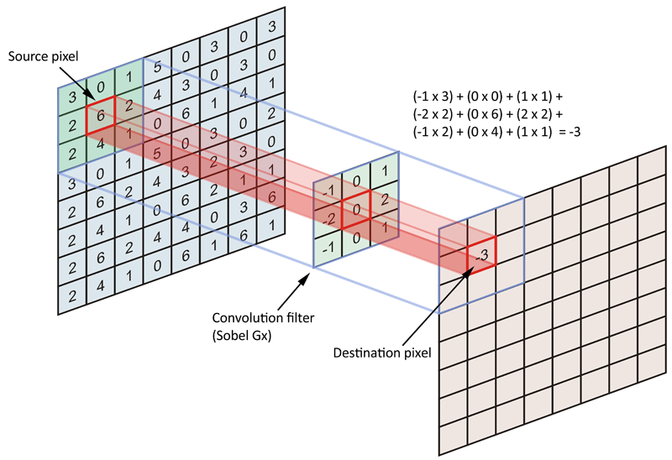
Convolution Layer
Convolution layer
Optional pooling layer
31
7
44
33
65
35
40
46
65
46
46
29
32
30
46
64
24
49
8
64

Slide 7
Convolution Example
Convolution
Filter
Input map
Output map
1
2
3
44
0
1
0
1
0
1
44
-1
×
2
4
3
1
0
0
=
-2
0
-1
5
-2
4
5
2
7
2
1
5
4
1
8
4
2
8
5
0
1
5
8
3
0
0
0
5
2
6
Channel partial sum[0][0] =
1 x 0 + 2 x 1 + 3 x 0
+ (-2) x 2 + 0 x 4 + (-1) x 3
+ 5 x 5 + (-2) x 2 + 4 x 7
= 44
Channel partial sum[0][0] =
1 x 0 + 2 x 1 + 3 x 0
+ (-2) x 2 + 0 x 4 + (-1) x 3
+ 5 x 5 + (-2) x 2 + 4 x 7
= 44
Typically adds zero padding to source matrix
to maintain dimensions

Slide 8
Multidimensional Convolution
“Feature Map” usually has multiple layers
  An image has R, G, B layers, or “channels”
One layer has many convolution filters, which create a multichannel output map
Input feature map
3x3x3 filter
Output feature map
×
1
2
3
=
-2
0
-1
5
-2
4
Channels

Slide 9
Multiple Convolutions
Filter 0
Output feature map 0
Input feature map
Filter 1
Output feature map 1

Slide 10
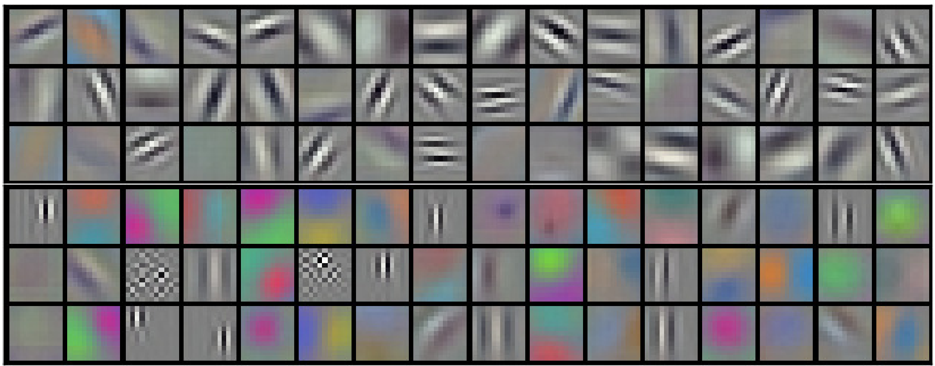
Example Learned Convolution Filters
Alex Krizhevsky et al., “ImageNet Classification with Deep Convolutional Neural Networks,” NIPS, 2012

Slide 11
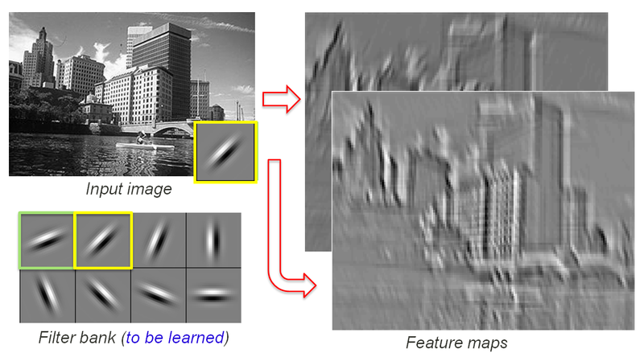
Multidimensional Convolution
Image found online. Original source unknown

Slide 12
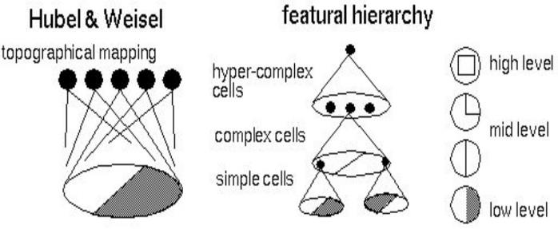
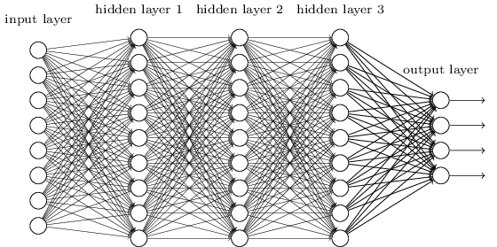
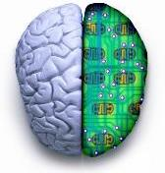
Recall: Biological analog
Hubel and Weisel’s architecture
Multi-layer neural network
Adapted from Jia-bin Huang

Slide 13
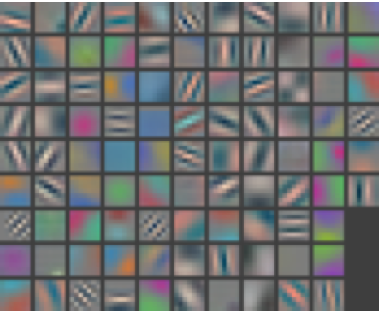
Layer 1
Visualizing and Understanding Convolutional Networks [Zeiler and Fergus, ECCV 2014]

Slide 14
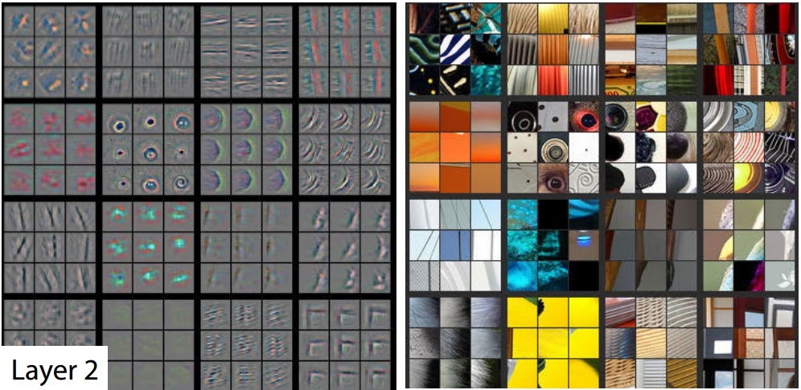
Layer 2
Activations projected down to pixel level via decovolution
Patches from validation images that give maximal activation of a given feature map
Visualizing and Understanding Convolutional Networks [Zeiler and Fergus, ECCV 2014]

Slide 15
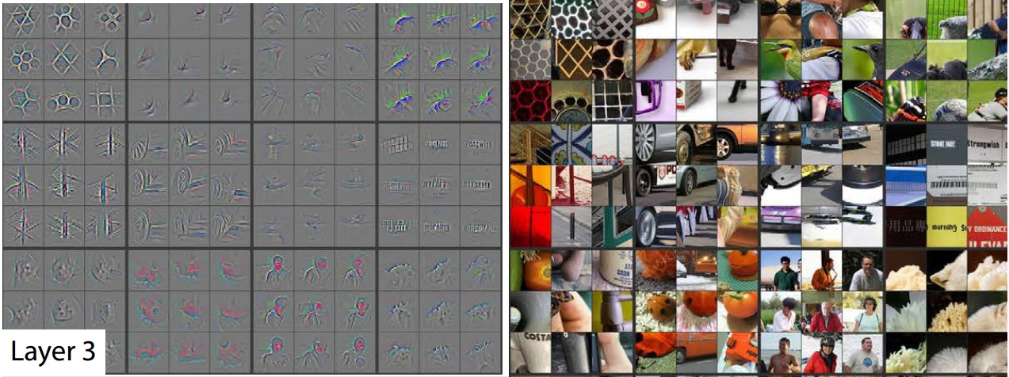
Layer 3
Visualizing and Understanding Convolutional Networks [Zeiler and Fergus, ECCV 2014]

Slide 16
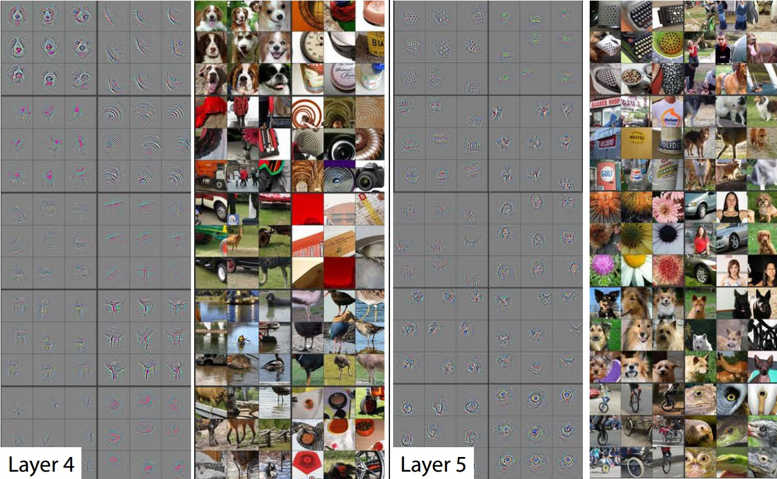
Layer 4 and 5
Visualizing and Understanding Convolutional Networks [Zeiler and Fergus, ECCV 2014]

Slide 17
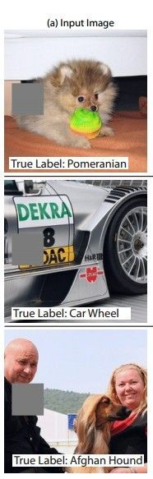
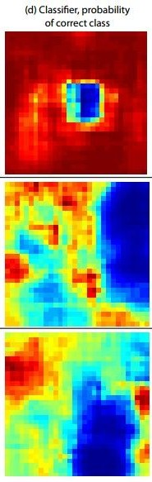
Occlusion experiments
(as a function of the position of the square of zeros in the original image)
[Zeiler & Fergus 2014]

Slide 18
Occlusion experiments
(as a function of the position of the square of zeros in the original image)
[Zeiler & Fergus 2014]
Andrej Karpathy

Slide 19
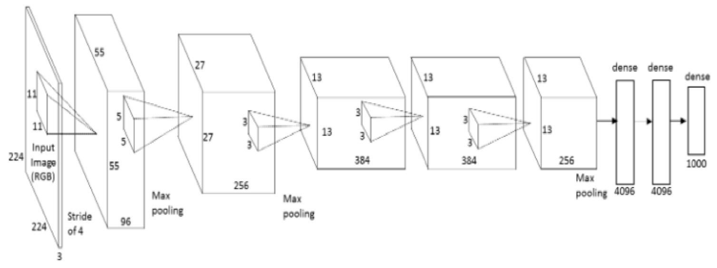
What image maximizes a class score?
Repeat:
Forward an image
Set activations in layer of interest to all zero, except for a 1.0 for a neuron of interest
Backprop to image
Do an “image update”
Andrej Karpathy

Slide 20
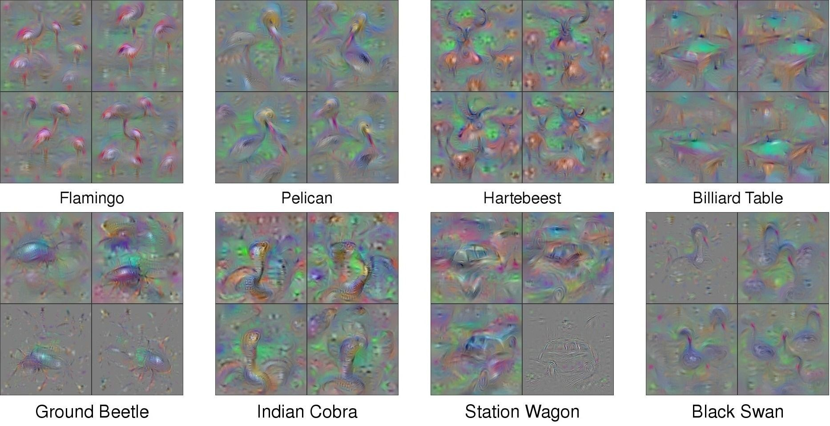
What image maximizes a class score?
[Understanding Neural Networks Through Deep Visualization, Yosinski et al. , 2015]
http://yosinski.com/deepvis
Andrej Karpathy

Slide 21
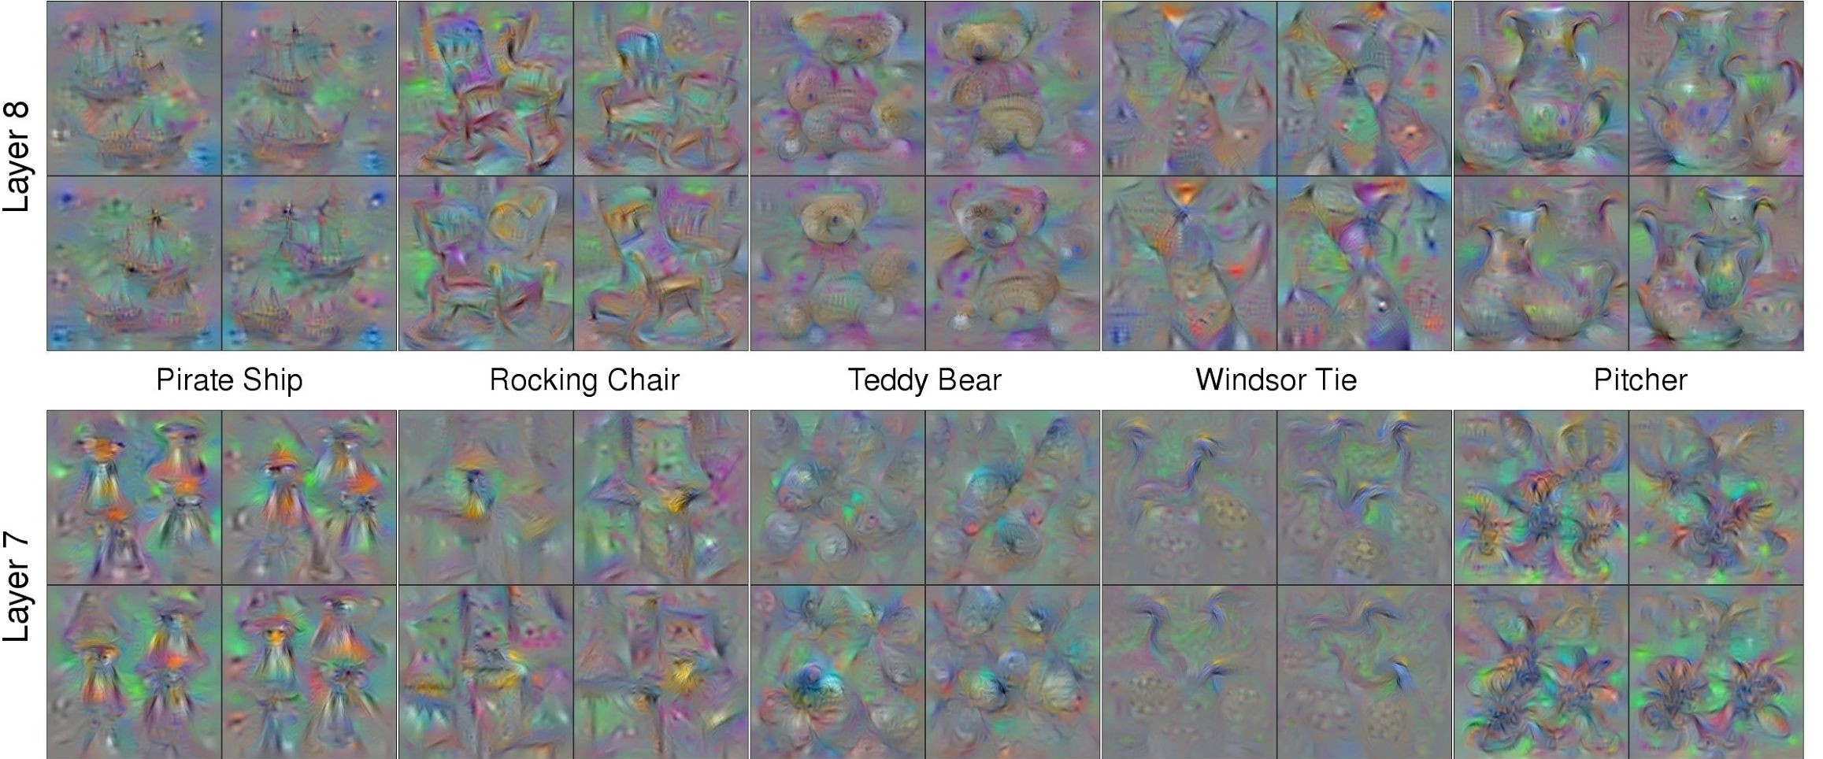
What image maximizes a class score?
Andrej Karpathy

Slide 22
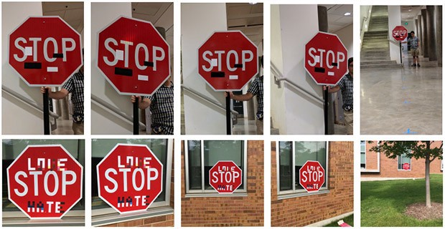
All is great then?
CNN models can be easily fooled
Notes:
Recently in 2020, the cybersecurity firm McAfee showed that Mobileye — the car intelligence system used by Tesla and other auto manufacturers — could be fooled into accelerating 50 MPH over the speed limit just by plastering a strip of black tape two inches wide to a speed limit sign.
Researchers from four universities including the University of Washington and UC Berkeley discovered that road sign recognition models were completely fooled when introduced to a bit of spray paint or stickers on stop signs — all completely natural and non-malicious alterations

Slide 23
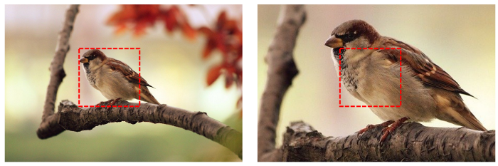
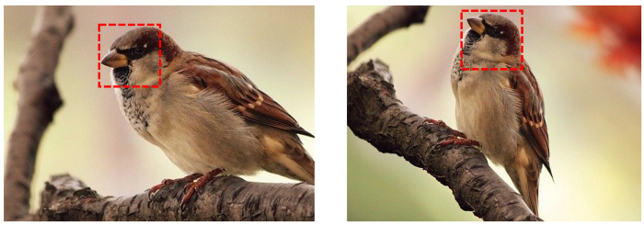
All is great then?
CNNs are bad at generalizing across scaling, shifts and rotations in images, as well as different angles of three-dimensional viewing.
Notes:
Recently in 2020, the cybersecurity firm McAfee showed that Mobileye — the car intelligence system used by Tesla and other auto manufacturers — could be fooled into accelerating 50 MPH over the speed limit just by plastering a strip of black tape two inches wide to a speed limit sign.
Researchers from four universities including the University of Washington and UC Berkeley discovered that road sign recognition models were completely fooled when introduced to a bit of spray paint or stickers on stop signs — all completely natural and non-malicious alterations

Slide 24
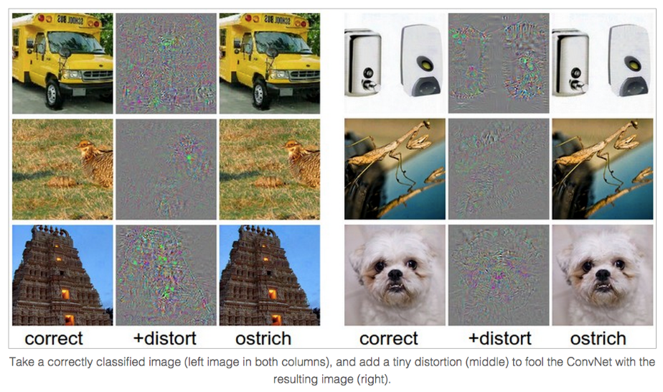
Breaking CNNs
Intriguing properties of neural networks [Szegedy ICLR 2014]
Andrej Karpathy

Slide 25
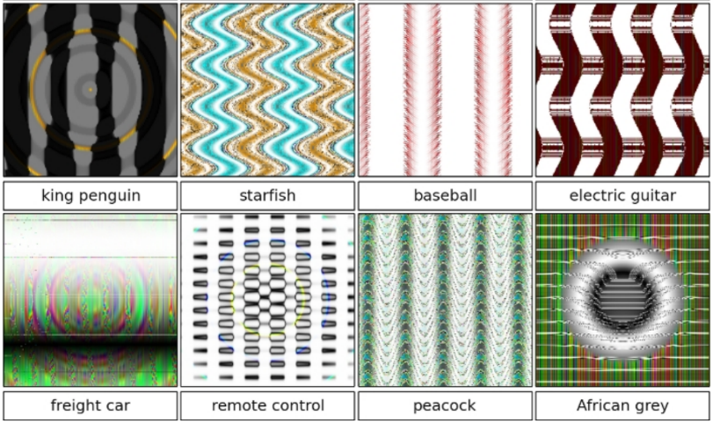
Breaking CNNs
Deep Neural Networks are Easily Fooled: High Confidence Predictions for Unrecognizable Images [Nguyen et al. CVPR 2015]
Jia-bin Huang

Slide 26
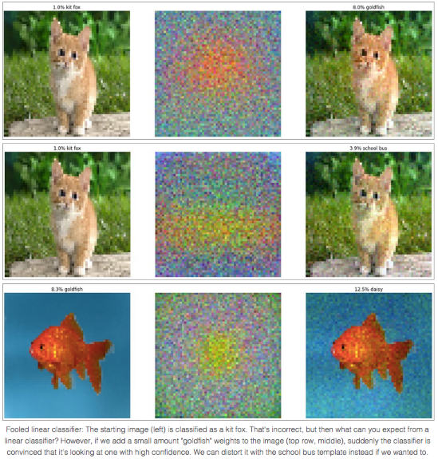
Fooling a linear classifier
To fool a linear classifier, add a small multiple of the weight vector to the training example:
x ← x + α w
http://karpathy.github.io/2015/03/30/breaking-convnets/
Jia-bin Huang

Slide 27
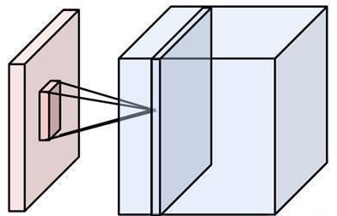
Convolutional Neural Networks
(CNN, ConvNet, DCN)
CNN = a multi-layer neural network with
  Local connectivity:
    Neurons in a layer are only connected to a small region of the layer before it
  Share weight parameters across spatial positions:
    Learning shift-invariant filter kernels
Image credit: A. Karpathy

Slide 28
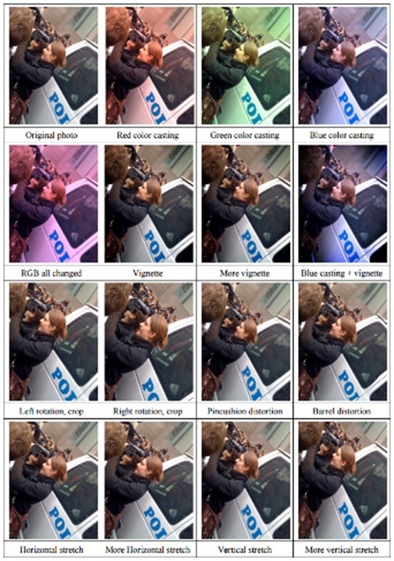
Data Augmentation (Jittering)
Create virtual training samples
  Horizontal flip
  Random crop
  Color casting
  Geometric distortion
Deep Image [Wu et al. 2015]

Slide 29
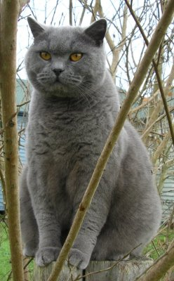
Data Augmentation
“cat”
Load image and label
Compute
loss
CNN

Slide 30
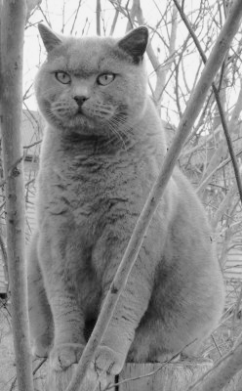
Data Augmentation
“cat”
Load image and label
Compute
loss
CNN
Transform image

Slide 31
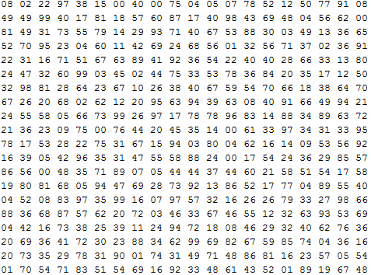
Data Augmentation
What the computer sees

Slide 32
Data Augmentation
Horizontal flips

Slide 33
Data Augmentation
2. Random crops/scales
Training: sample random crops / scales

Slide 34
Data Augmentation
2. Random crops/scales
Training: sample random crops / scales
ResNet:
Pick random L in range [256, 480]
Resize training image, short side = L
Sample random 224 x 224 patch

Slide 35
Data Augmentation
2. Random crops/scales
Training: sample random crops / scales
ResNet:
Pick random L in range [256, 480]
Resize training image, short side = L
Sample random 224 x 224 patch
Testing: average a fixed set of crops

Slide 36
Data Augmentation
2. Random crops/scales
Training: sample random crops / scales
ResNet:
Pick random L in range [256, 480]
Resize training image, short side = L
Sample random 224 x 224 patch
Testing: average a fixed set of crops
ResNet:
Resize image at 5 scales: {224, 256, 384, 480, 640}
For each size, use 10 224 x 224 crops: 4 corners + center, + flips

Slide 37
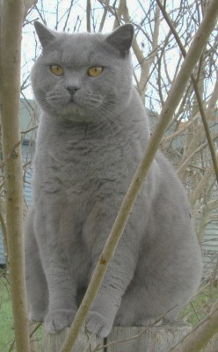
Data Augmentation
3. Color jitter
Simple:
Randomly jitter contrast

Slide 38
Data Augmentation
3. Color jitter
Complex:
Apply PCA to all [R, G, B] pixels in training set
Sample a “color offset” along principal component directions
Add offset to all pixels of a training image
Simple:
Randomly jitter contrast
(As seen in [Krizhevsky et al. 2012], ResNet, etc)

Slide 39
Data Augmentation
4. Get creative!
Random mix/combinations of :
translation
rotation
stretching
shearing,
lens distortions, … (go crazy)

Slide 40
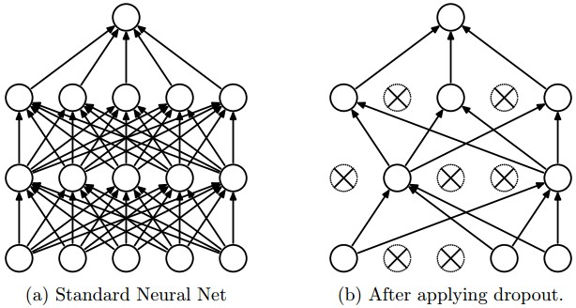
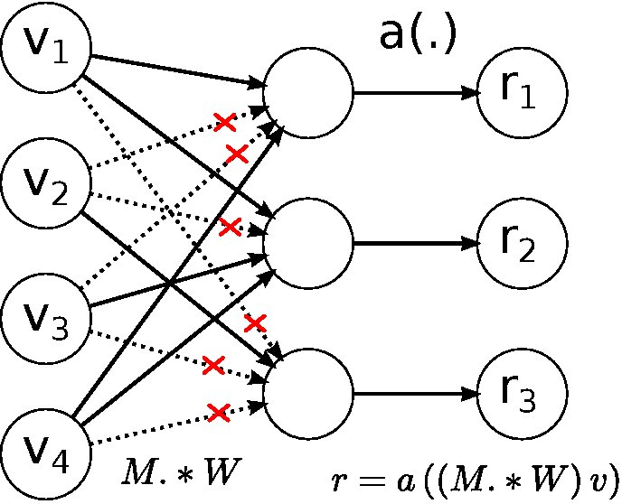
A general theme:
Training: Add random noise
Testing: Marginalize over the noise
Dropout
DropConnect
Data Augmentation
Batch normalization, Model ensembles

Slide 41
Data Augmentation: Gotchas
Be careful about performance measurements:
Test/train split before augmentation
Otherwise test data is an “easy” mod of training data
Ex: MNIST (handwritten digits)
Original dataset has 60,000 training images
The augmented dataset has 8 million synthetic images
Models trained on test/train splits of the synthetic data yield 0.0001% cross-validation error!

Slide 42
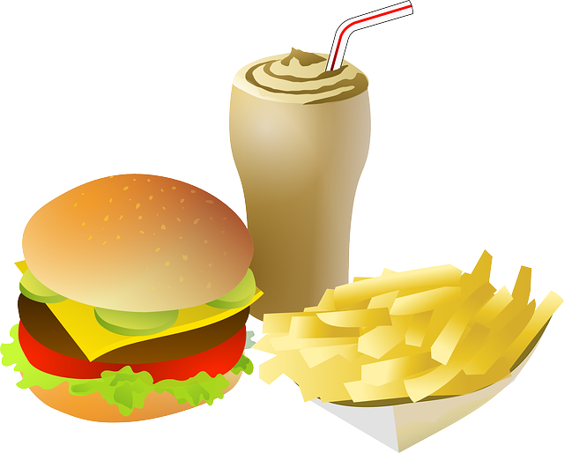
Data Augmentation: Takeaways
Simple to implement, use it
Especially useful for small datasets
Fits into framework of noise / marginalization

Slide 43
Transfer Learning
“You need a lot of a data if you want to train/use CNNs”
BUSTED

Slide 44
Transfer Learning
Improvement of learning in a new task through the transfer of knowledge from a related task that has already been learned.
Weight initialization for CNN
Two major strategies
  ConvNet as fixed feature extractor
  Fine-tuning the ConvNet

Slide 45
When to finetune your model?
New dataset is small and similar to original dataset.
  train a linear classifier on the CNN codes
New dataset is large and similar to the original dataset
  fine-tune through the full network
New dataset is small but very different from the original dataset
  SVM classifier from activations somewhere earlier in the network
New dataset is large and very different from the original dataset
  fine-tune through the entire network

Slide 46
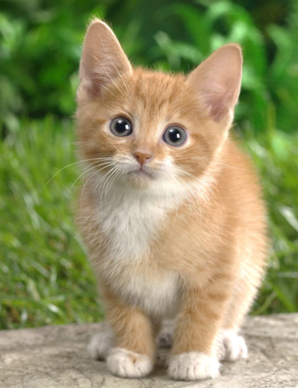
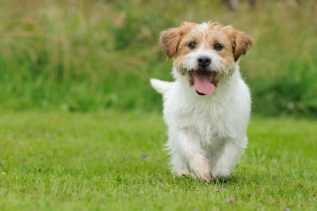


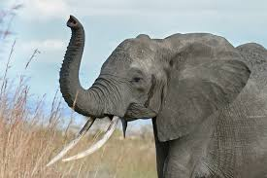
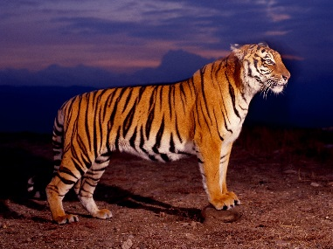
Transfer Learning
Dog/Cat
Classifier
cat
dog
Data not directly related to the task considered
elephant
tiger
dog
cat
Similar domain, different tasks
Different domains, same task

Slide 47

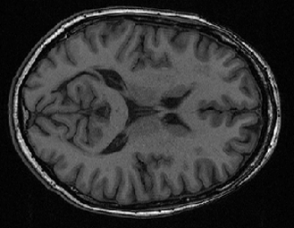



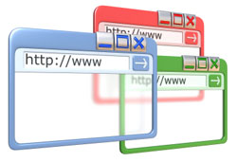
Why?
Task Considered
Data not directly related
Speech
Recognition
English
Chinese
Taiwanese
……
Image Recognition
Medical
Images
Text
Analysis
Specific domain
Webpages
Notes:
Transfer
Self-taught

Slide 48
Transfer Learning - Overview
Source Data (not directly related to the task)
labelled
unlabeled
Model Fine-tuning
labelled
Warning: different terminology in different literature
Target Data
unlabeled

Slide 49
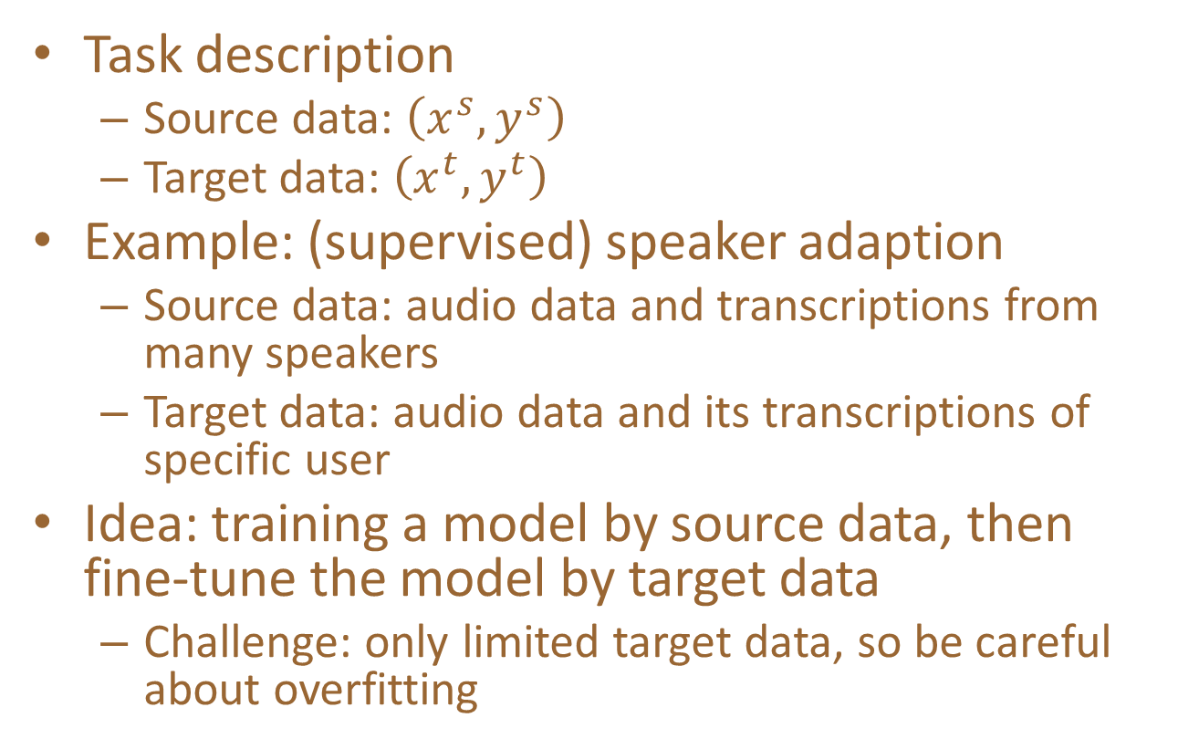
Model Fine-tuning
One-shot learning: only a few examples in target domain
Task description
  Source data: $\left(x^{s},y^{s}\right)$
  Target data: $\left(x^{t},y^{t}\right)$
Example: (supervised) speaker adaption
  Source data: audio data and transcriptions from many speakers
  Target data: audio data and its transcriptions of specific user
Idea: training a model by source data, then fine-tune the model by target data
  Challenge: only limited target data, so be careful about overfitting
A large amount
Very little

Slide 50
Conservative Training
Output layer
output close
Output layer
parameter close
initialization
Input layer
Input layer
Source data
(e.g. Audio data of
Many speakers)
Target data (e.g. A little data from target speaker)
Notes:
Just train cannot work
Extra constraint
To evaluate how the size of the adaptation set affects the result, the number of
adaptation utterances varies from 5 (32 s) to 200 (22min).

Slide 51
Layer Transfer
Output layer
Copy some parameters
Target data
Source data
Input layer
1. Only train the rest layers (prevent overfitting)
2. fine-tune the whole network (if there is sufficient data)
Notes:
Where shold I add -> I don’t know

Slide 52


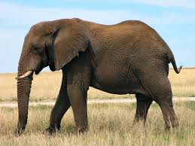




Layer Transfer
Which layer can be transferred (copied)?
  Speech: usually copy the last few layers
  Image: usually copy the first few layers
Pixels
Layer 1
Layer 2
Layer L
……
……
……
elephant
……
……
……
……
……
……

Slide 53
Layer Transfer - Image
fine-tune the whole network
Source: 500 classes from ImageNet
Only train the rest layers
Target: another 500 classes from ImageNet
Jason Yosinski, Jeff Clune, Yoshua Bengio, Hod Lipson, “How transferable are features in deep neural networks?”, NIPS, 2014

Slide 54
Layer Transfer - Image
Only train the rest layers
Jason Yosinski, Jeff Clune, Yoshua Bengio, Hod Lipson, “How transferable are features in deep neural networks?”, NIPS, 2014
Notes:
60,0000

Slide 55
Transfer Learning - Overview
Source Data (not directly related to the task)
labelled
unlabeled
Fine-tuning
labelled
Multitask Learning
Target Data
unlabeled

Slide 56
Multitask Learning
The multi-layer structure makes NN suitable for multitask learning
Task A
Task B
Task A
Task B
Input feature
Input feature for task A
Input feature for task B

Slide 57
Multitask Learning
- Multilingual Speech Recognition
states of French
states of German
states of Spanish
states of Italian
states of Mandarin
Human languages share some common characteristics.
acoustic features
Similar idea in translation: Daxiang Dong, Hua Wu, Wei He, Dianhai Yu and Haifeng Wang, "Multi-task learning for multiple language translation.“, ACL 2015
Notes:
Should I put Tanja’s AF here?

Slide 58
Multitask Learning - Multilingual
Mandarin only
Character Error Rate
With European Language
Hours of training data for Mandarin
Huang, Jui-Ting, et al. "Cross-language knowledge transfer using multilingual deep neural network with shared hidden layers." ICASSP, 2013
Notes:
Translation/summarization

Slide 59
Transfer Learning - Overview
Source Data (not directly related to the task)
labelled
unlabeled
Fine-tuning
labelled
Multitask Learning
Target Data
Domain-adversarial training
unlabeled

Slide 60
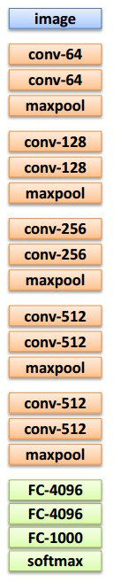
Transfer Learning with CNNs
1. Train on
Imagenet

Slide 61
Transfer Learning with CNNs
1. Train on
Imagenet
2. Small dataset:
feature extractor
Freeze these
Train this

Slide 62
Transfer Learning with CNNs
2. Small dataset:
feature extractor
3. Medium dataset:
finetuning
more data = retrain more of the network (or all of it)
1. Train on
Imagenet
Freeze these
Freeze these
Train this
Train this

Slide 63
Transfer Learning with CNNs
2. Small dataset:
feature extractor
3. Medium dataset:
finetuning
more data = retrain more of the network (or all of it)
1. Train on
Imagenet
Freeze these
Freeze these
tip: use only ~1/10th of the original learning rate in finetuning top layer, and ~1/100th on intermediate layers
Train this
Train this

Slide 64
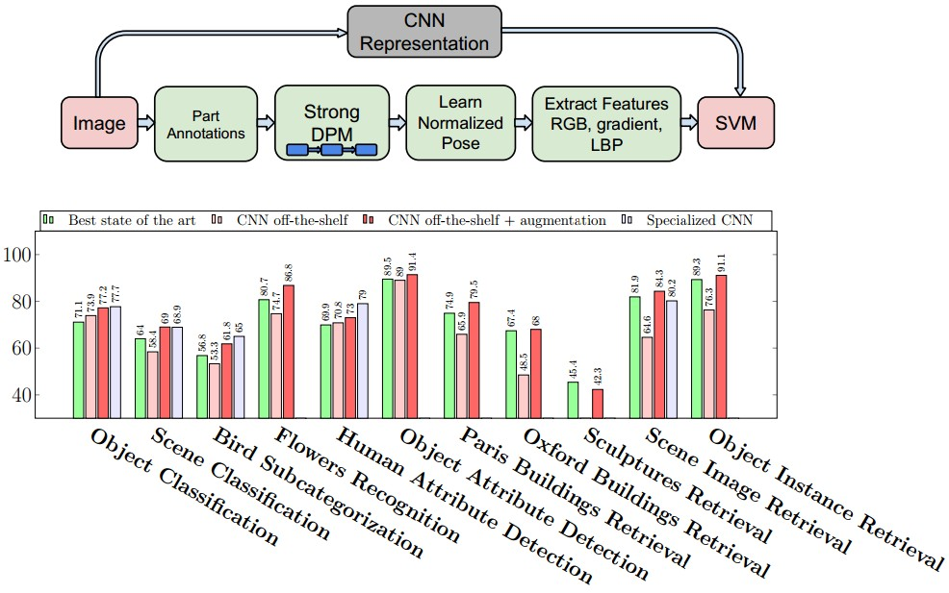
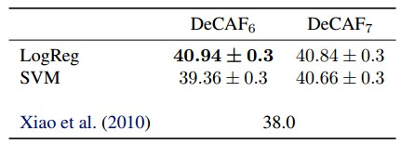
CNN Features off-the-shelf: an Astounding Baseline for Recognition
[Razavian et al, 2014]
DeCAF: A Deep Convolutional Activation Feature for Generic Visual Recognition
[Donahue*, Jia*, et al., 2013]
Notes:
Need to reread the papers

Slide 65
 | very similar dataset | very different dataset
very little data | ? | ?
quite a lot of data | ? | ?
more generic
more specific

Slide 66
 | very similar dataset | very different dataset
very little data | Use Linear Classifier on top layer | ?
quite a lot of data | Finetune a few layers | ?
more generic
more specific

Slide 67
 | very similar dataset | very different dataset
very little data | Use Linear Classifier on top layer | You’re in trouble… Try linear classifier from different stages
quite a lot of data | Finetune a few layers | Finetune a larger number of layers
more generic
more specific

Slide 68
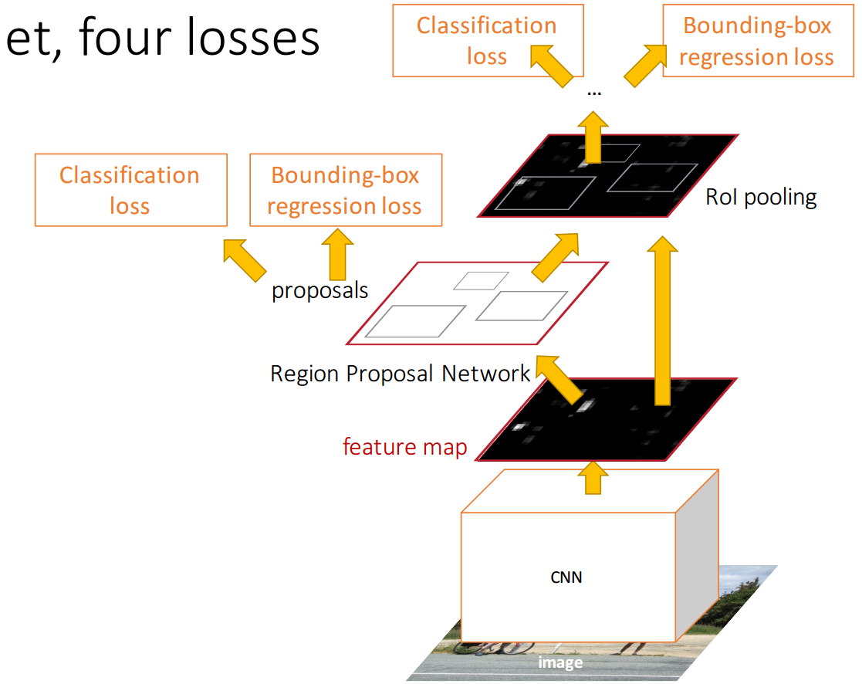
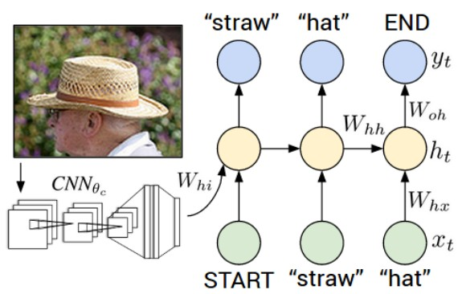
Transfer learning with CNNs is pervasive…
(it’s the norm, not an exception)
Image Captioning: CNN+RNN
Object Detection
(Faster R-CNN)

Slide 69
Transfer learning with CNNs is pervasive…
(it’s the norm, not an exception)
Image Captioning: CNN+RNN
CNN pretrained on ImageNet
Object Detection
(Faster R-CNN)

Slide 70
Transfer learning with CNNs is pervasive…
(it’s the norm, not an exception)
Image Captioning: CNN+RNN
CNN pretrained on ImageNet
Object Detection
(Faster R-CNN)
Word vectors pretrained from word2vec

Slide 71
Takeaway for your projects/beyond:
Have some dataset of interest but it has < ~1M images?
Find a very large dataset that has similar data, train a big ConvNet there.
Transfer learn to your dataset
Caffe ConvNet library has a “Model Zoo” of pretrained models:
https://github.com/BVLC/caffe/wiki/Model-Zoo

Slide 72
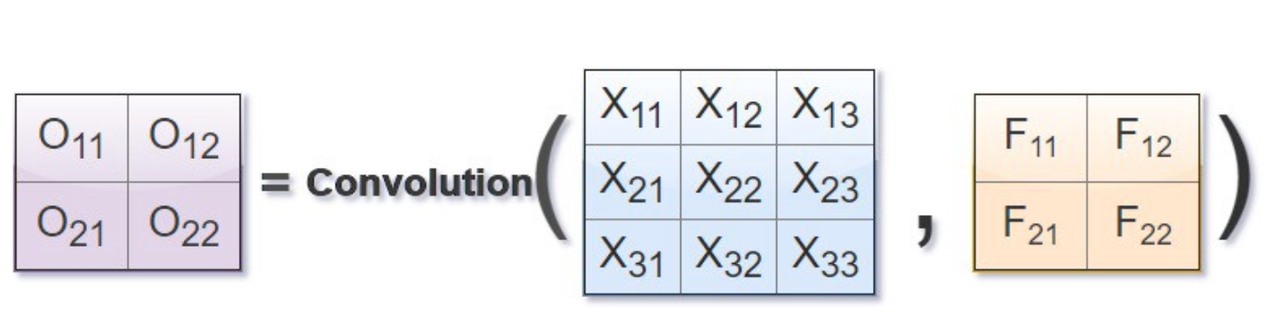
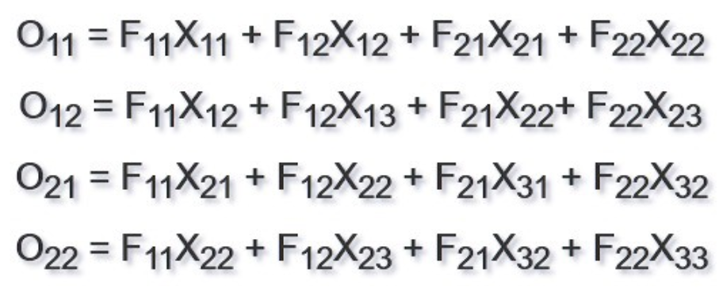
Backpropagation of convolution
Slide taken from Forward And Backpropagation in Convolutional Neural Network. - Medium

Slide 73
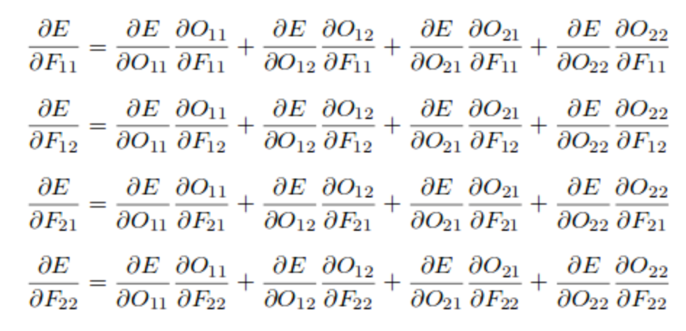
To calculate the gradients of error ‘E’ with respect to the filter ‘F’, the following equations needs to solved.
Slide taken from Forward And Backpropagation in Convolutional Neural Network. - Medium
Notes:
נבצע את הנגזרות החלקיות האלה ונקבל... עמוד הבא

Slide 74
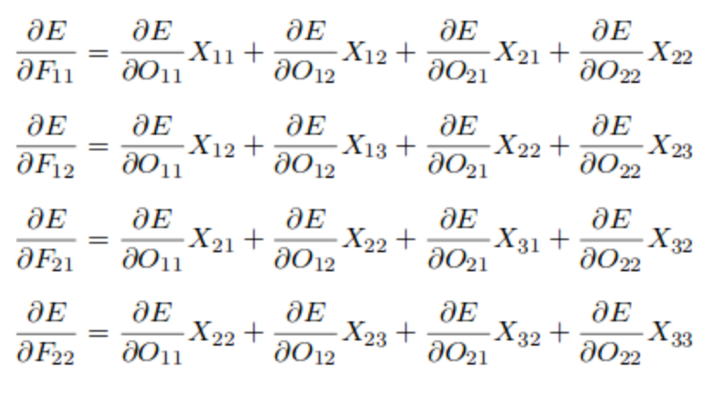
Which evaluates to-
Slide taken from Forward And Backpropagation in Convolutional Neural Network. - Medium
Notes:
אחרי שגזרנו את O לפי הFים, אנחנו מקבלים

Slide 75
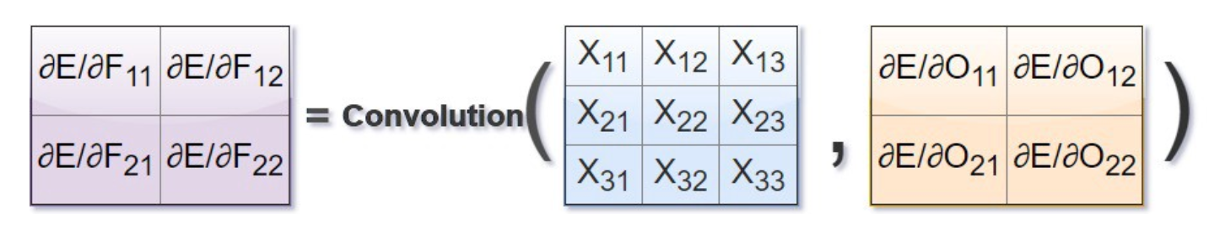
If we look closely the previous equation can be written in form of our convolution operation.
Slide taken from Forward And Backpropagation in Convolutional Neural Network. - Medium
Notes:
ונשים לב שהתוצאה שקיבלנו, ניתן לייצג אותה על ידי קונבולוציה עם פילטר שנראה כך.

Slide 76
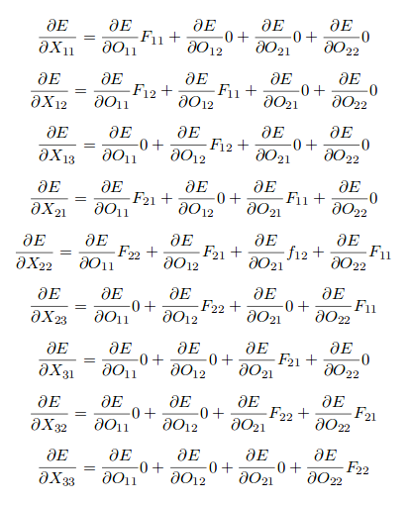
Similarly we can find the gradients of the error ‘E’ with respect to the input matrix ‘X’.
Slide taken from Forward And Backpropagation in Convolutional Neural Network. - Medium
Notes:
אז מקודם גזרנו את השגיאה E לפי הפילטרים F ועכשיו אנחנו נגזור את השגאה E לפי הinput X
ופה כבר עשינו את ההצבה של הנגזרות בחלקיות של O לפי X וככה גם התבטלנו לנו כל מיני איברים.

Slide 77
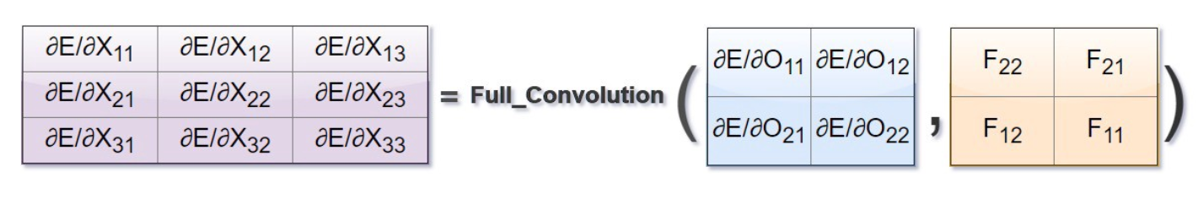
The previous computation can be obtained by a different type of convolution operation known as full convolution.
In order to obtain the gradients of the input matrix we need to rotate the filter by 180 degree and calculate the full convolution of the rotated filter by the gradients of the output with respect to error.
F₁₁
F₁₂
Rotate x
F₁₂
F₁₁
F₂₂
F₂₁
Rotate y
F₂₁
F₂₂
F₂₂
F₂₁
F₁₂
F₁₁
Slide taken from Forward And Backpropagation in Convolutional Neural Network. - Medium

Slide 78

Slide taken from Forward And Backpropagation in Convolutional Neural Network. - Medium

Slide 79
Backpropagation of max pooling
Suppose you have a matrix M of four elements:
and maxpool(M) returns d.
Then, the maxpool function really only depends on d. So, the derivative of maxpool relative to d is 1, and its derivative relative to a,b,c is zero. So you backpropagate 1 to the unit corresponding to d, and you backpropagate zero for the other units.
a
b
c
d
Slide taken from Forward And Backpropagation in Convolutional Neural Network. - Medium

Slide 80

A bit of history:
Gradient-based learning applied to document recognition
[LeCun, Bottou, Bengio, Haffner 1998]
LeNet-5
Lecture 5 -

Slide 81


LeNet [LeCun et al. 1998]
Gradient-based learning applied to document recognition [LeCun, Bottou, Bengio, Haffner 1998]
Jia-Bin Huang and Derek Hoiem, UIUC
LeNet-1 from 1993

Slide 82
82

Slide 83

A bit of history:
ImageNet Classification with Deep Convolutional Neural Networks [Krizhevsky, Sutskever, Hinton, 2012]
Lecture 5 -
“AlexNet”

Slide 84

AlexNet 2012
A strong prior has very low entropy, e.g. a Gaussian with low variance
An infinitely strong prior says that some parameters are forbidden, and places zero probability on them
The convolution ‘prior’ says the identical and zero weights
The pooling forces the invariance of small translations

Slide 85

Preview
[Zeiler and Fergus 2013]
Fei-Fei Li & Justin Johnson & Serena Yeung Lecture 5 - April 17, 2018

Slide 86


Preview
Fei-Fei Li & Justin Johnson & Serena Yeung Lecture 5 - April 17, 2018

Slide 87


one filter =>
one activation map
example 5x5 filters
(32 total)
We call the layer convolutional because it is related to convolution of two signals:
elementwise multiplication and sum of a filter and the signal (image)
Fei-Fei Li & Justin Johnson & Serena Yeung Lecture 5 - April 17, 2018

Slide 88



Slide 89

ImageNet Top-5 Classification Accuracy
Over the Years
15 million images 1000 classes in the ImageNet challenge
AlexNet, The Beginning
“The first* fast**
GPU-accelerated Deep Convolutional Neural Network
to win an image recognition contest
image-net.org “ImageNet Large Scale Visual Recognition Challenge (ILSVRC) 2017,” 2017

Slide 90

Real Convolutional Neural Network
-- AlexNet
96 11x11x3 kernels
256 5x5x48
384 3x3x128
…
Simplified intuition: Higher order information at later layer
Alex Krizhevsky et al., “ImageNet Classification with Deep Convolutional Neural Networks,” NIPS, 2012

Slide 91

Real Convolutional Neural Network
-- VGG 16
Contains 138 million weights and
15.5G MACs to process one 224 × 224 input image
Heuritech blog (https://blog.heuritech.com/2016/02/29/a-brief-report-of-the-heuritech-deep-learning-meetup-5/)

Slide 92


There are Many, Many Neural Networks
GoogLeNet, ResNet, YOLO, …
  Share common building blocks, but look drastically different
GoogLeNet (ImageNet 2014 winner)
ResNet
(ImageNet 2015 winner)

Slide 93



VGG-16
GoogleNet
ResNet

Slide 94
RESNET
Deep Residual Learning for Image Recognition - Kaiming He, Xiangyu Zhang, Shaoqing Ren, Jian Sun; 2015
Extremely deep network – 152 layers
Deeper neural networks are more difficult to train.
Deep networks suffer from vanishing and exploding gradients.
Present a residual learning framework to ease the training of networks that are substantially deeper than those used previously.
[He et al., 2015]
Notes:
הזוכה משנת 2015 –
כאן המודל הוא כבר ממש עמוק עם 152 שכבות
הבעיה היא בעצם שברשתות עמוקות, הגרדיאנטים נוטים לגדול מידי או לקטון מידי - להתפוצץ או לדעוך.
במאמר ציינו את הבעיה של training ברשתות עמוקות מאוד. בשקופיות הבאות נראה יותר לעומק את הבעיה הזו.

Slide 95

ResNet
  ILSVRC’15 classification winner (3.57% top 5 error, humans generally hover around a 5-10% error rate)
  Swept all classification and detection competitions in ILSVRC’15 and COCO’15!
Slide taken from Fei-Fei & Justin Johnson & Serena Yeung. Lecture 9.
[He et al., 2015]
Notes:
הרשת הזו היא שוב משמעותית יותר טובה מכל אלה שקדמו לה אבל נשים לב שהשיפור בדיוק הוא לא באותו יחס לגידול במספר שכבות.

Slide 96

ResNet
  What happens when we continue stacking deeper layers on a convolutional neural network?
  56-layer model performs worse on both training and test error
  -> The deeper model performs worse (not caused by overfitting)!
Slide taken from Fei-Fei & Justin Johnson & Serena Yeung.
[He et al., 2015]
Notes:
השאלה היא, מה קורה כשאנחנו מוסיפים עוד ועוד שכבות לרשת, האם הרשת הולכת ומשתפרת?
מסתבר שהתשובה היא לא
אנחנו רואים כאן השוואה בין מודל של 56 שכבות למודל של 20 שכבות
אנחנו רואים שבtest error הרשת עם ה56 שכבות מראה שגיאה גבוהה יותר מהרשת עם ה20 שכבות.
מה שמוזר זה שגם בtraining error אנחנו גם רואים שהמודל עם ה56 שכבות נותן תוצאות פחות טובות וזה מראה לנו שזה בעצם לא כתוצאה מoverfitting של רשת עמוקה עם הרבה פרמטרין אלא זה בגלל משהו אחר. כי בoverfitting אנחנו מקבלים דווקא training error טוב.

Slide 97
Problems when going deep
After the first CNN-based architecture (AlexNet) that win the ImageNet 2012 competition, every subsequent winning architecture uses more layers in a deep neural network to reduce the error rate.
This works for less number of layers, but when we increase the number of layers, there is a common problem in deep learning associated with that called the Vanishing/Exploding gradient.
This causes the gradient to become 0 or too large.
Thus when we increases number of layers, the training and test error rate also increases.

Slide 98
ResNet
  Hypothesis: The problem is an optimization problem. Very deep networks are harder to optimize.
  Solution: Use network layers to fit residual mapping instead of directly trying to fit a desired underlying mapping.
  We will use skip connections allowing us to take the activation from one layer and feed it into another layer, much deeper into the network.
  Use layers to fit residual F(x) = H(x) – x
  instead of H(x) directly
Slide taken from Fei-Fei & Justin Johnson & Serena Yeung
[He et al., 2015]
Notes:
ההיפותזה שהציעו במאמר היא שפשוט קשה יותר לעשות אופטמיזציה לרשתות עמוקות יותר.
הם טענו שרשתות עמוקות צריכות לתת תוצאות טובות לפחות כמו רשתות פחות עמוקות
וההוכחה לזה היא שלוקחים את השכבות שכבר למדנו ברשת רדודה, ומוסיפים על גביהן שכבות נוספות של identity mapping וכן התוצאות צריכות להיות זהות. אבל בפועל, לרשתות מאוד עמוקוץ, קשה לבחור פרמטרים שנותנים אפילו את הidentitfy function ולכן זה נותן תוצאה גרועה יותר במקום טובה יותר.
אז זה המוטיבציה
ועכשיו הם רוצים לעזור למודל ללמוד אופטמיזציה יותר טובה.

Slide 99

New Mapping
F(x) := H(x) - x which gives H(x) := F(x) + x.
Skip (Shortcut) connection

Slide 100

ResNet
Residual Block
Input x goes through conv-relu-conv series and gives us F(x). That result is then added to the original input x. Let’s call that H(x) = F(x) + x.
In traditional CNNs, H(x) would just be equal to F(x). So, instead of just computing that transformation (straight from x to F(x)), we’re computing the term that we have to add, F(x), to the input, x.
The advantage of adding this type of skip connection is that if any layer hurt the performance of architecture then it will be skipped by regularization. So, this results in training a very deep neural network without the problems caused by vanishing/exploding gradient.
[He et al., 2015]

Slide 101














ResNet
$$a^{[l+1]}$$
$$a^{[l]}$$
$$a^{[l+2]}$$
Short cut/ skip connection
$$a^{[l]}$$
$$Linear$$
$$ReLU$$
$$Linear$$
$$ReLU$$
$$a^{[l+2]}$$
$$a^{[l+1]}$$
$$z^{[l+1]}{=W}^{[l+1]}a^{[l]}+b^{[l+1]}$$
$$z^{[l+2]}= W^{[l+2]}a^{[l+1]}+b^{[l+2]}$$
$$a^{[l+1]}=g(z^{[l+1]})$$
$$a^{[l+2]}=g(z^{[l+2]})$$
$a^{[l+2]}=g\left(z^{\left[l+2\right]}+a^{\left[l\right]}\right)={g(W}^{[l+2]}a^{[l+1]}+b^{[l+2]}+a^{\left[l\right]}$)
[He et al., 2015]
Notes:
A – זה הactivation
נשים לב שה injection של a הוא אחרי השלב הלינארי אבל לפני הReLU.
אם נניח W נהיה 0 וגם b לצורך העניין בגלל weight decay
ואז g(a) שווה לa מכיוון שrelu נותן Identity במקרה החיובי.
אז ראינו שהidentity function זה משהו שקל לresidual block ללמוד
לכן זה לא יפגע ביכולת של הרשת שלנו להצליח כי מקסימום נקבל את הidentity function
ויותר מזה, זה יכול רק לעזור לרשת שלנו להצליח יותר וללמוד משהו טוב ויעיל בהוספת השכבות האלה.

Slide 102
ResNet
Full ResNet architecture:
Stack residual blocks
Every residual block has two 3x3 conv layers
Periodically, double # of filters and downsample spatially using stride 2 (in each dimension)
Additional conv layer at the beginning
No FC layers at the end (only FC 1000 to output classes)
Slide taken from Fei-Fei & Justin Johnson & Serena Yeung. Lecture 9.
[He et al., 2015]

Slide 103
ResNet
Total depths of 34, 50, 101, or 152 layers for ImageNet
For deeper networks (ResNet-50+), use “bottleneck” layer to improve efficiency (similar to GoogLeNet)
Slide taken from Fei-Fei & Justin Johnson & Serena Yeung
[He et al., 2015]
Notes:
בניסיונות שבהם עשו יותר מ50 שכבות, אז גם השתמשו בקונספט של bottleneck layers כדי לשפר יעילות על ידי הפחתת המימד של העומק לפני שעושים את הקונבולוציות

Slide 104
ResNet
Experimental Results:
Able to train very deep networks without degrading
Deeper networks now achieve lower training errors as expected
Slide taken from Fei-Fei & Justin Johnson & Serena Yeung. Lecture 9.
[He et al., 2015]

Slide 105
ResNet
The best CNN architecture that we currently have and is a great innovation for the idea of residual learning.
Even better than human performance!
[He et al., 2015]

Slide 106

Accuracy comparison
The best CNN architecture that we currently have and is a great innovation for the idea of residual learning.
Slide taken from Fei-Fei & Justin Johnson & Serena Yeung. Lecture 9.

Slide 107

Forward pass time and power consumption
The best CNN architecture that we currently have and is a great innovation for the idea of residual learning.
Slide taken from Fei-Fei & Justin Johnson & Serena Yeung. Lecture 9.

Slide 108

LeNet-5
Gradient Based Learning Applied To Document Recognition - Y. Lecun, L. Bottou, Y. Bengio, P. Haffner; 1998
Helped establish how we use CNNs today
Replaced manual feature extraction
[LeCun et al., 1998]
Notes:
כותב המאמר – יאן לקון – שהיום הוא הdirector of A.I. בFacebook עזר לבסס את הדרך שבה אנחנו משתמשים ב CNNs היום – כמבנה רב שכבתי של נוירונים לטובת עיבוד של פ'יצרים מורכבים, בשכבות העמוקות של הרשת.
התכונות של CNNs שונות מאלו של רשתות feed-forward מסורתיות הכמה היבטים, וגורמות להם להיות אפקטיביות לצרכים של בעיות ראיה.
למשל תמונות מיוצגות על ידי גובה רוחב ועומק כך שעומק מתייחס למספר הchannels בכל פיקסל. למשל 3 – R,G,B. אם היינו משתמשים במבנה מסורתי fully connected, היינו מקבלים עליה משמעותית במספר הפרמטרים וזה היה מביא לoverfitting. (עבור תמונה 670x1040 היינו מקבלים יותר מ 2 מיליון פרמטרים כבר בשכבה הראשונה)
CNNs מורידים את מספר הפרמטרים בכך שמאפשרים לחלקים שונים של הרשת להתמקד בHigh level features כמו טקסטורה או דוגמאות שחוזרות על עצמן.
במאמר, לקון מציין שבגלל שCNNs לומדות את כל המשקלים לבד באמצעות backpropagation, אז אפשר לראות את זה כאילו CNNs מייצרות את הפיצ'רים של עצמן. עד המימוש הזה של לקון, נעשו עבודות עם רשתות בתחום של ראיה, אבל הfeature extraction נעשה כסוג של preprocessing.

Slide 109










LeNet-5
conv
avg pool
conv
avg pool
. . .
5$×$ 5
s = 1
f = 2
s = 2
5$×$ 5
s = 1
f = 2
s = 2
32$×$32$×$1
28$×$28$×$6
14$×$14$×$6
10$×$10$×$16
FC
FC
. . .
$$\hat{y}$$
$$⋮$$
$$⋮$$
10
5$×$5$×$16
120
84
Reminder:
Output size = (N+2P-F)/stride + 1
This slide is taken from Andrew Ng
[LeCun et al., 1998]
Notes:
זו אחת הארכיטקטורות הראשונות של CNN ששימשה בהצלחה בפרקטיקה.
הארכיטקטורה הזו שימשה לזיהוי ספרות כתובות בכתב יד.
הרשת אומנה על תמונות grayscale ולכן הinput images הם 32x32x1.
השכבה הראשונה היא של 6 פילטרים בגודל 5x5 שמופעלים עם stride 1 וללא padding ולכן גודל output יהיה 28x28x6. לא הייתה בעיה של אפקטי קצה מכיוון שמצויין במאמר שהספרות לא חרגו מ28x28.
לאחר מכן, הארכיטקטורה של LeNet מפעילה שכבת pooling וכשהמאמר הזה נכתב, היה יותר נפוץ להשתמש בaverage pooling ולא בmax pooling כפי שמקובל כיום. מי שבוחר לממש ארכיטקטורה כזאת היום, כנראה היה בוחר להשתמש בmax pooling. Average pooling מופעל עם פילטר בגודל 2 וstride 2 כך שגם פה יש לנו reduction של המימדים לכדי 14x14x6.
השכבה הבאה היא קונבולוציה עם 16 פילטרים בגודל 5x5 המופעלים עם stride 1 ולכן גודל התוצאה יהיה 10x10x16. כשהמאמר הזה נכתב, לא היה נפוץ לעשות padding אז זה מה שנקרא “valid convolution” כלומר, שאין padding.
לאחר מכן מופעלת שכבת pooling נוספת שמביאה אותנו לגודל 5x5x16.
השכבה הבאה היא שכבה fully connected שמחברת כל אחת מה 400 Nodes מהשכבה הקודמת עם 120 נוירונים.
לאחר מכן יש שכבה fully connected עם 84 nodes ולבסוף שכבת הoutput y שיכול לקבל 10 אפשרויות שונות (ספרות 0-9).
פונקציית אקטיבציה
אילו היינו ממשים את הרשת הזאת היום, היינו משתמשים בReLU אבל פה השתמשו בTANH וsigmoid אחרי כל שכבת קונבולוציה ושכבה FC:
INPUT => CONV => RELU => POOL => CONV => RELU => POOL => FC => RELU => FC

Slide 110

LeNet-5
Only 60K parameters
As we go deeper in the network: $N_{H}{↓, N}_{W}↓, N_{C}↑$
General structure:
conv->pool->conv->pool->FC->FC->output
Different filters look at different channels
Sigmoid and Tanh nonlinearity
[LeCun et al., 1998]
Notes:
ברשת הזאת יש כ60,000 פרמטרים וברשתות האקטואליות היום יש בין 10 ל100 מיליון פרמטרים כך שזה לא חריג לראות רשתות שגדולות פי אלף מהרשת הזאת.
נשים לב שברשת הזאת וזה גם נפוץ ברשתות אחרות, ככל שאנחנו מעמיקים/מתקדמים ברשת, האורך והרוחב של הoutput הולך וקטן אבל מספר הchannelים דווקא גדל.
המבנה הכללי של הרשת הזאת שמורכבת משכבה אחת או יותר של קונבולוציה ואחריה שכבת pooling ואז עוד שכבת קונבולוציה אחת או יותר ושוב שכבת pooling, ולבסוף כמה שכבות fully connected ואז הoutput, זה גם מבנה כללי שחוזר על עצמו ברשתות אחרות.
דברים מוזרים שלא עושים היום, אבל עשו ברשת הזאת:
בשכבות הקונבולוציה, פילטרים שונים הסתכלו על channelים שונים, וזה כי מחשבים אז היו הרבה יותר איטיים אז עשו חיבורים כאלה שחוסכים מבחינת חישובית (פחות חיבורים משמע פחות חישובים). וגם מכיוון שבמאמר טענו שזה מוריד את הסימטריות ברשת ובכך "מכריחה" פילטרים שונים ללמוד פיצ'רים שונים ובתקווה משלימים.
השתמשו בnonlinearity (sigmoid) ובTanH והיום משתמשים בReLU.

Slide 111
AlexNet
ImageNet Classification with Deep Convolutional Neural Networks - Alex Krizhevsky, Ilya Sutskever, Geoffrey E. Hinton; 2012
Facilitated by GPUs, highly optimized convolution implementation and large datasets (ImageNet)
One of the largest CNNs to date
Has 60 Million parameter compared to 60k parameter of LeNet-5
[Krizhevsky et al., 2012]
Notes:
זוהי הרשת הראשונה שכבר הייתה ממימד יותר גבוה, שהצליחה להתמודד עם קלספיקציה של תמונות של imagenet והיא הצליחה לעקוף את כל המודלים שלא היו מבוססים deep learningשקדמו לה. לכן הרשת הזאת מהווה את ההתחלה המשמעותית של המחקר והשימוש ברשתות CNN.
מה שאפשר את המעבר המשמעותי הזה לרשתות CNN גדולות, או לחלופין מנע את ההתקדמות שלהם עד הנקודה הזו, זה: השימוש בGPU לטובת ובאופטמיזציות לחישוב יעיל של קונבולוציות והימצאות של datasets גדולים מאוד ומתוייגים.
הרשת הזאת מקבלת כinput תמונות RGB כך שהמימדים הם 227x227x3.

Slide 112
ImageNet Large Scale Visual Recognition Challenge (ILSVRC) winners
The annual “Olympics” of computer vision.
Teams from across the world compete to see who has the best computer vision model for tasks such as classification, localization, detection, and more.
2012 marked the first year where a CNN was used to achieve a top 5 test error rate of 15.3%.
The next best entry achieved an error of 26.2%.
Notes:
ImageNet זה dataset גדול מאוד של תמונות מתוייגות.
בתחרות ב2012 היו 1.2 מיליון תמונות מתוייגות לטובת training ב1000 קטגוריות . (בפועל יש הרבה יותר תמונות במאגר)
התחרות מהווה כמו אולימפיאדה עבור צוותים שעוסקים בראיה ממוחשבת מסביב לעולם.
2012 הייתה השנה הראשונה שהשתמשו בCNN לקבל top 5 test error rate of 15.3%. .
(Top 5 error is the rate at which, given an image, the model does not output the correct label with its top 5 predictions)
לשם השוואה, השני אחריו קיבל 26.2%

Slide 113

ImageNet Large Scale Visual Recognition Challenge (ILSVRC) winners
Slide taken from Fei-Fei & Justin Johnson & Serena Yeung. Lecture 9.
Notes:
אפשר לראות את השיפור המשמעותי שהביא הפתרון בCNN ב2012 לעומת השנים שקדמו.

Slide 114
AlexNet
ArchitectureCONV1
MAX POOL1
NORM1
CONV2
MAX POOL2
NORM2
CONV3
CONV4
CONV5
Max POOL3
FC6
FC7
FC8
Input: 227x227x3 images (224x224 before padding)
First layer: 96 11x11 filters applied at stride 4
Output volume size?
(N-F)/s+1 = (227-11)/4+1 = 55 -> [55x55x96]
Number of parameters in this layer?
(11*11*3)*96 = 35K
Slide taken from Fei-Fei & Justin Johnson & Serena Yeung. Lecture 9.
[Krizhevsky et al., 2012]
Notes:
מבנה הרשת הכללי מופיע משמאל – שכבת conv ואחריה שכבת Pooling ואז נורמליזציה וכו. בסוף יש 2 שכבות FC שמופיעות לפני הFC האחרון אל הoutput classes. סה"כ 5 שכבות קונבולוציה והיא יחסית דומה לארכיטקטורה הקודמת שראינו.
ננסה להבין קצת את המימדים של הארכיטקטורה הזו.
השכבה הראשונה היא שכבת קונבולוציה עם 96 פילטרים בגודל 11x11 וstride 4. מה גודל הOutput אחרי שכבה זו?
אנחנו רואים שהמימדים קטנו משמעותית (בערך חלקי 4 בגובה והרוחב) וזה משום שיש לנו stride גדול של 4.
מה מספר הפרמטרים עבור שכבה זו? ה-3 מגיע מזה שיש לנו 3 input channels.

Slide 115

AlexNet
[Krizhevsky et al., 2012]
Notes:
אלה 96 הפילטרים של שכבת הconv הראשונה.
כשהפילטרים נראים לנו מסודרים ועם patterns ברורים, זה לרוב אומר שהרשת אומנה היטב.
במקרה הזה אנחנו רואים קבוצה אחת של grayscale features וקבוצה שניה של color features וזה מכיוון שהארכיטקטורה של הרשת הזאת מתוכננת ב-2 streams כדי שתוכל לרוץ על 2 מכונות שונות, כלומר 2 GPUs נפרדים.
48 הפילטרים העליונים למדו על GPU אחד והתחתונים על השניה.

Slide 116
AlexNet
ArchitectureCONV1
MAX POOL1
NORM1
CONV2
MAX POOL2
NORM2
CONV3
CONV4
CONV5
Max POOL3
FC6
FC7
FC8
Input: 227x227x3 images (224x224 before padding)
After CONV1: 55x55x96
Second layer: 3x3 filters applied at stride 2
Output volume size?
(N-F)/s+1 = (55-3)/2+1 = 27 -> [27x27x96]
Number of parameters in this layer?
0!
Slide taken from Fei-Fei & Justin Johnson & Serena Yeung. Lecture 9.
[Krizhevsky et al., 2012]
Notes:
השכבה השניה היא שכבת של max pooling עם פילטרים בגודל 3x3 וstride 2. מה גודל הOutput אחרי שכבה זו?
0!

Slide 117

















AlexNet
conv
max pool
conv
max pool
. . .
11$×$ 11
s = 4
P = 0
3$×$ 3
s = 2
5$×$ 5
S = 1
P = 2
3$×$ 3
s = 2
227$×$227 $×$3
55$×$55 $×9$6
27$×$27 $×$96
27$×$27 $×$256
conv
conv
conv
max pool
. . .
. . .
3$×$ 3
S = 1
P = 1
3$×$ 3
s = 1
P = 1
3$×$ 3
S = 1
P = 1
3$×$ 3
s = 2
13$×$13 $×$256
13$×$13 $×$384
13$×$13 $×$384
13$×$13 $×$256
6$×$6 $×$256
This slide is taken from Andrew Ng
[Krizhevsky et al., 2012]
Notes:
Same convolution – משמרת את המימדים של הגובה והרוחב של התמונה על ידי padding
אם נכפיל 6x6x256 אנחנו מקבלים 9216 אז לפעמים מציירים את זה כעוד שכבה עם 9216 Nodes ואחר כך יש שכבת FC שהם יהיו מחוברים אליה.

Slide 118


AlexNet
FC
FC
. . .
$$⋮$$
$$⋮$$
Softmax
1000
4096
4096
This slide is taken from Andrew Ng
[Krizhevsky et al., 2012]

Slide 119
AlexNet
Details/Retrospectives:
first use of ReLU
used Norm layers (not common anymore)
heavy data augmentation
dropout 0.5
batch size 128
7 CNN ensemble
Slide taken from Fei-Fei & Justin Johnson & Serena Yeung. Lecture 9.
[Krizhevsky et al., 2012]
Notes:
CNNs עמוקים שמשתמשים בRELU, עושים training פי כמה יותר מהר מאשר כאלה שמבוססים על tanh וזה מאפשר ללמוד רשת שהיא עמוקה .
השתמשו בשכבות נורמליזציה (Local Response Normalization) כדי לנרמל את התגובה במיקום מסויים (פיקסל מסויים ) בין הchannels. המוטיבציה לזה הייתה שלכל מקום בתמונה, אנחנו לא רוצים שיהיו יותר מידי נוירונים עם תגובה מאוד חזקה. בהמשך הראו שאין לזה כל כך השפעה אז לא עושים את זה יותר.
data augmentation הכוונה לסיבוב, שכפול, מראה, הוספת jitter ומניפוליו, נוספו, שראינו בשבוע שעבר.
Dropout
Ensemble – הכוונה שהם אימנו מספר רשתות כאלה ועשו ממוצע בסוף לקבל תוצאות טובות יותר

Slide 120
AlexNet
Trained on GTX 580 GPU with only 3 GB of memory.
Network spread across 2 GPUs, half the neurons (feature maps) on each GPU.
CONV1, CONV2, CONV4, CONV5:
Connections only with feature maps on same GPU.
CONV3, FC6, FC7, FC8:
Connections with all feature maps in preceding layer, communication across GPUs.
Slide taken from Fei-Fei & Justin Johnson & Serena Yeung. Lecture 9.
[Krizhevsky et al., 2012]
Notes:
עם 2 GPUs מסוג GTX 580 3GB , לקח 5-6 ימים לtraining של הרשת.
בחלק מהשכבות כל GPU עובד באופן עצמאי ואז בחלק מהשכבות הם מתקשרים בינהם.

Slide 121
AlexNet
AlexNet was the coming out party for CNNs in the computer vision community. This was the first time a model performed so well on a historically difficult ImageNet dataset. This paper illustrated the benefits of CNNs and backed them up with record breaking performance in the competition.
[Krizhevsky et al., 2012]
Notes:
לסיכום, AlexNet הוא הזוכה מהתחרות בשנת 2012 והוא היה הראשון שהיה מבוסס CNN והוא הצליח להקטין באופן משמעותי את הerror-rate.
הוא שימש כארכיטקטורה בסיסית והיה מאוד מאוד נפוץ עד לפני כמה שנים. הוא גם שימש למשימות שונות של transfer learning (למשל כשמאמנים רשת לזהות חתולים אבל מגלים שהיא עוזרת לנו לזהות כלבים).
בהמשך הגיעו ארכיטקטורות נוספות שמשמשות היום וראה אותם בשקפים הבאים.

Slide 122

ImageNet Large Scale Visual Recognition Challenge (ILSVRC) winners
Slide taken from Fei-Fei & Justin Johnson & Serena Yeung. Lecture 9.
Notes:
לא נתעכב עליה
קרויה על שם מחברי המאמר - Matthew D. Zeiler and Rob Fergus
כאן יש את אותו מספר שכבות ואותו מבנה כללי רק ששיפרו את ההיפר פרמטרים כלומר:
שינו את הstride size
שינו את מספר הפילטרים
והצליחו להגיע לתוצאות טיפה יותר טובות.
With AlexNet stealing the show in 2012, there was a large increase in the number of CNN models submitted to ILSVRC 2013. The winner of the competition that year was a network built by Matthew Zeiler and Rob Fergus from NYU. Named ZF Net, this model achieved an 11.2% error rate. This architecture was more of a fine tuning to the previous AlexNet structure, but still developed some very keys ideas about improving performance. Another reason this was such a great paper is that the authors spent a good amount of time explaining a lot of the intuition behind ConvNets and showing how to visualize the filters and weights correctly.
In this paper titled “Visualizing and Understanding Convolutional Neural Networks”, Zeiler and Fergus begin by discussing the idea that this renewed interest in CNNs is due to the accessibility of large training sets and increased computational power with the usage of GPUs. They also talk about the limited knowledge that researchers had on inner mechanisms of these models, saying that without this insight, the “development of better models is reduced to trial and error”. While we do currently have a better understanding than 3 years ago, this still remains an issue for a lot of researchers! The main contributions of this paper are details of a slightly modified AlexNet model and a very interesting way of visualizing feature maps.
Main Points
Very similar architecture to AlexNet, except for a few minor modifications.
AlexNet trained on 15 million images, while ZF Net trained on only 1.3 million images.
Instead of using 11x11 sized filters in the first layer (which is what AlexNet implemented), ZF Net used filters of size 7x7 and a decreased stride value. The reasoning behind this modification is that a smaller filter size in the first conv layer helps retain a lot of original pixel information in the input volume. A filtering of size 11x11 proved to be skipping a lot of relevant information, especially as this is the first conv layer.
As the network grows, we also see a rise in the number of filters used.
Used ReLUs for their activation functions, cross-entropy loss for the error function, and trained using batch stochastic gradient descent.
Trained on a GTX 580 GPU for twelve days.
Developed a visualization technique named Deconvolutional Network, which helps to examine different feature activations and their relation to the input space. Called “deconvnet” because it maps features to pixels (the opposite of what a convolutional layer does).

Slide 123

ImageNet Large Scale Visual Recognition Challenge (ILSVRC) winners
Slide taken from Fei-Fei & Justin Johnson & Serena Yeung. Lecture 9.
Notes:
ב2014 היו 2 רשתות שהיו שונות בצורה משמעותית.
ההבדל העיקרי הוא שהן היו הרבה יותר עמוקות 19 ו-22 שכבות.
VGG-19
GoogleNet

Slide 124

The Alexnet network (Krizhevsky et al NIPS 2012)

Slide 125
The Problem: Classification
Classify an image into 1000 possible classes:
e.g. Abyssinian cat, Bulldog, French Terrier, Cormorant, Chickadee,
red fox, banjo, barbell, hourglass, knot, maze, viaduct, etc.
cat, tabby cat (0.71)
Egyptian cat (0.22)
red fox (0.11)
…..

Slide 126
The Data: ILSVRC
Imagenet Large Scale Visual Recognition Challenge (ILSVRC): Annual Competition
1000 Categories
~1000 training images per Category
~1 million images in total for training
~50k images for validation
Only images released for the test set but no annotations,
evaluation is performed centrally by the organizers (max 2 per week)

Slide 127
The Evaluation Metric: Top K-error
Top-1 error: 1.0
Top-1 accuracy: 0.0
Top-2 error: 1.0
Top-2 accuracy: 0.0
True label: Abyssinian cat
Top-3 error: 1.0
Top-3 accuracy: 0.0
Top-4 error: 0.0
Top-4 accuracy: 1.0
Top-5 error: 0.0
Top-5 accuracy: 1.0
cat, tabby cat (0.61)
Egyptian cat (0.22)
red fox (0.11)
Abyssinian cat (0.10)
French terrier (0.03)
…..

Slide 128

Top-5 error on this competition (2012)

Slide 129
Alexnet
https://www.saagie.com/fr/blog/object-detection-part1

Slide 130
What is happening?
https://www.saagie.com/fr/blog/object-detection-part1

Slide 131
SIFT + FV + SVM (or softmax)
Feature
extraction
(SIFT)
Feature
encoding
(Bag of words)
Classification
(SVM or softmax)
Deep Learning
Convolutional Network
(includes both feature extraction and classifier)

Slide 132
Preprocessing and Data Augmentation

Slide 133
Preprocessing and Data Augmentation
256
256

Slide 134
VGG Network
Top-5:
https://github.com/pytorch/vision/blob/master/torchvision/models/vgg.py
Simonyan and Zisserman, 2014.
https://arxiv.org/pdf/1409.1556.pdf

Slide 135
VGGNet
Very Deep Convolutional Networks For Large Scale Image Recognition - Karen Simonyan and Andrew Zisserman; 2015
The runner-up at the ILSVRC 2014 competition
Significantly deeper than AlexNet
140 million parameters
[Simonyan and Zisserman, 2014]
Notes:
זכתה במקום השני בקלספיקציה בתחרות ב2014 אבל במקום הראשון במשימות של לוקליזציה (לצייר bounding box סביב מיקום של האוביקט)
יש פה שיפור משמעותי ביחס לAlexNet והרשת עמוקה הרבה יותר (16-19 שכבות לעומת 8) ולכן יש הרבה מאוד פרמטרים.

Slide 136
VGGNet
Input
3x3 conv, 64
3x3 conv, 64
Pool 1/2
3x3 conv, 128
3x3 conv, 128
Pool 1/2
3x3 conv, 256
3x3 conv, 256
Pool 1/2
3x3 conv, 512
3x3 conv, 512
3x3 conv, 512
Pool 1/2
3x3 conv, 512
3x3 conv, 512
3x3 conv, 512
Pool 1/2
FC 4096
FC 4096
FC 1000
Softmax
Smaller filters
Only 3x3 CONV filters, stride 1, pad 1
and 2x2 MAX POOL , stride 2
Deeper network
AlexNet: 8 layers
VGGNet: 16 - 19 layers
ZFNet: 11.7% top 5 error in ILSVRC’13
VGGNet: 7.3% top 5 error in ILSVRC’14
Slide taken from Fei-Fei & Justin Johnson & Serena Yeung. Lecture 9.
[Simonyan and Zisserman, 2014]
Notes:
פה החליטו לעשות תמיד פילטרים בגודל 3x3 ותמיד עם stride 1 ועם Pad 1.
בנוסף, גם כל שכבות הpooling הן זהות, ומפעילות max pooling עם פילטר בגודל 2x2 וstride 2.

Slide 137
VGGNet
Why use smaller filters? (3x3 conv)
Stack of three 3x3 conv (stride 1) layers has the same effective receptive field as one 7x7 conv layer.
What is the effective receptive field of three 3x3 conv (stride 1) layers?
7x7
But deeper, more non-linearities
And fewer parameters: 3 * (3²C²) vs. 7²C² for C channels per layer
Slide taken from Fei-Fei & Justin Johnson & Serena Yeung. Lecture 9.
[Simonyan and Zisserman, 2014]
Notes:
היתרון שיש לנו עם 3 שכבות של 3x3 לעומת שכבה אחת של 7x7 היא שהרשת היא יותר עמוקה ולכן יותר אילינאריות.
ובנוסף, יש לנו פחות פרמטרים – 27 כפול C בריבוע לעומת 49 כפול C בריבוע. C זה העומק בinput או מספר הchannels.
הוספנו עוד C למקרה שאנחנו רוצים לשמר את מספר הchannels.

Slide 138
Reminder: Receptive Field
conv
conv
conv
Notes:
להראות שאחרי 3 שכבות של קונבולוציה עם פילטר 3x3, כל פיקסל בתוצאה "הסתכל" על 7x7 פיקסלים מתמונת המקור. לזה אנחנו קוראים receptive field.

Slide 139
Input memory: 224*224*3=150K params: 0
3x3 conv, 64 memory: 224*224*64=3.2M params: (3*3*3)*64 = 1,728
3x3 conv, 64 memory: 224*224*64=3.2M params: (3*3*64)*64 = 36,864
Pool memory: 112*112*64=800K params: 0
3x3 conv, 128 memory: 112*112*128=1.6M params: (3*3*64)*128 = 73,728
3x3 conv, 128 memory: 112*112*128=1.6M params: (3*3*128)*128 = 147,456
Pool memory: 56*56*128=400K params: 0
3x3 conv, 256 memory: 56*56*256=800K params: (3*3*128)*256 = 294,912
3x3 conv, 256 memory: 56*56*256=800K params: (3*3*256)*256 = 589,824
3x3 conv, 256 memory: 56*56*256=800K params: (3*3*256)*256 = 589,824
Pool memory: 28*28*256=200K params: 0
3x3 conv, 512 memory: 28*28*512=400K params: (3*3*256)*512 = 1,179,648
3x3 conv, 512 memory: 28*28*512=400K params: (3*3*512)*512 = 2,359,296
3x3 conv, 512 memory: 28*28*512=400K params: (3*3*512)*512 = 2,359,296
Pool memory: 14*14*512=100K params: 0
3x3 conv, 512 memory: 14*14*512=100K params: (3*3*512)*512 = 2,359,296
3x3 conv, 512 memory: 14*14*512=100K params: (3*3*512)*512 = 2,359,296
3x3 conv, 512 memory: 14*14*512=100K params: (3*3*512)*512 = 2,359,296
Pool memory: 7*7*512=25K params: 0
FC 4096 memory: 4096 params: 7*7*512*4096 = 102,760,448
FC 4096 memory: 4096 params: 4096*4096 = 16,777,216
FC 1000 memory: 1000 params: 4096*1000 = 4,096,000
Slide taken from Fei-Fei & Justin Johnson & Serena Yeung. Lecture 9.
[Simonyan and Zisserman, 2014]
Notes:
אם נסכום את כל השכבות נראה שיש לנו 16 שכבות במקרה של VGG16 ו19שכבות עבור VGG19 שיש לו ארכיטקטורה דומה אבל עוד כמה שכבות קונבולוציה.
זה VGG16 וה מתייחס ל16 שכבות של משקלים כלומר שכבות conv ושכבות FC

Slide 140
VGGNet
Input
3x3 conv, 64
3x3 conv, 64
Pool
3x3 conv, 128
3x3 conv, 128
Pool
3x3 conv, 256
3x3 conv, 256
3x3 conv, 256
Pool
3x3 conv, 512
3x3 conv, 512
3x3 conv, 512
Pool
3x3 conv, 512
3x3 conv, 512
3x3 conv, 512
Pool
FC 4096
FC 4096
FC 1000
Softmax
VGG16:
TOTAL memory: 24M * 4 bytes ~= 96MB / image
TOTAL params: 138M parameters
Slide taken from Fei-Fei & Justin Johnson & Serena Yeung. Lecture 9.
[Simonyan and Zisserman, 2014]
Notes:
אם נסכום את כל החישובים האלה נראה שאנחנו מקבלים בערך 100 MB פר תמונה, וזה רק עבור הforward pass כי כשאנחנו עושים backward pass אנחנו צריכים אפילו יותר זיכרון.
אז אנחנו מבינים שזה מאוד כבד, ואם למשל יש לנו 5 GB זיכרון, זה מאפשר לנו לעבוד עם 50 תמונות כאלה
אם נרצה להבין איפה השתמשנו ברוב הזיכרון ואיפה יש הרבה פרמטרים

Slide 141
Input memory: 224*224*3=150K params: 0
3x3 conv, 64 memory: 224*224*64=3.2M params: (3*3*3)*64 = 1,728
3x3 conv, 64 memory: 224*224*64=3.2M params: (3*3*64)*64 = 36,864
Pool memory: 112*112*64=800K params: 0
3x3 conv, 128 memory: 112*112*128=1.6M params: (3*3*64)*128 = 73,728
3x3 conv, 128 memory: 112*112*128=1.6M params: (3*3*128)*128 = 147,456
Pool memory: 56*56*128=400K params: 0
3x3 conv, 256 memory: 56*56*256=800K params: (3*3*128)*256 = 294,912
3x3 conv, 256 memory: 56*56*256=800K params: (3*3*256)*256 = 589,824
3x3 conv, 256 memory: 56*56*256=800K params: (3*3*256)*256 = 589,824
Pool memory: 28*28*256=200K params: 0
3x3 conv, 512 memory: 28*28*512=400K params: (3*3*256)*512 = 1,179,648
3x3 conv, 512 memory: 28*28*512=400K params: (3*3*512)*512 = 2,359,296
3x3 conv, 512 memory: 28*28*512=400K params: (3*3*512)*512 = 2,359,296
Pool memory: 14*14*512=100K params: 0
3x3 conv, 512 memory: 14*14*512=100K params: (3*3*512)*512 = 2,359,296
3x3 conv, 512 memory: 14*14*512=100K params: (3*3*512)*512 = 2,359,296
3x3 conv, 512 memory: 14*14*512=100K params: (3*3*512)*512 = 2,359,296
Pool memory: 7*7*512=25K params: 0
FC 4096 memory: 4096 params: 7*7*512*4096 = 102,760,448
FC 4096 memory: 4096 params: 4096*4096 = 16,777,216
FC 1000 memory: 1000 params: 4096*1000 = 4,096,000
Slide taken from Fei-Fei & Justin Johnson & Serena Yeung. Lecture 9.
[Simonyan and Zisserman, 2014]
Notes:
אם נרצה להבין איפה השתמשנו ברוב הזיכרון ואיפה יש הרבה פרמטרים
נראה שרוב הזיכרון הוא בשכבות הקונבולוציה העליונות שם יש לנו מבנה מרחבי גדול כי הוא עוד לא הספיק לקטון כתוצאה משכבות הpooling.
ויש הרבה פרמטרים בשכבות הFC האחרונות כי שם כל node מחובר לכל node אחר.
זו נקודה חשובה, כי בהמשך נראה ארכיטקטורות שמוותרות על השכבות FC ובכך הן חוסכות הרבה פרמטרים!
Notice:
Most memory in early convolutions
Most params in late FC layers

Slide 142
VGGNet
Details/Retrospectives :
ILSVRC’14 2nd in classification, 1st in localization
Similar training procedure as AlexNet
No Local Response Normalisation (LRN)
Use VGG16 or VGG19 (VGG19 only slightly better, more memory)
Use ensembles for best results
FC7 features generalize well to other tasks
Trained on 4 Nvidia Titan Black GPUs for two to three weeks.
Slide taken from Fei-Fei & Justin Johnson & Serena Yeung. Lecture 9.
[Simonyan and Zisserman, 2014]
Notes:
כפי שציינתי הוא זכה במקום השני בקלספיקציה ובמקו הראשון בלוקליזציה ב2014
הtraining היה דומה לAlexNet
לא השתמשו בנרמול לפי הchannels כי ראו שזה לא ממש עזר.
עשו ensembling כמו שעשו בalexnet וזה נתן להם תוצאות יוצר טובות כי עושים ממוצע על מספר מודלים.
הראו שהשכבה FC האחרונה (לפני ה1000 classes) הקרויה FC7 נותנת ייצוג טוב לפיצ'רים שאפשר להוציא את הפיצ'רים האלה מדאטא אחר ולהשתמש בזה למשימות אחרות.
Training היה על 4 מכונות GPU ולקח 2-3 שבועות.

Slide 143
VGGNet
VGG Net reinforced the notion that convolutional neural networks have to have a deep network of layers in order for this hierarchical representation of visual data to work.
Keep it deep.
Keep it simple.
[Simonyan and Zisserman, 2014]
Notes:
שוב נציין שהארכיטקטורה הזו חיזקה את המחשבה שעמוק יותר זה טוב יותר.
וכמובן שפילטרים קטנים יותר הם גם יותר טובים.

Slide 144
ImageNet Large Scale Visual Recognition Challenge (ILSVRC) winners
Slide taken from Fei-Fei & Justin Johnson & Serena Yeung. Lecture 9.
Notes:
נמשיך עכשיו לארכיטקטורה שזכתה קלסיפיקציה ב2014 וזה googleNet.

Slide 145
GoogleNet
Going Deeper with Convolutions - Christian Szegedy et al.; 2015
ILSVRC 2014 competition winner
Also significantly deeper than AlexNet
x12 less parameters than AlexNet
Focused on computational efficiency
[Szegedy et al., 2014]
Notes:
מאמר שיצא מקבוצת מחקר בגוגל כפי שאפשר להבין מהשם
המטרה שלהם הייתה להתמקד ביעילות החישובית ואפילו במאמר הם ציינו שהם הורידו את מספר הפרמטרים לכדי פי 12 פחות ממספר הפרמטרים בalexnet ובו בזמן, לשפר את הדיוק.
בנוסף, הם הגבילו את מספר פעולות החישוב במימוש שלהם כי הם רצו שלארכיטקטורה תהיה שימוש מסחרי ופרקטי ולא רק אקדמי.
הם לקחו רעיון של network in network שבעצם השתמש במבנה של רשת קטנה כדי לזהות אזורים לוקליים בתוך הreceptive field.

Slide 146

GoogleNet
22 layers
Efficient “Inception” module - strayed from the general approach of simply stacking conv and pooling layers on top of each other in a sequential structure
No FC layers
Only 5 million parameters!
ILSVRC’14 classification winner (6.7% top 5 error)
[Szegedy et al., 2014]
Notes:
22 שכבות
הם השתמשו במה שהם קראו לו הinception module
והם השתמשו במודל הזה מספר פעמים.
הם וויתרו על השכבות FC ובכך הורידו משמעותית את מספר הפרמטים. 5 מיליון במקום 60 מיליון.

Slide 147

GoogleNet
“Inception module”: design a good local network topology (network within a network) and then stack these modules on top of each other
Filter concatenation
1x1 convolution
3x3 convolution
5x5 convolution
1x1 convolution
1x1 convolution
1x1 convolution
3x3 max pooling
Previous layer
Slide taken from Fei-Fei & Justin Johnson & Serena Yeung. Lecture 9.
[Szegedy et al., 2014]
Notes:
אז כאן אנחנו רואים את המבנה הזה שהם קוראים לו inception module
נחשוב על זה כרשת בתוך רשת ואז לוקחים את התת רשת ומערימים אותן אחת על השניה.
עכשיו ננסה להבין את המבנה של התת רשת הזו

Slide 148
GoogleNet
  Naïve Inception Model
  Apply parallel filter operations on the input :
    Multiple receptive field sizes for convolution (1x1, 3x3, 5x5)
    Pooling operation (3x3)
  Concatenate all filter outputs together depth-wise
Filter concatenation
1x1 convolution
3x3 convolution
5x5 convolution
3x3 max pooling
Previous layer
Slide taken from Fei-Fei & Justin Johnson & Serena Yeung. Lecture 9.
[Szegedy et al., 2014]
Notes:
בCNN מסורתי, בכל שכבה אנחנו בעצם בוחרים אם להפעיל שכבת conv או שכבת pooling ואם בחרנו בשכבת conv אז אנחנו צריכים גם לבחור את גודל הפילטר. המודול הזה מאפשר להפעיל את הפעולות האלה במקביל וזה בעצם הרעיון של המודל הנאיבי.
הרעיון הוא להפעיל פילטרים בגדלים שונים על הinput שמגיע מהשכבה הקודמת במקביל, יחד עם pooling ובסוף לשרשר את התוצאות שאנחנו מקבלים מכל הפילטרים.
השרשור הוא בעומק
הסיבה היא שאנחנו לא בהכרח יודעים מה יעבוד הכי טוב. אז ככה אנחנו נותנים לרשת ללמוד את הפרמטרים כפי שהיא רוצה ועם השילובים שהיא רוצה, ואנחנו לא צריכים לבחור.
נשים לב שהשתמשנו בpadding פה גם עבור הmax pooling כי רצינו לשמר את אות מימדים

Slide 149
GoogleNet
  What’s the problem with this?
  High computational complexity
Filter concatenation
1x1 convolution
3x3 convolution
5x5 convolution
3x3 max pooling
Previous layer
Slide taken from Fei-Fei & Justin Johnson & Serena Yeung. Lecture 9.
[Szegedy et al., 2014]
Notes:
Basically, at each layer of a traditional ConvNet, you have to make a choice of whether to have a pooling operation or a conv operation (there is also the choice of filter size). What an Inception module allows you to do is perform all of these operations in parallel. In fact, this was exactly the “naïve” idea that the authors came up with.

Slide 150
GoogleNet
Output volume sizes:
1x1 conv, 128: 28x28x128
3x3 conv, 192: 28x28x192
5x5 conv, 96: 28x28x96
3x3 pool: 28x28x256
What is output size after
filter concatenation?
28x28x(128+192+96+256) = 28x28x672
Example:
Filter concatenation
1x1 conv 128
3x3 conv 192
5x5 conv 96
3x3 max pooling
Previous layer
28x28x256
Slide taken from Fei-Fei & Justin Johnson & Serena Yeung. Lecture 9.
[Szegedy et al., 2014]
Notes:
אנחנו יודעים שהpooling layer משמר לנו את העומק, כלומר את מספר הchannels ובגלל בחירת הpadding, גם שימרנו את המימדים המרחביים.
עשינו פה padding שמשמר את המימד המרחבי
נשים לב שהשרשור הוא בעומק
שמרנו על מימדים מרחביים אבל גדלנו בטירוך בעומק

Slide 151
GoogleNet
Number of convolution operations:
1x1 conv, 128: 28x28x128x1x1x256
3x3 conv, 192: 28x28x192x3x3x256
5x5 conv, 96: 28x28x96x5x5x256
Total: 854M ops
Filter concatenation
1x1 conv 128
3x3 conv 192
5x5 conv 96
3x3 max pooling
Previous layer
28x28x256
Slide taken from Fei-Fei & Justin Johnson & Serena Yeung. Lecture 9.
[Szegedy et al., 2014]
Notes:
החישוב פה הוא למשל עם פילטר 1x1 כשהinput הוא בעומק 256 אב הפעולה היא 1x1x256 בdot product אבל יש לנו 28x28 מיקומים שונים ו128 פילטרים שונים.
אלה דוגמאות שדומות למספרים שנראה באחת השכבות.
במודל עצמו יש פרמטרים שונים בכל הופעה של המודל בשכבה אחרת.

Slide 152
GoogleNet
Very expensive compute!
Pooling layer also preserves feature
depth, which means total depth after
concatenation can only grow at every layer.
Filter concatenation
1x1 conv 128
3x3 conv 192
5x5 conv 96
3x3 max pooling
Previous layer
28x28x256
Slide taken from Fei-Fei & Justin Johnson & Serena Yeung. Lecture 9.
[Szegedy et al., 2014]

Slide 153
GoogleNet
Solution: “bottleneck” layers that use 1x1 convolutions to reduce feature depth (from previous hour).
Filter concatenation
1x1 convolution
3x3 convolution
5x5 convolution
3x3 max pooling
Previous layer
Slide taken from Fei-Fei & Justin Johnson & Serena Yeung. Lecture 9.
[Szegedy et al., 2014]
Notes:
Basically, at each layer of a traditional ConvNet, you have to make a choice of whether to have a pooling operation or a conv operation (there is also the choice of filter size). What an Inception module allows you to do is perform all of these operations in parallel. In fact, this was exactly the “naïve” idea that the authors came up with.

Slide 154
GoogleNet
Solution: “bottleneck” layers that use 1x1 convolutions to reduce feature depth (from previous hour).
Filter concatenation
1x1 convolution
3x3 convolution
5x5 convolution
1x1 convolution
1x1 convolution
1x1 convolution
3x3 max pooling
Previous layer
Slide taken from Fei-Fei & Justin Johnson & Serena Yeung. Lecture 9.
[Szegedy et al., 2014]
Notes:
הפתרון הוא על ידי הוספת שכבות שנקראות bottleneck שמטרתן להטיל את הfeature maps למימד נמוך יותר לפני שכבות הקונבולוציה שהן השכבות היקרות.
הוספנו את הקונבולוציה 1x1 הזאת במקומות שזה עוזר לנו להוריד את מספר החישובים.

Slide 155
Number of convolution operations:
1x1 conv, 64: 28x28x64x1x1x256
1x1 conv, 64: 28x28x64x1x1x256
1x1 conv, 128: 28x28x128x1x1x256
3x3 conv, 192: 28x28x192x3x3x64
5x5 conv, 96: 28x28x96x5x5x264
1x1 conv, 64: 28x28x64x1x1x256
Total: 353M ops
Compared to 854M ops for naive version
Filter concatenation
1x1 conv 128
3x3 conv 192
5x5 conv 96
1x1 conv 64
1x1 conv 64
1x1 conv 64
3x3 max pooling
Previous layer
28x28x256
Slide taken from Fei-Fei & Justin Johnson & Serena Yeung. Lecture 9.
[Szegedy et al., 2014]
Notes:
עכשיו נראה איך התוספת הזאת משפיעה על הדוגמה שראינו. כשאנחנו נוסיפים את ה64 פילטרים של 1x1.
אתם בטח שואלים את עצמכם אם הקטנת הייצוג הזו פגעה לנו בביצועים-
אז ראו שאם משתמשים בשכבת הbottleneck הזאת בצורה הגיונית אז זה מאפשר לנו ממש להקטין את הייצוג ולחסוך חישובים, מבלי לפגוע בביצועים.

Slide 156
GoogleNet
  Details/Retrospectives :
  Deeper networks, with computational efficiency
  22 layers
  Efficient “Inception” module
  No FC layers
  12x less params than AlexNet
  ILSVRC’14 classification winner (6.7% top 5 error)
Slide taken from Fei-Fei & Justin Johnson & Serena Yeung. Lecture 9.
[Szegedy et al., 2014]
Notes:
עכשיו נראה את המבנה הכולל של הרשת כולה
מתחילים מלמטה מכמה שכבות של של conv-pool ואחרי זה יש את המודלים אחד על גבי השני.
אפשר לראות שבסוף לא שמו שכבות FC אלא יש classifier. ככה הם הפחיתו במספר הפרמטרים
לשלוחות האלה שיוצאים, קוראים auxilary classification outputs והם גם סוג של מיני רשת הבנוי מ
avg pooling-> 1x1 conv -> FC ->FC -> softmax
זה גם עוזר לרשת להמנע מoverfitting
הsoftmax שלוחות האלה הוא גם ל1000 קטגוריות של imagenet אז זה נותן לנו קלספיקציה מוקדמת יותר ברשת. זוזה גם עוזר לנו לעשות קלספיקציה
סהכ 22 שכבות עם משקלים
חשוב לזכור שמי שפיתח את זה, זה גוגל שיש להם הרבה קלסטרים רצים והרבה משאבים כדי להתנסות ולראות מה עובד.
לכל שכבה פה יש משקלים נפרדים
הבעיה ברשתות עמוקות זה שהגרדיאנט דועך כשאנחנו מתקדמים בתוך הרשת ולכן זה עוזר להוסיף גרדיאנט בתהליך הbackpropagation.

Slide 157
GoogleNet
Introduced the idea that CNN layers didn’t always have to be stacked up sequentially. Coming up with the Inception module, the authors showed that a creative structuring of layers can lead to improved performance and computationally efficiency.
[Szegedy et al., 2014]

Slide 158

ImageNet Large Scale Visual Recognition Challenge (ILSVRC) winners
Slide taken from Fei-Fei & Justin Johnson & Serena Yeung. Lecture 9.
Notes:
הזוכה משנת 2015 –
כאן המודל הוא כבר ממש עמוק עם 152 שכבות

Slide 159
GoogLeNet
https://github.com/kuangliu/pytorch-cifar/blob/master/models/googlenet.py
Szegedy et al. 2014
https://www.cs.unc.edu/~wliu/papers/GoogLeNet.pdf

Slide 160


Further Refinements – Inception v3, e.g.
GoogLeNet (Inceptionv1)
Inception v3

Slide 161

Slide by Mohammad Rastegari

Slide 162


Slide 163
References
Gradient-based learning applied to document recognition; ann LeCun, Léon Bottou, Yoshua Bengio, Patrick Haffner; 1998
ImageNet Classification with Deep Convolutional Neural Networks - Alex Krizhevsky, Ilya Sutskever, Geoffrey E. Hinton; 2012
Very Deep Convolutional Networks For Large Scale Image Recognition - Karen Simonyan and Andrew Zisserman; 2015
Going Deeper with Convolutions - Christian Szegedy et al.; 2015
Deep Residual Learning for Image Recognition - Kaiming He, Xiangyu Zhang, Shaoqing Ren, Jian Sun; 2015
Stanford CS231- Fei-Fei & Justin Johnson & Serena Yeung. Lecture 9
Coursera, Machine Learning course by Andrew Ng.

Slide 164
References
The 9 Deep Learning Papers You Need To Know About (Understanding CNNs Part 3) by Adit Deshpande https://adeshpande3.github.io/adeshpande3.github.io/The-9-Deep-Learning-Papers-You-Need-To-Know-About.html
CNNs Architectures: LeNet, AlexNet, VGG, GoogLeNet, ResNet and more … By Siddharth Das https://medium.com/@siddharthdas_32104/cnns-architectures-lenet-alexnet-vgg-googlenet-resnet-and-more-666091488df5
Slide taken from Forward And Backpropagation in Convolutional Neural Network. – Medium , By Sujit Rai
https://medium.com/@2017csm1006/forward-and-backpropagation-in-convolutional-neural-network-4dfa96d7b37e

Slide 165
Thank You!

