Slide 1
University of Cyprus
MAI – 642 – DEEP LEARNING
Theocharis Theocharides
Nov, 2023

Slide 2
Deep Learning Lecture 7: Optimizing Deep Neural Networks
Theocharis Theocharides
Associate Professor Dept. of Electrical and Computer Engineering University of Cyprus

Slide 3
Course Schedule & Content
DATE | Overview | Lecture Details | Scope
Week 1 | Introduction - Course Structure, Logistics, Fundamentals of Machine Learning and Neural Networks | 1. Introduction to Neural Network, Multilayer Perceptron, Back Propagation Learning - What is Deep Learning? | BASICS
Week 2 | Fundamentals of Learning | 2. Introduction to Deep Learning, Bayesian Learning, Hebbian Learning, Decision Surfaces, Representation Learning. 3. Theory of Deep Learning (Universal approximation theorem, convergence rate, and recent mathematical results)
Week 3 | Mathematics & Fundamentals of Deep Learning | 4. Linear Classifiers, Linear Machines with Hinge Loss, Gradient Descent, Activation and Loss Functions. 5. Optimization Techniques, Gradient Descent, Batch Optimization, Introduction to Meta-Learning, Hessian-Free Optimization.
Week 4 | Deep Neural Networks | Deep Neural Networks: Features, Feature Representation, Representation Learning, BoFs/BoWs, Feature Maps, Deep vs. Shallow Nets | FUNDAMENTALS OF DEEP (CONVOLUTIONAL) LEARNING
Week 5 | Convolutional Neural Networks | 6. Convolutional Neural Networks, Building blocks of CNN | DEEP NEURAL NETWORKS - DEEP INTO DEEP LEARNING
Week 6 | Deep Convolutional Neural Networks | Pooling, Convolutional, Softmax Layers
Week 7 | Deep Convolutional Neural Networks | Optimizing ConvNets, Transfer Learning, Residual Networks
Week 8 | Deep Learning Optimization | 11. Deep Learning Model Optimization; Early Stopping/Exit, Dropout, Batch Normalization, Instance Normalization, Group Normalization, Pruning, Quantization, Hyperparameter Optimization.
Week 9 | Recurrent Neural Networks, Transformers | RNNs, LSTMs
Week 10 | Transformers, Attention | Attention Mechanisms and Transformer Networks | EMERGING DEEP LEARNING RESEARCH AND APPLICATIONS
Week 11 | Generative Adversarial Networks | Unsupervised Learning with Deep Network, Autoencoders Cont’d, 8. Generative Adversarial Networks, Adversarial Learning Models, Variational Autoencoders
Week 12 | Deep Reinforcement Learning - Graph Neural Networks | Deep Reinforcement Learning (Q-learning, actor-critic, policy gradient, experience replay, double Q-learning, deep bootstrap networks).
Week 13 | Graph Neural Networks and Deep Learning Trends | Graph Neural Networks – Graph Signal Processing, Convolutional Networks on Graphs, Gated Graph Sequence Networks, Semi-Supervised Graph Convolutional Networks Interpretable Deep Neural Networks DNNs for Vision and NLP - GPTS/LLMS
Exam Period | Final Exam | Comprehensive Final Exam | EVALUATION

Slide 4
Revisiting Depth vs. Error

Slide 5
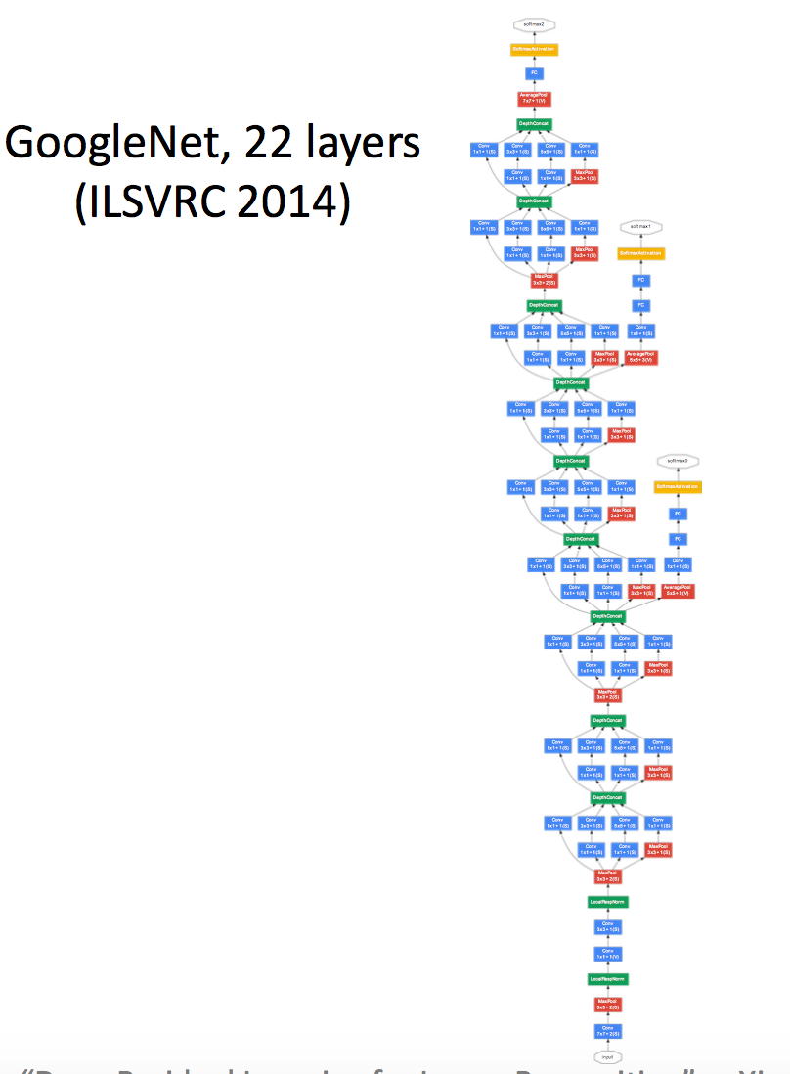
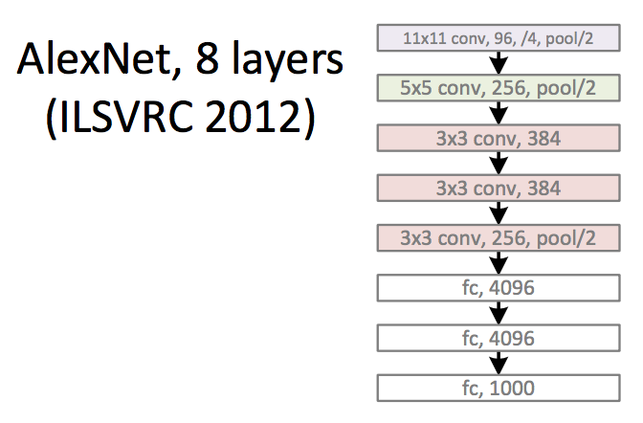
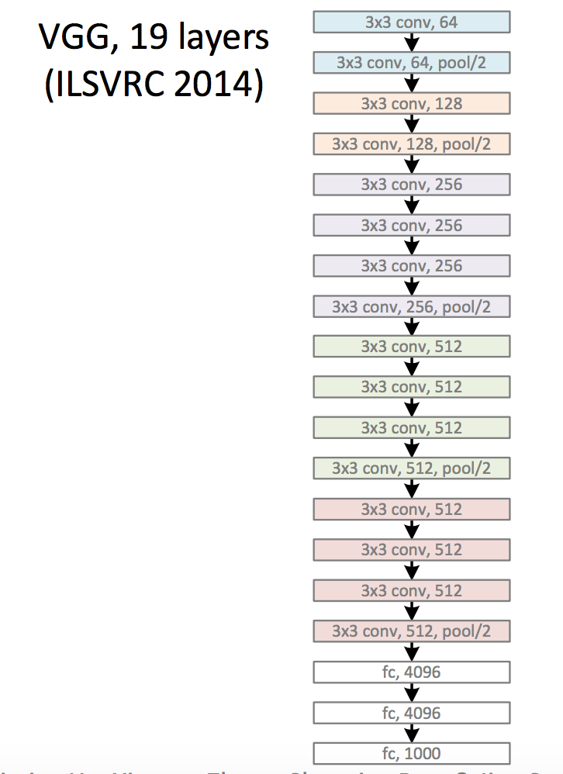
Revolution of Depth
Kaiming He, Xiangyu Zhang, Shaoqing Ren, & Jian Sun. “Deep Residual Learning for Image Recognition”. arXiv 2015.

Slide 6
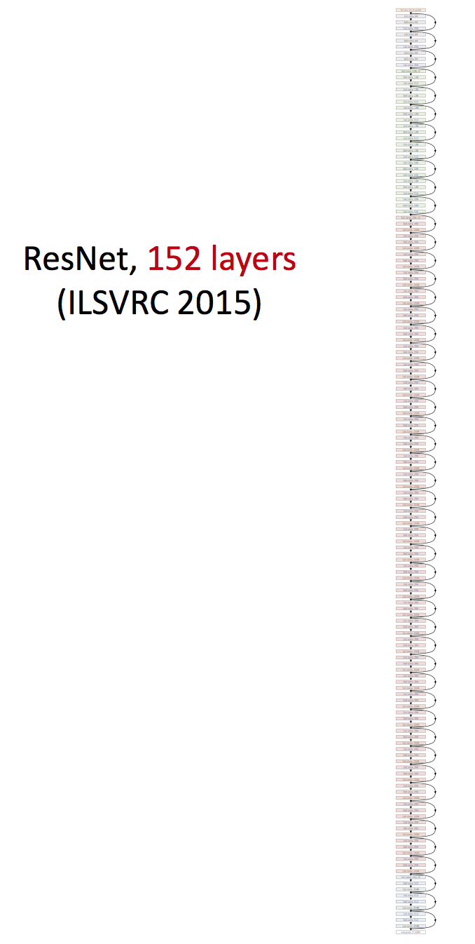
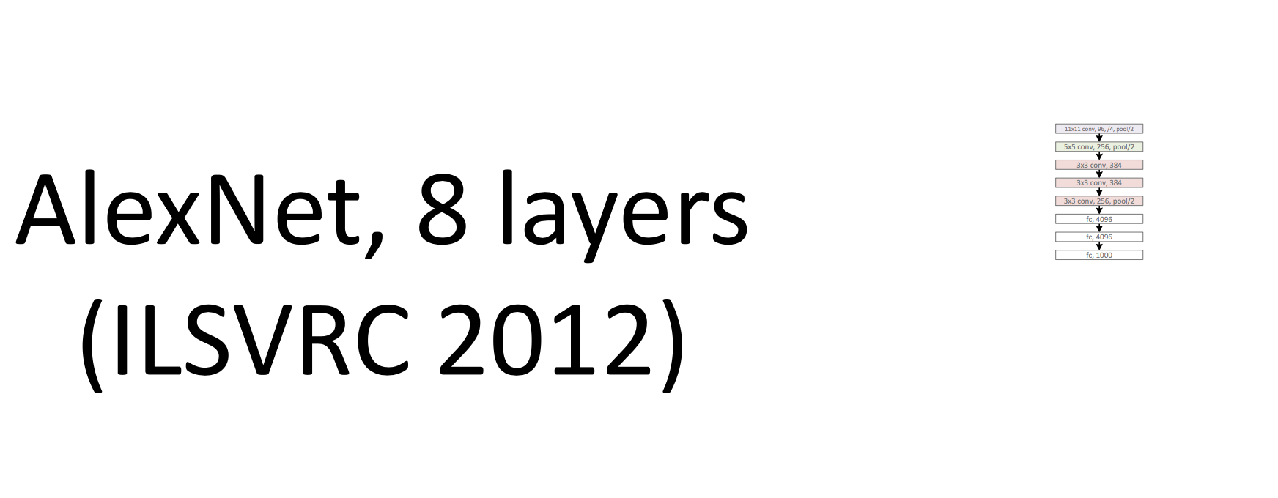
Revolution of Depth

Slide 7
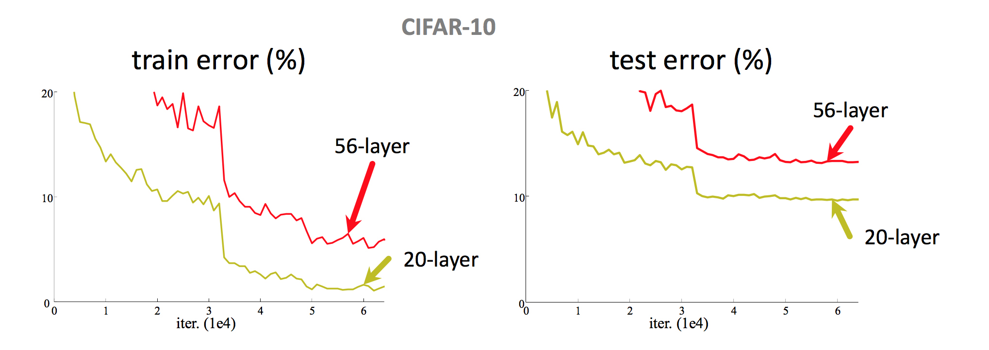
Simply stacking layers?
• Plain nets: stacking 3x3 Convlayers... • 56-layer net has higher training error and test error than 20-layer net

Slide 8
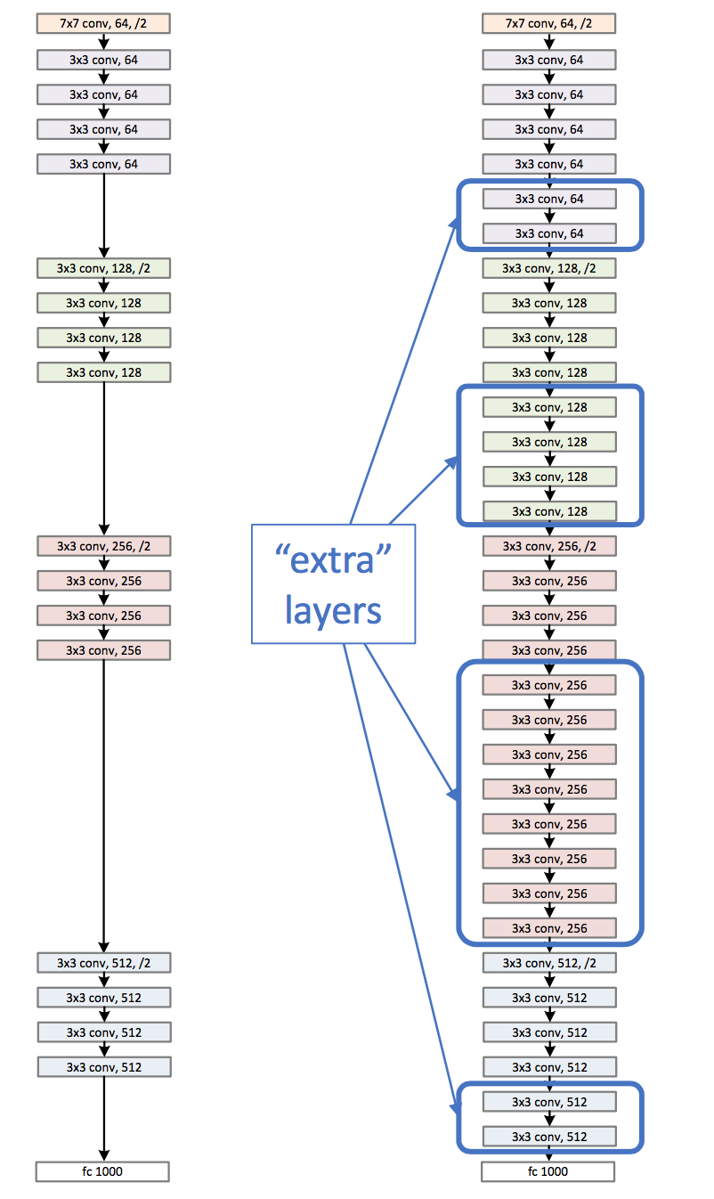
Left : a shallower model (18 layers)
Right : a deeper counterpart (34 layers)
• A deeper model should not have higher training error
• A solution by construction:
• original layers: copied from a learned shallower model
• extra layers: set as identity
• at least the same training error
• Optimization difficulties: solvers cannot find the solution when going deeper...

Slide 9
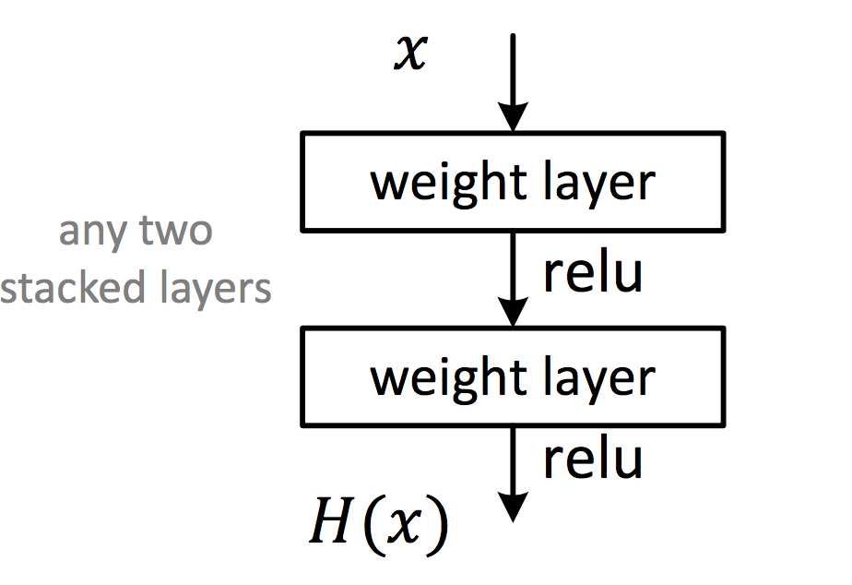
Deep Residual Learning
• Plain net
𝐻(𝑥) is any desired mapping, hope the 2 weight layers fit 𝐻(𝑥)

Slide 10
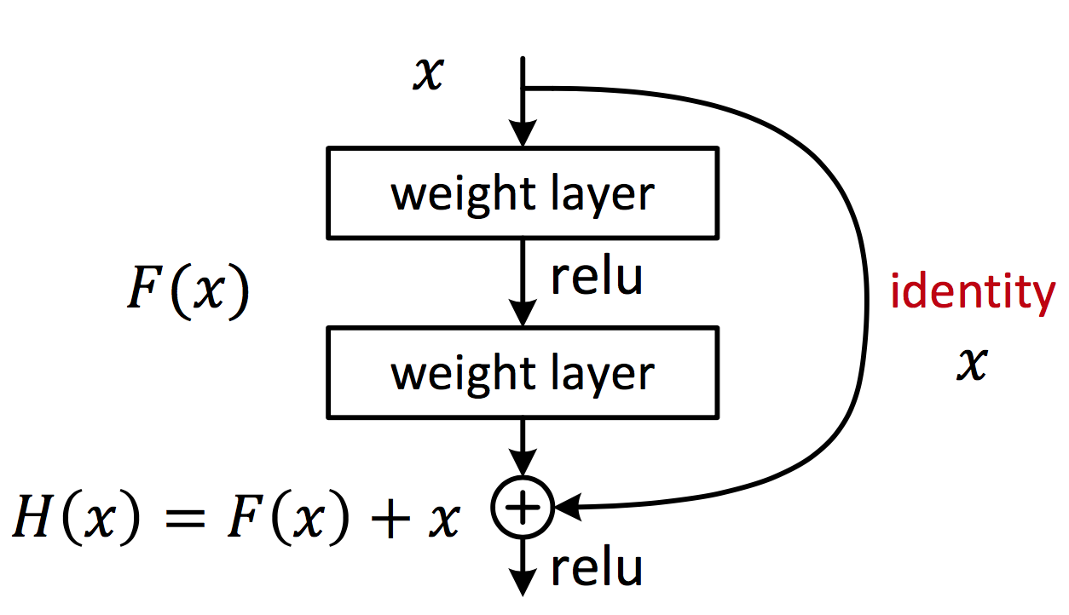
Deep Residual Learning
• Residual net
𝐻(𝑥) is any desired mapping, hope the 2 weight layers fit 𝐻(𝑥) hope the 2 weight layers fit 𝐹(𝑥) let 𝐻(𝑥) = 𝐹(𝑥) + 𝑥

Slide 11
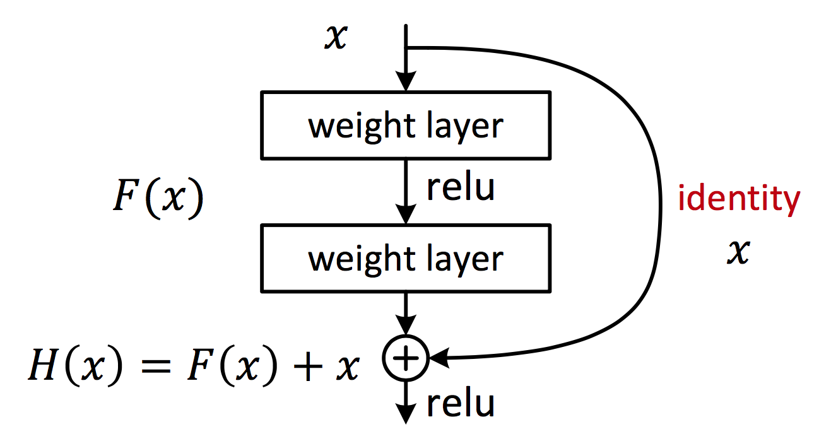
Deep Residual Learning
• 𝐹 𝑥 is a residual mapping w.r.t. identity
• If identity were optimal, easy to set weights as 0
• If optimal mapping is closer to identity, easier to find small fluctuations

Slide 12
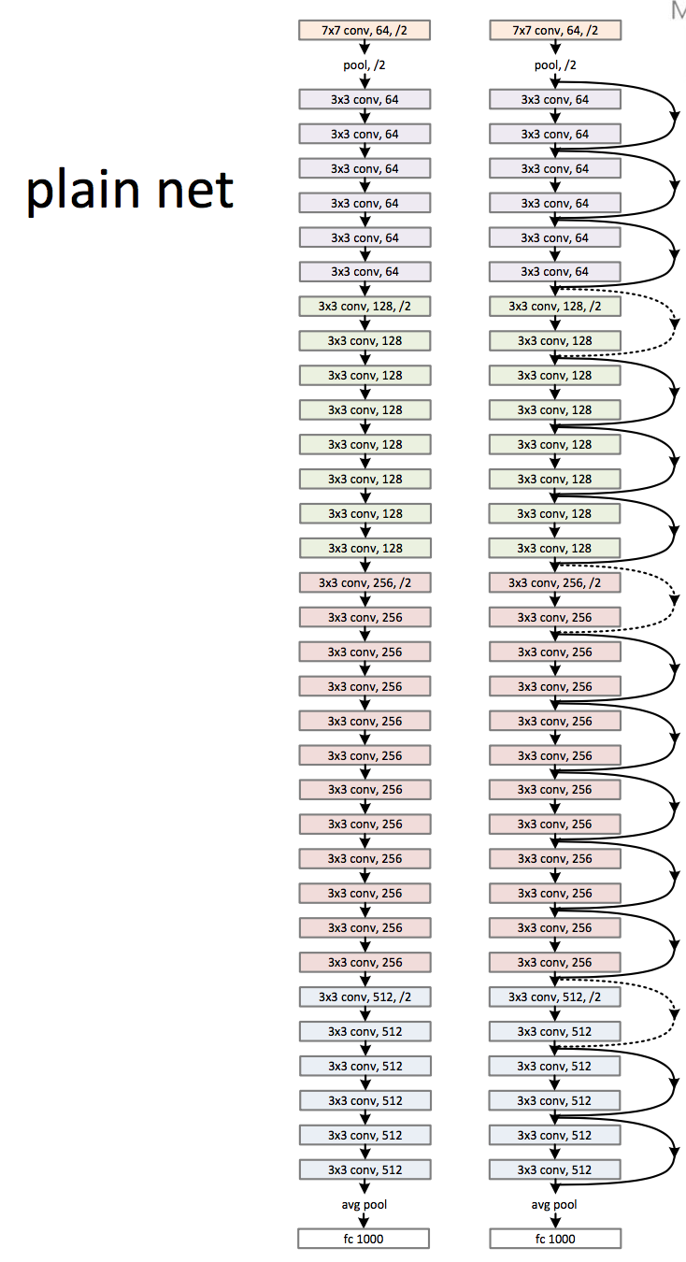
Network “Design”
ResNet
Keep it simple
The basic design (VGG-style)
• all 3x3 conv (almost) • spatial size /2 => # filters x2
• Simple design; just deep!
Other remarks: • no max pooling(almost)
• no hidden fc • no dropout

Slide 13
Lets Revisit Optimization Basics

Slide 14
Functions and their optima
The objective function of the ML problem we are solving (e.g., squared loss for regression)
Assume unconstrained for now, i.e., just a real-valued number/vector
Many ML problems require us to optimize a function $f$ of some variable(s) $x$
For simplicity, assume $f$ is a scalar-valued function of a scalar $x$($f:$ $ℝ →ℝ)$
Any function has one/more optima (maxima, minima), and maybe saddle points
Finding the optima or saddles requires derivatives/gradients of the function
$$f(x)$$
A local maxima
A local maxima
Global maxima
Usually interested in global optima but often want to find local optima, too
A local minima
For deep learning models, often the local optima are what we can find (and they usually suffice) – more later
A local minima
A local minima
$$x$$
Will see what these are later
Global minima

Slide 15
Derivatives
Will sometimes use $f^{′}(x)$ to denote the derivative
Magnitude of derivative at a point is the rate of change of the func at that point
Derivative becomes zero at stationary points (optima or saddle points)
The function becomes “flat” ($∆f\left(x\right)=0$ if we change $x$ by a very little at such points)
These are the points where the function has its maxima/minima (unless they are saddles)
$\frac{df(x)}{dx}$ = $\lim_{∆x→0}{\frac{∆f(x)}{∆x}}$
$$f(x)$$
Sign is also important: Positive derivative means $f$ is increasing at $x$ if we increase the value of $x$ by a very small amount; negative derivative means it is decreasing
$$∆f(x)$$
$$∆f(x)$$
$$∆x$$
$$∆x$$
$$x$$
Understanding how $f$ changes its value as we change $x$ is helpful to understand optimization (minimization/maximization) algorithms

Slide 16
Rules of Derivatives
Some basic rules of taking derivatives
Sum Rule: ${\left(f\left(x\right)+g\left(x\right)\right)}^{′}=f^{′}\left(x\right)+g^{′}\left(x\right)$
Scaling Rule: ${\left(a⋅f\left(x\right)\right)}^{′}=a⋅f^{′}\left(x\right)$ if $a$ is not a function of $x$
Product Rule: ${\left(f\left(x\right)⋅g\left(x\right)\right)}^{′}=f^{′}\left(x\right)⋅g\left(x\right)+g^{′}\left(x\right)⋅f\left(x\right)$
Quotient Rule: $\left(f\left(x\right)/g\left(x\right)\right)′=\left(f^{′}\left(x\right)⋅g\left(x\right)−g^{′}\left(x\right)f\left(x\right)\right)/{\left(g\left(x\right)\right)}^{2}$
Chain Rule: ${\left(f\left(g\left(x\right)\right)\right)}^{′}≝{\left(f∘g\right)}^{′}\left(x\right)=f^{′}\left(g\left(x\right)\right)⋅g^{′}\left(x\right)$
We already used some of these (sum, scaling and chain) when calculating the derivative for the linear regression model

Slide 17
Derivatives
How the derivative itself changes tells us about the function’s optima
The second derivative $f’’(x)$can provide this information
𝑓’(𝑥)= 0 and $f’’(x) < 0$
$x$ is a maxima
𝑓’(𝑥)= 0 at 𝑥
𝑓’(𝑥)= 0 just before 𝑥 𝑓’(𝑥)= 0 just after 𝑥
𝑥 may be a saddle
𝑓’(𝑥)= 0 at 𝑥, 𝑓’(𝑥)>0 just before 𝑥 𝑓’(𝑥)<0 just after 𝑥
𝑥 is a maxima
𝑓’(𝑥)= 0 and $f’’\left(x\right)> 0$
$x$ is a minima
𝑓’(𝑥)= 0 and $f’’\left(x\right)= 0$
$x$ may be a saddle. May need higher derivatives
𝑓’(𝑥)= 0 at 𝑥
𝑓’(𝑥)< 0 just before 𝑥 𝑓’(𝑥)>0 just after 𝑥
𝑥 is a minima

Slide 18
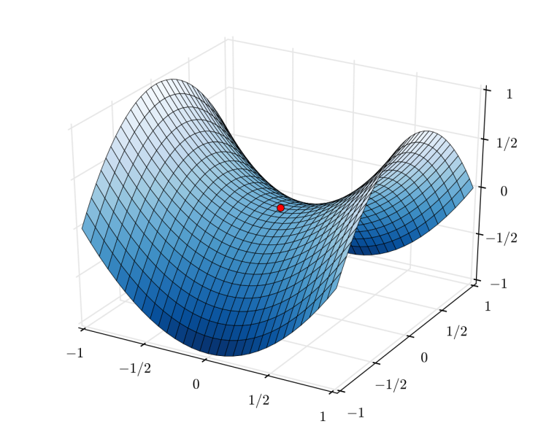
Saddle Points
Points where derivative is zero but are neither minima nor maxima
Saddle points are very common for loss functions of deep learning models
Need to be handled carefully during optimization
Second or higher derivative may help identify if a stationary point is a saddle
A saddle point
Saddle is a point of inflection where the derivative is also zero

Slide 19
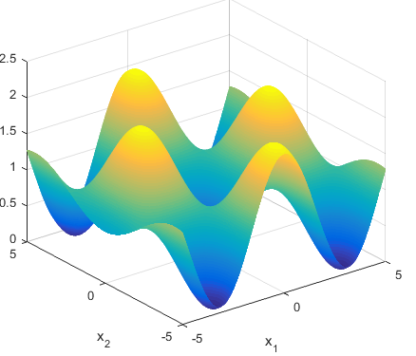
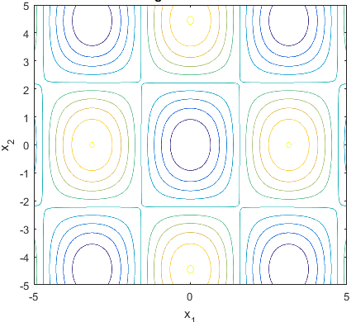
Multivariate Functions
Most functions that we see in ML are multivariate function
Example: Loss fn $L(w)$ in lin-reg was a multivar function of $D$-dim vector $w$
Here is an illustration of a function of 2 variables (4 maxima and 5 minima)
$L\left(w\right):ℝ^{D}$ $→ℝ$
Two-dim contour plot of the function (i.e., what it looks like from the above)
Plot courtesy: http://benchmarkfcns.xyz/benchmarkfcns/griewankfcn.html

Slide 20
Derivatives of Multivariate Functions
Can define derivative for a multivariate functions as well via the gradient
Gradient of a function $f(x):$ $ℝ^{D}$ $→ℝ$ is a $D×1$ vector of partial derivatives
Optima and saddle points defined similar to one-dim case
Required properties that we saw for one-dim case must be satisfied along all the directions
The second derivative in this case is known as the Hessian
$$∇f\left(x\right)=\left(\frac{∂f}{∂x_{1}},\frac{∂f}{∂x_{2}},…,\frac{∂f}{∂x_{D}}\right)$$
Each element in this gradient vector tells us how much $f$ will change if we move a little along the corresponding (akin to one-dim case)

Slide 21
The Hessian
For a multivar scalar valued function $f(x):$ $ℝ^{D}$ $→ℝ$, Hessian is a $D× D$matrix
The Hessian matrix can be used to assess the optima/saddle points
$∇f\left(x\right)$ = 0 and $∇^{2}f\left(x\right)$ is a positive semi-definite (PSD) matrix then $x$ is a minima
$∇f\left(x\right)$ = 0, and $∇^{2}f\left(x\right)$ is a negative semi-definite (NSD) matrix then $x$ is a maxima
Note: If the function itself is vector valued, e.g., $f(x):$ $ℝ^{D}$ $→ℝ^{K}$ then we will have $K$ such $D× D$Hessian matrices, one for each output dimension of $f$
$$∇^{2}f\left(x\right)=\left[\begin{matrix}\begin{aligned}\frac{∂^{2}f}{∂x_{1}^{2}} \\ \frac{∂^{2}f}{∂x_{2}x_{1}}\end{aligned} & \begin{aligned}\frac{∂^{2}f}{∂x_{1}x_{2}} \\ \frac{∂^{2}f}{∂x_{2}^{2}}\end{aligned} & \begin{aligned}… \\ …\end{aligned} \\ ⋮ & ⋮ & ⋱ \\ \frac{∂^{2}f}{∂x_{D}x_{1}} & \frac{∂^{2}f}{∂x_{D}x_{2}} & …\end{matrix} \begin{matrix}\frac{∂^{2}f}{∂x_{1}x_{D}} \\ \frac{∂^{2}f}{∂x_{2}x_{D}} \\ \begin{aligned}⋮ \\ \frac{∂^{2}f}{∂x_{D}^{2}}\end{aligned}\end{matrix}\right]$$
Gives information about the curvature of the function at point $x$
A square, symmetric $D×D$matrix M is PSD if $x^{⊤}Mx≥0$ $∀ x∈ ℝ^{D}$
Will be NSD if $x^{⊤}Mx≤0$ $∀ x∈ ℝ^{D}$
PSD if all eigenvalues are non-negative

Slide 22
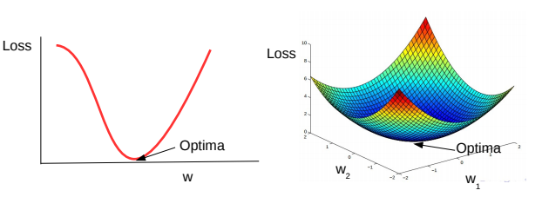
Convex and Non-Convex Functions
A function being optimized can be either convex or non-convex
Here are a couple of examples of convex functions
Here are a couple of examples of non-convex functions
Convex functions are bowl-shaped. They have a unique optima (minima)
Negative of a convex function is called a concave function, which also has a unique optima (maxima)
Non-convex functions have multiple minima. Usually harder to optimize as compared to convex functions
Loss functions of most deep learning models are non-convex

Slide 23
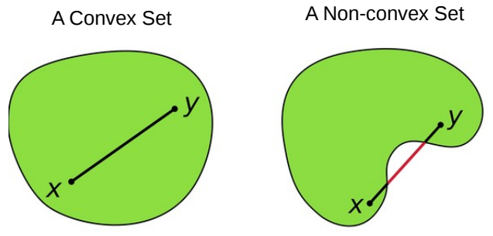
Convex Sets
A set S of points is a convex set, if for any two points $x, y ∈ S$, and 0 ≤ $α$ ≤ 1
Above means that all points on the line-segment between $x$ and $y$ lie within $S$
The domain of a convex function needs to be a convex set
$z$ is also called a “convex combination” of two points
Can also define convex combination of $N$ points $x_{1},x_{2},…,x_{N}$as $z = \sum_{i=1}^{N}{α_{i}x_{i}}$
$$z=αx+\left(1−α\right)y∈S$$

Slide 24
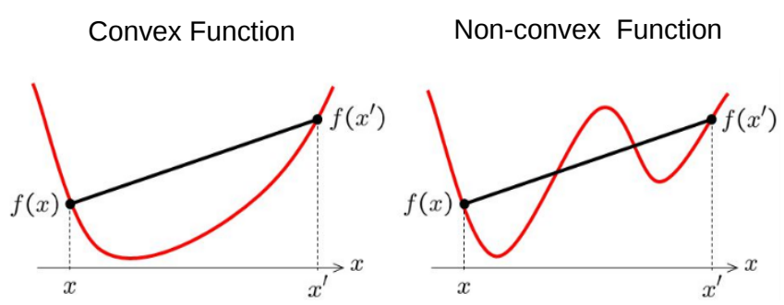
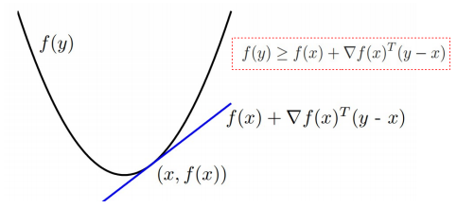
Convex Functions
Informally, $f(x)$ is convex if all of its chords lie above the function everywhere
Formally, (assuming differentiable function), some tests for convexity:
First-order convexity (graph of $f$ must be above all the tangents)
Second derivative a.k.a. Hessian (if exists) must be positive semi-definite

Slide 25
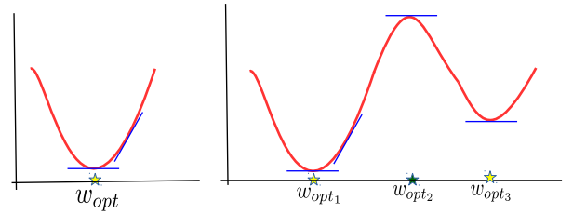
Optimization Using First-Order Optimality
Very simple. Already used this approach for linear and ridge regression
First order optimality: The gradient $g$ must be equal to zero at the optima
Sometimes, setting $g$ $= 0$and solving for $w$ gives a closed form solution
If closed form solution is not available, the gradient vector $g$ can still be used in iterative optimization algos, like gradient descent
Called “first order” since only gradient is used and gradient provides the first order info about the function being optimized
The approach works only for very simple problems where the objective is convex and there are no constraints on the values $w$ can take
$g=∇_{w}\left[L(w)\right]$ = 0

Slide 26
Optimization via Gradient Descent
Can I used this approach to solve maximization problems?
For max. problems we can use gradient ascent
$$w^{(t+1)}= w^{(t)}+η_{t}g^{(t)}$$
Iterative since it requires several steps/iterations to find the optimal solution
Fact: Gradient gives the direction of steepest change in function’s value
Will move in the direction of the gradient
For convex functions, GD will converge to the global minima
Good initialization needed for non-convex functions
Gradient Descent
The learning rate very imp. Should be set carefully (fixed or chosen adaptively). Will discuss some strategies later
Initialize $w$ as $w^{(0)}$
For iteration $t=0,1,2,…$(or until convergence)
Calculate the gradient $g^{(t)}$using the current iterates $w^{(t)}$
Set the learning rate $η_{t}$
Move in the opposite direction of gradient
Will see the justification shortly
Sometimes may be tricky to to assess convergence? Will see some methods later
$$w^{(t+1)}= w^{(t)}−η_{t}g^{(t)}$$

Slide 27
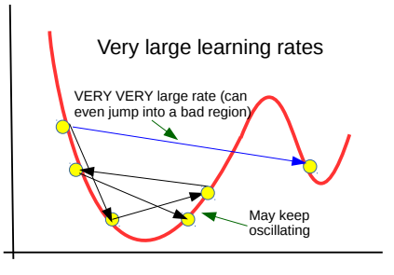
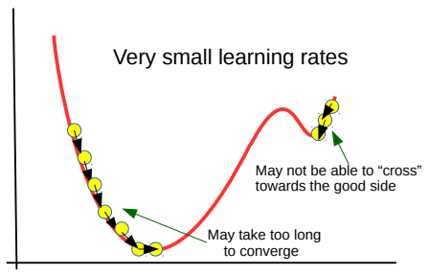
Gradient Descent: An Illustration
Negative gradient here $(\frac{δL}{δw}<0)$. Let’s move in the positive direction
Learning rate is very important
$$L(w)$$
Positive gradient here. Let’s move in the negative direction
$$w^{(2)}$$
$$w_{∗}$$
$$w^{(1)}$$
$$w^{(0)}$$
$$w$$
$$w^{(0)}$$
$$w^{(1)}$$
$$w^{(3)}$$
$$w^{(2)}$$
$$w^{(3)}$$
$$w_{∗}$$
Stuck at a local minima
Good initialization is very important

Slide 28
GD: An Example
Let’s apply GD for least squares linear regression
The gradient: $g=−\sum_{n=1}^{N}{2\left(y_{n}−w^{⊤}x_{n}\right)x_{n}}$
Each GD update will be of the form
Exercise: Assume $N=1$, and show that GD update improves prediction on the training input ($x_{n}$, $y_{n}$), i.e, $y_{n}$ is closer to ${w^{\left(t+1\right)}}^{⊤}x_{n}$ than to ${w^{\left(t\right)}}^{⊤}x_{n}$
This is sort of a proof that GD updates are “corrective” in nature (and it actually is true not just for linear regression but can also be shown for various other ML models)
$w_{ridge}$= ${\text{arg} \text{min}}_{w} L_{reg}\left(w\right)={\text{arg} \text{min}}_{w} \sum_{n=1}^{N}{{(y_{n}−w^{⊤}x_{n})}^{2}}$
Training examples on which the current model’s error is large contribute more to the update
Prediction error of current model $w^{(t)}$ on the $n^{th}$training example
$w^{(t+1)}= w^{(t)}+η_{t}$ $\sum_{n=1}^{N}{2\left(y_{n}−{w^{(t)}}^{⊤}x_{n}\right)x_{n}}$

Slide 29
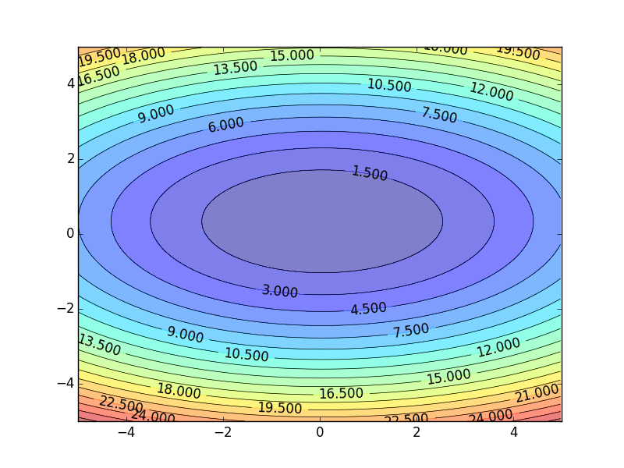
Gradient Descent
Assume there are only two parameters w₁ and w₂ in a network.
Error Surface
$$θ=\left\{w_{1},w_{2}\right\}$$
The colors represent the value of C.
Randomly pick a starting point $θ^{0}$
Compute the negative gradient at $θ^{0}$
$$w_{2}$$
$$θ^{∗}$$
$$−η∇C\left(θ^{0}\right)$$
$$−∇C\left(θ^{0}\right)$$
$$−∇C\left(θ^{0}\right)$$
Times the learning rate $η$
$$∇C\left(θ^{0}\right)=\left[\begin{matrix}∂C\left(θ^{0}\right)/∂w_{1} \\ ∂C\left(θ^{0}\right)/∂w_{2}\end{matrix}\right]$$
$$θ^{0}$$
$$−η∇C\left(θ^{0}\right)$$
$$w_{1}$$
Notes:
Eta
人站在 ｔｈｅｔａ０ 環顧四周 看看哪裡最低，那個方向就是 ｇｒａｄｉｅｎｔ

Slide 30
Gradient Descent
Eventually, we would reach a minima …..
Randomly pick a starting point $θ^{0}$
Compute the negative gradient at $θ^{0}$
$$θ^{2}$$
$$−η∇C\left(θ^{2}\right)$$
$$−η∇C\left(θ^{1}\right)$$
$$w_{2}$$
$$−∇C\left(θ^{2}\right)$$
$$−∇C\left(θ^{1}\right)$$
$$θ^{1}$$
$$−∇C\left(θ^{0}\right)$$
Times the learning rate $η$
$$θ^{0}$$
$$−η∇C\left(θ^{0}\right)$$
$$w_{1}$$

Slide 31
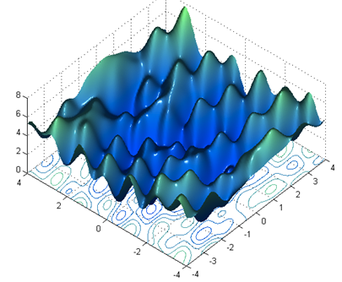
Gradient Descent
Gradient descent
Pros
Guaranteed to converge to global minimum for convex error surface
Converge to local minimum for non-convex error surface
Cons
Very slow
Intractable for dataset that do not fit in the memory
Different initial point $θ^{0}$
$$C$$
Reach different minima, so different results (non-convex)
$$w_{1}$$
$$w_{2}$$

Slide 32
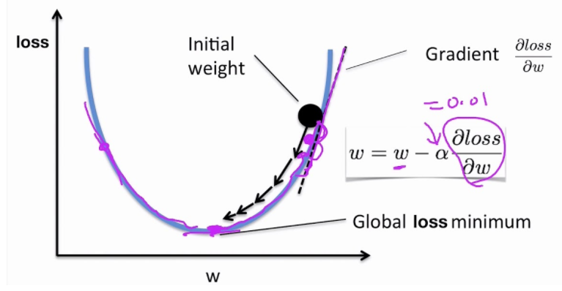
Gradient Descent Algorithm
Steps in the gradient descent algorithm:
Randomly initialize the model parameters$,θ^{0}$
In the figure, the parameters are denoted $w$
Compute the gradient of the loss function at $θ^{0}$: $∇ℒ\left(θ^{0}\right)$
Update the parameters as: $θ^{new}=θ^{0}−α∇ℒ\left(θ^{0}\right)$
Where α is the learning rate
Go to step 2 and repeat (until a terminating criterion is reached)

Slide 33
Gradient Descent Algorithm
Example: a NN with only 2 parameters $w_{1}$ and $w_{2}$, i.e., $θ=\left\{w_{1},w_{2}\right\}$
Different colors are the values of the loss (minimum loss$θ^{∗}$ is ≈ 1.3)
1. Randomly pick a starting point $θ^{0}$
2. Compute the gradient at $θ^{0}$, $∇ℒ\left(θ^{0}\right)$
$$θ^{∗}$$
$$w_{2}$$
3. Times the learning rate $η$, and update $θ,$
$$θ^{new}=θ^{0}−α∇ℒ\left(θ^{0}\right)$$
$$θ^{1}$$
$$θ^{1}=$$
$$θ^{0}−α∇ℒ\left(θ^{0}\right)$$
$$−∇ℒ\left(θ^{0}\right)$$
4. Go to step 2, repeat
$$θ^{0}$$
$$∇ℒ\left(θ^{0}\right)=\left[\begin{matrix}∂ℒ\left(θ^{0}\right)/∂w_{1} \\ ∂ℒ\left(θ^{0}\right)/∂w_{2}\end{matrix}\right]$$
$$w_{1}$$
Slide credit: Hung-yi Lee – Deep Learning Tutorial

Slide 34
Gradient Descent Algorithm
Example (contd.)
Eventually, we would reach a minimum …..
1. Randomly pick a starting point $θ^{0}$
2. Compute the gradient at $θ^{0}$,$∇ℒ\left(θ^{0}\right)$
$$θ^{2}$$
$$θ^{1}−α∇ℒ\left(θ^{1}\right)$$
3. Times the learning rate $η$, and update $θ,$
$$θ^{new}=θ^{0}−α∇ℒ\left(θ^{0}\right)$$
$$w_{2}$$
$$θ^{2}−α∇ℒ\left(θ^{2}\right)$$
$$θ^{1}$$
4. Go to step 2, repeat
$$θ^{0}$$
$$w_{1}$$
Slide credit: Hung-yi Lee – Deep Learning Tutorial

Slide 35
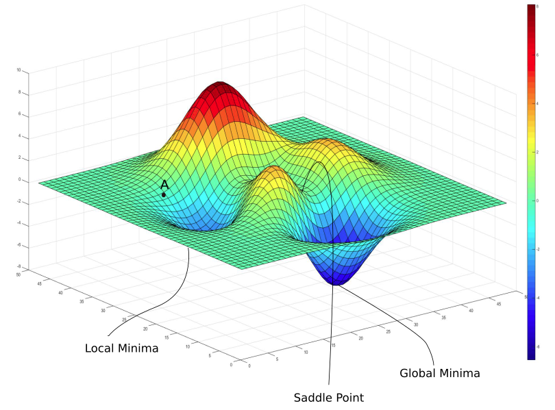
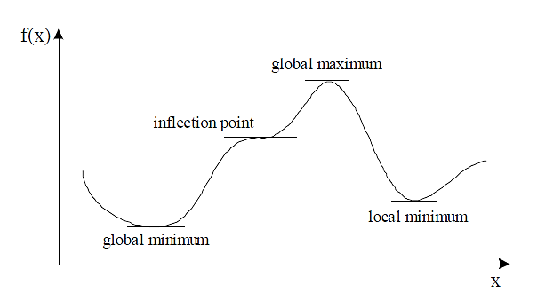
Gradient Descent Algorithm
Gradient descent algorithm stops when a local minimum of the loss surface is reached
GD does not guarantee reaching a global minimum
However, empirical evidence suggests that GD works well for NNs
$ℒ\left(θ\right)$
$$θ$$
Picture from: https://blog.paperspace.com/intro-to-optimization-in-deep-learning-gradient-descent/

Slide 36
Gradient Descent Algorithm
For most tasks, the loss surface $ℒ\left(θ\right)$ is highly complex (and non-convex)
Random initialization in NNs results in different initial parameters $θ^{0}$
Gradient descent may reach different minima at every run
Therefore, NN will produce different predicted outputs
Currently, we don’t have an algorithm that guarantees reaching a global minimum for an arbitrary loss function
$$ℒ$$
$$w_{1}$$
$$w_{2}$$
Slide credit: Hung-yi Lee – Deep Learning Tutorial

Slide 37
Gradient Descent: Practical Issues

Slide 38
Gradient explosion/diminishing problem
$$h_{0}$$
$$h_{1}$$
$$h_{2}$$
$$h_{3}$$
Linear + ReLU
Linear + ReLU
Linear + ReLU
$$W_{1}$$
$$W_{2}$$
$$W_{3}$$
$$W_{1}^{T}$$
$$W_{2}^{T}$$
$$W_{3}^{T}$$

Slide 39
Gradient explosion/diminishing problem
$$h_{0}$$
$$h_{1}$$
$$h_{2}$$
$$h_{3}$$
Linear
Linear
Linear
$$W_{}$$
$$W_{}$$
$$W_{}$$
$$W_{}^{T}$$
$$W_{}^{T}$$
$$W_{}^{T}$$
$${Δh}_{0}={\left(W_{}^{T}\right)}^{3}Δh_{3}$$
$${Δh}_{1}={\left(W_{}^{T}\right)}^{2}Δh_{3}$$
$${Δh}_{2}=W_{}^{T}Δh_{3}$$
$${Δh}_{3}$$
Gradient is magnified or diminished by factor W at every layer.
If we have many layers, they can explode or diminish to zero.

Slide 40
Vanishing Gradient Problem
In some cases, during training, the gradients can become either very small (vanishing gradients) of very large (exploding gradients)
They result in very small or very large update of the parameters
Solutions: ReLU activations, regularization, LSTM units in RNNs
……
y₁
……
y₂
……
……
……
……
……
……
y_{M}
Small gradients, learns very slow
Slide credit: Hung-yi Lee – Deep Learning Tutorial

Slide 41
Vanishing / Exploding gradients
When you're training a very deep network, sometimes the derivatives can get either very, very big, and this makes training difficult.
$$W^{1}$$
$$W^{2}$$
$$W^{L−1}$$
$$W^{L}$$
……
$$\overline{y}$$
……
$$Z^{1}=W^{1}x$$
$$Z^{2}=W^{2}Z^{1}$$
$$Z^{L−1}=W^{L−1}Z^{L−2}$$
$$\overline{y}=W^{L}Z^{L−1}$$
For simplicity, we assume bias ($b=0$) at every layer and the activation function is linear
Assuming the entries in the weight matrix are in the form
$${ W}^{L−1}=W^{L−2}=…W^{2}=W^{1}=\left[\begin{matrix}p & 0 \\ 0 & p\end{matrix}\right]$$
$$\overline{y}=W^{L}W^{L−1}W^{L−2}…W^{2}W^{1}x$$
$\overline{y}=W^{L}{×\left[\begin{matrix}p & 0 \\ 0 & p\end{matrix}\right]}^{L−1}×x$
then,
Source: https://www.coursera.org/learn/deep-neural-network/lecture/C9iQO/vanishing-exploding-gradients

Slide 42
Vanishing / Exploding gradients
When you're training a very deep network, sometimes the derivatives can get either very, very big, and this makes training difficult.
$$W^{1}$$
$$W^{2}$$
$$W^{L−1}$$
$$W^{L}$$
……
$$\overline{y}$$
……
$$Z^{1}=W^{1}x$$
$$Z^{2}=W^{2}Z^{1}$$
$$Z^{L−1}=W^{L−1}Z^{L−2}$$
$$\overline{y}=W^{L}Z^{L−1}$$
if $p>1$ and the number of layers in the network is large, the value of $\overline{y}$ will explode.
$$\overline{y}=W^{L}W^{L−1}W^{L−2}…W^{2}W^{1}x$$
Similarly, if $p<1$, the value of $\overline{y}$ will be very small. Hence, the gradient descent will take very tinny step.
$\overline{y}=W^{L}{×\left[\begin{matrix}p & 0 \\ 0 & p\end{matrix}\right]}^{L−1}×x$
Source: https://www.coursera.org/learn/deep-neural-network/lecture/C9iQO/vanishing-exploding-gradients

Slide 43
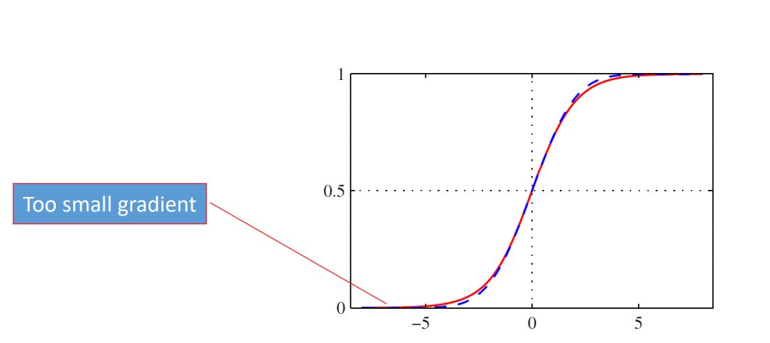
Solutions: Vanishing / Exploding gradients
Use a good initialization
Random Initialization
The primary reason behind initializing the weights randomly is to break symmetry.
We want to make sure that different hidden units learn different patterns.
Do not use sigmoid for deep networks
Problem: saturation
Image Source: Pattern Recognition and Machine Learning, Bishop

Slide 44
ReLU
Rectified Linear Unit (ReLU)
Reason:
$$a$$
$$σ\left(z\right)$$
1. Fast to compute
$$a=z$$
2. Vanishing gradient
problem
$$a=0$$
$$z$$
Notes:
Parametric ReLU, -> PReLU
Ref: Glorot, Xavier, Antoine Bordes, and Yoshua Bengio. "Deep sparse rectifier neural networks." International Conference on Artificial Intelligence and Statistics. 2011.
No differentailalbe how about 0
Benefit:
2011
Where does it come from?
fast to compute
biology?
many sigmoid

Slide 45
ReLU
$$a$$
$$a=z$$
$$a=0$$
$$z$$
0
0
0
0

Slide 46
ReLU
$$a$$
$$a=z$$
A Thinner linear network
$$a=0$$
$$z$$
Do not have smaller gradients

Slide 47
ReLU - variant
$$Leaky ReLU$$
$$Parametric ReLU$$
$$a$$
$$a$$
$$a=z$$
$$a=z$$
$$z$$
$$z$$
$$a=0.01z$$
$$a=αz$$
$α$ also learned by gradient descent

Slide 48
Loss Functions
Classification tasks
Training
examples
$ℝ^{n}×\left\{{class}_{1},…,{class}_{m}\right\}$ (one-hot encoding)
Output
Layer
Softmax Activation
[maps $ℝ^{m}$ to a probability distribution]
Loss function
$$ℒ\left(θ\right)=−\frac{1}{n}\sum_{i=1}^{n}{\sum_{k=1}^{K}{\left[y_{k}^{(i)}\log{{\hat{y}}_{k}^{(i)}+\left(1−y_{k}^{(i)}\right) }\log\left(1− {\hat{y}}_{k}^{\left(i\right)}\right)\right]}}$$
Cross-entropy
Slide credit: Ismini Lourentzou – Introduction to Deep Learning

Slide 49
Loss Functions
Regression tasks
Training
examples
$$ℝ^{n}×ℝ^{m}$$
Output
Layer
Linear (Identity) or Sigmoid Activation
$$ℒ\left(θ\right)= \frac{1}{n}\sum_{i=1}^{n}{{\left(y^{(i)}−{\hat{y}}^{(i)}\right)}^{2}}$$
Mean Squared Error
Loss function
$$ℒ\left(θ\right)= \frac{1}{n}\sum_{i=1}^{n}{\left|y^{(i)}−{\hat{y}}^{(i)}\right|}$$
Mean Absolute Error
Slide credit: Ismini Lourentzou – Introduction to Deep Learning

Slide 50
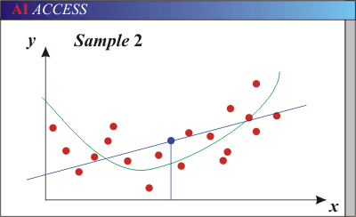
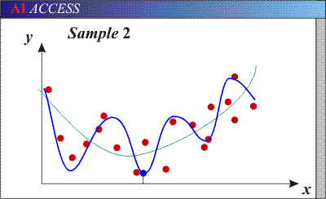
Generalization
Underfitting
The model is too “simple” to represent all the relevant class characteristics
Model with too few parameters
High error on the training set and high error on the testing set
Overfitting
The model is too “complex” and fits irrelevant characteristics (noise) in the data
Model with too many parameters
Low error on the training error and high error on the testing set
Blue line – decision boundary by the model
Green line – optimal decision boundary

Slide 51
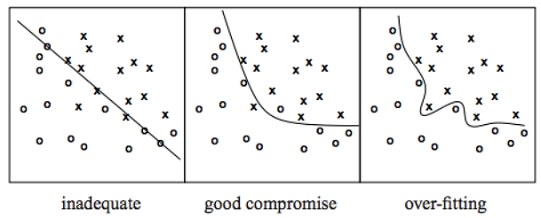
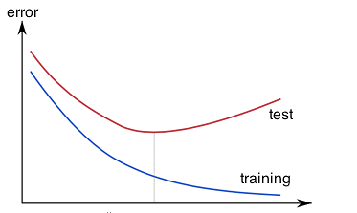
Overfitting
A model with high capacity fits the noise in the data instead of the underlying relationship
The model may fit the training data very well, but fails to generalize to new examples (test data)
Picture from: http://cs231n.github.io/assets/nn1/layer_sizes.jpeg

Slide 52
Overfitting in Deep Neural Nets
Deep neural networks contain multiple non-linear hidden layers
This makes them very expressive models that can learn very complicated relationships between their inputs and outputs.
In other words, model learns even the tiniest details present in the data.
But with limited training data, many of these complicated relationships will be the result of sampling noise
So they will exist in the training set but not in real test data even if it is drawn from the same distribution.
So after learning all the possible patterns it can find, the model tends to perform extremely well on the training set but fails to produce good results on the dev and test sets.

Slide 53
But…what else do we optimize?

Slide 54
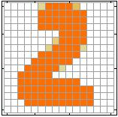
Neural Network Parameters
$$θ=\left\{W^{1},b^{1},W^{2},b^{2},⋯W^{L},b^{L}\right\}$$
……
y₁
is 1
0.1
……
y₂
0.7
is 2
……
……
……
……
……
y₁₀
is 0
0.2
16 x 16 = 256
Ink → 1
No ink → 0
Set the network parameters $θ$ such that ……
Input:
How to let the neural network achieve this
y₁ has the maximum value
Input:
y₂ has the maximum value

Slide 55
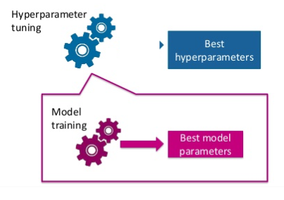
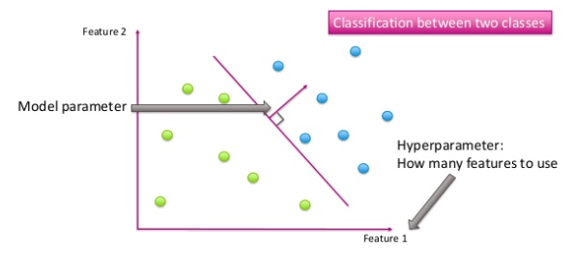
Parameters vs Hyperparameters
A model parameter is a variable of the selected model which can be estimated by fitting the given data to the model.
Hyperparameter is a parameter from a prior distribution; it captures the prior belief before data is observed.
These are the parameters that control the model parameters
In any machine learning algorithm, these parameters need to be initialized before training a model.
Image Source: https://www.slideshare.net/AliceZheng3/evaluating-machine-learning-models-a-beginners-guide

Slide 56
Deep Neural Network: Parameters vs Hyperparameters
Parameters:
$W^{1},b^{1},W^{2},b^{2},⋯W^{L},b^{L}$
Hyperparameters:
Learning rate $\left(α\right)$ in gradient descent
Number of iterations in gradient descent
Number of layers in a Neural Network
Number of neurons per layer in a Neural Network
Activations Functions
Mini-batch size
Regularizations parameters
Image Source: https://www.slideshare.net/AliceZheng3/evaluating-machine-learning-models-a-beginners-guide

Slide 57
Train / Dev / Test sets
Hyperparameters tuning is a highly iterative process, where you
start with an idea, i.e. start with a certain number of hidden layers, certain learning rate, etc.
try the idea by implementing it
experiment how well the idea has worked
refine the idea and iterate this process
Now how do we identify whether the idea is working? This is where the train / dev / test sets come into play.
Training Set
Dev Set
Test Set
We train the model on the training data.
Data
After training the model, we check how well it performs on the dev set.
When we have a final model, we evaluate it on the test set in order to get an unbiased estimate of how well our algorithm is doing.

Slide 58
Train / Dev / Test sets
Training Set (60%)
Dev Set (20%)
Test Set (20%)
Training Set (70%)
Test Set (20%)
Training Set (98%)
Dev Set (1%)
Test Set (1%)
Data
Previously, when we had small datasets, most often the distribution of different sets was
As the availability of data has increased in recent years, we can use a huge slice of it for training the model

Slide 59
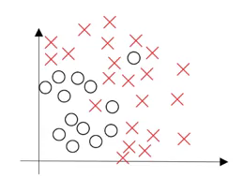
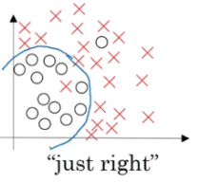
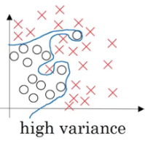
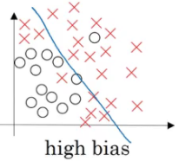
Bias / Variance Trade-off
Make sure the distribution of dev/test set is same as training set
Divide the training, dev and test sets in such a way that their distribution is similar
Skip the test set and validate the model using the dev set only
We want our model to be just right, which means having low bias and low variance.
Overfitting: If the dev set error is much more than the train set error, the model is overfitting and has a high variance
Underfitting: When both train and dev set errors are high, the model is underfitting and has a high bias
Image Source: https://www.analyticsvidhya.com/blog/2018/11/neural-networks-hyperparameter-tuning-regularization-deeplearning/

Slide 60
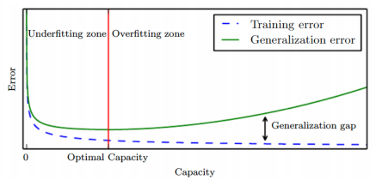
Regularization
Regularization is:
“any modification to a learning algorithm to reduce its generalization error but not its training error”
Reduce generalization error even at the expense of increasing training error
E.g., Limiting model capacity is a regularization method
Source: https://cedar.buffalo.edu/~srihari/CSE574/Chap5/Chap5.5-Regularization.pdf

Slide 61
Regularization Strategies

Slide 62
Parameter Norm Penalties
The most traditional form of regularization applicable to deep learning is the concept of parameter norm penalties.
This approach limits the capacity of the model by adding the penalty $Ω\left(θ\right)$ to the objective function resulting in:
$$\min_{θ}{J=ℓ\left(θ\right)+λΩ\left(θ\right)}$$
$λ∈[0, ∞)$ is a hyperparameter that weights the relative contribution of the norm penalty to the value of the objective function.

Slide 63
L2 Norm Parameter Regularization
Using L2 norm, we’re adding the constraints to the original loss function, such that the weights of the network don’t grow too large.
$$Ω\left(θ\right)=||θ||_{2}^{2}$$
Assuming there is no bias parameters, only weights
$$Ω\left(w\right)=||w||_{2}^{2}=w_{11}^{2}+w_{12}^{2}+…$$
By adding the regularized term, we’re fooling the model such that it won’t drive the training error to zero, which in turn reduces the complexity of the model.

Slide 64
L1 Norm Parameter Regularization
L1 norm is another option that can be used to penalize the size of model parameters.
L1 regularization on the model parameters w is:
$$Ω\left(w\right)=||w||_{1}=\sum_{i}{|w_{i}|}$$
The L2 Norm penalty decays the components of the vector w that do not contribute much to reducing the objective function.
On the other hand, the L1 norm penalty provides solutions that are sparse.
This sparsity property can be thought of as a feature selection mechanism.

Slide 65
Regularization: Weight Decay
$ℓ_{2}$ weight decay
A regularization term that penalizes large weights is added to the loss function
$$ℒ_{reg}\left(θ\right)= ℒ\left(θ\right)+λ\sum_{k}{θ_{k}^{2}}$$
For every weight in the network, we add the regularization term to the loss value
During gradient descent parameter update, every weight is decayed linearly toward zero
The weight decay coefficient $λ$determines how dominant the regularization is during the gradient computation
Data loss
Regularization loss

Slide 66
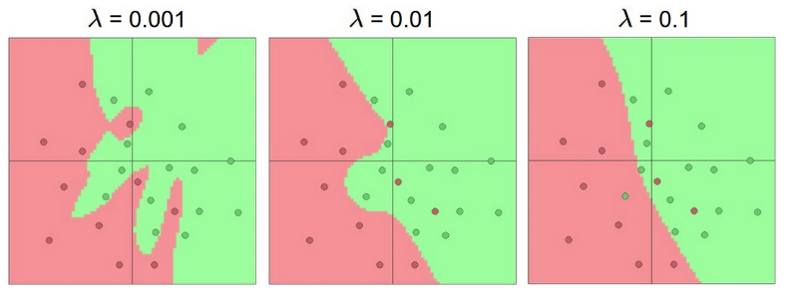
Regularization: Weight Decay
Effect of the decay coefficient $λ$
Large weight decay coefficient → penalty for weights with large values

Slide 67
Regularization: Weight Decay
$ℓ_{1}$ weight decay
The regularization term is based on the $ℓ_{1}$ norm of the weights
$ℒ_{reg}\left(θ\right)= ℒ\left(θ\right)+λ\sum_{k}{\left|θ_{k}\right|}$
$ℓ_{1}$ weight decay is less common with NN
Often performs worse than $ℓ_{2}$ weight decay
It is also possible to combine $ℓ_{1}$ and $ℓ_{2}$ regularization
Called elastic net regularization
$ℒ_{reg}\left(θ\right)= ℒ\left(θ\right)+λ_{1}\sum_{k}{\left|θ_{k}\right|+λ_{2}\sum_{k}{θ_{k}^{2}}}$

Slide 68
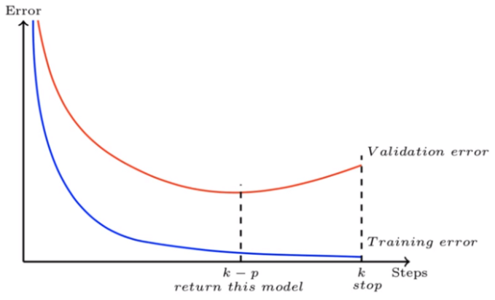
Early Stopping
When training models with sufficient representational capacity to overfit the task, we often observe that training error decreases steadily over time, while the error on the validation set begins to rise again or remaining the same for certain iterations, then there is no point in training the model further.
This means we can obtain a model with better validation set error (and thus, hopefully better test set error) by returning to the parameter setting at the point in time with the lowest validation set error

Slide 69
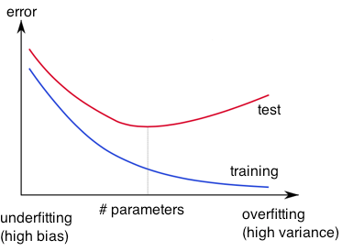
Regularization: Early Stopping
Early-stopping
During model training, use a validation set, along with a training set
A ratio of about 25% to 75% of the data is often used
Stop when the validation accuracy (or loss) has not improved after n subsequent epochs
The parameter n is called patience
Stop training
validation

Slide 70
Regularization: Dropout
Dropout
Randomly drop units (along with their connections) during training
Each unit is retained with a fixed dropout rate p, independent of other units
The hyper-parameter p to be chosen (tuned)
Often between 20 and 50 % of the units are dropped
Slide credit: Hung-yi Lee – Deep Learning Tutorial

Slide 71
Dropout
Idea: randomly drop activations during training
Benefit: reduces overfitting and improves generalization
Can be implemented as a layer

Slide 72
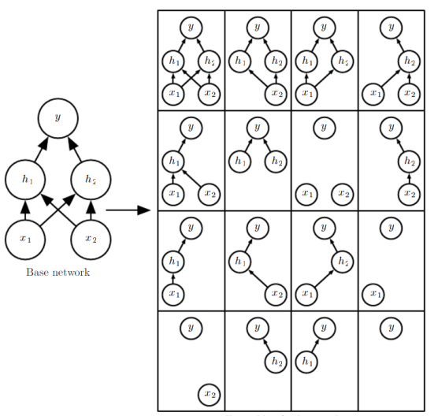
Dropout
Dropout is a bagging method
Bagging is a method of averaging over several models to improve generalization
Impractical to train many neural networks since it is expensive in time and memory
It is a method of bagging applied to neural networks
Dropout is an inexpensive but powerful method of regularizing a broad family of models
Specifically, dropout trains the ensemble consisting of all sub-networks that can be formed by removing non-output units from an underlying base network.

Slide 73
Regularization: Dropout
Dropout is a kind of ensemble learning
Using one mini-batch to train one network with a slightly different architecture
minibatch
1
minibatch
2
minibatch
3
minibatch
n
……
Slide credit: Hung-yi Lee – Deep Learning Tutorial

Slide 74
Dropout is a kind of ensemble.
Training Set
Ensemble
Set 1
Set 2
Set 3
Set 4
Network
1
Network
2
Network
3
Network
4
Train a bunch of networks with different structures

Slide 75
Dropout - Intuitive Reason
When teams up, if everyone expect the partner will do the work, nothing will be done finally.
However, if you know your partner will dropout, you will do better.
When testing, no one dropout actually, so obtaining good results eventually.
Notes:
Why the weights should multiply p (dropout rate) at testing?

Slide 76
Dropout
Training:
Each time before computing the gradients
Each neuron has p% to dropout
Notes:
Iteration v.s. epoch!!!!!!!!

Slide 77
Dropout
Training:
Thinner!
Each time before computing the gradients
Each neuron has p% to dropout
The structure of the network is changed.
Using the new network for training
Notes:
Do not worry that someone will not update

Slide 78
Dropout
Testing:
No dropout
If the dropout rate at training is p%, all the weights times (1-p)%
Assume that the dropout rate is 50%.
If a weight $w=1$ by training, set $w=0.5$ for testing.
Notes:
Bias do not have to multiply !!!!!!!!!!!!!!!!!!!!!!!!!!!!!!!!!!!
Reasonable !!!!!!!!!!!!!!!!!!!!

Slide 79
Dropout –randomly drops activations during training
Instance 1

Slide 80
Dropout –randomly drops activations during training
Instance 2

Slide 81
Dropout –randomly drops activations during training
Instance 3

Slide 82
Why the weights should multiply (1-p)% (dropout rate) when testing?
x₁
x₂
w₁
w₂
x₁
x₂
x₁
x₂
w₁
w₂
w₁
w₂
z=w₁x₁+w₂x₂
z=w₁x₁+w₂x₂
z=w₂x₂
x₁
x₂
x₁
x₂
x₁
x₂
$$\frac{1}{2}$$
$$\frac{1}{2}$$
w₁
w₂
w₁
w₂
w₁
w₂
$$z=\frac{1}{2}w_{1}x_{1}+\frac{1}{2}w_{2}x_{2}$$
z=w₁x₁
z=0

Slide 83
Dropout is a kind of ensemble.
Ensemble
Testing data x
Network
1
Network
2
Network
3
Network
4
y₁
y₂
y₃
y₄
average

Slide 84
Parameter Tying
Sometimes, we might not know which region the parameters would lie in, but rather we known that there is some dependencies between them.
Parameter Tying refers to explicitly forcing the parameters of two models to be close to each other, through the norm penalty.
$$||W^{(A)}−W^{(B)}||$$
Here, $W^{(A)}$refers to the weights of the first model while $W^{(B)}$refers to those of the second one.

Slide 85
Hyper-parameter Tuning
Training NNs can involve many hyper-parameter settings
The most common hyper-parameters include:
Number of layers, and number of neurons per layer
Initial learning rate
Learning rate decay schedule (e.g., decay constant)
Other hyper-parameters may include:
Regularization parameters ($ℓ_{2}$ penalty, dropout rate)
Batch size
Hyper-parameter tuning can be time-consuming for larger NNs

Slide 86
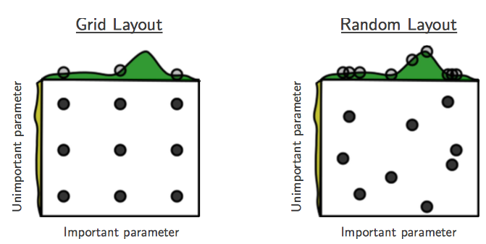
Hyper-parameter Tuning
Grid search
Check all values in a range with a step value
Random search
Randomly sample values for the parameter
Often preferred to grid search
Bayesian hyper-parameters optimization
Is an active area of research

Slide 87
Feature Scaling
$$x^{1}$$
$$x^{2}$$
$$x^{3}$$
$$x^{r}$$
$$x^{m}$$
For each dimension i:
$$x_{1}^{1}$$
$$x_{1}^{2}$$
$$x_{2}^{1}$$
$$x_{2}^{2}$$
……
……
mean: $m_{i}$
……
……
……
……
……
standard deviation: $σ_{i}$
$$x_{i}^{r}←\frac{x_{i}^{r}−m_{i}}{σ_{i}}$$
The means of all dimensions are 0, and the variances are all 1
In general, gradient descent converges much faster with feature scaling than without it.
Notes:
Can we demo this???????????????
https://standardfrancis.wordpress.com/2015/04/16/batch-normalization/

Slide 88
Internal Covariate Shift
The first guy tells the second guy, “go water the plants”, the second guy tells the third guy, “got water in your pants”, and so on until the last guy hears, “kite bang eat face monkey” or something totally wrong.
Let’s say that the problems are entirely systemic and due entirely to faulty red cups. Then, the situation is analogous to forward propagation
If can get new cups to fix the problem by trial and error, it would help to have a consistent way of passing messages in a more controlled and standardized (“normalized”) way. e.g: Same volume, same language, etc
“First layer parameters change and so the distribution of the input to your second layer changes”

Slide 89
Normalizing Inputs
The range of values of raw training data often varies widely
Example: Has kids feature in {0,1}
Value of car: $500-$100’sk
If one of the features has a broad range of values, the distance will be governed by this particular feature.
After, normalization, each feature contributes approximately proportionately to the final distance.
In general, Gradient descent converges much faster with feature scaling than without it.
Good practice for numerical stability for numerical calculations, and to avoid ill-conditioning when solving systems of equations.

Slide 90
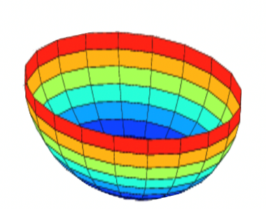
Why does normalizing the data make the algorithm faster?
Unnormalized:
In the case of unnormalized data, the scale of features will vary, and hence there will be a variation in the parameters learnt for each feature. This will make the cost function asymmetric.
$$J$$
$$w$$
$$b$$
Whereas, in the case of normalized data, the scale will be the same and the cost function will also be symmetric.
This makes it is easier for the gradient descent algorithm to find the global minima more quickly. And this, in turn, makes the algorithm run much faster.
Normalized:
$$J$$
$$w$$
$$b$$
Image Source: https://www.analyticsvidhya.com/blog/2018/11/neural-networks-hyperparameter-tuning-regularization-deeplearning/

Slide 91
Batch normalization [Ioffe &Szegedy, 2015]
Idea: normalize the activation of each unit to have zero mean and unit standard deviation using a mini-batch estimate of mean and variance.
Benefit: more stable and faster training. Often generalizes better
Can be implemented as a layer

Slide 92
Batch Normalization
Batch normalization layers act similar to the data preprocessing steps mentioned earlier
They calculate the mean μ and variance σ of a batch of input data, and normalize the data x to a zero mean and unit variance
I.e., $\hat{x}=\frac{x−μ}{σ}$
BatchNorm layers alleviate the problems of proper initialization of the parameters and hyper-parameters
Result in faster convergence training, allow larger learning rates
Reduce the internal covariate shift
The BatchNorm layers are inserted immediately after convolutional layers or fully-connected layers, and before activation layers
They are very common with convolutional NNs

Slide 93
Batch
$$x^{1}$$
$$W^{1}$$
$$z^{1}$$
Sigmoid
$$a^{1}$$
$$W^{2}$$
……
$$x^{2}$$
$$W^{1}$$
$$z^{2}$$
Sigmoid
$$a^{2}$$
$$W^{2}$$
……
$$x^{3}$$
$$W^{1}$$
$$z^{3}$$
Sigmoid
$$a^{3}$$
$$W^{2}$$
……
$$z^{1}$$
$$z^{2}$$
$$z^{3}$$
$$W^{1}$$
$$x^{1}$$
$$x^{2}$$
$$x^{3}$$
Batch
=
Notes:
上學期好多人做!
https://ntumlds.wordpress.com/2017/03/26/r05922005_rrrr/

Slide 94
Batch normalization
$$x^{1}$$
$$W^{1}$$
$$z^{1}$$
$$μ=\frac{1}{3}\sum_{i=1}^{3}{z^{i}}$$
$$x^{2}$$
$$W^{1}$$
$$z^{2}$$
$$σ=\sqrt{\frac{1}{3}\sum_{i=1}^{3}{{\left(z^{i}−μ\right)}^{2}}}$$
$$x^{3}$$
$$W^{1}$$
$$z^{3}$$
$μ$ and $σ$ depends on $z^{i}$
$$μ$$
$$σ$$
Notes:
上學期好多人做!
https://ntumlds.wordpress.com/2017/03/26/r05922005_rrrr/

Slide 95
Batch normalization
$$x^{1}$$
$$W^{1}$$
$$z^{1}$$
$${\tilde{z}}^{1}$$
Sigmoid
$$a^{1}$$
$$x^{2}$$
$$W^{1}$$
$$z^{2}$$
$${\tilde{z}}^{2}$$
Sigmoid
$$a^{2}$$
$$x^{3}$$
$$W^{1}$$
$$z^{3}$$
$${\tilde{z}}^{3}$$
Sigmoid
$$a^{3}$$
$μ$ and $σ$ depends on $z^{i}$
$$μ$$
$$σ$$
$${\tilde{z}}^{i}=\frac{z^{i}−μ}{σ+ε}$$
Batch Norms happens between computing Z and computing A. And the intuition is that, instead of using the un-normalized value Z, you can use the normalized value Z
Notes:
上學期好多人做!
https://ntumlds.wordpress.com/2017/03/26/r05922005_rrrr/

Slide 96
Batch normalization
Setting mean to $μ=0$ and $σ=1$ work for most of the applications, but in actual implementation, But we don't want the hidden units to always have mean 0 and variance 1
${\tilde{z}}^{i}=\frac{z^{i}−μ}{σ+ε}$, we replace with the following
$${\tilde{z}}_{norm}^{i}=γ{\tilde{z}}^{i}+β$$
where $γ$ and $β$ are learnable parameters.
$z^{i}$ is the special case of ${\tilde{z}}_{norm}^{i}=γ{\tilde{z}}^{i}+β$ at $γ=σ+ε$ and $β=μ$

Slide 97
Batch normalization at testing time
Acc
$$μ_{300}$$
$$μ_{100}$$
$$μ_{1}$$
Updates
$$\tilde{z}=\frac{z−μ}{σ}$$
$$\tilde{z}$$
$${\hat{z}}^{i}=γ⨀{\tilde{z}}^{i}+β$$
$$\hat{z}$$
$$x$$
$$W^{1}$$
$$z$$
$μ$, $σ$ are from batch
$γ$, $β$ are network parameters
We do not have batch at testing stage.
Ideal solution:
Computing $μ$ and $σ$ using the whole training dataset.
Practical solution:
Computing the moving average of $μ$ and $σ$ of the batches during training.
Notes:
上學期好多人做!
https://ntumlds.wordpress.com/2017/03/26/r05922005_rrrr/

Slide 98
Mini-batch
Randomly initialize $θ^{0}$
x¹
NN
y¹
Pick the 1st batch
$${\hat{y}}^{1}$$
$$L^{1}$$
$$C=L^{1}+L^{31}+⋯$$
Mini-batch
NN
x³¹
y³¹
$${\hat{y}}^{31}$$
$$θ^{1}←θ^{0}−η∇C\left(θ^{0}\right)$$
$$L^{31}$$
Pick the 2nd batch
……
$$C=L^{2}+L^{16}+⋯$$
NN
$$θ^{2}←θ^{1}−η∇C\left(θ^{1}\right)$$
x²
y²
$${\hat{y}}^{2}$$
$$L^{2}$$
…
Mini-batch
C is different each time when we update parameters!
x¹⁶
NN
y¹⁶
$${\hat{y}}^{16}$$
$$L^{16}$$
……
Notes:
Each time we update paramters, we have different target -> 不安
Shuffle data, and repeat above process

Slide 99
Mini-batch
Faster
Better!
Randomly initialize $θ^{0}$
x¹
NN
y¹
Pick the 1st batch
$${\hat{y}}^{1}$$
$$C^{1}$$
$$C=C^{1}+C^{31}+⋯$$
Mini-batch
NN
x³¹
y³¹
$${\hat{y}}^{31}$$
$$θ^{1}←θ^{0}−η∇C\left(θ^{0}\right)$$
$$C^{31}$$
Pick the 2nd batch
……
$$C=C^{2}+C^{16}+⋯$$
NN
$$θ^{2}←θ^{1}−η∇C\left(θ^{1}\right)$$
x²
y²
$${\hat{y}}^{2}$$
$$C^{2}$$
…
Until all mini-batches have been picked
Mini-batch
x¹⁶
NN
y¹⁶
$${\hat{y}}^{16}$$
$$C^{16}$$
one epoch
……
Repeat the above process
Notes:
Ｉｎ ｏｐｅｎ ｅｐｏｃｈ， ｕｐｄａｔｅ ｍａｎｙ ｔｉｍｅｓ
Shuffle data, and repeat above process

Slide 100
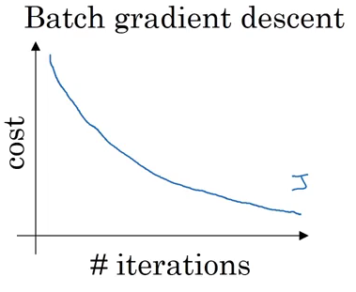
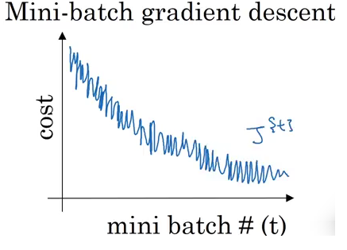
How can we choose a mini-batch size?
If the mini-batch size = m
It is a batch gradient descent where all the training examples are used in each iteration. It takes too much time per iteration.
If the mini-batch size = 1
It is called stochastic gradient descent, where each training example is its own mini-batch.
Since in every iteration we are taking just a single example, it can become extremely noisy and takes much more time to reach the global minima.
If the mini-batch size is between 1 to m
It is mini-batch gradient descent. The size of the mini-batch should not be too large or too small.
Source: https://www.coursera.org/learn/deep-neural-network/lecture/qcogH/mini-batch-gradient-descent

Slide 101
Minibatch size and convergence speed
1 pass over the dataset (1 epoch)
Parameter update
Full-batch gradient descent
Error
#samples
Large-minibatch gradient descent
Error
#samples
Small-minibatch gradient descent
Error
#samples

Slide 102
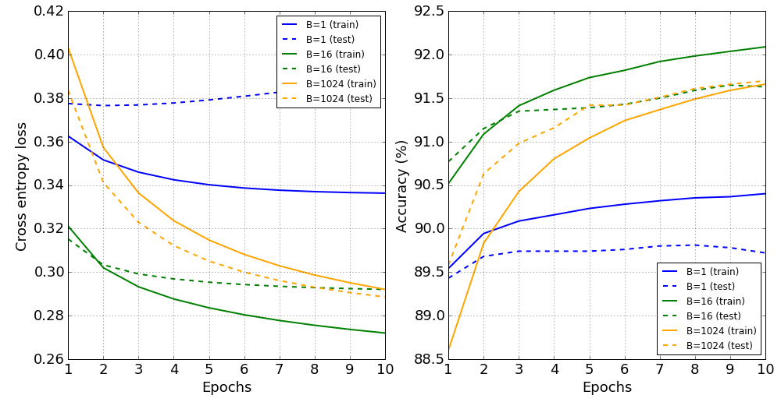
Effect of minibatch size B
Learning rate $η$ scaled as $η=0.025⋅\sqrt{B}$

Slide 103
Batch normalization
Inputs scaled to [0,1]
Weights and biases
drawn from
N(0, 1)
R.V. with scale
at most $\sqrt{784}$
784 dim
1024 dim

Slide 104
Batch normalization
Inputs scaled to [0,1]
R.V. with scale
at most $\sqrt{784}$
Weights and biases
drawn from
N(0, 1)
R.V. with scale
at most $\sqrt{784}$
$$μ_{1}$$
$$σ_{1}$$
$$μ_{2}$$
$$σ_{2}$$
$$μ_{3}$$
$$σ_{3}$$
$$μ_{H}$$
$$σ_{H}$$
784 dim
1024 dim

Slide 105
Acknowledgement
http://wavelab.uwaterloo.ca/wp-content/uploads/2017/04/Lecture_3.pdf
https://heartbeat.fritz.ai/deep-learning-best-practices-regularization-techniques-for-better-performance-of-neural-network-94f978a4e518
https://cedar.buffalo.edu/~srihari/CSE676/7.12%20Dropout.pdf
http://speech.ee.ntu.edu.tw/~tlkagk/courses/ML_2017/Lecture/DNN%20tip.pptx
Accelerating Deep Network Training by Reducing Internal Covariate Shift, Jude W. Shavlik
http://speech.ee.ntu.edu.tw/~tlkagk/courses/MLDS_2018/Lecture/ForDeep.pptx
Deep Learning Tutorial. Prof. Hung-yi Lee, NTU.
On Predictive and Generative Deep Neural Architectures, Prof. Swagatam Das, ISICAL

Slide 106
Further Optimizers

Slide 107
Mini-batch Gradient Descent
It is wasteful to compute the loss over the entire set to perform a single parameter update for large datasets
E.g., ImageNet has 14M images
GD (a.k.a. vanilla GD) is replaced with mini-batch GD
Mini-batch gradient descent
Approach:
Compute the loss $ℒ\left(θ\right)$ on a batch of images, update the parameters $θ$, and repeat until all images are used
At the next epoch, shuffle the training data, and repeat above process
Mini-batch GD results in much faster training
Typical batch size: 32 to 256 images
It works because the examples in the training data are correlated
I.e., the gradient from a mini-batch is a good approximation of the gradient of the entire training set

Slide 108
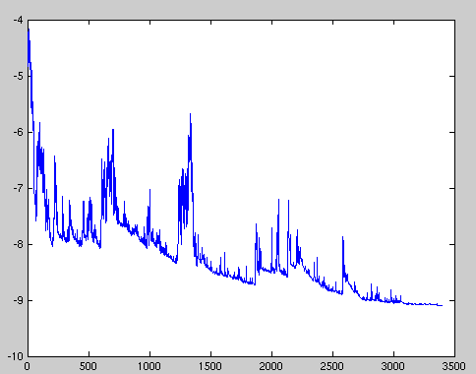
Stochastic Gradient Descent
Stochastic gradient descent
SGD uses mini-batches that consist of a single input example
E.g., one image mini-batch
Although this method is very fast, it may cause significant fluctuations in the loss function
Therefore, it is less commonly used, and mini-batch GD is preferred
In most DL libraries, SGD is typically a mini-batch SGD (with an option to add momentum)

Slide 109
Problems with Gradient Descent
Besides the local minima problem, the GD algorithm can be very slow at plateaus, and it can get stuck at saddle points
cost $ℒ\left(θ\right)$
Very slow at the plateau
Stuck at a saddle point
Stuck at a local minimum
$$∇ℒ\left(θ\right)≈0$$
$$∇ℒ\left(θ\right)=0$$
$$∇ℒ\left(θ\right)=0$$
$$θ$$
Slide credit: Hung-yi Lee – Deep Learning Tutorial

Slide 110
Why different optimization algorithms?
The main difference is actually how they treat the learning rate.
Stochastic Gradient Descent:
Theta (weights) is getting changed according to the gradient of the loss with respect to theta.
alpha is the learning rate.
If alpha is very small, convergence will be very slow. On the other hand, large alpha will lead to divergence.
Notes:
http://www.iro.umontreal.ca/~bengioy/papers/ftml.pdf

Slide 111
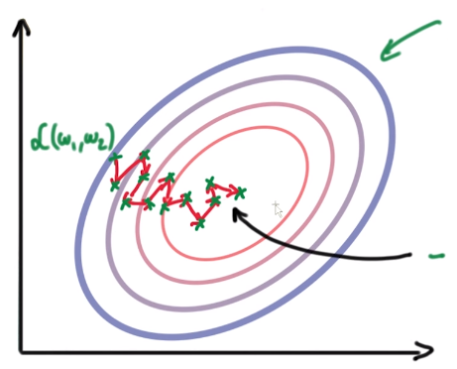
Why different optimization algorithms?
Due to the diversity of each training example, the gradient of the loss (L) changes quickly after each iteration. We are taking small steps but they are quite zig-zag (even though we slowly reach to a loss minima).
To overcome this, we introduce momentum. Basically taking knowledge from previous steps about where we should be heading. We are introducing a new hyperparameter:
Notes:
http://www.iro.umontreal.ca/~bengioy/papers/ftml.pdf

Slide 112
Gradient Descent with Momentum
Gradient descent with momentum uses the momentum of the gradient for parameter optimization
cost $ℒ\left(θ\right)$
Movement = Negative of Gradient + Momentum
Negative of Gradient
Momentum
Real Movement
$$θ$$
Gradient = 0
Slide credit: Hung-yi Lee – Deep Learning Tutorial

Slide 113
Gradient Descent with Momentum
Parameters update in GD with momentum : $θ^{new}=θ^{old}−V^{new}$
Where: $V^{new}$= $βV^{old}+α∇ℒ\left(θ^{old}\right)$
Compare to vanilla GD: $θ^{new}=θ^{old}−α∇ℒ\left(θ^{old}\right)$
The term $V^{new}$ is called momentum
This term accumulates the gradients from the past several steps
It is similar to a momentum of a heavy ball rolling down the hill
The parameter$β$ referred to as a coefficient of momentum
A typical value of the parameter $β$ is 0.9
This method updates the parameters $θ$ in the direction of the weighted average of the past gradients

Slide 114
More optimization algorithms
Momentum SGD: improves SGD by incorporating “momentum”

Slide 115
Nesterov Accelerated Momentum
Gradient descent with Nesterov accelerated momentum
Parameters update: $θ^{new}=θ^{old}−V^{new}$
Where: $V^{new}$= $βV^{old}+α∇ℒ\left(θ^{old}−βV^{old}\right)$
The term $θ^{old}−βV^{old}$ allows us to predict the position of the parameters in the next step (i.e., $θ^{next} ≈θ^{old}−βV^{old}$)
The gradient is calculated with respect to the approximate future position of the parameters in the next step, $θ^{next}$
GD with momentum
GD with Nesterov momentum
Picture from: https://towardsdatascience.com/learning-parameters-part-2-a190bef2d12

Slide 116
Adaptive optimization algorithms
Adam [Kingma & Ba 2015]: uses first and second order statistics of the gradients so that gradients are normalized
Benefit: prevents the vanishing/exploding gradient problem

Slide 117
Adam
Adaptive Moment Estimation (Adam)
Adam computes adaptive learning rates for each dimension of$θ$
Similar to GD with momentum, Adam computes a weighted average of past gradients, i.e., $V^{new}$= $β_{1}V^{old}+\left(1−β_{1}\right)∇ℒ\left(θ^{old}\right)$
Adam also computes a weighted average of past squared gradients, i.e., $U^{new}$= $β_{2}U^{old}+\left(1−β_{2}\right){\left(∇ℒ\left(θ^{old}\right)\right)}^{2}$
The parameters update is: $θ^{new}=θ^{old}−$ $\frac{α}{\sqrt{{\hat{V}}^{new}}+ε}$ ${\hat{U}}^{new}$
Where: ${\hat{V}}^{new}=\frac{V^{new}}{1−β_{1}}$ and ${\hat{U}}^{new}=\frac{U^{new}}{1−β_{2}}$
The proposed default values are $β_{1}$ = 0.9, $β_{2}$ = 0.999, and $ε={10}^{−8}$
Other commonly used optimization methods include:
Adagrad, Adadelta, RMSprop, Nadam, etc.
Most papers nowadays used Adam and SGD with momentum

Slide 118
Learning Rate
Learning rate
The gradient tells us the direction in which the loss has the steepest rate of increase, but it does not tell us how far along the opposite direction we should step
Choosing the learning rate (also called the step size) is one of the most important hyper-parameter settings for NN training
LR too small
LR too large

Slide 119
Learning Rate
Training loss for different learning rates
High learning rate: the loss increases or plateaus too quickly
Low learning rate: the loss decreases too slowly (takes many epochs to reach a solution)
Picture from: https://cs231n.github.io/neural-networks-3/

Slide 120
Annealing the Learning Rate
Reduce the learning rate over time (learning rate decay)
Approach 1
Reduce the learning rate by some factor every few epochs
Typical values: reduce the learning rate by a half every 5 epochs, or by 10 every 20 epochs
Exponential decay reduces the learning rate exponentially over time
These numbers depend heavily on the type of problem and the model
Approach 2
Reduce the learning rate by a constant (e.g., by half) whenever the validation loss stops improving

Slide 121
Learning rate decay
Reduce the learning rate or step-size parameter ($η$) once in a while
Typical setting: multiply 0.98 to $η$ every epoch.

Slide 122
Gradient Descent Algorithms For Optimization
SGD: Stochastic Gradient Descent http://ufldl.stanford.edu/tutorial/supervised/OptimizationStochasticGradientDescent/
RMSprop: Root Mean Square Propagation http://www.cs.toronto.edu/~tijmen/csc321/slides/lecture_slides_lec6.pdf)
Adagrad: Adaptive Gradient Algorithm http://jmlr.org/papers/v12/duchi11a.html
Adadelta: an extension of Adagrad that seeks to reduce its aggressive, monotonically decreasing learning rate https://arxiv.org/abs/1212.5701
Adam: Adaptive Moment Estimation – keeps separate learning rates for each weight as well as an exponentially decaying average of previous gradients. http://arxiv.org/abs/1412.6980v8
Adamax: A variant of Adam that scales the gradient inversely proportionally to the ℓ₂ norm of the past gradients https://arxiv.org/abs/1412.6980v8
Nadam: Nesterov-accelerated Adaptive Moment Estimation http://cs229.stanford.edu/proj2015/054_report.pdf

Slide 123
Thank You!

