Slide 1
University of Cyprus
MAI – 642 – DEEP LEARNING
Theocharis Theocharides
Nov, 2023

Slide 2
Deep Learning
Recurrent Neural Networks
Memory & Attention
Theocharis Theocharides
Associate Professor
Dept. of Electrical and Computer Engineering
University of Cyprus

Slide 3
Course Schedule & Content
DATE | Overview | Lecture Details | Scope
Week 1 | Introduction - Course Structure, Logistics, Fundamentals of Machine Learning and Neural Networks | 1. Introduction to Neural Network, Multilayer Perceptron, Back Propagation Learning - What is Deep Learning? | BASICS
Week 2 | Fundamentals of Learning | 2. Introduction to Deep Learning, Bayesian Learning, Hebbian Learning, Decision Surfaces, Representation Learning. 3. Theory of Deep Learning (Universal approximation theorem, convergence rate, and recent mathematical results)
Week 3 | Mathematics & Fundamentals of Deep Learning | 4. Linear Classifiers, Linear Machines with Hinge Loss, Gradient Descent, Activation and Loss Functions. 5. Optimization Techniques, Gradient Descent, Batch Optimization, Introduction to Meta-Learning, Hessian-Free Optimization.
Week 4 | Deep Neural Networks | Deep Neural Networks: Features, Feature Representation, Representation Learning, BoFs/BoWs, Feature Maps, Deep vs. Shallow Nets | FUNDAMENTALS OF DEEP (CONVOLUTIONAL) LEARNING
Week 5 | Convolutional Neural Networks | 6. Convolutional Neural Networks, Building blocks of CNN | DEEP NEURAL NETWORKS - DEEP INTO DEEP LEARNING
Week 6 | Deep Convolutional Neural Networks | Pooling, Convolutional, Softmax Layers
Week 7 | Deep Convolutional Neural Networks | Optimizing ConvNets, Transfer Learning, Residual Networks
Week 8 | Deep Learning Optimization | 11. Deep Learning Model Optimization; Early Stopping/Exit, Dropout, Batch Normalization, Instance Normalization, Group Normalization, Pruning, Quantization, Hyperparameter Optimization.
Week 9 | Recurrent Neural Networks, Transformers | RNNs, LSTMs
Week 10 | Transformers, Attention | Attention Mechanisms and Transformer Networks | EMERGING DEEP LEARNING RESEARCH AND APPLICATIONS
Week 11 | Generative Adversarial Networks | Unsupervised Learning with Deep Network, Autoencoders Cont’d, 8. Generative Adversarial Networks, Adversarial Learning Models, Variational Autoencoders
Week 12 | Deep Reinforcement Learning - Graph Neural Networks | Deep Reinforcement Learning (Q-learning, actor-critic, policy gradient, experience replay, double Q-learning, deep bootstrap networks).
Week 13 | Graph Neural Networks and Deep Learning Trends | Graph Neural Networks – Graph Signal Processing, Convolutional Networks on Graphs, Gated Graph Sequence Networks, Semi-Supervised Graph Convolutional Networks Interpretable Deep Neural Networks DNNs for Vision and NLP - GPTS/LLMS
Exam Period | Final Exam | Comprehensive Final Exam | EVALUATION

Slide 4
Acknowledgements
Selected pictures and Ccontents from: Andrew Ng, Stanford University, Chris Olah, Google Brain, Fei-Fei Li, Stanford University, Geoffrey Hinton, Google & University of Toronto, Hung-yi Lee, National Taiwan University, Ian Goodfellow, Google Brain, Yann LeCun, New York University, Yoshua Bengio, Universite de Montreal
Colah’s Blog, “Understanding LSTM Networks,” 2015
I. Witten, et al., “Data Mining,” 2017

Slide 5
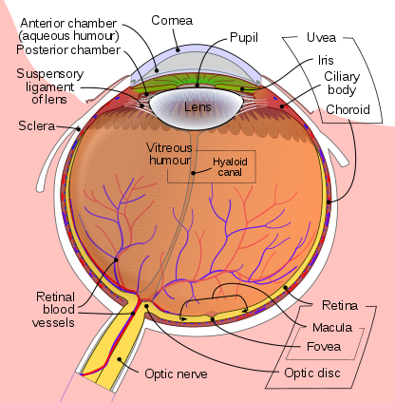
Human Vision: Fovea
Light enters eye
Retina
detects light
Acuity graph is licensed under CC A-SA 3.0 Unported

Slide 6
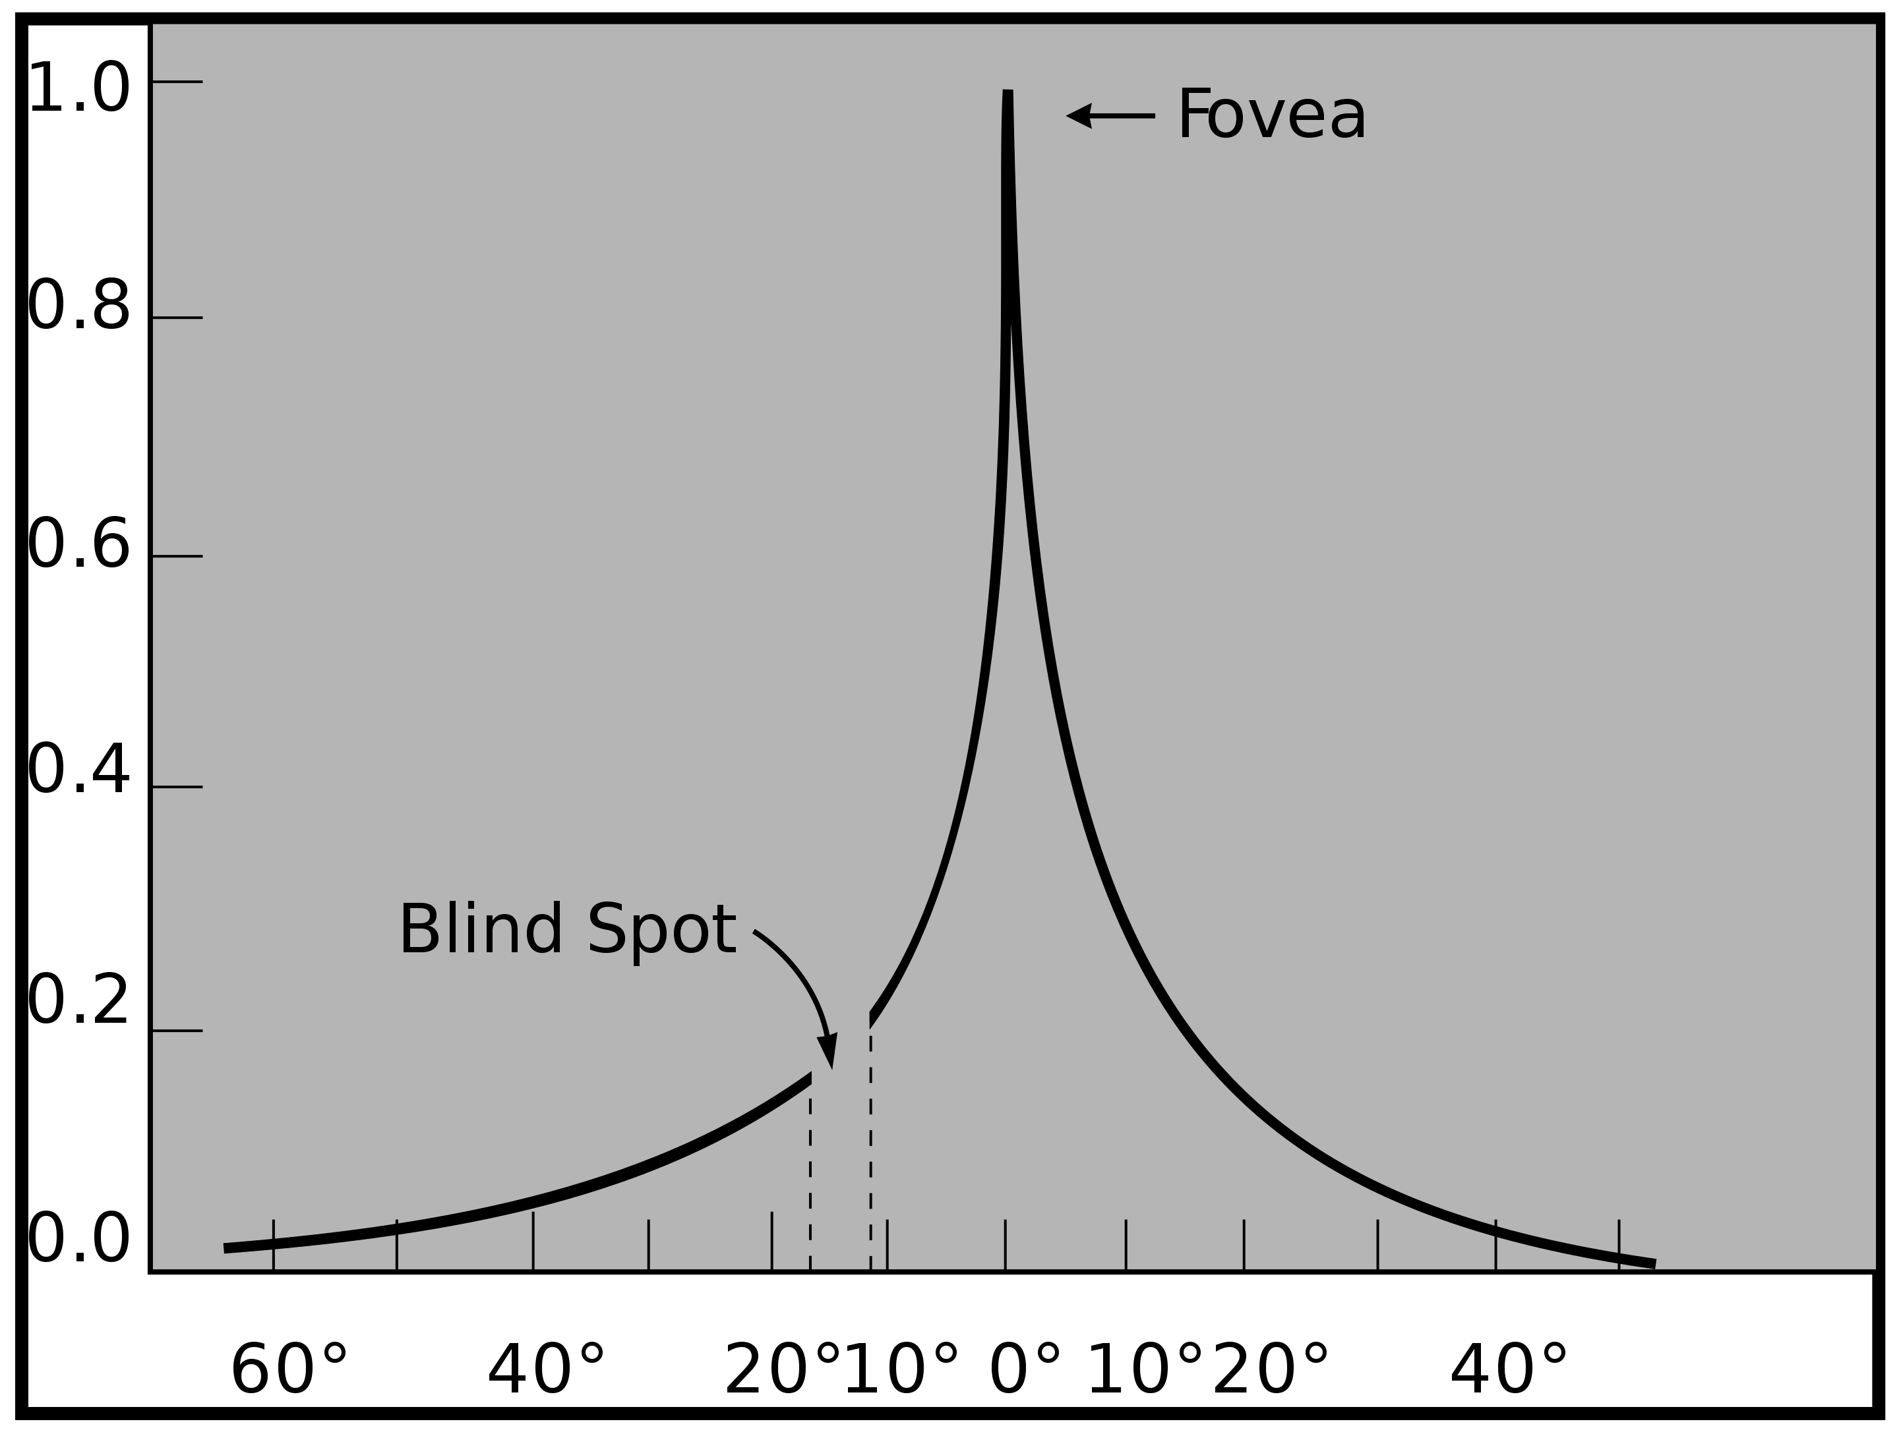
Human Vision: Fovea
The fovea is a any region of the retina that can see with high acuity
Light enters eye
Retina
detects light
Eye image is licensed under CC A-SA 3.0 Unported (added black arrow, green arc, and white circle)
Acuity graph is licensed under CC A-SA 3.0 Unported (No changes made)

Slide 7
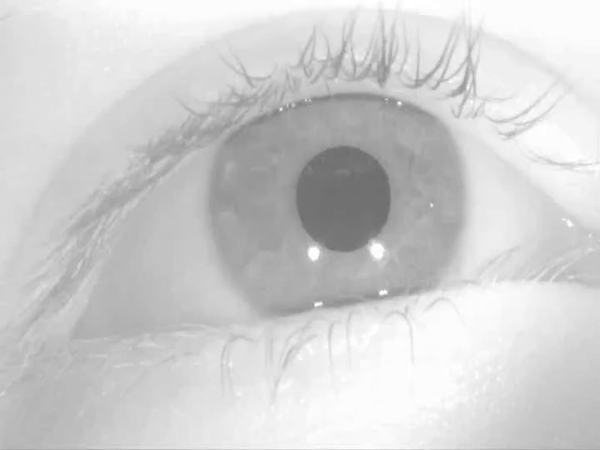
Human Vision: Saccades
The fovea is a any region of the retina that can see with high acuity
Human eyes are constantly moving so we don’t notice
Saccade video is licensed under CC A-SA 4.0 Interna$onal (no changes made)
Acuity graph is licensed under CC A-SA 3.0 Unported (No changes made)

Slide 8
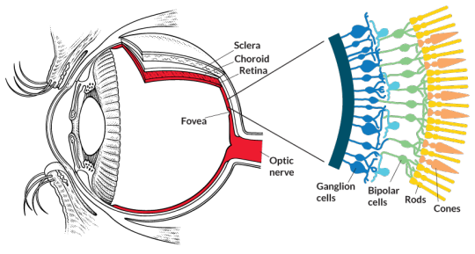
Receptive Fields
The receptive field of an individual sensory neuron is the particular region of the sensory space (e.g., the body surface, or the retina) in which a stimulus will trigger the firing of that neuron.
  In the auditory system, receptive fields can correspond to wave amplitudes in auditory space
Designing “proper” receptive fields for the input Neurons is a significant challenge.

Slide 9
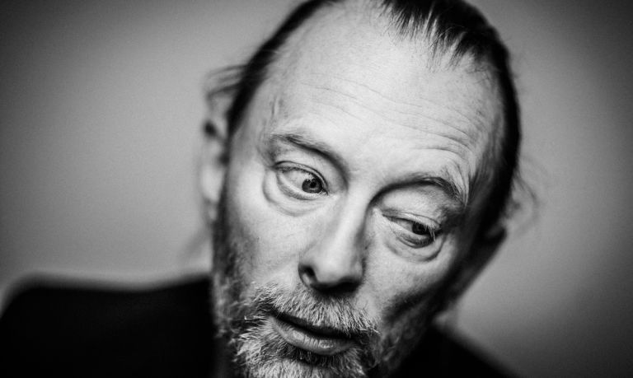
Image Classification
Consider a task with image inputs
  Receptive fields should give expressive features from the raw input to the system
  How would you design the receptive fields for this problem?
Human face or not?

Slide 10
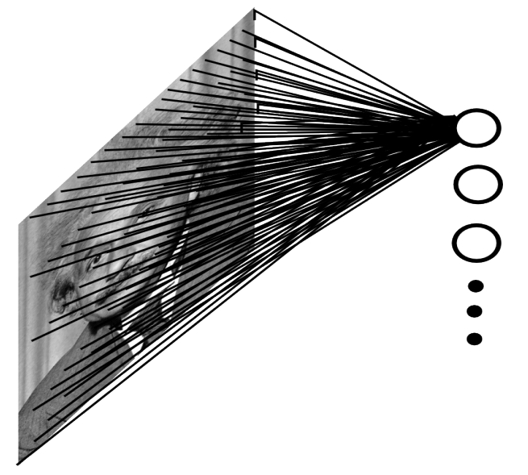

A fully connected layer:
  Example:
    $100 ×100$ sized image
    $1000$ units in the hidden layer
  Problems:
    ${10}^{7}$edges!
    Spatial correlations lost!
    Variables sized inputs.
    Potential overfitting
Input layer
Slide Credit: Marc'Aurelio Ranzato

Slide 11
Convolutional Layer
The convolution of the input (vector/matrix) with weights (vector/matrix) results in a response vector/matrix.
We can have multiple filters in each convolutional layer, each producing an output.
If it is an intermediate layer, it can have multiple inputs!
Convolutional Layer
Filter
Filter
Filter
One can add nonlinearity at the output of convolutional layer
Filter

Slide 12
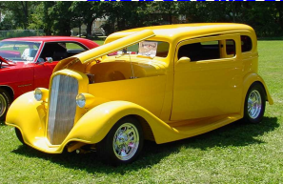
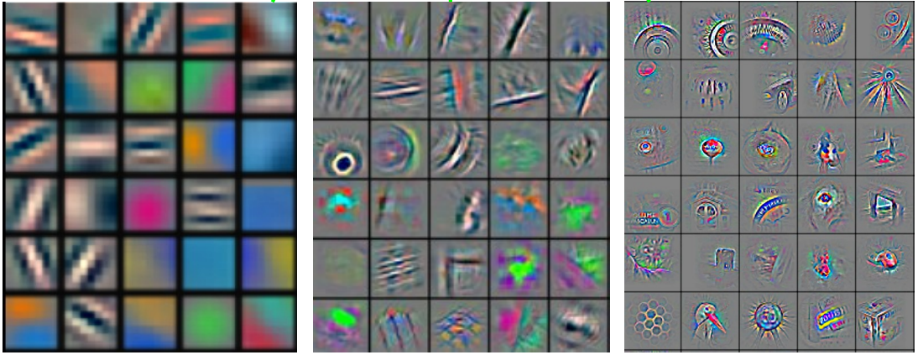
Convolutional Nets
Stage 1
Stage 2
Stage 3
Fully Connected Layer
Input Image
Class Label
Feature visualization of convolutional net trained on ImageNet from [Zeiler & Fergus 2013]

Slide 13
Outline
Recurrent Neural Networks
  Vanilla RNN
  Exploding and Vanishing Gradients
Networks with Memory
  Long Short-Term Memory (LSTM)
  Gated Recurrent Unit (GRU)
Sequence Learning Architectures
  Sequence Learning with one RNN Layer
  Sequence Learning with multiple RNN Layers
Implementation example using Keras in Python: sentiment analysis
Application: Sequence-to-Sequence Model in Activities of Daily Living (ADL) Recognition

Slide 14
Recurrent Neural Networks
Human brain deals with information streams. Most data is obtained, processed, and generated sequentially.
  E.g., listening: soundwaves → vocabularies/sentences
  E.g., action: brain signals/instructions → sequential muscle movements
Human thoughts have persistence; humans don’t start their thinking from scratch every second.
  As you read this sentence, you understand each word based on your prior knowledge.
The applications of standard Artificial Neural Networks (and also Convolutional Networks) are limited due to:
  They only accepted a fixed-size vector as input (e.g., an image) and produce a fixed-size vector as output (e.g., probabilities of different classes).
  These models use a fixed amount of computational steps (e.g. the number of layers in the model).
Recurrent Neural Networks (RNNs) are a family of neural networks introduced to learn sequential data.
  Inspired by the temporal-dependent and persistent human thoughts

Slide 15
Real-life Sequence Learning Applications
RNNs can be applied to various type of sequential data to learn the temporal patterns.
  Time-series data (e.g., stock price) → Prediction, regression
  Raw sensor data (e.g., signal, voice, handwriting) → Labels or text sequences
  Text → Label (e.g., sentiment) or text sequence (e.g., translation, summary, answer)
  Image and video → Text description (e.g., captions, scene interpretation)
Task | Input | Output
Activity Recognition (Zhu et al. 2018) | Sensor Signals | Activity Labels
Machine translation (Sutskever et al. 2014) | English text | French text
Question answering (Bordes et al. 2014) | Question | Answer
Speech recognition (Graves et al. 2013) | Voice | Text
Handwriting prediction (Graves 2013) | Handwriting | Text
Opinion mining (Irsoy et al. 2014) | Text | Opinion expression

Slide 16
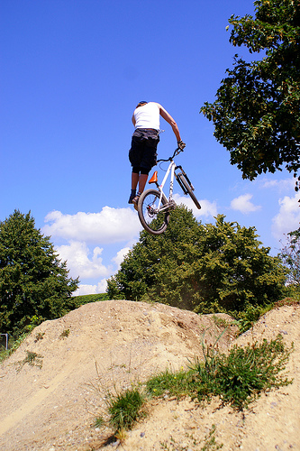
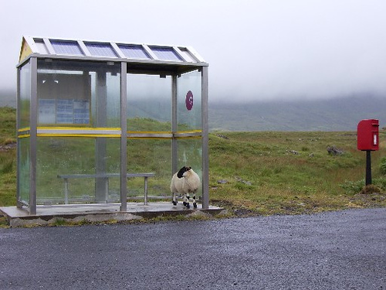
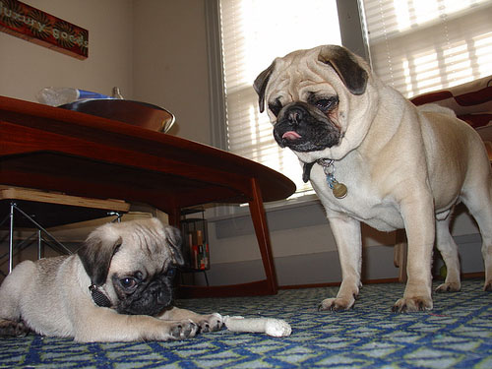
Some pre-RNN captioning results
This is a picture of one sky, one road and one sheep. The gray sky is over the gray road. The gray sheep is by the gray road.
Here we see one road, one sky and one bicycle. The road is near the blue sky, and near the colorful bicycle. The colorful bicycle is within the blue sky.
This is a picture of two dogs. The first dog is near the second furry dog.
Kulkarni et al., CVPR 2011
Notes:
This is a picture of one sky, one road…

Slide 17
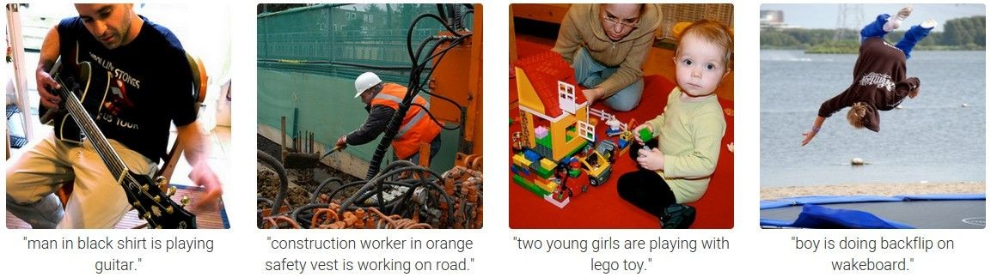
Results with Recurrent Neural Networks
Karpathy and Fei-Fei, CVPR 2015

Slide 18
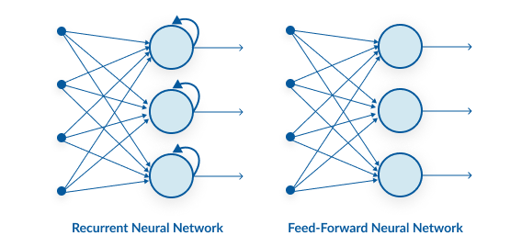
Recurrent Neural Networks

Slide 19
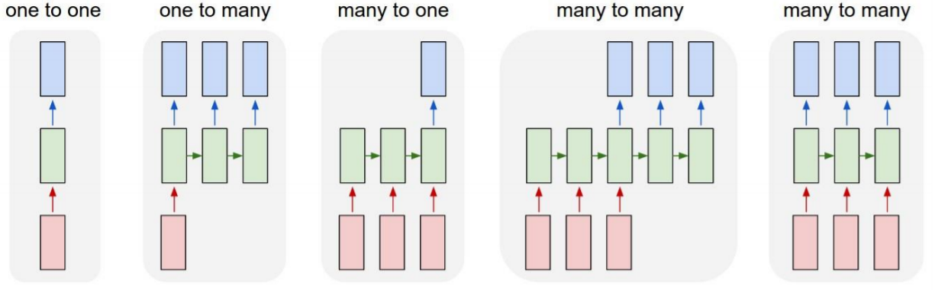
Recurrent Neural Networks
Original
RNN
Network
Image →
Sequence of
Words
Sequence of
Words →
Summary
Machine Translation
Video Classification
on frame level

Slide 20
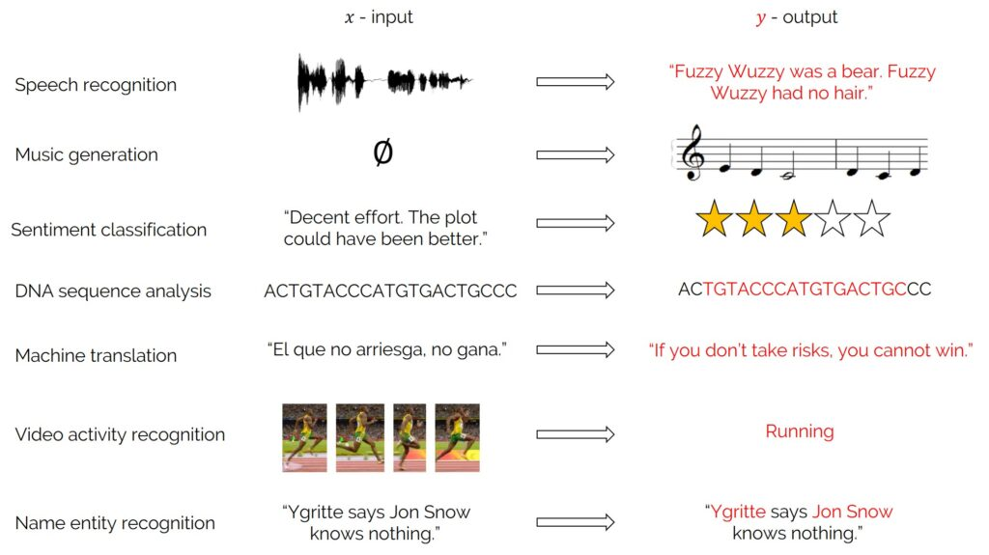
Recurrent Neural Networks
Used for sequence data:

Slide 21
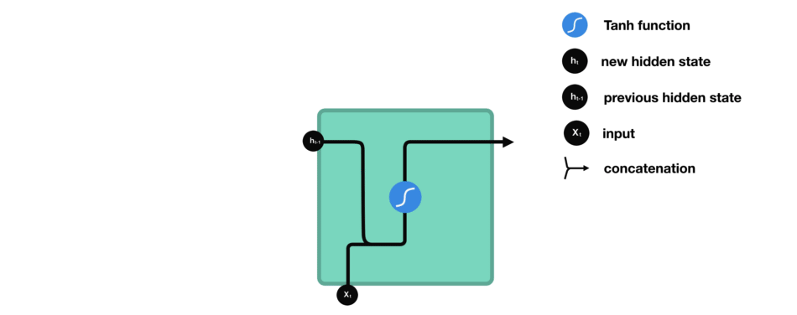
Recurrent Neural Networks: Intuition
Output
Hidden State
Hidden State
Input

Slide 22
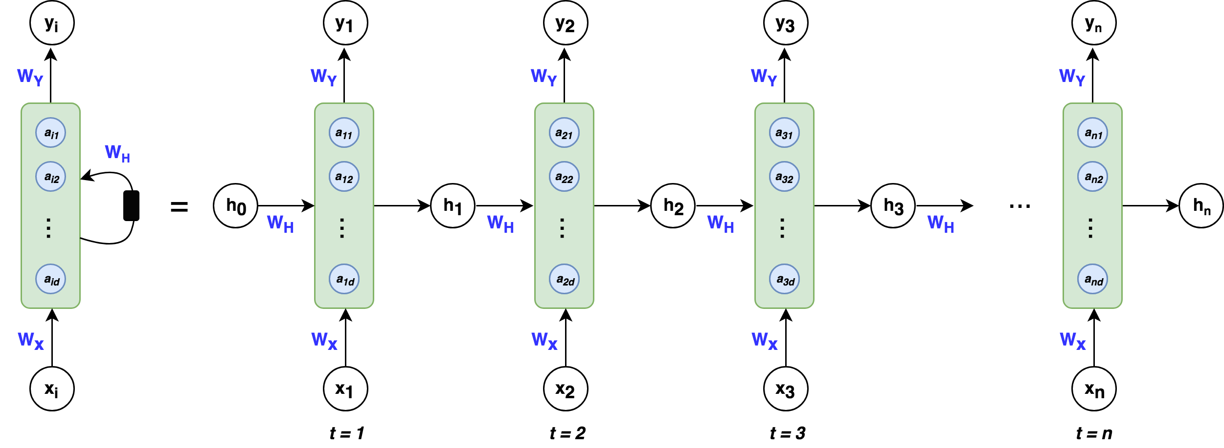
Recurrent Neural Networks
State is saved in hidden vector h → last step is preserved
→ no long-term dependencies
Need to be
learned
Random/Zero
initialization

Slide 23
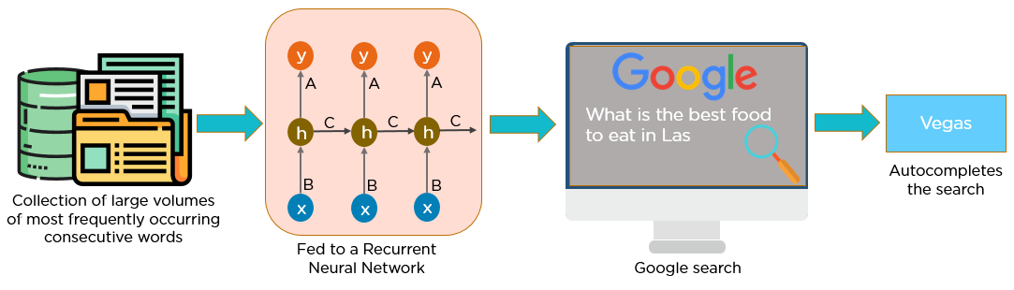
RNN: Example

Slide 24
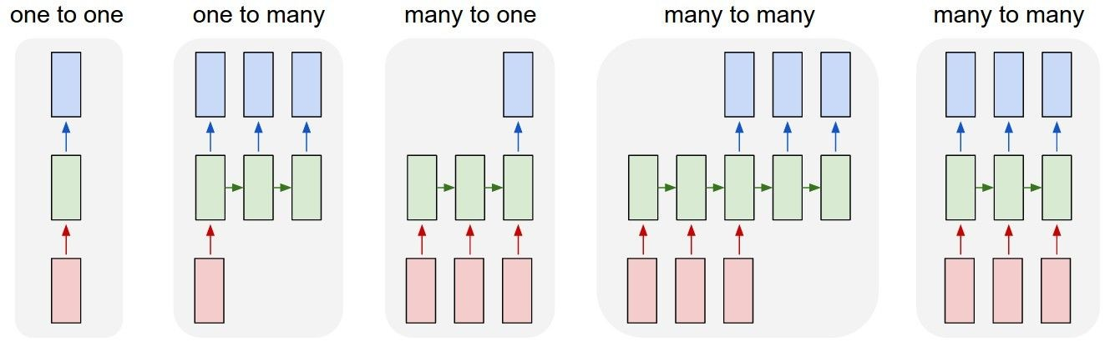
Recurrent Networks offer a lot of flexibility:
vanilla neural networks
Credit: Andrej Karpathy

Slide 25
Recurrent Networks offer a lot of flexibility:
e.g. image captioning
image -> sequence of words
Credit: Andrej Karpathy

Slide 26
Recurrent Networks offer a lot of flexibility:
e.g. sentiment classification
sequence of words -> sentiment
Credit: Andrej Karpathy

Slide 27
Recurrent Networks offer a lot of flexibility:
e.g. machine translation
seq of words -> seq of words
Credit: Andrej Karpathy

Slide 28
Recurrent Networks offer a lot of flexibility:
e.g. video classification on frame level
Credit: Andrej Karpathy

Slide 29
Recurrent Neural Network
RNN
RNN
x
Credit: Andrej Karpathy

Slide 30
Recurrent Neural Network
y
usually want to output a prediction at some time steps
RNN
x
Adapted from Andrej Karpathy

Slide 31

Recurrent Neural Network
We can process a sequence of vectors x by applying a recurrence formula at every time step:
y
RNN
new state
old state input vector at
some time step
some function
with parameters W
x
Andrej Karpathy

Slide 32
Recurrent Neural Network
We can process a sequence of vectors x by applying a recurrence formula at every time step:
y
RNN
Notice: the same function and the same set of parameters are used at every time step.
x
Andrej Karpathy

Slide 33
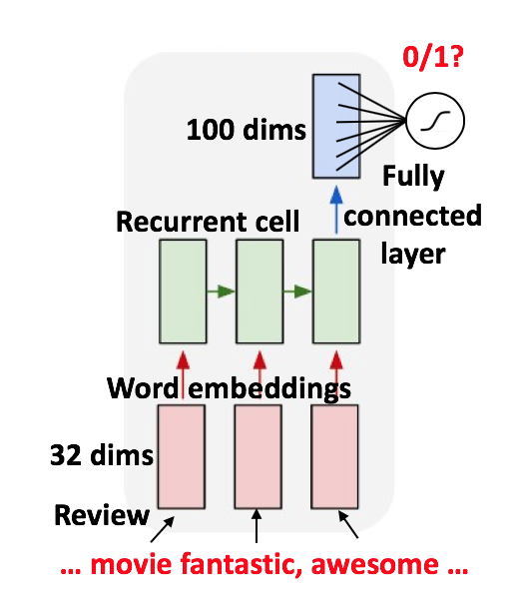



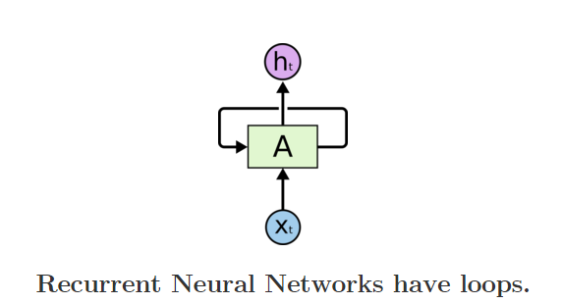

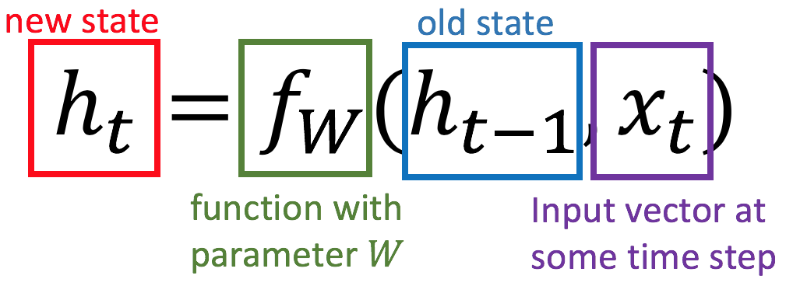
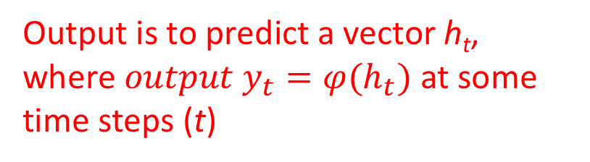
Recurrent Neural Networks
Recurrent Neural Networks are networks with loops, allowing information to persist.
Output is to predict a vector h_{t}, where ${output y}_{t}=φ(h_{t})$ at some time steps (t)
In the above diagram, a chunk of neural network, A = f_{W}, looks at some input xt and outputs a value ht. A loop allows information to be passed from one step of the network to the next.

Slide 34
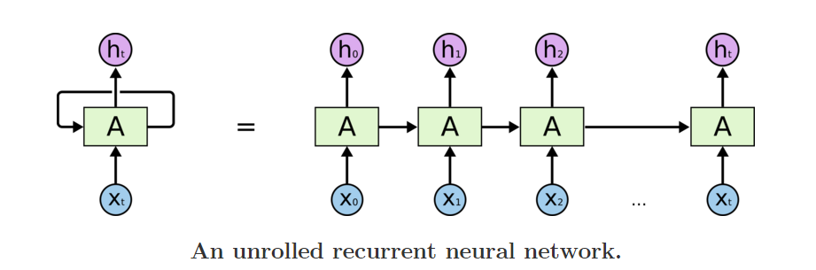
Recurrent Neural Networks
Unrolling RNN
A recurrent neural network can be thought of as multiple copies of the same network, each passing a message to a successor. The diagram above shows what happens if we unroll the loop.

Slide 35
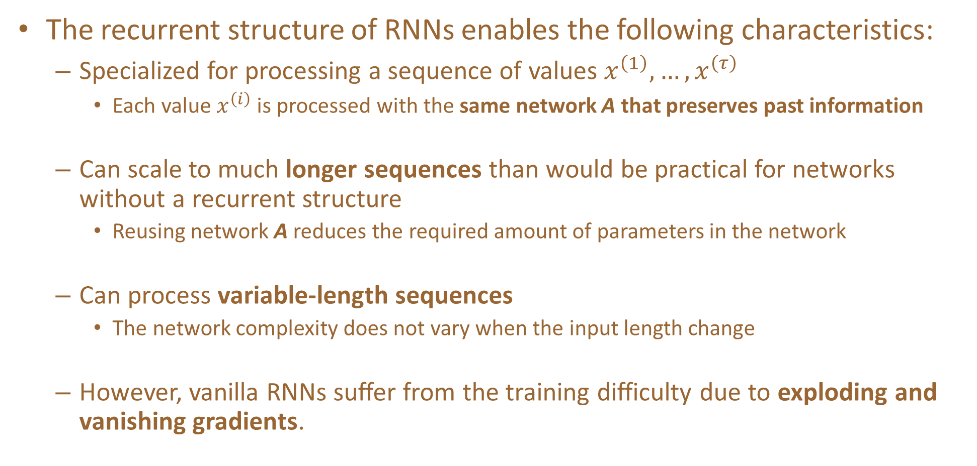
Recurrent Neural Networks
The recurrent structure of RNNs enables the following characteristics:
  Specialized for processing a sequence of values $x^{\left(1\right)}, …, x^{\left(τ\right)}$
    Each value $x^{\left(i\right)}$ is processed with the same network A that preserves past information
  Can scale to much longer sequences than would be practical for networks without a recurrent structure
    Reusing network A reduces the required amount of parameters in the network
  Can process variable-length sequences
    The network complexity does not vary when the input length change
  However, vanilla RNNs suffer from the training difficulty due to exploding and vanishing gradients.

Slide 36
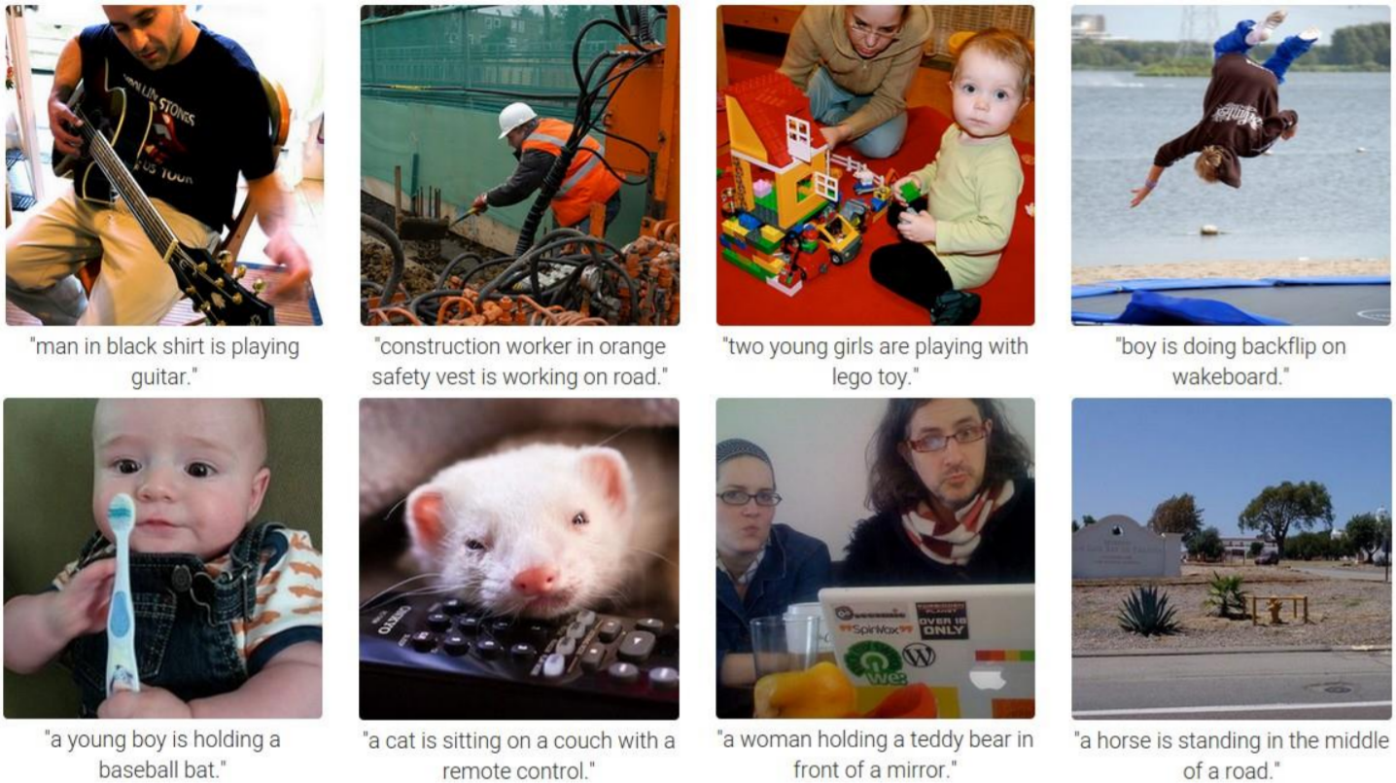
Difficult to train!

Slide 37
Getting targets when modeling sequences
When applying machine learning to sequences, we often want to turn an input sequence into an output sequence that lives in a different domain.
  E. g. turn a sequence of sound pressures into a sequence of word identities.
When there is no separate target sequence, we can get a teaching signal by trying to predict the next term in the input sequence.
  The target output sequence is the input sequence with an advance of 1 step.
  This seems much more natural than trying to predict one pixel in an image from the other pixels, or one patch of an image from the rest of the image.
  For temporal sequences there is a natural order for the predictions.
Predicting the next term in a sequence blurs the distinction between supervised and unsupervised learning.
  It uses methods designed for supervised learning, but it doesn’t require a separate teaching signal.

Slide 38
Memoryless models for sequences
Autoregressive models Predict the next term in a sequence from a fixed number of previous terms using “delay taps”.
Feed-forward neural nets These generalize autoregressive models by using one or more layers of non-linear hidden units.
input(t-2)
input(t-1)
input(t)
hidden
input(t-2)
input(t-1)
input(t)

Slide 39
Beyond memoryless models
If we give our generative model some hidden state, and if we give this hidden state its own internal dynamics, we get a much more interesting kind of model.
  It can store information in its hidden state for a long time.
  If the dynamics is noisy and the way it generates outputs from its hidden state is noisy, we can never know its exact hidden state.
  The best we can do is to infer a probability distribution over the space of hidden state vectors.
This inference is only tractable for two types of hidden state model.

Slide 40
Linear Dynamical Systems (engineers love them!)
These are generative models. They have a real-valued hidden state that cannot be observed directly.
  The hidden state has linear dynamics with Gaussian noise and produces the observations using a linear model with Gaussian noise.
  There may also be driving inputs.
To predict the next output (so that we can shoot down the missile) we need to infer the hidden state.
  A linearly transformed Gaussian is a Gaussian. So the distribution over the hidden state given the data so far is Gaussian. It can be computed using “Kalman filtering”.
time →
output
output
output
hidden
hidden
hidden
driving input
driving input
driving input

Slide 41
Hidden Markov Models (computer scientists love them!)
Hidden Markov Models have a discrete one-of-N hidden state. Transitions between states are stochastic and controlled by a transition matrix. The outputs produced by a state are stochastic.
  We cannot be sure which state produced a given output. So the state is “hidden”.
  It is easy to represent a probability distribution across N states with N numbers.
To predict the next output we need to infer the probability distribution over hidden states.
  HMMs have efficient algorithms for inference and learning.
output
output
output
time →

Slide 42
A fundamental limitation of HMMs
Consider what happens when a hidden Markov model generates data.
  At each time step it must select one of its hidden states. So with N hidden states it can only remember log(N) bits about what it generated so far.
Consider the information that the first half of an utterance contains about the second half:
  The syntax needs to fit (e.g. number and tense agreement).
  The semantics needs to fit. The intonation needs to fit.
  The accent, rate, volume, and vocal tract characteristics must all fit.
All these aspects combined could be 100 bits of information that the first half of an utterance needs to convey to the second half. 2^100 is big!

Slide 43
Recurrent neural networks
RNNs are very powerful, because they combine two properties:
  Distributed hidden state that allows them to store a lot of information about the past efficiently.
  Non-linear dynamics that allows them to update their hidden state in complicated ways.
With enough neurons and time, RNNs can compute anything that can be computed by your computer.
time →
output
output
output
hidden
hidden
hidden
input
input
input

Slide 44
Do generative models need to be stochastic?
Linear dynamical systems and hidden Markov models are stochastic models.
  But the posterior probability distribution over their hidden states given the observed data so far is a deterministic function of the data.
Recurrent neural networks are deterministic.
  So think of the hidden state of an RNN as the equivalent of the deterministic probability distribution over hidden states in a linear dynamical system or hidden Markov model.

Slide 45
Recurrent neural networks
What kinds of behaviour can RNNs exhibit?
  They can oscillate. Good for motor control?
  They can settle to point attractors. Good for retrieving memories?
  They can behave chaotically. Bad for information processing?
  RNNs could potentially learn to implement lots of small programs that each capture a nugget of knowledge and run in parallel, interacting to produce very complicated effects.
But the computational power of RNNs makes them very hard to train.
  For many years we could not exploit the computational power of RNNs despite some heroic efforts (e.g. Tony Robinson’s speech recognizer).

Slide 46
The equivalence between feedforward nets and recurrent nets
w1 w4
time=3
w1 w2 W3 W4
w2 w3
time=2
Assume that there is a time delay of 1 in using each connection.
The recurrent net is just a layered net that keeps reusing the same weights.
w1 w2 W3 W4
time=1
w1 w2 W3 W4
time=0

Slide 47
Providing input to recurrent networks
We can specify inputs in several ways:
  Specify the initial states of all the units.
  Specify the initial states of a subset of the units.
  Specify the states of the same subset of the units at every time step.
    This is the natural way to model most sequential data.
w1 w2 W3 W4
→
w1 w2 W3 W4
time
w1 w2 W3 W4

Slide 48
Teaching signals for recurrent networks
We can specify targets in several ways:
  Specify desired final activities of all the units
  Specify desired activities of all units for the last few steps
    Good for learning attractors
    It is easy to add in extra error derivatives as we backpropagate.
  Specify the desired activity of a subset of the units.
    The other units are input or hidden units.
w1 w2 W3 W4
w1 w2 W3 W4
w1 w2 W3 W4

Slide 49
A good toy problem for a recurrent network
We can train a feedforward net to do binary addition, but there are obvious regularities that it cannot capture efficiently.
  We must decide in advance the maximum number of digits in each number.
  The processing applied to the beginning of a long number does not generalize to the end of the long number because it uses different weights.
As a result, feedforward nets do not generalize well on the binary addition task.
11001100
hidden units
00100110
10100110

Slide 50
The algorithm for binary addition
1 0
0 1
0 0
1 1
no carry print 1
carry print 1
0 0
1 0
0 1
0 0
1 1
1 0
0 1
1 1
no carry print 0
carry print 0
0 0
1 1
0 1
1 0
This is a finite state automaton. It decides what transition to make by looking at the next column. It prints after making the transition. It moves from right to left over the two input numbers.

Slide 51
A recurrent net for binary addition
The network has two input units and one output unit.
It is given two input digits at each time step.
The desired output at each time step is the output for the column that was provided as input two time steps ago.
  It takes one time step to update the hidden units based on the two input digits.
  It takes another time step for the hidden units to cause the output.
0 0 1 1 0 1 0 0
0 1 0 0 1 1 0 1
1 0 0 0 0 0 0 1
time

Slide 52
The connectivity of the network
The 3 hidden units are fully interconnected in both directions.
  This allows a hidden activity pattern at one time step to vote for the hidden activity pattern at the next time step.
The input units have feedforward connections that allow then to vote for the next hidden activity pattern.
3 fully interconnected hidden units

Slide 53
What the network learns
It learns four distinct patterns of activity for the 3 hidden units. These patterns correspond to the nodes in the finite state automaton.
  Do not confuse units in a neural network with nodes in a finite state automaton. Nodes are like activity vectors.
  The automaton is restricted to be in exactly one state at each time. The hidden units are restricted to have exactly one vector of activity at each time.
A recurrent network can emulate a finite state automaton, but it is exponentially more powerful. With N hidden neurons it has 2^N possible binary activity vectors (but only N^2 weights)
  This is important when the input stream has two separate things going on at once.
  A finite state automaton needs to square its number of states.
  An RNN needs to double its number of units.

Slide 54

(Vanilla) Recurrent Neural Network
The state consists of a single “hidden” vector h:
y
RNN
x
Credit: Andrej Karpathy

Slide 55
Character-level language model example
Example
RNN
x
y
Vocabulary: [h,e,l,o]
Example training sequence: “hello”
Credit: Andrej Karpathy

Slide 56
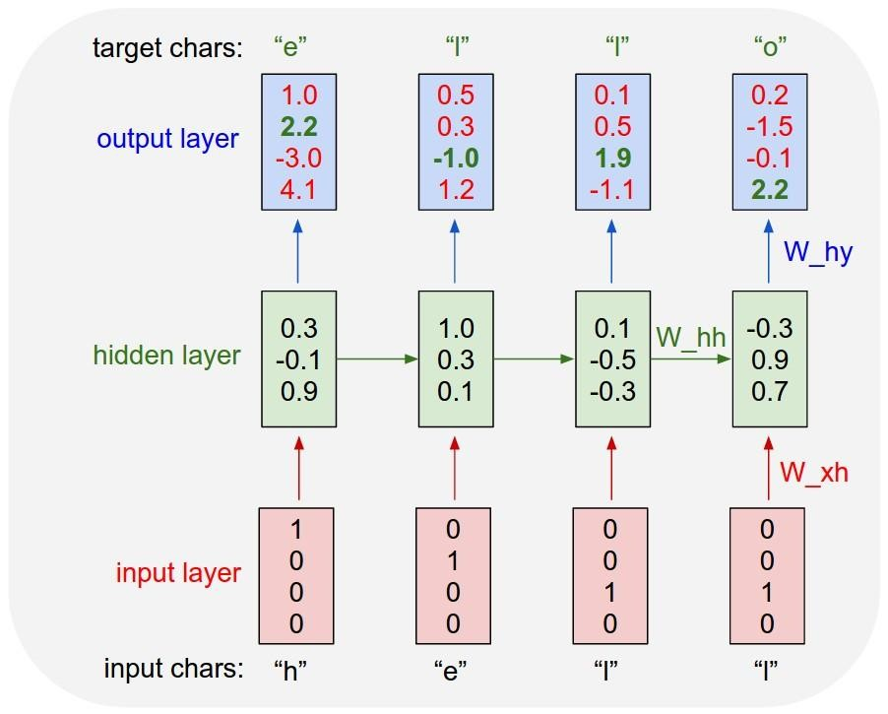
Example
Character-level language model example
Vocabulary: [h,e,l,o]
Example training sequence: “hello”
Credit: Andrej Karpathy

Slide 57
Example
Character-level language model example
Vocabulary: [h,e,l,o]
Example training sequence: “hello”
Credit: Andrej Karpathy

Slide 58
Example
Character-level language model example
Vocabulary: [h,e,l,o]
Example training sequence: “hello”
What do we still need to specify, for this to work?
What kind of loss can we formulate?
Credit: Andrej Karpathy

Slide 59




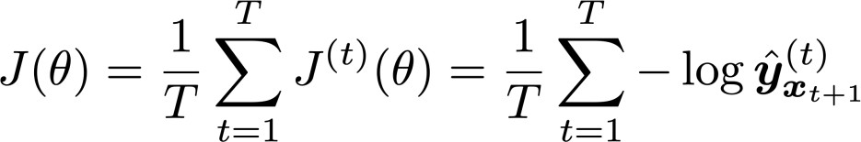
Training a Recurrent Neural Network
Get a big corpus of text which is a sequence of words
Feed into RNN; compute output distribution for every step t.
  i.e. predict probability distribution of every word, given words so far
Loss function on step t is cross-entropy between predicted probability
distribution , and true next word (one-hot); V is vocabulary
Average this to get overall loss for entire training set:
Credit: Andrej Karpathy
Adapted from Abigail See

Slide 60
















Recurrent unit
$$y3$$
$$y2$$
Classifier
…
$$y1$$
$$h3$$
Classifier
$$h3$$
$$h2$$
$$h2$$
Hidden layer
Classifier
$$h1$$
$$h1$$
Hidden layer
$$x3$$
Hidden layer
$$t = 3$$
$$x2$$
$$h0$$
$$x1$$
$$t = 2$$
$$t = 1$$

Slide 61
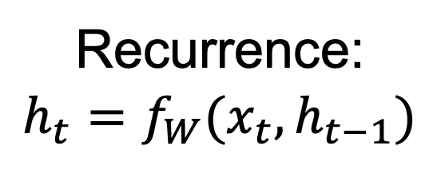
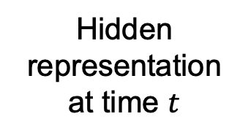







Recurrent unit
Output at time $t$
$$yt$$
Classifier
Recurrence:
$$h_{t}=f_{W}(x_{t},h_{t−1})$$
Hidden representation at time $t$
$$ht$$
new state
function of $W$
input at time$t$
old state
Hidden layer
Input at time $t$
$$xt$$

Slide 62

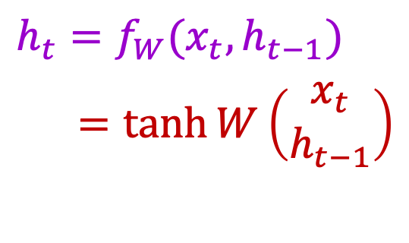



Vanilla RNN cell
$$ht$$
$$h_{t}=f_{W}(x_{t},h_{t−1})$$
$=\tanh{W}\left(\begin{matrix}x_{t} \\ h_{t−1}\end{matrix}\right)$
$$W$$
$$h_{t−1}$$
$$xt$$
J. Elman, Finding structure in time, Cognitive science 14(2), pp. 179–211, 1990

Slide 63
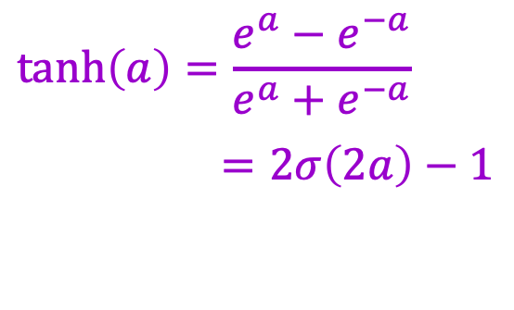


Vanilla RNN cell
$$ht$$
$$h_{t}=f_{W}(x_{t},h_{t−1})$$
$=\tanh{W}\left(\begin{matrix}x_{t} \\ h_{t−1}\end{matrix}\right)$
$$W$$
$$h_{t−1}$$
$$xt$$
$$\tanh\left(a\right)=\frac{e^{a}−e^{−a}}{e^{a}+e^{−a}}$$
$=2σ\left(2a\right)−1$
$$σ\left(a\right)$$
$$\tanh\left(a\right)$$
Credit: Andrej Karpathy

Slide 64
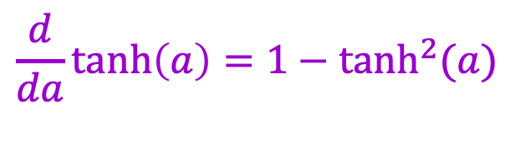
Vanilla RNN cell
$$ht$$
$$h_{t}=f_{W}(x_{t},h_{t−1})$$
$=\tanh{W}\left(\begin{matrix}x_{t} \\ h_{t−1}\end{matrix}\right)$
$$W$$
$$h_{t−1}$$
$$xt$$
$$\frac{d}{da}tanh\left(a\right)=1−\tanh^{2}(a)$$

Slide 65

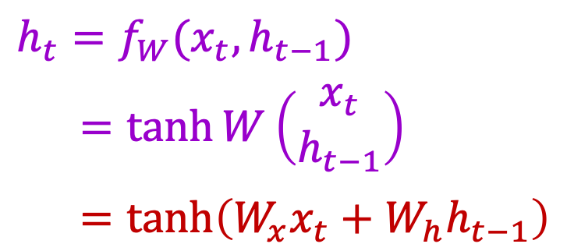
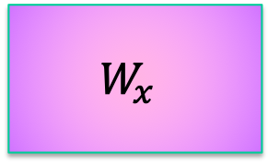
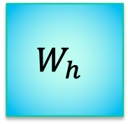

Vanilla RNN cell
$$ht$$
$$h_{t}=f_{W}(x_{t},h_{t−1})$$
$=\tanh{W}\left(\begin{matrix}x_{t} \\ h_{t−1}\end{matrix}\right)$
$=\tanh\left({W_{x}x_{t}+W}_{h}h_{t−1}\right)$
$$W$$
$$h_{t−1}$$
$$xt$$
n
m
$$W_{x}$$
$$W_{h}$$
$$x_{t}$$
m
n-dim.
$$h_{t−1}$$
m-dim.

Slide 66

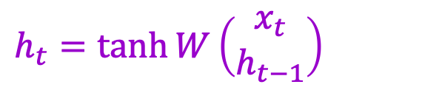

RNN forward pass
e₁
e₂
e₃
$$e_{t}=−log(y_{t}({GT}_{t}))$$
y₁
y₂
y₃
$$y_{t}=softmax(W_{y}h_{t})$$
$$h_{t}=\tanh{W}\left(\begin{matrix}x_{t} \\ h_{t−1}\end{matrix}\right)$$
h₁
h₂
h₃
shared weights
h₀ x₁
h₁ x₂
h₂ x₃
Notes:
Note that the weights are shared over time
Essentially, copies of the RNN cell are made over time (unrolling/unfolding), with different inputs at different time steps

Slide 67
RNN forward pass: Computation graph
L
e₁
e₂
e₃
$$e_{t}=−log(y_{t}({GT}_{t}))$$
y₁
y₂
y₃
$$y_{t}=softmax(W_{y}h_{t})$$
W_{y}
$$h_{t}=\tanh{W}\left(\begin{matrix}x_{t} \\ h_{t−1}\end{matrix}\right)$$
h₁
h₂
h₃
W
h₀ x₁
h₁ x₂
h₂ x₃
Notes:
Note that the weights are shared over time
Essentially, copies of the RNN cell are made over time (unrolling/unfolding), with different inputs at different time steps

Slide 68
Recurrent Neural Networks
Infinite uses of finite structure
Input
X0
X1
X2
X3
H0
H1
H2
W
W
W
W
H0
H1
H2
Hidden state representation
Y1
Y2
Y3
Y0
Output

Slide 69
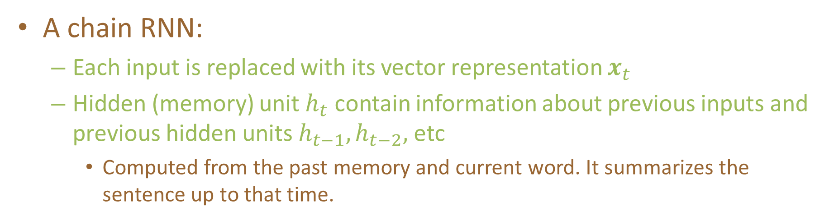
Recurrent Neural Networks
A chain RNN:
  Each input is replaced with its vector representation $x_{t}$
  Hidden (memory) unit $h_{t}$ contain information about previous inputs and previous hidden units $h_{t−1},h_{t−2},$ etc
    Computed from the past memory and current word. It summarizes the sentence up to that time.
$x_{t−1}$ ${ x}_{t}$ $x_{t+1}$
O O O O O
O O O O O
O O O O O
Input layer
O O O O O
O O O O O
O O O O O
Memory layer
$h_{t−1}$ $h_{t}$ $h_{t+1}$

Slide 70
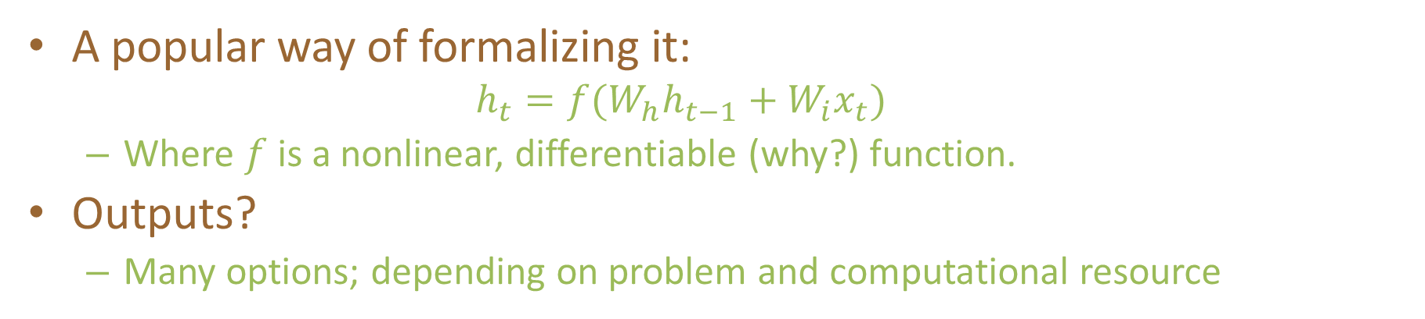
Recurrent Neural Networks
A popular way of formalizing it:
  $$h_{t}=f(W_{h}h_{t−1}+W_{i}x_{t})$$
  Where $f$ is a nonlinear, differentiable (why?) function.
Outputs?
  Many options; depending on problem and computational resource
$x_{t−1}$ ${ x}_{t}$ $x_{t+1}$
O O O O O
O O O O O
O O O O O
Input layer
O O O O O
O O O O O
O O O O O
Memory layer
$h_{t−1}$ $h_{t}$ $h_{t+1}$

Slide 71


Recurrent Neural Networks
Prediction for $x_{t}$, with $h_{t}$:
Some inherent issues with RNNs:
  Recurrent neural nets cannot capture phrases without prefix context
  They focus too much on last words in final vector
    A slightly more sophisticated solution: Long Short-Term Memory (LSTM) units
$$y_{t}=softmax\left(W_{o}h_{t} \right)$$
$x_{t−1}$ ${ x}_{t}$ $x_{t+1}$
O O O O O
O O O O O
O O O O O
Input layer
O O O O O
O O O O O
O O O O O
Memory layer
$h_{t−1}$ $h_{t}$ $h_{t+1}$
$y_{t−1}$ ${ y}_{t}$ $y_{t+1}$
Output layer

Slide 72
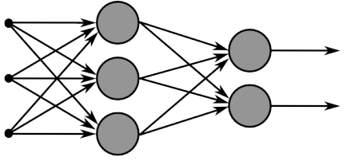
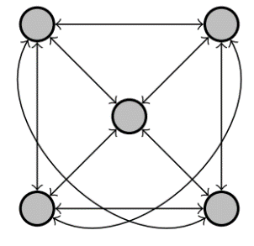
Recurrent Neural Networks
Multi-layer feed-forward NN: DAG
  Just computes a fixed sequence of
  non-linear learned transformations to convert an input patter into an output pattern
Recurrent Neural Network: Digraph
  Has cycles.
  Cycle can act as a memory;
  The hidden state of a recurrent net can carry along information about a “potentially” unbounded number of previous inputs.
  They can model sequential data in a much more natural way.

Slide 73
Equivalence between RNN and Feed-forward NN
Assume that there is a time delay of 1 in using each connection.
The recurrent net is just a layered net that keeps reusing the same weights.
w1 w4
time=3
1
2
3
W1 W2 W3 W4
time=2
1
2
3
1
2
3
W1 W2 W3 W4
w2 w3
time=1
1
2
3
W1 W2 W3 W4
time=0
1
2
3
Slide Credit: Geoff Hinton

Slide 74
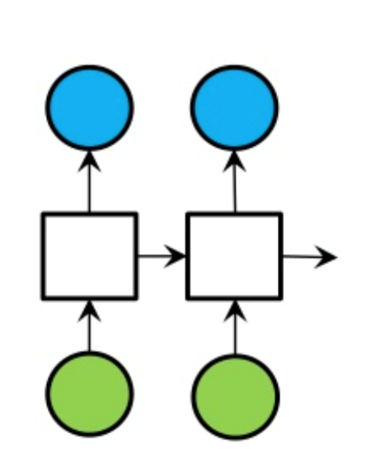
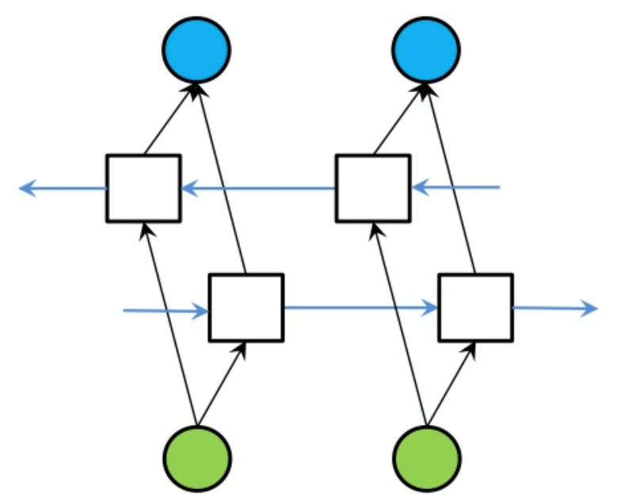
Bi-directional RNN
One of the issues with RNN:
  Hidden variables capture only one side context
A bi-directional structure
RNN
Bi-directional RNN

Slide 75
Training: Backpropagation through time (BPTT)
The unfolded network (used during forward pass) is treated as one big feed-forward network that accepts the whole time series as input
The weight updates are computed for each copy in the unfolded network, then summed (or averaged) and applied to the RNN weights

Slide 76
Backpropagation through time
Loss
Forward through entire sequence to compute loss, then backward to compute gradient
Source: J. Johnson

Slide 77
Backpropagation through time
Loss
Problem: Takes a lot of memory for long sequences!
Source: J. Johnson

Slide 78
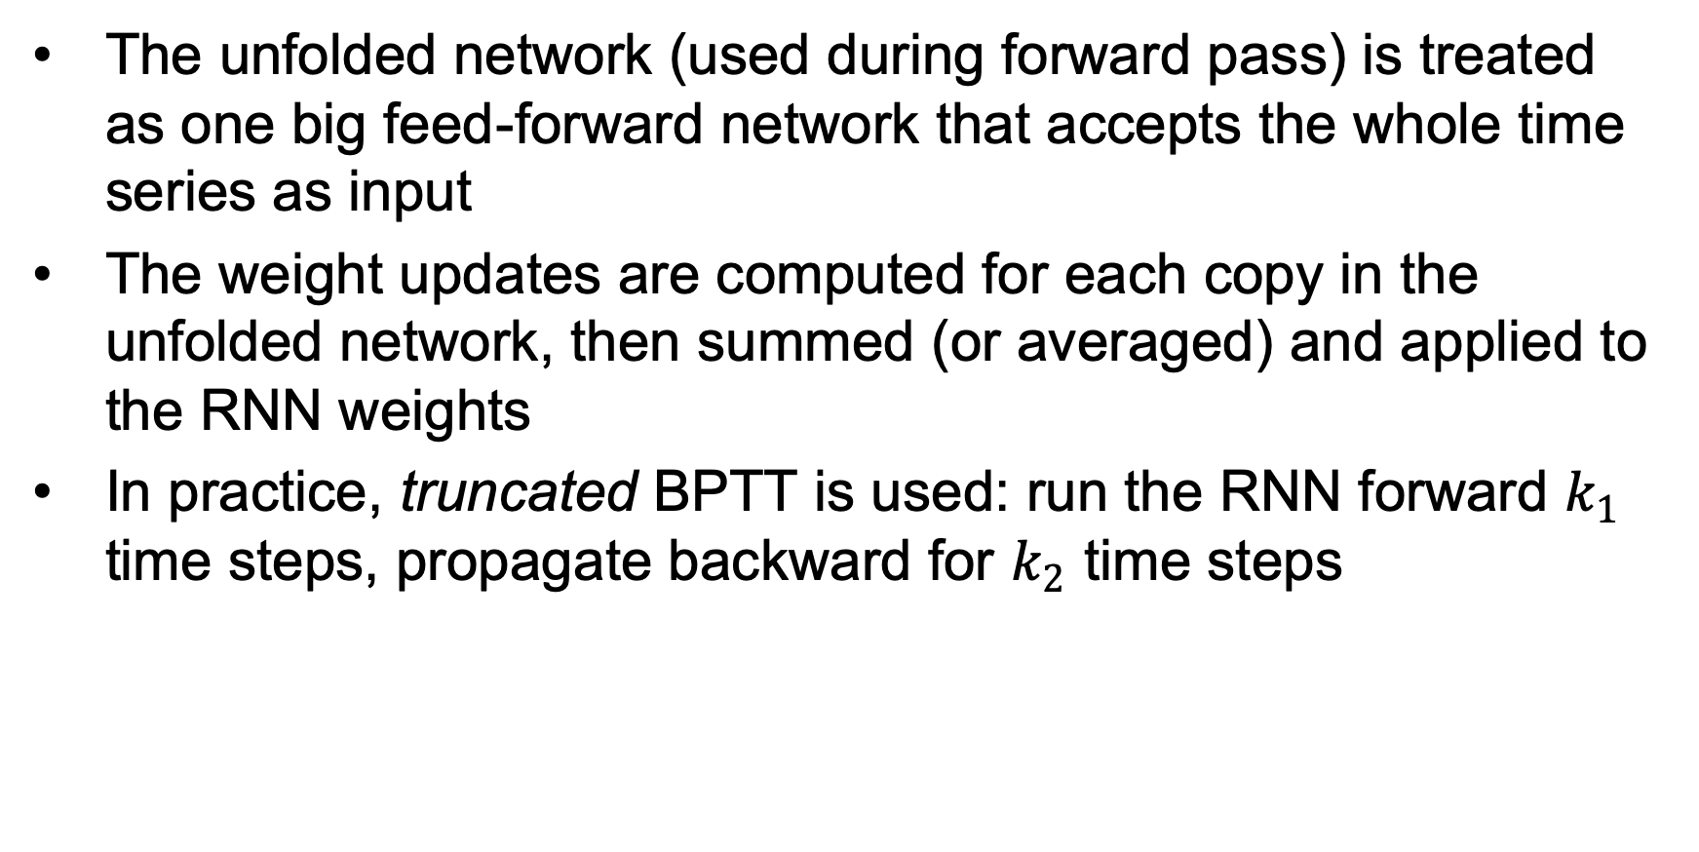
Training: Backpropagation through time (BPTT)
The unfolded network (used during forward pass) is treated as one big feed-forward network that accepts the whole time series as input
The weight updates are computed for each copy in the unfolded network, then summed (or averaged) and applied to the RNN weights
In practice, truncated BPTT is used: run the RNN forward $k_{1}$ time steps, propagate backward for $k_{2}$ time steps
https://machinelearningmastery.com/gentle-introduction-backpropagation-time/
http://www.cs.utoronto.ca/~ilya/pubs/ilya_sutskever_phd_thesis.pdf

Slide 79
Truncated backpropagation through time
Loss
Run forward and backward through chunks of the sequence instead of whole sequence
Source: J. Johnson

Slide 80
Truncated backpropagation through time
Loss
Carry hidden states forward in time farther, but only backpropagate for some smaller number of steps
Source: J. Johnson

Slide 81
Truncated backpropagation through time
Loss
Source: J. Johnson

Slide 82
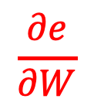

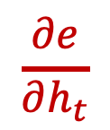

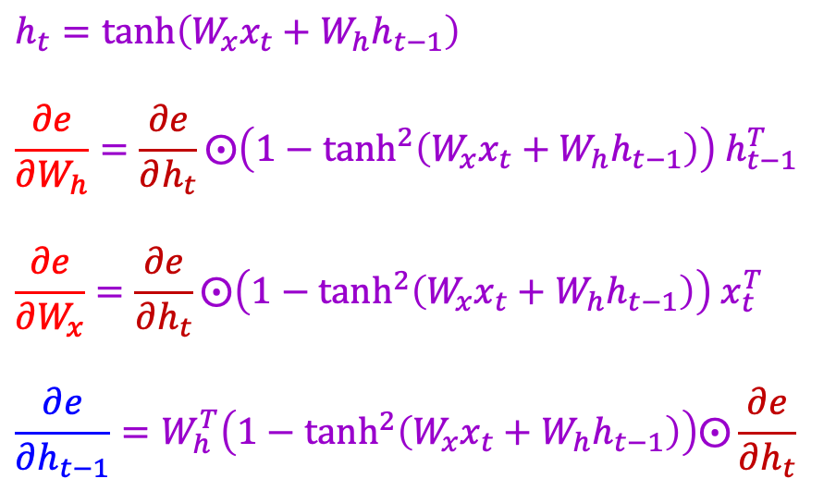


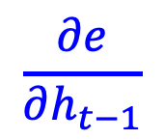
RNN backward pass
$$\frac{∂e}{∂h_{t}}$$
Error from predictions at future steps
$$ht$$
$$h_{t}=\tanh\left({W_{x}x_{t}+W}_{h}h_{t−1}\right)$$
$$\frac{∂e}{∂W_{h}}=\frac{∂e}{∂h_{t}}⨀\left(1−\tanh^{2}\left({W_{x}x_{t}+W}_{h}h_{t−1}\right)\right) h_{t−1}^{T}$$
$$\frac{∂e}{∂W_{x}}=\frac{∂e}{∂h_{t}}⨀\left(1−\tanh^{2}\left(W_{x}x_{t}+W_{h}h_{t−1}\right)\right){ x}_{t}^{T}$$
$$\frac{∂e}{∂h_{t−1}}=W_{h}^{T}\left(1−\tanh^{2}\left({W_{x}x_{t}+W}_{h}h_{t−1}\right)\right)⨀\frac{∂e}{∂h_{t}}$$
Parameter update
$$\frac{∂e}{∂W}$$
$$W$$
$$h_{t−1}$$
$$xt$$
$$\frac{∂e}{∂h_{t−1}}$$
Propagate to earlier time steps

Slide 83








The vanishing/exploding gradient problem
The error at a time step ideally can tell a previous time step from many steps away to change during backprop
Multiply the same matrix at each time step during backprop
yt−1
y_{t}
yt+1
ht−1
h_{t}
ht+1
W
W
xt−1
x_{t}
xt+1
Richard Socher

Slide 84



The vanishing gradient problem
Total error is the sum of each error at time steps t
Chain rule:
More chain rule:
Derivative of vector wrt vector is a Jacobian matrix of partial derivatives; norm of this matrix can become very small or very large quickly [Bengio et al 1994, Pascanu et al. 2013], leading to vanishing/exploding gradient
Adapted from Richard Socher

Slide 85


Exploding and Vanishing Gradients
Cliff/boundary
Plane/attractor
Exploding: If we start almost exactly on the boundary (cliff), tiny changes can make a huge difference.
Vanishing: If we start a trajectory within an attractor (plane, flat surface), small changes in where we start make no difference to where we end up.
Both cases hinder the learning process.

Slide 86



Exploding and Vanishing Gradients
$$E_{4}=J(y_{4}, \hat{y_{4}})$$
In vanilla RNNs, computing this gradient involves many factors of $W_{hh}$ (and repeated tanh)*. If we decompose the singular values of the gradient multiplication matrix,
  Largest singular value > 1 → Exploding gradients
    Slight error in the late time steps causes drastic updates in the early time steps → Unstable learning
  Largest singular value < 1 → Vanishing gradients
    Gradients passed to the early time steps is close to 0. → Uninformed correction
* Refer to Bengio et al. (1994) or Goodfellow et al. (2016) for a complete derivation

Slide 87

RNN 2.0: Long short-term Memory (LSTM)
Hidden State: holds previous information (Short-term memory)
Cell State: memory of the network (Long-term memory)
What should be forget in cell state
How much new data should be taken
How much does memory affect output

Slide 88
Long Short Term Memory (LSTM)
Hochreiter & Schmidhuber (1997) solved the problem of getting an RNN to remember things for a long time (like hundreds of time steps).
They designed a memory cell using logistic and linear units with multiplicative interactions.
Information gets into the cell whenever its “write” gate is on.
The information stays in the cell so long as its “keep” gate is on.
Information can be read from the cell by turning on its “read” gate.

Slide 89
Implementing a memory cell in a neural network
keep gate
To preserve information for a long time in the activities of an RNN, we use a circuit that implements an analog memory cell.
  A linear unit that has a self-link with a weight of 1 will maintain its state.
  Information is stored in the cell by activating its write gate.
  Information is retrieved by activating the read gate.
  We can backpropagate through this circuit because logistics are have nice derivatives.
1.73
write gate
read gate
input from rest of RNN
output to rest of RNN

Slide 90
Backpropagation through a memory cell
keep 0
keep 1
keep 1
keep 0
1.7
1.7
1.7
write 1
read
0
write 0
read
0
write 0
read
1
1.7
1.7
time →

Slide 91





Networks with Memory
Vanilla RNN operates in a “multiplicative” way (repeated tanh).
Two recurrent cell designs were proposed and widely adopted:
  Long Short-Term Memory (LSTM) (Hochreiter and Schmidhuber, 1997)
  Gated Recurrent Unit (GRU) (Cho et al. 2014)
Both designs process information in an “additive” way with gates to control information flow.
  Sigmoid gate outputs numbers between 0 and 1, describing how much of each component should be let through.
Standard LSTM Cell
GRU Cell
A Sigmoid Gate
E.g.
= Sigmoid ( W_{f} x_{t} + U_{t} h_{t-1} + b_{f} )

Slide 92
Long Short Term Memory
LSTM networks, add additional gating units in each memory cell.
  Forget gate
  Input gate
  Output gate
Prevents vanishing/exploding gradient problem and allows network to retain state information over longer periods of time.

Slide 93





Long short-term memory (LSTM)
Add a memory cell that is not subject to matrix multiplication or squishing, thereby avoiding gradient decay
$xt$
$$h_{t−1}$$
$$ht$$
$$c_{t−1}$$
$$ct$$
S. Hochreiter and J. Schmidhuber, Long short-term memory, Neural Computation 9 (8), pp. 1735–1780, 1997

Slide 94



Long Short-Term Memory (LSTM)
The key to LSTMs is the cell state.
  Stores information of the past → long-term memory
  Passes along time steps with minor linear interactions → “additive”
  Results in an uninterrupted gradient flow → errors in the past pertain and impact learning in the future
The LSTM cell manipulates input information with three gates.
  Input gate → controls the intake of new information
  Forget gate → determines what part of the cell state to be updated
  Output gate → determines what part of the cell state to output
Cell State $C_{t}$
Gradient Flow

Slide 95





The LSTM cell
$$x_{t}$$
$$Wg$$
$$ht$$
$$g_{t}=tanh⁡W_{g}\left(\begin{matrix}x_{t} \\ h_{t−1}\end{matrix}\right)$$
$$h_{t−1}$$
Notes:
* Dashed line indicates time-lag

Slide 96



The LSTM cell
$$x_{t}$$
$$Wg$$
Cell
$$ct$$
$$ht$$
$$h_{t}=tanh⁡c_{t}$$
$$g_{t}=tanh⁡W_{g}\left(\begin{matrix}x_{t} \\ h_{t−1}\end{matrix}\right)$$
$$h_{t−1}$$
$$c_{t}=c_{t−1}+g_{t}$$
Notes:
* Dashed line indicates time-lag

Slide 97
The LSTM cell
$$x_{t}$$
$$Wg$$
Cell
$$ct$$
$$ht$$
$$g_{t}=tanh⁡W_{g}\left(\begin{matrix}x_{t} \\ h_{t−1}\end{matrix}\right)$$
$$h_{t−1}$$

Slide 98






The LSTM cell
$xt$ $h_{t−1}$
$$it$$
$$Wi$$
Input Gate
$$i_{t}=σ\left(W_{i}\left(\begin{matrix}x_{t} \\ h_{t−1}\end{matrix}\right)+b_{i}\right)$$
$$x_{t}$$
$$Wg$$
Cell
.
$$ct$$
$$ht$$
$$g_{t}=tanh⁡W_{g}\left(\begin{matrix}x_{t} \\ h_{t−1}\end{matrix}\right)$$
$$h_{t−1}$$
$$c_{t}=c_{t−1}+i_{t}⨀ g_{t}$$

Slide 99




The LSTM cell
$xt$ $h_{t−1}$
$xt$ $h_{t−1}$
$$it$$
$$Wi$$
o_{t}
$$Wo$$
Input Gate
Output Gate
$$i_{t}=σ\left(W_{i}\left(\begin{matrix}x_{t} \\ h_{t−1}\end{matrix}\right)+b_{i}\right)$$
$$o_{t}=σ\left(W_{o}\left(\begin{matrix}x_{t} \\ h_{t−1}\end{matrix}\right)+b_{o}\right)$$
$$x_{t}$$
$$Wg$$
Cell
.
.
$$ct$$
$$ht$$
$$h_{t}=o_{t}⨀ tanh⁡c_{t}$$
$$g_{t}=tanh⁡W_{g}\left(\begin{matrix}x_{t} \\ h_{t−1}\end{matrix}\right)$$
$$h_{t−1}$$
$$c_{t}=c_{t−1}+i_{t}⨀ g_{t}$$

Slide 100



The LSTM cell
$xt$ $h_{t−1}$
$xt$ $h_{t−1}$
$$it$$
$$Wi$$
o_{t}
$$Wo$$
Input Gate
Output Gate
$$i_{t}=σ\left(W_{i}\left(\begin{matrix}x_{t} \\ h_{t−1}\end{matrix}\right)+b_{i}\right)$$
$$o_{t}=σ\left(W_{o}\left(\begin{matrix}x_{t} \\ h_{t−1}\end{matrix}\right)+b_{o}\right)$$
$$x_{t}$$
$$Wg$$
Cell
.
.
$$ct$$
$$ht$$
$$h_{t}=o_{t}⨀ tanh⁡c_{t}$$
$$g_{t}=tanh⁡W_{g}\left(\begin{matrix}x_{t} \\ h_{t−1}\end{matrix}\right)$$
$$h_{t−1}$$
$$c_{t}={f_{t}⨀c}_{t−1}+i_{t}⨀ g_{t}$$
Forget Gate
f_{t}
$$f_{t}=σ\left(W_{f}\left(\begin{matrix}x_{t} \\ h_{t−1}\end{matrix}\right)+b_{f}\right)$$
$$Wf$$
$xt$ $h_{t−1}$

Slide 101


LSTM forward pass summary
$$\left(\begin{matrix}g_{t} \\ i_{t} \\ \begin{aligned}f_{t} \\ o_{t}\end{aligned}\end{matrix}\right)=\left(\begin{matrix}tanh \\ σ \\ \begin{aligned}σ \\ σ\end{aligned}\end{matrix}\right)\left(\begin{matrix}W_{g} \\ W_{i} \\ \begin{aligned}W_{f} \\ W_{o}\end{aligned}\end{matrix}\right)\left(\begin{aligned}x_{t} \\ h_{t−1}\end{aligned}\right)$$
$c_{t}={f_{t}⨀c}_{t−1}+i_{t}⨀ g_{t}$
$h_{t}=o_{t}⨀ tanh⁡c_{t}$
Figure source

Slide 102

LSTM backward pass
Gradient flow from $c_{t}$ to $c_{t−1}$ only involves back-propagating through addition and elementwise multiplication, not matrix multiplication or tanh
For complete details: Illustrated LSTM Forward and Backward Pass
Figure source

Slide 103







LSTM: Components & Flow
LSM unit output
Output gate units
Transformed memory cell contents
Gated update to memory cell units
Forget gate units
Input gate units
Potential input to memory cell

Slide 104






Step-by-step LSTM Walk Through
Step 1: Decide what information to throw away from the cell state (memory) ➔
  The output of the previous state $h_{t−1}$ and the new information $x_{t}$ jointly determine what to forget
    $h_{t−1}$ contains selected features from the memory $C_{t−1}$
  Forget gate $f_{t}$ ranges between $[0, 1]$
Text processing example:
Cell state may include the gender of the current subject ($h_{t−1}$).
When the model observes a new subject ($x_{t}$), it may want to forget ($f_{t}→0$) the old subject in the memory ($C_{t−1}$).
Forget gate

Slide 105





Step-by-step LSTM Walk Through
Step 2: Prepare the updates for the cell state
from input ➔
  An alternative cell state $\tilde{C_{t}}$ is created from the new information $x_{t}$ with the guidance of $h_{t−1}$.
  Input gate $i_{t}$ ranges between $[0, 1]$
Example:
The model may want to add ($i_{t}→1$) the gender of new subject ($\tilde{C_{t}}$) to the cell state to replace the old one it is forgetting.
Input gate
Alternative cell state

Slide 106





Step-by-step LSTM Walk Through
Step 3: Update the cell state ➔
  The new cell state $C_{t}$ is comprised of information from the past $f_{t}∗C_{t−1}$ and valuable new information $i_{t}∗$ $\tilde{C_{t}}$
  $∗$ denotes elementwise multiplication
New cell state
Example:
The model drops the old gender information ($f_{t}∗C_{t−1}$) and adds new gender information ($i_{t}∗\tilde{C_{t}}$) to form the new cell state ($C_{t}$).

Slide 107





Step-by-step LSTM Walk Through
Step 4: Decide the filtered output from the
new cell state ➔
  tanh function filters the new cell state to characterize stored information
    Significant information in $C_{t}$ → $±1$
    Minor details → 0
  Output gate $o_{t}$ ranges between $\left[0, 1\right]$
  $h_{t}$ serves as a control signal for the next time step
Example:
Since the model just saw a new subject ($x_{t}$), it might want to output ($o_{t}→1$) information relevant to a verb ($tanh⁡(C_{t})$), e.g., singular/plural, in case a verb comes next.
Output gate

Slide 108


LSTM Network Architecture

Slide 109
Cell State
Maintains a vector C_{t} that is the same dimensionality as the hidden state, h_{t}
Information can be added or deleted from this state vector via the forget and input gates.

Slide 110
Cell State Example
Want to remember person & number of a subject noun so that it can be checked to agree with the person & number of verb when it is eventually encountered.
Forget gate will remove existing information of a prior subject when a new one is encountered.
Input gate "adds" in the information for the new subject.

Slide 111

Forget Gate
Forget gate computes a 0-1 value using a logistic sigmoid output function from the input, x_{t}, and the current hidden state, h_{t}:
Multiplicatively combined with cell state, "forgetting" information where the gate outputs something close to 0.

Slide 112

Hyperbolic Tangent Units
Tanh can be used as an alternative nonlinear function to the sigmoid logistic (0-1) output function.
Used to produce thresholded output between –1 and 1.

Slide 113

Input Gate
First, determine which entries in the cell state to update by computing 0-1 sigmoid output.
Then determine what amount to add/subtract from these entries by computing a tanh output (valued –1 to 1) function of the input and hidden state.

Slide 114

Updating the Cell State
Cell state is updated by using component-wise vector multiply to "forget" and vector addition to "input" new information.

Slide 115

Output Gate
Hidden state is updated based on a "filtered" version of the cell state, scaled to –1 to 1 using tanh.
Output gate computes a sigmoid function of the input and current hidden state to determine which elements of the cell state to "output".

Slide 116

Overall Network Architecture
Single or multilayer networks can compute LSTM inputs from problem inputs and problem outputs from LSTM outputs.
O_{t}
e.g. a POS tag as a “one hot” vector
e.g. a word “embedding” with
reduced dimensionality
I_{t}
e.g. a word as a “one hot” vector

Slide 117
LSTM Training
Trainable with backprop derivatives such as:
  Stochastic gradient descent (randomize order of examples in each epoch) with momentum (bias weight changes to continue in same direction as last update).
  ADAM optimizer (Kingma & Ma, 2015)
Each cell has many parameters (W_{f}, W_{i}, W_{C}, W_{o})
  Generally requires lots of training data.
  Requires lots of compute time that exploits GPU clusters.

Slide 118
General Problems Solved with LSTMs
Sequence labeling
  Train with supervised output at each time step computed using a single or multilayer network that maps the hidden state (h_{t}) to an output vector (O_{t}).
Language modeling
  Train to predict next input (O_{t} =I_{t+1})
Sequence (e.g. text) classification
  Train a single or multilayer network that maps the final hidden state (h_{n}) to an output vector (O).

Slide 119
Sequence to Sequence Transduction (Mapping)
Encoder/Decoder framework maps one sequence to a "deep vector" then another LSTM maps this vector to an output sequence.
Encoder
LSTM
Decoder
LSTM
I₁, I₂,…,I_{n}
h_{n}
O₁, O₂,…,O_{m}
Train model "end to end" on I/O pairs of sequences.

Slide 120



Gated Recurrent Unit (GRU)
GRU is a variation of LSTM that also adopts the gated design.
Differences:
  GRU uses an update gate $z$ to substitute the input and forget gates $i_{t}$ and $f_{t}$
  Combined the cell state $C_{t}$ and hidden state $h_{t}$ in LSTM as a single cell state $h_{t}$
GRU obtains similar performance compared to LSTM with fewer parameters and faster convergence. (Cho et al. 2014)
Update gate: controls the composition of the new state
Reset gate: determines how much old information is needed in the alternative state $\tilde{h_{t}}$
Alternative state: contains new information
New state: replace selected old information with new information in the new state

Slide 121

Summary of
LSTM Application Architectures
Image Captioning
Video Activity Recog
Text Classification
Video Captioning
Machine Translation
POS Tagging
Language Modeling

Slide 122
Sequence Learning Architectures
Learning on RNN is more robust when the vanishing/exploding gradient problem is resolved.
  RNNs can now be applied to different Sequence Learning tasks.
Recurrent NN architecture is flexible to operate over various sequences of vectors.
  Sequence in the input, the output, or in the most general case both
  Architecture with one or more RNN layers

Slide 123

Sequence Learning with One RNN Layer
Each rectangle is a vector and arrows represent functions (e.g. matrix multiply).
Input vectors are in red, output vectors are in blue and green vectors hold the RNN's state
1
2
3
4
5
(1) Standard NN mode without recurrent structure (e.g. image classification, one label for one image).
(2) Sequence output (e.g. image captioning, takes an image and outputs a sentence of words).
(3) Sequence input (e.g. sentiment analysis, a sentence is classified as expressing positive or negative sentiment).
(4) Sequence input and sequence output (e.g. machine translation, a sentence in English is translated into a sentence in French).
(5) Synced sequence input and output (e.g. video classification, label each frame of the video).

Slide 124

Sequence Learning with Multiple RNN Layers
Bidirectional RNN
  Connects two recurrent units (synced many-to-many model) of opposite directions to the same output.
  Captures forward and backward information from the input sequence
  Apply to data whose current state (e.g., $h_{0}$) can be better determined when given future information (e.g., $x_{1}, x_{2},…, x_{t}$)
    E.g., in the sentence “the bank is robbed,” the semantics of “bank” can be determined given the verb “robbed.”
B
B
B
B

Slide 125
Sequence Learning with Multiple RNN Layers
Sequence-to-Sequence (Seq2Seq) model
  Developed by Google in 2018 for use in machine translation.
  Seq2seq turns one sequence into another sequence. It does so by use of a recurrent neural network (RNN) or more often LSTM or GRU to avoid the problem of vanishing gradient.
  The primary components are one Encoder and one Decoder network. The encoder turns each item into a corresponding hidden vector containing the item and its context. The decoder reverses the process, turning the vector into an output item, using the previous output as the input context.
  Encoder RNN: extract and compress the
  semantics from the input sequence
  Decoder RNN: generate a sequence based
  on the input semantics
  Apply to tasks such as machine
  translation
    Similar underlying semantics
    E.g., “I love you.” to “Je t’aime.”
Decoded sequence
y₀
y₁
y₂
…
y_{m}
Encoded semantics
B
B
B
B
An RNN as the encoder
An RNN as the decoder
Input sequence

Slide 126
Sequential prediction example 1: Sentiment classification
Goal: classify a text sequence (e.g., restaurant, movie or product review, Tweet) as having positive or negative sentiment
  “The food was really good”
  “The vacuum cleaner broke within two weeks”
  “The movie had slow parts, but overall was worth watching”
Notes:
What makes this problem challenging?
What feature representation or predictor structure can we use for this problem?

Slide 127


Sequential prediction example 1: Sentiment classification
Recurrent model:
Classifier
Hidden state
“Memory”
“Context”
h₅
h₁
h₂
h₃
h₄
“The”
“food”
“was”
“really”
“good”

Slide 128


Sequential prediction example 2: Text generation
Sample from the distribution of a given text corpus
(also known as language modeling)

Slide 129
Sequential prediction example 2: Text generation
Sample from the distribution of a given text corpus –
also known as language modeling
Can be done one character or one word at a time:
“Thus”
“saith”
“the”
“Lord”
“of”
Classifier
Classifier
Classifier
Classifier
Classifier
h₁
h₂
h₃
h₄
h₅
h₁
h₂
h₃
h₄
h₅
“START”
“Thus”
“saith”
“the”
“Lord”
Image source

Slide 130








Sequential prediction example 3: Image captioning
A cat sitting on a suitcase on the floor
A cat is sitting on a tree branch
A dog is running in the grass with a frisbee
A white teddy bear sitting in the grass
Two people walking on the beach with surfboards
A tennis player in action on the court
Two giraffes standing in a grassy field
A man riding a dirt bike on a dirt track
Source: J. Johnson
Captions generated using neuraltalk2

Slide 131

Sequential prediction example 3: Image captioning
“The”
“dog”
“is”
“hiding”
“STOP”
Classifier
Classifier
Classifier
Classifier
Classifier
h₁
h₂
h₃
h₄
h₅
CNN
h₀
h₁
h₂
h₃
h₄
“START”
“The”
“dog”
“is”
“hiding”

Slide 132

Example 4: Machine translation
https://translate.google.com/

Slide 133
Example 4: Machine translation
Multiple input – multiple output (or sequence to sequence) scenario:
“Matches”
“Nature”
“is”
“Correspondances”
“La”
“nature”

Slide 134
Summary: Input-output scenarios
Single - Single
Feedforward Network
Multiple - Single
Sequence Classification
Single - Multiple
Sequence generation, captioning
Multiple - Multiple
Sequence generation, captioning
Multiple - Multiple
Translation

Slide 135
Recall: Input-output scenarios
Multiple - Single
Sequence Classification
Single - Multiple
Sequence generation, captioning
Multiple - Multiple
Sequence generation, captioning
Multiple - Multiple
Translation

Slide 136
RNN architectures
Most general configuration:
y₁
y₂
y₃
y₄
y₅
y₆
x₁
x₂
x₃
x₄
x₅
x₆

Slide 137
Multi-layer RNNs
We can of course design RNNs with multiple hidden layers
y₁
y₂
y₃
y₄
y₅
y₆
x₁
x₂
x₃
x₄
x₅
x₆
Anything goes: skip connections across layers, across time, …

Slide 138
Multi-layer RNNs
We can of course design RNNs with multiple hidden layers
y₁
y₂
y₃
y₄
y₅
y₆
x₁
x₂
x₃
x₄
x₅
x₆
Anything goes: skip connections across layers, across time, …

Slide 139
Multi-layer RNNs
We can of course design RNNs with multiple hidden layers
y₁
y₂
y₃
y₄
y₅
y₆
x₁
x₂
x₃
x₄
x₅
x₆
Anything goes: skip connections across layers, across time, …

Slide 140
Bi-directional RNNs
RNNs can process the input sequence in forward and in the reverse direction (common in speech recognition)
y₁
y₂
y₃
y₄
y₅
y₆
x₁
x₂
x₃
x₄
x₅
x₆

Slide 141

Google Neural Machine Translation (GNMT)
Y. Wu et al., Google's Neural Machine Translation System: Bridging the Gap between Human and Machine Translation, arXiv 2016
Notes:
The model architecture of GNMT, Google’s Neural Machine Translation system. On the left is the encoder network, on the right is the decoder network, in the middle is the attention module. The bottom encoder layer is bi-directional: the pink nodes gather information from left to right while the green nodes gather information from right to left. The other layers of the encoder are uni-directional. Residual connections start from the layer third from the bottom in the encoder and decoder. The model is partitioned into multiple GPUs to speed up training. In our setup, we have 8 encoder LSTM layers (1 bi-directional layer and 7 uni-directional layers), and 8 decoder layers. With this setting, one model replica is partitioned 8-ways and is placed on 8 different GPUs typically belonging to one host machine. During training, the bottom bi-directional encoder layers compute in parallel first. Once both finish, the uni-directional encoder layers can start computing, each on a separate GPU. To retain as much parallelism as possible during running the decoder layers, we use the bottom decoder layer output only for obtaining recurrent attention context, which is sent directly to all the remaining decoder layers. The softmax layer is also partitioned and placed on multiple GPUs. Depending on the output vocabulary size we either have them run on the same GPUs as the encoder and decoder networks, or have them run on a separate set of dedicated GPUs.

Slide 142
Successful Applications of LSTMs
Speech recognition: Language and acoustic modeling
Sequence labeling
  POS Tagging https://www.aclweb.org/aclwiki/index.php?title=POS_Tagging_(State_of_the_art)
  NER
  Phrase Chunking
Neural syntactic and semantic parsing
Image captioning: CNN output vector to sequence
Sequence to Sequence
  Machine Translation (Sustkever, Vinyals, & Le, 2014)
  Video Captioning (input sequence of CNN frame outputs)

Slide 143


Bi-directional LSTM (Bi-LSTM)
Separate LSTMs process sequence forward and backward and hidden layers at each time step are concatenated to form the cell output.
x_{t-1}
x_{t}
x_{t+1}
h_{t-1}
h_{t}
h_{t+1}

Slide 144
Gated Recurrent Unit
(GRU)
Alternative RNN to LSTM that uses fewer gates (Cho, et al., 2014)
  Combines forget and input gates into “update” gate.
  Eliminates cell state vector

Slide 145
GRU vs. LSTM
GRU has significantly fewer parameters and trains faster.
Experimental results comparing the two are still inconclusive, many problems they perform the same, but each has problems on which they work better.

Slide 146
Summary
LSTM and GRU are RNNs that retain past information and update with a gated design.
  The “additive” structure avoids vanishing gradient problem.
RNNs allow flexible architecture designs to adapt to different sequence learning requirements.
RNNs have broad real-life applications.
  Text processing, machine translation, signal extraction/recognition, image captioning
  Mobile health analytics, activity of daily living, senior care

Slide 147
Attention
For many applications, it helps to add “attention” to RNNs.
Allows network to learn to attend to different parts of the input at different time steps, shifting its attention to focus on different aspects during its processing.
Used in image captioning to focus on different parts of an image when generating different parts of the output sentence.
In MT, allows focusing attention on different parts of the source sentence when generating different parts of the translation.

Slide 148
Important References
Bengio, Y., Simard, P., & Frasconi, P. (1994). Learning long-term dependencies with gradient descent is difficult. IEEE transactions on neural networks, 5(2), 157-166.
Goodfellow, I., Bengio, Y., Courville, A., & Bengio, Y. (2016). Deep learning (Vol. 1). Cambridge: MIT press.
Graves, A. (2012). Supervised sequence labelling with recurrent neural networks. https://www.cs.toronto.edu/~graves/preprint.pdf
Jozefowicz, R., Zaremba, W., & Sutskever, I. (2015, June). An empirical exploration of recurrent network architectures. In International Conference on Machine Learning (pp. 2342-2350).
Lipton, Z. C., Berkowitz, J., & Elkan, C. (2015). A critical review of recurrent neural networks for sequence learning. arXiv preprint arXiv:1506.00019.
Salehinejad, H., Baarbe, J., Sankar, S., Barfett, J., Colak, E., & Valaee, S. (2017). Recent Advances in Recurrent Neural Networks. arXiv preprint arXiv:1801.01078.

Slide 149
Three Ways of Processing Sequences
Recurrent Neural Network
y₁
y₂
y₃
y₄
x₁
x₂
x₃
x₄
Works on Ordered Sequences (+) Good at long sequences: Aher
one RNN layer, h_{T} ”sees” the whole sequence
(-) Not parallelizable: need to
compute hidden states sequen0ally

Slide 150
Three Ways of Processing Sequences
Recurrent Neural Network 1D Convolu$on
y₁
y₂
y₃
y₄
y₁
y₂
y₃
y₄
x₁
x₂
x₃
x₄
x₁
x₂
x₃
x₄
Works on Ordered Sequences (+) Good at long sequences: Aher
one RNN layer, h_{T} ”sees” the whole sequence
(-) Not parallelizable: need to
compute hidden states sequen0ally
Works on Mul0dimensional Grids (-) Bad at long sequences: Need to stack many conv layers for outputs to “see” the whole sequence
(+) Highly parallel: Each output can
be computed in parallel

Slide 151
Three Ways of Processing Sequences
Recurrent Neural Network 1D Convolu$on
Self-AEen$on
y₁
y₂
y₃
y₄
y₁
y₂
y₃
y₄
Y₁ Y₂ Y₃
Product(→), Sum(↑)
V₃
^{A}1,3 ^{A}2,3 ^{A}3,3
^{A}1,2 ^{A}2,2 ^{A}3,2
^{A}1,1 ^{A}2,1 ^{A}3,1
Softmax(↑)
^{E}1,3 ^{E}2,3 ^{E}3,3
^{E}1,2 ^{E}2,2 ^{E}3,2
^{E}1,1 ^{E}2,1 ^{E}3,1
Q₁ Q₂ Q₃
X₁ X₂ X₃
V₂
V₁
K₃
K₂
x₁
x₂
x₃
x₄
x₁
x₂
x₃
x₄
K₁
Works on Ordered Sequences (+) Good at long sequences: Aher
one RNN layer, h_{T} ”sees” the whole sequence
(-) Not parallelizable: need to
compute hidden states sequen0ally
Works on Mul0dimensional Grids (-) Bad at long sequences: Need to stack many conv layers for outputs to “see” the whole sequence
(+) Highly parallel: Each output can
be computed in parallel
Works on Sets of Vectors
(-) Good at long sequences: aher one
self-a<en0on layer, each output “sees” all inputs!
(+) Highly parallel: Each output can
be computed in parallel (-) Very memory intensive

Slide 152
Three Ways of Processing Sequences
Recurrent Neural Network 1D Convolution Self-Attention
Y₁ Y₂ Y₃
Product(→), Sum(↑)
y₁ y₂ y₃ y₄ y₁ y₂ y₃ y₄ ^{V}3 ^{A}1,3 ^{A}2,3 ^{A}3,3
^{V}2 ^{A}1,2 ^{A}2,2 ^{A}3,2
^{V1 A}1,1 ^{A}2,1 ^{A}3,1
Softmax(↑)
^{K}3 ^{E}1,3 ^{E}2,3 ^{E}3,3
^{K}2 ^{E}1,2 ^{E}2,2 ^{E}3,2
^{K}1 ^{E}1,1 ^{E}2,1 ^{E}3,1
x₁ x₂ x₃ x₄ x₁ x₂ x₃ x₄
Q₁ Q₂ Q₃
X X X
1 2 3
Works on Ordered Sequences (+) Good at long sequences: After
one RNN layer, h_{T} ”sees” the whole sequence
(-) Not parallelizable: need to
compute hidden states sequen0ally
Works on Multidimensional Grids (-) Bad at long sequences: Need to stack many conv layers for outputs to “see” the whole sequence
(+) Highly parallel: Each output can
be computed in parallel
Works on Sets of Vectors
(-) Good at long sequences: aher one
self-attention layer, each output “sees” all inputs!
(+) Highly parallel: Each output can
be computed in parallel (-) Very memory intensive

Slide 153

Transformer
RNN: the longer the dependencies the worse
Especially useful in Natural Language Processing and Sequential Data
No sequential processing

Slide 154



Transformer: Structure

Slide 155


Transformer: all about Attention
Vanilla Attention: combination of previous hidden states
Self-Attention: combination of previous and future hidden states
How much attention should I give word x to word y?

Slide 156

Transformer: all about Attention

Slide 157


Autoencoder Networks
Generative Model: can generate data from randomized input
Training:

Slide 158

Autoencoder Networks
Encoder
Decoder
Smaller Space

Slide 159

Autoencoder Networks: Example

Slide 160
The Transformer
x₁
x₂
x₃
x₄

Slide 161
The Transformer
All vectors interact with each other
Self-Attention
x₁
x₂
x₃
x₄

Slide 162
The Transformer
Residual connection All vectors interact with each other
+
Self-Attention
x₁
x₂
x₃
x₄

Slide 163
The Transformer
Recall Layer Normalization:
Given h₁, …, h_{N} scale: 𝛾 shiD: 𝛽
𝜇_{i} = (1/D)∑_{j} h_{i,j}
(Shape: D)
(Shape: D)
(Shape: D) (scalar)
𝜎_{i} = (∑_{j} (h_{i,j} - 𝜇_{i})²)^{1/2}
z_{i} = (h_{i} - 𝜇_{i}) / 𝜎_{i} y_{i} = 𝛾 * z_{i} + 𝛽
(scalar)
Layer Normalization
Residual connec$on All vectors interact with each other
+
Ba et al, 2016
Self-Attention
x₁
x₂
x₃
x₄

Slide 164
The Transformer
Recall Layer Normalization:
Given h₁, …, h_{N} scale: 𝛾 shiD: 𝛽
𝜇_{i} = (1/D)∑_{j} h_{i,j}
(Shape: D)
(Shape: D)
(Shape: D) (scalar)
MLP independently on each vector
MLP
MLP
MLP
MLP
𝜎_{i} = (∑_{j} (h_{i,j} - 𝜇_{i})²)^{1/2}
z_{i} = (h_{i} - 𝜇_{i}) / 𝜎_{i} y_{i} = 𝛾 * z_{i} + 𝛽
(scalar)
Layer Normalization
Residual connection All vectors interact with each other
+
Self-Attention
x₁
x₂
x₃
x₄

Slide 165
The Transformer
Recall Layer Normalization:
Given h₁, …, h_{N} scale: 𝛾 shiD: 𝛽
𝜇_{i} = (1/D)∑_{j} h_{i,j}
(Shape: D)
(Shape: D)
(Shape: D) (scalar)
Residual connection
MLP independently on each vector
+
MLP
MLP
MLP
MLP
𝜎_{i} = (∑_{j} (h_{i,j} - 𝜇_{i})²)^{1/2}
z_{i} = (h_{i} - 𝜇_{i}) / 𝜎_{i} y_{i} = 𝛾 * z_{i} + 𝛽
(scalar)
Layer Normalization
Residual connection All vectors interact with each other
+
Self-Attention
Ba et al, 2016
x₁
x₂
x₃
x₄

Slide 166
The Transformer
y₁
y₂
y₃
y₄
Layer Normalization
Recall Layer Normalization:
Given h₁, …, h_{N} scale: 𝛾 shiD: 𝛽
𝜇_{i} = (1/D)∑_{j} h_{i,j}
(Shape: D)
(Shape: D)
(Shape: D) (scalar)
Residual connection
MLP independently on each vector
+
MLP
MLP
MLP
MLP
𝜎_{i} = (∑_{j} (h_{i,j} - 𝜇_{i})²)^{1/2}
z_{i} = (h_{i} - 𝜇_{i}) / 𝜎_{i} y_{i} = 𝛾 * z_{i} + 𝛽
(scalar)
Layer Normalization
Residual connection All vectors interact with each other
+
Self-Attention
x₁
x₂
x₃
x₄

Slide 167
The Transformer
y₁
y₂
y₃
y₄
Transformer Block: Input: Set of vectors x Output: Set of vectors y
Self-aEen$on is the only interaction between vectors!
Layer norm and MLP work independently per vector
Highly scalable, highly parallelizable
Layer Normalization
+
MLP
MLP
MLP
MLP
Layer Normalization
+
Self-Attention
x₁
x₂
x₃
x₄

Slide 168

The Transformer
Layer Normalization
+
MLP
MLP
MLP MLP
Transformer Block:
Layer Normalization
+
Self-Attention
Input: Set of vectors x Output: Set of vectors y
A Transformer is a sequence of transformer blocks
Layer Normalization
+
Self-Attention is the only interaction between vectors!
MLP
MLP
MLP MLP
Vaswani et al:
Layer Normalization
+
Self-Attention
12 blocks, D =512, 6 heads
Q
Layer norm and MLP work independently per vector
Layer Normalization
+
MLP
MLP
MLP MLP
Highly scalable, highly parallelizable
Layer Normalization
+
Self-Attention

Slide 169
The Transformer: Transfer Learning
Layer Normalization
+
MLP
MLP
MLP MLP
“ImageNet Moment for Natural Language Processing”
Layer Normalization
+
Self-Attention
Pretraining:
Layer Normalization
+
Download a lot of text from the internet
MLP
MLP
MLP MLP
Layer Normalization
+
Self-Attention
Train a giant Transformer model for language modeling
Layer Normalization
+
Finetuning:
Fine-tune the Transformer on your own NLP task
MLP
MLP
MLP MLP
Layer Normalization
+
Self-Attention

Slide 170
Scaling up Transformers
~$430,000 on Amazon AWS!
Model | Layers | Width | Heads | Params | Data | Training
Transformer-Base | 12 | 512 | 8 | 65M |  | 8x P100 (12 hours)
Transformer-Large | 12 | 1024 | 16 | 213M |  | 8x P100 (3.5 days)
BERT-Base | 12 | 768 | 12 | 110M | 13 GB
BERT-Large | 24 | 1024 | 16 | 340M | 13 GB
XLNet-Large | 24 | 1024 | 16 | ~340M | 126 GB | 512x TPU-v3 (2.5 days)
RoBERTa | 24 | 1024 | 16 | 355M | 160 GB | 1024x V100 GPU (1 day)
GPT-2 | 12 | 768 | ? | 117M | 40 GB
GPT-2 | 24 | 1024 | ? | 345M | 40 GB
GPT-2 | 36 | 1280 | ? | 762M | 40 GB
GPT-2 | 48 | 1600 | ? | 1.5B | 40 GB
Megatron-LM | 40 | 1536 | 16 | 1.2B | 174 GB | 64x V100 GPU
Megatron-LM | 54 | 1920 | 20 | 2.5B | 174 GB | 128x V100 GPU
Megatron-LM | 64 | 2304 | 24 | 4.2B | 174 GB | 256x V100 GPU (10 days)
Megatron-LM | 72 | 3072 | 32 | 8.3B | 174 GB | 512x V100 GPU (9 days)

Slide 171

Summary
Generalized Self-Attention is new, powerful neural network primitive
Transformers are a new neural network model that only uses attention
Adding Attention to RNN models lets them look at different parts of the input at each timestep
Y₁
Y₂
Y₃
y₁
y₂
y₃
y₄
Product(→), Sum(↑)
Layer Normalization
V₃
^{A}1,3 ^{A}2,3 ^{A}3,3
^{A}1,2 ^{A}2,2 ^{A}3,2
^{A}1,1 ^{A}2,1 ^{A}3,1
Softmax(↑)
^{E}1,3 ^{E}2,3 ^{E}3,3
^{E}1,2 ^{E}2,2 ^{E}3,2
^{E}1,1 ^{E}2,1 ^{E}3,1
Q₁ Q₂ Q₃
X₁ X₂ X₃
V₂
+
V₁
MLP
MLP
MLP
MLP
K₃
Layer Normalization
K₂
+
K₁
Self-Attention
x₁
x₂
x₃
x₄
Xu et al, “Show, Attend, and Tell: Neural Image Caption Generation with Visual Attention”, ICML 2015

Slide 172
Thank You!

