Slide 1
University of Cyprus
MAI – 642 – DEEP LEARNING
Theocharis Theocharides
Nov, 2023

Slide 2
Deep Learning
Lecture 9:
Transformers & Attention
Theocharis Theocharides
Associate Professor
Dept. of Electrical and Computer Engineering
University of Cyprus

Slide 3
Course Schedule & Content
DATE | Overview | Lecture Details | Scope
Week 1 | Introduction - Course Structure, Logistics, Fundamentals of Machine Learning and Neural Networks | 1. Introduction to Neural Network, Multilayer Perceptron, Back Propagation Learning - What is Deep Learning? | BASICS
Week 2 | Fundamentals of Learning | 2. Introduction to Deep Learning, Bayesian Learning, Hebbian Learning, Decision Surfaces, Representation Learning. 3. Theory of Deep Learning (Universal approximation theorem, convergence rate, and recent mathematical results)
Week 3 | Mathematics & Fundamentals of Deep Learning | 4. Linear Classifiers, Linear Machines with Hinge Loss, Gradient Descent, Activation and Loss Functions. 5. Optimization Techniques, Gradient Descent, Batch Optimization, Introduction to Meta-Learning, Hessian-Free Optimization.
Week 4 | Deep Neural Networks | Deep Neural Networks: Features, Feature Representation, Representation Learning, BoFs/BoWs, Feature Maps, Deep vs. Shallow Nets | FUNDAMENTALS OF DEEP (CONVOLUTIONAL) LEARNING
Week 5 | Convolutional Neural Networks | 6. Convolutional Neural Networks, Building blocks of CNN | DEEP NEURAL NETWORKS - DEEP INTO DEEP LEARNING
Week 6 | Deep Convolutional Neural Networks | Pooling, Convolutional, Softmax Layers
Week 7 | Deep Convolutional Neural Networks | Optimizing ConvNets, Transfer Learning, Residual Networks
Week 8 | Deep Learning Optimization | 11. Deep Learning Model Optimization; Early Stopping/Exit, Dropout, Batch Normalization, Instance Normalization, Group Normalization, Pruning, Quantization, Hyperparameter Optimization.
Week 9 | Recurrent Neural Networks, Transformers | RNNs, LSTMs
Week 10 | Transformers, Attention | Attention Mechanisms and Transformer Networks | EMERGING DEEP LEARNING RESEARCH AND APPLICATIONS
Week 11 | Generative Adversarial Networks | Unsupervised Learning with Deep Network, Autoencoders Cont’d, 8. Generative Adversarial Networks, Adversarial Learning Models, Variational Autoencoders
Week 12 | Deep Reinforcement Learning - Graph Neural Networks | Deep Reinforcement Learning (Q-learning, actor-critic, policy gradient, experience replay, double Q-learning, deep bootstrap networks).
Week 13 | Graph Neural Networks and Deep Learning Trends | Graph Neural Networks – Graph Signal Processing, Convolutional Networks on Graphs, Gated Graph Sequence Networks, Semi-Supervised Graph Convolutional Networks Interpretable Deep Neural Networks DNNs for Vision and NLP - GPTS/LLMS
Exam Period | Final Exam | Comprehensive Final Exam | EVALUATION

Slide 4
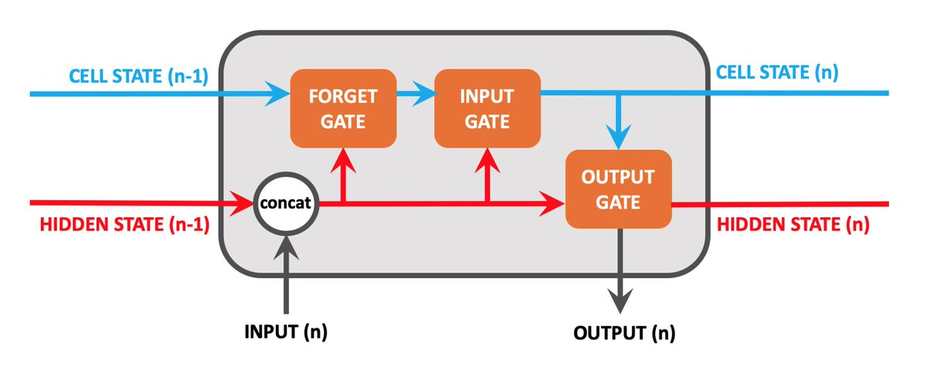
RNN 2.0: Long short-term Memory (LSTM)
Hidden State: holds previous information (Short-term memory)
Cell State: memory of the network (Long-term memory)
What should be forget in cell state
How much new data should be taken
How much does memory affect output

Slide 5





Long short-term memory (LSTM)
Add a memory cell that is not subject to matrix multiplication or squishing, thereby avoiding gradient decay
$xt$
$$h_{t−1}$$
$$ht$$
$$c_{t−1}$$
$$ct$$
S. Hochreiter and J. Schmidhuber, Long short-term memory, Neural Computation 9 (8), pp. 1735–1780, 1997

Slide 6
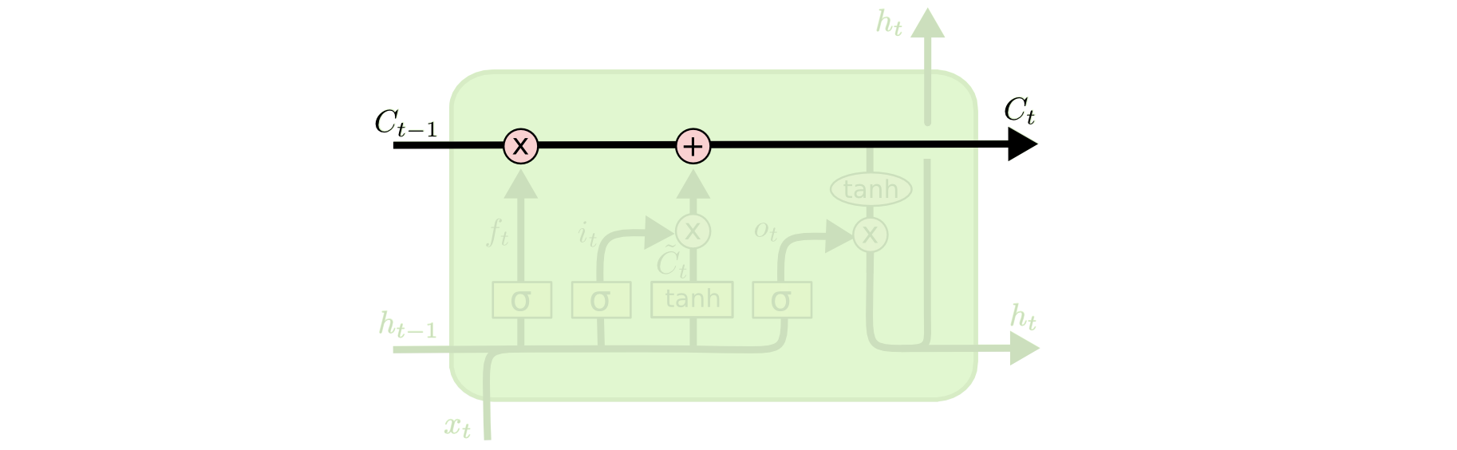
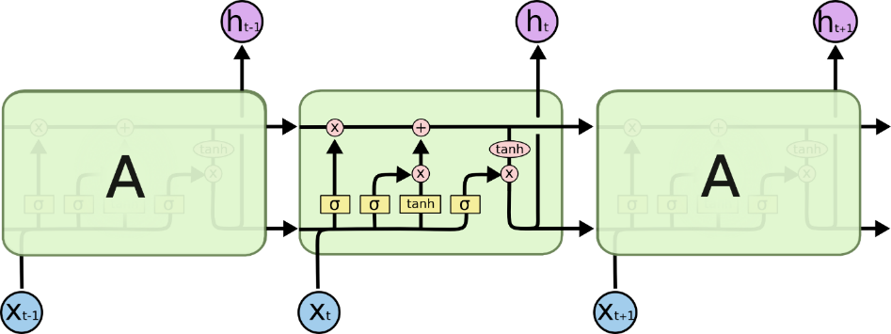

Long Short-Term Memory (LSTM)
The key to LSTMs is the cell state.
  Stores information of the past → long-term memory
  Passes along time steps with minor linear interactions → “additive”
  Results in an uninterrupted gradient flow → errors in the past pertain and impact learning in the future
The LSTM cell manipulates input information with three gates.
  Input gate → controls the intake of new information
  Forget gate → determines what part of the cell state to be updated
  Output gate → determines what part of the cell state to output
Cell State $C_{t}$
Gradient Flow

Slide 7





The LSTM cell
$$x_{t}$$
$$Wg$$
$$ht$$
$$g_{t}=tanh⁡W_{g}\left(\begin{matrix}x_{t} \\ h_{t−1}\end{matrix}\right)$$
$$h_{t−1}$$
Notes:
* Dashed line indicates time-lag

Slide 8



The LSTM cell
$$x_{t}$$
$$Wg$$
Cell
$$ct$$
$$ht$$
$$h_{t}=tanh⁡c_{t}$$
$$g_{t}=tanh⁡W_{g}\left(\begin{matrix}x_{t} \\ h_{t−1}\end{matrix}\right)$$
$$h_{t−1}$$
$$c_{t}=c_{t−1}+g_{t}$$
Notes:
* Dashed line indicates time-lag

Slide 9
The LSTM cell
$$x_{t}$$
$$Wg$$
Cell
$$ct$$
$$ht$$
$$g_{t}=tanh⁡W_{g}\left(\begin{matrix}x_{t} \\ h_{t−1}\end{matrix}\right)$$
$$h_{t−1}$$

Slide 10






The LSTM cell
$xt$ $h_{t−1}$
$$it$$
$$Wi$$
Input Gate
$$i_{t}=σ\left(W_{i}\left(\begin{matrix}x_{t} \\ h_{t−1}\end{matrix}\right)+b_{i}\right)$$
$$x_{t}$$
$$Wg$$
Cell
.
$$ct$$
$$ht$$
$$g_{t}=tanh⁡W_{g}\left(\begin{matrix}x_{t} \\ h_{t−1}\end{matrix}\right)$$
$$h_{t−1}$$
$$c_{t}=c_{t−1}+i_{t}⨀ g_{t}$$

Slide 11




The LSTM cell
$xt$ $h_{t−1}$
$xt$ $h_{t−1}$
$$it$$
$$Wi$$
o_{t}
$$Wo$$
Input Gate
Output Gate
$$i_{t}=σ\left(W_{i}\left(\begin{matrix}x_{t} \\ h_{t−1}\end{matrix}\right)+b_{i}\right)$$
$$o_{t}=σ\left(W_{o}\left(\begin{matrix}x_{t} \\ h_{t−1}\end{matrix}\right)+b_{o}\right)$$
$$x_{t}$$
$$Wg$$
Cell
.
.
$$ct$$
$$ht$$
$$h_{t}=o_{t}⨀ tanh⁡c_{t}$$
$$g_{t}=tanh⁡W_{g}\left(\begin{matrix}x_{t} \\ h_{t−1}\end{matrix}\right)$$
$$h_{t−1}$$
$$c_{t}=c_{t−1}+i_{t}⨀ g_{t}$$

Slide 12



The LSTM cell
$xt$ $h_{t−1}$
$xt$ $h_{t−1}$
$$it$$
$$Wi$$
o_{t}
$$Wo$$
Input Gate
Output Gate
$$i_{t}=σ\left(W_{i}\left(\begin{matrix}x_{t} \\ h_{t−1}\end{matrix}\right)+b_{i}\right)$$
$$o_{t}=σ\left(W_{o}\left(\begin{matrix}x_{t} \\ h_{t−1}\end{matrix}\right)+b_{o}\right)$$
$$x_{t}$$
$$Wg$$
Cell
.
.
$$ct$$
$$ht$$
$$h_{t}=o_{t}⨀ tanh⁡c_{t}$$
$$g_{t}=tanh⁡W_{g}\left(\begin{matrix}x_{t} \\ h_{t−1}\end{matrix}\right)$$
$$h_{t−1}$$
$$c_{t}={f_{t}⨀c}_{t−1}+i_{t}⨀ g_{t}$$
Forget Gate
f_{t}
$$f_{t}=σ\left(W_{f}\left(\begin{matrix}x_{t} \\ h_{t−1}\end{matrix}\right)+b_{f}\right)$$
$$Wf$$
$xt$ $h_{t−1}$

Slide 13
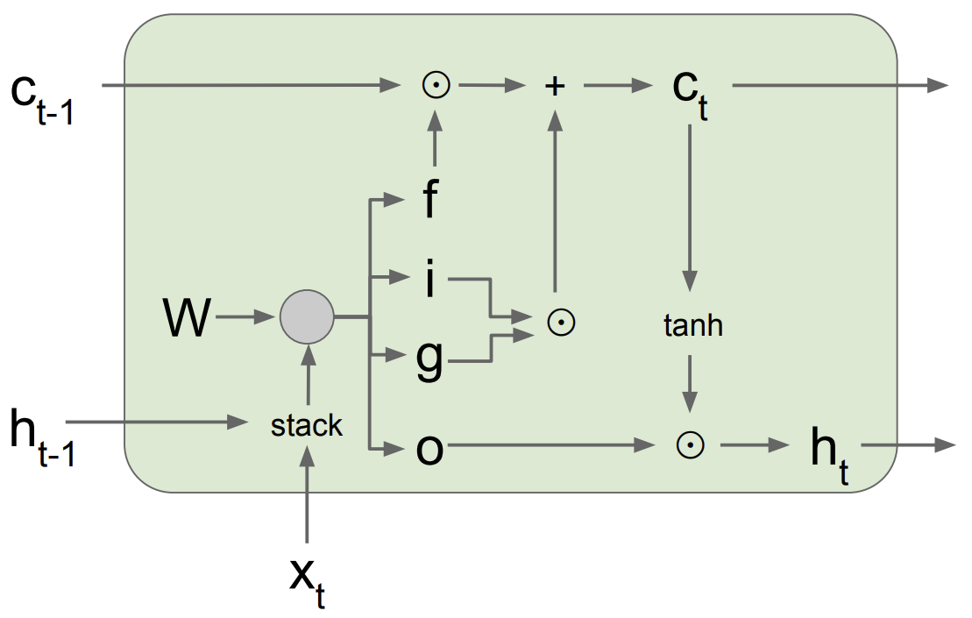
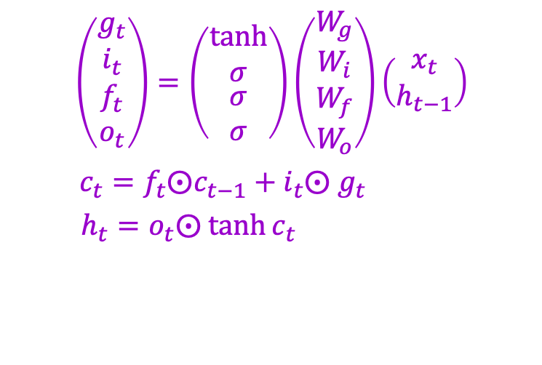
LSTM forward pass summary
$$\left(\begin{matrix}g_{t} \\ i_{t} \\ \begin{aligned}f_{t} \\ o_{t}\end{aligned}\end{matrix}\right)=\left(\begin{matrix}tanh \\ σ \\ \begin{aligned}σ \\ σ\end{aligned}\end{matrix}\right)\left(\begin{matrix}W_{g} \\ W_{i} \\ \begin{aligned}W_{f} \\ W_{o}\end{aligned}\end{matrix}\right)\left(\begin{aligned}x_{t} \\ h_{t−1}\end{aligned}\right)$$
$c_{t}={f_{t}⨀c}_{t−1}+i_{t}⨀ g_{t}$
$h_{t}=o_{t}⨀ tanh⁡c_{t}$
Figure source

Slide 14
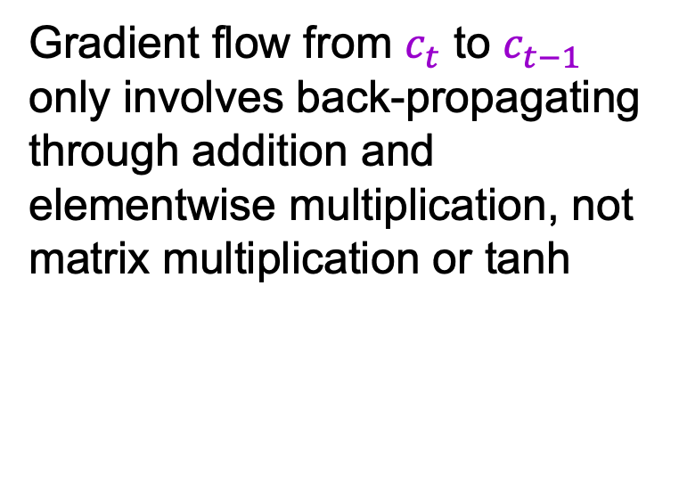
LSTM backward pass
Gradient flow from $c_{t}$ to $c_{t−1}$ only involves back-propagating through addition and elementwise multiplication, not matrix multiplication or tanh
For complete details: Illustrated LSTM Forward and Backward Pass
Figure source

Slide 15
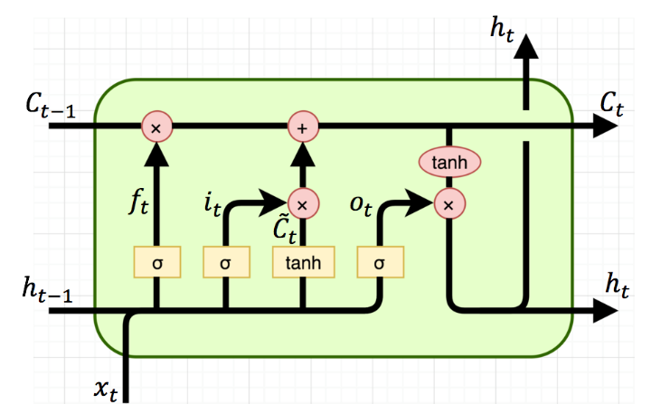

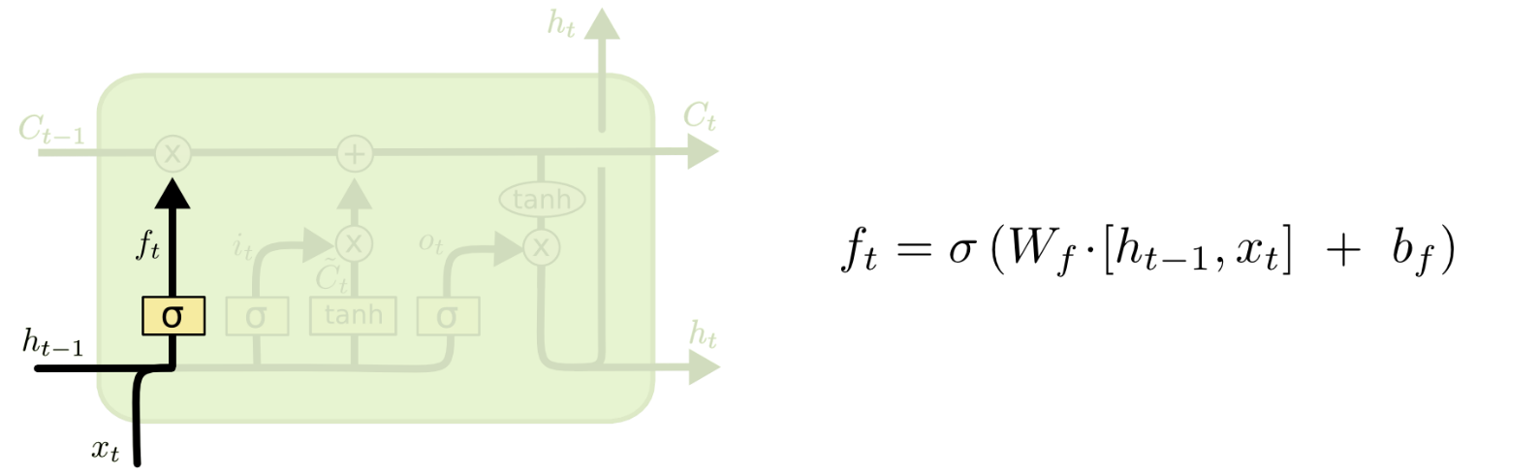

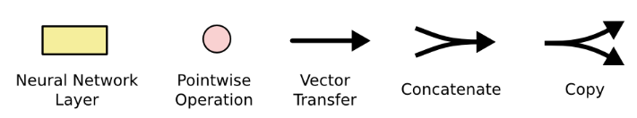
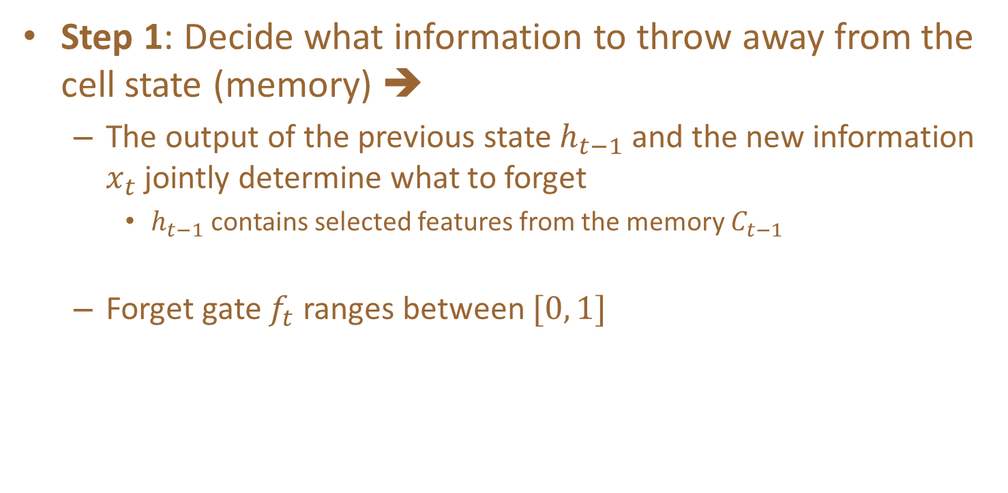
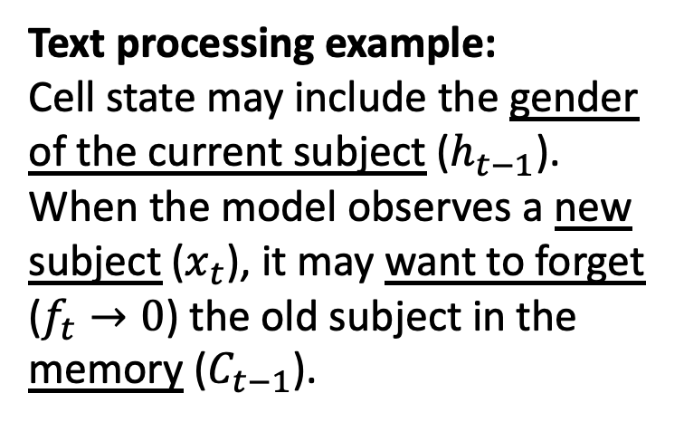
Step-by-step LSTM Walk Through
Step 1: Decide what information to throw away from the cell state (memory) ➔
  The output of the previous state $h_{t−1}$ and the new information $x_{t}$ jointly determine what to forget
    $h_{t−1}$ contains selected features from the memory $C_{t−1}$
  Forget gate $f_{t}$ ranges between $[0, 1]$
Text processing example:
Cell state may include the gender of the current subject ($h_{t−1}$).
When the model observes a new subject ($x_{t}$), it may want to forget ($f_{t}→0$) the old subject in the memory ($C_{t−1}$).
Forget gate

Slide 16

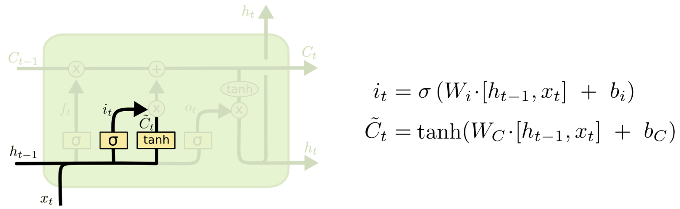
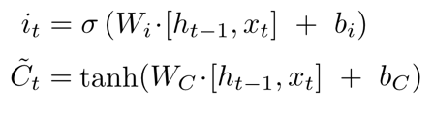

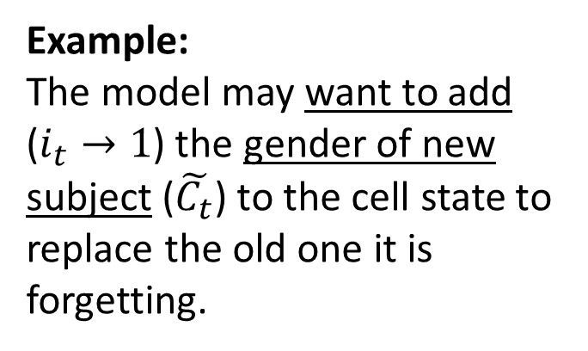
Step-by-step LSTM Walk Through
Step 2: Prepare the updates for the cell state
from input ➔
  An alternative cell state $\tilde{C_{t}}$ is created from the new information $x_{t}$ with the guidance of $h_{t−1}$.
  Input gate $i_{t}$ ranges between $[0, 1]$
Example:
The model may want to add ($i_{t}→1$) the gender of new subject ($\tilde{C_{t}}$) to the cell state to replace the old one it is forgetting.
Input gate
Alternative cell state

Slide 17

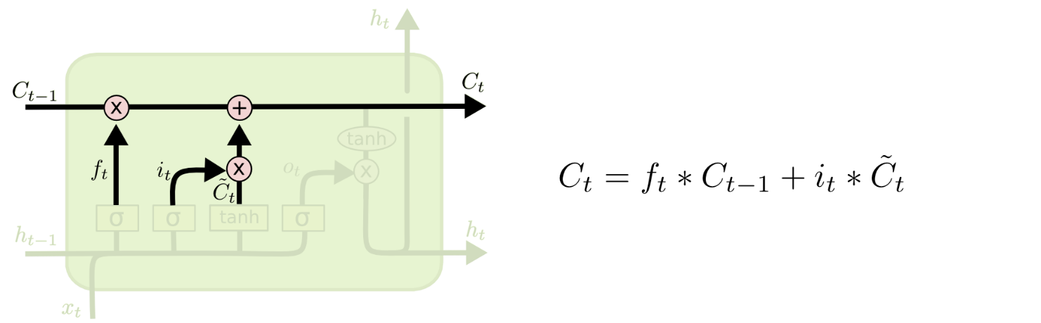


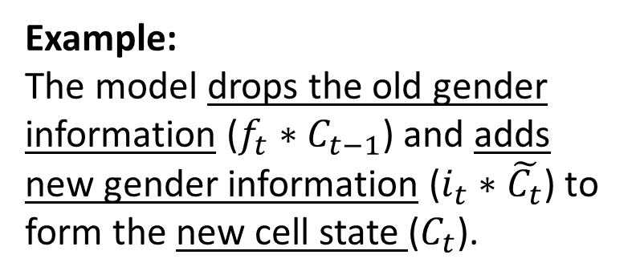
Step-by-step LSTM Walk Through
Step 3: Update the cell state ➔
  The new cell state $C_{t}$ is comprised of information from the past $f_{t}∗C_{t−1}$ and valuable new information $i_{t}∗$ $\tilde{C_{t}}$
  $∗$ denotes elementwise multiplication
New cell state
Example:
The model drops the old gender information ($f_{t}∗C_{t−1}$) and adds new gender information ($i_{t}∗\tilde{C_{t}}$) to form the new cell state ($C_{t}$).

Slide 18

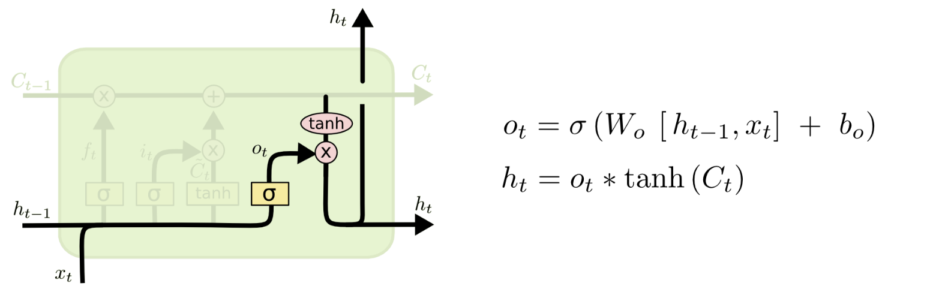

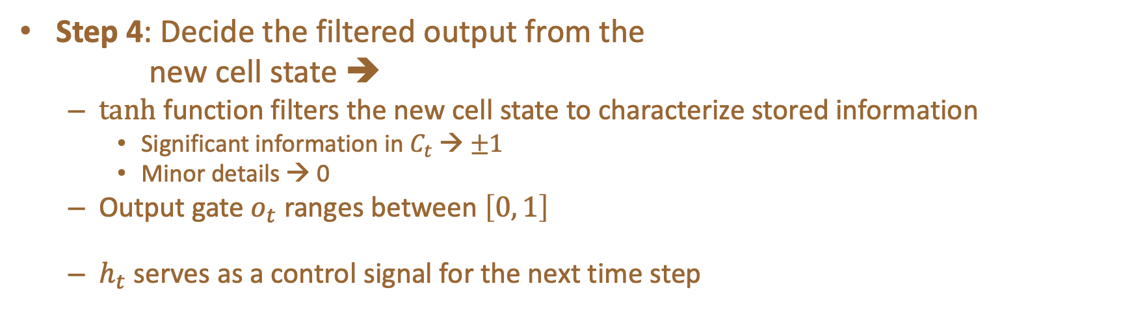
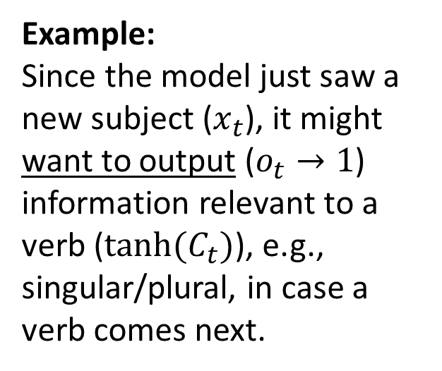
Step-by-step LSTM Walk Through
Step 4: Decide the filtered output from the
new cell state ➔
  tanh function filters the new cell state to characterize stored information
    Significant information in $C_{t}$ → $±1$
    Minor details → 0
  Output gate $o_{t}$ ranges between $\left[0, 1\right]$
  $h_{t}$ serves as a control signal for the next time step
Example:
Since the model just saw a new subject ($x_{t}$), it might want to output ($o_{t}→1$) information relevant to a verb ($tanh⁡(C_{t})$), e.g., singular/plural, in case a verb comes next.
Output gate

Slide 19
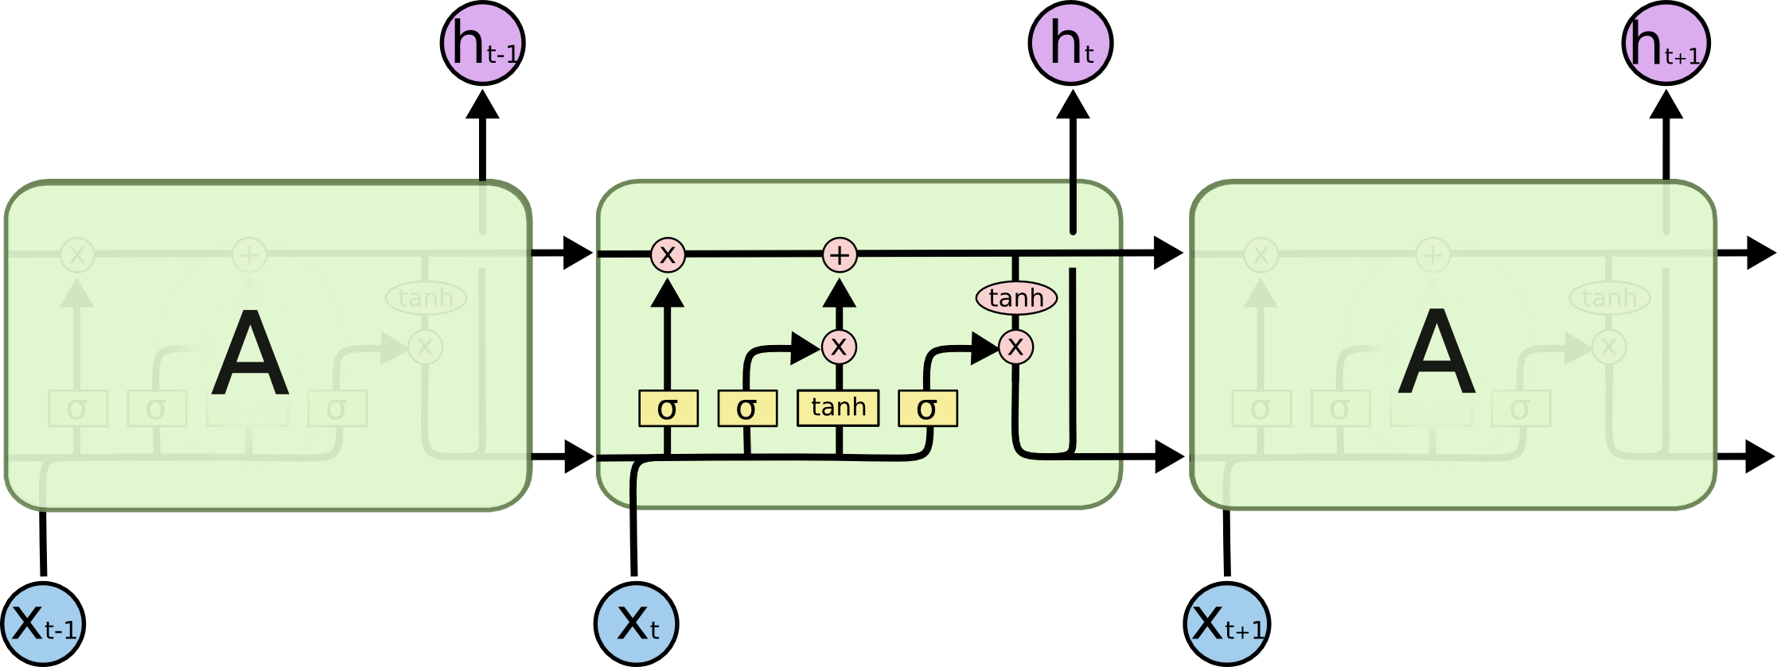

LSTM Network Architecture

Slide 20
Cell State
Maintains a vector C_{t} that is the same dimensionality as the hidden state, h_{t}
Information can be added or deleted from this state vector via the forget and input gates.

Slide 21
Cell State Example
Want to remember person & number of a subject noun so that it can be checked to agree with the person & number of verb when it is eventually encountered.
Forget gate will remove existing information of a prior subject when a new one is encountered.
Input gate "adds" in the information for the new subject.

Slide 22
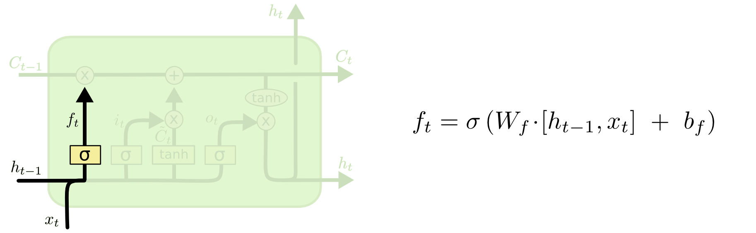
Forget Gate
Forget gate computes a 0-1 value using a logistic sigmoid output function from the input, x_{t}, and the current hidden state, h_{t}:
Multiplicatively combined with cell state, "forgetting" information where the gate outputs something close to 0.

Slide 23
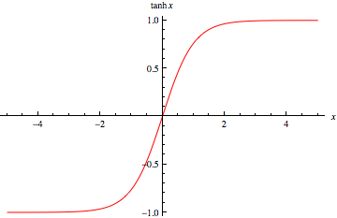
Hyperbolic Tangent Units
Tanh can be used as an alternative nonlinear function to the sigmoid logistic (0-1) output function.
Used to produce thresholded output between –1 and 1.

Slide 24
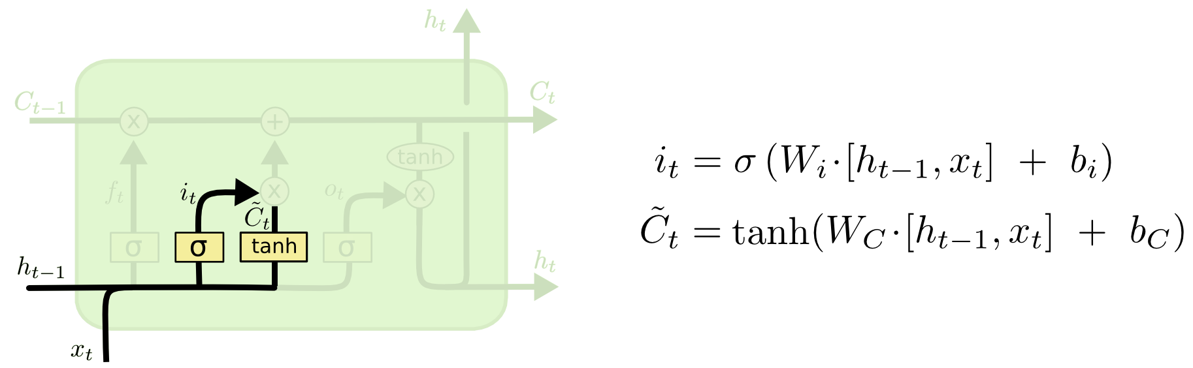
Input Gate
First, determine which entries in the cell state to update by computing 0-1 sigmoid output.
Then determine what amount to add/subtract from these entries by computing a tanh output (valued –1 to 1) function of the input and hidden state.

Slide 25
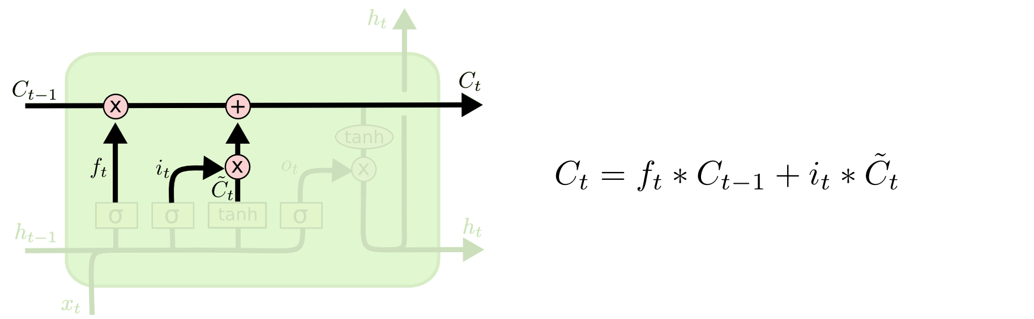
Updating the Cell State
Cell state is updated by using component-wise vector multiply to "forget" and vector addition to "input" new information.

Slide 26
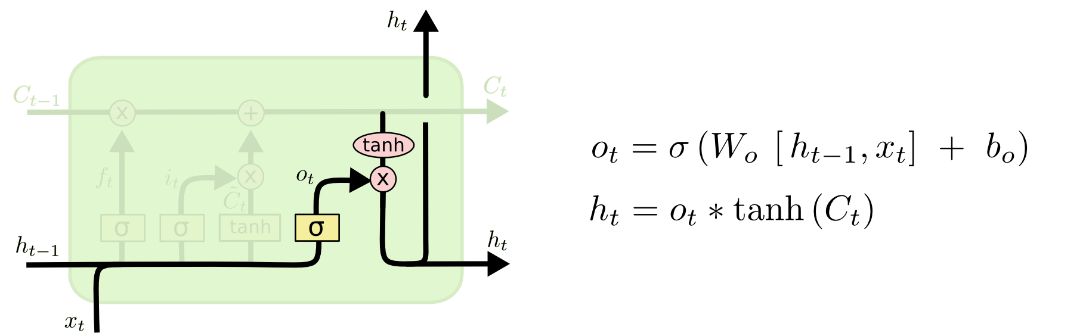
Output Gate
Hidden state is updated based on a "filtered" version of the cell state, scaled to –1 to 1 using tanh.
Output gate computes a sigmoid function of the input and current hidden state to determine which elements of the cell state to "output".

Slide 27

Overall Network Architecture
Single or multilayer networks can compute LSTM inputs from problem inputs and problem outputs from LSTM outputs.
O_{t}
e.g. a POS tag as a “one hot” vector
e.g. a word “embedding” with
reduced dimensionality
I_{t}
e.g. a word as a “one hot” vector

Slide 28
LSTM Training
Trainable with backprop derivatives such as:
  Stochastic gradient descent (randomize order of examples in each epoch) with momentum (bias weight changes to continue in same direction as last update).
  ADAM optimizer (Kingma & Ma, 2015)
Each cell has many parameters (W_{f}, W_{i}, W_{C}, W_{o})
  Generally requires lots of training data.
  Requires lots of compute time that exploits GPU clusters.

Slide 29
General Problems Solved with LSTMs
Sequence labeling
  Train with supervised output at each time step computed using a single or multilayer network that maps the hidden state (h_{t}) to an output vector (O_{t}).
Language modeling
  Train to predict next input (O_{t} =I_{t+1})
Sequence (e.g. text) classification
  Train a single or multilayer network that maps the final hidden state (h_{n}) to an output vector (O).

Slide 30
Sequence to Sequence Transduction (Mapping)
Encoder/Decoder framework maps one sequence to a "deep vector" then another LSTM maps this vector to an output sequence.
Encoder
LSTM
Decoder
LSTM
I₁, I₂,…,I_{n}
h_{n}
O₁, O₂,…,O_{m}
Train model "end to end" on I/O pairs of sequences.

Slide 31
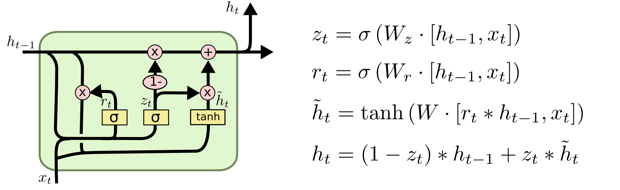
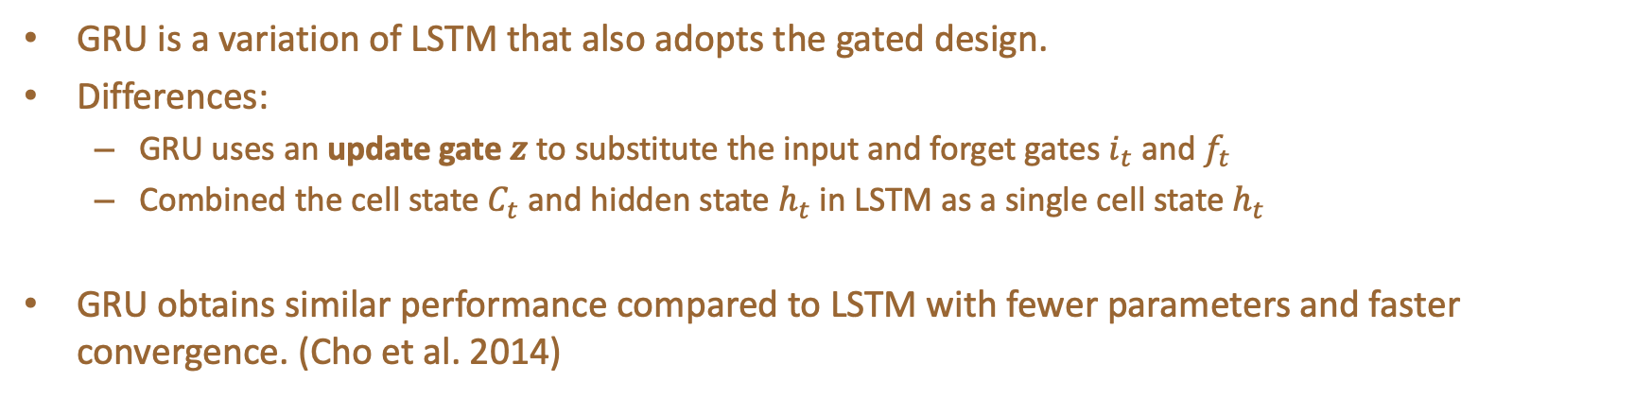
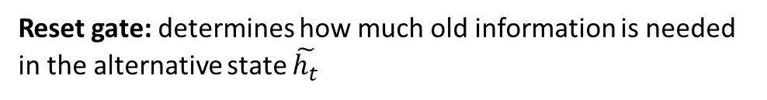
Gated Recurrent Unit (GRU)
GRU is a variation of LSTM that also adopts the gated design.
Differences:
  GRU uses an update gate $z$ to substitute the input and forget gates $i_{t}$ and $f_{t}$
  Combined the cell state $C_{t}$ and hidden state $h_{t}$ in LSTM as a single cell state $h_{t}$
GRU obtains similar performance compared to LSTM with fewer parameters and faster convergence. (Cho et al. 2014)
Update gate: controls the composition of the new state
Reset gate: determines how much old information is needed in the alternative state $\tilde{h_{t}}$
Alternative state: contains new information
New state: replace selected old information with new information in the new state

Slide 32
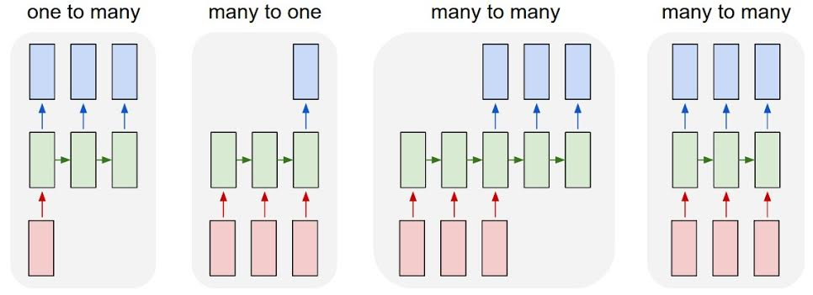
Summary of
LSTM Application Architectures
Image Captioning
Video Activity Recog
Text Classification
Video Captioning
Machine Translation
POS Tagging
Language Modeling

Slide 33
Sequence Learning Architectures
Learning on RNN is more robust when the vanishing/exploding gradient problem is resolved.
  RNNs can now be applied to different Sequence Learning tasks.
Recurrent NN architecture is flexible to operate over various sequences of vectors.
  Sequence in the input, the output, or in the most general case both
  Architecture with one or more RNN layers

Slide 34
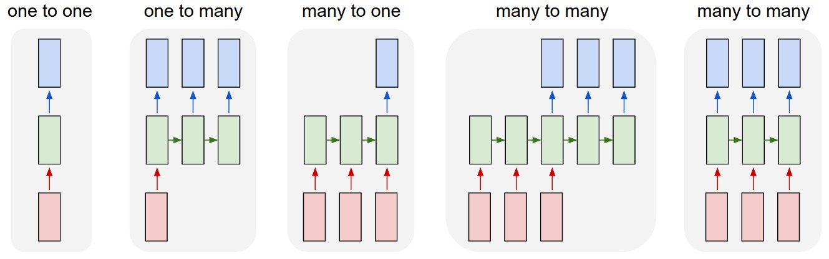
Sequence Learning with One RNN Layer
Each rectangle is a vector and arrows represent functions (e.g. matrix multiply).
Input vectors are in red, output vectors are in blue and green vectors hold the RNN's state
1
2
3
4
5
(1) Standard NN mode without recurrent structure (e.g. image classification, one label for one image).
(2) Sequence output (e.g. image captioning, takes an image and outputs a sentence of words).
(3) Sequence input (e.g. sentiment analysis, a sentence is classified as expressing positive or negative sentiment).
(4) Sequence input and sequence output (e.g. machine translation, a sentence in English is translated into a sentence in French).
(5) Synced sequence input and output (e.g. video classification, label each frame of the video).

Slide 35
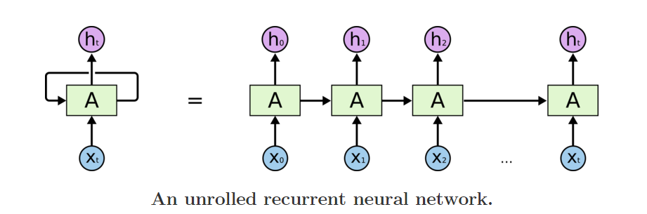
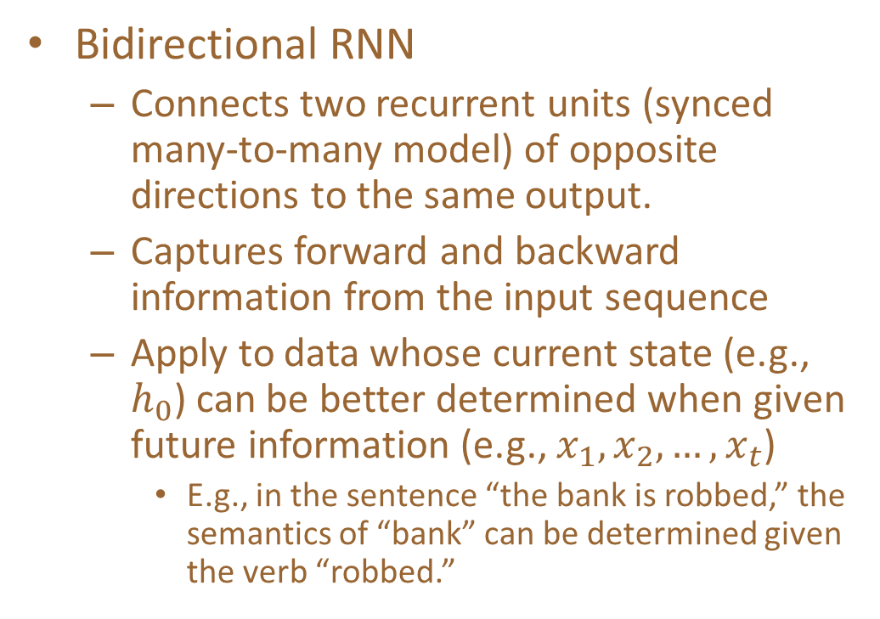
Sequence Learning with Multiple RNN Layers
Bidirectional RNN
  Connects two recurrent units (synced many-to-many model) of opposite directions to the same output.
  Captures forward and backward information from the input sequence
  Apply to data whose current state (e.g., $h_{0}$) can be better determined when given future information (e.g., $x_{1}, x_{2},…, x_{t}$)
    E.g., in the sentence “the bank is robbed,” the semantics of “bank” can be determined given the verb “robbed.”
B
B
B
B

Slide 36
Sequence Learning with Multiple RNN Layers
Sequence-to-Sequence (Seq2Seq) model
  Developed by Google in 2018 for use in machine translation.
  Seq2seq turns one sequence into another sequence. It does so by use of a recurrent neural network (RNN) or more often LSTM or GRU to avoid the problem of vanishing gradient.
  The primary components are one Encoder and one Decoder network. The encoder turns each item into a corresponding hidden vector containing the item and its context. The decoder reverses the process, turning the vector into an output item, using the previous output as the input context.
  Encoder RNN: extract and compress the
  semantics from the input sequence
  Decoder RNN: generate a sequence based
  on the input semantics
  Apply to tasks such as machine
  translation
    Similar underlying semantics
    E.g., “I love you.” to “Je t’aime.”
Decoded sequence
y₀
y₁
y₂
…
y_{m}
Encoded semantics
B
B
B
B
An RNN as the encoder
An RNN as the decoder
Input sequence

Slide 37
Sequential prediction example 1: Sentiment classification
Goal: classify a text sequence (e.g., restaurant, movie or product review, Tweet) as having positive or negative sentiment
  “The food was really good”
  “The vacuum cleaner broke within two weeks”
  “The movie had slow parts, but overall was worth watching”
Notes:
What makes this problem challenging?
What feature representation or predictor structure can we use for this problem?

Slide 38


Sequential prediction example 1: Sentiment classification
Recurrent model:
Classifier
Hidden state
“Memory”
“Context”
h₅
h₁
h₂
h₃
h₄
“The”
“food”
“was”
“really”
“good”

Slide 39


Sequential prediction example 2: Text generation
Sample from the distribution of a given text corpus
(also known as language modeling)

Slide 40
Sequential prediction example 2: Text generation
Sample from the distribution of a given text corpus –
also known as language modeling
Can be done one character or one word at a time:
“Thus”
“saith”
“the”
“Lord”
“of”
Classifier
Classifier
Classifier
Classifier
Classifier
h₁
h₂
h₃
h₄
h₅
h₁
h₂
h₃
h₄
h₅
“START”
“Thus”
“saith”
“the”
“Lord”
Image source

Slide 41


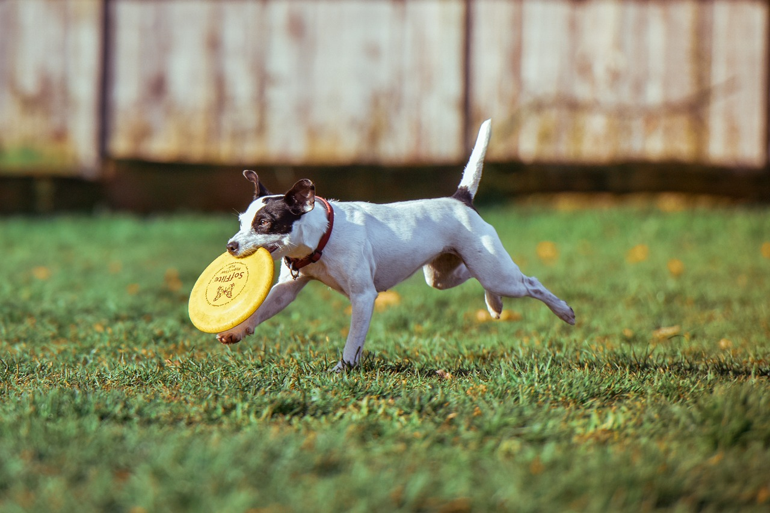


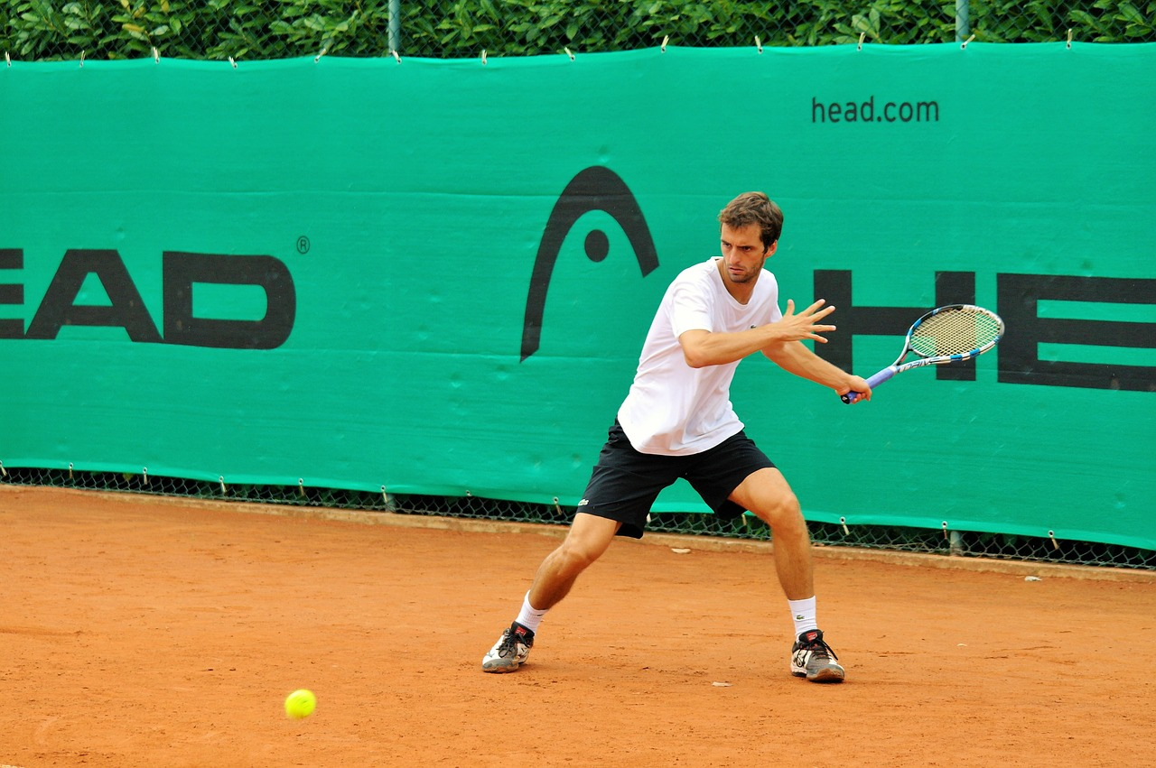
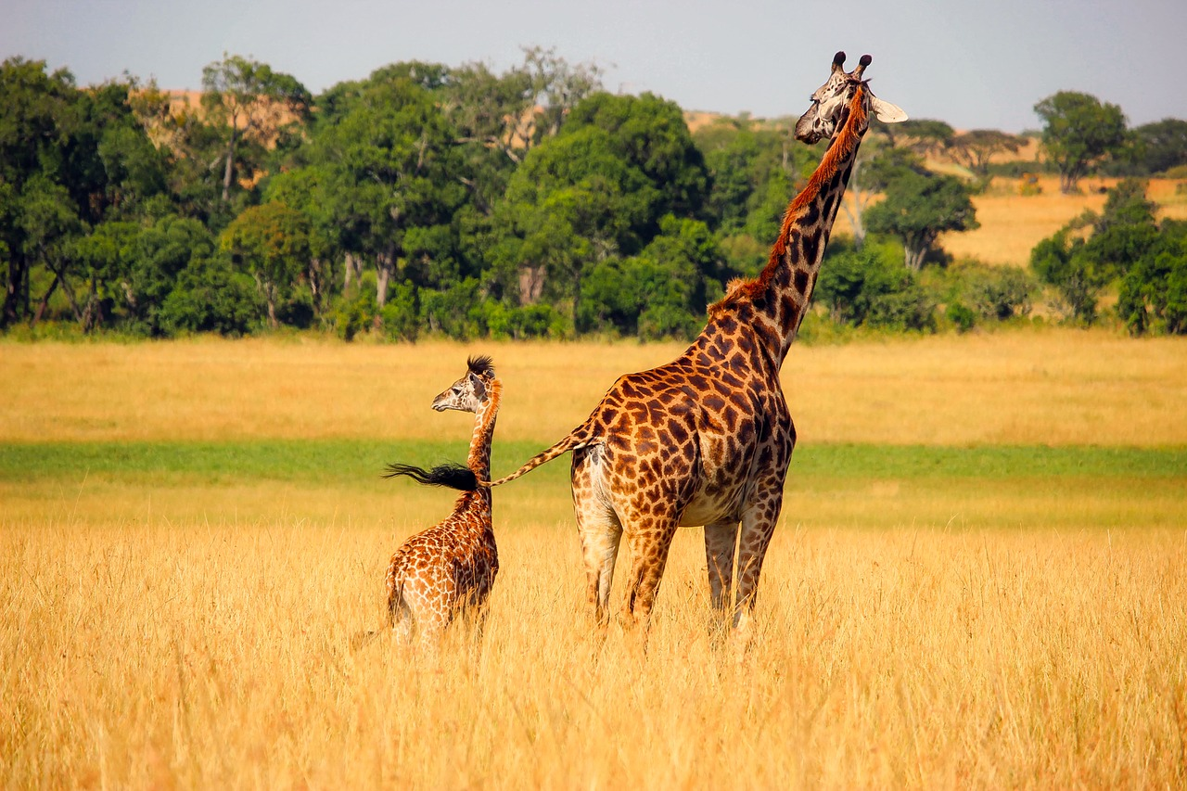
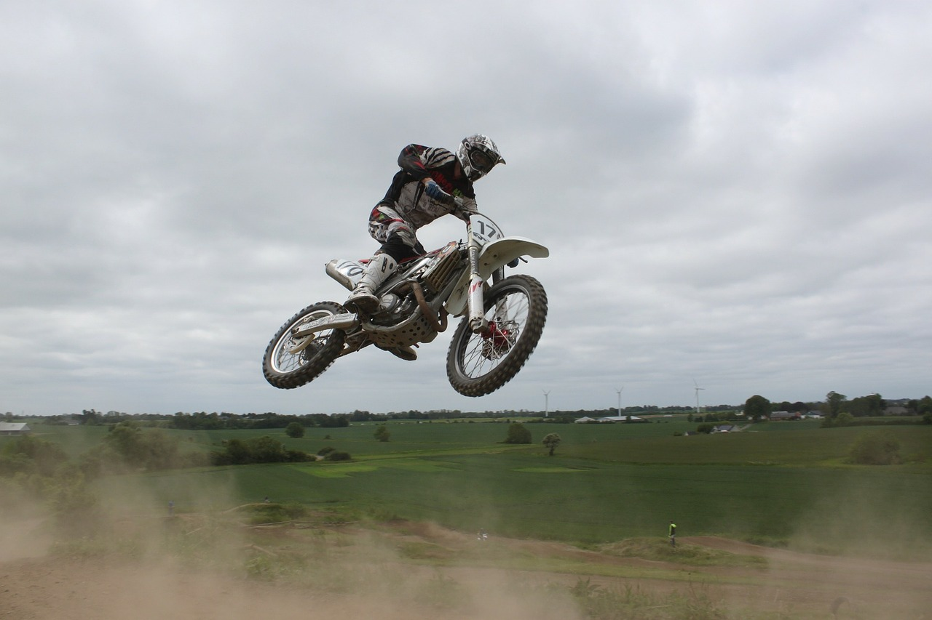
Sequential prediction example 3: Image captioning
A cat sitting on a suitcase on the floor
A cat is sitting on a tree branch
A dog is running in the grass with a frisbee
A white teddy bear sitting in the grass
Two people walking on the beach with surfboards
A tennis player in action on the court
Two giraffes standing in a grassy field
A man riding a dirt bike on a dirt track
Source: J. Johnson
Captions generated using neuraltalk2

Slide 42
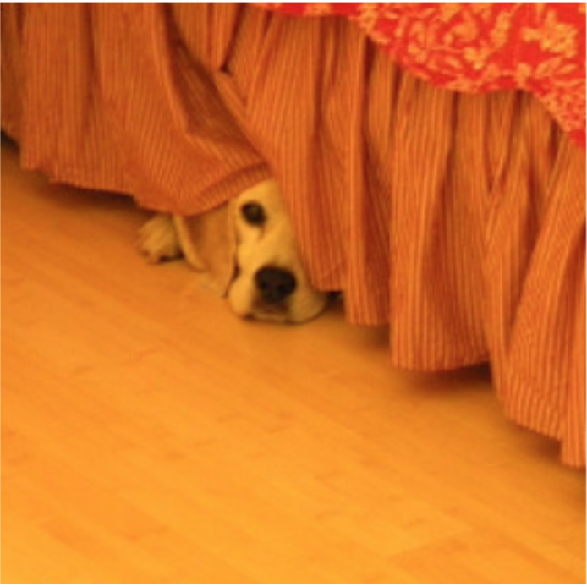
Sequential prediction example 3: Image captioning
“The”
“dog”
“is”
“hiding”
“STOP”
Classifier
Classifier
Classifier
Classifier
Classifier
h₁
h₂
h₃
h₄
h₅
CNN
h₀
h₁
h₂
h₃
h₄
“START”
“The”
“dog”
“is”
“hiding”

Slide 43
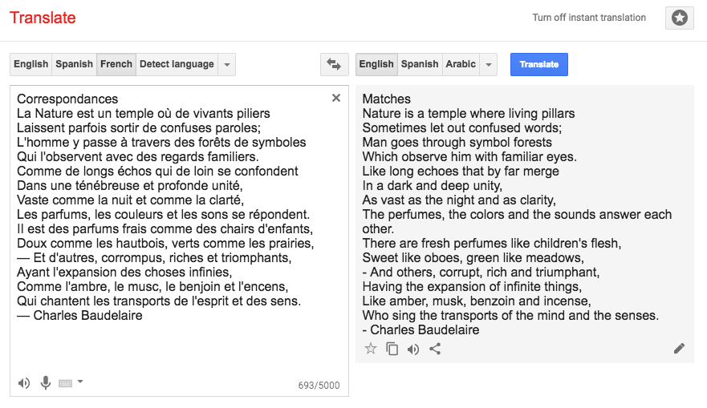
Example 4: Machine translation
https://translate.google.com/

Slide 44
Example 4: Machine translation
Multiple input – multiple output (or sequence to sequence) scenario:
“Matches”
“Nature”
“is”
“Correspondances”
“La”
“nature”

Slide 45
Summary: Input-output scenarios
Single - Single
Feedforward Network
Multiple - Single
Sequence Classification
Single - Multiple
Sequence generation, captioning
Multiple - Multiple
Sequence generation, captioning
Multiple - Multiple
Translation

Slide 46
Recall: Input-output scenarios
Multiple - Single
Sequence Classification
Single - Multiple
Sequence generation, captioning
Multiple - Multiple
Sequence generation, captioning
Multiple - Multiple
Translation

Slide 47
RNN architectures
Most general configuration:
y₁
y₂
y₃
y₄
y₅
y₆
x₁
x₂
x₃
x₄
x₅
x₆

Slide 48
Multi-layer RNNs
We can of course design RNNs with multiple hidden layers
y₁
y₂
y₃
y₄
y₅
y₆
x₁
x₂
x₃
x₄
x₅
x₆
Anything goes: skip connections across layers, across time, …

Slide 49
Multi-layer RNNs
We can of course design RNNs with multiple hidden layers
y₁
y₂
y₃
y₄
y₅
y₆
x₁
x₂
x₃
x₄
x₅
x₆
Anything goes: skip connections across layers, across time, …

Slide 50
Multi-layer RNNs
We can of course design RNNs with multiple hidden layers
y₁
y₂
y₃
y₄
y₅
y₆
x₁
x₂
x₃
x₄
x₅
x₆
Anything goes: skip connections across layers, across time, …

Slide 51
Bi-directional RNNs
RNNs can process the input sequence in forward and in the reverse direction (common in speech recognition)
y₁
y₂
y₃
y₄
y₅
y₆
x₁
x₂
x₃
x₄
x₅
x₆

Slide 52
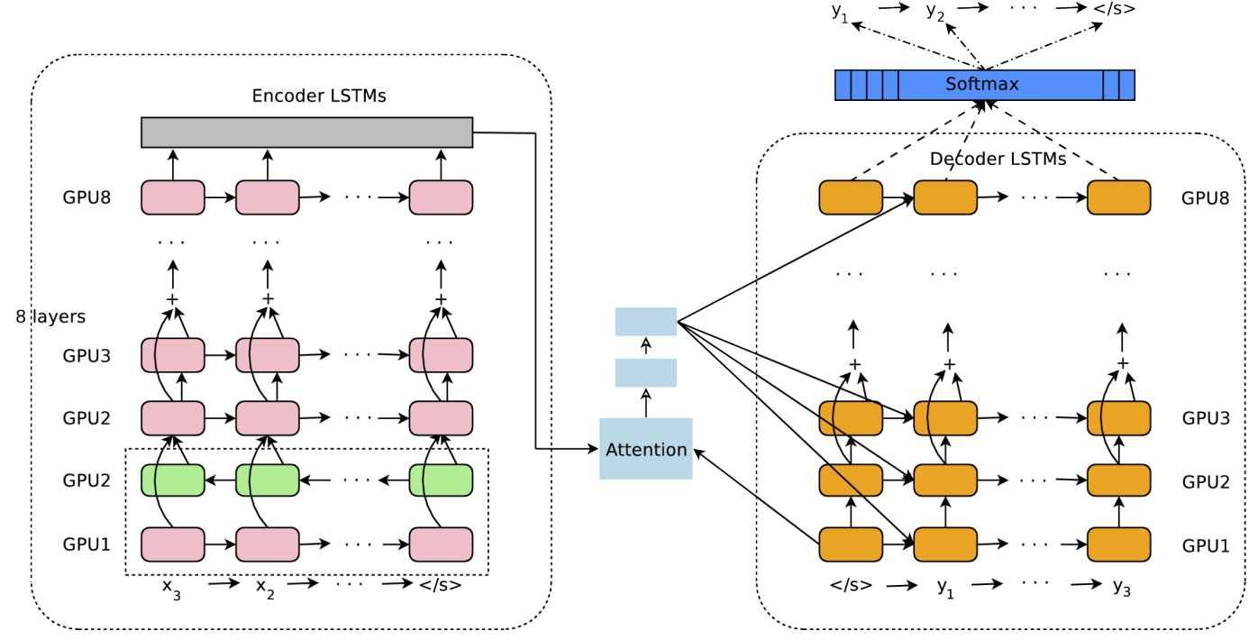
Google Neural Machine Translation (GNMT)
Y. Wu et al., Google's Neural Machine Translation System: Bridging the Gap between Human and Machine Translation, arXiv 2016
Notes:
The model architecture of GNMT, Google’s Neural Machine Translation system. On the left is the encoder network, on the right is the decoder network, in the middle is the attention module. The bottom encoder layer is bi-directional: the pink nodes gather information from left to right while the green nodes gather information from right to left. The other layers of the encoder are uni-directional. Residual connections start from the layer third from the bottom in the encoder and decoder. The model is partitioned into multiple GPUs to speed up training. In our setup, we have 8 encoder LSTM layers (1 bi-directional layer and 7 uni-directional layers), and 8 decoder layers. With this setting, one model replica is partitioned 8-ways and is placed on 8 different GPUs typically belonging to one host machine. During training, the bottom bi-directional encoder layers compute in parallel first. Once both finish, the uni-directional encoder layers can start computing, each on a separate GPU. To retain as much parallelism as possible during running the decoder layers, we use the bottom decoder layer output only for obtaining recurrent attention context, which is sent directly to all the remaining decoder layers. The softmax layer is also partitioned and placed on multiple GPUs. Depending on the output vocabulary size we either have them run on the same GPUs as the encoder and decoder networks, or have them run on a separate set of dedicated GPUs.

Slide 53
Successful Applications of LSTMs
Speech recognition: Language and acoustic modeling
Sequence labeling
  POS Tagging https://www.aclweb.org/aclwiki/index.php?title=POS_Tagging_(State_of_the_art)
  NER
  Phrase Chunking
Neural syntactic and semantic parsing
Image captioning: CNN output vector to sequence
Sequence to Sequence
  Machine Translation (Sustkever, Vinyals, & Le, 2014)
  Video Captioning (input sequence of CNN frame outputs)

Slide 54
Important References
Bengio, Y., Simard, P., & Frasconi, P. (1994). Learning long-term dependencies with gradient descent is difficult. IEEE transactions on neural networks, 5(2), 157-166.
Goodfellow, I., Bengio, Y., Courville, A., & Bengio, Y. (2016). Deep learning (Vol. 1). Cambridge: MIT press.
Graves, A. (2012). Supervised sequence labelling with recurrent neural networks. https://www.cs.toronto.edu/~graves/preprint.pdf
Jozefowicz, R., Zaremba, W., & Sutskever, I. (2015, June). An empirical exploration of recurrent network architectures. In International Conference on Machine Learning (pp. 2342-2350).
Lipton, Z. C., Berkowitz, J., & Elkan, C. (2015). A critical review of recurrent neural networks for sequence learning. arXiv preprint arXiv:1506.00019.
Salehinejad, H., Baarbe, J., Sankar, S., Barfett, J., Colak, E., & Valaee, S. (2017). Recent Advances in Recurrent Neural Networks. arXiv preprint arXiv:1801.01078.

Slide 55
Attention
For many applications, it helps to add “attention” to RNNs.
Allows network to learn to attend to different parts of the input at different time steps, shifting its attention to focus on different aspects during its processing.
Used in image captioning to focus on different parts of an image when generating different parts of the output sentence.
In MT, allows focusing attention on different parts of the source sentence when generating different parts of the translation.

Slide 56
Three Ways of Processing Sequences
Recurrent Neural Network
y₁
y₂
y₃
y₄
x₁
x₂
x₃
x₄
Works on Ordered Sequences (+) Good at long sequences: After
one RNN layer, h_{T} ”sees” the whole sequence
(-) Not parallelizable: need to
compute hidden states sequentially

Slide 57
Three Ways of Processing Sequences
Recurrent Neural Network 1D Convolution
y₁
y₂
y₃
y₄
y₁
y₂
y₃
y₄
x₁
x₂
x₃
x₄
x₁
x₂
x₃
x₄
Works on Ordered Sequences (+) Good at long sequences: After
one RNN layer, h_{T} ”sees” the whole sequence
(-) Not parallelizable: need to
compute hidden states sequentially
Works on Multidimensional Grids (-) Bad at long sequences: Need to stack many conv layers for outputs to “see” the whole sequence
(+) Highly parallel: Each output can
be computed in parallel

Slide 58
Three Ways of Processing Sequences
Recurrent Neural Network 1D Convolution
Self-Attention
y₁
y₂
y₃
y₄
y₁
y₂
y₃
y₄
Y₁ Y₂ Y₃
Product(→), Sum(↑)
V₃
^{A}1,3 ^{A}2,3 ^{A}3,3
^{A}1,2 ^{A}2,2 ^{A}3,2
^{A}1,1 ^{A}2,1 ^{A}3,1
Softmax(↑)
^{E}1,3 ^{E}2,3 ^{E}3,3
^{E}1,2 ^{E}2,2 ^{E}3,2
^{E}1,1 ^{E}2,1 ^{E}3,1
Q₁ Q₂ Q₃
X₁ X₂ X₃
V₂
V₁
K₃
K₂
x₁
x₂
x₃
x₄
x₁
x₂
x₃
x₄
K₁
Works on Ordered Sequences (+) Good at long sequences: After
one RNN layer, h_{T} ”sees” the whole sequence
(-) Not parallelizable: need to
compute hidden states sequentially
Works on Multidimensional Grids (-) Bad at long sequences: Need to stack many conv layers for outputs to “see” the whole sequence
(+) Highly parallel: Each output can
be computed in parallel
Works on Sets of Vectors
(-) Good at long sequences: after one
self-attention layer, each output “sees” all inputs!
(+) Highly parallel: Each output can
be computed in parallel (-) Very memory intensive

Slide 59
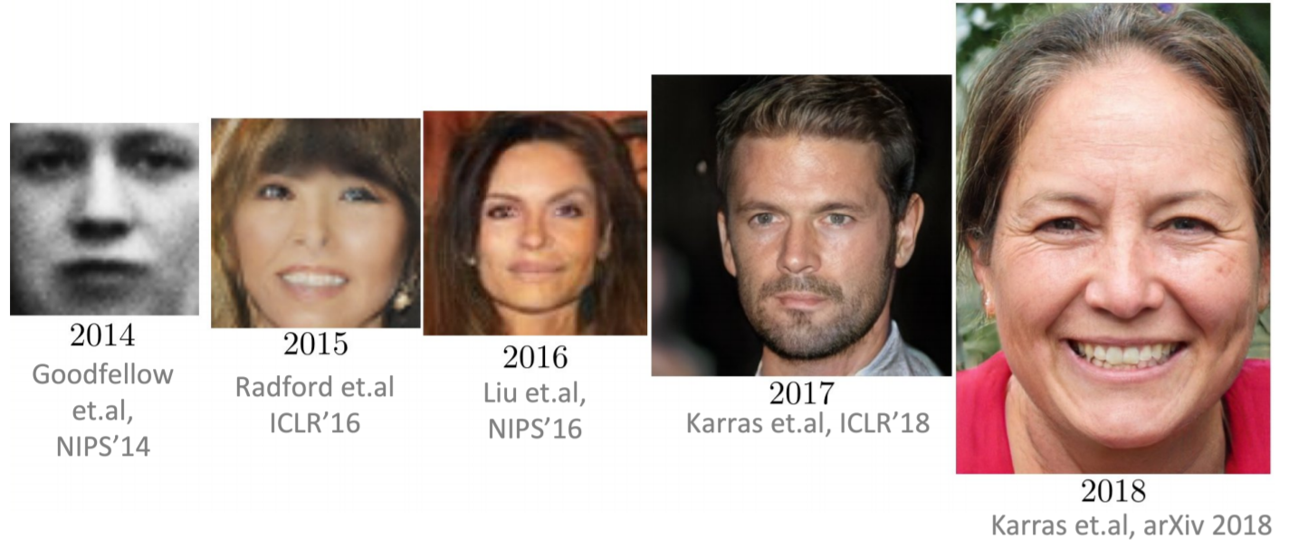
Autoencoder Networks: Example

Slide 60

Image caption generation using attention
A vector for each region
z⁰ is initial parameter, it is also learned
match
z⁰
0.7
CNN
filter
filter
filter
filter
filter
filter
filter
filter
filter
filter
filter
filter

Slide 61
Image caption generation using attention
Word 1
A vector for each region
z⁰
z¹
Attention to
a region
weighted sum
CNN
filter
filter
filter
filter
filter
filter
0.7
0.1
0.1
0.1
0.0
0.0
filter
filter
filter
filter
filter
filter

Slide 62
Image caption generation using attention
Word 1
Word 2
A vector for each region
z²
z⁰
z¹
weighted sum
CNN
filter
filter
filter
filter
filter
filter
0.0
0.8
0.2
0.0
0.0
0.0
filter
filter
filter
filter
filter
filter

Slide 63
Image Attention
Image caption generation using attention
Kelvin Xu, Jimmy Ba, Ryan Kiros, Kyunghyun Cho, Aaron Courville, Ruslan Salakhutdinov, Richard Zemel, Yoshua Bengio,
“Show, Attend and Tell: Neural Image Caption Generation with Visual Attention”, ICML, 2015

Slide 65
Let’s use attention on top of a seq2seq translation model that uses a biLSTM encoder and an LSTM decoder.

Slide 66
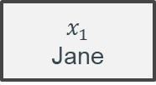
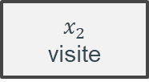
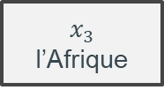
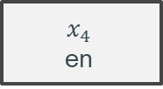
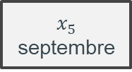
Let’s translate from French to English.

Slide 67









First, we compute the forward-facing hidden states of the biLSTM.

Slide 68










Next, we compute the backward-facing hidden states of the biLSTM.

Slide 69















We then concatenate our hidden states.

Slide 70



















Now visualize the decoder.

Slide 71







We want a context vector inputted to D at each timestep.

Slide 72
How do we encode the relevant information from n hidden states onto a fixed-length context vector?
For variable n.
For a specific timestep i.

Slide 73

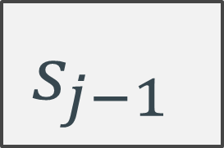

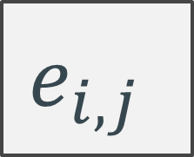
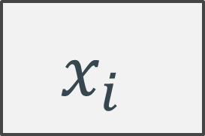

Slide 74












Slide 75



…and softmax.
Softmax

Slide 76
This the attention module!
Attention

Slide 77








The attention module gives us a weight for each input.
Attention for output timestep 1
Notes:
Fix timestep 1

Slide 78

The context vector is a weighted sum of the hidden encodings.
Attention for output timestep 1
Notes:
Fix timestep 1

Slide 79
The context vector is a weighted sum of the hidden encodings.
Attention for output timestep 1
Notes:
Fix timestep 1

Slide 80





We then repeat for future timesteps.
Attention for output timestep 1
Notes:
Fix timestep 1

Slide 81

We then repeat for future timesteps.
Attention for output timestep 1
Notes:
Fix timestep 1

Slide 82
Done!

Slide 83


This kind of architecture performs well (SOTA circa 2016).
Notes:
https://arxiv.org/pdf/1508.04025.pdf

Slide 84
What’s wrong with attentioned seq2seq models?
The (optional) encoder is still an RNN.
  And you won’t get very far without one.
The (non-negotiable) decoder is still an RNN.
Notes:
We wanted to parallelize to reduce computation! But attention only increases computation as of right now.

Slide 85
Transformers
Slides adopted from Lucas Beyer lbeyer@google.com

Slide 86
The classic landscape:
One architecture per "community"

Slide 87




Computer Vision
Convolutional NNs (+ResNets)
Natural Lang. Proc.
Recurrent NNs (+LSTMs)
[2]
h e l l o
[1]
Speech
Deep Belief Nets (+non-DL)
Translation
Seq2Seq
RL
BC/GAIL
s a l u t </s>
RBM
DBN
RBM
🔒
DBN
GRBM
🔒
DBN
h e l l o </s> s a l u t
[1] CNN image CC-BY-SA by Aphex34 for Wikipedia https://commons.wikimedia.org/wiki/File:Typical_cnn.png
[2] RNN image CC-BY-SA by GChe for Wikipedia https://commons.wikimedia.org/wiki/File:The_LSTM_Cell.svg

Slide 88
The Transformer's takeover:
One community at a time

Slide 89

Computer Vision
Natural Lang. Proc.
Reinf. Learning
Speech
Translation
Graphs/Science
Transformer image source: "Attention Is All You Need" paper

Slide 90

Transformer
RNN: the longer the dependencies the worse
Especially useful in Natural Language Processing and Sequential Data
No sequential processing

Slide 91



Transformer: Structure

Slide 92


Transformer: all about Attention
Vanilla Attention: combination of previous hidden states
Self-Attention: combination of previous and future hidden states
How much attention should I give word x to word y?

Slide 93

Transformer: all about Attention

Slide 94


Autoencoder Networks
Generative Model: can generate data from randomized input
Training:

Slide 95

Autoencoder Networks
Encoder
Decoder
Smaller Space

Slide 96

Transformer

Slide 97

An Encoder Block: same structure, different parameters

Slide 98

Encoder
Note: The ffnn is independent for each word.
Hence can be parallelized.

Slide 99

Add and Normalize
In order to regulate the computation, this is a normalization layer so that each feature (column) have the same average and deviation.

Slide 100


Layer Normalization (Hinton)
Layer normalization normalizes the inputs across the features.

Slide 101

The complete transformer

Slide 102
The Transformer
x₁
x₂
x₃
x₄

Slide 103
The Transformer
All vectors interact with each other
Self-Attention
x₁
x₂
x₃
x₄

Slide 104
The Transformer
Residual connection All vectors interact with each other
+
Self-Attention
x₁
x₂
x₃
x₄

Slide 105
The Transformer
Recall Layer Normalization:
Given h₁, …, h_{N} scale: 𝛾 shiD: 𝛽
𝜇_{i} = (1/D)∑_{j} h_{i,j}
(Shape: D)
(Shape: D)
(Shape: D) (scalar)
𝜎_{i} = (∑_{j} (h_{i,j} - 𝜇_{i})²)^{1/2}
z_{i} = (h_{i} - 𝜇_{i}) / 𝜎_{i} y_{i} = 𝛾 * z_{i} + 𝛽
(scalar)
Layer Normalization
Residual connection All vectors interact with each other
+
Ba et al, 2016
Self-Attention
x₁
x₂
x₃
x₄

Slide 106
The Transformer
Recall Layer Normalization:
Given h₁, …, h_{N} scale: 𝛾 shiD: 𝛽
𝜇_{i} = (1/D)∑_{j} h_{i,j}
(Shape: D)
(Shape: D)
(Shape: D) (scalar)
MLP independently on each vector
MLP
MLP
MLP
MLP
𝜎_{i} = (∑_{j} (h_{i,j} - 𝜇_{i})²)^{1/2}
z_{i} = (h_{i} - 𝜇_{i}) / 𝜎_{i} y_{i} = 𝛾 * z_{i} + 𝛽
(scalar)
Layer Normalization
Residual connection All vectors interact with each other
+
Self-Attention
x₁
x₂
x₃
x₄

Slide 107
The Transformer
Recall Layer Normalization:
Given h₁, …, h_{N} scale: 𝛾 shiD: 𝛽
𝜇_{i} = (1/D)∑_{j} h_{i,j}
(Shape: D)
(Shape: D)
(Shape: D) (scalar)
Residual connection
MLP independently on each vector
+
MLP
MLP
MLP
MLP
𝜎_{i} = (∑_{j} (h_{i,j} - 𝜇_{i})²)^{1/2}
z_{i} = (h_{i} - 𝜇_{i}) / 𝜎_{i} y_{i} = 𝛾 * z_{i} + 𝛽
(scalar)
Layer Normalization
Residual connection All vectors interact with each other
+
Self-Attention
Ba et al, 2016
x₁
x₂
x₃
x₄

Slide 108
The Transformer
y₁
y₂
y₃
y₄
Layer Normalization
Recall Layer Normalization:
Given h₁, …, h_{N} scale: 𝛾 shiD: 𝛽
𝜇_{i} = (1/D)∑_{j} h_{i,j}
(Shape: D)
(Shape: D)
(Shape: D) (scalar)
Residual connection
MLP independently on each vector
+
MLP
MLP
MLP
MLP
𝜎_{i} = (∑_{j} (h_{i,j} - 𝜇_{i})²)^{1/2}
z_{i} = (h_{i} - 𝜇_{i}) / 𝜎_{i} y_{i} = 𝛾 * z_{i} + 𝛽
(scalar)
Layer Normalization
Residual connection All vectors interact with each other
+
Self-Attention
x₁
x₂
x₃
x₄

Slide 109
The Transformer
y₁
y₂
y₃
y₄
Transformer Block: Input: Set of vectors x Output: Set of vectors y
Self-attention is the only interaction between vectors!
Layer norm and MLP work independently per vector
Highly scalable, highly parallelizable
Layer Normalization
+
MLP
MLP
MLP
MLP
Layer Normalization
+
Self-Attention
x₁
x₂
x₃
x₄

Slide 110

The Transformer
Layer Normalization
+
MLP
MLP
MLP MLP
Transformer Block:
Layer Normalization
+
Self-Attention
Input: Set of vectors x Output: Set of vectors y
A Transformer is a sequence of transformer blocks
Layer Normalization
+
Self-Attention is the only interaction between vectors!
MLP
MLP
MLP MLP
Vaswani et al:
Layer Normalization
+
Self-Attention
12 blocks, D =512, 6 heads
Q
Layer norm and MLP work independently per vector
Layer Normalization
+
MLP
MLP
MLP MLP
Highly scalable, highly parallelizable
Layer Normalization
+
Self-Attention

Slide 111
The origins:
Translation, learned alignment

Slide 112
Attention Is All You Need
2017, Ashish Vaswani, Noam Shazeer, Niki Parmar, Jakob Uszkoreit, Llion Jones, Aidan N. Gomez, Łukasz Kaiser, Illia Polosukhin
Attention is a function similar to a "soft" kv dictionary lookup:
1. Attention weights a_{1:N} are query-key similarities:
â_{i} = q · k_{i}
Normalized via softmax: a_{i} = e^{âi}/ ∑_{j}e^{âj}
Query q
Output z
2. Output z is attention-weighted average of values v_{1:N}:
z = ∑_{i}â_{i}v_{i} = â · v
Attention weights a
3. Usually, k and v are derived from the same input x:
k = W_{k} · x v = W_{v} · x
The query q can come from a separate input y:
q = W_{q} · y
Or from the same input x! Then we call it "self attention":
q = W_{q} · x
...
...
Keys k
Values v
Dictionary
W_{k}
W_{v}
Input x
...
Historical side-note: "non-local NNs" in computer vision and "relational NNs" in RL appeared almost at the same time and contain the same core idea!

Slide 113
Attention Is All You Need
2017, Ashish Vaswani, Noam Shazeer, Niki Parmar, Jakob Uszkoreit, Llion Jones, Aidan N. Gomez, Łukasz Kaiser, Illia Polosukhin
But that's not actually it! There are a few more details:
1. We usually use many queries q_{1:M}, not just one.
Stacking them leads to the Attention matrix A_{1:N,1:M}
and subsequently to many outputs:
z_{1:M} = Attn(q_{1:M},x) = [Attn(q₁,x) | Attn(q₂,x) | ... | Attn(q_{M},x)]
Attention matrix A
Queries q_{1:M}
Outputs z_{1:M}
2. We usually use "multi-head" attention. This means the
operation is repeated K times and the results are
concatenated along the feature dimension. Ws differ.
Attn₁(q_{i},x)
z_{i} = ⎛Attn₂(q_{i},x) ⎞
....
⎝ Attn_{K}(q_{i},x)⎠
Attention matrix A
Attention matrix A
Outputs z_{1:M}
Queries q_{1:M}
Attention matrix A
Outputs z_{1:M}
Queries q_{1:M}
Attention matrix A
Outputs z_{1:M}
Queries q_{1:M}
Outputs z_{1:M}
Queries q_{1:M}
3. The most commonly seen formulation:
z = softmax(QK'/√d_{key})V
Note that the complexity is O(N²)
Attention matrix A
Attention matrix A
Queries q_{1:M}
Attention matrix A
Outputs z_{1:M}

Slide 114
Attention Is All You Need - The Transformer architecture
2017, Ashish Vaswani, Noam Shazeer, Niki Parmar, Jakob Uszkoreit, Llion Jones, Aidan N. Gomez, Łukasz Kaiser, Illia Polosukhin
Thanks to Basil Mustafa for slide inspiration
Transformer image source: "Attention Is All You Need" paper

Slide 115
Attention Is All You Need - The Transformer architecture
2017, Ashish Vaswani, Noam Shazeer, Niki Parmar, Jakob Uszkoreit, Llion Jones, Aidan N. Gomez, Łukasz Kaiser, Illia Polosukhin
Input (Tokenization and) Embedding
Input text is first split into pieces. Can be characters, word, "tokens":
"The detective investigated" -> [The_] [detective_] [invest] [igat] [ed_]
Tokens are indices into the "vocabulary":
[The_] [detective_] [invest] [igat] [ed_] -> [3 721 68 1337 42]
Each vocab entry corresponds to a learned d_{model}-dimensional vector.
[3 721 68 1337 42] -> [ [0.123, -5.234, ...], [...], [...], [...], [...] ]
Positional Encoding
Remember attention is permutation invariant, but language is not!
(“The mouse ate the cat” vs “The cat ate the mouse”)
Need to encode position of each word; just add something.
Think [The_] + 10 [detective_] + 20 [invest] + 30 ... but smarter.
Thanks to Basil Mustafa for slide inspiration
Transformer image source: "Attention Is All You Need" paper
Notes:
Example where order matters a lot: “The cat at the mouse” vs “The mouse ate the cat”

Slide 116
Attention Is All You Need - The Transformer architecture
2017, Ashish Vaswani, Noam Shazeer, Niki Parmar, Jakob Uszkoreit, Llion Jones, Aidan N. Gomez, Łukasz Kaiser, Illia Polosukhin
Multi-headed Self-Attention
Meaning the input sequence is used to create queries, keys, and values!
Each token can "look around" the whole input, and decide how to update its representation based on what it sees.
MHSA
[The_] [detective_] [invest] [igat] [ed_]
Thanks to Basil Mustafa for slide inspiration
Transformer image source: "Attention Is All You Need" paper

Slide 117
Attention Is All You Need - The Transformer architecture
2017, Ashish Vaswani, Noam Shazeer, Niki Parmar, Jakob Uszkoreit, Llion Jones, Aidan N. Gomez, Łukasz Kaiser, Illia Polosukhin
Point-wise MLP
A simple MLP applied to each token individually:
z_{i} = W₂ GeLU(W₁x + b₁) + b₂
Think of it as each token pondering for itself about what it has observed previously.
There's some weak evidence this is where "world knowledge" is stored, too.
GeLU
GeLU
GeLU
GeLU
GeLU
It contains the bulk of the parameters. When people make giant models and sparse/moe, this is what becomes giant.
[The_] [detective_] [invest] [igat] [ed_]
Some people like to call it 1x1 convolution.
Thanks to Basil Mustafa for slide inspiration
Transformer image source: "Attention Is All You Need" paper

Slide 118
Attention Is All You Need - The Transformer architecture
2017, Ashish Vaswani, Noam Shazeer, Niki Parmar, Jakob Uszkoreit, Llion Jones, Aidan N. Gomez, Łukasz Kaiser, Illia Polosukhin
Residual connections
"Skip connection" ==
"Residual block"
Each module's output has the exact same shape as its input.
Following ResNets, the module computes a "residual" instead of a new value:
z_{i} = Module(x_{i}) + x_{i}
This was shown to dramatically improve trainability.
+
+
Block
Block
LayerNorm
Normalization also dramatically improves trainability.
There's post-norm (original) and pre-norm (modern)
z_{i} = LN(Module(x_{i}) + x_{i})
z_{i} = Module(LN(x_{i})) + x_{i}
Thanks to Basil Mustafa for slide inspiration
Transformer image source: "Attention Is All You Need" paper

Slide 119
Attention Is All You Need - The Transformer architecture
2017, Ashish Vaswani, Noam Shazeer, Niki Parmar, Jakob Uszkoreit, Llion Jones, Aidan N. Gomez, Łukasz Kaiser, Illia Polosukhin
Encoding / Encoder
Since input and output shapes are identical, we can stack N such blocks.
Typically, N=6 ("base"), N=12 ("large") or more.
Encoder output is a "heavily processed" (think: "high level, contextualized") version of the input tokens, i.e. a sequence.
This has nothing to do with the requested output yet (think: translation). That comes with the decoder.
Thanks to Basil Mustafa for slide inspiration
Transformer image source: "Attention Is All You Need" paper

Slide 120
Attention Is All You Need - The Transformer architecture
2017, Ashish Vaswani, Noam Shazeer, Niki Parmar, Jakob Uszkoreit, Llion Jones, Aidan N. Gomez, Łukasz Kaiser, Illia Polosukhin
p(z₃|z₂,z₁,x)
Decoding / the Decoder (alternatively Generating / the Generator)
What we want to model: p(z|x)
for example, in translation: p(z | "the detective investigated") ∀z
x
Seems impossible at first, but we can exactly decompose into tokens:
p(z|x) = p(z₁|x) p(z₂|z₁,x) p(z₃|z₂,z₁,x)...
Meaning, we can generate the answer one token at a time.
Each p is a full pass through the model.
For generating p(z₃|z₂,z₁,x):
x comes from the encoder,
z₁, z₂ is what we have predicted so far, goes into the decoder.
Once we have p(z|x) we still need to actually sample a sentence such as "le détective a enquêté". Many strategies: greedy, beam-search, ...
z₁, z₂
Thanks to Basil Mustafa for slide inspiration
Transformer image source: "Attention Is All You Need" paper

Slide 121
Attention Is All You Need - The Transformer architecture
2017, Ashish Vaswani, Noam Shazeer, Niki Parmar, Jakob Uszkoreit, Llion Jones, Aidan N. Gomez, Łukasz Kaiser, Illia Polosukhin
At training time: Masked self-attention
This is regular self-attention as in the encoder, to process what's been decoded so far, eg z₂,z₁ in p(z₃|z₂,z₁,x), but with a trick...
If we had to train on one single p(z₃|z₂,z₁,x) at a time: SLOW!
Instead, train on all p(z_{i}|z_{1:i},x) simultaneously.
How? In the attention weights for z_{i}, set all entries i:N to 0.
This way, each token only sees the already generated ones.
At generation time
There is no such trick. We need to generate one z_{i} at a time. This is why autoregressive decoding is extremely slow.
Thanks to Basil Mustafa for slide inspiration
Transformer image source: "Attention Is All You Need" paper

Slide 122

Attention Is All You Need - The Transformer architecture
2017, Ashish Vaswani, Noam Shazeer, Niki Parmar, Jakob Uszkoreit, Llion Jones, Aidan N. Gomez, Łukasz Kaiser, Illia Polosukhin
"Cross" attention
Each decoded token can "look at" the encoder's output:
Attn(q=W_{q}x_{dec}, k=W_{k}x_{enc}, v=W_{v}x_{enc})
This is the same as in the 2014 paper.
This is where |x in p(z₃|z₂,z₁,x) comes from.
x_{enc}
x_{dec}
Because self-attention is so widely used, people have started just calling it "attention".
Hence, we now often need to explicitly call this "cross attention".
Thanks to Basil Mustafa for slide inspiration
Transformer image source: "Attention Is All You Need" paper ; heatmap image source: "Neural Machine Translation by Jointly Learning to Align and Translate" paper

Slide 123
Attention Is All You Need - The Transformer architecture
2017, Ashish Vaswani, Noam Shazeer, Niki Parmar, Jakob Uszkoreit, Llion Jones, Aidan N. Gomez, Łukasz Kaiser, Illia Polosukhin
Feedforward and stack layers.
Thanks to Basil Mustafa for slide inspiration
Transformer image source: "Attention Is All You Need" paper

Slide 124
Attention Is All You Need - The Transformer architecture
2017, Ashish Vaswani, Noam Shazeer, Niki Parmar, Jakob Uszkoreit, Llion Jones, Aidan N. Gomez, Łukasz Kaiser, Illia Polosukhin
Output layer
Assume we have already generated K tokens, generate the next one.
The decoder was used to gather all information necessary to predict a probability distribution for the next token (K), over the whole vocab.
Simple:
linear projection of token K
SoftMax normalization
Thanks to Basil Mustafa for slide inspiration
Transformer image source: "Attention Is All You Need" paper

Slide 125


Attention Is All You Need - Summary and results
2017, Ashish Vaswani, Noam Shazeer, Niki Parmar, Jakob Uszkoreit, Llion Jones, Aidan N. Gomez, Łukasz Kaiser, Illia Polosukhin
Animation source: https://ai.googleblog.com/2017/08/transformer-novel-neural-network.html
Table source: "Attention Is All You Need" paper

Slide 126
Transformers

Slide 127

Notes:
A transformer is a static electrical device that transfers electrical energy between two or more circuits.

Slide 128


Slide 129


Slide 130


Slide 131

What is a transformer?
A Google Brain model.
  Variable-length input
  Fixed-length output (but typically extended to a variable-length output)
  No recurrence
  Surprisingly not patented.
Uses 3 kinds of attention
  Encoder self-attention.
  Decoder self-attention.
  Encoder-decoder multi-head attention.
Notes:
https://arxiv.org/pdf/1706.03762.pdf

Slide 132
The overall architecture

Slide 133

Let’s blow up a transformer bit-by-bit.

Slide 134

There is an encoder and a decoder.

Slide 135
There are several encoder and decoder layers.
Notes:
Constant number, tuned manually

Slide 136

Each encoder / decoder layer has a self-attention layer and a ff.

Slide 137

Transformers use the self-attention in the encoder and decoder to learn better context-sensitive representations of the inputs.

Slide 138

Transformers use the self-attention in the encoder and decoder to learn better context-sensitive representations of the inputs.

Slide 139
Understanding multihead attention

Slide 140


Slide 141
The inputs: K, V, Q.
In seq2seq attention, we used the n encoder hidden states to learn attention weights over themselves (the encoder hidden states) in order to update the decoder hidden state.
Rename these as key, value, query.
Key vectors determine the attention weights.
Value vectors get multiplied by attention weights.
Query vectors are what we're trying to learn context for.

Slide 142

Scaled dot-product attention
Key vectors determine the attention weights.
Value vectors get multiplied by attention weights.
Query vectors are what we're trying to learn context for.

Slide 143
Scaled dot-product attention
We weight each value vector v based on how similar its corresponding key is to the query.
Key vectors determine the attention weights.
Value vectors get multiplied by attention weights.
Query vectors are what we're trying to learn context for.

Slide 144
The entire multihead attention module
Notes:
Just a good way of attendint to information from different representation subspaces.

Slide 145
The entire multihead attention module
Take h different linear transformations of each input (h = 8 in the original paper).
Notes:
Just a good way of attendint to information from different representation subspaces.

Slide 146
The entire multihead attention module
Run each of the h ordered triples of transformed inputs through the scaled dot-product module.
Take h different linear transformations of each input (h = 8 in the original paper).
Notes:
Just a good way of attendint to information from different representation subspaces.

Slide 147
The entire multihead attention module
One more linear transform for good measure.
Run each of the h ordered triples of transformed inputs through the scaled dot-product module.
Take h different linear transformations of each input (h = 8 in the original paper).
Notes:
Just a good way of attendint to information from different representation subspaces.

Slide 148

What are K, V, Q in the encoder?

Slide 149
What are K, V, Q in the encoder?

Slide 150
What are K, V, Q in the encoder?
Encoder Layer 1
Encoder Layer 2
Query is also the positionally encoded input.
Key, value are both the positionally encoded input.

Slide 151
What are K, V, Q in the encoder?
Encoder Layer 1
Encoder Layer 2
Query is also the positionally encoded input.
Query is the value. (self-attention)
Key, value are both the positionally encoded input.
Layer 1 outputs a new key, value pair

Slide 152
The encoder sends its final (K, V) output to each of the decoder layers.

Slide 153

What are K, V, Q in the decoder?
Encoder-decoder multi-head attention
Key, value are the final encoding layer's outputs.
Query is the output of the previous decoder layer.
Decoder self-attention
Key, value are the the outputs of the previous layer.
Query is the value (self-attention).
Notes:
Caveat: we mask the attention weights so that the decoder outputs for position i can only see the query at positions less than i.

Slide 154
One last look at the whole architecture.

Slide 155
One last look at the whole architecture.

Slide 156

We get the variable-length outputs using beam search.

Slide 158
The first (1.5th) big takeover:
Language Modeling / NLP

Slide 159
Decoder-only
GPT
Encoder-only
BERT
Enc-Dec
T5
Das ist gut.
A storm in Attala caused 6 victims.
This is not toxic.
[sat_]
[*] [*] [sat_] [*] [the_] [*]
Translate EN-DE: This is good.
Summarize: state authorities dispatched…
Is this toxic: You look beautiful today!
[START] [The_] [cat_]
[The_] [cat_] [MASK] [on_] [MASK] [mat_]
Transformer image source: "Attention Is All You Need" paper

Slide 160
The second big takeover:
Computer Vision

Slide 161



Previous approaches
Many prior works attempted to introduce self-attention at the pixel level.
For 224px², that's 50k sequence length, too much!
1. On pixels, but locally or factorized
Usually replaces 3x3 conv in ResNet:
Results:
Are usually "meh", nothing to call home about
Do not justify increased complexity
Do not justify slowdown over convolutions
Examples:
Non-local NN (Wang et.al. 2017)
SASANet (Stand-Alone Self-Attention in Vision Models)
HaloNet (Scaling Local Self-Attn for Parameter Efficient...)
LR-Net (Local Relation Networks for Image Recognition)
SANet (Exploring Self-attention for Image Recognition)
...
Image credit: Stand-Alone Self-Attention in Vision Models by Ramachandran et.al.
Image credit: Local Relation Networks for Image Recognition by Hu et.al.

Slide 162


Previous approaches
2. Globally, after/inside a full-blown CNN, or even detector/segmenter!
Cons:
result is highly complex, often multi-stage trained architecture.
not from pixels, i.e. transformer can't "learn to fix" the (often frozen!) CNN's mistakes.
Examples:
DETR (Carion, Massa et.al. 2020) Visual Transformers (Wu et.al. 2020)
UNITER (Chen, Li, Yu et.al. 2019) ViLBERT (Lu et.al. 2019) etc...
VisualBERT (Li et.al. 20190)
Image credit: UNITER: UNiversal Image-TExt Representation Learning by Chen et.al.
Image credit: Visual Transformers: Token-based Image Representation and Processing for Computer Vision by Wu et.al.

Slide 163

An Image is Worth 16x16 Words: Transformers for Image Recognition at Scale
2020, A Dosovitskiy, L Beyer, A Kolesnikov, D Weissenborn, X Zhai, T Unterthiner, M Dehghani, M Minderer, G Heigold, S Gelly, J Uszkoreit, N Houlsby
Vision Transformer (ViT)
Many prior works attempted to introduce self-attention at the pixel level.
For 224px², that's 50k sequence length, too much!
Thus, most works restrict attention to local pixel neighborhoods, or as high-level mechanism on top of detections.
The key breakthrough in using the full Transformer architecture, standalone, was to "tokenize" the image by cutting it into patches of 16px², and treating each patch as a token, e.g. embedding it into input space.

Slide 164

Notes:
Model overview. We split an image into fixed-size patches, linearly embed each of them, add position embeddings, and feed the resulting sequence of vectors to a standard Transformer encoder. In order to perform classification, we use the standard approach of adding an extra learnable “classification token” to the sequence. The illustration of the Transformer encoder was inspired by Vaswani et al. (2017)

Slide 165

Notes:
Model overview. We split an image into fixed-size patches, linearly embed each of them, add position embeddings, and feed the resulting sequence of vectors to a standard Transformer encoder. In order to perform classification, we use the standard approach of adding an extra learnable “classification token” to the sequence. The illustration of the Transformer encoder was inspired by Vaswani et al. (2017)

Slide 166

Notes:
Model overview. We split an image into fixed-size patches, linearly embed each of them, add position embeddings, and feed the resulting sequence of vectors to a standard Transformer encoder. In order to perform classification, we use the standard approach of adding an extra learnable “classification token” to the sequence. The illustration of the Transformer encoder was inspired by Vaswani et al. (2017)

Slide 167


Side-note: MLP-Mixer
2020, I Tolstikhin, N Houlsby, A Kolesnikov, L Beyer, X Zhai, T Unterthiner, J Yung, A Steiner, D Keysers, J Uszkoreit, M Lucic, A Dosovitskiy
After ViT answered the question "Are convolutions really needed to process images?" with NO...
We wondered if self-attention is really needed?
The role of self-attention is to "mix" information across tokens.
Another simple way to achieve this, is to "transpose" tokens and run that through an MLP:

Slide 169
Context
The Vision Transformer (ViT) [3] is an Artificial Neural Network (ANN) architecture for Computer Vision for category-level recognition.
It can be seen as an extension of Convolutional Neural Networks (CNNs) with an arbitrarily large receptive field.

Slide 170

Receptive Field
Receptive field of neuron $j$ of layer $l$ w.r.t layer $l−1$
Region of layer $l−1$ that neuron $j$ has access to in order to produce its activation [1]
The receptive field of a CNN is strictly dependent upon the kernel size of the given convolutional layer.
Image source: Lin, Haoning & Shi, Zhenwei & Zou, Zhengxia. (2017). Maritime Semantic Labeling of Optical Remote Sensing Images with Multi-Scale Fully Convolutional Network. Remote Sensing. 9. 480. 10.3390/rs9050480.

Slide 171

Attention
Attention is a mechanism for creating arbitrarily long-range weighted dependencies between word tokens in language models
If we can find a way to translate this tool to images, we can effectively find a way to replace/expand convolutions

Slide 172

Self-attention (I)
The self-attention mechanism is a tool to relate a pixel in an image to all the pixels inside the same image.
For each pixel $i$, we create:
A row vector $q_{i,∙}$called query
A row vector $k_{i,∙}$ called key
A row vector $v_{i,∙}$ called value
we suppose they share the dimensions $d$.

Slide 173
Self-attention (II)
We can now view the process of self-attention as a question-making:
«Pixel $i$, what are you looking at?»
«Pixel $i$, where is your attention directed?»
More fitfully for images, we can view self-attention as a mechanism for building (semantic) long-range learnable relationships between pixels in the same image which are also useful for the task at hand

Slide 174
Self-attention (III)
$$q_{i,∙}$$
The concept is closely related to a key-value store, where we save concepts (values) indexed by a key.
If we wish to retrieve information from this store, we create a query for this task.
In the attention mechanism, the query is matched to the keys in order to "return" the values
$$K$$
$$V$$

Slide 175


Self-attention (IV)
The implementation of self-attention, is similar to the ideas expressed before, but we need a mathematical formulation of it that renders it differentiable (why?).
Dot product as similarity
$$q_{i,∙}{⋅K}^{⊤}$$

Slide 176

Self-attention (V)
After having obtained the similarity with soft-product, we take the softmax of it to get a probability distribution out of it
$a=softmax(q_{i,∙}⋅K^{⊤})$
The process of retrieval is completed by obtaining the dot-product of $a$ with $V$, the matrix storing the values
$s=aV$
This is repeated for each query vector: we have then
$S=softmax\left(\frac{QK^{⊤}}{\sqrt{d}}\right)V$
$\sqrt{d}$ (square root of dimension) is used as a rescaling factor to avoid large values of the dot product when $d$ is large
Biological connections may be viewed here http://d2l.ai/chapter_attention-mechanisms/attention-cues.html

Slide 177
Self-attention (VI)
How does this process relate to the key-value store example?
In the key-value store, we're applying a so-called hard attention
We formulate a query
$$argmax\left(q_{i,∙}⋅K^{⊤}\right)V$$
We pick the best-matching key
$$softmax\left(q_{i,∙}⋅K^{⊤}\right)V$$
We retrieve the corresponding value
In the attention mechanism, we apply soft attention
Soft attention is differentiable, hence we can use it in ANNs
$A$measures the extent to which a given pixel attends to all the other pixels in the image.

Slide 178
The Multi-headed Self-Attention layer
+
MLP
As we can see from the scheme on the left, the Self-Attention layer is composed of an MSA part + a regular MLP with nonlinearity
The "layer norm." refer to layer normalization, a variant of batchnorm
There are ResNet-like skip connections to avoid vanishing gradient
Skip connection
layer norm.
+
*
U_{msa}
concat
Skip connection
MSA
Q
K
V
H
layer norm.
INPUT

Slide 179
Embedding the input
ViT draws heavily from the transformer, which is an ANN architecture used in language modelling
Transformers make heavy use of attention tools
One of the staples of transformers is the embedding of the input in a lower dimension to reduce complexity
Moreover, the transformer attaches an additional learnable embedding called [class], a learnable initial context
Equivalent to RNN «context token»
Input image
$$∈ℝ^{h×w×C}$$
*
0
1
2
...
N
Learnable [class] embedding
$$E∈ℝ^{C×D}$$

Slide 180


Embedding the imput as patches
By operating this embedding, though, the issue is that the model is still too complex
Self-attention is $𝒪(n^{2})$, which is still huge if we have, e.g., images of size $224× 224$
→ solves this issue by applying the embedding to image patches instead of pixels
For an RBG image, we have $N$ patches $x_{p}$ of shape $P× P×C$
$E∈ℝ^{{ (P}^{2}⋅C)×D}⇒ vec\left(x_{p}^{\left(i\right)}\right)⋅E ∈ℝ^{D}$
We add params $E, x_{class}$
Image source: [3]

Slide 181


Permutation Invariance
We still have one issue to solve: attention works on (non-ordered) sets, which means that the attention mechanism has no way to determine which is the position of any one of the N embeddings.
The effect of this is that we may induce permutation invariance in our ViT, which is a property we don't really want.

Slide 182

Positional embedding
We solve this issue by attaching positional embeddings to each embedding.
The best solution found in [3] is to let the positional embedding be a learnable matrix $E_{pos}∈ℝ^{(N+1)×D}$ (i.e., we learn the positions)
We just sum it to the input embedding from before.
$z_{0}=\left[x_{class};x_{p}^{\left(1\right)}E;…;x_{p}^{\left(N\right)}E\right]+E_{pos}$
$z_{0}∈ℝ^{\left(N+1\right)×D}$
We add parameter $E_{pos}$
N+1
0 | ​ | 1 | ​ | 2 |  | 3 |  | 4 |  | 5 |  | 6 |  | 7 |  | 8
​ | ​ | ​ | ​
D
+
D
​ | ​ | ​ | ​
​ | ​ | ​ | ​
=
D
​ | ​ | ​ | ​
​ | ​ | ​ | ​
Embeddings

Slide 183



The MultiLayer Perceptron
Skip conn.
The MLP inside the MSA layer is composed of 2 hidden layers with GELU activation function
  $GELU\left(x\right)=x⋅Φ\left(x\right), Φ\left(x\right)$ is the normal CDF
MLP
MSA
Skip conn.
Output of MSA
$$N+1$$
$$Π^{(1)}∈ℝ^{m×D}$$
$$Π^{(3)}∈ℝ^{D×m}$$
$$y^{⊤}$$
$$∈ℝ^{\left(N+1\right)×D}$$
$${z^{′^{⊤}}= \left(MSA\left(z\right)+z\right)}^{⊤}$$
$$∈ℝ^{D×(N+1)}$$
…
…
We forward-propagate through the NN column-by-column
$$l_{1}∈ℝ^{m×(N+1)}$$
«(N+1)-dimensional» F-C layer: $l_{1}={\left[GELU\left(Π^{\left(1\right)}z_{\left[:, j\right]}^{′^{⊤}} \right)\right]}_{j=\{1,…,N+1\}}$
Image sources: CDF: Mikael Häggström - File:Normal Distribution CDF.svg, CC0, https://commons.wikimedia.org/w/index.php?curid=17162130
GELU vs ReLU: By Ringdongdang - Own work, CC BY-SA 4.0, https://commons.wikimedia.org/w/index.php?curid=95947821

Slide 184



Building the ViT
The CNN is (mainly) a stack of convolutional layers
The ViT is a stack of MSA layers
$$z_{0}$$
MSA
MLP
$$z_{1}$$
MSA
MLP
MSA
MLP
$$z_{L}$$
?
…
Embed
We’re missing one last step

Slide 185

Classifier (MLP-head)
The final classifier is a 1D fully-connected layer + layernorm
It operates only on the first component of the embedding
  It’s the equivalent of the RNN context (the [class] token), which gets «updated» layer-by-layer
  Linear reprojection onto a $cl$-dimensional space…
    $cl$ = num classes
  …expresses the confidence of the network in the prediction for each class
cat
…
MSA
MLP
$$z_{L}$$
dog
layer norm.
building
$$\left(N+1\right)×D$$
duck
$$D$$
$$cl$$

Slide 186
Recap: input treatment
ViT is implementing the self-attention mechanism for image classification
The image is split in multiple patches
Each patch is embedded in a latent dimension using a learnable linear projection

Slide 187
Recap: positional encoding/embedding
The MSA layer does not know the concept of ordering in its input
  If we leave the embedded patches as-is, we treat them as bags of patches (→permutation invariance)
To each embedded patch, we sum a learnable matrix of the same shape
This matrix represents a positional encoding of the patch within the image
Positional encoding is an elegant solution to the treatment of categorical data as input to an ANN

Slide 188
Recap: Self-Attention (I)
The main idea behind self-attention in ViT is to find long-range relations between (embedded) patches, extending beyond the small receptive field of convolutions
For each patch, we extrapolate a query vector, a key vector, and a value vector.
The idea behind the QKV paradigm can be summarised with the key-value store:
  We’re interested in recovering a value from a database indexed by keys
  We can interrogate the database with a query (one per patch)
  The query is matched on the keys

Slide 189
Recap: Self-Attention (II)
We’re not interested in retrieving one single value from our database
rather, we wish to get a measure of importance of the patches w.r.t. the query patch
  we can view this importance as the level of attention that a patch gives to the other patches
then, we weigh the values for this vector of importances
We repeat the process for each query

Slide 190
Recap: Self-Attention (scheme)
$$U_{q}$$
match
softmax
query
«attention levels»
keys (one per patch)
embedded vectorized image patch
$$U_{MSA}$$
embedded vectorized «attended» image patch
weight
«attended» embedding
(i.e. retrieval of the key-value store interrogation)
«attention levels»
values
NB: the process is shown for each single patch and head (i.e. it must be repeated for each of the $N+1$ embeddings and $H$ heads

Slide 191

Recap: MSA
In order to be able to run multiple attention tools in parallel, we create a multi-headed attention mechanism
We create $H$ versions of $Q, K, V$ via an array of $U_{qkv}^{(h)}$ matrices
We have a query for each head → each patch can potentially attend to multiple concepts in the same layer (recall the «La scuola di Atene» example during the lecture)
Each one of these attention heads create its own «attended» patches (embeddings) in dimension $d$
The embeddings are combined via column concatenation
We linearly re-project these embeddings in the latent dimension $D$ via $U_{MSA}$

Slide 192
Recap: architecture
«MLP head»
$$z_{0}=\left[x_{class};x_{p}^{\left(1\right)}E;…;x_{p}^{\left(N\right)}E\right]+E_{pos}$$
$$z_{1}=MLP\left(z^{′}\right)+z′∈ℝ^{\left(N+1\right)×D}$$
$$cl$$
Embed
MLP
$$z_{L}^{(0)}∈ℝ^{D}$$
$$z_{0}$$
MSA
MLP
$$z_{1}$$
MSA
MLP
MSA
MLP
$$z_{L}$$
…
$$\left[Q^{(h)}, K^{(h)}, V^{(h)}\right]=\left(z⋅U_{qkv}^{\left(h\right)}\right)∈ℝ^{\left(N+1 \right)×d}$$
$$z′=\left(\left[S^{\left(1\right)}, …,S^{\left(h\right)}\right]U_{MSA}+z\right)∈ℝ^{\left(N+1\right)×D}$$
$$S^{(h)}=softmax\left(\frac{Q^{\left(h\right)}K^{\left(h\right)⊤}}{\sqrt{d}}\right)V$$

Slide 193
Recap: parameters
$$U_{qkv}^{(h)}∈ℝ^{D×3d}$$
$$E∈ℝ^{P^{2}C×D}$$
one per head $h$
$H$ heads
$$E_{pos}∈ℝ^{\left(N+1\right)×D}$$
$$U_{MSA}∈ℝ^{\left(Hd\right)×D}$$
$$MLP_{Head}∈ℝ^{cl×D}$$
$$MLP_{MSA}∈{[ℝ}^{m×D}, ℝ^{m×m}, ℝ^{D×m}]$$
Note: bias not included in the schemes
one per layer
NB: the middle layer is absent in the implementation from the original paper

Slide 194

Architectural specs
ViT-L/16
Large spec
16x16 patches
Note: usually $d=\frac{D}{H}$
Dropout is applied after these linear ops:
Patch embedding
Projection with $U_{MSA}$
MLP
The smaller the patches, the larger the attention structures

Slide 195
Visualizing the attention
See http://jbcordonnier.com/posts/attention-cnn/
and https://epfml.github.io/attention-cnn/

Slide 196
References
This lecture is inspired mainly by three resources
The illustrated transformer http://jalammar.github.io/illustrated-transformer/, by Jay Alammar
Lecture on Attention and Transformers by Alfredo Canziani (NYU) https://atcold.github.io/pytorch-Deep-Learning/en/week12/12-3/
Yannic Kilcher's readthrough of [3] https://youtu.be/TrdevFK_am4

Slide 197
Bibliography
[1] Le, Hung, and Ali Borji. "What are the receptive, effective receptive, and projective fields of neurons in convolutional neural networks?." arXiv preprint arXiv:1705.07049 (2017).
[2] Vaswani, Ashish, et al. "Attention is all you need." NIPS 2017
[3] Dosovitskiy, Alexey, et al. "An image is worth 16x16 words: Transformers for image recognition at scale.". NIPS 2020

Slide 199
So why use transformers?

Slide 200

Nice computational properties
Amount of computation per layer is reduced.
Number of layers (i.e. path length along computational graph) is reduced.
Almost all computation is parallelizable.
Notes:
Trainable in "only 12 hours" for SOTA

Slide 201

State-of-the-art performance

Slide 202

State-of-the-art performance!!!
Notes:
https://github.com/RedditSota/state-of-the-art-result-for-machine-learning-problems

Slide 203
Transformers in PyTorch

Slide 204


Attentioned RNN: the encoder
Notes:
https://github.com/jadore801120/attention-is-all-you-need-pytorch/blob/master/transformer/Models.py

Slide 205


Attentioned RNN: the decoder
Notes:
https://github.com/jadore801120/attention-is-all-you-need-pytorch/blob/master/transformer/Models.py

Slide 206


Slide 207

Open AI's GPT is just a really, really large transformer.
Notes:
https://openai.com/blog/better-language-models/

Slide 209
The third big takeover:
Speech

Slide 210

Conformer: Convolution-augmented Transformer for Speech Recognition
2020, A Gulati, J Qin, C-C Chiu, N Parmar, Y Zhang, J Yu, W Han, S Wang, Z Zhang, Y Wu, R Pang
[igat]
Largely the same story as in computer vision.
But with spectrograms instead of images.
Conformer adds a third type of block using convolutions, and slightly reorder blocks, but overall very transformer-like.
Exists as encoder-decoder variant, or as encoder-only variant with CTC loss.
UPDATE Sept 2022: Plain transformer model in “Whisper” by
A Radford, J W Kim, T Xu, G Brockman, C McLeavey, I Sutskever
[The_] [detective_] [invest]
Transformer image source: "Attention Is All You Need" paper

Slide 211
The fourth big takeover:
Reinforcement Learning

Slide 212

Decision Transformer: Reinforcement Learning via Sequence Modeling
2021, L Chen, K Lu, A Rajeswaran, K Lee, A Grover, M Laskin, P Abbeel, A Srinivas, I Mordatch
Cast the (supervised/offline) RL problem into a sequence ("language") modeling task:
Can generate/decode sequences of actions with desired return (eg skill)
The trick is prompting: "The following is a trajectory of an expert player: [obs] ..."
Slide credit: Igor Mordatch

Slide 213
The Transformer's
Unification of communities

Slide 214



Anything you can tokenize, you can feed to Transformer
ca 2021 and onwards
[2]
Tokenize different modalities each in their own way (some kind of "patching"), and send them all jointly into a Transformer...
Seems to just work...
Currently an explosion of works doing this!
[3]
[1]
Images from:
[1] LIMoE by B Mustafa, C Riquelme, J Puigcerver, R Jenatton, N Houlsby
[2] MERLOT Reserve by R Zellers, J Lu, X Lu, Y Yu, Y Zhao, M Salehi, A Kusupati, J Hessel, A Farhadi, Y Choi
[3] VATT by H Akbari, L Yuan, R Qian, W-H Chuang, S-F Chang, Y Cui, B Gong

Slide 215
A note on
Efficient Transformers

Slide 216


A note on Efficient Transformers
The self-attention operation complexity is O(N²) for sequence length N.
We'd like to use large N:
Whole articles or books
Full video movies
High resolution images
Many O(N) approximations to the full self-attention have been proposed in the past two years.
Unfortunately, none provides a clear improvement.
They always trade-off between speed and quality.
Based on "Efficient Transformers: A Survey" by Yi Tay, Mostafa Dehghani, Dara Bahri, Donald Metzler
and "Long Range Arena: A Benchmark for Efficient Transformers" by Y Tay, M Dehghani, S Abnar, Y Shen, D Bahri, P Pham, J Rao, L Yang, S Ruder, D Metzler

Slide 217
The Transformer: Transfer Learning
Layer Normalization
+
MLP
MLP
MLP MLP
“ImageNet Moment for Natural Language Processing”
Layer Normalization
+
Self-Attention
Pretraining:
Layer Normalization
+
Download a lot of text from the internet
MLP
MLP
MLP MLP
Layer Normalization
+
Self-Attention
Train a giant Transformer model for language modeling
Layer Normalization
+
Finetuning:
Fine-tune the Transformer on your own NLP task
MLP
MLP
MLP MLP
Layer Normalization
+
Self-Attention

Slide 218
Scaling up Transformers
~$430,000 on Amazon AWS!
Model | Layers | Width | Heads | Params | Data | Training
Transformer-Base | 12 | 512 | 8 | 65M |  | 8x P100 (12 hours)
Transformer-Large | 12 | 1024 | 16 | 213M |  | 8x P100 (3.5 days)
BERT-Base | 12 | 768 | 12 | 110M | 13 GB
BERT-Large | 24 | 1024 | 16 | 340M | 13 GB
XLNet-Large | 24 | 1024 | 16 | ~340M | 126 GB | 512x TPU-v3 (2.5 days)
RoBERTa | 24 | 1024 | 16 | 355M | 160 GB | 1024x V100 GPU (1 day)
GPT-2 | 12 | 768 | ? | 117M | 40 GB
GPT-2 | 24 | 1024 | ? | 345M | 40 GB
GPT-2 | 36 | 1280 | ? | 762M | 40 GB
GPT-2 | 48 | 1600 | ? | 1.5B | 40 GB
Megatron-LM | 40 | 1536 | 16 | 1.2B | 174 GB | 64x V100 GPU
Megatron-LM | 54 | 1920 | 20 | 2.5B | 174 GB | 128x V100 GPU
Megatron-LM | 64 | 2304 | 24 | 4.2B | 174 GB | 256x V100 GPU (10 days)
Megatron-LM | 72 | 3072 | 32 | 8.3B | 174 GB | 512x V100 GPU (9 days)

Slide 219

Summary
Generalized Self-Attention is new, powerful neural network primitive
Transformers are a new neural network model that only uses attention
Adding Attention to RNN models lets them look at different parts of the input at each timestep
Y₁
Y₂
Y₃
y₁
y₂
y₃
y₄
Product(→), Sum(↑)
Layer Normalization
V₃
^{A}1,3 ^{A}2,3 ^{A}3,3
^{A}1,2 ^{A}2,2 ^{A}3,2
^{A}1,1 ^{A}2,1 ^{A}3,1
Softmax(↑)
^{E}1,3 ^{E}2,3 ^{E}3,3
^{E}1,2 ^{E}2,2 ^{E}3,2
^{E}1,1 ^{E}2,1 ^{E}3,1
Q₁ Q₂ Q₃
X₁ X₂ X₃
V₂
+
V₁
MLP
MLP
MLP
MLP
K₃
Layer Normalization
K₂
+
K₁
Self-Attention
x₁
x₂
x₃
x₄
Xu et al, “Show, Attend, and Tell: Neural Image Caption Generation with Visual Attention”, ICML 2015

Slide 220
Thanks for your... 🥁
Attention
Transformer image source: "Attention Is All You Need" paper

Slide 221
Thank You!

