Slide 1
University of Cyprus - MSc Artificial Intelligence
MAI612 - MACHINE LEARNING
Lecture 10: Neural Networks 2: Training
Vassilis Vassiliades, PhD
Winter Semester 2022/23

Slide 2
Lecture 10: Neural Networks 1: Training
Learning Outcomes
You will learn about:
The cost function of neural network models for regression and classification
How to train neural networks using backpropagation
How to implement backpropagation efficiently
Stochastic gradient descent with momentum
Advanced optimization methods for training neural networks
How to improve the performance of neural networks using early stopping, hyperparameter tuning and ensembles
Evolving neural networks

Slide 3
Regression cost function
Linear regression + Regularization:
$$L\left(θ\right)=\frac{1}{2m}\left[\sum_{i=1}^{m}{{(f_{θ}(x^{(i)})−y^{(i)})}^{2}}\right]+ \frac{λ}{2m}\sum_{j=1}^{n}{θ_{j}^{2}}$$
Neural network + Regularization:
$$L\left(Θ\right)=\frac{1}{2m}\left[\sum_{i=1}^{m}{\sum_{k=1}^{K}{{\left({\left(f_{Θ}(x^{(i)})\right)}_{k}^{}−y_{k}^{(i)}\right)}_{}^{2}}}\right]+ \frac{λ}{2m}\sum_{l=1}^{L−1}{\sum_{i=1}^{n_{l}}{\sum_{j=1}^{n_{l+1}}{{\left(Θ_{j,i}^{(l)}\right)}_{}^{2}}}}$$
Κ output units $\left(y∈ℝ^{K}\right)$

Slide 4
Multiclass classification cost function
Multinomial logistic regression + Regularization:
$$L(θ)=−\frac{1}{m}\sum_{i=1}^{m}{\sum_{k=1}^{K}{{\left[y_{k}^{(i)} log{\left(f_{θ}(x^{(i)})\right)}_{k}^{}\right]}^{}+ \frac{λ}{2m}\sum_{j=1}^{n}{θ_{j}^{2}}}}$$
Neural network + Regularization:
$$L(Θ)=−\frac{1}{m}\sum_{i=1}^{m}{\sum_{k=1}^{K}{{\left[y_{k}^{(i)} log{\left(f_{Θ}(x^{(i)})\right)}_{k}^{}\right]}^{}+ \frac{λ}{2m}\sum_{l=1}^{L−1}{\sum_{i=1}^{n_{l}}{\sum_{j=1}^{n_{l+1}}{{\left(Θ_{j,i}^{(l)}\right)}_{}^{2}}}}}}$$

Slide 5
Gradient Computation
Objective: minimize $L\left(Θ\right)$
Using Gradient Descent
Need to compute:
Observations:
A NN has more than 1 parameter to optimize
A NN is a composition of functions
We need to know how to compute partial derivatives of a composite function
$$Θ$$
$$L\left(Θ\right)$$
$$\frac{∂}{∂Θ_{j,i}^{(l)}}L(Θ)$$

Slide 6
Partial derivatives
For a function of two or more variables $f(x_{1},x_{2})$ there is no single derivative but partial derivatives with respect to each variable.
These are just the ordinary derivatives of the function with respect to one variable while holding the other variables constant.
Example: for $f\left(x_{1},x_{2}\right)=x_{1}^{2}+3x_{2}−x_{1}x_{2}$
$$\frac{∂f}{∂x_{1}}=2x_{1}−x_{2}$$
$$\frac{∂f}{∂x_{2}}=3−x_{1}$$

Slide 7
Composite functions
For a composite function $y=f\left[g(x)\right]$ we can apply the chain rule to get $f′\left(x\right)$:
$$f^{′}(x)=\frac{dy}{dx}=\frac{dy}{dg} \frac{dg}{dx}=f^{′}\left[g(x)\right] g′(x)$$
Although the argument of $f$ is another function $g(x)$, we treat $g(x)$ as if it were just a regular variable and differentiate $f$ using ordinary differentiation with respect to that variable.
We then multiply the derivative of $g$ with respect to $x$, i.e., $g′(x)$, to get the complete derivative.
Similarly if $y=f(u)$ where $u=g(v)$ and $v=h(x)$ then:
$$\frac{dy}{dx}=\frac{dy}{du} \frac{du}{dv} \frac{dv}{dx}$$

Slide 8
Composite functions
Example:$y=f\left[g(x)\right]$
$$g\left(x\right)=x^{2}$$
$$f\left(z\right)=3z$$
$$z=g\left(x\right)$$
$$⇒f\left(g\left(x\right)\right)=f\left(x^{2}\right)=3x^{2}$$
$$⇒f^{′}\left(x\right)=\frac{df}{dx}=6x$$
Chain rule:
$$\frac{dy}{dx}=\frac{dy}{dg} \frac{dg}{dx}$$
$$=3 ∙ 2x$$
$$=6x$$

Slide 9
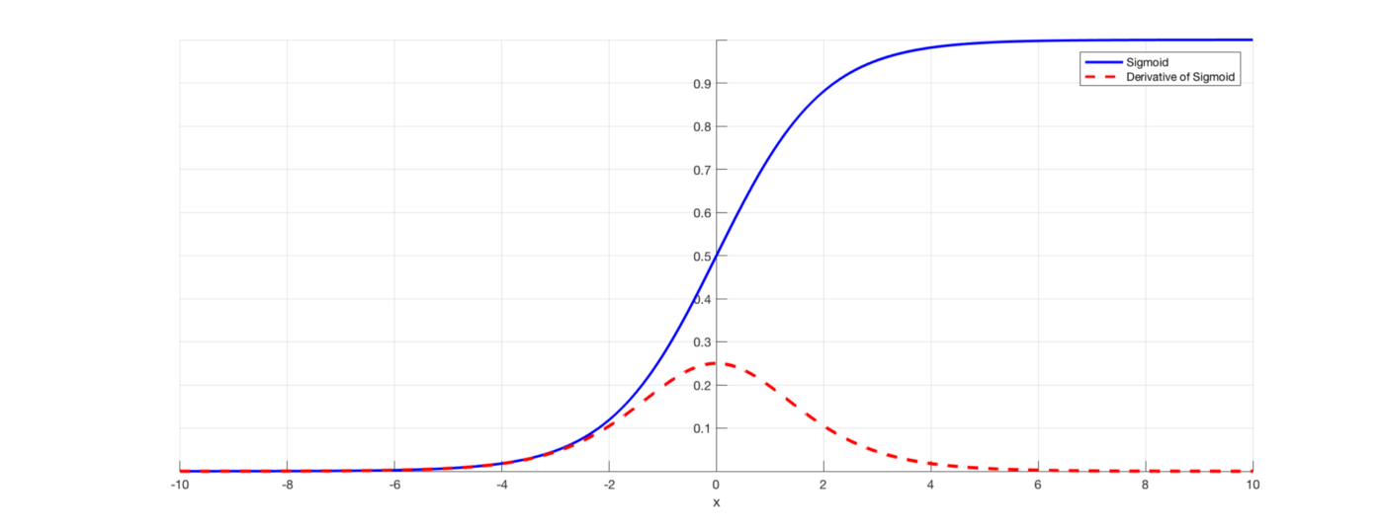
Derivative of the sigmoid function
$$y=f\left(x\right)=\frac{1}{1+exp⁡(−ax)}$$
$$\begin{matrix}f\left(x\right) & = & \frac{d}{dx}\left(\frac{1}{1+exp⁡(−ax)}\right)\end{matrix}$$
$$\begin{matrix} & = & \frac{a exp⁡(−ax)}{{\left(1+exp⁡(−ax)\right)}^{2}}\end{matrix}$$
$$\begin{matrix} & = & a f\left(x\right) \left(1−f\left(x\right)\right)\end{matrix}$$

Slide 10
Backpropagation algorithm
Forward propagation:
Takes an input pattern and transforms it by propagating it forward into the network
Computes the activation of each node $a_{i}^{(k)}$ in order to compute the error
Backpropagation:
Computes the gradient at a specific input pattern
“Reverses the flow of information” by propagating errors backwards in the network (uses the chain rule)
Intuitively: each node needs to compute its own error: $δ_{i}^{(k)}$
Backpropagation is sometimes referred to as an algorithm that trains a neural network.
It is actually an efficient way of computing the gradient
Various gradient-based optimization methods can be used (typically gradient descent)

Slide 11
Forward propagation
$$a_{0}^{(k)}$$
$$z_{j}^{(k+1)}=\sum_{i=0}^{n_{k}}{Θ_{j,i}^{\left(k\right)}a_{i}^{(k)}}$$
$$a_{j}^{(k+1)}=φ\left(z_{j}^{\left(k+1\right)}\right)$$
$$Θ_{j,0}^{\left(k\right)}$$
$$z_{j}^{(k+1)}$$
$$a_{1}^{(k)}$$
$$Θ_{j,1}^{\left(k\right)}$$
$$a_{j}^{(k+1)}$$
$$Σ$$
$$φ(.)$$
$$Θ_{j,n_{k}}^{\left(k\right)}$$
$$⋮$$
$$a_{n_{k}}^{(k)}$$

Slide 12
Backpropagation
$$\frac{∂a}{∂z}$$
$$\frac{∂Ε}{∂a}$$
$$\frac{∂Ε}{∂z}=\frac{∂Ε}{∂a} \frac{∂a}{∂z}$$
$$\frac{∂Ε}{∂z}=\frac{∂Ε}{∂a} φ^{′}(z)$$
$$z$$
$$φ\left(.\right)$$
$$a$$
$$E$$
$$a=φ\left(z\right)$$
$$\frac{∂Ε}{∂z}$$
$$\frac{∂a}{∂z}$$
$$\frac{∂Ε}{∂a}$$
$$=$$

Slide 13
Backpropagation
$$\frac{∂Ε}{∂z}=\frac{∂Ε}{∂z_{2}}\frac{∂z_{2}}{∂a}\frac{∂a}{∂z}$$
$$\frac{∂Ε}{∂z}=\frac{∂Ε}{∂z_{2}} w φ^{′}(z)$$
$$z$$
$$φ\left(.\right)$$
$$a$$
$$w$$
$$z_{2}$$
$$E$$
$$…$$
$$a=φ\left(z\right)$$
$$z_{2}=wa$$

Slide 14
Backpropagation
$$z_{1}=w_{1}a$$
$$z_{1}$$
$$\frac{∂Ε}{∂z}=\left(\frac{∂Ε}{∂z_{1}}\frac{∂z_{1}}{∂a}+\frac{∂Ε}{∂z_{2}}\frac{∂z_{2}}{∂a}\right)\frac{∂a}{∂z}$$
$$\frac{∂Ε}{∂z}=φ^{′}(z)\sum_{k=1}^{\#out}{w_{k}\frac{∂Ε}{∂z_{k}}}$$
$$w_{1}$$
$$…$$
$$z$$
$$φ\left(.\right)$$
$$a$$
$$E$$
$$…$$
$$w_{2}$$
$$z_{2}$$
$$…$$
$$a=φ\left(z\right)$$
$$z_{2}=w_{2}a$$

Slide 15
Backpropagation Algorithm
Online Updating
Step by Step

Slide 16
Pattern p is presented
1
1
1
$$a_{1}^{(2)}$$
$$a_{1}^{(3)}$$
$$x_{1}$$
Loss Function
(e.g., sum of squares)
$$a_{1}^{(4)}$$
$$a_{2}^{(2)}$$
$$a_{2}^{(3)}$$
$$x_{2}$$
Training Set
$$x_{}^{(p)}$$

Slide 17
Forward propagation: Compute node outputs
1
1
$$Θ_{1,0}^{\left(1\right)}$$
1
$$a_{1}^{(2)}=φ(Θ_{1,0}^{\left(1\right)}+Θ_{1,1}^{\left(1\right)}x_{1}+Θ_{1,2}^{\left(1\right)}x_{2})$$
$$a_{1}^{(2)}$$
$$a_{1}^{(3)}$$
$$Θ_{1,1}^{\left(1\right)}$$
$$x_{1}$$
Loss Function
(e.g., sum of squares)
$$a_{1}^{(4)}$$
$$Θ_{1,2}^{\left(1\right)}$$
$$a_{2}^{(2)}$$
$$a_{2}^{(3)}$$
$$x_{2}$$
Training Set

Slide 18
Forward propagation: Compute node outputs
1
1
1
$$a_{2}^{(2)}=φ(Θ_{2,0}^{\left(1\right)}+Θ_{2,1}^{\left(1\right)}x_{1}+Θ_{2,2}^{\left(1\right)}x_{2})$$
$$Θ_{2,0}^{\left(1\right)}$$
$$a_{1}^{(2)}$$
$$a_{1}^{(3)}$$
$$x_{1}$$
Loss Function
(e.g., sum of squares)
$$a_{1}^{(4)}$$
$$Θ_{2,1}^{\left(1\right)}$$
$$a_{2}^{(2)}$$
$$a_{2}^{(3)}$$
$$x_{2}$$
Training Set
$$Θ_{2,2}^{\left(1\right)}$$

Slide 19
Forward propagation: Compute node outputs
1
$$Θ_{1,0}^{\left(2\right)}$$
1
1
$$a_{1}^{(3)}=φ(Θ_{1,0}^{\left(2\right)}+Θ_{1,1}^{\left(2\right)}a_{1}^{(2)}+Θ_{1,2}^{\left(2\right)}a_{2}^{(2)})$$
$$a_{1}^{(2)}$$
$$Θ_{1,1}^{\left(2\right)}$$
$$a_{1}^{(3)}$$
$$x_{1}$$
Loss Function
(e.g., sum of squares)
$$a_{1}^{(4)}$$
$$a_{2}^{(2)}$$
$$Θ_{1,2}^{\left(2\right)}$$
$$a_{2}^{(3)}$$
$$x_{2}$$
Training Set

Slide 20
Forward propagation: Compute node outputs
1
1
1
$$a_{2}^{(3)}=φ(Θ_{2,0}^{\left(2\right)}+Θ_{2,1}^{\left(2\right)}a_{1}^{(2)}+Θ_{2,2}^{\left(2\right)}a_{2}^{(2)})$$
$$Θ_{2,0}^{\left(2\right)}$$
$$a_{1}^{(2)}$$
$$a_{1}^{(3)}$$
$$x_{1}$$
Loss Function
(e.g., sum of squares)
$$a_{1}^{(4)}$$
$$Θ_{2,1}^{\left(2\right)}$$
$$a_{2}^{(2)}$$
$$a_{2}^{(3)}$$
$$x_{2}$$
$$Θ_{2,2}^{\left(2\right)}$$
Training Set

Slide 21
Forward propagation: Compute node outputs
1
1
1
$$Θ_{1,0}^{\left(3\right)}$$
$$a_{1}^{(4)}=φ(Θ_{1,0}^{\left(3\right)}+Θ_{1,1}^{\left(3\right)}a_{1}^{(3)}+Θ_{1,2}^{\left(3\right)}a_{2}^{(3)})$$
$$a_{1}^{(2)}$$
$$a_{1}^{(3)}$$
$$Θ_{1,1}^{\left(3\right)}$$
$$x_{1}$$
Loss Function
(e.g., sum of squares)
$$a_{1}^{(4)}$$
$$a_{2}^{(2)}$$
$$a_{2}^{(3)}$$
$$Θ_{1,2}^{\left(3\right)}$$
$$x_{2}$$
Training Set

Slide 22
Forward propagation: Compute the loss
1
1
1
$$loss=\frac{1}{2}{\left(a_{1}^{\left(4\right)}−y_{1}^{\left(p\right)}\right)}^{2}$$
$$a_{1}^{(2)}$$
$$a_{1}^{(3)}$$
$$x_{1}$$
Loss Function
(e.g., sum of squares)
$$a_{1}^{(4)}$$
$$a_{2}^{(2)}$$
$$a_{2}^{(3)}$$
$$x_{2}$$
Training Set
$$y_{}^{\left(p\right)}$$

Slide 23
Backpropagation: Compute partial derivatives
Derivative of the loss with respect to the output $a_{1}^{\left(4\right)}$
1
1
1
$δ_{1}^{(4)}=$ $a_{1}^{\left(4\right)}\left(1−a_{1}^{\left(4\right)}\right) ∙ \left(a_{1}^{\left(4\right)}−y_{1}^{\left(p\right)}\right)$
$$a_{1}^{(2)}$$
$$a_{1}^{(3)}$$
$$δ_{1}^{(4)}$$
$$x_{1}$$
Loss Function
(e.g., sum of squares)
$$a_{1}^{(4)}$$
$$a_{2}^{(2)}$$
$$a_{2}^{(3)}$$
$$x_{2}$$
Derivative of the output node’s activation function (i.e., sigmoid)

Slide 24
Backpropagation: Compute partial derivatives
1
1
1
$δ_{1}^{(3)}=$ $a_{1}^{\left(3\right)}\left(1−a_{1}^{\left(3\right)}\right) ∙ \left(Θ_{1,1}^{\left(3\right)}{ δ}_{1}^{(4)}\right)$
$$δ_{1}^{(3)}$$
$$a_{1}^{(2)}$$
$$a_{1}^{(3)}$$
$$Θ_{1,1}^{\left(3\right)}$$
$$δ_{1}^{(4)}$$
$$x_{1}$$
Loss Function
(e.g., sum of squares)
$$a_{1}^{(4)}$$
$$a_{2}^{(2)}$$
$$a_{2}^{(3)}$$
$$x_{2}$$

Slide 25
Backpropagation: Compute partial derivatives
1
1
1
$δ_{2}^{(3)}=$ $a_{2}^{\left(3\right)}\left(1−a_{2}^{\left(3\right)}\right) ∙ \left(Θ_{1,2}^{\left(3\right)}{ δ}_{1}^{(4)}\right)$
$$δ_{1}^{(3)}$$
$$a_{1}^{(2)}$$
$$a_{1}^{(3)}$$
$$δ_{1}^{(4)}$$
$$x_{1}$$
Loss Function
(e.g., sum of squares)
$$a_{1}^{(4)}$$
$$δ_{2}^{(3)}$$
$$a_{2}^{(2)}$$
$$a_{2}^{(3)}$$
$$Θ_{1,2}^{\left(3\right)}$$
$$x_{2}$$

Slide 26
Backpropagation: Compute partial derivatives
1
1
1
$δ_{1}^{(2)}=$ $a_{1}^{\left(2\right)}\left(1−a_{1}^{\left(2\right)}\right) ∙ \left(Θ_{1,1}^{\left(2\right)}{ δ}_{1}^{(3)}+Θ_{2,1}^{\left(2\right)}{ δ}_{2}^{(3)}\right)$
$$δ_{1}^{(2)}$$
$$δ_{1}^{(3)}$$
$$a_{1}^{(2)}$$
$$Θ_{1,1}^{\left(2\right)}$$
$$a_{1}^{(3)}$$
$$δ_{1}^{(4)}$$
$$x_{1}$$
Loss Function
(e.g., sum of squares)
$$a_{1}^{(4)}$$
$$Θ_{2,1}^{\left(2\right)}$$
$$δ_{2}^{(3)}$$
$$a_{2}^{(2)}$$
$$a_{2}^{(3)}$$
$$x_{2}$$

Slide 27
Backpropagation: Compute partial derivatives
1
1
1
$δ_{2}^{(2)}=$ $a_{2}^{\left(2\right)}\left(1−a_{2}^{\left(2\right)}\right) ∙ \left(Θ_{1,2}^{\left(2\right)}{ δ}_{1}^{(3)}+Θ_{2,2}^{\left(2\right)}{ δ}_{2}^{(3)}\right)$
$$δ_{1}^{(2)}$$
$$δ_{1}^{(3)}$$
$$a_{1}^{(2)}$$
$$a_{1}^{(3)}$$
$$δ_{1}^{(4)}$$
$$x_{1}$$
Loss Function
(e.g., sum of squares)
$$a_{1}^{(4)}$$
$$δ_{2}^{(2)}$$
$$δ_{2}^{(3)}$$
$$a_{2}^{(2)}$$
$$Θ_{1,2}^{\left(2\right)}$$
$$a_{2}^{(3)}$$
$$x_{2}$$
$$Θ_{2,2}^{\left(2\right)}$$

Slide 28
Update the parameters with stochastic gradient descent
1
1
1
$$δ_{1}^{(2)}$$
$$δ_{1}^{(3)}$$
$$a_{1}^{(2)}$$
$$a_{1}^{(3)}$$
$$δ_{1}^{(4)}$$
$$x_{1}$$
$$a_{1}^{(4)}$$
$$δ_{2}^{(2)}$$
$$δ_{2}^{(3)}$$
$$a_{2}^{(2)}$$
$$a_{2}^{(3)}$$
$$x_{2}$$

Slide 29
Update the parameters with stochastic gradient descent
1
1
$$Θ_{1,0}^{\left(1\right)}$$
Derivative of the loss with respect to $Θ_{1,0}^{\left(1\right)}$
1
$$δ_{1}^{(2)}$$
$$δ_{1}^{(3)}$$
$$a_{1}^{(2)}$$
$$a_{1}^{(3)}$$
$Θ_{1,0}^{\left(1\right)}≔$ $Θ_{1,0}^{\left(1\right)}−η δ_{1}^{\left(2\right)}x_{0}^{}$
$Θ_{1,1}^{\left(1\right)}≔$ $Θ_{1,1}^{\left(1\right)}−η δ_{1}^{\left(2\right)}x_{1}^{}$
$Θ_{1,2}^{\left(1\right)}≔$ $Θ_{1,2}^{\left(1\right)}−η δ_{1}^{\left(2\right)}x_{2}^{}$
$$Θ_{1,1}^{\left(1\right)}$$
$$δ_{1}^{(4)}$$
$$x_{1}$$
$$a_{1}^{(4)}$$
$$δ_{2}^{(2)}$$
$$δ_{2}^{(3)}$$
$$Θ_{1,2}^{\left(1\right)}$$
$$a_{2}^{(2)}$$
$$a_{2}^{(3)}$$
$$x_{2}$$

Slide 30
Update the parameters with stochastic gradient descent
1
1
1
$$δ_{1}^{(3)}$$
$$Θ_{2,0}^{\left(1\right)}$$
$$a_{1}^{(2)}$$
$$a_{1}^{(3)}$$
$Θ_{2,0}^{\left(1\right)}≔$ $Θ_{2,0}^{\left(1\right)}−η δ_{2}^{\left(2\right)}x_{0}^{}$
$Θ_{2,1}^{\left(1\right)}≔$ $Θ_{2,1}^{\left(1\right)}−η δ_{2}^{\left(2\right)}x_{1}^{}$
$Θ_{2,2}^{\left(1\right)}≔$ $Θ_{2,2}^{\left(1\right)}−η δ_{2}^{\left(2\right)}x_{2}^{}$
$$δ_{1}^{(4)}$$
$$x_{1}$$
$$a_{1}^{(4)}$$
$$Θ_{2,1}^{\left(1\right)}$$
$$δ_{2}^{(2)}$$
$$δ_{2}^{(3)}$$
$$a_{2}^{(2)}$$
$$a_{2}^{(3)}$$
$$x_{2}$$
$$Θ_{2,2}^{\left(1\right)}$$

Slide 31
Update the parameters with stochastic gradient descent
1
$$Θ_{1,0}^{\left(2\right)}$$
1
1
$$δ_{1}^{(3)}$$
$$a_{1}^{(2)}$$
$$Θ_{1,1}^{\left(2\right)}$$
$$a_{1}^{(3)}$$
$Θ_{1,0}^{\left(2\right)}≔$ $Θ_{1,0}^{\left(2\right)}−η δ_{1}^{\left(3\right)}a_{0}^{(2)}$
$Θ_{1,1}^{\left(2\right)}≔$ $Θ_{1,1}^{\left(2\right)}−η δ_{1}^{\left(3\right)}a_{1}^{(2)}$
$Θ_{1,2}^{\left(2\right)}≔$ $Θ_{1,2}^{\left(2\right)}−η δ_{1}^{\left(3\right)}a_{2}^{(2)}$
$$δ_{1}^{(4)}$$
$$x_{1}$$
$$a_{1}^{(4)}$$
$$δ_{2}^{(3)}$$
$$a_{2}^{(2)}$$
$$Θ_{1,2}^{\left(2\right)}$$
$$a_{2}^{(3)}$$
$$x_{2}$$

Slide 32
Update the parameters with stochastic gradient descent
1
1
1
$$Θ_{2,0}^{\left(2\right)}$$
$$a_{1}^{(2)}$$
$$a_{1}^{(3)}$$
$Θ_{2,0}^{\left(2\right)}≔$ $Θ_{2,0}^{\left(2\right)}−η δ_{2}^{\left(3\right)}a_{0}^{(2)}$
$Θ_{2,1}^{\left(2\right)}≔$ $Θ_{2,1}^{\left(2\right)}−η δ_{2}^{\left(3\right)}a_{1}^{(2)}$
$Θ_{2,2}^{\left(2\right)}≔$ $Θ_{2,2}^{\left(2\right)}−η δ_{2}^{\left(3\right)}a_{2}^{(2)}$
$$δ_{1}^{(4)}$$
$$x_{1}$$
$$a_{1}^{(4)}$$
$$Θ_{2,1}^{\left(2\right)}$$
$$δ_{2}^{(3)}$$
$$a_{2}^{(2)}$$
$$a_{2}^{(3)}$$
$$x_{2}$$
$$Θ_{2,2}^{\left(2\right)}$$

Slide 33
Update the parameters with stochastic gradient descent
1
1
1
$$Θ_{1,0}^{\left(3\right)}$$
$$a_{1}^{(2)}$$
$$a_{1}^{(3)}$$
$Θ_{1,0}^{\left(3\right)}≔$ $Θ_{1,0}^{\left(3\right)}−η δ_{1}^{\left(4\right)}a_{0}^{(3)}$
$Θ_{1,1}^{\left(3\right)}≔$ $Θ_{1,1}^{\left(3\right)}−η δ_{1}^{\left(4\right)}a_{1}^{(3)}$
$Θ_{1,2}^{\left(3\right)}≔$ $Θ_{1,2}^{\left(3\right)}−η δ_{1}^{\left(4\right)}a_{2}^{(3)}$
$$Θ_{1,1}^{\left(3\right)}$$
$$δ_{1}^{(4)}$$
$$x_{1}$$
$$a_{1}^{(4)}$$
$$a_{2}^{(2)}$$
$$a_{2}^{(3)}$$
$$Θ_{1,2}^{\left(3\right)}$$
$$x_{2}$$

Slide 34
All parameters have been updated
1
1
1
$$a_{1}^{(2)}$$
$$a_{1}^{(3)}$$
$$x_{1}$$
$$a_{1}^{(4)}$$
$$a_{2}^{(2)}$$
$$a_{2}^{(3)}$$
$$x_{2}$$

Slide 35
Pattern p+1 is presented
1
1
1
The procedure is the same as before…
$$a_{1}^{(2)}$$
$$a_{1}^{(3)}$$
$$x_{1}$$
Loss Function
(e.g., sum of squares)
$$a_{1}^{(4)}$$
$$a_{2}^{(2)}$$
$$a_{2}^{(3)}$$
$$x_{2}$$
Training Set
$$x_{}^{(p+1)}$$

Slide 36
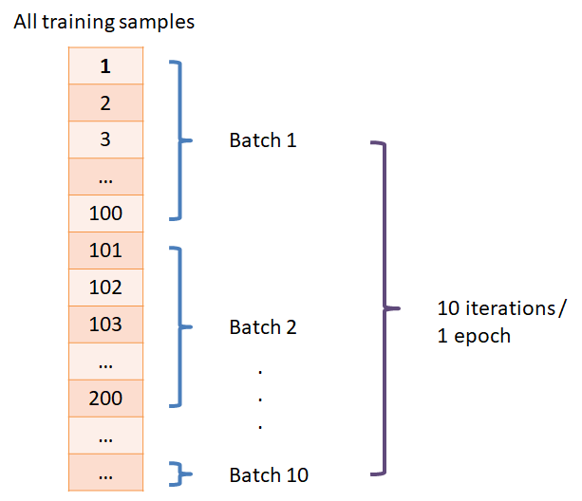
Backpropagation algorithm
Mini-batch sampling/updating:
Instead of using the whole training set, use nonoverlapping subsets of it (mini-batches)
Use the batch updating procedure where $m$ is the size of the mini-batch
Weight update equation:
$${∆Θ}_{j,i}^{\left(k\right)}=−η ∙\frac{∂}{∂Θ_{j,i}^{\left(l\right)}}L\left(Θ\right)$$
where:
$$\frac{∂}{∂Θ_{j,i}^{\left(l\right)}}L\left(Θ\right)=δ_{j}^{\left(k+1\right)}a_{i}^{(k)}$$
$$\frac{∂}{∂Θ_{j,i}^{\left(l\right)}}L\left(Θ\right)=\frac{1}{m}\sum_{p=1}^{m}{δ_{j}^{\left(k+1\right)}\left(p\right) a_{i}^{\left(k\right)}\left(p\right)}$$
Online updating (stochastic gradient descent)
Batch updating (batch gradient descent)
source

Slide 37
Training feedforward NNs using backpropagation
For each epoch (or until total error or gradient norm is small enough)
Set $∆_{ij}^{(l)}=0$ (for all $l,i,j$)
for $i =1 to m$
Set $a_{}^{(1)}=x_{}^{(i)}$
Forward propagation: Compute $a_{}^{(l)}$ for $l=2,3,..,L$
Backpropagation: Compute ${δ_{}^{(L)}=a}_{}^{(L)}−y_{}^{\left(i\right)}, δ_{}^{\left(L−1\right)},δ_{}^{\left(L−2\right)},…,δ_{}^{(2)}$
$∆_{ij}^{(l)}≔∆_{ij}^{\left(l\right)}+a_{j}^{(l)}δ_{i}^{(l+1)}$
$D_{ij}^{(l)}≔\frac{1}{m}∆_{ij}^{\left(l\right)}+λΘ_{ij}^{\left(l\right)}$ if $j≠0$
$D_{ij}^{(l)}≔\frac{1}{m}∆_{ij}^{\left(l\right)}$if $j=0$
Epoch: 1 pass over all training data

Slide 38
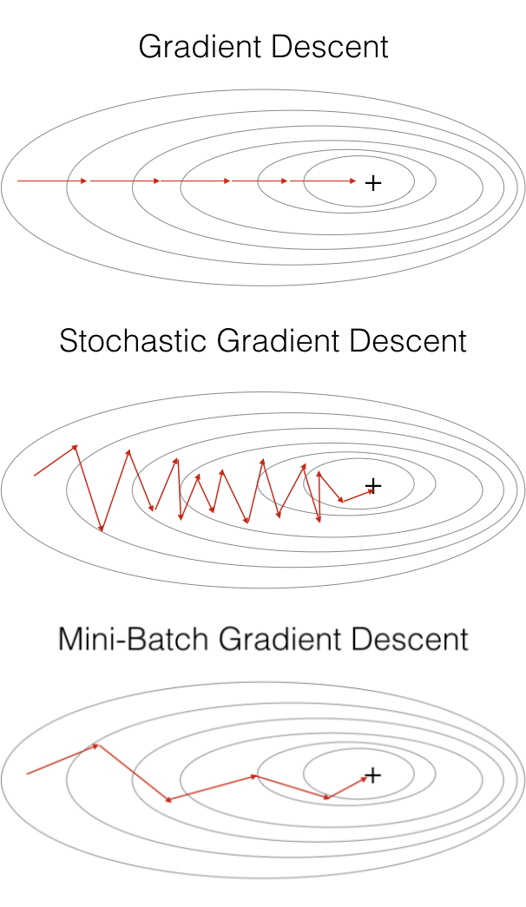
Gradient descent
Use batch GD if the training set can fit in memory
Smooth training curve
Slow (1 update requires the whole training set)
Can easily get stuck in local minima
Use stochastic GD for big training sets:
Noisy training curve
Fast (1 update requires a single instance)
Still prone to getting stuck in local minima, but less than batch GD
In practice:
Use mini-batch GD by setting the batch size depending on the problem (e.g., instance size) and the specs of the computer so that it can fit in memory
Batch size: $2^{0},2^{1},2^{2},…,m$
source

Slide 39
Efficiency of Backpropagation
Backpropagation:
Needs $O(W)$ operations where $W$ = number of parameters
Numerical differentiation:
Finite differences method:
$$\frac{∂L(θ_{0},…,{θ_{i},…,θ}_{k})}{∂θ_{i}}≈\frac{L\left(θ_{0},…,θ_{i}+ε,…,θ_{k}\right)−L\left(θ_{0},…,θ_{i}−ε,…,θ_{k}\right)}{2ε} ε={10}^{−4}$$
Need to perturb every parameter and calculate the loss: $O(W^{2})$ operations
Can be used to check if the implementation of backpropagation is correct

Slide 40
Vectorized Implementation
Forward propagation:
$$a_{}^{(1)}=x$$
$$z_{}^{(2)}=Θ_{}^{(1)}a_{}^{(1)}$$
$$a_{}^{(2)}=φ(z_{}^{(2)})$$
Add $a_{0}^{(2)}=1$
$$z_{}^{(3)}=Θ_{}^{(2)}a_{}^{(2)}$$
$$a_{}^{(3)}=φ\left(z_{}^{\left(3\right)}\right)=f_{Θ}^{}(x)$$
$$x_{0}$$
$$a_{0}^{(2)}$$
$$x_{1}$$
$$a_{1}^{(2)}$$
$$a_{1}^{(3)}$$
$$f_{Θ}^{}(x)$$
$$x_{2}$$
$$a_{2}^{(2)}$$
$$a_{2}^{(3)}$$

Slide 41
Vectorized Implementation
Backpropagation:
$$δ_{}^{(3)}=a_{}^{(3)}−y$$
$$δ_{}^{(2)}={\left(Θ^{(2)}\right)}^{T}δ_{}^{(3)}.∗φ′(z_{}^{(2)})$$
$.∗$ : element-wise multiplication
$$φ^{′}\left(z_{}^{\left(2\right)}\right)=a_{}^{(2)}.∗\left(1−a_{}^{\left(2\right)}\right)$$
Νο $δ_{}^{(1)}$
$$x_{0}$$
$$a_{0}^{(2)}$$
$$x_{1}$$
$$a_{1}^{(2)}$$
$$a_{1}^{(3)}$$
$$f_{Θ}^{}(x)$$
$$x_{2}$$
$$a_{2}^{(2)}$$
$$a_{2}^{(3)}$$
$$\frac{∂}{∂Θ_{j,i}^{\left(l\right)}}L\left(Θ\right)=a_{j}^{(l)}δ_{i}^{(l+1)}$$

Slide 42
Random Initialization
How to initialize $Θ_{j,i}^{\left(l\right)}$ ?
Zero initialization : $Θ_{j,i}^{\left(l\right)}=0$ for all $i, j, l$
After each update, weights that have the same source neuron are identical
All hidden units compute the same function
Network does not learn well
Random initialization : $Θ_{j,i}^{\left(l\right)}\sim U(−ε,ε)$
E.g. $ε=1$
Each node computes a different function
Network learns more interesting functions
$$x_{0}$$
$$a_{0}^{(2)}$$
$$x_{1}$$
$$a_{1}^{(2)}$$
$$a_{1}^{(3)}$$
$$f_{Θ}^{}(x)$$
$$x_{2}$$
$$a_{2}^{(2)}$$
$$a_{2}^{(3)}$$

Slide 43
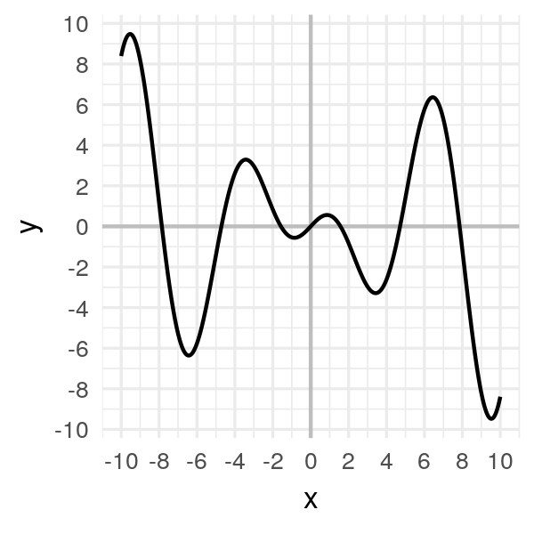
Quiz
$$p_{1}$$
Where will gradient descent end up if it uses a small learning rate and starting from:
A:
p2
B:
p3
C:
p4
p6 will never be reached
A
$$p_{5}$$
C
B
$$p_{3}$$
$$p_{4}$$
$$p_{2}$$
$$p_{6}$$
Adapted from source

Slide 44
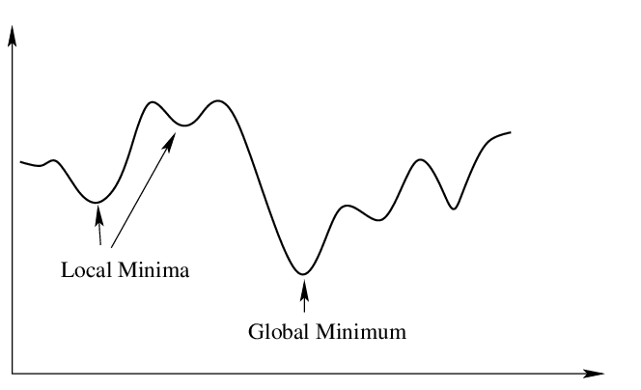
Problems with SGD
Getting stuck in local minima
Slow convergence or divergence
Let’s revise the approach…
source

Slide 45
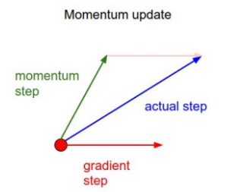
Stochastic gradient descent with momentum
Gradient Descent
$$θ\left(t+1\right)=θ\left(t\right)−η ∇L(θ\left(t\right))$$
Gradient descent with momentum
$$z\left(t+1\right)=μ z\left(t\right)+∇L(θ\left(t\right))$$
$$θ\left(t+1\right)=θ\left(t\right)−η z\left(t+1\right)$$
learning rate
momentum factor
$$z\left(0\right)=0$$
If $μ=0$ we get SGD

Slide 46
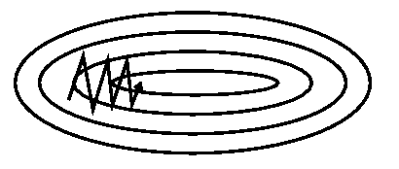
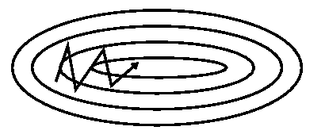
Stochastic gradient descent with momentum
Momentum term: type of memory of the previous direction we were following
Can speed up learning
by dampening oscillations
by increasing the effective learning rate in low curvature regions
Can escape local optima
Typical value: $μ=0.9$
SGD
SGD with momentum

Slide 47
SQD with Momentum
$$η=0.003$$
$$μ=0.0$$
source

Slide 48
SQD with Momentum
$η=0.00$4
$$μ=0.0$$
source

Slide 49
SQD with Momentum
$$η=0.003$$
$$μ=0.85$$
source

Slide 50
SQD with Momentum
$$η=0.004$$
$$μ=0.85$$
source

Slide 51
SQD with Momentum
$$η=0.005$$
$$μ=0.85$$
source

Slide 52
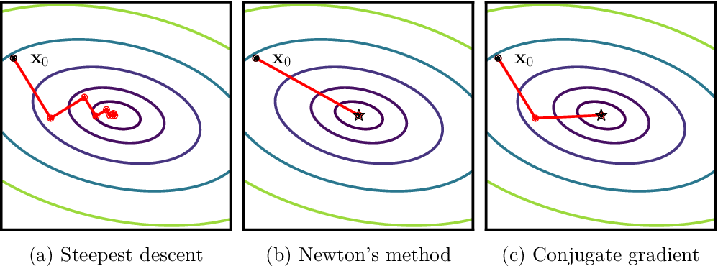
Advanced optimization methods
Gradient descent is a first-order optimization method
Second-order methods use curvature information (2nd derivative) to accelerate convergence to the optimum
Newton’s method
Conjugate gradient method
Levenberg–Marquardt algorithm
…
source

Slide 53
Advanced optimization methods
Second order methods
More complex and harder to implement and tune
More expensive in terms of iteration cost and memory
They consider access to the true gradient
Harder to make them work with mini-batch updating
Modern neural network training is based on variants of SGD

Slide 54
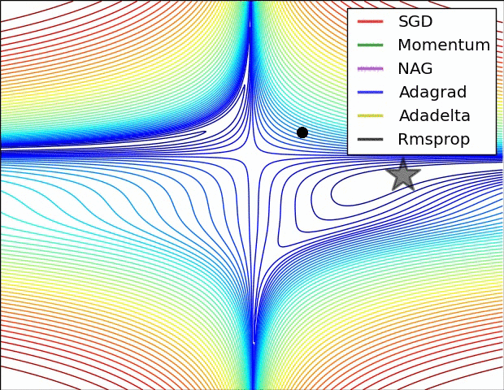
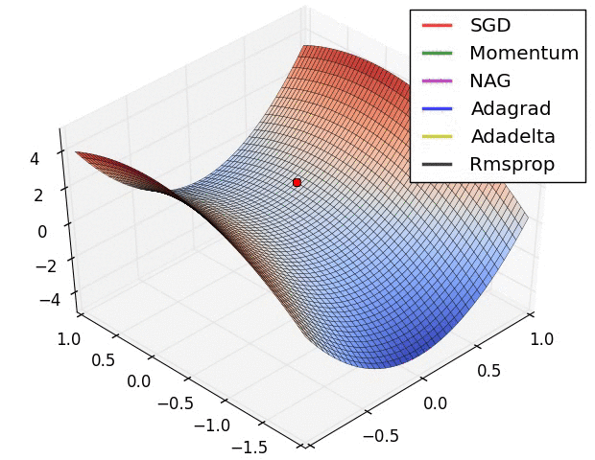
Advanced optimization methods: SGD variants
Vanilla SQD
SQD with momentum
Nesterov’s accelerated gradient
Adagrad
Adadelta
RMSProp
Adam
AdaMax
Nadam
…
source

Slide 55
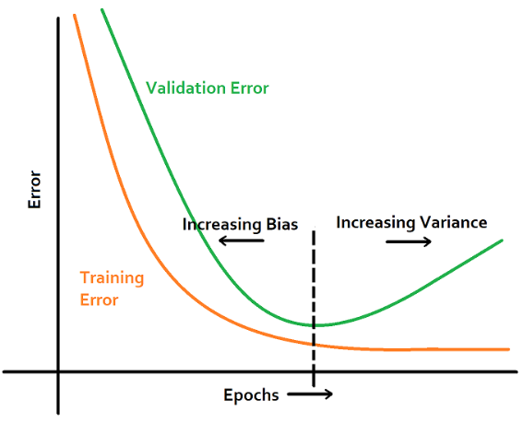
Early stopping
NNs are models with large learning capacity: prone to overfitting
Early stopping as regularization:
While training, evaluate the performance on the validation set
Save the network weights if the validation error is decreasing
When the validation error starts increasing (consistently) stop and return the network with the saved weights
Source

Slide 56
Hyperparameter tuning
Model hyperparameters:
Number of hidden layers
Number of units per layer
Activation functions per layer (per neuron?)
Activation function parameters
Learning algorithm hyperparameters:
Learning rate
Momentum factor
Learning rate decay
Initialization parameters
Regularization
…
Model selection is used as before evaluating combinations of hyperparameters using the (cross-)validation set.

Slide 57
Ensembles
NNs have many parameters: the error landscape is high-dimensional with many optima
Gradient descent is a noisy process that is not guaranteed to converge to the same local optimum for every run
We can train multiple independent networks and average their performance
We can use bagging or boosting or more advanced methods (e.g., dropout) and obtain lower validation errors

Slide 58
Automatic differentiation
For different cost functions or activation functions we need to write explicit code that computes their derivative
For a more flexible neural network architecture, we need to write explicit code for forward and backward propagation
Automatic differentiation:
A generalized way of using the chain rule with various operations and functions
Essentially: backpropagation implemented for us
Libraries: TensorFlow, PyTorch, JAX

Slide 59
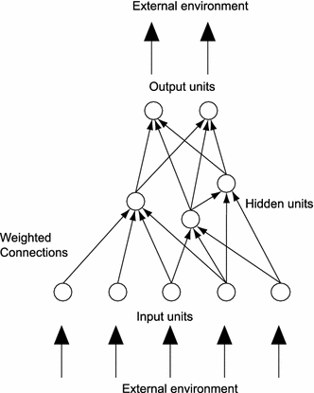
Learning the structure of the network
Neural networks are function compositions
Composing these functions in a layered feedforward manner works (universal approximation theorem), however, there more efficient ways of composing them for a given problem.
Learning the connectivity cannot be (easily) formulated as a gradient-based optimization objective.
Need gradient-free methods
Grid search or random search can be inefficient
Neuroevolution: using evolutionary algorithms to design/optimize neural networks
source

Slide 60
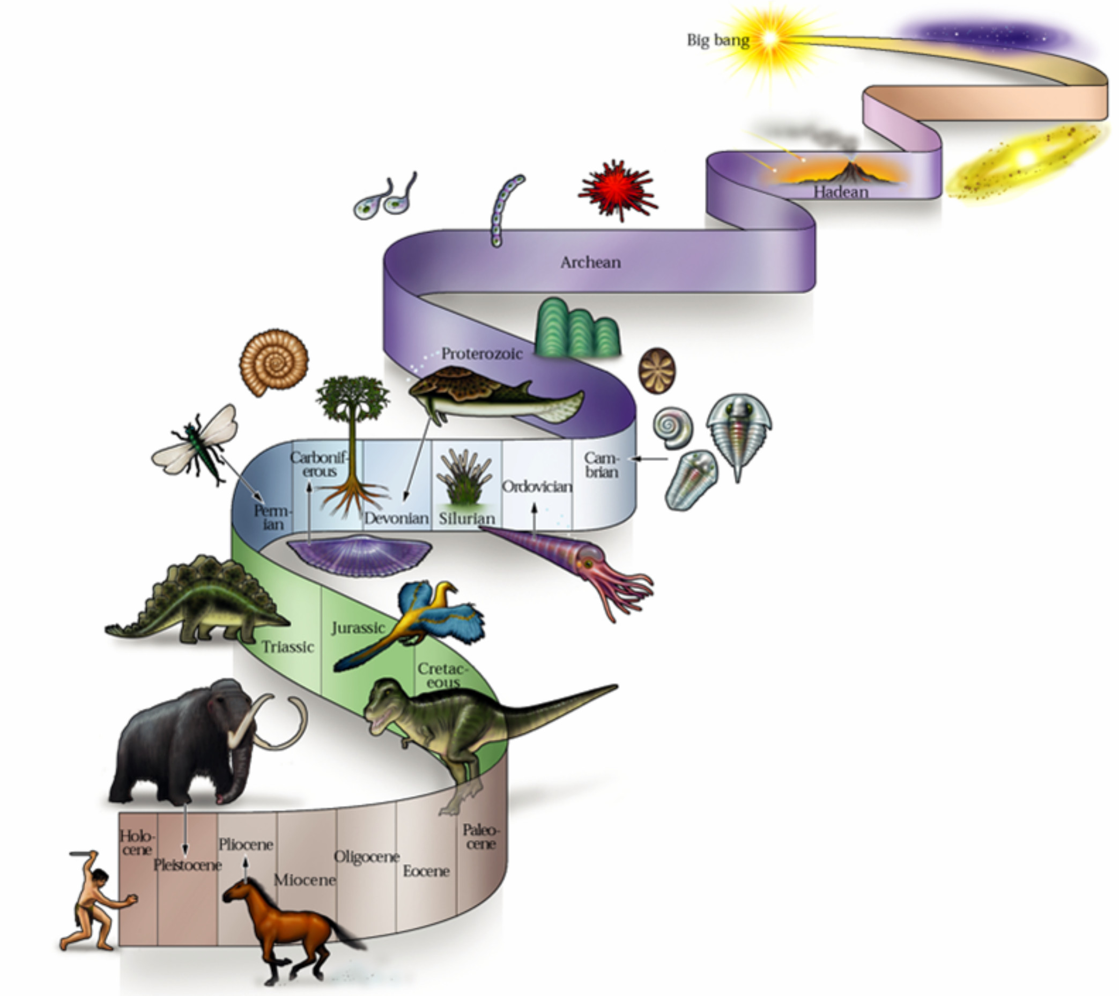
Evolutionary Systems
All biological systems are the result of an evolutionary process
Biological systems are:
robust
complex
adaptive
Evolutionary algorithms are abstractions of natural evolutionary processes with the aim of automatically finding solutions to complex problems.
E.g. As global optimizers

Slide 61
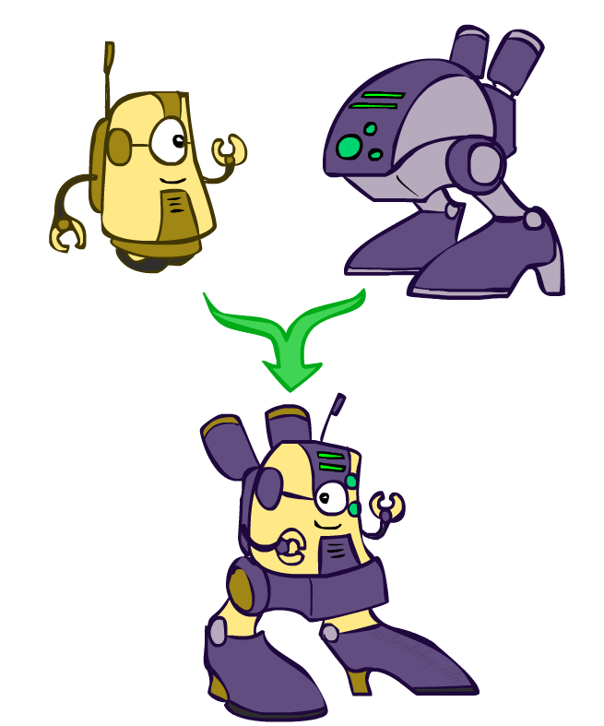
Genetic Algorithms
source
Parents
Offspring
10
26
9
22
Fitness
Replace
Natural selection metaphor
Parents produce offspring through crossover and mutation of genes
If the offspring has traits that are advantageous to its environment (better fitness) it survives, thus, allowed to propagate its genes in the next generation

Slide 62
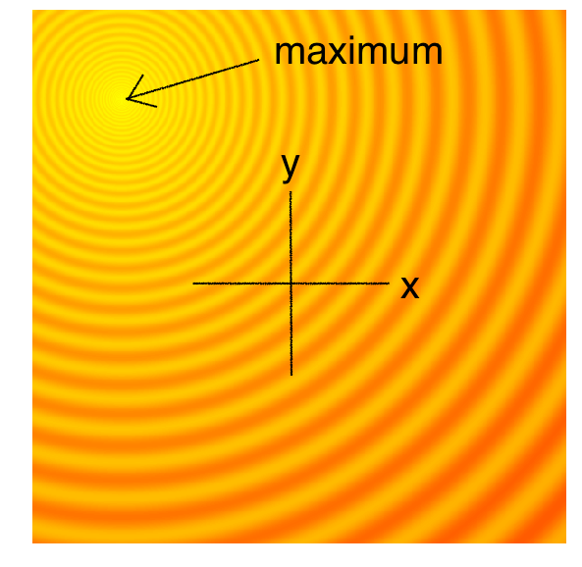
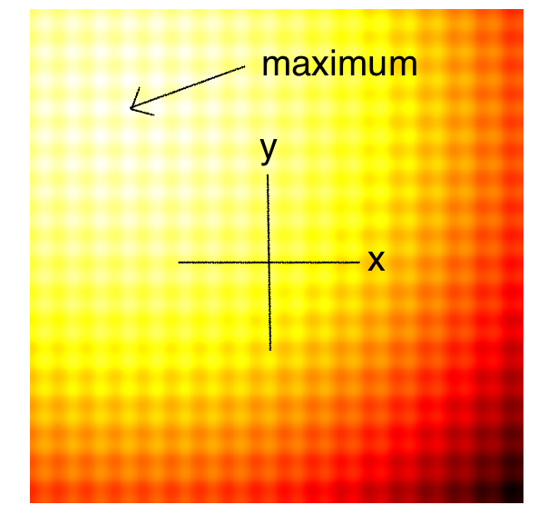
Evolutionary Algorithms in Action
source

Slide 63
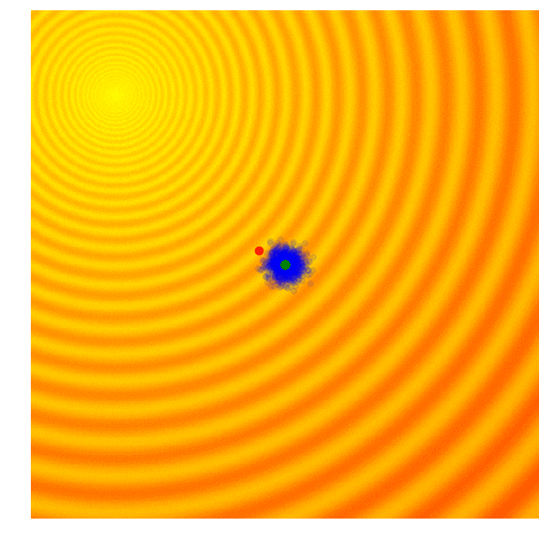
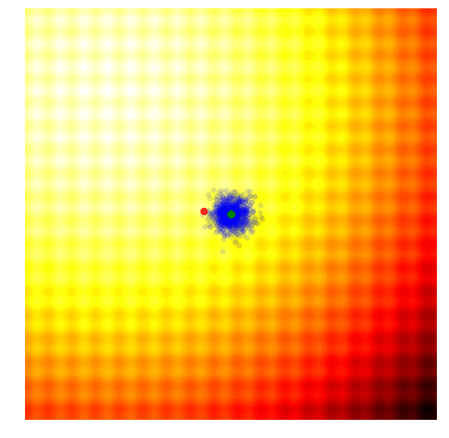
Simple Genetic Algorithms
source

Slide 64
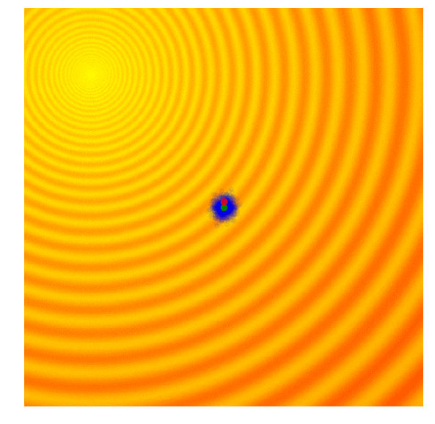
Simple Evolution Strategies
source

Slide 65
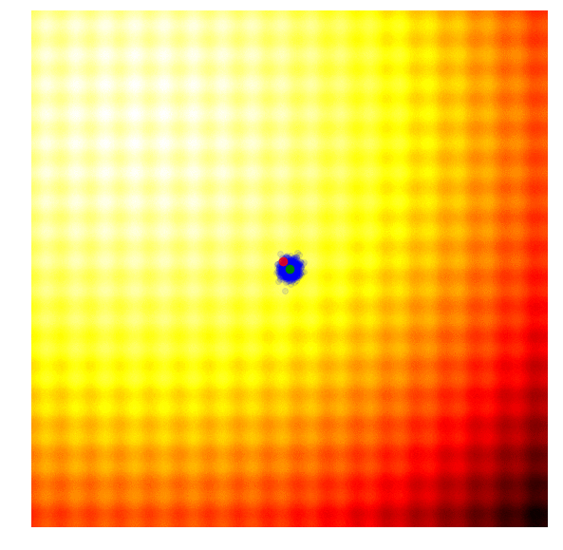
Advanced Evolution Strategies: CMA-ES
source

Slide 66
Neuroevolution
Evolution of neural networks
Inspired by the fact that natural brains are the products of an evolutionary process
Can be used to optimize:
Parameters (weights) – rather than gradient descent
Connectivity (topology)
Activation functions
Learning algorithms (evolution of learning) – more relevant for reinforcement learning problems
Need to define the representation of the network and the operators (cross-over, mutation) that modify the representation
A complementary approach to other machine learning algorithms!

Slide 67
Resources
Function composition – Wikipedia
Backpropagation – Wikipedia
Stochastic gradient descent – Wikipedia
Automatic differentiation – Wikipedia
Neuroevolution – Wikipedia

Slide 68
Next Lectures
Neural Networks 3: Introduction to Deep Learning
Part 3: Unsupervised Learning
Clustering

Slide 69
Thank you

