Slide 1
University of Cyprus - MSc Artificial Intelligence
MAI612 - MACHINE LEARNING
Lecture 11: Neural Networks 3: Introduction to
Deep Learning
Vassilis Vassiliades, PhD
Winter Semester 2022/23

Slide 2
Revision

Slide 3
Neural Networks
Artificial Neural Networks (ANNs) are models inspired by the human brain
Composed of many simple processing elements called artificial neurons
Artificial neurons compute the weighted sum of their inputs and feed it through an activation function which then becomes their output
Activation functions:
Heaviside step (non-differentiable) $→$Perceptron model
Linear $→$Linear regression
Sigmoid $→$Logistic regression
Perceptrons are linear classifiers
By combining multiple perceptrons in layers we can classify nonlinearly separable problems
E.g., XOR can be solved using 2 hidden neurons and 1 output neuron
However, we cannot train them using gradient descent when they use the Heaviside step function as it is non-differentiable

Slide 4
Neural Networks
Multilayer Perceptrons is a synonym for feedforward ANNs (typically with differentiable activation functions)
As a classifier, an MLP with:
1 hidden layer forms open or convex decision regions
2 hidden layers create arbitrary decision regions
Forward propagation is the process that feeds a data instance to the input layer of a NN and this is gradually transformed into the output prediction (regression or classification) through some nonlinear transformation.
This nonlinear transformation computes features of the input which are learned
A second hidden layer computes features as functions of existing features
Learning in NNs can be done using backpropagation and gradient descent

Slide 5
Neural Networks
Backpropagation: an efficient way to compute partial derivatives of the error function with respect to each parameter using the chain rule (since a NN is a composition of functions)
Error function: MSE for regression, Cross-Entropy for classification
Forward propagation computes the activation (output) of each node, while Backpropagation computes the error (delta) of each node
Delta (error) of each node: A x B
A = derivative of the node’s activation function
B = derivative of error with respect to the node’s output
For an output node: this is the derivative of the error function wrt to the activation of the output node
For a hidden node i at layer k: this is the sum of all deltas at nodes in layer k+1 (which are connected to node i) multiplied by their connecting weight
Gradient of the Error wrt to a weight = (delta of postsynaptic node) x (output of presynaptic node)

Slide 6
Neural Networks
Stochastic GD: weight update after the presentation of every pattern
Batch GD: weight update after the presentation of all patterns in the training set
Mini-batch GD: weight update after the presentation of subsets of patterns in the training set
Momentum term: memory of previous direction, speeds up learning
Early stopping: way to prevent overfitting by stopping training when the validation error starts increasing
We can improve the performance of NN models using regularization, hyperparameter tuning and ensembles
Learning the NN topology can be done using gradient-free methods, such as evolutionary algorithms.

Slide 7
Lecture 11: Neural Networks 3:
Introduction to Deep Learning
Learning Outcomes
You will learn about:
What deep learning is and why use it
Convolutional networks for image data
Handling sequential data
Recurrent neural networks
Backpropagation through time
The vanishing and exploding gradient problem
Echo State Networks
Long short-term memory (LSTM) networks
Word embeddings for handling text

Slide 8
From Machine Learning to Deep Learning
ML model transforms input data into meaningful outputs
Learned using examples
How to meaningfully transform data?
How to learn representations of the input data that get us closer to the expected output
Representation: different way to look at the data – to represent or encode the data
Examples:
Color image can be encoded in the RGB (red-green-blue) or HSV (hue-saturation-value) format
Points on a plane can be represented using Cartesian (x,y) or polar (r,θ) coordinates
Some tasks may be difficult with one representation and easier with another. Example:
Task: “select all red pixels in the image” simpler with RGB format
Task: “make the image less saturated” simpler in the HSV format
ML models are all about finding appropriate representations for their input data – transformations of the data that make it more manageable for the task at hand (e.g., classification)
Adapted from: Chollet, F. (2018). Deep Learning with Python. Manning Publications.

Slide 9
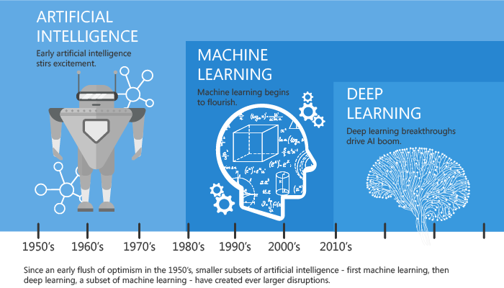
What is Deep Learning
Deep Learning is a subfield of ML that focuses on learning successive layers of meaningful representations using neural networks.
“Deep” = Successive layers of representation
Other potential names: layered representations learning, hierarchical representations learning
How many layers are considered “deep”?
2 layers of representations: shallow learning
>2 layers: deep learning
Often: tens or hundreds of successive representations
source
Adapted from: Chollet, F. (2018). Deep Learning with Python. Manning Publications.

Slide 10
Why deep learning? Why now?
Hardware
1990-2010: CPUs became faster by a factor of ~5000
Throughout the 2000s companies like NVIDIA and AMD have been heavily investing in developing fast, massively parallel chips (graphics processing units [GPUs]) to power the graphics of increasingly photorealistic video games
2007: NVIDIA launched the CUDA programming interface for its line of GPUs
Small number of GPUs replace massive clusters of CPUs in various highly parallelizable applications (e.g., physics modeling)
2011-2012: First CUDA implementations of NNs that won competitions (e.g., ImageNet)
The deep-learning industry is starting to go beyond GPUs (e.g., Tensor Processing Units [TPUs])
Adapted from: Chollet, F. (2018). Deep Learning with Python. Manning Publications.

Slide 11
Why deep learning? Why now?
Datasets and benchmarks
AI is the new industrial revolution
If AI is the steam engine of this revolution, then data is its coal
Exponential progress in storage hardware over the past 20 years
Game changer: rise of the Internet, makes it feasible to collect and distribute very large datasets for ML
Today: companies work with image datasets, video datasets and natural-language datasets that could not have been collected without the internet
ImageNet dataset: Catalyst for the rise of deep learning
1.4 million images hand annotated with 1000 image categories
Yearly competition
Public competitions (e.g., Kaggle): excellent way to motivate researchers to advance the state of the art
Adapted from: Chollet, F. (2018). Deep Learning with Python. Manning Publications.

Slide 12
Why deep learning? Why now?
Algorithmic advances
Until the 2000s, we were missing reliable ways to train deep NNs
NNs were shallow (1-2 hidden layers), unable to compete against SVMs or Random Forests
Key issue: gradient faded away as number of layers increased
2009-2016: Algorithmic improvements allow better gradient propagation:
Better activation functions for neural layers
Better weight initialization schemes, starting with layer-wise pretraining, which was abandoned
Better optimization schemes (e.g., RMSProp, Adam)
Batch normalization
Residual connections
However, older techniques such as LSTMs were now feasible because of hardware & data
Adapted from: Chollet, F. (2018). Deep Learning with Python. Manning Publications.

Slide 13
Why deep learning? Why now?
A new wave of investment
Deep learning (DL) became the new state of the art for computer vision in 2012-2013 and eventually all perceptual tasks – industry leaders took notice
Gradual wave of industry investment afterwards, far beyond anything previously seen in the history of AI. For example, the total venture capital investment in AI:
2011 (before deep learning spotlight) = ~$19M
2014: ~$394M
2013: Google acquired DeepMind for $500M (largest acquisition of an AI startup)
2014: Baidu started a DL research centre in Silicon Valley (investing $300M)
Deep Learning became central to the product strategy of tech giants
Research and number of people working on/with deep learning increased exponentially over the last years
Adapted from: Chollet, F. (2018). Deep Learning with Python. Manning Publications.

Slide 14
Why deep learning? Why now?
The democratization of deep learning
Early days required significant C++ and CUDA expertise, which few people possessed
Nowadays, basic Python scripting skills suffice to do advanced DL research
This has been driven primarily by the development of Theano, TensorFlow, and PyTorch: symbolic tensor¹-manipulation frameworks for Python that support autodifferentiation
Rise of user-friendly libraries, such as Keras, which makes DL easy
Culture on uploading papers on arXiv and releasing the code as open-source (see paperswithcode)
¹Tensor: Generalizaton of a matrix to N-dimensional space
Adapted from: Chollet, F. (2018). Deep Learning with Python. Manning Publications.

Slide 15
Structure helps learning
If data has some structure and the NN does not need to learn the structure from scratch, then the NN will perform better
Example: Letter classification
What do you think would be easier for a classifier to learn?
1. A model that uses the color image?
2. A model that only looks at the gray scale?
R
G CLASSIFIER
B
b
Color does not matter!
A
c
D
R+G+B
3
CLASSIFIER
Adapted from Udacity’s Deep Learning course

Slide 16
Statistical Invariance
Example: Dog image classification
Does not matter where the dog is, it is still an image with a dog
We should explicitly teach a NN that objects in images are the same irrespective of where they are in the image
This is called Translation Invariance
Adapted from Udacity’s Deep Learning course

Slide 17
Statistical Invariance
Example: Text that talks about dogs
The quick brown dog jumped over the lazy white dog.
Once upon a time, there was a dog with pointy ears and a short tail.
Does the meaning of dog change depending on whether it is in the 1st sentence or the 2nd one?
No
We want the part of the NN that learns what a dog is to be reused every time the NN sees the word dog, and not to re-learn it every time.
Adapted from Udacity’s Deep Learning course

Slide 18
Statistical Invariance: Weight sharing
When we know that 2 or more inputs contain the same information then we share their weights and train the weights jointly for those inputs
Statistical invariants: things that do not change on average across time or space
$$θ_{j}$$
The quick brown dog jumped over the lazy white dog.
Once upon a time, there was a dog with pointy ears and a short tail.
$$θ_{i}$$
Convolutional
Networks
Embeddings or Recurrent NNs
$$θ_{j}$$
$$θ_{j}$$
$$θ_{i}$$
Text or Sequences
Image Data
Adapted from Udacity’s Deep Learning course

Slide 19
Image Data

Slide 20
Image Data
Example: Classification task
Input: 256x256x3 (RGB) $→$ tensor
Output: Cat or not cat
Suppose that we use an MLP with 1 fully connected (FC) hidden layer of 100 neurons
196,608 x 100 (input to hidden) + 100 (hidden to output) = 19,660,900 parameters!
Cons:
MLPs require a huge amount of parameters (prone to overfitting)
MLPs do not account for translational invariance

Slide 21
Convolutional Networks (ConvNets)
Convolutional NNs are regularized versions of MLPs, i.e., they reduce the number of parameters and try to account for translation invariance, based on 3 ideas:
Local receptive fields
Each neuron receives input only from a restricted area of the previous layer (typically a square, e.g., 5x5)
The learnable parameters of each such neuron are called a filter or a kernel
In contrast, the receptive field of FC layers is the entire previous layer
Weight sharing
Each filter is convolved with the previous layer, i.e., slices over the previous entire activation map (e.g., the original image) and computes the dot product between the filter entries and the input patch
The output of this operation is an activation map for each filter
Spatial sub-sampling (pooling) [optional]
Reduces the dimensions of the data by combining the outputs of neuron clusters into a single number
Typically, max-pooling or average pooling

Slide 22
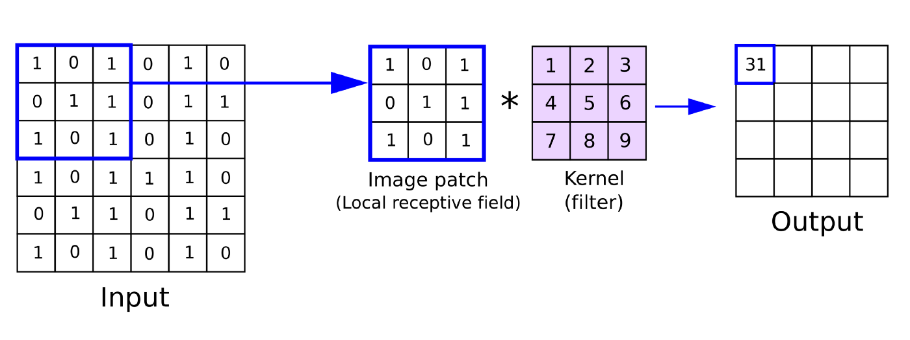
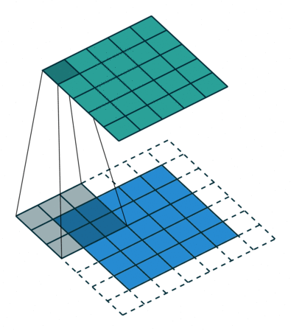
Convolutional Networks (ConvNets)
Convolution
Local receptive field: 3x3 filter
Weight sharing: only 9 parameters are learned to produce the output activation map (of this filter)

Slide 23
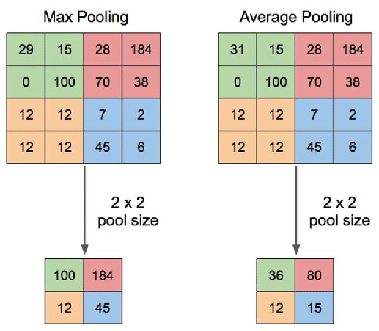
Convolutional Networks (ConvNets)
Pooling
source

Slide 24
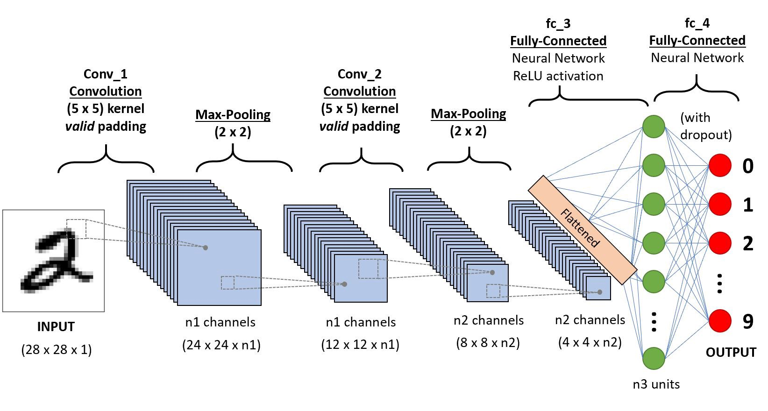
Convolutional Networks

Slide 25
What ConvNets learn
Each layer in the hierarchy learns progressively better representations
Input layer: original pixel values
Layer 1: presence/absence of edges of particular orientation at particular position
Layer 2: local arrangements of edges
Layer 3: assemblies of local arrangements that may correspond to parts of objects
Layer 4: combinations of parts of objects that may represent complete objects
Output Layer: classification

Slide 26
Applications of ConvNets
Every task that requires image data:
Image recognition
Video recognition
Image classification
Image segmentation
Medical image analysis
…
Can also be used for other types of data:
Natural language processing
Time series forecasting
…

Slide 27
Sequential Data

Slide 28
Sequential data
Sequential data refers to any data that contain elements that are ordered into sequences
The order differentiates this data from other cases we have seen so far
Examples:
The price of a stock over time
Environmental data (pressure, temperature, precipitation etc.) over time
Sequence of queries in a search engine, or the frequency of a query over time
EEG signals
A DNA sequence of nucleotides
The words in a document as they appear in order
Event occurrences in a log
Video-based action recognition

Slide 29
Time-series data
Time series:
Typical case of sequential data
Vector of numeric values that change over time
Typically, collected at regular intervals
Components:
Trends: smooth long-term direction
Seasonality: patterns of change within a year which tend to repeat each year
Cyclic variation: rise and fall over periods typically longer than a year
Noise: random variation / unpredictable component

Slide 30
Quiz
Sequential data and time-series data mean exactly the same thing. True or False?
False. There exist data that contains elements whose order is not defined by a time axis. For example, a DNA sequence, or words in a document.
Nevertheless, in most applications, sequential data are temporal data.
In the following slides, we will be using the word “order” and “time” synonymously.

Slide 31
Handling sequential data
Why deal with sequential data?
Stock prices do not make sense without the time information
Individual words in a sentence do not make sense without their context
How to handle sequential data?
Need some form of memory.
Two approaches:
Order is externally processed
Order is internally processed

Slide 32
External processing of order
Order (or time) is preprocessed in an order-to-space transformation. Only the spatial transformation is accessed by the network, which contains a dimension whose semantics are related to the order.
Feature engineering approach: introduction of new features (inputs)
Shifted versions of the input signal, e.g., $x_{t},x_{t−1},x_{t−2},…,x_{t−k}$
Moving averages, e.g., $x_{MA,t}=\frac{\sum_{i=t−k}^{t}{x_{i}}}{k}$
Need to define the length of the context (time) window, $k$
Sliding window on sequential data converts the sequence within the window into static data

Slide 33
External processing of order: MLP
Inflexible approach:
Rigid limit on duration of patterns
Does not capture the translational invariance of the same temporal pattern at different absolute times
[0,0,1,1,1,0,0,1,0,0] t
[0,0,0,0,1,1,1,0,0,1] t+2

Slide 34
Internal processing of order
The model uses an internal state which is constantly updated according to an input stream, and maintains the preceding state of the nodes which is reintroduced at the following step.
Typically done:
At the neuron level: the neuron model introduces some delay when integrating the input and calculating the response
At the connection level: the signal propagates from one neuron to the other with some delay

Slide 35
Internal processing of order: neuron level
Example: discrete-time dynamic neuron model
$$α\left(t+1\right)=μ α\left(t\right)+\sum_{i=1}^{n}{θ_{i}x_{i}}$$
$$y\left(t\right)=φ\left(α\left(t\right)−θ_{0}\right)$$
$$x_{0}=1$$
$$θ_{0}$$
$$x_{1}(t)$$
$$θ_{1}$$
$$μ$$
$$x_{2}(t)$$
$$θ_{2}$$
$$Σ$$
$$φ(.)$$
$$Δ$$
$$y(t)$$
$$α(t+1)$$
$$α(t)$$
$$⋮$$
$$θ_{n}$$
$$x_{n}(t)$$

Slide 36
Internal processing of order: connection level
In feedforward networks, we consider that forward propagation, i.e., the propagation of an input signal all the way to the output layer is done in a single time step.
$$y_{j}^{}=φ\left(θ_{i,j}^{}y_{i}^{}\right)$$
$$y_{j}^{}(t)=φ\left(θ_{i,j}^{}y_{i}^{}(t)\right)$$
$$y_{j}^{}(t)=φ\left(θ_{i,j}^{}y_{i}^{}(t−1)\right)$$
$$y_{j}^{}(t)=φ\left(θ_{i,j}^{}y_{i}^{}(t−Δ_{t}^{})\right)$$
Connections with a delay are known as recurrent connections.
Neural networks that use recurrent connections are known as recurrent neural networks.
$$y_{i}^{}$$
$$θ_{i,j}^{}$$
$$y_{j}^{}$$
$$y_{i}^{}(t)$$
$$θ_{i,j}^{}$$
$$y_{j}^{}(t)$$
$$Δ_{t}^{}=0$$
$$y_{i}^{}(t)$$
$$θ_{i,j}^{}$$
$$y_{j}^{}(t)$$
$$Δ_{t}^{}=1$$

Slide 37
Recurrent Neural Networks

Slide 38
Recurrent Neural Networks: forward propagation
Recurrent connections typically have a delay of 1
$$a_{}^{\left(1\right)}\left(t\right)=θ_{i,1} x\left(t\right)+θ_{1,1}{ a}_{}^{\left(1\right)}\left(t−1\right)+θ_{2,1}{ a}_{}^{\left(2\right)}\left(t−1\right)$$
$$a_{}^{\left(2\right)}\left(t\right)=θ_{1,2}{ a}_{}^{\left(1\right)}\left(t\right)+θ_{2,2}{ a}_{}^{\left(2\right)}\left(t−1\right)$$
Every neuron that has an outgoing recurrent connection is said to maintain some state
This is its activation which is needed at the next time step
$$θ_{2,2}$$
$$a_{}^{\left(2\right)}(t)$$
$$θ_{1,2}$$
$$θ_{2,1}$$
$$a_{}^{\left(1\right)}(t)$$
$$θ_{1,1}$$
$$θ_{i,1}$$
$$x(t)$$

Slide 39
Training: Backpropagation through time
Backpropagation can still be used to train recurrent neural networks
Modification:
forward propagation: unroll the computational graph over time, i.e., maintain all neuron states in memory for the length of the sequence, t = 1 to T
backpropagate errors starting from the last time step (T) towards the first time step, while at each time step we also backpropagate errors from the output layer (if any)
accumulate all gradients and apply gradient descent

Slide 40
Unroll the computational graph
The network becomes very deep
Source

Slide 41
Backpropagate errors
Source

Slide 42
Apply parameter update
Once all gradients are accumulated, we do a gradient descent step and modify the parameters
Notice that we use weight sharing: the unrolled graph uses the same weights for the processing of different inputs in the sequence
If the weights were different then it would be a type of feedforward neural network
This enables RNNs to limit computational resources and process sequences of variable length
Source

Slide 43
RNN Examples
source
Each rectangle is a vector and arrows represent functions (e.g. matrix multiply). Input vectors are in red, output vectors are in blue and green vectors hold the RNN's state

Slide 44
RNN Examples
source
Vanilla mode of processing without RNN, from fixed-sized input to fixed-sized output (e.g. image classification).

Slide 45
RNN Examples
source
Sequence output (e.g. image captioning takes an image and outputs a sentence of words).

Slide 46
RNN Examples
source
Sequence input (e.g. sentiment analysis where a given sentence is classified as expressing positive or negative sentiment).

Slide 47
RNN Examples
source
Sequence input and sequence output (e.g. Machine Translation: an RNN reads a sentence in English and then outputs a sentence in French).

Slide 48
RNN Examples
source
Synced sequence input and output (e.g. video classification where we wish to label each frame of the video).

Slide 49
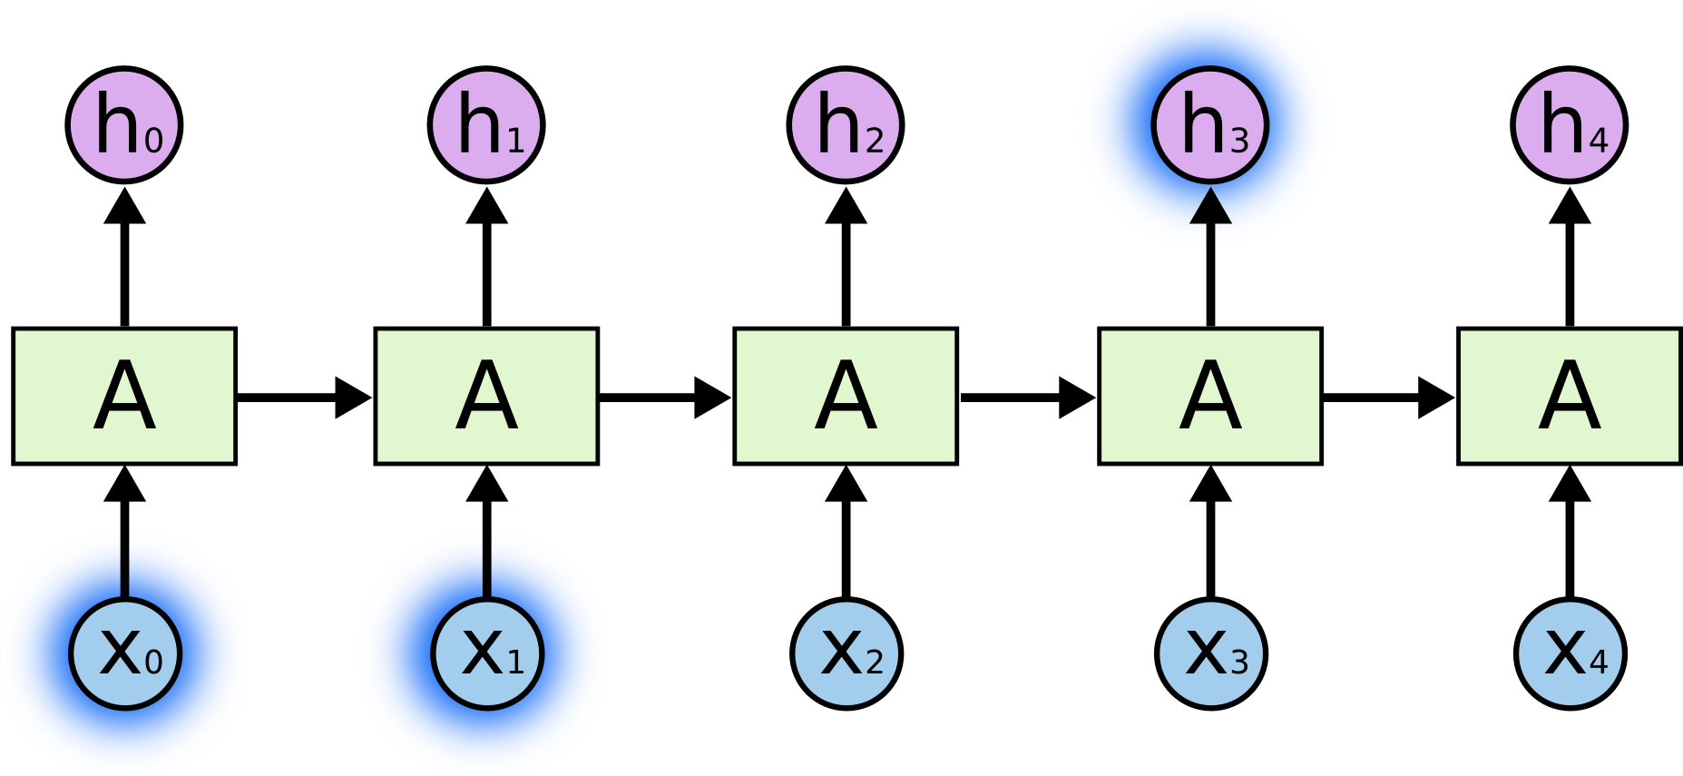
The problem of long-term dependencies
Consider a language model trying to predict the next word based on the previous ones
If we are trying to predict the last word in “the clouds are in the sky,” we don’t need any further context – it’s pretty obvious the next word is going to be sky.
In such cases, where the gap between the relevant information and the place that it’s needed is small, RNNs can learn to use the past information.
Source

Slide 50
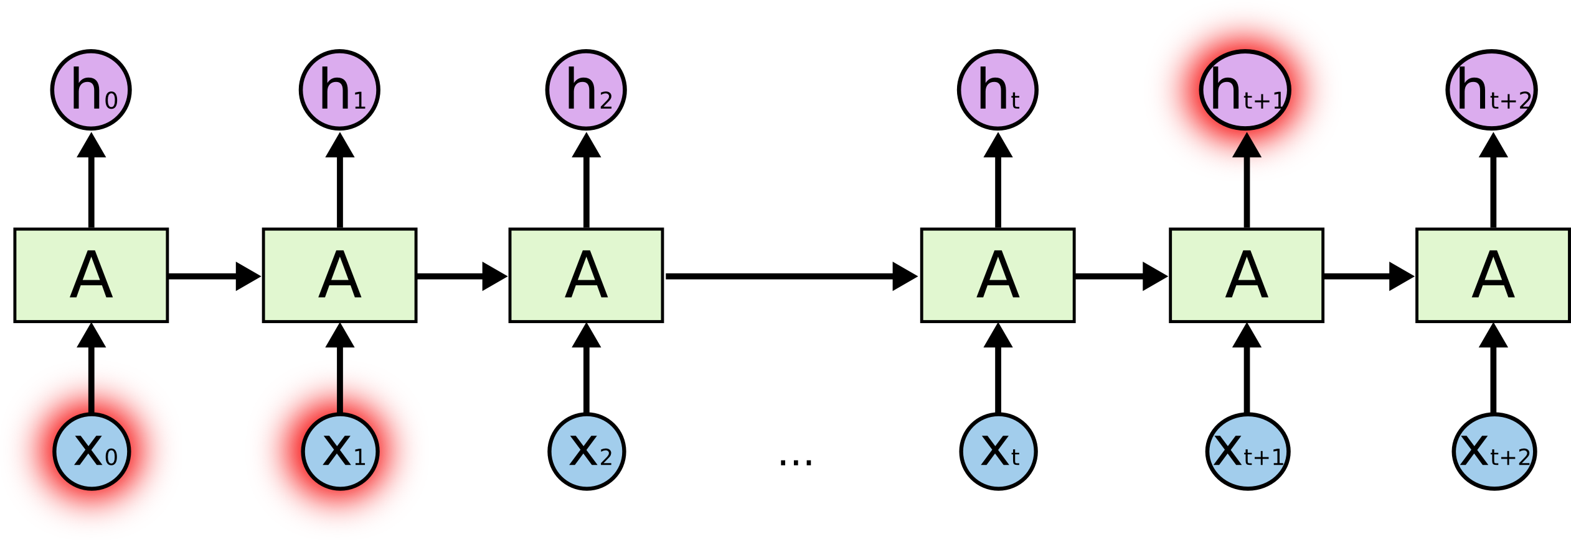
The problem of long-term dependencies
Consider trying to predict the last word in the text “I grew up in France […] I speak fluent French.”
Recent information suggests that the next word is probably the name of a language.
If we want to narrow down which language, we need the context of France, from further back.
Gap between relevant information and point where it needed can become very large.
As that gap grows, RNNs become unable to learn to connect the information.
Source

Slide 51
The vanishing and exploding gradient problem
When backpropagating the gradients in a deep network (e.g., a recurrent neural network unrolled for many time steps) from the output layer to the input layer it is often the case that the gradients get smaller and smaller and approach zero.
Gradient descent leaves the weights of the lower layers unchanged
Never converges to the optimum
This is known as the vanishing gradients problem
In some cases, the gradients become larger and larger
This causes large weight updates which makes gradient descent to diverge
This is known as the exploding gradients problem

Slide 52
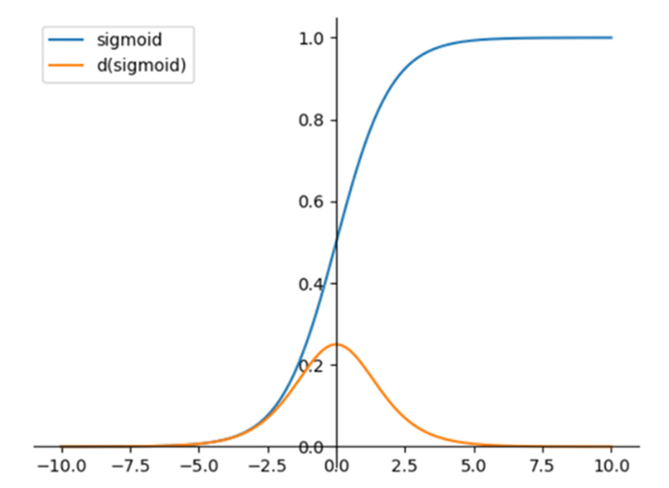
Why do gradients vanish?
Activation functions such as the sigmoid, squashes a large input space into a smaller output space that lies in [0,1]
Larger inputs (positive or negative) saturate the function which results in a derivative close to zero
This means that there are practically no gradients to propagate backward while any residual ones keep on diluting.
Image source

Slide 53
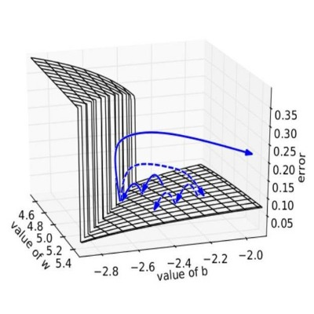
Why do gradients explode?
Suppose that the initial parameters result in some large loss.
The gradients can accumulate during an update and result in very large gradients which eventually result in very large updates to the network parameters
It is sometimes the case that the parameters overflow and produce NaN values
Image source

Slide 54
Potential solutions?
Better weight initialization (e.g., considering the variance of inputs and outputs at each layer)
Use non-saturating activation functions (ReLU, Leaky ReLU, ELU,…)
Batch normalization (zero-mean normalization of input to a layer based on mini-batch data)
Gradient clipping (gradient values beyond -1 or +1 are clipped to this range)
Do not learn the recurrent weights: ignore the problem (see next slide)
Use a more advanced architecture (see next slides)

Slide 55
Ignoring the problem: Echo State Networks
We unroll the computational graph when we want to train recurrent connections.
By NOT training the recurrent connections, we do not have the problem of vanishing/exploding gradients.
Echo State Networks:
Reservoir computing: large sparsely connected hidden layer (1% connectivity) with connectivity and weights fixed and randomly assigned.
Input-to-hidden, and output-to-hidden connections also random
Only connections from hidden layer to output are trainable
Regression problems: output is a linear combination of the hidden state

Slide 56
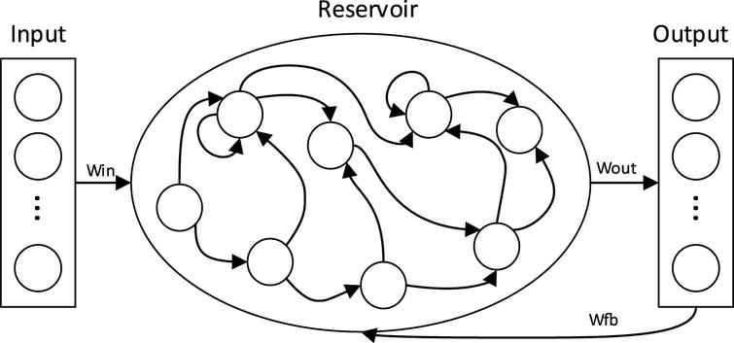
Echo State Networks: how they work
Input at each time step is fed into the dynamical reservoir, which along with its internal recurrent connections and recurrent connections from the output layer calculates its next state.
The output is computed as a linear combination of the current state of the reservoir and the output weights.

Slide 57
Echo State Networks: how to train them
The hidden units act as features that are computed from the sequence.
Can be seen as a type of feature engineering
We can use linear regression to train the output weights!

Slide 58
Echo State Networks
Good performance in many signal processing applications, and time series prediction tasks.
Easy to implement
Consider them when the problem is not too complex and when cheap, fast, and adaptive training is desired
However, for tasks that have many variables and long-term memory (e.g., in natural language processing), they would need a reservoir of an excessive size.
The advent of autodifferentiation libraries, and more stable recurrent architectures (see next slide) enable the training of RNNs

Slide 59
Mitigating the problem: Long Short-Term Memory
LSTM: Special type of RNN capable of handling long-term dependencies
Introduces special gating mechanisms that enable to learn:
what information to forget,
what new information to store in memory and
what information to output
How it achieves gating:
feed a signal through a sigmoid operation: produces a value in $[0,1]$
multiply the result with another signal $x$: makes the result in $[0,x]$

Slide 60
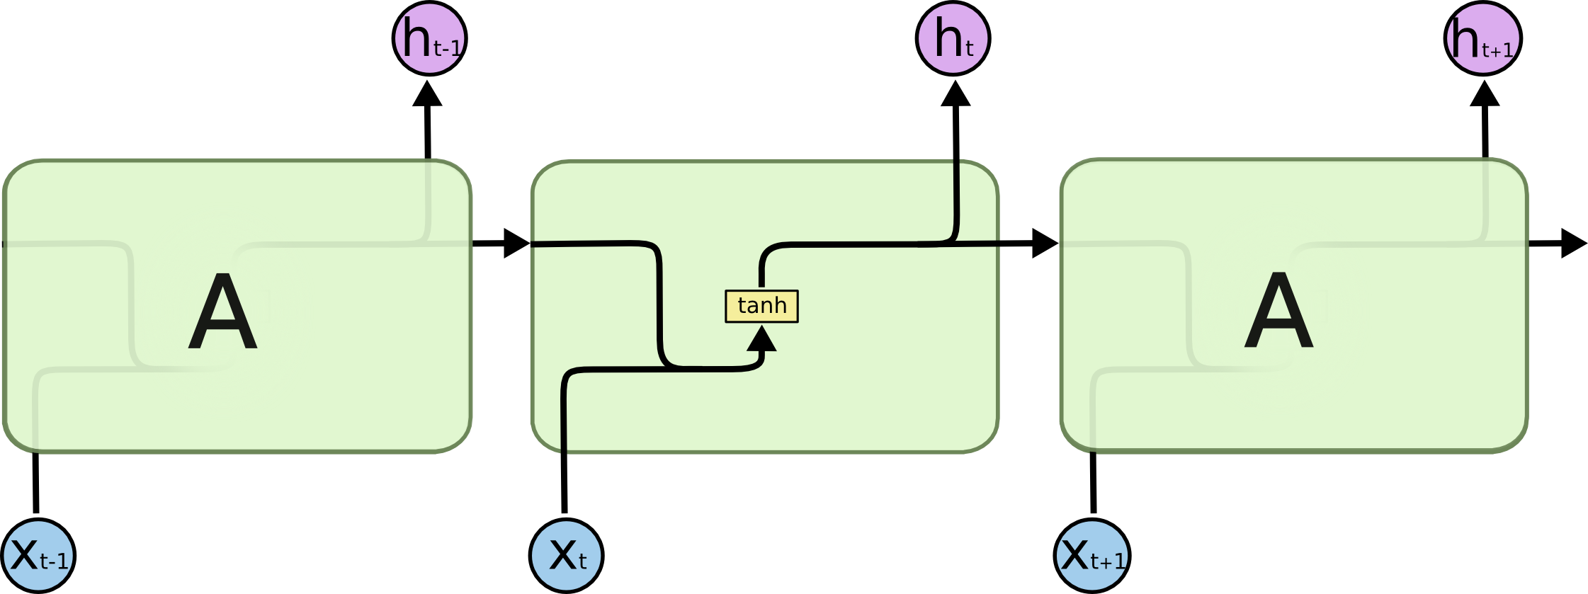
A recurrent tanh layer
A hidden layer with recurrent connections that uses the tanh activation function takes as input the input vector at time t ($x_{t}$) and the hidden state at time t-1 ($h_{t−1}$), and outputs the hidden state at time t ($h_{t}$) which can be used in another layer (on top) or propagated forward in time (on the right).
Source

Slide 61
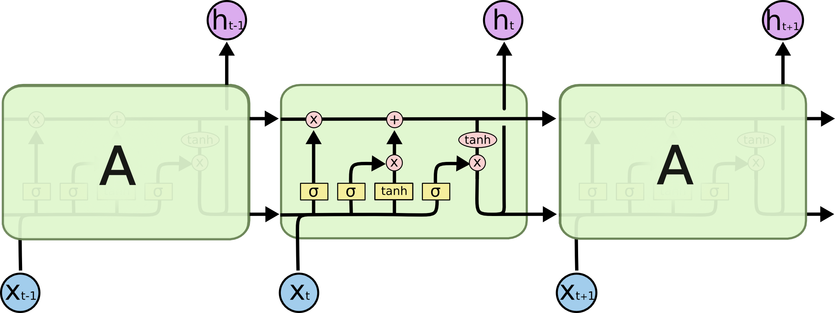
LSTM layers
An LSTM cell outputs two states: (1) the cell state which is propagated forward in time, and (2) the hidden state which can be used in other layers on top or propagated forward in time.
LSTM: has 3 gates to protect and control cell state
Source

Slide 62
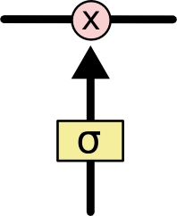
LSTM layers
Cell state runs with only some minor linear interactions. It is propagated forward in time.
Gates: way to optionally let information through
Composed of sigmoid layer and pointwise multiplication operation
Sigmoid output: [0,1]
Value of 0: let nothing through
Value of 1: let everything through
Source

Slide 63
LSTM layers
Forget gate: what information to throw away
Outputs [0,1]
1: completely keep this
0: completely forget this
Source

Slide 64
LSTM layers
Input gate: what information to store in the cell state
Vector of new candidate values that could be added to the state: pushed through tanh to become in [-1,1]
Source

Slide 65
LSTM layers
Update the old cell state into the new state
Controls what to forget
Controls what to add
Source

Slide 66
LSTM layers
Output gate: decide what part of the cell state to output
Hidden state: cell state through tanh to become in [-1,1] gated by the output gate
Source

Slide 67
LSTM applications
Robot control
Time series prediction
Speech recognition
Rhythm learning
Music composition
Grammar learning
Handwriting recognition
Human action recognition
Drug design
…

Slide 68
Text Data

Slide 69
Word representation
$V=$ [a, aaron, …, zulu]
1-hot encoding
$$\left|V\right|=10,000$$
Weakness: Does not generalize well across words!
I want a glass of orange _____
I want a glass of apple _____
Distance between any pair of these words will be the same
Man
(5391)
$$\left[\begin{matrix}\begin{matrix}0 \\ 0 \\ 0\end{matrix} \\ \begin{matrix}0 \\ ⋮ \\ 1\end{matrix} \\ \begin{matrix}⋮ \\ 0 \\ 0\end{matrix}\end{matrix}\right]$$
Woman
(9853)
$\left[\begin{matrix}\begin{matrix}0 \\ 0 \\ 0\end{matrix} \\ \begin{matrix}0 \\ 0 \\ ⋮\end{matrix} \\ \begin{matrix}1 \\ ⋮ \\ 0\end{matrix}\end{matrix}\right]$
King
(4914)
$\left[\begin{matrix}\begin{matrix}0 \\ 0 \\ 0\end{matrix} \\ \begin{matrix}⋮ \\ 1 \\ ⋮\end{matrix} \\ \begin{matrix}0 \\ 0 \\ 0\end{matrix}\end{matrix}\right]$
Queen
(7157)
$\left[\begin{matrix}\begin{matrix}0 \\ 0 \\ 0\end{matrix} \\ \begin{matrix}0 \\ 0 \\ ⋮\end{matrix} \\ \begin{matrix}1 \\ ⋮ \\ 0\end{matrix}\end{matrix}\right]$
Apple
(456)
$\left[\begin{matrix}\begin{matrix}0 \\ ⋮ \\ 1\end{matrix} \\ \begin{matrix}⋮ \\ 0 \\ 0\end{matrix} \\ \begin{matrix}0 \\ 0 \\ 0\end{matrix}\end{matrix}\right]$
Orange
(6257)
$\left[\begin{matrix}\begin{matrix}0 \\ 0 \\ 0\end{matrix} \\ \begin{matrix}0 \\ 0 \\ ⋮\end{matrix} \\ \begin{matrix}1 \\ ⋮ \\ 0\end{matrix}\end{matrix}\right]$
Adapted from: Andrew Ng, Deep Learning course, Coursera

Slide 70
Word embeddings
Convert one-hot representation into a featurized one, i.e., a numerical vector representation in a predefined N-dimensional space
This transformation is learned
Each word has a unique vector representation
Word embeddings try to capture the semantic, contextual and syntactic meaning of each word based on the usage of these words in sentences
Words that have similar semantic and contextual meaning also have similar vector representations
Popular models: Word2Vec, Glove, ELMo

Slide 71
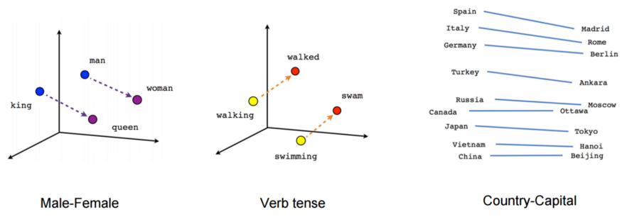
Properties of word embeddings

Slide 72
Applications
Named entity recognition
Sentiment classification
Document classification
Analyzing survey responses
Information retrieval
Language Translation
Spam detection
Recommender systems
…

Slide 73
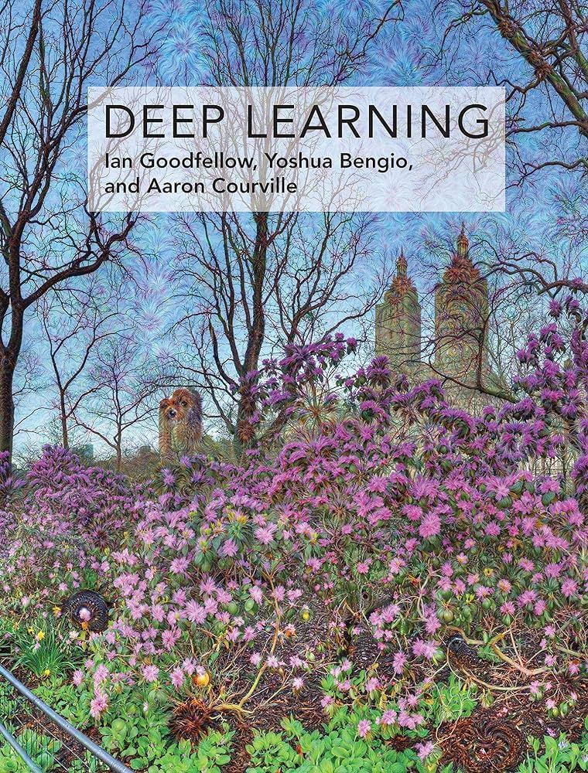
Resources
Deep Learning – Wikipedia
Deep Learning book (Goodfellow et al. 2016)
Convolutional neural network – Wikipedia
Recurrent neural network – Wikipedia
Echo state network – Wikipedia
Long short-term memory – Wikipedia
Word embedding – Wikipedia

Slide 74
Thank you

