Slide 1
University of Cyprus - MSc Artificial Intelligence
MAI612 - MACHINE LEARNING
Lecture 12: Clustering
Vassilis Vassiliades, PhD
Winter Semester 2022/23

Slide 2
Lecture 12: Clustering
Learning Outcomes
You will learn about:
The problem of clustering in unsupervised learning and its difference between supervised classification
The k-means clustering algorithm: how it works, and how to tune it
How clustering can help supervised learning

Slide 3
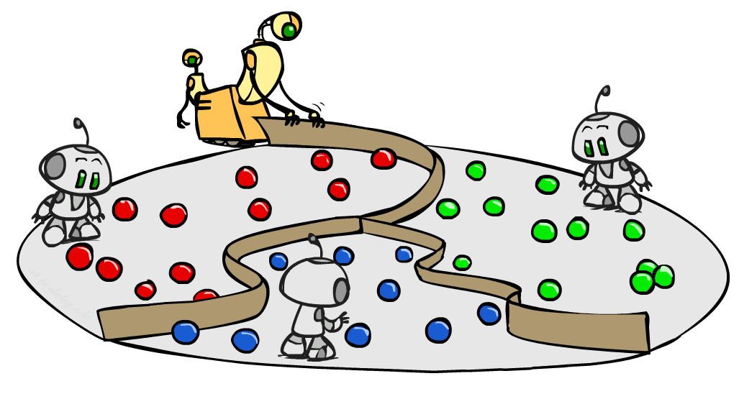
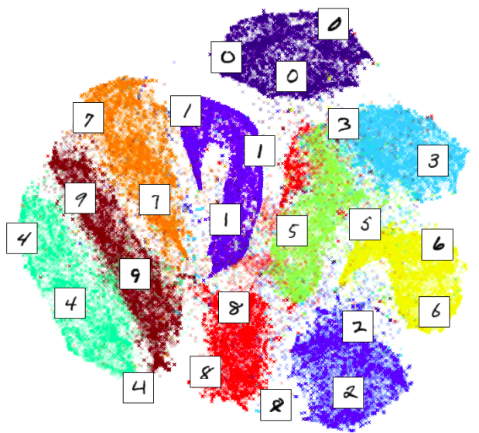
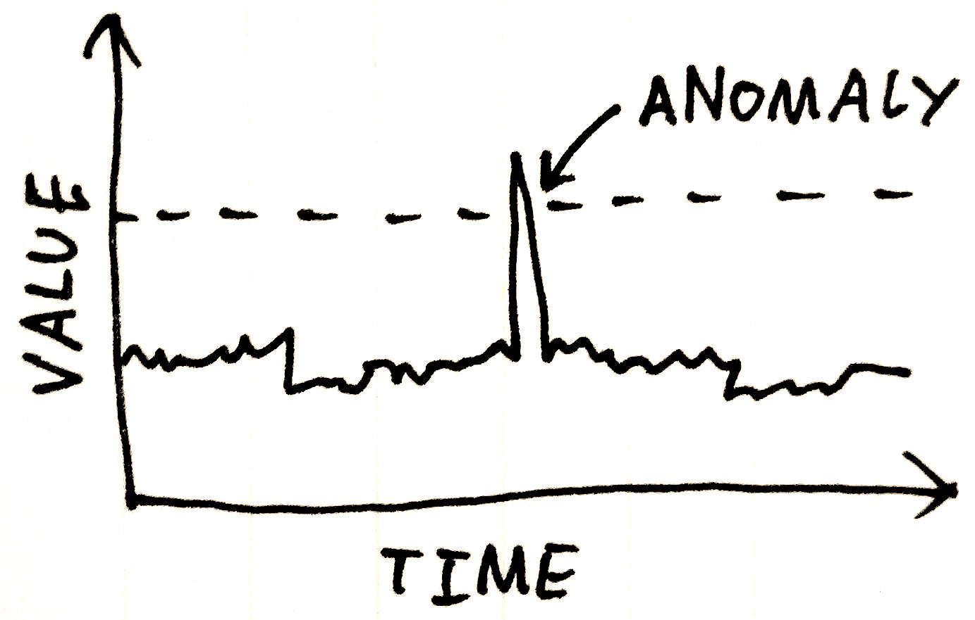
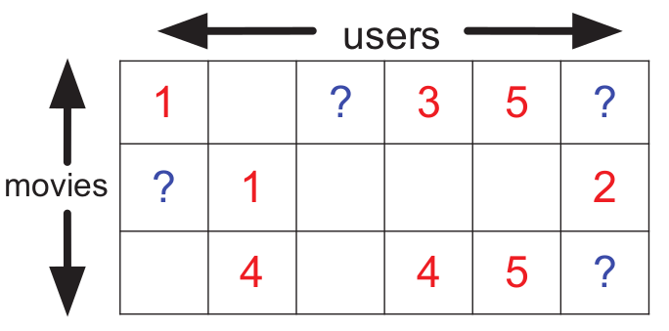
Unsupervised Learning
We present an input to the system, but we have no "teacher" to provide any "target" output
Common problems:
1. Clustering
2. Dimensionality reduction
3. Anomaly detection
4. Matrix completion (e.g., recommender systems)

Slide 4
Supervised Classification vs Clustering
Supervised Binary Classification
Clustering
Training set: { (x⁽¹⁾,y⁽¹⁾), ... , (x^{(m)},y^{(m)}) }
Training set: { x⁽¹⁾, x⁽²⁾, ... , x^{(m)} }

Slide 5
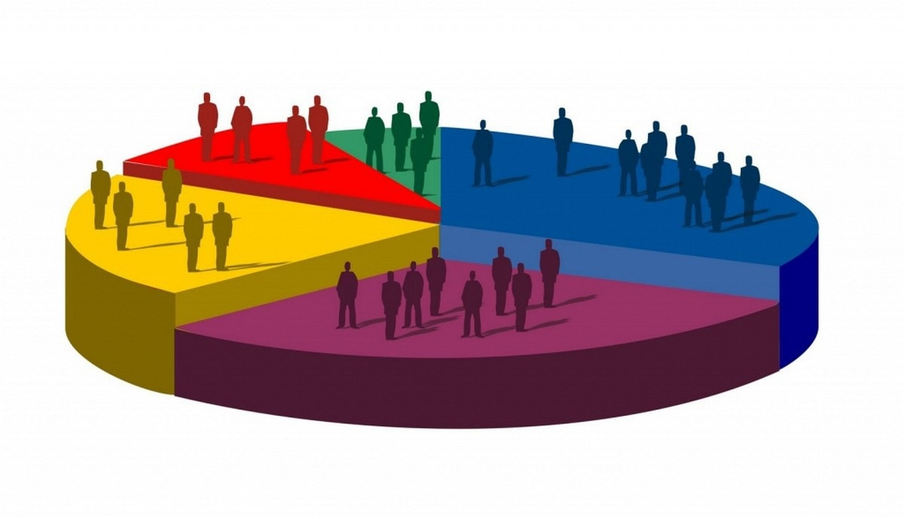
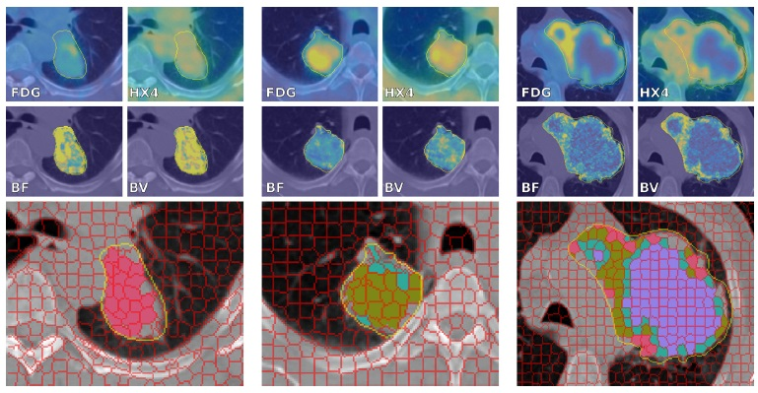
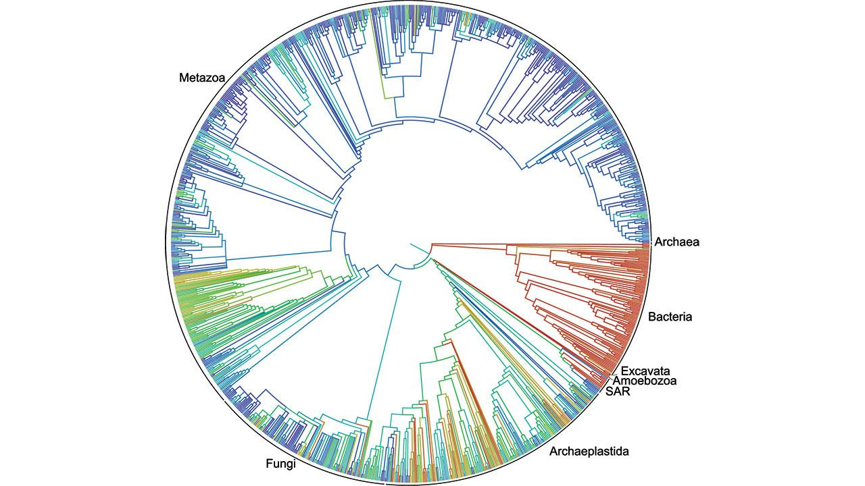
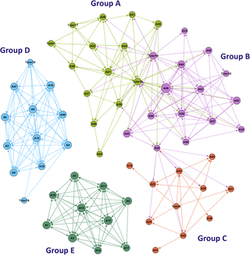
Applications
Market segmentation
Medical imaging
Animal ecology
Social Network Analysis

Slide 6
K-means clustering algorithm
Input: Training set: { x⁽¹⁾, x⁽²⁾, ... , x^{(m)} }, x^{(i)} $∈R^{n}$
Number of clusters K
Randomly initialize K cluster centroids μ₁, μ₂, ... , μ_{Κ} $∈R^{n}$
Repeat:
Assign each training point to a cluster centroid
for i = 1 to m
c(i) = index (1 to K) of cluster centroid closest to x^{(i)}
Update the cluster centoids
for j = 1 to K
μ_{j} = mean of points assigned to cluster j
$$\min_{k}{\left\|x^{\left(i\right)}−μ_{k}\right\|}^{2}$$
j=2
c(3)=2, c(6)=2, c(7)=2
μ₂ = 1/3 (x⁽³⁾+x⁽⁶⁾+x⁽⁷⁾)

Slide 7
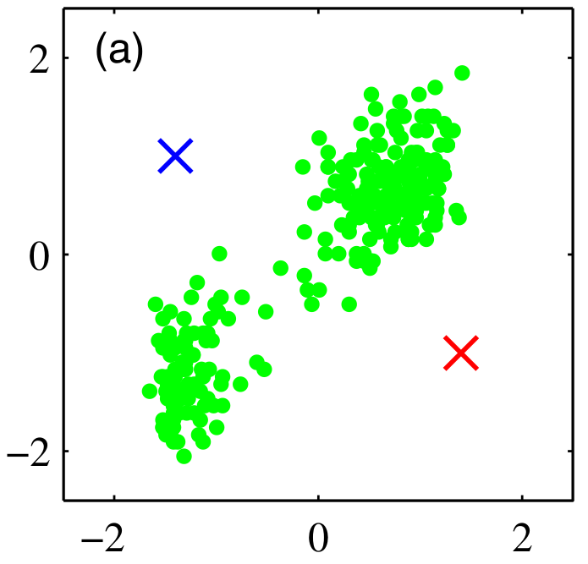
K-means clustering algorithm
Randomly initialize
K=2 cluster centroids
source: Bishop 2006

Slide 8
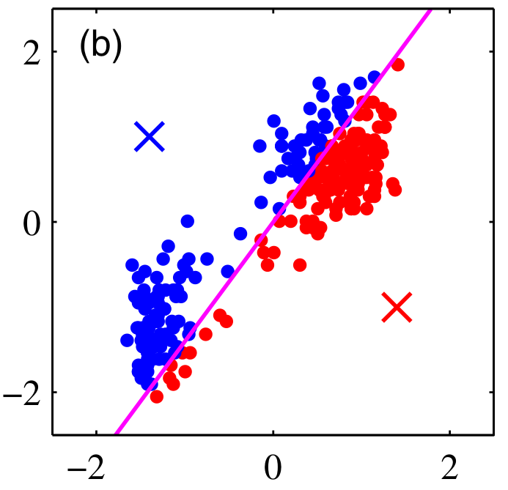
K-means clustering algorithm
Iteration: 1
Assignment step
source: Bishop 2006

Slide 9
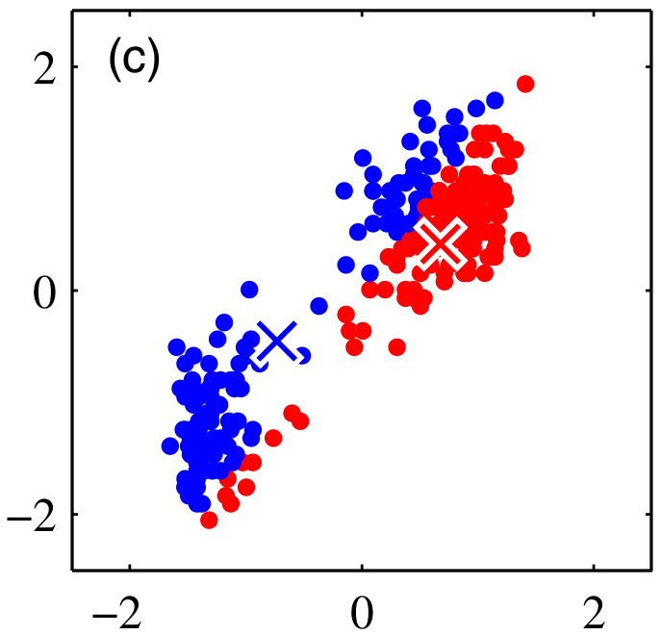
K-means clustering algorithm
Iteration: 1
Update step
source: Bishop 2006

Slide 10
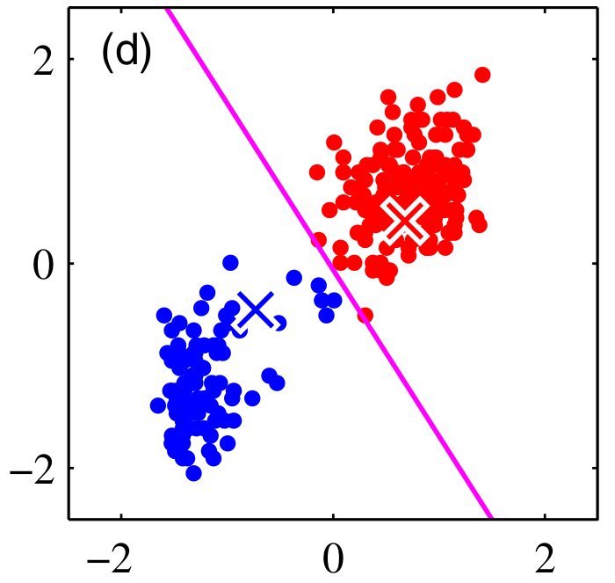
K-means clustering algorithm
Iteration: 2
Assignment step
source: Bishop 2006

Slide 11
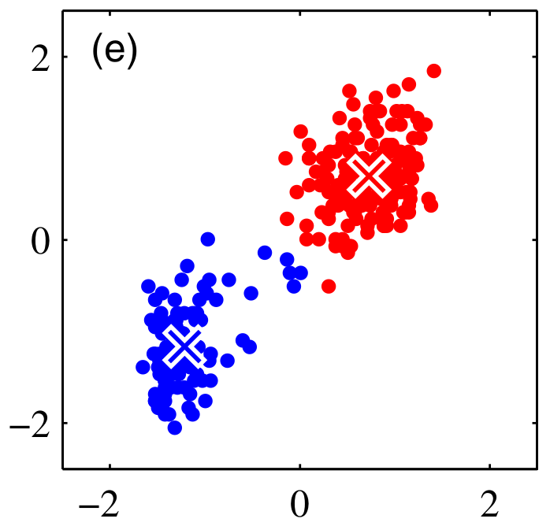
K-means clustering algorithm
Iteration: 2
Update step
source: Bishop 2006

Slide 12
K-means clustering algorithm
Iteration: 3
Assignment step
source: Bishop 2006

Slide 13
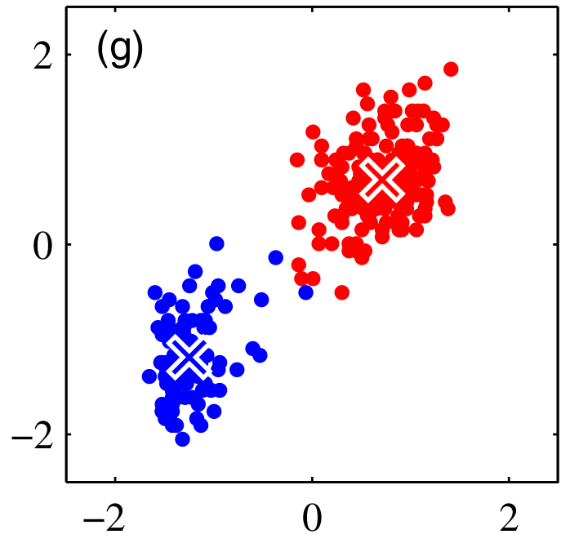
K-means clustering algorithm
Iteration: 3
Update step
source: Bishop 2006

Slide 14
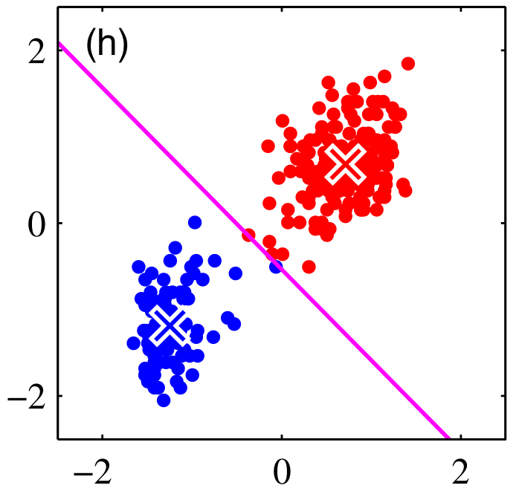
K-means clustering algorithm
Iteration: 4
Assignment step
source: Bishop 2006

Slide 15
K-means clustering algorithm
Iteration: 4
Update step
source: Bishop 2006

Slide 16
Random initialization
x
Instead of random initial centroids,
randomly pick K training instances
Set μ₁, μ₂, ... , μ_{Κ} equal to
these K points
Should have K < m
x
K=2
μ₁ = x^{(i)}
μ₂ = x^{(j)}
x
x

Slide 17
Random initialization
x
x
x
Local Optima
x
x
x
Global Optimum
x
x
x

Slide 18
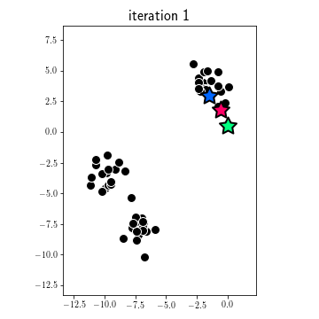
Empty clusters
source

Slide 19
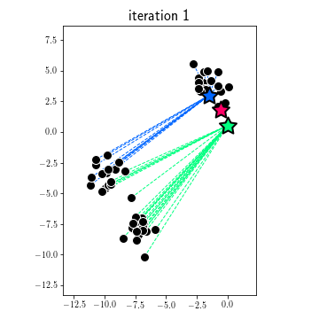
Empty clusters
source
Assignment step

Slide 20
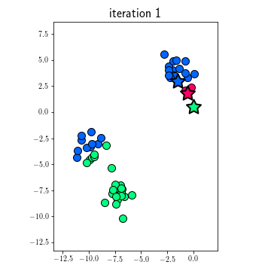
Empty clusters
source
Assignment step

Slide 21
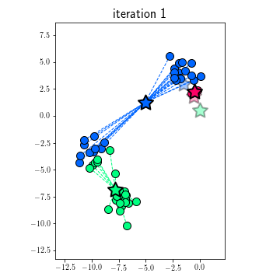
Empty clusters
source
Update step

Slide 22
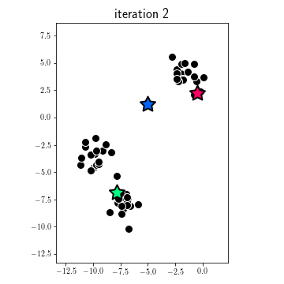
Empty clusters
source

Slide 23
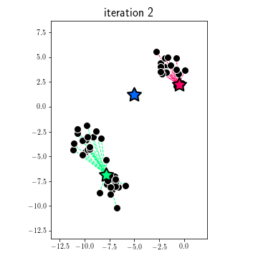
Empty clusters
source
Assignment step
No points are close to the blue centroid

Slide 24
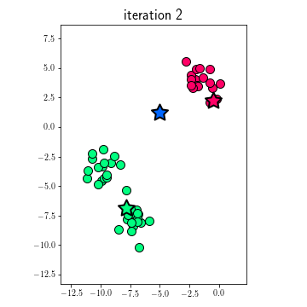
Empty clusters
source
Assignment step
The blue centroid ends up without any points assigned to it

Slide 25
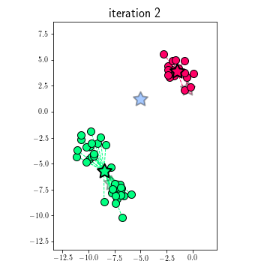
Empty clusters
source
Update step

Slide 26
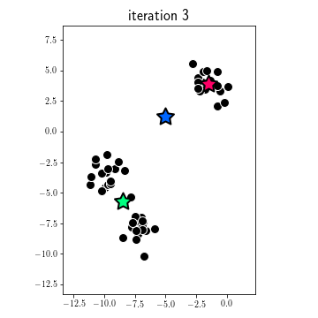
Empty clusters
source

Slide 27
Empty clusters
source
Assignment step

Slide 28
Empty clusters
source
Assignment step

Slide 29
Empty clusters
source
Update step
The blue centroid will never be assigned any points.
Potential remedy: when discovering empty clusters, reduce K by 1, or restart from a different random initialization

Slide 30
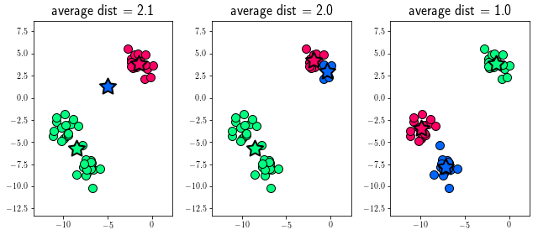
Avoiding local optima
Run K-means multiple times:
for i = 1 to N
Randomly initialize K-means
Run K-means. Get θ = c(1),...,c(m),μ₁,...,μ_{K}
Compute Cost Function: L(θ) = L(c(1),...,c(m),μ₁,...,μ_{K})
Pick clustering with the lowest cost L(θ)
What is the cost function?

Slide 31
Cost function
Notation
μ_{j} = cluster centroid j (μ_{j} $∈R^{n}$)
c(i) = index of cluster (1 to K) to which x^{(i)} is assigned
μ_{c(i)} = cluster centoid of cluster to which x^{(i)} is assigned
Example
x^{(i)} assigned to cluster 3
c(i) = 3
μ_{c(i)} = μ₃
$$x^{(i)}$$
Objective
$$minimize L(θ)$$
x₂
Average Intra-cluster distance
$$μ_{c(i)}$$
θ
x
$L(θ)$ = L(c(1),...,c(m),μ₁,...,μ_{K}) = $\frac{1}{m}\sum_{i=1}^{m}{{|| x^{(i)}−μ_{c(i)} ||}^{2}}$
x₁

Slide 32
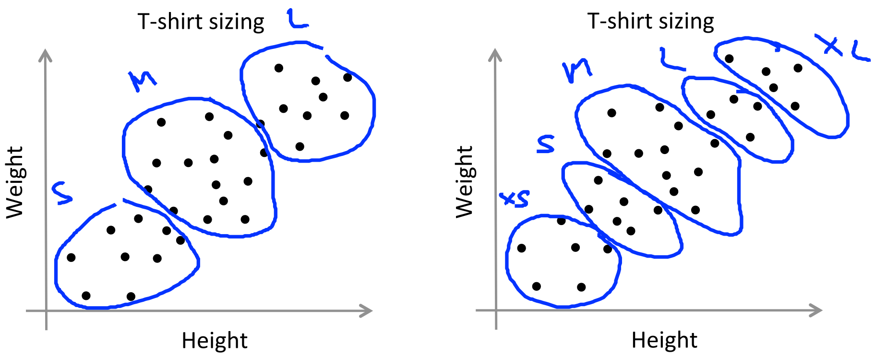
How to choose K
Domain knowledge
T-shirt sizing: K=3 K=5
source: Andrew Ng - Machine Learning, Coursera

Slide 33
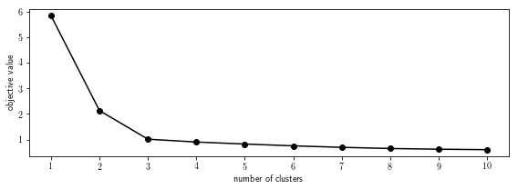
How to choose K
“Elbow” method
Elbow
K = 3

Slide 34
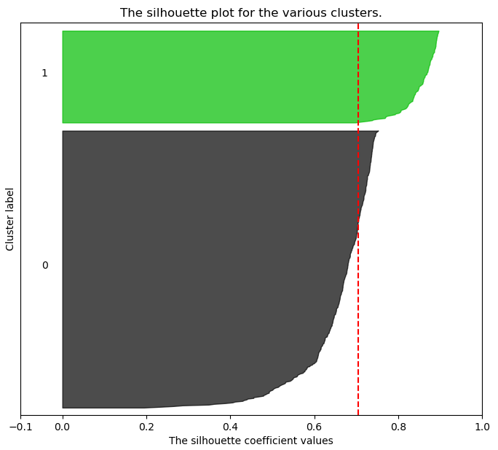
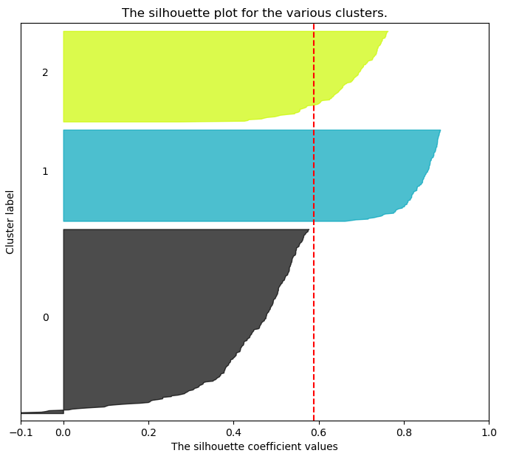
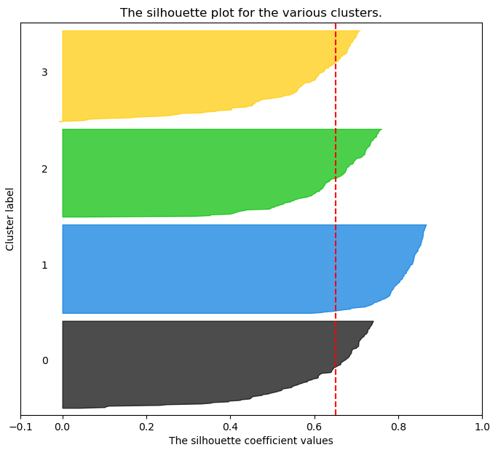
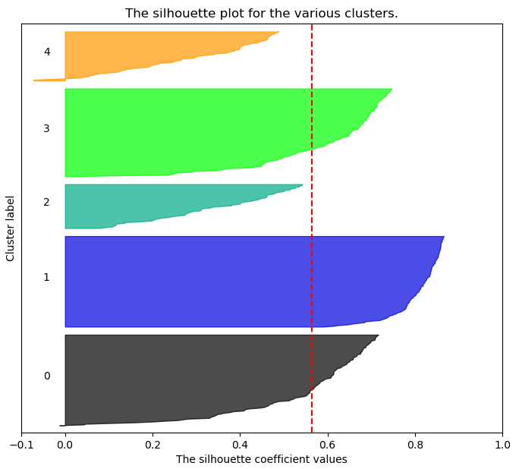
Uniform thickness
No negative values
All beyond avg
How to choose K
Silhouette Score
K=2
K=3
K=4
K=5
0.705
0.588
0.651
0.564

Slide 35
K-medoids algorithm
Similar to k-means, by attempting to minimize the distance between points to be in the cluster and points designated as the center of the cluster
Difference:
k-medoids chooses actual data points as centers
It minimizes the sum of pairwise dissimilarities instead of sum of squared Euclidean distances
This makes it more robust to noise and outliers than k-means

Slide 36
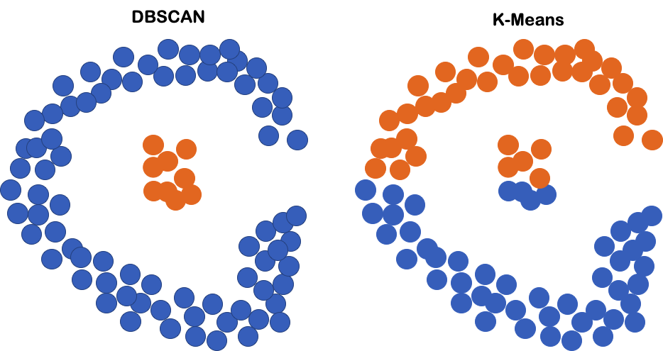
DBSCAN
Density-based clustering algorithm
Does not need to specify the number of clusters
It finds it automatically based on the density of the points
Need to define the maximum distance between two samples for one to be considered as int the neighborhood of the other

Slide 37
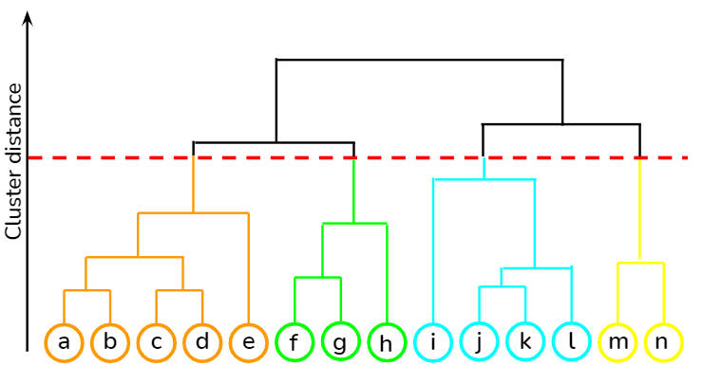
Hierarchical Clustering
Used when we want to build a hierarchy of clusters, and do not have knowledge about the number of clusters
Two categories:
Agglomerative clustering: bottom-up approach
Each point starts in its own cluster and pairs of clusters are merged as we move up the hierarchy
Divisive clustering: top-down approach
All points start in one cluster and splits are performed recursively as we move down the hierarchy
Output: a tree-shaped structure known as a dendrogram

Slide 38
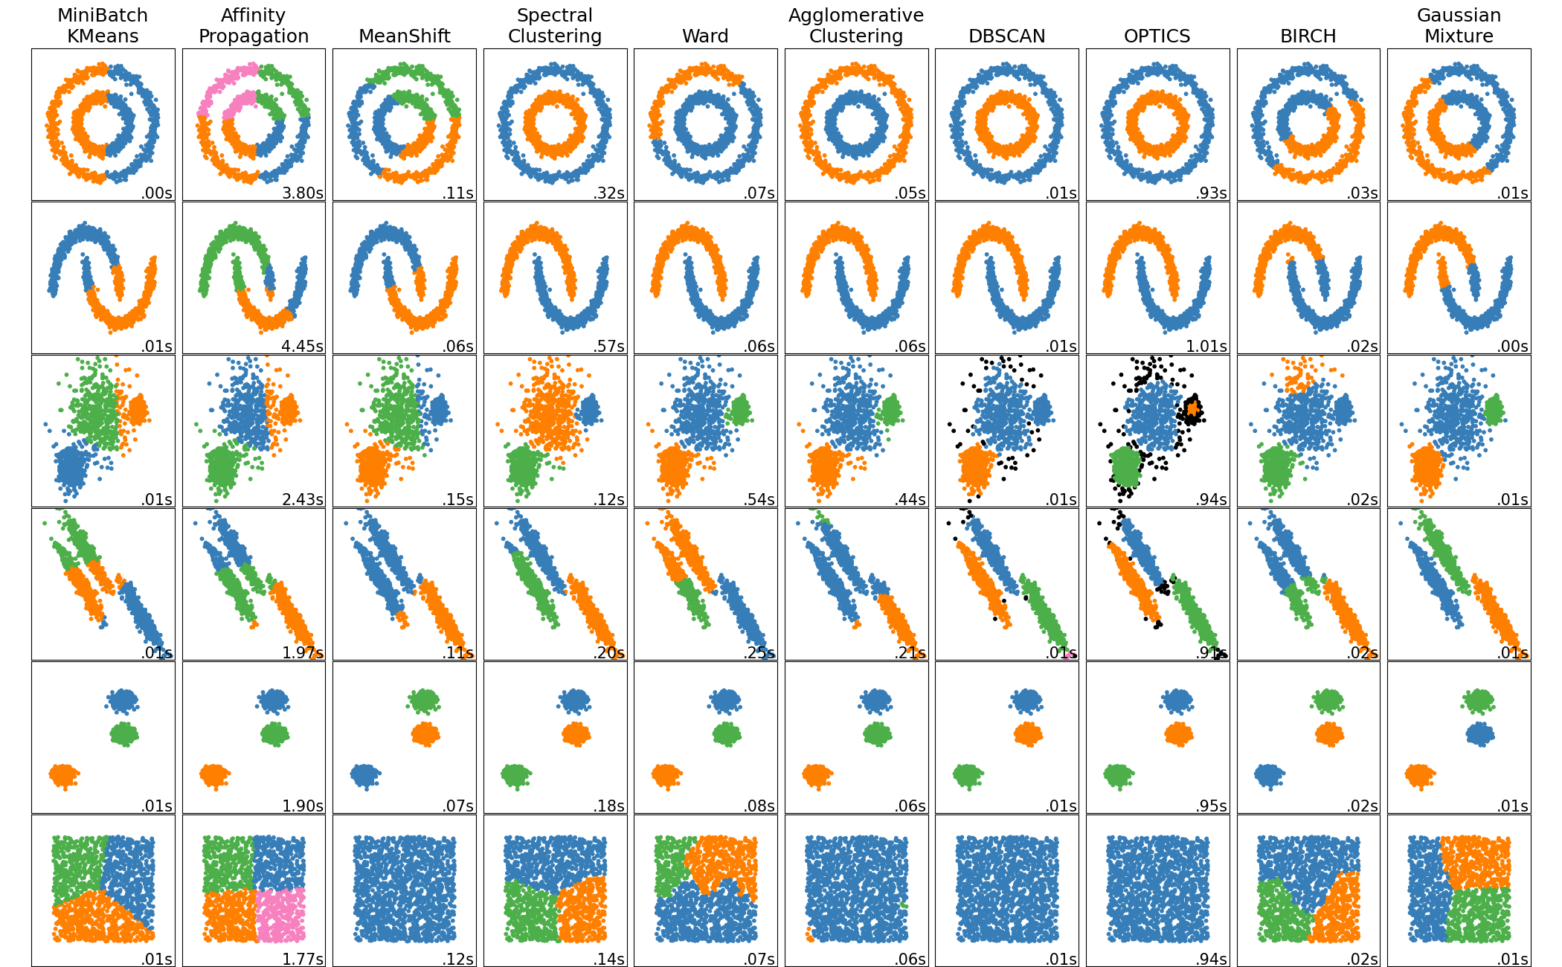
Clustering in scikit-learn
K-means in scikit-learn uses a better default initialization strategy (k-means++)

Slide 39
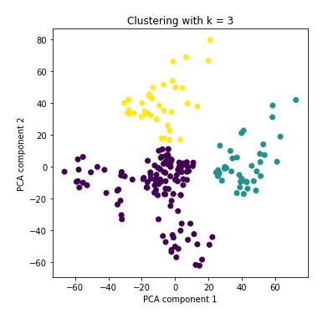
Clustering high-dimensional data
High-dimensional data: dozen to thousands of dimensions
Examples: images, text documents
Problem: As the dimensionality increases, data points become more sparse, thus, distance of the farthest point becomes closer to the distance of the closest point
Thus, distance metrics in clustering algorithms become meaningless
Mitigation: Reduce data dimensionality, then cluster
- Feature Selection
- Dimensionality reduction e.g., using PCA

Slide 40
Clustering can help supervised learning
Finding the initial centres for RBF networks
RBF networks with adjustable centres have an initialization phase where we choose the initial coordinates of the centres
The algorithm then proceeds in adapting the centre coordinates using gradient descent (GD)
How to choose initial centres:
Approach 1: Choose centres uniformly at random from data points
Simple, however, if centres not properly chosen, GD might get stuck in local optima
Approach 2: Use clustering
Results in better initial coordinates, which helps GD
Some clustering methods can even decide the optimal number of centres

Slide 41
Clustering can help supervised learning
When there are more unlabeled examples than labelled ones
Supervised learning works on labeled examples
$D_{labelled}={\left\{\left(x^{(i)},y^{(i)}\right)\right\}}_{i=1:l}$
Unlabeled examples, however, are often easier to collect
$D_{unlabelled}={\left\{\left(x^{(j)} \right)\right\}}_{j=1:u}$
Usually $u>>l$
Example: for an animal recognition task, we might have abundant images for various animals, but only very few labels
It is also often costly to label
Example: medical images, we need to employ experts to properly tag them

Slide 42
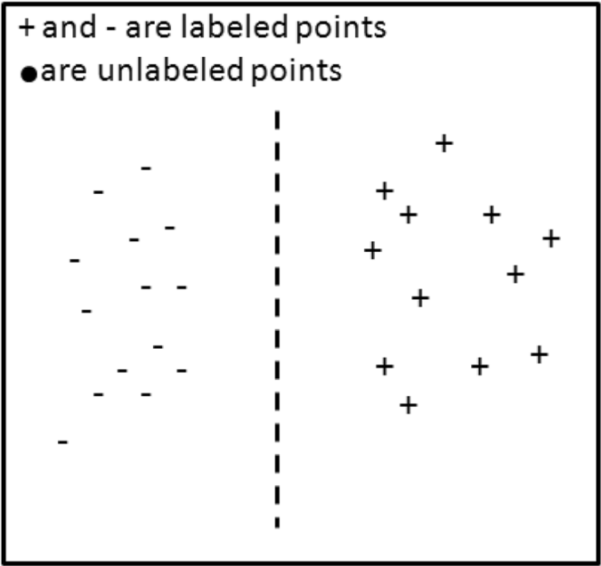
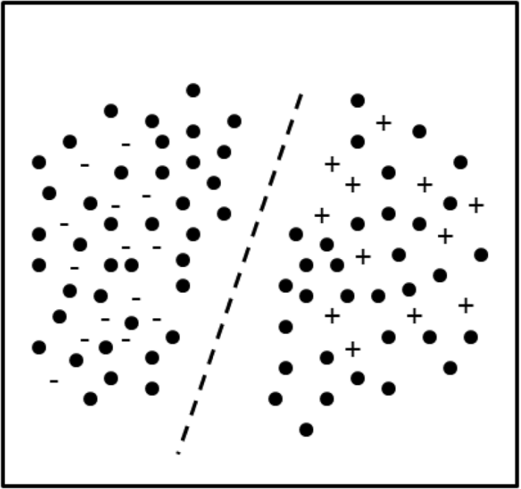
Clustering can help supervised learning
When there are more unlabeled examples than labelled ones
If we consider only labeled examples:
$$D_{labelled}$$
If we consider all data as training data:
$${D=D}_{labelled}∪D_{unlabelled}$$
Different decision boundary
Improved generalization performance
Images source

Slide 43
Resources
Unsupervised learning – Wikipedia
Clustering – Wikipedia
K-means clustering – Wikipedia
Elbow method – Wikipedia
Silhouette – Wikipedia

Slide 44
Next Lecture
- Dimensionality Reduction

Slide 45
Thank you

