Slide 1
University of Cyprus - MSc Artificial Intelligence
MAI612 - MACHINE LEARNING
Lecture 14: Anomaly Detection
Vassilis Vassiliades, PhD
Winter Semester 2022/23

Slide 2
Revision

Slide 3
Dimensionality Reduction
What is dimensionality reduction: transformation of high-dimensional data to low-dimensional space
Why dimensionality reduction:
Data visualization
Data compression
Can help ML algorithms (supervised learning, clustering)
Principal Component Analysis
Linear transformation into a new coordinate system
Maximize variance of low-dimensional data = minimizing reconstruction error
Finds $n$ orthogonal vectors each ranked by how much it explains the variance in data
These are the principal components or eigenvectors
Projection = encoding in low dimensions
Reconstruction = decoding from low dimensions to high-dimensions
We can choose the number of components based on a desired ratio of explained variance (typically 90-99%)

Slide 4
Dimensionality Reduction
PCA works well in various problems but it is a linear method
Nonlinear dimensionality reduction methods address this shortcoming
Kernel PCA uses the kernel trick
Autoencoders are NNs trained to encode and reconstruct the input
Manifold learning approaches = nonlinear dimensionality reduction methods that explicitly consider that the data lie on low-dimensional structures embedded in high-dimensional space
Isomap: instead of Euclidean distance, considers the geodesic distance
Geodesic distance: distance on the manifold
Swiss roll example: isomap can unfold it
Allows better interpolation as the interpolated points expected to lie on the manifold
t-SNE
used for visualization
stochastic method that preserves local similarities
can give different results for different initializations

Slide 5
Lecture 14: Anomaly Detection
Learning Outcomes
You will learn about:
The problem of anomaly detection and its difference with binary classification
The concept of density estimation and how to use it for anomaly detection
How to fit the parameters of a Gaussian probability density
Building an anomaly detection model using kernel density estimation, one-class SVMs, isolation forests and autoencoders
How to evaluate anomaly detection systems

Slide 6
Anomaly Detection
Anomaly detection algorithms look at an unlabeled dataset of normal events and raise an alarm when an unusual or anomalous event occurs.
Fraud detection example:
Given a dataset $D=\left\{x^{(1)},…,x^{(m)}\right\}$
$x^{(i)}$ features of user i’s activities
Features:
$x_{1}=$ number of transactions
$x_{2}=$ typing speed
New user: $x^{(new)}$
$$x_{2}$$
anomaly
ok
$$x_{1}$$

Slide 7
Supervised Binary Classification vs Anomaly Detection
(c)
(a)
(b)
Availability of a large number of positive and negative examples
Algorithm understands how to structure the decision boundary
Future negative examples likely to be similar to ones in training set
If there are no negative examples available during training how should the decision boundary be?
Examples:
Fraud detection
Machine monitoring

Slide 8
Anomaly Detection
Outlier Detection
Novelty Detection
new instances
outlier
inlier
Training data polluted by outliers (instances far from the others)
Fit regions of most concentrated data
Assume outliers are not concentrated
No outliers in training data
Interested in detecting whether a new instance is an outlier (novelty)
Novelties could be concentrated as long as they are in a low-density region of the training data

Slide 9
Density Estimation
Random variable $x$ sampled from unknown probability distribution $p(x)$
$x$ is a feature
Probability density: relationship between outcomes (values) of $x$ and its probability
Some outcomes of a random variable will have low probability density, others will have a high probability density
Probability distribution: the shape of the probability density across the domain of $x$
E.g., uniform, Gaussian, exponential
Calculation of probabilities for specific outcomes of $x$is performed by a probability density function (PDF)
Useful to know the PDF for a sample of data in order to know whether a given observation is unlikely, so as to consider it an outlier or anomaly
(Probability) Density Estimation: we are using the observations from our sample (data) to estimate the density of probabilities beyond just the sample
source

Slide 10
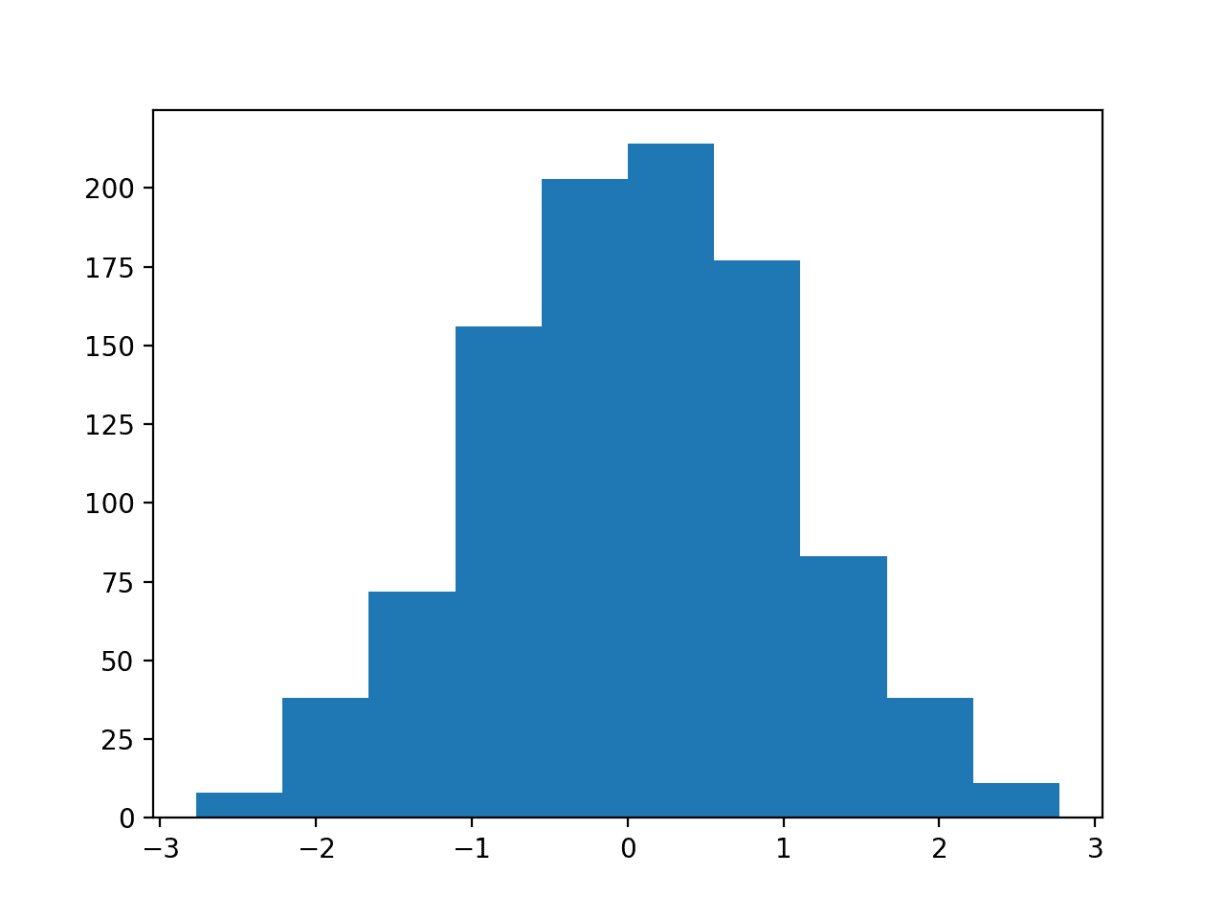
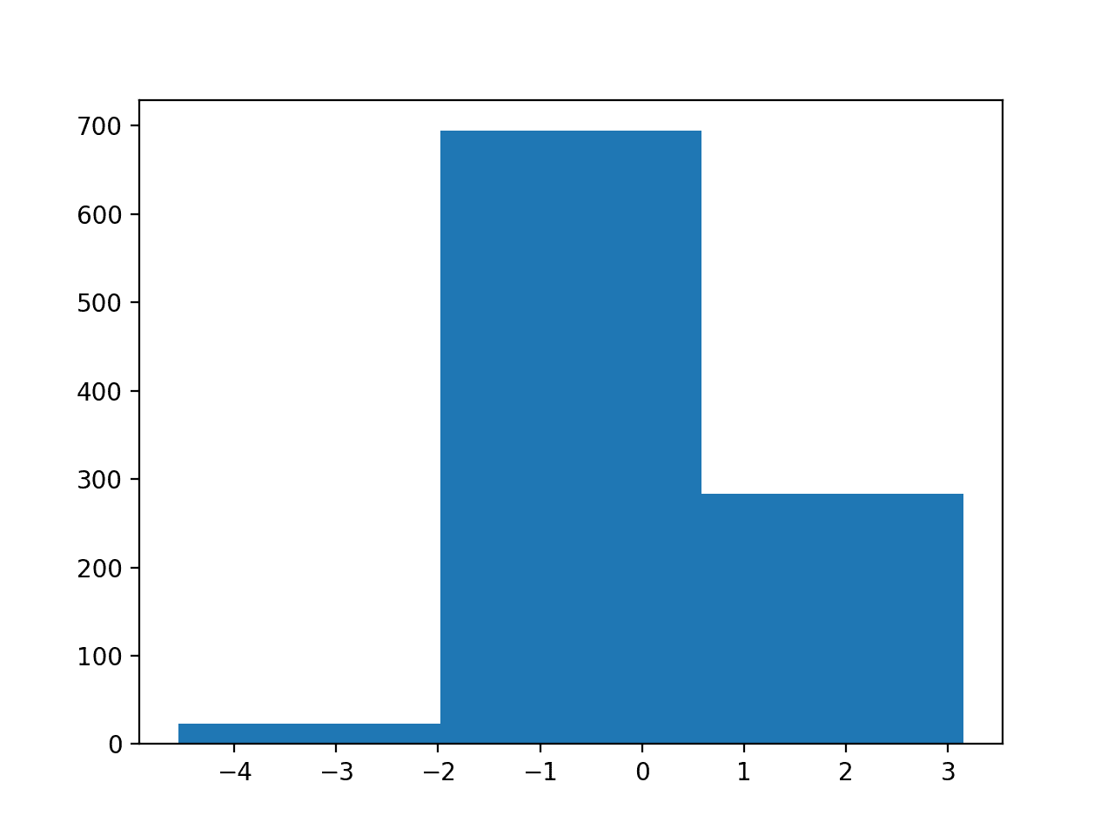
Density Estimation: Histogram
Histogram: plot that groups observations into bins and counting the number of events that fall in the bin
The counts (or frequencies) in each bin are plotted as a bar graph with bins on x-axis and frequency on y-axis
Choice of number of bins is important:
controls the coarseness of the distribution
how well the density of observations is plotted
Shape of the histogram often matches well-known probability distributions
10 bins
3 bins
source

Slide 11
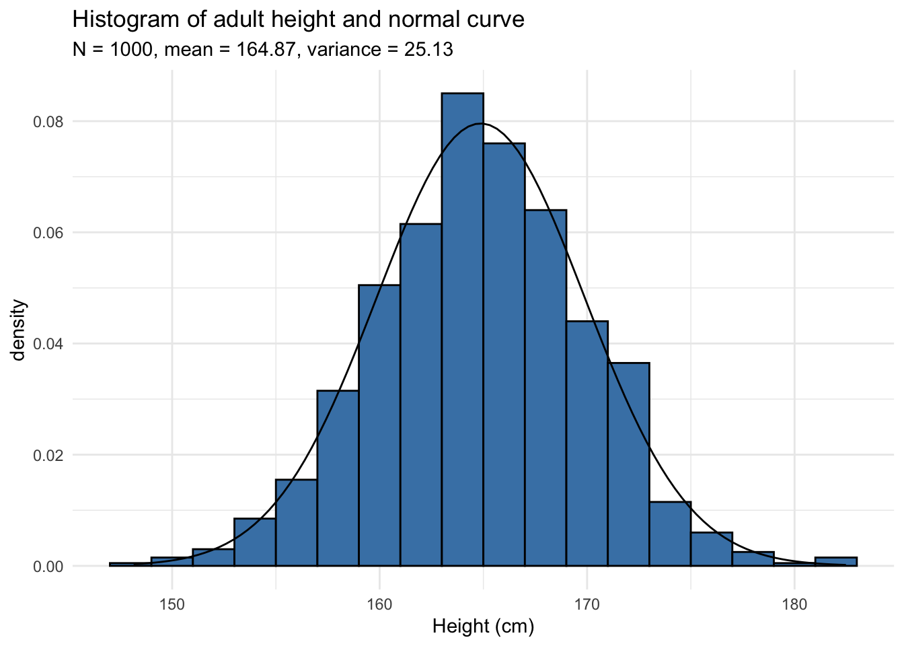
Parametric Density Estimation
Example:
Take 1000 random people and measure their height
Create a histogram of the data
Sampled points follow a Gaussian distribution
It has parameters: mean and variance
Mean: 164.87
Variance: 25.13
Gaussian
distribution

Slide 12
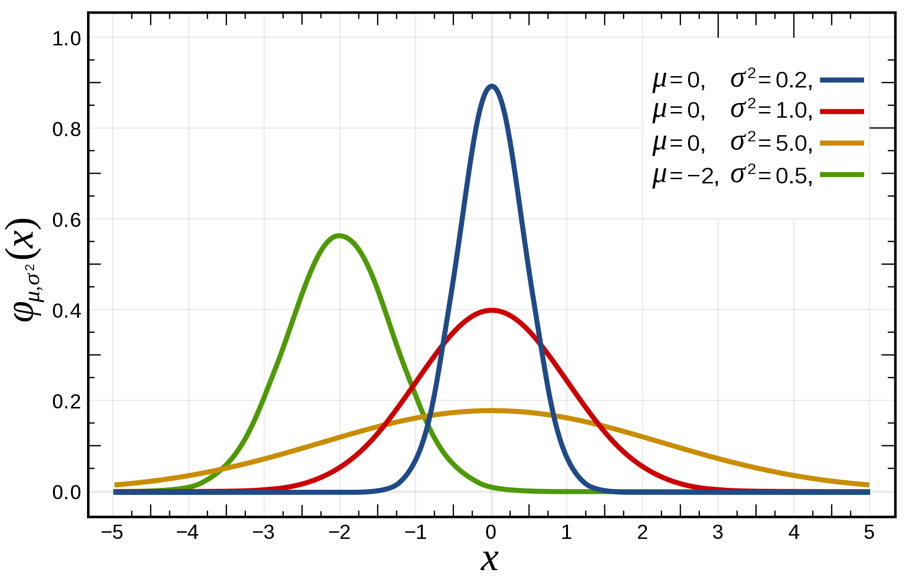
Gaussian Distribution
$$x\sim N(μ,σ^{2})$$
$$f_{θ}\left(x\right) where θ=\left(μ,σ^{2}\right)$$
$$f_{μ,σ^{2}}(x)=\frac{1}{σ\sqrt{2π}}exp\left(\frac{−{(x−μ)}^{2}}{2σ^{2}}\right)$$
$$f_{θ}(x)=\frac{1}{θ_{2}\sqrt{2π}}exp\left(\frac{−{(x−θ_{1})}^{2}}{2θ_{2}^{2}}\right)$$
Linear regression: $f_{θ}(x)=$ $θ_{1}x+θ_{2}$

Slide 13
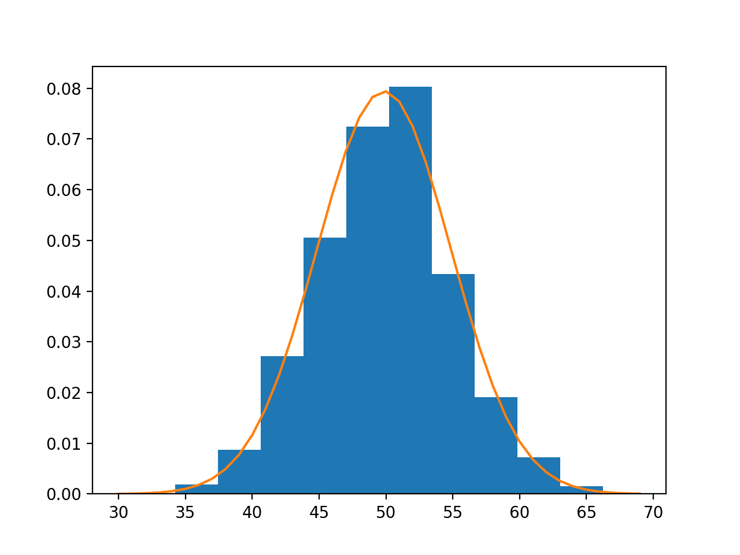
Parameter fitting
How do we estimate the parameters of this model?
$$p(x)$$
high
Dataset: $D=\left\{x^{(1)},…,x^{(m)}\right\}$
$$μ=\frac{1}{m}\sum_{i=1}^{m}{x^{(i)}}$$
$$σ^{2}=\frac{1}{m}\sum_{i=1}^{m}{{\left(x^{(i)}−μ\right)}^{2}}$$
$$p(x)$$
low
$$p\left(x\right)=f_{μ,σ^{2}}(x)=\frac{1}{σ\sqrt{2π}}exp\left(\frac{−{(x−μ)}^{2}}{2σ^{2}}\right)$$
x
x

Slide 14
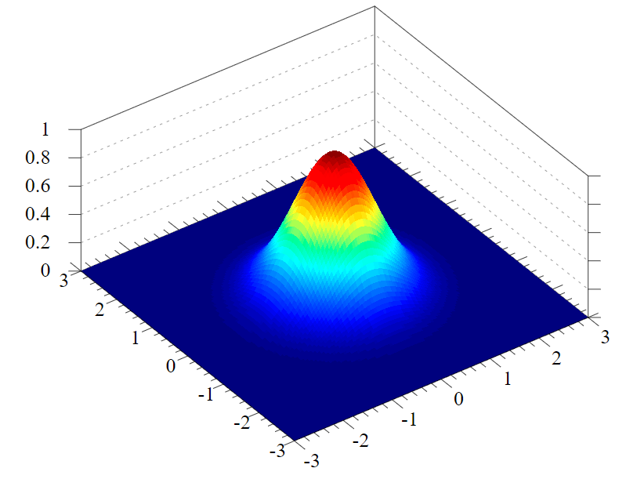
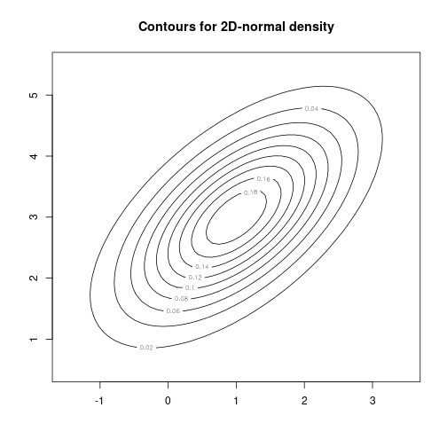
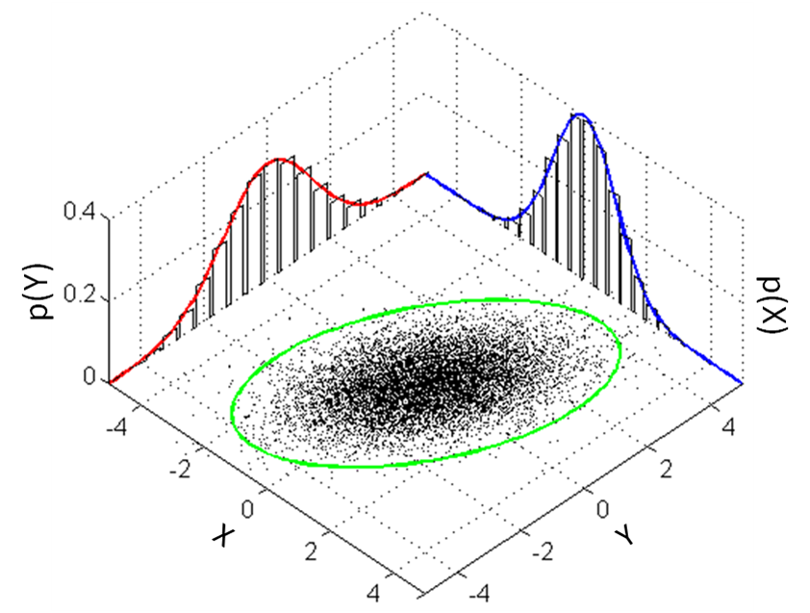
Multidimensional Gaussian Distributions

Slide 15
Density estimation in multidimensional case
Training set: $D=\left\{x^{(1)},…,x^{(m)}\right\}$
Each $x^{(i)}∈ℝ^{n}$ (has $n$ features)
$$p\left(x\right)=p\left(x_{1};μ_{1},σ_{1}^{2}\right)∗p\left(x_{2};μ_{2},σ_{2}^{2}\right)∗…∗p\left(x_{n};μ_{n},σ_{n}^{2}\right)$$
We multiply because the probability of $x_{1}$ taking a particular value AND $x_{2}$ taking a particular value becomes lower.
$$p\left(x\right)=\prod_{j=1}^{n}{p\left(x_{j};μ_{j},σ_{j}^{2}\right)}$$

Slide 16
Anomaly detection using density estimation
Dataset $D=\left\{x^{(1)},…,x^{(m)}\right\}$
Is $x^{(new)}$ anomalous?
$$p\left(x^{\left(new\right)}\right)< ε$$
anomaly
normal
Model $p\left(x\right)$
$$p\left(x^{\left(new\right)}\right)≥ ε$$
$$x_{2}$$
anomaly
In order to model $p(x)$ we will use a Gaussian distribution
$$x_{1}$$

Slide 17
Anomaly Detection Algorithm
Given dataset $D=\left\{x^{(1)},…,x^{(m)}\right\}$
1. Choose $n$ features that might be indicative of anomalous examples
2. Fit parameters $μ_{1},…,μ_{n},σ_{1}^{2},…,σ_{n}^{2}$
$μ_{j}=\frac{1}{m}\sum_{i=1}^{m}{x_{j}^{(i)}}$ $σ_{j}^{2}=\frac{1}{m}\sum_{i=1}^{m}{{\left(x_{j}^{(i)}−μ_{j}\right)}^{2}}$
3. Given new example $x$, compute $p\left(x\right)$
$p\left(x\right)=\prod_{j=1}^{n}{p\left(x_{j};μ_{j},σ_{j}^{2}\right)}=\prod_{j=1}^{n}{\frac{1}{σ_{j}^{}\sqrt{2π}}exp\left(\frac{−{(x_{j}−μ_{j})}^{2}}{2σ_{j}^{2}}\right)}$
4. If $p\left(x\right)<ε$: $x$ is an anomaly
$$(μ_{1}{,σ}_{1}^{2},μ_{2}{,σ}_{2}^{2})$$
x₂
$$ε=0.01$$
x₁
$$p(x)=f_{μ_{1}σ_{1}^{2}}(x_{1})f_{μ_{2}σ_{2}^{2}}(x_{2})$$
$$p\left(x\right)=0.001< ε$$
anomaly
$$p\left(x\right)=0.041≥ ε$$
normal

Slide 18
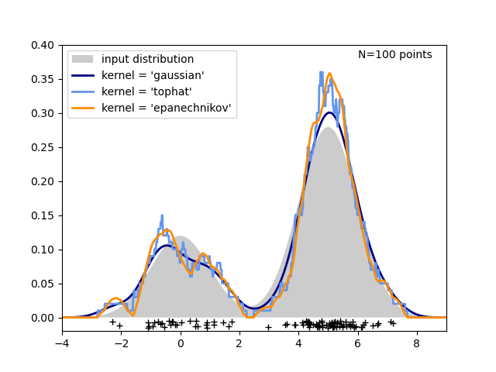
Nonparametric Density Estimation
What if the data are not Gaussian distributed?
100 points drawn from a bimodal distribution
Parametric density estimation will not estimate the distribution of data well
Gaussian will be centred in the middle of the points
Use Kernel Density Estimation

Slide 19
One-class classification
Common approach for anomaly detection
Instead of estimating the density we force a discriminative model to learn a conservative decision boundary that encompasses the normal points (points of the positive class)
Typical choices:
One-class SVM
Isolation forests

Slide 20
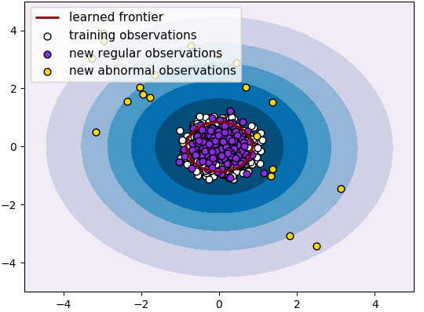
One-class SVM
Try to encompass all instances of the normal class using a hypersphere
Create the smallest possible hypersphere
Everything outside the hypersphere is considered an anomaly

Slide 21
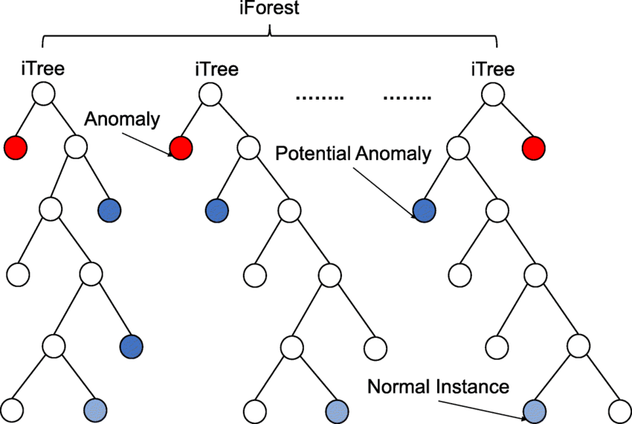
Isolation forests
Like random forests
Anomalies = observations with short average path lengths
Outliers / Anomalies are easier to isolate (short path lengths)
Inliers / Normal instances are harder to isolate (longer path lengths)

Slide 22
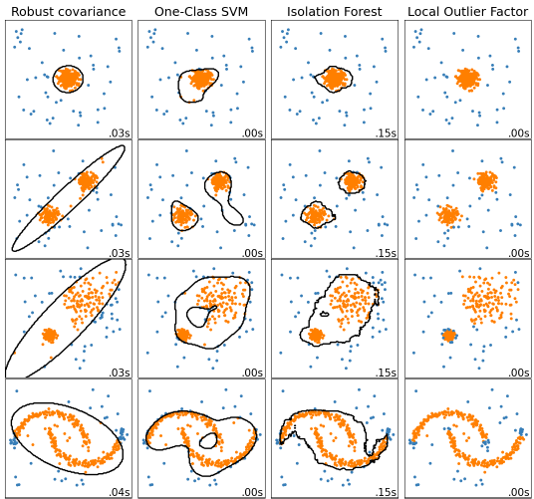
Outlier detection in scikit-learn
Typically need to set some outlier fraction parameter

Slide 23
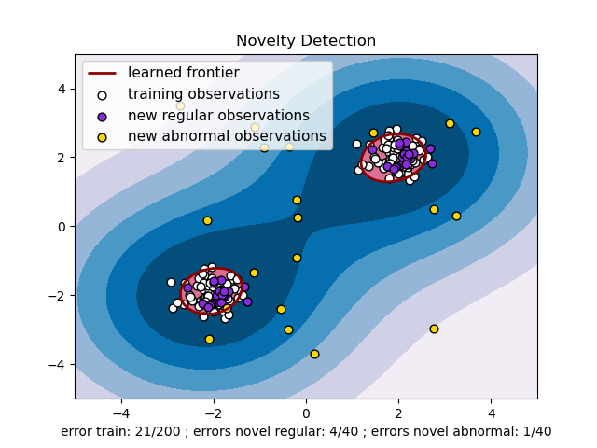
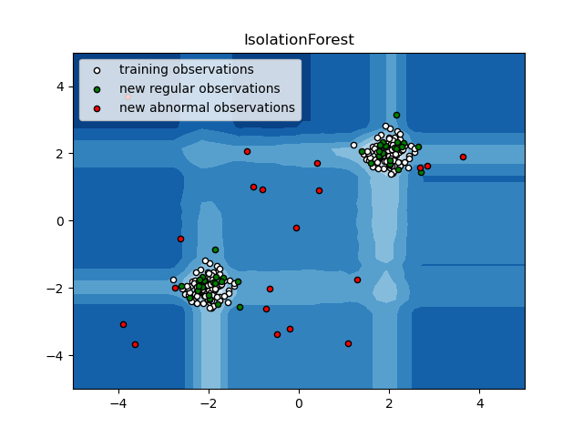
Novelty detection in scikit-learn

Slide 24
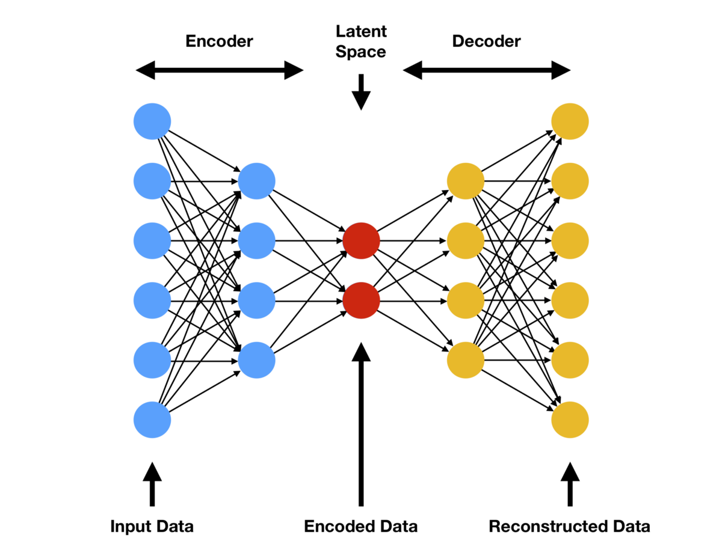
Anomaly Detection using Autoencoders
Autoencoders provide a way of finding regularities in the data, by compressing the input and reconstructing it.
They are trained to minimize the reconstruction error for a given dataset.
Key idea behind using an autoencoder for anomaly detection: normal data will have low reconstruction error, while abnormal data will have higher reconstruction error.

Slide 25
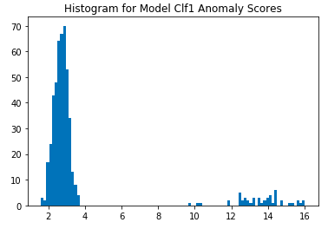
Anomaly Detection using Autoencoders
Procedure:
Given a dataset $D=\left\{x^{(1)},…,x^{(m)}\right\}$
Train an autoencoder to codify and reconstruct each input vector $x^{(i)}$
After training, use a histogram to visualize the frequency of the errors
Establish the decision threshold based on the histogram (e.g., 4)
Future data that have a reconstruction error:
smaller than the threshold are classified as normal
larger than the threshold are classified as abnormal
normal
abnormal
Frequency
error

Slide 26
Anomaly Detection Example
Transaction fraud detection: A fraudster will typically try to abuse the card as much as possible in a short period of time before the card is detected and suspended.
Merchant id | Merchant category code | Merchant city | Time | Transaction method | Transaction type | Amount
K2203 | BC | LIMASSOL | 9:02 | Magnetic | Retail | 100.10
L3425 | GD | NICOSIA | 9:10 | Magnetic | Retail | 40.10
F3928 | VS | NICOSIA | 10:20 | Chip | Retail | 5.10
W9843 | TY | PAPHOS | 13:20 | Magnetic | Internet | 200.00
Importance of feature engineering:
travel_speed = distance between cities / time difference between two adjacent transactions
travel_speed = 85 km / 8 min = 10.625 km/min = 637.5 km/h !!
Adapted from here

Slide 27
Evaluating an anomaly detection system

Slide 28
Evaluating an anomaly detection system
When developing an anomaly detection system (e.g., features, models, algorithms) having a way to evaluate its performance would make decisions much easier
Assume we have a small amount of labelled data
y=1: anomalous
y=0: normal
Training set should have only normal (non-anomalous; y=0) data: $x^{\left(1\right)}, x^{\left(2\right)},…,x^{\left(m\right)}$
Cross-validation and test sets should contain labelled data:
$\left(x_{cv}^{\left(1\right)},y_{cv}^{\left(1\right)}\right),…,\left(x_{cv}^{\left(m_{cv}\right)},y_{cv}^{\left(m_{cv}\right)}\right)$ , $\left(x_{test}^{\left(1\right)},y_{test}^{\left(1\right)}\right),…,\left(x_{test}^{\left(m_{test}\right)},y_{test}^{\left(m_{test}\right)}\right)$
Mostly normal examples (y=0)
A few anomalous examples (y=1)
Slides based on Andrew Ng’s Machine Learning course - Coursera

Slide 29
Engine monitoring example
Still unsupervised learning because training set contains unlabelled examples
10000 Good (normal) engines
20 Flawed (anomalous) engines
Training set: 6000 good engines
CV: 2000 good engines (y=0) 10 anomalous (y=1)
Test: 2000 good engines (y=0) 10 anomalous (y=1)
Alternative: No test set
Training set: 6000 good engines
CV: 4000 good engines (y=0) 20 anomalous (y=1)
$→$ tune hyperparameters
$→$ evaluate
$→$ Only use if very few labelled anomalous examples
$→$ tune hyperparameters, but higher risk of overfitting
Slides based on Andrew Ng’s Machine Learning course - Coursera

Slide 30
Anomaly detection system evaluation
Fit model (e.g., $p(x)$) on training set $x^{\left(1\right)}, x^{\left(2\right)},…,x^{\left(m\right)}$
On a cross validation / test example $x$, predict
y=1 if anomaly (e.g., if $p(x)<ε$)
y=0 if normal (e.g., if $p\left(x\right)≤ε$)
Like binary classification, so possible evaluation metrics:
True positive, false positive, false negative, true negative rates
Precision / recall
F1-score
AUC score
Use cross validation set to tune hyperparameters
Slides based on Andrew Ng’s Machine Learning course - Coursera

Slide 31
Resources
Anomaly detection – Wikipedia
Density estimation – Wikipedia
Novelty and Outlier Detection – scikit learn
Isolation forest – Wikipedia

Slide 32
Thank you

