Slide 1
University of Cyprus - MSc Artificial Intelligence
MAI612 - MACHINE LEARNING
Lecture 16: Introduction to Reinforcement Learning
Vassilis Vassiliades, PhD
Winter Semester 2022/23

Slide 2
Revision

Slide 3
Anomaly Detection
Anomaly detection is the problem of modeling a dataset of normal events and raising an alarm when an unusual event occurs in the future.
Normal events are assumed to be concentrated
Outlier detection: outliers exist in the training set
Novelty detection: no outliers in the training set
Approaches:
Density estimation
One-class classification using discriminative models
Autoencoders
Density estimation: Parametric and Non-parametric
Build a model of the probability of points
Use a threshold (ε) on the probability to classify an anomaly (unlikely point) from a normal point
Parametric: fit a Gaussian (Parameters: mean and variance)
Non-parametric: kernel density estimation

Slide 4
Anomaly Detection
One-class classification using discriminative models:
Create a conservative decision boundary
One-class SVM: try to encompass all (normal) training data using the smallest hypersphere
Isolation Forests: anomalies are data points that have short path lengths in a tree
Autoencoders:
Normal data have low reconstruction error
Abnormal data have higher reconstruction error
Use a histogram of the errors and decide an anomaly threshold
Feature engineering can be very important in anomaly detection systems
Supervised anomaly detection: way to evaluate anomaly detection systems
Have small amount of labelled data
Training set: normal data, no labels
CV and test sets: normal+abnormal labelled data
Evaluation metrics like in binary classification (TP rate, precision, AUC score,…)

Slide 5
Recommender Systems
Recommender systems are systems that provide suggestions for items that are most relevant to a particular user
Matrix completion problem:
sparse matrix with lots of missing values
predict missing values from the others
Example: predicting movie ratings (0-5)
Rows: movies
Columns: users
Use different linear regression model for each user (e.g., if 1M users, we have 1M models)
When we have the features for each movie we can formulate a cost function for learning the parameters of all users using gradient descent
Supervised regression problem using the squared error loss

Slide 6
Recommender Systems
Collaborative filtering:
Recommend items based on ratings of users who gave similar ratings
Unsupervised because it does not assume knowledge of features
Formulates a cost function that can be used to simultaneously learn both the features and the parameters for each user using gradient descent
For binary labels we can use a logistic regression prediction model and a binary cross-entropy loss
When a new user arrives we can use mean normalization so that the predicted ratings of the new user will equal the mean of all ratings for each movie
Content-based filtering:
Recommendation based on features of user and item to find good match
Compute embeddings (e.g., using a NN) from features which need to be of the same size
Predicted rating: dot product of embeddings
Finding related items (e.g., movies related to movie i) can be done using a k-nearest neighbor search (in feature or embedding space)

Slide 7
Lecture 16: Introduction to Reinforcement Learning
Learning Outcomes
You will learn about:
what reinforcement learning (RL) is and how it differs from other types of machine learning
how to formalize the RL problem
the different agent components and agent categories
the different applications of RL

Slide 8
Brief history of automation
First, automation of repeated physical solutions
Industrial revolution (1750 - 1850) and Machine Age (1870 - 1940)
Second, automation of repeated mental solutions
Digital revolution (1950 - now) and Information Age
Next step: allow machines to find solutions themselves
Artificial Intelligence
Only need to specify a problem and/or goal
Requires learning autonomously how to make decisions
Slides based on DeepMind’s Reinforcement Learning Lectures

Slide 9
What is artificial intelligence?
We will use the following definition of intelligence:
To be able to learn to make decisions to achieve goals
Learning, decisions, and goals are all central
Slides based on DeepMind’s Reinforcement Learning Lectures

Slide 10
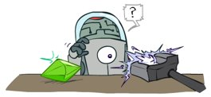
What is reinforcement learning?
People and animals learn by interacting with our environment
This differs from certain other types of learning
It is active rather than passive
Interactions are often sequential — future interactions can depend on earlier ones
We are goal-directed
We can learn without examples of optimal behaviour
Instead, we optimise some reward signal
Trial-and-error learning
Image Source: UC Berkeley CS188 – Intro to AI course
Slides based on DeepMind’s Reinforcement Learning Lectures

Slide 11
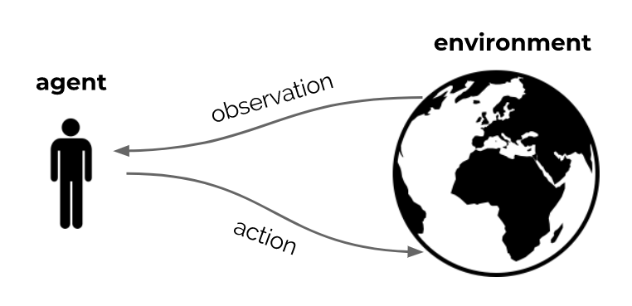
The interaction loop
Goal: optimize sum of rewards, through repeated interaction
Slides based on DeepMind’s Reinforcement Learning Lectures

Slide 12
The reward hypothesis
Reinforcement Learning is based on the reward hypothesis
Any goal can be formalized as the outcome of maximizing a cumulative reward
Can you find a counterexample?
Slides based on DeepMind’s Reinforcement Learning Lectures

Slide 13
Examples of RL problems
Fly a helicopter
Manage an investment portfolio
Control a power station
Make a robot walk
Play video or board games
Reward: air time, inverse distance, ...
Reward: gains, gains minus risk, ...
Reward: efficiency, ...
Reward: distance, speed, ...
Reward: win, maximize score, ...
If the goal is to learn via interaction, these are all reinforcement learning problems
(Irrespective of which solution you use)
Slides based on DeepMind’s Reinforcement Learning Lectures

Slide 14
What is reinforcement learning?
There are distinct reasons to learn:
Find solutions
A program that plays chess really well
A manufacturing robot with a specific purpose
Adapt online, deal with unforeseen circumstances
A chess program that can learn to adapt to you
A robot that can learn to navigate unknown terrains
Reinforcement learning can provide algorithms for both cases
Note that the second point is not (just) about generalization — it is about continuing to learn efficiently online, during operation
Slides based on DeepMind’s Reinforcement Learning Lectures

Slide 15
What is reinforcement learning?
Science and framework of learning to make decisions from interaction
This requires us to think about
time
(long-term) consequences of actions
actively gathering experience
predicting the future
dealing with uncertainty
Huge potential scope
A formalization of the AI problem
Slides based on DeepMind’s Reinforcement Learning Lectures

Slide 16
Example: Learning to play Atari
Video source

Slide 17
Formalizing the RL problem

Slide 18
Agent and Environment
At each step t the agent:
Receives observation O_{t} (and reward R_{t})
Executes action A_{t}
The environment:
Receives action A_{t}
Emits observation O_{t+1} (and reward R_{t+1})
Slides based on DeepMind’s Reinforcement Learning Lectures

Slide 19
Rewards
A reward R_{t} is a scalar feedback signal
Indicates how well agent is doing at step t — defines the goal
The agent’s job is to maximize cumulative reward
G_{t} = R_{t+1} + R_{t+2} + R_{t+3} + ...
We call this the return
Reinforcement learning is based on the reward hypothesis:
Any goal can be formalized as the outcome of maximizing a cumulative reward
Slides based on DeepMind’s Reinforcement Learning Lectures

Slide 20
Values
We call the expected cumulative reward, from a state s , the value
The value depends on the actions the agent takes
Goal is to maximize value, by picking suitable actions
Rewards and values define utility of states and action (no supervised feedback)
Returns and values can be defined recursively
Slides based on DeepMind’s Reinforcement Learning Lectures

Slide 21
Maximizing value by taking actions
Goal: select actions to maximise value
Actions may have long term consequences
Reward may be delayed
It may be better to sacrifice immediate reward to gain more long-term reward
Examples:
Refueling a helicopter (might prevent a crash in several hours)
Defensive moves in a game (may help chances of winning later)
Learning a new skill (can be costly & time-consuming at first)
A mapping from states to actions is called a policy
Slides based on DeepMind’s Reinforcement Learning Lectures

Slide 22
Action values
It is also possible to condition the value on actions:
We will talk in depth about state and action values later
Slides based on DeepMind’s Reinforcement Learning Lectures

Slide 23
Core concepts
The reinforcement learning formalism includes
Environment (dynamics of the problem)
Reward signal (specifies the goal)
Agent, containing:
Agent state
Policy
Value function estimate?
Model?
We will now go into the agent
Slides based on DeepMind’s Reinforcement Learning Lectures

Slide 24
Inside the Agent

Slide 25
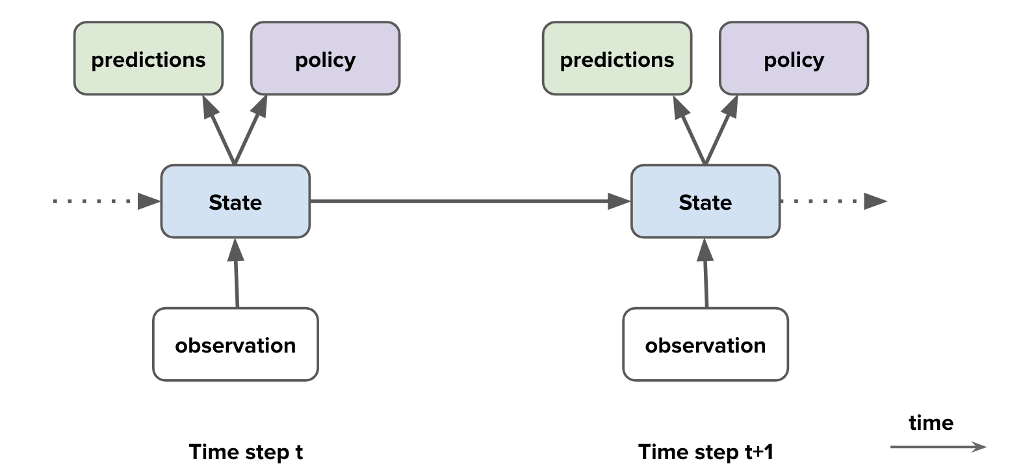
Agent components
Agent components
Agent state
Policy
Value function
Model
Slides based on DeepMind’s Reinforcement Learning Lectures

Slide 26
Environment state
The environment state is the environment’s internal state
It is usually invisible to the agent
Even if it is visible, it may contain lots of irrelevant information
Slides based on DeepMind’s Reinforcement Learning Lectures

Slide 27
Agent state
The history is the full sequence of observations, actions, rewards
For instance, the sensorimotor stream of a robot
This history is used to construct the agent state S_{t}
Slides based on DeepMind’s Reinforcement Learning Lectures

Slide 28
Fully Observable Environments
Full observability
Suppose the agent sees the full environment state
observation = environment state
The agent state could just be this observation:
S_{t} = O_{t} = environment state
Slides based on DeepMind’s Reinforcement Learning Lectures

Slide 29
Markov Decision Processes
Markov decision processes (MDPs) are a useful mathematical framework
Definition: A decision process is Markov if:
This means that the state contains all we need to know from the history
Doesn’t mean it contains everything, just that adding more history doesn’t help
Once the state is known, the history may be thrown away
Typically, the agent state S_{t} is some compression of H_{t}
Note: we use S_{t} to denote the agent state, not the environment state
Slides based on DeepMind’s Reinforcement Learning Lectures

Slide 30
Partially Observable Environments
Partial observability: The observations are not Markovian
A robot with camera vision isn’t told its absolute location
A poker playing agent only observes public cards
Now using the observation as state would not be Markovian
This is called a partially observable Markov decision process (POMDP)
The environment state can still be Markov, but the agent does not know it
We might still be able to construct a Markov agent state
Slides based on DeepMind’s Reinforcement Learning Lectures

Slide 31
Agent State
The agent’s actions depend on its state
The agent state is a function of the history
For instance, S_{t} = O_{t}
More generally:
where u is a ‘state update function’
The agent state is often much smaller than the environment state
Slides based on DeepMind’s Reinforcement Learning Lectures

Slide 32
Agent State
The full environment state of a maze
Slides based on DeepMind’s Reinforcement Learning Lectures

Slide 33
Agent State
A potential observation
Slides based on DeepMind’s Reinforcement Learning Lectures

Slide 34
Agent State
An observation at a different location
Slides based on DeepMind’s Reinforcement Learning Lectures

Slide 35
Agent State
The two observations are indistinguishable
Slides based on DeepMind’s Reinforcement Learning Lectures

Slide 36
Agent State
These two states are not Markov
How could you construct a Markov agent state in this maze (for any reward signal)?
What if we take the previous observation into account?
Depends on policy and state transitions (whether they are probabilistic).
Slides based on DeepMind’s Reinforcement Learning Lectures

Slide 37
Partially Observable Environments
To deal with partial observability, agent can construct suitable state representations
Examples of agent states:
Last observation: S_{t} = O_{t} (might not be enough)
Complete history: S_{t} = H_{t} (might be too large)
A generic update: S_{t} = u(S_{t−1}, A_{t−1}, R_{t}, O_{t}) (but how to pick/learn u ?)
Constructing a fully Markovian agent state is often not feasible
More importantly, the state should allow good policies and value predictions
Slides based on DeepMind’s Reinforcement Learning Lectures

Slide 38
Agent components
Agent components
Agent state
Policy
Value function
Model
Slides based on DeepMind’s Reinforcement Learning Lectures

Slide 39
Policy
A policy defines the agent’s behaviour
It is a map from agent state to action
Deterministic policy: A = π(S)
Stochastic policy: π(A | S) = p(A | S)
Slides based on DeepMind’s Reinforcement Learning Lectures

Slide 40
Agent components
Agent components
Agent state
Policy
Value function
Model
Slides based on DeepMind’s Reinforcement Learning Lectures

Slide 41
Value Function
The actual value function is the expected return
We introduced a discount factor
Trades off importance of immediate vs long-term rewards
The value depends on a policy
Can be used to evaluate the desirability of states
Can be used to select between actions
Slides based on DeepMind’s Reinforcement Learning Lectures

Slide 42
Value Function
The return has a recursive form
Therefore, the value has as well
Here A_{t} ~ π(s) means A_{t} is chosen by policy π in state s (even if π is deterministic)
This is known as a Bellman equation (Bellman 1957)
A similar equation holds for the optimal (=highest possible) value:
This does not depend on a policy
Slides based on DeepMind’s Reinforcement Learning Lectures

Slide 43
Value Function approximations
Agents often approximate value functions
We will discuss algorithms to learn these efficiently
With an accurate value function, we can behave optimally
With suitable approximations, we can behave well, even in intractably big domains
Slides based on DeepMind’s Reinforcement Learning Lectures

Slide 44
Agent components
Agent components
Agent state
Policy
Value function
Model
Slides based on DeepMind’s Reinforcement Learning Lectures

Slide 45
Model
A model predicts what the environment will do next
E.g., predicts the next state
E.g., predicts the next (immediate) reward
A model does not immediately give us a good policy - we would still need to plan
We could also consider stochastic (generative) models
Slides based on DeepMind’s Reinforcement Learning Lectures

Slide 46
An Example

Slide 47
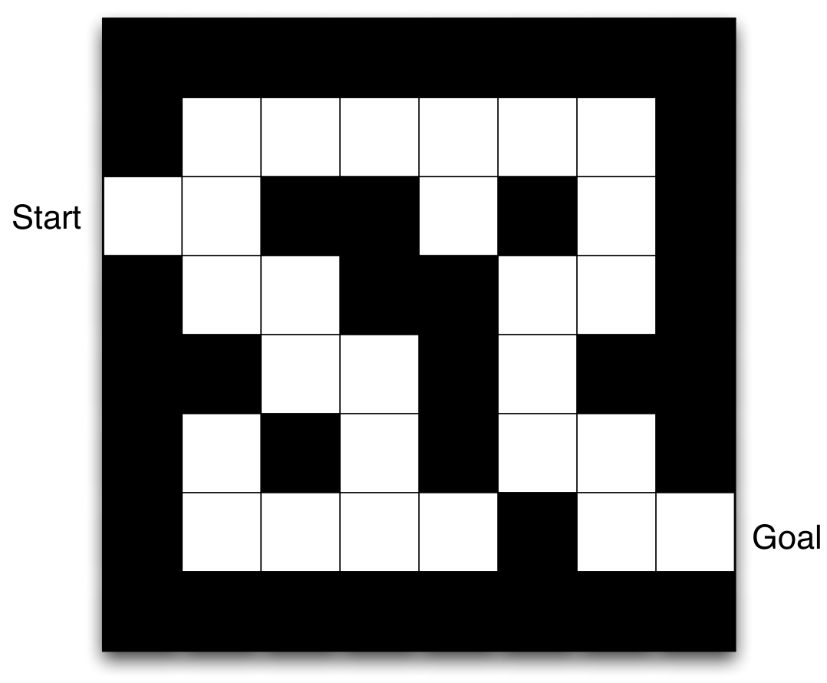
Maze Example
Rewards: -1 per time-step
Actions: N, E, S, W
States: Agent’s location
Tip: When using a negative reward per time step and a reward of 0 at the goal, we define a shortest-path problem.
That is, we incentivize the agent to go to the goal as quickly as possible because this would give it the lowest amount of -1s
Slides based on DeepMind’s Reinforcement Learning Lectures

Slide 48
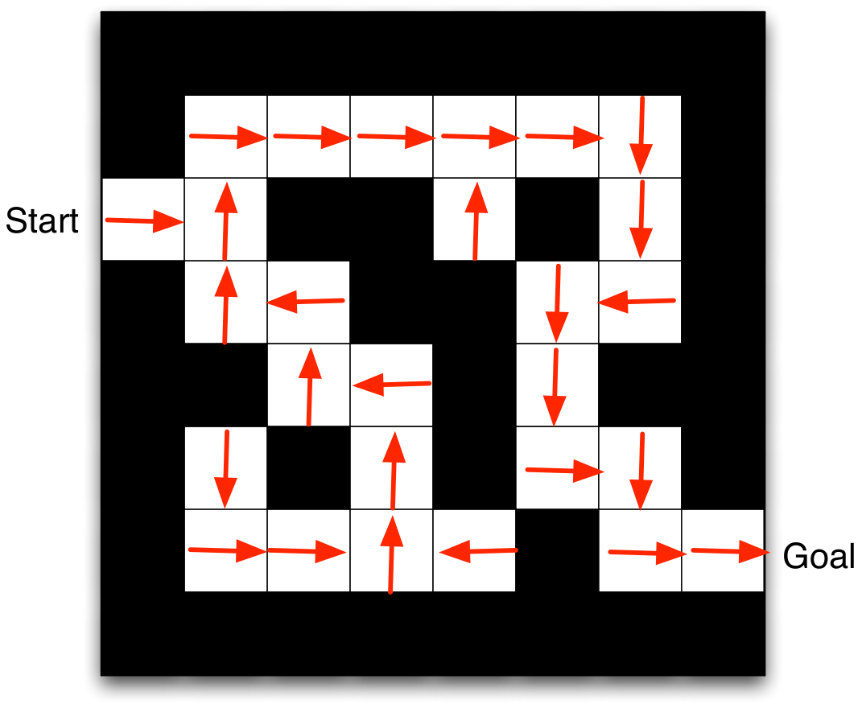
Maze Example: Policy
Arrows represent policy π(s) for each state s
Slides based on DeepMind’s Reinforcement Learning Lectures

Slide 49
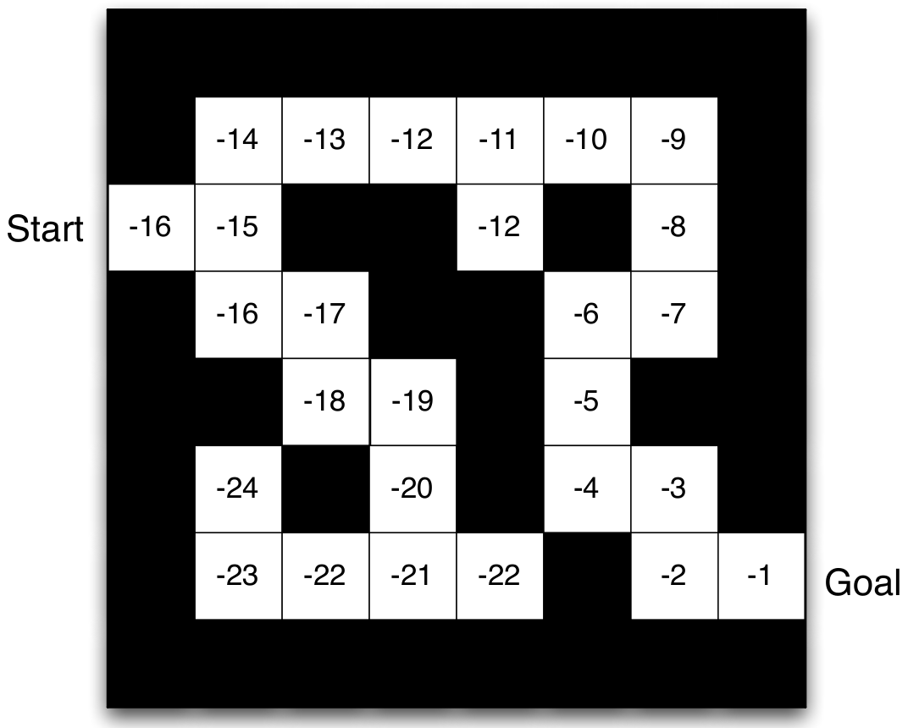
Maze Example: Value Function
Numbers represent value v_{π}(s) of each state s
Here since we used a reward of -1 per time-step each value reflects the number of steps to the goal.
Slides based on DeepMind’s Reinforcement Learning Lectures

Slide 50
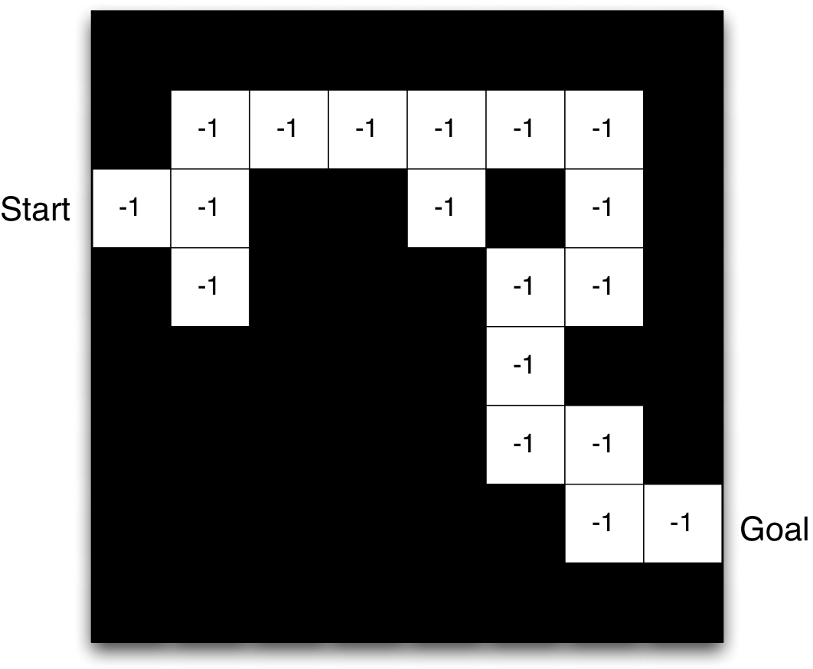
Maze Example: Model
Grid layout represents partial transition model
Numbers represent immediate reward from each state s (same for all a and s’ in this case)
The agent learned this inaccurate model because it might not have explored the bottom part of the maze
The agent can use this model to plan its actions and arrive to the optimal solution for the states it has seen
Slides based on DeepMind’s Reinforcement Learning Lectures

Slide 51
Agent Categories

Slide 52
Agent Categories
Value Based
No Policy (Implicit)
Value Function
Policy Based
Policy
No Value Function
Actor Critic
Policy
Value Function
Model Free
Policy and/or Value Function
No Model
Model Based
Optionally Policy and/or Value Function
Model
Slides based on DeepMind’s Reinforcement Learning Lectures

Slide 53
Subproblems of the RL problem

Slide 54
Prediction and Control
Prediction: evaluate the future (for a given policy), e.g., learning a value function
Control: optimise the future (find the best policy)
These can be strongly related:
If we could predict everything do we need anything else?
Slides based on DeepMind’s Reinforcement Learning Lectures

Slide 55
Learning and Planning
Two fundamental problems in reinforcement learning
Learning:
The environment is initially unknown
The agent interacts with the environment
Planning:
A model of the environment is given (or learnt)
The agent plans in this model (without external interaction)
a.k.a. reasoning, pondering, thought, search, planning
Slides based on DeepMind’s Reinforcement Learning Lectures

Slide 56
Learning Agent Components
All components are functions
Policies: π : S → A (or to probabilities over A)
Value functions: v : S → R
Models: m : S → S and/or r : S → R
State update: u : S × O → S
E.g., we can use neural networks, and use deep learning techniques to learn
Take care: we do often violate assumptions from supervised learning (iid, stationarity)
Deep learning is an important tool
Deep reinforcement learning is a rich and active research field
Slides based on DeepMind’s Reinforcement Learning Lectures

Slide 57
Examples

Slide 58
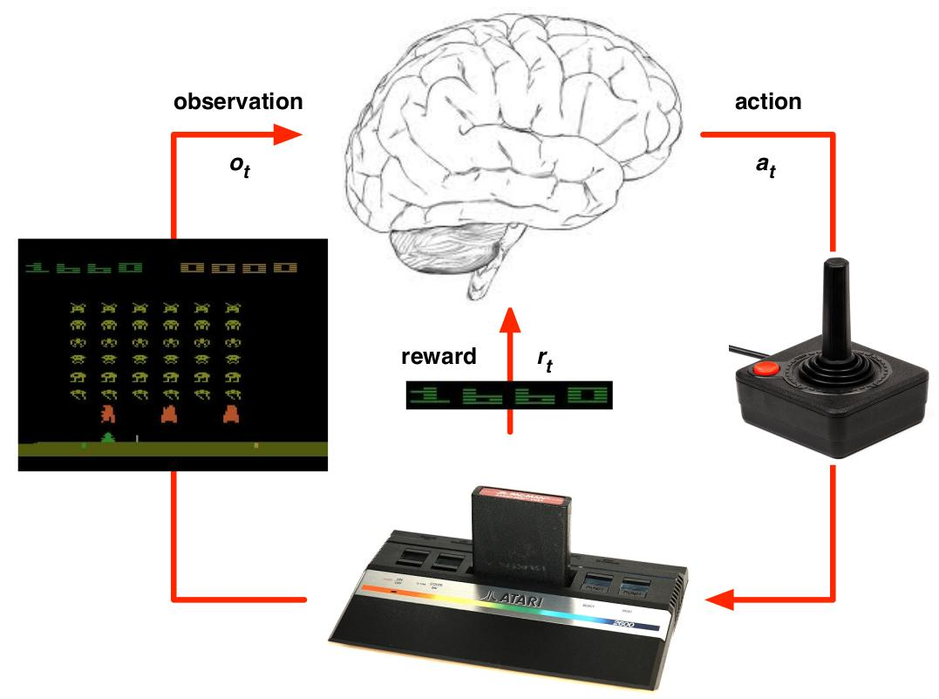
Atari Games
Rules of the game are unknown (model-free RL)
Learn directly from interactive game-play
Pick actions on joystick, see pixels and scores
Slides based on DeepMind’s Reinforcement Learning Lectures

Slide 59
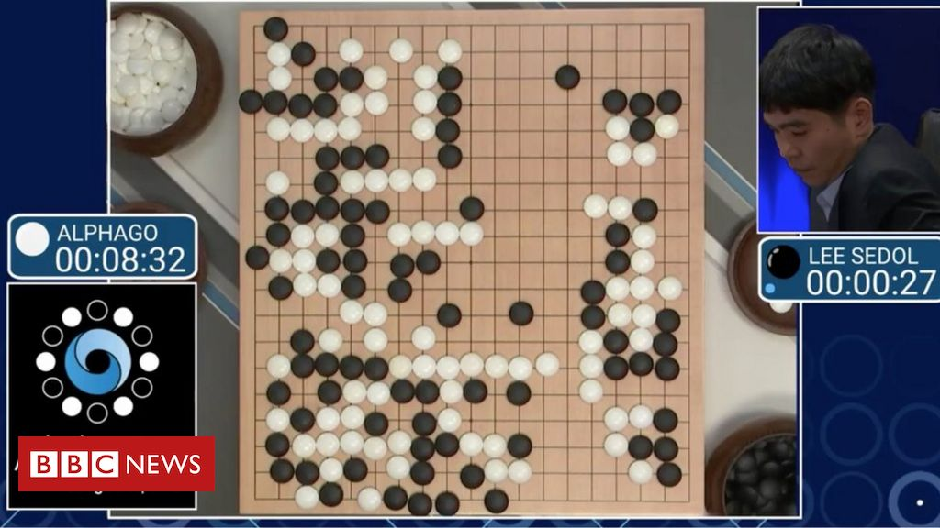
AlphaGo
Go: ~ 10¹⁷⁰ number of board configurations
Chess: ~ 10⁴⁴
Number of atoms in the universe: ~ 10⁸²
Rules of the game are known (model-based RL)
Combines planning (tree-search) with deep neural networks
Policy network: selects next move
Value network: predicts the winner of the game
Defeated world champions
See documentary on Netflix or YouTube
Image Source

Slide 60
Robotic Quadrupedal Locomotion
YouTube Video

Slide 62
Other RL applications / successes
TD-Gammon computer backgammon program
Flying helicopters for aerobatic maneuvers
Flying stratospheric balloons
AlphaZero: mastering the games of chess, shogi and go without expert knowledge
MuZero: master games without knowing their rules
AlphaStar: Mastering the real-time strategy game StarCraft 2
Controlling nuclear fusion reactors
Designing hardware chips
Discovering more efficient matrix multiplication algorithms
Solving Rubik’s cube with a robot hand
…

Slide 63
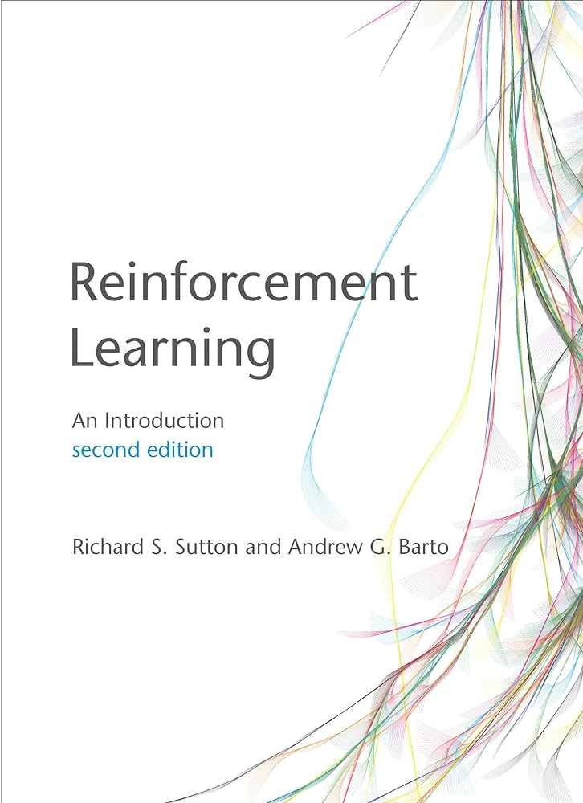
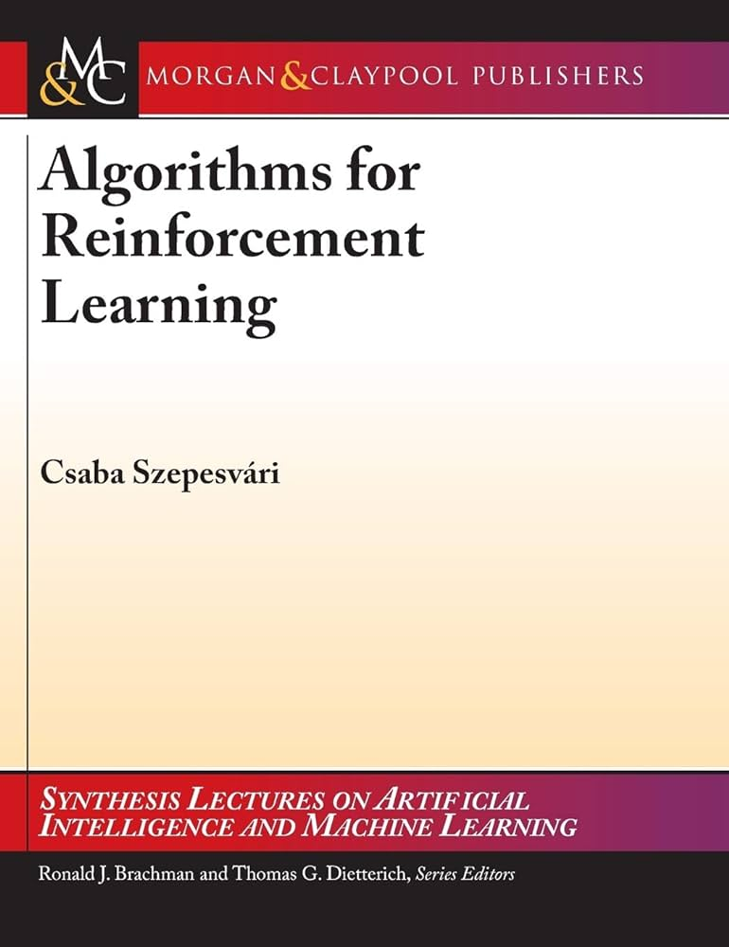
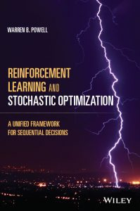
Resources
Reinforcement Learning – Wikipedia
Reinforcement Learning: An Introduction (2nd edition, Sutton and Barto, 2018)
Algorithms for Reinforcement Learning (Szepesvari, 2009)
Reinforcement Learning and Stochastic Optimization (Powell, 2022)

Slide 64
Thank you

