Slide 1
University of Cyprus - MSc Artificial Intelligence
MAI612 - MACHINE LEARNING
Lecture 17: Markov Decision Processes and Dynamic Programming
Vassilis Vassiliades, PhD
Winter Semester 2022/23

Slide 2
Lecture 17: Markov Decision Processes and Dynamic Programming
Learning Outcomes
You will understand:
How to formalize the RL problem using the framework of Markov Decision Processes (MDPs).
What value functions are and how they relate with the objectives in an MDP.
Two classes of RL problems: prediction and control.
How to use the Bellman Equations to solve RL problems.
Dynamic programming and the value iteration and policy iteration algorithms for finding solutions to MDPs.

Slide 3
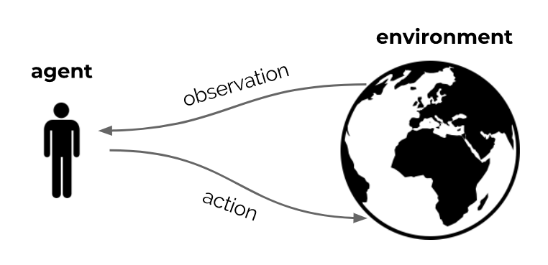
Recap
Reinforcement learning is the science of learning to make decisions
Agents can learn a policy, value function and/or a model
The general problem involves taking into account time and consequences
Decisions affect the reward, the agent state, and environment state
Learning is active: decisions impact data
Slides based on DeepMind’s Reinforcement Learning Lectures

Slide 4
Formalizing the RL interface
We will discuss a mathematical formulation of the agent-environment interaction
This is called a Markov Decision Process (MDP)
Enables us to talk clearly about the objective and how to achieve it
Slides based on DeepMind’s Reinforcement Learning Lectures

Slide 5
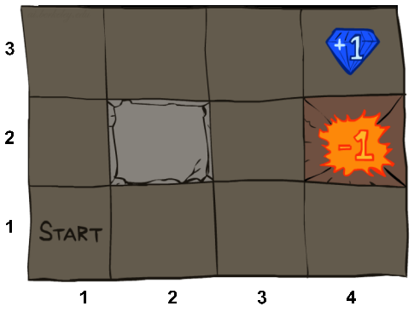
Example: Grid World
A maze-like problem
The agent lives in a grid
Walls block the agent's path
Noisy movement: actions do not always go as planned
80% of the time, the action North takes the agent North (if there is no wall there)
10% of the time, North takes the agent West; 10% East
If there is a wall in the direction the agent would have been taken, the agent stays put
The agent receives rewards each time step
Small “living” reward each step (can be negative)
Big rewards come at the end (good or bad)
Goal: maximize sum of rewards
Slide based on : UC Berkeley CS188 – Intro to AI course

Slide 6
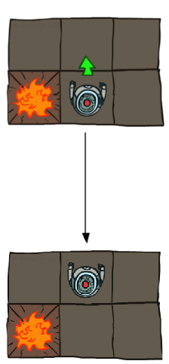
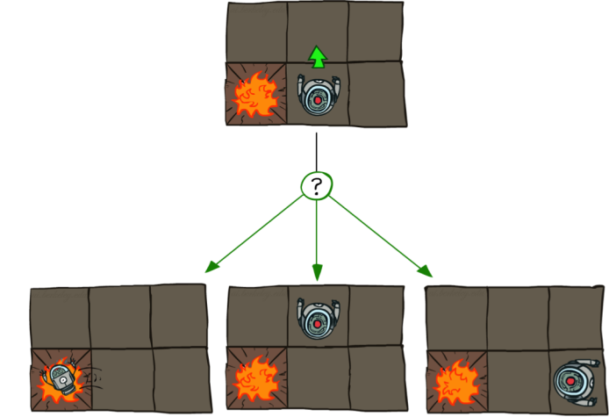
Example: Grid World Actions
Deterministic Grid World
Stochastic Grid World
Slide based on : UC Berkeley CS188 – Intro to AI course

Slide 7
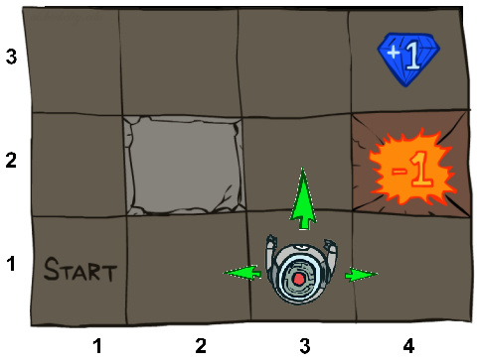
Markov Decision Process Definition
A Markov Decision Process is a tuple (S, A, T, r) where:
S is the set of all possible states
A is the set of all possible actions (e.g., motor controls)
T(s,a,s') is a transition function that defines the probability of transitioning to state s', given a state s and action a, i.e., p(s' | s,a)
defines the dynamics of the problem
r(s,a) is the reward function (sometimes r(s), r(s') or r(s,a,s'))
Slides based on DeepMind’s Reinforcement Learning Lectures

Slide 8
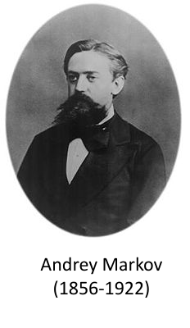
Markov Property
"Markov" means that given the present state, the future is independent of the past
For MDPs, "Markov" means action outcomes depend only on the current state
In an MDP all states are assumed to have the Markov property
The state captures all relevant information from the history.
Once the state is known, the history may be thrown away.
The state is a sufficient statistic of the past.
Slides based on DeepMind’s Reinforcement Learning Lectures

Slide 9
Example: cleaning robot
Consider a robot that cleans soda cans
Two states: high battery charge or low battery charge
Actions: {wait, search} in high, {wait, search, recharge} in low
Dynamics may be stochastic
p(St+1 = high | St = high, At = search) = α
p(St+1 = low | St = high, At = search) = 1 − α
Reward could be expected number of collected cans (deterministic), or actual number of collected cans (stochastic)
Slides based on DeepMind’s Reinforcement Learning Lectures

Slide 10
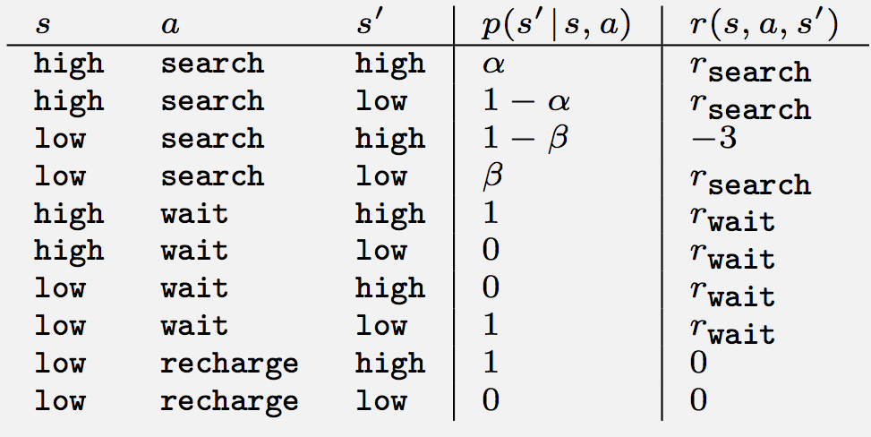
Example: cleaning robot MDP
Slides based on DeepMind’s Reinforcement Learning Lectures

Slide 11
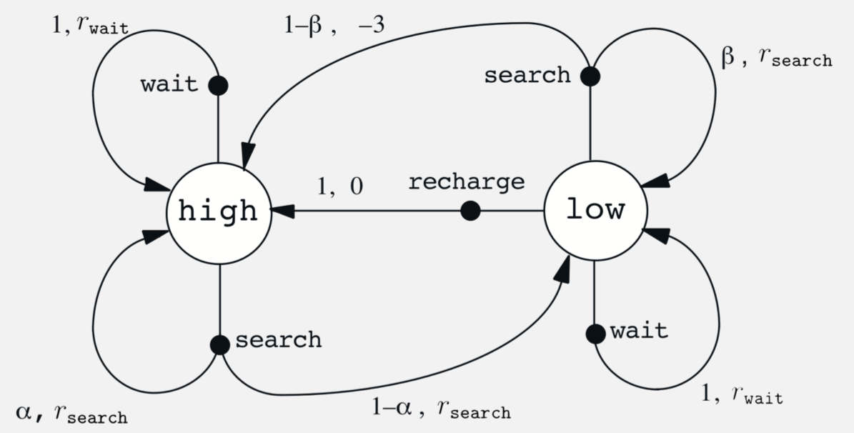
Example: cleaning robot MDP
Slides based on DeepMind’s Reinforcement Learning Lectures

Slide 12
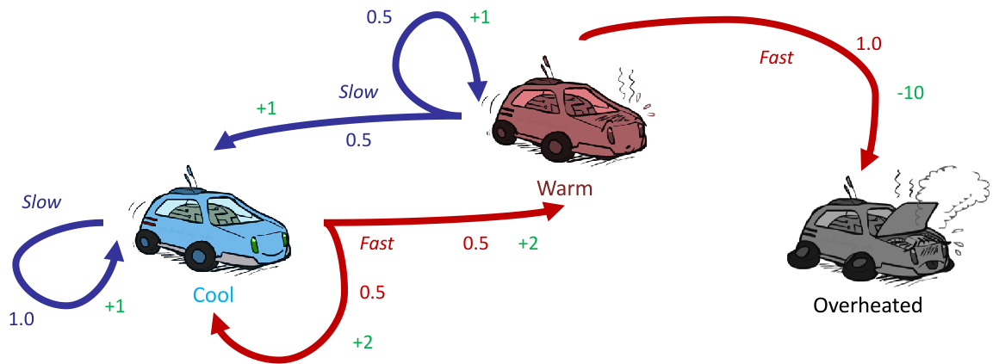
Example: racing
A robot car wants to travel far, quickly
Three states: Cool, Warm, Overheated
Two actions: Slow, Fast
Going faster gets double reward
Slide based on : UC Berkeley CS188 – Intro to AI course

Slide 13
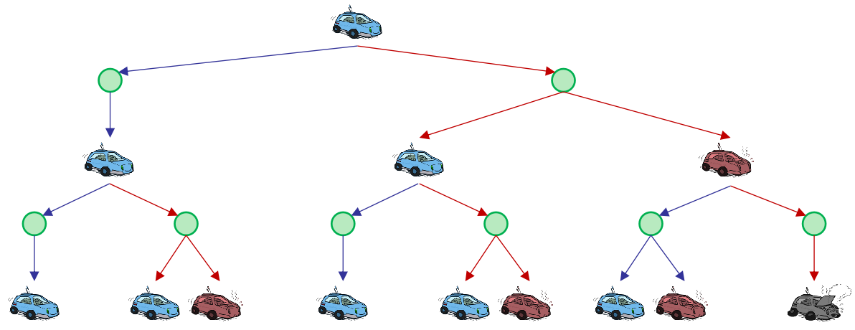
Example: racing search tree
Slide based on : UC Berkeley CS188 – Intro to AI course

Slide 14
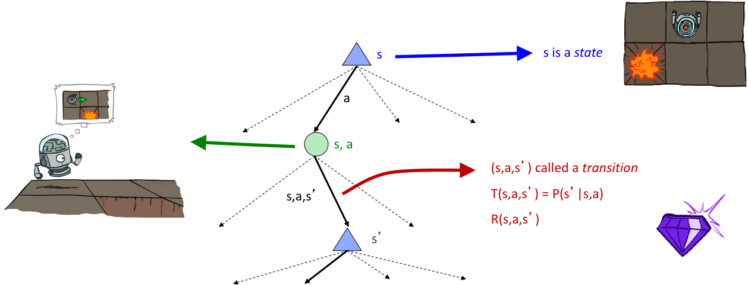
MDP Search Trees
Each MDP state projects a search tree
Slide based on : UC Berkeley CS188 – Intro to AI course

Slide 15
Formalizing the objective

Slide 16
Returns
Acting in a MDP results in immediate rewards Rt , which leads to returns Gt :
Undiscounted return (episodic/finite horizon problem)
Discounted return (finite or infinite horizon problem)
Average return (continuing, infinite horizon problem)
Note: These are random variables that depend on MDP and policy
Slides based on DeepMind’s Reinforcement Learning Lectures

Slide 17
Discounted Return
It is reasonable to maximize the sum of rewards
It is also reasonable to prefer rewards now to rewards later
One solution: values of rewards decay exponentially
Discounted returns Gt for infinite horizon T → ∞:
The discount γ ∈ [0, 1] is the present value of future rewards
The value of receiving reward R after k + 1 time-steps is γ^{k}R
Slides based on DeepMind’s Reinforcement Learning Lectures

Slide 18
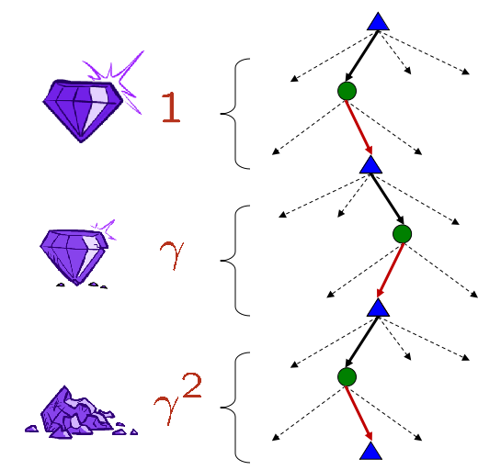
Discounting
How to discount?
Each time we descend a level, we multiply in the discount once
Why discount?
Sooner rewards probably have higher value that later rewards
γ close to 0 leads to "myopic" evaluation: immediate rewards more important than delayed rewards
γ close to 1 leads to "far-sighted" evaluation
Mathematically convenient: avoids infinite returns in cyclic MDPs
Slides based on DeepMind’s Reinforcement Learning Lectures

Slide 19
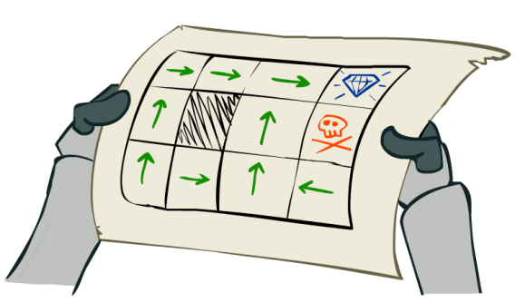
Policies
Goal of an RL agent:
find a behaviour policy that maximises the expected return G_{t}
A policy is a mapping that, for every state s assigns for each action a ∈ A the probability of taking that action in state s. Denoted by π(a|s).
An optimal policy is one that maximises expected return if followed.
For deterministic policies, we sometimes use the notation a_{t} = π(s_{t}) to denote the action taken by the policy.
Slides based on DeepMind’s Reinforcement Learning Lectures

Slide 20
Value Functions
The value function v(s) gives the long-term value (expected return) of state s
We can define (state-)action values:
Connection between them:
Slides based on DeepMind’s Reinforcement Learning Lectures

Slide 21
Optimal Value Functions
The optimal state-value function v∗(s) is the maximum value function over all policies
The optimal action-value function q∗(s, a) is the maximum action-value function over all policies
The optimal value function specifies the best possible performance in the MDP
An MDP is “solved” when we know the optimal value function
Slides based on DeepMind’s Reinforcement Learning Lectures

Slide 22
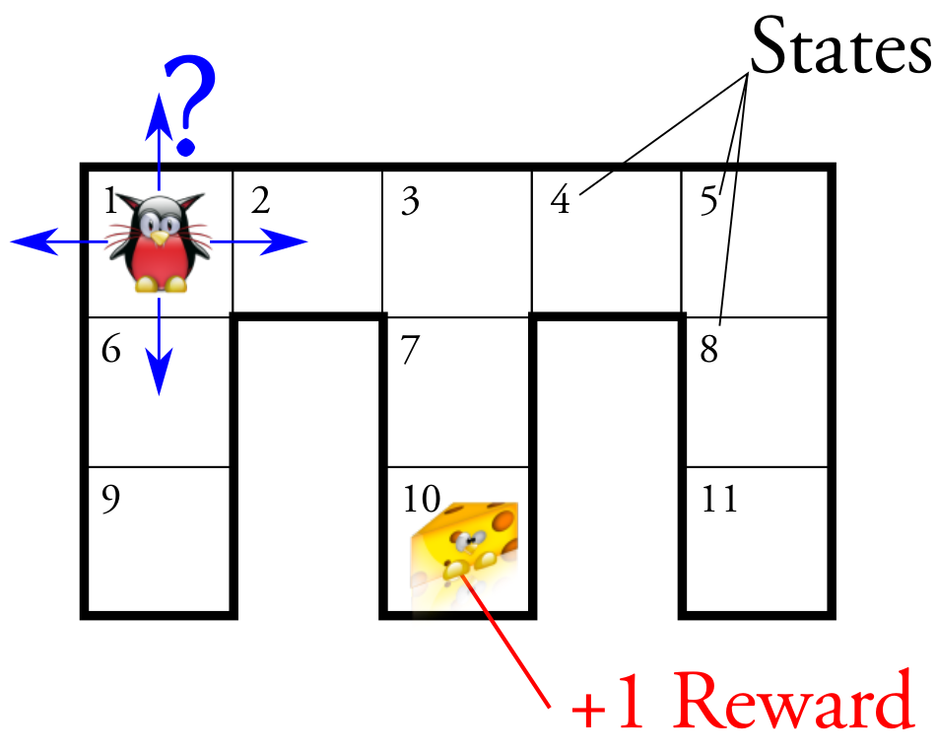
Value Functions Intuition Example
Goal: find policy π : S → A to maximize

Slide 23
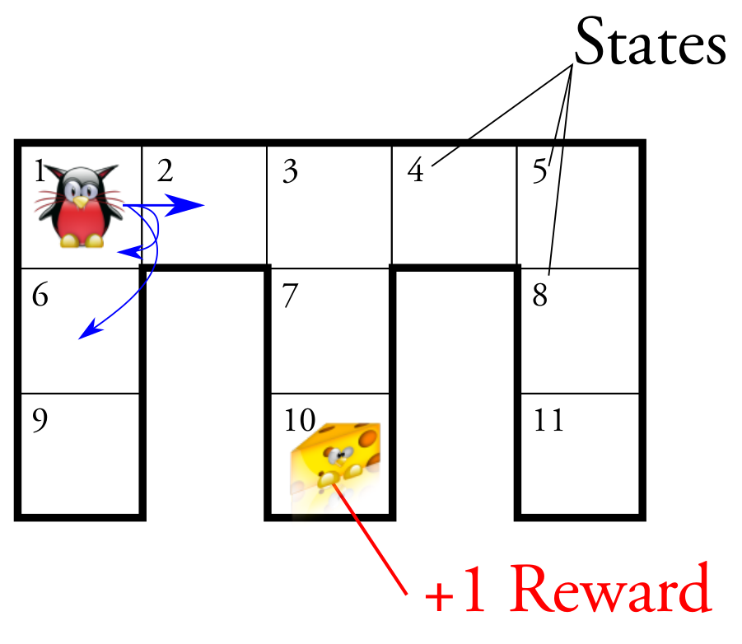
Value Functions Intuition Example
Goal: find policy π : S → A to maximize
The agent's actions may be stochastic

Slide 24
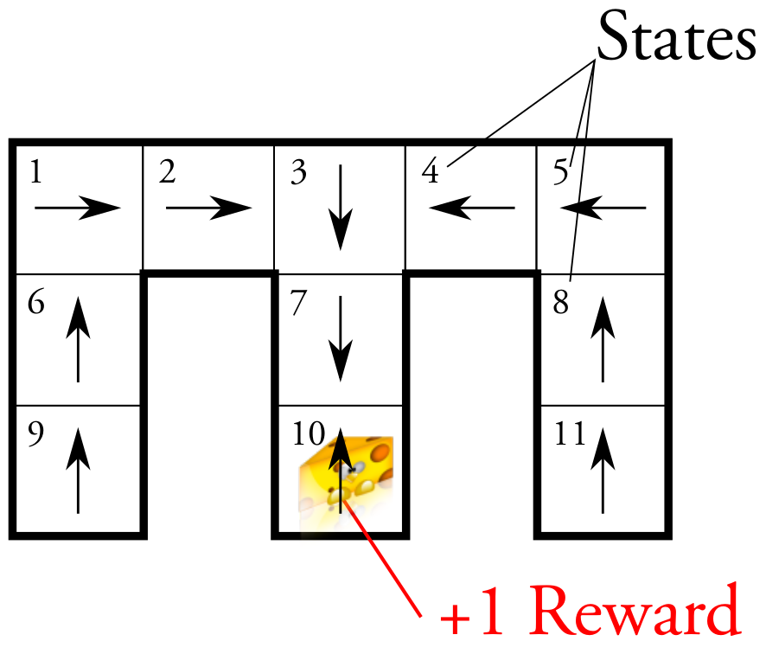
Value Functions Intuition Example
Goal: find policy π : S → A to maximize
This is the optimal policy
… but how do we find it?

Slide 25
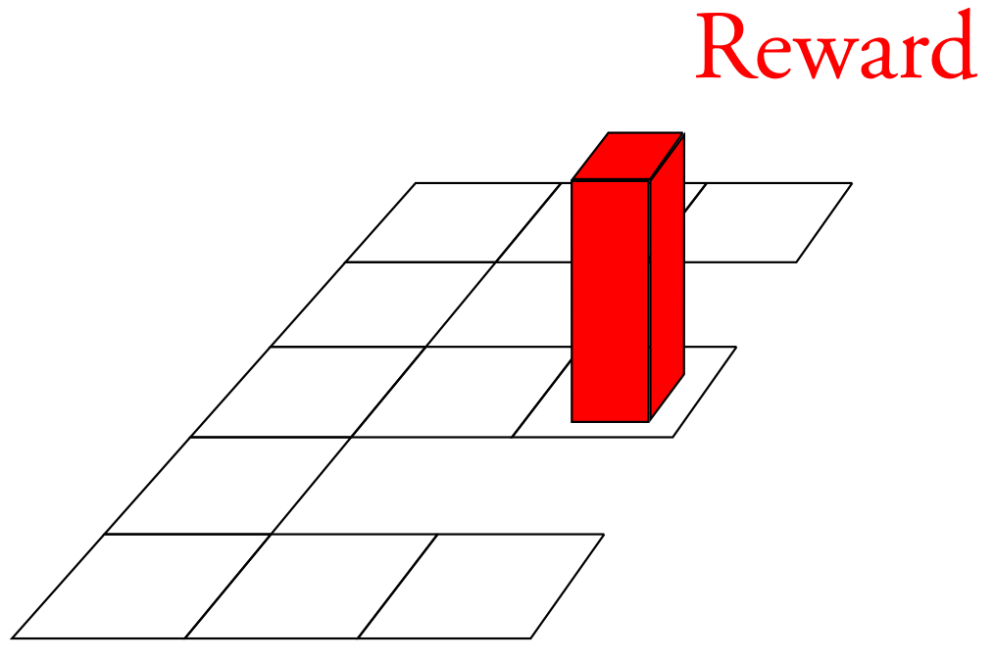
Value Functions Intuition Example
The optimal value function transforms this "sparse landscape"

Slide 26
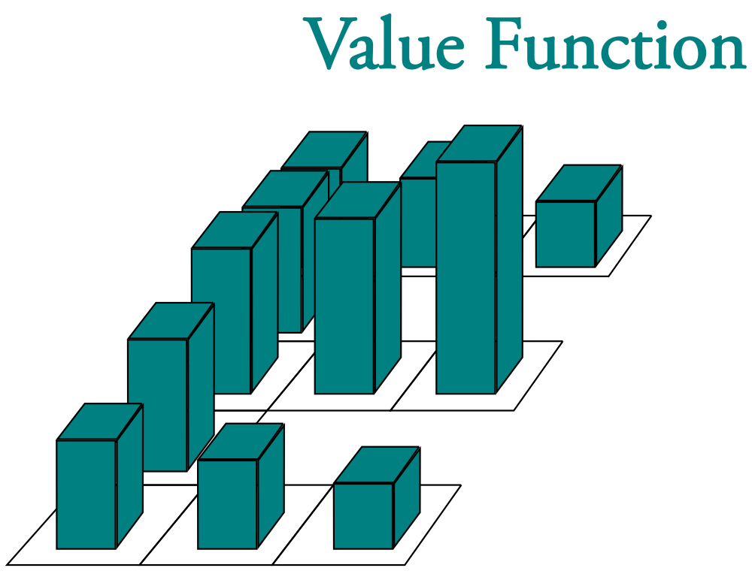
Value Functions Intuition Example
… to this "dense" one, which can be used to compute the optimal policy

Slide 27
Finding an Optimal Policy
An optimal policy can be found by maximising over q∗(s, a)
Observations:
There is always a deterministic optimal policy for any MDP
If we know q∗(s, a), we immediately have the optimal policy
There can be multiple optimal policies
If multiple actions maximize q∗(s, ·), we can also just pick any of these (including stochastically)
Slides based on DeepMind’s Reinforcement Learning Lectures

Slide 28
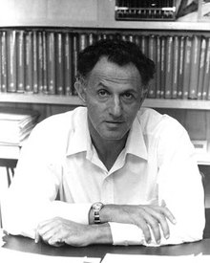
Bellman Equations
Richard Bellman
(1920 – 1984)

Slide 29
Bellman Equations
Value Function
The value function v (s) gives the long-term value of state s:
It can be defined recursively:
The final step writes out the expectation explicitly
Slides based on DeepMind’s Reinforcement Learning Lectures

Slide 30
Bellman Equations
Action values
We can define state-action values:
This implies
Note that:
Slides based on DeepMind’s Reinforcement Learning Lectures

Slide 31
Bellman Equations
Bellman Expectation Equations
Given an MDP, for any policy π, the value functions obey the following expectation equations:
Slides based on DeepMind’s Reinforcement Learning Lectures

Slide 32
Bellman Equations
Bellman Optimality Equations
Given an MDP, the optimal value functions obey the following expectation equations:
Slides based on DeepMind’s Reinforcement Learning Lectures

Slide 33
Solving RL problems using the Bellman Equations

Slide 34
Problems in RL
Two problems:
Estimating v_{π} or q_{π} is called policy evaluation or, simply, prediction
Given a policy, what is my expected return under that behaviour?
Given this treatment protocol/trading strategy, what is my expected return?
Estimating v∗ or q∗ is sometimes called control, because these can be used for policy optimisation
What is the optimal way of behaving? What is the optimal value function?
What is the optimal treatment? What is the optimal control policy to minimise time, fuel consumption, etc?
Slides based on DeepMind’s Reinforcement Learning Lectures

Slide 35
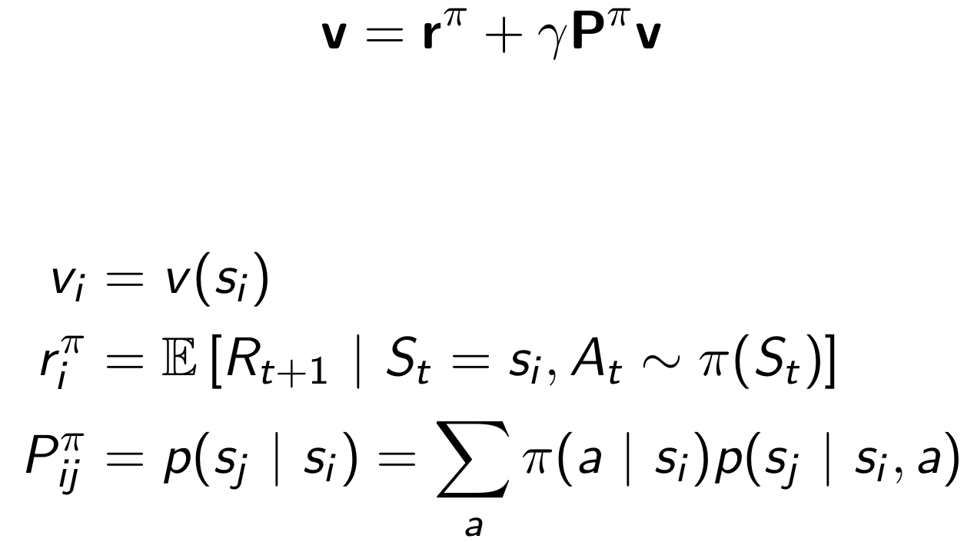
A solution
Bellman Equation in Matrix Form
The Bellman equation, for given policy π, can be expressed using matrices,
where
Slides based on DeepMind’s Reinforcement Learning Lectures

Slide 36
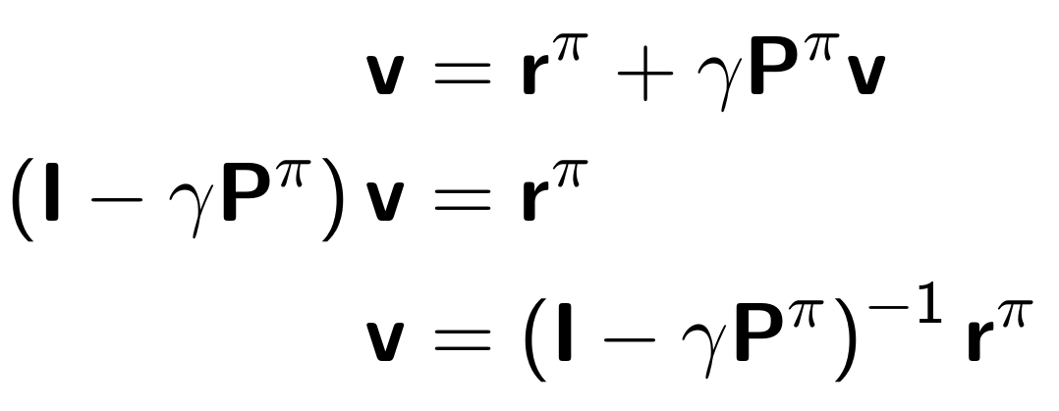
A solution
Bellman Equation in Matrix Form
The Bellman equation, for given policy π, can be expressed using matrices,
This is a linear equation that can be solved directly:
Computational complexity is O(|S|³) - only possible for small problems
There are iterative methods for larger problems
Slides based on DeepMind’s Reinforcement Learning Lectures

Slide 37
A solution
Solving the Bellman Optimality Equation
The Bellman optimality equation is non-linear (because of the max operator)
Cannot use the same direct matrix solution as for policy evaluation
Many iterative solution methods:
Using models / dynamic programming
Value iteration
Policy iteration
Using samples
Monte Carlo
Q-learning
SARSA
Slides based on DeepMind’s Reinforcement Learning Lectures

Slide 38
Dynamic Programming
Dynamic programming refers to a collection of algorithms that can be used to compute optimal policies given a perfect model of the environment as a Markov decision process (MDP).
Sutton & Barto 2018
Dynamic programming:
decomposes a problem into smaller subproblems in a recursive manner
consist of two important parts:
policy evaluation and policy improvement
Slides based on DeepMind’s Reinforcement Learning Lectures

Slide 39
Policy Evaluation
We start by discussing how to estimate
Idea: turn this equality into an update
Algorithm
Initialize v₀, e.g., to zero
Iterate:
Stopping: whenever v_{k+1}(s) = v_{k}(s), for all s, we must have found v_{π}
Slides based on DeepMind’s Reinforcement Learning Lectures

Slide 40
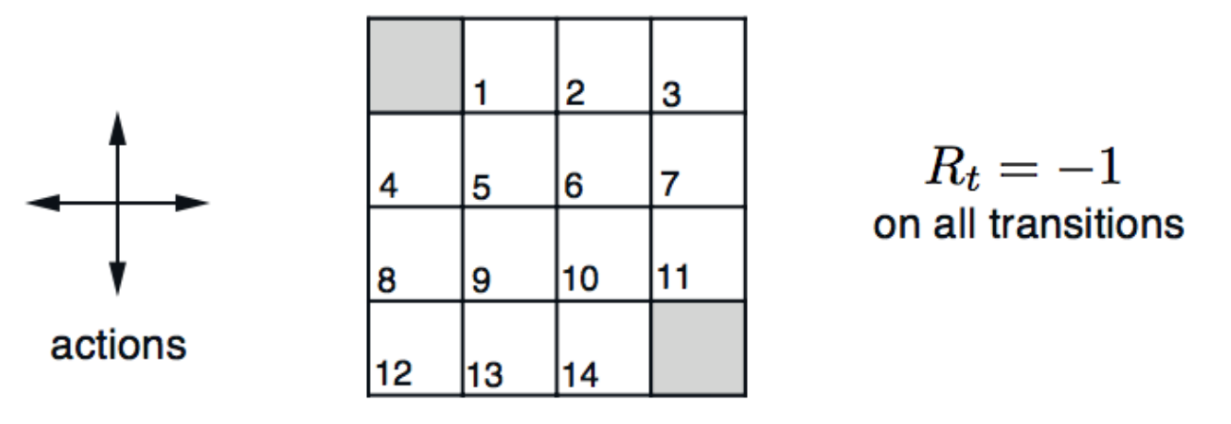
Example: Policy Evaluation
Goal
π = random policy
γ = 1.0
Goal
Slides based on DeepMind’s Reinforcement Learning Lectures

Slide 41
Example: Policy Evaluation
v₀ = 0
v_{k+1}(s_{t})= E [ R_{t+1} + γ v_{k}(s_{t+1}) ]
= E [ -1 + v_{k}(s_{t+1}) ]
= -1 + E [ v_{k}(s_{t+1}) ]
v₁(s_{t}) = -1 + E [ v₀(s_{t+1}) ] = -1
v₂(s_{t}) = -1 + E [ v₁(s_{t+1}) ]
= -1 + (-1-1-1+0)/4 = -1.75
Slides based on DeepMind’s Reinforcement Learning Lectures

Slide 42
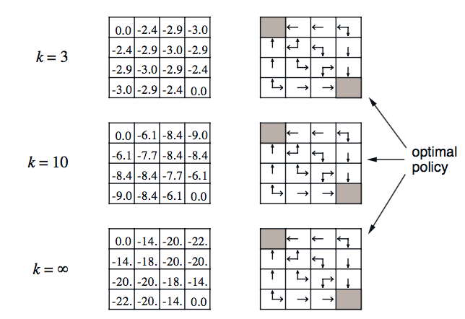
Example: Policy Evaluation
Policy evaluation may require many steps
v_{k+1}(s_{t}) = -1 + E [ v_{k}(s_{t+1}) ]
v_{k+1}(s_{t}) = v_{k}(s_{t+1})
v_{k}= v_{π}
Value function of the random policy
When the value function does not change, we have finished policy evaluation
Slides based on DeepMind’s Reinforcement Learning Lectures

Slide 43
Policy Improvement
We can use evaluation to then improve our policy
Just being greedy with respect to the values of the random policy may suffice (not true in general)
Algorithm
Iterate using:
Evaluate π_{new} and repeat
Slides based on DeepMind’s Reinforcement Learning Lectures

Slide 44
Example: Policy evaluation + Greedy Improvement
We can take some value function and extract some policy using greedy improvement
Slides based on DeepMind’s Reinforcement Learning Lectures

Slide 45
Example: Policy evaluation + Greedy Improvement
Notice that value function still changing but the optimal policy has been learned from k=3
We can take some value function and extract some policy using greedy improvement
Slides based on DeepMind’s Reinforcement Learning Lectures

Slide 46
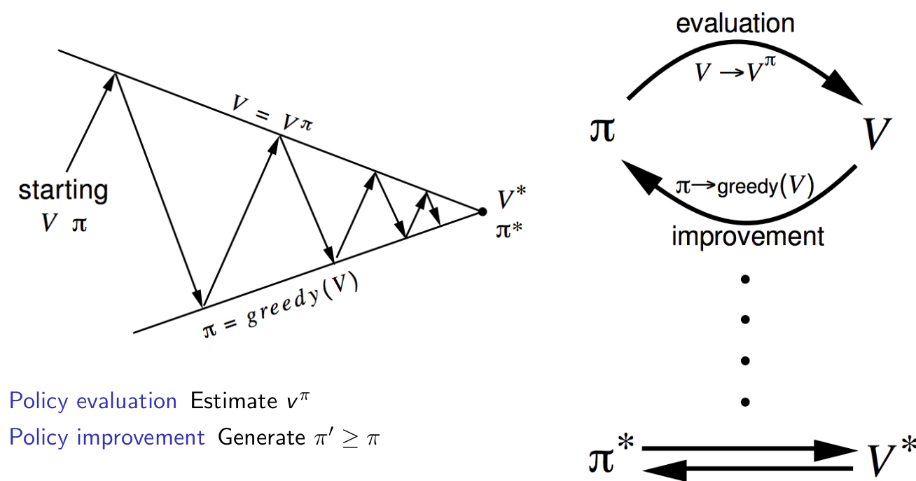
Policy Iteration
Iterative, i.e., may require a lot of computation
Policy Evaluation
Policy Improvement
Slides based on DeepMind’s Reinforcement Learning Lectures

Slide 47
Policy Iteration
Does policy evaluation need to converge to v_{π} ?
Or should we stop when we are ‘close’ ? (E.g., with a threshold on the change to the values)
Or simply stop after k iterations of iterative policy evaluation?
In the small gridworld k = 3 was sufficient to achieve optimal policy
Extreme: Why not update policy every iteration — i.e. stop after k = 1?
This is equivalent to value iteration
Slides based on DeepMind’s Reinforcement Learning Lectures

Slide 48
Value Iteration
We could take the Bellman optimality equation, and turn that into an update
This is equivalent to policy iteration, with k = 1 step of policy evaluation between each two (greedy) policy improvement steps
Algorithm: Value Iteration
Initialise v₀
Update:
Stopping: whenever v_{k+1}(s) = v_{k}(s), for all s, we must have found v*
Slides based on DeepMind’s Reinforcement Learning Lectures

Slide 49
Value Iteration racing example
Algorithm
1.
2. Repeat until convergence:
Convergence:
Slide based on : UC Berkeley CS188 – Intro to AI course

Slide 50
Value Iteration racing example
Slide based on : UC Berkeley CS188 – Intro to AI course

Slide 51
Value Iteration racing example
Slide based on : UC Berkeley CS188 – Intro to AI course

Slide 52
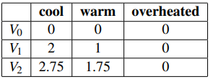
Value Iteration racing example
Need more iterations to converge to the optimal value function
Slide based on : UC Berkeley CS188 – Intro to AI course

Slide 53
Policy iteration vs Value iteration
Policy iteration:
Starts with random policy
Runs policy evaluation until convergence, and then a policy improvement step
Requires few iterations to converge, but at the expense of more computation time due to policy evaluation
Value iteration:
Starts with a random (or zero) value function
Runs one step of policy evaluation followed by policy improvement
Requires more iterations to converge to the optimal value function

Slide 54
What have we covered
Markov Decision Processes
Objectives in an MDP : different notion of return
Value functions – expected returns, condition on state (and action)
Optimality principles in MDPs: optimal value functions and optimal policies
Bellman Equations
Two class of problems in RL: evaluation and control
How to compute v_{π} (aka solve an evaluation/prediction problem)
How to compute the optimal value function via dynamic programming
Policy Iteration
Value Iteration
Slides based on DeepMind’s Reinforcement Learning Lectures

Slide 55
Resources
Reinforcement Learning specialization – Coursera
Markov Decision Process – Wikipedia
Dynamic Programming – Wikipedia
Bellman Equation – Wikipedia

Slide 56
Next Lectures
Model-free Reinforcement Learning
Revision

Slide 57
Thank you

