Slide 1
University of Cyprus - MSc Artificial Intelligence
MAI612 - MACHINE LEARNING
Lecture 18: Model-free Reinforcement Learning
Vassilis Vassiliades, PhD
Winter Semester 2022/23

Slide 2
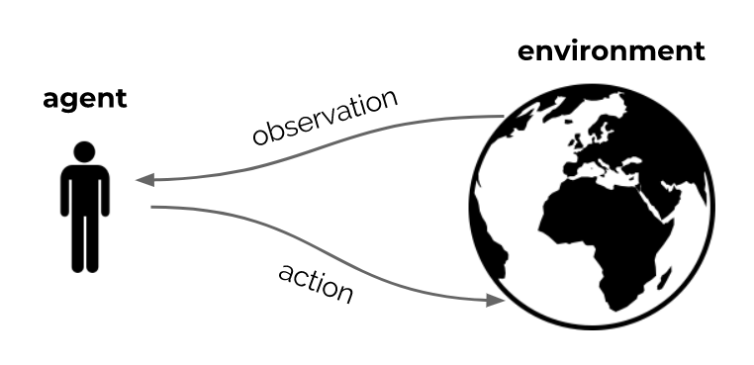
Recap
Reinforcement learning is the science of learning to make decisions
Agents can learn a policy, value function and/or a model
The general problem involves taking into account time and consequences
Decisions affect the reward, the agent state, and environment state
Learning is active: decisions impact data
Slides based on DeepMind’s Reinforcement Learning Lectures

Slide 3
Last lecture:
If we know a model of the MDP we can use planning by dynamic programming to solve it.
This lecture:
If we don't know the model of the MDP we can use sampling methods
Slides based on DeepMind’s Reinforcement Learning Lectures

Slide 4
Lecture 18: Model-free Reinforcement Learning
Learning Outcomes
You will learn about:
The simpler framework of multi-armed bandits and the exploration-exploitation tradeoff
Model-free prediction to estimate values in an unknown MDP: Monte Carlo, Temporal-Difference (TD) Learning, and Multi-step TD learning
Model-free control to optimise values in an unknown MDP: SARSA and Q-learning algorithms
Optimistic initialization of the value function to help exploration

Slide 5
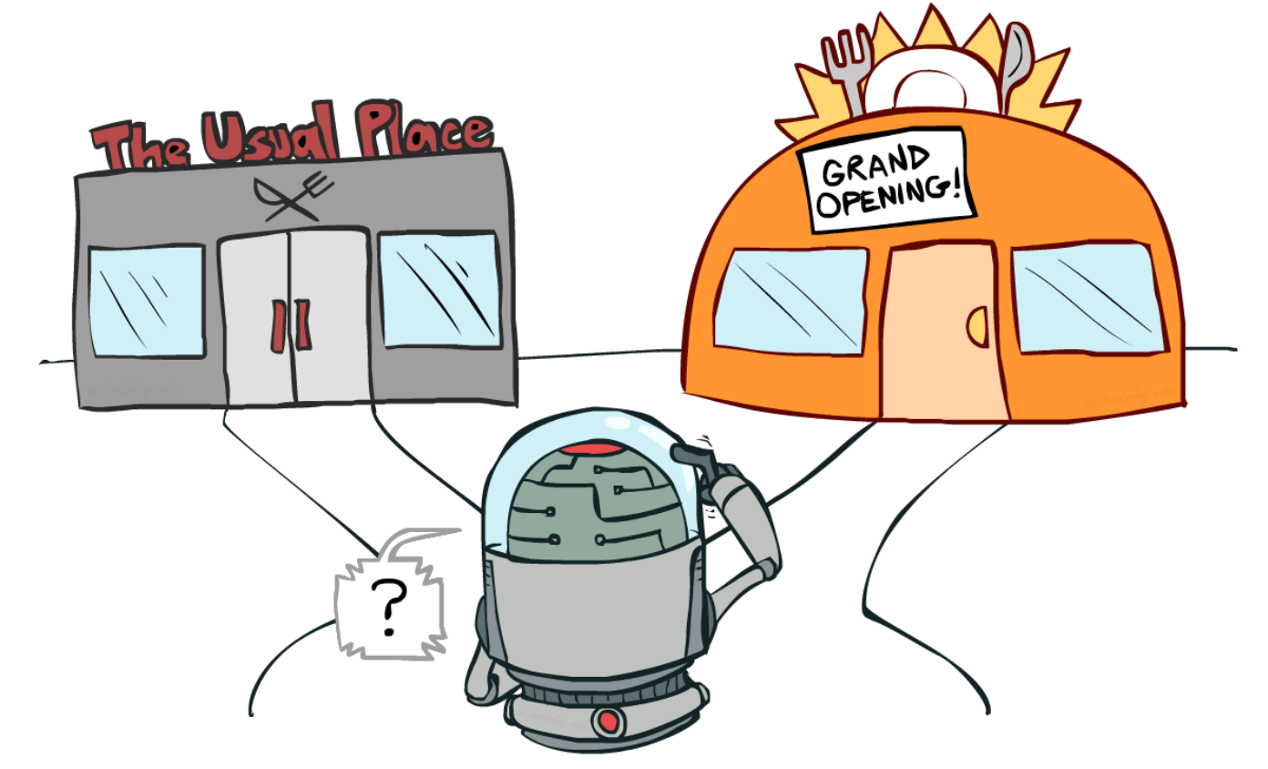
Exploration vs Exploitation
Learning agents need to trade off two things
Exploitation: Maximize performance based on current knowledge
Exploration: Increase knowledge
We need to gather information to make the best overall decisions
The best long-term strategy may involve short-term sacrifices
Image source: UC Berkeley AI course slide, lecture 11.
Slides based on DeepMind’s Reinforcement Learning Lectures

Slide 6
Multi-armed bandits

Slide 7
A simpler setting: the multi-armed bandit
The environment is assumed to have only a single state
⇒ actions no longer have long-term consequences in the environment
⇒ actions still do impact immediate reward
⇒ other observations can be ignored
We discuss how to learn a policy in this setting
Slides based on DeepMind’s Reinforcement Learning Lectures

Slide 8
The multi-armed bandit
A multi-armed bandit is a set of distributions
is a (known) set of actions (or “arms")
is a distribution on rewards, given action a
At each step t the agent selects an action
The environment generates a reward
The goal is to maximise cumulative reward
We do this by learning a policy: a distribution on
Slides based on DeepMind’s Reinforcement Learning Lectures

Slide 9
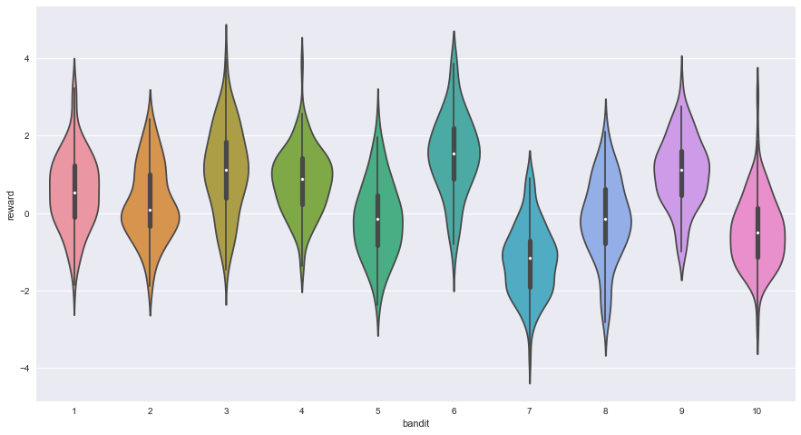
The multi-armed bandit
Image source
One-armed bandit
One slot machine
Actions are independent
K-armed bandit
K slot machines
Different reward distributions
Goal is to find the slot machine that is expected to give us more reward
Which arm has the highest median reward?

Slide 10
The multi-armed bandit: industrial applications
Clinical trials: one of the main practical problems that uses multi-armed bandits.
To evaluate K possible treatments for a disease, pool of N patients is partitioned randomly into K groups.
Reward: 1 if the treatment is successful else 0.
After a while the majority of the patients can be put to the best found treatment.
Online ad-placement: Deciding which advertisement to display on the webpage.
Website optimization: sequentially choosing design elements (font, images, layout) for the web page to maximize click through rate
Network packet routing: reward is the time it takes to deliver a packet from source to destination and there are K different paths available.

Slide 11
Values
The action value for action a is the expected reward
The optimal value is
Slides based on DeepMind’s Reinforcement Learning Lectures

Slide 12
Algorithms
There are various algorithms for finding the policy:
Greedy
ε-greedy
UCB
Thomson sampling
Policy gradients
We will discuss greedy and ε-greedy:
They use action value estimates
Slides based on DeepMind’s Reinforcement Learning Lectures

Slide 13
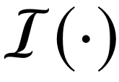
Action value estimates
The action value for action a is the expected reward​
A simple estimate is the average of the sampled rewards:
is the indicator function:
The count for action a is
Slides based on DeepMind’s Reinforcement Learning Lectures

Slide 14
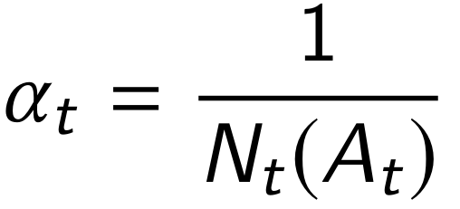
Action value estimates
This can also be updated incrementally:​
with
Slides based on DeepMind’s Reinforcement Learning Lectures

Slide 15
The greedy policy
One of the simplest policies is greedy:
Select action with highest value:
Equivalently:
Pure exploitation: can get stuck on a suboptimal action forever
Slides based on DeepMind’s Reinforcement Learning Lectures

Slide 16
ε-greedy algorithm
The ε-greedy algorithm:
With probability 1-ε select greedy action:
With probability ε select a random action
Equivalently:
ε-greedy continues to explore
Slides based on DeepMind’s Reinforcement Learning Lectures

Slide 17
Quiz
In the ε-greedy algorithm, setting ε=0 results in the greedy algorithm (pure exploitation), and setting ε=1 results in pure exploration. True or False?
True

Slide 18
Model-free Prediction

Slide 19
Monte Carlo Algorithms
We can use experience samples to learn without a model
Monte Carlo learning: direct sampling of episodes
MC is model-free: no knowledge of MDP is required, only samples
Slides based on DeepMind’s Reinforcement Learning Lectures

Slide 20
Monte Carlo Policy Evaluation
Goal: learn $v_{π}$ from episodes of experience under policy $π$
The return is the total discounted reward (for an episode ending at time T>t):
The value function is the expected return:
We can just use sample average return instead of expected return
We call this Monte Carlo policy evaluation
Slides based on DeepMind’s Reinforcement Learning Lectures

Slide 21
Disadvantages of Monte Carlo Learning
MC algorithms can be used to learn value predictions
But when episodes are long, learning can be slow
… we have to wait until an episode ends before we can learn
… return can have high variance
Are there alternatives?
Slides based on DeepMind’s Reinforcement Learning Lectures

Slide 22
Temporal-Difference Learning
Previous lecture: Bellman equations
Previous lecture: Approximate by iterating
We can sample this!
This is likely quite noisy – better to take a small step (with parameter α):
Slides based on DeepMind’s Reinforcement Learning Lectures

Slide 23
Temporal-Difference Learning
Prediction setting: learn $v_{π}$ online from experience under policy $π$
Monte-Carlo
Update value $v_{n}\left(S_{t}\right)$ towards sampled return $G_{t}$
Temporal-difference learning:
Update value $v_{n}\left(S_{t}\right)$ towards estimated return $R_{t+1}+γ v\left(S_{t+1}\right)$
$δ_{t}=R_{t+1}+$ $γ v_{t}\left(S_{t+1}\right)−v_{t}\left(S_{t}\right)$ is called the TD error
Slides based on DeepMind’s Reinforcement Learning Lectures

Slide 24
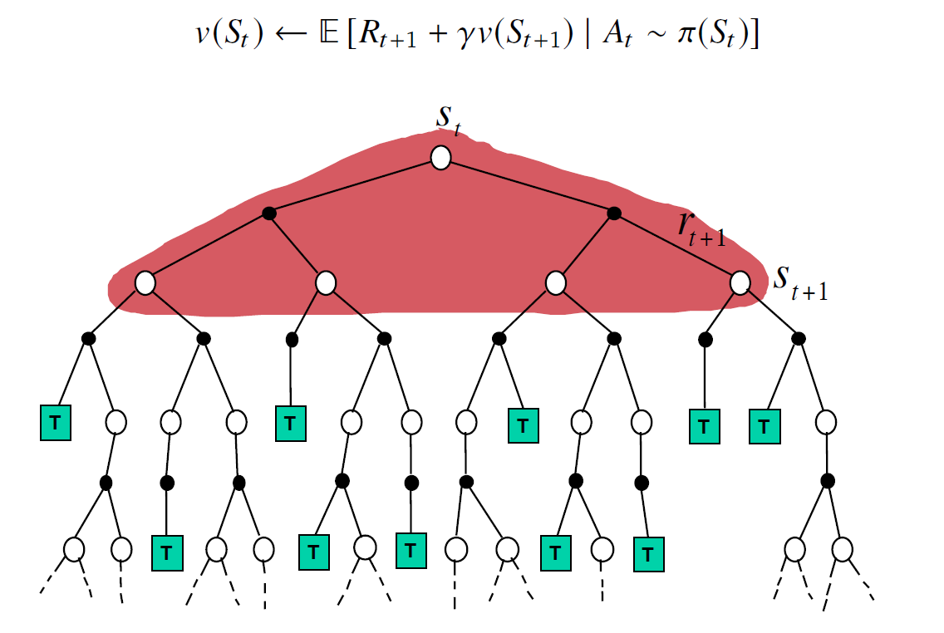
Dynamic Programming Backup
Slides based on DeepMind’s Reinforcement Learning Lectures

Slide 25
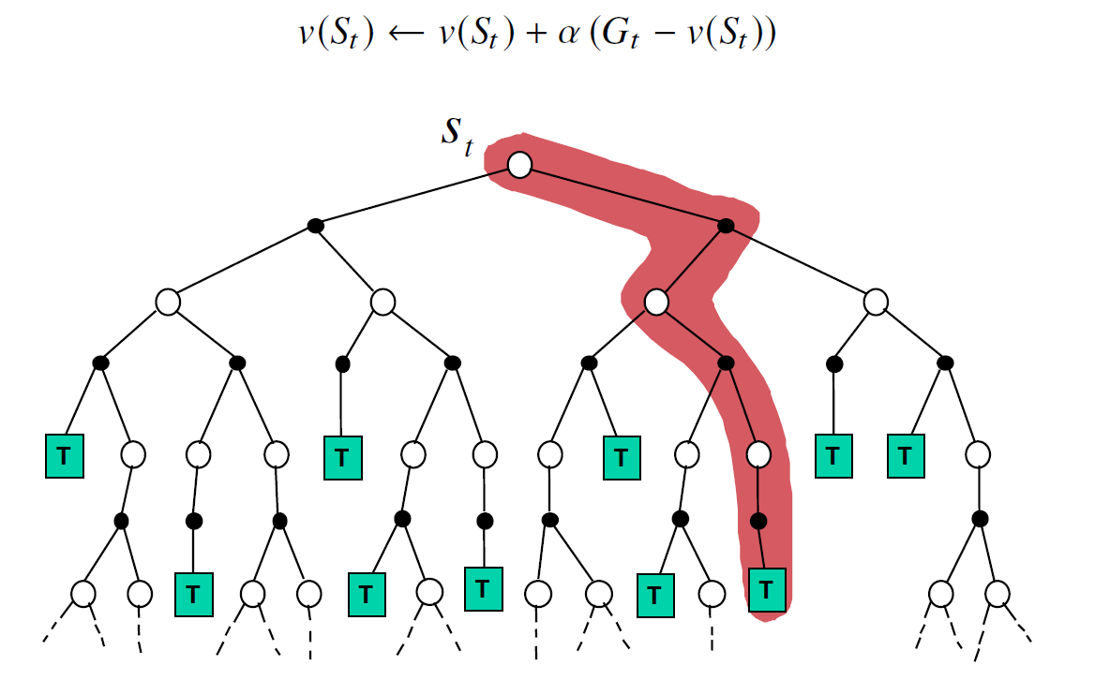
Monte Carlo Backup
Slides based on DeepMind’s Reinforcement Learning Lectures

Slide 26
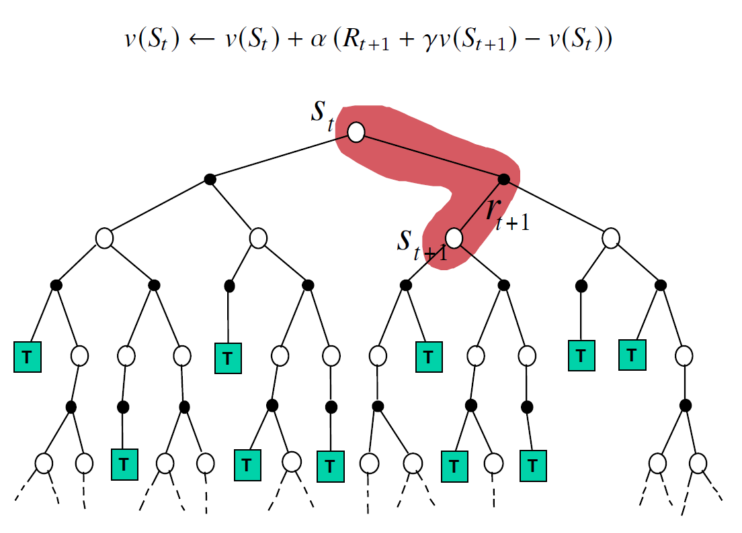
Temporal-Difference Backup
Slides based on DeepMind’s Reinforcement Learning Lectures

Slide 27
Bootstrapping and Sampling
Bootstrapping: update involves an estimate (i.e., value of the next state)
MC does not bootstrap
DP bootstraps
TD bootstraps
Sampling: update samples an expectation
MC samples
DP does not sample (i.e., computes the update as it has knowledge of the model)
TD samples
Slides based on DeepMind’s Reinforcement Learning Lectures

Slide 28
Temporal-Difference Learning
We can apply the same idea to action values
TD learning for action values:
Update value $q_{t}\left(S_{t}, A_{t}\right)$ towards estimated return $R_{t+1}+γ q\left(S_{t+1}, A_{t+1}\right)$
This algorithm is known as SARSA, because it uses $\left(S_{t}, A_{t}, R_{t+1}, S_{t+1}, A_{t+1}\right)$
Slides based on DeepMind’s Reinforcement Learning Lectures

Slide 29
Temporal-Difference Learning
TD is model-free (no knowledge of MDP) and learns directly from experience
TD can learn from incomplete episodes by bootstrapping
TD can learn during each episode
Slides based on DeepMind’s Reinforcement Learning Lectures

Slide 30
Advantages and Disadvantages of MC vs TD
TD can learn before knowing the final outcome
TD can learn online after every step
MC must wait until the end of episode before return is known
TD can learn without the final outcome
TD can learn from incomplete sequences
MC can only learn from complete sequences
TD works in continuing (non-terminating) environments
MC only works for episodic (terminating) environments
TD is independent of the temporal span of the prediction
TD can learn from single transitions
MC must store all predictions (or states) to update at the end of an episode
Slides based on DeepMind’s Reinforcement Learning Lectures

Slide 31
Between MC and TD:
Multi-Step TD

Slide 32
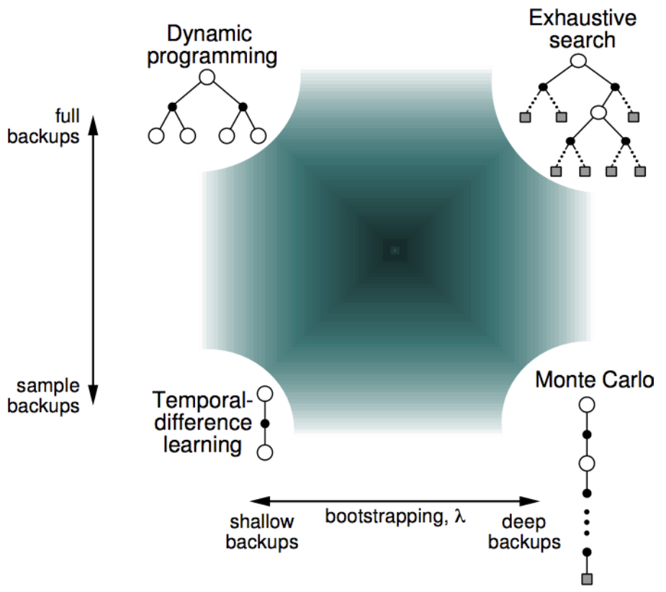
Unified View of RL
Slides based on DeepMind’s Reinforcement Learning Lectures

Slide 33
Multi-Step Updates
TD uses value estimates which might be inaccurate
In addition, information can propagate back quite slowly
In MC information propagates faster, but the updates are noisier
We can go in between TD and MC
Slides based on DeepMind’s Reinforcement Learning Lectures

Slide 34
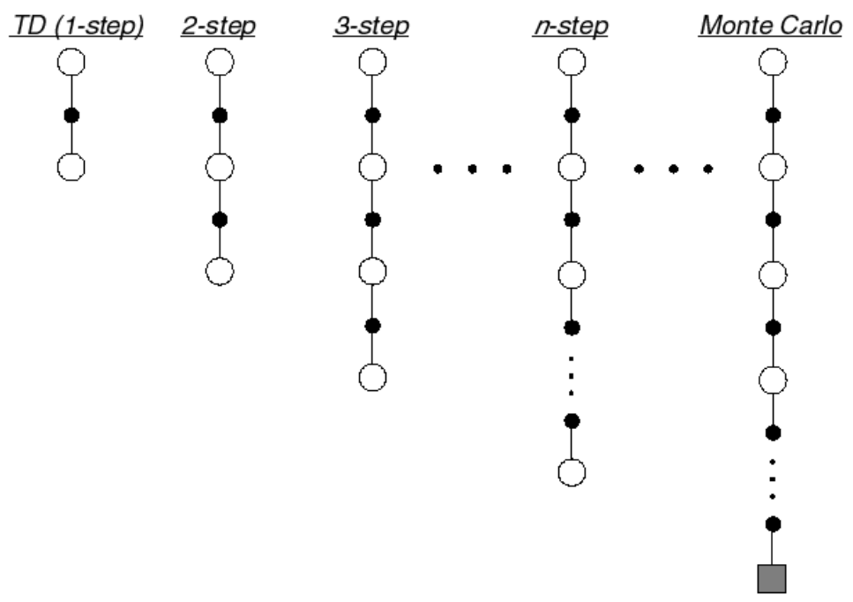
Multi-Step Prediction
Let TD target look $n$ steps into the future
Slides based on DeepMind’s Reinforcement Learning Lectures

Slide 35
Multi-Step Returns
Consider the following $n$-step returns for $n=1,2,∞:$
In general, the $n$-step return is defined by
Multi-step TD learning
Slides based on DeepMind’s Reinforcement Learning Lectures

Slide 36
Grid Example
(Reminder: SARSA is TD for action values $q(s,a)$)
Slides based on DeepMind’s Reinforcement Learning Lectures

Slide 37
Temporal-Difference Learning for Control

Slide 38
On and Off-Policy Learning
On-policy learning
Learn about behaviour policy $π$ from experience sampled from $π$
SARSA algorithm
Off-policy learning
Learn about target policy $π$ from experience sampled from $μ$
Learn “counterfactually” about other things you could do: “what if…?”
E.g., “What if I would turn left?” => new observations, rewards?
E.g., “What if I would play more defensively?” => different win probability?
E.g., “What if I would continue to go forward?” => how long until I bump into a wall?
Slides based on DeepMind’s Reinforcement Learning Lectures

Slide 39
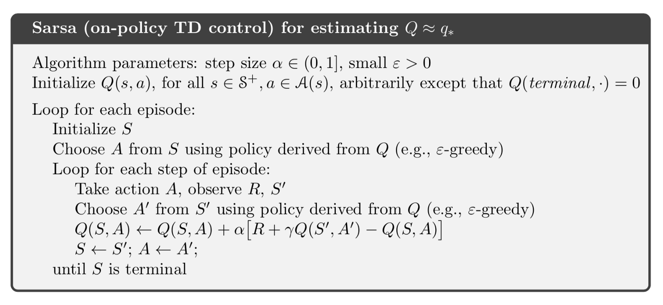
SARSA algorithm
Source: Sutton & Barto (2018). Reinforcement Learning – An Introduction (2nd edition)

Slide 40
SARSA algorithm
Tabular SARSA converges to the optimal action-value function, if the policy is Greedy in the Limit of Infinite Exploration (GLIE)
All state-action pairs are explored infinitely many times
The policy converges to a greedy policy
For example, ε-greedy with ε decaying over time
Slides based on DeepMind’s Reinforcement Learning Lectures

Slide 41
Off-Policy Learning
Evaluate target policy $π\left(α | s\right)$ to compute $v_{π}\left(s\right)$ or $q_{π}\left(s,a\right)$
While using behaviour policy $μ\left(α | s\right)$ to generate actions
Why is this important?
Learn from observing humans or other agents (e.g., from logged data)
Re-use experience from old policies (e.g., from your own past experience)
Learn about multiple policies while following one policy
Learn about greedy policy while following exploratory policy
Q-learning estimates the value of the greedy policy
Acting greedy all the time would not explore sufficiently
Slides based on DeepMind’s Reinforcement Learning Lectures

Slide 42
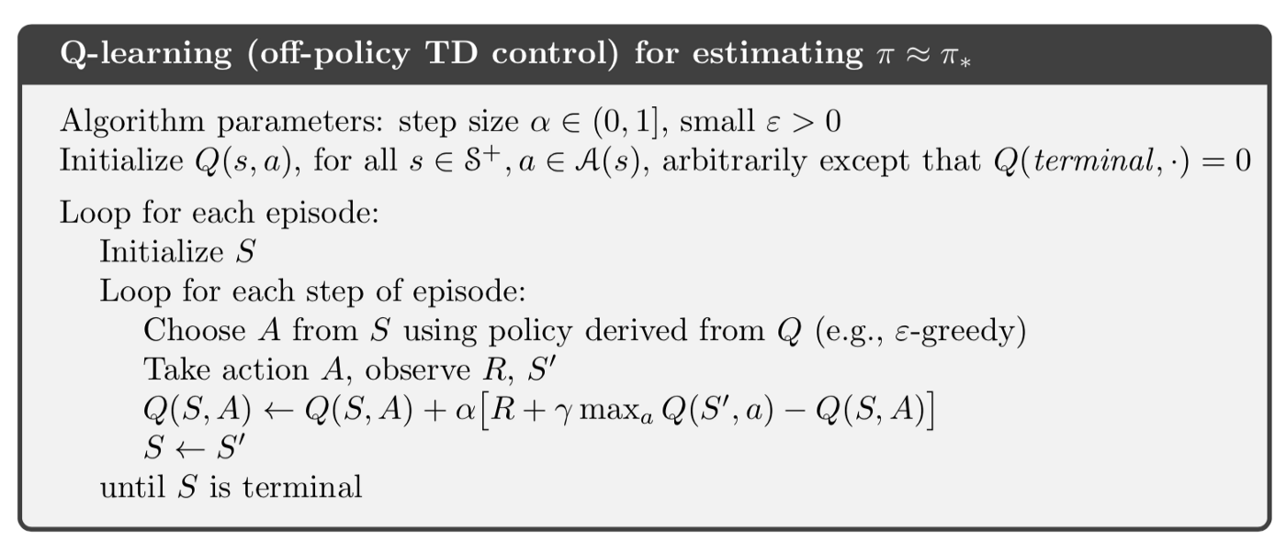
Q-learning algorithm
Source: Sutton & Barto (2018). Reinforcement Learning – An Introduction (2nd edition)

Slide 43
Q-learning algorithm
Q-learning control converges to the optimal action-value function, as long as we take each action in each state infinitely often
No need for greedy behaviour!
Works for any policy that eventually selects all actions sufficiently often
Requires appropriately decaying step sizes
Slides based on DeepMind’s Reinforcement Learning Lectures

Slide 44
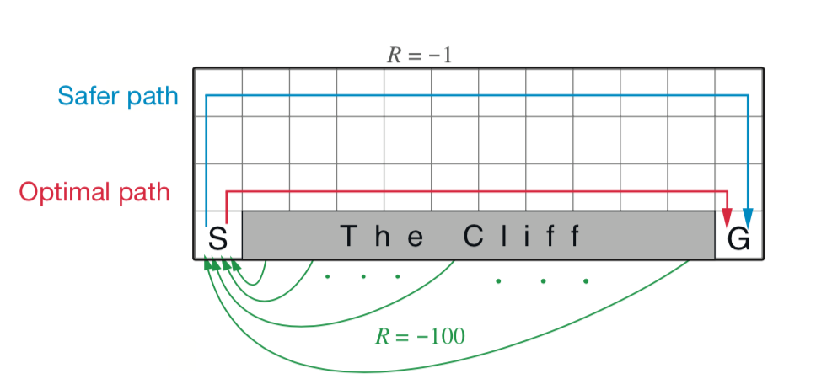
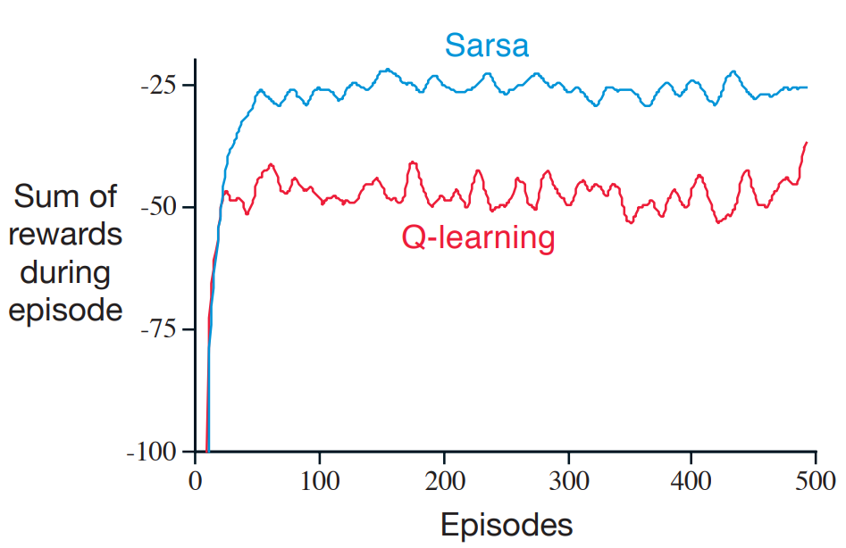
Cliff Walking Example
Q-learning learns values for the optimal policy, that which travels right along the edge of the cliff.
This results in occasionally falling off the cliff because of the ε-greedy action selection
SARSA takes action selection into account and learns the longer but safer path through the upper part of the grid.
Although Q-learning learns the values of the optimal policy, its online performance is worse than that of SARSA, which learns the roundabout policy
If ε were gradually reduced, then both methods would asymptotically converge to the optimal policy.
Source: Sutton & Barto (2018). Reinforcement Learning – An Introduction (2nd edition)

Slide 45
Optimistic Initialization

Slide 46
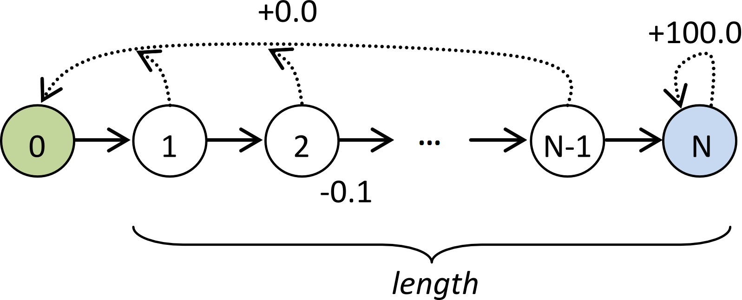
Optimistic Initialization
Simple approach to ensure exploration of state(-action) space
Instead of initializing the value function to 0, initialize to r_{max} / (1-γ)
Acting greedily (instead of ε-greedy) allows the algorithm to try each action in every state at least once
Doing so the agent is able to discover a delayed reward
Example: Combination-lock MDP

Slide 47
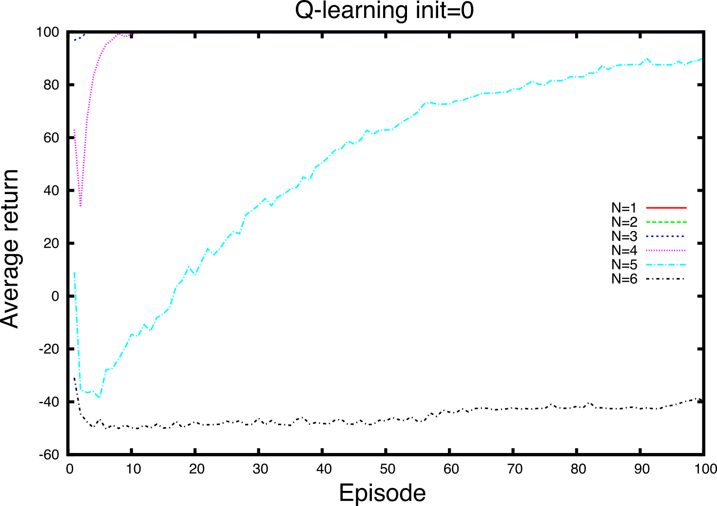
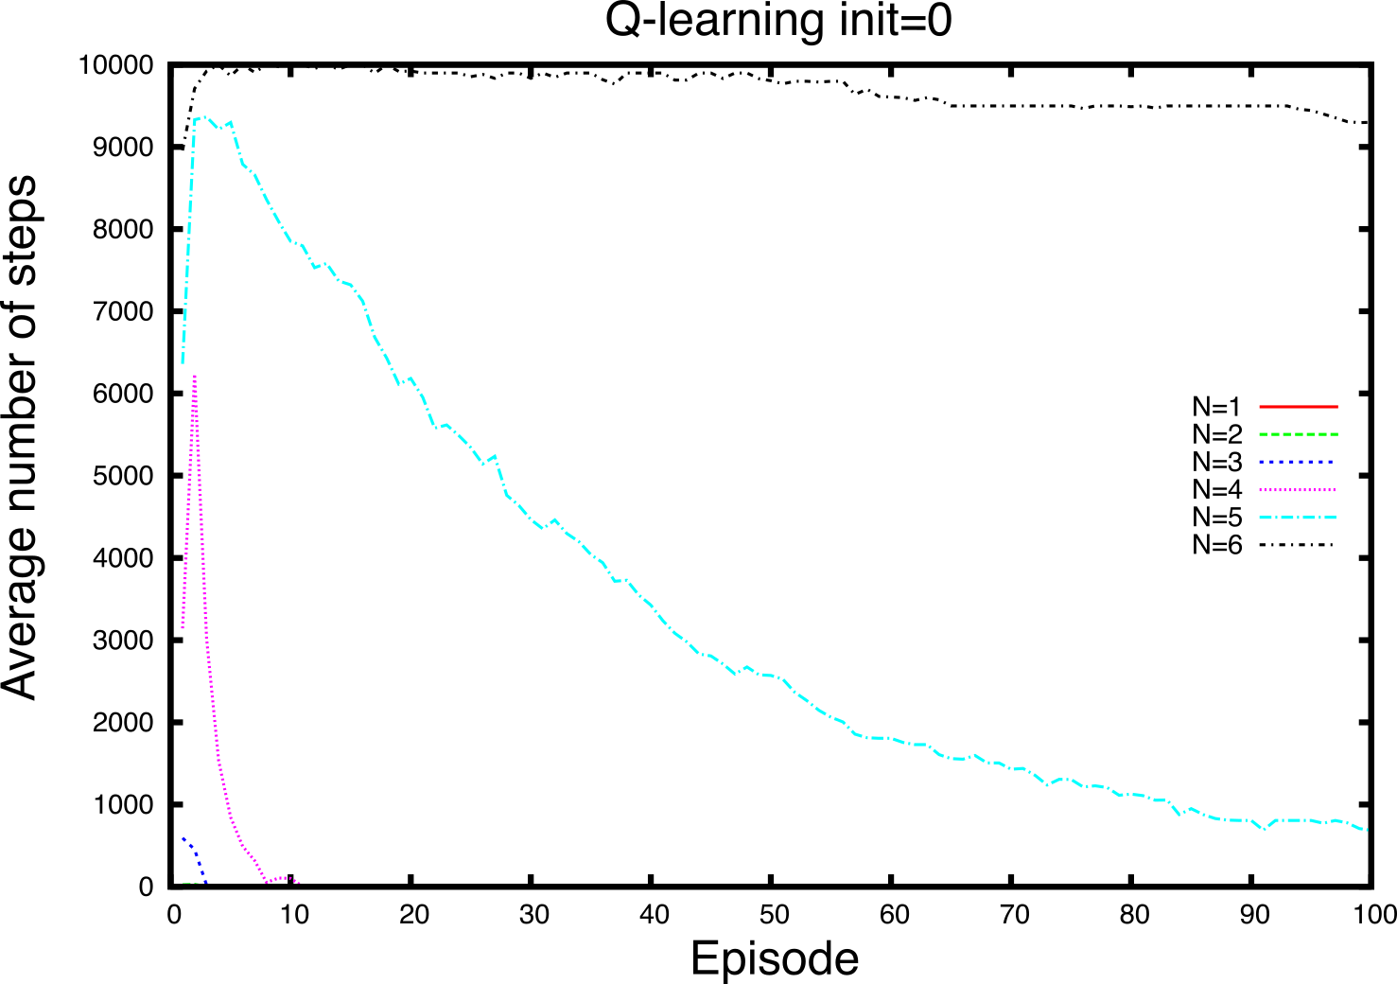
Combination-lock MDP results: $Q_{init}=0$
Parameters
ε=0.1
α=0.95
γ=0.95
episodes=100
max_steps=10K
runs=100
Qinit=0

Slide 48
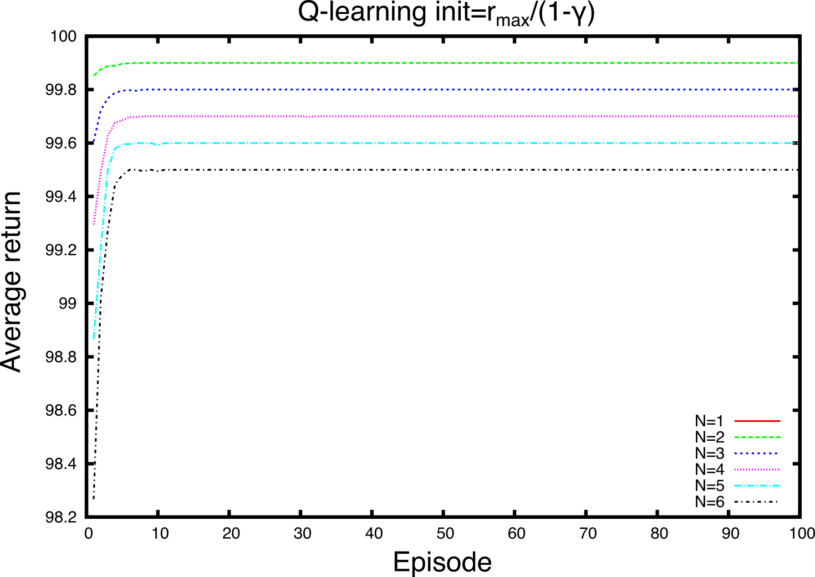
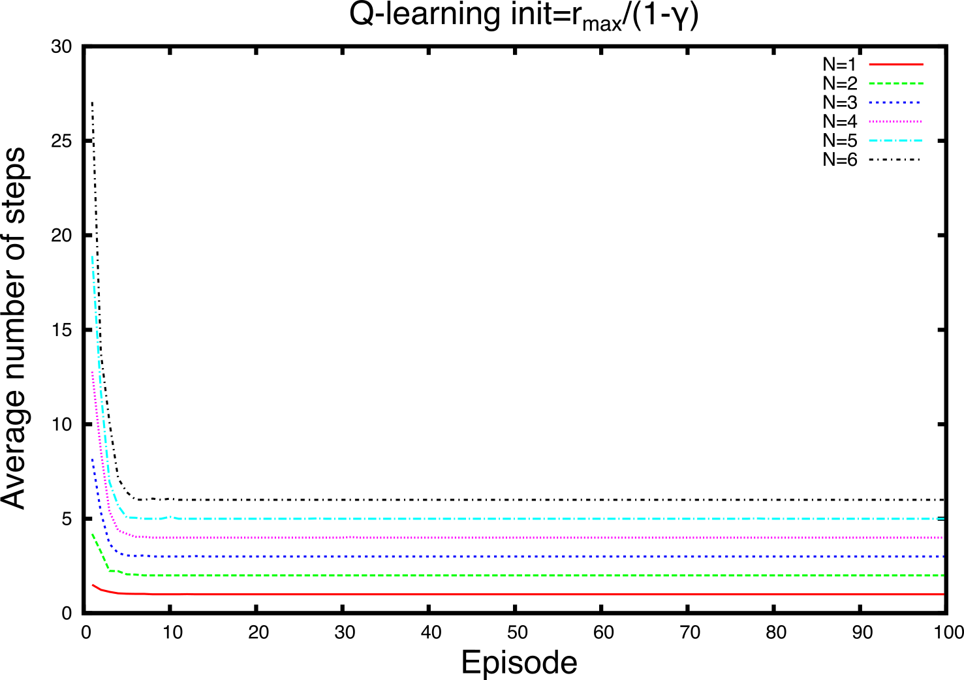
Combination-lock MDP results: $Q_{init}={r_{max}}/{1−γ}$
Parameters
ε=0
α=0.95
γ=0.95
episodes=100
max_steps=10K
runs=100
Qinit=2000

Slide 49
Resources
Multi-armed bandit – Wikipedia
Temporal difference learning – Wikipedia Scholarpedia
SARSA – Wikipedia
Q-learning – Wikipedia

Slide 50
Thank you

