Slide 1
University of Cyprus - MSc Artificial Intelligence
MAI612 - MACHINE LEARNING
Lecture 19: Revision and Overview of Advanced ML
Vassilis Vassiliades, PhD
Winter Semester 2022/23

Slide 2
Revision

Slide 3
Introduction to ML
ML is a subfield of AI that uses data to teach computers how to predict and act
Can be seen as program discovery from data
Its goal is to generalize to unseen data, rather than memorizing
ML has countless applications:
Spam filter
Grouping customers to drive marketing actions
Predicting whether a tumor is benign or malignant from (from features such as its size)
Predicting house prices (from features such as size and number of bedrooms)
Animal sound recognition
Image recognition (e.g., faces, products, characters, medical images)
Natural language translation
Recommender systems (e.g., movies, music, news)
Identifying whether an industrial machine is faulting from its noise levels
Teaching a robot dog to walk

Slide 4
Introduction to ML
There are 3 main types of ML approaches:
Supervised learning: when we have labels
Classification
Regression
Unsupervised learning: when we do not have labels
Clustering
Dimensionality Reduction
Anomaly Detection
Matrix completion (e.g. recommender systems)
Reinforcement learning: when the problem involves sequential decision making
The ML project lifecycle:
Strategy -> Data Preparation <-> Model Development <-> Model Deployment

Slide 5
Data Preparation
Types of data:
Tabular, Text, Images, Signals (audio), Video, Point clouds, Graphs…
Data Collection: acquiring, integrating, labelling
Need to have diversity
Data Preprocessing:
Data cleaning: fix inconsistencies, missing data, remove duplicates
Data encoding: one-hot encoding, ordinal encoding
Data Visualization: see patterns, problems
Can use dimensionality reduction

Slide 6
Data Preparation
Data Transformation:
Feature scaling:
min-max normalization: when we know the feature ranges
Mean-normalization: when we don’t know the feature ranges
Feature selection: choose a subset of the features
L1-regularization can sometimes perform feature selection
Feature Extraction: features with lower dimensionality than the original
PCA, Autoencoders
Feature Engineering: additional features
Polynomial features, domain knowledge
Data Augmentation: additional data points (when we have small or imbalanced dataset)
Data Sampling: remove points (when we have a huge or imbalanced dataset)
Dataset splitting: training, validation (or cross-validation), test sets

Slide 7
Regression
Regression is the supervised learning problem of predicting a continuous value
K-nearest neighbor regression
Nonparametric model
Prediction is the average of the K nearest neighbors
K=1: noisy, 1<K<m better captures the trend, K=m always produces the average of all
Strengths: no training time, handles nonlinearities, …
Weaknesses: prediction becomes slower as the dataset becomes larger, …
Linear regression
Parametric model: 1 parameter per feature + intercept term
Prediction is the dot product of parameter vector and input vector (weighted sum)
Learning can be done either using gradient-based methods (iterative) or computing the analytic solution (non-iterative)

Slide 8
Regression
Linear regression optimizes the MSE, which has a convex shape (single optimum)
Gradient descent starts from a random point (parameter vector), and alternates by computing the partial derivatives of a function at that point and modifying the point by adding a value proportional to the negative gradient
A small learning rate results in slower convergence, a large learning rate may result in divergence
Need to use feature scaling with gradient descent
The analytic solution is not iterative (does not start from a random initial parameter vector)
Fast for small number of features and points
Cannot use it for very large number of features (e.g., thousands) and points (e.g., thousands or millions)
Does not use regularization (could overfit when using a large number of features)
Linear regression
Strengths: constant prediction time, analytic solution easy to implement,…
Weaknesses: cannot model nonlinear relationships,…
Weakness can be addressed using polynomial features

Slide 9
Classification
Classification is the supervised learning problem of predicting a discrete value
K-nearest neighbor classification
Prediction is the majority vote of the K nearest neighbors
K=1: fit the noise, K=m always predict the majority class
Logistic regression
Simple method for binary classification
Feeds the output of linear regression through the sigmoid function which makes it in [0,1]
The output is seen as the estimated probability of predicting the positive class
Uses a default (probability) threshold of 0.5 for placing the decision boundary
Decision boundary of logistic regression is linear, can be nonlinear if we use polynomial features
Logistic regression optimizes the Cross-Entropy error which has a convex shape
We use gradient-based methods to find the minimum
The CE error penalizes the model a lot if its predicted probability is very far from the actual

Slide 10
Classification
Error analysis for binary classifiers
True positives, True Negatives, False Positives and False Negatives
Metrics: Accuracy, Precision, TP rate, FP rate, F1-score
ROC curve: plots the FP rate and the TP rate for all classification thresholds
AUC score: a single metric based on ROC which can be used to compare classifiers
Multiclass classification
One-vs-rest: train K binary classifiers; prediction is the class of the most confident classifier
Softmax: uses one-hot encoding of classes; prediction is a probability distribution over K classes
Confusion matrix for multiclass classification
TPs: diagonal
TP rate (class A): TP(class A) / number of samples for class A
Precision: TP(class A) / number of predictions for class A
Accuracy: number of TPs / total number of samples

Slide 11
Model Evaluation and Improvement
We want our models to exhibit generalization capabilities instead of memorizing the training set.
Generalization: good performance on unseen data, drawn from the same distribution
Underfitting: too simple model / high bias
Overfitting: too complex model / fit the noise rather than the trend / high variance
The bias-variance tradeoff is the conflict of trying to minimize both bias and variance
Practically, we achieve that by splitting the dataset into a training, validation and test sets, and selecting the model that has the lowest validation error.
k-fold cross validation:
splits the training+validation dataset into k subsets, and trains k independent models where subset $i$ is used for validation and the remaining as training set
the performance of the model is the average validation error over all k subsets
used when the dataset is small, because of its complexity in training k models rather than just one.

Slide 12
Model Evaluation and Improvement
Learning curves can be used to inspect whether we need to acquire more data
More data typically benefits high variance models but not high bias ones
Regularization is a penalty given to the loss function of high variance models to reduce the magnitude of their parameters, and thus, their complexity
L1 regularization uses the absolute value norm and can sometimes be used for feature selection
L2 regularization users the Euclidean norm and typically produces a better fit than L1
Hyperparameter tuning is the process of varying the hyperparameters of models and learning algorithms, and select the combination that results in the lowest validation error.
Model improvement can be achieved using ensembles: training multiple models instead of one and aggregating their outputs
Improve high bias models through: complexification, ensembles
Improve high variance models through: hyperparameter tuning, regularization, ensembles, more data

Slide 13
Trees and Forests
Decision trees are models that have a natural if-then-else structure, thus being interpretable and fast
For a given dataset, there can be multiple decision trees that classify the data
An algorithm for learning decision trees needs to choose one that generalizes well by deciding the feature to use for splitting at each node, and when to stop splitting
Using irrelevant features creates larger decision trees, thus simplicity is preferred
The best feature to use for splitting is the one that is most informative, i.e., the one that minimizes the disorder aka entropy
The entropy $H$ takes as input the proportion of positive examples $p_{+}$, and as $p_{+}$ goes from 0 to 0.5, $H$ increases from 0 to 1, and as $p_{+}$ goes from 0.5 to 1, $H$ decreases from 1 to 0.
Information gain measures the expected reduction in entropy due to splitting on some feature A
It is measured as the difference between the entropy of the initial set, and the weighted sum of the entropies in the branches
We want to maximize information gain, or equivalently minimize the weighted sum
To split on a continuous variable, we first calculate all possible unique thresholds (using the midpoints of pairs of sorted points), and select the one with the highest information gain.

Slide 14
Trees and Forests
Regression trees:
predict the average of the values in their leaf nodes
use the variance instead of the entropy, and the variance reduction instead of the information gain
Ensemble methods:
typically have lower generalization error than single learners
can reduce both bias and variance
they rely on diverse learners that produce different errors
aggregation function: average for regression, majority vote for classification
Bagging trains models in parallel by varying their training data using sampling with replacement
Random forests use bagging with the additional step of randomizing the feature choice
Boosting trains models incrementally by focusing on previously misclassified examples
Stacking is a method that trains models typically at 2 levels, where the predictions of the models at level 1 become training data for a model at level 2 which learns how to combine them.

Slide 15
Kernel methods
Classification problems often require nonlinear decision boundaries
These can be constructed using feature engineering, e.g., adding polynomial features
As we add features, we increase the dimensionality of the input which often makes the problem linearly separable, i.e., easier to solve in higher dimensions
However, this approach can exponentially increase the number of parameters to be learned, and has the disadvantage of needing to compute features explicitly
Kernel trick: the technique of using kernel functions (i.e., similarity functions over pairs of raw data points) that allow the model to operate in a high-dimensional space without explicitly transforming the raw data in the higher dimensional space.
Kernel examples: polynomial, Gaussian
We can make valid kernels by combining valid kernels through addition, multiplication and scaling with a positive constant
Kernel methods are instance-based learners which compute the similarity of an input with stored training points and multiply this by some learned weight which is specific for that particular training point

Slide 16
Kernel methods
Support Vector Machines are binary classification models that learn the separating hyperplane with the maximum margin, and use kernels to deal with nonlinearly separable problems
Maximum margin decision boundary:
minimizes the generalization error, as it ensures that points are classified far from the separating hyperplane
computed by finding the support vectors, i.e., the training points closest to the separating hyperplane
Trained SVMs only need to keep the support vectors to make a prediction, which makes the prediction fast
We can do multi-class classification with SVMs using the one-vs-rest approach
Support Vector Regression extends SVMs to regression problems
fits a line to the data with a margin (tube) around it
ignores points inside the tube because their combined error is small

Slide 17
Kernel methods
Radial-basis function (RBF) networks are kernel methods that compute nonlinear features of the input based on proximity to fixed centres.
The output is a linear combination of coefficients and features
Mainly used for regression, in particular for exact interpolation and approximation
The centre of the kernel can be at a training point (exact interpolation), however, it can be elsewhere
Commonly used kernel: Gaussian
Value of 0 if distance between queried point and kernel centre is large
Value of 1 if distance between queried point and kernel centre is 0 (same point)
If σ (Gaussian width) is large: smoother fit, thus, higher bias, lower variance
We can use the normal equations to compute the RBF network weights for interpolation and approximation (fixed centres)

Slide 18
Kernel methods
We can adapt the weights, centre coordinates and Gaussian widths of an RBF network using gradient descent: results in better fit
Unnormalized RBFs: more localized, need more (or wider) to cover the input space
Normalized RBF networks may exhibit better generalization with fewer nodes
RBF networks can be used for classification by feeding the output of regression RBF network into a sigmoid function (similarly to logistic regression)
Gaussian processes: nonparametric probabilistic regression models that output not only the prediction but also the confidence in the prediction
Probability distribution over functions: can sample functions from it
Good for low-data problems
Can be provided with prior knowledge about the function we want to model

Slide 19
Kernel methods
Applications of SVMs:
Cancer prediction from features
Whether a mushroom is poisonous or not
Spam filter (with low-dimensional features)
Predict whether the income of a person exceeds 50K
Applications of RBFs:
Predict price of houses based on size + number of bedrooms
Predict price of stocks based on time series data
Predict the value of a continuous function based on sampled points
Predict medical insurance costs based on age, gender, BMI, smoker, …
Predict wine quality (1-10) based on chemical characteristics

Slide 20
Neural Networks
Artificial neurons compute the weighted sum of their inputs and feed it through an activation function which then becomes their output
Activation functions:
Heaviside step (non-differentiable) $→$Perceptron model
Linear $→$Linear regression
Sigmoid $→$Logistic regression
Perceptrons are linear classifiers
By combining multiple perceptrons in layers we can classify nonlinearly separable problems
E.g., XOR can be solved using 2 hidden neurons and 1 output neuron
However, we cannot train them using gradient descent when they use the Heaviside step function as it is non-differentiable

Slide 21
Neural Networks
Multilayer Perceptrons is a synonym for feedforward ANNs (typically with differentiable activation functions)
As a classifier, an MLP with:
1 hidden layer forms open or convex decision regions
2 hidden layers create arbitrary decision regions
Forward propagation is the process that feeds a data instance to the input layer of a NN and this is gradually transformed into the output prediction (regression or classification) through some nonlinear transformation.
This nonlinear transformation computes features of the input which are learned
A second hidden layer computes features as functions of existing features
Learning in NNs can be done using backpropagation and gradient descent

Slide 22
Neural Networks
Backpropagation: an efficient way to compute partial derivatives of the error function with respect to each parameter using the chain rule (since a NN is a composition of functions)
Error function: MSE for regression, Cross-Entropy for classification
Forward propagation computes the activation (output) of each node, while Backpropagation computes the error (delta) of each node
Delta (error) of each node: A x B
A = derivative of the node’s activation function
B = derivative of error with respect to the node’s output
For an output node: this is the derivative of the error function wrt to the activation of the output node
For a hidden node i at layer k: this is the sum of all deltas at nodes in layer k+1 (which are connected to node i) multiplied by their connecting weight
Gradient of the Error wrt to a weight = (delta of postsynaptic node) x (output of presynaptic node)

Slide 23
Neural Networks
Stochastic GD: weight update after the presentation of every pattern
Batch GD: weight update after the presentation of all patterns in the training set
Mini-batch GD: weight update after the presentation of subsets of patterns in the training set
Stochastic or mini-batch GD are used when we have massive training sets
Momentum term: memory of previous direction, speeds up learning
Early stopping: way to prevent overfitting by stopping training when the validation error starts increasing
We can improve the performance of NN models using regularization, hyperparameter tuning and ensembles
Learning the NN topology can be done using gradient-free methods, such as evolutionary algorithms.

Slide 24
Introduction to Deep Learning
Deep learning is about learning successive layers of representations
Using NNs with more than 2 hidden layers
Deep Leaning is possible mostly because of hardware advancements (GPUs) and abundance of data
When we want to detect a particular concept that could be in different places of the input we use weight sharing, i.e., we build a single feature detector for this concept by training the weights of these inputs jointly
This helps generalization
Example 1: creating a dog image classifier: a dog could appear everywhere in an image
Example 2: text completion network: we want the part of the NN that learns what a dog is to be reused every time the NN sees the word dog

Slide 25
Introduction to Deep Learning
Convolutional networks are NNs more suitable for image data
They use local receptive fields (filters) and shift them (convolve) over the activation map of the previous layer to create the activation map of the current layer
This reduces the number of parameters compared to fully connected feedforward networks
Each filter becomes a feature detector over different parts of the input (translation invariance):
Layer 1: edge detectors
Layer 2: corner detectors
Layer 3: parts-of-objects detectors
Layer 4: complete-objects detectors

Slide 26
Introduction to Deep Learning
Sequential data: data ordered into sequences
Typically: time series data
A way to handle sequential data using NNs is by using feedback (delayed) connections: recurrent NNs (RNNs)
A recurrent NN creates its own internal representation of time
We can train RNNs using backpropagation through time
We unroll the RNN over time and backpropagate the errors from the last time step to the first
We accumulate the gradients and apply gradient descent
Unrolled RNNs can become very deep networks
When doing so we might have the vanishing or exploding gradients problems

Slide 27
Introduction to Deep Learning
Echo state networks:
use a large sparsely connected hidden layer which is not trained
they do not use backprop through time
they do not have the vanishing or exploding gradients problems
we can compute the analytic solution for a regression problem (similarly to linear regression)
good performance in tasks that require fast, adaptive training
not good performance in tasks with many variables and long-term dependencies

Slide 28
Introduction to Deep Learning
Long short-term memory networks:
Use gating mechanisms that allow the network to learn what to forget, what to store in memory and what to output
Gating: sigmoid multiplied by signal : sigmoid modulates how much of the signal is allowed to pass through
Can be applied to tasks requiring long-term dependencies
Text data:
One-hot word representation: sparse, high dimensional, does not generalize well
Word embeddings: learned, numerical vector representation
Try to capture the meaning of words based on their usage in sentences
Words with similar meaning have similar vector representations
King – Man + Woman = Queen

Slide 29
Clustering
Clustering is the problem of grouping data with similar characteristics
We do not have labels that specify the correct outputs
k-means clustering is a clustering algorithm that alternates between assigning all training points to their closest cluster centroid, and updating the cluster centroids to the average value of all their assigned points
Uses a pre-specified number (k) of clusters
Randomly initializes the k cluster centroids
We can avoid local optima by running k-means multiple times and selecting the clustering with the lowest cost
We choose k using domain knowledge, the Elbow method or the Silhouette score
Clustering can help supervised learning, e.g., by
Finding the initial centres of RBF networks
Allowing to use both labelled and unlabelled data to improve generalization

Slide 30
Dimensionality Reduction
Dimensionality reduction: transformation of high-dimensional data to low-dimensional space
Why dimensionality reduction:
Data visualization
Data compression
Can help ML algorithms (supervised learning, clustering)
Principal Component Analysis
Linear transformation into a new coordinate system
Maximize variance of low-dimensional data = minimizing reconstruction error
Finds $n$ orthogonal vectors each ranked by how much it explains the variance in data
These are the principal components or eigenvectors
Projection = encoding in low dimensions
Reconstruction = decoding from low dimensions to high-dimensions
We can choose the number of components based on a desired ratio of explained variance (typically 90-99%)

Slide 31
Dimensionality Reduction
PCA works well in various problems but it is a linear method
Nonlinear dimensionality reduction methods address this shortcoming
Kernel PCA uses the kernel trick
Autoencoders are NNs trained to encode and reconstruct the input
Manifold learning approaches = nonlinear dimensionality reduction methods that explicitly consider that the data lie on low-dimensional structures embedded in high-dimensional space
Isomap: instead of Euclidean distance, uses the geodesic distance
Geodesic distance: distance on the manifold
Swiss roll example: isomap can unfold it
Allows better interpolation as the interpolated points expected to lie on the manifold
t-SNE
used for visualization
stochastic method that preserves local similarities
can give different results for different initializations

Slide 32
Anomaly Detection
Anomaly detection is the problem of modeling a dataset of normal events and raising an alarm when an unusual event occurs in the future.
Normal events are assumed to be concentrated
Outlier detection: outliers exist in the training set
Novelty detection: no outliers in the training set
Approaches:
Density estimation
One-class classification using discriminative models
Autoencoders
Density estimation: Parametric and Non-parametric
Build a model of the probability of points
Use a threshold (ε) on the probability to classify an anomaly (unlikely point) from a normal point
Parametric: fit a Gaussian (Parameters: mean and variance)
Non-parametric: kernel density estimation

Slide 33
Anomaly Detection
One-class classification using discriminative models:
Create a conservative decision boundary
One-class SVM: try to encompass all (normal) training data using the smallest hypersphere
Isolation Forests: anomalies are data points that have short path lengths in a tree
Autoencoders:
Normal data have low reconstruction error
Abnormal data have higher reconstruction error
Use a histogram of the errors and decide an anomaly threshold
Feature engineering can be very important in anomaly detection systems
Supervised anomaly detection: way to evaluate anomaly detection systems
Have small amount of labelled data
Training set: normal data, no labels
CV and test sets: normal+abnormal labelled data
Evaluation metrics like in binary classification (TP rate, precision, AUC score,…)

Slide 34
Recommender Systems
Recommender systems are systems that provide suggestions for items that are most relevant to a particular user
Matrix completion problem:
sparse matrix with lots of missing values
predict missing values from the others
Example: predicting movie ratings (0-5)
Rows: movies
Columns: users
Use different linear regression model for each user (e.g., if 1M users, we have 1M models)
When we have the features for each movie we can formulate a cost function for learning the parameters of all users using gradient descent
Supervised regression problem using the squared error loss

Slide 35
Recommender Systems
Collaborative filtering:
Recommend items based on ratings of users who gave similar ratings
Unsupervised because it does not assume knowledge of features
Formulates a cost function that can be used to simultaneously learn both the features and the parameters for each user using gradient descent
For binary labels we can use a logistic regression prediction model and a binary cross-entropy loss
When a new user arrives we can use mean normalization so that the predicted ratings of the new user will equal the mean of all ratings for each movie
Content-based filtering:
Recommendation based on features of user and item to find good match
Compute embeddings (e.g., using a NN) from features which need to be of the same size
Predicted rating: dot product of embeddings
Finding related items (e.g., movies related to movie i) can be done using a k-nearest neighbor search (in feature or embedding space)

Slide 36
Introduction to Reinforcement Learning
Predictions AND actions
Interaction with environment
Trial-and-error learning
Learn to achieve goals
Goals defined using reward functions
Example: robot learning to escape a room
-1 everywhere, 0 at the exit would encourage the robot to find the shortest path
RL: find a policy that maximizes the expected return (sum of rewards)
Policy: behavior of the agent
mapping from states to actions
Deterministic or stochastic
Value function: how good a state (or state-action pair) is
Estimate of the expected return

Slide 37
Introduction to Reinforcement Learning
Model: what the environment will do next
Which state will I end up if I am in state s and execute action a
What reward I will receive?
Deterministic or stochastic
Environment: fully-observable, partially-observable
Agent categories:
Value-based, Policy-based, Actor-Critic
Model-free, Model-based
Prediction: learn a value function for a given policy
Control: find the best policy
Learning: unknown environment, interaction of agent with external environment
Planning: when we have (or learned) a model, “interaction” of agent with the model

Slide 38
Markov Decision Processes and Dynamic Programming
MDP: (S,A,T,r)
S: set of states
A: set of actions
T: transition probabilities
r: reward function
T and r define the model of the environment
Markov means that the probability of transitioning to $s_{t+1}$is only affected by $s_{t}$ and $a_{t}$ (not the history)
Return:
Undiscounted: used in episodic tasks (when there is an end)
Discounted: used in episodic or continuing tasks
Average: used typically in continuing tasks
Discounted return: how much some future reward is worth to us right now
$γ≈0$ $→$ myopic agent
$γ≈1$ $→$ farsighted agent

Slide 39
Markov Decision Processes and Dynamic Programming
Value function: expected return of a given policy (for every state or state-action pair)
Optimal value function: best value function over all policies
Best possible performance in an MDP
Optimal policy: action that maximizes the optimal value function for a given state
Bellman equations can be used to find:
the value functions of a given policy
the optimal value functions
Dynamic programming: used to find the optimal value function
Policy Evaluation: find the value function of some policy (multiple iterations)
Policy Improvement: given some value function, take the greedy action at every state
Policy Iteration:
Start with random policy
Repeat: Run policy evaluation until convergence, then policy improvement step
Value Iteration:
Start with random or zero value function
Repeat: Run single step of policy evaluation, then policy improvement step

Slide 40
Model-free Reinforcement Learning
When we know the model (T,r) we use planning to find the optimal policy
When we don’t know the model, we use sampling
Exploitation: go to areas that you have been before that are rewarding
Exploration: sample new experiences
Exploration vs Exploitation tradeoff: how to choose between these two?
Multi-armed bandits setting: only actions, no states
Goal: find the action that results in the highest expected return
ε-greedy action selection:
Select random action with probability ε (exploration)
Select the greedy action with probability 1-ε (exploitation)
Model-free RL:
Monte Carlo Learning
Temporal Difference Learning

Slide 41
Model-free Reinforcement Learning
Monte Carlo algorithms
Only work in episodic tasks: update after the end of the episode
Updates can be noisy
Temporal Difference learning algorithms
Work in episodic and continuing tasks: learn after every step
Use bootstrapping like in dynamic programming:
Update the value estimate of a state (or state-action pair) based on another estimate (of the value of the next state or state-action pair)
Single-step value estimates can be inaccurate
We can use multi-step TD to mitigate this
TD for control:
use state-action (Q) value functions
On-policy: learn about some behavior policy while following that policy
Off-policy: follow some policy, but learn about a different policy

Slide 42
Model-free Reinforcement Learning
SARSA is on-policy:
$Q\left(s_{t},a_{t}\right)=Q\left(s_{t},a_{t}\right)+η\left(R_{t+1}+γQ\left(s_{t+1},a_{t+1}\right)−Q\left(s_{t},a_{t}\right)\right)$
Converges to the optimal action-value function if the policy is greedy in the limit of infinite exploration (e.g., ε-greedy starting with high epsilon and decreasing it)
Q-learning is off-policy:
$Q\left(s_{t},a_{t}\right)=Q\left(s_{t},a_{t}\right)+η\left(R_{t+1}+γ\max_{b}{Q\left(s_{t+1},b \right)}−Q\left(s_{t},a_{t}\right)\right)$
Learns about the greedy policy while following some other policy (e.g., random)
Converges to the optimal action-value function if all state-action pairs are visited infinitely often
Initializing the action-value function optimistically and acting greedily allows the agent to explore all state-action pairs.
Optimistic initialization:
maximum possible expected return from each state-action pair
$Q_{init}={r_{max}}/{1−γ}$

Slide 43
Looking forward

Slide 44
ML for Natural Language Processing
How do we process and analyze natural language data?
Tasks:
speech recognition
text2speech
dialogue generation
automatic summarization
machine translation
sentiment analysis
natural language understanding
natural language generation
text2image generation
Models: BERT, GPT3, PaLM,...

Slide 45
ML for Computer Vision
How do we process images, video, point clouds?
Tasks:
object recognition
object segmentation
object tracking
pose estimation
activity recognition
scene reconstruction
image captioning
face recognition
style transfer
text2image generation

Slide 46
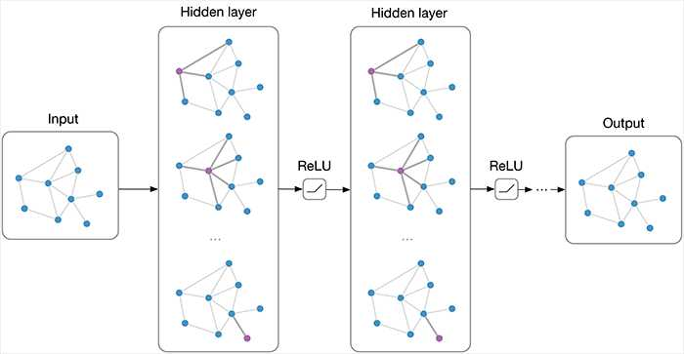
ML for graph data
Graph data:
social networks
molecules
images as graphs
text as graphs
Graph neural networks

Slide 47
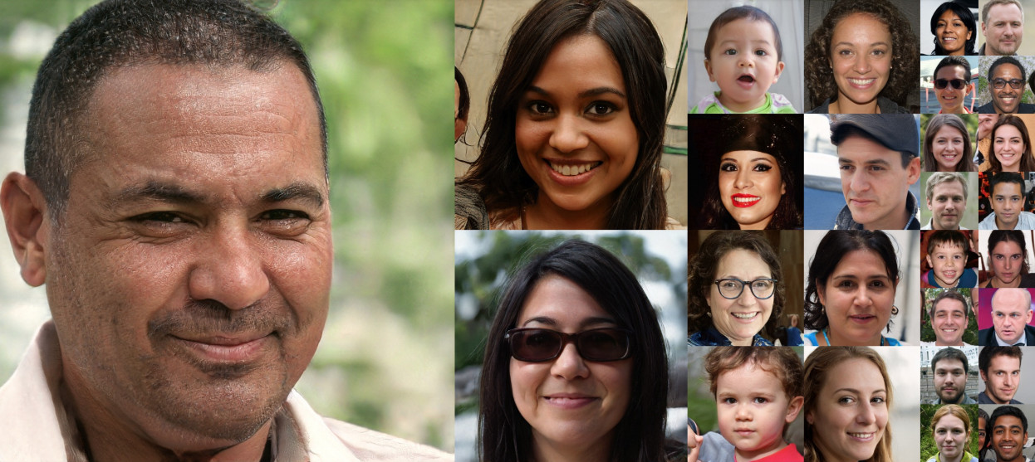
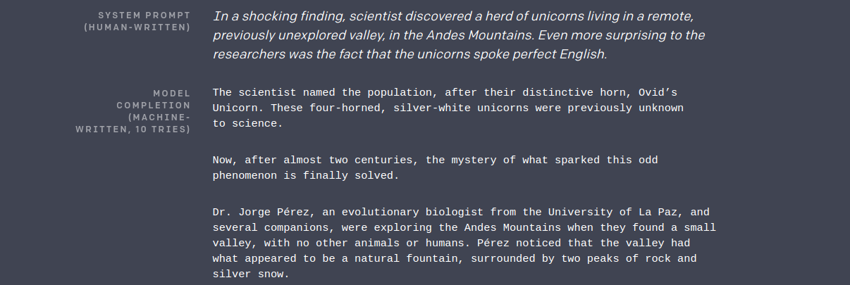
Generative Models
Can generate images, audio, music, text, …
Models:
Variational Autoencoders
Generative Adversarial Networks
Flows
Diffusion models
Go to:
https://this-person-does-not-exist.com/

Slide 48
Meta-learning
Learning to learn fast
Learn from a distribution of tasks how to adapt quickly to a new task (drawn from the same distribution)
Various methods:
learning an optimizer (instead of using backprop)
learning good initial values for NNs coupled with gradient based optimization
Can help generalization
Can help with data efficiency

Slide 49
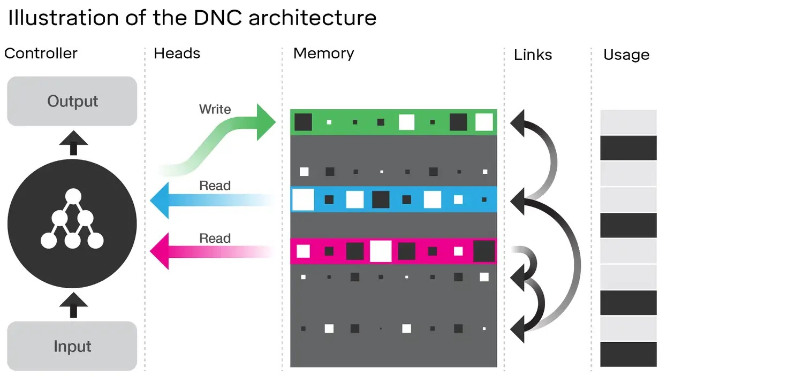
Memory-augmented NNs
Decoupling memory from computation
CPU + RAM
Learn how to read/write from/to memory, and modify memory
Examples:
Neural Turing Machines
Memory Networks
Differentiable Neural Computers

Slide 50
Self-supervised Learning
No labelled data
Extract supervisory signals from the data and use supervised techniques to learn representations
e.g. predicting parts of images from other parts
Often used with data augmentation
Promising approach to learn better representations

Slide 51
(More on) Reinforcement Learning
Deep Reinforcement Learning
RL : learning to act
DL : learning good representations
High dimensional input and output spaces
e.g., self-driving car, humanoid robot
How do we learn in the absence of external rewards?
e.g., curiosity, intrinsic motivation
How do we structure the learning process to facilitate learning?
automatic curriculum, open-ended learning
How do we combine learning and planning?
learning a model of the world
...

Slide 52
Multiagent Learning
MDP framework assumes a single agent trying to maximize reward
The world consists of multiple agents interacting and learning
Competition: e.g., creating superhuman AI for playing games
Coordination: how do we create agents that coordinate their behavior to solve a complex problem (e.g. push a block towards a certain position)
Mixture of competition/coordination: e.g., robot soccer, most of real-world interactions
Communication: e.g., for resolving conflicts, avoiding deadlocks
Agents teaching other agents:
agent societies
how human intelligence arose

Slide 53
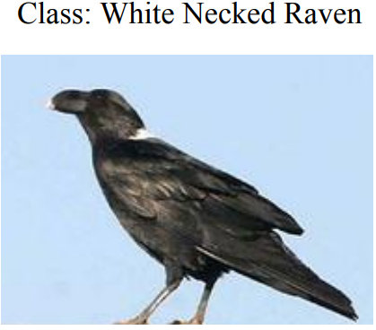
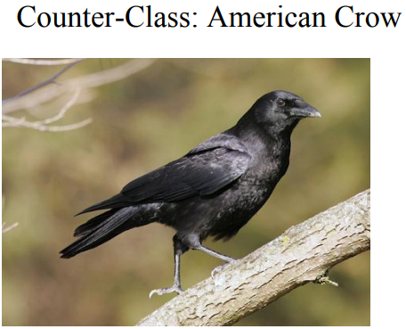
Explainable ML
ML models are often viewed as black boxes
know the inputs and outputs but not the internals
especially the case of NNs
Often models learn the wrong association, which however results in good performance
e.g., learning to recognize cows
How do we create systems that explain their predictions or decisions?
e.g., through textual descriptions or visualizations
Enable counterfactural reasoning/explanations
source

Slide 54
Continual Learning
Transfer learning: train on task T1, adapt/fine-tune on task T2
we take a model trained on task 1, and fine-tune it with data from task 2, where tasks 1 and 2 are expected to be similar
doing so is expect to learn task 2 without requiring a lot of data
we don’t care about solving T1 with the new model
Multi-task learning: train a model simultaneously on tasks {T1,T2,...,Tn}
Meta-learning: train on tasks {T1,T2,..,Tn}, adapt on task Tn+1
Sequential multi-task learning: train on task 1, then train on task 2, then train on task 3,...
naive transfer learning will result in catastrophic forgetting, i.e., knowledge about previous tasks will get overwritten
Continual learning: how to tackle the problem of catastrophic forgetting when learning sequentially
how does the brain do it?
one of the grand AI challenges!

Slide 55
Thank you

