Slide 1
University of Cyprus - MSc Artificial Intelligence
MAI612 - MACHINE LEARNING
Lecture 1: Introduction to Machine Learning
Vassilis Vassiliades, PhD
Winter Semester 2022/23

Slide 2
About Me
Vassilis Vassiliades, PhD
Research Team Leader at CYENS Centre of Excellence
Research Interests:
Machine Learning, Evolutionary Computation, Robotics
Google Scholar:
https://scholar.google.com/citations?user=_Hzp2B0AAAAJ&hl=en

Slide 3
Learning Outcomes
Understand how to structure ML projects and their lifecycle: data preparation, development, evaluation, deployment.
Gain practical experience with various supervised learning models for regression and classification problems.
Know how to implement unsupervised learning models for clustering, dimensionality reduction, anomaly detection and recommendation systems.
Understand what reinforcement learning is, how it can be used for sequential decision making problems and acquire hands-on experience with it.

Slide 4
Syllabus
Part 1: Introduction
Introduction, Data preparation
Part 2: Supervised Learning
Regression, Classification, Model Evaluation and Improvement, Trees and Forests, Kernel-based methods, Neural Networks
Part 3: Unsupervised Learning
Clustering, Dimensionality Reduction, Anomaly Detection, Recommender Systems
Part 4: Reinforcement Learning
Introduction, Markov Decision Processes and Dynamic Programming, Model-free Prediction and Control

Slide 5
Lecture 1: Introduction to Machine Learning
Learning Outcomes
You will gain a basic understanding of:
how Machine Learning (ML) relates to Artificial Intelligence (AI)
the difference between traditional programming and ML
what ML is, some terminology and applications
the three main types of ML
the lifecycle of an ML project

Slide 6
Artificial Intelligence

Slide 7
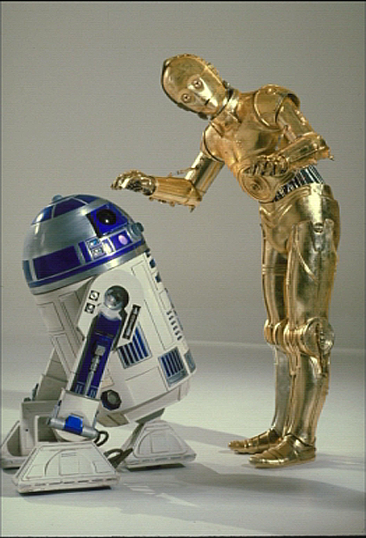
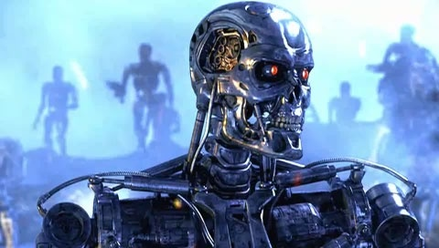
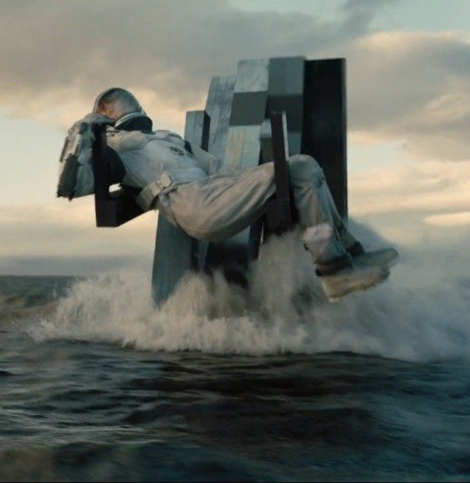
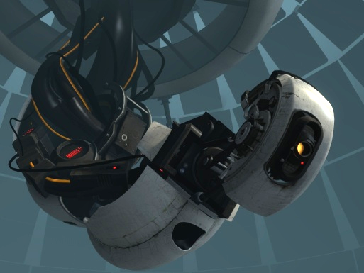
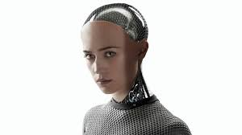
Sci-fi Quiz

Slide 8
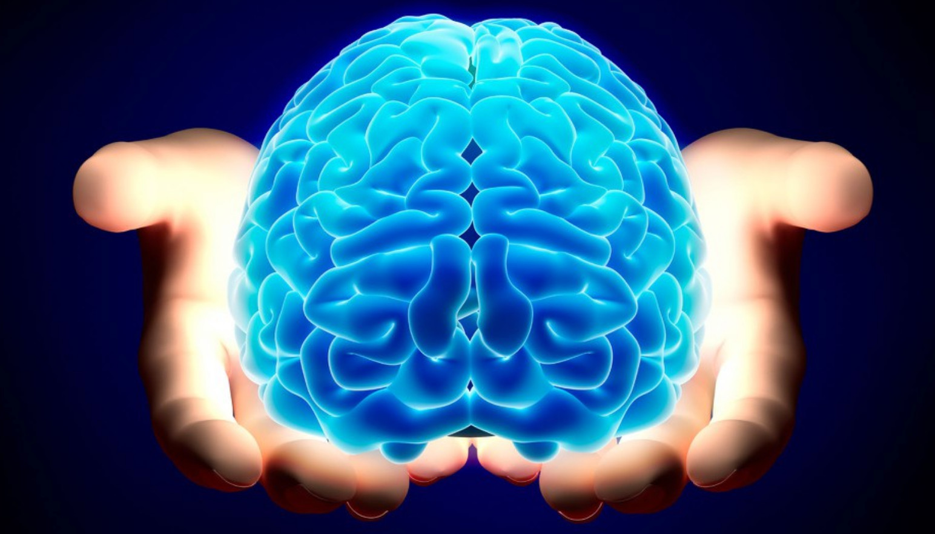
Intelligence
“Capacity for: logic, understanding, self-awareness, learning, emotional knowledge, reasoning, planning, creativity, critical thinking, and problem solving.”
“Ability to perceive or infer information, and to retain it as knowledge to be applied towards adaptive behaviors within an environment or context.”
Source: https://en.wikipedia.org/wiki/Intelligence

Slide 9
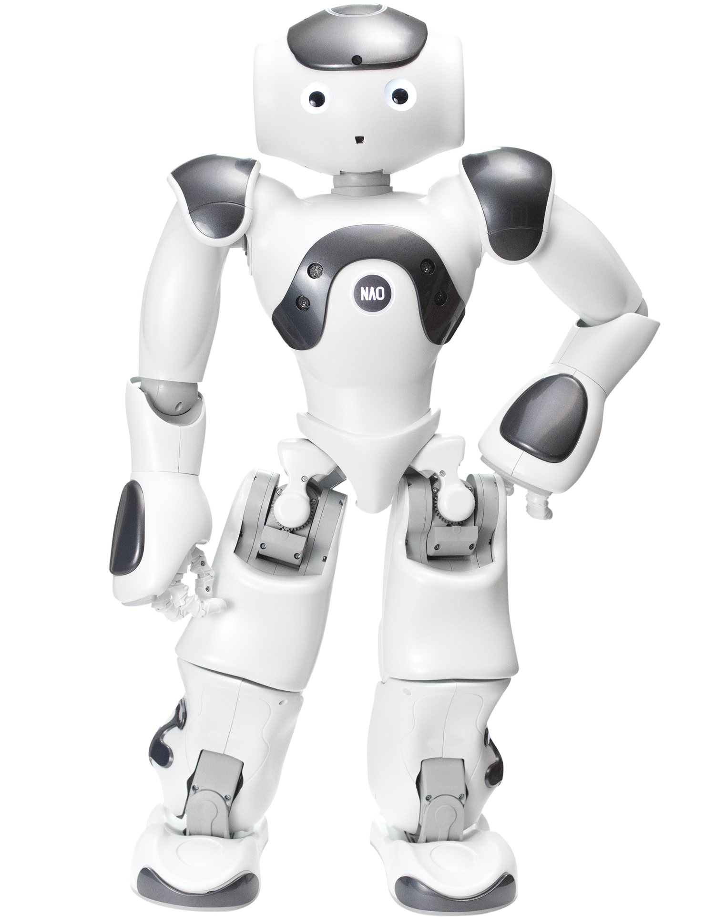
What is Artificial Intelligence?
Can it reason?
(e.g. draw logical conclusions)
Can it see?
(and identify things)
Can it hear?
(and respond in a useful and sensible way)
Can it move?
(by itself, not on a programmed path)
Can it read?
(and analyse patterns in text)
Can it learn?
(modify its behavior to become more efficient)

Slide 10
Foundations of AI
Biology
Psychology
Economics
Computer Engineering
Artificial
Intelligence
Mathematics
Control theory & Cybernetics
Philosophy
Linguistics

Slide 11
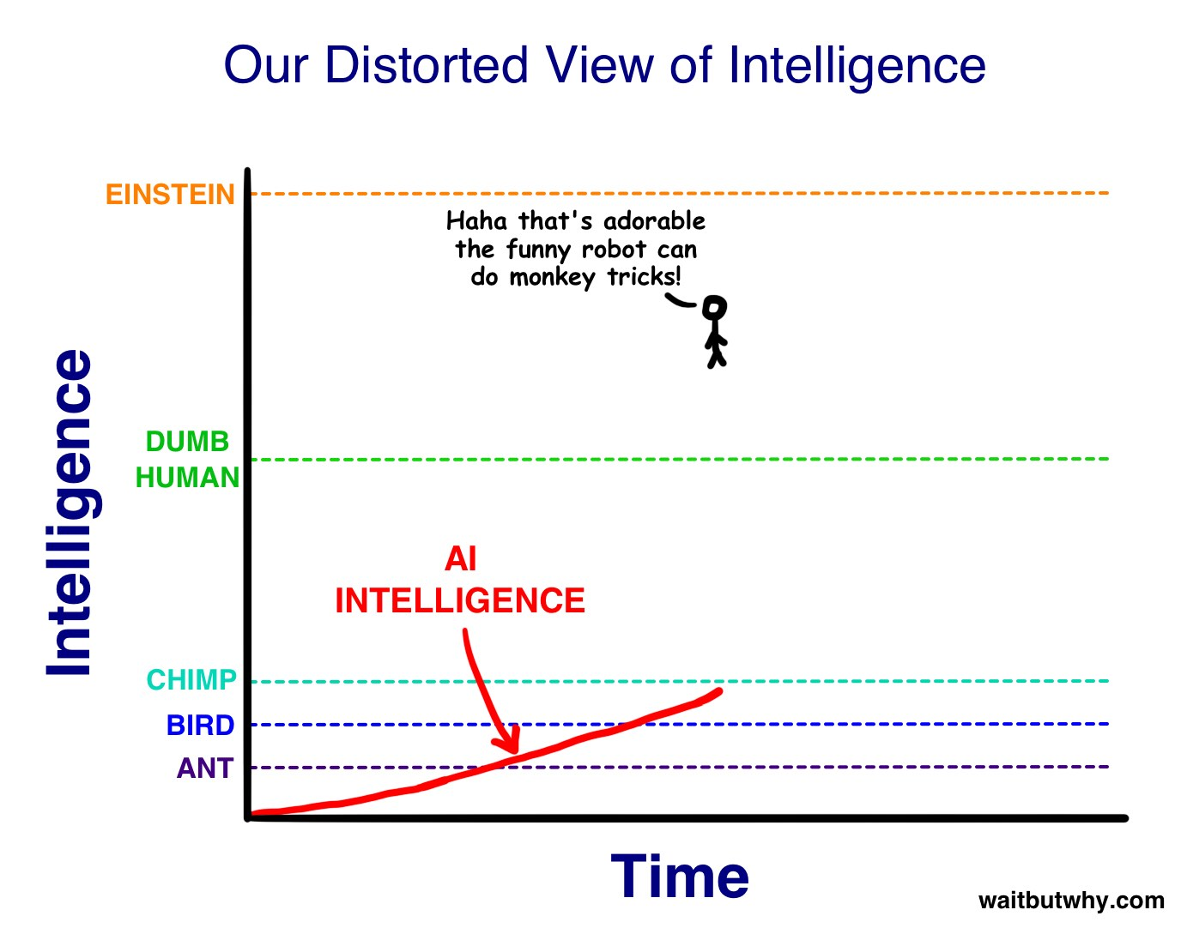

Slide 12
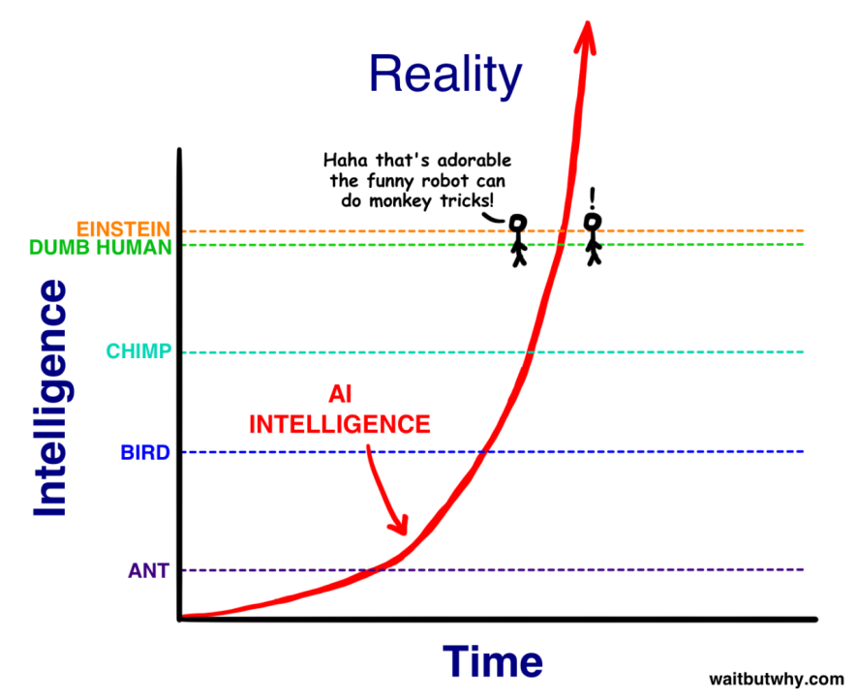

Slide 13
The fourth industrial revolution
source

Slide 14
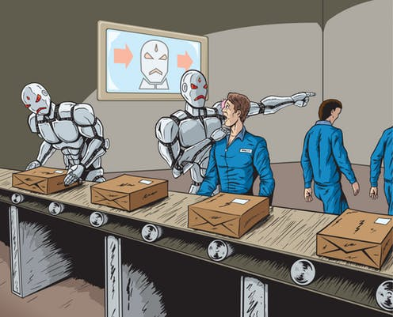
Will robots take over our jobs?
Which jobs will be replaced by AI?
Taxi drivers?
Lawyers?
Artists?

Slide 15
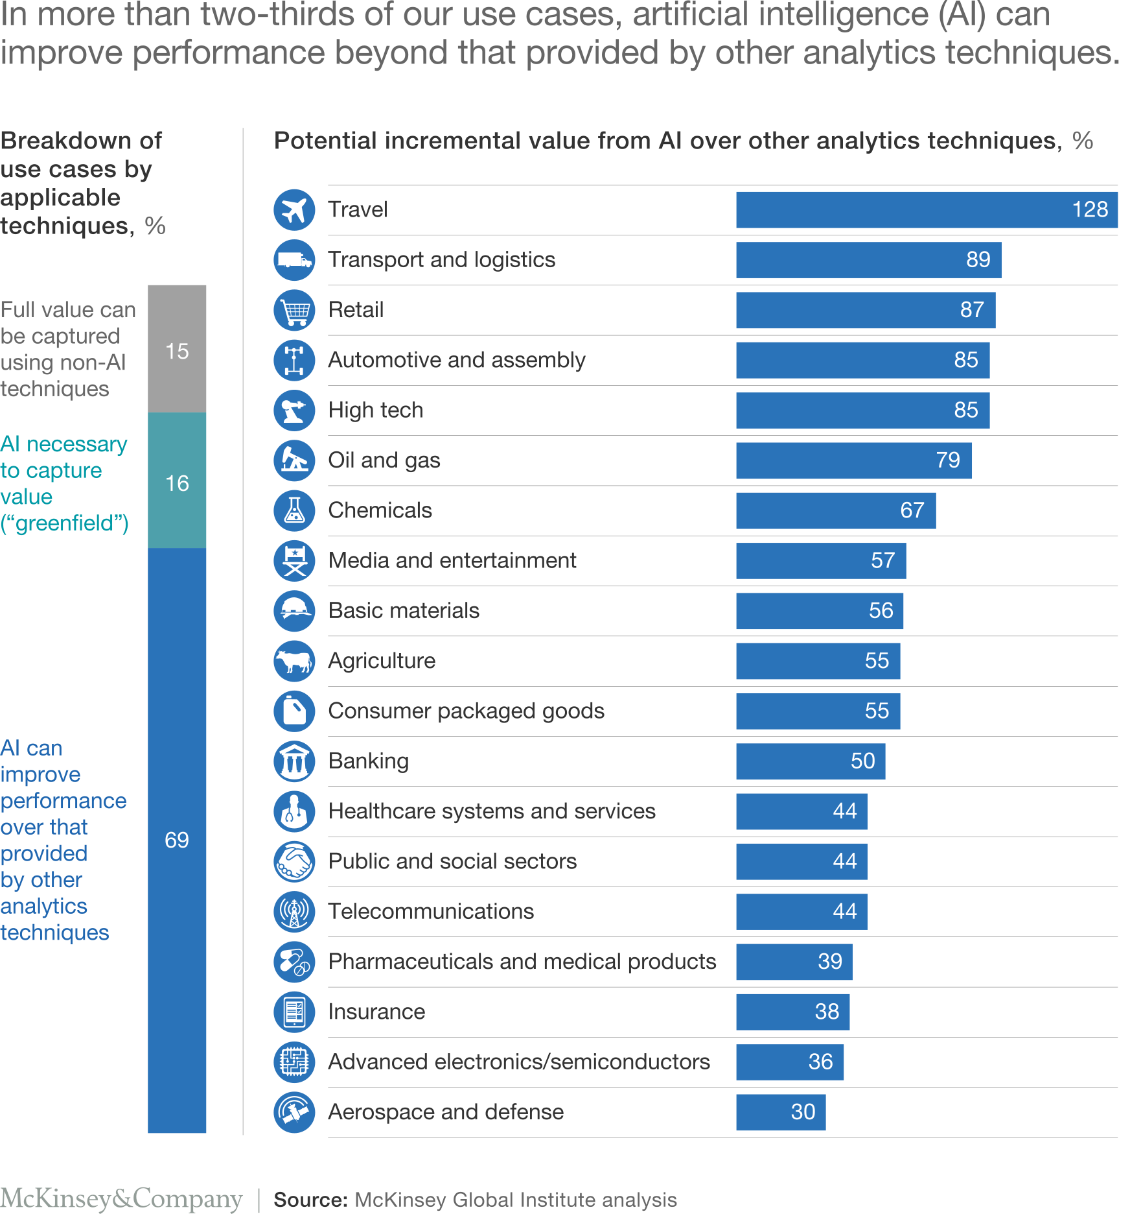
AI impact in all industries
Technology has created more jobs than it has destroyed (source)
UK government estimated that AI would add £630 billion to UK economy by 2035!

Slide 16
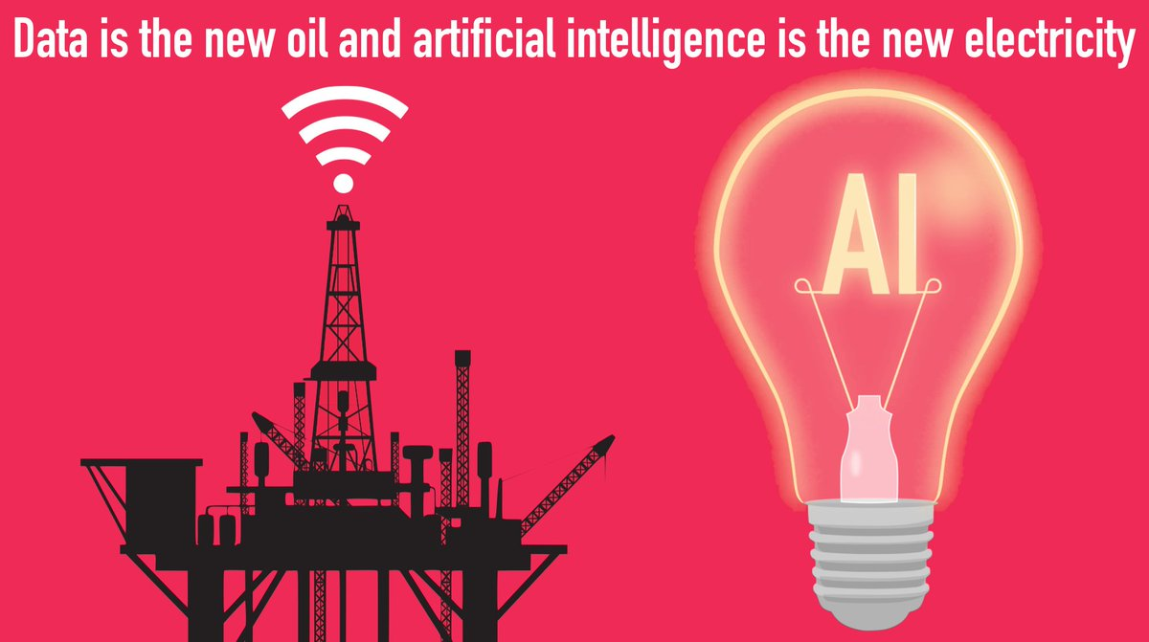
source

Slide 17
Machine Learning

Slide 18
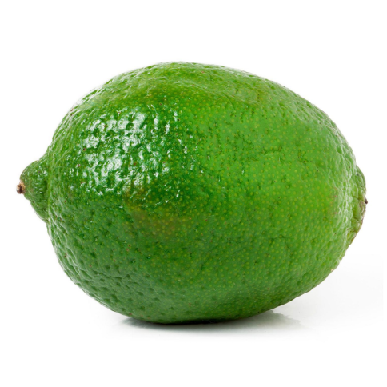
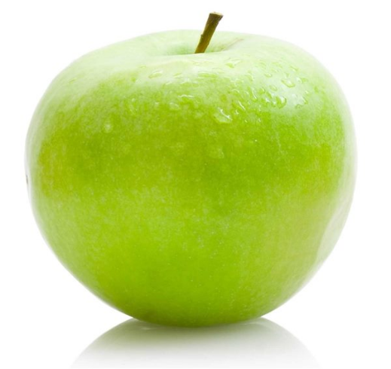
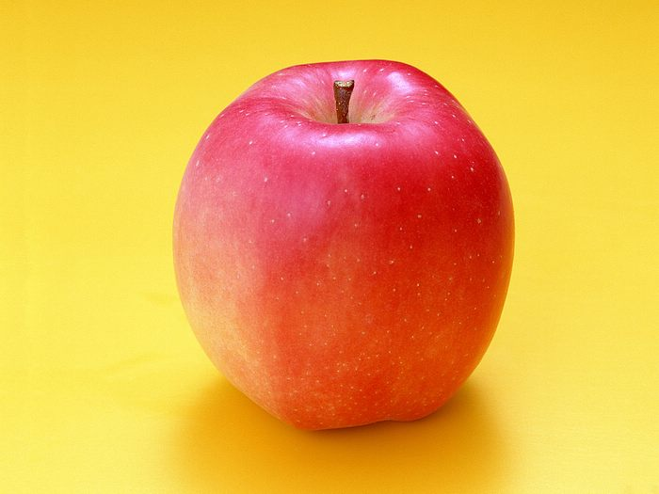
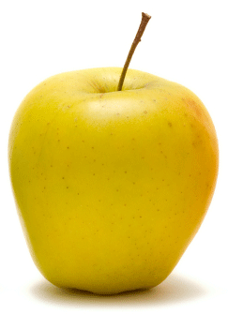
Programming vs Learning: Let’s program a fruit image classifier
if most pixels are yellow: banana
else: strawberry
if most pixels are yellow: banana
else if most pixels are red: strawberry
else: lime
if most pixels are yellow:
if shape is oval-like: lemon
else: banana
else most pixels are red: strawberry
else: lime
Traditional programming is tedious and prone to human error!
Can we automate the discovery of the “correct” program?

Slide 19
Programming vs Learning
Software 1.0
Programmer:
identifies desirable behavior of every case
writes explicit instructions to the computer
Source code:
written in languages such as Python, C++, ...
compiled into a binary which becomes a specific point in program space
Software 2.0
Programmer:
specifies the goal of the desirable program (e.g., “correctly classify a dataset of input-output pairs of examples”, or “win a game of chess”)
writes a rough skeleton of the code that identifies a subset of program space to search
provides an algorithm to search this space.
Source code:
dataset and/or functions defining desirable behavior
“initial model” that gives the rough skeleton of the code but with details to be filled in
“compilation” is the process of searching through program space for the “final model”
Adapted from source

Slide 20
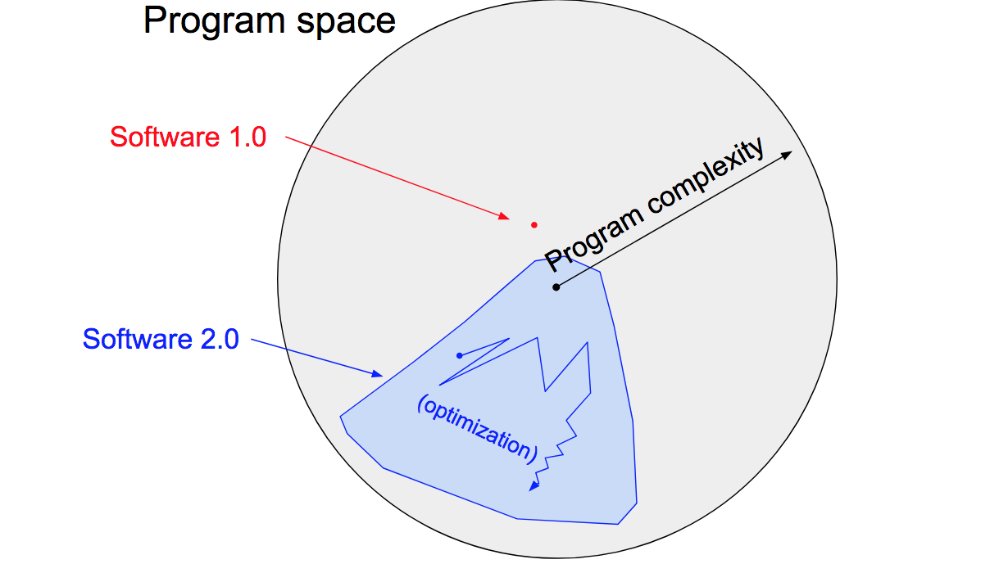
Programming vs Learning
Source

Slide 21
Machine Learning (ML)
Subfield of AI that teaches computers how to learn and act without explicitly programming them.
Discover the hidden structure and regularities in the data.
Use these to make good predictions about the future (unseen data).
Program Discovery from Data.
Artificial Intelligence
Machine Learning

Slide 22
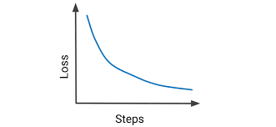
ML Definition and Terminology
Model
Learning Algorithm
Data
e.g., object recognition, fraud detection, forecasting, customer segmentation
Error Function
decreasing error
“A computer program
is said to
learn
from
experience E
with respect to some
task T
and some
performance measure P,
if its performance on T, as measured by P,
improves
with experience E.”
- Tom Mitchell. Machine Learning (1997)

Slide 23
Applications

Slide 24
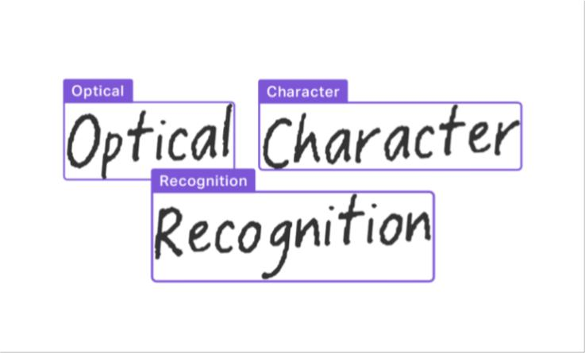
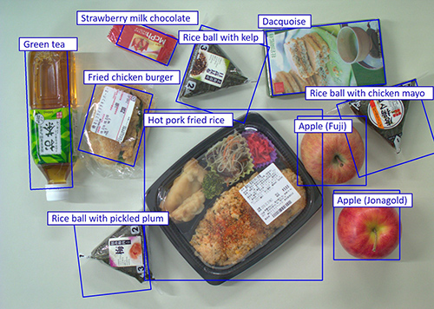
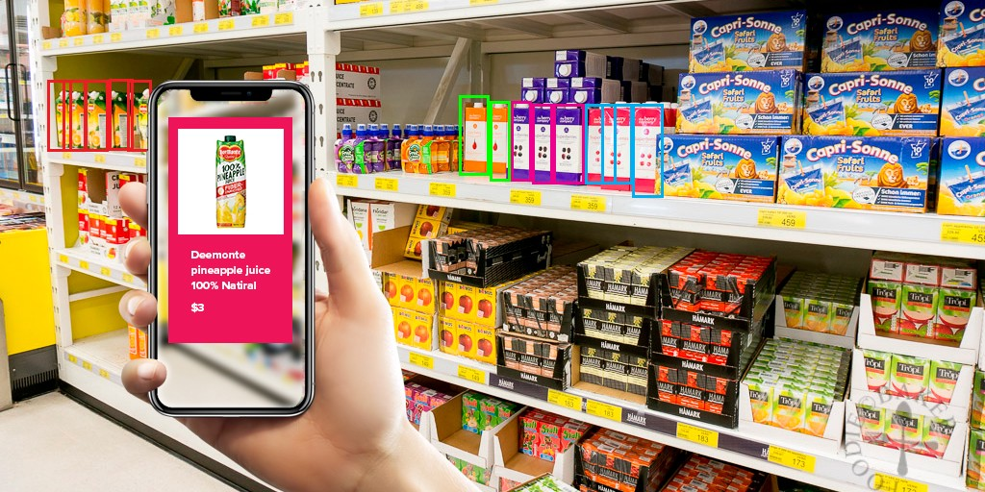
Image Recognition

Slide 25
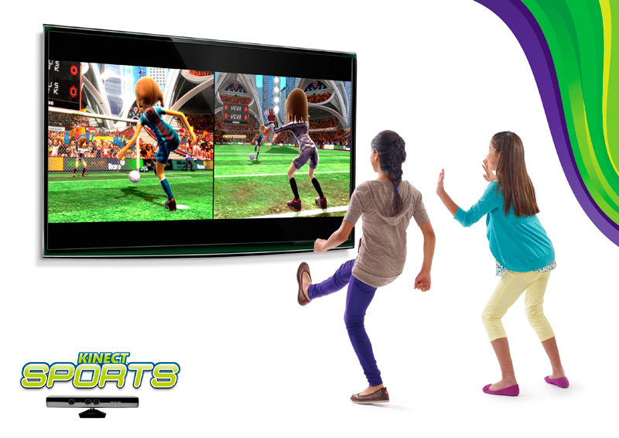
Video Games

Slide 26
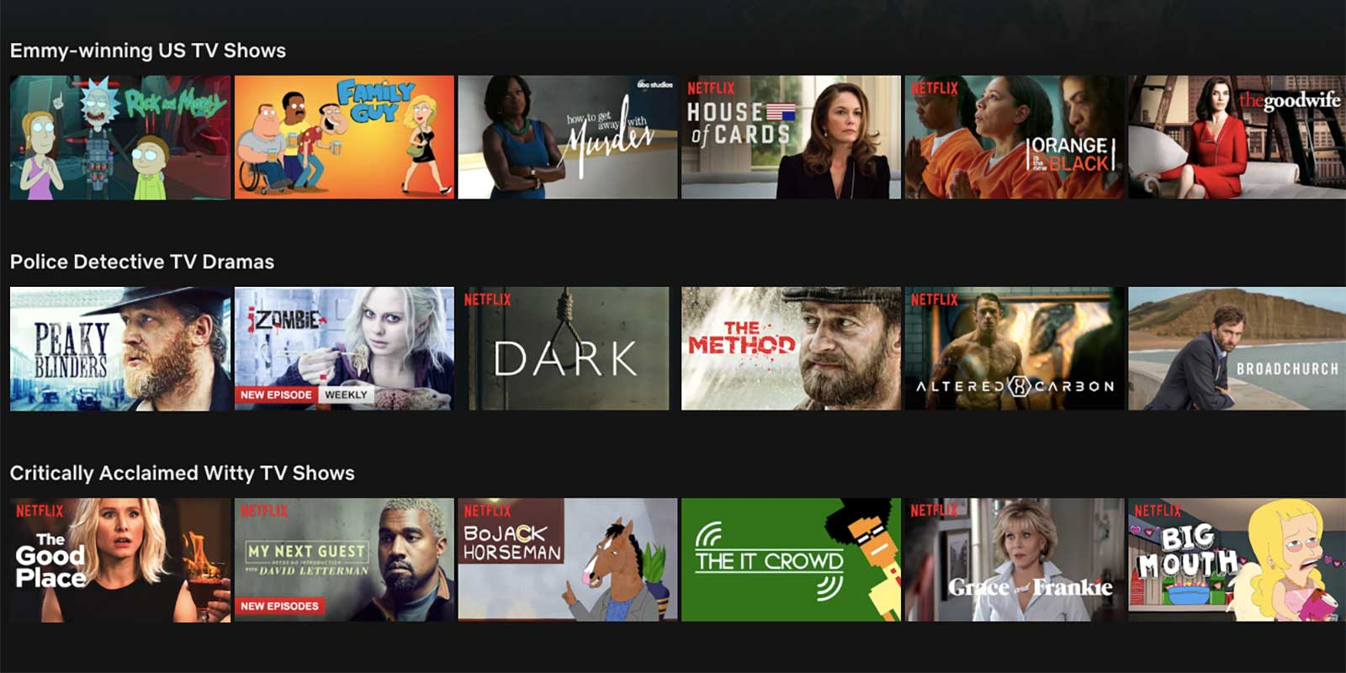
Recommendation Systems

Slide 27
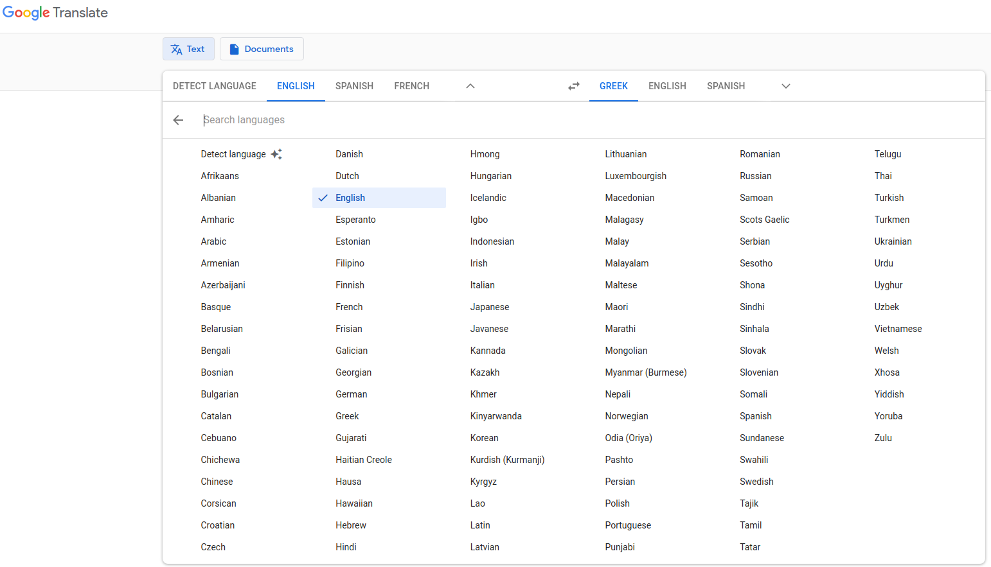
Natural Language Translation

Slide 28
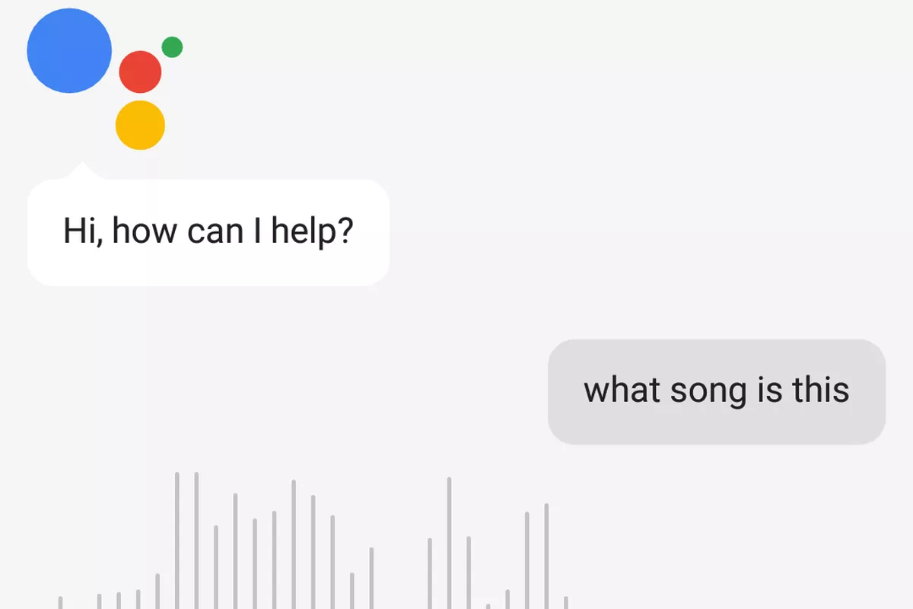
Personal Assistants

Slide 29
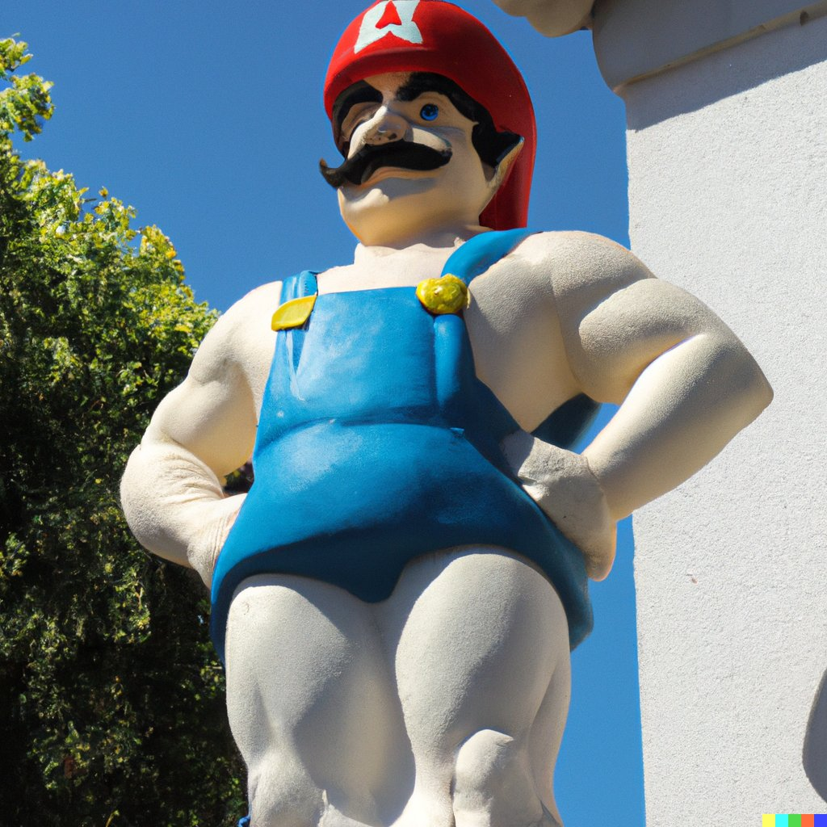
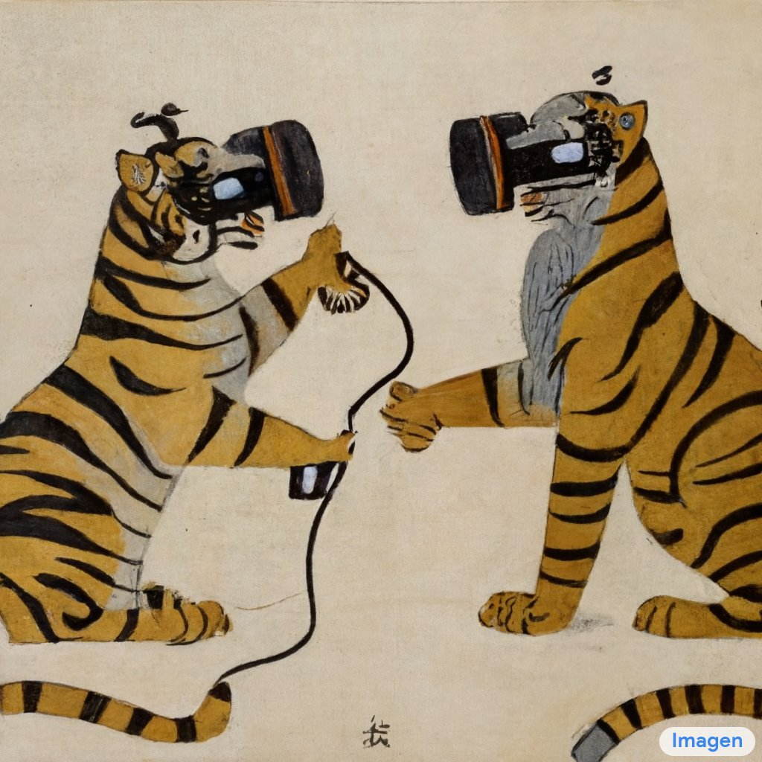
Image Generation from Prompt
"Super Mario in the style of a Greek god statue, realistic photo in Athens"
- Generated using Dalle2
“Oriental painting of tigers wearing VR headsets during the Song dynasty”
- Generated using Imagen

Slide 30
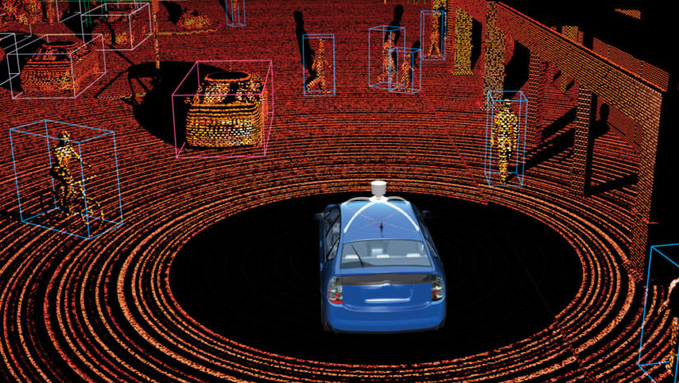
Self-driving cars
Source

Slide 31
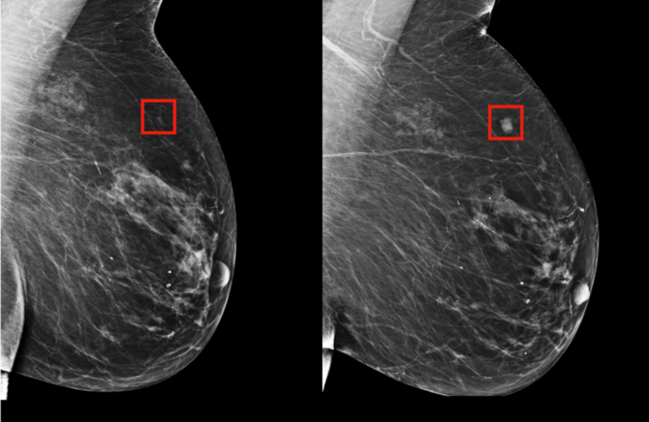
Breast cancer prediction
Source

Slide 32
Quiz (T / F)
Artificial intelligence is about learning from data
False
A program uses machine learning if it improves at problem solving with experience
True
The goal of machine learning is to create predictive models that generalize to unseen data
True

Slide 33
Types of ML

Slide 34
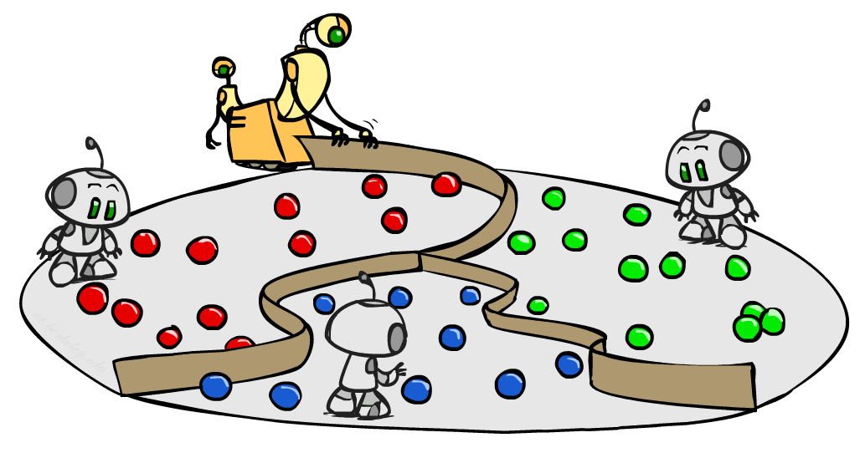
Types of ML approaches
Supervised learning
learning with a teacher
Unsupervised learning
learning without any external feedback
Reinforcement learning
trial-and-error learning
Images Source: UC Berkeley CS188 – Intro to AI : http://ai.berkeley.edu/course_schedule.html

Slide 35
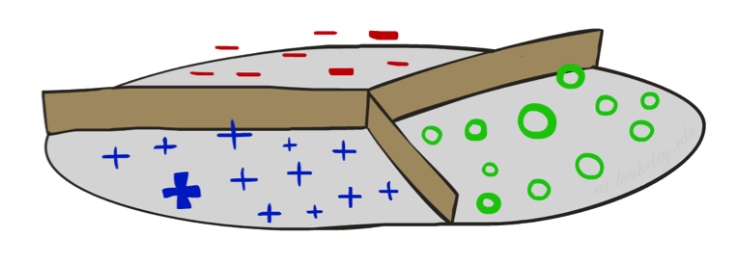
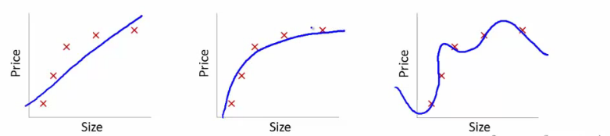
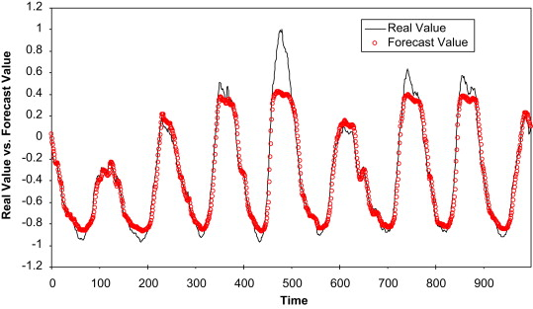
Supervised Learning
small
large
Classification (discrete variables)
Regression (continuous variables)
circles
binary
multi-class
crosses
multi-label

Slide 36
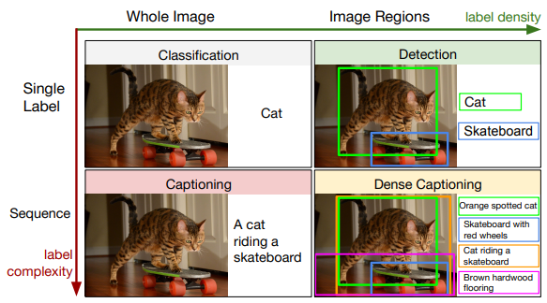
Image captioning

Slide 37
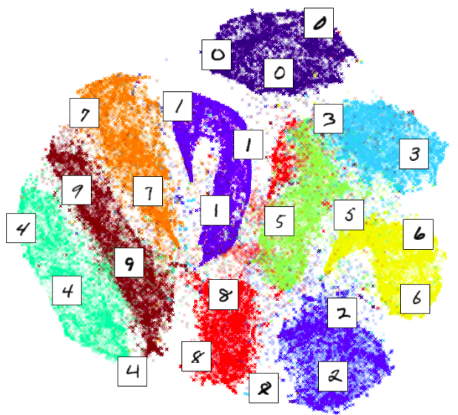
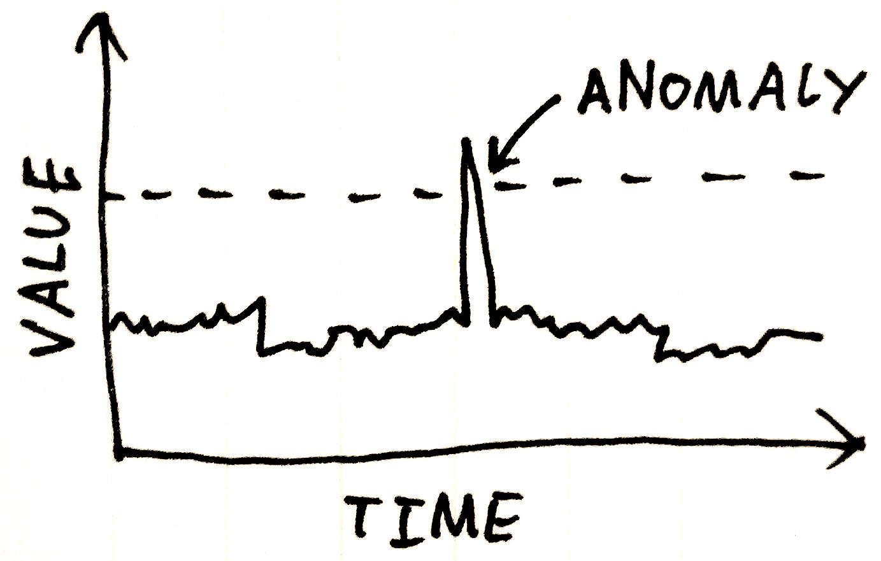
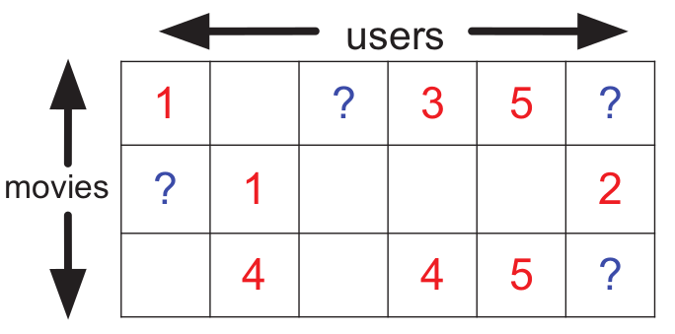
Unsupervised Learning
Clustering
Dimensionality Reduction
Anomaly Detection
Matrix Completion

Slide 38
Smart paintbrush

Slide 39
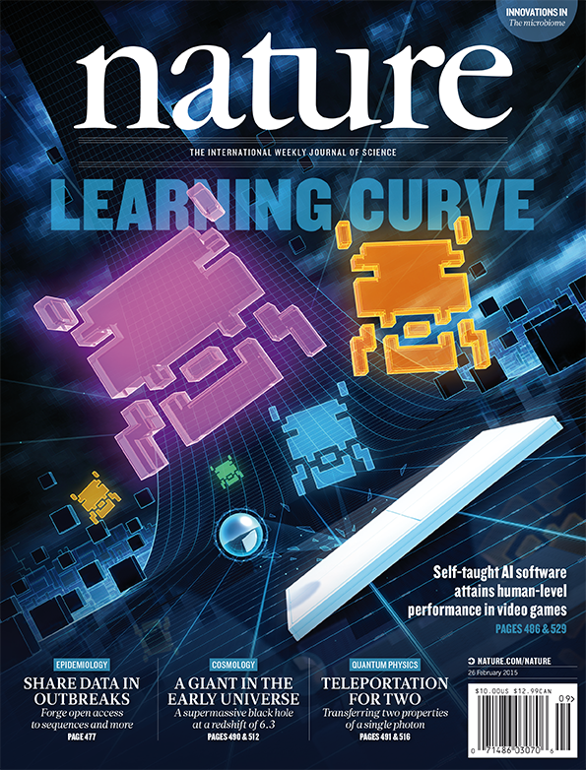
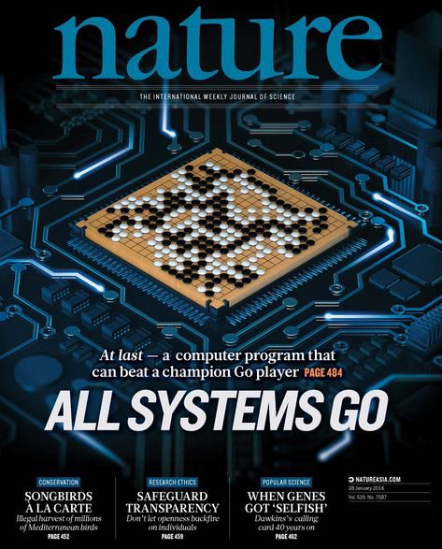
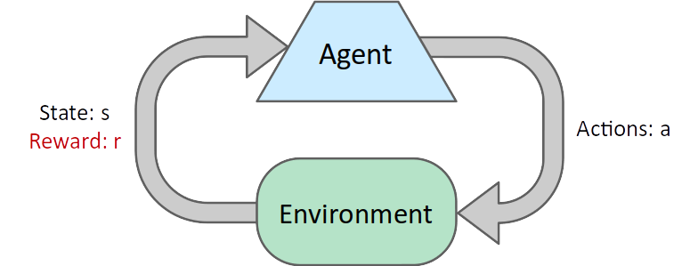
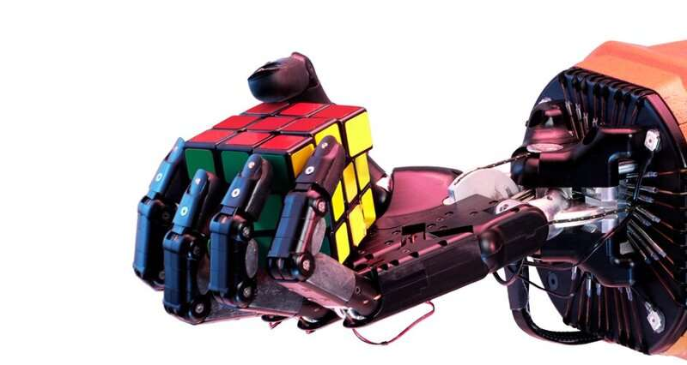
Reinforcement Learning
Learning by trial and error
Not just prediction
Feedback in the form of rewards
Agent needs to learn to act so as to maximize cumulative reward

Slide 40
Robotic Quadrupedal Locomotion
YouTube Video

Slide 42
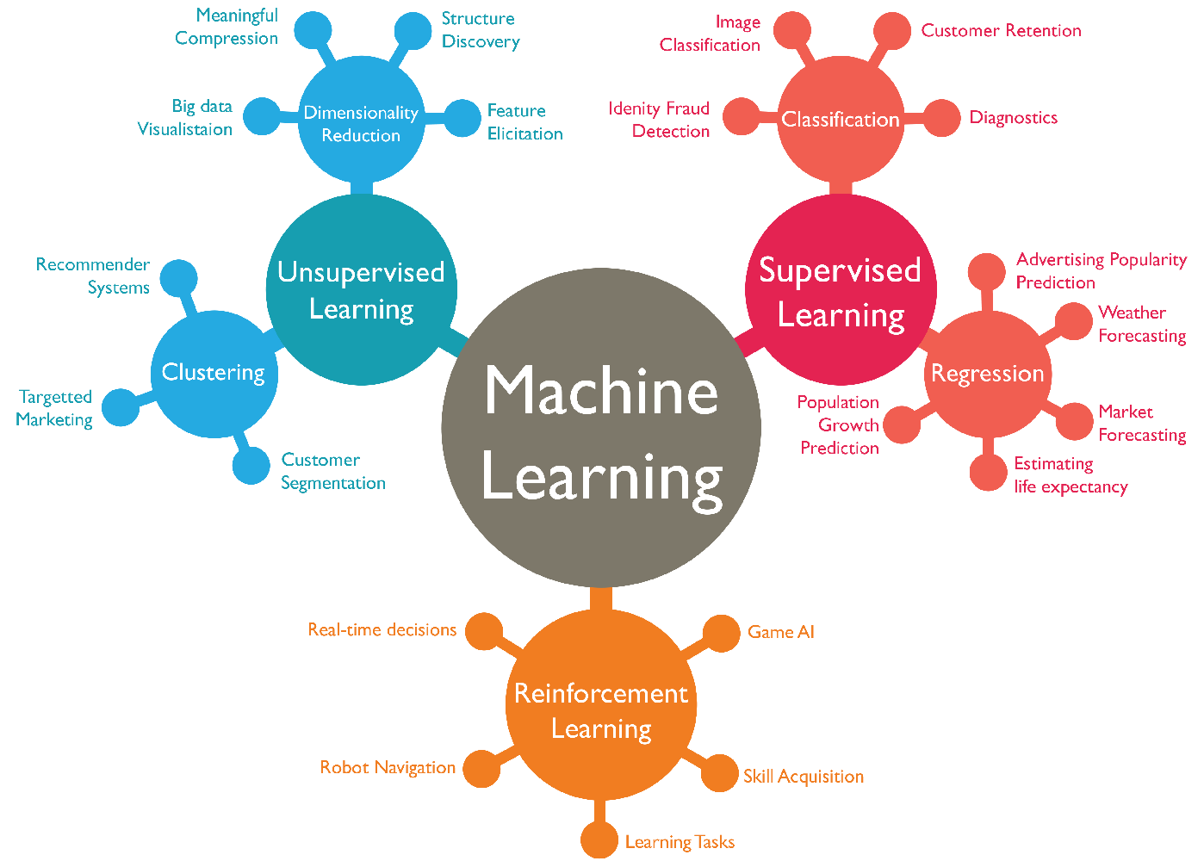

Slide 43
Quiz
In terms of type of machine learning approach (supervised/unsupervised/reinforcement) and problem (e.g., binary classification, clustering etc.) how would you characterize the following:
Spam filter
Grouping customers to drive marketing actions
Animal sound recognition
Music completion
Identifying if an industrial machine is faulting,
from its noise levels
Teaching a robotic arm to pick and place various objects
Supervised: Binary classification
Unsupervised: Clustering
Supervised: Multiclass classification
Unsupervised
Supervised/Unsupervised: Anomaly Detection
Reinforcement Learning

Slide 44
Machine Learning Project Lifecycle
Strategy
Data Preparation
Model Development
Model Deployment
Project definition
Objectives
Solutions
Requirements
Planning
Collection
Preprocessing
Transformation
Visualization
Dataset splitting
Model training
Model evaluation and testing
Iterative improvement
Model optimization
Containers
Web services
Mobile devices
Monitoring and maintainance

Slide 45
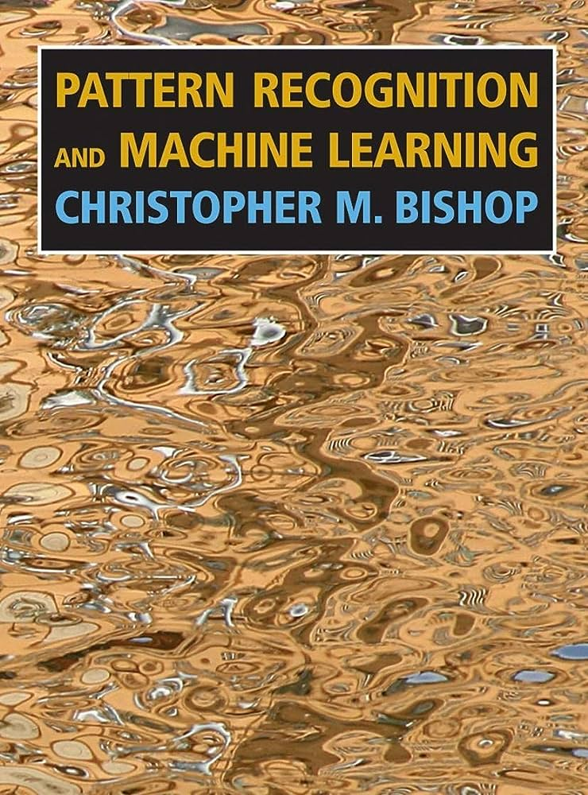
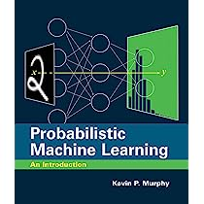
Resources
Books:
Pattern Recognition and Machine Learning (Bishop 2006)
Probabilistic Machine Learning – An Introduction (Murphy 2022)
Online courses:
Machine Learning Specialization – Coursera
Machine Learning - Udacity

Slide 46
Thank you

