Slide 1
University of Cyprus - MSc Artificial Intelligence
MAI612 - MACHINE LEARNING
Lecture 2: Data Preparation
Vassilis Vassiliades, PhD
Winter Semester 2022/23

Slide 2
Lecture 2: Data Preparation
Learning Outcomes
You will understand:
the process of collecting data and preparing datasets for developing machine learning solutions
the importance of data preparation
the data preprocessing and data transformation steps
the importance of data visualization and exploratory data analysis
why we split a dataset into a training and a test set

Slide 3
Fruit image classifier using ML
You are a ML engineer at company XYZ and you are tasked to create a mobile app that classifies different fruit images, to their respective classes (apple, orange, etc.).
You want to use ML
What is the first step of the process?
Data collection
How?
Online
Take photos, and associate them with labels

Slide 4
Data Preparation
Strategy
Data Preparation
Model Development
Model Deployment
Data Preparation
Data
Collection
Data
Preprocessing
Data
Visualization
Data
Transformation
Dataset
Splitting

Slide 5
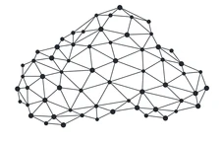
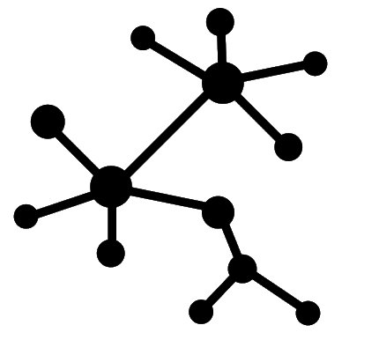
Data
tabular
text
signals
images
video
point clouds
graphs

Slide 6
Data Collection

Slide 7
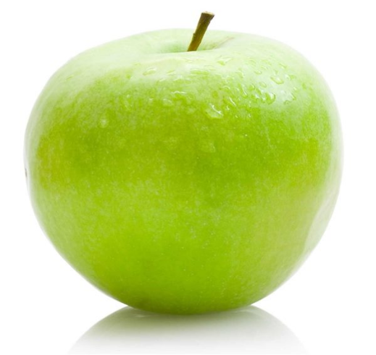
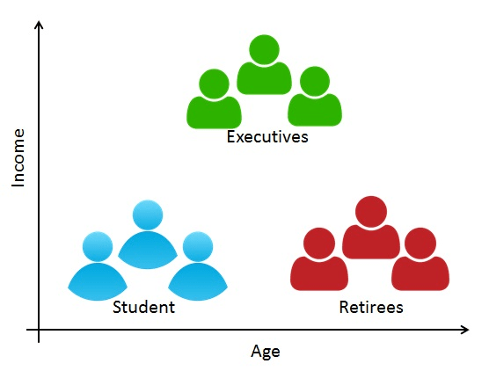
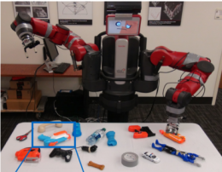
Data Collection
Data may need to be acquired for the task at hand
fruit images for a fruit image classifier
questionnaire with demographics for customer segmentation
a robotic arm learning to grasp different objects

Slide 8
Data Collection
Data already exist:
may need to be integrated from multiple sources
e.g. in fraud detection: timing between two consecutive transactions and distance between places where transactions happened
may need to be labelled
all supervised learning settings
requires human effort (often domain experts)
can be outsourced (data labelling services, e.g., Amazon Mechanical Turk)
transfer learning: use an already trained model with its labels

Slide 9
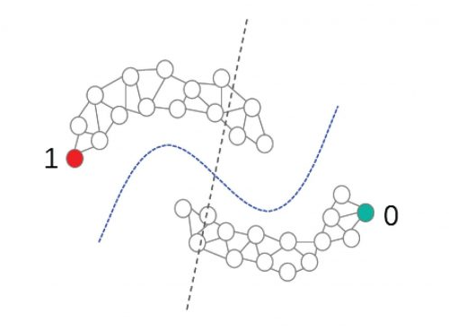
Data Collection
More advanced ML types related to data collection:
Semi-supervised learning
Large amount of unsupervised data, small amount of labelled data
Between unsupervised and supervised learning
Active Learning
Used when labelling is costly
Intelligently choose the next data point to label in a way that minimizes the effort of labelling
Image source

Slide 10
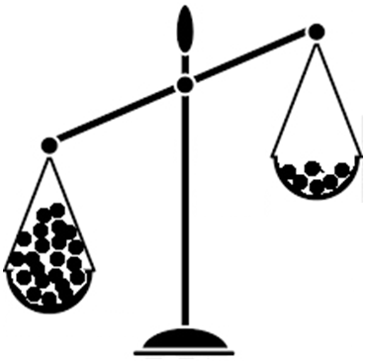
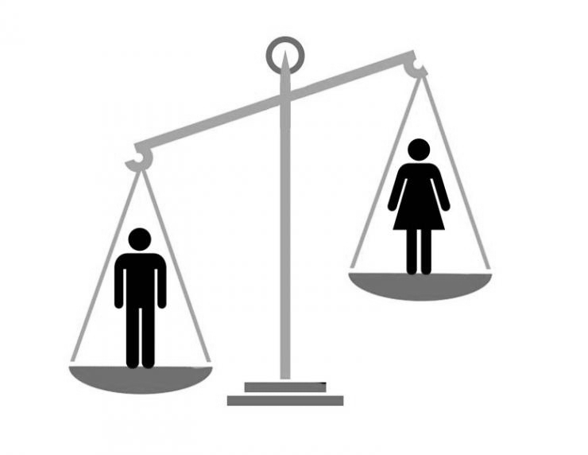
Data Collection
Other issues:
Data Privacy
Need to work with anonymized data
The preprocessing step deals with sensitive data
Class Imbalance
Need to have approximately the same number of instances for all classes in classification tasks
Bias & Fairness
It is very important to have diversity in our data
See next slides

Slide 11
Bias & Fairness: The ‘Gorillas’ Incident
One of these predictions
is very wrong!
Why do you think this happened?

Slide 12
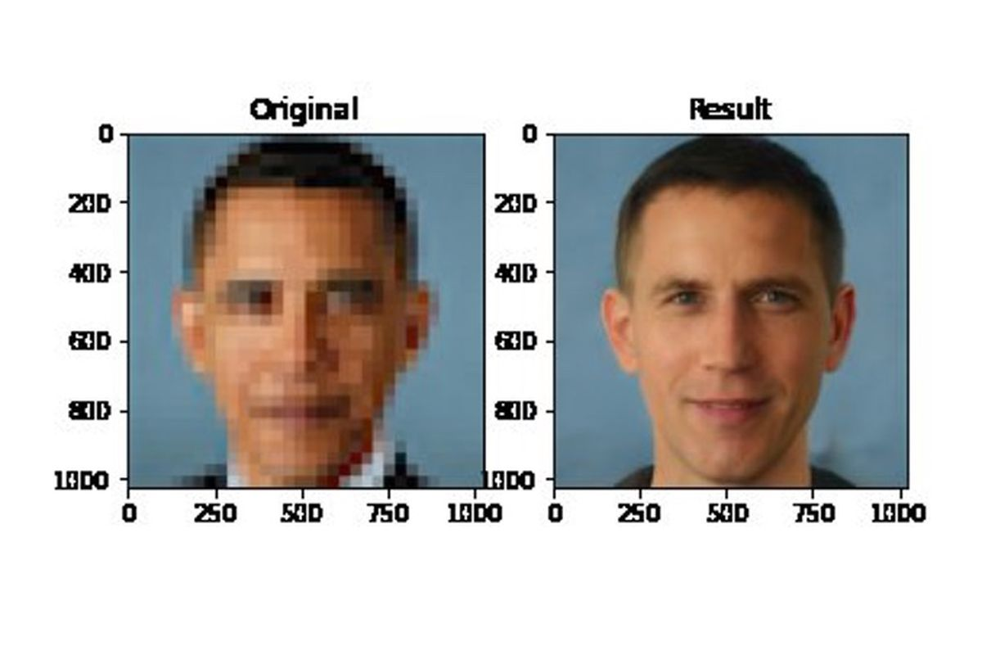
Bias & Fairness: Obama reconstructed as white male
Face upsampling system makes everyone look white because it was trained on a dataset which mainly contains pictures of white people.

Slide 13
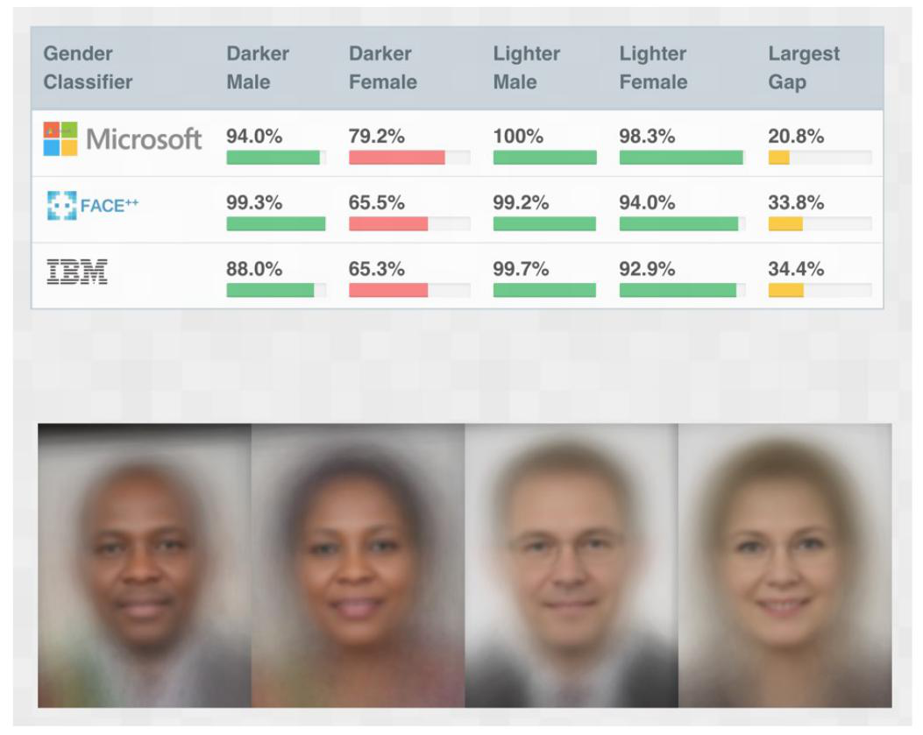
Bias & Fairness: Error rate per gender and race
All models have more trouble classifying correctly darker females than lighter males.
Classifiers were not trained with sufficient diversity
Importance of having balanced datasets
Your model is only as good as your data!

Slide 14
Tabular Data
Variable / Attribute / Feature
Column 1 | Column 2 | Column 3 | Column 4
Input variables: columns provided to the model to make a prediction
Output variable: column to be predicted by the model
Example / instance / case

Slide 15
Data Variable Types
Qualitative / Categorical
Made up of words
Nominal (named categories)
e.g. gender
Ordinal (order matters)
e.g. mood
Quantitative / Numerical
Made up of numbers
Discrete (integers)
e.g. shoe size
Continuous (any number)
e.g. weight

Slide 16
Data Variable Types Quiz
Categorical (Nominal, Ordinal) or Numerical (Discrete, Continuous) ?
Ethnicity
Age
Color
Temperature
Number of children
Satisfaction rating (unhappy/neutral/happy)
Date?
Nominal
Continuous or Discrete
Nominal
Continuous
Discrete
Ordinal
String: Needs feature transformation

Slide 17
Data Preprocessing

Slide 18
Data Preprocessing
What is data preprocessing?
- Process of bringing raw data in a form suitable for modeling
- Typically involves: Data Cleaning, Data Encoding
Why is it important?
- ML algorithms expect numbers (e.g., some cannot deal with categorical attributes)
- ML algorithms have requirements (e.g., cannot deal with missing values)

Slide 19
Data Preprocessing
Data Cleaning
Fix errors: typos, incorrect capitalization, inconsistencies etc. (e.g., “N/A” vs “Not Applicable”, “Male” vs “male”, …)
Missing data (remove, replace with 0, or interpolate)
Remove duplicate rows/columns
Remove irrelevant data (e.g. when analyzing data for millennial customers, remove older generations)
Remove outliers (might be due to a mistake in data collection)
Data Encoding
Categorical variables
Anonymizing data

Slide 20
Data Encoding
Encode categorical variables using a numerical representation. Typically:
- Nominal variables: “one-hot” encoding: as many new binary variables as there are named categories
Gender = {male, female} -> GenderMale = {0,1}, GenderFemale = {0,1}
Color = {red, green, blue} -> ColorRed = {0,1}, ColorGreen = {0,1}, ColorBlue = {0,1}
- Ordinal variables: ordinal encoding: convert to integer values
SatisfactionRating = {sad,neutral,happy} -> {0,1,2}

Slide 21
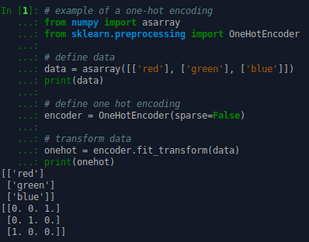
Data Encoding: One-hot encoding example

Slide 22
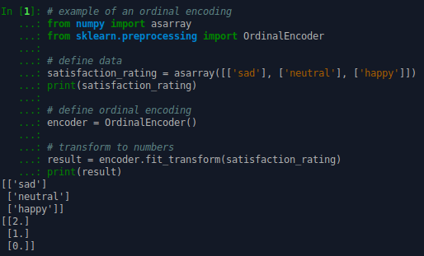
Data Encoding: Ordinal encoding example

Slide 23
Data Visualization

Slide 24
Data Visualization
Exploratory data analysis
are there any obvious patterns (might give hints on what method to choose)?
are there any obvious problems (label noise or outliers)?
involves basic statistics (e.g., mean, variance, correlation coefficient) and plots
Tabular data with small number of features: use a pair plot
High-dimensional data: use dimensionality reduction
e.g., Principal Components Analysis
will study in later lectures

Slide 25
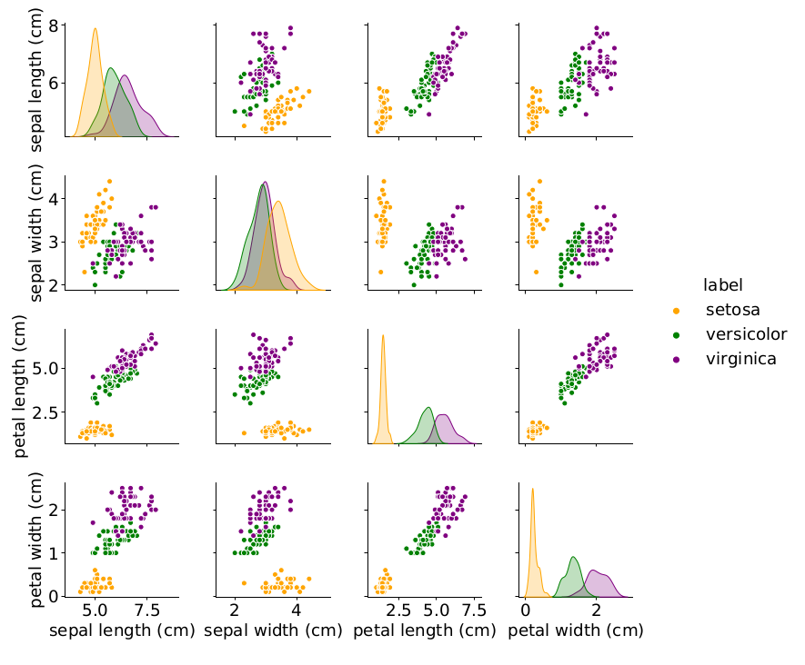
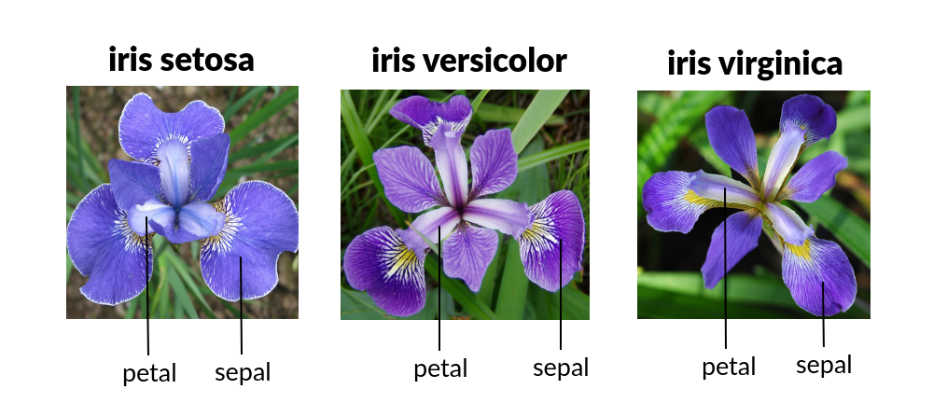
Source: Murphy, K. (2022). Probabilistic Machine Learning - An Introduction. MIT Press
Iris dataset
3 classes of 50 instances each
4 features (petal/sepal length/width in cm)
Which class is linearly separable from the others?

Slide 26
Importance of data visualization over summary statistics
Source: Murphy, K. (2022). Probabilistic Machine Learning - An Introduction. MIT Press
Anscombe’s quartet: All of these datasets have the same mean, variance and correlation coefficient.

Slide 27
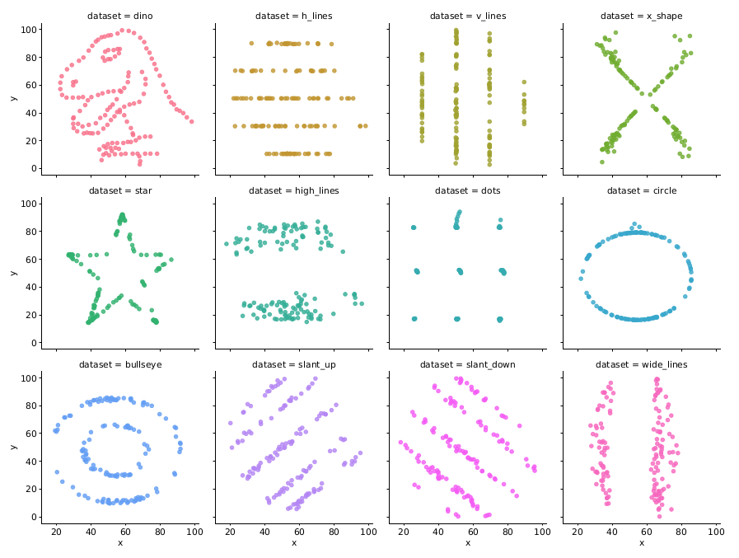
Importance of data visualization over summary statistics
Datasaurus dozen: All of these datasets have the same mean, variance and correlation coefficient.
Source: Murphy, K. (2022). Probabilistic Machine Learning - An Introduction. MIT Press

Slide 28
Data Transformation

Slide 29
Data Transformation
What is data transformation?
- Process of transforming data in a form more suitable for modeling
- Typically involves: Feature Scaling, Feature Selection, Feature Extraction, and Feature Construction (or Engineering)
- Sometimes: Data Augmentation, Data Sampling
Why is it important?
- ML algorithms have requirements (e.g., comp. complexity of some algorithms scales with number of data points)
- Model performance depends on data (e.g., different feature ranges affect many algorithms)

Slide 30
Feature Scaling
Min-max normalization (or linear scaling):
used when the feature is uniformly distributed in a fixed range
typically scaled in the range [0,1]
can be greatly affected by outliers
Standardization (or z-score normalization):
used when we don’t know the feature range
scaled feature distributions have mean=0 and sd=1
less affected by outliers

Slide 31
Feature Selection
Process that chooses a subset of M features from the original set of N features (M < N), so that the feature space is optimally reduced according to a certain criterion.
Role:
reduce dimensionality of feature space
speed up a learning algorithm
improve the predictive accuracy of a model
improve the comprehensibility of the results

Slide 32
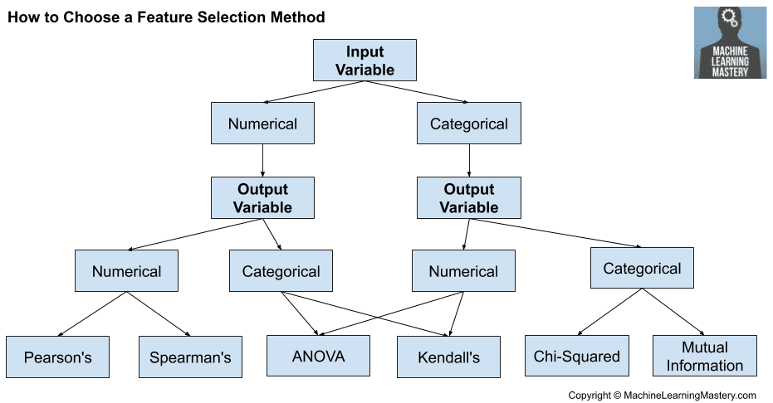
Feature Selection
Select subsets of features based on their relationship with the target
Typically by using statistical techniques
Filter methods
Search
less
features
features
Learning Algorithm

Slide 33
Feature Selection
Wrapper methods
Search for well-performing subsets of features
Examples:
Recursive Feature Elimination
Heuristic search algorithms (e.g., genetic algorithms, particle swarm optimization)
Computational cost?
For each subset, a new model is trained and tested to obtain the accuracy
Search
features
less
features
Learning Algorithm

Slide 34
Feature Selection
Intrinsic / implicit / embedded methods
Automatic feature selection during training
Examples:
Rule-based models
Tree-based models (will study in a later lecture)
L1 regularization (will study in a later lecture)

Slide 35
Feature Extraction (Dimensionality Reduction)
Process that extracts a set of M new features from the original N features (M < N) through some functional mapping.
Goal: search for a minimum set of new features via some transformation according to some performance measure.
Approaches:
Principal Components Analysis (and other dimensionality reduction methods)
Neural networks
Will be studied in later lectures

Slide 36
Feature Construction (Feature Engineering)
Process that discovers missing information about the relationships between features and augments the space of features by inferring or creating additional features.
Can be done using:
Automated methods - examples:
Numerical features: polynomial expansion
Nominal features: conjunction, disjunction, negation
Domain knowledge (e.g., SurfaceArea = Height x Width)
Goal: increase the expressive power of original features

Slide 37
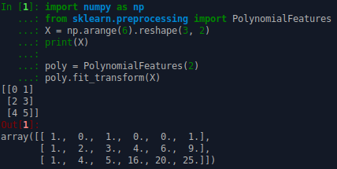
Example: Polynomial Features
Degree-2 polynomial:
Input: [a,b]
Output: [1, a, b, a^2, ab, b^2].

Slide 38
Quiz (T/F)
Feature selection typically decreases the number of features
True
Feature extraction typically increases the number of features
False
Feature construction typically increases the number of features
True

Slide 39
Data Augmentation (or Data Over-Sampling)
Technique that introduces additional data points (instances)
Used when we have:
a small dataset
an imbalanced dataset (e.g., 100 samples of class 0, 10 samples of class 1)
Approaches:
naive random over-sampling (repeated data)
add small Gaussian noise (for numerical features)
SMOTE [1] and variants (for numerical features)
See imbalanced-learn library
[1] Nitesh et al. Smote: synthetic minority over-sampling technique. Journal of artificial intelligence research, 16:321–357, 2002.

Slide 40
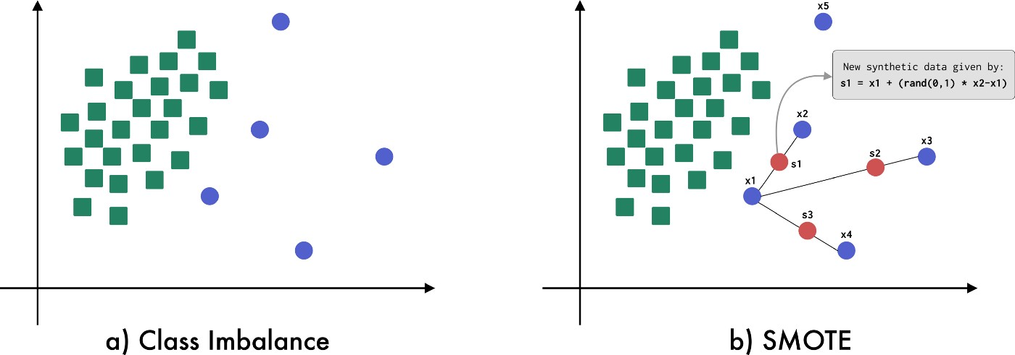
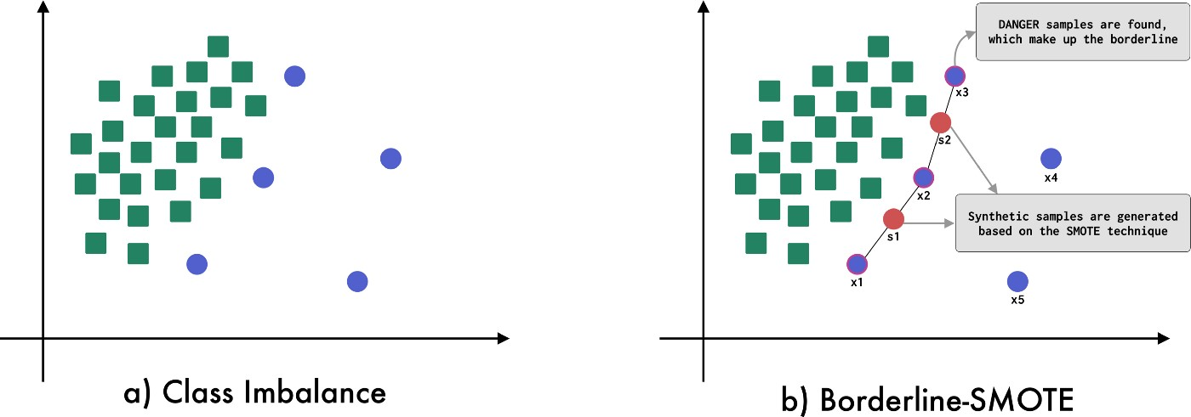
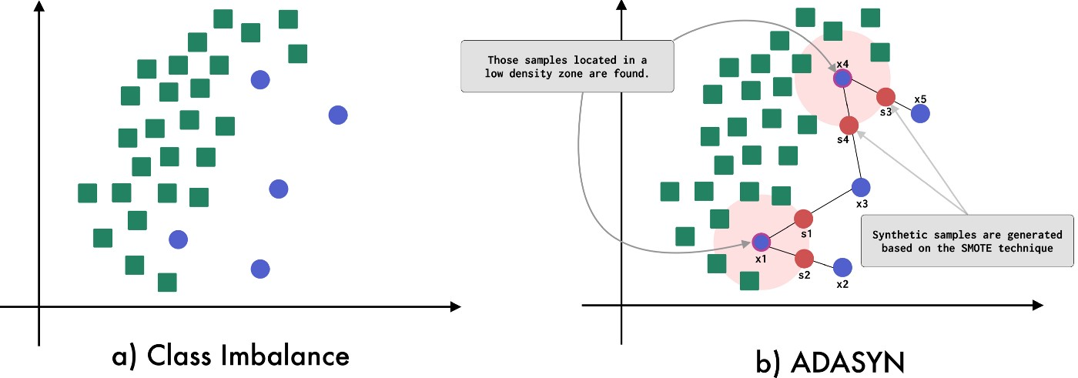
Data Augmentation (or Data Over-Sampling)
Images source

Slide 41
Data Sampling (or Data Under-Sampling)
Technique that removes data points (instances)
Used when we have:
a huge dataset (that cannot typically fit in memory)
an imbalanced dataset (e.g., 1000 samples of class 0, 100 samples of class 1)
Approaches:
simple random sampling
cluster sampling

Slide 42
Data Under-Sampling and Over-sampling

Slide 43
Dataset Splitting

Slide 44
Dataset Splitting
Why do we need this?
Dataset is a sample from the underlying data distribution.
If we use the whole set we run into the risk of “overfitting” the model into the nuances of the sample.
More on this in later lectures...
70%
30%
Used for fitting the model: improving its performance
Used for checking the generalization performance of the model

Slide 45
Common Pitfall: Data Leakage
Knowledge of the held-out (test) set is leaked when preparing the data
Typical example: feature scaling considers the whole dataset instead of only the training set
Can result in wrong model performance on new data
How to avoid it: fit the data transformation process on the training set, and only evaluate on the test set
The test set is not only used for evaluating the trained model, but also the data transformation process.

Slide 46
Resources
What is Data Preparation in a Machine Learning Project
Data Preparation and Feature Engineering in ML

Slide 47
Next Lecture
Part 2: Supervised Learning
Regression
Classification

Slide 48
Thank you

