Slide 1
University of Cyprus - MSc Artificial Intelligence
MAI612 - MACHINE LEARNING
Lecture 3: Regression
Vassilis Vassiliades, PhD
Winter Semester 2022-2023

Slide 2
Revision

Slide 3
Lecture 3: Regression
Learning Outcomes
You will understand:
The problem of "regression" in supervised learning
The k-nearest neighbour regression model
The linear regression model
Gradient descent for finding the parameters of the linear regression model
The analytic solution to the linear regression model

Slide 4
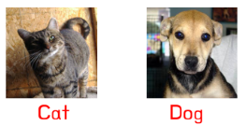
Supervised Learning
We present an input to the system: "teacher" provides the "target" output
System tries to match its predictions with the target ones
Example: images of cats and dogs with their corresponding label
Goal: Use data to create a model that generalizes to unseen input-output pairs
Two common problems:
1. Regression - Output: continuous value
2. Classification - Output: discrete value

Slide 5
Regression
numerical input
numerical output
What is the value of y given x?
y = lookup(x)
<x,y>₁
<x,y>₂
...
<x,y>_{m}
store
Data
Pros:
+ simple
+ fast
+ remembers
Cons:
- no generalization
Database
y = f [neighbors(x)]
number of instances

Slide 6
k-nearest neighbor regression

Slide 7
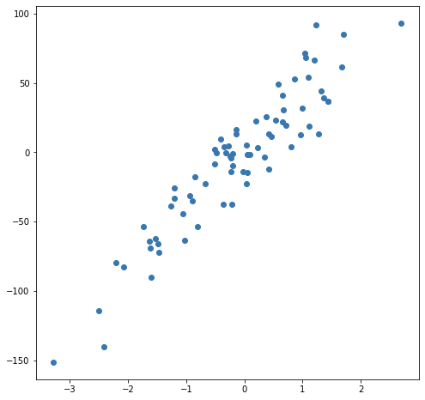
k-nearest neighbor regression
Source

Slide 8
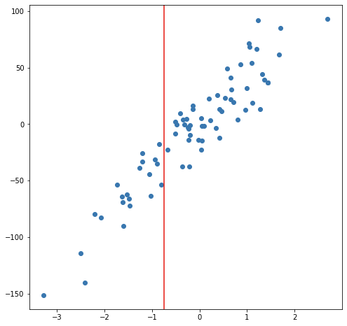
k-nearest neighbor regression
Source

Slide 9
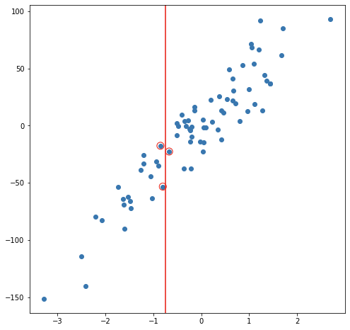
k-nearest neighbor regression
Source
k = 3

Slide 10
k-nearest neighbor regression
Source
k = 3

Slide 11
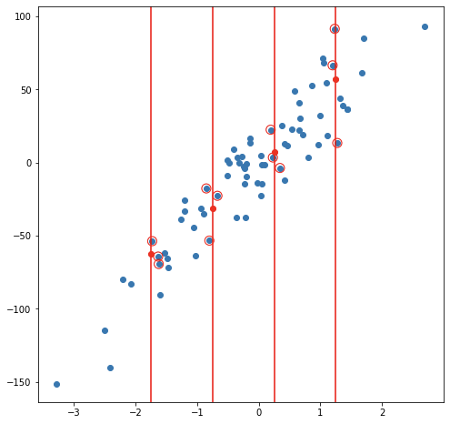
k-nearest neighbor regression
Source
k = 3

Slide 12
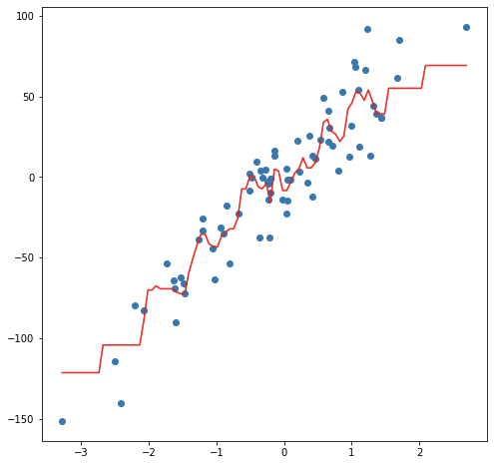
k-nearest neighbor regression
Source
k = 3

Slide 13
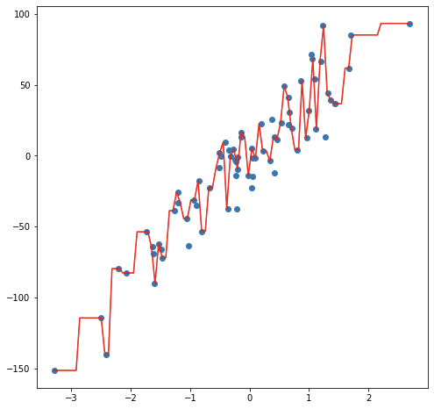
k-nearest neighbor regression
Source
k = 1
Model captures the nuances and noise instead of the trend
This is known as overfitting

Slide 14
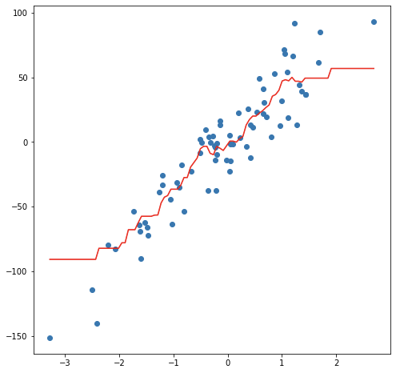
k-nearest neighbor regression
Source
k = 10
Smoother prediction, but problem at the edges
What if k=m?

Slide 15
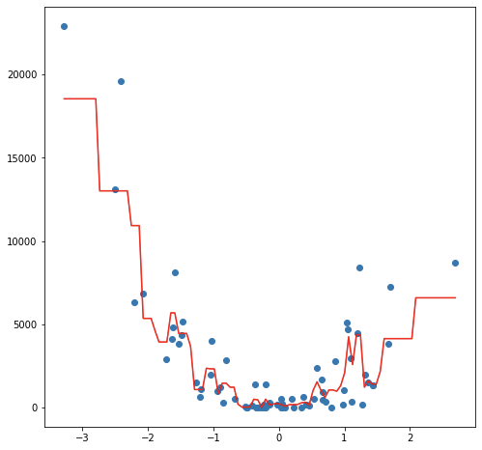
k-nearest neighbor regression
Source
k = 3

Slide 16
k-nearest neighbor regression
Strengths
easy to implement
no training time
handles non-linearities
Weaknesses
prediction becomes slower as the dataset becomes bigger
does not work well in high dimensions
needs feature scaling
sensitive to noisy data or outliers
lacks interpretability

Slide 17
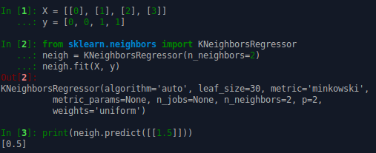
Example

Slide 18
Regression
Alternative approach
<x,y>₁
<x,y>₂
...
<x,y>_{m}
<x,y>₁
<x,y>₂
...
<x,y>_{m}
y = knn(x)
y = f(x)
What is the simplest function we can use?
Instance-based learning / memory-based learning
or
Non-parametric models / Exemplar-based models

Slide 19
Regression
<x,y>₁
<x,y>₂
...
<x,y>_{m}
<x,y>₁
<x,y>₂
...
<x,y>_{m}
y = knn(x)
y = αx + β
Instance-based learning / memory-based learning
or
Non-parametric models / Exemplar-based models
Model-based learning
or
Parametric models

Slide 20
Linear Regression
α=0
y=β
y
y = αx + β
α
β
β=0
y=αx
x

Slide 21
Model Representation
intercept term (β)
Training Set
<x,y>₁
<x,y>₂
...
<x,y>_{m}
Model
Learning Algorithm
$$f_{θ}(x)=θ_{0}+θ_{1}x_{1}+...+θ_{n}x_{n}$$
$$θ∈ℝ^{n+1}$$
estimated value of y
slopes (α) in every dimension
$$y∈ℝ^{}$$
$$x∈ℝ^{n}$$
n=1 Simple Linear Regression
n>1 Multiple Linear Regression
dimensionality of the input

Slide 22
Model Representation
$$f_{θ}(x)=θ_{0}+θ_{1}x_{1}+...+θ_{n}x_{n}$$
$f_{θ}(x)=θ_{0}x_{0}+θ_{1}x_{1}+...+θ_{n}x_{n}$ where $x_{0}=1$, so now $x∈ℝ^{n+1}$
$$f_{θ}(x)=θ^{T}x$$
$$θ∈ℝ^{n+1}$$
$$\left[\begin{matrix}\begin{matrix}θ_{0} & θ_{1}\end{matrix} & \begin{matrix}… & θ_{n}\end{matrix}\end{matrix}\right]∙\left[\begin{matrix}\begin{matrix}x_{0} \\ x_{1}\end{matrix} \\ \begin{matrix}⋮ \\ x_{n}\end{matrix}\end{matrix}\right]=f_{θ}(x)$$

Slide 23
Objective
Choose $θ0, … , θn$so that $f_{θ}(x)$ is close to $y$ for all our training examples ${<x,y>}_{1:m}$
How?
A common approach is to use the method of Least Squares
Minimize the sum of squares of residuals
Residual: difference between the actual value (y) and the estimated ($f_{θ}(x)$ fitted by the model)
$${(f_{θ}(x^{(i)})−y^{(i)})}^{2}$$

Slide 24
Objective & Cost function
Choose $θ0, … , θn$so that $f_{θ}(x)$ is close to $y$ for all our training examples ${<x,y>}_{1:m}$
$$minimize L(θ)$$
θ
$$L(θ)=\frac{1}{2m}\sum_{i=1}^{m}{{(f_{θ}(x^{(i)})−y^{(i)})}^{2}}$$
Mean Squared Error function
Can the error be < 0?

Slide 25
Cost function
$$f_{θ_{1}}(x)$$
$$L(θ_{1})$$
y
$$L(θ_{1})$$
$$θ_{1}=0$$
x
0
$$θ_{1}$$

Slide 26
Gradient Descent

Slide 27
Optimization: Gradient Descent
Start from random $θ_{1}$
Repeat until convergence
$$minimize L(θ_{1})$$
$$θ_{1}$$
positive
slope
negative
slope
change $θ_{1}$ so as to move downhill
$$L(θ_{1})$$
$$θ_{1}=θ_{1}−α\frac{dL(θ_{1})}{dθ_{1}}$$
$$α∈[0,1]$$
x
$$\frac{dL(θ_{1})}{dθ_{1}}>0$$
decreases
$$θ_{1}$$
0
$$θ_{1}$$
This is where we want to end up
(local minimum)
$$\frac{dL(θ_{1})}{dθ_{1}}<0$$
increases
$$θ_{1}$$

Slide 28
Gradient Descent: learning rate α
α too small
α too large
$$L(θ_{1})$$
$$L(θ_{1})$$
0
0
$$θ_{1}$$
$$θ_{1}$$
slow convergence
possible divergence

Slide 29
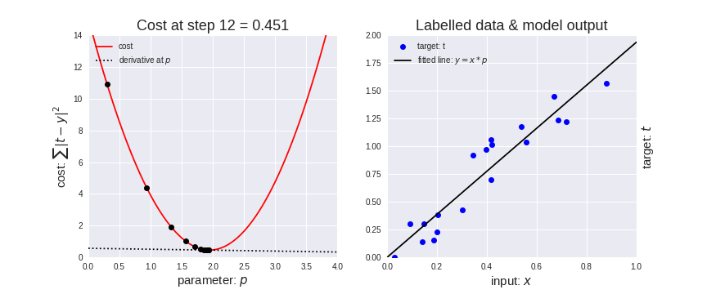
Gradient Descent
$$minimize L(θ_{1})$$
$$θ_{1}$$
source

Slide 30
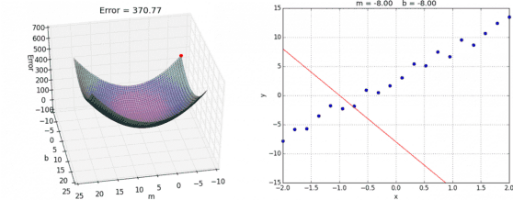
Gradient Descent
$$minimize L(θ_{0},θ_{1})$$
$$θ_{0},θ_{1}$$
source

Slide 31
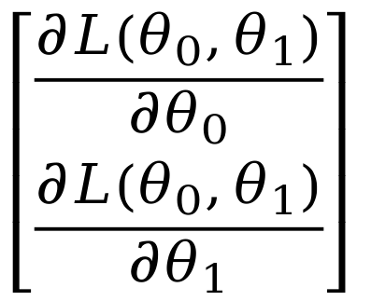
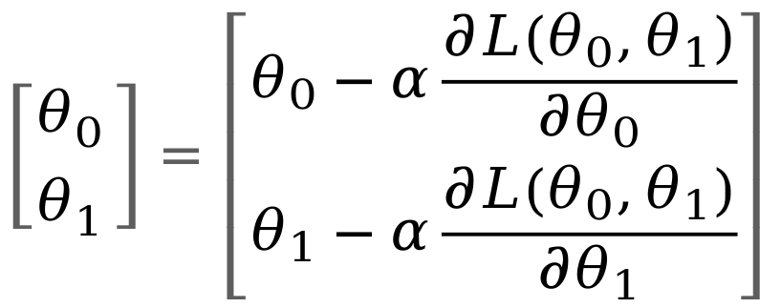
Gradient Descent in Practice
Implementation:
Repeat until convergence:
Calculate loss
Calculate gradient vector
Update parameter vector
$$\left||∇L|\right|<ε$$

Slide 32
Gradient Descent in Practice
"Batch" gradient descent:
Uses all training examples (m)
Used when the size of the training set is small (e.g., m = 10¹ – 10³)
Other variants of gradient descent:
Stochastic Gradient Descent
Mini-batch Gradient Descent
will look in later lectures

Slide 33
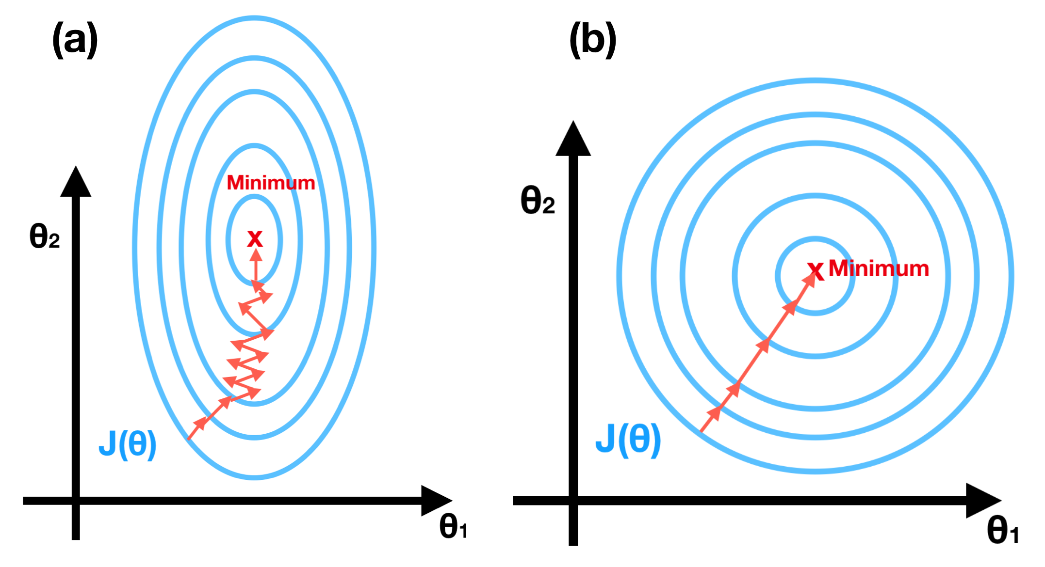
Gradient Descent in Practice
Use Feature Scaling
Without feature scaling
With feature scaling
Make sure features are on a similar scale
Example:
x₁ = size (0 – 2000 feet²)
x₂ = number of bedrooms (1-5)
new_x₁ = x₁ / 2000 new_x₁ $∈[0,1]$
new_x₂ = x₂ / 5 new_x₂ $∈[0,1]$
source

Slide 34
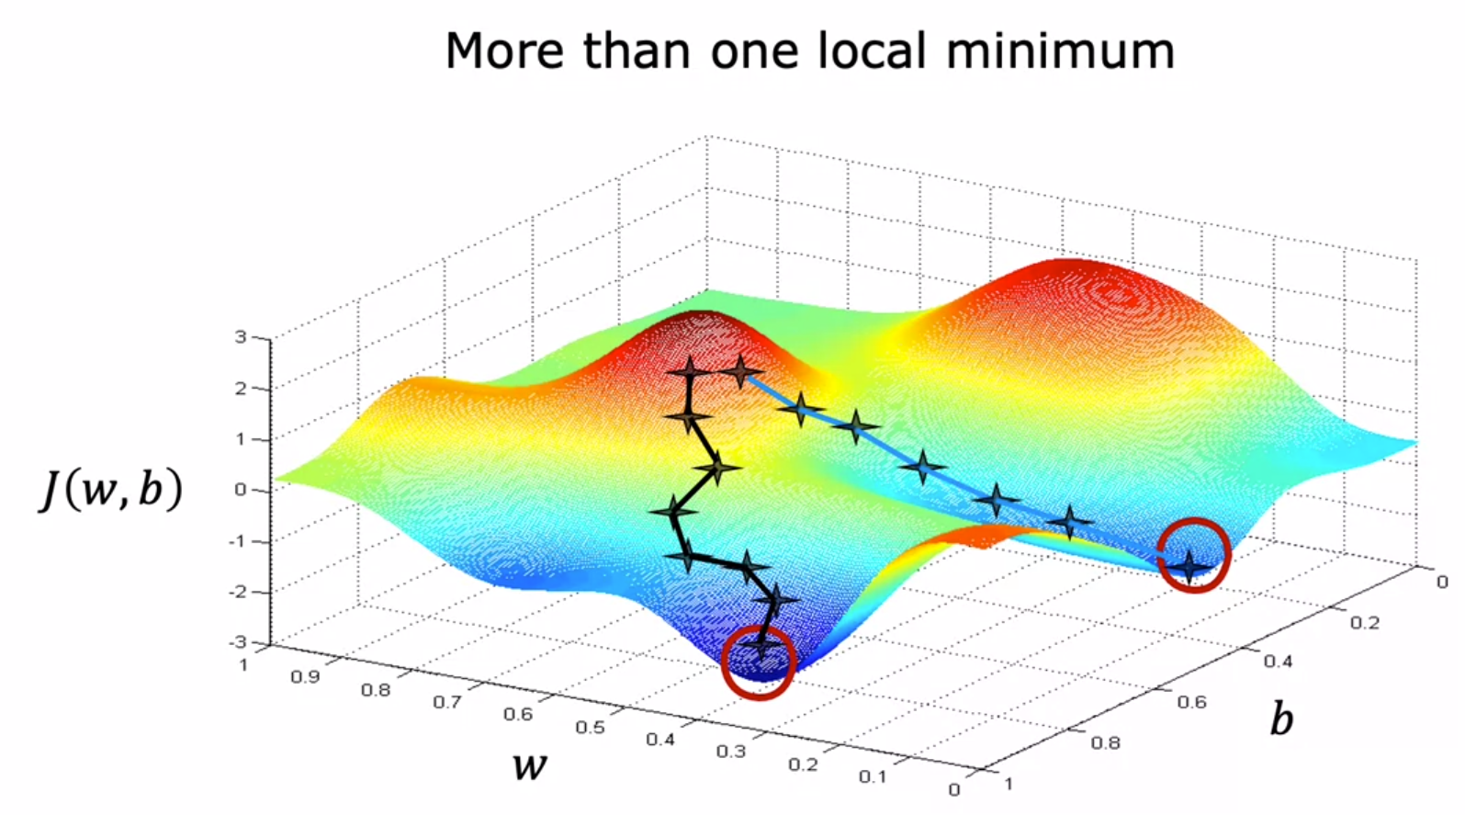
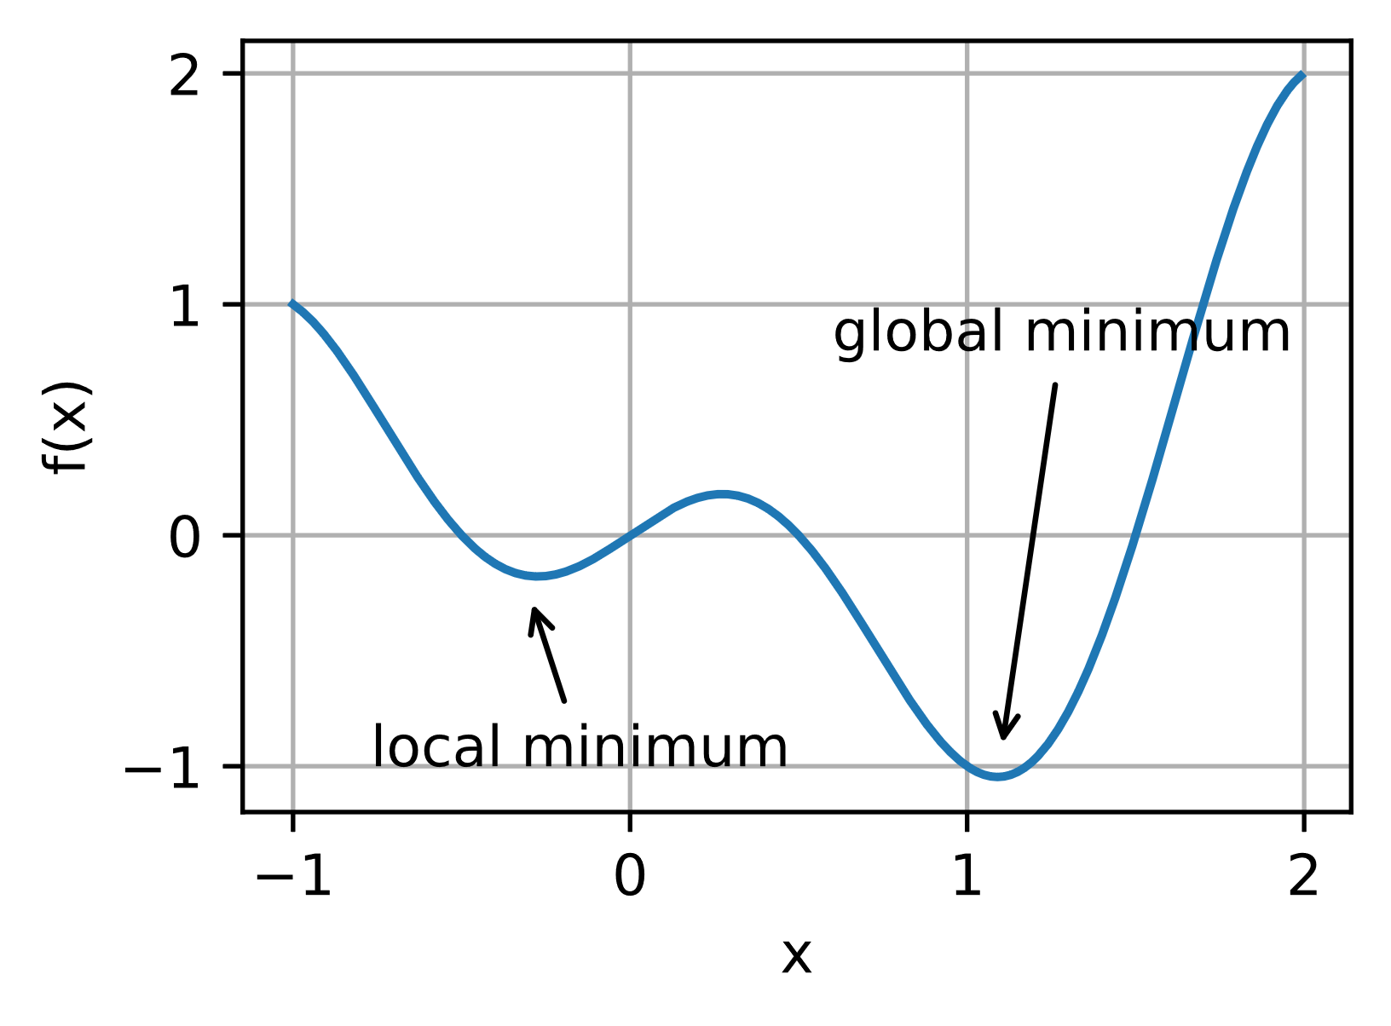
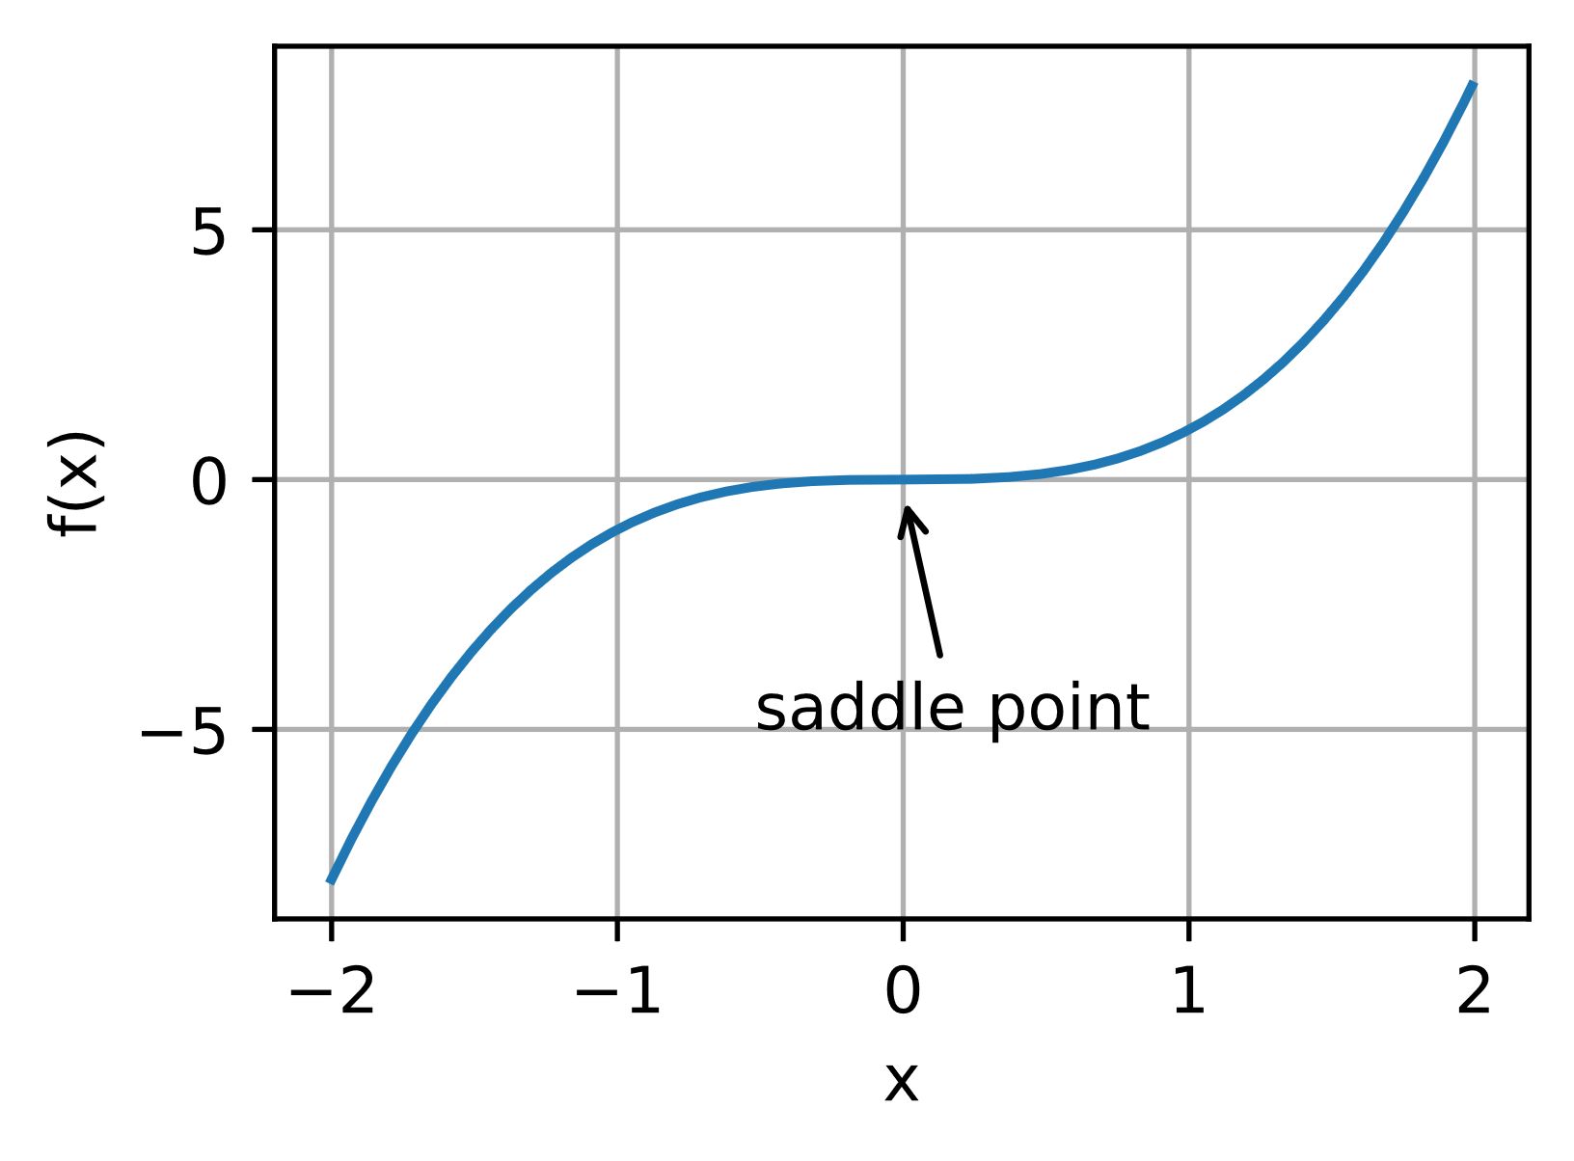
Gradient Descent on a non-convex 2D function
Source: Andrew Ng – Coursera, Machine Learning
Source

Slide 35
Gradient Descent on the Mean Squared Error
Does the MSE when using the Linear Regression model have more than one minima?
No – a single global minimum
For this particular case, there is an analytic (closed-form / non-iterative) solution.

Slide 36
Analytic Solution: Normal Equations
$$θ_{0}+θ_{1}x_{1}+...+θ_{n}x_{n}≈y$$
$$\left[\begin{matrix}\begin{matrix}1 & x_{1}^{(1)} \\ 1 & x_{1}^{(2)}\end{matrix} & \begin{matrix}… & x_{n}^{(1)} \\ … & x_{n}^{(2)}\end{matrix} \\ \begin{matrix}⋮ & ⋮ \\ 1 & x_{1}^{(m)}\end{matrix} & \begin{matrix}⋱ & ⋮ \\ … & x_{n}^{(m)}\end{matrix}\end{matrix}\right]$$
$$\left[\begin{matrix}\begin{matrix}θ_{0} \\ θ_{1}\end{matrix} \\ \begin{matrix}⋮ \\ θ_{n}\end{matrix}\end{matrix}\right]$$
$$≈ \left[\begin{matrix}\begin{matrix}y^{(1)} \\ y^{(2)}\end{matrix} \\ \begin{matrix}⋮ \\ y^{(m)}\end{matrix}\end{matrix}\right]$$
x
y
x⁽¹⁾ y⁽¹⁾
x⁽²⁾ y⁽²⁾
... ...
x^{(m)} y^{(m)}
$$X$$
$$θ$$
$$y$$
$$θ={\left(X^{T}X\right)}^{−1}X^{T}y$$
Important: $m>n$

Slide 37
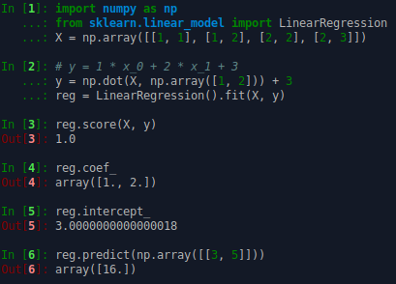
Example

Slide 38
Linear regression
Strengths
easy to implement (analytic solution)
small computation time for fitting (analytic solution)
constant prediction time (does not save any data points)
analytic solution does not need feature scaling
less sensitive to noisy data
more interpretable
Weaknesses
does not handle nonlinear relationships in the data
for large datasets it requires iterative methods, e.g., gradient descent
gradient descent needs feature scaling

Slide 39
Linear regression
Strengths
easy to implement (analytic solution)
small computation time for fitting (analytic solution)
constant prediction time (does not save any data points)
analytic solution does not need feature scaling
less sensitive to noisy data
more interpretable
Weaknesses
does not handle nonlinear relationships in the data
for large datasets it requires iterative methods, e.g., gradient descent
gradient descent needs feature scaling
How can we fix this?
… without changing the algorithm?

Slide 40
Polynomial regression
Use feature engineering to construct polynomial features
Find the solution to the new linear regression problem
e.g. for 2 variables
and polynomial degree=2
$$x_{1},x_{2},x_{1}^{2},x_{2}^{2},x_{1}x_{2}$$
$$θ_{0}+θ_{1}x_{1}+θ_{2}x_{2}+{θ_{3}x}_{1}^{2}+{θ_{4}x}_{2}^{2}+θ_{5}x_{1}x_{2}≈y$$
$$θ={\left(X^{T}X\right)}^{−1}X^{T}y$$

Slide 41
Resources
Supervised Learning – Scikit-learn
Linear regression – Wikipedia
Mean squared error – Wikipedia
Gradient descent – Wikipedia

Slide 42
Thank you

