Slide 1
University of Cyprus - MSc Artificial Intelligence
MAI612 - MACHINE LEARNING
Lecture 4: Classification
Vassilis Vassiliades, PhD
Winter Semester 2022/23

Slide 2
Lecture 4: Classification
Learning Outcomes
You will understand:
the k-nearest neighbor classification algorithm
how logistic regression works
the concept of the decision boundary
cross-entropy error function for binary and multi-class classification
error analysis: metrics, confusion matrix and ROC curves
multi-class classification using the OneVsRest and the softmax classifier.

Slide 3
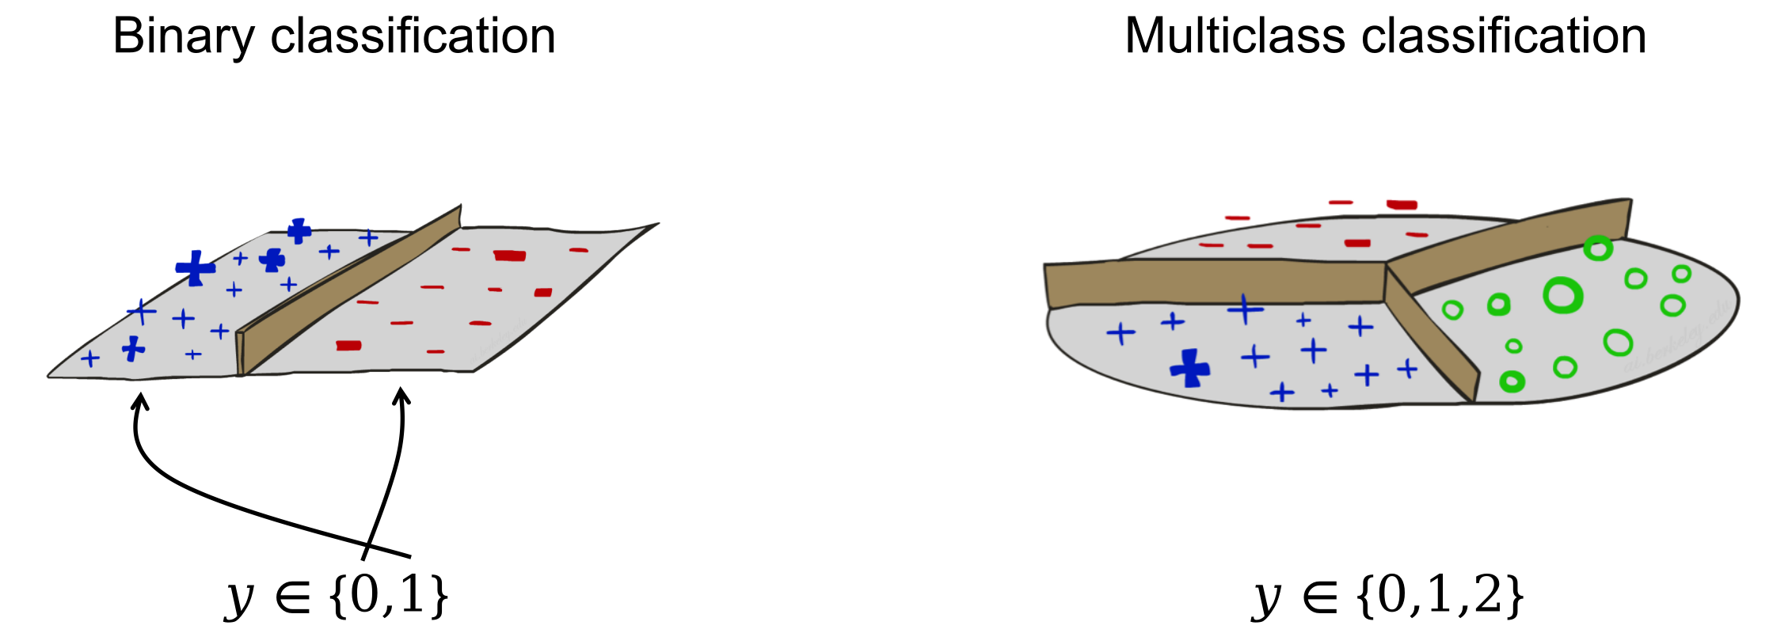
Classification
Images Source: UC Berkeley CS188 – Intro to AI course

Slide 4
K-nearest neighbour classification
Given:
Training Data $D ={\{x^{\left(i\right)},y^{\left(i\right)}\}}_{i=1:m}$
Query point $q$
Distance Metric $d(q,x^{\left(i\right)})$
Number of neighbours $k$
NN = { $i$ : $d(q,x^{\left(i\right)}) k$ smallest } (k closest to query point)
Return:
Regression:
Classification:
q
q
mean of the y^{(i)} in NN
vote of the y^{(i)} in NN

Slide 5
K-nearest neighbour classification
What if k = m?
Always predict the majority class

Slide 6
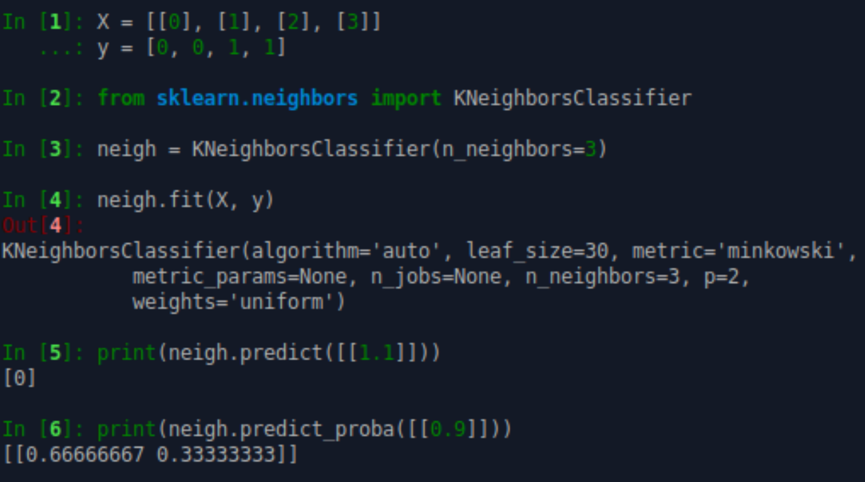
Example

Slide 7
Logistic Regression

Slide 8
Linear regression for classification
$$f_{θ}(x)$$
(Yes) 1
Logistic Regression
$${0≤f}_{θ}(x)≤1$$
if $f_{θ}(x)≥0.5$, predict “y=1”
if $f_{θ}(x)<0.5$, predict “y=0”
Malignant ?
0.4
(No) 0
tumor size
Linear regression could work but:
we need another parameter (threshold):
it is unbounded
if $f_{θ}(x)≥0.4$, predict “y=1”
if $f_{θ}(x)<0.4$, predict “y=0”
$f_{θ}(x)$ can be > 1 and < 0

Slide 9
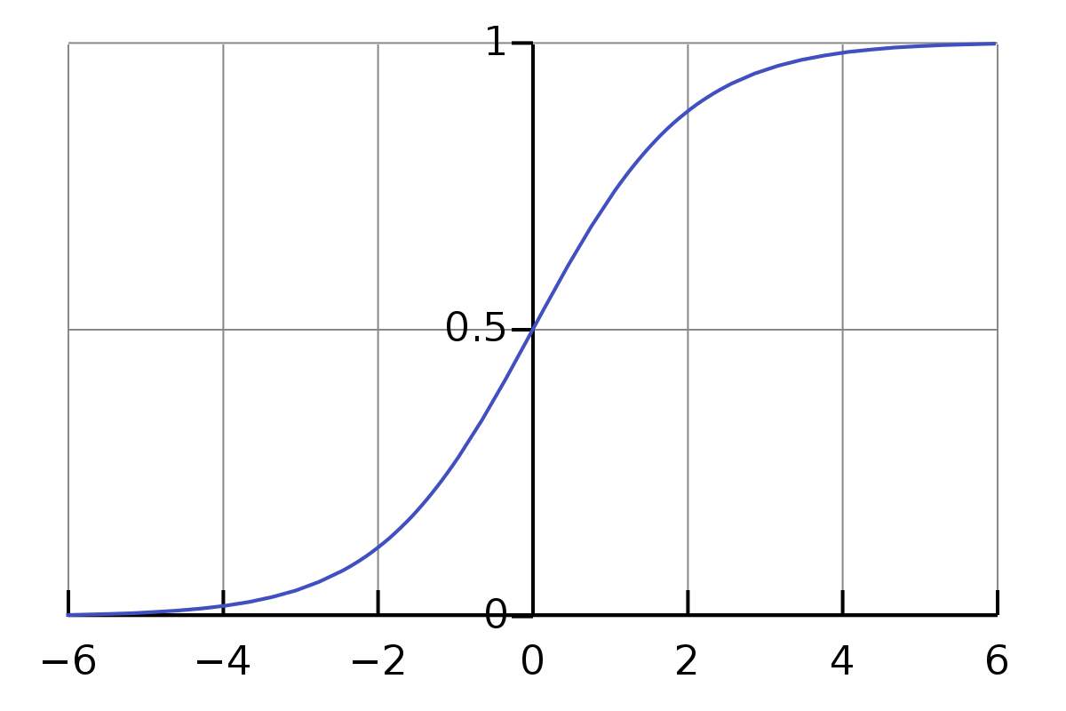
Logistic function
or
Sigmoid function
Logistic regression
$${0≤f}_{θ}(x)≤1$$
$$f_{θ}(x)= g ( θ^{T}x )$$
$$g(z)=\frac{1}{(1+e^{−z})}$$
$$g(z)$$
$$f_{θ}(x)=\frac{1}{(1+e^{−θ^{T}x})}$$
estimated probability that “y=1” on input x
$$z$$

Slide 10
Quiz
Suppose that we want to predict whether a tumor is malignant or not based on its size.
What is x (the input) and what do we mean by “y=1” and “y=0”?
x: size, “y=1”: tumor is malignant, “y=0”: tumor is not malignant
Suppose now that
What does this mean?
The estimated probability that x is a tumor as predicted by our model is 0.8.
Similarly the estimated probability that x is NOT a tumor is 0.2 (= 1 - 0.8).
$f_{θ}(x)=0.8$

Slide 11
Decision boundary
$$f_{θ}(x)= g(θ^{T}x)$$
$$g(z)=\frac{1}{(1+e^{−z})}$$
$$g(z)$$
if $f_{θ}(x)≥0.5$, predict “y=1”
$$θ^{T}x≥0$$
$$z$$
if $f_{θ}(x)<0.5$, predict “y=0”
$$θ^{T}x<0$$

Slide 12
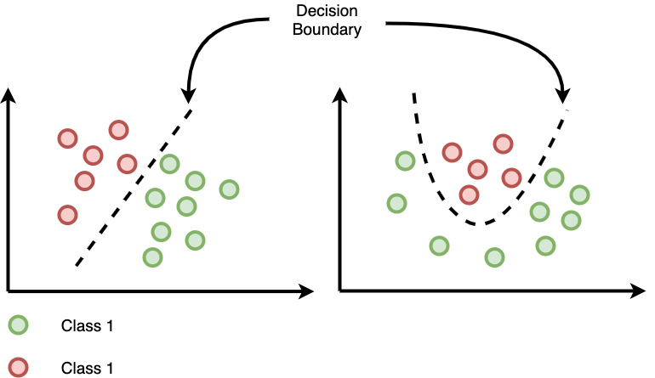
Decision boundary
Class 1
Class 2

Slide 13
Cost function
We do NOT minimize the Mean Squared Error
Instead we minimize the Cross-Entropy Error:
Intuitively: distance between two probability distributions (target and estimated)
The Squared Error has a non-convex landscape when used with Logistic Regression
The CE Error has a convex landscape
To find θ we use gradient descent (or more advanced optimization algorithms, e.g., conjugate gradient, L-BFGS).

Slide 14
Cost function
Cross-Entropy Error
$$L(θ)=−\frac{1}{m}\sum_{i=1}^{m}{{[{y^{(i)}logf}_{θ}(x^{(i)})+(1−y^{(i)})log(1−f_{θ}(x^{(i)}))]}^{}}$$
same as in
Gradient
Linear Regression:
$$f_{θ}(x)= θ^{T}x$$
$$∇_{θ_{j}}L(θ)=\frac{1}{m}\sum_{i=1}^{m}{{[f_{θ}(x^{(i)})−y^{(i)})]x_{j}^{(i)}}^{}}$$
$$f_{θ}(x)=\frac{1}{(1+e^{−θ^{T}x})}$$
Logistic Regression:

Slide 15
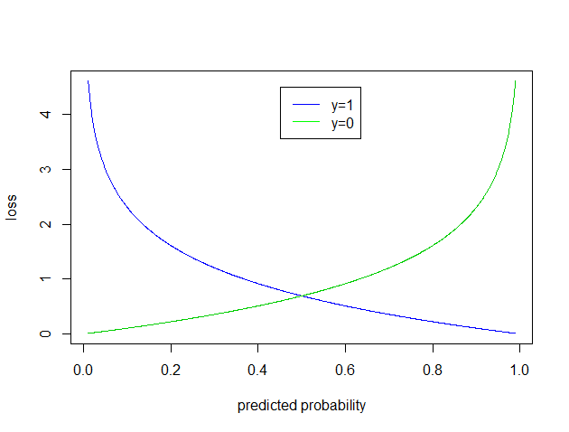
Cross Entropy Error
$$L(θ)=−\frac{1}{m}\sum_{i=1}^{m}{{[{y^{(i)}logf}_{θ}(x^{(i)})+(1−y^{(i)})log(1−f_{θ}(x^{(i)}))]}^{}}$$
$$L(θ)=\frac{1}{m}\sum_{i=1}^{m}{{[loss(f_{θ}(x^{(i)}), y^{(i)})]}^{}}$$
$loss(f_{θ}(x^{(i)}), y^{(i)})= \left\{\begin{aligned}−log(f_{θ}(x^{(i)})) if y^{(i)}=1 \\ −log({1 − f}_{θ}(x^{(i)})) if y^{(i)}=0\end{aligned}\right.$
Cost increases to infinity as predicted probability is very far away from the actual
source

Slide 16
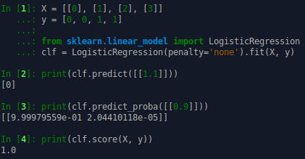
Example

Slide 17
Error Analysis

Slide 18
Error Analysis
In binary classification we may characterize the performance of a classifier based on a metric called accuracy
number of correct predictions divided by the number of samples in the set
gives a value between 0 and 1.
However, we can go beyond Accuracy by investigating the types of error the classifier does.

Slide 19
Error Analysis
Example (source): Given a sample of 12 individuals, 8 that have been diagnosed with cancer and 4 that are cancer-free, where individuals with cancer belong to class 1 (positive) and non-cancer individuals belong to class 0 (negative), we can display that data as follows:

Slide 20
Error Analysis
Example continued: Assume that we have a classifier that distinguishes between individuals with and without cancer in some way, we can take the 12 individuals and run them through the classifier. The classifier then makes 9 accurate predictions and misses 3: 2 individuals with cancer wrongly predicted as being cancer-free (sample 1 and 2), and 1 person without cancer that is wrongly predicted to have cancer (sample 9).

Slide 21
Error Analysis
Example continued:
True Positive (TP): Positive actual classification, positive predicted classification
True Negative (TN): Negative actual classification, negative predicted classification
False Positive (FP): Negative actual classificiation, positive predicted classification
False Negative (FN): Positive actual classificiation, negative predicted classification

Slide 22
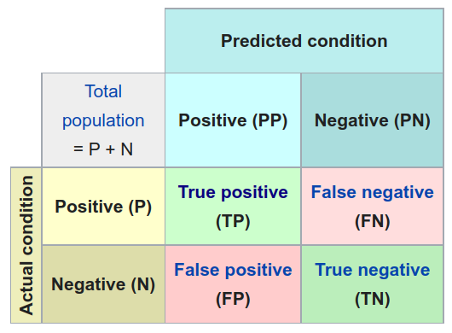
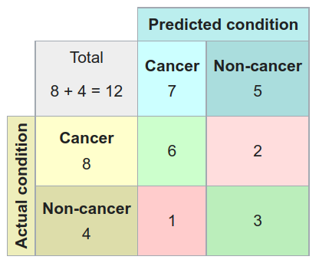
Confusion matrix

Slide 23
Metrics
Accuracy = (TP + TN) / (P + N)
Precision = TP / (TP + FP)
True positive rate = TP / (TP + FN)
Also known as: recall, sensitivity, hit rate or probability of detection
False Positive Rate = FP / (FP + TN)
Also known as: probability of false alarm
F1-score (harmonic mean of precision and sensitivity) = 2TP / (2TP + FP + FN)

Slide 24
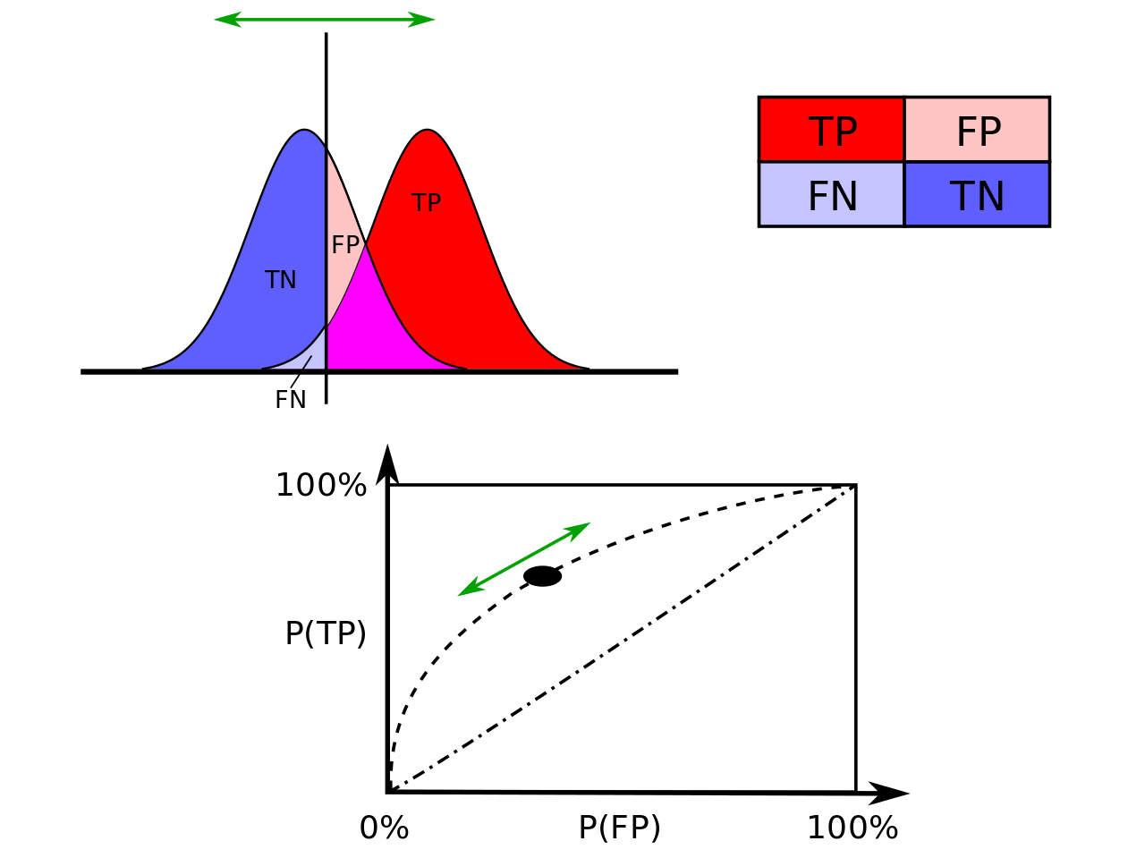
ROC Curve
A binary classifier needs a threshold to decide where to put the decision boundary
The threshold choice affects both the TPR and the FPR
We can vary the thresholds and plot the TPR with respect to FPR
This is known as a Receiver operating characteristic (ROC) Curve

Slide 25
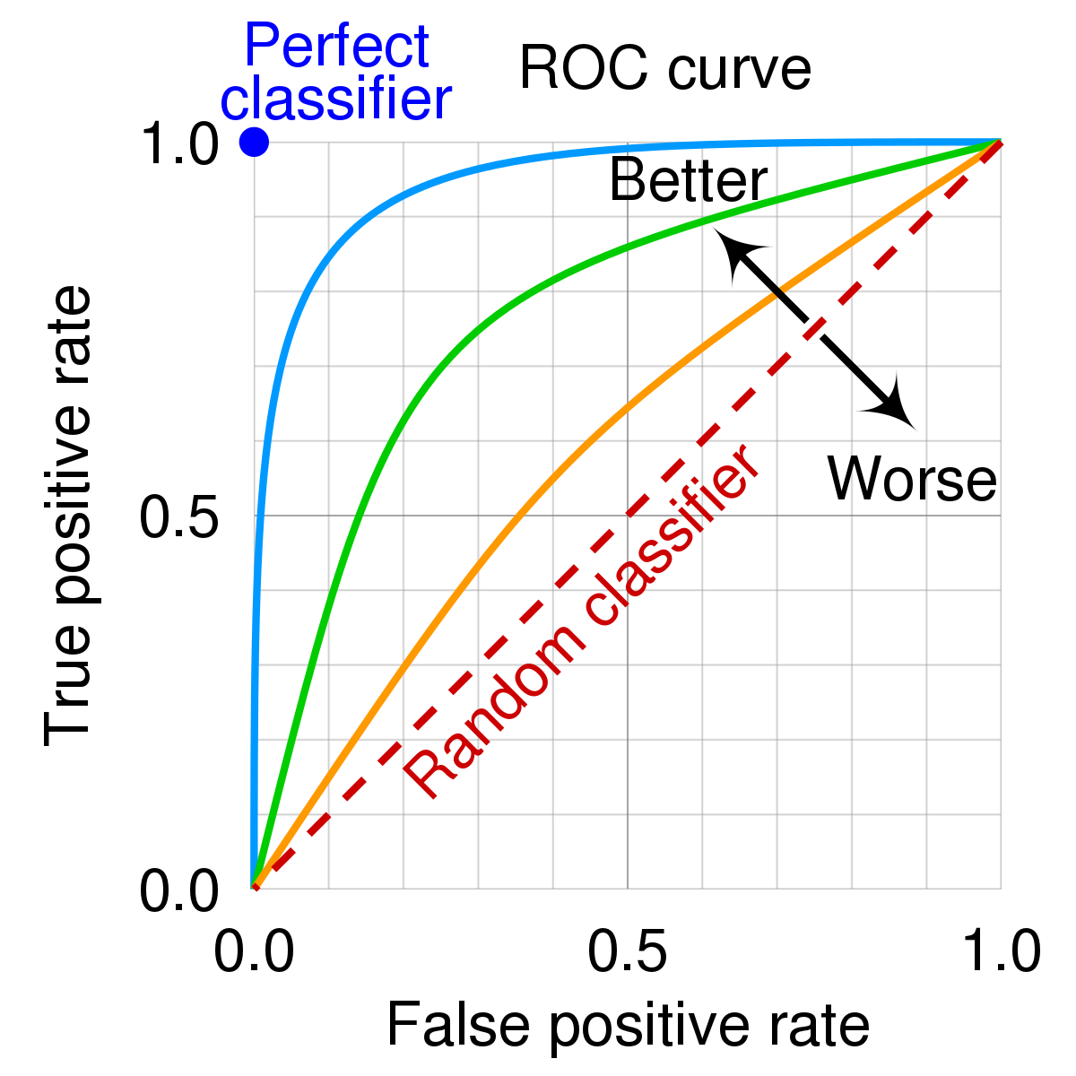
ROC Curve
ROC curve: graph showing the performance of a binary classification model at all classification thresholds.
Lowering the classification threshold classifies more items as positive, thus increasing both FPs and TPs.
Purpose:
Analyze the strength / predictive power of a classifier
Compare classifiers
Determine the “optimal” threshold based on user’s preferences
source

Slide 26
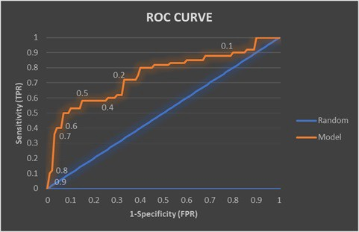
ROC Curve: It’s a tradeoff
Which threshold would you choose?
If you care more about FPR $≤0.1$
(obtained with thresholds 0.9, 0.8, 0.7, and 0.6)
If you care more about high TPR ($≥0.7$)
If you are happy with a TPR $≈0.6$
(obtained with thresholds 0.5 and 0.4)
source

Slide 27
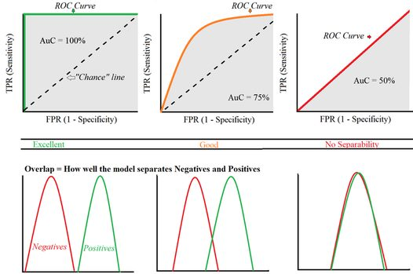
ROC Curve: Comparing Classifiers
Area Under the Curve (AUC)
single metric (from 0 to 1)
aggregate measure of performance across all possible classification thresholds
measure of how much the model is capable of distinguishing the two classes
Scale invariant: measures how well predictions are ranked, rather than their absolute values
Classification-threshold invariant: measures quality of model’s predictions irrespective of classification threshold
Source

Slide 28
Quiz
Suppose that you have a classifier that predicts all positives as negatives and all negatives as positives.
Is this classifier worse than the random classifier?
YES
What is its AUC score?
0
Can we fix it somehow?
Yes. Just flip its predictions and you get a perfect classifier!

Slide 29
Multiclass Classification

Slide 30
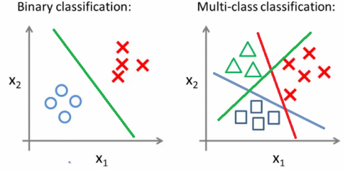
Multiclass classification

Slide 31
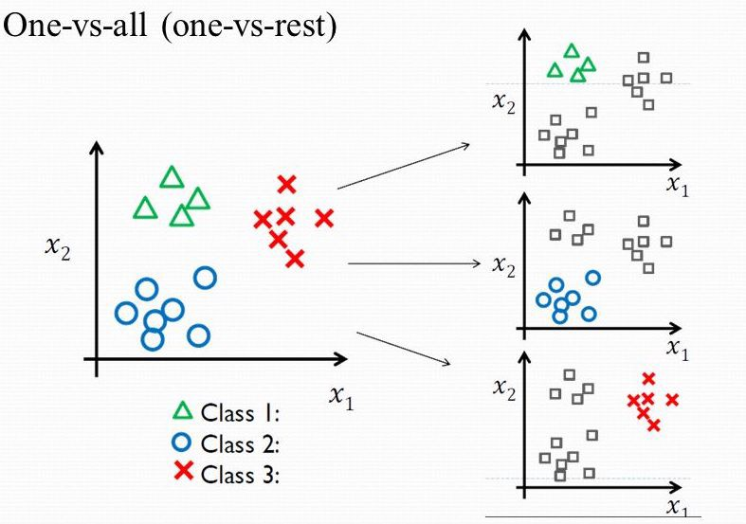
Multiclass classification
Convert the problem into K binary classification problems (K number of classes)
Train a logistic regression classifier for each class.
To make a prediction pick the class whose classifier is most confident.

Slide 32
Softmax classifier
Natural generalization of binary Logistic Regression classifier to multiple classes
Also called multinomial logistic regression
Output: normalized class probabilities
Softmax function: converts a vector of K real numbers into a probability distribution of K possible outcomes.

Slide 33
Cross Entropy Error for Multiple Classes
Categorical Cross Entropy Error
Each $y^{(i)}$ is one-hot encoded for K classes
The estimated ${\hat{y}}^{(i)}$ is the output of the softmax classifier
$loss({\hat{y}}^{\left(i\right)}, y^{(i)})=−\sum_{c=1}^{K}{{[y_{c}^{(i)} log {\hat{y}}_{c}^{(i)}]}^{}}$
$$L(θ)=−\frac{1}{m}\sum_{i=1}^{m}{\sum_{c=1}^{K}{{[y_{c}^{(i)} log {\hat{y}}_{c}^{(i)}]}^{}}}$$

Slide 34
Softmax classifier: numeric stability issues
When writing code for computing the Softmax function, the term and may be very large due to the exponentials.
Dividing large numbers can be numerically unstable, so it is important to use a normalization trick.
$$\sum_{c=1}^{K}{e^{z_{c}}}$$
$$e^{z_{j}}$$
$$\frac{e^{z_{j}}}{\sum_{c=1}^{K}{e^{z_{c}}}}=\frac{{A e}^{z_{j}}}{A \sum_{c=1}^{K}{e^{z_{c}}}}=\frac{e^{z_{j}+logA}}{\sum_{c=1}^{K}{e^{z_{c}+logA}}}$$
$$logA = −\max_{c}z_{c}$$
Shifts values of $z_{j}$ so that the highest is 0

Slide 35
Softmax classifier: example
Logits
Probabilities
$$z_{0}=2.0$$
Softmax
$${σ(z)}_{0}=?$$
$$z_{1}=1.0$$
$${σ(z)}_{i}=\frac{e^{z_{i}}}{\sum_{j=1}^{K}{e^{z_{j}}}}$$
$${σ(z)}_{1}=?$$
$$z_{2}=0.1$$
$${σ(z)}_{2}=?$$

Slide 36
Softmax classifier: example
Logits
Probabilities
$$z_{0}=2.0$$
Softmax
$${σ(z)}_{0}=0.66$$
$$z_{1}=1.0$$
$${σ(z)}_{i}=\frac{e^{z_{i}}}{\sum_{j=1}^{K}{e^{z_{j}}}}$$
$${σ(z)}_{1}=0.24$$
$$z_{2}=0.1$$
$${σ(z)}_{2}=0.1$$

Slide 37
Resources
Binary classification – Wikipedia
Cross-entropy – Wikipedia
Confusion matrix – Wikipedia
Multiclass classification – Wikipedia
Logistic regression – Wikipedia
ROC curve – Wikipedia
Softmax function – Wikipedia

Slide 38
Next Lecture
Model Evaluation and Improvement
Trees and Forests

Slide 39
Thank you

