Slide 1
University of Cyprus - MSc Artificial Intelligence
MAI612 - MACHINE LEARNING
Lecture 5: Model Evaluation and Improvement
Vassilis Vassiliades, PhD
Winter Semester 2022/23

Slide 2
Revision

Slide 3
Regression
Regression is the supervised learning problem of predicting a continuous value
K-nearest neighbor regression
Nonparametric model
Prediction is the average of the K nearest neighbors
K=1: noisy, 1<K<m better captures the trend, K=m always produces the average of all
Strengths: no training time, handles nonlinearities, …
Weaknesses: prediction becomes slower as the dataset becomes larger, …
Linear regression
Parametric model: 1 parameter per dimension + intercept term
Prediction is the dot product of parameter vector and input vector
Learning can be done either using gradient-based methods or computing the analytic solution

Slide 4
Regression
Linear regression optimizes the MSE, which has a convex shape (single optimum)
Gradient descent is about computing the partial derivatives of a function at a point, and changing the point by adding a value proportional to the negative gradient
A small learning rate results in slower convergence, a large learning rate may result in divergence
Gradient vector of MSE for linear regression
Need to use feature scaling with gradient descent
Linear regression
Strengths: constant prediction time, analytic solution easy to implement,…
Weaknesses: cannot model nonlinear relationships,…
Weakness can be addressed using polynomial features

Slide 5
Classification
Classification is the supervised learning problem of predicting a discrete value
K-nearest neighbor classification
Prediction is the majority vote of the K nearest neighbors
K=1: fit the noise, K=m always predict the majority class
Logistic regression
Simple method for binary classification
Feeds the output of linear regression through the sigmoid function which makes it in [0,1]
The output is seen as the estimated probability of predicting the positive class
Uses a default (probability) threshold of 0.5 for placing the decision boundary
Decision boundary of logistic regression is linear, can be nonlinear if we use polynomial features

Slide 6
Classification
Logistic regression optimizes the Cross-Entropy error which has a convex shape
We use gradient-based methods to find the minimum
The CE error penalizes the model a lot if its predicted probability is very far from the actual
Gradient vector of CE error for logistic regression (similar to MSE for linear regression)
Error analysis for binary classifiers
True positives, True Negatives, False Positives and False Negatives
Metrics: Accuracy, Precision, TP rate, FP rate, F1-score
ROC curve: plots the FP rate and the TP rate for all classification thresholds
AUC score: a single metric based on ROC which can be used to compare classifiers
Multiclass classification
One-vs-rest: train K binary classifiers; prediction is the class of the most confident classifier
Softmax: uses one-hot encoding of classes; prediction is a probability distribution over K classes

Slide 7
Lecture 5: Model Evaluation and Improvement
Learning Outcomes
You will understand:
the issue of generalization in machine learning and how it is related to model evaluation
the concepts of overfitting, underfitting and the bias-variance tradeoff
the importance of training, validation and test sets
what k-fold cross-validation is and when to use it
when to acquire more data to improve ML models
how to improve ML models using L1 and L2 regularization
how to improve ML models by tuning their hyperparameters

Slide 8
Model Development
Strategy
Data Preparation
Model Development
Model Deployment
Data Preparation
Model Development
Model Evaluation and Improvement
…
Dataset
Splitting
Training
Validation
Test
8

Slide 9
The issue of generalization
What is generalization?
Not memorizing the very details of our training samples
Model's ability to have “good performance” on previously unseen data, drawn from the same distribution as the one used to train the model
Why we want generalization?
Our dataset is a sample from a broader distribution
We want to train a model in a way that does not focus on the “noise” in the samples
Ignoring the noise will allow the model to have predictive power over the broader distribution

Slide 10
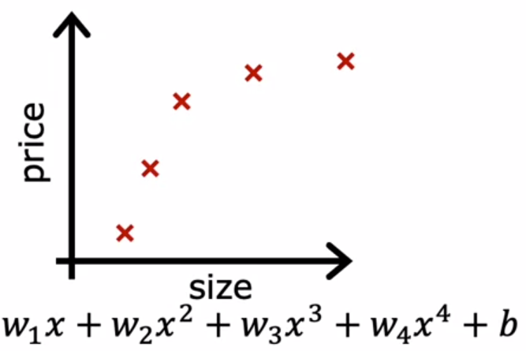
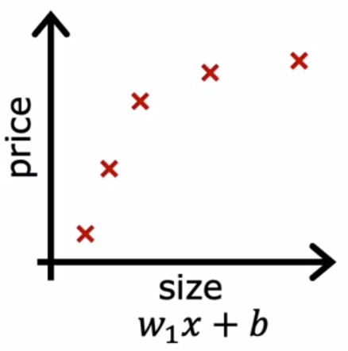
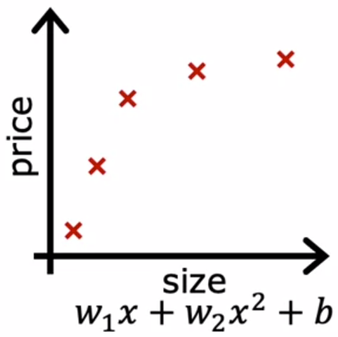
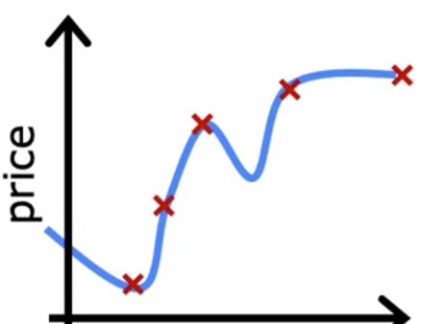
Regression Example
Source: Andrew Ng, Machine Learning - Coursera
(a)
(b)
(c)
Which model is better, i.e., provides better generalization?

Slide 11
Regression Example: Underfitting vs Overfitting
Source: Andrew Ng, Machine Learning - Coursera
Model too simple
Does not fit the training set well
Underfitting
Model just right
Fits training set well
Generalization
Model too complex
Fits training set extremely well
Overfitting

Slide 12
Regression Example: Underfitting vs Overfitting
Source: Andrew Ng, Machine Learning - Coursera
Model too simple
Does not fit the training set well
High Bias
Model just right
Fits training set well
Generalization
Model too complex
Fits training set extremely well
High Variance

Slide 13
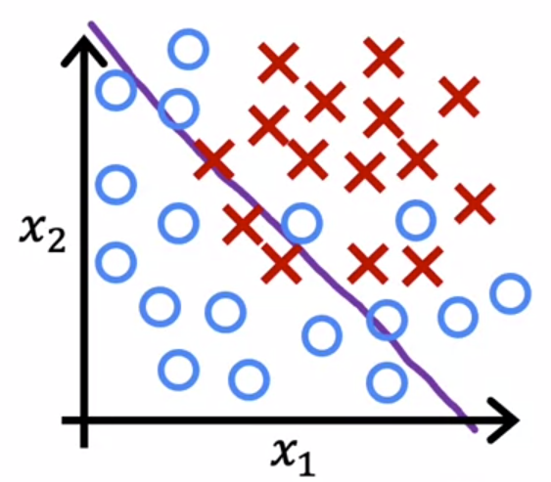
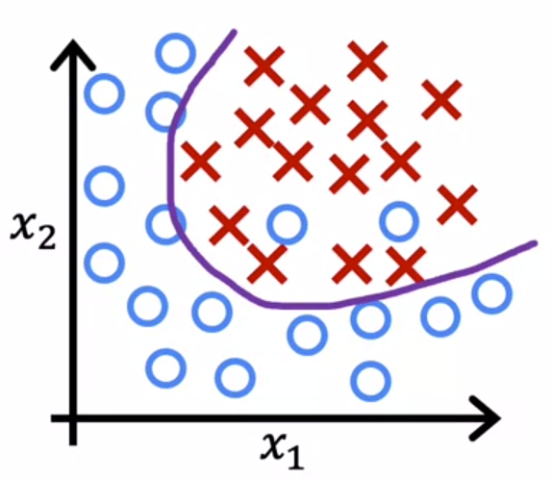
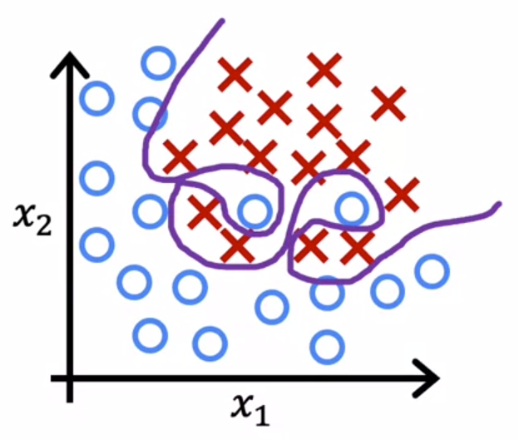
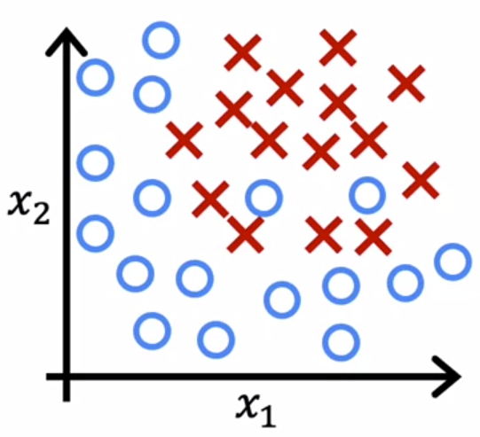
Classification Example
Source: Andrew Ng, Machine Learning - Coursera
$$z=θ_{0}+θ_{1}x_{1}+θ_{2}x_{2}$$
$$f_{θ}(x) = g(z)$$
$g$ is the sigmoid function
$$z=θ_{0}+θ_{1}x_{1}+θ_{2}x_{2}$$
$$+θ_{3}x_{1}^{2}+θ_{4}x_{2}^{2}+θ_{5}x_{1}x_{2}$$
$$z=θ_{0}+θ_{1}x_{1}+θ_{2}x_{2}$$
$$+θ_{3}x_{1}^{2}x_{2}+θ_{4}{x_{1}^{2}x}_{2}^{2}$$
$$+θ_{5}{x_{1}^{2}x}_{2}^{3}+...$$
Underfitting
High Bias
Overfitting
High Variance
Generalization

Slide 14
Quiz
Source: Andrew Ng, Machine Learning - Coursera
Our goal when creating a model is to be able to use the model to predict outcomes correctly for new examples. A model which does this is said to generalize well.
When a model fits the training data well but does not work well with new examples that are not in the training set, this is an example of:
Underfitting (high bias)
Overfitting (high variance)
A model that generalizes well (neither high variance nor high bias)

Slide 15
Bias-Variance Tradeoff
Bias: error from erroneous (simplifying) assumptions in the learning algorithm.
High bias can cause an algorithm to miss the relevant relations between features and target outputs (underfitting).
Variance: error from sensitivity to small fluctuations in the training set.
High variance may result from an algorithm modeling the random noise in the training data (overfitting).
Bias-variance tradeoff: conflict in trying to simultaneously minimize these two sources of error that prevent supervised learning algorithms from generalizing beyond their training set.

Slide 16
Bias-Variance Decomposition of the MSE
Assume there is a function with noise: $y=f\left(x\right)+ε$ , where $ε\sim Ν\left(0,σ^{2}\right)$
We want to find a function ${\hat{f}}_{θ}(x;D)$ that approximates the true function $f\left(x\right)$ as well as possible using a learning algorithm and a training set $D=\left\{\left(x^{(1)},y^{(1)}\right),…,\left(x^{(m)},y^{(m)}\right)\right\}$, where $D\sim P(x,y)$
We measure the MSE between $y$ and ${\hat{f}}_{θ}\left(x;D\right)$ : we want to minimize ${\left(y−{\hat{f}}_{θ}(x;D)\right)}^{2}$ for all points in $D$ and outside
We cannot do so perfectly, because $y^{(i)}$ contains noise $ε$ so we need to accept some irreducible error.
We can decompose the expected error of a model ${\hat{f}}_{θ}$ on an unseen sample $x$ as follows:
$E_{D,ε}\left[{\left(y−{\hat{f}}_{θ}(x;D)\right)}^{2}\right]={\left({Bias}_{D}\left[{\hat{f}}_{θ}(x;D)\right]\right)}^{2}+{Var}_{D}\left[{\hat{f}}_{θ}(x;D)\right]+σ^{2}$
where ${Bias}_{D}\left[{\hat{f}}_{θ}(x;D)\right]=E_{D}\left[{\hat{f}}_{θ}(x;D)\right]−f\left(x\right)$
${Var}_{D}\left[{\hat{f}}_{θ}(x;D)\right]=E_{D}\left[{\left(E_{D}\left[{\hat{f}}_{θ}(x;D)\right]−{\hat{f}}_{θ}(x;D)\right)}^{2}\right]$

Slide 17
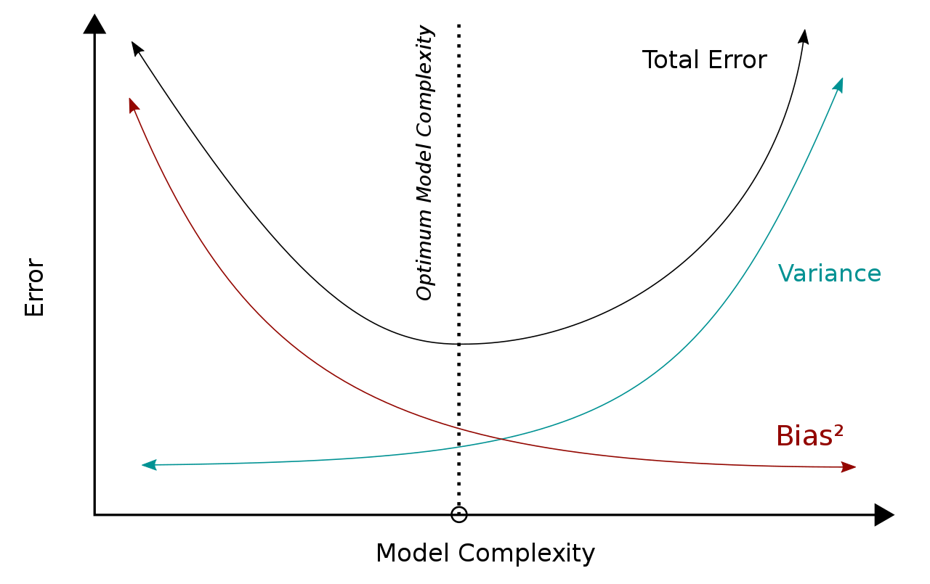
Bias-Variance Tradeoff
As we increase the complexity of the model:
the squared bias decreases
the variance increases
the total error (Bias² + Variance + ε) decreases up to a point where it starts increasing again.
This is considered the optimal model complexity with regards to the model and dataset that we have.
Source

Slide 18
Bias-Variance Tradeoff
In k-nearest neighbor regression:
k=1 : low bias, high variance
k=m : high bias, low variance
In linear regression:
less features: high bias, low variance
many features: low bias, high variance

Slide 19
Quiz
Suppose that we have a dataset that contains many features (columns). We use a linear regression model for our prediction, however, it seems that it suffers from high variance. What data preparation methods can we use to decrease the variance?
What we mentioned about the bias-variance tradeoff of MSE is theoretical. The definition of Bias includes a term about the true function, which we do not have access to. What can we do in practice to derive the optimal complexity of a model?

Slide 20
Generalization evaluation on Train-Test Error
What is generalization?
Model's ability to have “good performance” on previously unseen data, drawn from the same distribution
Dataset Splitting
Is there a way to measure generalization?
Let’s visualize it by plotting the train and test errors on the same graph!
70%
30%

Slide 21
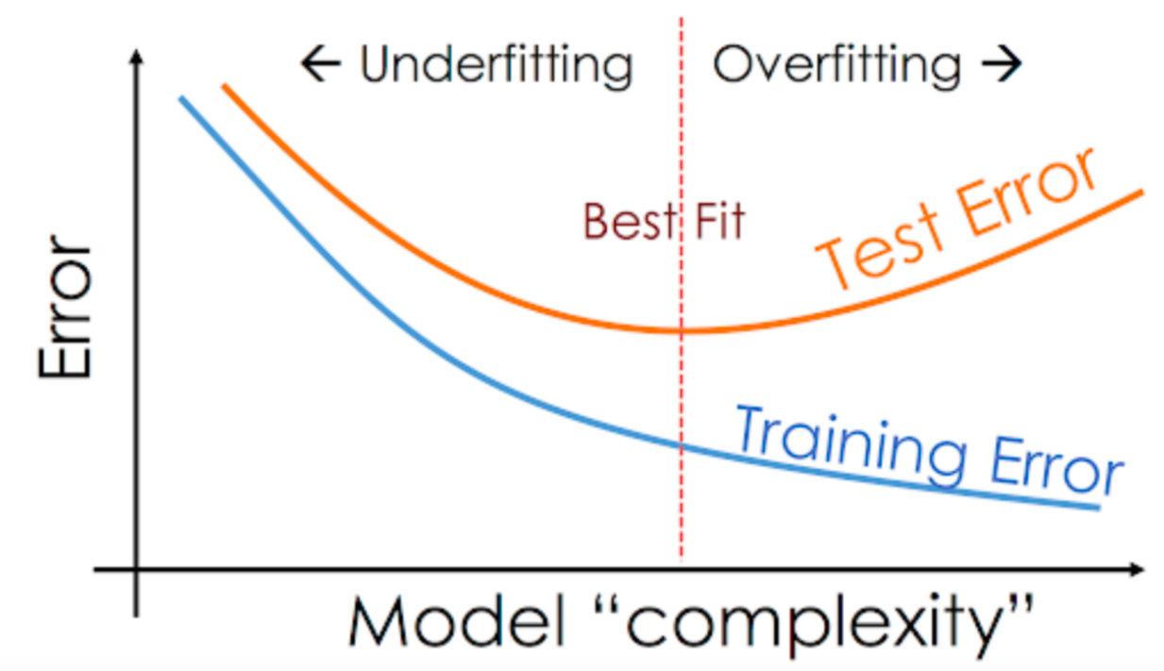
Generalization evaluation on Train-Test Error
Increasing the model complexity:
decreases the training error
decreases the test error up to a point where it starts increasing again.
Best fit is for model complexity that corresponds to the lowest test error
We select the model that has the lowest test error
Source

Slide 22
Revisiting Dataset Splitting
So far: Split Dataset => Training set + Test set
We perform model selection on the unseen test set
However, we did see the test set to find the optimal complexity of the model!
How do we know that our selected model does well on unseen samples?
The selected model might happen to be optimal for our particular choice of a test set
We should hide the test set: do not perform model selection on it
In ML competitions (e.g., Kaggle) the test set is not provided

Slide 23
Revisiting Dataset Splitting
Instead, Split Dataset:
Training set: train the model
Validation set: perform model selection (hyperparameters, complexity, use different models)
Test set: just report the performance - do NOT use for any decisions
In practice (execute in the following order):
Split Dataset to Training and Test sets
Split Training set to Training and Validation sets (or Test set to Validation and Test sets)

Slide 24
Model generalization
Training-test split: e.g. 70%-30%
Do not touch the test set during training!
Procedure
1. Train on training set: L_{train}(θ)
2. Predict on test set: L_{test}(θ)
Training-validation-test split: e.g. 60%-20%-20%
Do not touch the test set during training-validation!
Procedure
1. For each model/hyperparameter:
1.1. Train on training set: L_{train}(θ)
1.2. Predict on validation set: L_{validation}(θ)
2. Choose models/hyperparameters that have lowest L_{validation}(θ)
3. Predict on test set: L_{test}(θ)
Model Selection on θ
Model Selection on hyperparameters

Slide 25
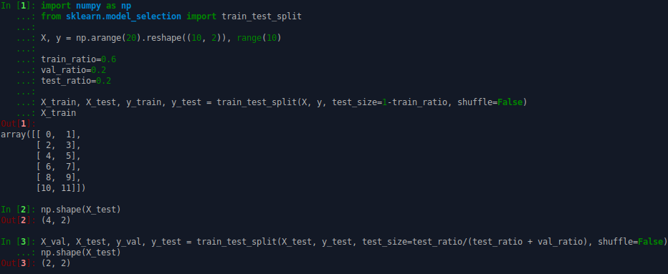
Example

Slide 26
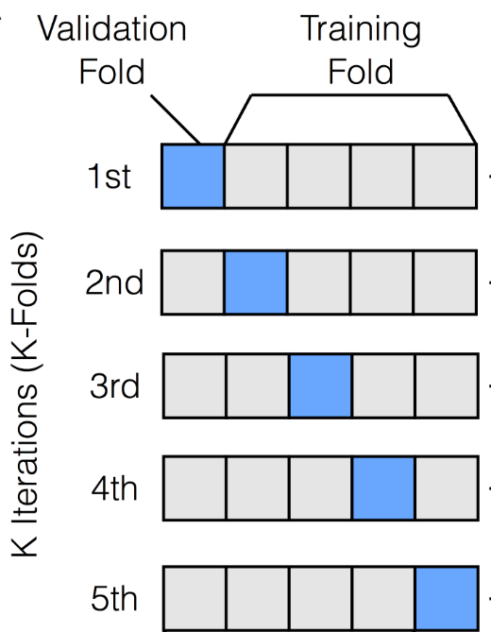
k-fold Cross-Validation
Used when we do not have many datapoints in the training + validation sets
Procedure:
1. Split Training+Validation sets to k folds
2. for i = 1 to k
2.1. Use fold i as the validation set, remaining as the training set
2.2. Train on training set, validate on validation set
3. Report the average validation error over the k validation folds
Source

Slide 27
k-fold Cross-Validation
What is the downside of this approach?
Computationally expensive
What is an extreme/exhaustive form of k-fold cross validation?
Leave-one-out cross-validation (m models trained and validated)
Choosing k:
Need to balance size of dataset, computational capacity, time...
Typically: k=5, k=10

Slide 28
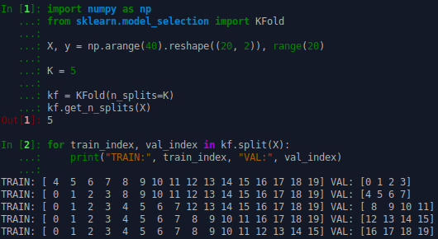
Example

Slide 29
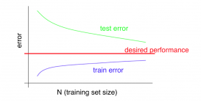
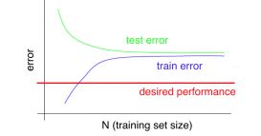
When to acquire more data
Source: Andrew Ng, Machine Learning - Coursera
High Bias Models
e.g. simple linear regression
Getting more data will likely NOT going to help.
High Variance Models
e.g. polynomial features, neural network
Getting more data will likely help.

Slide 30
Quiz
Having more data helps all machine learning models equally. True or False?
Models with high complexity suffer from high variance. Getting more data is a method for decreasing the variance in such models. True or False?

Slide 31
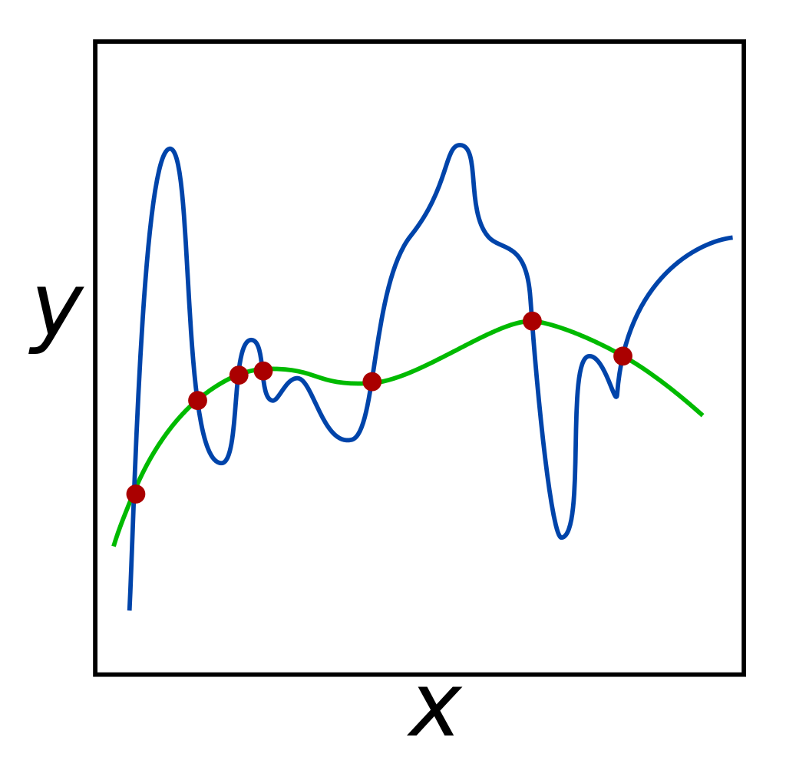
Model improvement through regularization
Complex models have the overfitting problem, i.e., high-variance (fit the noise)
There are many complex models
How to choose between them?
Solution:
Simpler models are more likely to generalize (“Ockham’s razor”)
Reduce variance by simplifying the model
Both blue and green lines have 0 training error

Slide 32
Model improvement through regularization
Regularization:
way of reducing the contribution of certain features
involves modification of the Loss function L(θ):
new L(θ) = L(θ) + λ * R(θ)
where:
R(θ) : penalty on the complexity of the model
λ : parameter controlling the importance of regularization
Properly adjusted λ would choose the simpler model (green line)

Slide 33
L1 and L2 Regularization
L1 regularization:
- R($θ$) = ${|| θ ||}_{1}^{}$ = $\sum_{i=1}^{n}{|{ θ}_{i} |}$
- tends to shrink parameters to zero (sparsity)
- useful for feature selection
- called Lasso regression when extending linear regression
L2 regularization:
- R($θ$) = ${|| θ ||}_{2}^{2}$ = $\sum_{i=1}^{n}{θ_{i}^{2}}$
- tends to shrink coefficients evenly
- useful when we have codependent features (e.g., “gender” and “ispregnant”)
- called Ridge regression when extending linear regression
Both can be used with any model

Slide 34
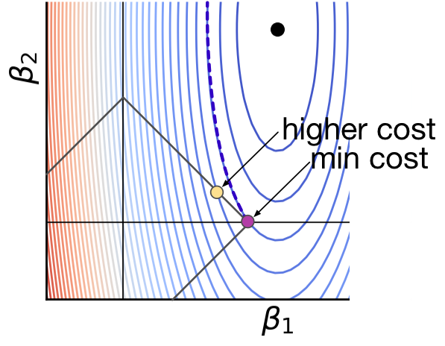
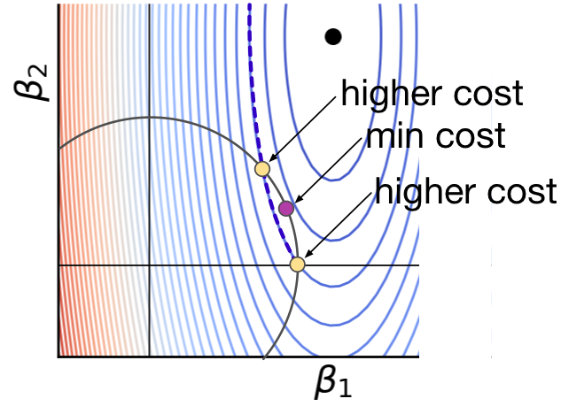
Why is L1 more likely to zero coefficients than L2?
(a) L1 constraint diamond
(b) L2 constraint circle
Source

Slide 35
L1 vs L2 regularization
L1 regularization:
Tends to produce solutions that have:
few big errors and
lots of very insignificant errors
Distribution of errors will be very “spiky”
More robust to outliers
L2 regularization:
Tends to produce solutions that have:
very few big errors (they are penalized a lot more)
lots of small errors that are still significant
Distribution of errors will be more “even”
Produces a better “fit”
Source

Slide 36
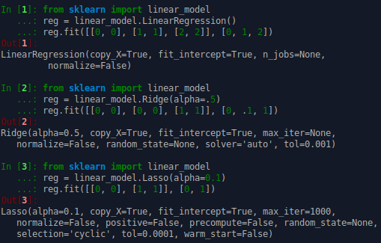
Example

Slide 37
Model improvement through hyperparameter tuning
Models have hyperparameters:
k-nearest neighbor regression: k
polynomial regression: polyomial degree
Learning algorithms have hyperparameters:
stochastic gradient descent: learning rate, momentum
regularization coefficient on the loss function
Hyperparameter settings are important for the performance of a learning algorithm – model combination
Tune hyperparameters using cross-validation
Two simple methods:
Grid search: specify a set of values for each hyperparameter and try all combinations of values
Random search: randomly sample hyperparameters from specified ranges

Slide 38
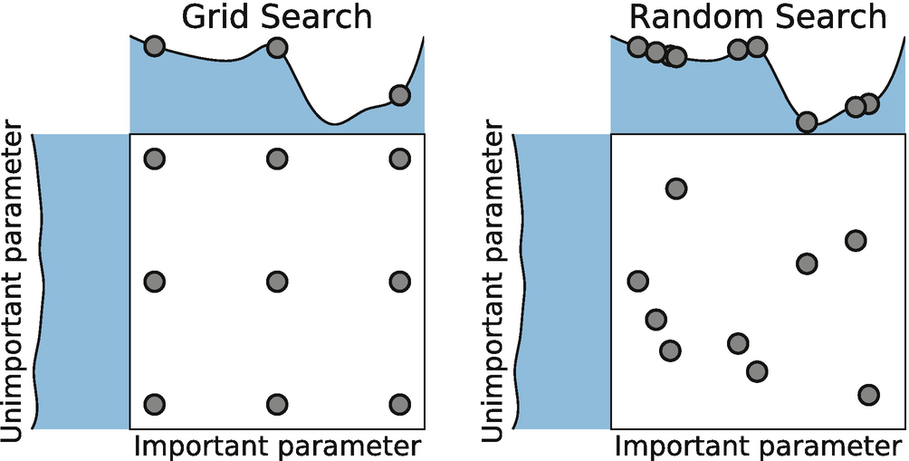
Model improvement through hyperparameter tuning

Slide 39
Hyperparameter tuning in scikit-learn
Grid Search: sklearn.model_selection.GridSearchCV
Random Search: sklearn.model_selection.RandomizedSearchCV

Slide 40
Model improvement through ensembling
“More heads are better than one”
“Wisdom of the crowd”
Ensembles: train multiple models instead of one to attain better predictive performance
More in the following lecture.

Slide 41
Resources
Overfitting – Wikipedia
Bias-variance tradeoff – Wikipedia
Regularization – Wikipedia
Hyperparameter optimization – Wikipedia
Training, validation, and test data sets – Wikipedia

Slide 42
Thank you

