Slide 1
University of Cyprus - MSc Artificial Intelligence
MAI612 - MACHINE LEARNING
Lecture 6: Trees and Forests
Vassilis Vassiliades, PhD
Winter Semester 2022/23

Slide 2
Lecture 6: Trees and Forests
Learning Outcomes
You will understand:
how decision tree models work
how to train decision trees using the concepts of entropy and information gain
how to use continuous variables in decision trees
classification and regression trees
why ensembles of models can achieve lower generalization errors
ensemble methods such as bagging, random forests, boosting, XGBoost and stacking

Slide 3
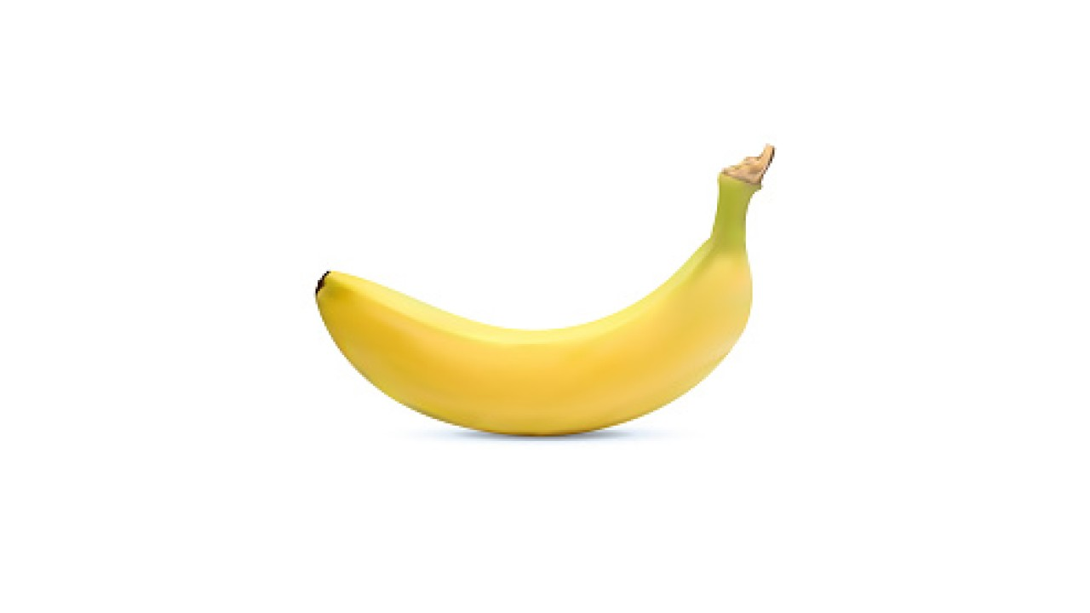
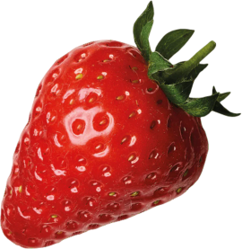
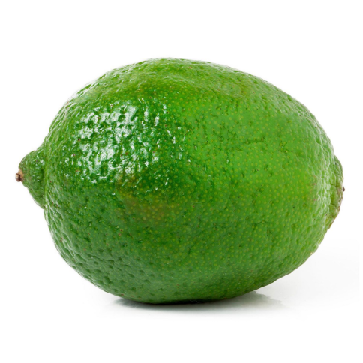
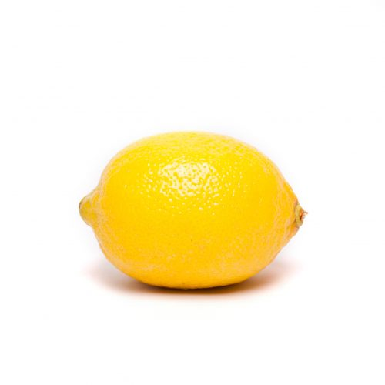
Introductory example: fruit image classifier
Pros:
+ Interpretable
+ Fast prediction
Is there a way to learn such programs from data?
if most pixels are yellow:
if shape is oval-like: lemon
else: banana
else most pixels are red: strawberry
else: lime

Slide 4
Decision Tree Representation for Fruit Image Classifier
decision nodes
most_pixels
root node
if most pixels are yellow:
if shape is oval-like: lemon
else: banana
else most pixels are red: strawberry
else: lime
yellow
red
other
shape
strawberry
lime
oval-like
other
lemon
banana
leaf nodes

Slide 5
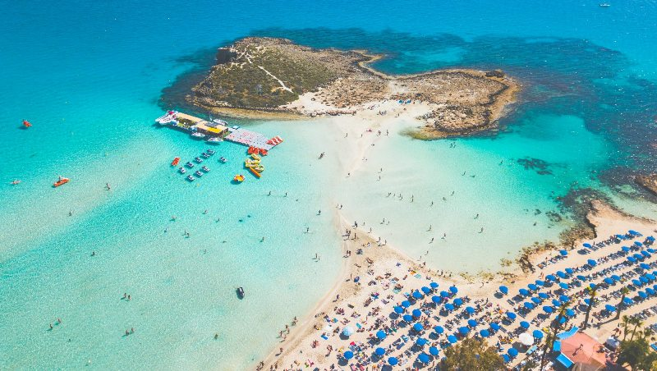
Another Example
Nissi Beach
Ayia Napa
Cyprus
Source

Slide 6
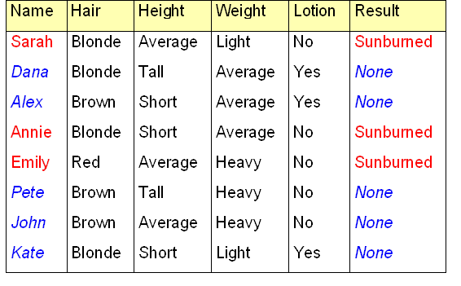
Sunburn Data Collected
We want to predict whether some person will get a sunburn based on the other features
Slide based on Ata Kaban’s Machine Learning course - University of Birmingham.

Slide 7
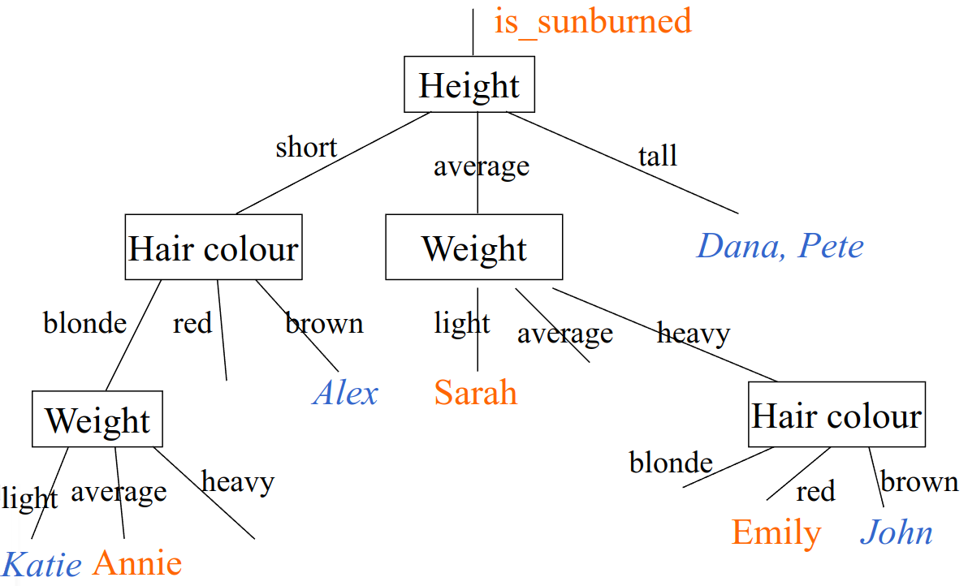
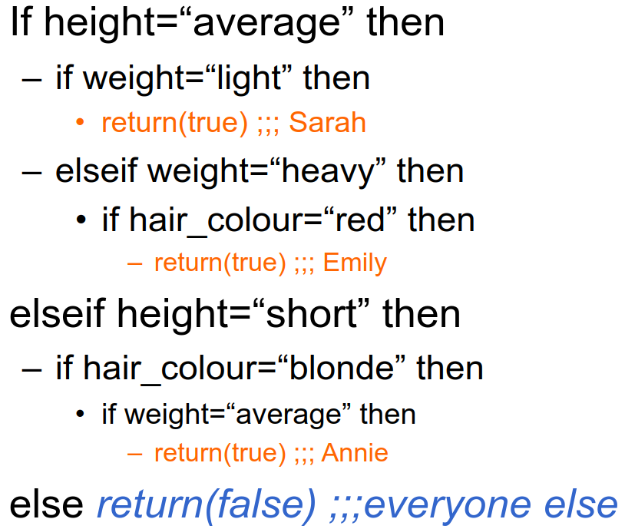
Decision Tree 1
Sunburn sufferers are...
Slide based on Ata Kaban’s Machine Learning course - University of Birmingham.

Slide 8
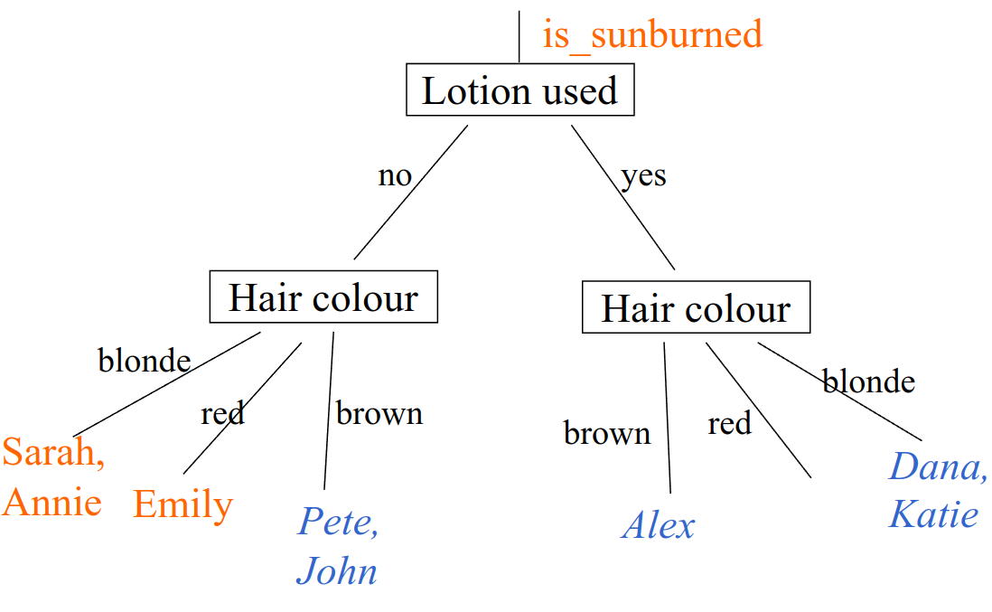
Decision Tree 2
Simpler than the previous decision tree
Slide based on Ata Kaban’s Machine Learning course - University of Birmingham.

Slide 9
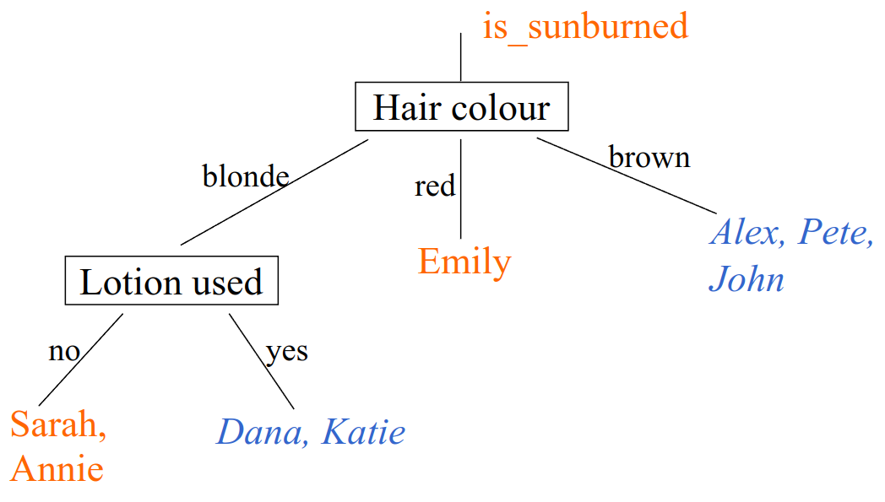
Decision Tree 3
Even simpler than the previous decision tree
Slide based on Ata Kaban’s Machine Learning course - University of Birmingham.

Slide 10
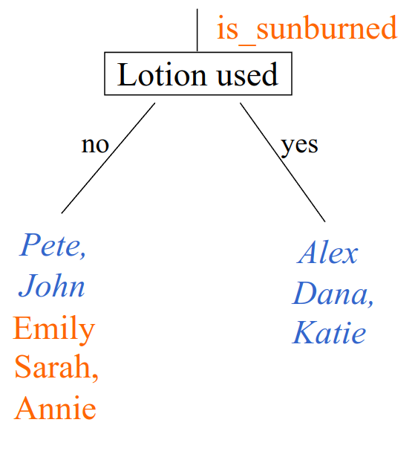
Decision Tree 4
We cannot tell much from this

Slide 11
Many Possibilities
Among these decision trees some do better than others on the training, validation and test sets.
The learning algorithm needs to pick one out of all the possibilities in order to do well on the training set and ideally to generalize well on the validation and test sets.

Slide 12
Decision Tree Learning
pain
Decision 1: How to choose what feature to split on at each node
yes
no
maximize order (or minimize disorder)
Emily,
Sarah,
Annie
Dana,
Alex,
Pete,
John,
Kate
Lotion used
Hair color
yes
no
blonde
brown
red
Dana,
Alex,
Kate
Emily,
Sarah,
Annie,
Pete,
John
Dana,
Sarah,
Annie,
Kate
Alex,
Pete,
John
Emily
3/3
sunburned
0/5
sunburned
0/3
sunburned
3/5
sunburned
2/4
sunburned
0/3
sunburned
1/1
sunburned
Slide based on Andrew Ng’s Machine Learning course - Coursera

Slide 13
Decision Tree Learning
Decision 2: When do you stop splitting?
Depth 0
When a node is 100% one class
When splitting a node will result in the tree exceeding a maximum depth
When improvements in ‘order’ score are below a threshold
When number of examples in node is below a threshold
When the error in the validation set starts increasing
Depth 1
Depth 2
Slide based on Andrew Ng’s Machine Learning course - Coursera

Slide 14
Decision 1: Choosing the feature to split
Irrelevant features do not classify the data well
Using irrelevant features thus causes larger decision trees
A learning algorithm could look for simpler decision trees
Q: How?
Slide based on Ata Kaban’s Machine Learning course - University of Birmingham.

Slide 15
A: How did WE do it?
Q: Which is the best feature for splitting up the data?
A: The one which is most informative for the classification we want to get
Q: What does ‘more informative’ mean?
A: The feature which best reduces the disorder
Q: How can we measure something like that?
A: See next slides
Slide based on Ata Kaban’s Machine Learning course - University of Birmingham.

Slide 16
Disorder
We need a quantity to measure the disorder in a set of examples
$$S = \{s_{1},s_{2},…,s_{m}\}$$
where $s_{1}$=’Sarah’, $s_{2}$=’Dana’, ...
What properties should the Disorder (D) have?
When D(S)=0 $→$ all examples in S have the same class
When D(S)=1 $→$ half of the examples in S are of one class and half are the opposite class
We need a function that takes as input the proportion of positive examples
As the proportion increases from 0 to 0.5, D needs to go from 0 to 1
As the proportion increases from 0.5 to 1, D needs to go from 1 to 0
Slide based on Ata Kaban’s Machine Learning course - University of Birmingham.

Slide 17
Examples
D({‘Dana’, ‘Pete’}) = 0
D({‘Sarah’, ‘Annie’, ‘Emily’}) = 0
D({‘Sarah’, ‘Emily’, ‘Alex’, ‘John’}) = 1
D({‘Sarah’, ‘Emily’, ‘Alex’}) = ?
Slide based on Ata Kaban’s Machine Learning course - University of Birmingham.

Slide 18
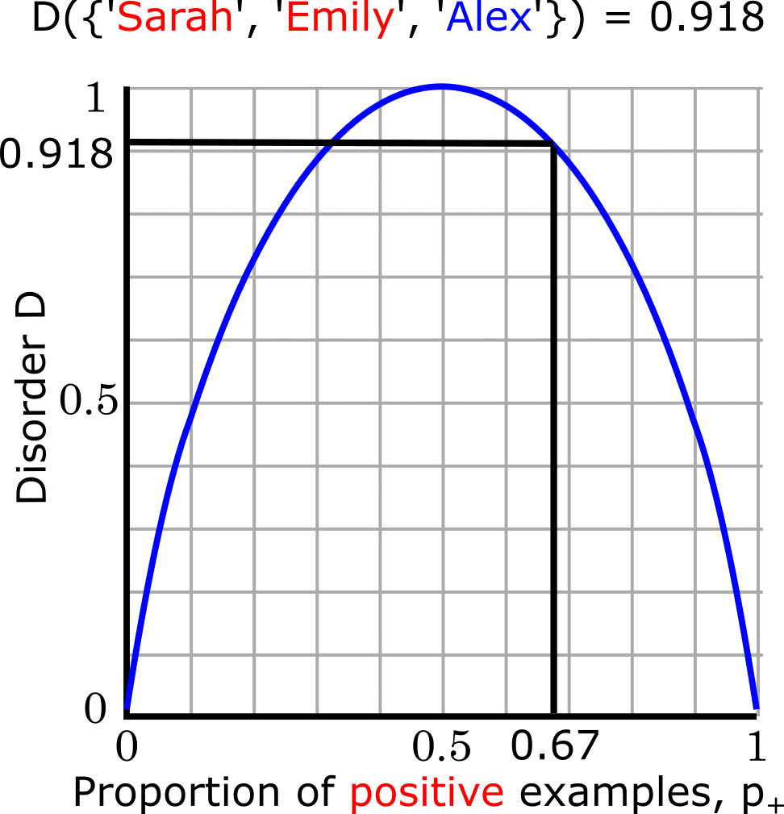
Disorder function intuition
We need a function that takes as input the proportion of positive examples
As the proportion increases from 0 to 0.5, D needs to go from 0 to 1
As the proportion increases from 0.5 to 1, D needs to go from 1 to 0

Slide 19
Entropy as a measure of disorder
The Entropy measures the disorder of a set S containing a total $m$examples of which $m_{+}$ are positive and $m_{−}$ are negative and it is given by
$$H\left(p_{+} \right)=−p_{+}\log_{2}p_{+}−p_{−}\log_{2}p_{−}$$
where
$$p_{+}={m_{+}}/m and{ p}_{−}={m_{−}}/m= 1−p_{+}$$
H(0) = 0
H(1) = 0
H(0.5) = 1

Slide 20
Back to the beach
D({‘Sarah’, ‘Dana’, ‘Alex’, ‘Annie’, ‘Emily’, ‘Pete’, ‘John’, ‘Katie’}) = $H(3/8)$
$$H\left(3/8\right)=−\frac{3}{8}\log_{2}\frac{3}{8}−\frac{5}{8}\log_{2}\frac{5}{8}$$
= 0.954
Slide based on Ata Kaban’s Machine Learning course - University of Birmingham.

Slide 21
Minimizing the disorder
What we know:
How to measure the disorder of a set
What’s left:
We want to measure how much the disorder of a set would reduce by knowing the value of a particular feature
This will help us figure out which feature to use for splitting up the data
Slide based on Ata Kaban’s Machine Learning course - University of Birmingham.

Slide 22
Information Gain
The Information Gain measures the expected reduction in entropy due to splitting on a feature A
$$Gain\left(S,A\right)=D\left(S\right)−\sum_{v ε Values(A)}{\frac{\left|S_{v}\right|}{\left|S\right|}D(S_{v})}$$
We want the largest gain
The same as smallest average disorder
The average disorder is just the weighted sum of the disorders in the branches (subsets) created by the values of A
Slide based on Ata Kaban’s Machine Learning course - University of Birmingham.

Slide 23
Back to the beach: calculate the average disorder associated with hair color
Hair color
blonde
brown
red
Dana,
Sarah,
Annie,
Kate
Alex,
Pete,
John
Emily
$$\frac{\left|S_{blonde}\right|}{\left|S\right|}D(S_{blonde})$$
$$\frac{\left|S_{brown}\right|}{\left|S\right|}D(S_{brown})$$
$$\frac{\left|S_{red}\right|}{\left|S\right|}D(S_{red})$$
Slide based on Ata Kaban’s Machine Learning course - University of Birmingham.

Slide 24
Back to the beach: calculate the average disorder associated with hair color
Hair color
blonde
brown
red
Dana,
Sarah,
Annie,
Kate
Alex,
Pete,
John
Emily
$$\frac{4}{8}H\left(2/4\right)=0.5∗1$$
$$\frac{\left|S_{brown}\right|}{\left|S\right|}D(S_{brown})$$
$$\frac{\left|S_{red}\right|}{\left|S\right|}D(S_{red})$$
Slide based on Ata Kaban’s Machine Learning course - University of Birmingham.

Slide 25
Back to the beach: calculate the average disorder associated with hair color
Hair color
blonde
brown
red
Dana,
Sarah,
Annie,
Kate
Alex,
Pete,
John
Emily
$$\frac{3}{8}H\left(0/3\right)=0$$
$$\frac{1}{8}H\left(1/1\right)=0$$
$$0.5$$
So the average disorder created when splitting on hair color is 0.5 + 0 + 0 = 0.5
Slide based on Ata Kaban’s Machine Learning course - University of Birmingham.

Slide 26
Which decision variable minimizes the disorder?
Test | Average Disorder | Information Gain
Hair Color | 0.5 | 0.954 – 0.5 = 0.454
Height | 0.69 | 0.954 – 0.69 = 0.264
Weight | 0.94 | 0.954 – 0.94 = 0.014
Lotion used | 0.61 | 0.954 – 0.61 = 0.344
This is what we have just computed
These are the average disorders of the other attributes, computed in the same way
Which decision variable maximizes the Information Gain then?
The one which minimizes the average disorder
Hair Color
Slide based on Ata Kaban’s Machine Learning course - University of Birmingham.

Slide 27
Splitting on a continuous variable
Suppose that a feature (e.g., weight) is represented with continuous values
How do we split this feature?
49.3 kg
63.6 kg
72.1 kg
65.8 kg
86.7 kg
97.3 kg
102.2 kg
53.4 kg

Slide 28
Splitting on a continuous variable
Weight < 60 kg
Sunburned
$$\frac{2}{8}H\left(1/2\right)+\frac{6}{8}H\left(2/6\right)=0.94$$
Weight < 80 kg
$$\frac{5}{8}H\left(2/5\right)+\frac{3}{8}H\left(1/3\right)=0.95$$
Not
sunburned
Weight (kg)
50
60
70
80
90
100
110
Based on these two splits, which would you choose?

Slide 29
Splitting on a continuous variable
Sunburned
Procedure
Get pairs of sorted points and choose the midpoint as the value to split
Calculate the information gain for all splits
Select the threshold with the highest information gain
Not
sunburned
Weight (kg)
50
60
70
80
90
100
110

Slide 30
Regression Trees
Hair color
blonde
brown
red
49.3 kg
63.6 kg
72.1 kg
65.8 kg
86.7 kg
97.3 kg
102.2 kg
53.4 kg
Lotion used
Lotion used
86.7
yes
no
yes
no
Emily
58.5
57.55
72.1
99.75
Weights
86.7
Dana
Kate
Sarah
Annie
Alex
Pete
John
Weights
63.6
53.4
Weights
49.3
65.8
Weights
72.1
Weights
97.3
102.2
x₁
x₂
y
x₃

Slide 31
Regression Trees: choosing a split
Lotion used
Variance at root: 339.07
Hair color
Variance at root: 339.07
yes
no
blonde
brown
red
Dana,
Alex,
Kate
Emily,
Sarah,
Annie,
Pete,
John
Dana,
Sarah,
Annie,
Kate
Alex,
Pete,
John
Emily
Weights: 63.6, 49.3, 65.8, 53.4
Weights: 72.1, 97.3, 102.2
Weights: 86.7
Weights: 63.6, 72.1, 53.4
Weights: 86.7, 49.3, 65.8, 97.3, 102.2
Variance: 47.26
Variance: 173.9
Variance: 0.0
Variance: 58.44
Variance: 396.16
$$\frac{3}{8}∗58.44+ \frac{5}{8}∗396.16=269.52$$
$$\frac{4}{8}∗47.26+ \frac{3}{8}∗173.9+\frac{1}{8}∗0.0=88.84$$
339.07-269.52 = 69.55
Variance Reduction
339.07-88.84 = 250.23

Slide 32
Ensemble Learning

Slide 33
Ensemble Learning
“Two (or more) heads are better than one”
“Wisdom of the crowd”
The judgement of each individual has noise
Collective opinion (through averaging the responses) is often superior to the one of any individual as it cancels out the effects of this noise
Ensemble methods:
train multiple (typically weak) models instead of one
each model will produce different errors at different instances
diversity helps promote generalization and build a strong learner
need a way to combine/aggregate the output from different models:
for regression: take the average
for classification: take the majority vote

Slide 34
Regression Aggregation Example
Average
$$f_{1}$$
62.1
x
$$f_{2}$$
55.7
58.9
$$f_{3}$$
58.9

Slide 35
Classification Aggregation Example
Majority Voting
$$f_{1}$$
sunburned
x
$$f_{2}$$
sunburned
sunburned
$$f_{3}$$
not sunburned

Slide 36
Ensemble Learning Algorithms
Ensembles tend to produce better results when there is significant diversity among the models
Ensemble algorithms seek to promote diversity among the models they combine
Categories of Algorithms:
Parallel methods (e.g., Bagging)
Sequential methods (e.g., Boosting)
Stacking
Ensemble learning can be used with any model

Slide 37
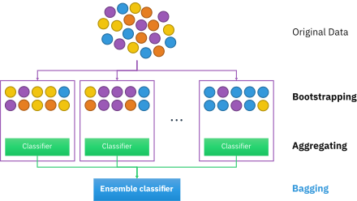
Bagging (Bootstrap aggregating)
Seeks diversity of the ensemble members by varying their training data
Boostrapping: Given a training set D of m instances create B new training sets D_{i} each of size m' by sampling from D uniformly with replacement
This ensures the samples are independent
Aggregating: Fit B models on their respective training sets D_{i} and combine the results by averaging or voting
Source

Slide 38
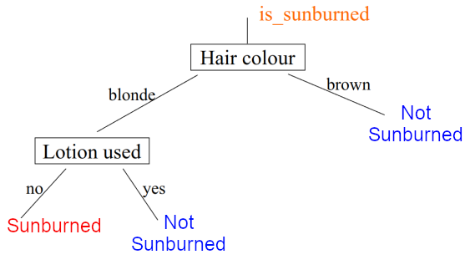
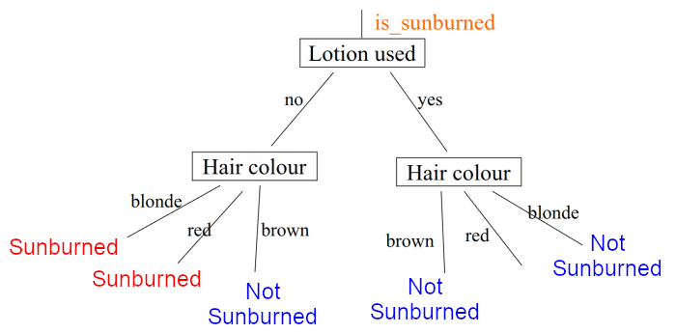
Bagged decision tree
Name | Hair | Height | Weight | Lotion | Result
Annie | Blonde | Short | Average | No | Sunburned
Dana | Blonde | Tall | Average | Yes | None
John | Brown | Average | Heavy | No | None
Dana | Blonde | Tall | Average | Yes | None
Sarah | Blonde | Average | Light | No | Sunburned
Pete | Brown | Tall | Heavy | No | None
Annie | Blonde | Short | Average | No | Sunburned
Kate | Blonde | Short | Light | Yes | None
Procedure
Given a training set D of size m
For b = 1 to B
Create a new training set D_{b} of size m using sampling with replacement
Train a decision tree on D_{b}
Aggregate the results over the B trees
Setting B to a large number (e.g., 100) results in better performance, however, a very large value (e.g., 1000) slows down computation without offering much improvement.
Name | Hair | Height | Weight | Lotion | Result
Pete | Brown | Tall | Heavy | No | None
Kate | Blonde | Short | Light | Yes | None
Sarah | Blonde | Average | Light | No | Sunburned
Annie | Blonde | Short | Average | No | Sunburned
Emily | Red | Average | Heavy | No | Sunburned
Emily | Red | Average | Heavy | No | Sunburned
Alex | Brown | Short | Average | Yes | None
Emily | Red | Average | Heavy | No | Sunburned
...

Slide 39
Random Forests
Additional step:
Randomize the feature choice
At each node, when choosing a feature for splitting, if $n$ features are available, pick a random subset of $k < n$features and allow the algorithm to only choose from that subset
Typically: $k=\sqrt{n}$

Slide 40
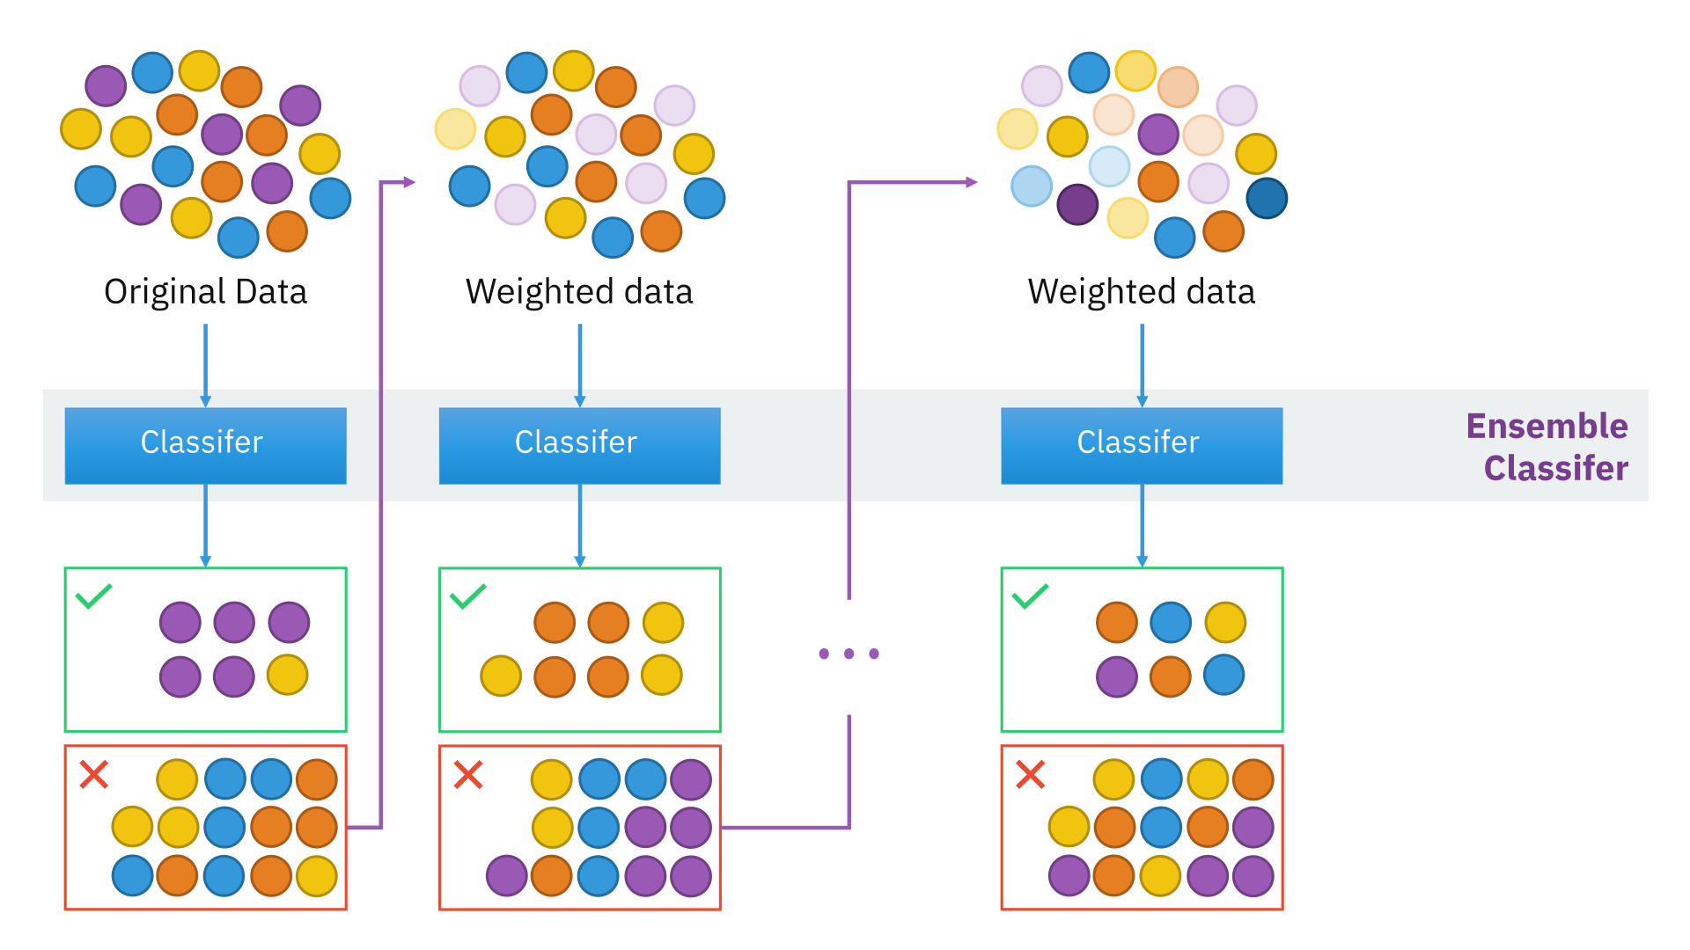
Boosting
Incrementally build the ensemble where each new model focuses on previously misclassified examples
Initially, all training instances (D1) are given the same weight
The training data (D1) are given to a base learner (L1)
Misclassified instances by L1 now have higher weight than correctly classified ones
Boosted data (D2) are given to a second learner (L2) and so on
Results are aggregated from all models using a weighted average
Source

Slide 41
XGBoost (eXtreme Gradient Boosting)
Open source software library of boosted trees
Efficient, scalable and portable implementation
Built in regularization to prevent overfitting
Runs on a single machine or on distributed environments
Very successful and highly competitive in machine learning competitions (e.g., Kaggle)

Slide 42
XGBoost Examples
Classification
from xgboost import XGBClassifier
model = XGBClassifier()
model.fit(X_train, y_train)
y_pred = model.predict(X_test)
Regression
from xgboost import XGBRegressor
model = XGBRegressor()
model.fit(X_train, y_train)
y_pred = model.predict(X_test)

Slide 43
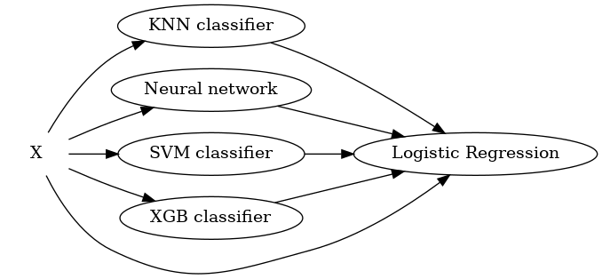
Stacking
Train multiple models on the training data
The predictions of the models become the training data of a 2nd level (typically logistic regression) that learns how to combine them
Source

Slide 44
Quiz
Q: What is the main difference between bagging and boosting?
A: Bagging trains the ensemble members in parallel, whereas Boosting trains them sequentially
Q: Where does a machine learning engineer go camping?
A: In a random forest ☺ (credit Andrew Ng)

Slide 45
Resources
Decision tree learning – Wikipedia
Information gain – Wikipedia
Ensemble learning – Wikipedia
Random forest – Wikipedia
XGBoost – Wikipedia

Slide 46
Next Lecture
Kernel-based methods

Slide 47
Thank you

