Slide 1
University of Cyprus - MSc Artificial Intelligence
MAI612 - MACHINE LEARNING
Lecture 7: Kernel-based methods 1
Vassilis Vassiliades, PhD
Winter Semester 2022/23

Slide 2
Revision

Slide 3
Model Evaluation and Improvement
We want our models to exhibit generalization capabilities instead of memorizing the training set.
Generalization: good performance on unseen data, drawn from the same distribution
Modeling simplistic assumptions about the relationship of the data with the target (e.g., using a linear model) might lead to underfitting. In this case we say that the model suffers from high bias.
On the other hand, if the model is too complex, it fits the noise and does not capture the trend in the data, leading to overfitting. In this case, we say that the model suffers from high variance.
The bias-variance tradeoff is the conflict of trying to minimize both bias and variance
The optimal complexity of a model is at the point where the total error (Bias² + Variance + ε) is at its minimum
Practically, we achieve that by splitting the dataset into a training, validation and test sets, and selecting the model that has the lowest validation error.

Slide 4
Model Evaluation and Improvement
k-fold cross validation:
splits the training+validation dataset into k subsets, and trains k independent models where subset $i$ is used for validation and the remaining as training set
the performance of the model is the average validation error over all k subsets
used when the dataset is small, because of its complexity in training k models rather than just one.
Learning curves can be used to inspect whether we need to acquire more data
More data typically benefits high variance models but not high bias ones
Regularization is a penalty given to the loss function of high variance models to reduce the magnitude of their parameters, and thus, their complexity
L1 regularization uses the absolute value norm and can sometimes be used for feature selection
L2 regularization users the Euclidean norm and typically produces a better fit than L1
Hyperparameter tuning is the process of varying the hyperparameters of models and learning algorithms, and select the combination that results in the lowest validation error.
Model improvement can be achieved using ensembles: training multiple models instead of one and aggregating their outputs

Slide 5
Trees and Forests
Decision trees are models that have a natural if-then-else structure, thus being interpretable and fast
For a given dataset, there can be multiple decision trees that classify the data
An algorithm for learning decision trees needs to choose one that generalizes well by deciding the feature to use for splitting at each node, and when to stop splitting
Using irrelevant features creates larger decision trees, thus simplicity is preferred
The best feature to use for splitting is the one that is most informative, i.e., the one that minimizes the disorder aka entropy
The entropy $H$ takes as input the proportion of positive examples $p_{+}$, and as $p_{+}$ goes from 0 to 0.5, $H$ increases from 0 to 1, and as $p_{+}$ goes from 0.5 to 1, $H$ decreases from 1 to 0.
Information gain measures the expected reduction in entropy due to splitting on some feature A
It is measured as the difference between the entropy of the initial set, and the weighted sum of the entropies in the branches
We want to maximize information gain, or equivalently minimize the weighted sum
To split on a continuous variable, we first calculate all possible unique thresholds (using the midpoints of pairs of sorted points), and select the one with the highest information gain.

Slide 6
Trees and Forests
Regression trees:
predict the average of the values in their leaf nodes
use the variance instead of the entropy, and the variance reduction instead of the information gain
Ensemble methods:
typically have lower generalization error than single learners
they rely on diverse learners that produce different errors
aggregation function: average for regression, majority vote for classification
Bagging trains models in parallel by varying their training data using sampling with replacement
Random forests use bagging with the additional step of randomizing the feature choice
Boosting trains models incrementally by focusing on previously misclassified examples
Stacking is a method that trains models typically at 2 levels, where the predictions of the models at level 1 become training data for a model at level 2 which learns how to combine them.

Slide 7
Lecture 7: Kernel-based methods 1
Learning Outcomes
You will understand:
The concept of a linear and non-linear decision boundary.
What kernel methods are and the kernel trick.
Different kernels and how to construct valid kernels.
The support vector machine (SVM) algorithm.
The concept of the maximum margin classifier.
The objective function of SVMs and how it relates to logistic regression.
How to create non-linear SVMs using kernels.
The basics of Support Vector Regression.

Slide 8
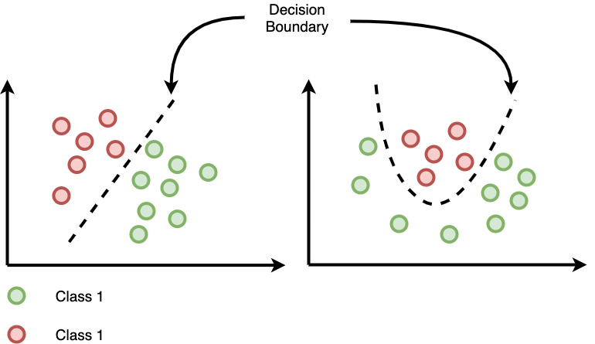
Decision Boundaries
Linear Decision Boundary
Nonlinear Decision Boundary
Class 1
Class 2

Slide 9
Learning nonlinear decision boundaries
We can use polynomial features to transform raw data to feature vectors that would allow us to learn nonlinear decision boundaries.
Examples:
2 variables (x,y) , polynomial degree = 2 : x, y, x², xy, y²
3 variables (x,y,z), polynomial degree = 2 : x, y, z, x², xy, xz, y², yz, z²
Observation: Each new feature increases the dimensionality of the input by one which could make the problem “easier” to be solved in the new feature space

Slide 10
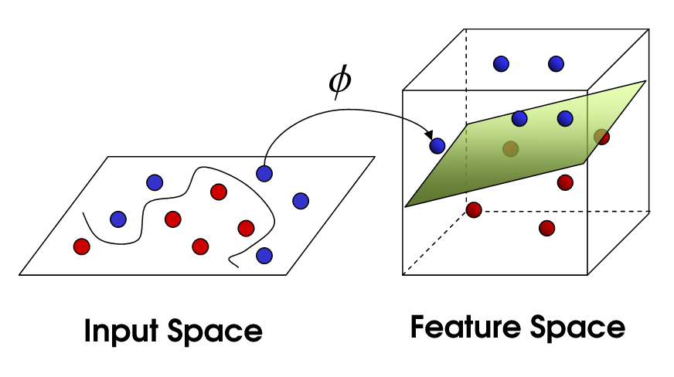
Linear separability in higher dimensions
Adding a new feature dimension may be enough to linearly separate the two classes.
Cover’s Theorem on the Separability of Patterns:
“a complex classification problem cast in high-dimensional space nonlinearly is more likely to be linearly separable than in a low-dimensional space” (Cover, 1965).
Source

Slide 11
Learning nonlinear decision boundaries
We can use polynomial features to transform raw data to feature vectors that would allow us to learn nonlinear decision boundaries.
Examples:
2 variables (x,y) , polynomial degree = 2 : x, y, x², xy, y²
3 variables (x,y,z), polynomial degree = 2 : x, y, z, x², xy, xz, y², yz, z²
However, we have a combinatorial blowup in the number of parameters to be learned.
Is there a more efficient way to learn nonlinear decision boundaries?

Slide 12
Kernel Methods
In many ML algorithms, raw data need to be explicitly transformed into feature vectors via a user-specified feature map.
In contrast, kernel methods require only a user-specified kernel, i.e., a similarity function over pairs of raw data points.
This enables them to operate in a high-dimensional, implicit feature space without computing the coordinates of the data in that space.
They compute the inner products between the images of all pairs of training data in the feature space: often computationally cheaper than the explicit computation of coordinates.
This is known as the “kernel trick”.

Slide 13
The Kernel Trick
Allows to operate in the original feature space without computing the coordinates of the data in the higher dimensional space
Example: 2D input space, 3D feature space
$$O(n^{2})$$
Computing , and
is more computationally expensive than
computing
$$O(n)$$

Slide 14
Kernels
Polynomial kernel
$$k\left(x,z\right)={(x_{}^{T}z+c)}^{d}$$
Gaussian or Radial Basis Function (RBF) kernel
$$k\left(x,z\right)=exp⁡\left(−\frac{{\left\|x−z\right\|}^{2}}{2σ^{2}}\right)$$
$$k\left(x,z\right)=exp⁡\left(−γ{\left\|x−z\right\|}^{2}\right)$$
where $γ=\frac{1}{2σ^{2}}$

Slide 15
Making new kernels
We can make new kernels from valid kernels by allowed operations
For example, addition, multiplication, rescaling of kernels gives a proper kernel as long as the resulting Gram matrix is symmetric, positive semi-definite
$$k\left(x,z\right)=k_{1}\left(x,z\right)+k_{2}\left(x,z\right)$$
$$k\left(x,z\right)=k_{1}\left(x,z\right)k_{2}\left(x,z\right)$$
$$k\left(x,z\right)={λ k}_{1}\left(x,z\right) , λ>0$$

Slide 16
Quiz
Given that $k_{1}$ and $k_{2}$ are proper kernels, decide which of the following formulae define proper kernels:
$$k_{3}\left(x,z\right)={5k}_{1}\left(x,z\right)+{3k}_{2}\left(x,z\right)$$
Proper
$$k_{4}\left(x,z\right)={−k}_{1}\left(x,z\right)k_{2}\left(x,z\right)$$
Not proper

Slide 17
Kernel Methods (or Kernel Machines)
They are instance-based learners:
they learn a weight, $w_{i}$, for each training example $(x_{i}, y_{i})$
prediction for unlabeled inputs is done by applying the similarity function k (i.e., the kernel) between the unlabeled input $z$ and each of the training inputs $x_{i}$
for instance, a kernelized binary classifier typically computes a weighted sum of similarities:
$$\hat{y}=\operatorname{sgn}{\sum_{i=1}^{m}{w_{i}y_{i}k(x_{i},z})}$$
where $\hat{y} ∈\left\{−1,+1\right\}, k:X×X→ℝ, \operatorname{sgn}{x ≔ \left\{\begin{aligned}−1 if x<0, \\ +1 if x≥0.\end{aligned}\right.}$

Slide 18
Support Vector Machines

Slide 19
Support Vector Machines
Powerful supervised learning models for classification
Two key ideas
Assuming linearly separable classes, learn separating hyperplane with maximum margin
Maximum margin: minimal generalization error
Use kernels to expand input into high-dimensional space to deal with linearly non-separable cases

Slide 20
Separating Hyperplane
Training set: $\left(x_{}^{(i)},y_{}^{(i)} \right),$
$$i=1,2,…,m; y_{}^{(i)}∈\{+1,−1\}$$
Hyperplane: $θ^{T}x=0$
Which line would you choose?
$$x_{2}$$
$${\left[θ_{0},θ_{1},⋯,θ_{n} \right]}^{T}$$
$${\left[1,x_{1},⋯,x_{n} \right]}^{T}$$
$$x_{1}$$

Slide 21
Maximum Margin
We need to be able to correctly separate new data points
According to theorem from Learning Theory, from all possible linear decision boundaries the one that maximizes the margin of the training set will minimize the generalization error.
$$x_{2}$$
margin
$$x_{1}$$

Slide 22
Support Vectors
The training points that are closest to the separating hyperplane are called support vectors.
These are the most important points as they determine which hyperplane will be chosen by the optimization procedure.
$$x_{2}$$
$$x_{1}$$

Slide 23
Maximum margin
If $y=1$, we want $θ^{T}x≥1$ (not just $≥0$)
If $y=−1$, we want $θ^{T}x≤−1$ (not just $<0$)
We set the margin to a fixed value and want to constrain the data points to lie beyond that margin
Positive
margin
$$θ^{T}x=+1$$
$$x_{2}$$
Negative
margin
$$θ^{T}x=−1$$
$$θ^{T}x=0$$
$$x_{1}$$

Slide 24
Optimization Objective
where:
$$loss\left(θ^{T}x^{\left(i\right)}, y^{\left(i\right)}\right):=max⁡\left(0, 1−y^{\left(i\right)}θ^{T}x^{\left(i\right)}\right)$$
$$f_{θ}\left(x^{\left(i\right)}\right)=\operatorname{sgn}\left(θ^{T}x^{\left(i\right)}\right)=\left\{\begin{aligned}\begin{matrix}+1 & if θ^{T}x^{\left(i\right)}≥0\end{matrix} \\ \begin{matrix}−1 & otherwise\end{matrix}\end{aligned}\right.$$
$$min C \sum_{i=1}^{m}{loss\left(θ^{T}x^{\left(i\right)}, y^{\left(i\right)}\right)}+\frac{1}{2}{|| θ ||}_{2}^{2}$$
θ
Hinge Loss
(non-differentiable)

Slide 25
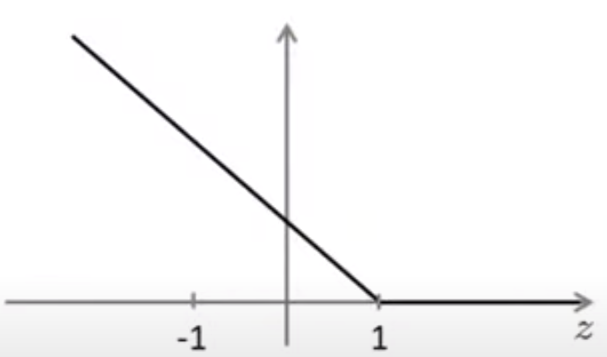
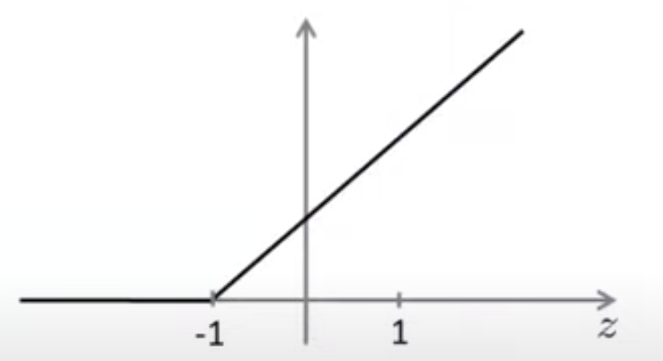
Hinge Loss
$$max⁡\left(0, 1−yθ^{T}x\right)$$
If $y=1$
If $y=−1$
Positive
margin
Negative
margin
Negative
margin
Positive
margin
$$θ^{T}x^{}$$
$$θ^{T}x^{}$$

Slide 26
Optimization Objective compared to Logistic Regression
Regularized Logistic Regression
$$A+λB$$
$$C=\frac{1}{λ}$$
$$min \frac{1}{m} \sum_{i=1}^{m}{{loss}_{LR}\left(θ^{T}x^{\left(i\right)}, y^{\left(i\right)}\right)}+\frac{λ}{2m}{|| θ ||}_{2}^{2}$$
$$CA+B$$
θ
so a small C corresponds to giving B a larger weight
Large C: Lower bias, high variance
Small C: Higher bias, low variance
$$A$$
$$B$$
Support Vector Machine
$$min C \sum_{i=1}^{m}{{loss}_{SVM}\left(θ^{T}x^{\left(i\right)}, y^{\left(i\right)}\right)}+\frac{1}{2}{|| θ ||}_{2}^{2}$$
θ

Slide 27
Optimization Objective
This is a quadratic programming problem with linear inequality constraints
There are well known procedures for solving it, where data enters only in the form of dot products.
The optimal parameter vector can be written in the following form:
where $a_{i}^{∗}≥0$ are the Langrangian coefficients and they are non-zero only for the support vectors.
s.t.
$${y^{\left(i\right)}θ}^{T}x^{\left(i\right)}−1≥0, i=1,…,m$$
$$min \frac{1}{2}{|| θ ||}_{2}^{2}$$
θ
$$θ^{∗}=\sum_{i=1}^{m}{a_{i}^{∗}y^{(i)}x^{(i)}}$$

Slide 28
Classifying new data points
$$f_{θ}\left(x^{(new)}\right)=\operatorname{sgn}\left(θ^{T}x^{\left(new\right)}\right)=\left\{\begin{aligned}\begin{matrix}+1 & if θ^{T}x^{\left(new\right)}≥0\end{matrix} \\ \begin{matrix}−1 & otherwise\end{matrix}\end{aligned}\right.$$
Once the parameters are found by solving the required QP problem on the training set, the SVM can be used to classify new points using only the support vectors, their label and the associated coefficients.
$$θ^{T}x^{\left(new\right)}=\sum_{i=1}^{m}{a_{i}^{∗}y^{(i)}x^{(i)}}x^{\left(new\right)}=\sum_{i∈SV}{a_{i}^{∗}y^{(i)}x^{(i)}}x^{\left(new\right)}$$
Data enters in the form of dot products
SVMs work well for linearly separable data.
What if the data are not linearly separable?

Slide 29
Non-linear SVMs
The solution of the SVM has the nice property that the data enters only in the form of dot products.
This allows us to make SVMs non-linear without complicating the algorithm, using kernels.
The linear SVM depends on $x^{(i)}x^{(j)}$
The nonlinear SVM replaces $x^{(i)}x^{(j)}$ with ${k(x}^{(i)},x^{(j)})$

Slide 30
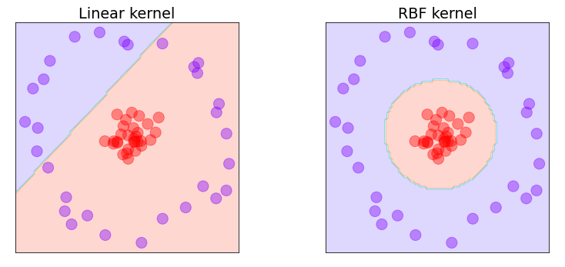
Non-linear SVMs
Source

Slide 31
SVM with a polynomial kernel visualization
Youtube Video

Slide 32
Source

Slide 33
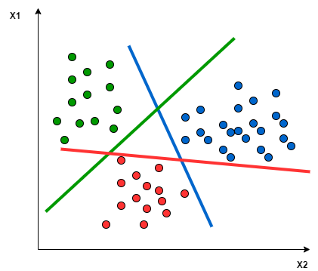
Multi-class classification
Many SVM packages have built-in functionality for multi-class classification
Use one-vs-all method
Train K SVMs (K=number of classes)
Get parameter vectors $θ^{(1)},…,θ^{(K)}$
Pick class with largest ${\left(θ^{(i)}\right)}^{T}x$
Source

Slide 34
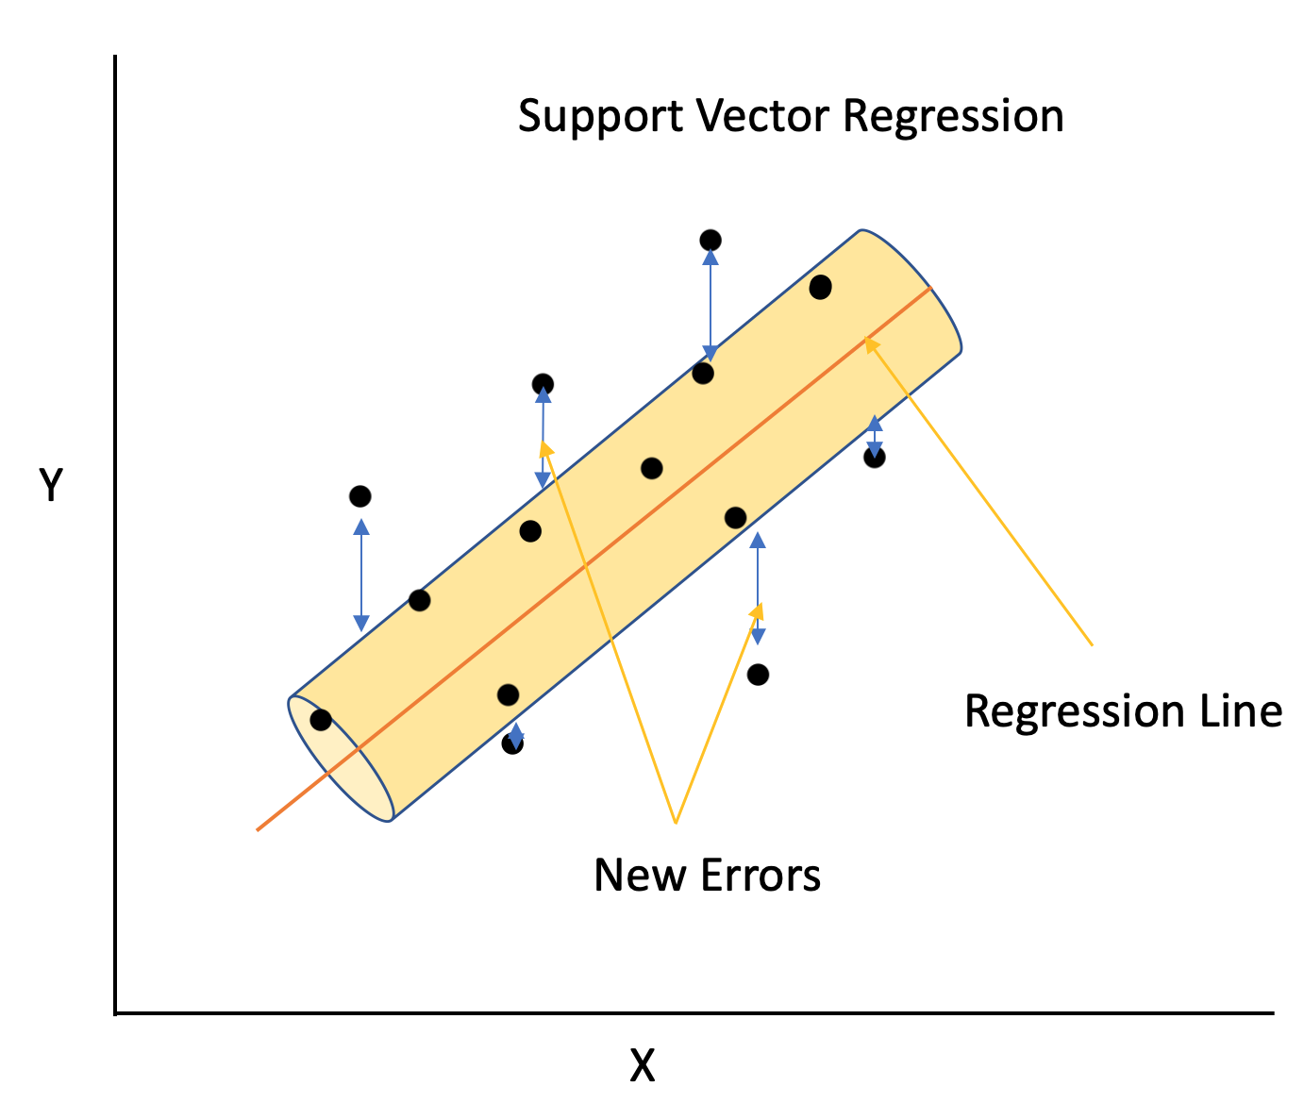
Support Vector Regression
Extension of SVM to regression problems
ε-insensitive tube: margin of error we are allowing our model to have
Do not care about error inside the tube
Ignore samples whose prediction is close to their target
Slack Variables: points outside the tube
Only care about their errors
Source

Slide 35
Support Vector Regression
Simple Linear Regression
Support Vector Regression
Source

Slide 36
Logistic regression vs SVMs
If $n$ is large relative to $m$, e.g., $n=10,000, m=10,…1000$
Use logistic regression, or SVM without a kernel (linear kernel)
If $n$ is small, $m$ is intermediate, e.g., $n=1−1000, m=100−10,000$
Use SVM with Gaussian or Polynomial kernel
If $n$ is small, $m$ is large, e.g., $n=1−1000, m≥50,000$
Create/add more features, then use logistic regression or SVM without a kernel
Slide adapted from Andrew Ng’s Machine Learning course, Coursera

Slide 37
Summary
A nonlinearly separable problem can be made linearly separable in higher dimensions
The Kernel trick allows us to operate in a high-dimensional feature space without explicitly computing the coordinates of the data in that space
The Support Vector Machine uses the concept of maximum margin in order to improve generalization error
SVMs can use the kernel trick to learn non-linear decision boundaries
SVMs can be used for multiclass classification problems and have been extended to regression problems

Slide 38
Resources
Kernel method – Wikipedia
Support vector machine – Wikipedia
Hinge loss – Wikipedia

Slide 39
Thank you

