Slide 1
University of Cyprus - MSc Artificial Intelligence
MAI612 - MACHINE LEARNING
Lecture 8: Kernel-based methods 2
Vassilis Vassiliades, PhD
Winter Semester 2022/23

Slide 2
Lecture 8: Kernel-based methods 2
Learning Outcomes
You will understand:
About exact interpolation vs approximation
What Radial Basis Functions (RBF) are and how they can be used in RBF networks
How to train an RBF network for exact interpolation
How to train an RBF network for approximation
How to automatically optimize the parameters of the RBF using gradient descent
Normalized RBF networks
RBF networks for classification
The XOR problem
The basics about the Gaussian Process model

Slide 3
Radial Basis Function Networks

Slide 4
Kernel methods for regression
Placing a kernel at each training point allows to do exact interpolation
the model gives exactly the correct outputs for all training data
What if we have a huge training set?
What if the data points are noisy?
Approximation:
we have less kernels than training data points
the model relates well the training vectors to the desired outputs, but does not produce the exactly correct outputs
Radial Basis Function (RBF) Networks: models for interpolation and approximation

Slide 5
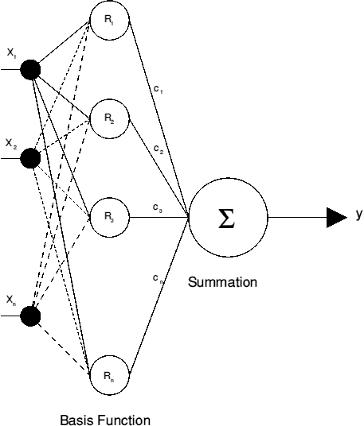
Radial Basis Function Networks
Layered network architecture
Input layer:
distributes the input vector to all hidden nodes
Hidden layer:
each node is a kernel containing a centre and a Basis Function
performs a non-linear mapping from input space (n) typically into a higher dimensional space (k>n)
Output layer:
multiplies output of each hidden layer by a coefficient and sums the resulting values

Slide 6
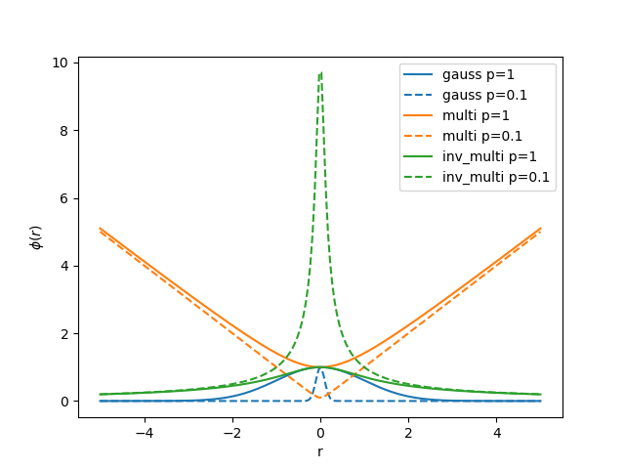
Radial Basis Function (RBF)
Real-valued function $φ$ whose value depends only on the distance between the input $x$and some fixed point $μ$, so that $φ\left(x\right):=φ(r)$, where $r=\left\|x−μ\right\|$, and distance is usually Euclidean distance.
Examples
Gaussian: $φ\left(r\right)=\exp\left(−{r^{2}}/{p^{2}}\right)$
Multiquadric: $φ\left(r\right)=\sqrt{r^{2}+p^{2}}$
Inverse multiquadric: $φ\left(r\right)=1/{\sqrt{r^{2}+p^{2}}}$
source

Slide 7
RBF Network Main Idea
$$φ_{1}\left(x\right)=k\left(x,R_{}^{\left(1\right)}\right)$$
$φ_{2}\left(x\right)=k\left(x,R_{}^{\left(2\right)}\right)$
$$φ_{3}\left(x\right)=k\left(x,R_{}^{\left(3\right)}\right)$$
Given $x$ the estimated output $\hat{y}$ is the linear combination of coefficients and features.
$$\hat{y}=\sum_{i=1}^{k}{c_{i}}φ_{i}\left(x\right)$$
Features are based on proximity to centre$R_{}^{(i)}:$
$$φ_{i}\left(x\right)=k\left(x,R_{}^{\left(i\right)}\right)$$
Compare with simple linear regression:
$$\hat{y}=\sum_{i=1}^{k}{c_{i}x_{i}} where k=n$$
$$R_{}^{\left(3\right)}$$
$$x_{}$$
$$y$$
$$R_{}^{\left(2\right)}$$
$$R_{}^{\left(1\right)}$$
$$x_{1}$$
Assuming a Gaussian kernel, which feature has the largest and which has the smallest value?

Slide 8
Gaussian RBF kernel and proximity
$$φ_{1}\left(x\right)=k\left(x,R_{}^{\left(1\right)}\right)=\exp\left(−\frac{{\left\|x−R_{}^{\left(1\right)}\right\|}^{2}}{2σ^{2}}\right)=\exp\left(−\frac{{\sum_{j=1}^{n}{\left(x_{j}−R_{j}^{(1)}\right)}}^{2}}{2σ^{2}}\right)$$
$R_{}^{\left(1\right)}$ is the $n$-dimensional centre
If $x≈R_{}^{\left(1\right)}$:
$$φ_{1}\left(x\right)≈\exp\left(−\frac{0^{2}}{2σ^{2}}\right)≈1$$
If $x$is far from $R_{}^{\left(1\right)}$:
$$φ_{1}\left(x\right)≈\exp\left(−\frac{{(large number)}^{2}}{2σ^{2}}\right)≈0$$

Slide 9
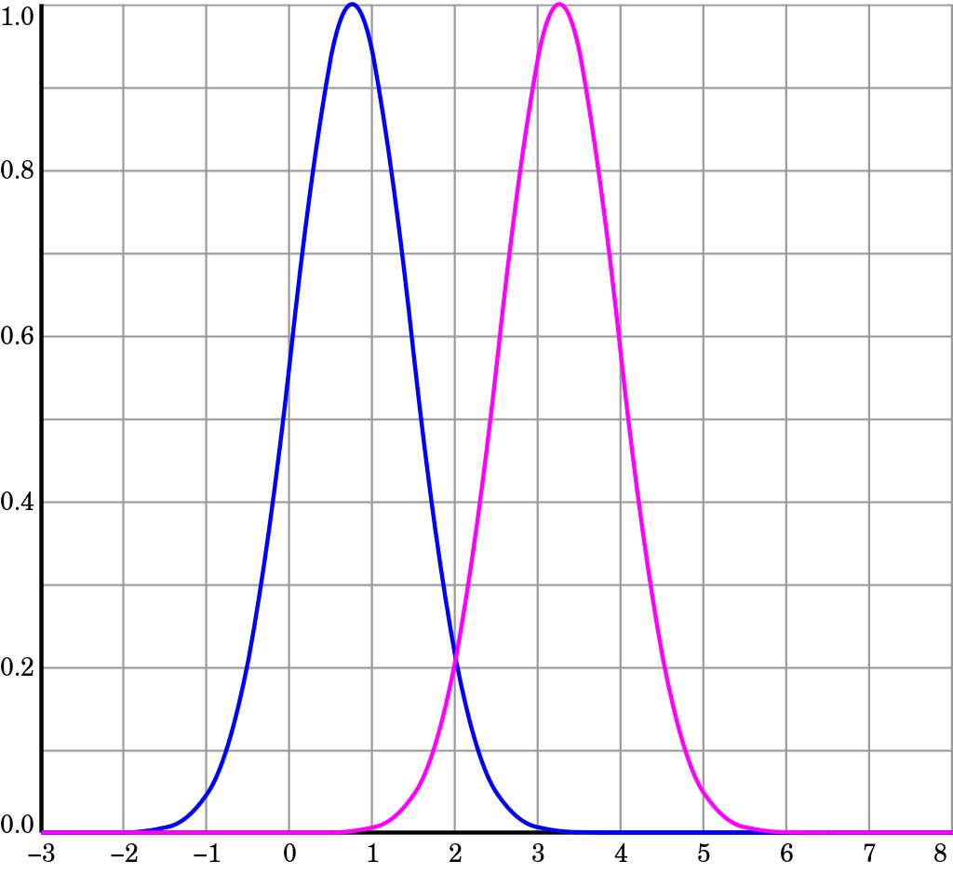
RBF kernel: centre coordinates
Keeping σ fixed
$$R^{(1)}= 0.75$$
$$R^{(2)}= 3.25$$
When designing an RBF network it is crucial to cover the whole data space with kernels.
The influence of each kernel diminishes with distance.
Source

Slide 10
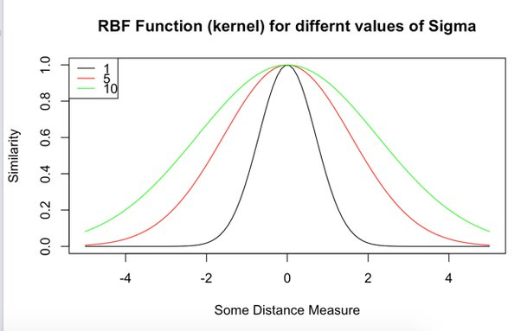
RBF kernel: effect of σ
σ = width of Gaussian
Large σ: Features vary more smoothly
Higher bias, lower variance
Small σ: Features vary less smoothly
Lower bias, higher variance
source

Slide 11
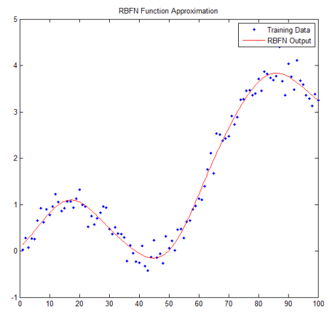
What does a trained RBF network learn
Example
1D input
Dataset of 100 points
RBF with 10 basis functions
source

Slide 12
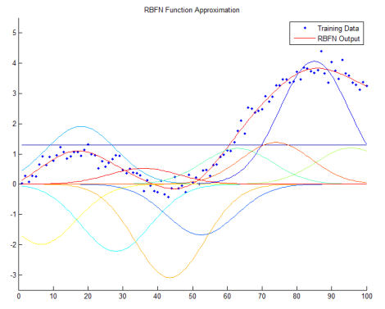
How does a trained RBF network learn
The output of the RBF network is the weighted sum of 10 Gaussians
Each Gaussian has a different center
The height is determined by the learned coefficient (weight) which can be negative
source

Slide 13
Training an RBF network for interpolation
1. Create m centres, where each centre is placed at a training point: $R_{}^{\left(i\right)}=x_{}^{\left(i\right)}$
2. Set σ to some appropriate value
3. Compute parameters c
For each training pair $(x_{}^{\left(i\right)},y_{}^{\left(i\right)})$ we have one equation:
$$y_{}^{\left(1\right)}=c_{1}k\left(x_{}^{\left(1\right)},R_{}^{\left(1\right)}\right)+c_{2}k\left(x_{}^{\left(1\right)},R_{}^{\left(2\right)}\right)+…+c_{m}k\left(x_{}^{\left(1\right)},R_{}^{\left(m\right)}\right)$$
$$y_{}^{\left(2\right)}=c_{1}k\left(x_{}^{\left(2\right)},R_{}^{\left(1\right)}\right)+c_{2}k\left(x_{}^{\left(2\right)},R_{}^{\left(2\right)}\right)+…+c_{m}k\left(x_{}^{\left(2\right)},R_{}^{\left(m\right)}\right)$$
…
$$y_{}^{\left(m\right)}=c_{1}k\left(x_{}^{\left(m\right)},R_{}^{\left(1\right)}\right)+c_{2}k\left(x_{}^{\left(m\right)},R_{}^{\left(2\right)}\right)+…+c_{m}k\left(x_{}^{\left(m\right)},R_{}^{\left(m\right)}\right)$$

Slide 14
Training an RBF network for interpolation
Represent equations in matrix form:
$$\left[\begin{matrix}\begin{matrix}y^{(1)} \\ y^{(2)}\end{matrix} \\ \begin{matrix}⋮ \\ y^{(m)}\end{matrix}\end{matrix}\right]=\left[\begin{matrix}k(x_{}^{\left(1\right)},R_{}^{\left(1\right)}) & … & k(x_{}^{\left(1\right)},R_{}^{\left(m\right)}) \\ ⋮ & ⋱ & ⋮ \\ k(x_{}^{\left(m\right)},R_{}^{\left(1\right)}) & … & k(x_{}^{\left(m\right)},R_{}^{\left(m\right)})\end{matrix}\right]\left[\begin{matrix}\begin{matrix}c_{1} \\ c_{2}\end{matrix} \\ \begin{matrix}⋮ \\ c_{m}\end{matrix}\end{matrix}\right]$$
Solve for c:
$$c ={\left(A^{T}A\right)}^{−1}A^{T}y$$
$$y$$
$$A$$
$$c$$

Slide 15
Training an RBF network for approximation using fixed centres
1. Choose k<m appropriate centres:
equidistantly spaced
randomly sampled (e.g., uniformly over space or from set of examples)
use clustering algorithms (e.g., k-means clustering)
2. Set σ to some appropriate value
manually
determined from cluster radius (could have different σ for each centre)
3. Compute parameters c

Slide 16
Training an RBF network for approximation using fixed centres
In matrix form:
$$\left[\begin{matrix}\begin{matrix}y^{(1)} \\ y^{(2)}\end{matrix} \\ \begin{matrix}⋮ \\ y^{(m)}\end{matrix}\end{matrix}\right]=\left[\begin{matrix}k(x_{}^{\left(1\right)},R_{}^{\left(1\right)}) & … & k(x_{}^{\left(1\right)},R_{}^{\left(k\right)}) \\ ⋮ & ⋱ & ⋮ \\ k(x_{}^{\left(m\right)},R_{}^{\left(1\right)}) & … & k(x_{}^{\left(m\right)},R_{}^{\left(k\right)})\end{matrix}\right]\left[\begin{matrix}\begin{matrix}c_{1} \\ c_{2}\end{matrix} \\ \begin{matrix}⋮ \\ c_{k}\end{matrix}\end{matrix}\right]$$
Solve for c:
$$c ={\left(A^{T}A\right)}^{−1}A^{T}y$$
$$y$$
$$A$$
$$c$$

Slide 17
Width of the Gaussian (σ)
Interpolation task:
Small σ: bumpy interpolations
Larger σ: extend the influence of each sample
Very large σ: too global influence of each sample
Approximation task:
To get a good generalisation, the width should be larger than the average distance between adjacent vectors, but smaller than the distance across all input space.

Slide 18
Training an RBF network for approximation using adjustable centres
We can train coefficients c, centres R, and variances σ
This means that the centre coordinates and the radii of the basis functions could be better adapted to the data
We can use (Stochastic) Gradient Descent to achieve this
Need: loss function, derivatives of the loss w.r.t. c, R and σ

Slide 19
Training an RBF network for approximation using adjustable centres
Choose the number (k) and initial coordinates of the centres (R).
Choose the initial value of the spread parameter (σ) for each centre (R).
Initialize the weights/coefficients (c) to small random values [-1,1].
Repeat until stopping criteria are satisfied (e.g., maximum number of epochs)
Give an input $(x^{\left(p\right)},y^{\left(p\right)})$ to the network and calculate the network’s output
$\hat{y^{(p)}}=c_{0}+\sum_{h=1}^{k}{c_{h}φ(x^{\left(p\right)},R^{\left(h\right)},σ_{h})}$ where $φ\left(x^{\left(p\right)},R^{\left(h\right)},σ_{h}\right)=\exp\left(−\frac{{\left\|x^{\left(p\right)}−R_{}^{\left(h\right)}\right\|}^{2}}{2σ_{h}^{2}}\right)$
Update network’s parameters (c, R, σ) (next slide)

Slide 20
Training an RBF network for approximation using adjustable centres
Update c:
$$c_{0}^{}≔c_{0}^{}−η_{c} ε_{}^{(p)}$$
$$c_{h}^{}≔c_{h}^{}−η_{c} ε_{}^{(p)}φ(x^{\left(p\right)},R^{\left(h\right)},σ_{h})$$
Update $R$:
$$R_{}^{(h)}≔R_{}^{\left(h\right)}−η_{R} ε_{}^{\left(p\right)}c_{h}^{}φ\left(x^{\left(p\right)},R^{\left(h\right)},σ_{h}\right){(x^{\left(p\right)}−R_{}^{\left(h\right)})}/{σ_{h}^{2}}$$
Update σ:
$$σ_{h}^{}≔σ_{h}^{}−η_{σ} ε_{}^{\left(p\right)}c_{h}^{}φ\left(x^{\left(p\right)},R^{\left(h\right)},σ_{h}\right){{\left\|x^{\left(p\right)}−R_{}^{\left(h\right)}\right\|}^{2}}/{σ_{h}^{3}}$$
$$ε_{}^{(p)}=\hat{y^{(p)}}−y^{\left(p\right)}$$
$$L\left(c, R, σ\right)=\frac{1}{2}{[ε^{(p)}]}^{2}$$
$$\frac{∂L}{∂c}$$
$$\frac{∂L}{∂R}$$
Learning Rates
$${0<η}_{c}≤1$$
$${0<η}_{R}≤1$$
$${0<η}_{σ}≤1$$
$$\frac{∂L}{∂σ}$$

Slide 21
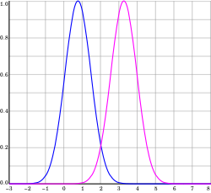
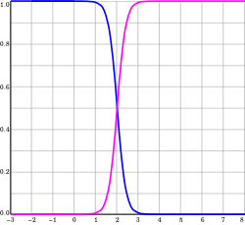
Normalized RBF network
Unnormalized:
$$\hat{y}=\sum_{i=1}^{k}{c_{i}}φ_{i}\left(x\right)$$
Normalized:
$$\hat{y}=\frac{\sum_{i=1}^{k}{c_{i}}φ_{i}\left(x\right)}{\sum_{i=1}^{k}{φ_{i}\left(x\right)}}$$
Unnormalized:
- more localized
Normalized:
- may exhibit better generalization
Both are universal function approximators: given enough hidden units, they can approximate any continuous function.

Slide 22
RBF networks for classification
We can use RBF networks for classification by feeding the output into the logistic/sigmoid function:
$\hat{y}=σ\left(\sum_{i=1}^{k}{c_{i}}φ_{i}\left(x\right)\right)$, where $σ\left(z\right)=\frac{1}{(1+e^{−z})}$
This is the same as logistic regression, where the features are computed using the Gaussian RBF kernel.
Creates nonlinear decision boundaries

Slide 23
XOR problem
OR
AND
XOR
OR, AND: linearly separable
XOR: not linearly separable
Motivates the need for nonlinear transformation of inputs
$$1$$
$$+$$
$$+$$
$$1$$
$$−$$
$$+$$
$$1$$
$$+$$
$$−$$
$$x_{2}$$
$$x_{2}$$
$$x_{2}$$
?
$$−$$
$$+$$
$$−$$
$$−$$
$$−$$
$$+$$
$$0$$
$$x_{1}$$
$$1$$
$$0$$
$$x_{1}$$
$$1$$
$$0$$
$$x_{1}$$
$$1$$
$$x_{1}$$ | $$x_{2}$$ | $$y$$
0 | 0 | 0
0 | 1 | 1
1 | 0 | 1
1 | 1 | 1
$$x_{1}$$ | $$x_{2}$$ | $$y$$
0 | 0 | 0
0 | 1 | 0
1 | 0 | 0
1 | 1 | 1
$$x_{1}$$ | $$x_{2}$$ | $$y$$
0 | 0 | 0
0 | 1 | 1
1 | 0 | 1
1 | 1 | 0

Slide 24
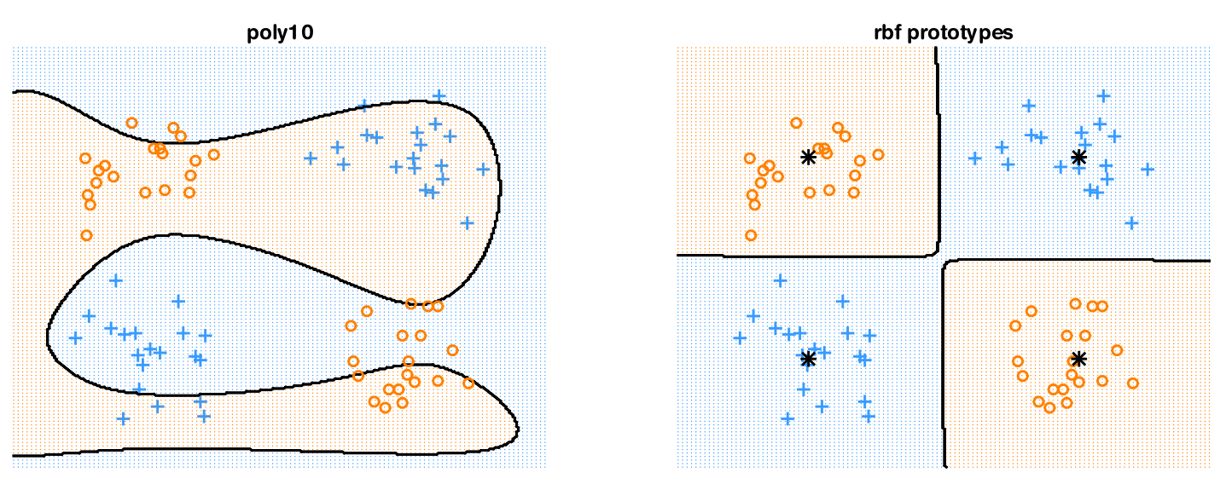
Noisy XOR problem
Fitting a linear logistic regression classifier using:
degree 10 polynomial expansion
cannot separate the classes
RBF kernel with centres specified by the 4 black points
easily solves the problem
(a)
(b)
Source: Murphy, K. (2022). Probabilistic Machine Learning - An Introduction. MIT Press

Slide 25
Gaussian Processes

Slide 26
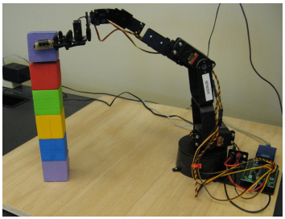
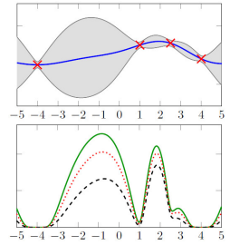
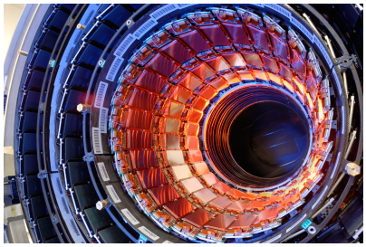
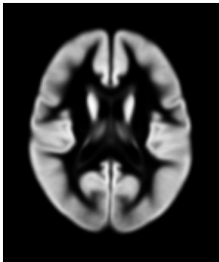
Gaussian Processes
Gaussian process: probabilistic method that gives a confidence for the predicted function
Used mostly in regression tasks (however, it has also been used in classification and clustering tasks)
Some Application areas:
Robotics
Experimental Design
Geostatistics
Time-series modeling and forecasting
High-energy physics
Medical applications

Slide 27
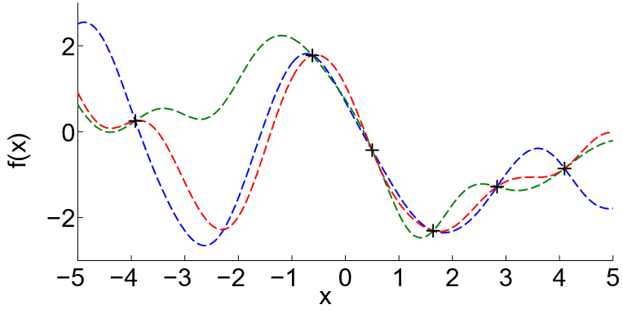
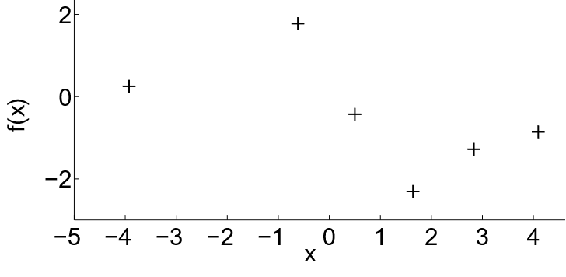
Gaussian Processes Main Idea
For a given set of training points, there are potentially infinitely many functions that fit the data
How can we deal with this?
Figures adapted from: Deisenroth, M. P. & Rasmussen, C. E. (2011) PILCO: A Model-Based and Data-Efficient Approach to Policy Search

Slide 28
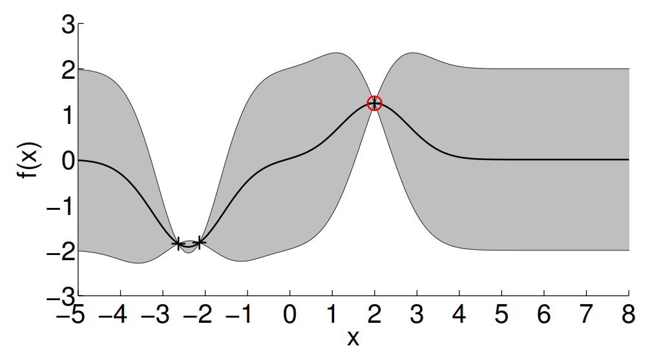
Gaussian Processes Main Idea
GPs assign a probability to each of these functions
The mean of this probability distribution (black line) represents the most probable characterization of the data
Probabilistic approach allows us to incorporate the confidence of the prediction into the regression result (shown as shaded region)
Source

Slide 29
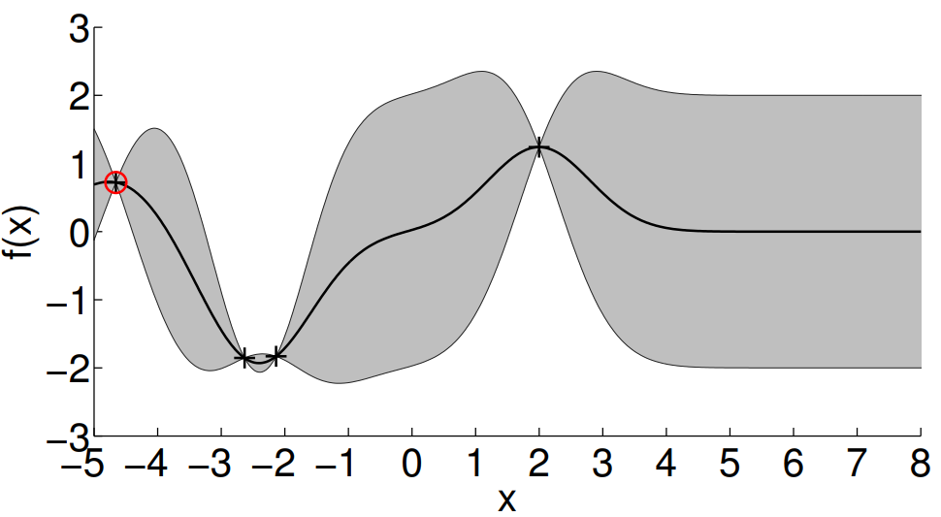
Gaussian Processes Main Idea
As we add more data points, we adapt the distribution
Source

Slide 30
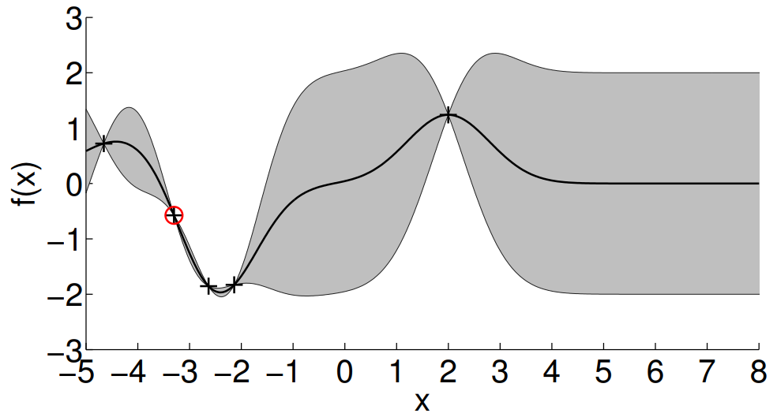
Gaussian Processes Main Idea
As we add more data points, we adapt the distribution
Source

Slide 31
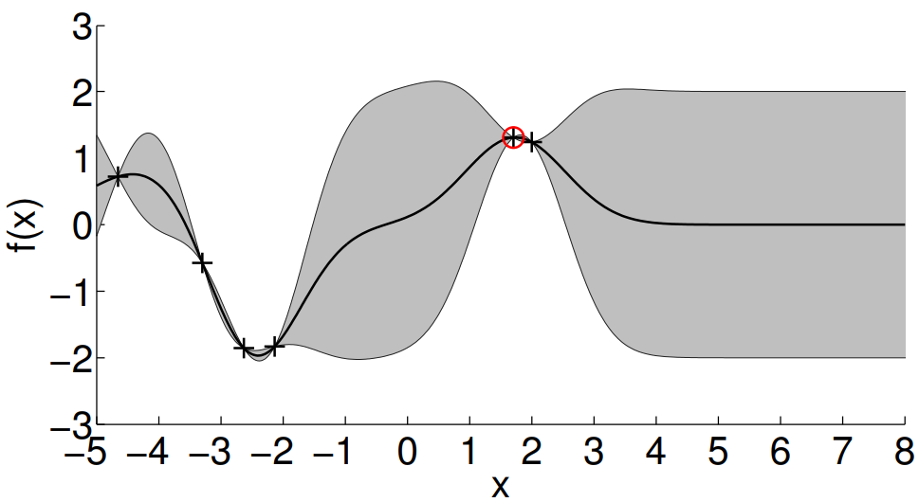
Gaussian Processes Main Idea
As we add more data points, we adapt the distribution
Source

Slide 32
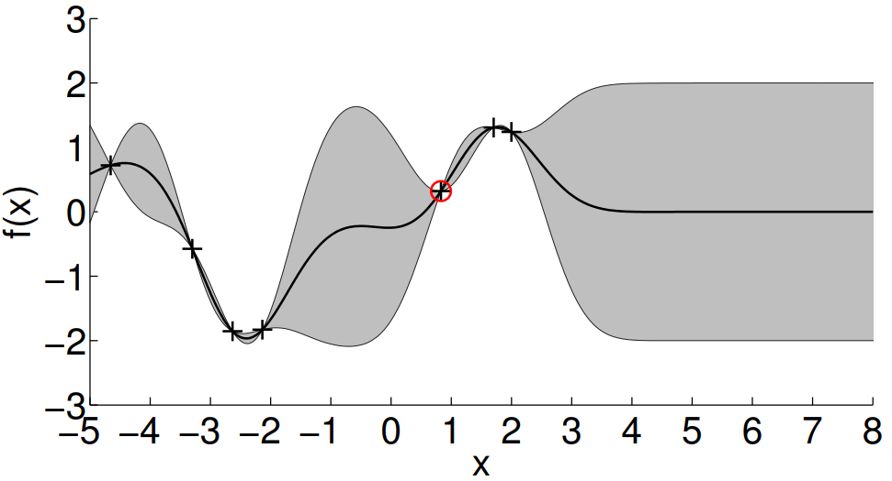
Gaussian Processes Main Idea
As we add more data points, we adapt the distribution
Source

Slide 33
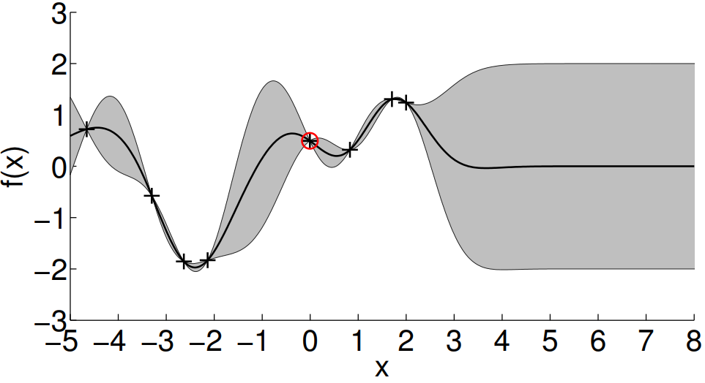
Gaussian Processes Main Idea
As we add more data points, we adapt the distribution
Source

Slide 34
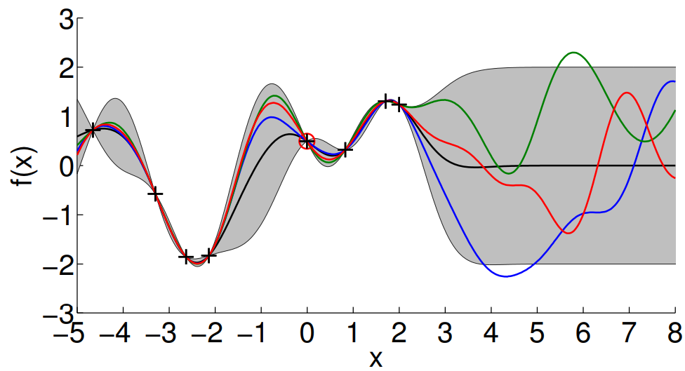
Gaussian Processes Main Idea
Since a GP is a probability distribution over functions, we can sample functions from it.
Source

Slide 35
Gaussian Process Definition
We place a distribution $p(f)$ on functions $f$
Informally, a function can be considered an infinitely long vector of function values $f=[f_{1},f_{2},f_{3},…]$
A GP is a generalization of a multivariate Gaussian distribution to infinitely many variables.
Definition (Rasmussen & Williams, 2006): A GP is a collection of random variables $f_{1},f_{2},…$, any finite number of which is Gaussian distributed.
A Gaussian distribution is specified by a mean vector $μ$ and a covariance matrix $Σ$
A GP is specified by a mean function $m(.)$and a covariance function (kernel) $k(.,.)$

Slide 36
Gaussian Process Regression as Bayesian Inference
Objective: For a set of observations $y_{}^{(i)}=f\left(x^{\left(i\right)}\right)+ε, ε \sim N(0,σ_{}^{2})$ find a (posterior) distribution over functions $p(f(.)|X,y)$ that explains the data. Here: $X$training inputs, $y$ training targets.
Training data: $X$, $y$. Bayes’ theorem yields
$$p(f(.)|X,y)= \frac{p(y|f\left(.\right),X)p(f\left(.\right))}{p(y|X)}$$
Prior: $p\left(f\left(.\right)\right)=GP(m,k)$
Likelihood (noise model): $p\left(y | f\left(.\right),X\right)=N(f\left(X\right),σ_{}^{2}Ι)$
Marginal likelihood (evidence): $p\left(y | X\right)=\int{p\left(y | f\left(.\right),X\right)p(f(.)|X)ⅆf}$
Posterior: $p\left(f\left(.\right) | X,y\right)=GP(m_{post},k_{post})$
Specify mean function $m$ and kernel $k$

Slide 37
GP prior
What characterizes the function we want to model?
Mean function
Allows us to bias the model (can make sense in application-specific settings)
Can be a parametrized function. Example: $m_{θ}^{}\left(x\right)=θ^{T}φ(x)$
Can incorporate problem-specific prior knowledge (e.g., in robotics, natural sciences)
Can simplify the problem
Often: “Agnostic” mean function in the absence of data or prior knowledge: $m\left(.\right)=0$ everywhere
Covariance function (kernel)
Encodes high-level structural assumptions (e.g., smoothness, periodicity) of the function we want to model
Gaussian kernel: $k_{Gauss}\left(x^{\left(i\right)},x^{\left(j\right)}\right)=σ_{f}^{2}exp\left(−{{\left(x^{\left(i\right)}−x^{\left(j\right)}\right)}^{T}(x}^{\left(i\right)}−x^{\left(j\right)})/λ^{2}\right)$
$σ_{f}^{}$: Amplitude (vertical magnitude) of the function
$λ^{}$: Length scale (standard deviation in a Gaussian distribution)

Slide 38
Gaussian Processes Interactive diagrams
https://distill.pub/2019/visual-exploration-gaussian-processes/
http://chifeng.scripts.mit.edu/stuff/gp-demo/
http://www.infinitecuriosity.org/vizgp/
https://edward-rees.com/gp/
http://smlbook.org/GP/

Slide 39
Application of Gaussian Processes: Robot Damage Recovery
YouTube Video

Slide 40
Resources
Radial basis function – Wikipedia
Radial basis function network – Wikipedia
Gaussian process – Wikipedia
A visual exploration of Gaussian processes

Slide 41
Next Lecture
- Neural Networks

Slide 42
Thank you

