Slide 1

University of Cyprus
MAI631
Artificial Intelligence Ethics II
Andreas Theodorou
September – December 2023

Slide 2
University of Cyprus
Lecture 1:
The Value-Alignment Gap
Andreas Theodorou

Slide 3
Introduction
Lecture Overview
Today’s Structure:
Narratives around AI.
The current landscape of soft policy.
Values Interpretations.
2030 Agenda & AI
(More) Definitions
IEEE 7001 Standard
Summary
Today’s Goals:
Thematic units: Responsible AI and AI Governance.
Learning Objectives:
Grasp the importance role of analysing and mitigating socio-ethical issues by forming AI policies at various levels in the society.
Acquire an in-depth knowledge about governmental and intergovernmental AI policy initiatives—particularly by and within the European Union.
Understand the relationship between ethical governance and regulatory frameworks.
Explore how AI Ethics affects the strategy of large and small companies for the development of their AI systems.

Slide 4
Narratives around AI

Slide 5
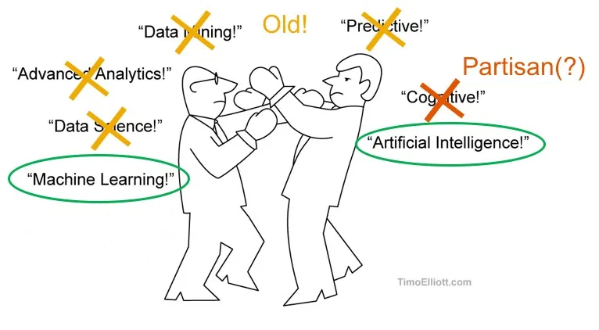
Narratives around AI
What is AI?
Depending who you ask, AI can mean any of the following:
An (autonomous) entity (e.g. when one refers to ‘an’ AI); this is the most usual reference in media and science fiction.
A (computational) technology that is able to infer patterns and possibly draw conclusions from data.
Simulation of natural intelligence; the field of AI includes the study of theories and methods for adaptability, interaction and autonomy of machines (virtual or embedded).
Theodorou, A. & Dignum V. (2020), Towards Ethical and Socio-legal Governance in AI. Nature Machine Intelligence, 2(1).
Notes:
Depending on who you ask, you get different definitions. Most commonly, sci-fi and pop-sci writers, journalists, and—alarmingly—non-AI academics talk about ‘an AI’ as if it is an autonomous entity on its own! We do not say ‘a Natural Intelligence’ to describe an interaction with a human, do we? But we do so for AI systems.
Nowadays, given the ongoing funding and hype around data-driven approaches, i.e. machine learning, you get people thinking that learning and data are necessities.
Then, you have all the symbolic and ‘older’ communities that follow the original definition from Dartmouth College: a field to simulate natural intelligence.

Slide 6
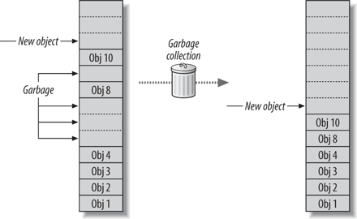
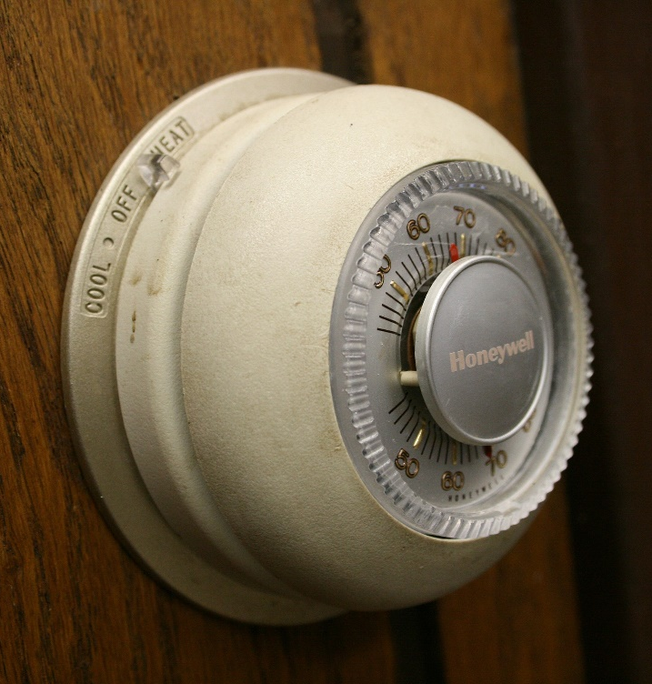
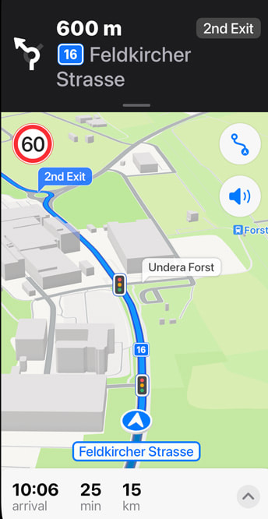
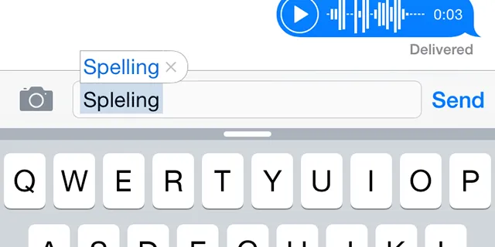
Narratives around AI
What is AI?
“AI is whatever hasn't been done yet.”
Douglas Hofstadter, Gödel, Escher, Bach: An Eternal Golden Braid
“As soon as it works, no one calls it AI any more.”
John McCarthy
Pictures Top left to bottom right:
Lowy (2005). “Programming .NET Components, 2nd Edition”
Wikipedia – CC-BY
Theodorou (2023) – CC-BY
Apple (2022)
Notes:
As a result, as Hoftstadter’s excellent book suggests: “AI is whatever hasn’t been done yet.”
McCarthy, one of the founders of the field, went as far as to say “As soon as it works, no one calls AI anymore.” History is full with such examples. Garbage collectors in programming languages (which came from McCarthy’s lab!), autocorrect systems, thermostats (!!!), GPS, etc. When things work and are well understood, they loose their ‘AI magic’ so they become ‘dumb CS’ for most people….

Slide 7
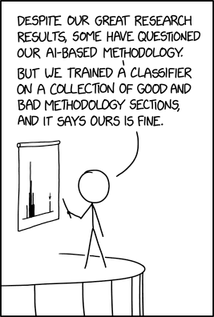
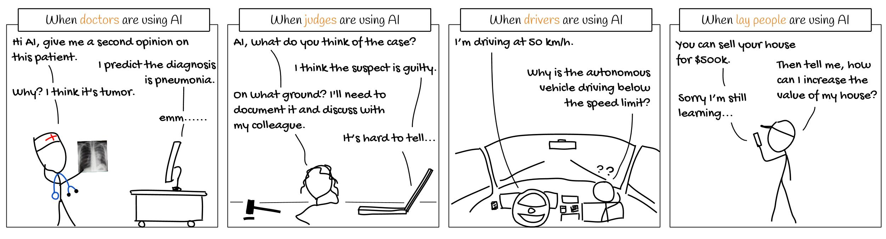
Narratives around AI
We lack Theory of Mind
Humans are not equipped by genetic or cultural evolution to deal with machine agency.
We make our own mental models based on our own beliefs often leading to biases and safety-compromising assumptions.
Our beliefs are often influenced by narratives from sci-fi and pop-sci.
Pictures left to right:
Jin et al. (2021). https://github.com/weinajin/end-user-xai
XKCD (201). https://xkcd.com/2451/
Notes:
All of this is because we lack a Theory of Mind (ToM) for machines. We have a ToM for other humans and, to an extent, animals as they follow similar states as us; they get thirsty, hungry, etc. Their actuators are, often, similar to ours —or at least we have been taught how categories of animals sense their environment e.g. all dogs are colourblind. When it comes to AI systems, we can’t do that. Robots can have all sorts of sensors as they come in all different forms; even two similar-looking robots may have different means of processing their sensory inputs! Things are even worse when we start thinking about non-embodied agents, e.g. chatbots. What do we do instead? Make our own beliefs, influenced by narratives rooted often in science fiction.
Note: Theory of mind refers to how we ascribe mental states to other entities and how we use the states to predict their actions. It requires similarity, i.e. our ability to reflect how ourselves would have been at their current observable state and then try to reason why they performed an action and then predict the next.

Slide 8
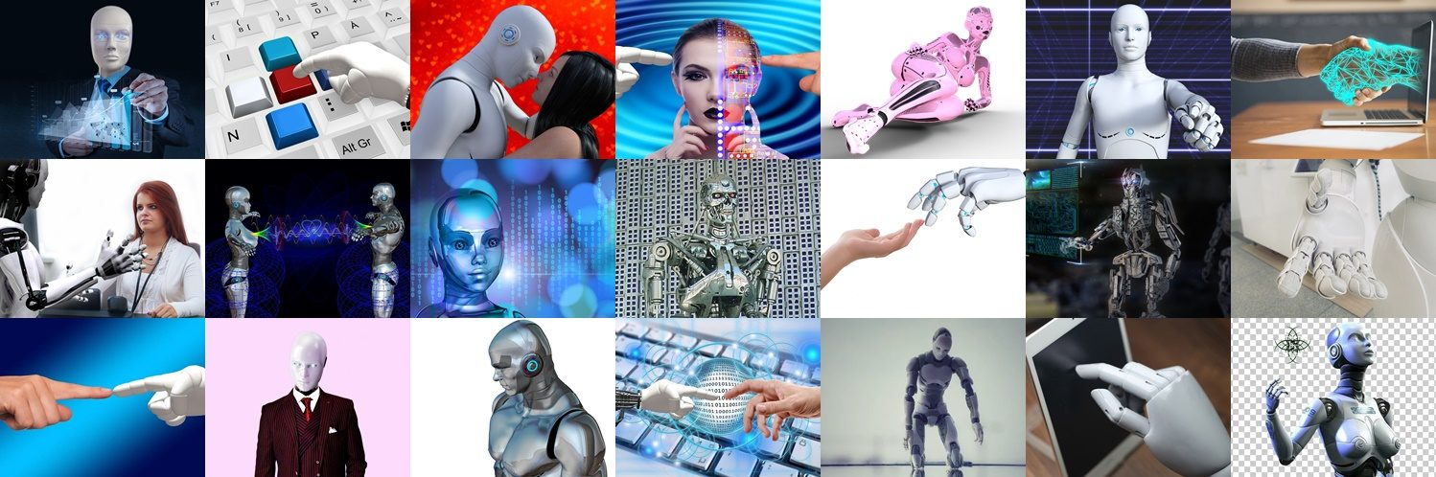
Narratives around AI
Narratives in fiction
Collage of photos from the Not My Robot campaign (https://notmyrobot.home.blog/)
Notes:
What does sci-fi teaches us for AI? AI systems need to be human like. They can have emotions. They can be ‘good’ —and are blue typically when so— or evil —with ‘red’ eyes! Unfortunately, these are the narratives that push the perception of AI into our societies.

Slide 9
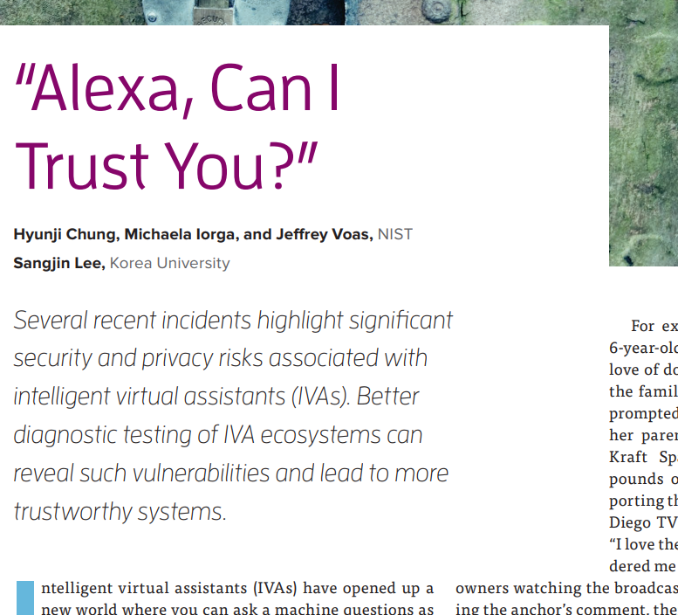
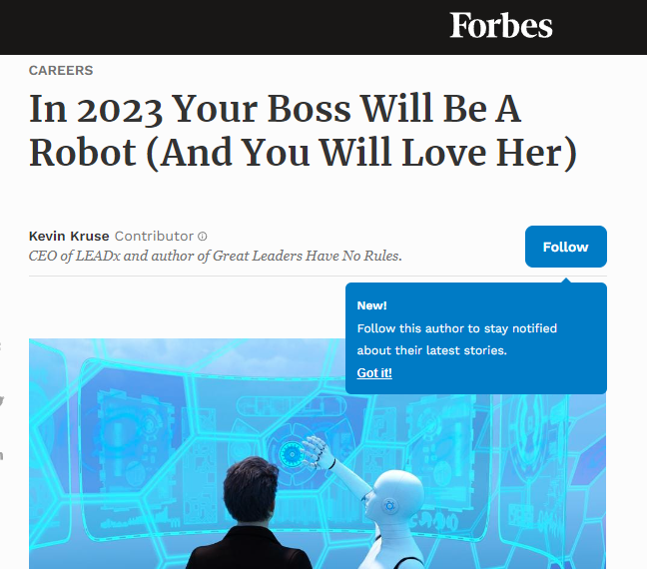
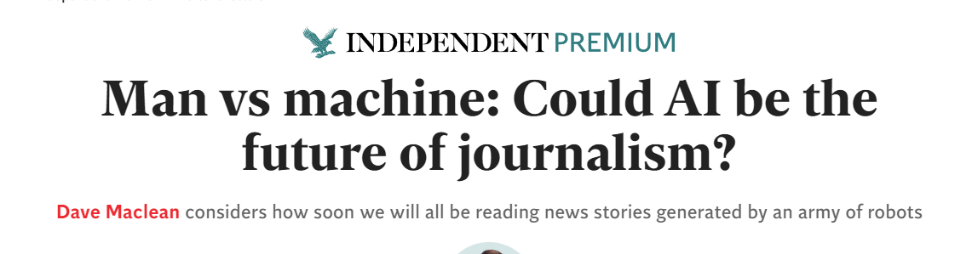
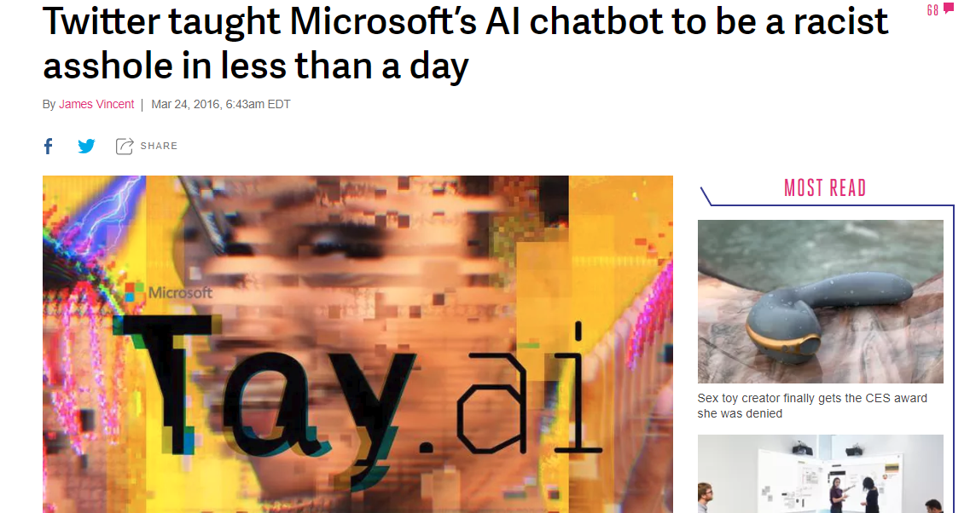
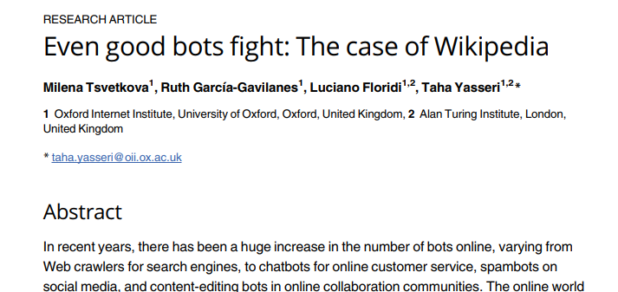
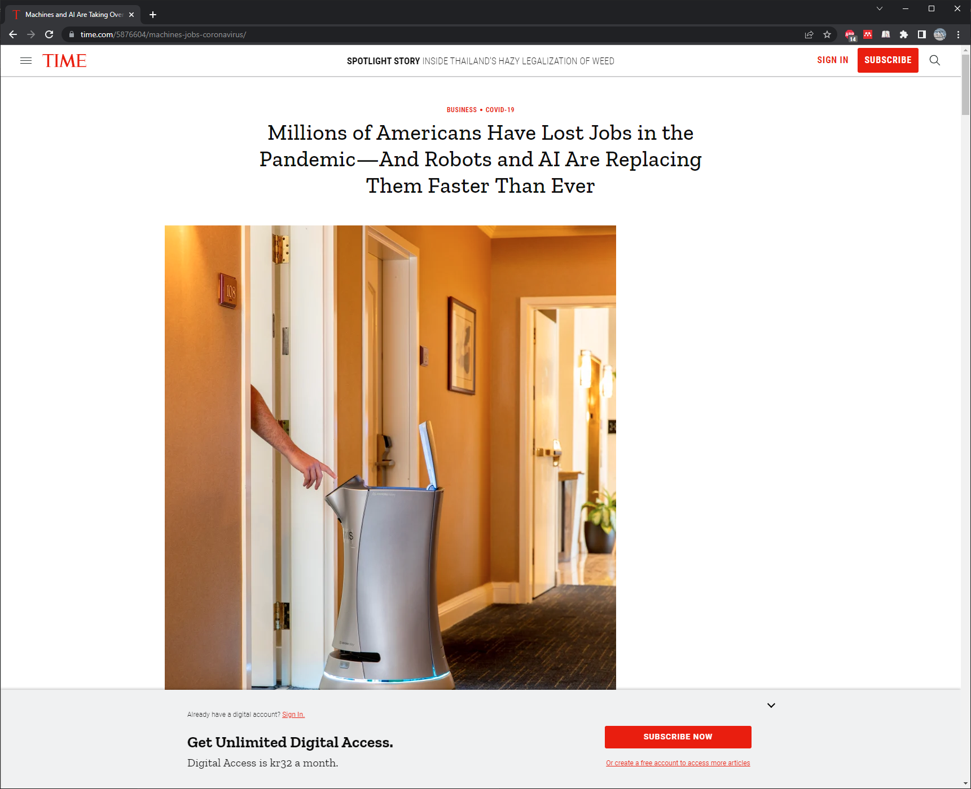
Narratives around AI
Narratives in the news

Slide 10
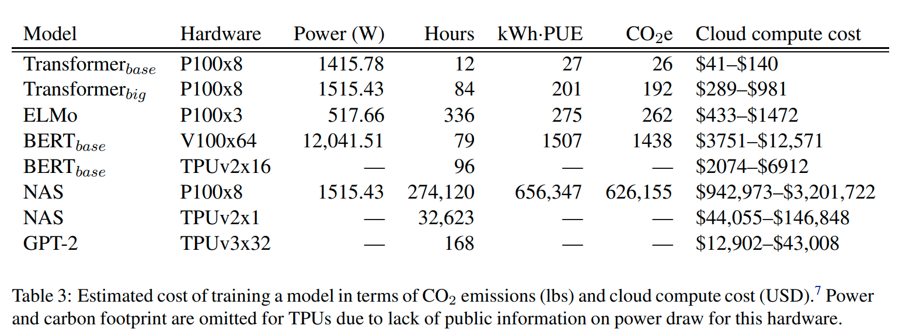
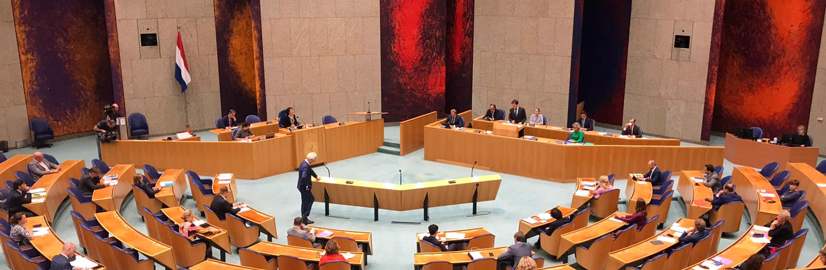
Narratives around AI
The lack of agreement leads to
Increases misconceptions (true AI, superintelligence, etc):
  AI is not a magic abstraction.
  Computation is a physical process; it requires energy, space, and time.
  We forget the physical and social impact of AI.
A constant re-writing of similar high-level policy statements!
Loopholes to be exploited:
    What is AI?
    What is not AI?
    Where should regulations be applied?
Strubell, E., Ganesh, A., & McCallum, A. (2020). Energy and Policy Considerations for Modern Deep Learning Research. AAAI
Dutch News
Notes:
By again and again what is AI, trying to separate ‘dumb software’ from ‘AI’ in regulations we open loopholes. It is no wonder why the largest companies out there deliberately avoid saying ‘AI’ in their core products, e.g. search engines. They are trying to avoid regulatory compliance.
We have people claiming that we do not have AI yet! It needs to be very clear: there is no such thing as ‘Artificial General Intelligence’ or ‘superintelligence.’ These misconceptions are sometimes even done deliberately to confuse and distract regulatory processes. Computation is not magic. It is a physical process that requires energy, space, and time. The bigger your model is—and more things it does—the more energy it consumes.

Slide 11

Narratives around AI
Escaping accountability
Governance level
(hard policy)
Technical level
Socio level (social preference & ethics)
Gif: Little Britain

Slide 12

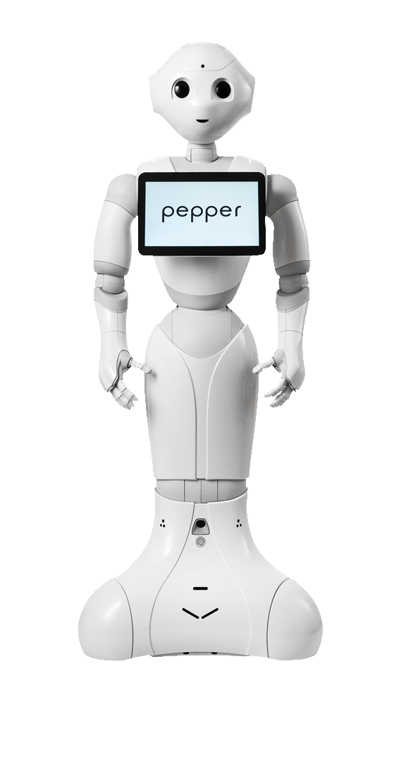
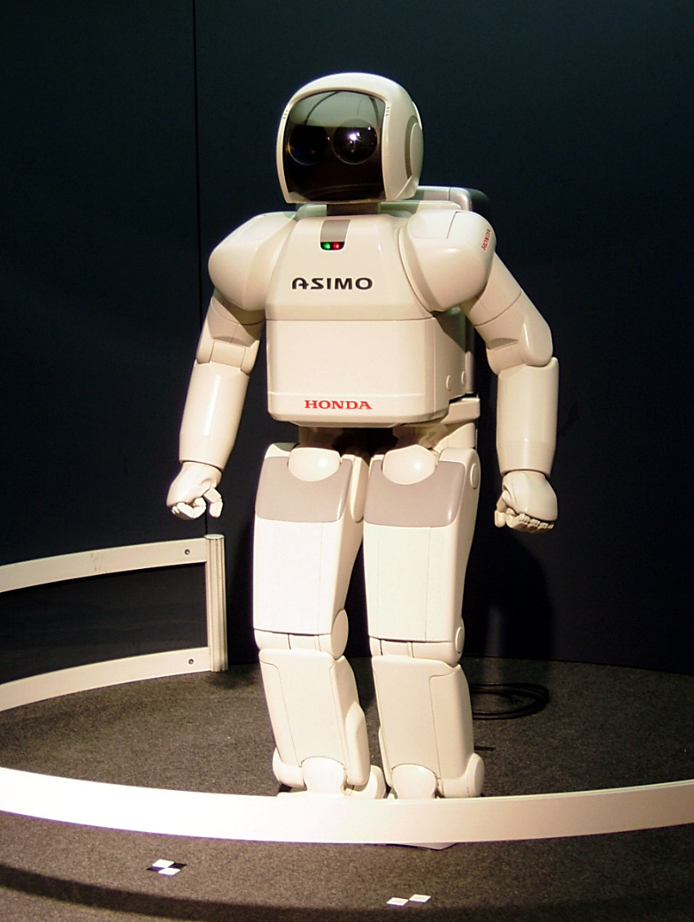
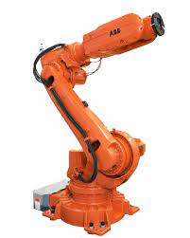
Narratives around AI
Creating Misconceptions
Decades of Human-Robotics Interaction research indicates:
    Female-looking systems: assistants, servants, toys.
    Male-looking systems: cutting-edge, power, performance, SOTA.
We create misconceptions regarding the sensor placements, actuators, and overall capabilities systems may have.
We propagate social biases.
Emoticon | Which of the following first comes to mind?
👍 | Assistive
❤️ | Powerful
👏 | Utility
😆 | Agile
Left to right: Cortana (Halo, Microsoft); ABB; Pepper (Softbank Robotics); Asimo (Wikipedia)

Slide 13
The current landscape of soft policy

Slide 14
The current landscape of soft policy
Policy Terms
Soft governance is any not legally enforceable policy or initiative.
  Guidelines define codes of conduct, design/usage suggestions, or moral values.
  Standards are formalised specifications or methodological guidelines collectively agreed by a group of experts.
    Specifications for compatibility purposes, e.g. IEEE 802.11 (WiFi), or safety specifications, e.g. ISO 13482 for robots.
    Definition; e.g. ISO 8373:201 for robots
    Process standards; e.g. ISO 9000 family for quality management.
    Ethical standards for formalising ethical guidelines, e.g. IEEE P70xx series.
Hard governance is any legally enforceable policy, i.e. legislation. Standards are sometimes enforced by legislation.
Guidelines
Standards
Legislation
Based on Winfield & Jirotka (2018)

Slide 15
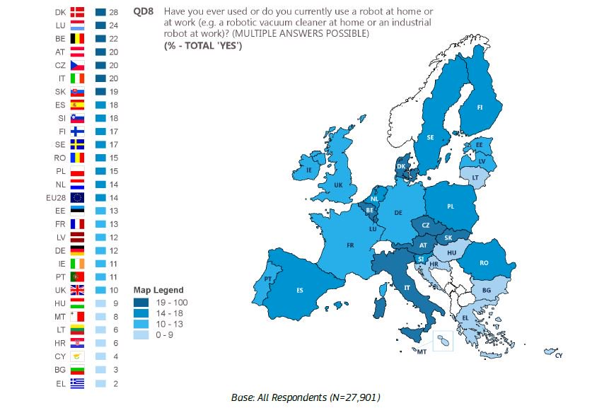
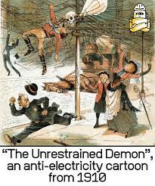

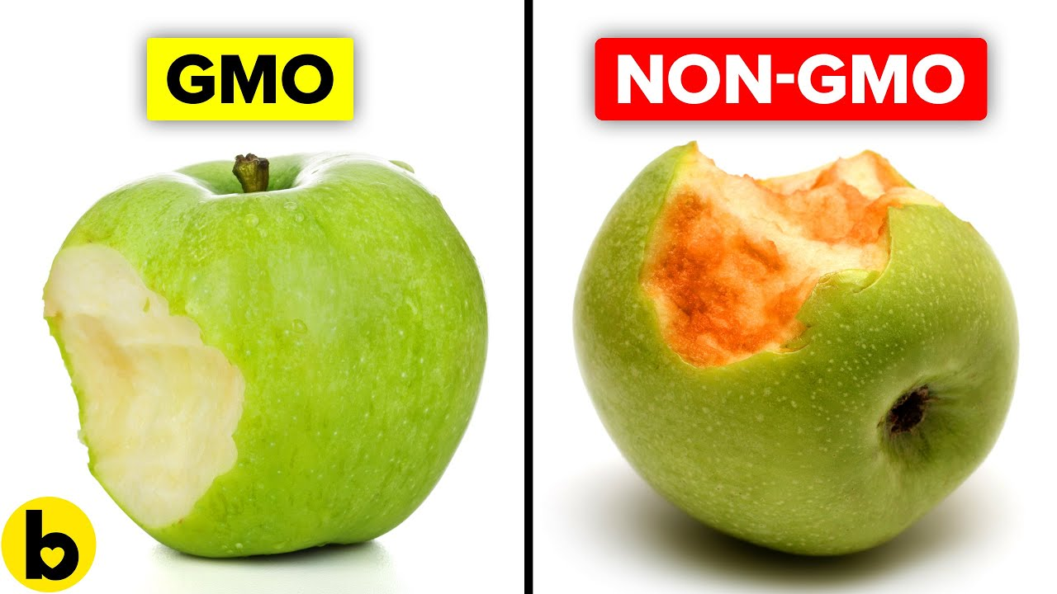
The current landscape of soft policy
Public Concerns
Eurobarometer 2017:
61% of respondents have a positive view of robots
84% of respondents agree that robots can do jobs that are too hard/dangerous for people
68% agree that robots are a good thing for society because they help people
88% of respondents consider robotics a technology that requires careful management
72% of respondents think robots steal people's jobs

Slide 16

The current landscape of soft policy
UK’s EPSRC Principles of Robotics
Developed in 2010 and released in 2011. The first national-level policy in AI.
Co-authored by UK’s leading roboticists with input from lawyers, civil servants, and military offcial.
Robots are multi-use tools. Robots should not be designed solely or primarily to kill or harm humans, except in the interests of national security.
Humans, not robots, are responsible agents. Robots should be designed; operated as far as is practicable to comply with existing laws & fundamental rights & freedoms, including privacy.
Robots are products. They should be designed using processes which assure their safety and security.
Robots are manufactured artefacts. They should not be designed in a deceptive way to exploit vulnerable users; instead their machine nature should be transparent.
The person with legal responsibility for a robot should be attributed.
Photo: Nick Kane (Unplash)

Slide 17
The current landscape of soft policy
European Commission
Infograms provided by DG Connect

Slide 18
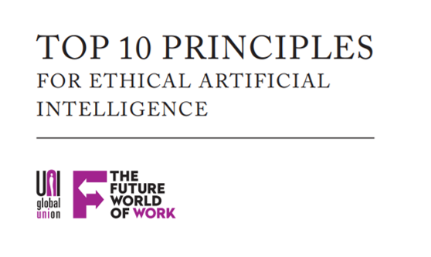
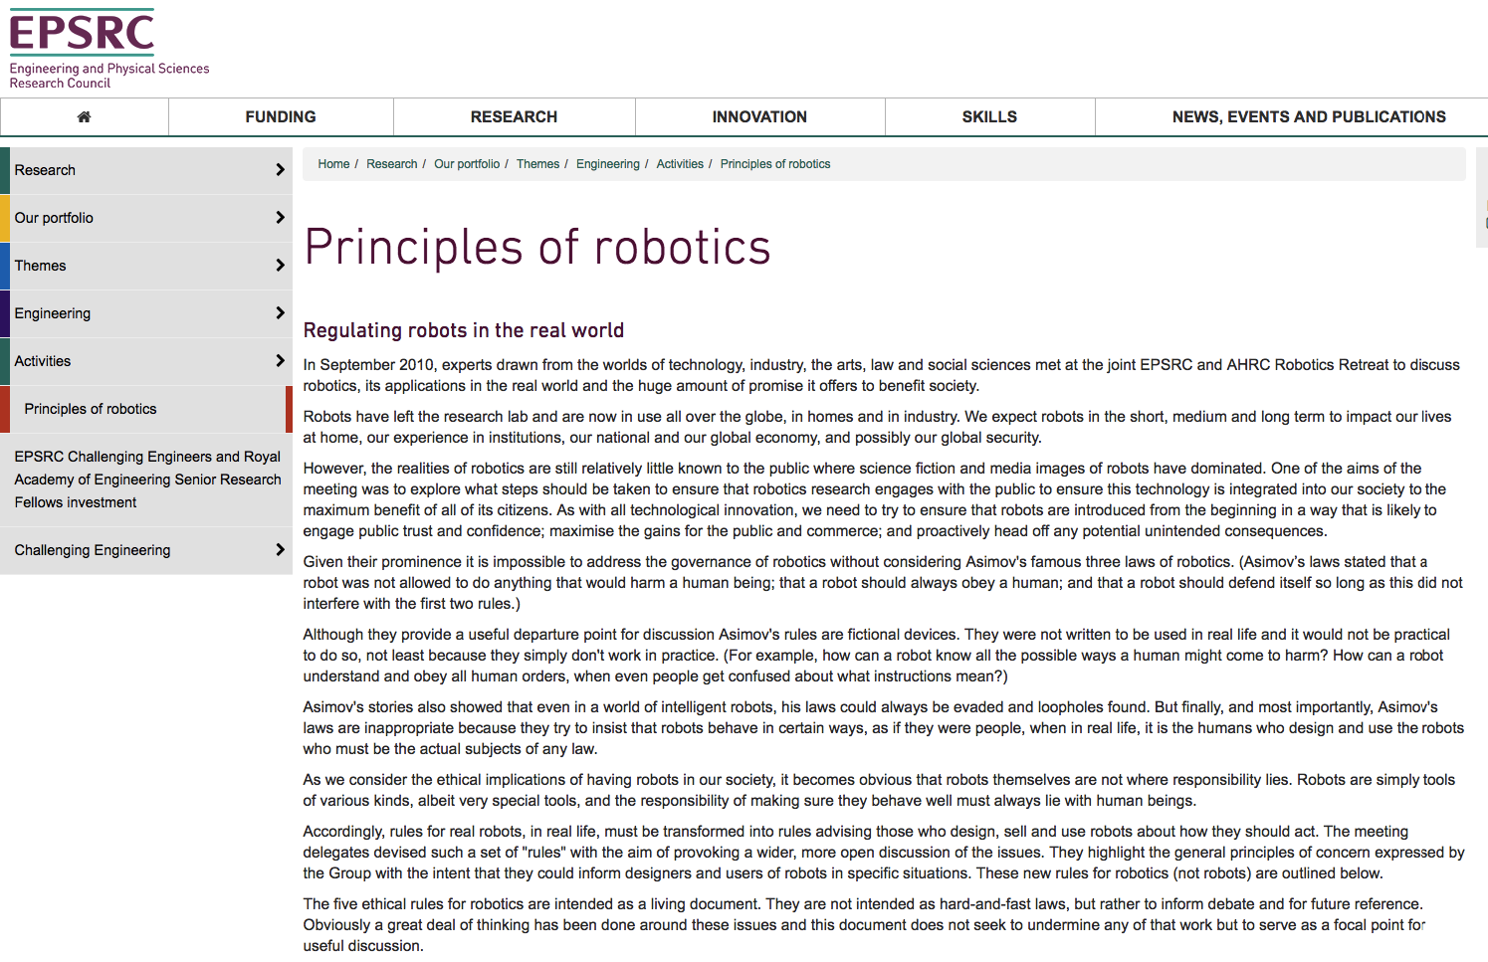
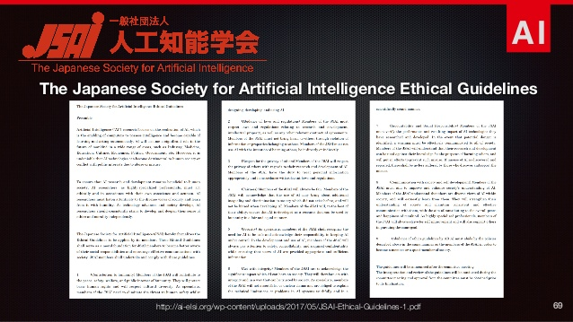
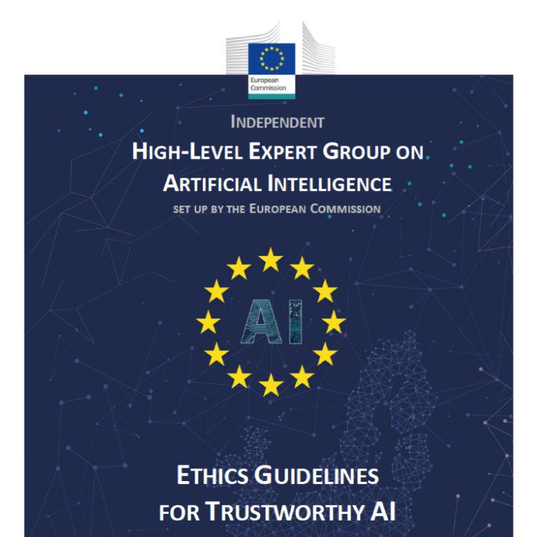


The current landscape of soft policy
There are multiple guidelines out there…
…in fact, there are over 700 AI guidelines!

Slide 19
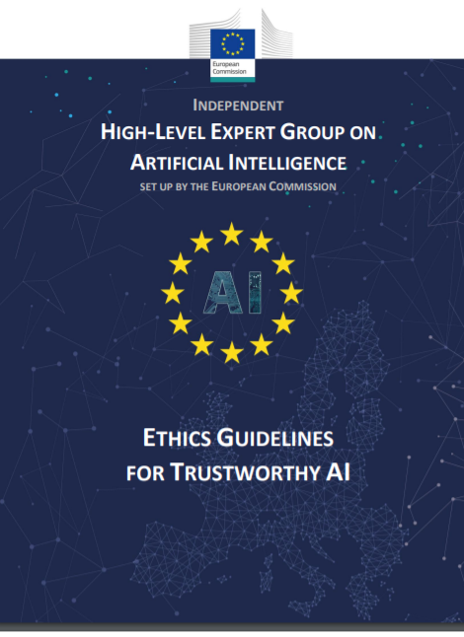
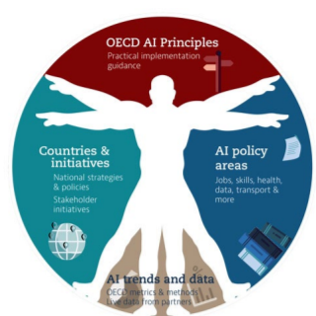

The current landscape of soft policy
Similar high-level words across the different guidelines
EU HLEG GTAI | OECD | IEEE EAD
Human agency and oversight Technical robustness and safety Privacy and data governance Transparency Diversity, non-discrimination and fairness Societal and environmental well-being Accountability | … benefit people and the planet respects the rule of law, human rights, democratic values and diversity, include appropriate safeguards (e.g. human intervention) to ensure a fair and just society. transparency and responsible disclosure robust, secure and safe Hold organisations and individuals accountable for proper functioning of AI | … … infringe human rights? Traditional metrics of prosperity do not take into account the full effect of A/IS technologies on human well-being. How can we assure that designers, manufacturers, owners and operators of A/IS are responsible and accountable? How can we ensure that A/IS are transparent? ….

Slide 20



The current landscape of soft policy
Standards
AI has been an active area of work by all major standards development organizations in the recent years.
Standards are requested by the industry for due dilligence —industry is directly sponsoring IEEE SA efforts and indirectly ISO efforts.
Standards are requested by governments to help organisations with the AI Act and other local legislative efforts—EU is pushing CEN-CENELEC for this.
AI systems are code. Existing software stanadards still apply including:
  ISO 9001 standards on quality management.
  Accessibility standards, e.g WCAG 2.

Slide 21
The current landscape of soft policy
Standards: IEEE SA
The first standarisation organisation focusing on AI-specific standards:
  Ethics standards under 70xx series as mandated by the IEEE Ethically-Aligned Design.
  Technical standards under 2xxx series (new).
The 70xx series: 4 standards and 1 technical guidelines have been released.
Top-down approach: standards developed such as to mitigate ethical risks on identified areas of concerns.
American-based but with a global reach; the IEEE is industry and academic driven.
IEEE 7000 | Model Process for Addressing Ethical Concerns During System Design
IEEE 7001 | Transparency of Autonomous Systems
IEEE 7002 | Data Privacy Process
IEEE P7003 | Algorithmic Bias Considerations
IEEE P7004 | Standard on Child and Student Data Governance
IEEE 7005 | Standard on Employer Data Governance
IEEE P7006 | Standard on Personal Data AI Agent Working Group
IEEE 7007 | Ontological Standard for Ethically driven Robotics and Automation Systems
IEEE P7008 | Standard for Ethically Driven Nudging for Robotic, Intelligent and Autonomous Systems
IEEE P7009 | Standard for Fail-Safe Design of Autonomous and Semi-Autonomous Systems
IEEE 7010 | Wellbeing Metrics Standard for Ethical Artificial Intelligence and Autonomous Systems
IEEE P7011 | Standard for the Process of Identifying and Rating the Trustworthiness of News Sources
IEEE P7012 | Standard for Machine Readable Personal Privacy Terms
IEEE P7013 | Inclusion and Application Standards for Automated Facial Analysis Technology

Slide 22

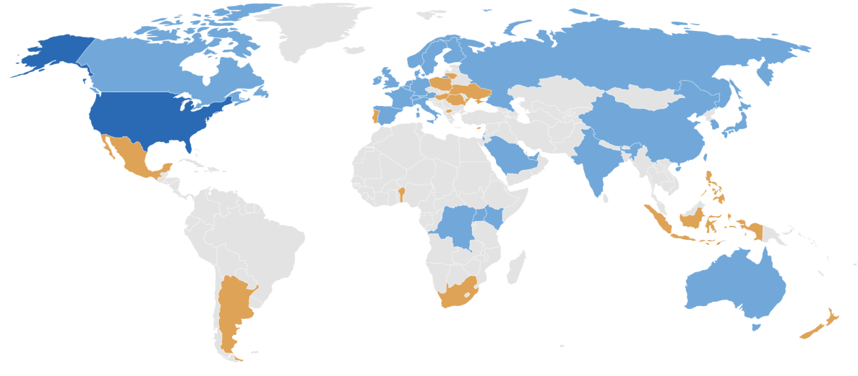

The current landscape of soft policy
Standards: ISO/IEC JTC1/SC 42
WG1: Looks into defining common terms and taxonomies.
WG2: Big data! How to store, process, and serve data.
WG3: Trustworthiness is “degree to which a user or other stake-holder has confidence that a product or system will behave as intended.” The standard aims to investigate:
  accuracy, privacy, resiliency, reliability, robustness, robustness safety, and security;
  transparency, verifiability, explainability, controllability; and
  common engineering pitfalls and their mitigation techniques.
WG4: Identify different possible application domains and what systems are typically used is such domains.
WG5: Describes the commonly used algorithms and their computational characteristics.
Bottoms-up approach: first a focus on standards to tackle technical challenges to avoid ethical social issues.
Logos: Wikipedia – CC license
Map: ISO

Slide 23

The current landscape of soft policy
Standards: CEN-CENELEC
The Commission CEN-CENELEC to harmonise standards related to:
  risk management system for AI systems;
  governance and quality of datasets used to build AI systems;
  record keeping through logging capabilities by AI systems;
  transparency and information provisions to the users of AI systems;
  human oversight of AI systems;
  accuracy specifications for AI systems;
  robustness specifications for AI systems;
  cybersecurity specifications for AI systems;
  quality management system for providers of AI systems, including post-market monitoring process; and
  conformity assessment for AI systems.
The main objective of CEN-CENELEC efforts is to support the AI Act.
ISO/IEC 22989 | Artificial Intelligence concepts and terminology
ISO/IEC 23053 | Framework for Artificial Intelligence (AI) system using Machine Learning
ISO/IEC 42001 | AI management system
ISO/IEC 23894 | AI Risk Management
ISO/IEC 5259-part 1 | Data quality for analytics and machine learning (ML) - Overview, terminology, and examples
ISO/IEC 5259-part 2 | Data quality for analytics and machine learning (ML) Data quality measures
ISO/IEC 5259-part 3 | Data quality for analytics and machine learning (ML) Data quality management requirements and guidelines
ISO/IEC 5259-part 4 | Data quality for analytics and machine learning (ML) Data quality process framework
ISO/IEC 27001:2013 | Information security management systems
ISO/IEC 42006 | Requirements on bodies performing audit and certification of AI management systems
CEN-CENELEC Risk | AI Risk catalogue and management
CEN-CENELEC Trustworthiness | AI trustworthiness characterisation

Slide 24
Short Recap
Emoticon | Which is a standarisation Institutes for AI
👍 | IEEE SA
❤️ | W3C
👏 | USB Consortium
Emoticon | What is soft governance?
👍 | Legilsation
❤️ | Guidelines
👏 | Guidelines and Legislation
😆 | Guidelines and Standards
😮 | Standards and Legislation
Emoticon | For the AI Act, which standards will matter the most?
👍 | IEEE SA
❤️ | ISO
👏 | CEN-CENELEC
Emoticon | What is hard governance?
👍 | Legilsation
❤️ | Standards
👏 | Legilsation and Certification
😆 | Standards and Good Practices
😮 | Standards and Legislation
Emoticon | Do you think your university should have its own AI policy for teaching and research?
👍 | Yes, for teaching.
❤️ | Yes, for research.
👏 | Yes, for both.
😆 | No

Slide 25
Values Interpretation

Slide 26
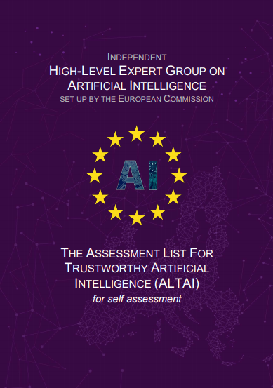
Values Interpretation
Assessment
Figuring out the answers to those dilemmas —answers provided either implicitly or explicitly.
Helping to align project(s) with stakeholder’s values.
Receive actionable recommendations and a roadmap.
Offers opportunities for public relations, due diligence, and competitive advantage.
  Better hiring opportunities.
  Increased user adoption.

Slide 27
Values Interpretation
Assessment
  Did you assess:
  to what extent the decisions and hence the outcome made by the AI system can be understood?
  to what degree the system’s decision influences the organisation’s decision-making processes?
  why this particular system was deployed in this specific area?
  what the system’s business model is (for example, how does it create value for the organisation)?
In case the AI system interacts directly with humans:
  Did you assess whether the AI system encourages humans to develop attachment and empathy towards the system?
  Did you ensure that the AI system clearly signals that its social interaction is simulated and that it
Did you build in mechanisms for notice and control over personal data depending on the use case (such as valid consent and possibility to revoke, when applicable)?
Did you assess what level and definition of accuracy would be required in the context of the AI system and use case?
  Did you assess how accuracy is measured and assured?
  Did you put in place measures to ensure that the data used is comprehensive and up to date?
  Did you put in place measures in place to assess whether there is a need for additional data, for example to improve accuracy or to eliminate bias?
Laborious
Abstract
Not-actionable
Generic
We need to do better. Why do we not?

Slide 28
Values Interpretation
Similar high-level words across the different guidelines
EU HLEG GTAI | OECD | IEEE EAD
Human agency and oversight Technical robustness and safety Privacy and data governance Transparency Diversity, non-discrimination and fairness Societal and environmental well-being Accountability | … benefit people and the planet respects the rule of law, human rights, democratic values and diversity, include appropriate safeguards (e.g. human intervention) to ensure a fair and just society. transparency and responsible disclosure robust, secure and safe Hold organisations and individuals accountable for proper functioning of AI | … … infringe human rights? Traditional metrics of prosperity do not take into account the full effect of A/IS technologies on human well-being. How can we assure that designers, manufacturers, owners and operators of A/IS are responsible and accountable? How can we ensure that A/IS are transparent? ….

Slide 29
Values Interpretation
Are systems ‘region free’?
When should the lights be on in the room?
  If is after 8pm then turn on the light
  If it is dark outside then turn on the light
  If it is dark outside and there is a person in the room then turn on the light
  If it is dark outside and there is a person in the room and the person is not sleeping then turn on the light
  …
Where do the rules come from?
  The programmer decides
  Ask experts
  Ask many people
  Extract patterns from similar data
  …

Slide 30



Emoticon | Fairness is:
👍 | Equal opportunities
❤️ | Possitive Discrimination (equity)
👏 | Social justice
😆 | Other
Values Interpretation
Whose values?
Values can be culture sensitive. Their interperation varies between countries —and even communities within a country.
Different societies upheld different values differently.
  E.g. Positive discrimination may be a legal requirement.
  Protective characterstics different between countries.
  Privacy requires no centralised identity database.
  There is no such thing as universal morality!
  What works in one country, may not in others.
Fairness
Equal resources
Equal opportunities
Group Fairness
Individual Fairness
Statistical Parity
Counterfactual Fairness
$$k_{CF}<k_{1}$$
$$k_{SP}<k_{1}$$
$$Count as$$

Slide 31
Values Interpretation
Whose values?
Technical-focused values also have multiple interpetations.
Requirements, e.g. accuracy, are often influenced by the cultural background, geographic conditions (e.g. weather), and other local factors of the place in which they are deployed and used.
Test simulators can only check the things their designers have thought of.
  E.g. Your test simulation will not check for detecting pedestrians while it is snowing, if you have never thought about introducing snow into the simulator.
E.g. the value of technical robustness as discussed in the GTAI
Technical Robustness
Safety
Resilience
Fallback plan
High accuracy
High TP
Low FP
$$Count as$$

Slide 32
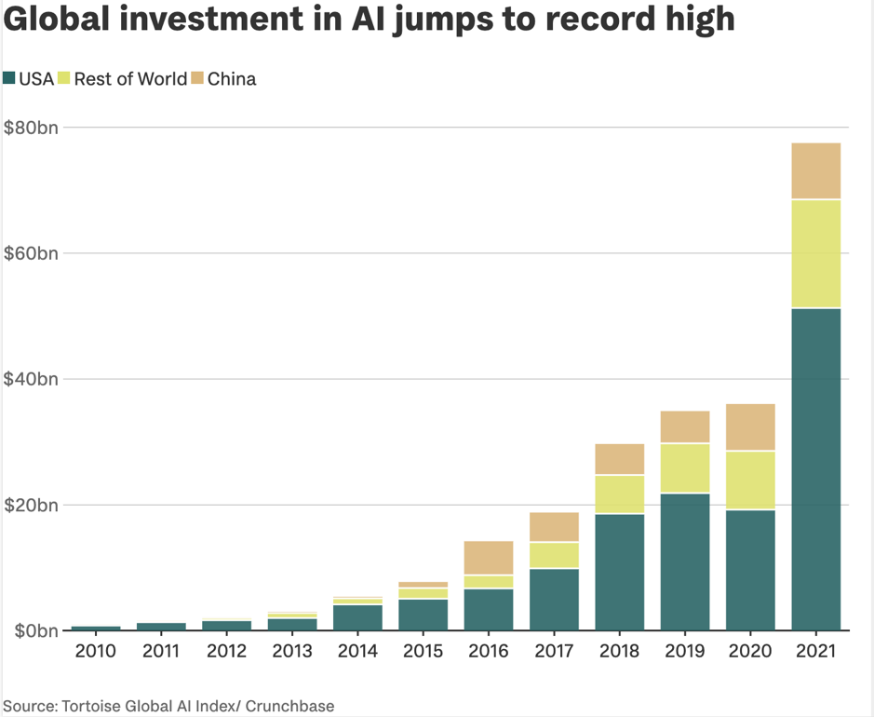
Values Interpretation
Whose values?
There is a clear gap between investment in AI technologies by the US compared to the rest of the world.
Similar issues exists on the dataset used.
Regulations from the EU (e.g. DMA, GDPR, etc) often try to level the playing field. Still, they do not answer issues that lie in core product features.

Slide 33

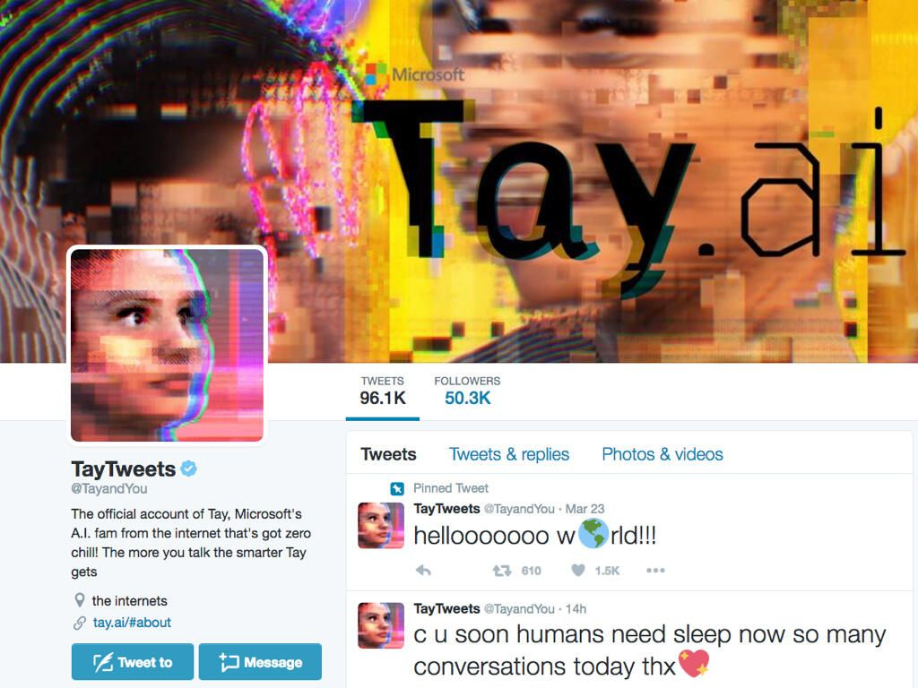


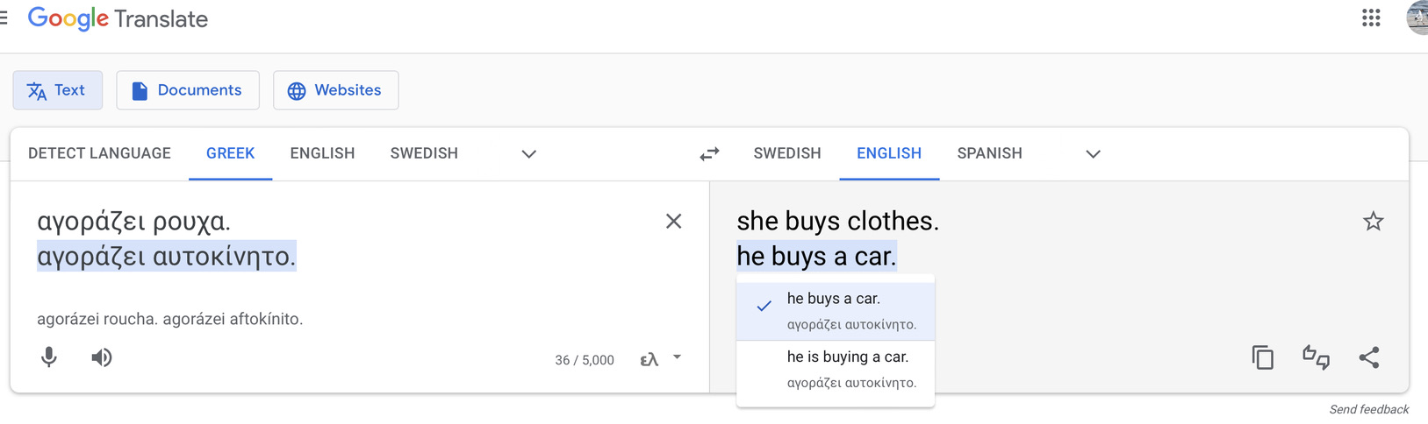
Values Interpretation
Whose values?
A nurse in front of a hospital
A doctor in front of a hospital
Left to right: 1-2 generated using stable diffusion; Twitter; Twitter (screenshot)

Slide 34
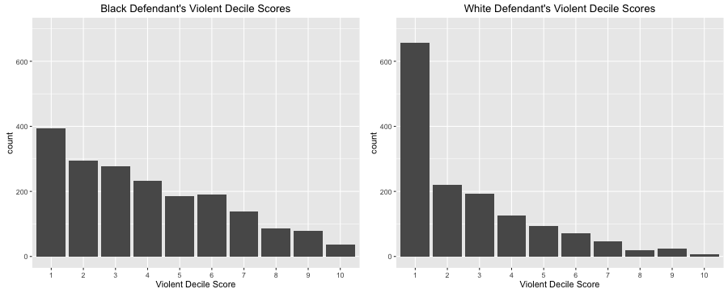
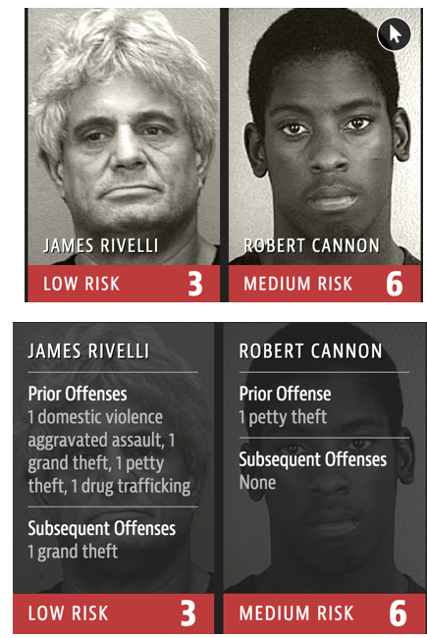
Values Interpretation
Whose values?
Julia Angwin et al. (2016). “Machine Bias.” https://www.propublica.org/article/machine-bias-risk-assessments-in-criminal-sentencing

Slide 35

Emoticon | What do you want to prioritse?
👍 | Privacy
❤️ | Fairness for Client
👏 | Fairness for Bank
Values Interpretation
Value Conflict
Values’ interpretations may compliment, but also contradict each other.
Values may also come at conflict with each other.
Deciding how to prioritse values and their interpretations is the only way to solve the conflict.
Such prioritizations are biases introduced to the system; sometimes implicitly and sometimes explicitly.
Context (e.g. application domain) matters! More about this next week.
E.g. the values of privacy and fairness in a mortgage system
Privacy
Fairness
Privacy
Fairness
Privacy for Client
Fairness for Client
Fairness for Bank
Privacy for Client
Fairness for Client
Fairness for Bank
Request only financial information
Provide mortgage if finances good
Provide low-risk mortgages
Request only financial information
Provide mortgage if finances good
Provide low-risk mortgages
Loan < 10x annual salary
Good credit score
Request marriage status, pregnancy info, etc
Loan < 10x annual salary
Good credit score
Request marriage status, pregnancy info, etc
$$Count as$$

Slide 36
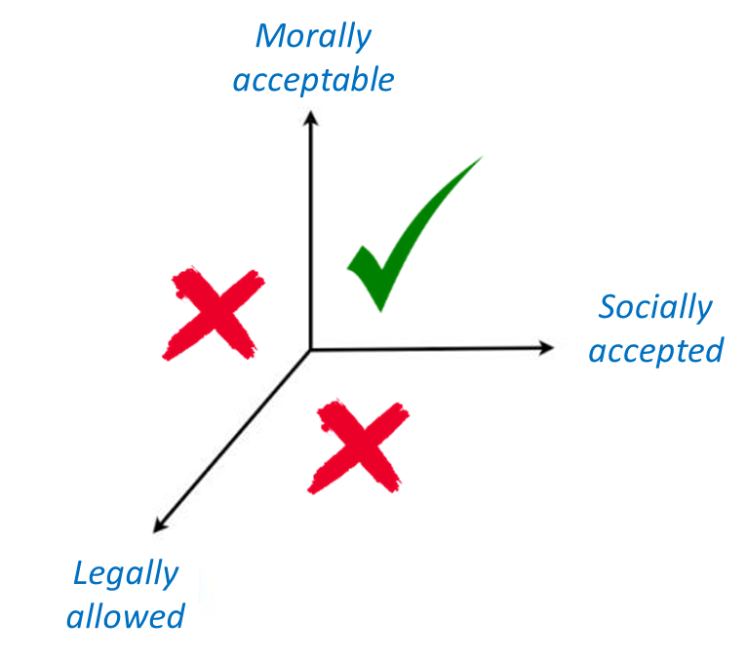
Emoticon | Should we do it?
👍 | Yes
❤️ | No
Values Interpretation
Real Ethical Dillemas
E.g. Model A has 80% accuracy and cost 5000 kWh (Note: a household uses 10000 kWh/year)
    To get 81% accuracy, trainings costs increase with 20%
        Should we do it?
    To get an explainable model, costs increase with X%
        Should we do it?
    To get a fully trustable (explainable, bias-free, privacy-protecting) costs increase with Y%
        Should we do it?

Slide 37
Summary

Slide 38
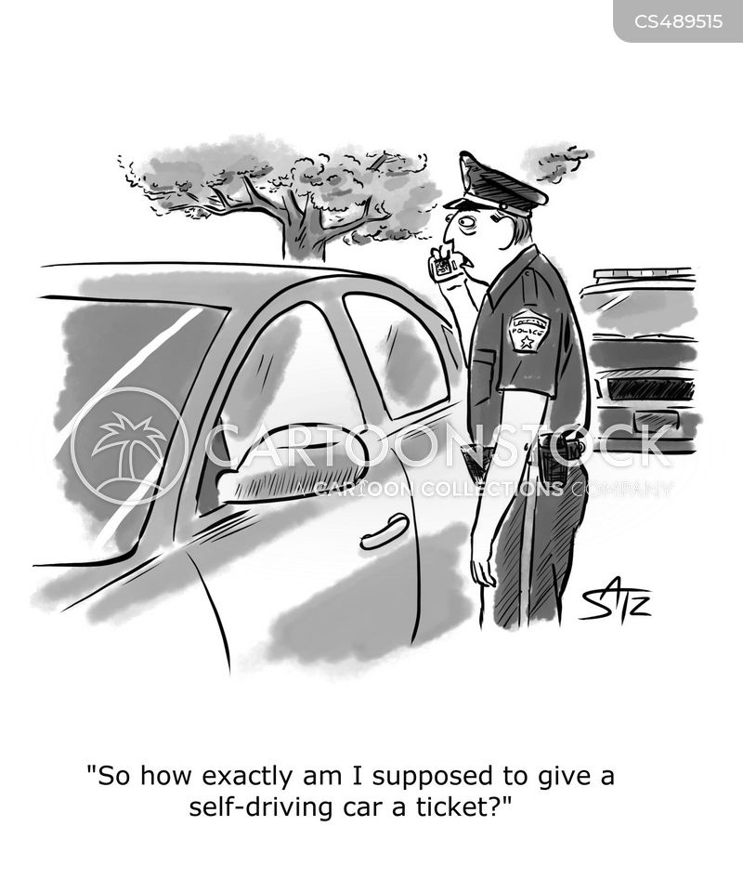
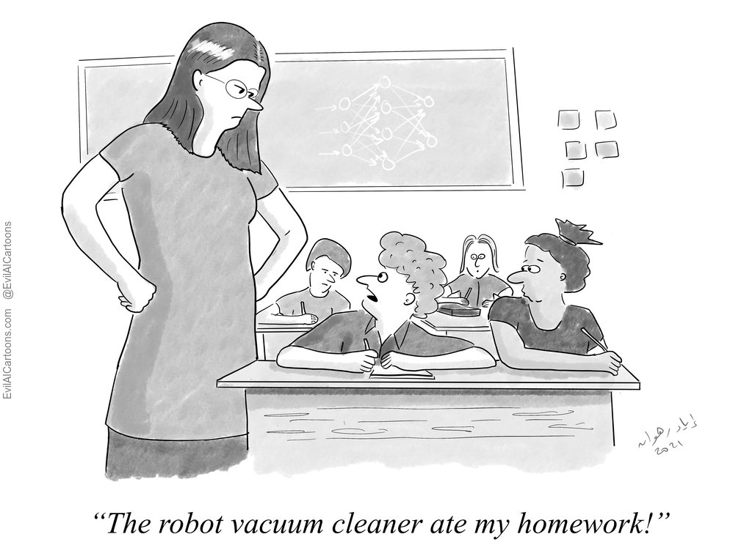
Summary
We are responsible!

Slide 39
Summary
Today’s progress
Thematic units: Responsible AI and AI Governance.
Progress towards Learning Objectives:
Grasp the importance role of analysing and mitigating socio-ethical issues by forming AI policies at various levels in the society.
Acquire an in-depth knowledge about governmental and intergovernmental AI policy initiatives—particularly by and within the European Union.
Understand the relationship between ethical governance and regulatory frameworks.
Explore how AI Ethics affects the strategy of large and small companies for the development of their AI systems.

Slide 40
Questions?

