Slide 1
University of Cyprus
MAI631
Artificial Intelligence Ethics II
Andreas Theodorou
September – December 2023

Slide 2
University of Cyprus
Lecture 2:
Value Sensitive Design for Socio-technical systems
Andreas Theodorou

Slide 3
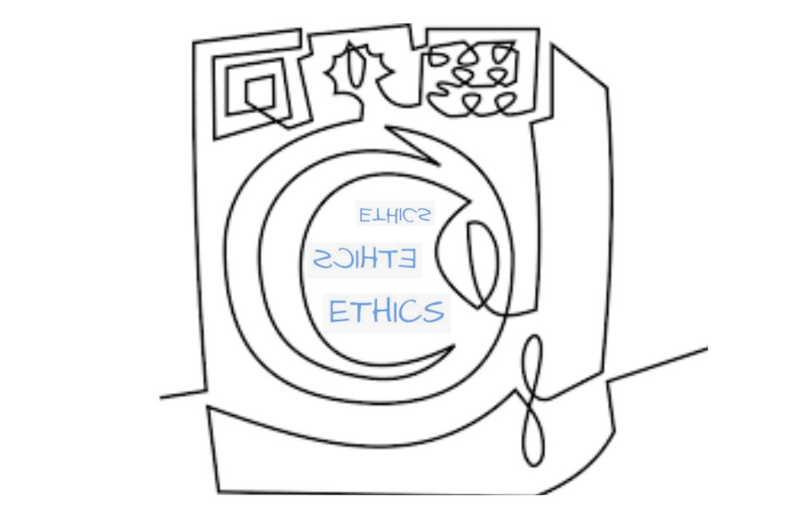
Introduction
In the previous episode…
We reviewed the current landscape for soft policy: guidelines and standards.
We briefly looked at the interaction between standards and legislation.
We identified the core problem: lack of concrete assessment due to the abstract nature of the values used.
There are multiple interpretations of the same value; some conflict with each other resulting to values conflict.
Still, a question is whose and which values? How?

Slide 4
Introduction
Lecture Overview
Today’s Structure:
Socio-Technical Systems
Values and AI
Value Sensitive Design
Using norms as an intermediate step
IEEE 7001 Standard
Summary
Today’s Goals:
Thematic units: AI Governance and policy making.
Learning Objectives:
Grasp the importance role of analysing and mitigating socio-ethical issues by forming AI policies at various levels in the society.
Acquire an in-depth knowledge about governmental and intergovernmental AI policy initiatives—particularly by and within the European Union.
Explore how AI Ethics affects the strategy of large and small companies for the development of their AI systems.

Slide 5
Socio-Technical Systems

Slide 6
Socio-technical Systems
The core components
Technological system: Set of components (e.g. data, algorithms) designed to fulfil a function.
+
Social system: a structure of social interactions according to
shared cultural norms and meanings.
=
Socio-technical system: understand the contribution of phenomena at the human social level to the performance of technical
systems
Complex External Environment
Org. Structure
‘Physical’ System
People
Tasks / Goals
Socio-
technical
Enrico Coiera, Putting the technical back into socio-technical system research, International Journal of Medical Informatics, Volume 76, Supplement 1, 2007

Slide 7
Socio-technical Systems
Interaction between components
Social and technical sub-systems influence one another through feedback loops
There is an emergent behaviour: the relationship between social and technical components is constantly redefined and evolving.
E.g. A growing organization adds more people with new tasks and requires a more complex system.
A new automation system removes tasks and adds others; people need retraining.
The social and technical subsystems must constantly work together.
Complex External Environment
Org. Structure
‘Physical’ System
People
Tasks / Goals
Socio-
technical
Appelbaum, S.H. (1997). “Socio Technical systems theory: An intervention strategy for organizational development.” Manag. Decis.

Slide 8
Socio-technical Systems
Joint optimisation
Joint optimization: ensures that both the social and technical subsystems are optimised.
No single approach exists for joint optimisation, but some common principles:
Responsible autonomy individuals/stakeholders take responsibility for the outcome/performance can make decisions autonomously;
Adaptability as internal and external factors emerge; distributed or central optimisation.
Meaningfulness of tasks including skill variety and identity.
Feedback loops between the STS components.
Complex External Environment
Org. Structure
‘Physical’ System
People
Tasks / Goals
Socio-
technical

Slide 9
Values and AI

Slide 10
Values and AI
Responsible AI
AI systems can potentially do a lot. Should it?
Who should decide?
Which values should be considered? Whose values?
How do we deal with dilemmas?
How should values be prioritized?
…..
Responsible AI
=
Ethical
+
Robust
+
Legal
+
Veriable
AI

Slide 11
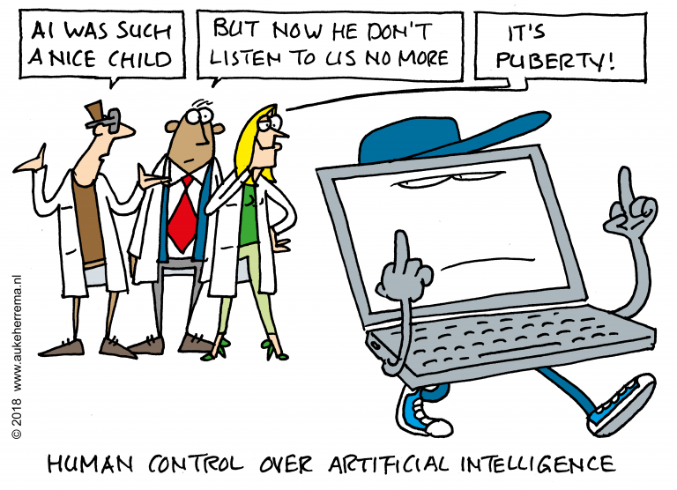
Values and AI
Meaningful Human Control
Human presence is not sufficient.
We need to be able to:
track relevant reasons behind a decision;
verify their compliance to any policy; and
trace back to an individual along the chain who is aware and accepting of their responsibility.
The world is not static: contexts that change will demand changing levels of responsiveness.
Requires us to consider wider issues around Responsible AI, including whose values and how.

Slide 12
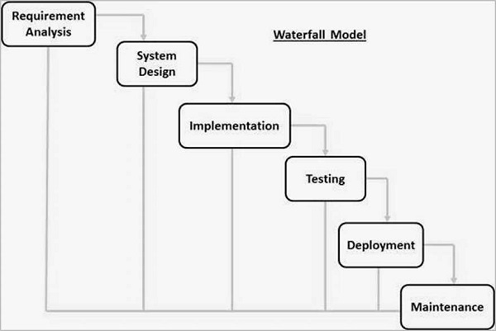
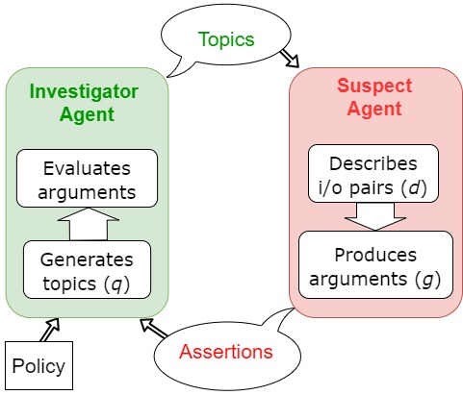
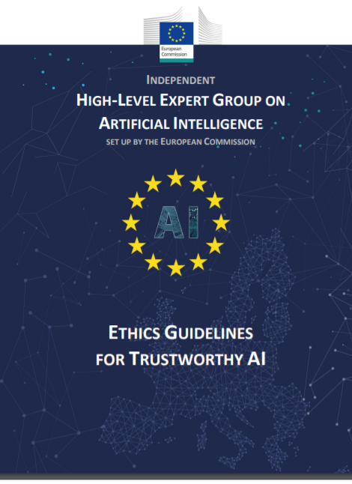
Values and AI
Taking Responsibility
Responsible AI
IN
(processes)
FOR
(stakeholders)
BY
(behavior/ results)
Aler Tubella A., Theodorou A., Nieves J.C. (2021). Interrogating the Black Box: Transparency through Information-Seeking Dialogues. AAMAS 2021
Based on a taxonomy developed by Dignum V. (2017)
Notes:
Prof. V. Dignum (UmU) talks about Responsibility:
in processes which refers to both all the decisions made during the system’s lifecycle and who made those decisions;
for stakeholders which refers to stakeholders being part of professional bodies, following codes of ethics, and overall establishing policies; and
by behaviour which refers to ensuring that the system exhibits the correct behaviour.

Slide 13
Values and AI
Design for Values
Assumptions:
Values can and are embedded in technology
There is moral significance to explicitly considering which values are embedded in our designs —forced due to social accountability.
Values should be considered from the early stage of design, to guide the process.
Otherwise, we cannot ensure meaningful human control (we are looking at this concept in another lecture).
Working with values in AI:
Value operationalisation: Linking values to specific requirements on functionalities of the system.
Value conflicts: Prioritising values for the specific context and application.
Measurement-Assessing whether the design fulfils the values
This can but should not be done in isolation from the wider socio-technical system and those affected.
Participatory Design approaches are key to ensure multiple sources are used.
van de Poel (2015). Design for Values: An Introduction. In: Handbook of Ethics, Values, and Technological Design]
van den Hoven, J, Vermaas, P. E; vande Poel, Ibo (Ed.): Handbook of Ethics, Values, and Technological Design: Sources, Theory, Values and Application Domains, pp. 151–178, Springer Netherlands]

Slide 14
Value Sensitive Design
Sources of values
Project requirements, briefs, etc.
Designers, developers, and deployers
﻿﻿
Users and stakeholders.
﻿﻿
Codes of ethics, codes & standards, law, society.
Own choices.
Values
Policy
Requirements
THESE ARE (PART OF) THE BIASES
THAT WE EMBED INTO OUR SYSTEMS.

Slide 15
Value Sensitive Design

Slide 16
Value Sensitive Design
Concretising Values
﻿﻿System developers have been embedding their values all the time but make more explicit, transparent, and systematic.
We need a structured and explicit process of translating abstract values into concrete requirements inline with policy.
VSD is such a way!
Values
Policy
Requirements

Slide 17
Value Sensitive Design
The 3 types of investigation
Conceptual investigation
Who are the stakeholders? What values are implicated? What trade- offs arise?
Empirical investigation
User/community needs, existing systems, patterns of behaviour, preferences, technical competences, effectiveness of features...
Technical investigation
What kind of features support the stated values? What are the capabilities of the technology and how do they fit the desired results? How best to incorporate the needs and capabilities of the users?
Conceptual Investigation
Empirical Investigation
Technical Investigation
Batya, F. and Kahn Jr., P. H. (2002). “Value Sensitive Design: Theory and Methods.” University of Washington Technical, no. December: 1–8

Slide 18
Value Sensitive Design
Tools for VSD
There are multiple tools and frameworks to conduct those 3 investigations: from ethnography to qualitative interviews to the use of ‘serious-game activities.’
We will see them in practice during the serious game.
Stakeholder Analysis: Identification of key individuals, groups, and that might reasonably be affected by the socio-technical system. There are 2 overarching categories for stakeholders: those who interact directly with the system, i.e. direct stakeholders; and those who indirectly—knowingly or not—are affected by the system, i.e. indirect stakeholders.
Value Scenario: The use narratives, i.e. short stories, intended to capture the key requirements with the socio-technical context emerging from the story. Value scenarios emphasize implications for direct and indirect stakeholders, key values, use of the system, indirect impacts, and even the effects of longer-term use.
Value Source Analysis: Distinguish among the explicitly supported project values, designers’ personal values, and values held by other direct and indirect stakeholders.
Value-oriented Semi-structured Interview: Semi-structured interview questions emphasising stakeholders’ evaluative judgements about a technology as well as reasoning behind decisions.

Slide 19
Value Sensitive Design
Value Scenario
Automobile company EvilCorp is developing a new Autonomous Vehicle (AV). The new AV is meant to replace current models.
Existing models have to follow technical robustness and safety standards. EvilCorp takes pride in providing safe cars.
For its navigation, the AV will use a combination of onboard sensors and GPS coordinates. Amongst others, the AV contains a lidar and a radar sensor for navigation purposes. Front-facing cameras provide object recognition using advance machine learning algorithms.
The AV is meant to move inside European cities and have to follow GDPR rules for data capturing.
EvilCorp being a luxerious brand wants to provide a personalised experience to its users. So far, they have been achieving this through automatic driver recognition and changing of parameters (e.g. cabin lighting).
After conducting user interviews, it is believed that users will only trust an AV if they have explicit information about what the AV is doing: where is it heading and if/ why it is breaking. Drivers already get various metrics (e.g. speed) on their cockpit display, hence, additional information should be there for consistency purposes.
The user should be able, at any time, take control of the vehicle by steering the wheel or pressing the brakes to stop the car.
Value scenario examples are available here:
Wedin A, Wikman-Svahn P. A (2021). “Value Sensitive Scenario Planning Method for Adaptation to Uncertain Future Sea Level Rise.” Sci Eng Ethics. Nov 17;27(6):69. DOI: 10.1007/s11948-021-00347-0.

Slide 20
Value Sensitive Design
Stakeholder Identification
Stakeholder | Interaction with the system | Interaction with other stakeholders
Direct stakeholders
Main user | Sits in the cabin of the system. Touches the start/ off button. Sets the final destination. Able to press breaks if needed. Being monitored for awereness detection. | Verabally exhanges information. Negotiates the purchase price. Decided on th ecar model.
Maintenance crew member | Tests the different hardware components. Performs software update. Analyses problem and information to fix unexpected behaviour (e.g. in a break down). | Verabally exhanges information. Supports others during the deployment and maintenance phases.
… | … | …
Indirect stakeholders | Privacy Data Governance
Executive | Machine Ethics | Verabally exhanges information. Deciding business requirements and providing final oversight.
Bystander | Not interacting with the system, but stands near the AV as it passes. Themselves and/ or car may be processed by the AV. | Does not exhange information.
… | … | …

Slide 21
Value Sensitive Design
Values Identification
Identify both implicit and explicit values: the former are values not encoded but exist in the system (e.g. values due to technical decisions and constrains) and latter are when we alter the socio-technical system to ensure their compliance.
This is a continuous process; as we proceed with other identifications, we need to keep coming back here and updating our tables.
Value | Original system | Future system
Transparency (user) | Speed, fuel, oil temperature, and other metrics are clearly indicated on the dashboard. | Metrics are indicated in addition to the current destination of the car. There is a clear indication if the car is detecting any object or not and what that is.
Transparency (bystander) | N/A | There is a sign indicating what audiovisual data is being recorded.
Agency | The user/ driver has complete control over the system under normal conditions. | The user transfers control the AV, but can at any point press breaks to stop the car or the wheel to disangage the automatic driving system.
.. | .. | …

Slide 22
Value Sensitive Design
Values Tensions
Values can align or come into tension with each other.
The balance among the values of a person, group, or society at large shifts over time and so do value tensions.
Value 1 | Value 2 | Tension description
Agency (Personalised experience, user) | Privacy (user) | Increasing personalisation by accessing more information about the user.
Transparency (bystander), Privacy (bystander) | Safety (user) | We want to use more sensors, such as front-facing cameras for better safety, but in the process we add aditional capabilities to the car that those expected by the bystenders and reduce privacy.
.. | .. | …

Slide 23
Value Sensitive Design
Technology Identification
Sensor | Purpose | Supporting value
Lidar | Calculates distance to various objects. Creates 3D images of the detected objects and mapping the surroundings | Robustness, safety
Front-facing cameras | Identification of objects and current position with respect to the road. | Robustness, safety , transparency
Internal-facing cameras | Face recognition of the user and awareness detection based on pupil dilation. | Agency, safety
Radar | Send out radio waves that detect objects and gauge their distance and speed in relation to the vehicle. | Robustness, Transparency
Pressure sensor (wheels) | Calculates the pressure of the car’s tyres; enabling the detection of a flat tyre. | Safety, Transparency
… | …
Actuator | Purpose | Supporting value
Driver’s screen | Provide information to the driver’s line of sight towards the road. | Robustness, safety
Infotainment | Identification of objects and current position with respect to the road. | Robustness, safety
… | … | …
Subsystem | Purpose | Supporting value
Face Recognition | Detect who is the driver and change personalisation settings automatically. Uses FR technology foo. | Agency, user engagement
.. | … | …

Slide 24
Value Sensitive Design
Where to start and end
﻿Top-down: Start with the problem specifications and identification of stakeholders.
Bottoms-up: Use existing requirements and constraints.
﻿Context-dependent consultations: which values apply here? how do stakeholders interpret them?
It is a continious process: you need to moving between the 3 types of investigation.
You may not be able to find how all values or solutions on how to upheld them. You rather need to be lawful and explicit.
You finish when you are satisfied with your discoveries. Deciding if what you have is enough is part of the biases introduced to the system.
Conceptual Investigation
Empirical Investigation
Technical Investigation

Slide 25
Using norms as an intermediate step

Slide 26
Using norms as an intermediate step
Norms as an intermediate steps
Deciding which values and how is a normative question.
Typical VSD approaches provide a good approximation but: ﻿﻿Sources provide first approximation, but:
which values must be included;﻿﻿
which values are worth including;
which values must not be included; and
which values are not worth including
Using explicit norms as an intermediate can help us perform VSD.
Values
Policy & stakeholders
Norms
Socio-tech.
Requirements

Slide 27
Using norms as an intermediate step
Norms & Social Practices
Many definitions of norms in social science, game theory, psychology, legal theory.
A norm is what is appropriate, commonly understood, ...
Norms provide: common beliefs, attitudes, and behaviors that shape our interactions.
Social system: a structure of social interactions according to shared cultural norms and meanings [Parsons, Ogburn]
Norms can be:
Emergent: arising from the shared goals of a community, regulate interactions, and other frameworks for behaviours.
Consensus-based: explicit, regulatory, enforced, institutional.
Personal: preferences and own value systems.
Open questions:
Are we aware of the norms we follow?
Should we always design AI that follows social norms? If so, how?
Who sets the norms for a designed artifact? Interrogating assumptions and purposefully engaging with norms.

Slide 28
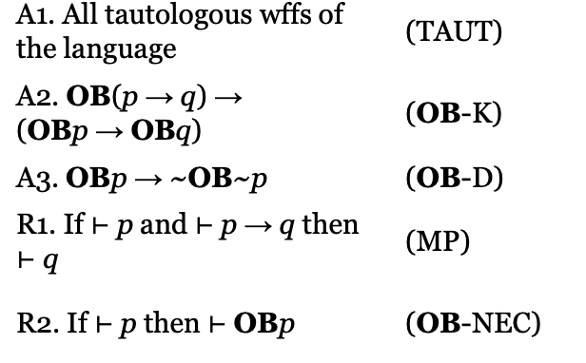
Using norms as an intermediate step
Norms and AI
Game theory: Rules of collaboration- rational behaviour
Agents community:
Norms as obligations.
Norms as goals or objectives from theory to practice.
Norms as constraints.
Norms as part of the environment (sanctions, incentives)
Multi-agent systems: coordination mechanism (marketplace, distributed networks, simulation...).
HCI/ HRI: social norms affect our attitude towards artifacts
Specifications, incorporating in the reasoning of the agent, finding inconsistencies, etc
Deontic logic approaches:
permissible (permitted)
impermissible (forbidden, prohibited)
obligatory (duty, required)
omissible (non-obligatory)
Optional
ought
Argumentation logics: allows for inconsistency and prioritisation.
We have a class just looking into machine ethics: i.e. how we incorporate normative ethical reasoning in AI systems.

Slide 29
Using norms as an intermediate step
Hierarchies of norms
Value1
Privacy
Fairness
Norm 1
Norm 1
Privacy for Client
Fairness for Client
Fairness for Bank
Requirement 1
Requirement 2
Requirement 3
Requirement 4
Request only financial information
Provide mortgage if finances good
Provide low-risk mortgages
Loan < 10x annual salary
Good credit score
Request marriage status, pregnancy info, etc

Slide 30
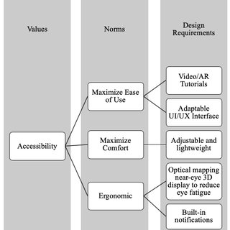
Using norms as an intermediate step
Hierarchies of norms
Gazzaneo, Lucia & Padovano, Antonio & Umbrello, Steven. (2020). Designing Smart Operator 4.0 for Human Values: A Value Sensitive Design Approach. Procedia Manufacturing. 42.
Umbrello, S., van de Poel, I. Mapping value sensitive design onto AI for social good principles. AI Ethics 1, 283–296 (2021). https://doi.org/10.1007/s43681-021-00038-3

Slide 31
IEEE 7001 Standard

Slide 32
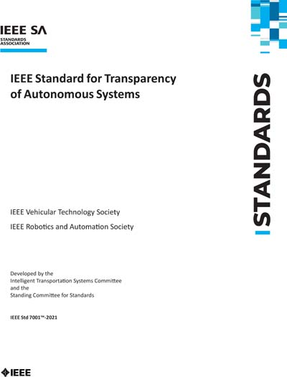
IEEE 7001 Standard
Transparency in 7001 Standard
“To consider an autonomous system transparent to inspection, the stakeholder should have the ability to request meaningful explanations of the system’s status either at a specific moment or over a specific period or of the general principles by which decisions are made (as appropriate to the stakeholder) (Theodorou et. al., 2017)”
Winfield AFT, Booth S, Dennis LA, Egawa T, Hastie H, Jacobs N, Muttram RI, Olszewska JI, Rajabiyazdi F, Theodorou A, Underwood MA, Wortham RH and Watson E (2021) IEEE P7001: A Proposed Standard on Transparency. Front. Robot. AI
Theodorou A., Wortham R.H., and Bryson J. (2017). Designing transparency for real time inspection of autonomous robots. Connection Science, Vol. 29, Issue 3

Slide 33
IEEE 7001 Standard
Stakeholder-specific Requirements
Different stakeholders:
Users
General public/bystanders
Validation and certification agencies and auditors
Incident investigators
Lawyers & Expert Witnesses
We define each stakeholder and added requirements specific to that stakeholder.
5 different non-addictive levels of compliance for each stakeholder.
Lower levels:
passive (e.g. documentation);
easy-to-implement (e.g. LED lights on a robot).
Higher levels:
interactive (e.g. user can query for more information);
proactive (e.g. agent alerts user)
Not an one-size-fits-all approach.

Slide 34
IEEE 7001 Standard
Example: different maturity levels
Low level (1)
The user shall be provided with accessible* documentation that provides as a minimum the following information:
example scenarios with the expected and anticipated system behavior including degraded modes of operation;
general principles of its operation, i.e. if there is a learning component and what data it uses.
*accessible means: in a format which is appropriate to the audio, visual or cognitive capabilities of the system’s intended users.
…
High level (5)
The user shall be provided with a continuous explanation of behavior, which adapts the content and presentation of the explanation based on the user’s information needs and context.
This may include access to log files and training data as long as they do not contain sensitive information such as personal data.
…
Winfield AFT, Booth S, Dennis LA, Egawa T, Hastie H, Jacobs N, Muttram RI, Olszewska JI, Rajabiyazdi F, Theodorou A, Underwood MA, Wortham RH and Watson E (2021) IEEE P7001: A Proposed Standard on Transparency. Front. Robot. AI

Slide 35
IEEE 7001 Standard
Overview
Other P70xx standards may have their own definitions of transparency.
It does not have to be a ‘perfect’ definition. Rather, it needs to be:
Abstract enough to accommodate a variety of requirements, fitting to multiple levels.
Concrete enough that requirements could be extracted and validated.
We provided definitions – and most importantly concrete requirements – for each stakeholder.
Allowing different maturity levels, opens flexibility for different domains and AI approaches.
We didn’t fix the problem of definitions.
We worked around the problem.
The important thing is that we are transparent with actionable requirements.
Winfield AFT, Booth S, Dennis LA, Egawa T, Hastie H, Jacobs N, Muttram RI, Olszewska JI, Rajabiyazdi F, Theodorou A, Underwood MA, Wortham RH and Watson E (2021) IEEE P7001: A Proposed Standard on Transparency. Front. Robot. AI

Slide 36
Summary

Slide 37
Summary
Today’s progress
We looked 2030 Agenda and AI and what is Responsible AI.
Socio-technical systems: a combination of social and technical components
Value sensitive design: a process of breaking down values into requirements using 3 distinct but interlinked investigations: conceptual, empirical, and technical.
Norms: guide and regulate social interactions, we can use them as intermediates in our values-to-requirements hiearchies or even embed them directly!
Thematic units: Governance and AI policymaking.
Progress towards Learning Objectives:
Grasp the importance role of analysing and mitigating socio-ethical issues by forming AI policies at various levels in the society.
Acquire an in-depth knowledge about governmental and intergovernmental AI policy initiatives—particularly by and within the European Union.
Explore how AI Ethics affects the strategy of large and small companies for the development of their AI systems.

Slide 38
Questions?

