Slide 1
University of Cyprus
MAI631
Artificial Intelligence Ethics II
Michael Chatzipanagiotis
September – December 2023

Slide 2
University of Cyprus
Lecture 3: Basics of Law and Regulation of AI
Michael Chatzipanagiotis

Slide 3
Basics of Law and Regulation of AI
Michael Chatzipanagiotis
Assistant Professor in Private Law
mchatz07@ucy.ac.cy

Slide 4
What is law?
A system of rules, usually binding, which regulate human activities and relationships.
Objective: Prevent and solve problems.
Laid down by institutions or persons with the power and authority to create law.
They often involve a balance of conflicting interests.
Each country has its own legal rules, despite the existence of common rules in some cases, such as international law and EU law.

Slide 5
Law and morals/ ethics
Morals
Law
Ethics

Slide 6
Main branches of law
Public law -> regulates the relationships between the State and its citizens or people lining in its territory
Private law -> regulates relationships between individuals
Criminal law –> public law establishing specific behaviours as worthy of punishment and laying down punishments for violation of its rules. Criminal law is often a reflection of the morals of a society (e.g. criminalization of adultery, homosexuality).

Slide 7
Hierarchy of norms
Constitution, EU law and International law
Laws voted by the parliament/ judicial judgments (in common-law countries)
Administrative acts
The hierarchy is important in cases of conflicting norms -> if there is no conflict, then the hierarchy of norms is not practically important.

Slide 8
Fundamental rights
‘Right’ = Interest recognized and protected by a legal rule
‘Fundamental’ or ‘human’ rights = rights inherent to all human beings, without any discrimination (e.g. nationality, place of residence, sex, national or ethnic origin, colour, religion, language etc.). These rights enjoy a very high degree protection and are enshrined in the Constitution and special international treaties or texts (e.g. UN Declaration of Human Rights, European Convention of Human Rights, Charter of Fundamental Rights in the EU)
Fundamental rights are not absolute. They are often subject to limitations, because they may be conflicting with each other.
-> Balance of interests, depending on the circumstances of the particular case.
-> Principle of proportionality: the limitation of the right should not exceed what is strictly necessary to achieve a lawful purpose.
See e.g. Arts 2, 8, 10, 17 and 18 of the European Convention of Human Rights.

Slide 10
EU law
Division of competences between the EU and its Member States
EU law supersedes national law, if there are conflicting provisions.
Primary EU law: Treaty on the Functioning of the EU (TFEU), Treaty on the European Union (TEU), Charter of Fundamental Rights in the EU (CFREU)
Secondary EU law comprises mainly Regulations and Directives.
Regulation: Directly applicable to the MS.
Directive: Defines an objective and leaves it to the MS to determine the means for its achievement. They require implementing measures to have effect in national legal systems.

Slide 11
Legislative procedure of EU law
Determination of policy objectives, based on provisions of primary EU law.
The Commission lays down a proposal for a Directive or a Regulation.
The Parliament and the Council of the EU provide their views.
Tripartite negotiations (‘trilogues’) take place for the finalisation of the legislative text.
Implementing measures may follow by the Commission and/or the MS.

Slide 12
Regulation of AI
Source: stock.adobe.com

Slide 13
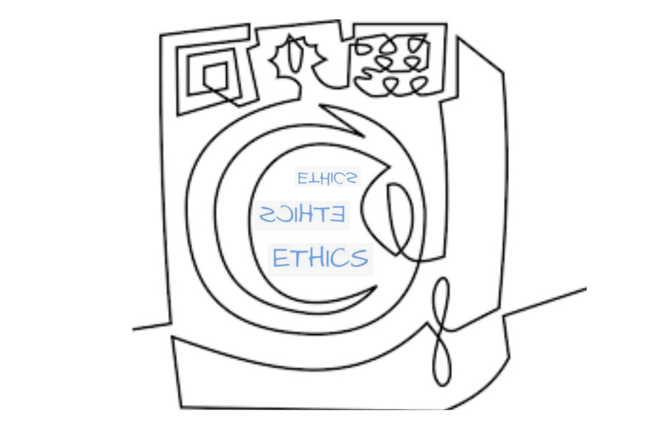
Introduction
In the previous episode…
We reviewed the current landscape for soft policy: guidelines and standards.
We briefly looked at the interaction between standards and legislation.
We identified the core problem: lack of concrete assessment due to the abstract nature of the values used.
There are multiple interpretations of the same value; some conflict with each other resulting to values conflict.
Still, a question is whose and which values? How?

Slide 14
Generic remarks
Regulation of AI = special rules on AI
Lack of regulation ≠ Legal vacuum (general legal rules apply, e.g. on prohibition of discrimination, personal data processing, protection of Intellectual Property Rights etc.)
Need to consider various factors, such as to
protect fundamental rights of citizens
be future proof (i.e. effective despite technological development)
foster (or at least not hinder) innovation
ensure effective enforcement

Slide 15
Main challenges in regulation of AI
Technological development is much faster than legislative proceedings
-> Future proof regulation
2) Technological development does not know any national borders
-> International rules necessary
3) Balance protection of society and users with technological innovation and economic development.
4) Enforcement issues

Slide 16
Special rules in other pieces of EU legislation
GDPR (automated decision-making)
Digital Markets Act (competition issues)
Digital Services Act (control of illegal content)
Draft Modernisation of the Product Liability Directive (strict civil liability)
Draft AI Liability Act (civil liability for fault)
Draft Modernisation of the Machinery Directive (industrial machinery/ robots)
General Product Safety Regulation (identification and communication of notified dangerous products )
Consumer Rights Directive (notification for personalised pricing)

Slide 17
The (draft) AI Act
source: slate.com
source: tenor.com

Slide 18
AI Act – General characteristics
Human-centric (safe, compliant with the law and respect of fundamental rights)
Risk based (regulation depended on the risk posed by particular applications)
Based on the AI Ethics Guidelines, developed in 2019 by the HLEG
[The European Parliament wants the AI Ethics Guidelines to be explicitly incorporated in the text of the AI Act as “General principles applicable to all AI systems]
[Still a draft, negotiations among the Council, the Parliament and the Commission ongoing]

Slide 19
Inspired by the rules on product safety
Quality-assurance requirements
Market surveillance powers and procedures
One generic instrument, accompanied by sectoral legislation and implementing provisions
Inspired by the GDPR as to enforcement
EU-wide consulting board
Provisions on coordination of enforcement and hefty fines

Slide 20
Risks under the AI Act - overview
Source: digital-strategy.ec.europa.eu

Slide 21
Risk categories and their implications
Unacceptable risk
Social scoring,
Exploitation of vulnerable persons
Use of ‘subliminal techniques’ to distort a person’s behaviour in a manner likely to cause harm to such person or to others
Remote biometric identification in public areas,
Emotion recognition in law enforcement, border management, the workplace, and educational institutions,
Predictive policing
-> Prohibited

Slide 22
2) High risk -> Significant harm to
health,
safety,
fundamental rights,
critical infrastructure
the environment,
electoral behavior of voters,
recommender systems of online platforms
List of legislation in Annex II + List in Annex III, which the Commission can update with simplified procedures
-> subject to compliance with certain mandatory requirements and an ex-ante conformity assessment

Slide 23
Requirements for high-risk AI systems
Risk management system (Art. 9):
risk analysis and mitigation measures so that the overall risk posed is acceptable
Consideration of combined use with other systems or products
For providers of AI systems that are subject to special sectoral requirements regarding internal risk management processes, risk management under the AI Act may be part of these internal processes
2. Data and data governance (Art. 10):
training, validation and testing data that meet specific quality requirements
-> Non compliance can lead to fines up to 6% annual global turnover
3. Technical documentation (Art. 11): documentation demonstrating compliance with regulatory requirements

Slide 24
4. Ability for automated recording of events (logs) (Art. 12)
Ensure traceability of the functioning of the AI system throughout its lifecycle
5. Transparency and provision of information to users (Art. 13) (incl. explainability)
6. Human oversight (Art. 14)
Built-in measures
Measures to be implemented by the user
7. Accuracy, robustness and cybersecurity (Art. 15)

Slide 25
Obligations of providers of high-risk AI systems
Quality management system for regulatory compliance (Art. 17).
Documentation of the elements mentioned in Annex IV (Art. 18)
Conformity assessment under Art. 43 prior to placing on the market or putting into service (Art. 19)
Keeping of automatically generated logs for at least six months (Art. 20)
Investigation and corrective action in suspected cases of non-compliance (Art. 21)
Duty to inform the competent supervisory authority in case of an AI system that presents a risk at national level under Art. 65 AI Act (Art. 22)
Cooperation with competent authorities, incl. access to logs (Art. 23)

Slide 26
Obligations of other persons
Manufacturers (Art. 24)
Importers (Art. 26)
Authorised representatives (for non-EU providers and where an importer cannot be identified) (Art. 25)
Distributors (Art. 27)
Anyone who markets the AI product/ service in its own name or modifies the intended purpose of the product or modifies substantially the product shall have the duties of an AI provider (Art. 28)
Professional users of high-risk AI systems (Art. 29)

Slide 27
Foundation models
The European Parliament wants special provisions on providers of foundation models to be inserted in the AI Act. These include:
assessment and mitigation of risks to health, safety, fundamental rights, environment, democracy and the rule of law;
use of datasets according to appropriate data governance measures, to ensure especially that are free from biases;
design and development of the foundation model in order to achieve throughout its lifecycle appropriate levels of performance, predictability, interpretability, corrigibility, safety and cybersecurity
ensure that the model is energy efficient;

Slide 28
draw up extensive technical documentation and intelligible instructions for use, in order to enable the downstream providers to comply with their obligations;
registration of the foundation models in a special database;
special requirements for providers of LLMs, including
ensure that the model does not generate illegal content
documentation and publication of a sufficiently detailed summary of the use of training data protected under copyright law.

Slide 29
The role of standardisation
Technical standards as key to ensure conformity (Arts 40-41)
European harmonised standards under Regulation 1025/2012.
Common specifications adopted by the Commission, if EU harmonised standards do not exist, or the Commission finds them insufficient.
International technical standards
(National technical standards)
Source: freepik.com

Slide 30
3) Limited risk (Art. 52)
Systems presenting specific manipulation risks
Commission expects it to comprise the majority of AI systems/ products
-> Transparency obligations (e.g. notify users that they are interacting with an AI system, notification of AI generated content etc.)
4) Minimal risk
-> No obligations

Slide 31
Support of innovation (Art. 53-54)
Regulatory sandboxes (special environments with laxed regulatory requirements for experimentation under real-world conditions)
Reduced regulatory duties for SMEs and start-ups

Slide 32
Governance and implementation
Establishment of European AI Board (Arts 56-58)
Representatives of the Commission, the MS supervisory authorities and the European Data Protection Supervisor
Facilitate harmonised implementation through cooperation with national authorities and the Commission, advising the Commission, collection of best practices etc.
Designation of national supervisory authorities (Art. 59)
Public EU-wide database for stand-alone high-risk AI systems (Art. 60)
Operated by the Commission
Data from AI system operators, which have a registration duty

Slide 33
Post-market monitoring and reporting duties of high-risk AI systems providers (Arts 61-62)
Market surveillance powers of supervisory authorities (Arts 63-68)
Providers of AI systems must grant to supervisory authorities full access to training, validation and testing datasets
Providers of high-risk AI systems may have to grant access to the source code
Providers of high-risk AI systems must grant access to any documentation created or maintained under the AI Act
Supervisory authorities may request providers of high-risk AI systems to organize testing.
Power to order restoration of conformity, withdrawal from the market or recall, yet the Commission may evaluate the lawfulness and necessity of such measures
However, supervisory authorities have also confidentiality duties
Establishment of non-binding codes of conduct for providers of non-high risk AI systems (Art. 69)

Slide 34
Criticism of the draft AI Act
One size does not fit all
Too vague requirements
Too strict requirements will affect innovation and technological development
Dual use systems? (AI Act inapplicable to military systems)
Major enforcement challenges
Coordination among competent authorities at national, cross-border and EU level
Resources of the supervisory authorities (human and material)
Doubts on the effectiveness of enforcement

Slide 35
Conclusion on AI regulation
Source: oneclass.com
Source: stock.adobe.com

Slide 36
To be continued…

Slide 37
Questions?

