Slide 1
University of Cyprus
Lecture 5:
Machine Ethics
Dr. Andreas Theodorou
October, 2023

Slide 2
Introduction
In the previous episodes…
We reviewed the current policy landscape!
We talked about the current legal landscape.
We talked about value elicitation techniques, participatory design, and socio-technical systems.
Still, a question is: how do we integrate the above into AI systems?

Slide 3
Introduction
Lecture Overview
Today’s Structure:
Engineering Machine Ethics
Moor’s Ethical Agents
Deontic Logic
SOTA Examples
Moral standards
Today’s Goals:
Thematic units: Evaluation of AI policy and Challenges for “Ethicacy” of AI policy
Learning Objectives:
4. Develop a critical understanding of socio-technical mechanisms for the governance of AI systems, recognizing the drawbacks and benefits of each approach.
5. Reflect upon how research in AI feeds into AI policy and how AI policy creates new needs for research into AI Ethics.

Slide 4
AI Ethics vs Machine Ethics
AI Ethics emphasizes the responsibility of the developer/user towards ensuring:
The developer is responsible for the ethical decision making!
Machine Ethics focus on building ‘ethical reasoning’ into AI systems themselves.
Ethical Impact Agents
Implicit Ethical Agents
Explicit Ethical Agents
Autonomous Explicit Ethical Agents
The machine is ‘responsible’ for ethical decision making.

Slide 5
Engineering Machine Ethics

Slide 6

Engineering Machine Ethics
Engineering Machine Ethics
Top-down strategies: agent acts in accordance with the principles underlying ethical theories that are meant to guide decision making.
  Engineering approach: breaking down a problem into subproblems until a solution can be found, i.e. given an ethical framework, move to concrete rules.
Bottom-up strategies: ethical behaviour emerges via the collective activity of individuals.
  Engineering approach: describing the solution, find an answer to solve the problem, i.e. training an agent to solve the problem at hand.
Hybrid approaches: there are increased discussions on combining top-down and bottom-up approaches. Hint: the surge for neuro-symbolic approaches are driving these discussions.
Virtue Ethics
Being fair
Upholding group Fairness
Statistical Parity
$$k_{SP}<k_{1}$$
Wallach, W., Allen, C. & Smit, I. (2008). “Machine morality: bottom-up and top-down approaches for modelling human moral faculties.” AI & Soci. https://doi.org/10.1007/s00146-007-0099-0

Slide 7
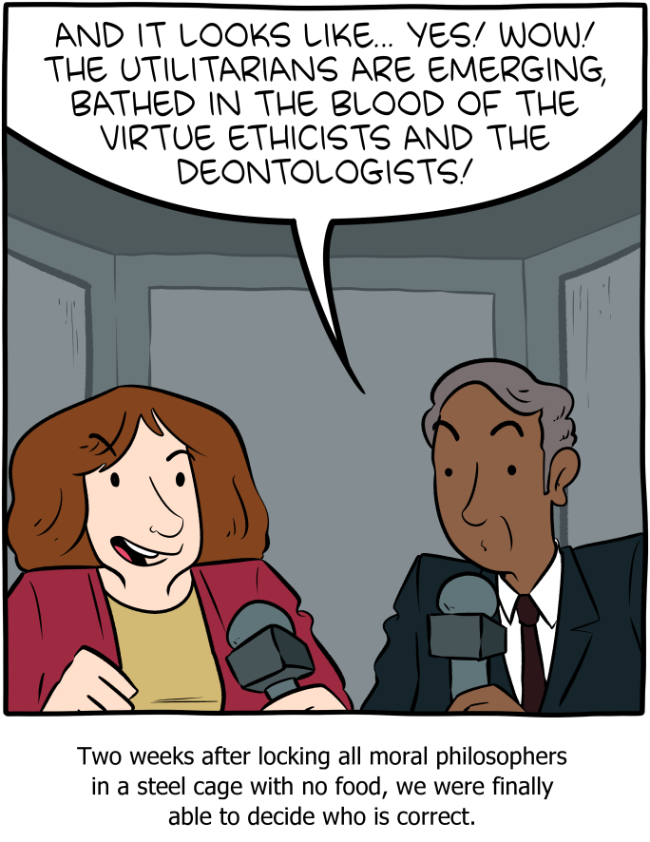
Building Machine Ethics
Top-down approaches
Advantages:
Transparency: we know which theory to expect compliance towards to.
Verification: we can easily change if an action complies or not
Disadvantages:
Which theory should be used?
Standards placed on the machine: idealistic —if not unrealistic.
Requires lots of computational power during run time.
Picture: Saturday Morning Breakfast Cereal.
https://www.smbc-comics.com/comic/ethics-2

Slide 8
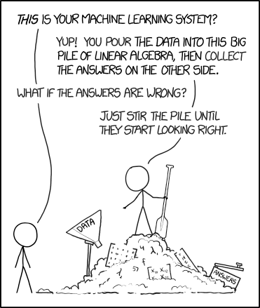
Building Machine Ethics
Bottoms-up approaches
Advantages:
More ‘human-like’ approach:
  People make decisions with moral worth without considering specific moral theories. Instead, they base their decisions on personal and cultural biases.
  People learn little-by-little how to be ‘moral.’
Robust and fast at runtime; full autonomous!
Less concerns that the developer forgot something, e.g. a rule.
Disadvantages:
Uncertainty on what will be produced behaviour.
Labelling training data as good/ bad and/or defining the reward function is still objective.
Requires lots of computational power during training.
Picture: xkcd Machine Learning https://xkcd.com/1838/

Slide 9

Building Machine Ethics
Hybrid approaches
Advantages:
Maintain the dynamic and flexible morality of bottom-up approaches, but also have the transparency and verifiability of top-down systems.
Disadvantages:
Hard to implement — lack of research!
No such thing as a free lunch: they take more time in runtime than pure bottom-up approaches, but also more time in training than pure top-down approaches.

Slide 10
morally accountable actions. MTT-based evaluations are vulnerable to deception, inadequate reasoning, and inferior moral performance
1 thomas.arnold@tufts.edu, matthias.scheutz@tufts.edu
vis a vis a system’s capabilities.
morally accountable actions. MTT-based evaluations are vulnerable to deception, inadequate reasoning, and inferior moral performance
1 thomas.arnold@tufts.edu, matthias.scheutz@tufts.edu
vis a vis a system’s capabilities.
Building Machine Ethics
Ethical Turing Test
Allen et. al. propose the use of a test, named after the well-known ‘Turing Test,’ to judge if an agent’s moral behaviour is acceptable or not.
They state how “Human-like performance, which is prone to include immoral actions, may not be acceptable in machines, but moral perfection may be computationally unattainable.” but still recognise the need to ensure of adequate moral behaviour.
The test, like in the original Turing Test, is meant to answer the question: can a machine think? Later iterations defined it further to include questions such as: which ethical theory computational approaches to moral judgment the system employs?
The test is vulnerable to deception.
The test itself is flawed: what is considered moral or not, lies on the eyes of the observer.
A system can get the ‘right answers’ even if ‘moral reasoning’ was not explicitly part of the decision-making process.
To date, no such test has been produced or used. However, the discussions never die! Instead, they appear every few years.
Allen, C., Varner, G., and Zinser, J. (2000). “Prolegomena to any future artificial moral agent.” Journal of Experimental & Theoretical Artificial Intelligence
Arnold T. and Scheutz M. (2016). “Against the Moral Turing Test: Accountable Design and the Moral Reasoning of Autonomous System.” Ethics of Information Technology

Slide 11
Moor’s ethical agents

Slide 12
Moor’s ethical agents
Moor’s categories
Moor categorised agents in 4 categories with regards to their ethical impact/ reasoning capabilities:
Ethical Impact Agents
Implicit Ethical Agents
Explicit Ethical Agents
Full Ethical Agents
Realistic
Science Fiction
Moor J. H. (2006). “The Nature, Importance, and Difficulty of Machine Ethics.” IEEE Intelligent Systems.

Slide 13
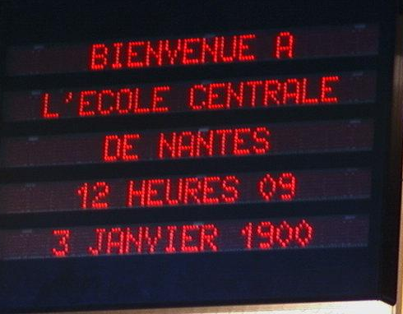
Moor’s ethical agents
Ethical impact agents
Any agents whose actions result to an ethical impact whether intended or not.
Answering how machines handle issues of privacy, property, power, etc.
An agent that compares dates but has the millennium bug is such an example:
  ethical impact agent before 2000, (i.e. when systems were working);
  unethical impact agent thereafter (i.e. after dates were misrepresented).
Arguably, all agents have an (un)ethical impact.
e
Picture: Bug de l'an 2000, CC BY-SA 3.0

Slide 14

Moor’s ethical agents
Implicit ethical agents
Agents programmed to have a fail-safe or a built-in virtue to avoid ‘unethical behaviour.’
Mostly related to the ‘AI Safety’ field: ensuring that machines are designed such as not to harm humans and avoid unethical behaviour.
A top-down view: how can we constrain the actions of an agent so that they follow a given moral theory?
A bottoms-up view: how do we build the necessary fail-safe or critical features to ensure safety?

Slide 15
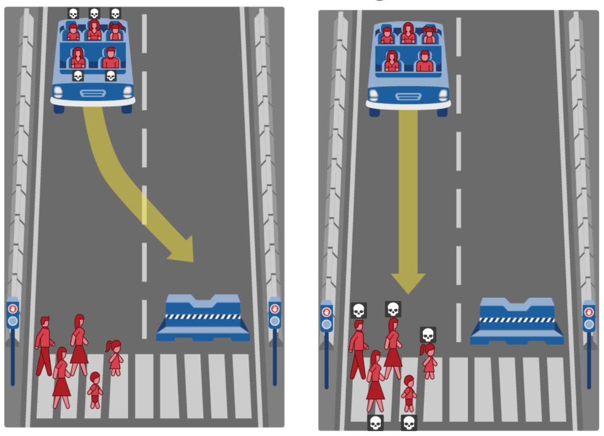
Moor’s ethical agents
Explicit ethical agents
Agents capable of processing scenarios and acting on ethical decisions; i.e. make ethical decisions on a dynamic basis.
Agents are not considered conscious.
Top-down view: how can we build the agent to follow a given moral theory?
Bottom-down view: how to build an agent that given examples of right and wrong learns to make moral choices?
Awad et. al.(2018). “The Moral Machine Experiment.” Nature

Slide 16
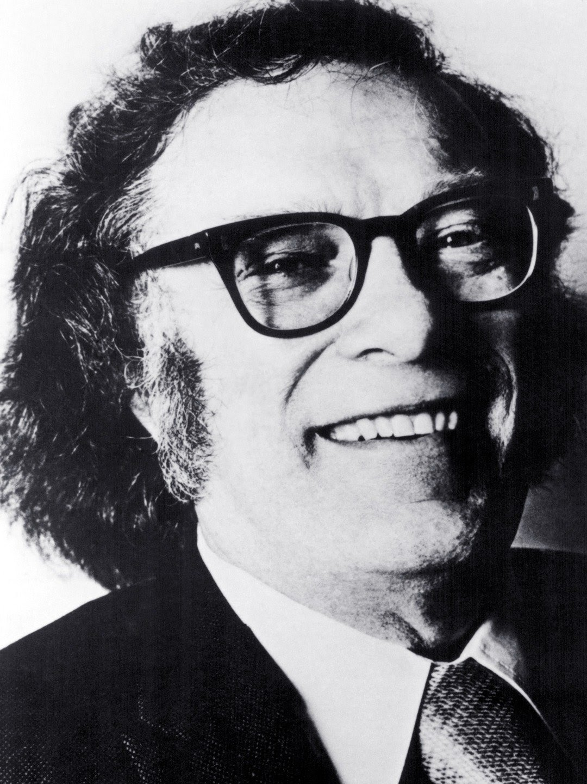
Moor’s ethical agents
Three Laws of Robotics
A robot may not injure a human being or, through inaction, allow a human being to come to harm.
A robot must obey the orders given it by human beings except where such orders would conflict with the First Law.
A robot must protect its own existence as long as such protection does not conflict with the First or Second Laws

Slide 17
Dyrkolbotn
Sjur Dyrkolbotn
Western Norway University of Applied Sciences, Bergen, Norway
View Profile
,
Moor’s ethical agents
Implicit vs Explicit Ethical Agents
Moor’s distinction boils down to explicit agents being able to ‘reason’ over ‘ethics.’
Realistically, “ethical” refers to explicit normative behaviour rather than a fully-fledged theory of ethics.
Saying that a machine is following virtue or utilitarian is as abstract as saying fairness:
E.g. Based on Dyrkolbotn et al. (2018), a calculator can be said to maximise the utility, i.e. act in a utilitarian way with regards to its function, associated with correct arithmetic but none will that ethical behaviour!
E.g. An autonomous vehicle developed to limit human casualties in case of a fault may be consider utilitarian given a specific interpretation.
The difference between implicit and explicit ethical agents can only be discovered by looking at the internal logic of the agents.
Agents are highly complex, with opaque emerging behaviour meaning that it is very hard to predict and understand —particularly in uncontrolled environments.
Categorising agents becomes a philosophical debate on the origins of the intention behind the action and up to the observant of the behaviour.
Dyrkolbotn S. et al. (2018). “On the distinction between implicit and explicit ethical agency .” AAAI/ACM Conference on AI, Ethics, and Society
Notes:
By contrast, a human agent that is very bad at calculat- ing and always makes the wrong decision might still be an explicit utilitarian, provided that the human attempts to ap- ply utilitarian principles to reach conclusions. The autonomy needed to regard the behaviour as agency is now present, along with some (flawed) knowledge of how to apply util- itarianism. Unlike a human, the artificial agent might have perfect knowledge about the relevant rules and how to ap- ply them. However, when it is given a set of numbers and a utility function associated with possible outcomes, it cannot be said to engage in autonomous reasoning about the ethi- cal utility of its choice. Hence, it is an implicit ethical agent

Slide 18
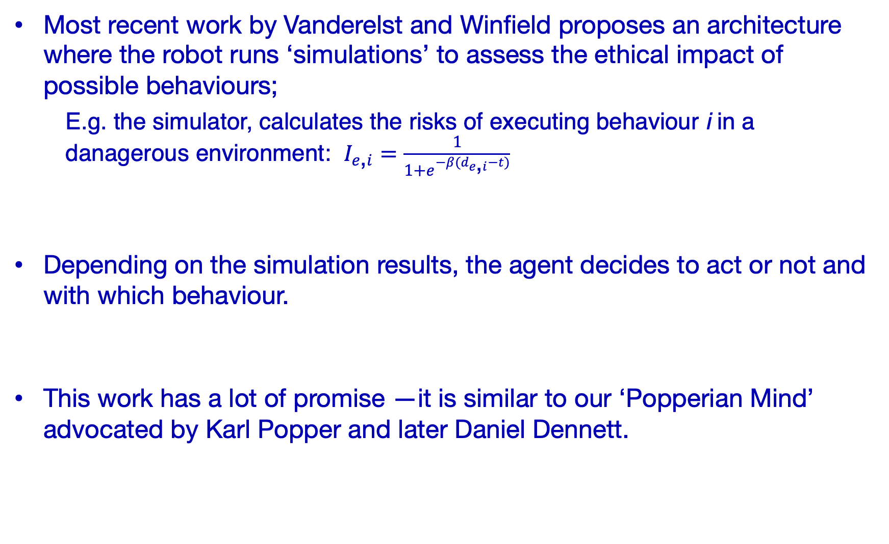
Moor’s ethical agents
Explicit ethical agents
Ethical concepts are internally represented and used by the agent in its decision making.
For top-down approaches, multiple frameworks and architectures exist to ensure normative behaviour.
For bottom-up approaches, we have seen the use of min-max
Hybrid approaches rely on using symbolic representations of values for monitoring and correction purposes.
Most recent work by Vanderelst and Winfield proposes an architecture where the robot runs ‘simulations’ to assess the ethical impact of possible behaviours;
  E.g. the simulator, calculates the risks of executing behaviour i in a danagerous environment: $I_{e\text{,}i}=\frac{1}{1+e^{−β(d_{e\text{,}i}−t)}}$
Depending on the simulation results, the agent decides to act or not and with which behaviour.
This work has a lot of promise —it is similar to our ‘Popperian Mind’ advocated by Karl Popper and later Daniel Dennett.
Vanderelst D. and Winfield A.(2018). “An architecture for ethical robots inspired by the simulation theory of cognition.” Cognitive Science Research

Slide 19
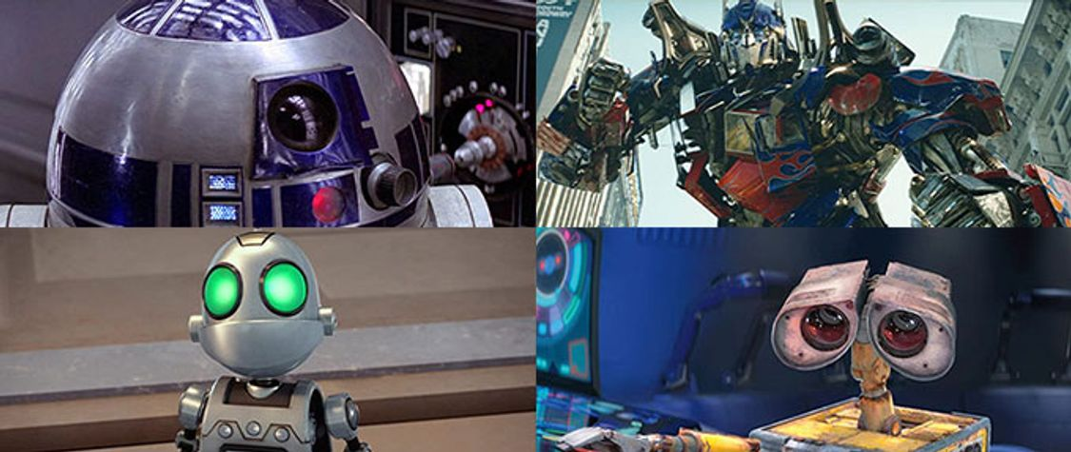
Moor’s ethical agents
Full ethical agents
Like explicit ethical agents, they can reason and make decisions with ‘ethical considerations’ in mind.
Unlike explicit ethical agents, full ethical agents are attributed with the metaphysical features of consciousness, intentionality, and free will.
Normal adult humans are our only example of full ethical agents.
Full ethical agents implies moral agency.

Slide 20
Moor’s ethical agents
Moral Agency
Special type of agency: agents that are entitled to benefits but also have moral obligations to other entities.
The main conditions ‘universally’ agreed:
  Able to reason and decide how to act;
  Able to pass moral judgement, i.e. understand what is right and what is wrong, on its decisions; and
  Makes its decision out of its own free will.
This means that infants, children, and even mentally ill are not moral agents.
What is right or wrong depends on many factors and it has been debated since the Ancient Greeks…
The concept of moral agency led to the inclusion of the concept of mens rea in law: the state of mind during an act.
Depending on the mens rea, the sentencing of an act can be affected.
For animals, environemnt, infants, children and mentally ill moral patiency: i.e. entities entitled to benefits but have no moral obligations to others.

Slide 21
Deontic Logic

Slide 22
Deontic Logic
Logics
Propositional logic: statements and operations over statements
First order logic: properties of statements (quantify over statements)
Modal logic: relations between sets of statements (states/worlds)
Second order logic: properties of properties (quantify over properties)
If something is a bird, then it can fly. bird(x) →fly(x)
All birds can fly. ∀x bird(x) →fly(x)
If something is a bird, then it is possible that it can fly. b → P(f)
Two birds are the same species if they share the same features. (𝑥=𝑦)⟺(∀𝐴.(𝐴𝑥)⟺(𝐴𝑦))

Slide 23
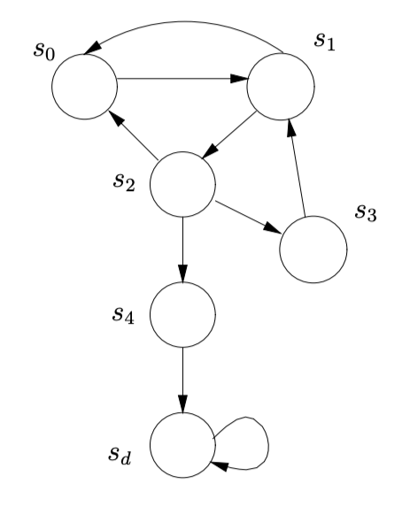
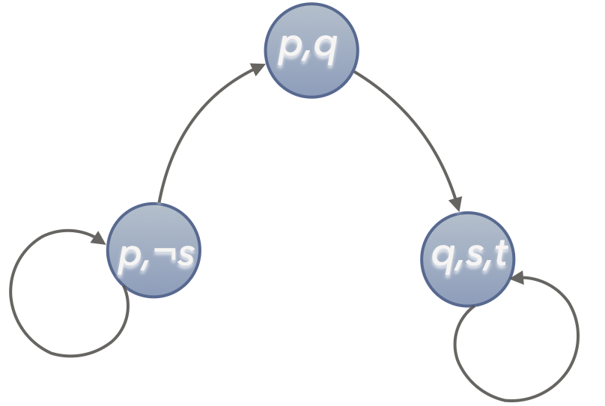
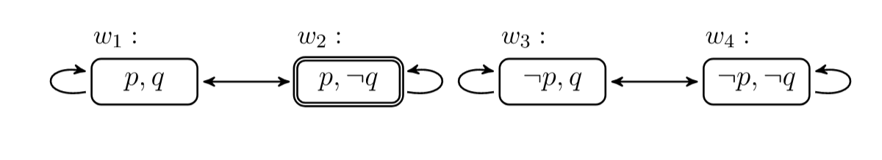
Deontic Logic
Modal Logic
Family of logics which uses additional operators and axioms over first-order logic.
Different modalities express different types of statements, e.g.
  alethic modality necessary and possible as additional operators
  temporal modality with necessary « "always" and possible sometimes
  deontic modality with permissible (allowed) and obligatory (must)
  epistemic modality with knows and beliefs as operators

Slide 24
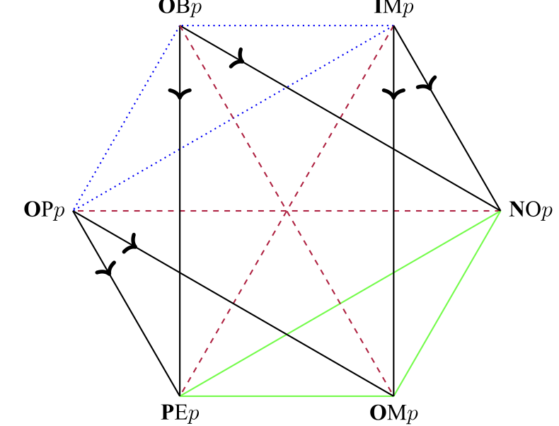
Deontic Logic
Telling agents what and what not to do
The basic deontological ethical theory suggests that an action is right or wrong based on rules that exist at time of execution rather than its outcome.
The five normative statuses are:
  it is obligatory that (OB)
  it is permissible that (PE)
  it is impermissible (prohibited) that (IM)
  it is omissible that (OM)
  it is optional that (OP)
It is generally assumed that:
  If OBp then p (if it is obligatory that p, then p is true).
  If p, then PEp (if p is true, then it is permissible).
Arrowed line: implication
Dotted blue lines: contrary (cannot be true together)
Green lines: subcontraries (cannot be false together)
Dashed purple lines: contradictories (cannot be true or false together)
Stanford’s Plato Encyclopedia https://plato.stanford.edu/entries/logic-deontic/
Notes:
Implication [arrowed line],
OBp (corner 1) to NOp (corner 3)
OBp (corner 1) to PEp (corner 5)
IMp (corner 2) to NOp (corner 3)
IMp (corner 2) to OMp (corner 4)
OPp (corner 6) to OMp (corner 4)
OPp (corner 6) to PEp (corner 5)
Contraries [dotted blue line],
OBp and IMp (corners 1 and 2)
OBp and OPp (corners 1 and 6)
IMp and OPp (corners 2 and 6)
Subcontraries [green line],
NOp and OMp (corners 3 and 4)
NOp and PEp (corners 3 and 5)
PEp and OMp (corners 4 and 5)
Contradictories [dashed purple lines].
OBp and OMp (corners 1 and 4)
IMp and PEp (corners 2 and 5)
NOp and OPp (corners 3 and 6)

Slide 25
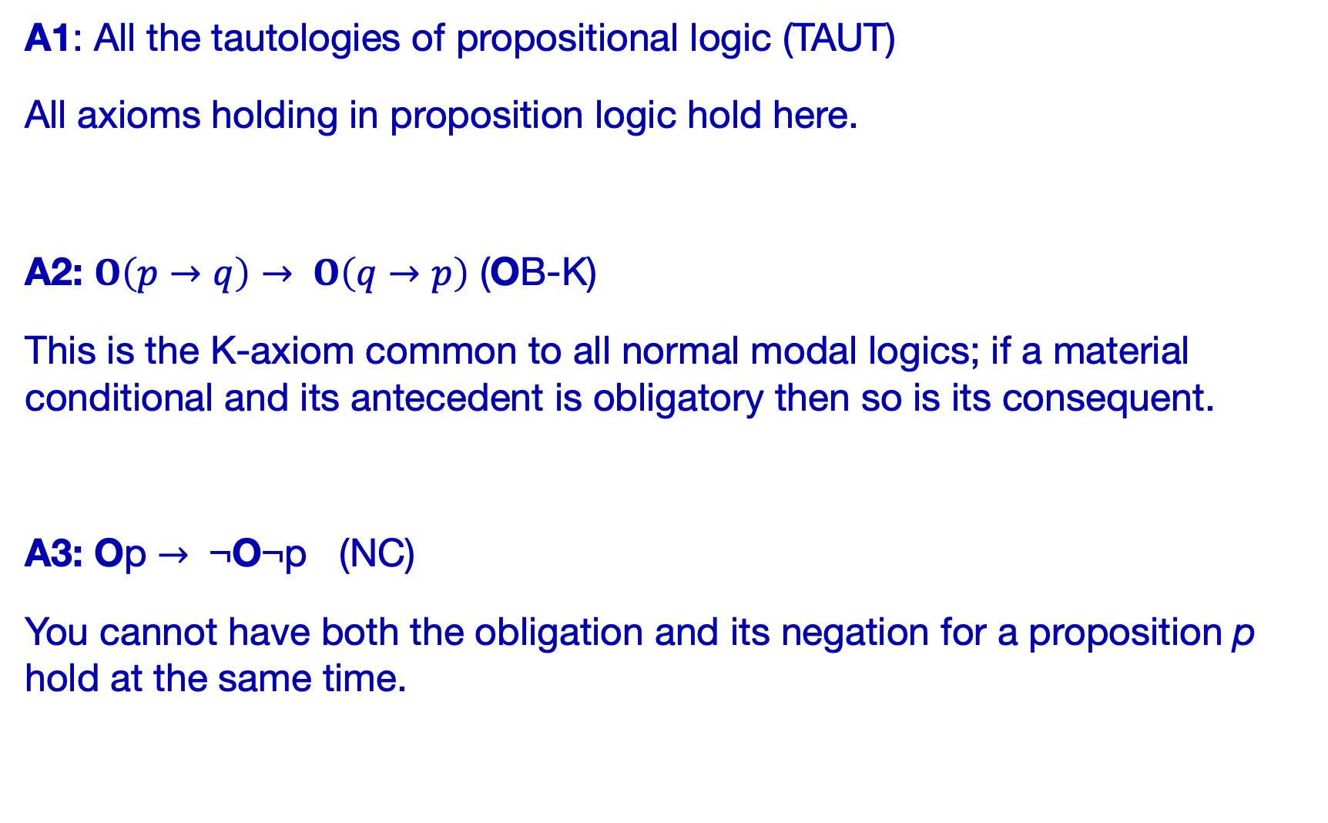

Deontic Logic
Standard Deontic Logic (SDL)
A1: All the tautologies of propositional logic (TAUT)
All axioms holding in proposition logic hold here.
A2: $O\left(p→q\right)→ O\left(q→p\right)$ (OB-K)
This is the K-axiom common to all normal modal logics; if a material conditional and its antecedent is obligatory then so is its consequent.
A3: Op $→$ ¬O¬p (NC)
You cannot have both the obligation and its negation for a proposition p hold at the same time.
R1: If $⊢p$ and $⊢p→q$ then $⊢q$ (MP)
Compliments A1 for theorems.
R2: If $⊢p$, then $⊢OBp$ (OB-NEC)
If anything is a theorem, then the claim that that thing is obligatory is also a theorem.
Stanford’s Plato Encyclopedia https://plato.stanford.edu/entries/logic-deontic/

Slide 26

Deontic Logic
Chisholm's Paradox
It ought to be that Jones goes (to the assistance of his neighbours).
It ought to be that if Jones goes, then he tells them he is coming.
If Jones doesn't go, then he ought not tell them he is coming.
Jones doesn't go.
Og
O $\left(g→t\right)$
¬g $→$ O(¬t)
¬g
g
t

Slide 27


Deontic Logic
Chisholm's Paradox
Given:
Og
O $\left(g→t\right)$
¬g $→$ O(¬t)
¬g
does either Ot or O¬t hold?
Given OB-K and popositions 1-2, Ot holds!
Given propositions 3-4 then O¬t also holds!
A1: All the tautologies of propositional logic (TAUT)
A2: $O\left(p→q\right)→ O\left(q→p\right)$ (OB-K)
A3: Op $→$ ¬O¬p (NC)
R1: If $⊢p$ and $⊢p→q$ then $⊢q$ (MP)
R2: If $⊢p$, then $⊢OBp$ (OB-NEC)

Slide 28

Deontic Logic
Forrester’s Pradox
It is obligatory (under the law) that Smith not murder Jones.
It is obligatory that, if Smith murders Jones, Smith murder Jones gently.
Smith murders Jones.
Is Smith obliged to kill Jones?
O¬k
O(k $→$g) $→($k $→$Og )
k
Ok because of axiom OB-K

Slide 29
SOTA EXAMPLES
(Not in the exams)

Slide 30
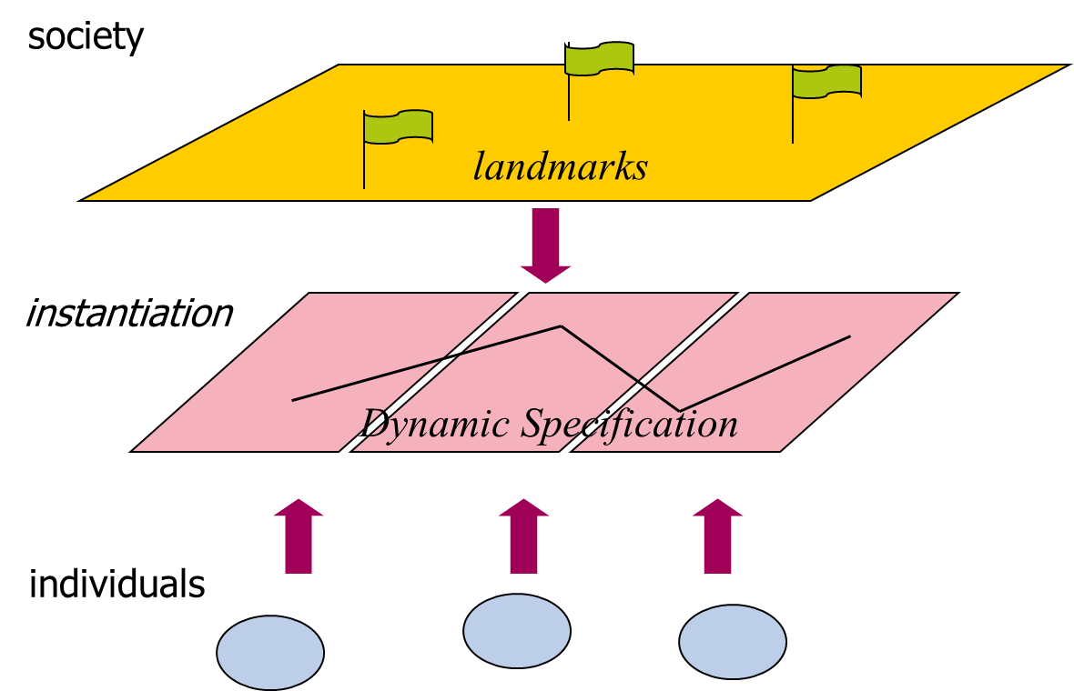
SOTA EXAMPLES: AWKWARD
OPERA
Allow us to define temporal interaction scenes and social roles for the agents in those interaction scenes.
Deontic operator describe permitted, obliged, and non-permitted normative behaviours for each role.
IF … THEN
  OBLIGED(role A, behaviour)
ELSE
  NOT PERMITTED(role B, behaviour)
ENDIF
Dignum, V. (2004). A model for organizational interaction: based on agents, founded in logic. PhD thesis.

Slide 31
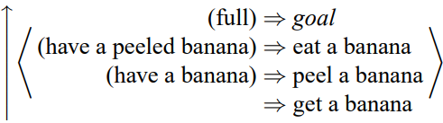
SOTA EXAMPLES: AWKWARD
Behaviour Oriented Design
Reactive planning paradigm: a prioritised list of actions converging to a goal.
Each action requires stimuli to be activated; guarding it by its environmental context requirement.
Bryson, J. J. (2001). Intelligence by design: Principles of modularity and coordination for engineering complex adaptive agents. PhD thesis,

Slide 32
SOTA EXAMPLES: AWKWARD
Behaviour Oriented Design
Reactive planning paradigm: a prioritised list of actions converging to a goal.
Each action requires stimuli to be activated; guarding it by its environmental context requirement.
Bryson, J. J. (2001). Intelligence by design: Principles of modularity and coordination for engineering complex adaptive agents. PhD thesis,

Slide 33
SOTA EXAMPLES: AWKWARD
Agents With Knowledge About Real-time Duties
Fulfilment of societal goals requires altruistic or other pro-social behaviour.
Fulfilment of individual goals may require freeriding, selfish, and anti-social behaviours.
There is a need to alternate between different behaviours given the situation.
Inspired by Dennett’s Kinds of Minds:
  Darwinian – hardwired in phenotypes (evolutions)
  Skinnerian – ABC Learning
  Popperian – permits our hypotheses to die in head
  Gregorian – import tools from cultural environment
Or even ‘System 1/ System 2’

Slide 34
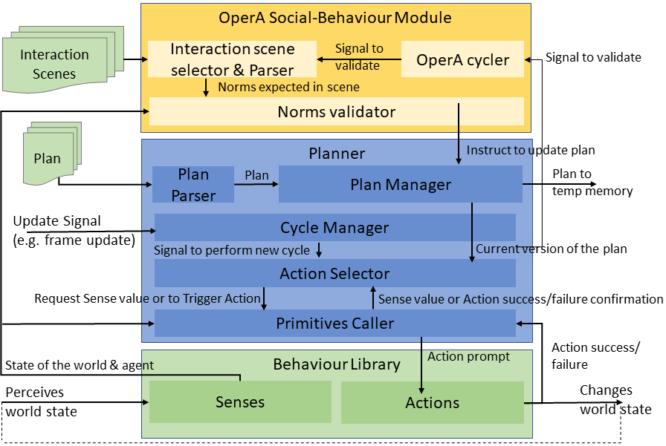
SOTA EXAMPLES: AWKWARD
Agents With Knowledge About Real-time Duties
OperA
Behaviour Oriented Design
Methnani, L., Antoniades, A., & Theodorou, A. (2022). Embracing AWKWARD! Real-time Adjustment of Reactive Plans Using Social Norms. COINE 2022. arXiv:2204.10740.
Notes:
OperA in particular offers an interaction model that allows for the specification of agreements between the agents in the form of interaction contracts. These contracts also serve as verification for the fulfilment of interaction agreements between relevant actors, thus giving us the power to adjust agents’ plans for action-selection in real-time. These specifications surely also offer transparency into the interactions that occur between agents without requiring knowledge about internal architecture of the individual agent.
Then, for the individual agent, we look towards Behaviour-based approaches for the advantage of quick and reactive behavioural adjustments to dynamic and uncertain environments. More specifically we use Behaviour Oriented Design which is a cognitive architecture that comes also with an agile methodology for developing modular reactive planning agents. Again, emphasis is put on transparency both during the development process and the modular structure of the agent itself.
What we developed is a hybrid architecture called Agents With KnoWledge About Real-Time Duties, or AWKWARD for short.

Slide 35
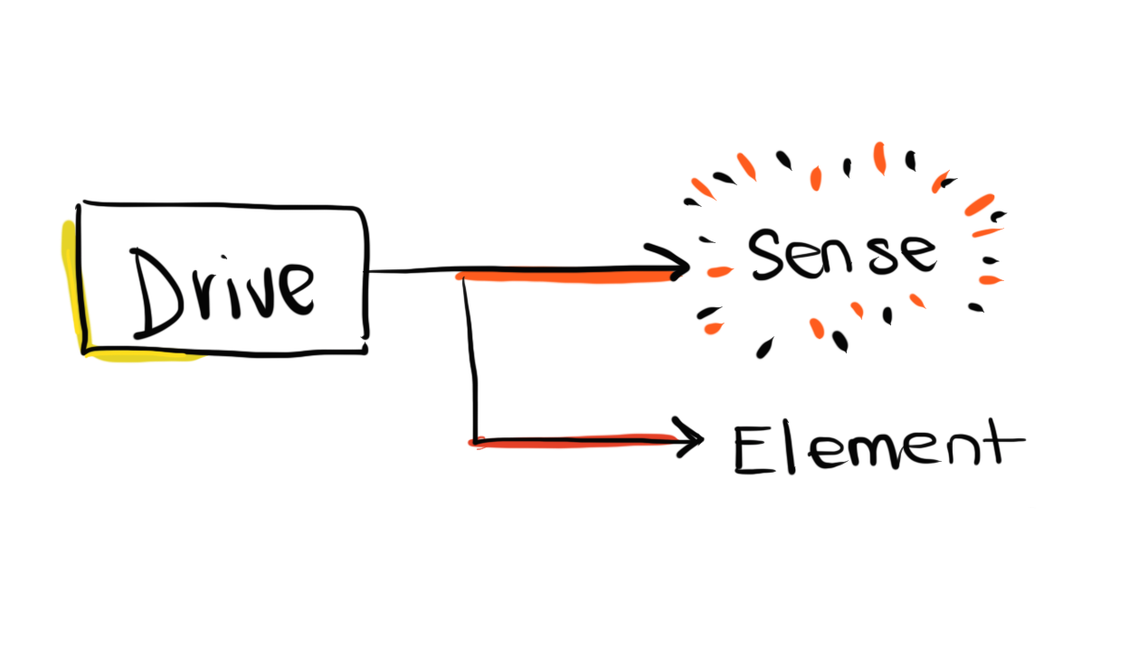
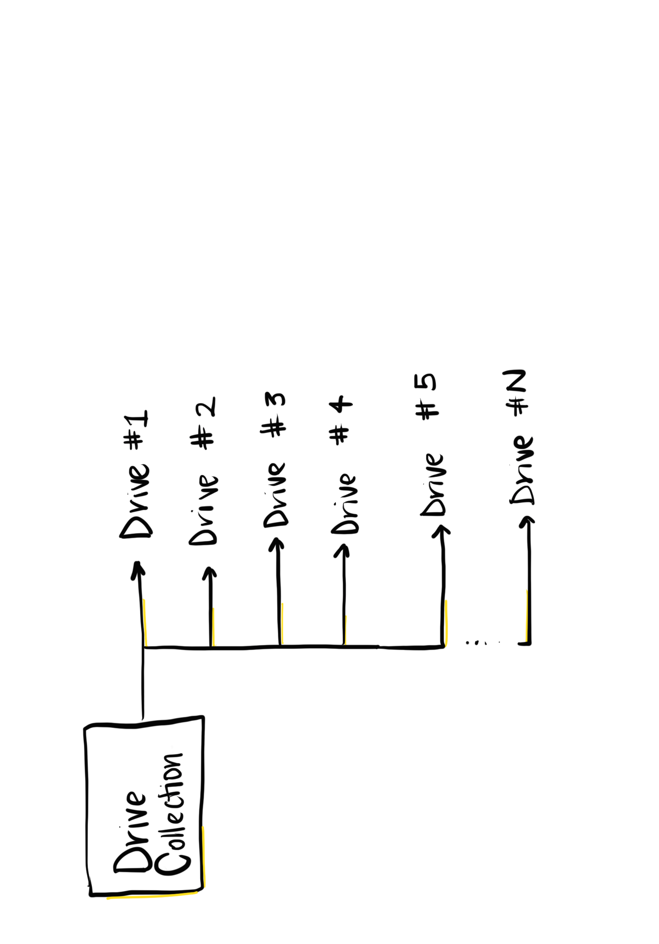
SOTA EXAMPLES: AWKWARD
Agents With Knowledge About Real-time Duties
IF … THEN
  OBLIGED(role A, behaviour)
ELSE
  NOT PERMITTED(role B, behaviour)
ENDIF
Methnani, L., Antoniades, A., & Theodorou, A. (2022). Embracing AWKWARD! Real-time Adjustment of Reactive Plans Using Social Norms. COINE 2022. arXiv:2204.10740.
Notes:
OperA in particular offers an interaction model that allows for the specification of agreements between the agents in the form of interaction contracts. These contracts also serve as verification for the fulfilment of interaction agreements between relevant actors, thus giving us the power to adjust agents’ plans for action-selection in real-time. These specifications surely also offer transparency into the interactions that occur between agents without requiring knowledge about internal architecture of the individual agent.
Then, for the individual agent, we look towards Behaviour-based approaches for the advantage of quick and reactive behavioural adjustments to dynamic and uncertain environments. More specifically we use Behaviour Oriented Design which is a cognitive architecture that comes also with an agile methodology for developing modular reactive planning agents. Again, emphasis is put on transparency both during the development process and the modular structure of the agent itself.
What we developed is a hybrid architecture called Agents With KnoWledge About Real-Time Duties, or AWKWARD for short.

Slide 36
SOTA EXAMPLES: AWKWARD
Agents With Knowledge About Real-time Duties
Gregorian Mind / System 2
Darwinian Mind / System 1
Embodiment
Methnani, L., Antoniades, A., & Theodorou, A. (2022). Embracing AWKWARD! Real-time Adjustment of Reactive Plans Using Social Norms. COINE 2022. arXiv:2204.10740.
Notes:
OperA in particular offers an interaction model that allows for the specification of agreements between the agents in the form of interaction contracts. These contracts also serve as verification for the fulfilment of interaction agreements between relevant actors, thus giving us the power to adjust agents’ plans for action-selection in real-time. These specifications surely also offer transparency into the interactions that occur between agents without requiring knowledge about internal architecture of the individual agent.
Then, for the individual agent, we look towards Behaviour-based approaches for the advantage of quick and reactive behavioural adjustments to dynamic and uncertain environments. More specifically we use Behaviour Oriented Design which is a cognitive architecture that comes also with an agile methodology for developing modular reactive planning agents. Again, emphasis is put on transparency both during the development process and the modular structure of the agent itself.
What we developed is a hybrid architecture called Agents With KnoWledge About Real-Time Duties, or AWKWARD for short.

Slide 37

SOTA EXAMPLES: AWKWARD
DOTA2 Example
Multiplayer real-time strategy game.
Complex and dynamic environment.
Varied hero abilities; social agent interaction is key.

Slide 38

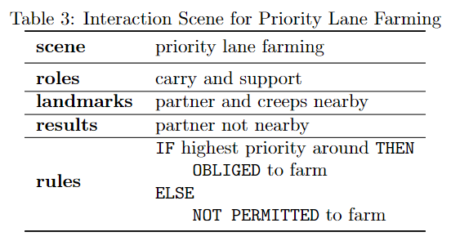
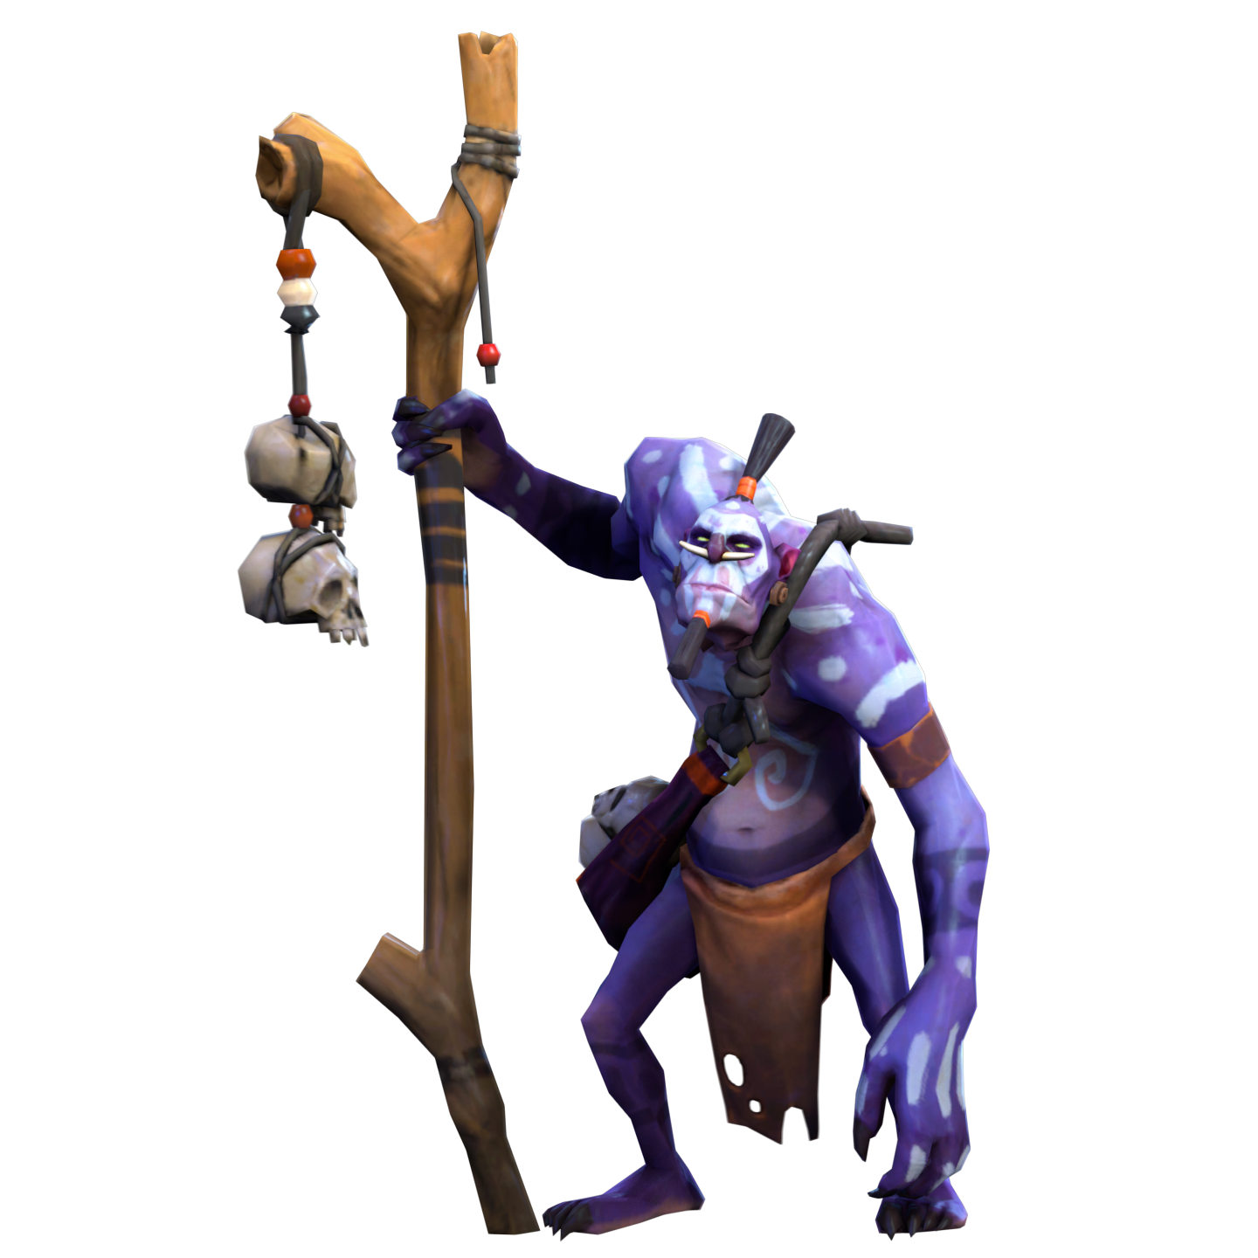
SOTA EXAMPLES: AWKWARD
Interaction Scenes
Position 1
Position 5

Slide 39
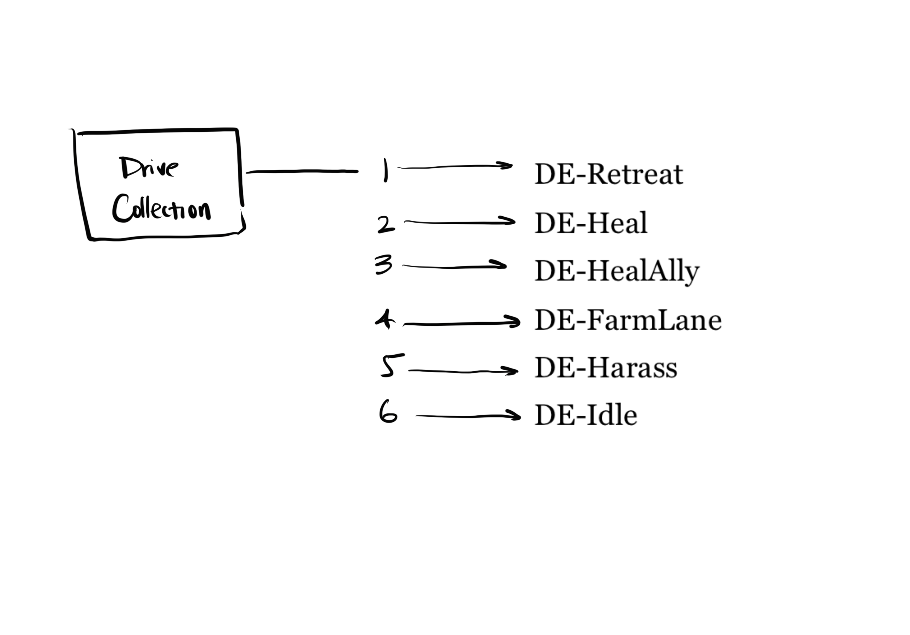
SOTA EXAMPLES: AWKWARD
Plan manipulation
DE-Retreat
DE-Heal
DE-HealAlly
DE-FarmLane
DE-Harass
DE-Idle
Notes:
Qualitatively, this looks promising!

Slide 40
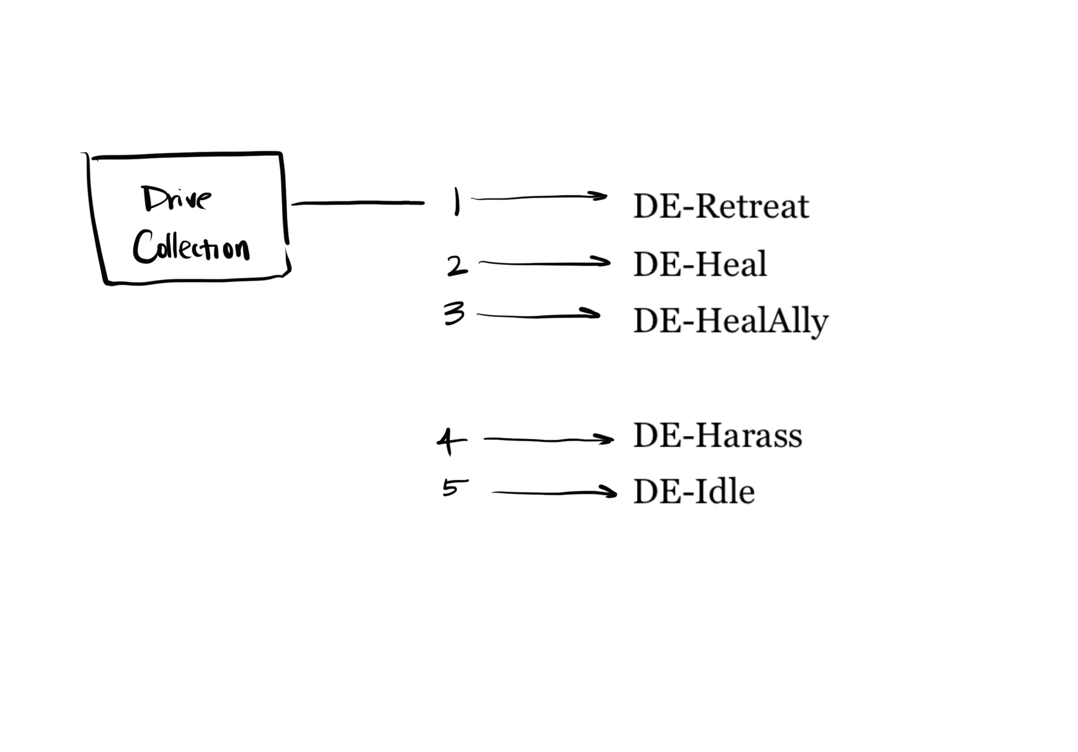

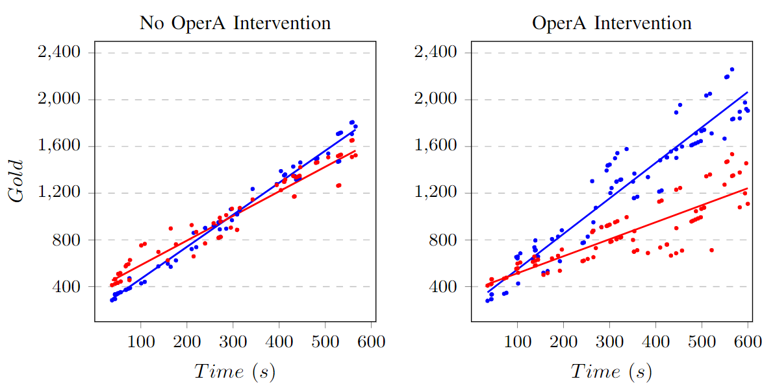
SOTA EXAMPLES: AWKWARD
Social Interaction
Position 1
Position 5

Slide 41
SOTA EXAMPLES: GLASS BOX
Glass Box
Aler Tubella A., Theodorou A., Dignum F., Dignum V. (2019). Governance by Glass-box: implementing transparent moral bounds for AI behaviour. International Joint Conference on Artificial Intelligence (IJCAI) 2019. Macao, China.

Slide 42
SOTA EXAMPLES: GLASS BOX
Formalising the glass box
A multi-modal logic with counts-as operator is enough to encode a Glass Box.
We encode statements of the form: “A counts-as B in context C”.
It allows for verification in reasonable time.
Aler Tubella A., Dignum V. (2019). The Glass Box Approach: Verifying Contextual Adherence to Values. Workshop in AI Safety 2019

Slide 43
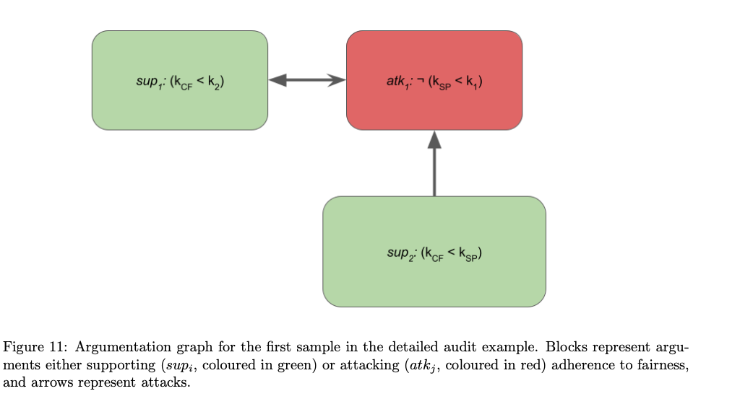
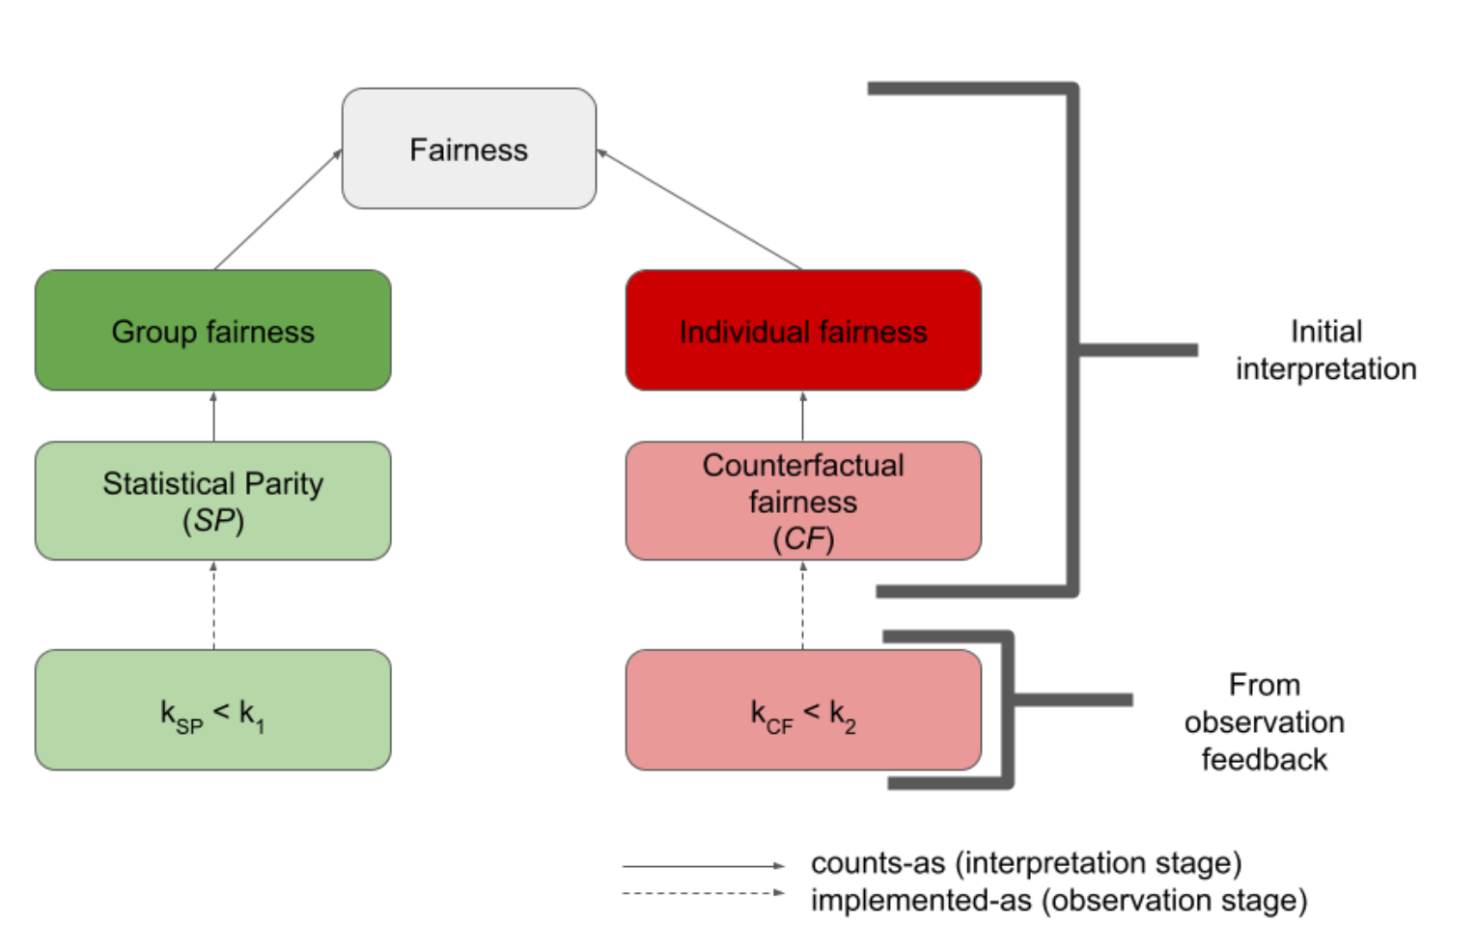
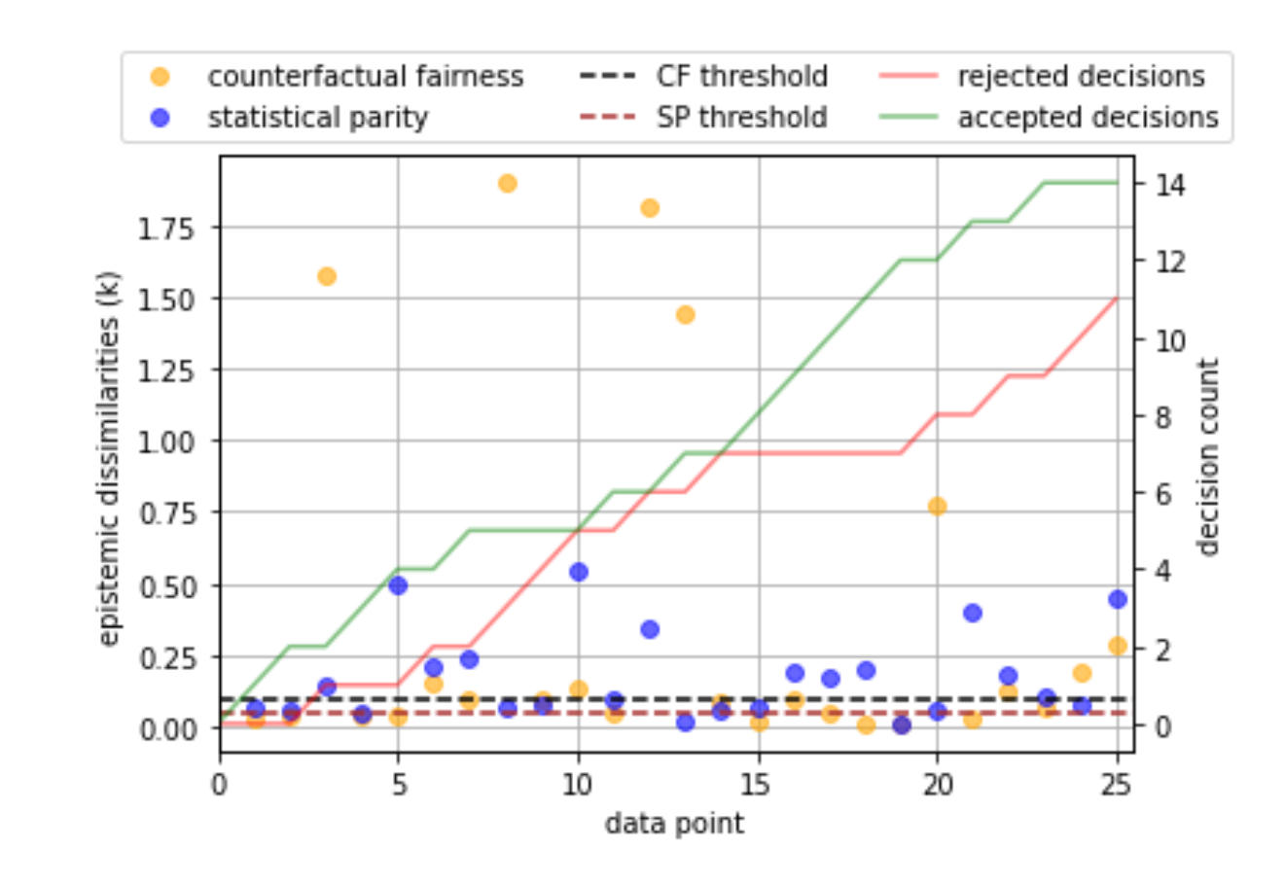
SOTA EXAMPLES: GLASS BOX
Formalising the glass box

Slide 44
Moral Standards

Slide 45
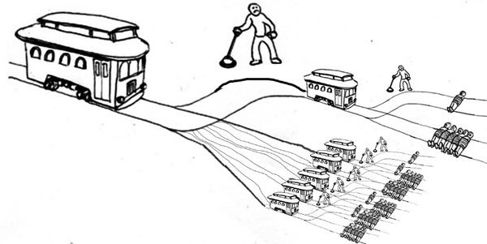
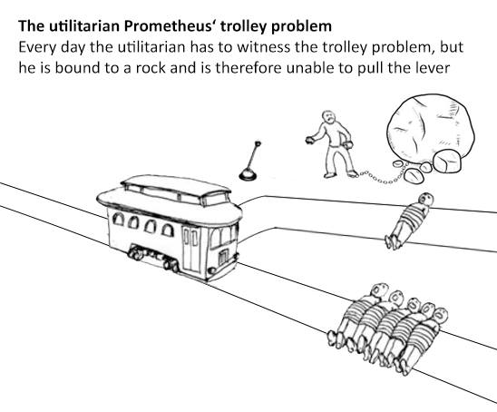
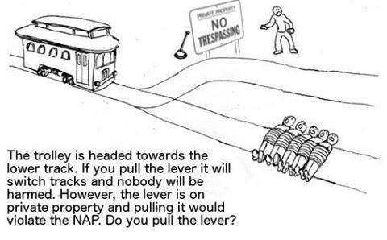
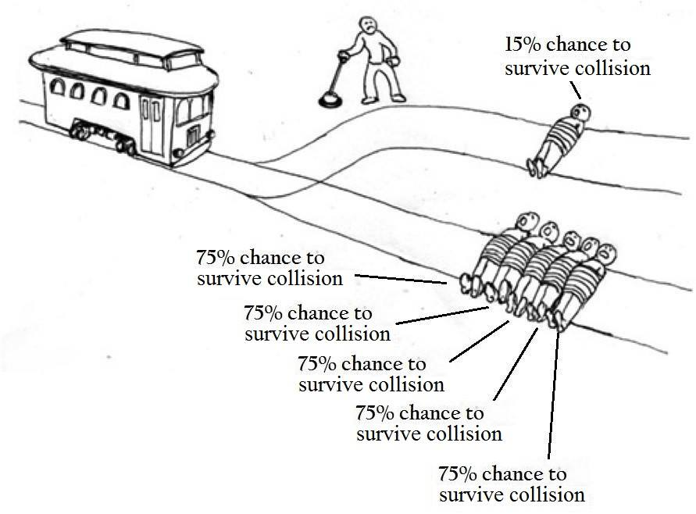
Moral Standards
Trolley Problem

Slide 46
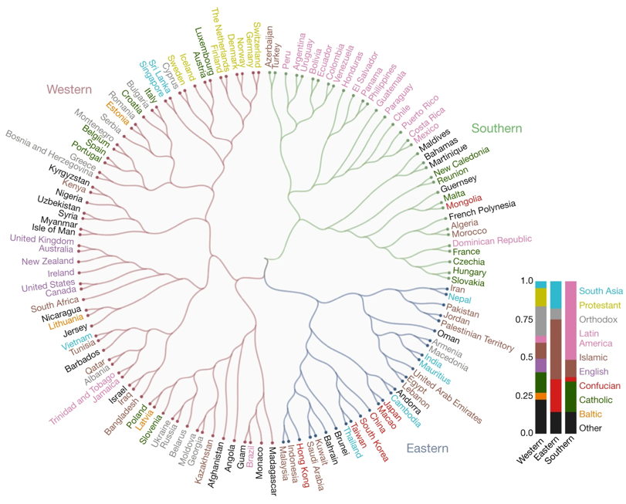
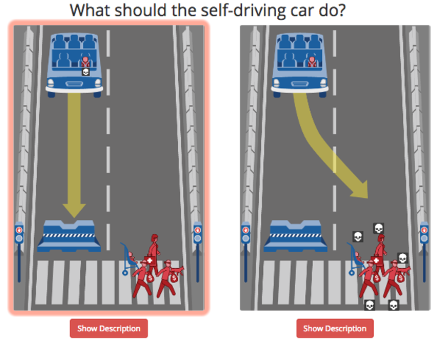
Moral Standards
Trolley Problem
J. F. Bonnefon, A. Shariff, I. Rahwan (2016). The Social Dilemma of Autonomous Vehicles Science
E. Awad, S. Dsouza, R. Kim, J. Schulz, J. Henrich, J., A. Shariff, F. Bonnefon, I. Rahwan (2018). The Moral Machine Experiment Nature

Slide 47
THE Trolley MORAL MACHINE problem
J. F. Bonnefon, A. Shariff, I. Rahwan (2016). The Social Dilemma of Autonomous Vehicles Science
Andreas Theodorou | t: @recklesscoding

Slide 48
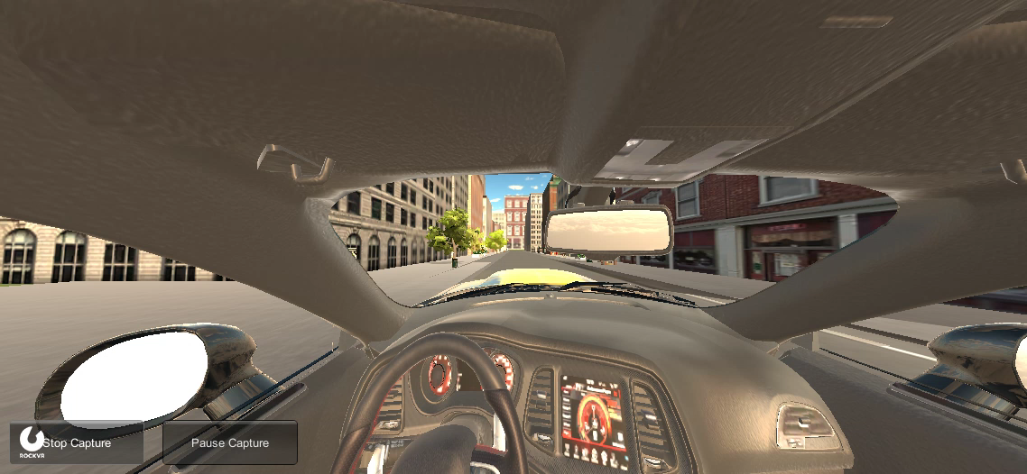
Wilson H. and Theodorou A. (2019). Slam the breaks! Perceptions of Moral Decisions in Driving Dilemmas. Workshop on AI Safety IJCAI 2019.

Slide 49
Experimental Setup
Condition | Description
Opaque AV | Participants told that they will be driven in an AV; no post-crash explanation.
Transparent AV | Participants told that they will be driven in an AV; post-crash explanation: “The self-driving car made the decision on the basis that...”.
“Human” Driver | Participants told that they will be driven in a human-controlled car.
Wilson H. and Theodorou A. (2019). Slam the breaks! Perceptions of Moral Decisions in Driving Dilemmas. Workshop on AI Safety IJCAI 2019.

Slide 50
Moral Standards
Key Findings
Our experiment elicited strong emotional reactions in participants.
They were vocal against selection based on social value.
AV users may feel unconformable to be associated with an autonomous vehicle that uses protected demographic and socio-economic characteristics for its decision-making process.
We tend to assign less blame to human-made errors easier than machine-made errors (Madhavan and Wiegmann, 2007; Salem et al., 2015).
Least blame towards the ‘human’ driver (rated least machinelike), medium blame to the opaque AV (rated “medium” machinelike), but most blame to the transparent AV (rated most machinelike).
Poornima Madhavan and Douglas A Wiegmann (2007). Similarities and differences between human–human and human–automation trust: an integrative review. Theoretical Issues in Ergonomics Science.
Maha Salem, Gabriella Lakatos, Farshid Amirabdollahian, and Kerstin Dautenhahn (2015). Would you trust a (faulty) robot?: Effects of error, task type and personality on human-robot cooperation and trust. In Proceedings of the Tenth Annual ACM/IEEE International Conference on Human-Robot Interaction

Slide 51
Moral Standards
Key Findings
Human drivers (Group 1) were perceived to be significantly more morally culpable than autonomous vehicle in the opaque AV condition (Group 2) and transparent AV.
In the AV was considered significantly less morally culpable when the car’s decision-making system was made transparent compare to the opaque condition.
At the same time, people were assigning more blame to the AV as we were making its machine nature more transparent.
Literature also suggests that utilitarian action is also be more permissible —if not expected— when taken by a robot than human (Malle et al., 2015).
We believe that the increased attribution of moral responsibility is due to realisation that the action was determined based on social values.
“Human drivers” were perceived as significantly more humanlike.
Bertram F Malle, Matthias Scheutz, Thomas Arnold, John Voiklis, and Corey Cusimano (2015). Sacrifice one for the good of many?: People apply different moral norms to human and robot agents. In Proceedings of the tenth annual ACM/IEEE International Conference on Human-Robot Interaction.

Slide 52
Moral Standards
So far we have talked how
We do not always understand that we are interacting with an intelligent system.
We do not always understand a system’s actions/behaviours.
We do not always understand a system’s limitations.
We held intelligent systems to a different performance standard.
We held intelligent systems to a different moral standard!

Slide 53
Conclusions

Slide 54
Summary
Today we have looked at …
Top-down vs bottom-up approach on engineering ethics.
Moor’s categories of ethical agents:
  Ethical Impact Agents
  Implicit Ethical Agents
  Explicit Ethical Agents
  Full Ethical Agents
Deontic Logic
SOTA examples
Moral standards: we held machine in different standards than humans!
Today’s Goals:
Thematic units: Evaluation of AI policy and Challenges for “Ethicacy” of AI policy
Learning Objectives:
4. Develop a critical understanding of socio-technical mechanisms for the governance of AI systems, recognizing the drawbacks and benefits of each approach.
5. Reflect upon how research in AI feeds into AI policy and how AI policy creates new needs for research into AI Ethics.

Slide 55
Questions?

