Slide 1
University of Cyprus
MAI631
Artificial Intelligence Ethics II
Andreas Theodorou
September – December 2023

Slide 2
University of Cyprus
Lecture 7:
eXplainable AI (XAI)
Dr. Andreas Theodorou
October, 2023

Slide 3
Introduction
Lecture Overview
Today’s Structure:
What is and why XAI
Pre-model XAI & XAI by Design
Post-hoc XAI
Use Cases & Challenges
Today’s Goals:
Thematic units: AI Governance
This lecture follows up the guest speaker’s talk on Fairness by looking up close another popular value: eXplainability.
Learning Objectives:
Develop a critical understanding of socio-technical mechanisms for the governance of AI systems, recognizing the drawbacks and benefits of each approach.

Slide 4
What is and why XAI

Slide 5
What is and why XAI
A Supervised Learning Example
Model Training
Model Usage
Data:
Label:
Shape
Colour
Acorn
Input
…
Chicken leg
Output
Chicken leg
Apple
Bananas

Slide 6
What is and why XAI
A Supervised Learning Example
Model Training
Model Usage
Data:
Label:
Shape
Colour
Acorn
Input
…
Why?
Chicken leg
Output
Acorn
Apple
Bananas

Slide 7
What is and why XAI
A Supervised Learning Example
Model Training
Model Usage
Why?
Data:
Label:
Shape
Shape similar: this image looks like an acorn.
Colour similar: model more sensitive to
colour than shape.
…
Colour
Acorn
Input
…
Chicken leg
Output
Acorn
Apple
XAI focus: explaining why
Bananas

Slide 8
What is and why XAI
Some awkard situations

Slide 9
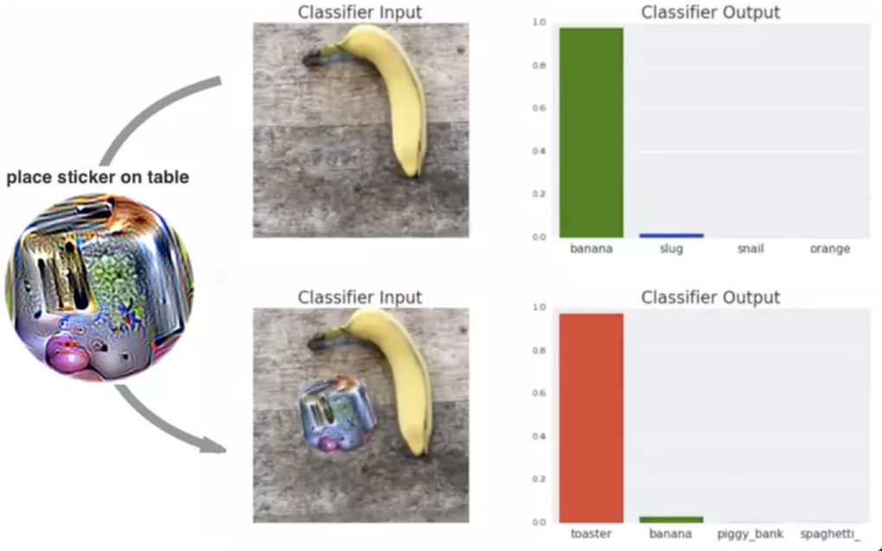
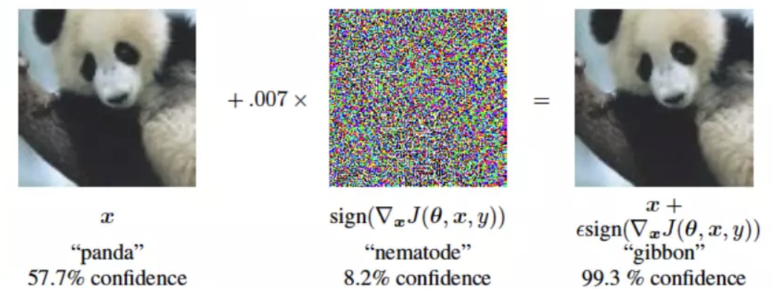
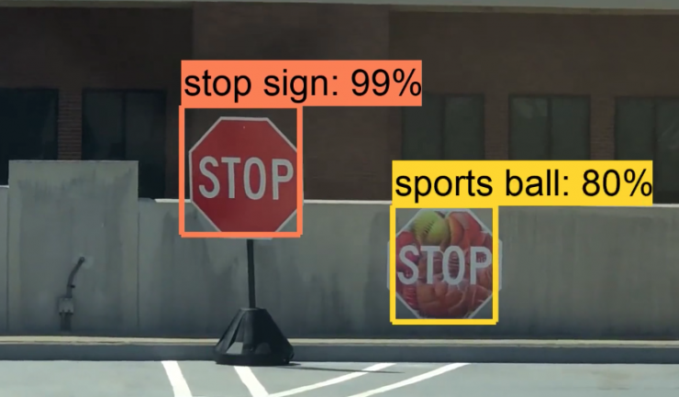
What is and why XAI
Some awkard situations
Kurakin, A., Goodfellow, I., & Bengio, S. (2016). Adversarial
examples in the physical world. arXiv preprint arXiv:1607.02533.
https://www.ft.com/content/e07cee0c-3949-11e7-821a-6027b8a20f23
Brown, T. B., Mané, D., Roy, A., Abadi, M., & Gilmer, J. (2017). “Adversarial patch.” arXiv preprint arXiv:1712.09665.
Chen, S.-T. et al. (2019). “ShapeShifter: Robust Physical Adversarial Attack on Faster R-CNN Object Detector.” arXiv: 1804.05810

Slide 10
What is and why XAI
“Right to Explanation”
EU GDPR:
“The data subject should have the right not to be subject to a decision, which may include a measure, evaluating personal aspects relating to him or her which is based solely on automated processing and which produces legal effects concerning him or her or similarly significantly affects him or her, such as automatic refusal of an online credit application or e-recruiting practices without any human intervention.
…
In any case, such processing should be subject to suitable safeguards, which should include specific information to the data subject and the right to obtain human intervention, to express his or her point of view, to obtain an explanation of the decision reached after such assessment and to challenge the decision.”
US’ Equal Credit Opportunity Act:
“Creditors are required to notify applicants who are denied credit with specific reasons for the detail. As detailed in §1002.9 (b)(2):
Statement of specific reasons. The statement of reasons for adverse action required by paragraph (a)(2)(i) of this section must be specific and indicate the principal reason(s) for the adverse action. Statements that the adverse action was based on the creditor's internal standards or policies or that the applicant, joint applicant, or similar party failed to achieve a qualifying score on the creditor's credit scoring system are insufficient.”
Unlike popular belief, the source of the explanation does not have to be the AI system.

Slide 11
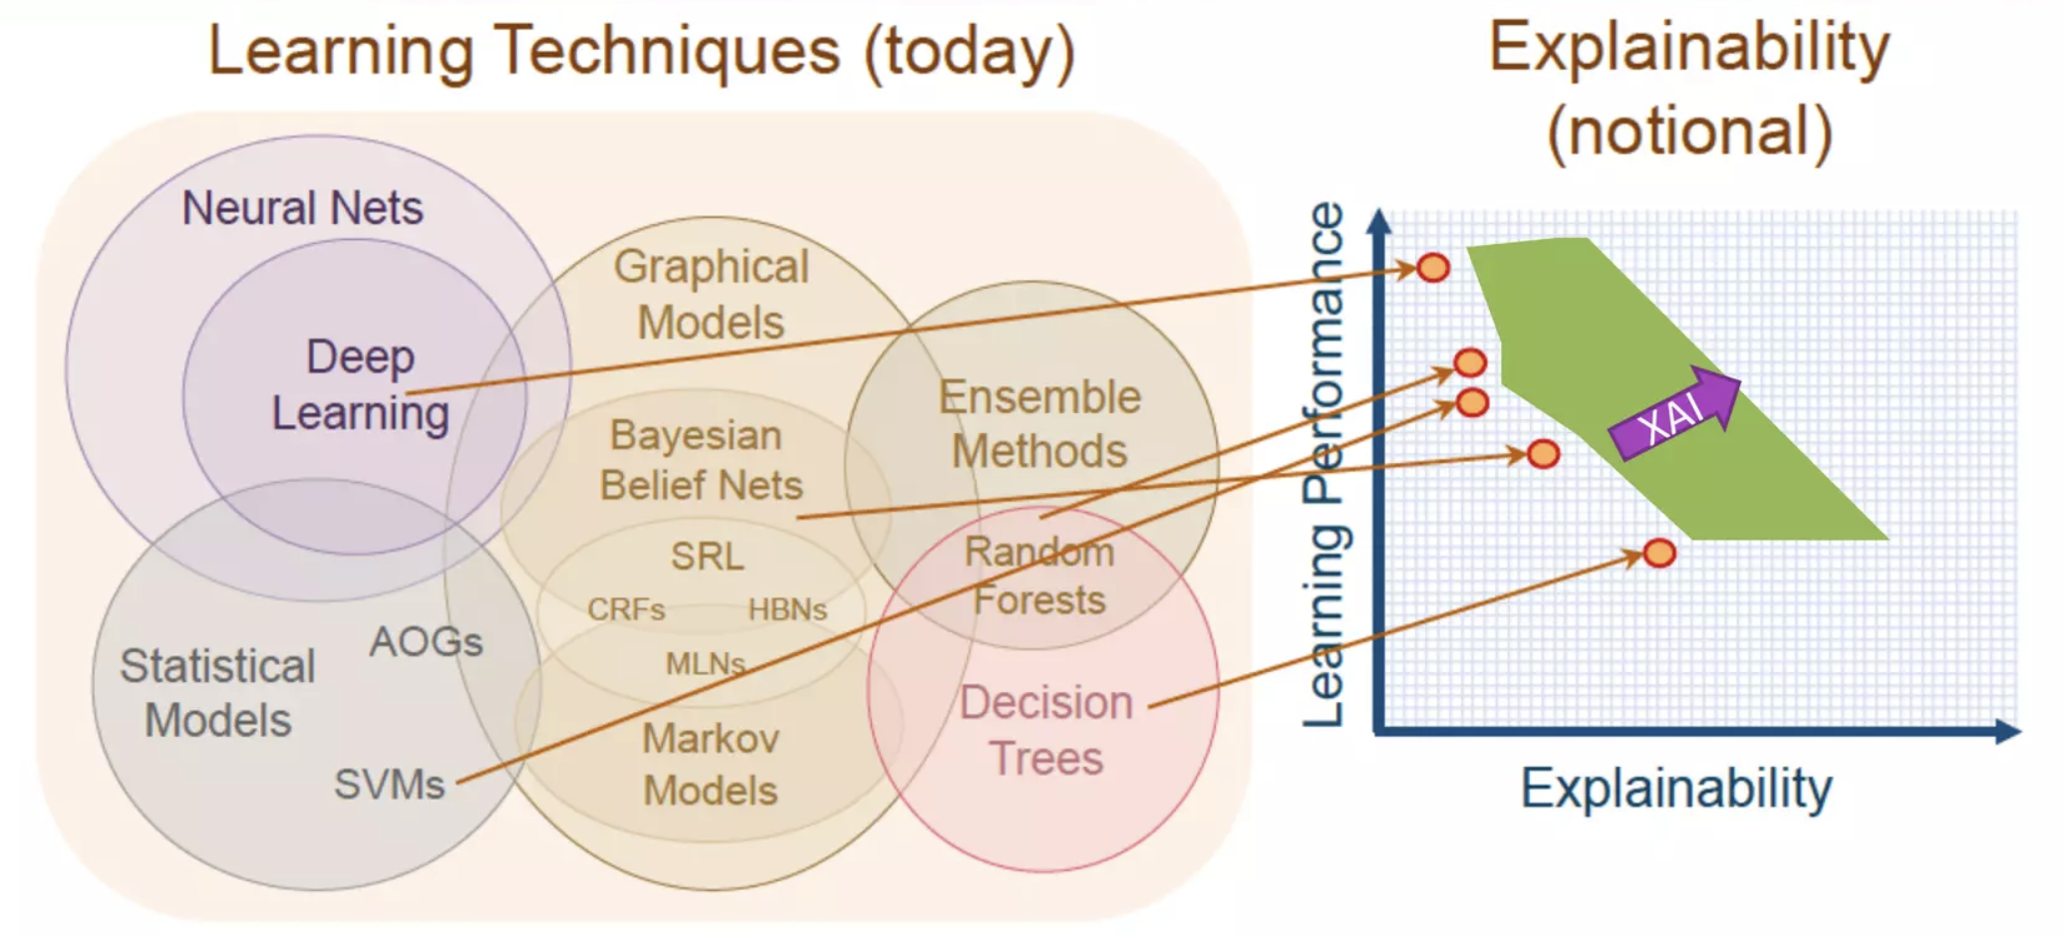
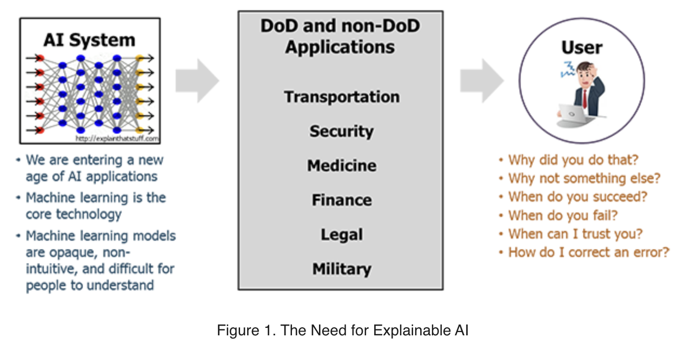
What is and why XAI
XAI Boom

Slide 12
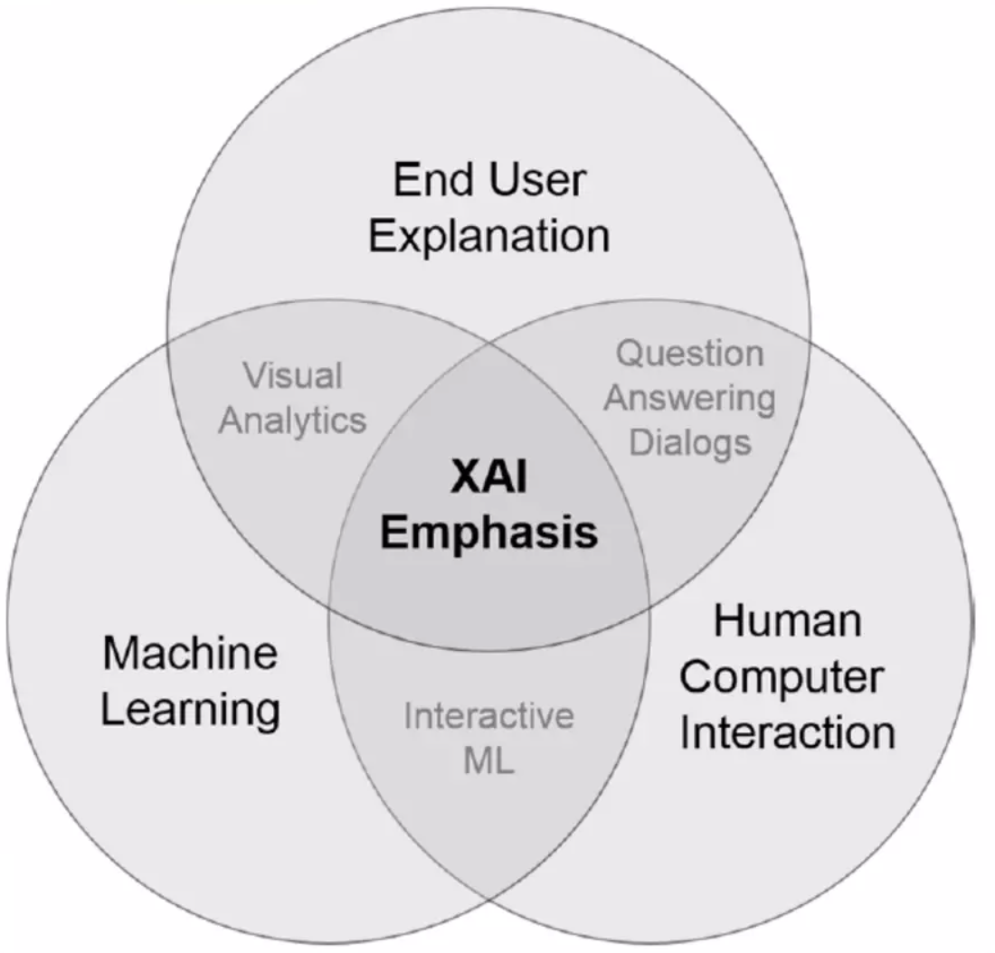
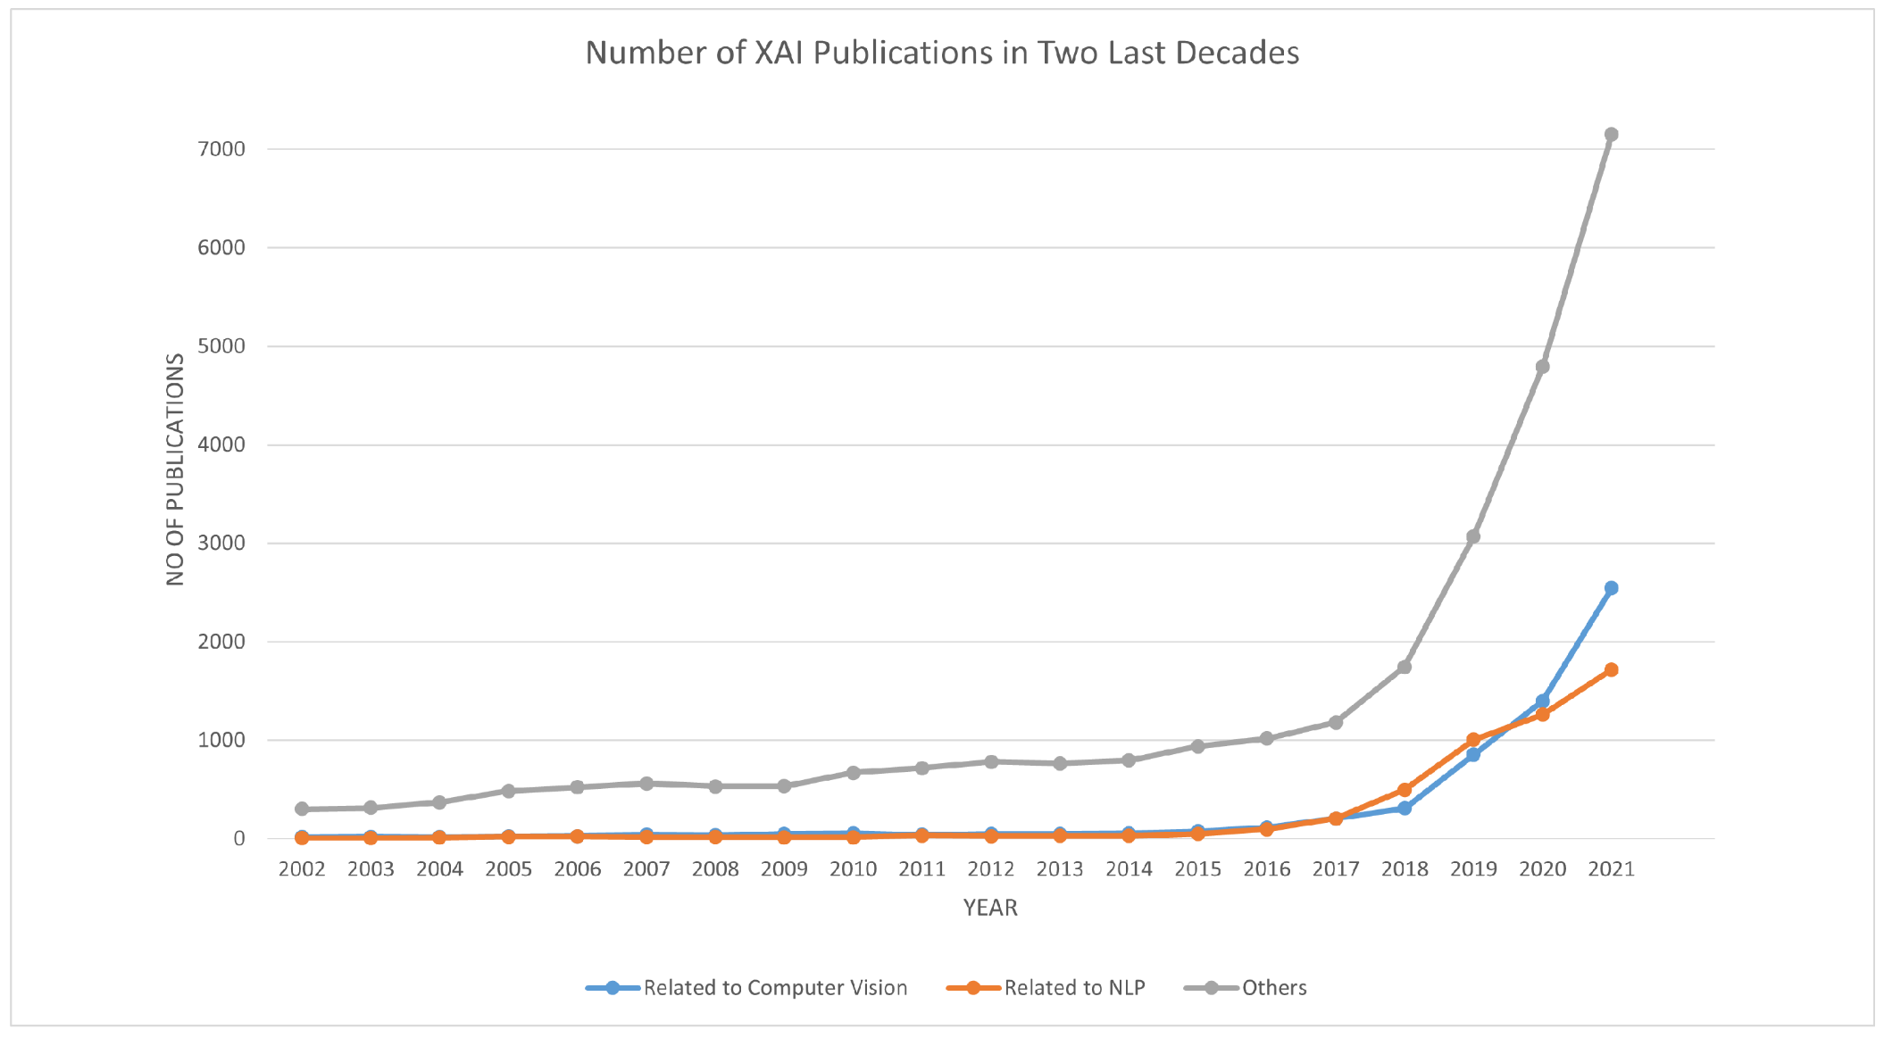
What is and why XAI
XAI Boom
Nagahisarchoghaei, M.; Nur, N.; Cummins, L.; Nur, N.; Karimi, M.M.; Nandanwar, S.; Bhattacharyya, S.; Rahimi, S. (2023). An Empirical Survey on Explainable AI Technologies: Recent Trends, Use-Cases, and Categories from Technical and Application Perspectives. Electronics, 12, 1092.

Slide 13
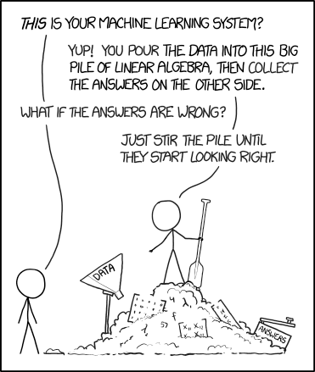
What is and why XAI
Definitions
Broader definition: Techniques and methods that make a model’s decisions understandable by people.
Interpretability is a concept that results from the interaction between several definitions:
The degree to which a human can understand the cause of a decision.
The degree to which a human can consistently predict the model’s result.
XKCD. “Machine Learning.” https://xkcd.com/1838/
Miller T. (2018). “Explanation in artificial intelligence: Insights from the social sciences.”

Slide 14
What is and why XAI
Categories
Model-specific explainability: XAI techniques tailored for working only on specific models.
Model-agnostic explainability: XAI techniques working across a variety of models and, often, types of models and domains.
Global-level explainability: understanding the algorithm’s behavior at a high/dataset/populational level, something that is typically done by researchers and designers of the algorithm
Local-level explainability: understanding the algorithm’s behavior at a low/subset/individual level, typically those being targeted by an algorithm
There are 3 stages or categories for XAI based on the lifecycle:
1. Pre-model/ pre-hoc: understand the data before building the model.
Answers: “What will my model be trained on?”
2. Explainable modelling: make the model explainable-by-design.
Answers: “How does my model looks like?”
3. Post-model/ post-hoc: perform posterior analysis of the model predictions.
Answers: “Why did my model made this prediction?”
Arieta A. B. et al. (2019). “Explainable Artificial Intelligence (XAI): Concepts, Taxonomies, Opportunities and Challenges toward Responsible AI.” arXiv:1910.10045

Slide 15
What is and why XAI
XAI not Transparency
While they are often used interchangeable, the two values are not: XAI focuses on understanding, transparency focuses on exposing information.
Transparency does not imply explainability —nor does the vice versa. However, it may be easier to achieve explainability if we have transparency.
A way to consider is: transparency provides information needed for explainability, but it is up to the receiver of said information to connect the dots.
Transparency: figuring out what is going on inside the model.
Black-box model
XAI: figuring out why this came out

Slide 16
Pre-model XAI & XAI by Design

Slide 17
Pre-model XAI & XAI by Design
Pre-model XAI
We aim to perform an analysis of the data distribution to understand what data we are actually training our system on.
This comprehension of the data may contribute to having a higher confidence with the decisions that the production model provides.
Classification techniques—yes, other potential black boxes—are often used; e.g. k-Means, k-NN, and Prototypes and Criticisms.

Slide 18
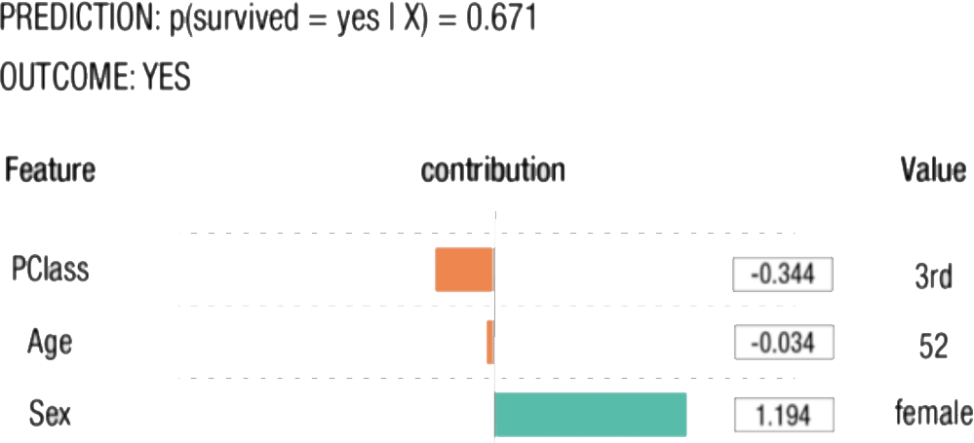
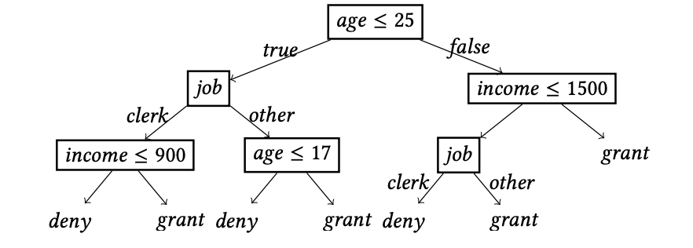
Pre-model XAI & XAI by Design
Inherently Explainable Models
Some approaches, e.g. linear model; decision trees; and rule-based models, are considered ‘explainable by design.’
However, how much they are considered ‘explainable’ is debatable.
Decision tree by: Guidotti, R., Monreale, A., Ruggieri, S., Pedreschi, D., Turini, F., & Giannotti, F. (2018). Local Rule-Based Explanations of Black Box Decision Systems. arXiv:1805.10820

Slide 19
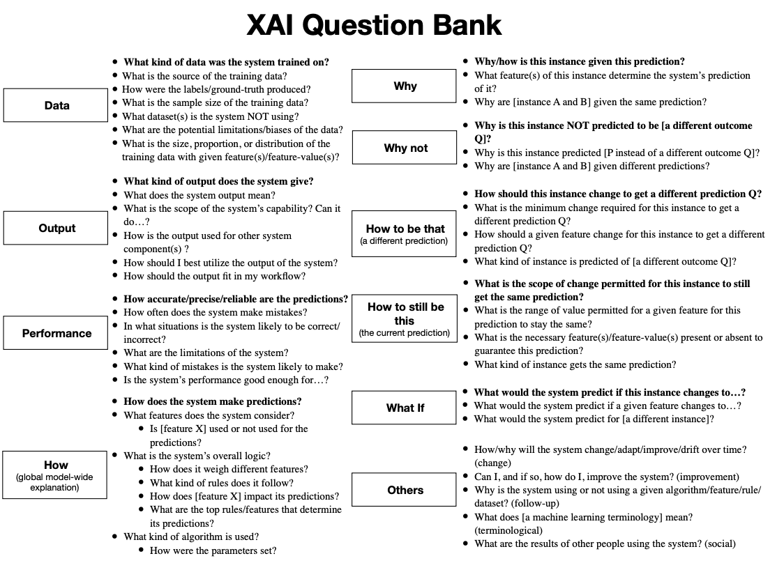
Pre-model XAI & XAI by Design
XAI-By-Design
Some approaches, e.g. linear model; decision trees; and rule-based models, are considered ‘explainable by design.’
However, how much they are considered ‘explainable’ is debatable.
Liao et al. (2020). “Questioning the AI: Informing Design Practices for Explainable AI User Experiences.” CHI 2020

Slide 20
Post-hoc XAI

Slide 21
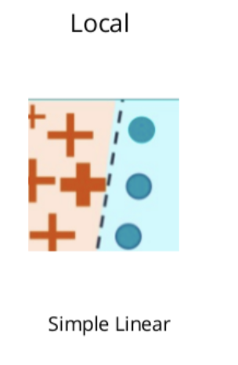
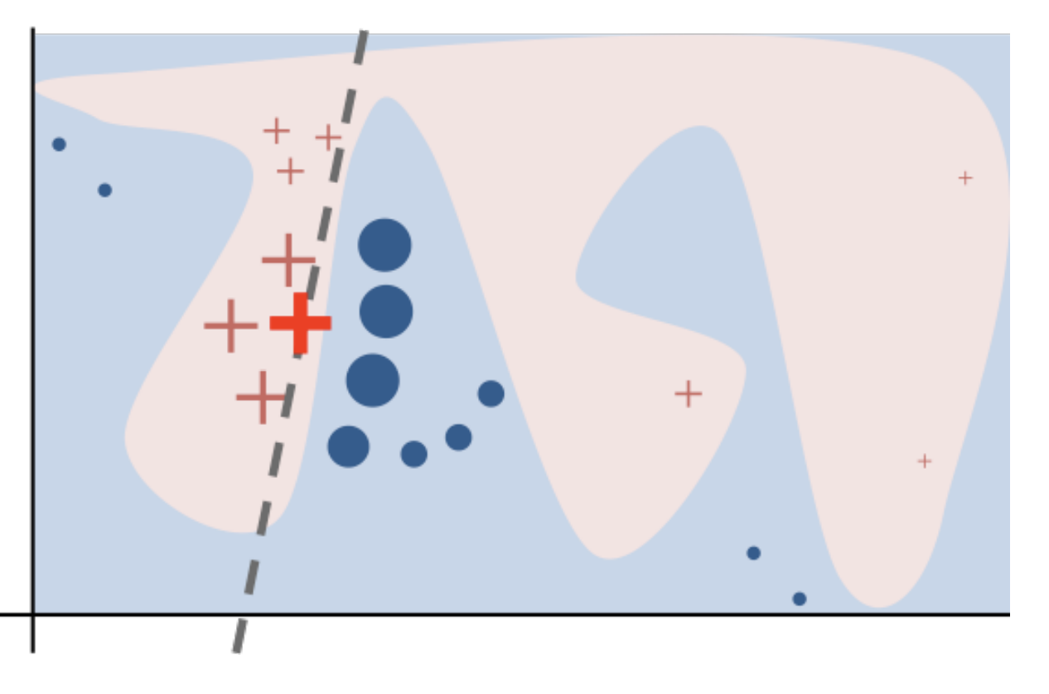
Post-hoc XAI
Local Interpretable Model-Agnostic Explanations (LIME)
The overall decision boundary is complex, but in the neighborhood of a single decisionthe boundary is simple!
A single decision can be explained by auditing the model around the given instance and learning a local decision.
Perturb the original data points.
Feed them into the black box model and then observe their corresponding outputs.
Weigh new data points as a function of their proximity to the original point
Create a surrogate model using LASSO regression.
The explanation for a data point x is the model g that minimizes the locality-aware loss L(f,g,Π_{x}) measuring how unfaithful g approximates the model to be explained f in its vicinity Π_{x} while keeping the model complexity denoted low:

Slide 22
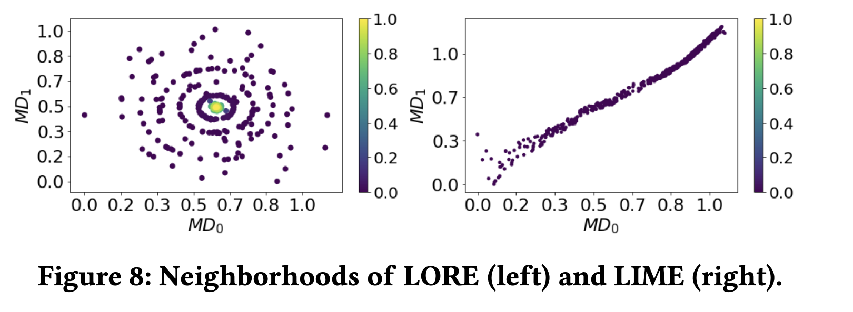
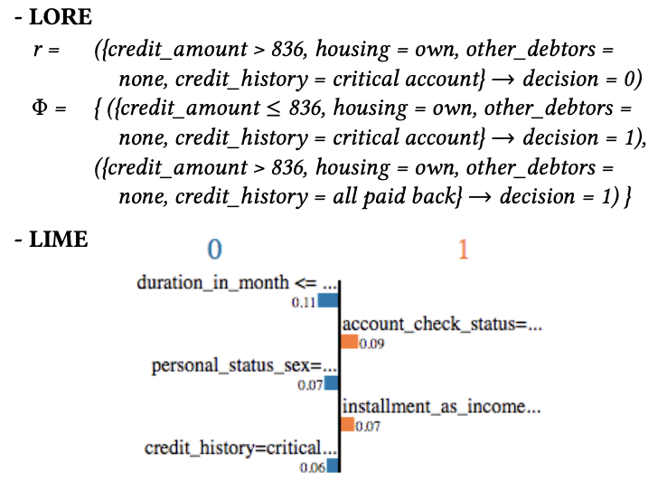
Local Rule-Based Explanations (LORE)
Model-agnostic local-explanation method that is gaining increasing popularity.
Offers better performance and accuracy than LIME.
High-level description:
It uses local interpretable predictor on a synthetic neighborhood generated by a genetic algorithm.
It derives from the logic of the local interpretable predictor a meaningful explanation consisting of:
a decision rule, which explains the reasons of the decision; and
a set of counterfactual rules, suggesting the changes in the instance’s features that lead to a different outcome
Guidotti, R., Monreale, A., Ruggieri, S., Pedreschi, D., Turini, F., & Giannotti, F. (2018). Local Rule-Based Explanations of Black Box Decision Systems. arXiv:1805.10820

Slide 23
LIME and LORE
Z = {}
X = instance to explain
x’ = real2interpretable(x)
for i in {1, 2, …, N}
$Z_{i}$= sample_around(x’)
z = interpretabel2real($Z_{i}$)
Z = Z ∪ {${<Z}_{i}$, b($Z_{i}$), d<x,z>}
w = solve_Lasso(Z, k)
return w
x instance to explain
$Z_{\text{=}}$= geneticNeighborhood(x, fitness=, N/2)
$Z_{\text{≠}}$ = geneticNeighborhood(x, fitness≠, N/2)
Z = $Z_{\text{=}}$∪ $Z_{\text{≠}}$
c = buildTree(Z, b(Z))
r = (p -> y) = extractRule(c, x) 07 ϕ = extractCounterfactual(c, r, x)
return e = <r,φ>
Guidotti, R., Monreale, A., Ruggieri, S., Pedreschi, D., Turini, F., & Giannotti, F. (2018). Local Rule-Based Explanations of Black Box Decision Systems. arXiv:1805.10820

Slide 24
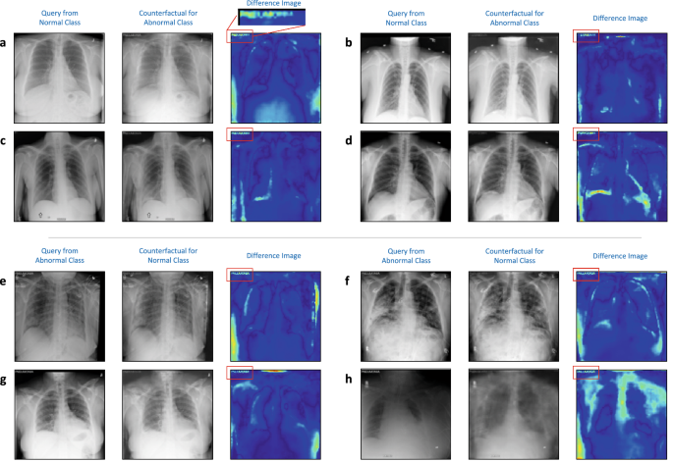
Post-hoc XAI
Counterfactuals
A counterfactual explanation describes a causal situation in the form:
“If X had not occurred, Y would not have occurred”
We are trying to find out the smallest change to the feature values needed to change the prediction.
Great means of explaining “what should I do to get Y output?” type of questions.
Thiagarajan, J.J., Thopalli, K., Rajan, D. et al. Training calibration-based counterfactual explainers for deep learning models in medical image analysis. Sci Rep 12, 597 (2022). https://doi.org/10.1038/s41598-021-04529-5

Slide 25
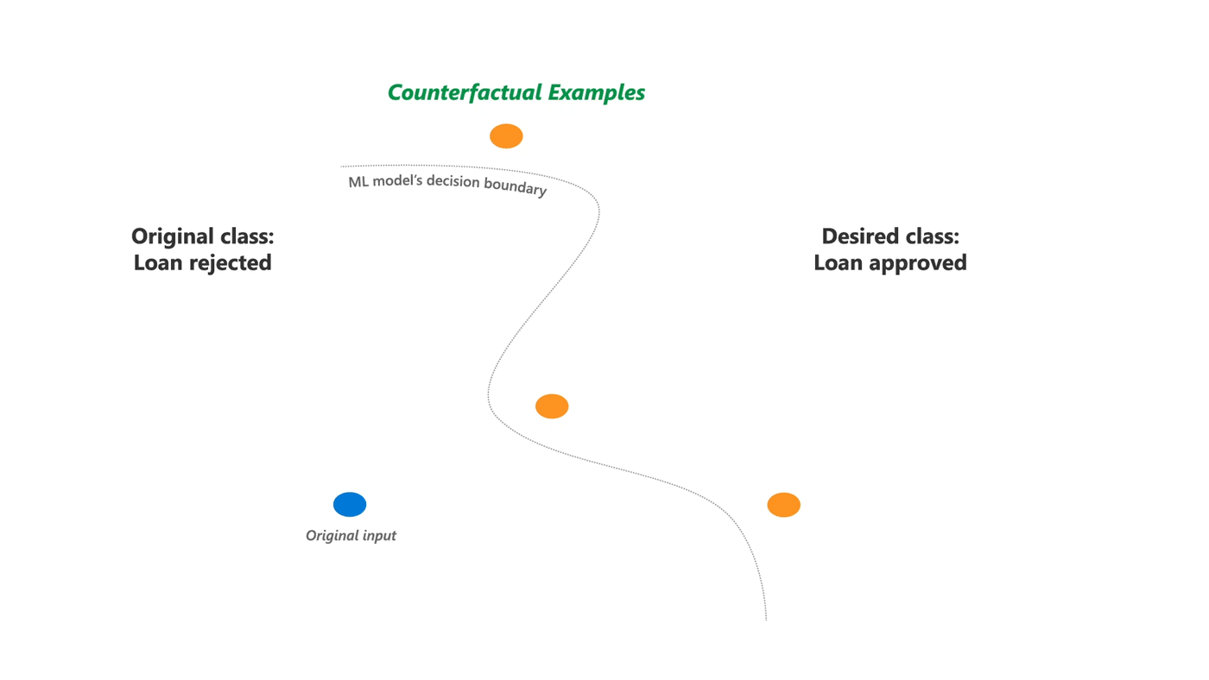
Post-hoc XAI
Diverse Counterfactual Explanations (DiCE)
import dice
# load dataset
ml d = dice_ml.Data(. .)
# load trained model
m = dice_ml.Model(. .)
# create DiCE "explanation"
ex = dice_ml.Dice(d, m)
# model input
q = {'age': 22, 'race': 'White', . .)
# now generate 4 counterfactuals
cfs = ex.generate_counterfactuals(q, 4, . .)
Mothilal R. K., Sharma A., Tan C. (2020). “Explaining Machine Learning Classifiers through Diverse Counterfactual Explanations.” FA*T 2020.
Github: https://github.com/interpretml/DiCE#diverse-counterfactual-explanations-dice-for-ml

Slide 26
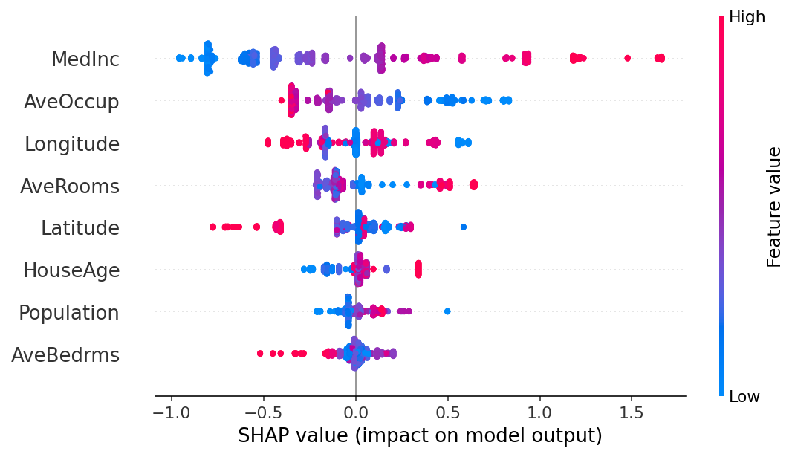
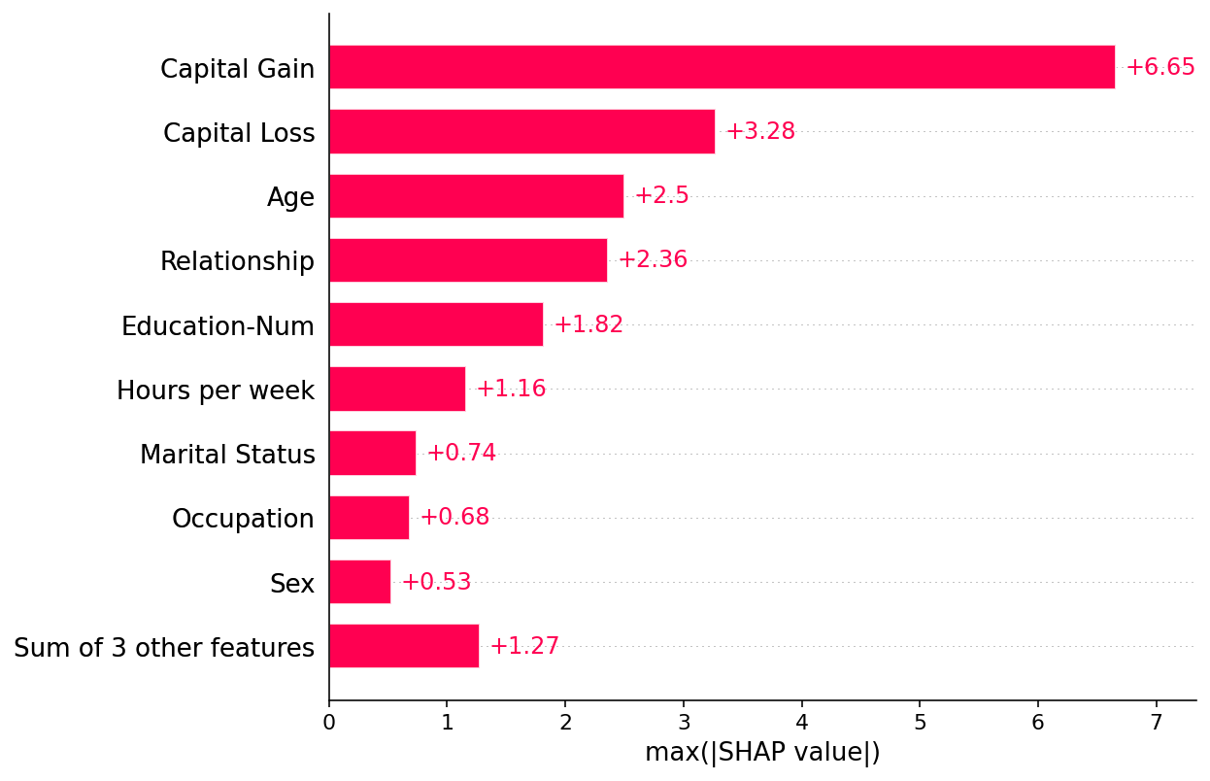
Post-hoc XAI
SHapley Additive exPlanations (SHAP)
A game theoretic approach to explain the output of any machine learning model.
Connects optimal credit allocation with local explanations using the classic Shapley values from game theory —i.e. average expected marginal contribution of one player (feature) after all possible combinations have been considered
Shapley values are used to assign each feature an importance value representing its contribution to the model's output by averaging the marginal contributions of each player (i.e. feature) across all potential permutations of players.
SHAP assesses every possible combination of features to determine the impact each feature has on the model’s prediction.
Ironically, SHAP is a black box!!!

Slide 27
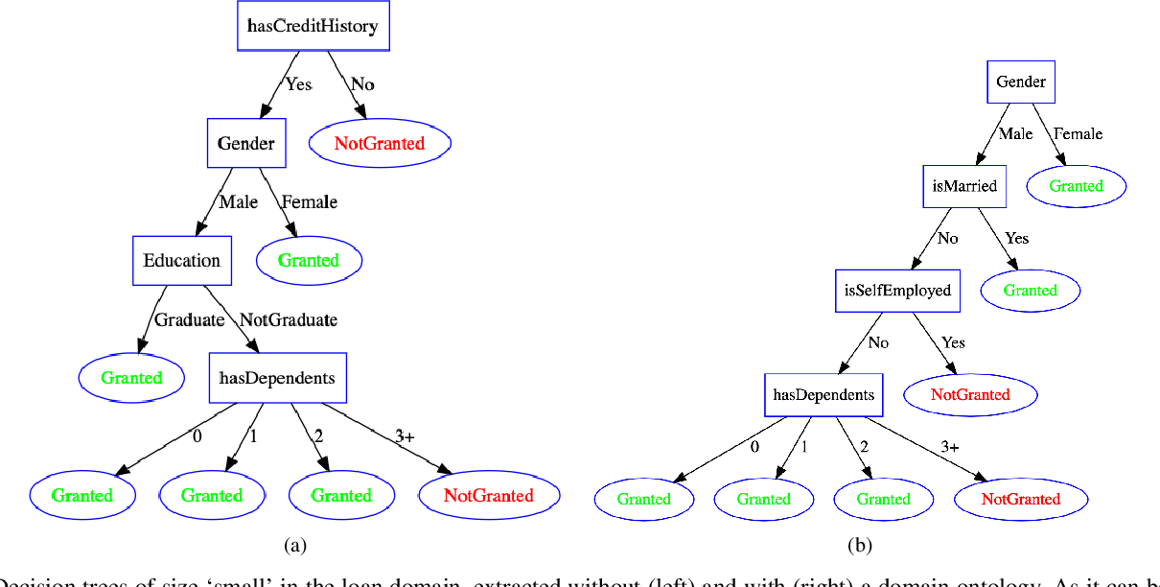
Post-hoc XAI
Trepan – Approximation Techniques
A tree induction algorithm that recursively extracts decision trees from neural networks .
The neural network classifies examples during the learning process. And then generates new examples by sampling from distributions over the given examples and constraints —i.e. conditions that examples must satisfy in order to reach a node/ leaf.
It expands a tree in a best-first manner by means of a priority queue by entropy, that prioritises nodes that have greater potential for improvement.
This is a surrogate model approach: approximating the function f(x) with another model, this time the new model should be explainable.
Craven M., and Shavlik J.W. (1996). “Extracting tree-structured representations of trained networks.” NIPS.
Picture: Confalonieri, R., Weyde, T., Besold, T.R., & Martin, F.M. (2020). “Trepan Reloaded: A Knowledge-driven Approach to Explaining Artificial Neural Networks.” ECAI 2020.

Slide 28
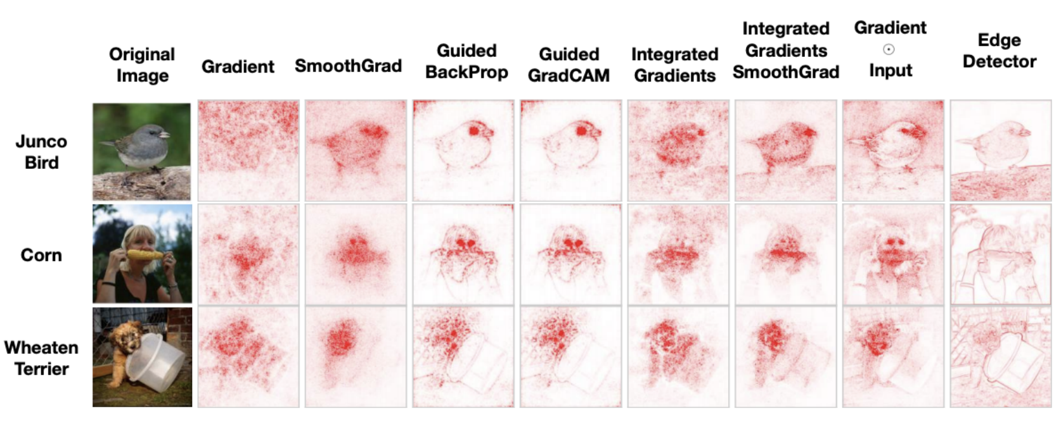
Post-hoc XAI
Saliency Maps
Picture: Adebayo J., Gilmer J., Muelly M. C., Goodfellow I., Hardt M., and Kim B. (2018). “Sanity checks for saliency maps.”
Picture: Zhou X., Wang D., Krähenbühl M. (2019). “Objects as Points.” arXiv:1904.07850

Slide 29
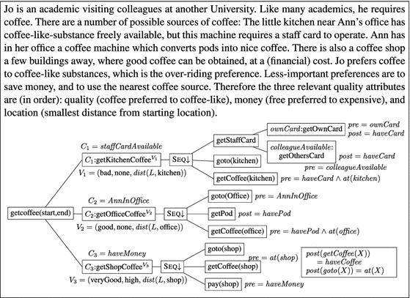
Post-hoc XAI
Explaining BDI Agents
Even symbollic agents, e.g. BDI, can be considered black boxes!
The fact that we can understand individual rules in isolation does not solve the problems of emergence and complexibility as the system scales.
A valuing approach can provide explanations such as:
“I preferred V to {V1, . . . , Vn}”)
“I did N1 in order to be able to later do N2”
e
Winikoff M., Sidorenko G., Dignum V., Dignum F. (2021). “Why bad coffee? Explaining BDI agent behaviour with valuings.” Artificial Intelligence Journal.

Slide 30
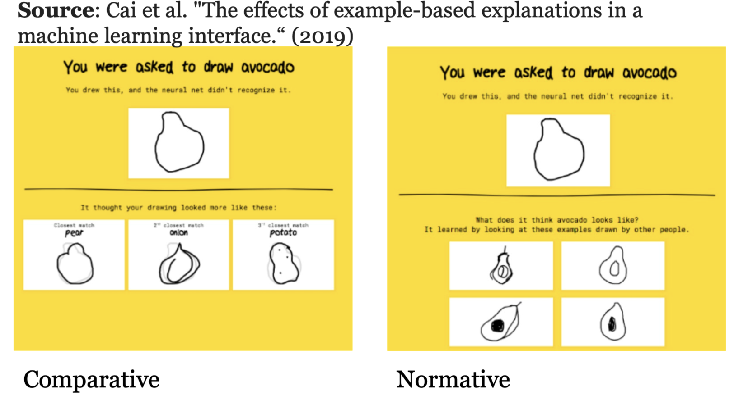
Post-hoc XAI
Example-based explanations
A more recent approach which compains the basic principle behind pre-model XAI: understanding of your data.
Matches the input to images used by the training data.
Some refer to example-based explanations to a wider range of methods when a model uses historic data as means of explaining its decision.
Cai et al. (2019). "The effects of example-based explanations in a machine learning interface.”

Slide 31
Use Cases & Challenges

Slide 32
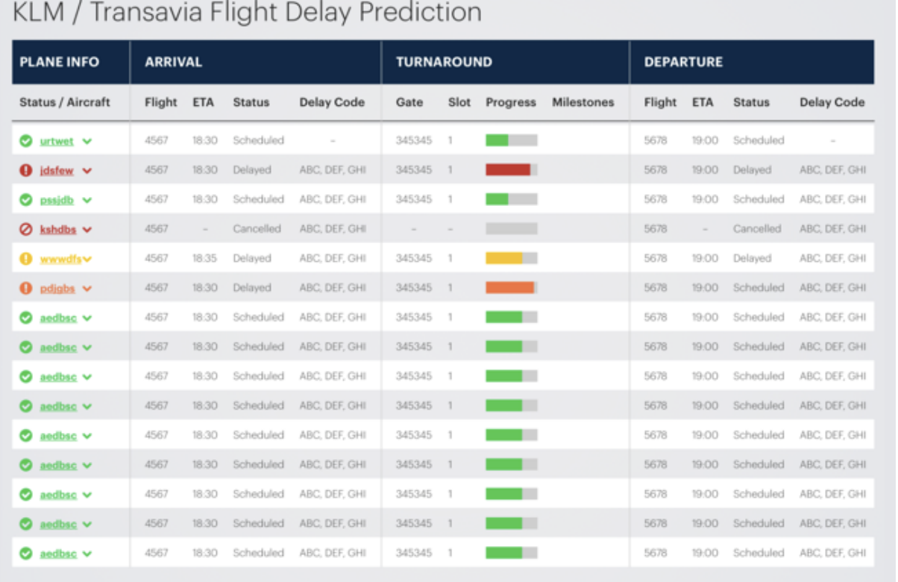
Use Cases & Challenges
Explainable On-Time Performance - Transportation
Problem: Airline-caused delays totalled 20.2 million minutes last year, generating huge cost for KLM. Existing in-house technique reaches 53% accuracy for predicting flight delay, does not provide any time estimation (in minutes as opposed to True/False) and is unable to capture the underlying reasons (explanation).
AI Solution: Integration of AI technologies for building a robust model which can: 1) predict flight delays in minutes; 2) explain delays by comparing with historical cases. Knowledge graph embedded Sequence Learning using LSTMs is used for XAI!
Jiaoyan Chen, Freddy Lécué, Jeff Z. Pan, Ian Horrocks, Huajun Chen: Knowledge-Based Transfer Learning Explanation. KR 2018: 349-358
Nicholas McCarthy, Mohammad Karzand, Freddy Lecue: Amsterdam to Dublin Eventually Delayed? LSTM and Transfer Learning for Predicting Delays of Low Cost Airlines: AAAI 2019

Slide 33
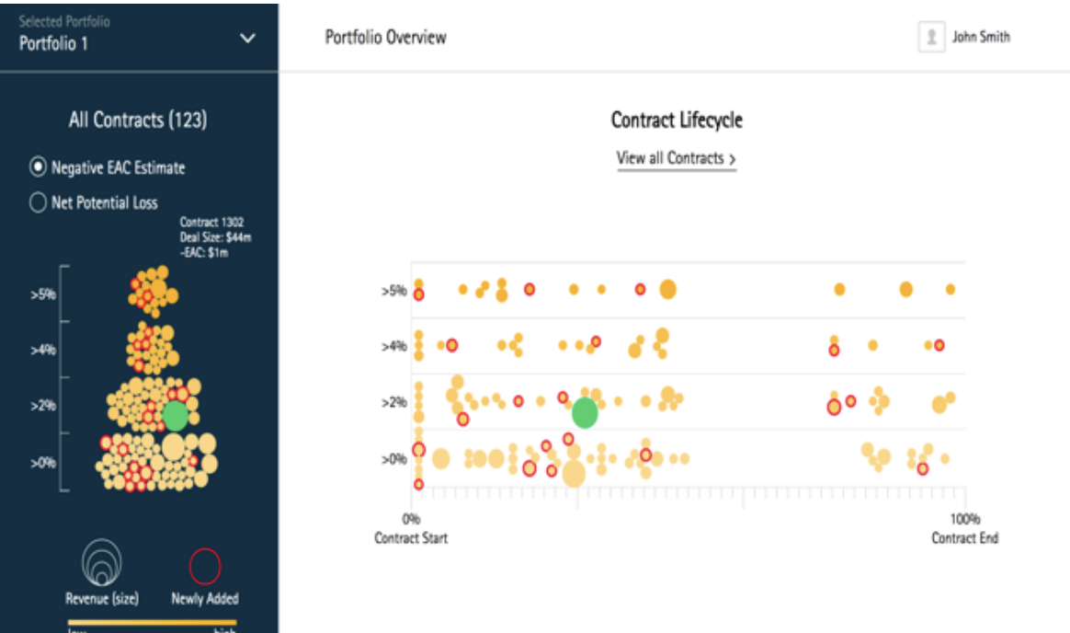
Use Cases & Challenges
Explainable Risk Management - Finance
Problem: Accenture is managing every year more than 80,000 opportunities and 35,000 contracts with an expected revenue of $34.1 billion. Revenue expectation does not meet estimation due to the complexity and risks of critical contracts.
AI Solution: Neurosymbollic approach with Knowledge graph embedded Random Forrest for: 1) predict revenue loss; 2) recommend corrective actions; and 3) explain why such actions might have a positive impact.
Jiewen Wu, Freddy Lécué, Christophe Guéret, Jer Hayes, Sara van de Moosdijk, Gemma Gallagher, Peter McCanney, Eugene Eichelberger: Personalizing Actions in Context for Risk Management Using Semantic Web Technologies. International Semantic Web Conference (2) 2017: 367-383

Slide 34
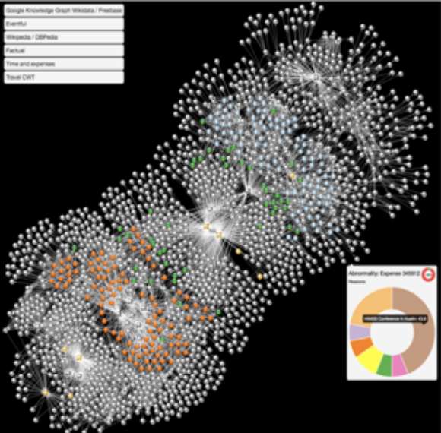
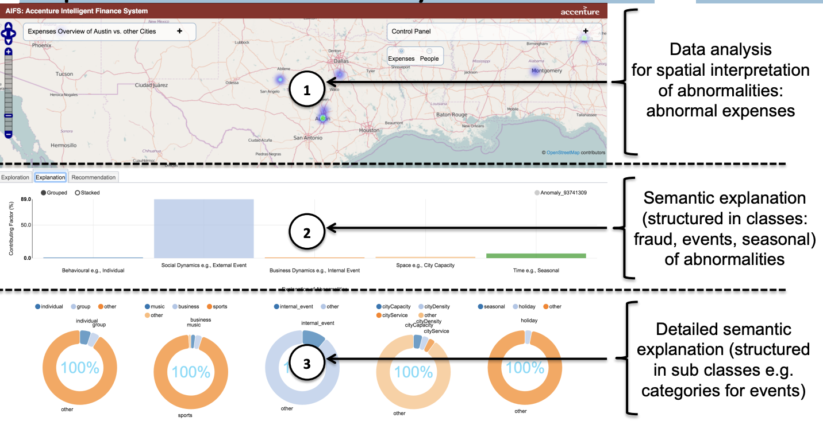
Use Cases & Challenges
Explainable anomaly detection – Finance (Compliance)
Problem: Predicting and explaining abnormally employee travel expenses —as high accommodation price in 1000+ cities.
Solution: Combining live data from travel and expenses, Google Knowledge Graph, DBPedia, and social events from Eventful by constructing a knowledge graph with embedded ensemble learning allows finding and explaining abnormalities.
Freddy Lécué, Jiewen Wu: Explaining and predicting abnormal expenses at large scale using knowledge graph based reasoning. J. Web Sem. 44: 89-103 (2017)

Slide 35
Use Cases & Challenges
Open Challenges
There is no agreement on what an explanation is —or what suffices as an explanation!
There is no agreed formalism for explanations, making it hard to automatically validate and verify explanation.
What happens when black box make decision in presence of latent features?
Computational costs for producing explanations are still relatively high.
There is no work that seriously addresses the problem of quantifying the grade of comprehensibility of an explanation for humans.
What works for one user, may not work for another.
All of our XAI methods focus on causality or counterfactuals. The latter might be very helpful but very expensive to produce.
XAI is not a panacea: too much explanability may not be desirable at all.

Slide 36
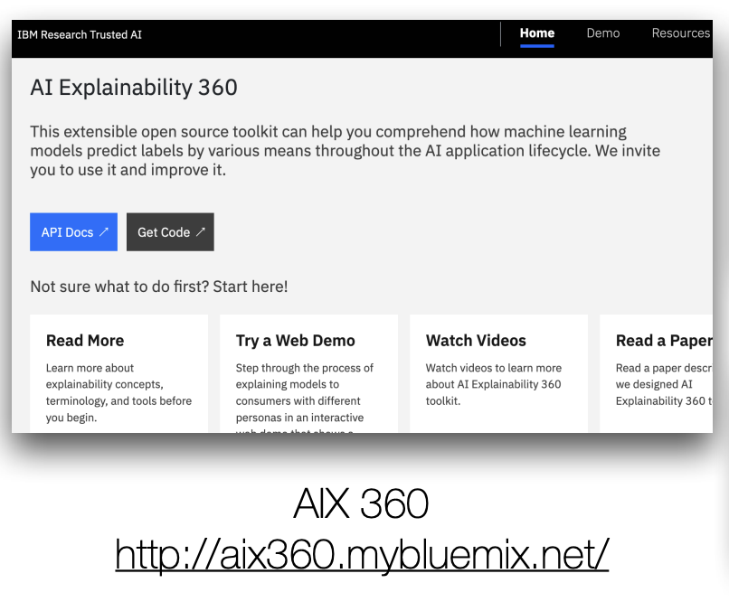
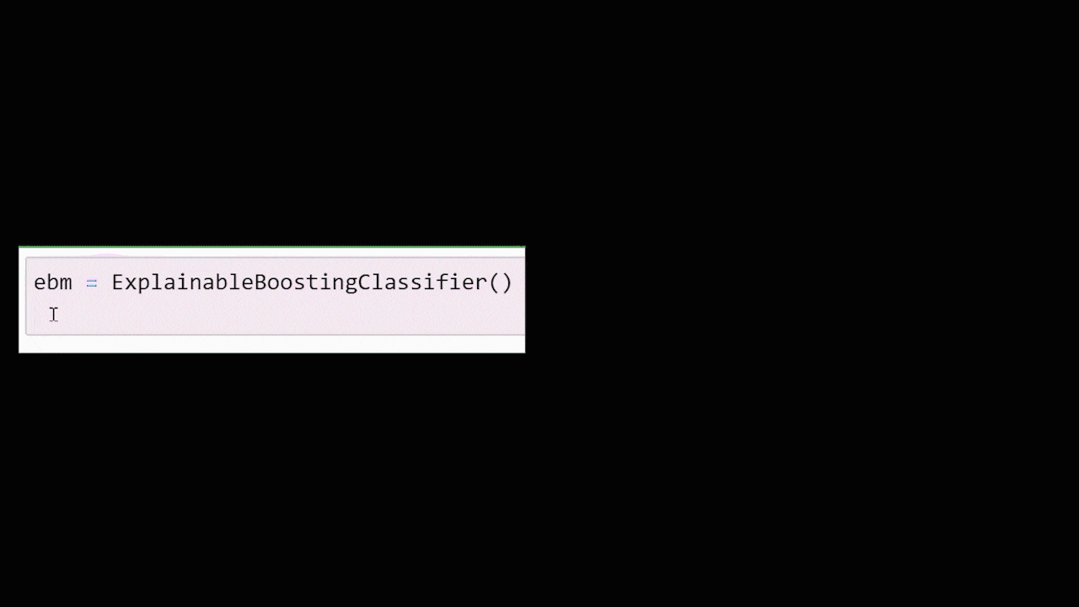
Post-hoc XAI
Commercial Toolkits

Slide 37
Conclussions

Slide 38
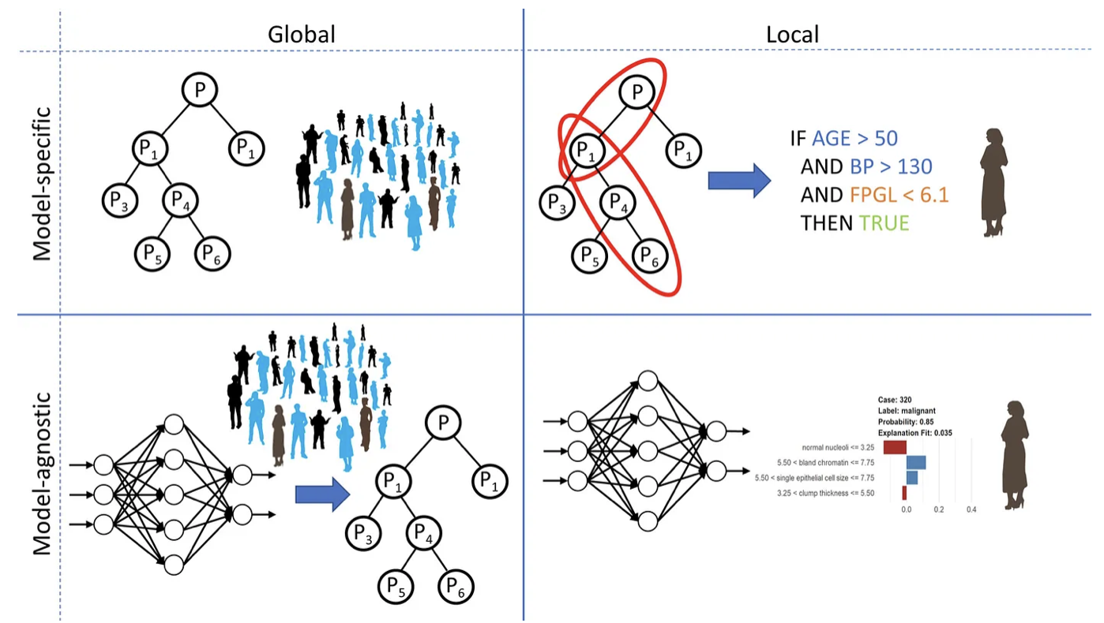
Use Cases & Challenges
Conclussions
It is no a new problem – a reformulation of past research challenges in AI!
Explainable AI is motivated by both regulatory and real-world application of AI.
Multi-disciplinary: multiple AI fields, HCI, cognitive psychology, social science, and others.
Yet, most work—as we have seen—focus on feature importance.

Slide 39
Questions?

