Slide 1
University of Cyprus
MAI631
Artificial Intelligence Ethics II
Michael Chatzipanagiotis
September – December 2023

Slide 2
University of Cyprus
Lecture 8: AI & Tort Law
Michael Chatzipanagiotis

Slide 3
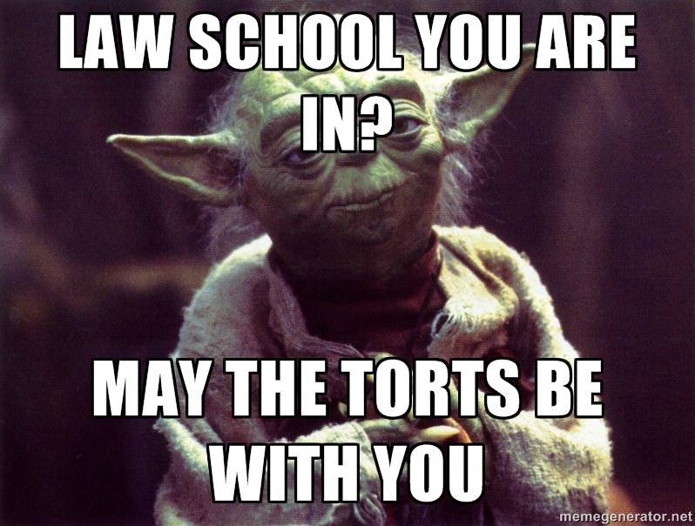
AI and Tort Law
Michael Chatzipanagiotis
Assistant Professor in Private Law
mchatz07@ucy.ac.cy

Slide 4
What is a tort?
Breach of a duty that the law imposes on someone (defendant/ wrongdoer), in order to protect legal rights and interests of another person (claimant/ victim).
In other words: A wrong committed against someone, resulting in the right of that person to claim compensation (or other remedies) from the wrongdoer.
There are many different torts/ wrongs, each one of which is subject to specific rules, e.g. negligence, defamation, assault, deceit etc. They may regard both natural persons and legal entities (e.g. companies, associations, foundations, municipalities etc.)

Slide 5
Main objectives of tort law
Protection of fundamental rights (e.g. life, property, private life and privacy) + balance of interests protected by fundamental rights (e.g. freedom of speech vs right to private life)
Compensation of victims (= to restore victims to the condition that they would have been, if the tort against them had not been committed)
Establishment of illegal behaviours
Allocation of risks arising from human activities, e.g. liability of the manufacturer of defective products despite the absence of any negligence.
Filling legal gaps (e.g. new situations arising from technological development)

Slide 6
Distinction between torts and criminal offences
Torts
Criminal offences
Aim at restoring/ compensating the victim
Sources: Judicial judgments + statutes
Protection of private interests
Proof: Balance of possibilities (>50%). The claimant bears the burden of proof the establishment of liability.
Aim at punishing the offender’s behavior
Sources: Statute
Protection of society in general
Proof: Beyond any reasonable doubt. The prosecutor bears the burden of proof for the establishment of liability.

Slide 7
Individuals torts and AI systems

Slide 8
Negligence
≈ damage of the victim caused by failure of the defendant to demonstrate the reasonable care than an average prudent person would show in place of the defendant under the same factual circumstances.
Problem with AI systems:
Defendants and their respective duties (operator, manufacturer, other)?
What is the appropriate standard of care regarding AI systems (given that the AI systems can modify their behavior or e.g. that these systems have different abilities than humans)?
Causation between the behavior of the wrongdoer and the damage of the victim, in view of self-learning abilities of AI systems and ‘black-box effect’?
Allocation of liability among multiple defendants in their inner relationship (i.e. after the victim has been compensated)?

Slide 9
Example: Self-driving cars (automated vehicles)
https://www.youtube.com/watch?v=7mxG4IBoMes
https://www.youtube.com/watch?v=Hb_u6P31xQ4
https://www.scientificamerican.com/article/who-is-liable-when-ai-kills1/
Ethical parameters
https://onlineethics.org/cases/questions-tesla-motors-about-autopilot

Slide 10
Strict liability under the Product Liability Directive (Directive 85/374/EEC)
‘Producer’ liable if ‘product’ is ‘defective’, irrespective of negligence.
‘Producer’ = end manufacturer, component manufacturer, importer (etc.)
‘Product’ = a tangible, movable object
‘Defectiveness’ = non-compliance with reasonable consumer expectations taking into account all circumstances of the particular case.
Damage of the defective product itself is not compensated.
No liability if the defect arose after the product was put into the market.

Slide 11
Defamation
≈ a statement made by one person, which harms the reputation of another person, i.e. of the way other persons think about the latter person.
No negligence required.
Legal challenges regarding generative AI systems.
https://www.youtube.com/watch?v=MaANSBK7rx8
https://www.theverge.com/2023/6/9/23755057/openai-chatgpt-false-information-defamation-lawsuit

Slide 12
Digital Services Act (Regulation 2022/2065) – Liability for content moderation
Arts 4-6: Providers of intermediary services not liable for content produced/ posted etc. by users, unless they are aware of it or should have been aware of it.
Arts 33-35 for Very Large Online Platforms: Duty to prevent dissemination of illegal and/or harmful content.

Slide 13
Potential solutions
Liability for AI operations irrespective of negligence?
AI as a tool?
AI to be treated as an animal (strict liability of the owner)?
AI as an independent actor via attribution of separate legal personality (AI legal entity)?
[Mandatory insurance requirements for operators of AI systems] – although it helps victims, it merely transfers the problem to the level of liable defendants and their insurers

Slide 14
Initiatives at EU level
Commission proposal for revision of the Product Liability Directive
‘Product’ to include software
‘Defectiveness’ presumed if non-compliance with mandatory safety requirements (which includes EU harmonized standards)
Duty of producers to ensure safety of the product throughout its life cycle.
Commission proposal on an AI Liability Act
Presumptions of defectiveness if the court asks AI operator for disclosure of evidence and operator fails to conform.
Presumptions of causal link for high-risk AI systems if they violate provisions of the AI Act.
Individual remedies for violations of the AI Act (under negotiation)

Slide 15
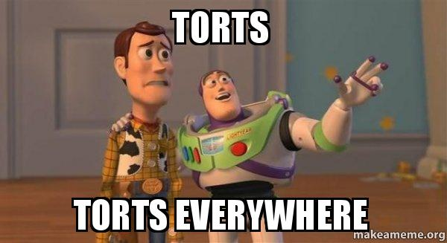
Thank you!

Slide 16
Questions?

