Slide 1
University of Cyprus
MAI631
Artificial Intelligence Ethics II
Andreas Theodorou
September – December 2023

Slide 2
University of Cyprus
Lecture 9: Human Control
Dr. Andreas Theodorou
November, 2023

Slide 3
Introduction
Lecture Overview
Today’s Structure:
Accountability and Responsibility
Human Control
Control Frameworks (HITL, HOTL, HOOTL, VA)
Today’s Goals:
Thematic units: AI Governance
This lecture follows up the guest speaker’s talk on Variable Autonomy, but also looks into two other core values: Accountability & Responsibility.
Learning Objectives:
Develop a critical understanding of socio-technical mechanisms for the governance of AI systems, recognizing the drawbacks and benefits of each approach.

Slide 4
Accountability & Responsibility

Slide 5
Accountability & Responsibility
Acountability
“AI actors should be accountable for the proper functioning of AI systems and for the respect of the above principles, based on their roles, the context, and consistent with the state of art.” - OECD
Umbrella term, covering amongst others:
legal accountability ;
professional accountability;
political accountability;
administrative accountability; and
social accountability.
Liability refers to implication due to actions (or inaction).
Accountability is a mean of control: that compels adherence to specified regulations and practices to demonstrate due diligence to avoid liability.
Incidents will occur —and sometimes reoccur: fallback plans are important!
Bovens, M. (2007). Analysing and Assessing Accountability: A Conceptual Framework. Eur. L. J.

Slide 6
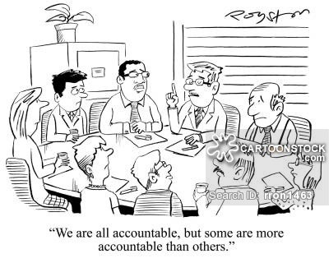
Accountability & Responsibility
Responsibility
We are the moral agents, never the machines.
There is a chain of responsibility.
Our design/deployment/use decisions inform that our responsibility.
Professional certification can make those responsibilities explicit.
Education can help people understand their role.
Technical solutions to track actions and decisions.
Bovens, M. (2007). Analysing and Assessing Accountability: A Conceptual Framework. Eur. L. J.

Slide 7
Accountability & Responsibility
Moral Agency
Special type of agency: agents that are entitled to benefits but also have moral obligations to other entities.
The main conditions ‘universally’ agreed:
Able to reason and decide how to act;
Able to pass moral judgement, i.e. understand what is right and what is wrong, on its decisions; and
Makes its decision out of its own free will.
This means that infants, children, and even mentally ill are not moral agents.
What is right or wrong depends on many factors and it has been debated since the Ancient Greeks…
The concept of moral agency led to the inclusion of the concept of mens rea in law: the state of mind during an act.
Depending on the mens rea the sentencing of an act can be affected.
For animals, environemnt, infants, children and mentally ill moral patiency: i.e. entities entitled to benefits but have no moral obligations to others.

Slide 8
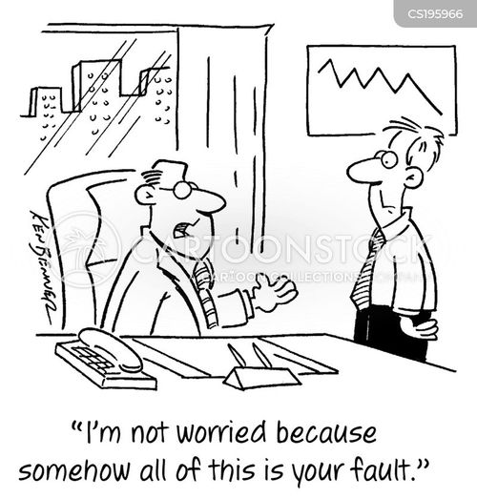
Accountability & Responsibility
Accountability & Responsibility
Accountability is backwards thinking, provides an account of events after they have occurred.
Responsibility is forwards thinking, i.e., acting to deter incidents and violations of our ethical and legal values from occurring.
To be held accountable, you need to be considered responsible… and if you can attributed as responsible, you can be held accountable.
This is why there is a concern about ‘legal personhood’ for machines! The ultimate ‘scapegoats.’

Slide 9
Human Control

Slide 10
Human Control
What is Control?
Is it big red ‘STOP’ button?
Is it someone telling an AI system do X or Y?
Is it us being able to ‘stop learning’ when we want to?
Is it us able to ’stop AGI?’

Slide 11
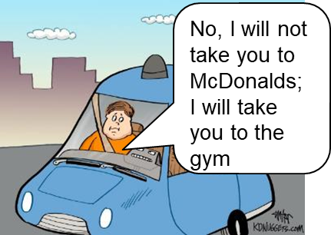
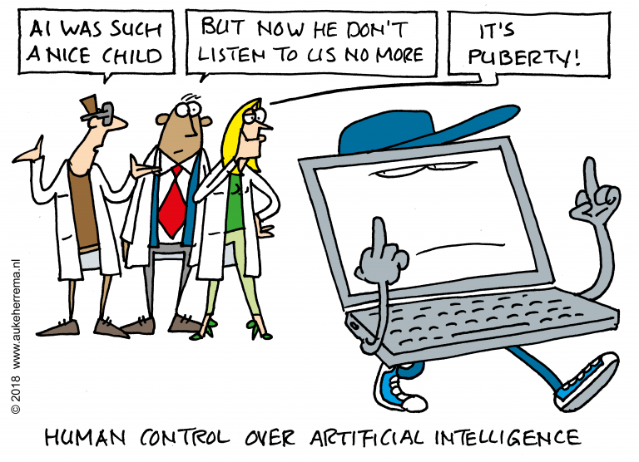
Which decisions?
Control is about selecting what an AI should do!
Control is about selecting

Slide 12
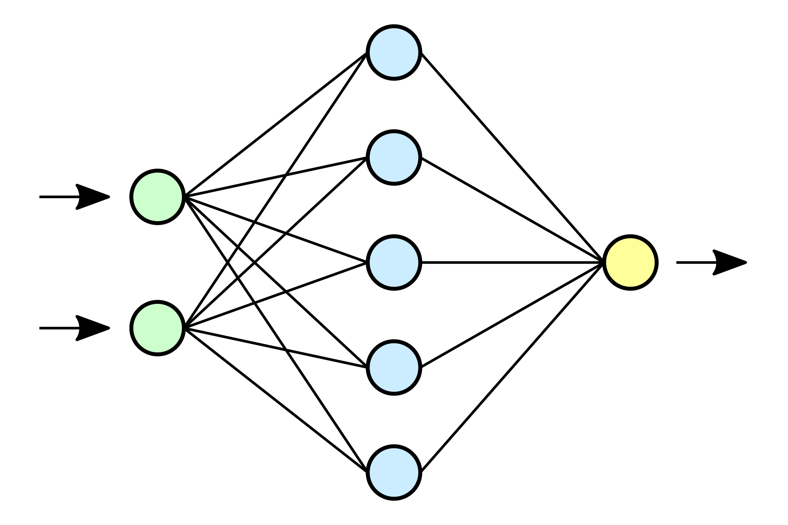
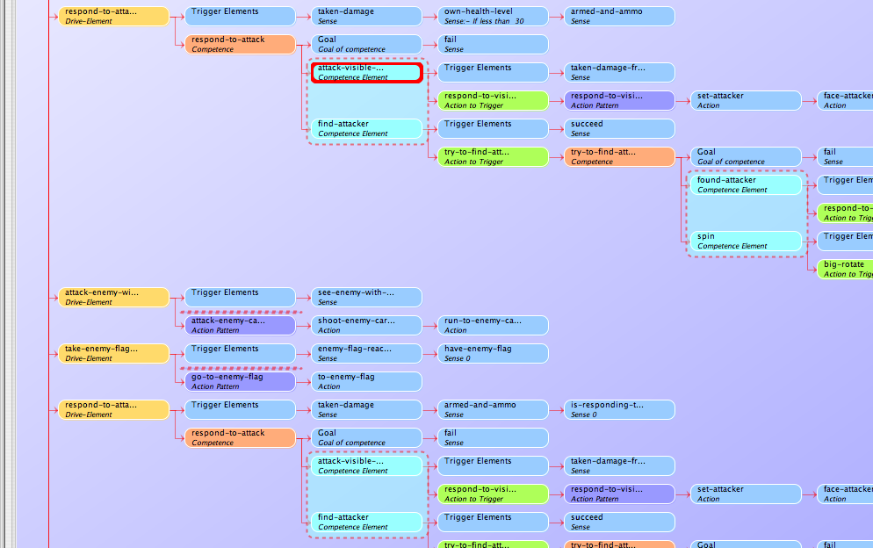
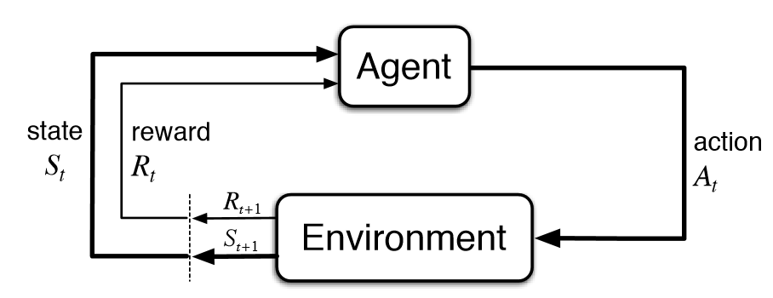
Human Control
How does the system makes decisions?

Slide 13
We do not understand AI systems!
“Trying to create a 3D map of the area? At one stage I thought it might be going to throw something into the bucket once it had mapped out but couldn't quite tell if it had anything to throw”
“aiming for the black spot in the picture.”
“Is it trying to identify where the abstract picture is and how to show the complete picture?”
“is circling the room, gathering information about it with a sensor. It moves the sensor every so often in different parts of the room, so I think it is trying to gather spacial information about the room “

Slide 14
Human Control
Do we accurately trust the decisions made by the system?
How was a decision made?
Having accurate mental models is important for control.
Explainable AI and Transparency are key here! Otherwise, we may over/distrust the system.

Slide 15
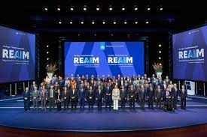
Human Control
Meaningful Human Control
Human presence is not sufficient.
We need to be able to:
track relevant reasons behind a decision;
verify their compliance to any policy; and
trace back to an individual along the chain who is aware and accepting of their responsibility.
Establishing control starts at the requirements gathering of a system and continues throughout its lifecycle.
Santoni de Sio, F., and Van den Hoven, J. (2018). Meaningful Human Control over Autonomous Systems: A Philosophical Account
Airman 1st Class Victoria Nuzzi, US Air Force

Slide 16
Control Frameworks

Slide 17
Control Frameworks
Control Frameworks
Human-in-the-loop
(HITL)
Human-on-the-loop
(HOTL)
Human-out-of-the-loop
(HOOTL)
Drawings made by Methnani L. (UMU)

Slide 18
Control Frameworks
Human-IN-the-Loop
Allows oversight
Should
I kill David?
No! I am David!
Approves or disapproves

Slide 19
Control Frameworks
Human-IN-the-Loop
Most ethical guidelines advocate for this blindly.
Required by the draft version of the AI Act for very high-risk systems.
In ML: the user provides feedback to the system for real-world training. The aim here is to improve accuracy and safety.
Inefficient and introduce bottlenecks in the system. *
The human may not have enough information—or courses of action—to effectively influence the system at every decision. **
Shifts all responsibility to the system’s ‘supervisor’.
* Holzinger, A. (2016). Interactive Machine Learning for Health Informatics: when Do We Need the Human-In-The-Loop?. Brain Inf. 3 (2), 119–131.
** Horowitz, M. C., and Scharre, P. (2015). Meaningful Human Control in Weapon Systems: A Primer.

Slide 20
Control Frameworks
Human-ON-the-Loop
Not critical decision: does not inform.
I will fly the ship.
I don’t care.
Ignores or disapproves

Slide 21
Control Frameworks
Human-ON-the-Loop
I will fly the ship.
Takes action

Slide 22
Control Frameworks
Human-ON-the-Loop
Stop flying!
Intervenes

Slide 23
Control Frameworks
Human-ON-the-Loop
I stopped.

Slide 24
Control Frameworks
Human-ON-the-Loop
Critical decision: informs
Should
I kill David?
No! I am David!
Intervenes

Slide 25
Control Frameworks
Human-ON-the-Loop
Proposed as an alternative ‘fix’ to the bottlenecks introduced by human-in-the loop.
The human only has to worry about the safety-critical actions; improving the performance (compared to human-in-the-loop) of the overall socio-technical system.
Coordination of the human-AI teaming becomes increasingly difficult to manage as systems grow more complex.
Humans do not place realistic trust expectations onto AI systems.
Shifts responsibility to the system’s ‘supervisor’.
Holzinger, A. (2016). Interactive Machine Learning for Health Informatics: when Do We Need the Human-In-The-Loop?. Brain Inf. 3 (2), 119–131.
Horowitz, M. C., and Scharre, P. (2015). Meaningful Human Control in Weapon Systems: A Primer.

Slide 26
Control Frameworks
Human-OUT-OF-the-Loop
I will fly the ship.
I am having a nap.

Slide 27
Control Frameworks
Human-OUT-OF-the-Loop
I will fly the ship.
Takes action

Slide 28
Control Frameworks
Human-OUT-OF-the-Loop
Why are you flying? Stop flying!
Intervenes

Slide 29
Control Frameworks
Human-OUT-OF-the-Loop
I will kill David.
I am having a nap.

Slide 30
Control Frameworks
Human-OUT-OF-the-Loop
I am turning of the atmosphere system.
Acts.
What is happening?
Tries to intervene

Slide 31
Control Frameworks
Human-OUT-OF-the-Loop
David has been exterminated.
VICTORY!

Slide 32
Control Frameworks
Human-OUT-OF-the-Loop
The human is almost nowhere to be found!
It removes ‘the bottleneck’ of the human; no approval, oversight, or input is needed.
Better equipped to handle the high speeds, massive datasets, or complex computations involved.
If kept out of the loop for too long, the human user may blindly trust the system.
Relies to the developers making an adequate risk analysis.
Holzinger, A. (2016). Interactive Machine Learning for Health Informatics: when Do We Need the Human-In-The-Loop?. Brain Inf. 3 (2), 119–131.
Horowitz, M. C., and Scharre, P. (2015). Meaningful Human Control in Weapon Systems: A Primer.

Slide 33
Control Frameworks
Variable Autonomy
I will fly the ship.
I am having a nap.

Slide 34
Control Frameworks
Variable Autonomy
I will fly the ship.
Takes action

Slide 35
Control Frameworks
Variable Autonomy
I woke up and I want to fly.
Intervenes — takes control

Slide 36
Control Frameworks
Variable Autonomy
Takes action
I am flying!

Slide 37
Control Frameworks
Variable Autonomy
I see an asteroid. I will
Takes action: stops the ship

Slide 38
Control Frameworks
Variable Autonomy
I am seeing an asteroid. I am taking control.
Acts
Claims control

Slide 39
Control Frameworks
Variable Autonomy
Keep flying. I want to check something else.
Intervenes

Slide 40
Control Frameworks
Variable Autonomy
Promotes the idea of ‘human-AI teaming,’ coexisting and responsible for different systems.
VA indirectly promotes transparency: the operator needs to have awareness and sufficient information
VA indirectly promotes meaningful human control: transfer of control can be logged, people need to be aware of their repsonsibilities, and later contested.
VA is also known as mixed initiatives—especially, in the co-creativity domain.

Slide 41
Conclusions

Slide 42
Conclusions
Conclusions
We have looked at Accountability and Responsibility and how one connects to the other.
We have looked at what is human control and what is meaningful human control.
We have looked 4 high level control frameworks: HITL, HOTL, HOOTL, and VA.
Questions? Email me!

Slide 43
Questions?

